Slide 1
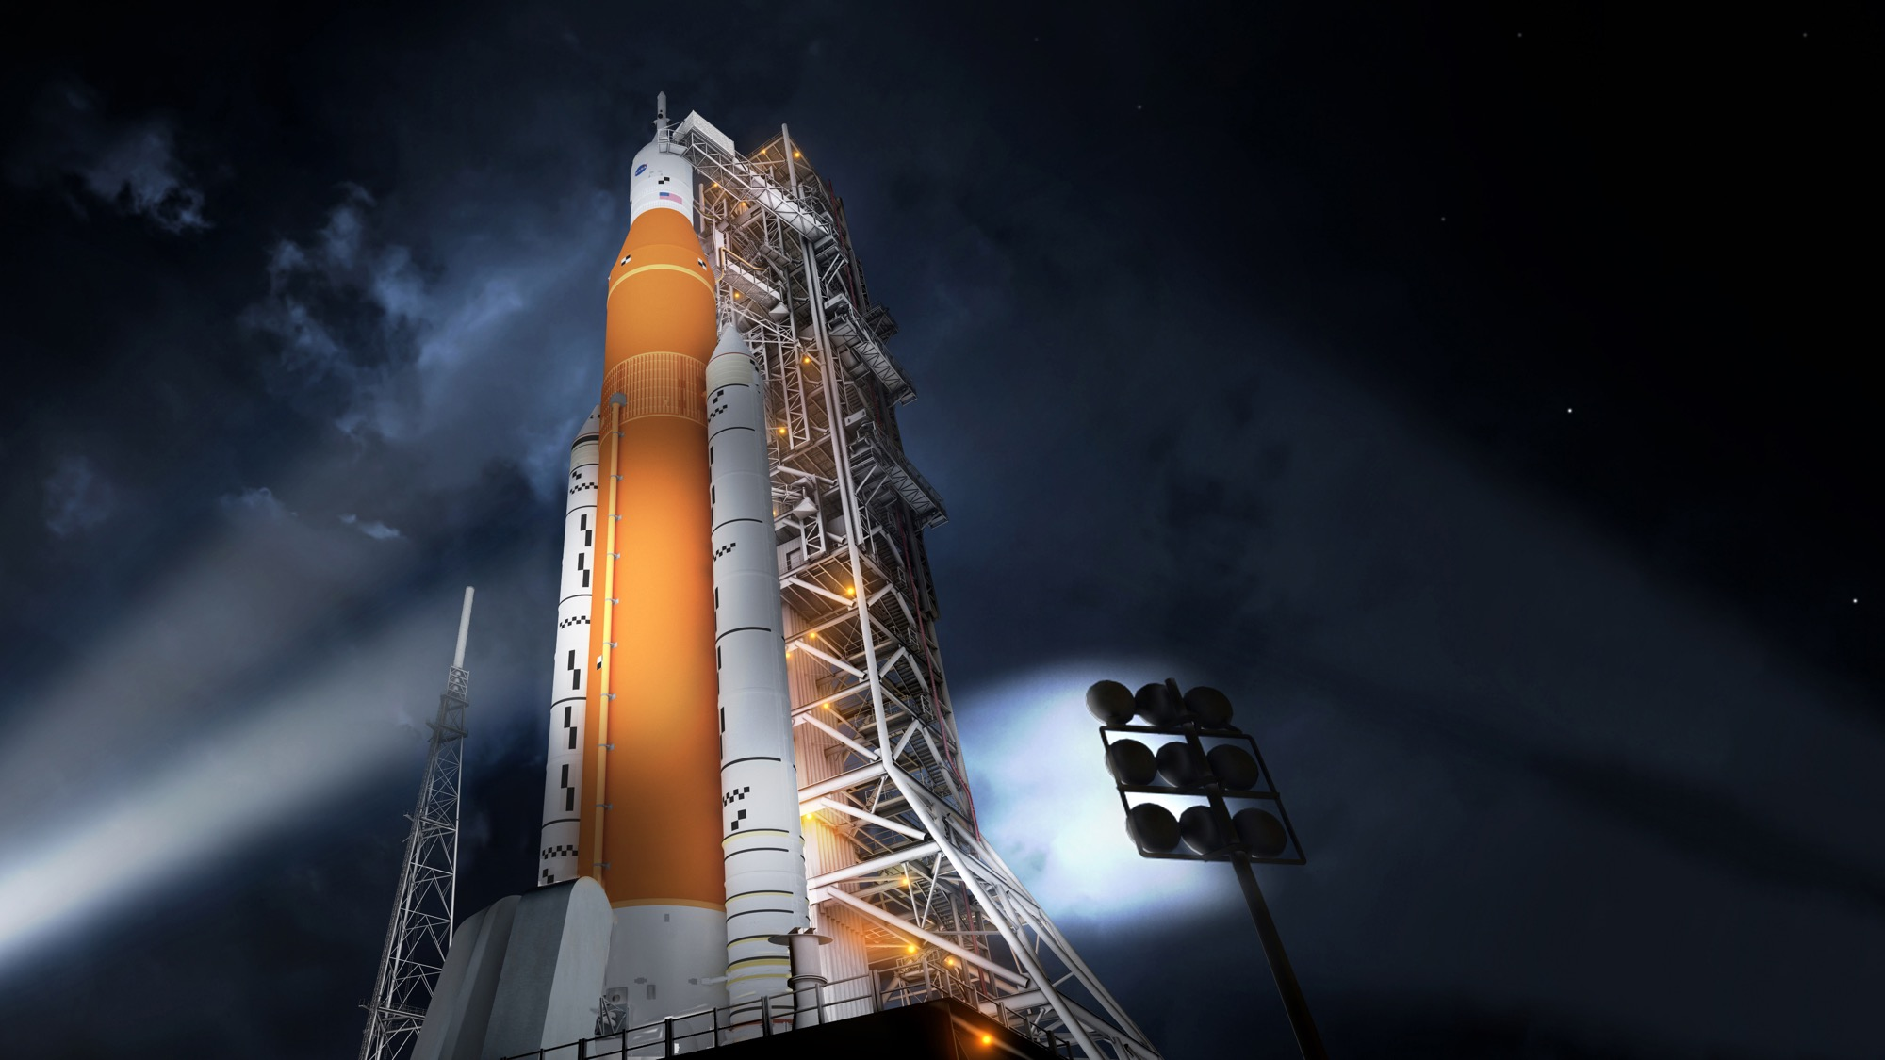

NASA’s Space launch system Status
Steve Creech
Manager, Spacecraft/Payload Integration & Evolution (SPIE)
NASA’s Space Launch System
Notes:
You have 30 minutes, including Q&A

Slide 2
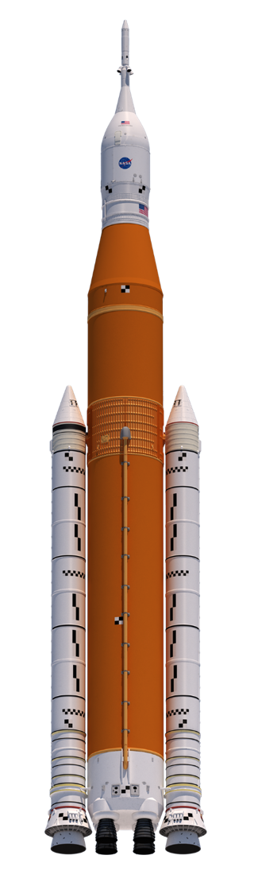
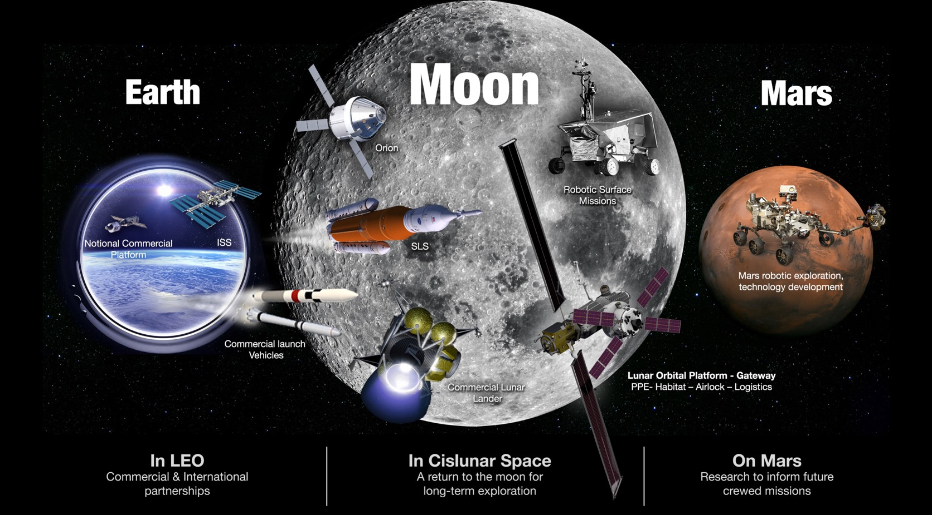
NASA’s Exploration plans
NASA’s Gateway
PPE – Habitat – Airlock – Logistics
Notes:
NASA has a phased approach to successful human exploration of deep space
We began LEO, where we’ve lived aboard the ISS continuously for 17 yrs, 9 mos., and 6 days (as of today)
Expedition 1 arrived Nov 2, 2000
School’s getting ready to start and today’s H.S. seniors have never known a time when there wasn’t a space station in LEO with astronauts living and working
What have we learned in those 17 yrs, 9 mos. And 6 days that will help us put boots on the moon with eyes toward Mars? And also help us on Earth?
Advances in materials research
Tried out 3D printing
Engineered life support systems for sustained stays in space
Better understanding of the effects of microgravity on the human body
We deploy CubeSats from the ISS
We’ve learned how to better cooperate with international partners
Don’t we all need better understanding of each other in this day and age?
We’ve opened transportation to LEO to commercial vehicles
Allowing commercial companies to take over LEO frees NASA to explore
Next step is back to the Moon
NASA will establish a lunar Gateway near the moon (near rectilinear halo orbit)
The Gateway will be crew tended (but crew won’t live there permanently like on ISS)
Gateway will communicate with Earth and lunar surface
Will open new opportunities for robotic exploration of the moon, especially far side of the moon and poles
Prospecting for volatiles will be high on the list of priorities
SLS/Orion will participate in gateway assembly and operation
Will serve as a testbed for new technologies and inform future Mars missions
Data from EM-1 lunar cubesats can be used to help plan future prospecting missions
After learning how to live and work in deep space like we did in LEO, NASA will move on Mars missions.
SLS’s capability to accommodate primary, co-manifested and secondary payloads (when available) is a key component in making this vision a reality

Slide 3
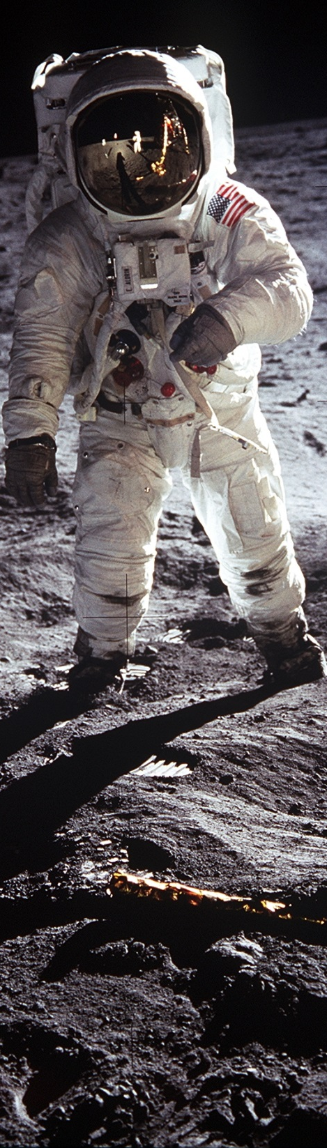
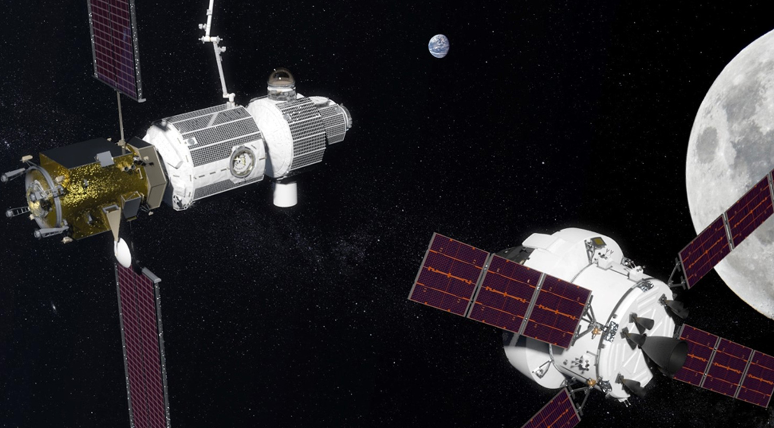
NASA’s Gateway
STEPPING STONE TO THE SOLAR SYSTEM
Notional rendering
Notes:
Our initial goal is building a crew-tended “Gateway” spaceport in orbit around the Moon. We’re accelerating to 2022 plans to deliver the first Gateway element.
A power and propulsion element, as well as habitation, airlock and logistics capabilities, will establish the core functionalities of the Gateway.
NASA is looking at commercial and SLS co-manifested payload options to launch the individual Gateway components, and assemble them in space.
The Gateway can operate from a variety of lunar orbits and be moved when the crew is not present.
Our first experience “sailing the gravity rivers” of the Earth-Moon system – the low-energy transfer orbits we need to understand for a permanent architecture.
The Gateway can contribute to lunar surface activities and have application to farther destinations in the solar system, including Mars. It serves both a function as training and hardware maturation element as well as operational element needed to send humans beyond low-Earth orbit.
NASA is discussing components that International Space Station partners could potentially provide to the Gateway.
NASA and its partners will use the gateway for deep-space operations including missions to and on the Moon with decreasing reliance on Earth. Using lunar orbit, the agency will develop its exploration systems and gain the experience necessary to extend human presence farther into the solar system than ever before.

Slide 4
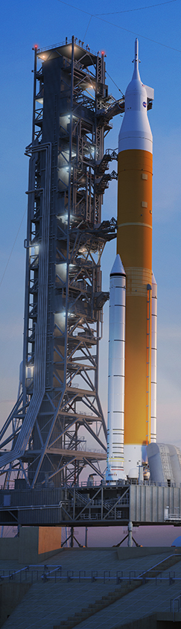
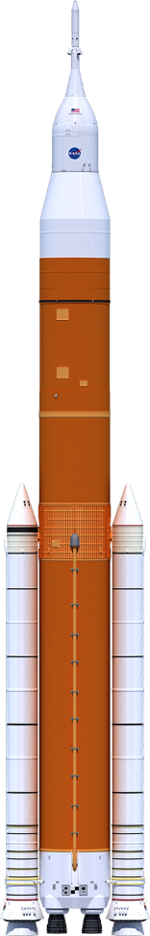
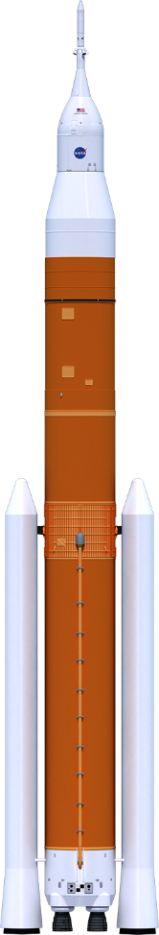
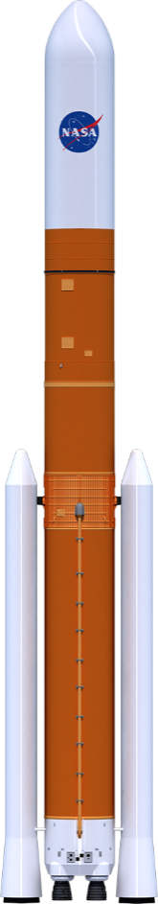
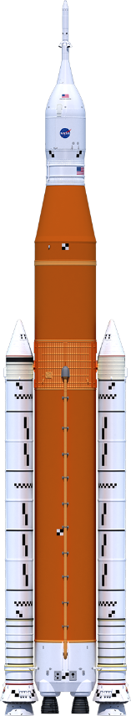
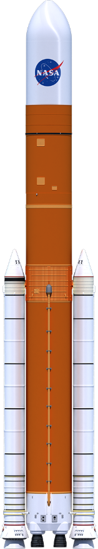
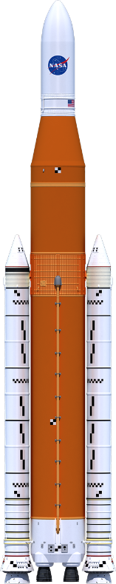
SLS LIFT CAPABILITIES
322 ft.
Up to 313 ft.
365 ft.
325 ft.
365 ft.
355 ft.
Universal
Stage Adapter
Universal
Stage Adapter
Launch Abort System
5m Class Fairing
(up to 63’)
Orion
8.4m Fairing
Short (Up to 63’)
8.4m Fairing
Long (Up to 90’)
Interim Cryogenic
Propulsion Stage
Exploration Upper Stage
Exploration Upper Stage
Exploration Upper Stage
Launch Vehicle
Stage Adapter
Interstage
Interstage
Interstage
Core Stage
Core Stage
Core Stage
Solid
Rocket
Boosters
Solid
Rocket
Boosters
Evolved
Boosters
RS-25 Engines
RS-25 Engines
SLS Block 1
SLS Block 1 Cargo
SLS Block 1B Crew
SLS Block 1B Cargo
SLS Block 2 Crew
SLS Block 2 Cargo
> 26 t (57k lbs)
> 26 t (57k lbs)
34–37 t (74k–81k lbs)
37–40 t (81k–88k lbs)
> 45 t (99k lbs)
> 45 t (99k lbs)
Payload to TLI/Moon
Notes:
Heights:
Block 1 cargo = 98 m tall; Block 1 cargo = up to 95.4 m
Block 1B crew = 111.2 m; Block 1B cargo = 99 m
Block 2 crew = 111.2 m; Block 2 cargo = 108.2 m
Block 1 is just the beginning; Block 1B will be our workhorse for lunar missions, with the additional power of the EUS and the co-manifested payload volume in the USA
SLS isn’t designed for LEO
Block 1 will have lift more than 26 t to the Moon
Block 1B will lift 34 to 40 tons to the Moon, depending on crew or cargo configuration
Block 2 cargo will lift more than 45 t payload to the moon
The VW Golf was the best-selling German car in Q1
At about 1,420 kg for the small sedan, Blk 1 could take 18 Golfs to the Moon; Blk 1B crew could take four astronauts in Orion and 23 VW Golfs to the Moon! Block 1B cargo = 26 Golfs; Block 2 cargo = at least 31 Golfs!
Hubble weighed almost 11 t. Block 1 = 2.4 Hubbles – to the Moon; Block 1B = 3.4 Hubbles to TLI; Block 2 = 4+ Hubbles to the Moon (mass only/not volume comparison)
That is by far more capability than any existing rocket
The benefits of heavy lift are obvious for something as challenging as space exploration. The ability to transport large payloads reduces payload complexity and operational complexity from the ground all the way to space. It saves time and money and increases our chances for mission success.

Slide 5
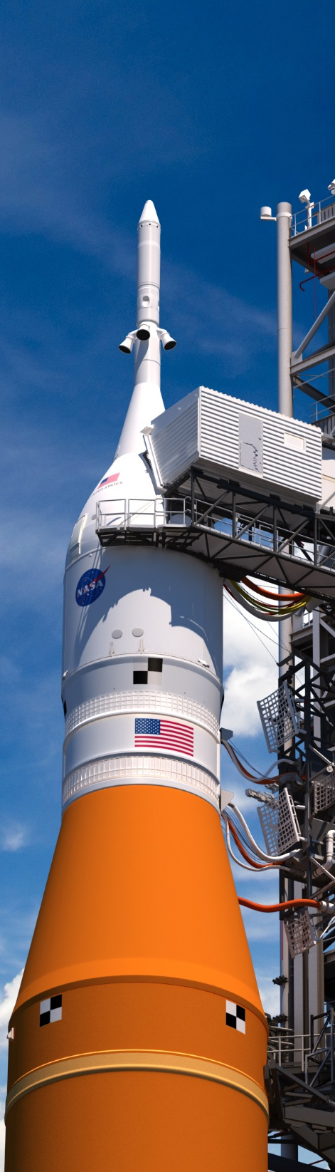
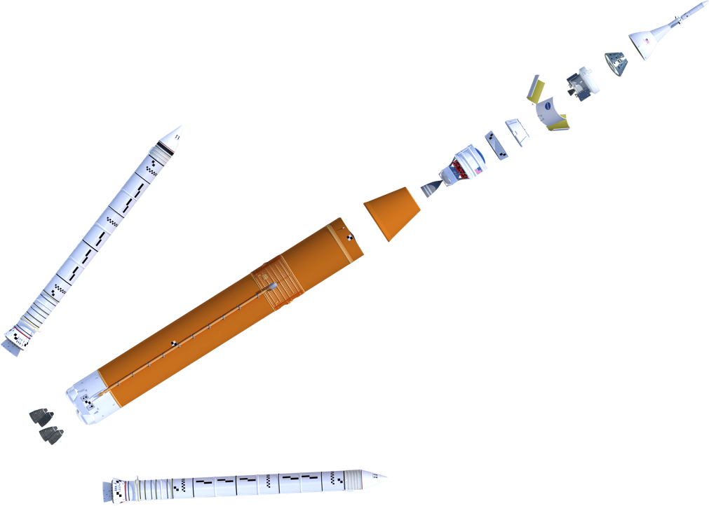
SLS BLOCK 1 CONFIGURATION
Launch Abort System (LAS)
Crew Module (CM)
Service Module (SM)
Encapsulated Service Module (ESM) Panels
Spacecraft Adapter
Orion Spacecraft
Lockheed Martin
5 Segment Solid Rocket Boosters (2)
Northrop Grumman
Orion Stage Adapter
Interim Cryogenic
Propulsion Stage (ICPS)
Boeing/United Launch Alliance
Launch Vehicle Stage Adapter
Teledyne Brown Engineering
Core Stage & Avionics
Boeing
RS-25 Engines (4)
Aerojet Rocketdyne
Notes:
This is the rocket we’re building now for our first mission – Exploration Mission 1:
Visible are the major elements and prime contractors for the EM-1 vehicle – solid rocket boosters, core stage (engine section, LH2 tank, intertank, LOX tank, forward skirt) LVSA and ICPS, OSA, and Orion/SM/LAS.
The Orion spacecraft is managed by Johnson Space Center and built by its prime contractor, Lockheed Martin.
This “Block 1” configuration of SLS will be more capable than any current launch vehicle, able to deliver greater than 26 metric tons to TLI (95 t to LEO)
As you’ll see later, much of this vehicle is complete or nearly complete
The EM-1 test flight is planned for fiscal year 2020
EM-1 will take the Orion crew vehicle farther into space than humans have ever ventured before
Primary objectives include validation of thermal, control and data systems; testing deep space maneuvers, communications and tracking; and demonstrating landing and recovery operations
EM-1 will provide a critical first end-to-end test of materials, manufacturing, testing, integration, and launch and flight operations for SLS, Orion, and launch facilities at Kennedy. It will also launch 13 small secondary payloads.

Slide 6
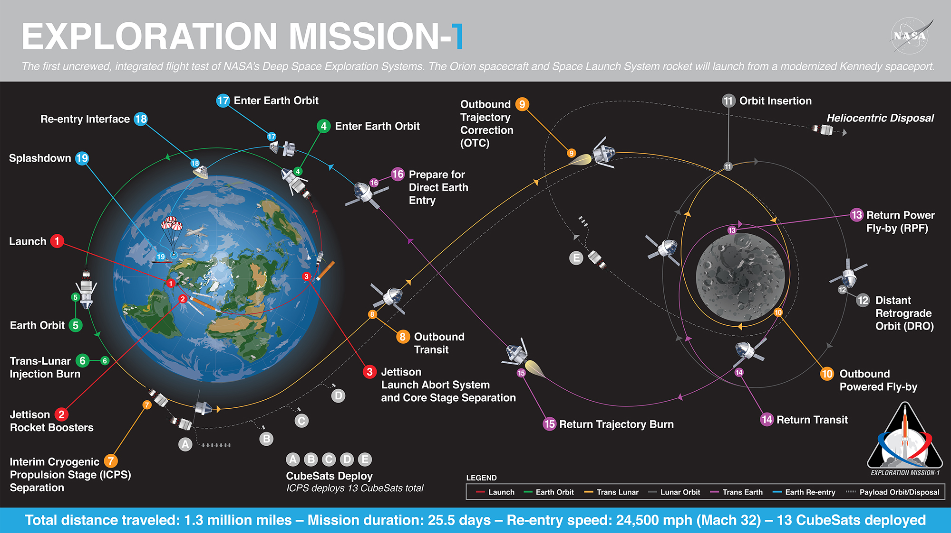
Notes:
For General Public
Overview of Exploration Mission-1, a twenty-five and a half day mission and the first integrated flight test of the Orion spacecraft and the Space Launch System rocket, launching from the Kennedy Space Center. This is first of many missions ahead, signaling what astronauts that dare to operate in deep space can expect.

Slide 7
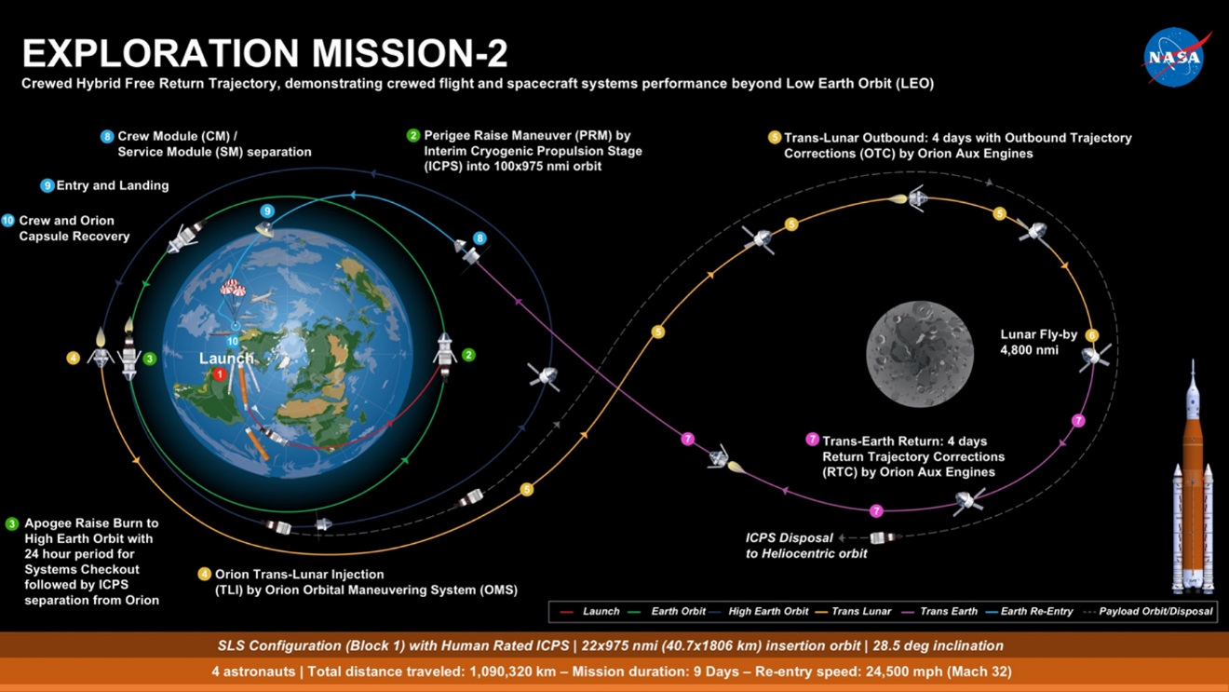

Slide 8

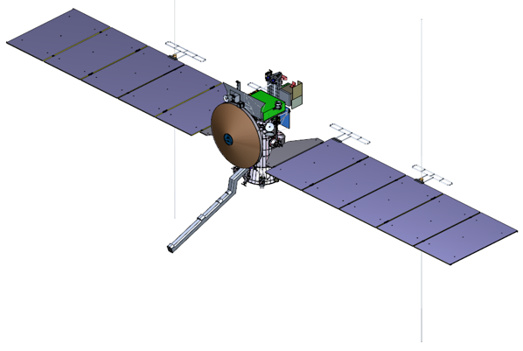
SCIENCE MISSION-1: EUROPA CLIPPER
OBJECTIVES
OCEAN: Existence, extent, salinity
ICE SHELL: Water within or beneath; nature of surface-ice-ocean exchange
COMPOSITION: Key compounds; links to ocean composition
GEOLOGY: Surface feature formation; sites of recent or current activity
RECONNAISANCE: Surface characteristics at lander scales.
INSTRUMENTS
Plasma Instrument for Magnetic Sounding (PIMS) Interior
Characterization of Europa using Magnetometry (ICEMAG)
Mapping Imaging Spectrometer for Europa (MISE)
Europa Imaging System (EIS)
Radar for Europa Assessment and Sounding: Ocean to Near-surface (REASON)
Europa Thermal Emission Imaging System (E-THEMIS)
MAss SPectrometer for Planetary EXploration/Europa (MASPEX)
Ultraviolet Spectrograph/Europa (UVS) .
SUrface Dust Mass Analyzer (SUDA)

Slide 9

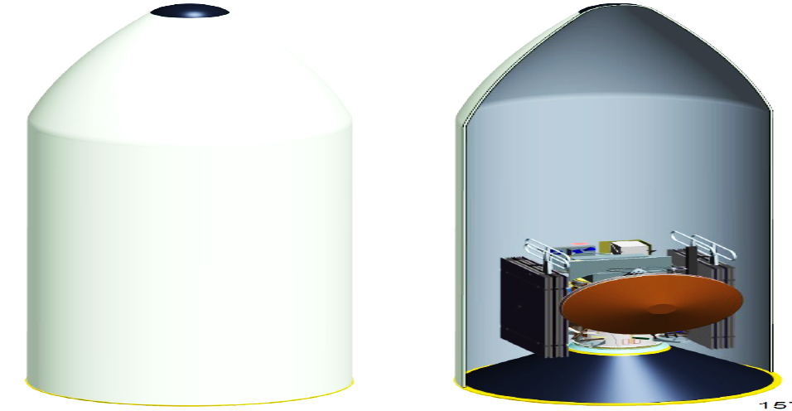
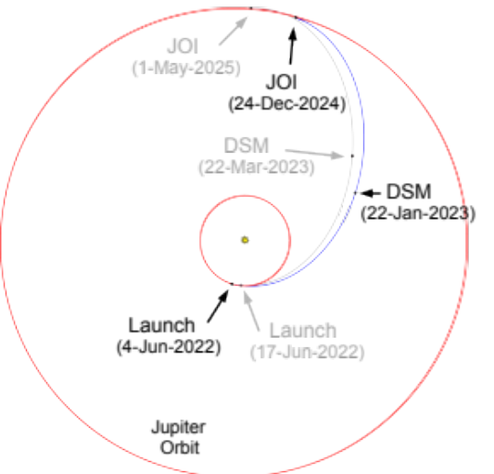


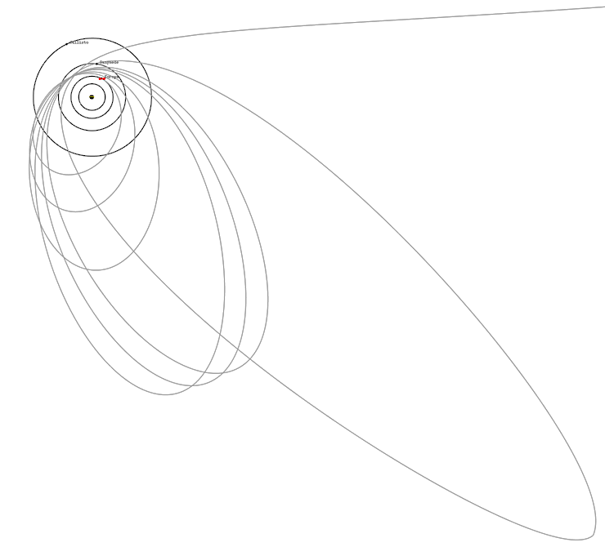
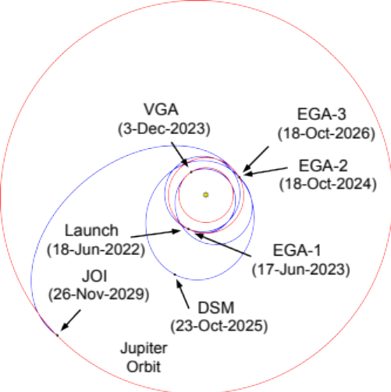

SCIENCE MISSION-1: EUROPA CLIPPER
Incoming
Interplanetary
.
G0
JOI
.
E1
.
-
G1
Baseline
1.8:0.8
3:1
5:1
32:3
Secondary
202-day
capture orbit
.
PRM

Slide 10
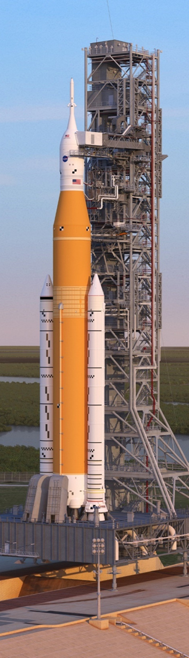
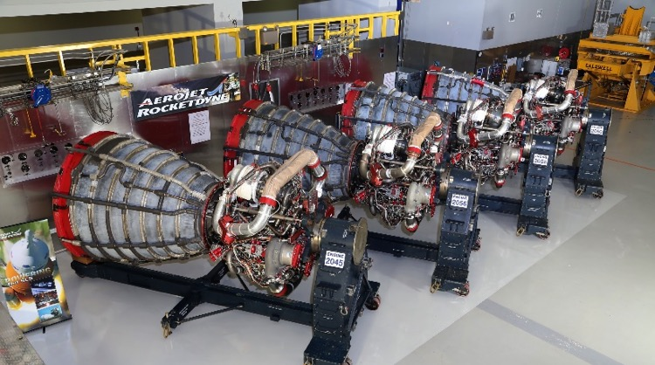
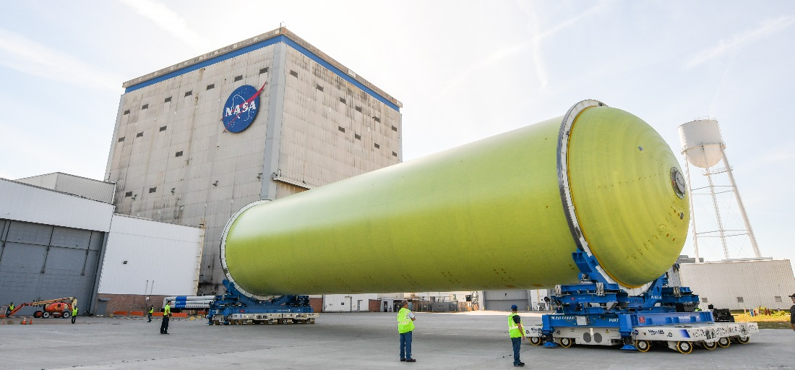
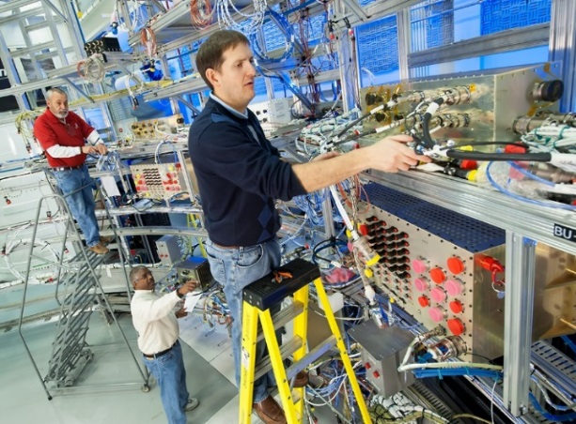
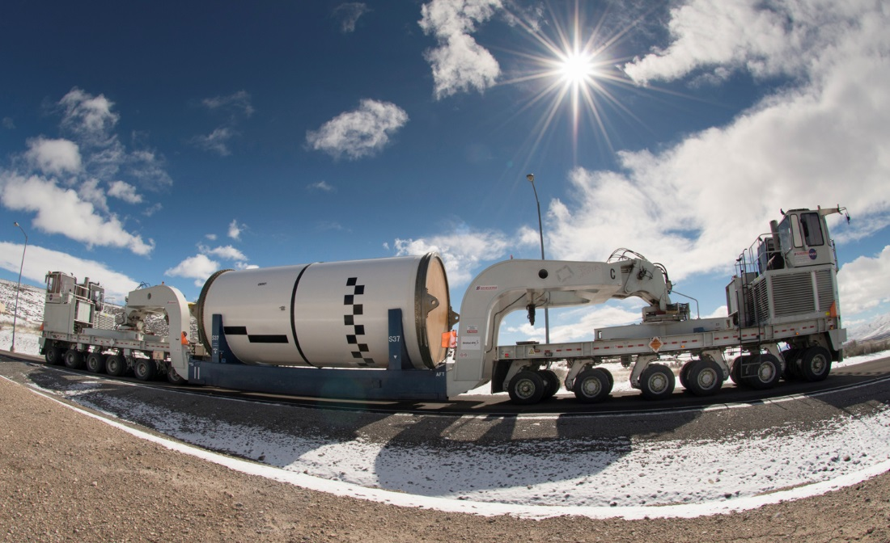
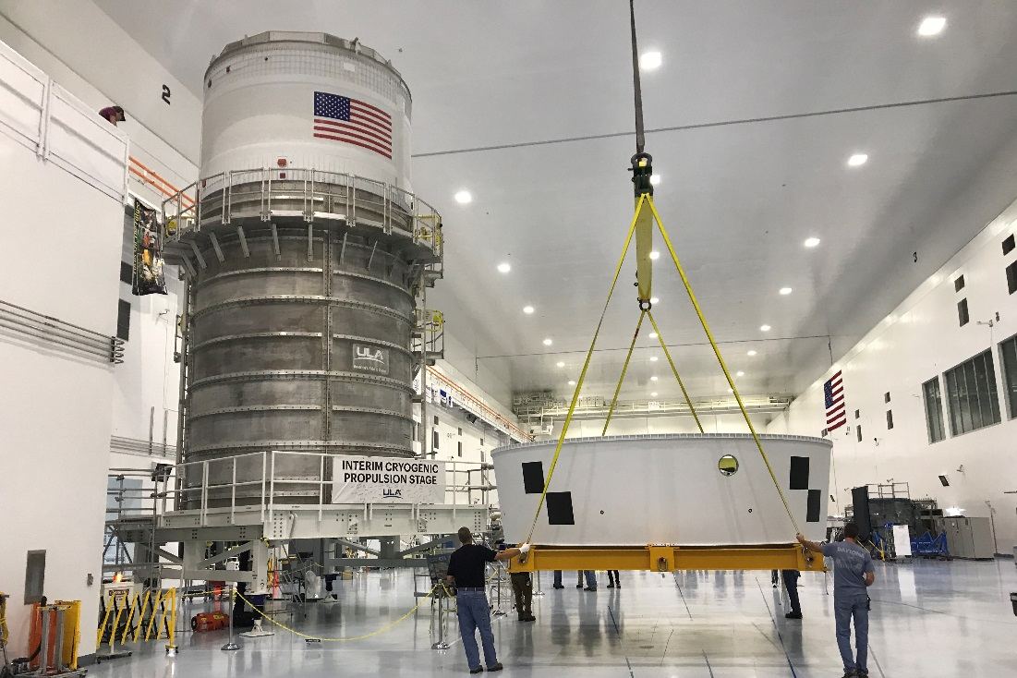
PROGRESS TOWARD EXPLORATION MISSION-1
Notes:
Progress:
Upper part of the rocket – FINISHED; ICPS, OSA, putting finishing touches on LVSA
Core stage: all five structures built, forward skirt complete, interiors being outfitted for flight
Forward join: forward skirt + LOX tank + intertank scheduled to begin in October
When complete, half the core stage will be finished!
Engines: FINISHED, upgraded with new controllers, ready for integration with core stage
Scheduled to ship to MAF in Dec for integration with CS
Boosters: motors pretty close to finished (end of Oct), forward and aft assemblies ready early in ‘19
This EM-1 rocket is nearly ready, except for the core stage
CS is all-new development and it’s been challenging but team has worked hard to overcome challenges
Launch scheduled for fiscal year 2020

Slide 11
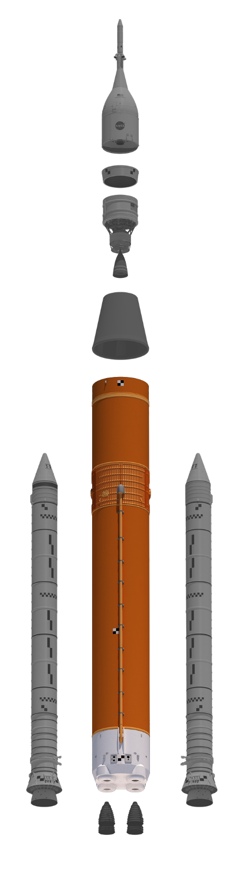
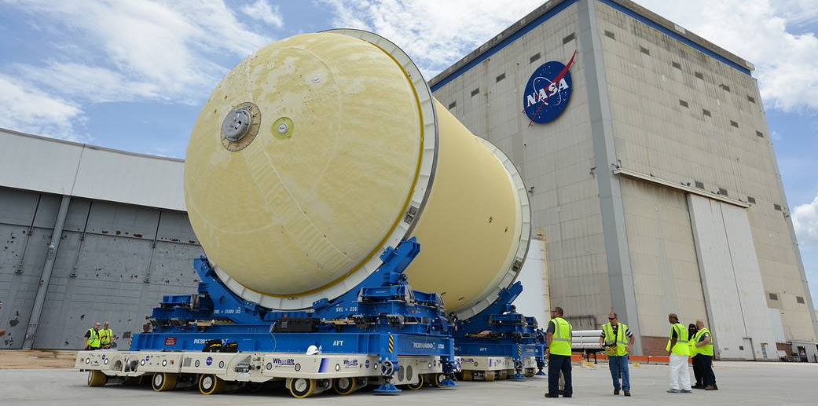
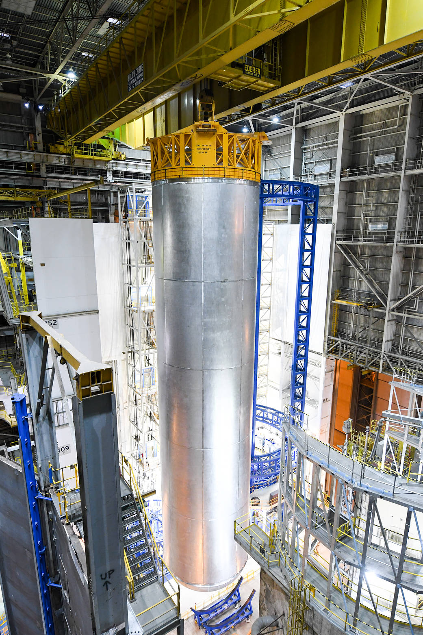
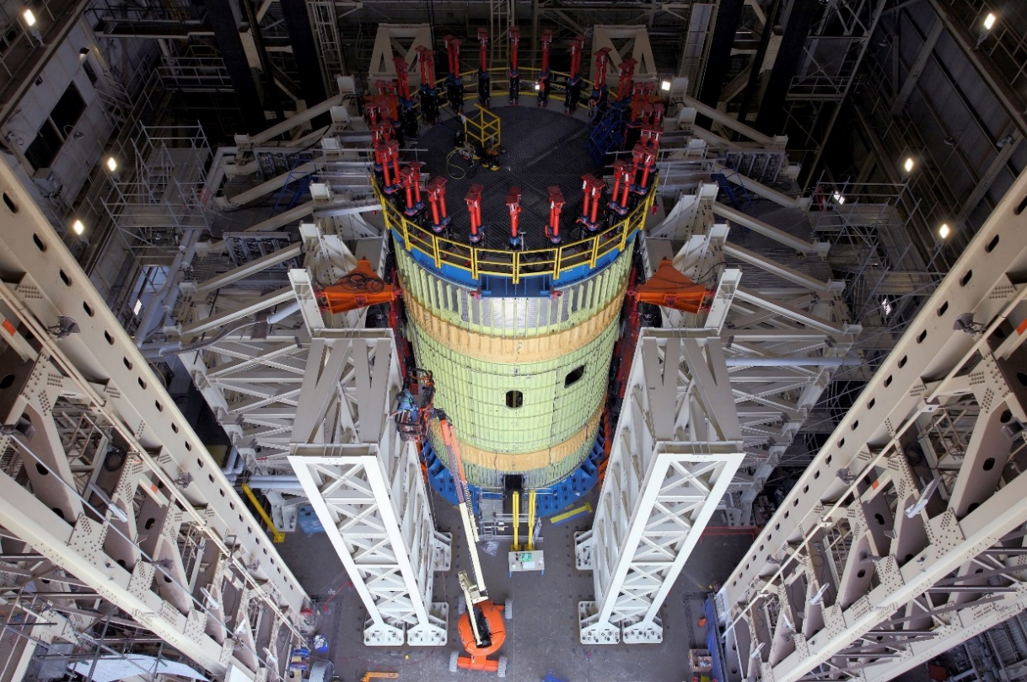
CORE STAGE
Notes:
Top Left Image: The EM-1 LOX tank is shown here after robotic thermal protection system application. It moved to another area for sensor installation and preparations to be stacked with the completed intertank and forward skirt.
Bottom Left Image:
The intertank is the second core stage test article delivered to Marshall Space Flight Center in Huntsville, Alabama, for structural testing. The flight version of the intertank will connect the core stage's two colossal fuel tanks, serve as the upper-connection point for the two solid rocket boosters and house the avionics and electronics that will serve as the "brains" of the rocket. We got it up here from Michould Assembly Facility earlier this year, and we have completed our initial round of tests. We will begin the second round this fall.
Right Image:
Liquid Hydrogen tank is 130 feet tall and holds 537,000 gallons of hydrogen at minus 423 degrees. Since this photo, it’s been primed and insulated and is undergoing sensor installation. Then it will be ready for the aft join integration with the engine section and then final integration with the forward join section.
Basics:
The SLS Core Stage will be the tallest rocket stage ever flown. When completed, the Core Stage will be 212 feet tall (64.6 m) and 27.6 ft. (8.4 m) in diameter.
It will weigh 2.3 million pounds when fueled
The liquid hydrogen tank measures more than 130 feet tall, comprises almost two-thirds of the core stage and holds 537,000 gallons of liquid hydrogen cooled to minus 423 degrees Fahrenheit.
The Core Stage is being built by prime contractor Boeing at Michoud Assembly Facility outside New Orleans, LA, using state-of-the-art manufacturing tools, including the world’s largest friction-stir welding tool, the Vertical Assembly Center.
Hardware Status:
Structural work is complete on the engine section, LH tank, intertank, LOX tank and forward skirt for the 212-foot EM-1 core stage, and all are being outfitted with internal hardware and instrumentation for flight.
SITF-Q completed software testing as part of intertank functional tests in 2018, and forward skirt testing was recently completed to demonstrate the flight computers and other avionics.
Core Stage Pathfinder built in 2017 and barged to Michoud to begin practice operations. Test moves with core stage GSE planned for this year.
B-2 test stand at Stennis Space Center continuing to get ready for core stage green run.
Ground support equipment in testing.

Slide 12
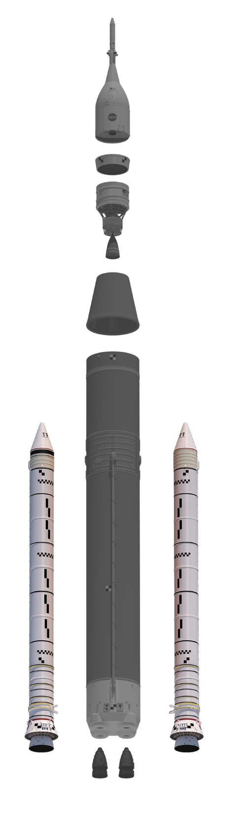
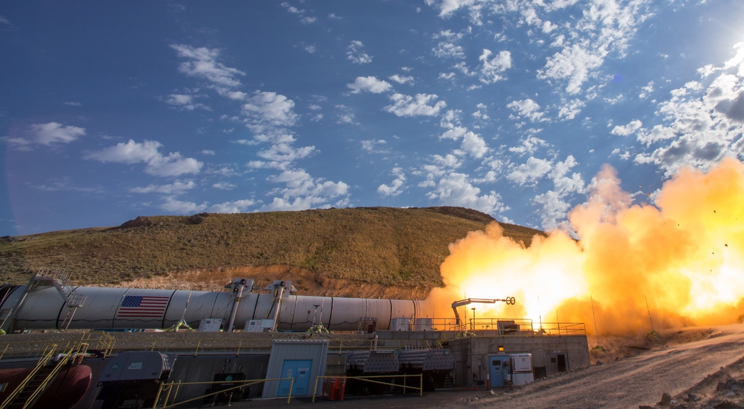
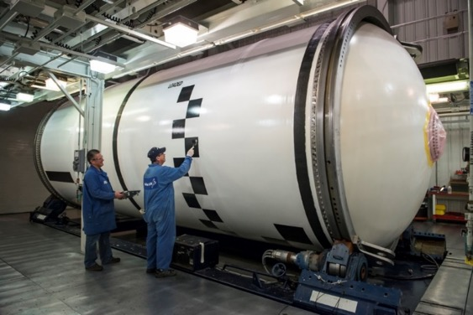
SOLID ROCKET boosterS
Notes:
Large image:
Qualification Motor QM-2 test in Promontory, Utah at Northrop Grumman’s facility in June of 2016.
Inset image:
Booster production continues at prime contractor Northrop Grumman’s facilities, where technicians are applying photogrammetric markings on completed segments for the five-segment solid rocket booster motors for the first integrated mission of SLS and Orion.
Basics:
- Each 177 feet or 17 stories tall – taller than the Statue of Liberty
- Each is 12 feet in diameter.
- Each booster burns through 1,385,000 pounds of propellant in two minutes – that’s an average of 5.5 tons of propellant every second.
- Each booster’s thrust is greater than 14 four-engine Boeing 747s at full take-off power.
- During flight, the temperature of the motor chamber gases reach more than 5,000°F – hot enough to boil steel!
Hardware Status:
Two full-scale static hot-fire tests have been conducted and are paving the way for qualification.
The first test (March 2015) tested the propellant at a temperature of about 90 degrees.
The second test (June 2016) tested the propellant at about 40 degrees
At Northrop Grumman in Utah, all 10 EM-1 motor segments have been cast with propellant and several are completely painted, finished and are awaiting shipment to Kennedy Space Center.
Both nozzles are finished at Northrop Grumman facilities in UT.
At Kennedy, the forward and aft skirts are being refurbished and outfitted for flight. TVC has been installed in the left-hand aft skirt and teams recently completed a hot fire test on an aft skirt pathfinder in preparation for final assembly and checkout.
Upper and lower TVC frames have been installed in the right-hand aft skirt.
Booster separation motors are currently being installed on the left-hand aft skirt.
At Marshall, the avionics recently finished qualification testing and will be tested with vehicle avionics later this year.
Booster segments are now being cast for EM-2

Slide 13
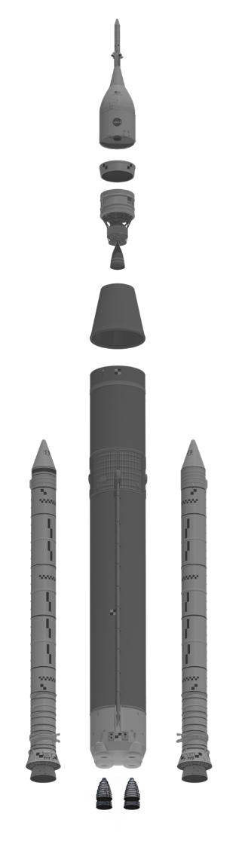
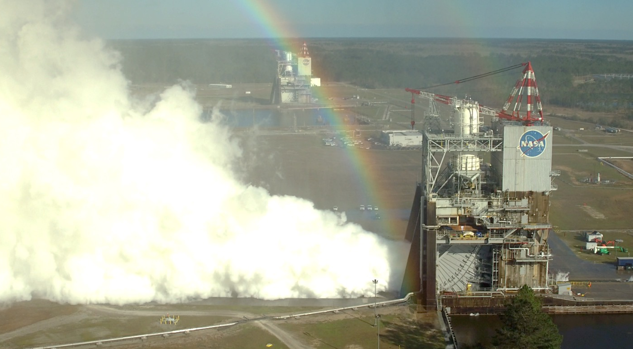
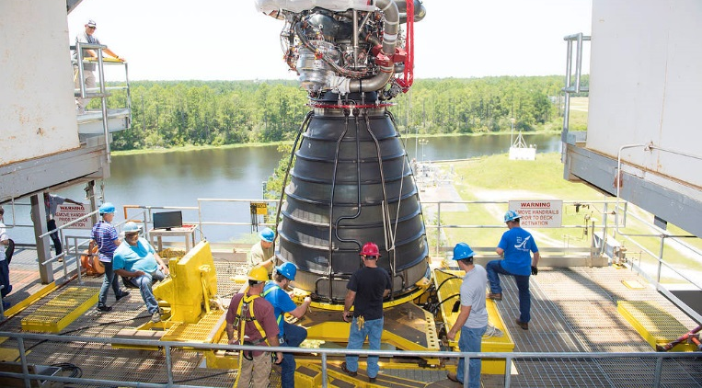
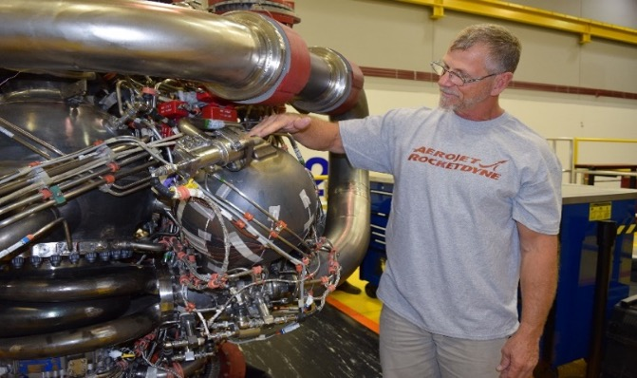
ENGINES
Notes:
Top Inset Image: EM-1 engines in processing
Bottom inset image: Development test engine with 3-D printed Pogo accumulator
Right Image: RS-25 testing at SSC
Basics:
4 RS-25 engines vs 3 for shuttle, 109% thrust vs 104.5%, new controller and software and nozzle insulation, more than 500,000 lb thrust each, more than 1 million seconds total ground and flight time.
Program starts with 14 flown engines and 2 new serial number engines built from spares.
Hardware Status:
Program has been hot-fire testing the RS-25 engines since 2015 to ensure the engines can perform under the different SLS pre-launch conditions, higher heating environment, and flight thrust profiles, and also to qualify the new EM-1 controllers. More than 20 tests, more than 10,000 seconds hotfire time.
All 4 EM-1 engines processing complete. All 4 EM-1 controllers and all 4 EM-2 controllers green run tested.
Most recent test (2/21/18) took the RS-25 to 113% thrust, the highest ever, and it continued to function nominally (with no issues).
Concurrent work is under way on developing a new more affordable, expendable variant of the RS-25 that costs at least 30 percent less and operates at 111% (521,000 lb) thrust. It incorporates new materials and new manufacturing processes, as well as new technology like 3D printing. First test was early 2018 of a 3D printed pogo accumulator on a ground test engine.\
New test series to begin in August that will include the pogo accumulator plus a new HIP (Hot Isostatic Pressure) – Bonded main combustion chamber that reduces production time and cost.

Slide 14
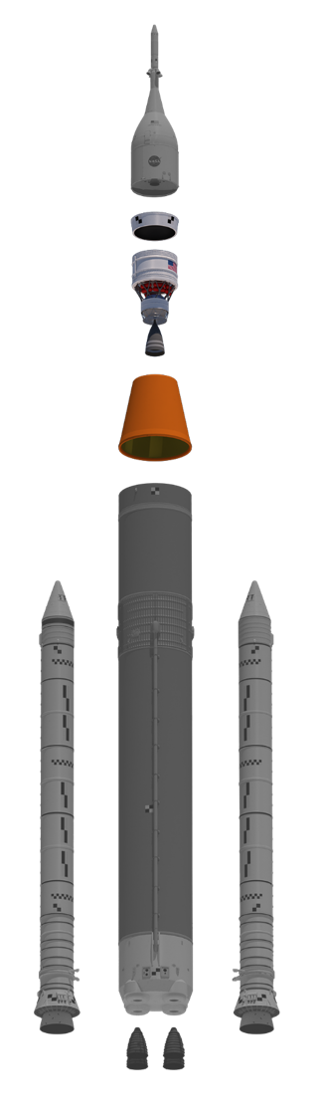
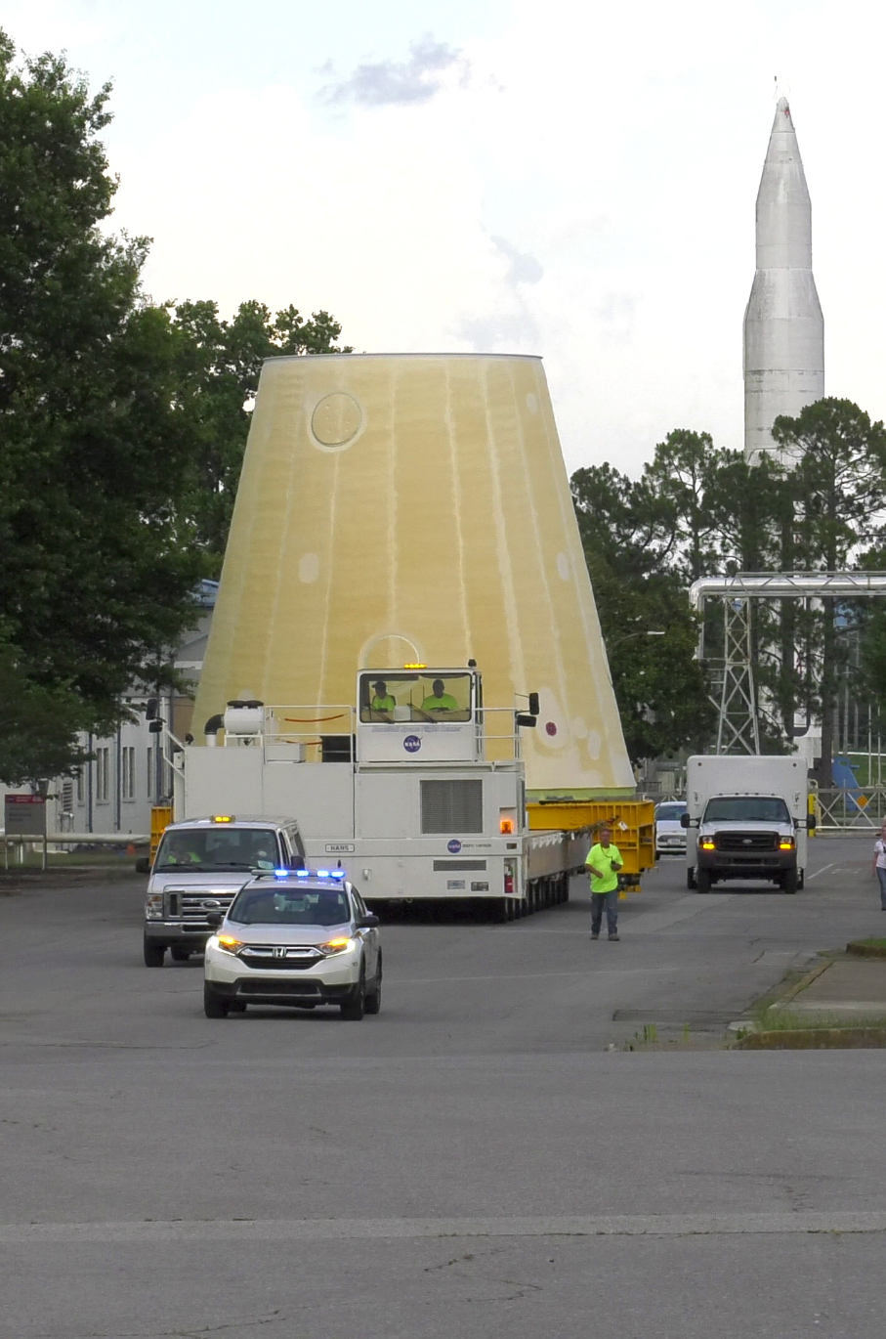
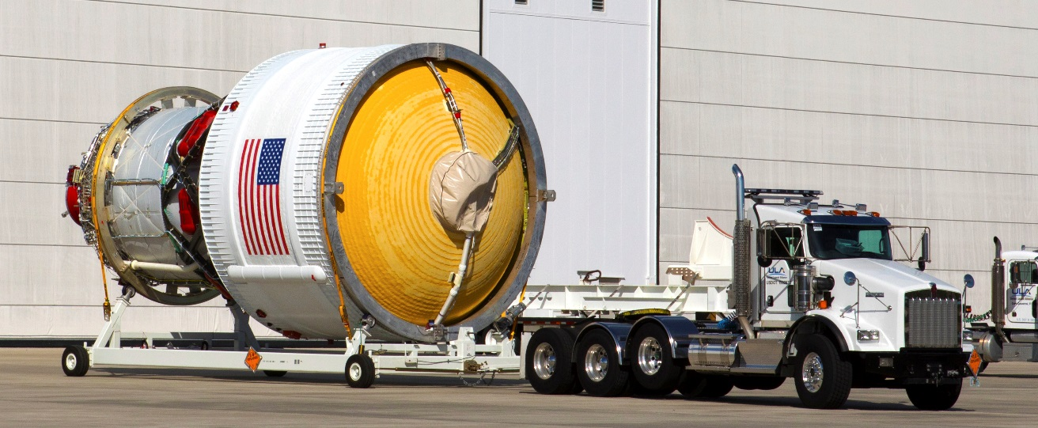
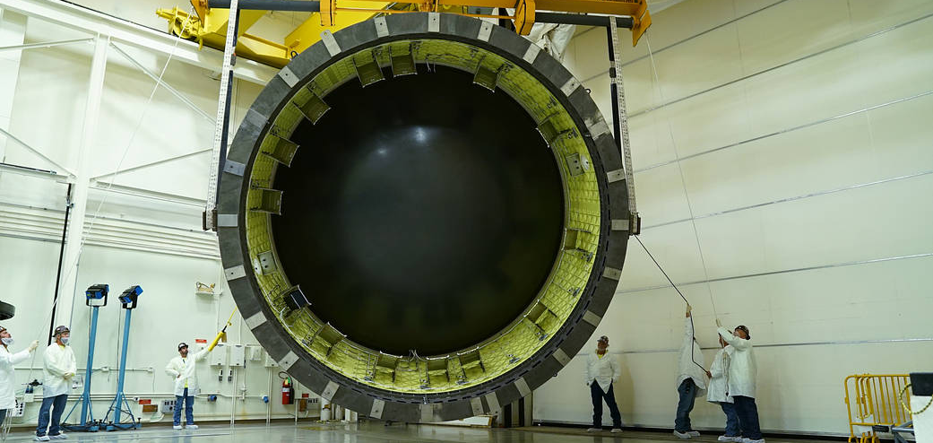
IN-SPACE STAGE AND ADAPTERS
Notes:
Left Image:
Launch Vehicle Stage Adapter after application of foam insulation (thermal protection system) being transported to its final stop at Marshall where it will be outfitted for flight.
Top Right Image:
Interim Cryogenic Propulsion System at Kennedy Space Center for EM-1 integration
Bottom Right Image:
Orion Stage Adapter at MSFC ready for shipment to KSC for EM-1 integration.
Basics:
ICPS:
Built by Boeing/ULA
Modified Delta Cryogenic Second Stage by lengthening LH2 tank, adding hydrazine bottles for attitude control and minor avionics changes
42’ tall x 16’ wide
Powered by one AR RL-10B-2 engine
24,750 lbs thrust
Operates about 700 seconds
Provides TLI burn for Orion
LVSA:
Connects core and upper stages
27.5’ long and 27.5’ wide at base, tapers to 5 m at top
Friction-stir welded lightweight aluminum alloy
OSA:
Connects ICPS and Orion
5’ high, ~18’ diameter
Holds 13 cubesats for EM-1
Hardware Status:
ICPS and OSA finished and shipped to EGS in 2017 and 2018
ICPS will remain in Space Station Processing Facility until needed for stacking
OSA will remain in SSPF until payloads are integrated, then it will be stacked
LVSA recently completed TPS, will soon be integrated with frangible joint assembly
LVSA scheduled to ship on Pegasus at the end of this year
Integrated Structural Test of upper stage successfully completed in May 2017 at MSFC
Consisted of test articles of ICPS, LVSA, OSA and FJA
First major structural test to be completed

Slide 15

Notes:
“Built to Explore” 30-sec. video

Slide 16
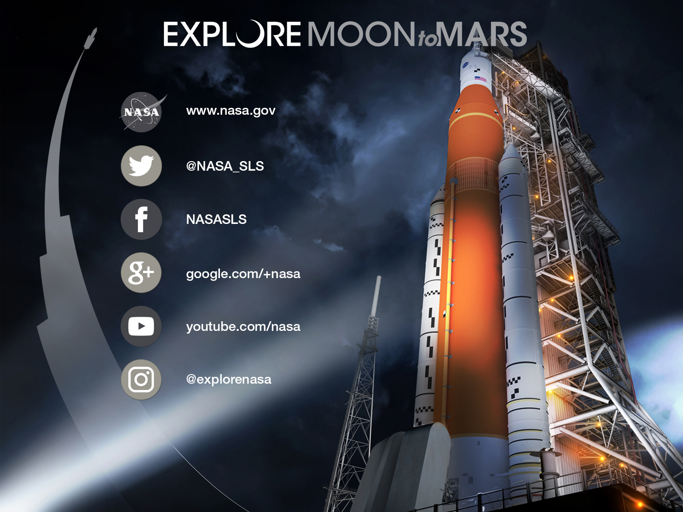
Notes:
The best way to stay up-to-date on SLS is to follow us on social media.

Slide 17
BACKUP

Slide 18
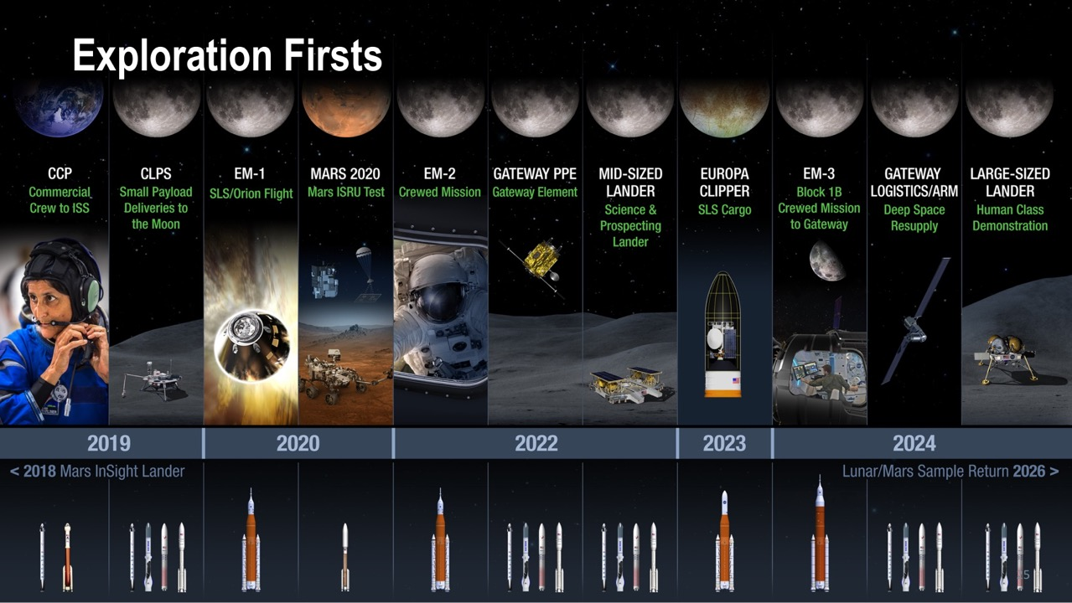
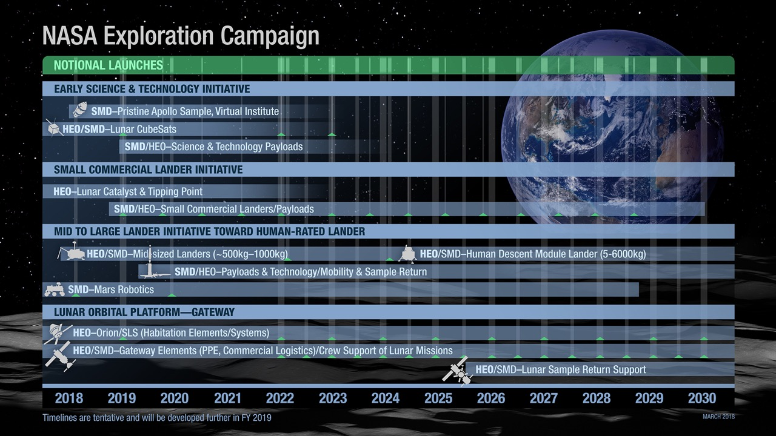
Yearly Launch Cadence after 2022
Notes:
Animated version available to unveil each initiative group one at a time.

