Slide 1


Air quality forecasts using the NASA GEOS composition model
Christoph A. Keller
NASA Global Modeling and Assimilation Office (GMAO)
Universities Space Research Association (USRA)
In collaboration with:
Emma Knowland, Lesley Ott, Steven Pawson, Kris Wargan, Brad Weir (GMAO)
Bryan Duncan, Melanie Follette-Cook, Junhua Liu, Fei Liu, Julie Nicely (NASA GSFC)
Kevin Cromar (NYU), Felipe Mandarino (City of Rio de Janeiro)
AGU Fall Meeting
12 December 2018

Slide 2
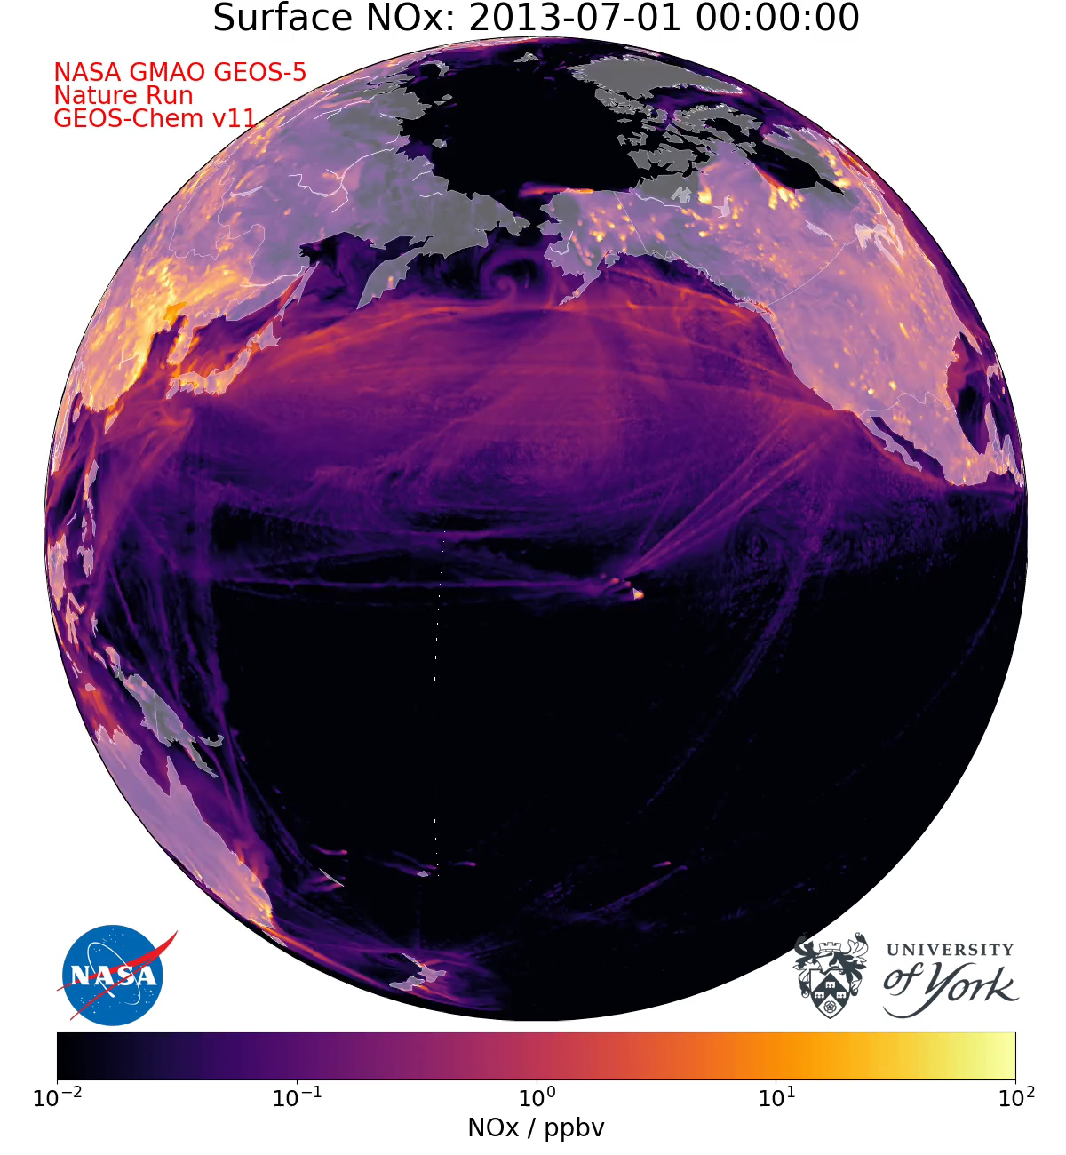
Global high-resolution air quality modeling
christoph.a.keller@nasa.gov

Slide 3
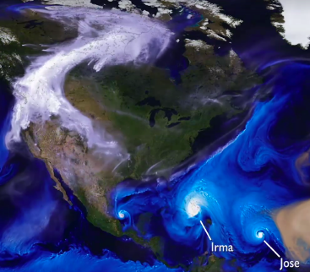
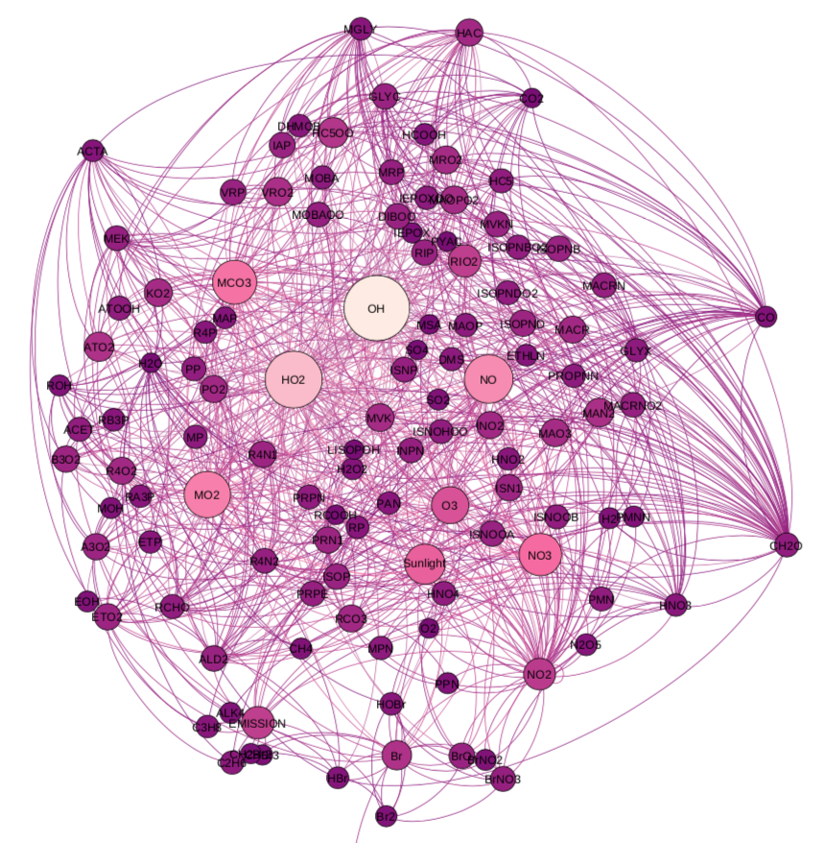
GMAO produces composition forecasts in near-real time
GEOS - CF
Ozone (O₃)
GEOS Weather & Aerosols
Nitrogen Dioxide (NO₂)
GEOS - Chem
Fine Particulate Matter (PM_{2.5})
christoph.a.keller@nasa.gov
Notes:
Used in exposure and health studies

Slide 4
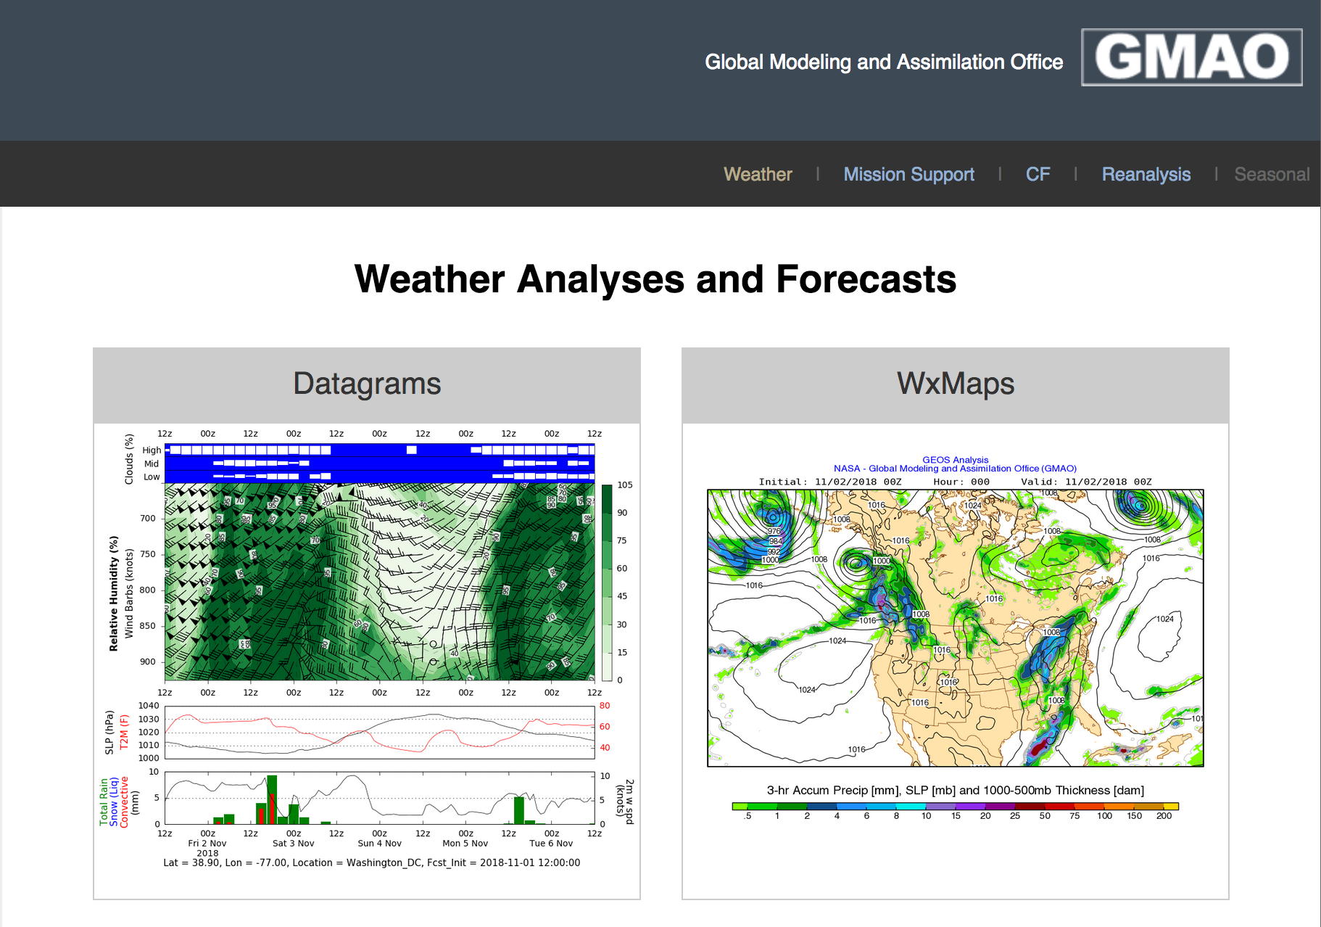
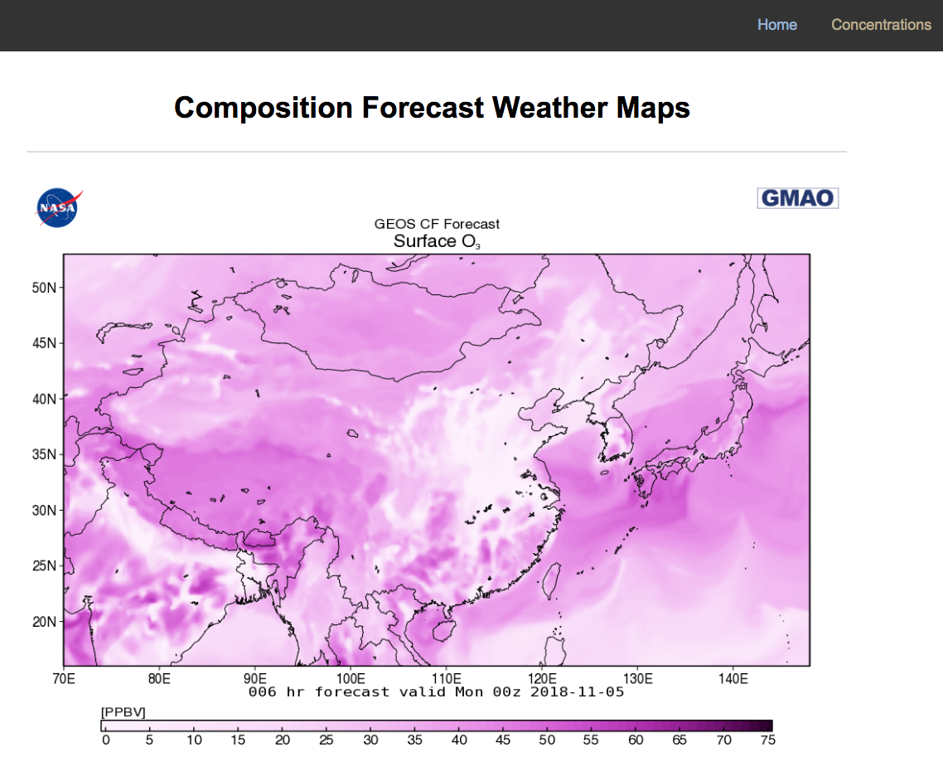
Forecasts are available at fluid.nccs.nasa.gov
christoph.a.keller@nasa.gov

Slide 5
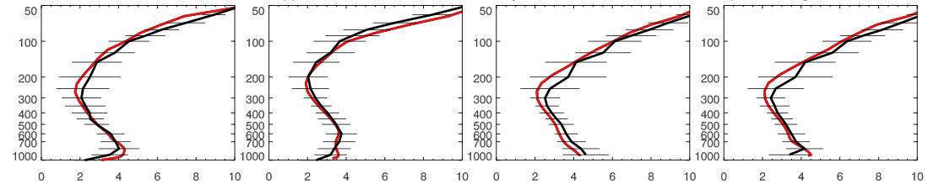
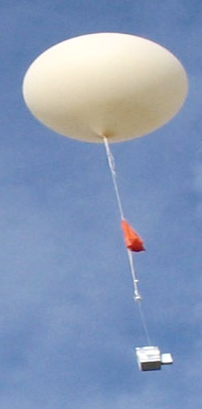
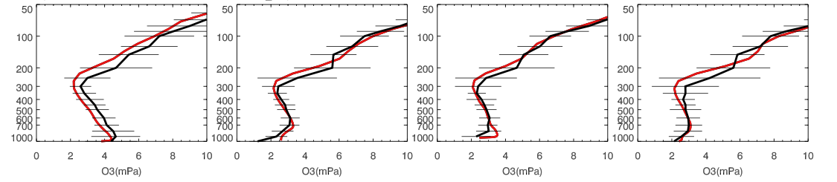
GEOS-CF compares well against ozone sondes
Trinidad Head, CA Sapporo, Japan Payerne, Switzerland Hohenpeissenberg
Legionowo, Poland Goose Bay, Canada Edmonton, Canada Churchill, Canada
Sondes
GEOS-CF
christoph.a.keller@nasa.gov

Slide 6
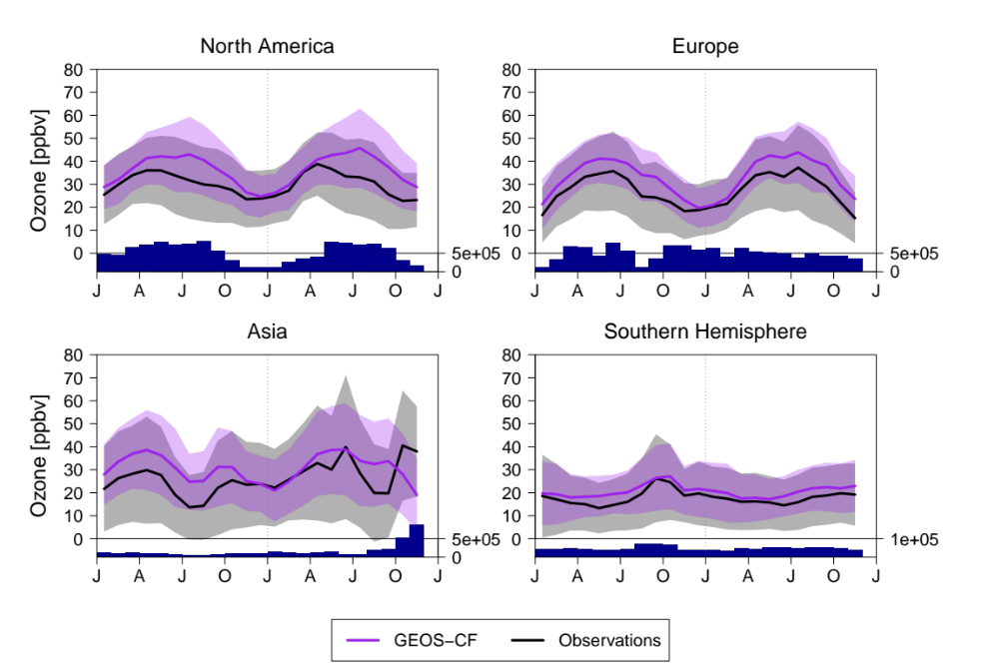
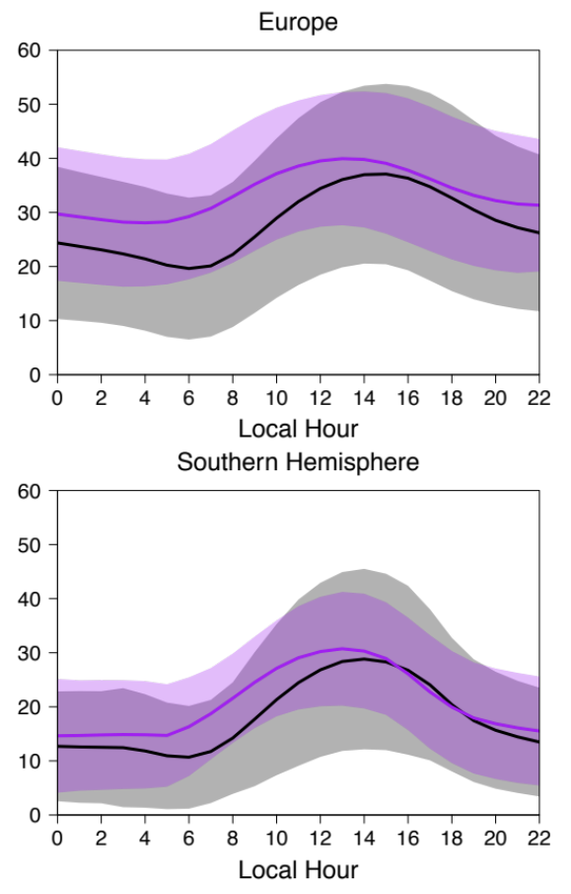
Overall good agreement with surface observations, but over-prediction of summertime ozone
Monthly means
Diurnal cycle
2017
2018
2017
2018
Not enough
titration?
2017
2018
2017
2018
christoph.a.keller@nasa.gov

Slide 7
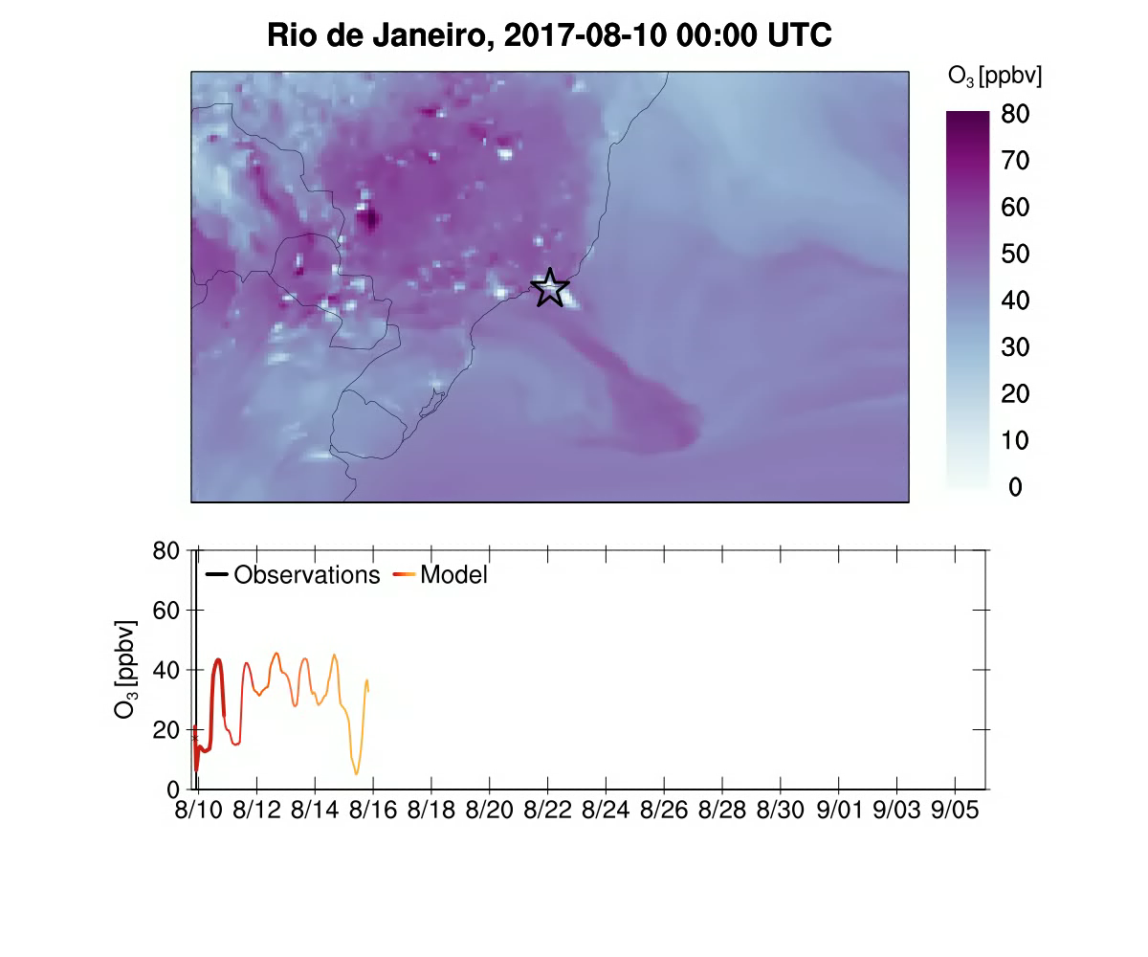
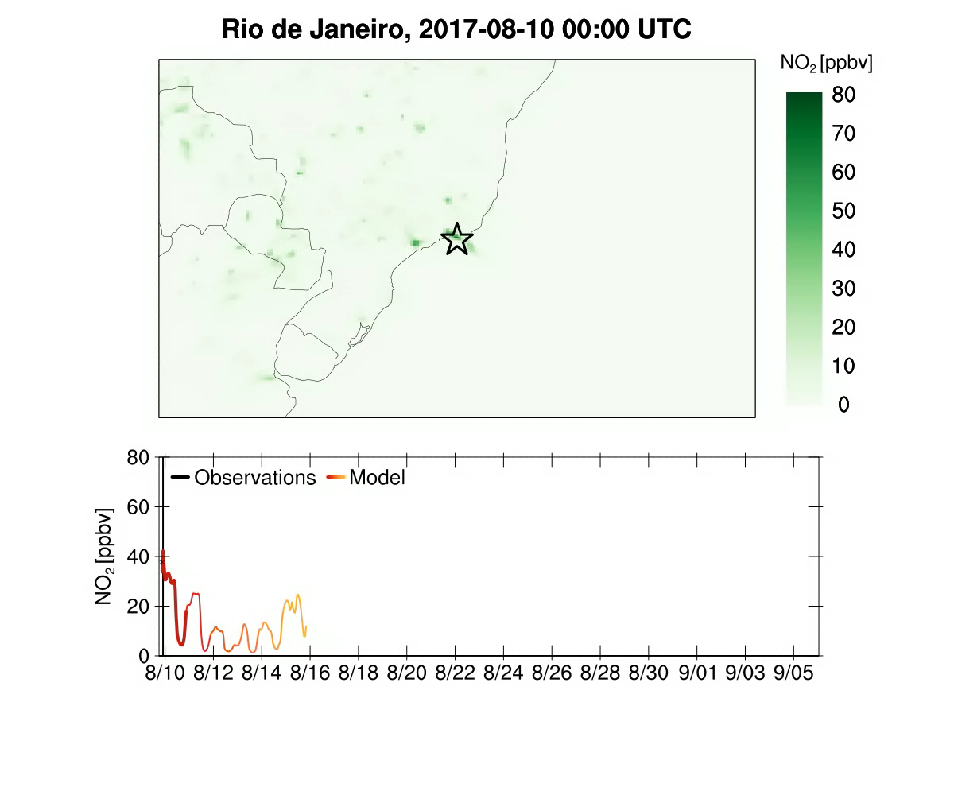

Example 1: Improve air quality forecasts in Rio de Janeiro
Observation
0 +1 +2 +3 +4 +5
GEOS-CF
christoph.a.keller@nasa.gov

Slide 8
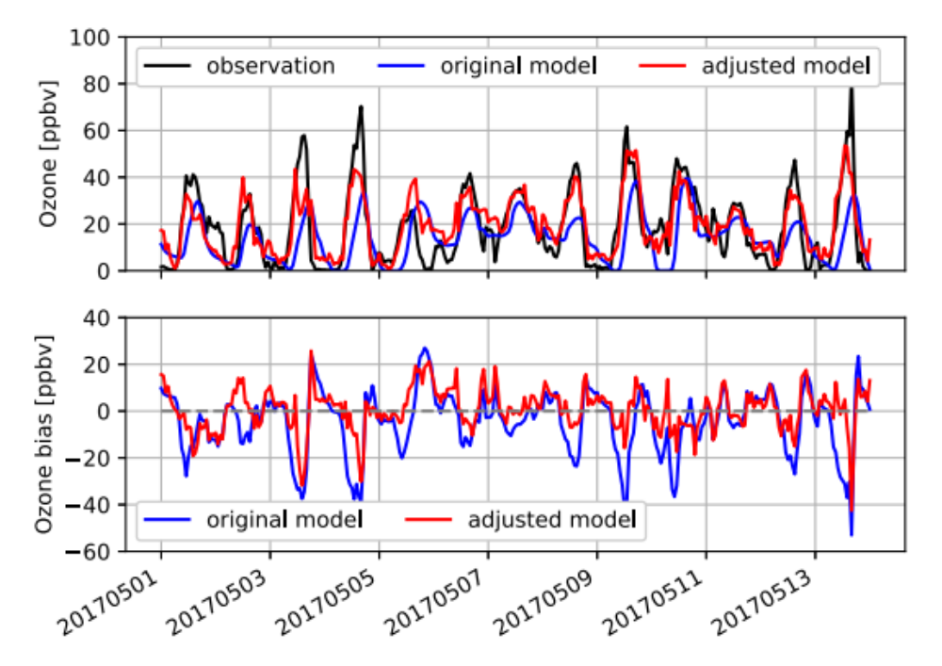
Example 1 (cont.): Improve local forecasts using statistical bias correction?
christoph.a.keller@nasa.gov

Slide 9
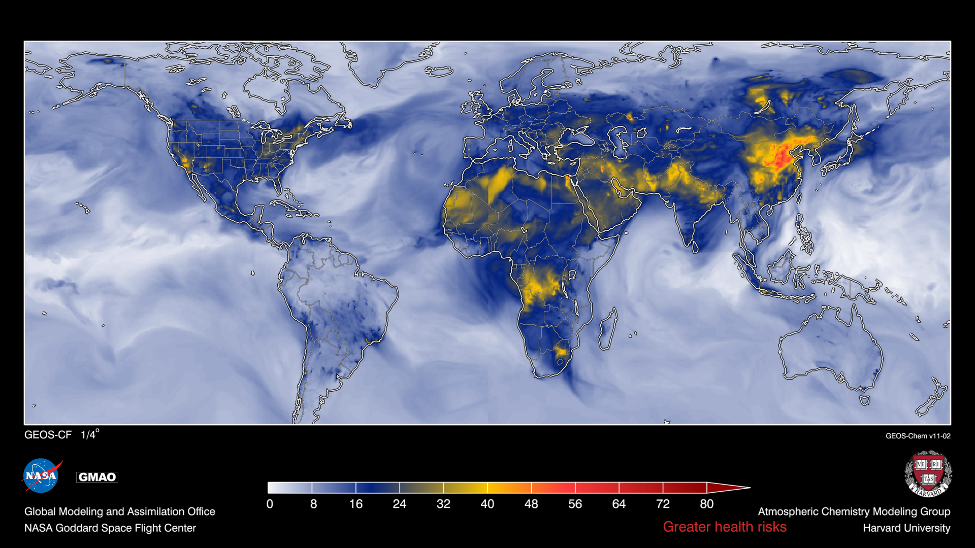
Example 2: Global HAQI developed by Kevin Cromar (NYU)
HAQI = f ( PM_{2.5}, O₃, NO₂ )
Lower Health Risks
Higher Health Risks
christoph.a.keller@nasa.gov
NYU and UNICEF will use GEOS-CF to refine HAQI for children

Slide 10
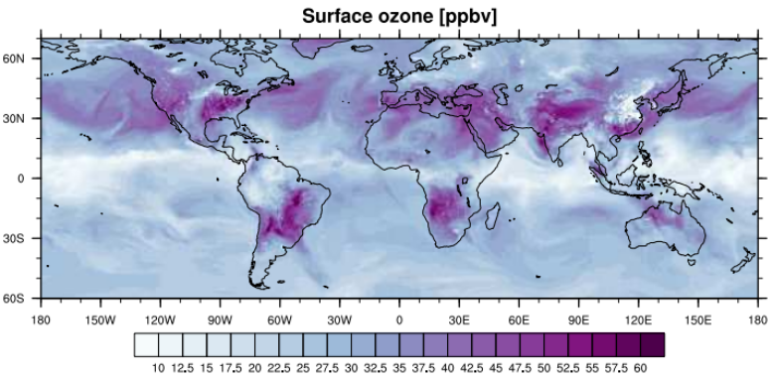
Summary
GEOS-CF produces daily global composition forecasts at 25 km horizontal resolution
Working with end users to enable improved AQ forecasts and health alerts
Open question:
End users have different needs; what is the best way to make output accessible to everyone?
christoph.a.keller@nasa.gov

Slide 11
christoph.a.keller@nasa.gov

Slide 12
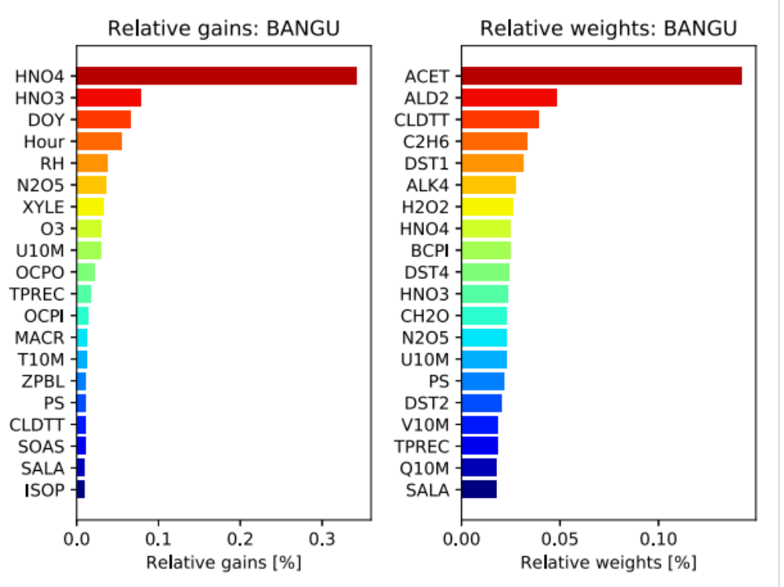
Feature importance (Bangu station)
christoph.a.keller@nasa.gov

Slide 13
Model underestimation of NO₂ not confirmed by OMI observations
OMI
GEOS-CF
GEOS-CF - OMI
christoph.a.keller@nasa.gov

Slide 14
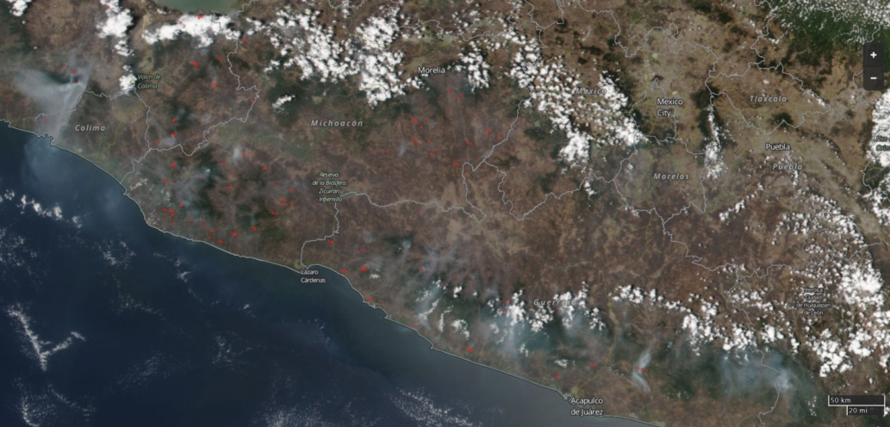
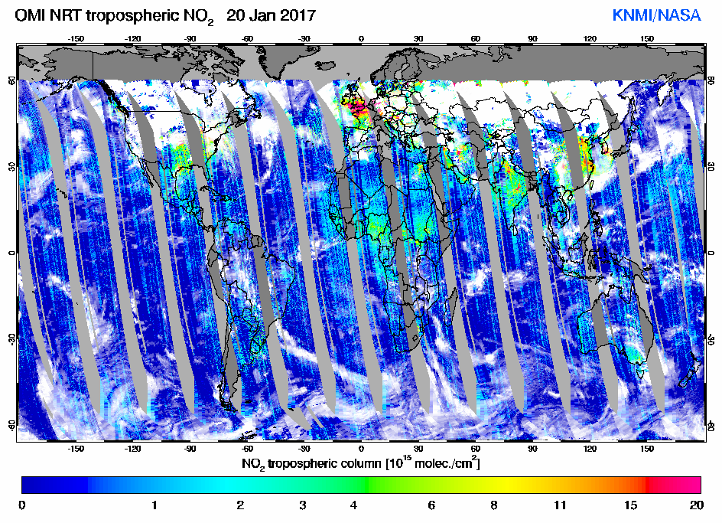
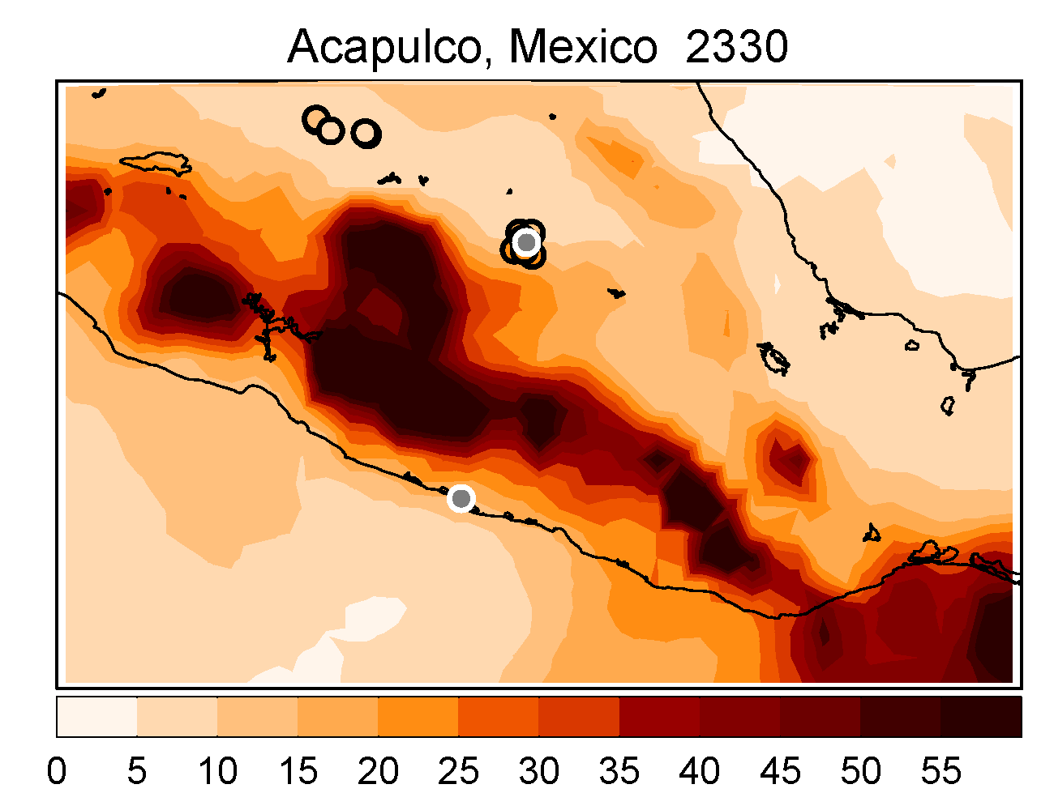
Satellite observations are a critical element of GEOS-CF
Aura OMI O₃ / (NO₂)
Mexico City
Smoke
Acapulco
http://tempo.si.edu
christoph.a.keller@nasa.gov

Slide 15
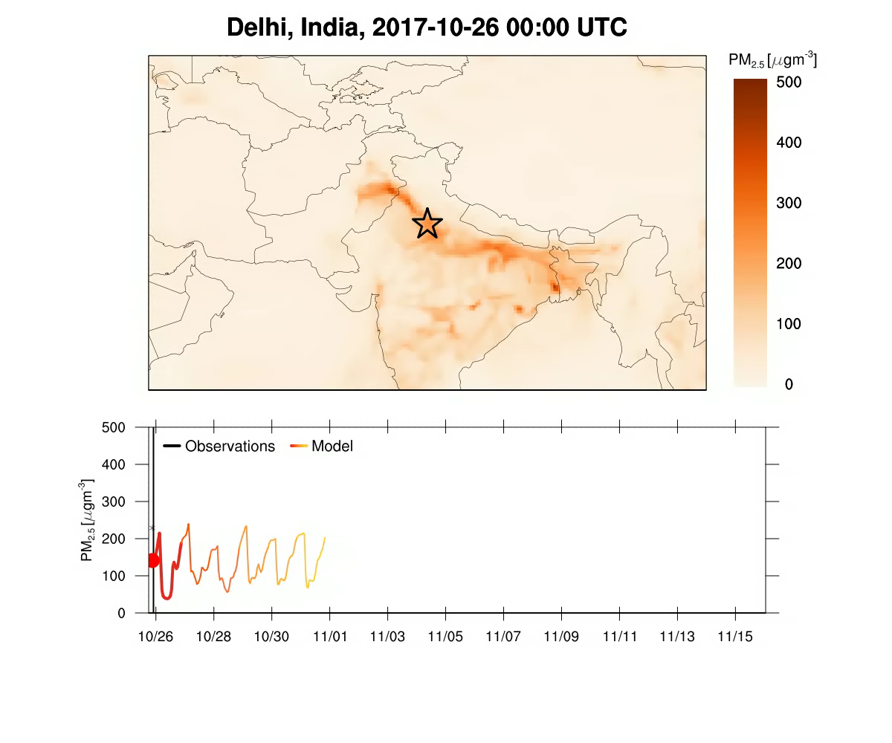
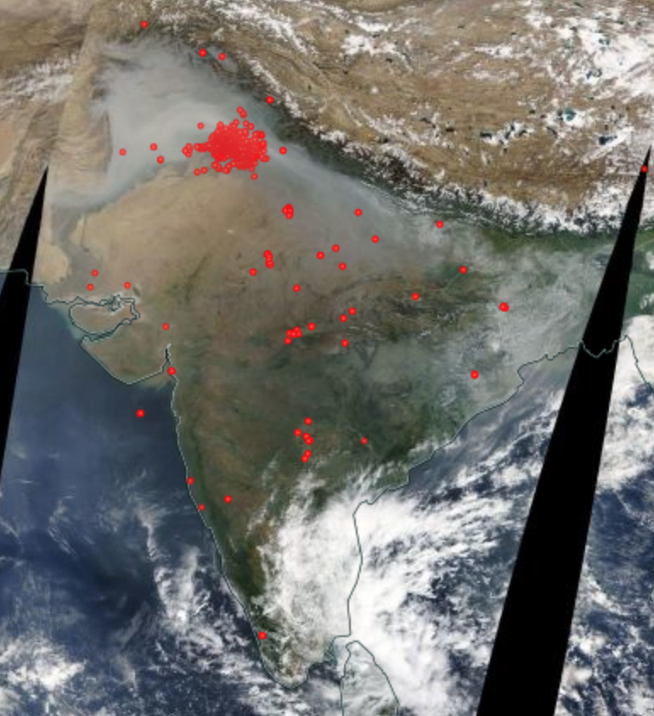
Case study: agricultural fires in India
MODIS fires Nov 01, 2017
Observation
-1 +1 +2 +3 +4 +5
GEOS-CF
christoph.a.keller@nasa.gov

Slide 16
Application: Health Air Quality Index (HAQI)
Ozone
Nitrogen Dioxide
Particulate Matter
HAQI is a function of O₃, NO₂, and PM_{2.5}
christoph.a.keller@nasa.gov

Slide 17
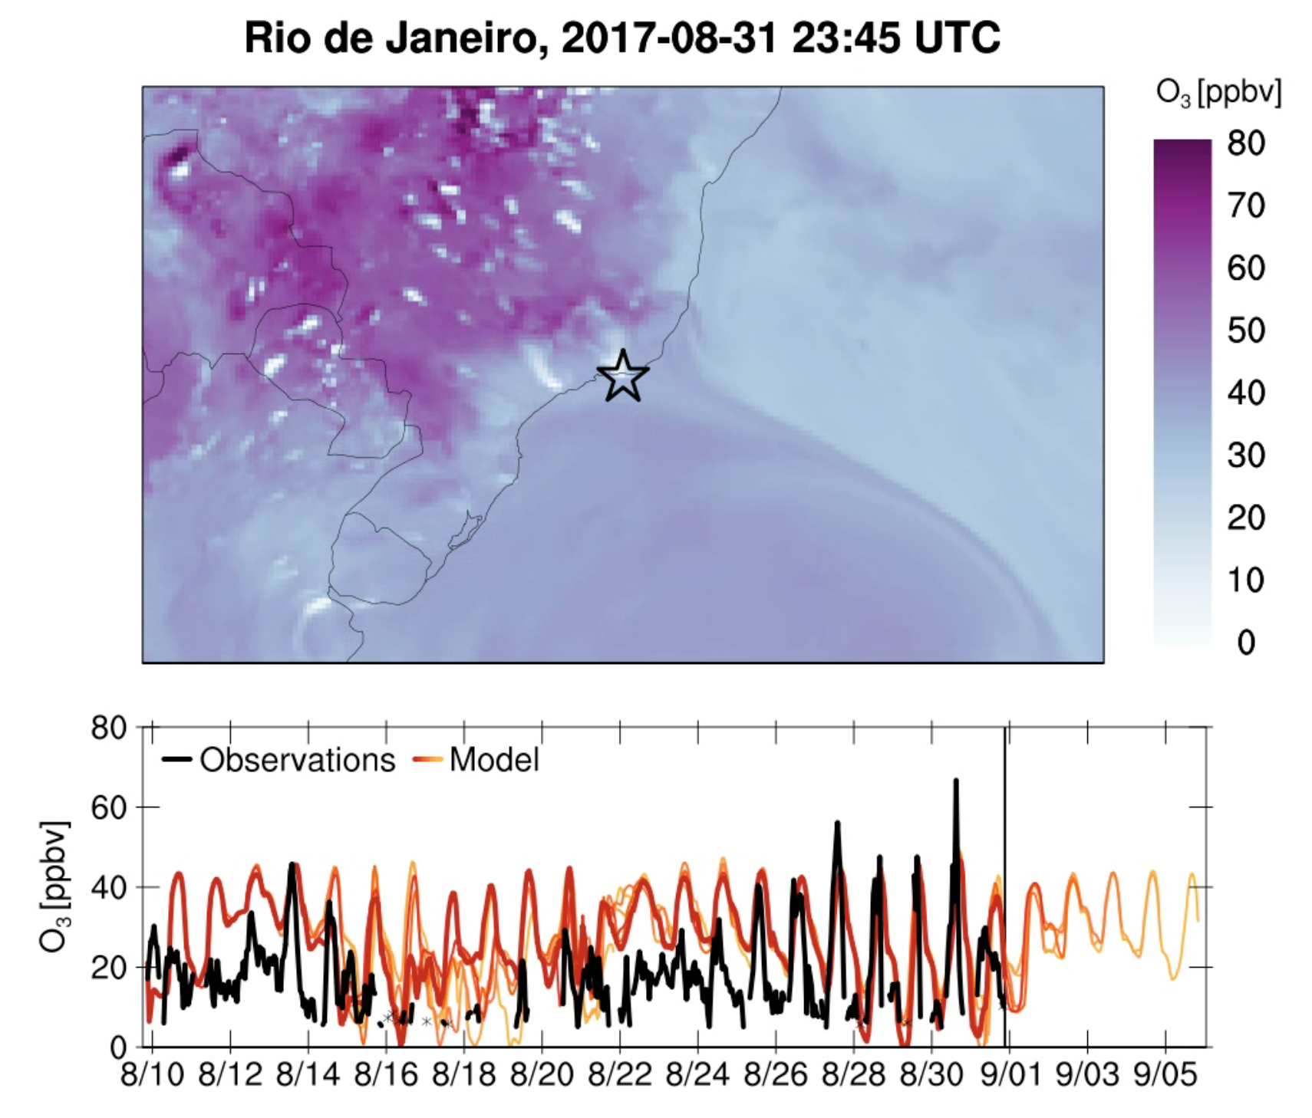
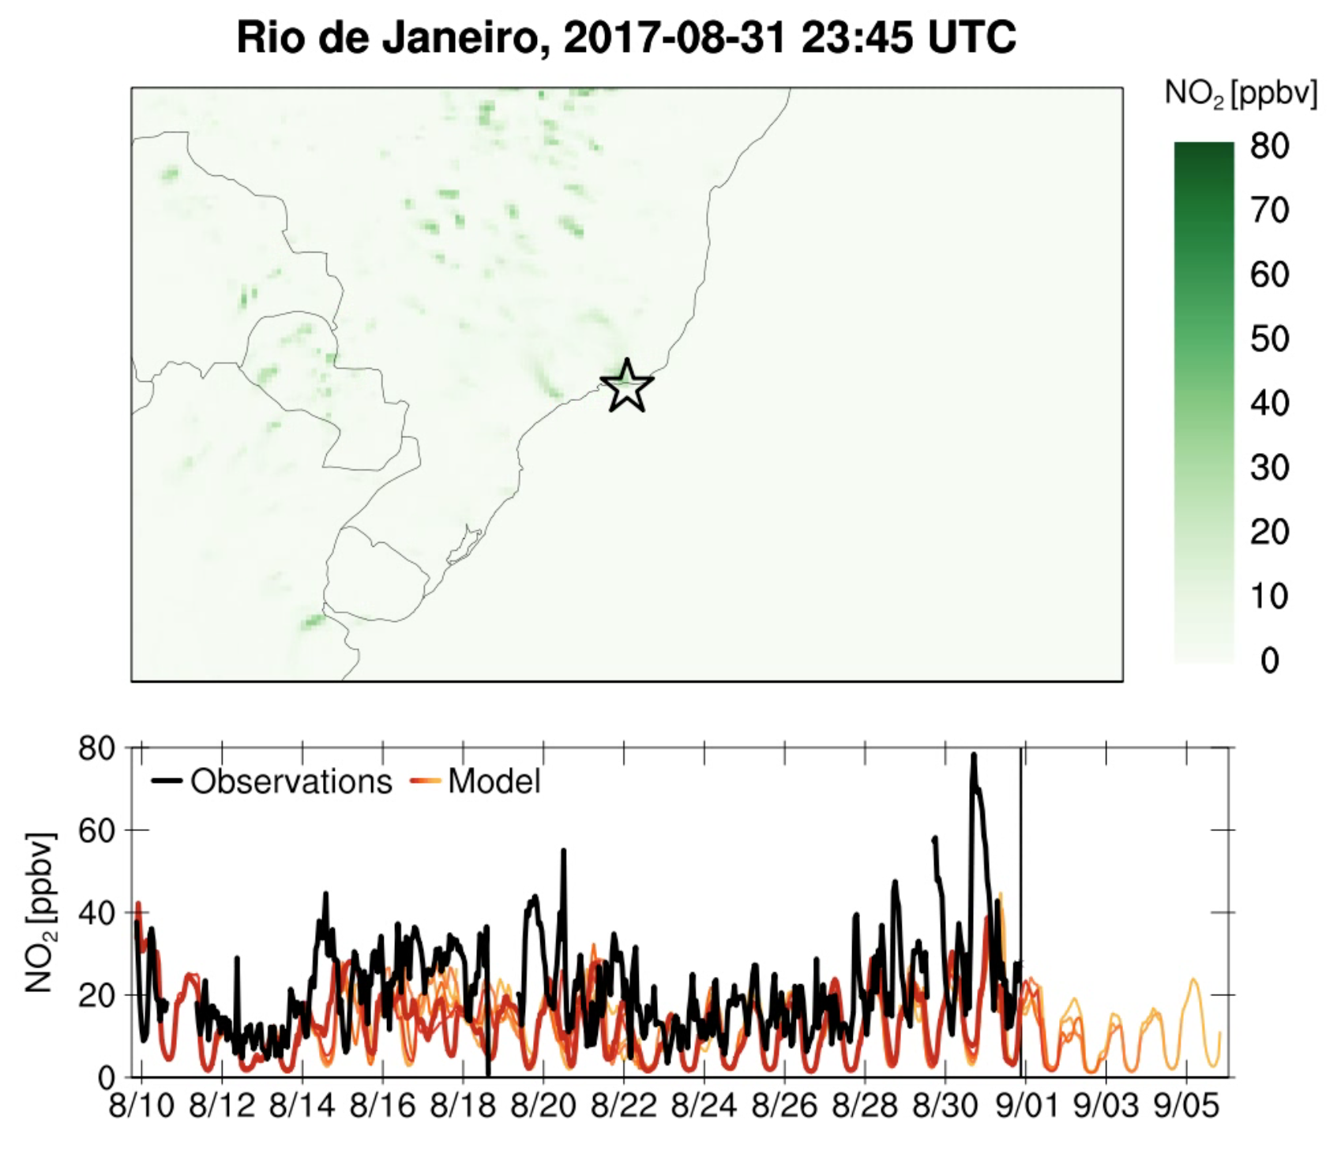
Local observations in Rio de Janeiro suggest that GEOS-CF underestimates surface NO₂
christoph.a.keller@nasa.gov

