Slide 1
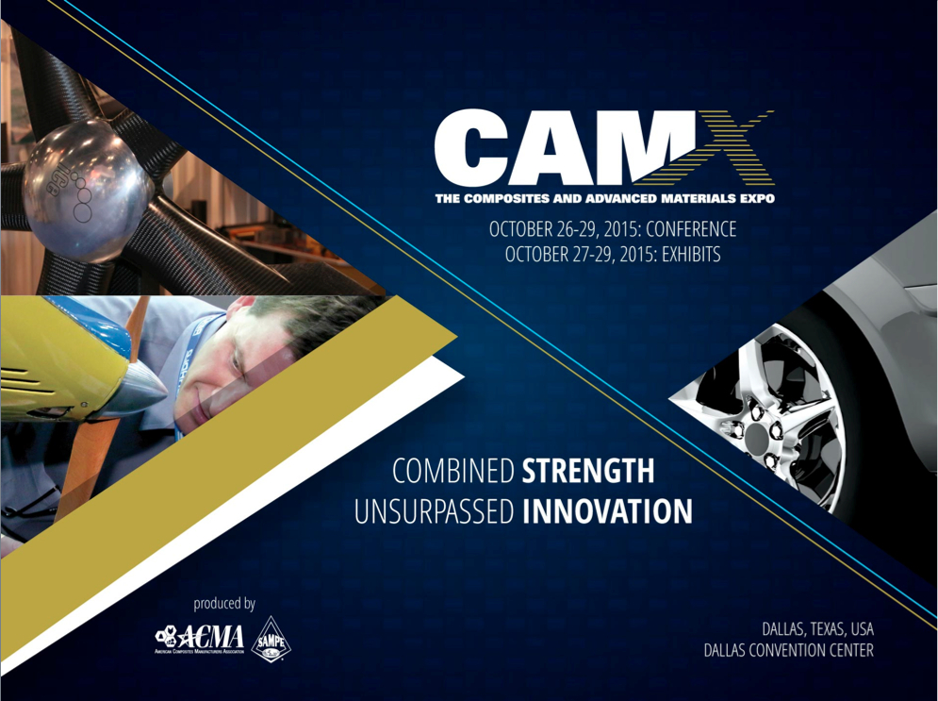

Slide 2

Development of an Ablative 3D Quartz / Cyanate Ester Composite for the Orion Spacecraft Compression Pad
Jay Feldman, ERC. Inc. @ NASA Ames
Ethiraj Venkatapathy, NASA Ames
Curt Wilkinson, Bally Ribbon Mills
Ken Mercer, San Diego Composites
The Composites and Advanced Materials Expo
Dallas, TX | October 27-29, 2015

Slide 3
Outline
Introductions
  Orion Multipurpose Crew Vehicle – Compression Pad
  3D Woven Thermal Protection Systems (Woven TPS)
3D Multifunctional Ablative Thermal Protection System (3DMAT) Project
  Requirements & Drivers
  Material Development
  Material Testing
  Status & Outlook

Slide 4
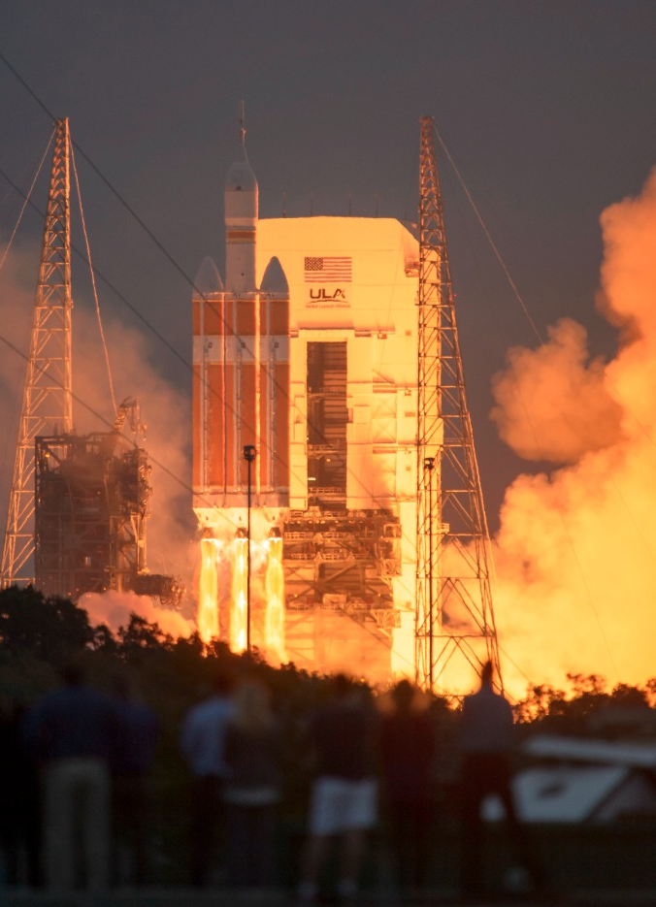
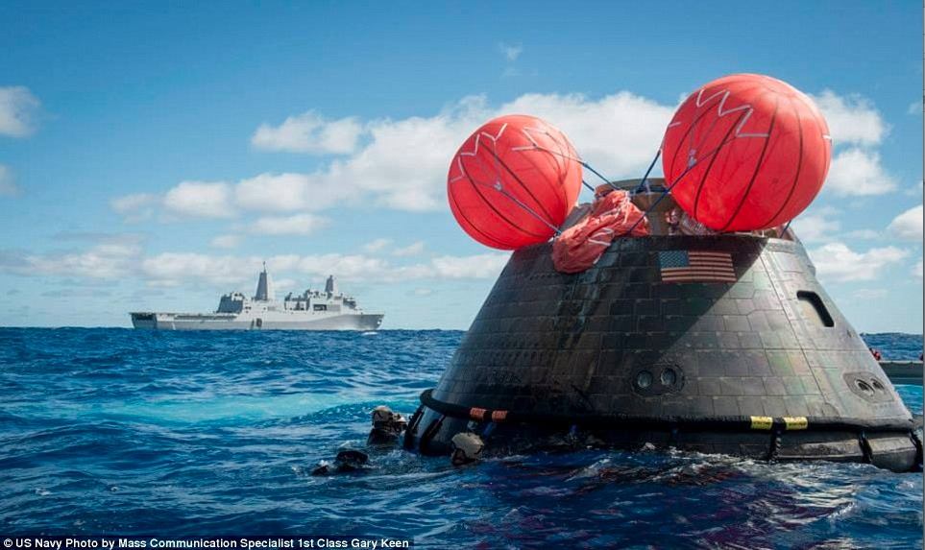
Orion Multipurpose Crew Vehicle
Orion Flight Test Launch Dec. 5, 2014
Orion Flight Test Recovery
Orion Multipurpose Crew Vehicle astronaut missions to Mars targeted for 2030s
Significant technical hurdles to overcome on the path to human Mars missions!
Today’s talk will discuss one challenge we’ve addressed on the ablative heat shield
Peak Altitude: 3,600 miles
(Space Station: 220 miles)
Notes:
NASA community is very excited about the Orion flight test a few months ago & that we are on the path to putting astronauts in space on an American vehicle.
Our country is on a path to regaining the ability to send astronauts to space with U.S. built spacecraft!
Com. Crew: Have been hitching rides on the Russion Soyuz since 2011 at a rising cost of $71M per seat.

Slide 5
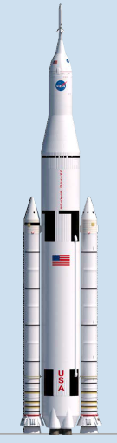
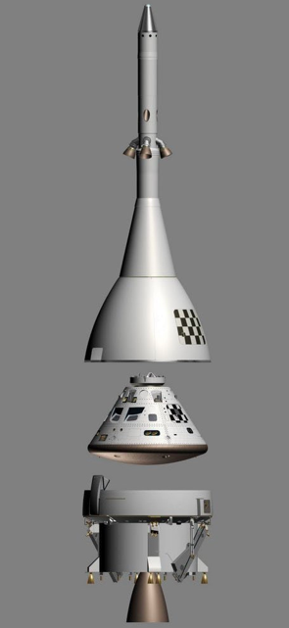
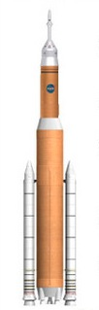
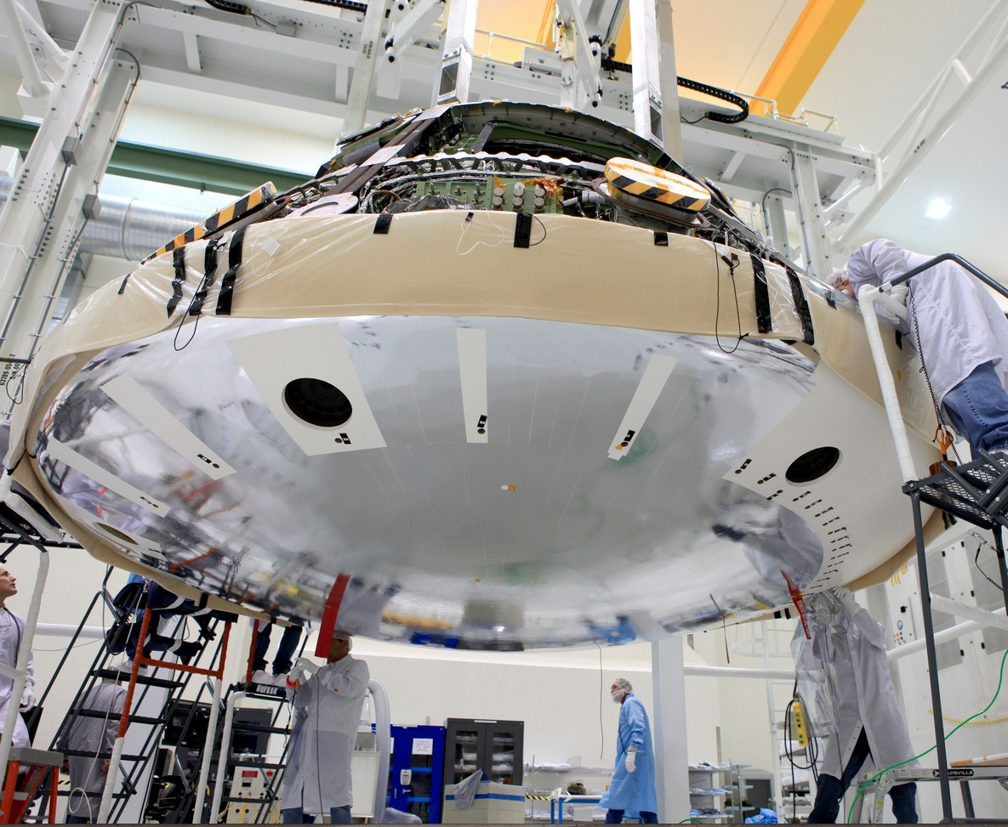
Background: Orion Compression Pad
Orion EFT-1 Vehicle
Launch
Abort System
Compression Pad Locations (6)
Crew
Module
Service
Module
Orion compression pads are the interface between Crew Module (CM) & Service Module (SM)
Required to withstand: - Launch & ascent structural loads
- Pyro-shock (CM/SM separation event)
- Earth re-entry (high heating, ablation)
Notes:
SM: Power, propulsion, life support
ABLATION – heat shield is charred and partially consumed while keeping the inside of the vehicle cool

Slide 6
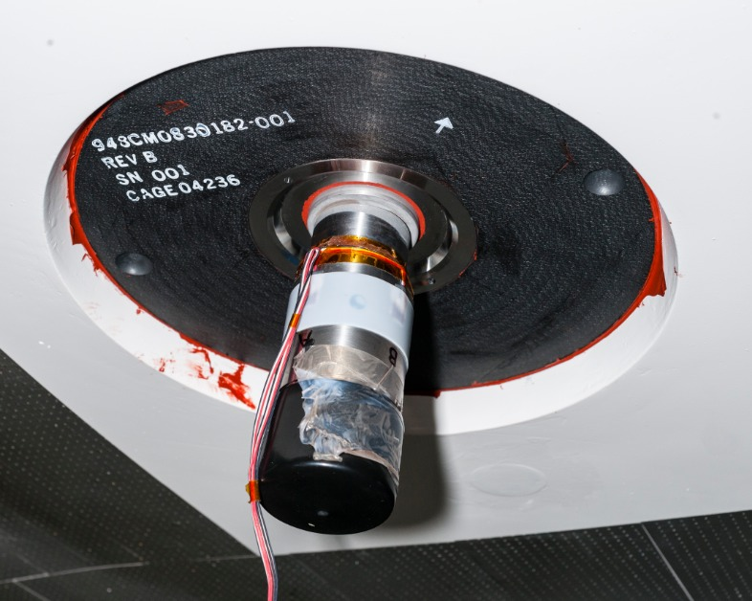
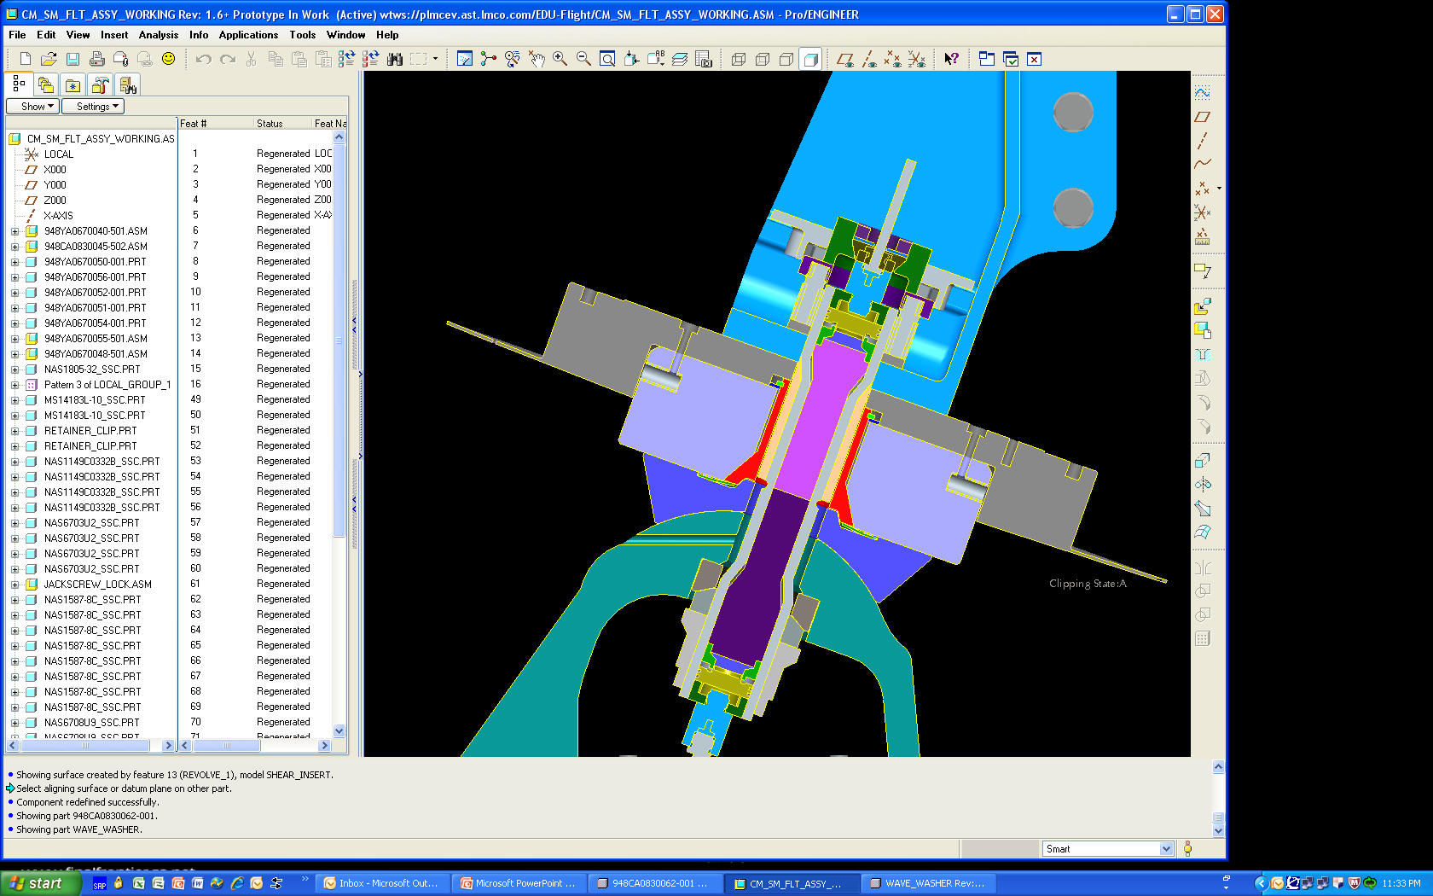
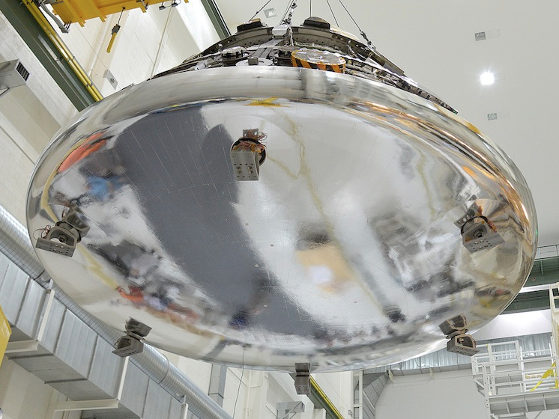
EFT-1 Compression Pad
Retention & Release Mechanism
Compression Pad
(2D carbon phenolic)
CM Bracket
Heat Shield
Steel Insert
CM Insert
Explosive Bolt
Heat Shield
SM Interface Pad
Service Module Bracket

Slide 7
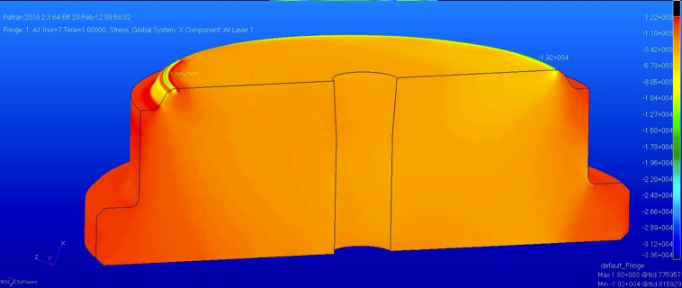
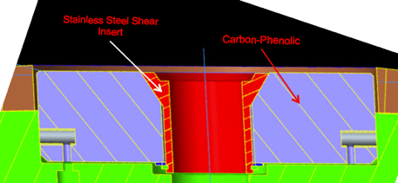
The Compression Pad Problem
Initial Pad Design: All Composite
EFT-1 (Earth Orbit) Only Design
Steel Insert
Carbon Phenolic
This design failed for 2D carbon phenolic laminate: poor inter-laminar strength
Metallic insert used for first flight where entry heating was relatively low
2D laminates have insufficient strength to take all structural loads
Metallic insert is problematic as it creates a thermal short, results in melt flow onto surrounding materials
Future Orion missions will go beyond Earth orbit & have significantly higher heating compared to EFT-1 flight
A robust 3D composite would eliminate the need for the metallic insert

Slide 8
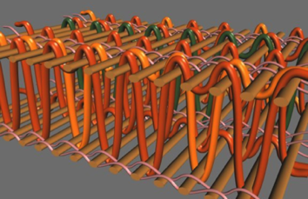
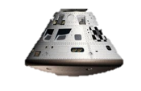
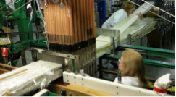
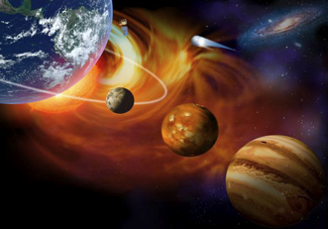
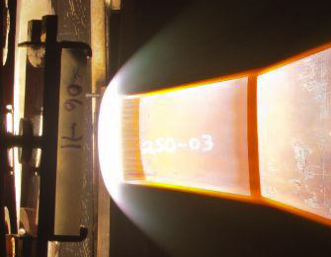
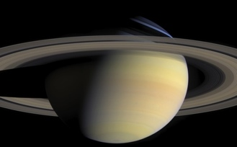
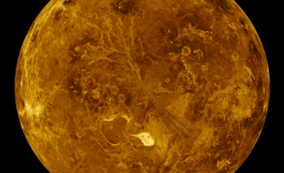
3D Woven Thermal Protection System (TPS) Development
3D Woven Multifunctional
Ablative TPS (3D-MAT)
2018: Lunar
2022: Crew
Enabling Orion with Lunar
Capable Compression Pad
Woven TPS
IR&D
2020 - 2022
Woven TPS GCT BAA
Heat-shield for Extreme Entry
Environment Technology (HEEET)
Tech. Maturation to enable Venus, Saturn and outer planets missions
Discovery AO Incentive
March 2011
Jan. 2012
June, 2012
Robust Heat-shield for Human Missions
(Future Potential)
Oct, 2013
Sept. 2016
2016+
3DMAT is tailoring a specific Woven TPS solution for the Orion compression pad & developing it for the 2018 Lunar Flight (EM-1)
8
Notes:
A few years ago a small group of us at Ames began researching the use of 3D weaving to make NASA heatshields.
The exploratory effort was highly successful, and we turned our attention to two near-term needs that we believed Woven TPS could fulfill.
It was a highly successful effort, and several candidate materials & architectures were explored. We realized there were two near-term needs that Woven TPS could likely fulfill.
… for planetary entry probes, which have a very different set of RQTS compared with the Orion compression pad

Slide 9
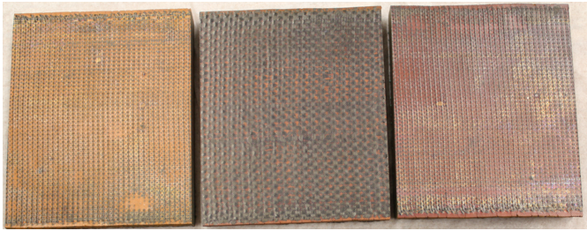
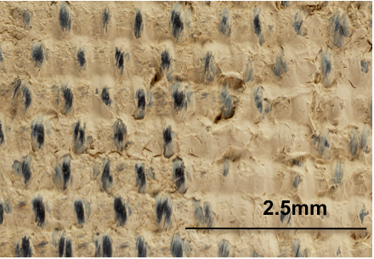
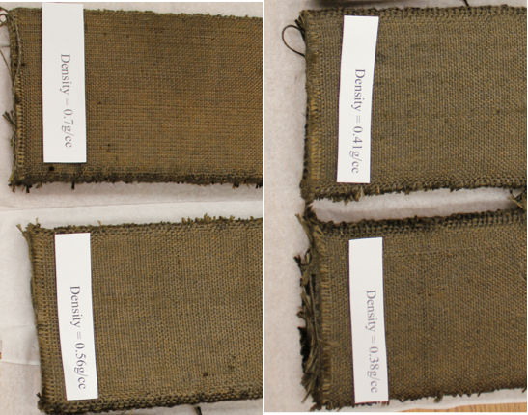
3D Woven TPS Materials
Fully Dense: Carbon Preforms with Various Resins
Low Loading of Phenolic Resin
Phenolic
Polyimide
Cyanate Ester
3 cm
Flexible, Dry-Woven, 2-Layer 3D CP Family
3 cm

Slide 10
3DMAT: Requirements & Challenges
Type | Orion Compression Pad Requirements
Thermal | Compression pad to Avcoat/carrier-structure interface shall maintain positive margin against the 500 °F maximum bondline temperature
Structural | Compression pad shall carry compression moment & shear loads
Structural | Tension tie shall maintain preload with losses due to creep & joint relaxation
Structural | Compression pad shall thermally function after exposure to the separation bolt pyro-shock event
Size | Pad material shall be manufacturable to at least 3” thickness by 11” diameter
Project Challenges
Aggressive schedule to develop in time for Orion PDR (2015) & EM-1 flight (2018)
  2012 3DMAT project start date
New weaving & resin infusion processes developed to meet size requirement
  Scale up = challenging!
  Multiple process refinements needed during development
Notes:
Achieving the development within the aggressive schedule needed to support Orion EM-1 flight

Slide 11
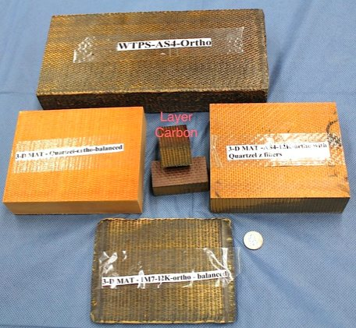
3DMAT: Phase 1 Material Evaluations
A variety of 3D weave architectures & compositions combined with 3 different resin systems were initially produced, tested & assessed against Orion requirements
 | 3D Woven Quartz Composite | Layer-to-Layer CP | 3D Orthogonal Carbon Phenolic |  | Hybrid Carbon/Quartz-Z
Fiber(s) | Quartz | Carbon | Carbon | Carbon | X/Y: Carbon Z: Quartz
Weave | 3D Orthogonal | Layer-to-Layer | 3D Ortho. | 3D Ortho. | 3D Ortho.
Z-loading | 33% | 5-10% | 16% | 33% | 16%
Resin | Phenolic, Cyanate Ester, Polyimide | Phenolic | Phenolic | Phenolic | Phenolic
Structural Performance | Good | Poor | Fair | TBD | TBD
Thermal Performance | Good | Poor | Fails | Fails | TBD
Orion requirements drove material selections:
3D orthogonal weave, high fiber volume (57%): structural robustness
Fused quartz fiber: high temperature capability with low thermal conductivity
Low viscosity cyanate ester resin system infused via resin transfer molding (RTM): full densification of large 3D preforms
Notes:
Manufacture several sub-scale candidate materials w/ dif fibers, weave architectures, resin systems etc
Add: thermal and strctrl performance with color code
Add: thermal conductivity comparison

Slide 12
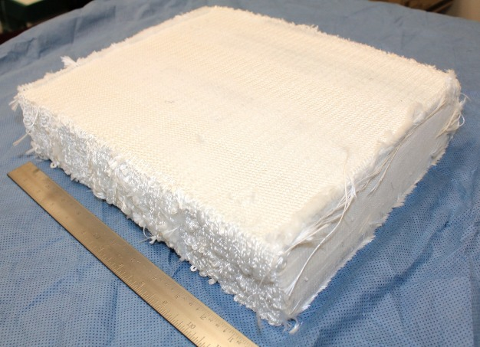
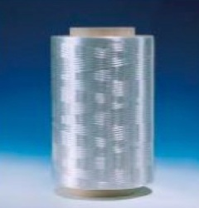
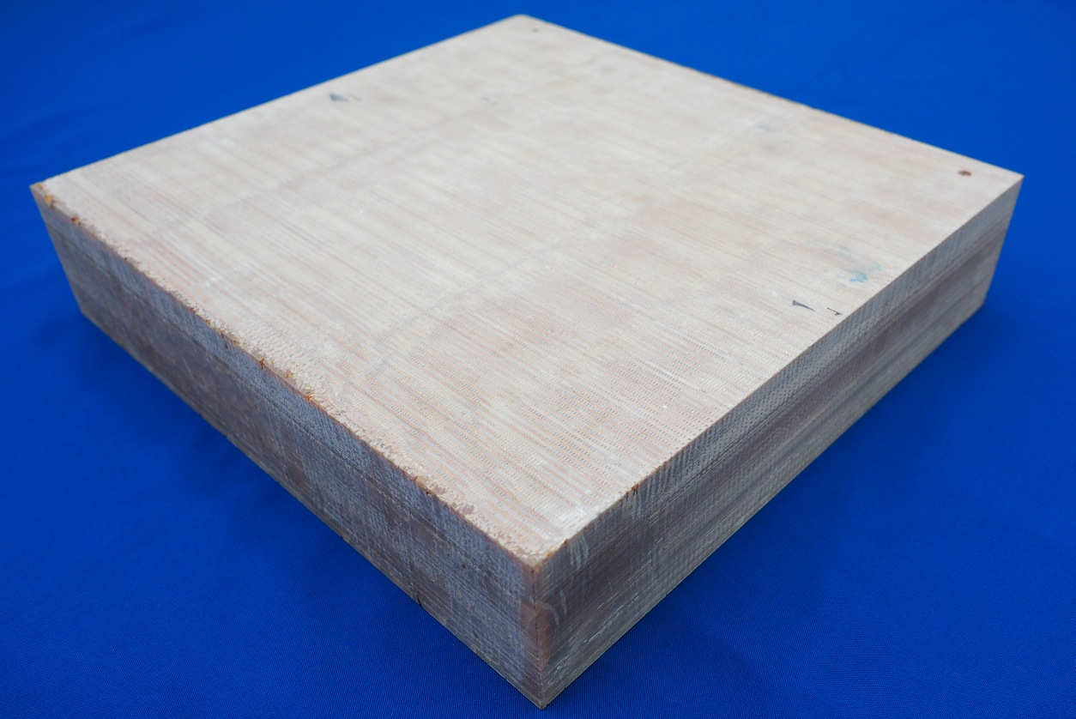
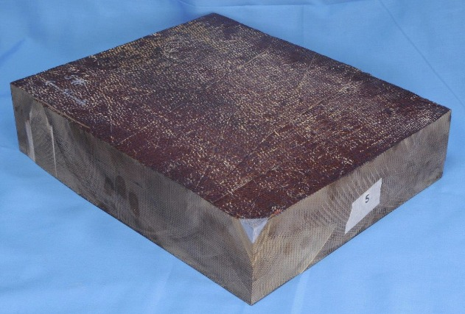
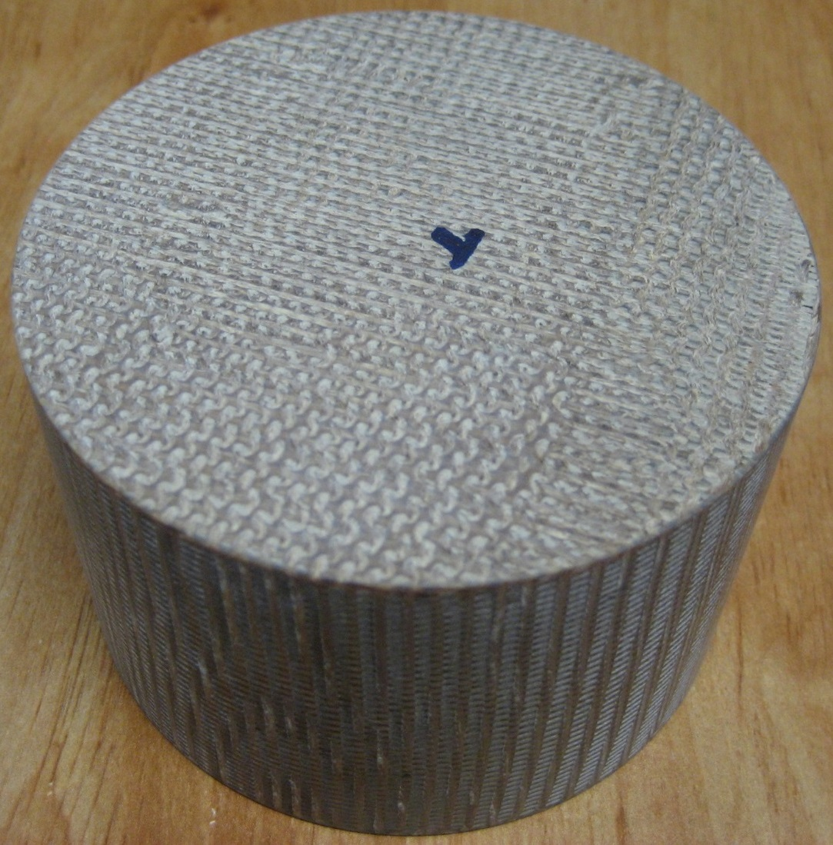
Manufacturing Process Overview
Quartz Yarn
3D Preform
3D Weaving
Resin
Infusion
3D Composite Billet
Final Machining

Slide 13
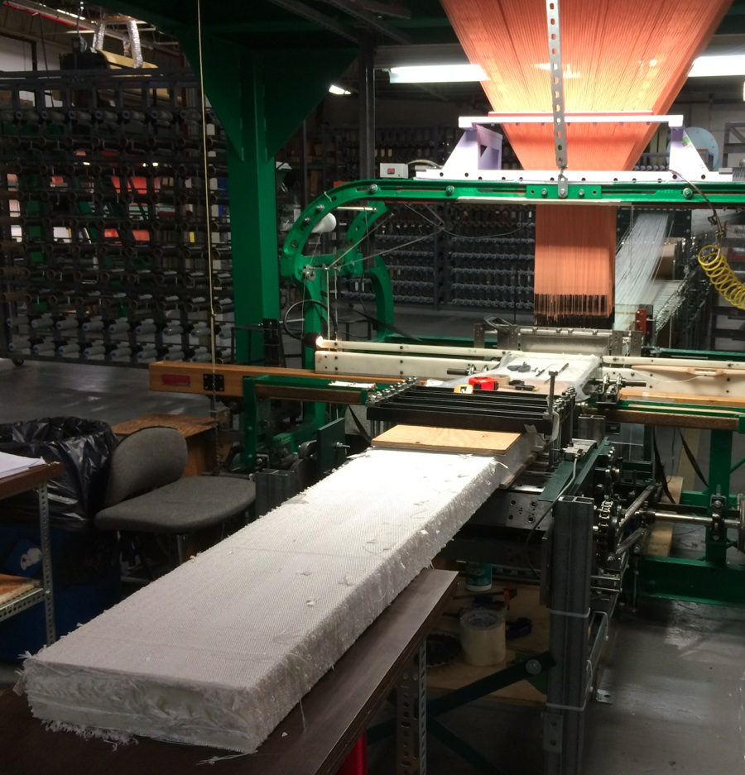
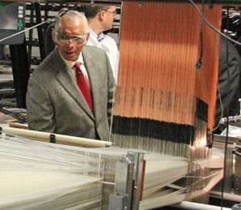
Weaving Scale Up
First ever achievement of continuous, automated weaving (Jacquard loom) at 12” x 3” scale
  57% fiber volume, 1/3 of fibers in X/Y/Z directions
  Cross-section scale up by a factor of 4 was challenging!
Bally Ribbon Mills
photo: Ken Kremer

Slide 14
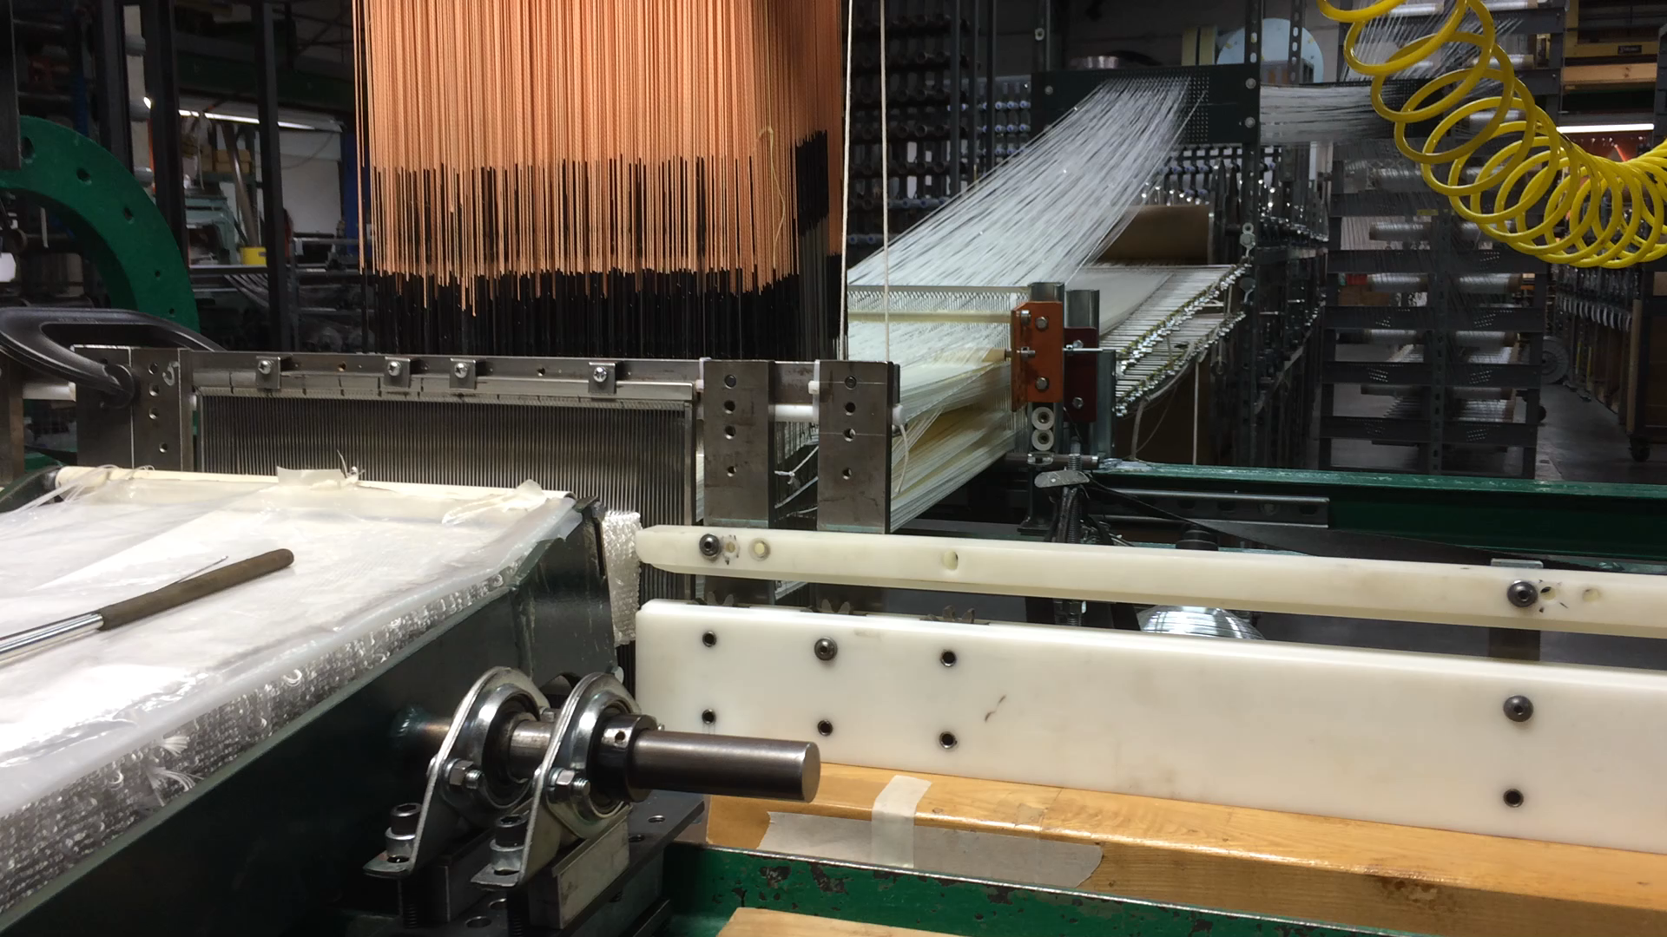
Weaving Video
Discuss:
5000? Individual warp yarns individually controlled
~50 layers built up from top to bottom prior to advancing one linear step
Large infrastructure of fibers on the creel etc.
14

Slide 15
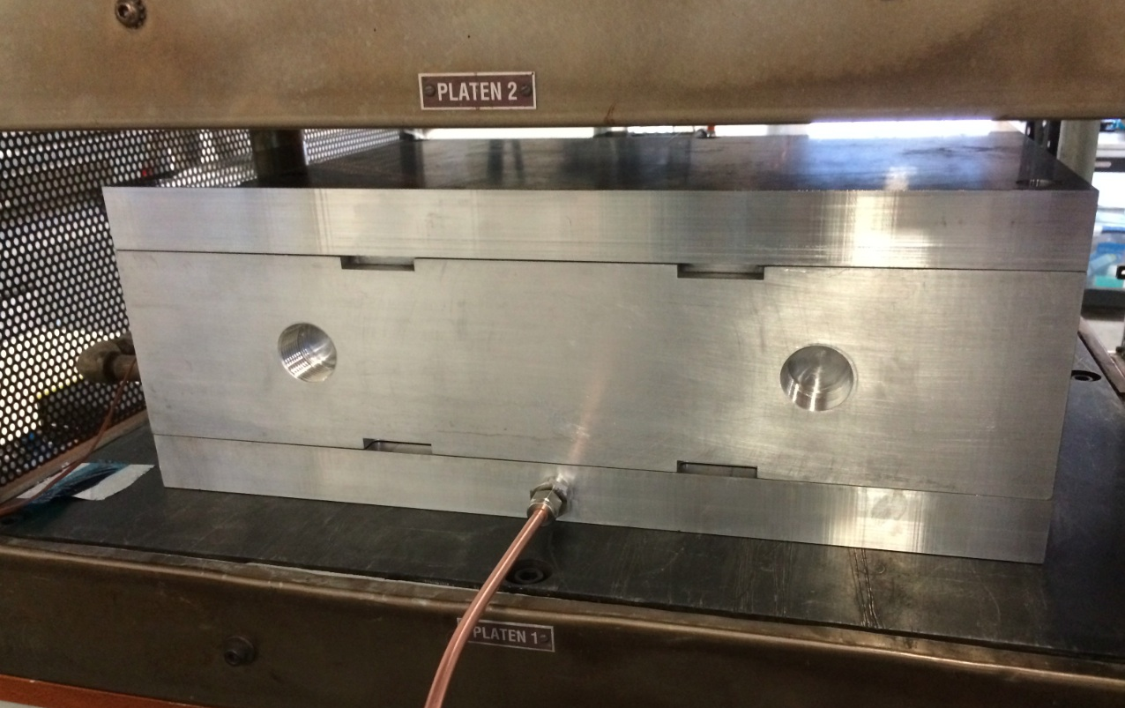
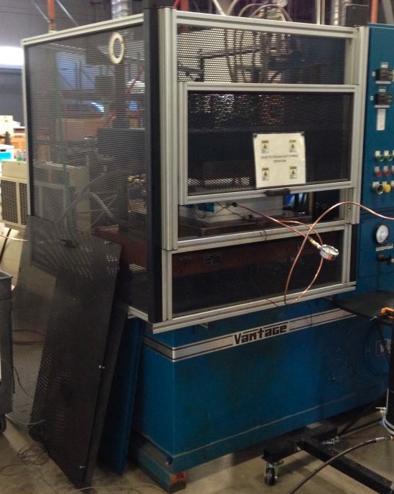
Resin Infusion Development
Cyanate Ester Resin Transfer Molding (RTM) at San Diego Composites
Resin infusion & full densification (<2% porosity) of thick preforms is not well-established
Various vacuum bagging processes were initially explored but proved insufficient
Resin transfer molding is widely used for full densification of thin (typically <0.25”) composites
3DMAT developed a robust RTM process for large scale preforms
yielding billets with very low porosity (< 0.5%)

Slide 16
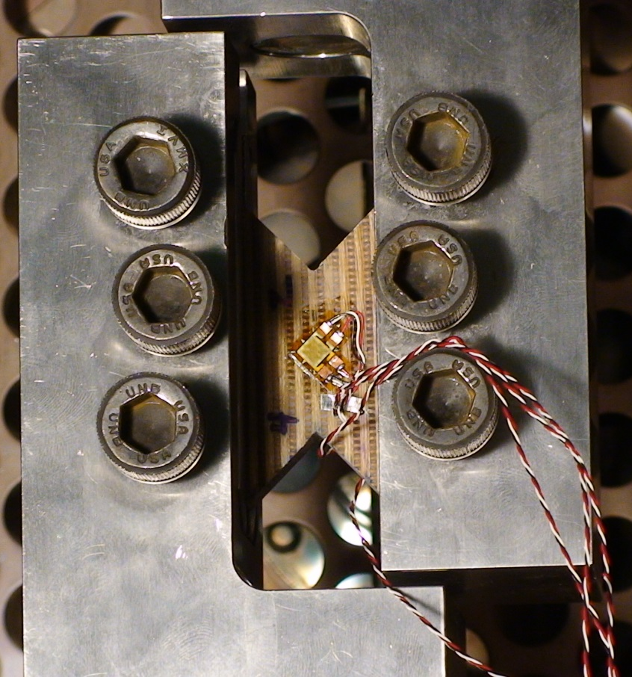
Material Property Testing
Full testing suite undertaken to support thermal and structural modeling
  Testing conducted on multiple 3DMAT billets
  Testing conducted at Southern Research Institute plus NASA centers: Ames, Johnson, Langley
Thermal Model | Property | Measured Temp (°C) | Measured Temp (°F) | Orienta-tion | grand total
 | Thermal Conductivity - virgin | 21 - 290 | 73 - 550 | Z | 4
 |  | " | " | X | 2
 |  | " | " | Y | 2
 | Thermal Conductivity - char | 10 - 1530 | 50 - 2800 | Z | 6
 | Specific Heat Capacity-virgin | 10 - 290 | 50 - 550 | - | 3
 | Specific Heat Capacity-char | 120 - 290 | 250 - 2500 | - | 3
 | Thermal expansion-virgin | -100 - 1530 | -150 – 2800 | X | 4
 |  | " | " | Y | 4
 |  | " | " | Z | 2
 | Elemental Composition - virgin | n/a | n/a | n/a | 6
 | Elemental Composition - char | n/a | n/a | n/a | 6
 | Heat of Combustion - virgin | n/a | n/a | n/a | 3
 | Heat of Combustion - char | n/a | n/a | n/a | 3
 | TGA / Char Yield - virgin | 23 - 1010 | 73 - 1850 | n/a | 6
 | Emissivity - char | 23 | 70 |  | 6
Structural | Tension strength, strain, modulus | 23 | 75 | Z | 13
 |  | 260 | 500 | Z | 2
 |  | 23 | 75 | X | 9
 |  | 23 | 75 | Y | 9
 | Compression strength, strain, modulus | 23 | 75 | Z | 20
 |  | 260 | 500 | Z | 3
 |  | 23 | 75 | X | 26
 |  | 260 | 500 | X | 4
 |  | 23 | 75 | Y | 18
 |  | 260 | 500 | Y | 5
 |  | 23 | 75 | 45° bias | 58
 |  | 260 | 500 | 45° bias | 2
 | Shear strength, strain, modulus | 23 | 75 | XY | 14
 |  | 260 | 500 | XY | 3
 |  | 23 | 75 | XZ | 17
 |  | 260 | 500 | XZ | 3
 |  | 23 | 75 | YZ | 17
 |  | 260 | 500 | YZ | 3
 | Poisson's Ratio | 23 | 75 | XY | 6
 |  | 23 | 75 | YX | 6
 |  | 23 | 75 | ZX | 6
 | Porosity | n/a |  |  | 20
Shear Testing
Notes:
full suite of properties to support trm & tsa

Slide 17
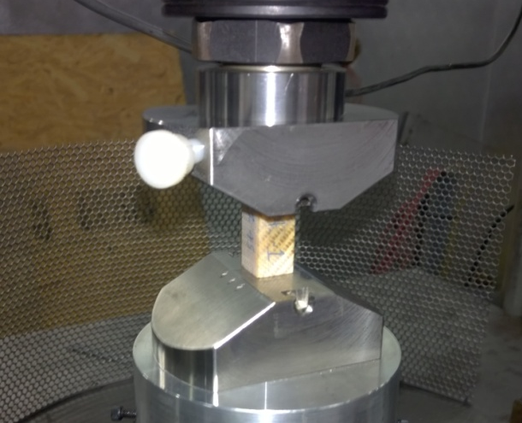
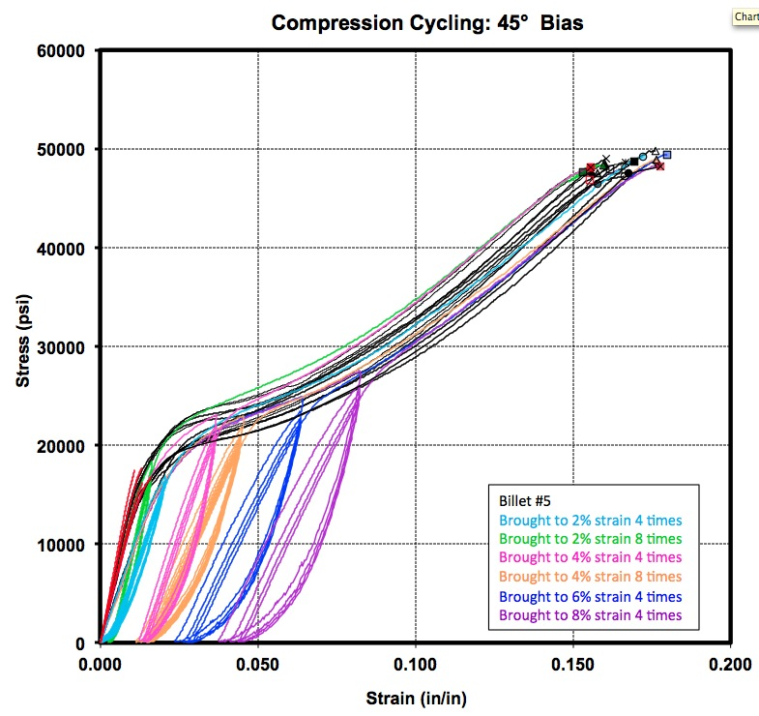
Compressive Testing
Compressive Cycling: 45° Bias
Very robust compressive performance!
Notes:
compression stress-vs strain including on-axis and 45. Show separate 45 cycling past knee. For both indicate where carbon phenolic lies.
Show Tensile properties: either stress strain or else just table comparison

Slide 18
Material Properties Comparison
Property | 3DMAT vs 2D Carbon Phenolic
Compression Strength: On-axis (X,Y,Z) 45° bias | 140% 135% (failure onset strength = 55%)
Tensile Strength: Interlayer (Z) Tensile Strength: In-Plane (X/Y) | 900% 245%
Thermal Conductivity: Interlayer (Z) In-Plane (X/Y) | 75% 55%
3DMAT material developed for Orion Exploration missions has superior properties relative to the 2D carbon phenolic laminate used for EFT-1 (Earth Orbit flight test)
  Higher compressive strength
  Significantly higher inter-layer strength due to 3D architecture
  Lower thermal conductivity

Slide 19
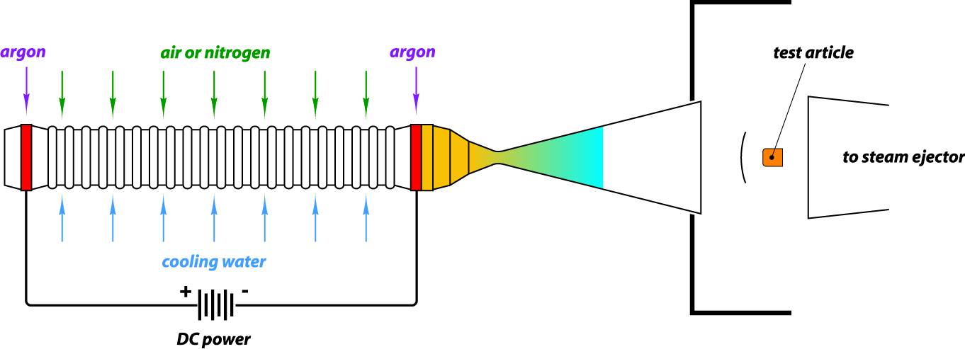
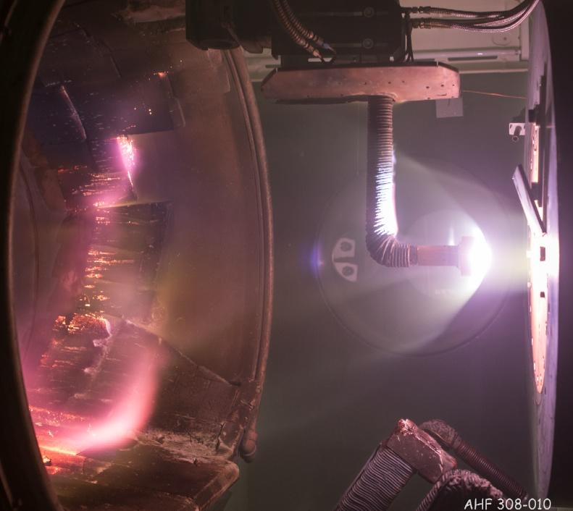
Arc Jet Introduction
Supersonic
flow
Objective
Create heating & pressure environments relevant to planetary entry
Test Facility
Gas flow is heated by electric discharge in a water-cooled, constricted arc column
The hot gas is expanded through a converging-diverging nozzle into a chamber where the test article is mounted on a water-cooled mechanical swing arm
The electrical power, gas flow rate, nozzle configuration, and distance of the test article from the nozzle exit plane are adjusted to achieve the desired stagnation pressure and temperature (or heat flux)
Notes:
Another critical test series in the development of 3DMAT was arc jet testing
electrode

Slide 20
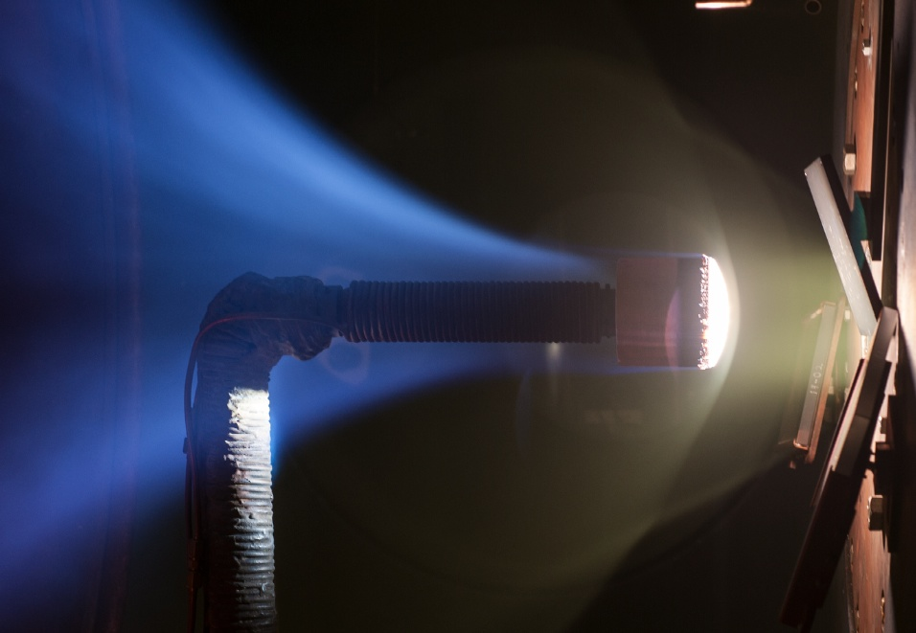
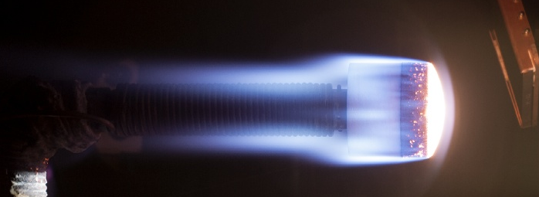
Arc Jet Conditions
Conditions Tested in 20 MW TP3 Facility
Heat Flux: 140 – 660 W/cm² (Shuttle: 6 – 60 W/cm²)
Pressure: 3 – 55 kPa
Duration: 60 – 200 s
Max Surface Temp: 1550 – 2400 °C
a
Cond 5 XY W/cm2
4”
Cond 4 W/cm2
20
Notes:
4” diameter – if we go bigger we reduce the amount of heating experienced by the model.

Slide 21

Arc Jet Video: 660 W/cm², 35 kPa
Max Surface Temperature: 2400 °C

Slide 22
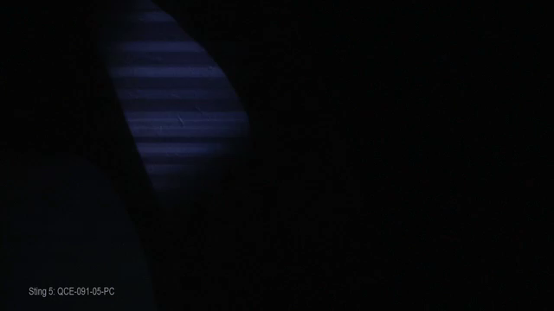
Arc Jet Video: 140 W/cm², 3 kPa
Max Surface Temperature: 1550 °C

Slide 23
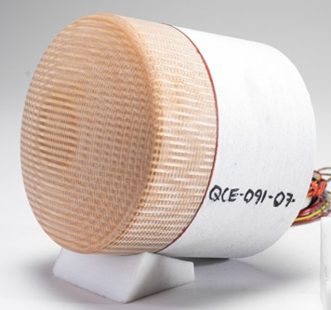
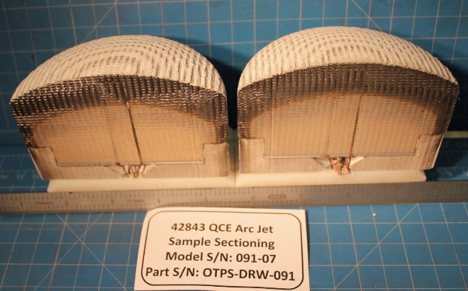
Arc Jet Testing Results
Condition | Heat Flux (W/cm²) | Pressure (kPa) | Time (s) | Max Surface Temp (°C) | Recession (mm)
1 | 660 | 35.4 | 60 60 | 2400 2300 | 3.0 2.0
2 | 585 | 55.0 | 120 | 2350 | 4.1
3 | 465 | 16.0 | 100 100 | 2200 2250 | 3.5 1.3
4 | 215 | 16.2 | 150 100 150 | 1680 1650 1720 | -0.6 -0.6 -1.9
5 | 205 | 55.1 | 120 80 | 1700 1750 | -0.4 -0.1
6 | 140 | 3.3 | 200 200 | 1550 1600 | -0.5 -0.7
Pre-Test 3DMAT
Post-Test Cross-Sectioned
Near-zero recession behavior for wide range of Exploration Mission relevant conditions

Slide 24
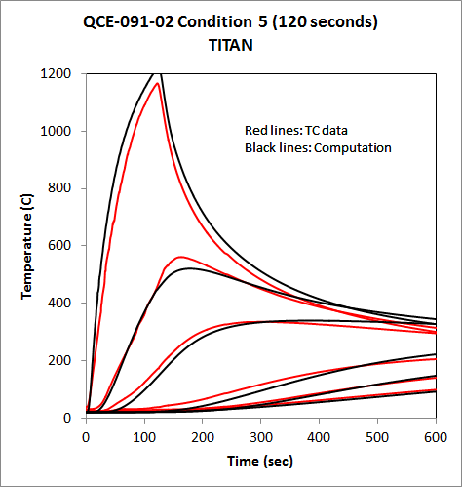
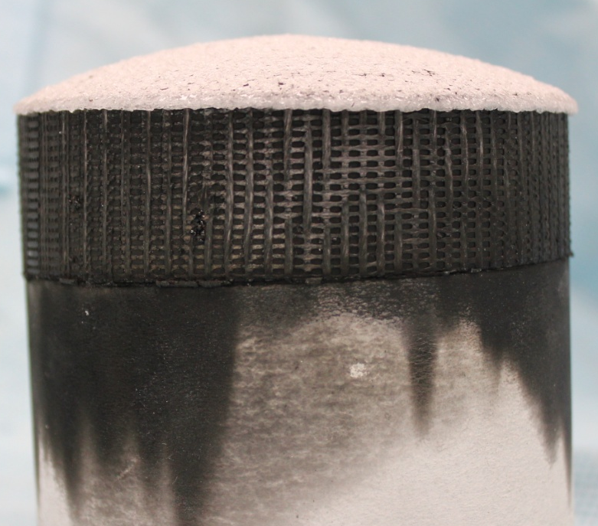
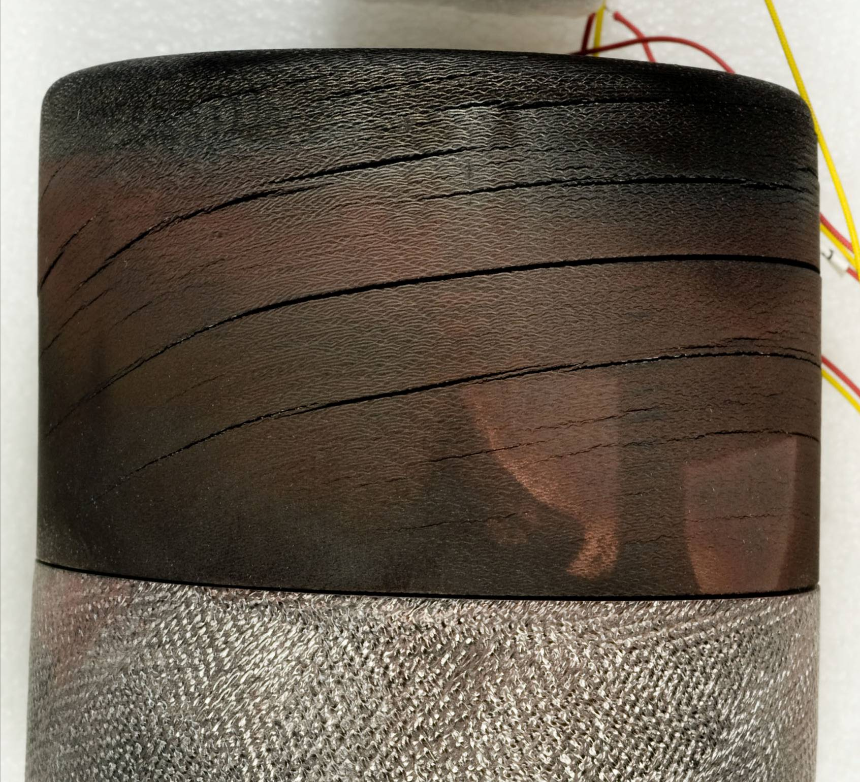
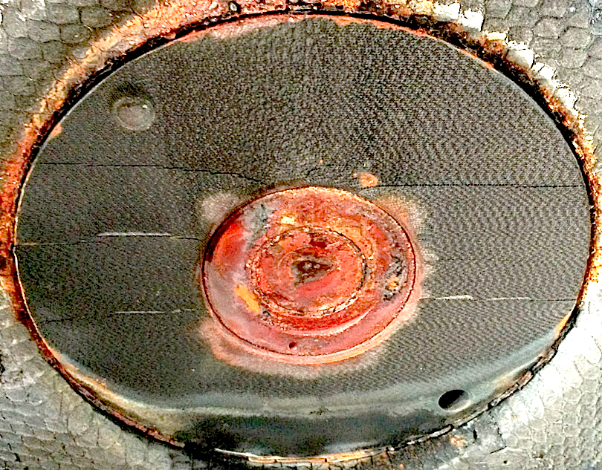
Aerothermal Performance & Response Modeling
Thermal Response Modeling
Post-test 3DMAT
Post-test 2D CP
TC Data
Computation
Side View
Side View
Under similar test conditions, carbon phenolic consistently cracks between lamina
All EFT-1 carbon phenolic pads contained inter-laminar cracks post-flight
Ablation chemistry & property-based thermal response model predicts the temperature as a function of depth & time (thermocouples at various depths)

Slide 25
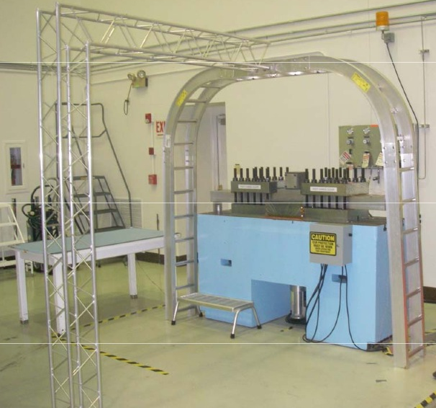
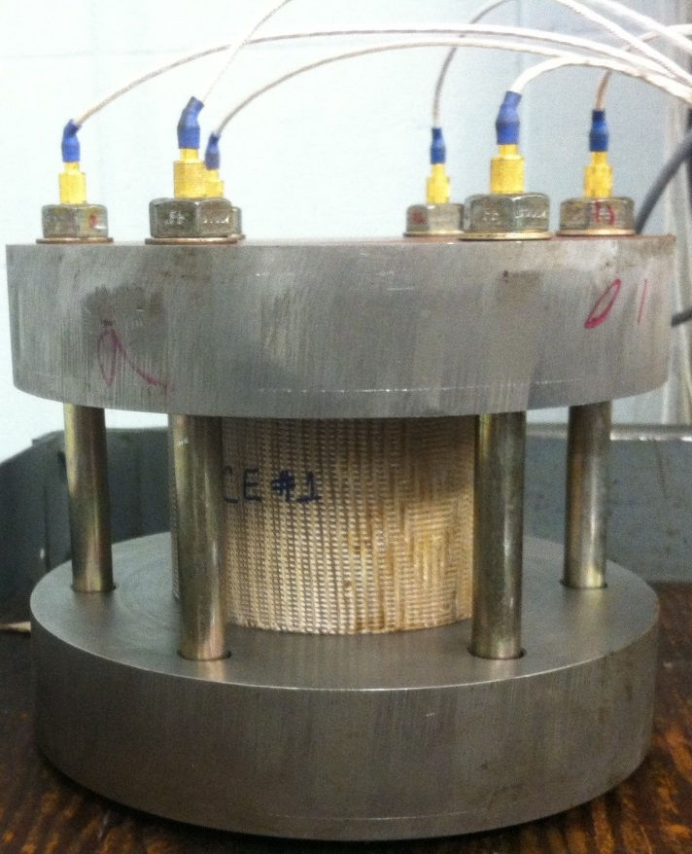
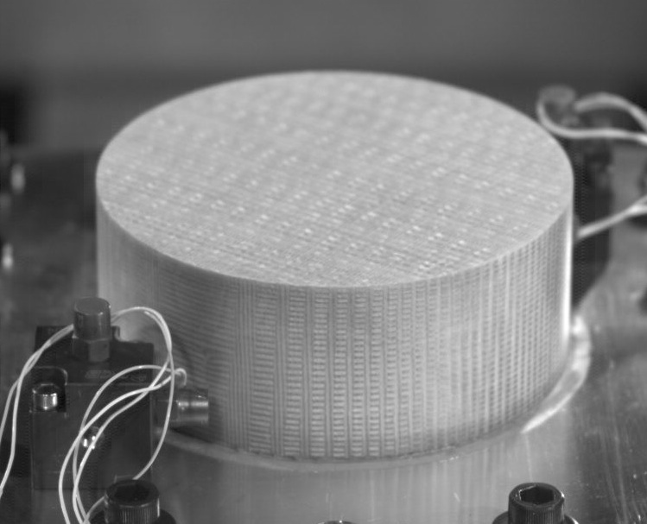
Shock & Creep Testing
Pyro-Shock Simulation: JPL Tunable Beam
Creep / Stress Relaxation Testing
Explosive bolt pyroshock environment simulation via tunable beam testing @ JPL
Stress relaxation of 3DMAT/system under Orion-like preload measured with instrumented fasteners

Slide 26
Summary & 3DMAT Status
3DMAT project addressed a material capability need for Orion by developing a 3D woven quartz fiber / cyanate ester composite with robust structural and aerothermal performance
  Continuous, automated weaving the high fiber volume quartz preform has been achieved at a scale never before demonstrated (12” wide x 3” thick)
  Full densification of large preforms has been accomplished with a new resin transfer molding process
TRL 4/5 achieved in 3 years via manufacturing development & testing
Orion Program is currently producing 34 billets for EM-1 flight and development (2018 lunar flight test)
3DMAT development team is working with other aerospace companies for whom the 3DMAT material may fulfill a critical need
Notes:
3DMAT project addressed a material capability need for Orion by developing a robust 3D composite.
Initial

Slide 27
Acknowledgments
NASA Funding & Management Support
Space Technology Mission Directorate – Game Changing Development
  Steve Gaddis
  Harry Partridge
  James Reuther
  Ryan Stephan
Orion Program
  John Kowal
  Charlie Lundquist
  Jeremy Vander Kam
Ames Research Center
  Ron Chinnapongse
  Joe Conley
  Dean Kontinos
NASA Technical Support
  Gary Allen
  Adam Beerman
  Tane Boghozian
  Enrique Carballo
  YK Chen
  Don Ellerby
  Dan Empey
  Mike Fowler
  Peter Gage
  Cole Kazemba
  Joe Mach
  Mike Olson
  Keith Peterson
  Carl Poteet
  Erika Rodriguez
  Kristina Skokova
  Mairead Stackpoole
  Matt Switzer
Bally Ribbon Mills
  Leon Bryn
  Hakan Gokce
  Amir Islam
Lockheed Martin
  Tracy Colwell
  Damon Erb
  Eric Goodman
  Mike Tangredi
San Diego Composites
  Leonard Carson
  Rob Kolozs
  Kevin Proum
Southern Research
  David Bell

Slide 28

Thank You

