Slide 1


Air Quality Forecasts using the NASA GEOS Composition Modeling and
Data Assimilation System
K. Emma Knowland
USRA/GESTAR
NASA Global Modeling and Assimilation Office (GMAO)
In collaboration with:
GMAO: Christoph Keller, Lesley Ott, Steven Pawson, Emily Saunders, Brad Weir, Kris Wargan
Atmospheric Chemistry and Dynamics Lab: Bryan Duncan,
Melanie Follette-Cook, Junhua Liu, Julie Nicely
9 April 2019

Slide 2
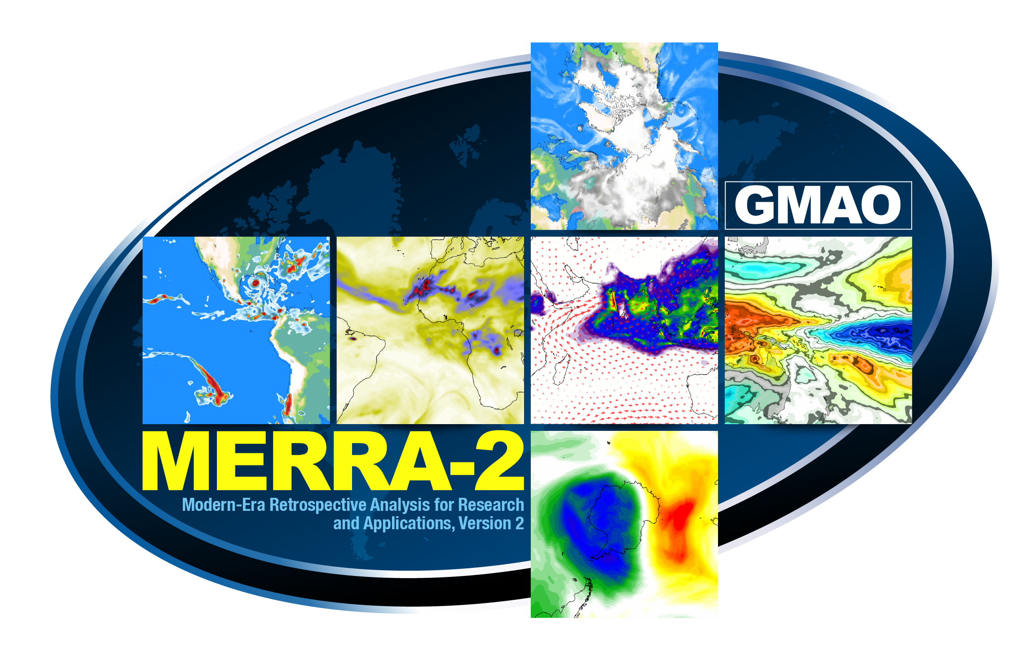
NASA GMAO global meteorology and chemistry products
GEOS
Forecasting
Reanalysis
GEOS-FP
GEOS-FPIT
MERRA-2
Research product
GEOS-CF
k.e.knowland@nasa.gov christoph.a.keller@nasa.gov

Slide 3
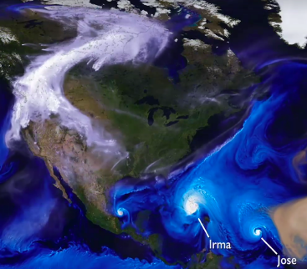
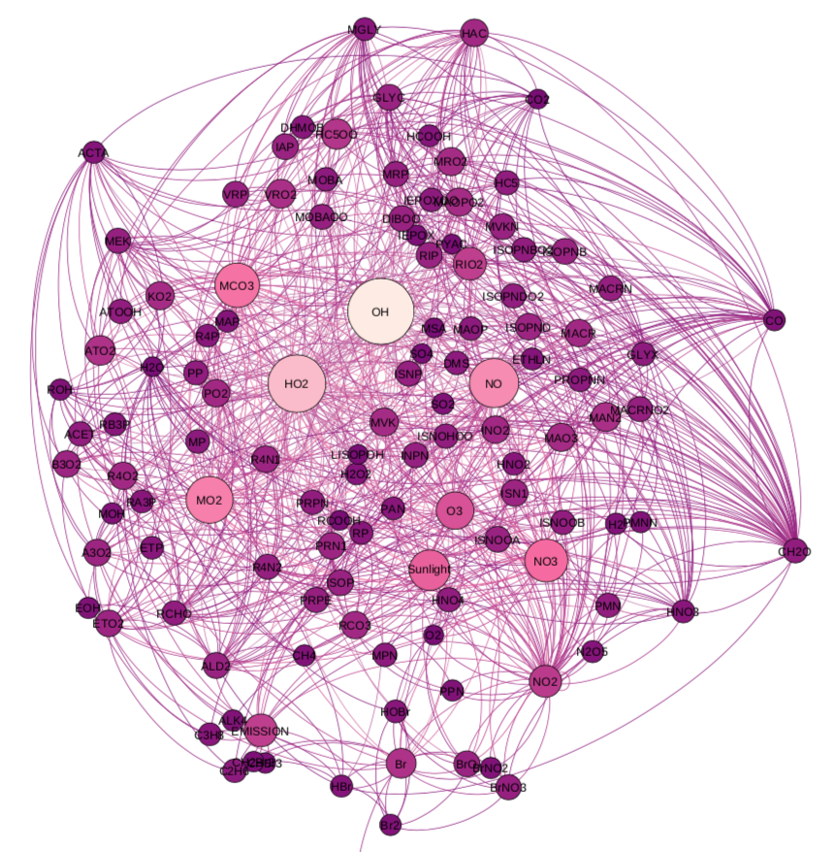
NASA’s composition forecast (GEOS-CF)
Ozone (O₃)
GEOS NWP
Nitrogen Dioxide (NO₂)
GEOS - Chem
Fine Particulate Matter (PM_{2.5})
k.e.knowland@nasa.gov christoph.a.keller@nasa.gov

Slide 4

GEOS-Chem is a state-of-the science chemistry model
Tropospheric and Stratospheric full chemistry
250 reactive species, 725 reactions
100+ user/developer groups worldwide
Updated version is released about every year
k.e.knowland@nasa.gov christoph.a.keller@nasa.gov

Slide 5
Daily composition forecast
GEOS - CF
One 5-day forecast per day
GEOS NWP
GEOS - Chem
k.e.knowland@nasa.gov christoph.a.keller@nasa.gov

Slide 6
Daily composition forecast
GEOS - CF
One 5-day forecast per day
  1-day hindcast
GEOS NWP
GEOS - Chem
k.e.knowland@nasa.gov christoph.a.keller@nasa.gov

Slide 7
Daily composition forecast
GEOS - CF
One 5-day forecast per day
  1-day hindcast
  5-day forecast
GEOS NWP
GEOS - Chem
k.e.knowland@nasa.gov christoph.a.keller@nasa.gov

Slide 8
Daily composition forecast
GEOS - CF
One 5-day forecast per day
  1-day hindcast
  5-day forecast
  c360 (0.25°, ~25x25 km²) resolution, 72 model layers
  O₃, NO_{x}, VOCs, PM ...
  1 January 2018 to NRT
GEOS NWP
GEOS - Chem
k.e.knowland@nasa.gov christoph.a.keller@nasa.gov

Slide 9
Daily composition forecast
GEOS - CF
  Currently no direct data assimilation of constituents in GEOS-CF
GEOS NWP
GEOS - Chem
k.e.knowland@nasa.gov christoph.a.keller@nasa.gov

Slide 10
Daily composition forecast
GEOS - CF
  Currently no direct data assimilation of constituents in GEOS-CF
  Aerosols constrained by satellite measurements of AOD
  Biomass burning emissions from QFED
GEOS NWP
GEOS - Chem
k.e.knowland@nasa.gov christoph.a.keller@nasa.gov

Slide 11
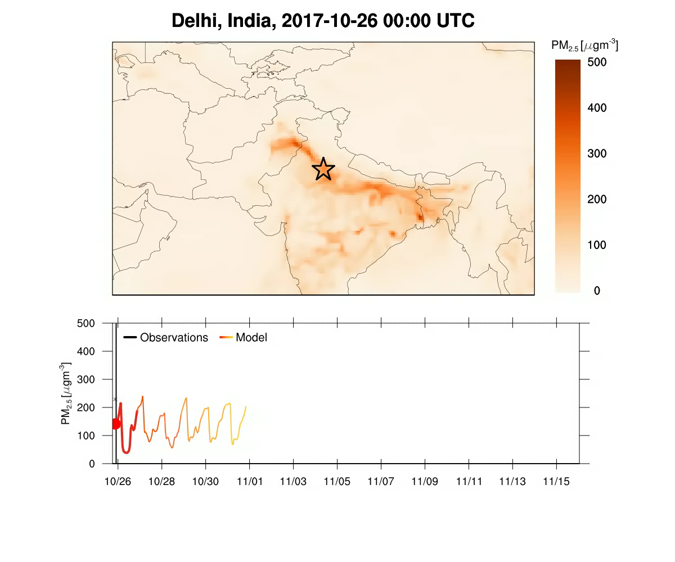
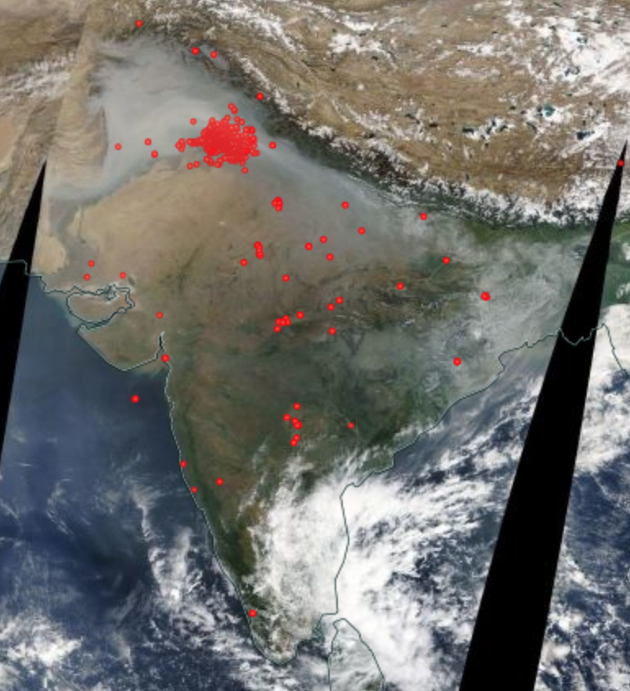
Case study: agricultural fires in India
MODIS fires Nov 01, 2017
Observation
0 +1 +2 +3 +4 +5
GEOS-CF
k.e.knowland@nasa.gov christoph.a.keller@nasa.gov

Slide 12
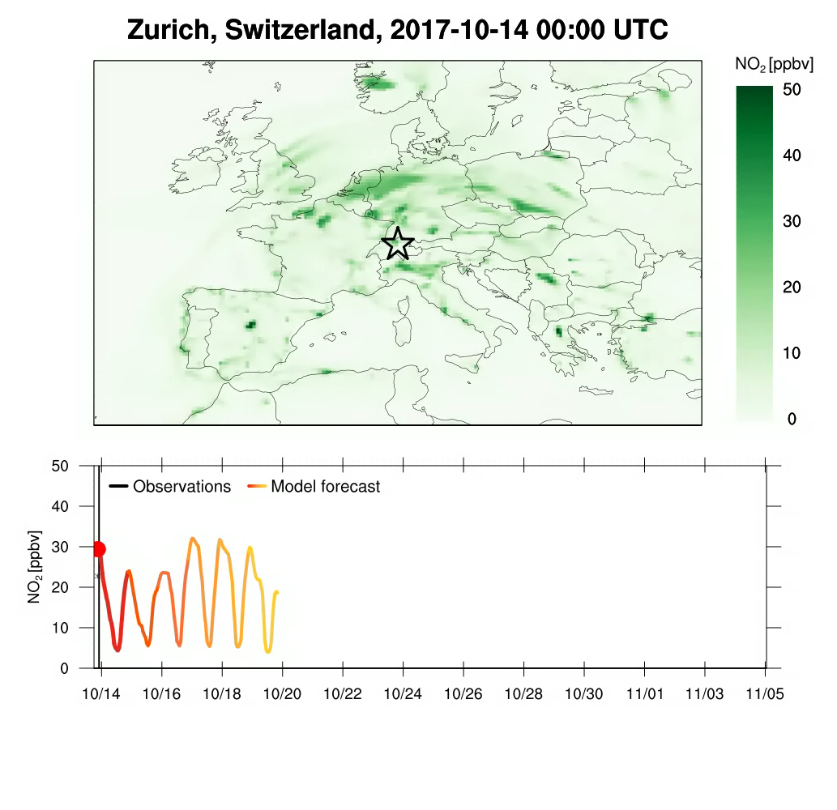
Daily composition forecast
GEOS - CF
  Currently no direct data assimilation of constituents in GEOS-CF
  Annual emission scale factors based on satellite
  Scale factors applied to emissions for diurnal and weekly variations
Observation
0 +1 +2 +3 +4 +5
GEOS-CF
k.e.knowland@nasa.gov christoph.a.keller@nasa.gov

Slide 13
Toward an air quality modeling system in the
NASA GEOS model
GEOS data assimilation system:
→ Weather
Aerosols
Fires
GEOS-Chem composition forecast model
Chemical data assimilation:
O₃, NO₂, CO, …
Air Quality Modeling System
k.e.knowland@nasa.gov christoph.a.keller@nasa.gov

Slide 14
Daily composition forecast
GEOS - CF
  Currently no direct data assimilation of constituents in GEOS-CF
  Stratospheric Ozone relaxed to GEOS-FP O3
GEOS NWP
GEOS - Chem
k.e.knowland@nasa.gov christoph.a.keller@nasa.gov

Slide 15
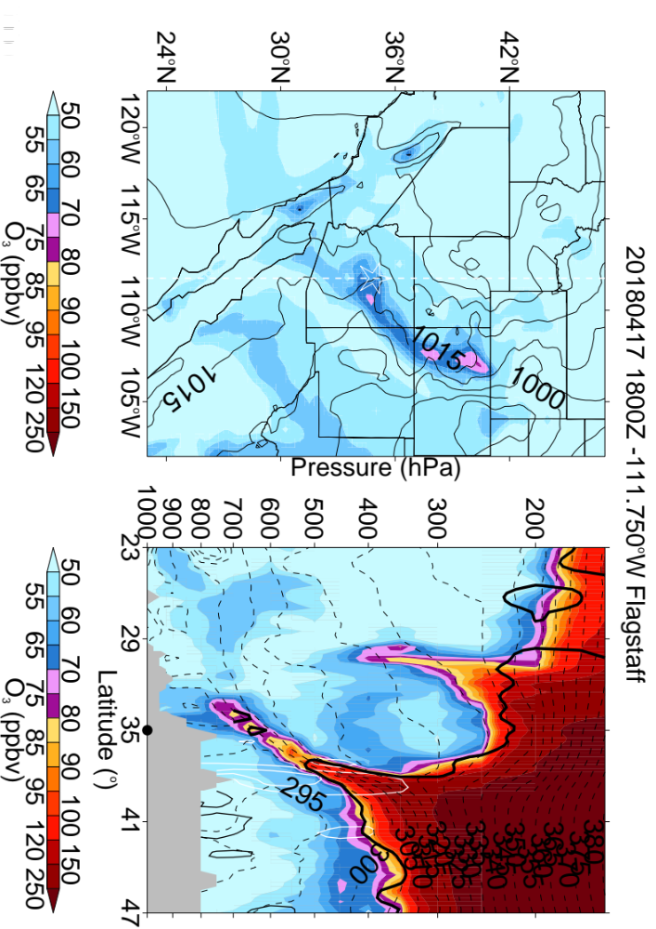
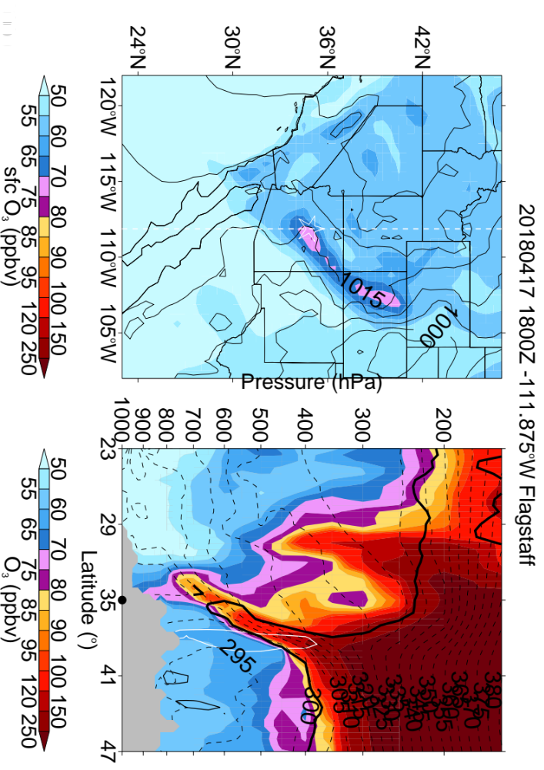
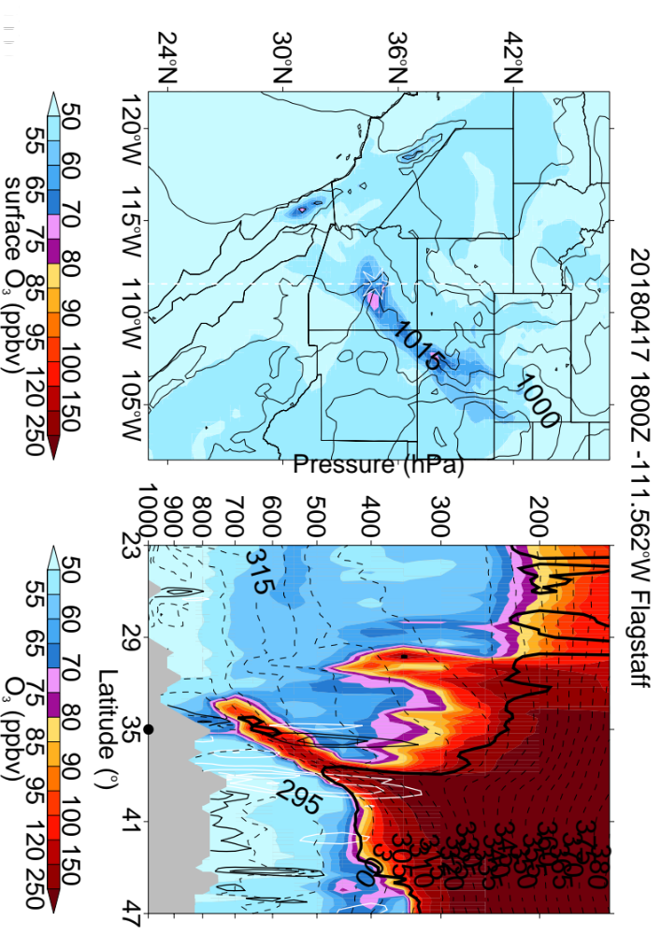
Careful: Large gradient in O3 at UTLS
GEOS FP
GEOS-CF
MERRA-2
Flagstaff, Arizona, USA 17 April 2018 18UTC
O₃ (ppbv)
O₃ in UT is greater in the assimilated products (GEOS FP & MERRA-2)
k.e.knowland@nasa.gov
christoph.keller@nasa.gov

Slide 16
Chemical data assimilation system for reactive gases
MOPITT
GEOS NWP
Data Assimilation System
CO, NO_{x}, O₃
OMI
Weakly coupled; 6 hour assimilation window
MLS
GEOS - Chem
k.e.knowland@nasa.gov christoph.a.keller@nasa.gov

Slide 17
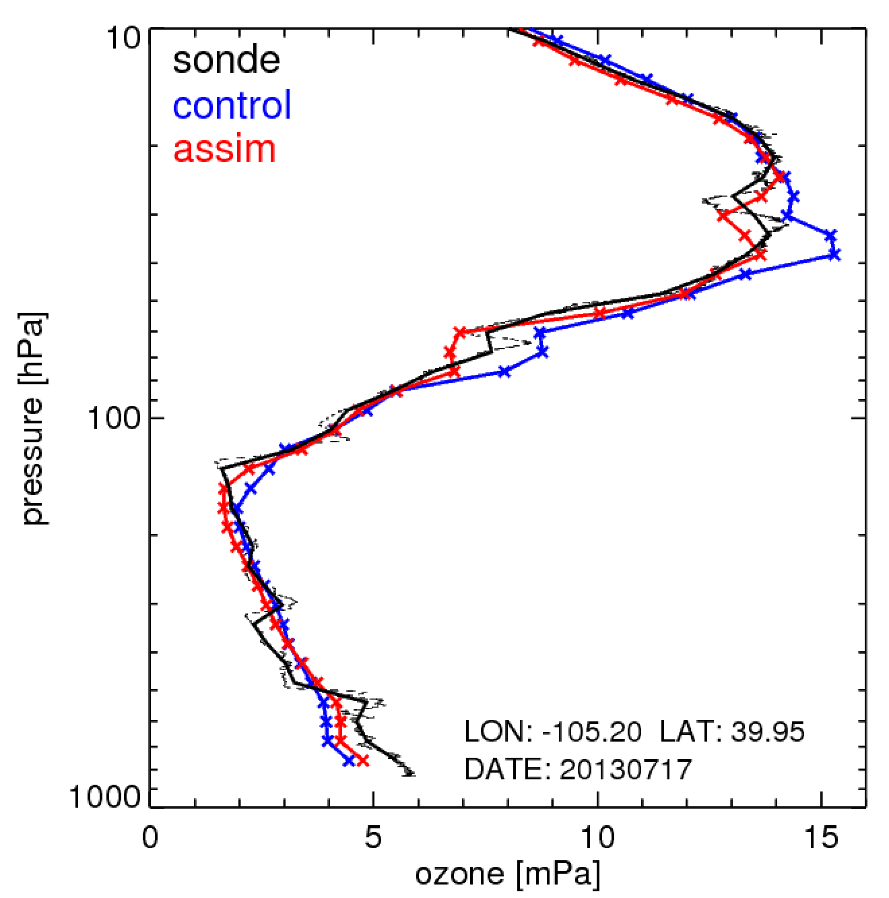
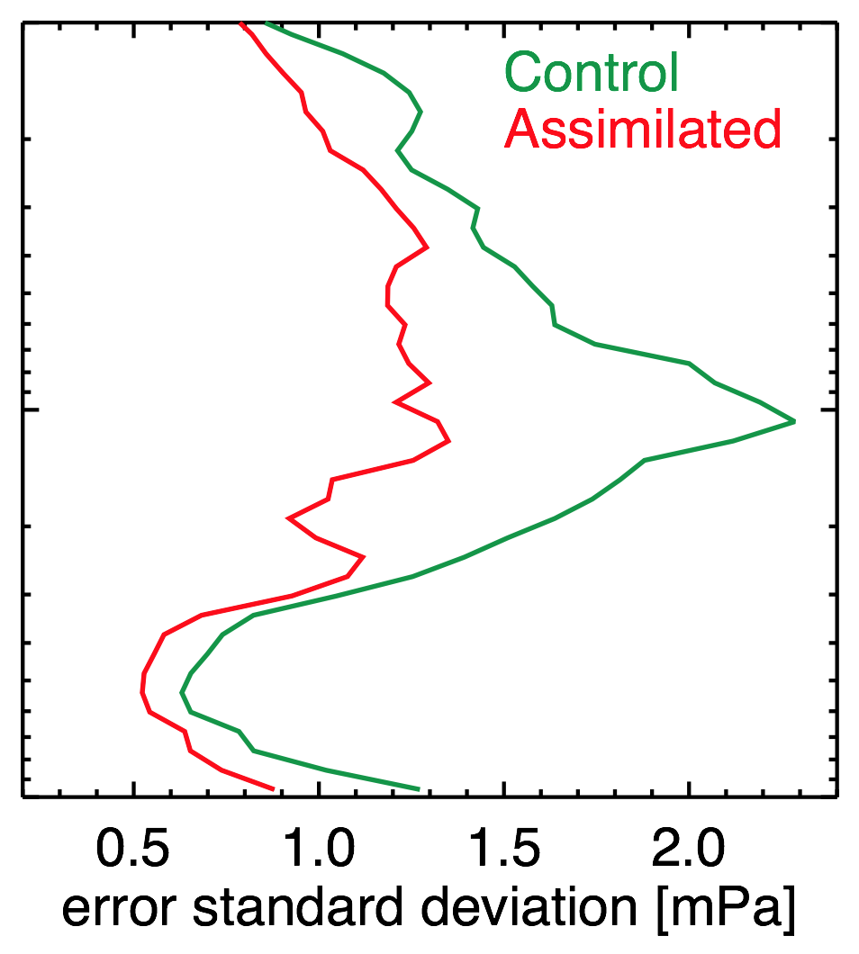
Impacts of ozone assimilation are primarily seen in stratosphere
Boulder, 2013-07-25
k.e.knowland@nasa.gov christoph.a.keller@nasa.gov

Slide 18
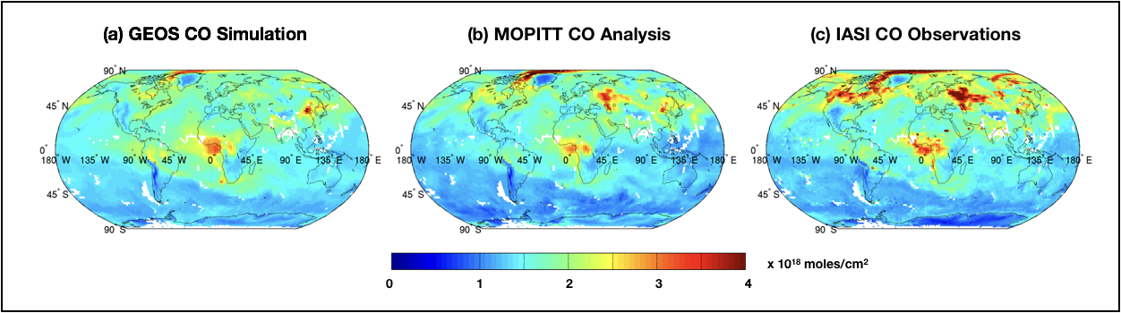
Impacts of CO assimilation:
Aug 2010 Russian Wildfires
GEOS CO Simulation
GEOS CO Assimilation
IASI CO Observations
k.e.knowland@nasa.gov christoph.a.keller@nasa.gov

Slide 19
Assimilation of CO reduces low bias relative to surface observations
Control (no assimilation)
With assimilation
CO [ppbv]
Implies significant (~20%) underestimation of CO emissions (?)
Alternatively: CO lifetime too short (→ OH)
k.e.knowland@nasa.gov christoph.a.keller@nasa.gov

Slide 20
Assimilation of NO_{x} and CO exacerbates
tropospheric ozone bias
Control (no assimilation)
With multi-species assimilation
Ozone [ppbv]
Improved diurnal cycle, most likely due to improved afternoon NO₂
k.e.knowland@nasa.gov christoph.a.keller@nasa.gov

Slide 21
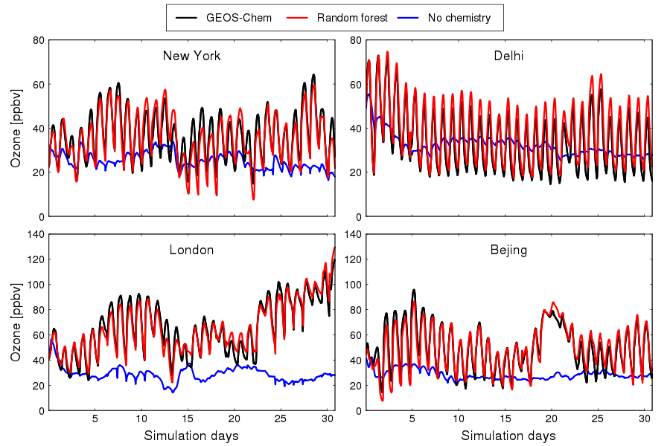
Machine learning mechanism for chemistry solver (random forest)
For more info see Christoph Keller’s
Presentation, Thursday 17:45
Room 0.60
k.e.knowland@nasa.gov christoph.a.keller@nasa.gov

Slide 22
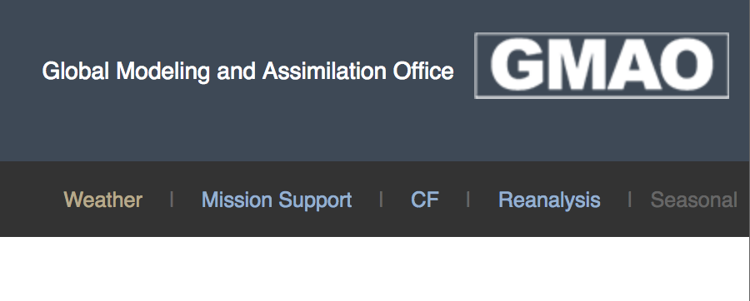
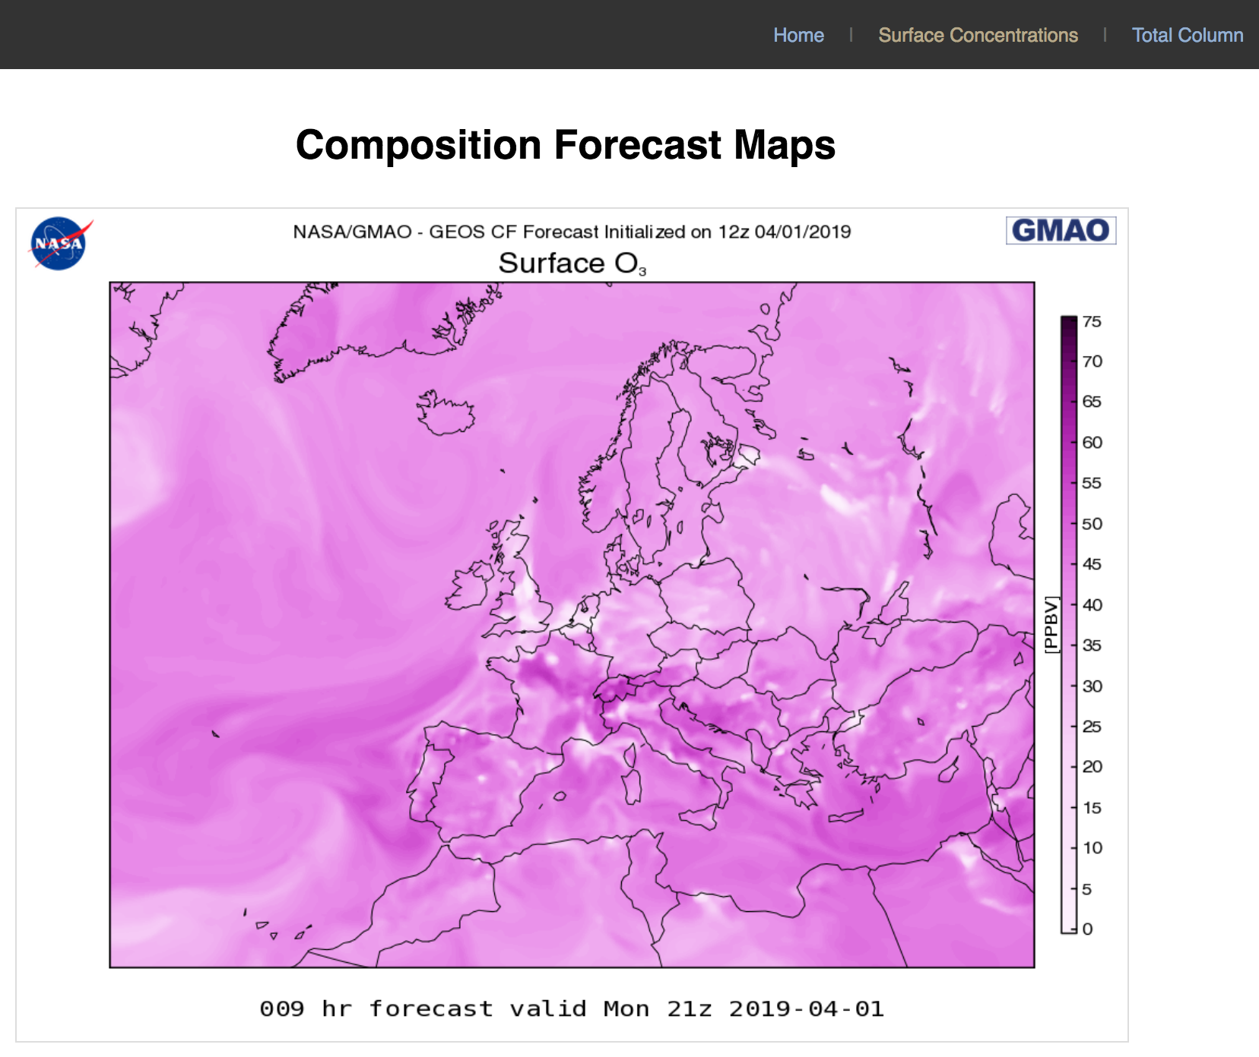
Summary
GEOS-CF produces daily global air quality forecasts at 25km (16 miles) horizontal resolution since 1 January 2018
Output available at fluid.nccs.nasa.gov/cf
k.e.knowland@nasa.gov :: christoph.a.keller@nasa.gov
k.e.knowland@nasa.gov christoph.a.keller@nasa.gov

Slide 23
Summary
GEOS-CF produces daily global air quality forecasts at 25km (16 miles) horizontal resolution
Output available at fluid.nccs.nasa.gov
Under development:
Assimilation system for trace gases (O₃, NO_{x}, CO, & others)
k.e.knowland@nasa.gov :: christoph.a.keller@nasa.gov
k.e.knowland@nasa.gov christoph.a.keller@nasa.gov

Slide 24
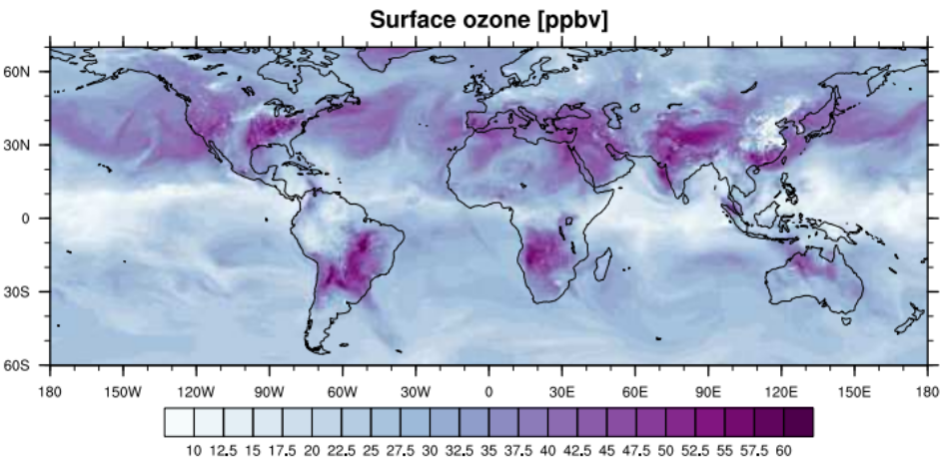
Thank you!
k.e.knowland@nasa.gov :: christoph.a.keller@nasa.gov
https:/fluid.nccs.nasa.gov/cf
k.e.knowland@nasa.gov christoph.a.keller@nasa.gov

