Slide 1
Science Driven by Space Biology Omics Data Utilizing NASA GeneLab Platform
Afshin Beheshti, PhD
Bioinformatician at GeneLab
Principal Investigator
Space Biosciences Division, KBRWyle
NASA Ames Research Center, Moffett Field, CA
Adjunct Assistant Professor at Department of Medicine
Rutgers Robert Wood Johnson Medical School
Visiting Researcher at Broad Institute
Cambridge, MA
afshin.beheshti@nasa.gov
abehesht@broadinstitute.org

Slide 2
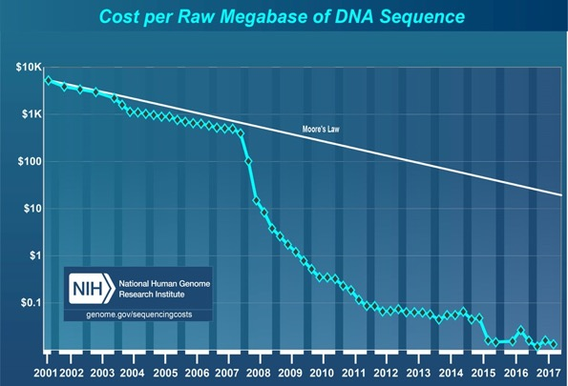
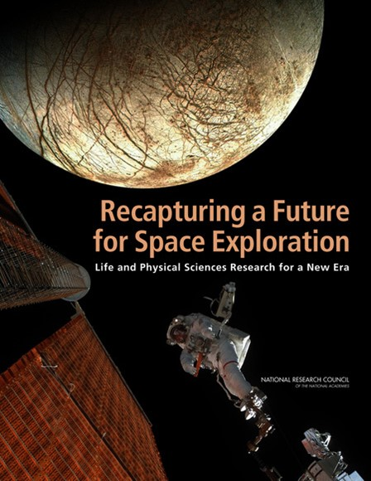
2011 NRC Decadal Survey and the Sequencing Paradigm Shift
Another log10 since 2011
“…genomics, transcriptomics, proteomics, and metabolomics offer an immense opportunity to understand the effects of spaceflight on biological systems…”
“…Such techniques generate considerable amounts of data that can be mined and analyzed for information by multiple researchers…”

Slide 3
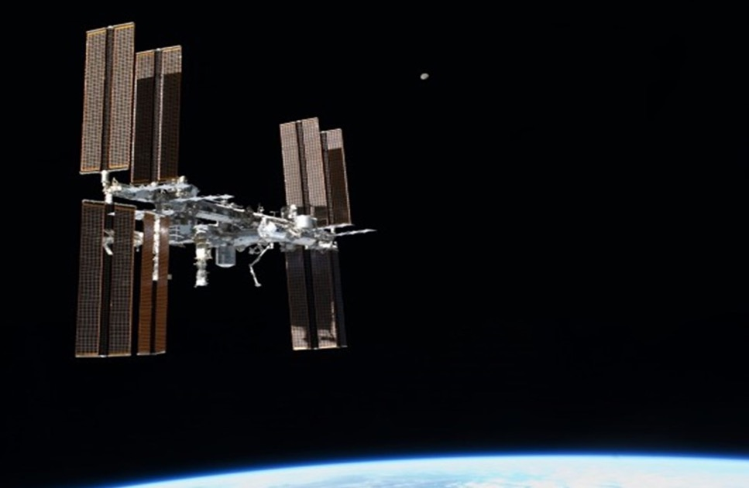
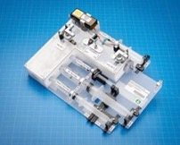
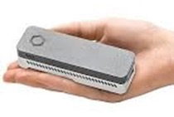
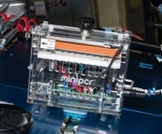
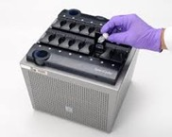
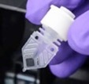
Omics Acquisition in Space is Now a Reality
This is truly an exciting time for cellular and molecular biology, omics and biomedicine research on ISS with these amazing additions to the suite of ISS Laboratory capabilities.
Sample Preparation Module
Oxford Nanopore MinION Gene Sequencer
Reaction tube containing lyophilized chemical assay bead
(proprietary)
Cepheid Smart Cycler qRT-PCR
Mini-PCR

Slide 4
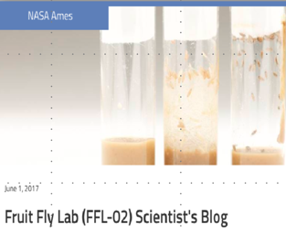








GeneLab ecosystem: maximizing knowledge by bringing experiments together as a system
Sequencing on ISS is still limited in the amount of data generated
  Most of the work needs to happen on earth
Measurements on human cannot be too invasive and limited in numbers
  Usage of animals
Increasing Genetic Diversity (more samples/payload)
Identify Shared Processes/ Molecular Signatures
Hypoxic Response ?
Oxidative Stress
Common Tissue (e.g. muscle, liver, heart, eyes, brain,…)
Human?
PLANT
For Spaceflight
High “n” number – statistically significant data
Genetically identical animals
Low resource requirements
Short life cycle - multiple generations
Measure response of a whole multicellular animal
Flies used as a model for humans for innate immunity, circadian rhythm, oxidative stress, neurobehavior, development, genetics, GWAS, “omics” studies etc.
Increasing Human Relevance
ANIMAL
MULTI-OMICS
MICROBE

Slide 5
GeneLab Data Democratization
Community
Data type
Visualization Portal
Disease states
Pathway changes
Differential expression
Mapped reads
Raw data
New Knowledge
Analysis Working Groups
Citizen scientists
Web
Portal
Analysis
Toolshed
User Data Workspace
Biologists
GeneLab
Data scientists
Missions/
Experiments
ANL MG-RAST
EBI PRIDE
Open Data
NCBI GEO
GeneLab
Sample Processing
Data Federation

Slide 6
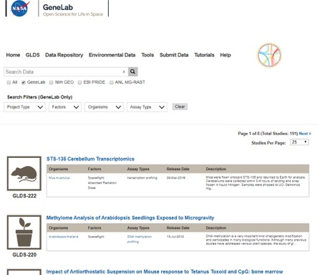
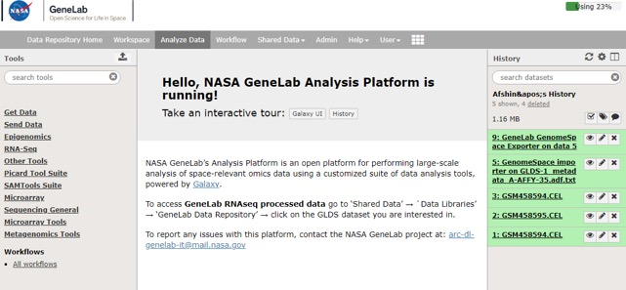
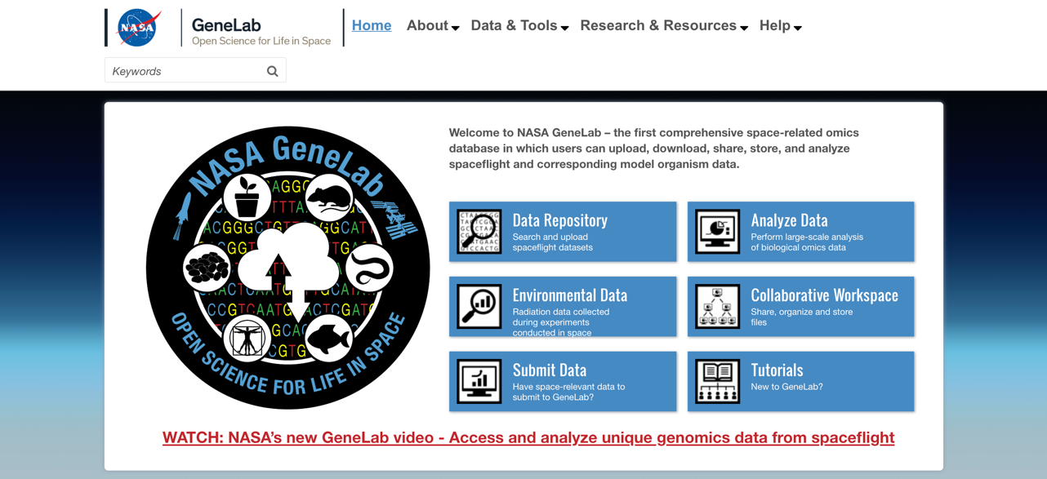

GeneLab Webpage: genelab.nasa.gov
October 2019 will be the release for GeneLab’s Visualization Portal!

Slide 7
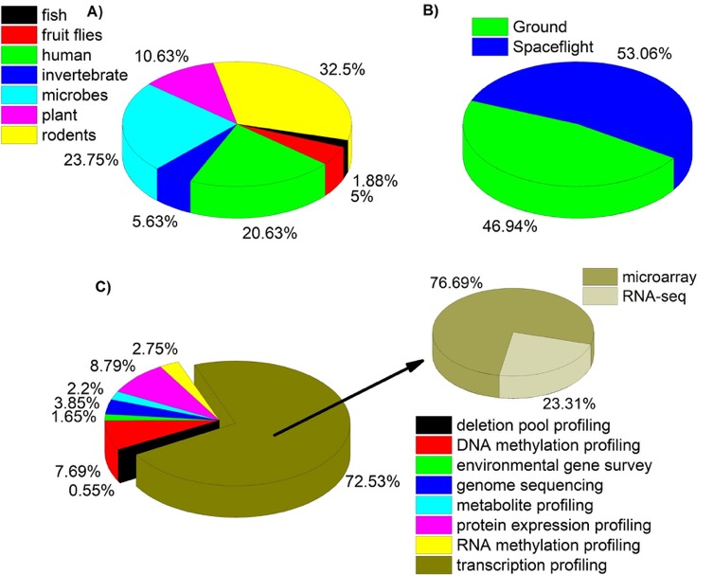
GeneLab Database: >200 data sets
Beheshti et al., Radiation Research 2018

Slide 8
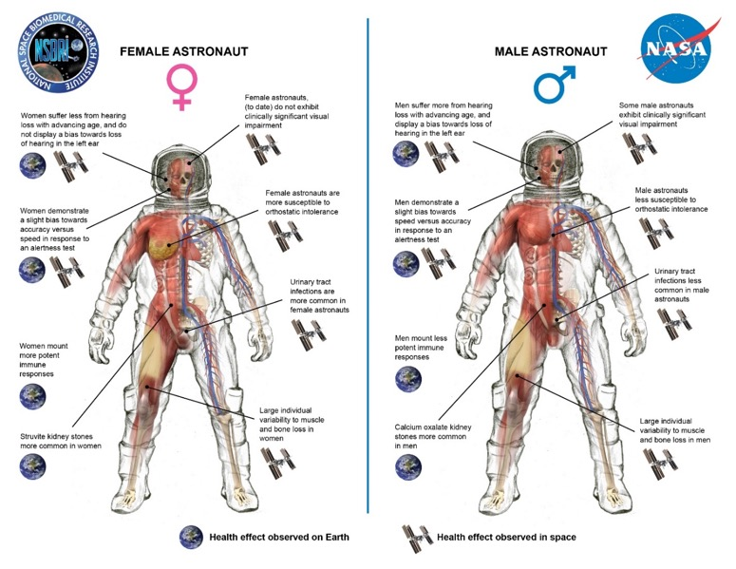
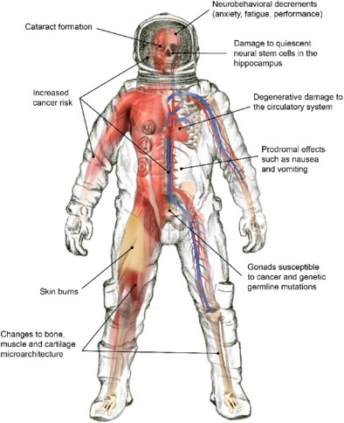
Space Radiation Risk On Astronauts
Select health effects due to space radiation exposures.
From: J. Chancellor et al., Space Radiation: The Number One Risk to Astronaut Health beyond Low Earth Orbit. Life, 4(3), 491-510;

Slide 9
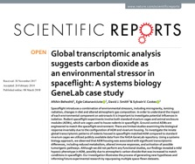
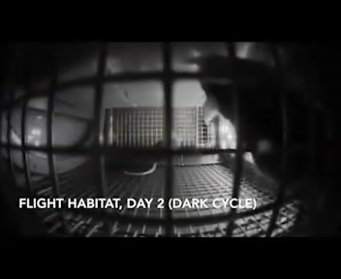
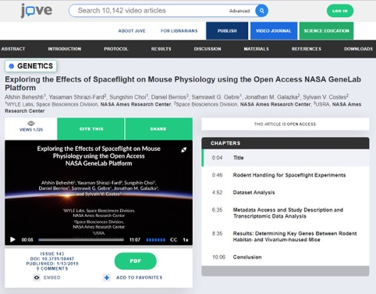
Examples of using Big Data to generate Hypothesis for Space Biology
Cage Effects with rodent experiments: Carbon Dioxide as an Environmental Stressor in Spaceflight
Systems Biology analysis reveals biological spaceflight master regulators
Space Radiation induces long term impact on the cardiovascular system by the activation of FYN through Reactive Oxygen Species

Slide 10
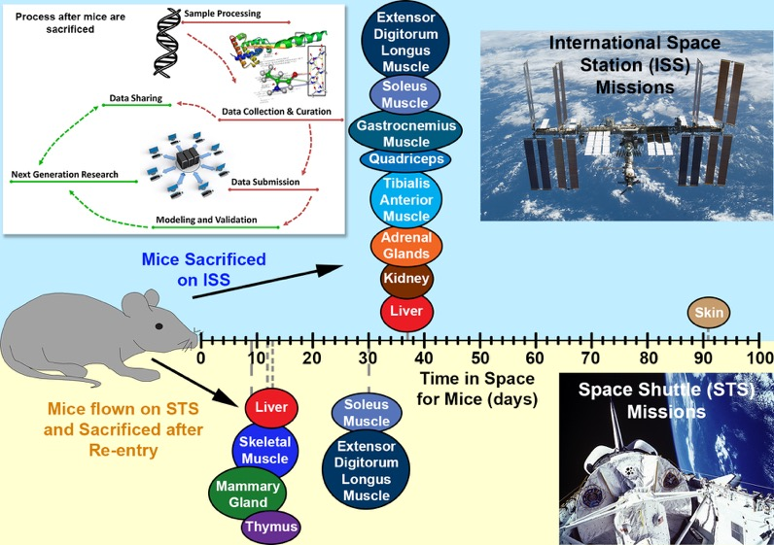
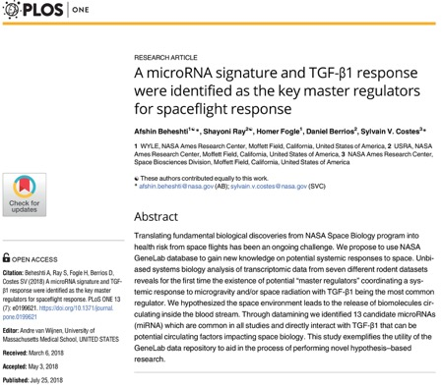
Systems Biology analysis reveals biological spaceflight master regulators

Slide 11
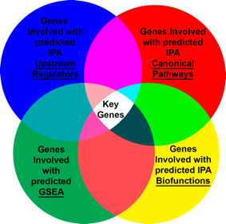

Predicted Key Genes for Spaceflight and the Connections
TGFβ1 found to be central regulator of key genes
  TGFβ is known to play a context specific role in sustaining tissue homeostasis predominantly via transcriptional regulation of genes involved in differentiation, cell motility, proliferation, cell survival along with regulating immune responses during homeostasis and infection.
  Previous Studies found reduction in gravitational force to diminish TGF-β expression and apoptosis with higher carcinoembryonic antigen expression in 3D human colorectal carcinoma cells, as compared to 3D cultures in unit gravity.
  In another study, differential regulation of blood vessel growth using basic fibroblast growth factor was identified in modeled microgravity with induction early and late apoptosis, extracellular matrix proteins, endothelin-1 and TGFb1 expression
Beheshti, et al. Cancer Research 2015
Beheshti, et al. Oncotarget 2015
Beheshti, et al. Cancer Informatics 2015
Beheshti, et al, Radiat Res. 2014 & J. Radiat Res. 2015.
Ravi, Beheshti, et al. Cancer Research 2016
Beheshti, et al. Scientific Reports 2018
Beheshti, et al. PLOS One 2018
Beheshti, et al., PLOS One, 2018

Slide 12
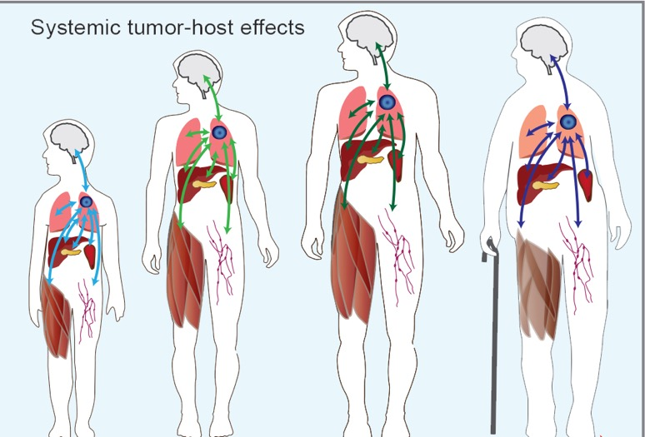
General Approach to Studying a Systematic Response in the Host
Circulating miRNAs

Slide 13
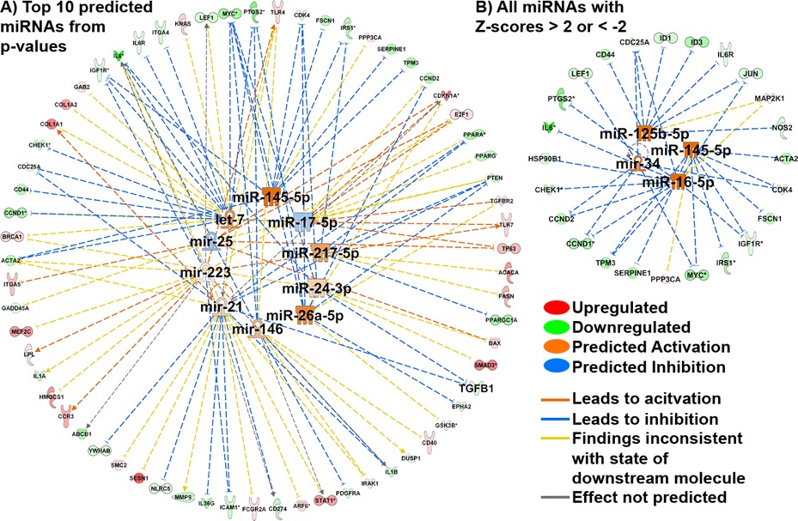
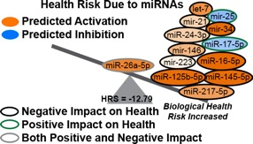
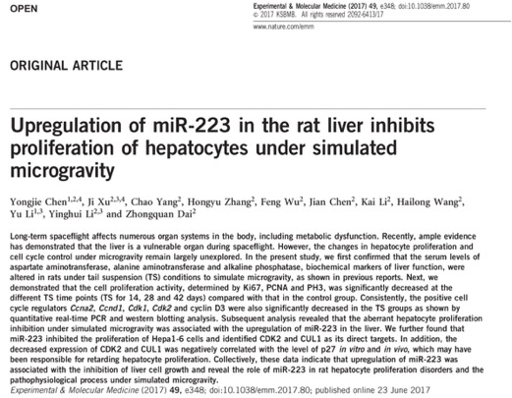
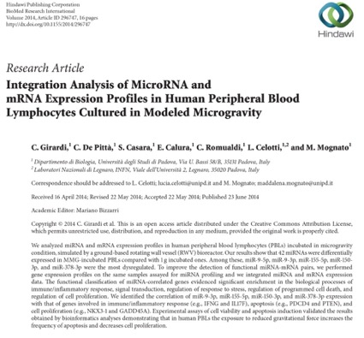
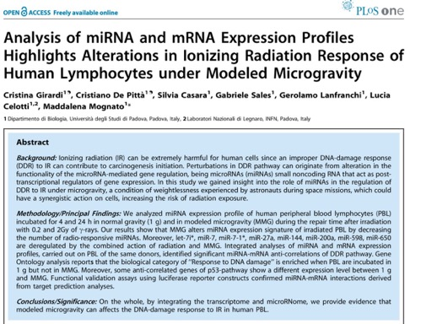
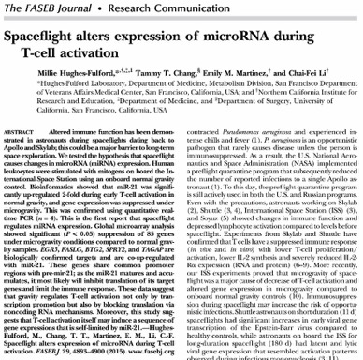
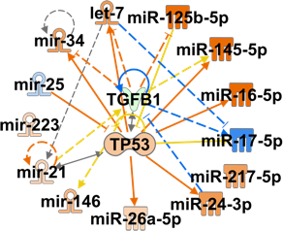
Predicted miRNAs Involved with Spaceflight
Beheshti, et al., PLOS One, 2018

Slide 14
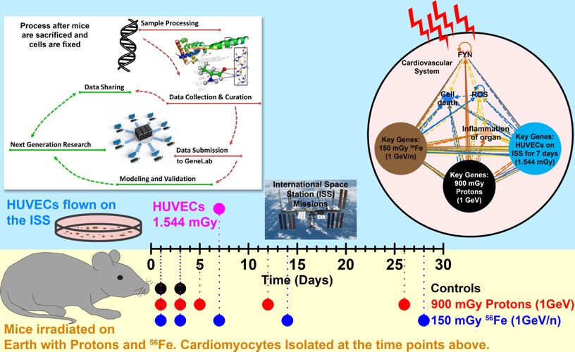
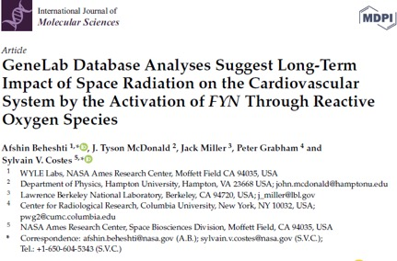
Utilizing GeneLab to Predict Mechanism with Space Radiation Cardiovascular Risk

Slide 15
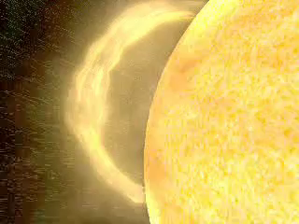
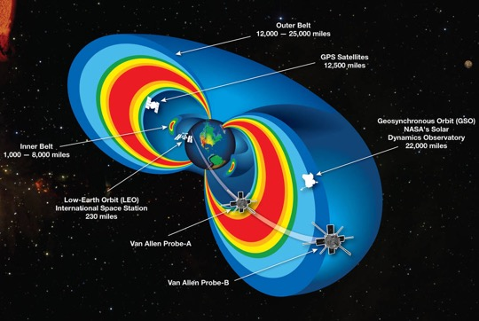
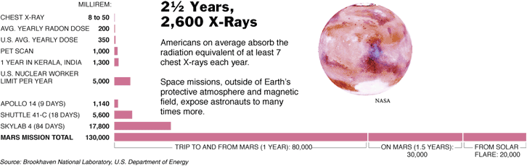
Earth’s magnetic field protects us from cosmic radiation
Image obtained from: https://www.nasa.gov/mission_pages/sunearth/news/gallery/20130228-radiationbelts.html
Notes:
This computer animation illustrates the Earth's space storm shield in action. The solar wind, a thin, high-velocity electrified gas, or plasma, blows constantly from the Sun at an average speed of 250 miles per second (400 kilometers/sec). It is represented as a stream of yellow particles flowing from the Sun. The solar wind impacts the Earth's magnetic field, represented by the blue lines. As the solar wind flows past the Earth's magnetic field, it generates enormous electric currents that heat Earth's space storm shield -- a layer in the Earth's electrically charged outer atmosphere (ionosphere) -- causing the shield to eject electrically charged oxygen atoms (oxygen ions) into space. The expelled oxygen ions are represented by the green particle streams. The ejected oxygen ions gain tremendous speed as they leave the atmosphere, become trapped by the Earth's magnetic field and ultimately encircle the Earth, where they form a billion-degree plasma cloud around the planet, represented by the red cloud. The blue doughnut shape represents the high-speed flow of these particles around the Earth. The red 'ring of fire' around the Earth's polar regions represents the contribution of the particles to the aurora (the northern and southern lights).

Slide 16
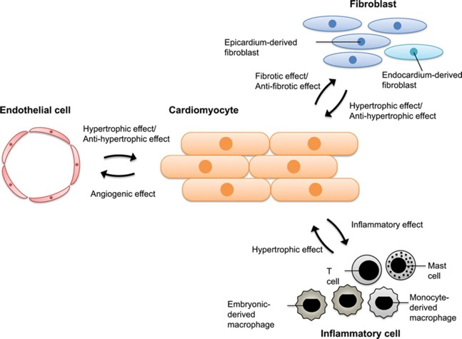
GeneLab Data Used and Hypothesis
Analyzed 3 datasets from GeneLab:
  GLDS-117 and GLDS-109:
    Are ground studies of cardiomyocytes followed-up for 28 days after exposure to 90cGy of proton at 1GeV and 15cGy of ⁵⁶Fe at 1GeV
    Cardiomyocytes are the muscle cells (myocytes) that make up the cardiac muscle (heart muscle).
  GLDS-52:
    human endothelial cells (HUVECs) that were cultured for 10 days on the ISS
Endothelial cells are known to directly regulate the development and activity of cardiomyocytes, and thus their response to spaceflight should be highly correlated with cardiomyocytes.
The ground studies were designed to characterize the long-term impact following space irradiation on cardiomyocytes for 5 different time points up to 28 days after irradiation.
Our analysis was guided by the hypothesis that there are common persistent molecules affecting the cardiovascular system due to radiation effects during spaceflight.
From: T. Kamo et al., Circ Res. 2015;117:89-98

Slide 17
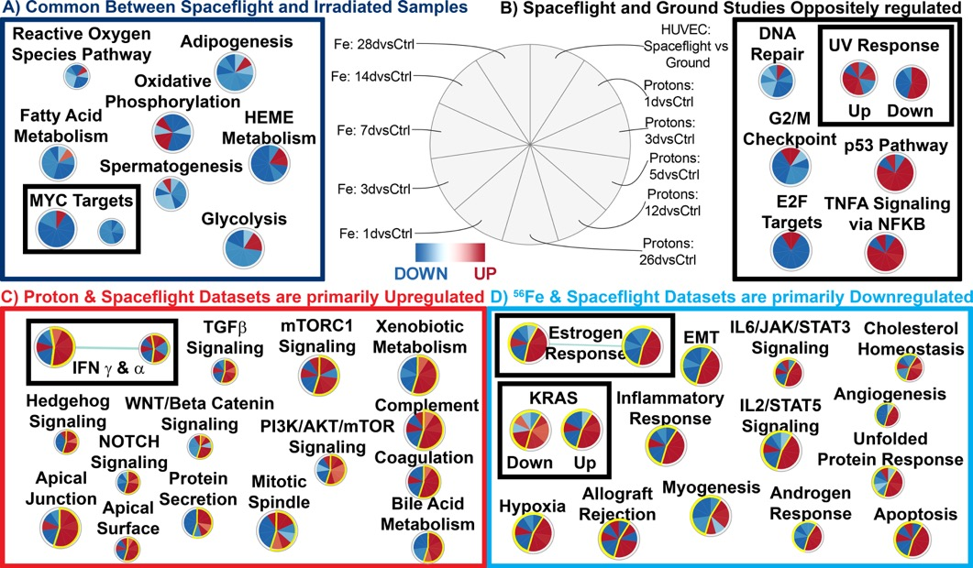
Functional Impact on Health: Reactive Oxygen Species
ROS are formed as a natural byproduct of the normal metabolism of oxygen and have important roles in cell signaling and homeostasis.
During times of environmental stress (e.g., radiation exposure), ROS levels can increase dramatically.
This may result in significant damage to cell structures.
ROS are also generated by exogenous sources such as ionizing radiation

Slide 18
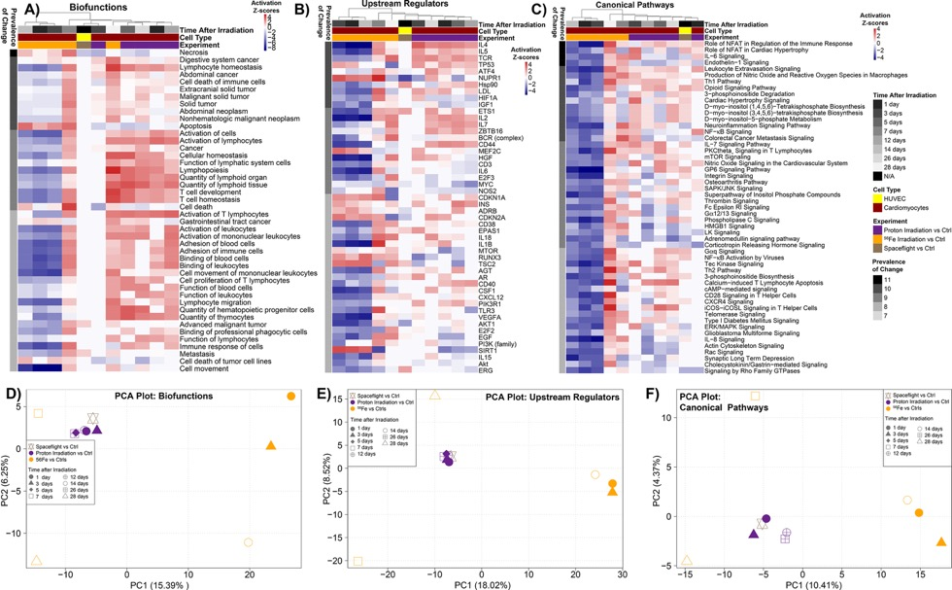
Functional Impact on Health: Protons Majority of Radiation at LEO
It is interesting to note that the functional predictions show that the spaceflight samples cluster (or behave) very similar to the proton irradiated samples.
Possible indication (and hypothesis) that in general samples from the ISS may be experiencing more proton ions than other type of ions.

Slide 19
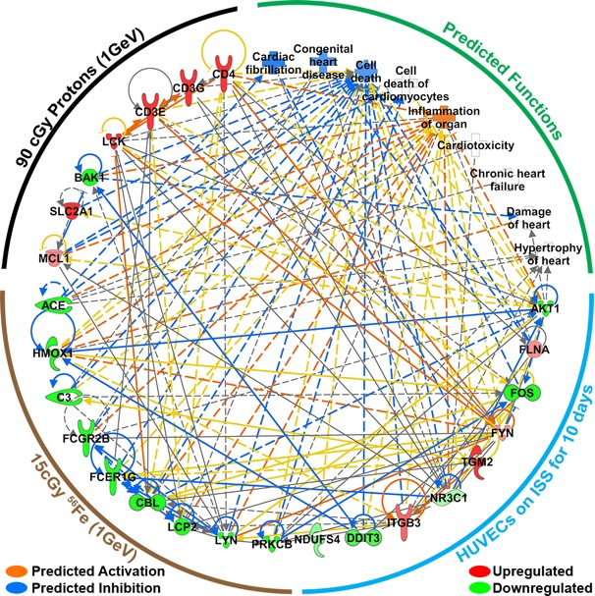
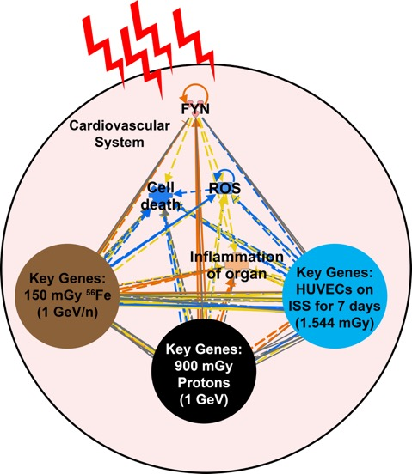
Key Drivers Involved with Space Radiation Induced Cardiovascular Risk
It is worth noting the activation of FYN is a key event that prevents cardiac cell death and ROS production.

Slide 20
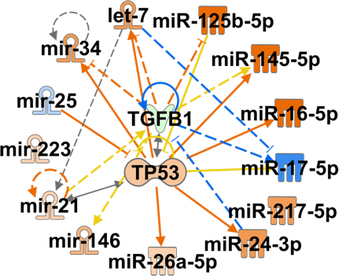
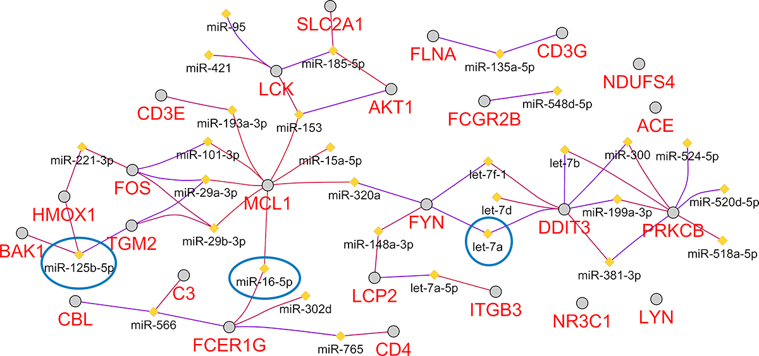
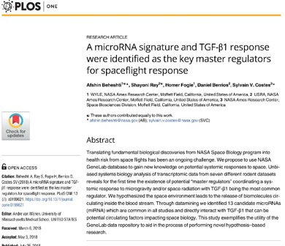
miRNA impact?
Circulating miRNAs predicted to be involved in general with spaceflight from Beheshti et al. PLOS One 2018

Slide 21
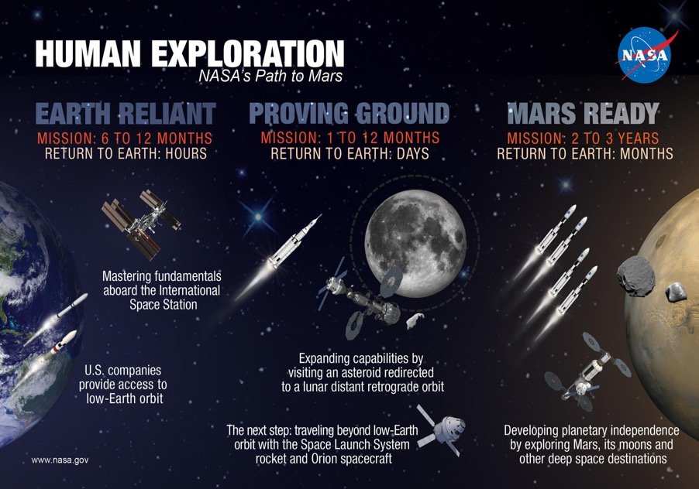
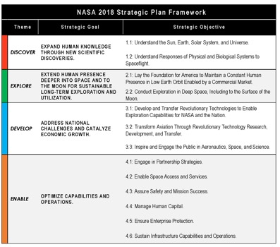
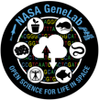
Many Space Biology Questions and Challenges Still Need to Addressed!

Slide 22
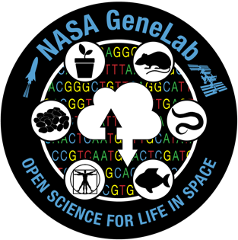
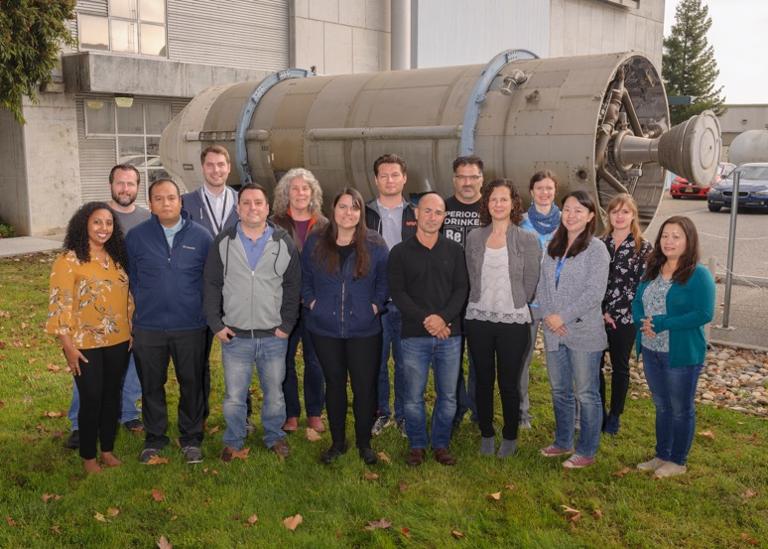

Acknowledgements
https://genelab.nasa.gov/

