Slide 1
Google Colaboratory for HDF-EOS
ESIP 2019 Summer
Hyo-Kyung Joe Lee
Software Engineer
hyoklee@hdfgroup.org
This work was supported by NASA/GSFC under Raytheon Co. contract number NNG15HZ39C.
This document does not contain technology or Technical Data controlled under either the U.S. International Traffic in Arms Regulations or the U.S. Export Administration Regulations.

Slide 2
What is Google Colaboratory?
Free Jupyter notebook environment
No setup
100% Cloud
Python 2 and 3
Hardware accelerator
  Graphical Processing Unit (GPU)
  Tensor Processing Unit (TPU)

Slide 3
What is HDF-EOS?
HDF: Hierarchical Data Format
EOS: Earth Observing System
HDF-EOS is a standard format to store data collected from EOS satellites: Terra, Aqua and Aura.
Point, Swath, Grid data types
2 Libraries:
  HDF-EOS2 / HDF-4
  HDF-EOS5 / HDF-5

Slide 4
I’ve NEVER heard of HDF-EOS.
No problem – visit http://hdfeos.org.
Tools examples
  Conversion to familiar data formats
  Excel / ArcGIS / Google Earth / etc.
Programming examples
  MATLAB / Python / IDL* / NCL** / R / C / etc.
281 NASA product specific examples
  http://hdfeos.org/zoo
* = Interactive Data Language
** = NCAR (National Center for Atmospheric Research) Command Language

Slide 5
How to Run Zoo Example Codes
Download HDF-EOS data from NASA.
Modify code a little bit.
  File name
  Dataset name
  Data processing
Run the code to generate plot on map.
These are all done on your local computer!

Slide 6
Can I run them on cloud, instead?
Yes, you can for Python examples!
Use Google Colaboratory (Colab).
Set up (if you’ve never used Gmail):
https://accounts.google.com/signup
https://drive.google.com

Slide 7
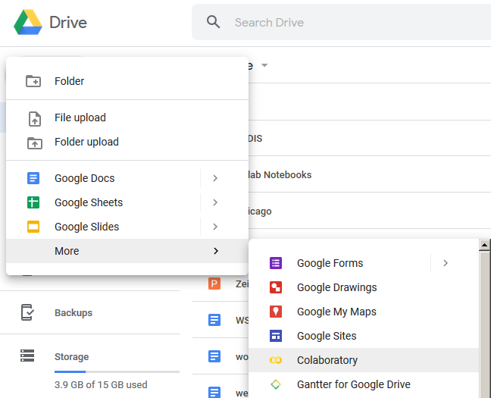
Let’s create a new Colab notebook.

Slide 8
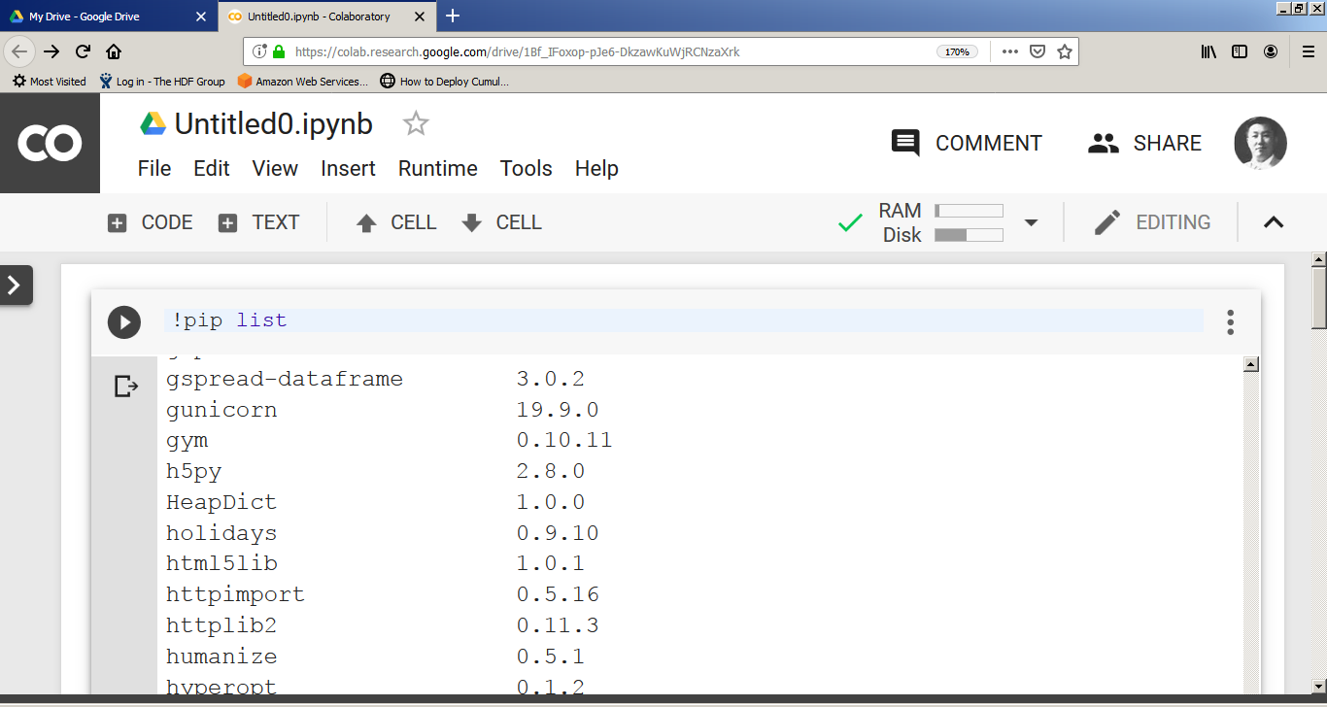
Colab has many built-in packages...

Slide 9
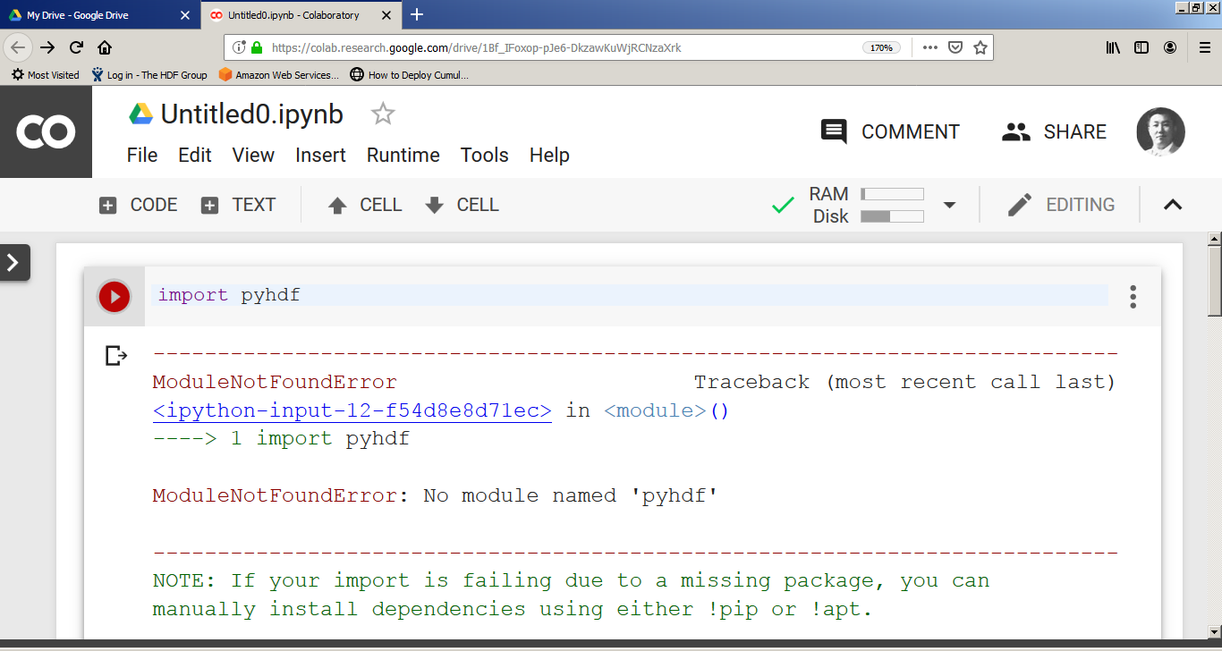
but NO pyhdf, netCDF*4, basemap!
* = Network Common Data Form

Slide 10
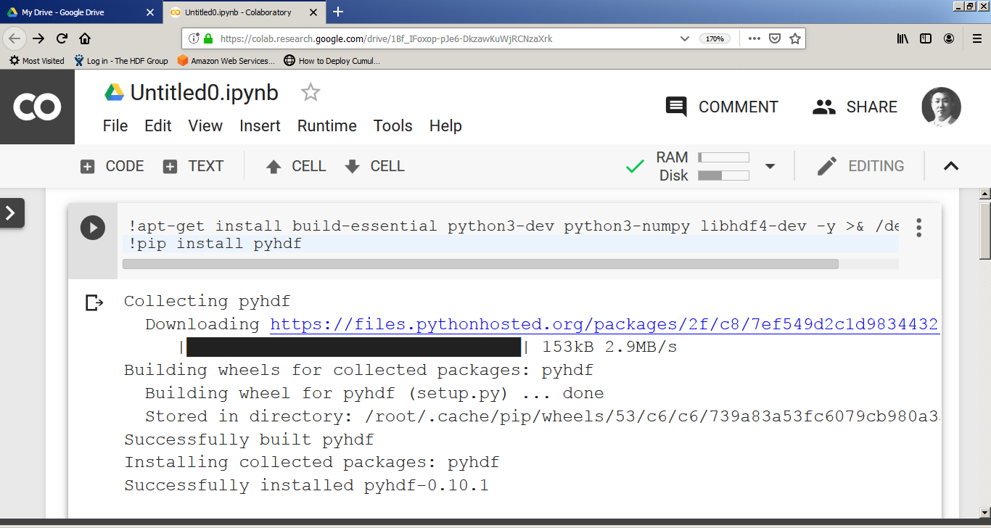
Colab allows you to install package.

Slide 11
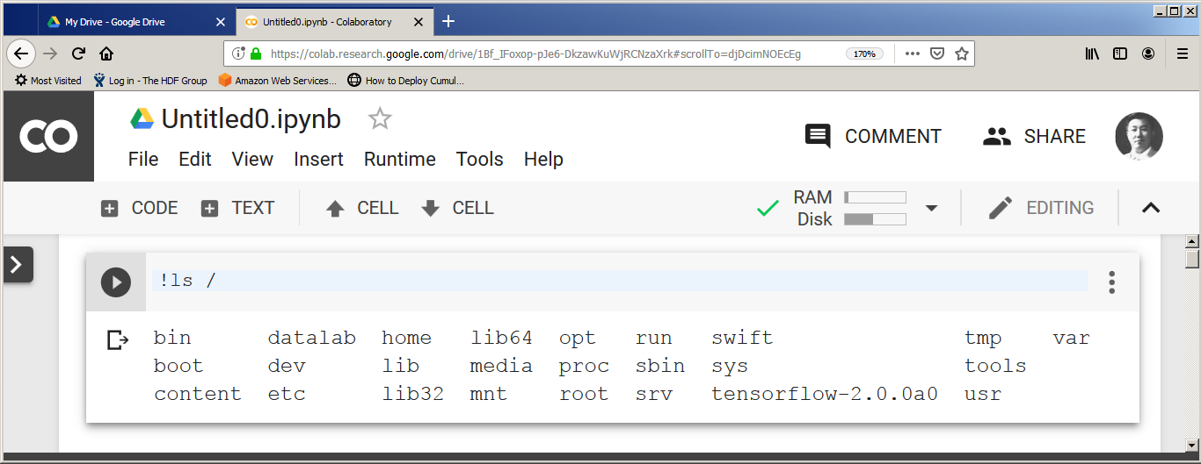
“!” allows you to run any command.
Try ‘df –h’ and ‘uname –a’ to check system.
Notes:
Knowing the limits of system is useful.

Slide 12
Let’s install required packages.
!apt-get install build-essential python3-dev python3-numpy libhdf4-dev -y
!pip install pyhdf
!pip install pyproj==1.9.6
!apt install proj-bin libproj-dev libgeos-dev
!pip install https://github.com/matplotlib/basemap/archive/v1.2.0rel.tar.gz
Notes:
Knowing the limits of system is useful.

Slide 13
Download file.
!wget https://gamma.hdfgroup.org/ftp/pub/outgoing/NASAHDF/AIRS.2003.02.05.L3.RetStd_H001.v6.0.12.0.G14112124328.hdf
Or upload file.
from google.colab import files
uploaded = files.upload()
Notes:
Knowing the limits of system is useful.

Slide 14
Copy and paste code from Zoo.
from pyhdf.SD import SD, SDC
hdf = SD(FILE_NAME, SDC.READ)
# Read dataset.
data3D = hdf.select(DATAFIELD_NAME)
data = data3D[0,:,:]
# Read geolocation dataset.
lat = hdf.select('Latitude')
latitude = lat[:,:]
lon = hdf.select('Longitude')
longitude = lon[:,:]
Notes:
Knowing the limits of system is useful.

Slide 15
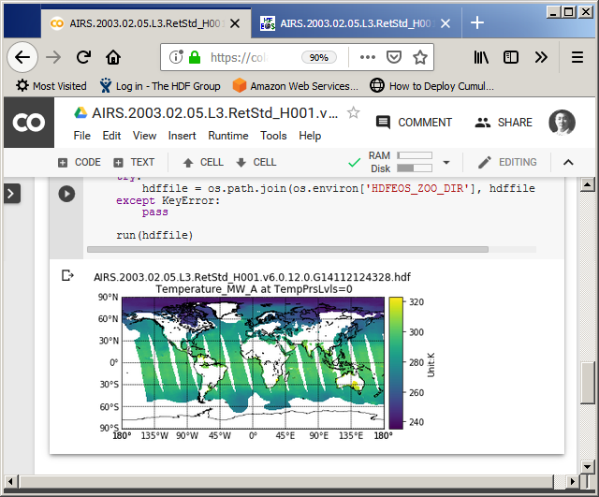
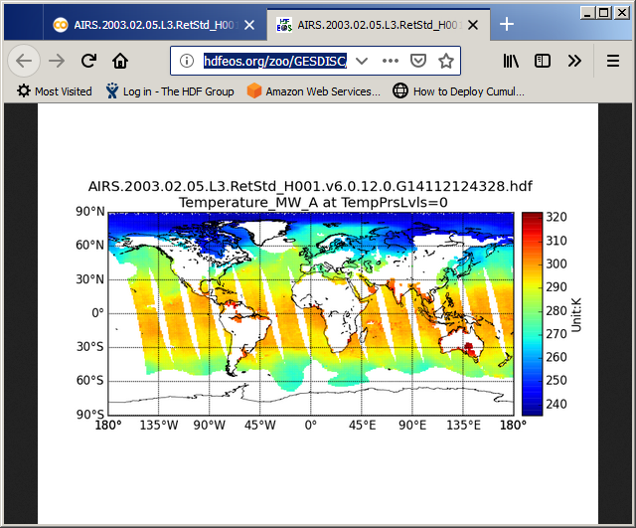
You’ll get the exact same plot.
Colab
zoo
Notes:
Knowing the limits of system is useful.

Slide 16
OPeNDAP* works, too!
!pip install pydap
from pydap.client import open_url, open_dods
from pydap.cas.urs import setup_session
# Make sure you use https.
FILE_NAME = 'MLS-Aura_L2GP-BrO_v04-23-c03_2016d302.he5'
url = 'https://acdisc.gesdisc.eosdis.nasa.gov:443/opendap/HDF-EOS5/Aura_MLS_Level2/ML2BRO.004/2016/'+FILE_NAME
# Use your own NASA URS username and password.
session = setup_session('eosdap', '******', check_url=url)
dataset = open_url(url, session=session)
* = Open-source Project for a Network Data Access Protocol
Notes:
Knowing the limits of system is useful.

Slide 17
Awesome Sharing Feature
Save Colab to Google Drive and share.
Save Colab to GitHub directly.
Upload / Download Colab to local drive.
Share and control revisions like any other Google document.
Notes:
Knowing the limits of system is useful.

Slide 18
Other Cool Features
If an error occurs, it automatically provides a link to StackOverflow.
You can add forms for input parameters from user.
Mount Google Drive and access data from Google Sheet.
Notes:
Knowing the limits of system is useful.

Slide 19
Some Limits and Potential Solution
Some built-in package versions are old.
Only pydap worked with NASA Earthdata Login (cf., netCDF/netCDF_pydap)
There’s about 13G memory and 25G disk space limit.
“Colaboratory lets you connect to a local runtime using Jupyter. This allows you to execute code on your local hardware and have access to your local file system.”
Notes:
Knowing the limits of system is useful.

Slide 20













This work was supported by NASA/GSFC under Raytheon Co. contract number NNG15HZ39C.
in partnership with

