Slide 1

Reusability in NASA’s Earth Observation System Data and Information System (EOSDIS)
Paper IN21A-09, December 10, 2019
Fall AGU Meeting, San Francisco, CA
Hampapuram (Rama) Ramapriyan^{1,2} and Christopher Lynnes²
¹Science Systems and Applications, Inc. &
²ESDIS Project, NASA/Goddard Space Flight Center

Slide 2
Topics
What is EOSDIS?
EOSDIS and FAIR
Reusability
Conclusion

Slide 3
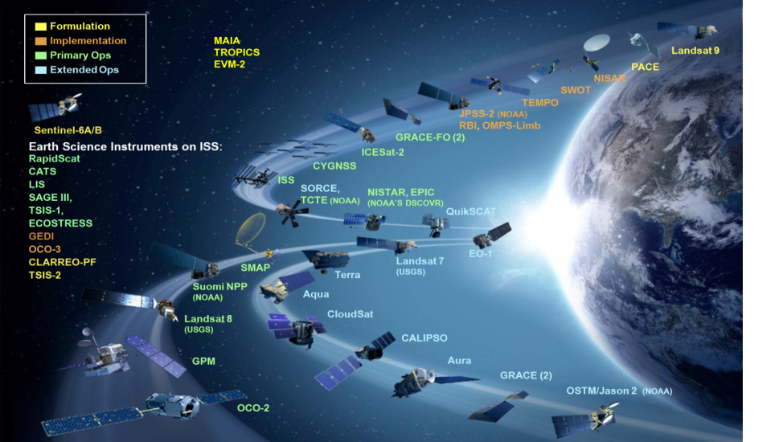
The Problem starts with NASA’s diverse portfolio of Earth Observing satellites

Slide 4







The Earth Observing System Data and Information System (EOSDIS) stores and distributes NASA’s Earth Observations
EOSDIS
Commercial
Distribute
Research
Applications
Transform
Education
Archive
Capture and clean
Process

Slide 5
EOSDIS’s distributed architecture has compelled support for distributed discovery, access and interoperability
LPDAAC
Land Processes
SEDAC
Human Interactions in Global Change
PO.DAAC
Physical Oceanography
LAADS
Atmosphere
CDDIS
Crustal Dynamics
ASF DAAC
Synthetic Aperture Radar
GES DISC
Atmosphere
Modeling
Hydrology
OB.DAAC
Ocean Biosphere
ASF: Alaska Satellite Facility
LP: Land Processes
PO: Physical Oceanography
OB: Ocean Biology
ORNL: Oak Ridge National Laboratory
NSIDC: National Snow and Ice Data Center
GHRC: Global Hydrology Research Center
ASDC: Atmospheric Science Data Center
CDDIS: Crustal Dynamics Data and Information System
SEDAC: Socio-Economic Data and Applications Center
LAADS: Level 1 and Atmosphere Archive and Distribution System
GES DISC: Goddard Earth Sciences Data and Information Services Center
NSIDC DAAC
Cryosphere
ORNL
Biogeochemical Dynamics
ASDC
Radiation Budget
Troposphere
GHRC
Severe Weather

Slide 6
EOSDIS – Operating and Evolving Since 1994
Lessons learned and information technology advances coupled with advice/comments from community supports a continuously evolving data system with growing capabilities
Federated active archives; loosely coupled
User Needs driven development
Common Metadata Repository + Unified Metadata Model
User registration with single sign-on
Collaboratively dev-eloped analytics software
Open Source software on GitHub
Commercial cloud usage
Easy access imagery
Continuous technology infusion
Heterogeneous, distributed data providers
Minimal set of core standards + community standards
Coordinated websites
Preservation – content specifications
On-line archives and cross-system services
Near Real-Time access
Common data model
Expanded software tools and services
Some interoperability with external data sources
High data volume on nearline media
Improved access to heritage data
Cross-DAAC search / access interoperability
Common distribution format (HDF)
Some data on nearline media
Mission data systems
Few community standards
Cumbersome inter-use
Data on offline media
<1990
Mid-1990s
Late 90s +
2000s
2010s +
EOSDIS Operational
FAIR

Slide 7
FAIR Guiding Principles
Aimed at clarifying meaning of “good data management and stewardship, and defining simple guideposts to inform those who publish and/or preserve scholarly data” – Wilkinson, et al., https://doi.org/10.1038/sdata.2016.18
Findable, Accessible, Interoperable, and Reusable
  Result of 2014 workshop held in Leiden, Netherlands
  Domain-independent, high-level principles
  Emphasize human and machine accessibility
  GO-FAIR initiative elaborates on each of the FAIR Principles - https://www.go-fair.org/fair-principles/
While EOSDIS predates FAIR Principles by two decades, it is useful to assess its on-going evolution relative to them
  Specifically, we address Reusability

Slide 8
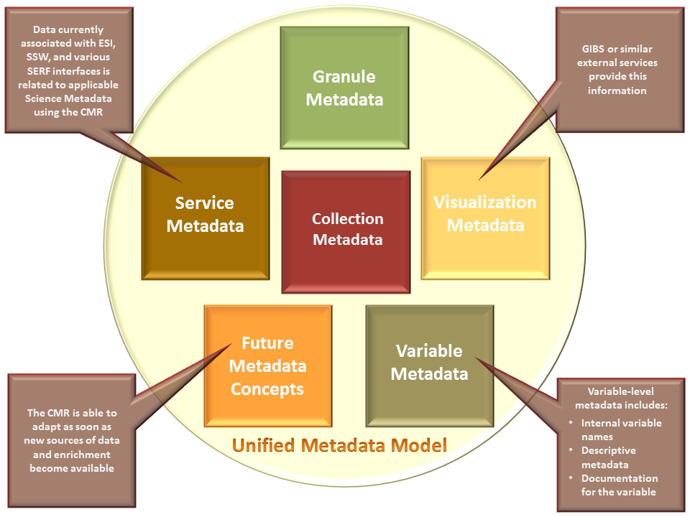
Reusability – R1
(Meta)data are richly described with a plurality of accurate and relevant attributes
  Unified Metadata Model
  References in datasets
  and their landing pages
  to inform users about
  scope and limitations of
  data
  Known issues documents
  Quality flags help users
  filter data before use

Slide 9
Reusability – R1.1
(Meta)data are released with a clear and accessible data usage license
  NASA’s data and information policy - https://earthdata.nasa.gov/collaborate/open-data-services-and-software/data-information-policy
  Most data are free and open
  “Earthdata Login” required to get data
  End User License Agreement (EULA) provided where needed

Slide 10
Reusability – R1.2
(Meta)data are associated with detailed provenance
  Metadata (UMM-C, UMM-G) include details such as: authorship, platform, instrument, inputs needed, version, data center, processing level, spatial and temporal extent, etc.
  For ensuring future reusability
      Preservation Content Specification (PCS) – provenance and context (as complete as possible)
      Leading development of an ISO standard (ISO 19165-2)
    Title: Geographic information -- Preservation of digital data and metadata -- Part 2: Content specifications for Earth observation data and derived digital products
    Based on NASA’s PCS, and Long-Term Data Preservation Contents adopted by Committee on Earth Observation Satellites (CEOS)

Slide 11
Reusability – R1.3
(Meta)data meet domain-relevant community standards
  Earth Science Data and Information System (ESDIS) Standards Office (ESO) maintains acceptable standards for NASA’s Earth science data (https://earthdata.nasa.gov/esdis/eso/standards-and-references)
    E.g., HDF5, NetCDF4, CF, GeoTIFF, KML, ICARTT, ISO 19115, UMM
    Path for reviewing and adopting community standards as they evolve
  Even while complying with standards there is some flexibility in implementation that may make interoperability and reusability difficult
    DAACs work with data producers to utilize the applicable standards and conventions
    Data Product Development Guide for Data Producers Guidebook provides guidance on how to construct compliant, thus more reusable, data products.

Slide 12
Conclusion
NASA’s EOSDIS robustly supports FAIR principles in general and specifically Reusability
It works very well for human interfaces
Machine actionability is improving, but needs more work

