Slide 1
Supporting Material for APL’s Interstellar Probe Final Report
December 3, 2019
Rob Stough / XP50
David Hitt / XP50
Barney Holt / ED04
Alan Philips / ED04
Margaret Patrick / ED04

Slide 2
Data Package Summary
Stage adaptor sizing GR&A and estimated mass
Integrated Stages and adaptors under the 8.4m, short fairing
SLS Block 1B GR&A for C3 estimates
SLS C3 performance with additional upper stages
Representative Trajectory
Supplemental Descriptions

Slide 3
Star48BV
43.3 inch top interface diameter
Estimated 143.9 inch tall adapter (45. deg angle)
4,772 lb motor total mass (NGIS catalog)
Supporting 22,050 lb payload (design point)
Estimated 121 inches to CG
1821 lb (basic mass) + 328 lb (MGA) = 2149 lb predicted mass

Slide 4
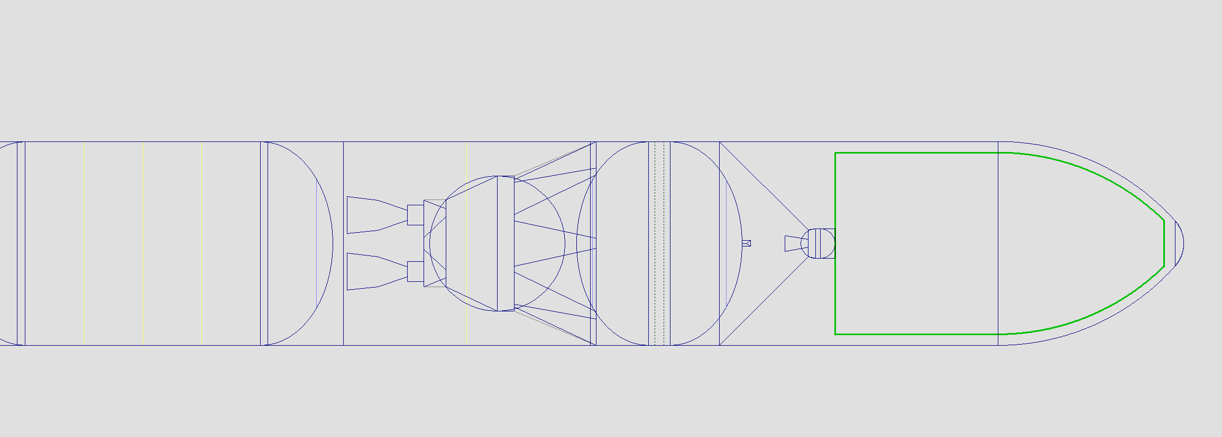
489 m³
13.5 m

Slide 5
Star48GXV
49.0 inch top interface diameter
Estimated 141.0 inch tall adapter (45 deg. angle)
Supporting 22,050 lb payload
Estimated 139 inches to CG
1717 lb (basic mass) + 309 lb (MGA) = 2026 lb adapter predicted mass

Slide 6
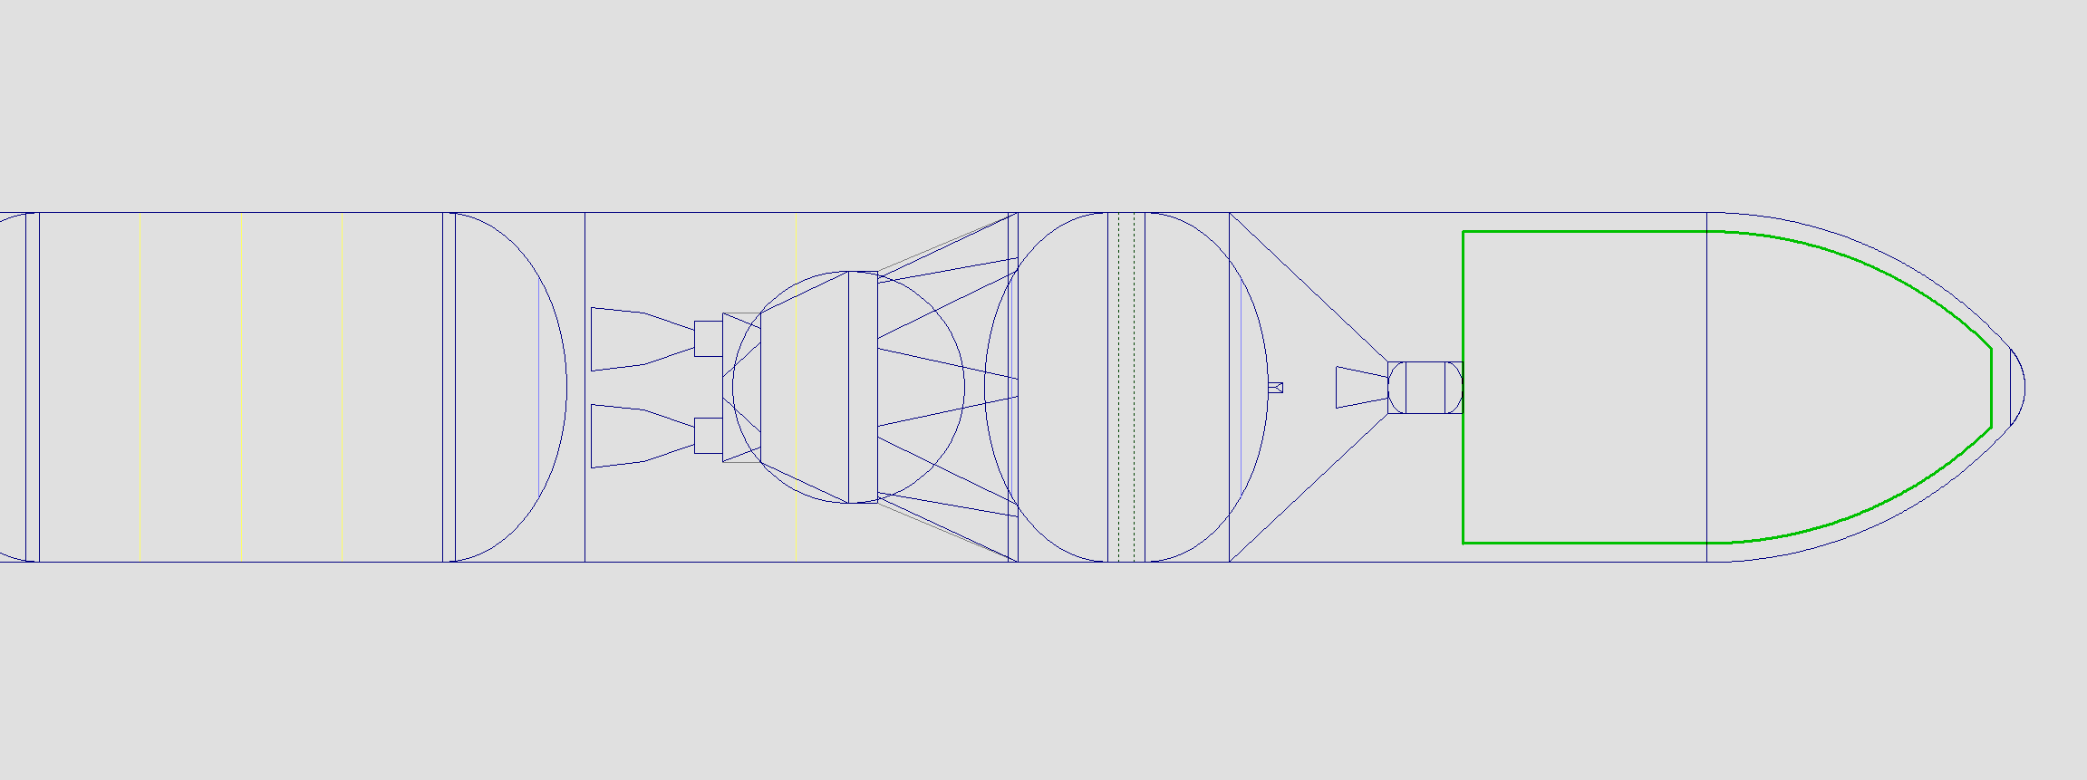
452 m³
12.7 m

Slide 7
Orion 50XL
52.2 inch top interface diameter
Estimated 139.4 inch tall adapter (45. deg angle)
9,494 lb motor total mass (source:NGIS catalog)
Supporting 22,050 lb payload
Estimated 138 inches to CG
1768 lb (basic mass) + 318 lb (MGA) = 2086 lb adapter predicted mass

Slide 8
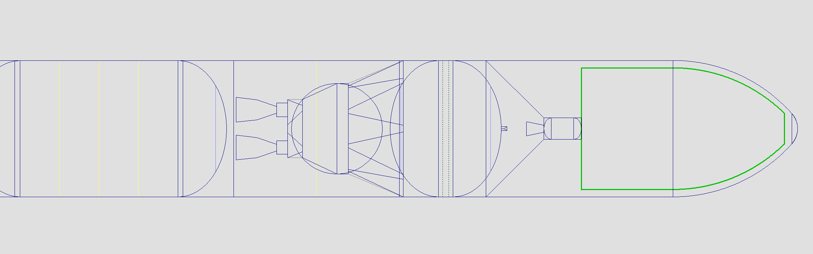
441 m³
12.4 m

Slide 9

Centaur D
NOTE: May require a forward bearing reactor
120.0 inch top interface diameter
Estimated 181.3 inch tall adapter (nozzle clearance)
34,524 lb stage total mass (MSFC internal estimate)
Supporting 22,050 lb payload
Estimated 152 inches to CG
2154 lb (basic mass) + 388 lb (MGA) = 2542 lb adaptor predicted mass

Slide 10
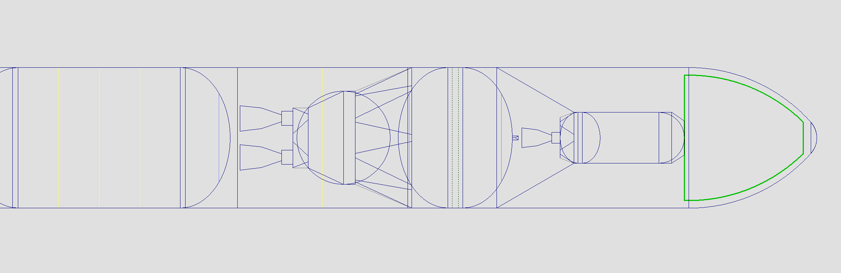
205 m³
7.1 m

Slide 11
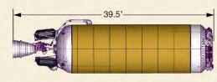
Atlas V Centaur
NOTE: May require a forward bearing reactor
120.0 inch top interface diameter
Estimated 199.0 inch tall adapter (nozzle clearance)
Estimated 54,665 lb stage (MSFC internal estimate)
Supporting 22,050 lb payload
Estimated 166.5 inches to CG
2550 lb (basic mass) + 459 lb (MGA) = 3009 lb adapter predicted mass

Slide 12
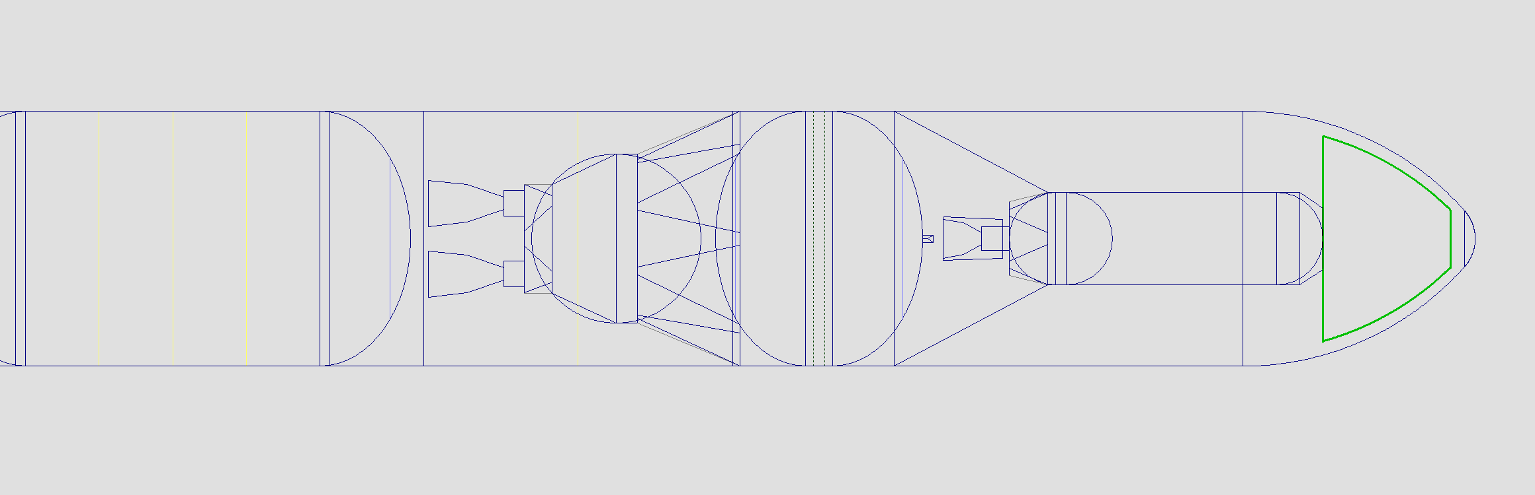
85 m³
4.2 m

Slide 13
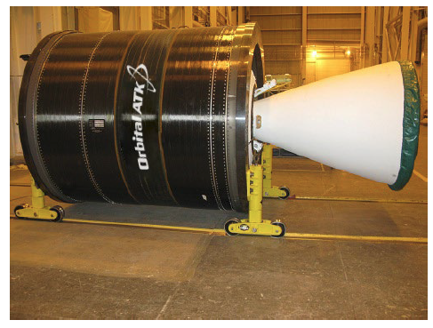
Castor 30B
95.0 inch estimated top interface diameter
Estimated 139.3 inch tall adapter (nozzle clearance)
30,800 lb motor mass (source:NGIS catalog)
Supporting 22,050 lb payload
Estimated 200 inches to CG
2265 lb (basic mass) + 408 lb (MGA) = 2673 lb adaptor predicted mass

Slide 14
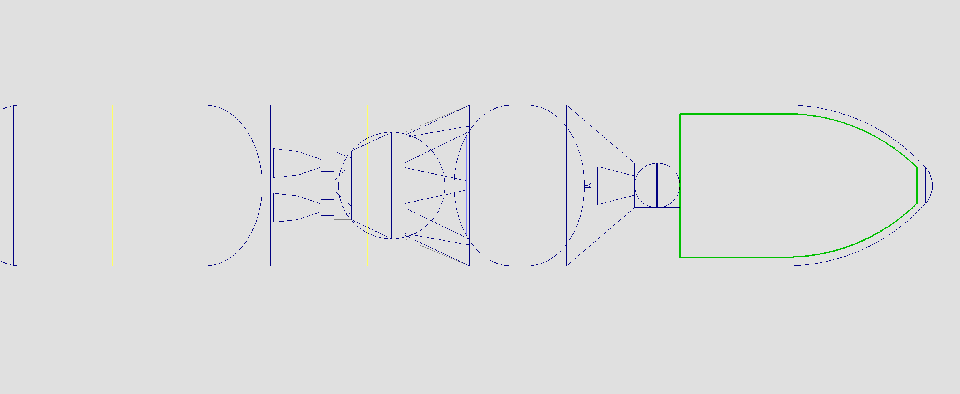
438 m³
12.3 m

Slide 15
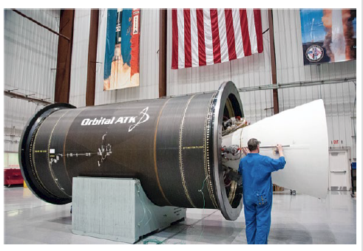
Castor 30XL
95.0 inch estimated top interface diameter
Estimated 154.0 inch tall adapter (nozzle clearance)
58,217 lb motor total mass (source: NGIS catalog)
Supporting 22,050 lb payload
Estimated 230 inches to CG
2934 lb (basic mass) + 528 lb (MGA) = 3462 lb adapter predicted mass

Slide 16
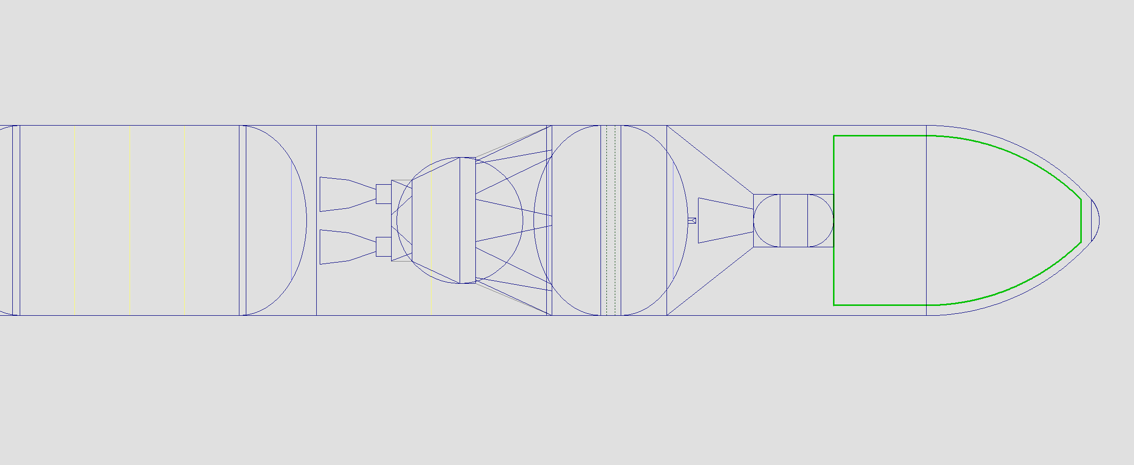
374 m³
10.9 m

Slide 17
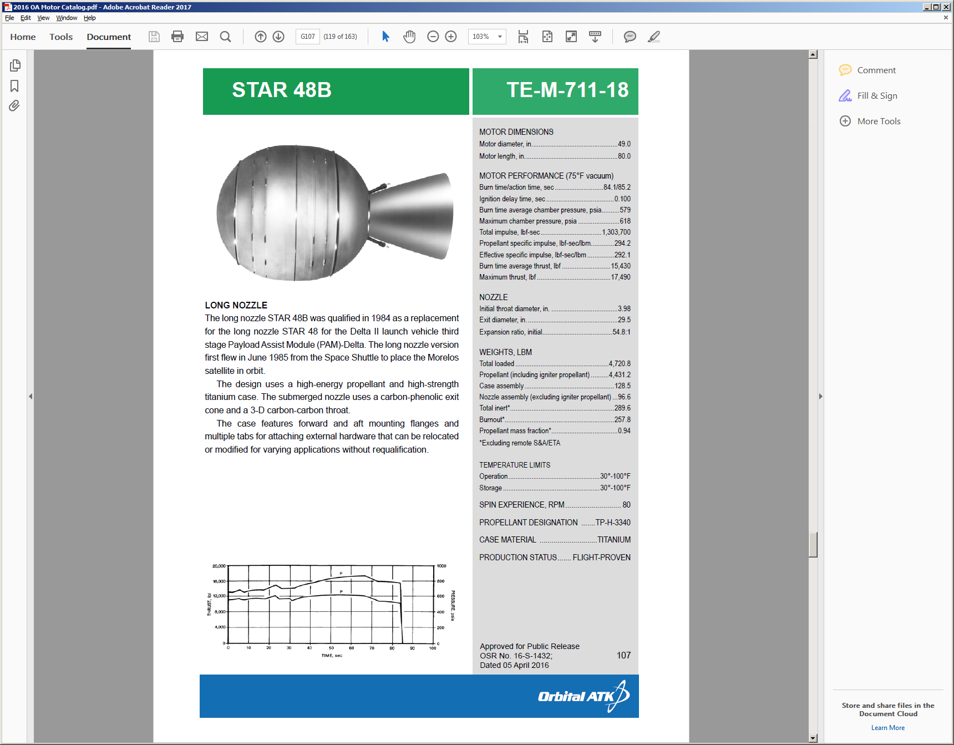
Castor 30B – Star 48BV
EUS to Castor 30B
  2703 lb (basic mass) + 486 lb (MGA) = 3189 lb predicted mass
  Dimensions: 139.3 in tall, 331.0 in base, 95.0 in top
  Supporting 63,968 lbs including Castor 30B, Star 48BV, and 10 mt payload
  139.3 in to clear EUS fwd dome, vent valve, and nozzle
Castor 30B to Star 48BV
  302 lb (basic mass) + 55 lb (MGA) = 357 lb predicted mass
  Dimensions: 45.0 in tall, 95.0 in base, 43.3 in top
  Supporting 28,241 lbs including Star 48BV and 10 mt payload
  45.0 in to clear nozzle

Slide 18
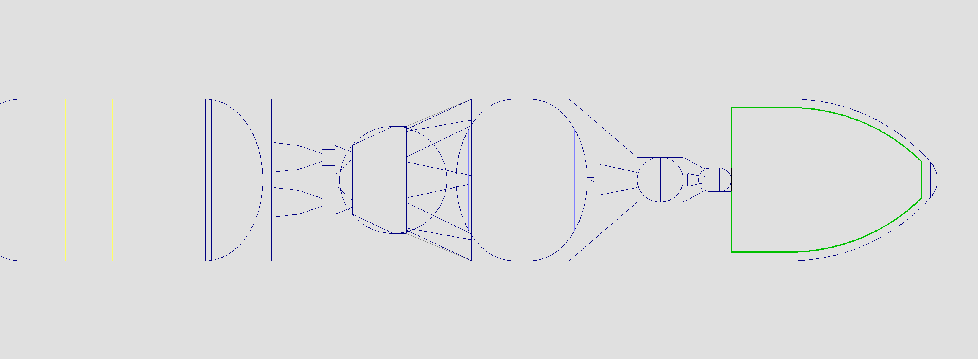
328 m³
9.8 m

Slide 19
Castor 30XL – Star 48BV
EUS to Castor 30XL
  3470 lb + 625 lb (MGA) = 4095 lb adapter predicted mass
  Dimensions: 154.0 in tall, 331.0 in base, 95.0 in top
  Supporting 85,384 lbs including Castor 30XL, Star 48BV, and 10 mt payload
  154.0 in to clear EUS fwd dome, vent valve, and nozzle
Castor 30XL to Star 48BV
  302 lbs (basic mass) + 55 lb (MGA) = 357 lb adapter predicted mass
  Dimensions: 45.0 in tall, 95.0 in base, 43.3 in top
  Supporting 28,241 lbs including Star 48BV and 10 mt payload
  45.0 in to clear nozzle

Slide 20
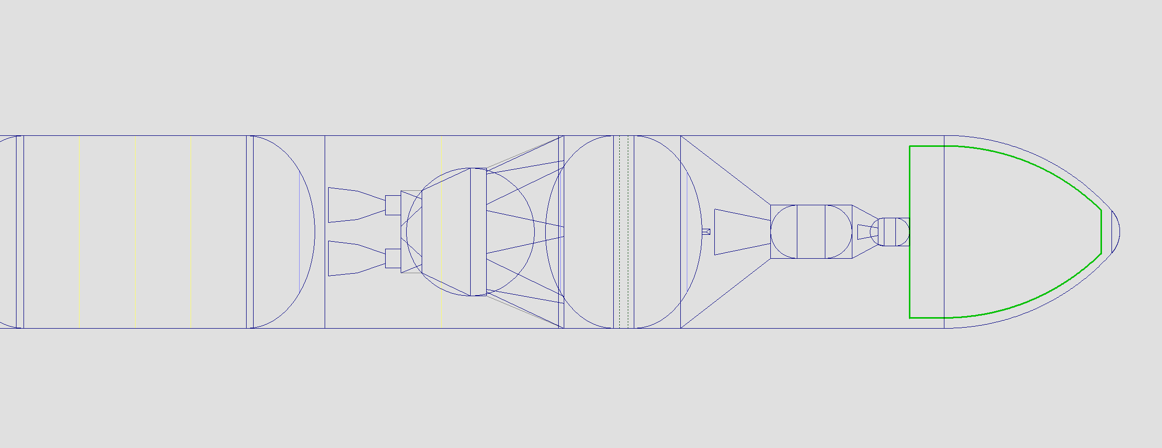
259 m³
8.3 m

Slide 21
Centaur D – Star 48BV
EUS to Centaur D
  2918 lb (basic mass) + 525 lb (MGA) = 3443 lb adapter predicted mass
  Dimensions: 181.3 in tall, 331.0 in base, 120.0 in top
  Supporting 61,877 lbs including Centaur D, Star 48BV, and 10 mt payload
  181.3 in to clear EUS fwd dome, vent valve, and nozzle
Centaur D to Star 48BV
  439 lb (basic mass) + 79 lb (MGA) = 518 lb adapter predicted mass
  Dimensions: 45.0 in tall, 120.0 in base, 43.3 in top
  Supporting 26,818 lbs including Star 48BV and 10 mt payload
  45.0 in to clear nozzle

Slide 22
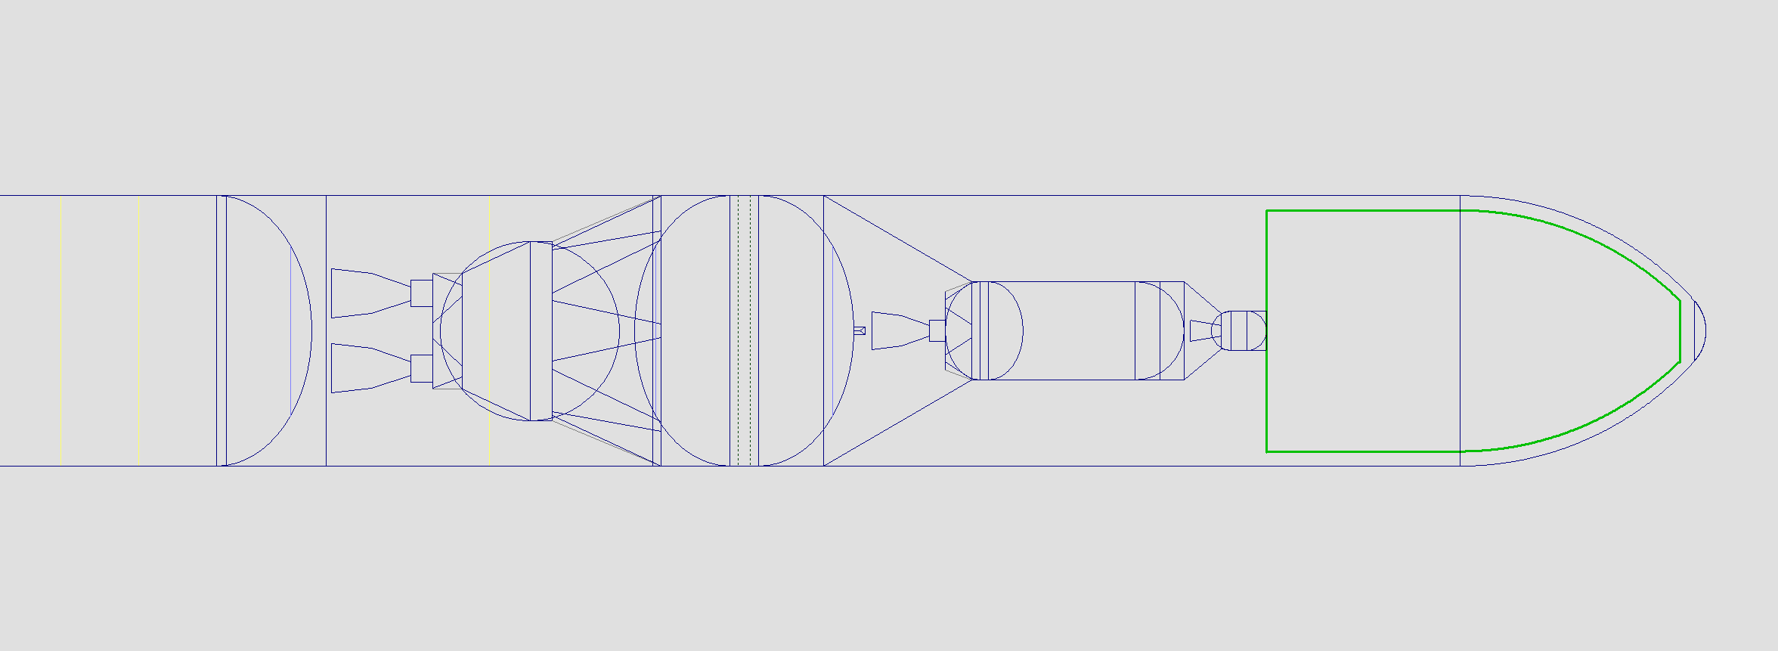
459 m³
12.8 m

Slide 23
Centaur (Atlas V) – Star 48BV
EUS to Centaur (Atlas V)
  3523 lb (basic mass) + 634 lb (MGA) = 4157 lb adapter predicted mass
  Dimensions: 199.0 in tall, 331.0 in base, 120.0 in top
  Supporting 84,432 lbs including Centaur, Star 48BV, and 10 mt payload
  199.0 in to clear EUS fwd dome, vent valve, and nozzle
Centaur (Atlas V) to Star 48BV
  439 lbs + 79 lb (MGA)= 518 lb adapter predicted mass
  Dimensions: 45.0 in tall, 120.0 in base, 43.3 in top
  Supporting 26,818 lbs including Star 48BV and 10 mt payload
  45.0 in to clear nozzle

Slide 24
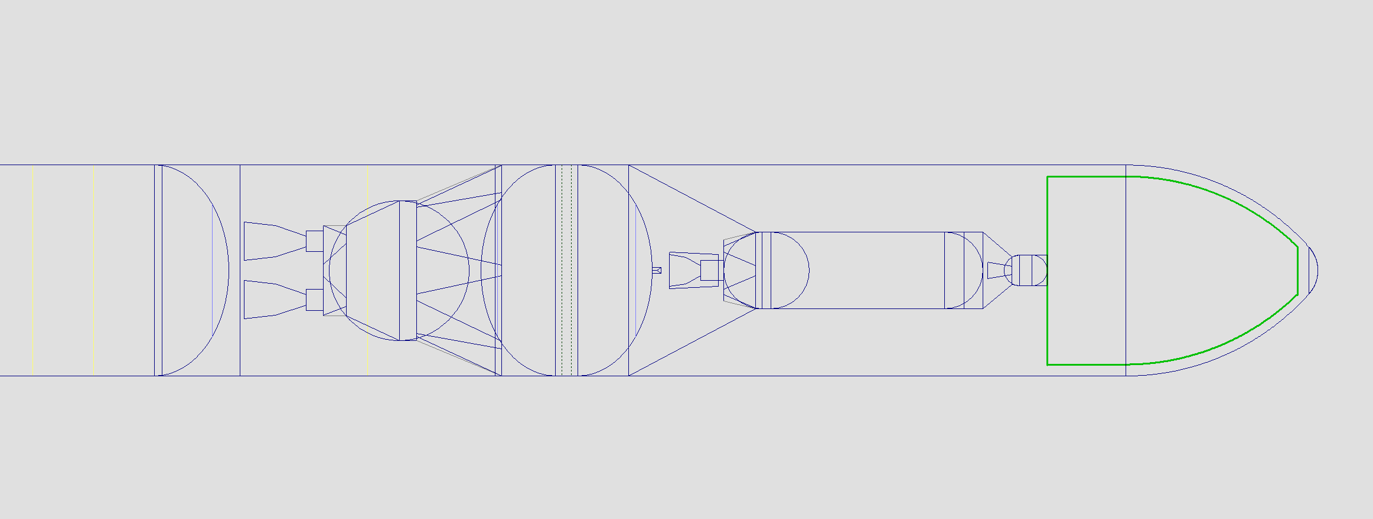
331 m³
9.9 m

Slide 25
Orion 50XL – Star 48BV
EUS to Orion 50XL
  2172.8 lb (basic mass) + 392 lb (MGA) = 2564 lb adaptor predicted mass
  Dimensions: 139.4 in tall, 331.0 in base, 52.2 in top
  Supporting 36,312 lbs including Orion 50XL, Star 48BV, and 10 mt payload
  139.4 in for 45 degree adapter
Orion 50XL to Star 48BV
  96 lb (basic mass) + 17 lb (MGA)= 113 lb adaptor predicted mass
  Dimensions: 45.0 in tall, 52.2 in base, 43.3 in top
  Supporting 26,818 lbs including Star 48BV and 10 mt payload
  45.0 in to clear nozzle

Slide 26
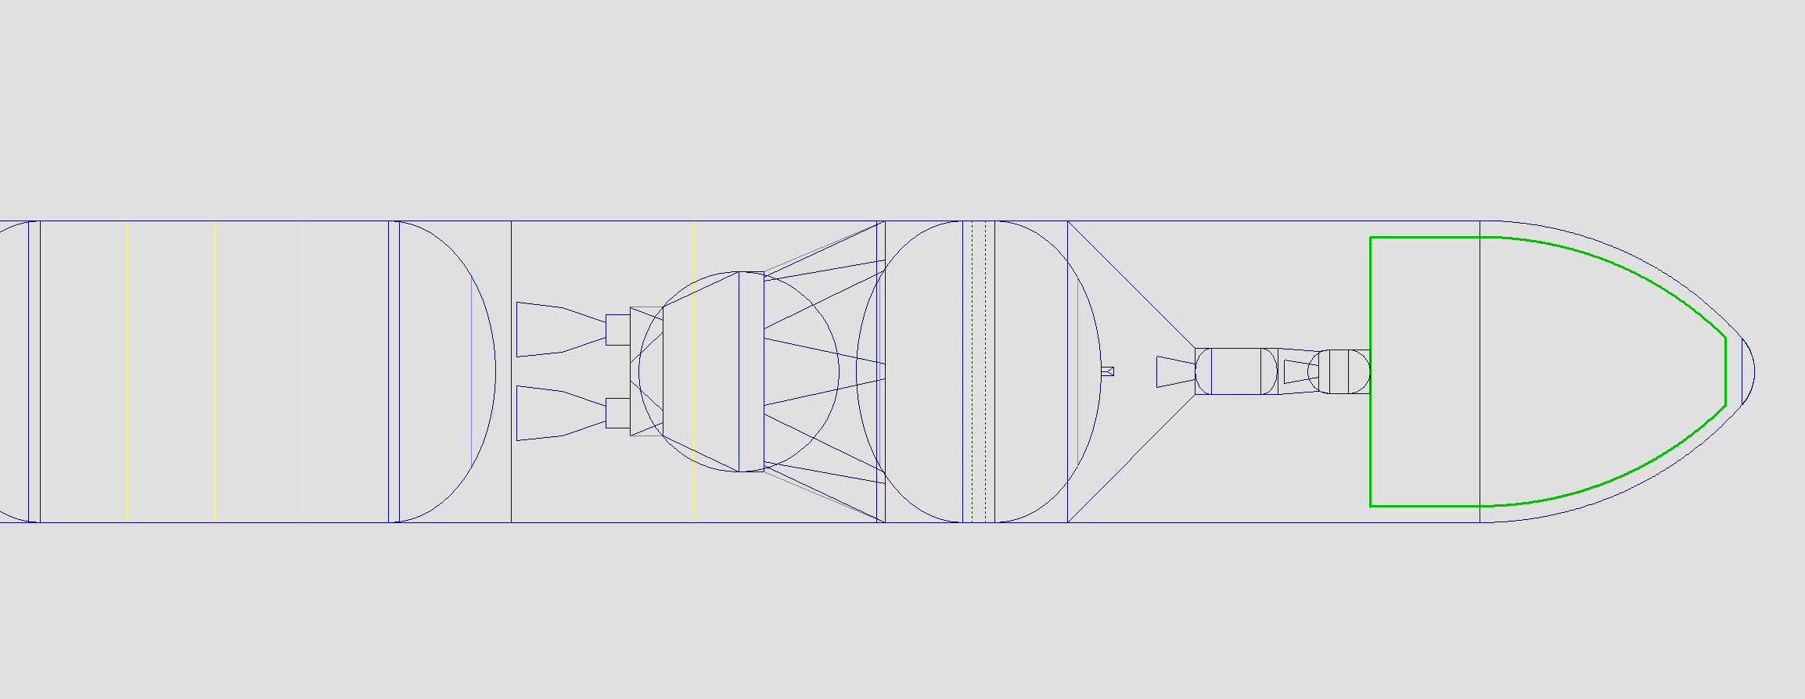
328 m³
9.9 m

Slide 27
Castor 30B – Star 48GXV
EUS to Castor 30B
  2780 lb (basic mass) + 500 lb (MGA) = 3280 lb adapter predicted mass
  Dimensions: 139.3 in tall, 331.0 in base, 95.0 in top
  Supporting Castor 30B, Star 48GXV, and 10 mt payload
  139.3 in to clear EUS fwd dome, vent valve, and nozzle
Castor 30B to Star 48GXV
  318 lb (basic mass) + 57 lb (MGA) = 375 lb adapter predicted mass
  Dimensions: 60.0 in tall, 95.0 in base, 49.0 in top
  Supporting Star 48GXV and 10 mt payload
  60.0 in to clear nozzle

Slide 28
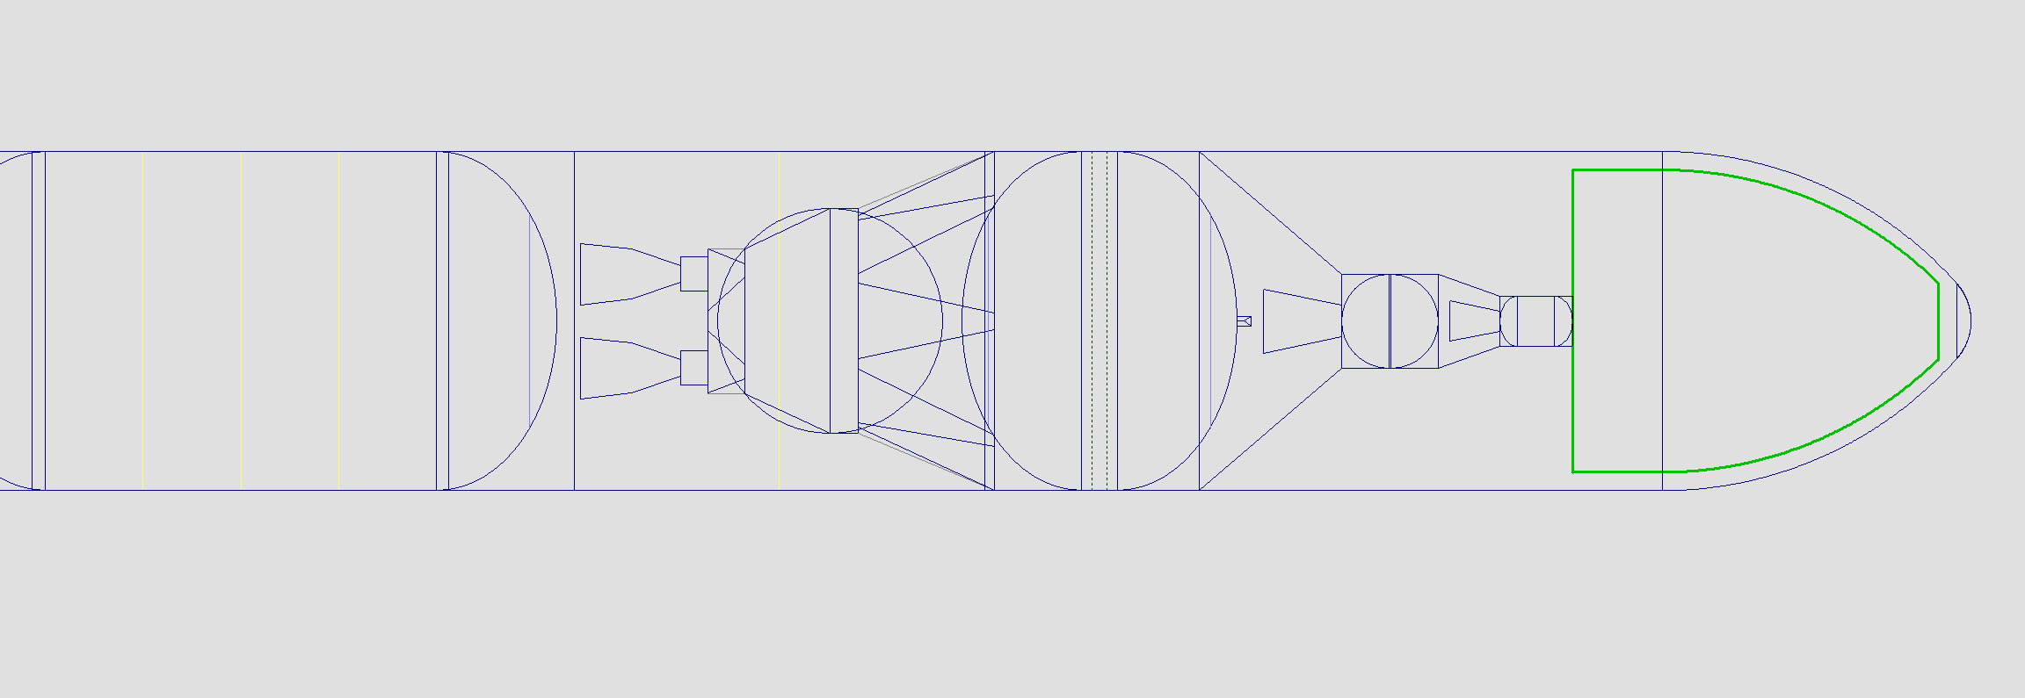
292 m³
9.0 m

Slide 29
Castor 30XL – Star 48GXV
EUS to Castor 30XL
  3493 lb (basic mass) + 629 lb (MGA) = 4122 lb adapter predicted mass
  Dimensions: 154.0 in tall, 331.0 in base, 95.0 in top
  Supporting Castor 30XL, Star 48GXV, and 10 mt payload
  154.0 in to clear EUS fwd dome, vent valve, and nozzle
Castor 30XL to Star 48GXV
  318 lb (basic mass) + 57 lb (MGA) = 375 lb adapter predicted mass
  Dimensions: 60.0 in tall, 95.0 in base, 49.0 in top
  Supporting Star 48GXV and 10 mt payload
  60.0 in to clear nozzle

Slide 30
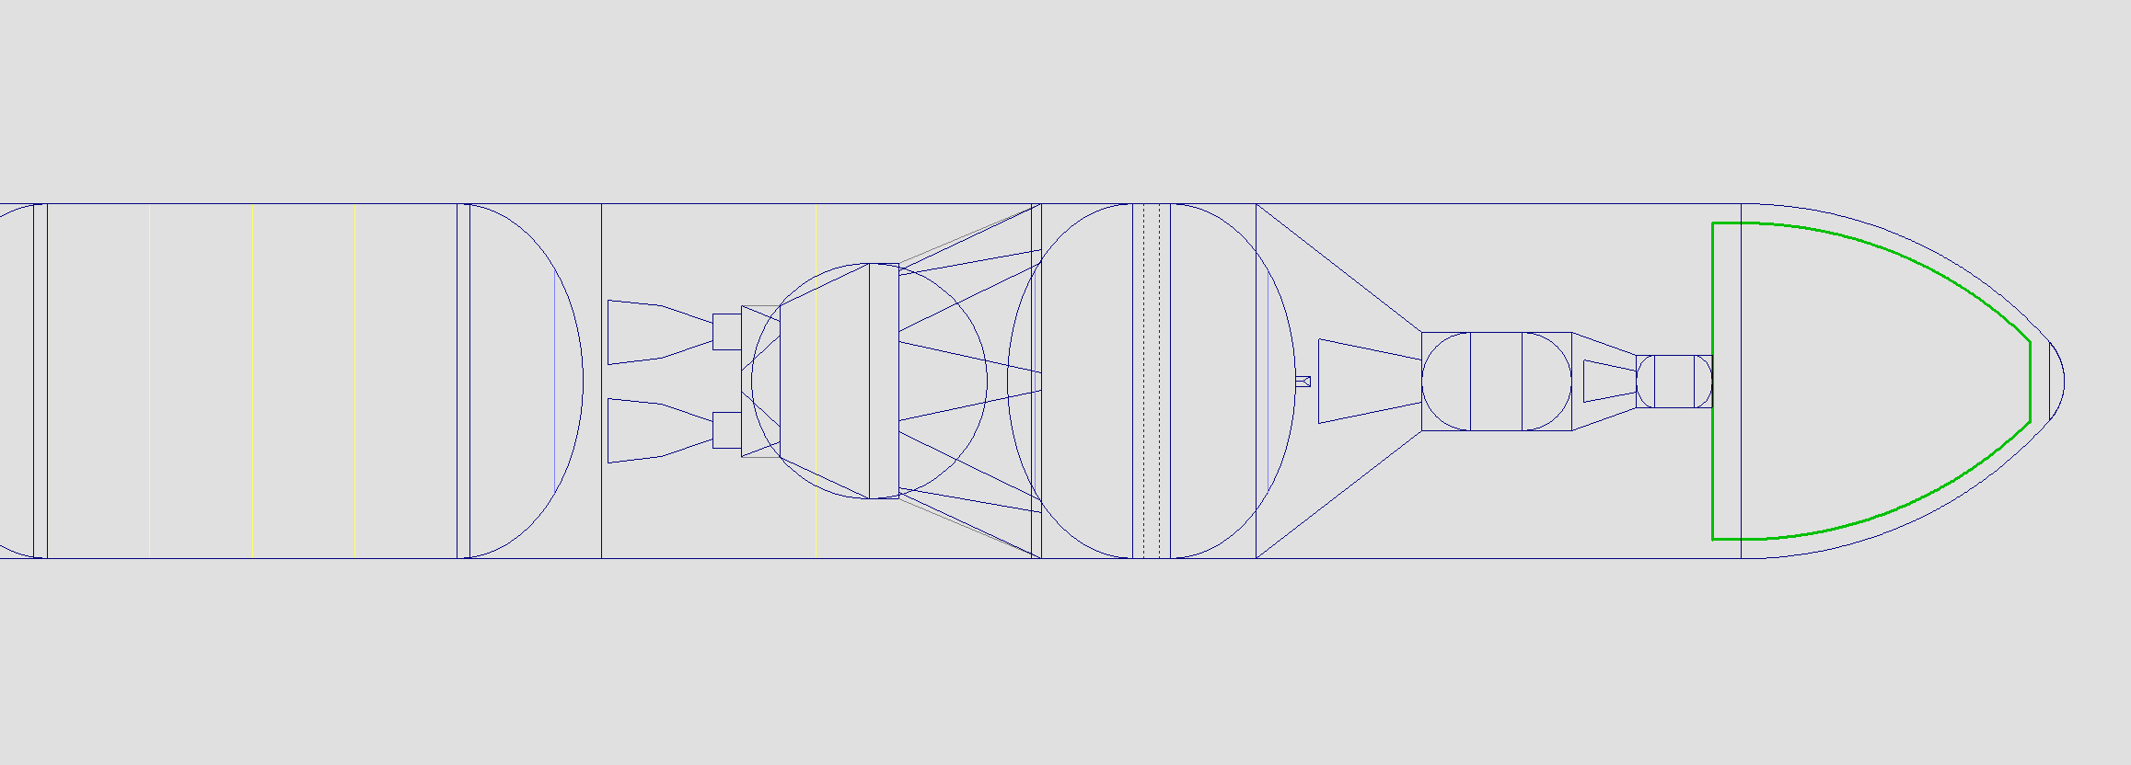
223 m³
7.5 m

Slide 31
Centaur D – Star 48GXV
EUS to Centaur D
  3025 lb (basic mass) + 545 lb (MGA) = 3570 lb adapter predicted mass
  Dimensions: 181.3 in tall, 331.0 in base, 120.0 in top
  Supporting Centaur D, Star 48GXV, and 10 mt payload
  181.3 in to clear EUS fwd dome, vent valve, and nozzle
Centaur D to Star 48GXV
  451 lb (basic mass) + 119 lb (MGA) = 532 lb adapter predicted mass
  Dimensions: 60.0 in tall, 120.0 in base, 49.0 in top
  Supporting Star 48GXV and 10 mt payload
  60.0 in to clear nozzle

Slide 32
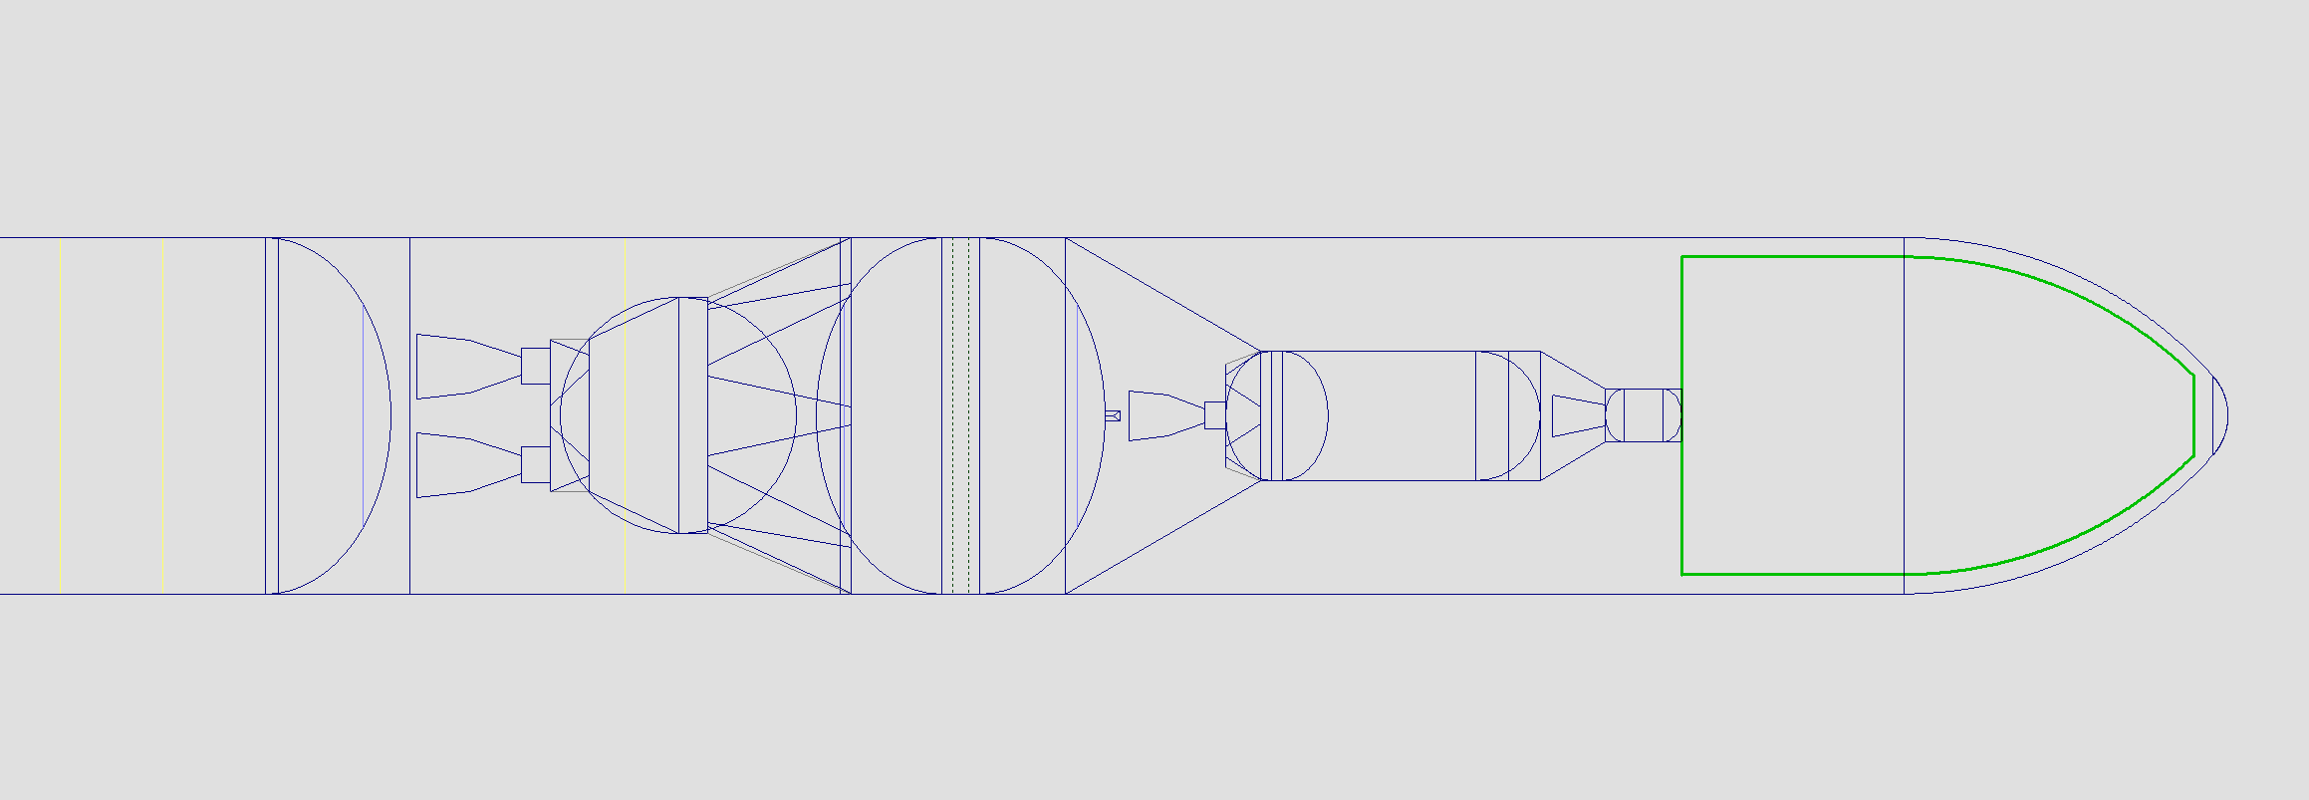
425 m³
12.1 m

Slide 33
Centaur (Atlas V) – Star 48GXV
EUS to Centaur (Atlas V)
  3565 lb (basic mass) + 642 lb (MGA) = 4207 lb adapter predicted mass
  Dimensions: 199.0 in tall, 331.0 in base, 120.0 in top
  Supporting Centaur, Star 48GXV, and 10 mt payload
  199.0 in to clear EUS fwd dome, vent valve, and nozzle
Centaur (Atlas V) to Star 48GXV
  451 lb (basic mass) + 119 lb (MGA) = 532 lb adapter predicted mass
  Dimensions: 60.0 in tall, 120.0 in base, 49.0 in top
  Supporting Star 48GXV and 10 mt payload
  60.0 in to clear nozzle

Slide 34
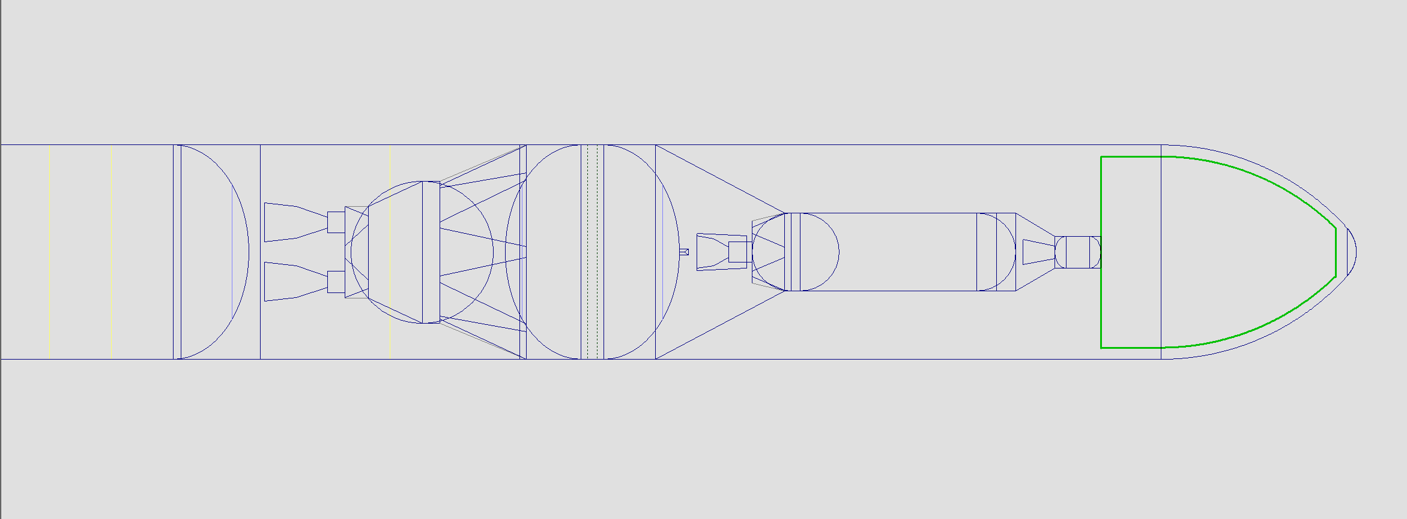
298 m³
9.2 m

Slide 35
Orion 50XL – Star 48GXV
EUS to Orion 50XL
  2499 lb (basic mass) + 450 lb (MGA) = 2949 lb adapter predicted mass
  Dimensions: 139.4 in tall, 331.0 in base, 52.2 in top
  Supporting Orion 50XL, Star 48GXV, and 10 mt payload
  139.4 in for 45 degree adapter
Orion 50XL to Star 48GXV
  125 lb (basic mass) + 23 lb (MGA) = 148 lb adapter predicted mass
  Dimensions: 60.0 in tall, 52.2 in base, 49.0 in top
  Supporting Star 48GXV and 10 mt payload
  60.0 in to clear nozzle

Slide 36
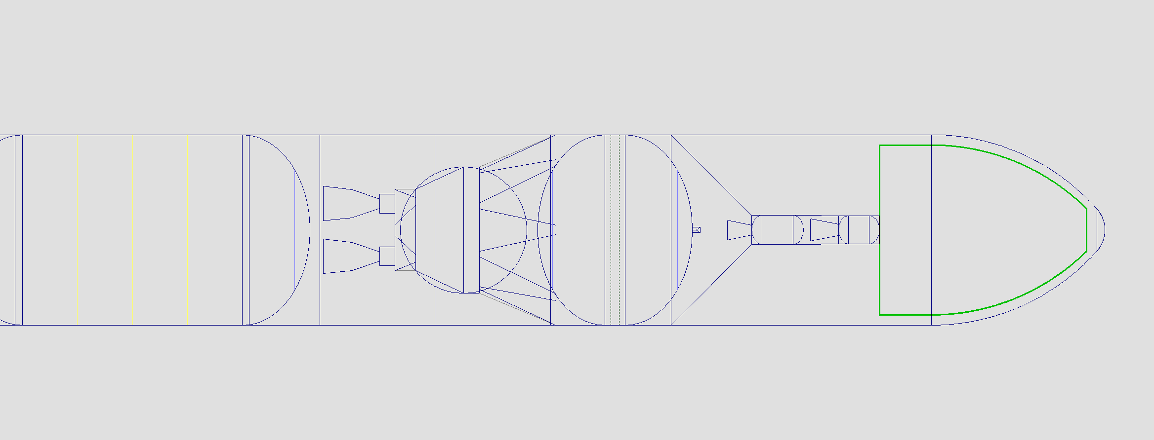
295 m³
9.1 m

Slide 37
SLS GR&A for High C3 Performance
B1B Vehicle:
  Expanded look at B1B, B1B with new build RS25s, and B1B BOLE
  Predicted masses for all elements and nominal propulsion performance.
Fairing:
  Keep integrated upper stages and payload within the 8.4m short PLF dynamic envelope
Upper stages:
  All 3rd and 4th stages are encapsulated under the fairing
  Existing stages in production
  FPR (Liquid Stages)
  Propellant Boiloff
  Solid performance nominal
  3rd Stages Assessed:
    Castor 30B (NGIS provided data)
    Castor 30XL (NGIS provided data
    Centaur (Government Estimate)
  4th Stages Assessed:
    Star 48 BV (NGIS provided data)
    Star48 GXV (NGIS provided data)

Slide 38
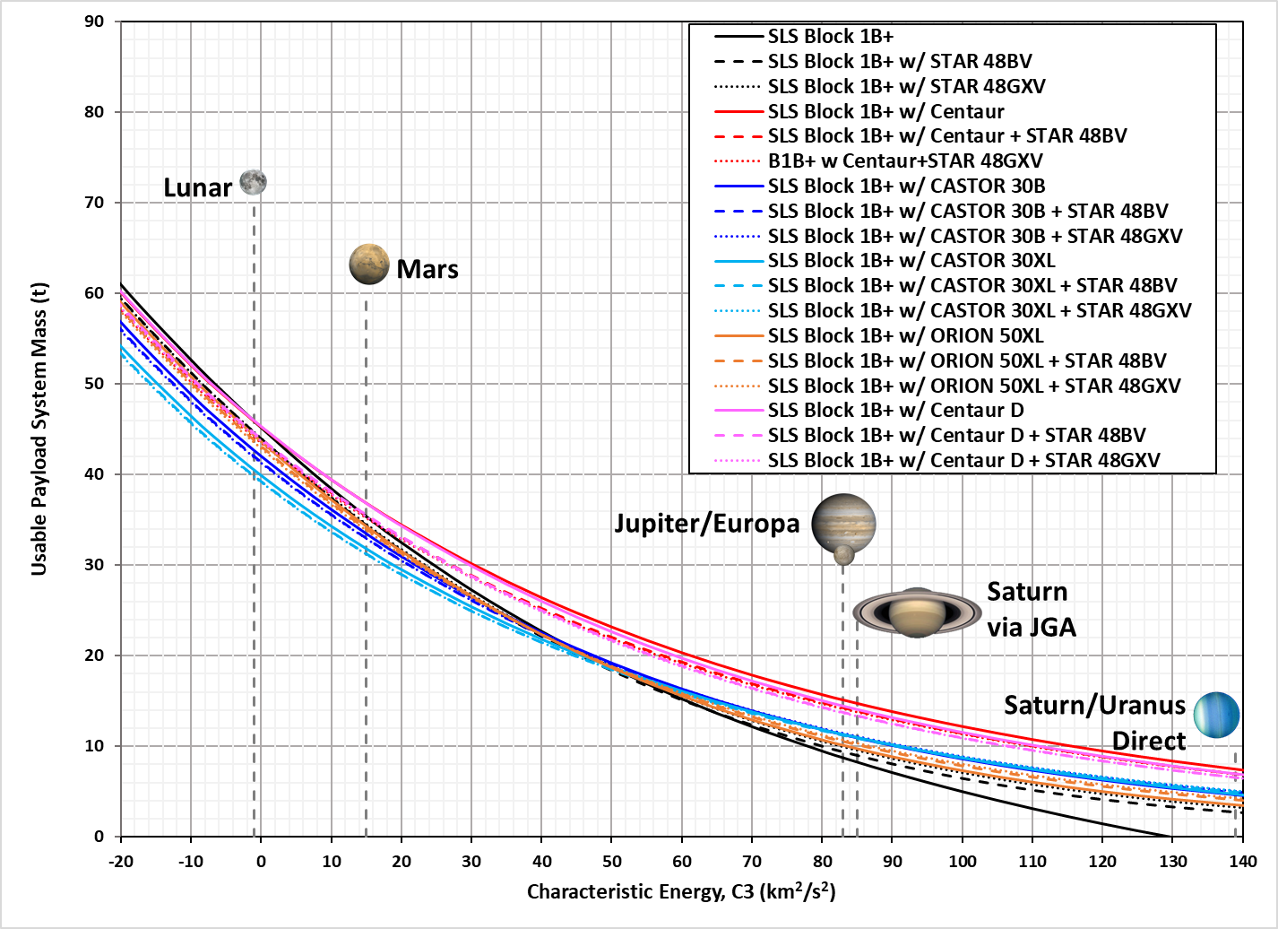
Low Range C3 Performance

Slide 39
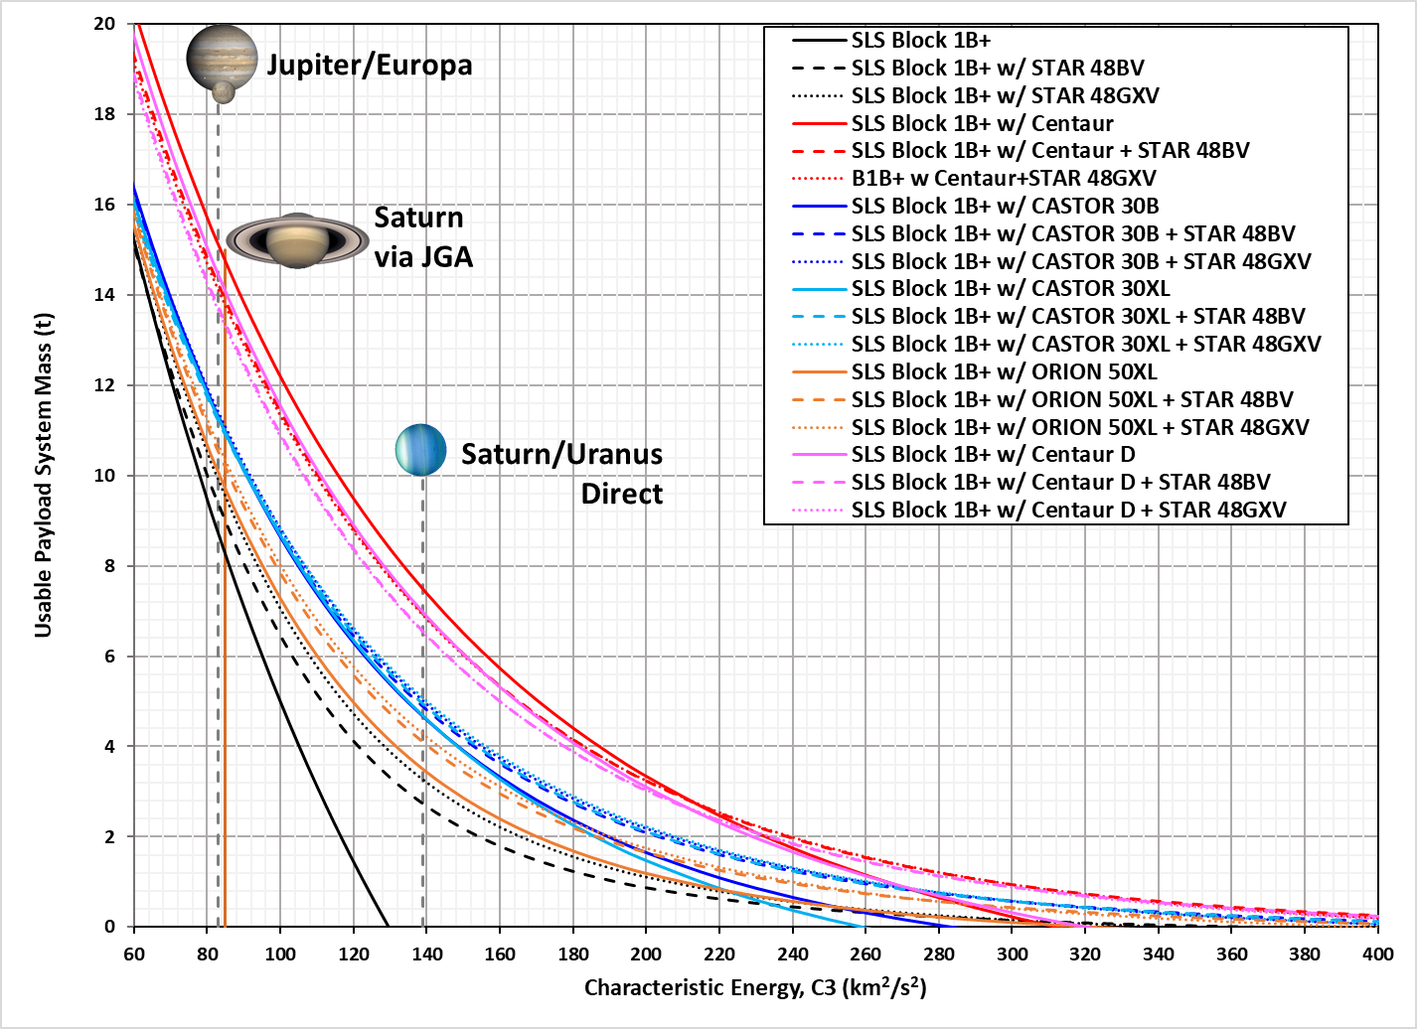
Mid-Range C3 Performance

Slide 40
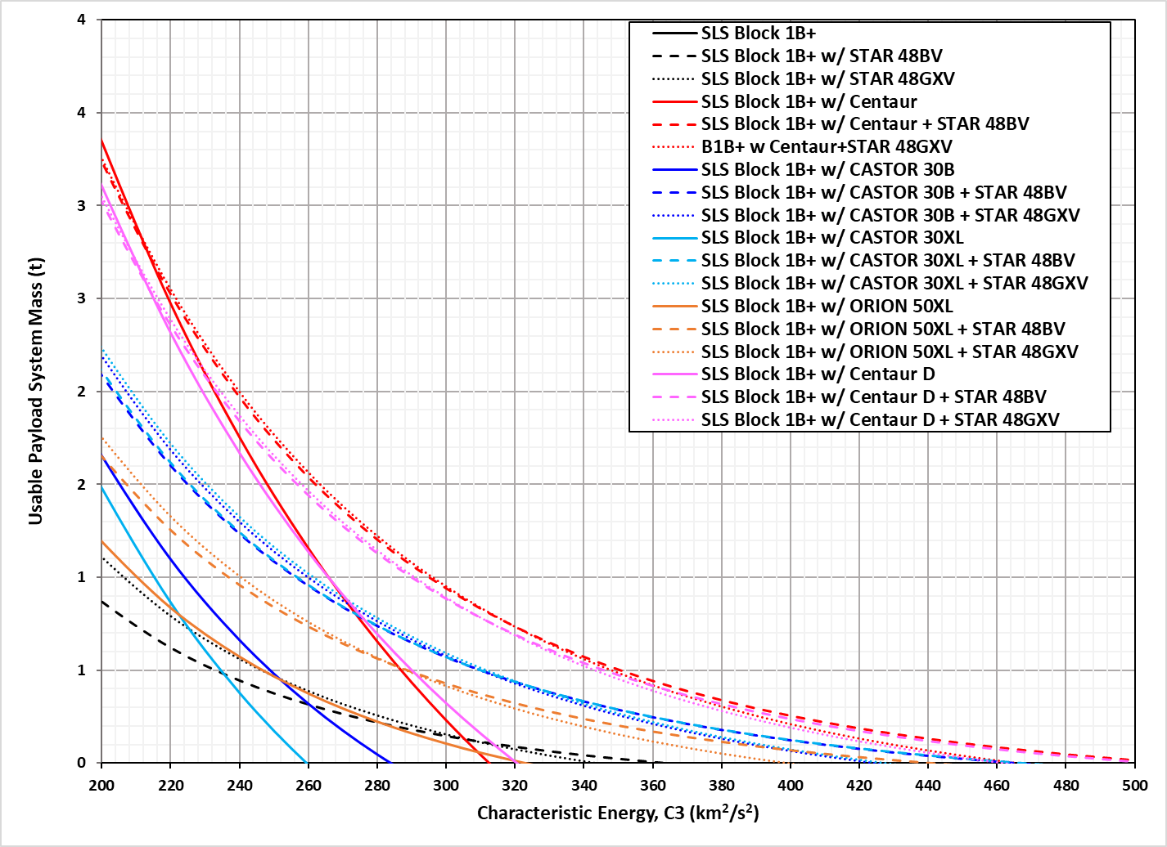
High Range C3 Performance

Slide 41
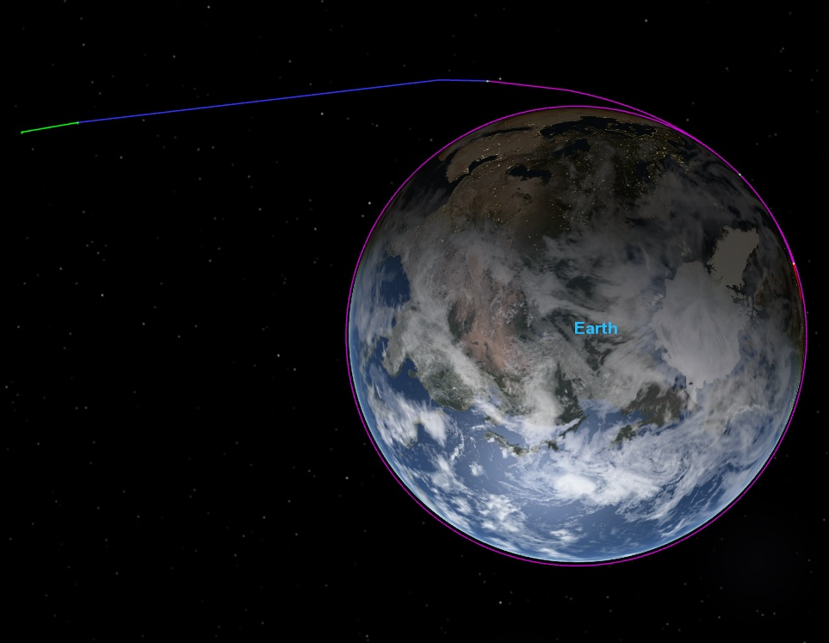
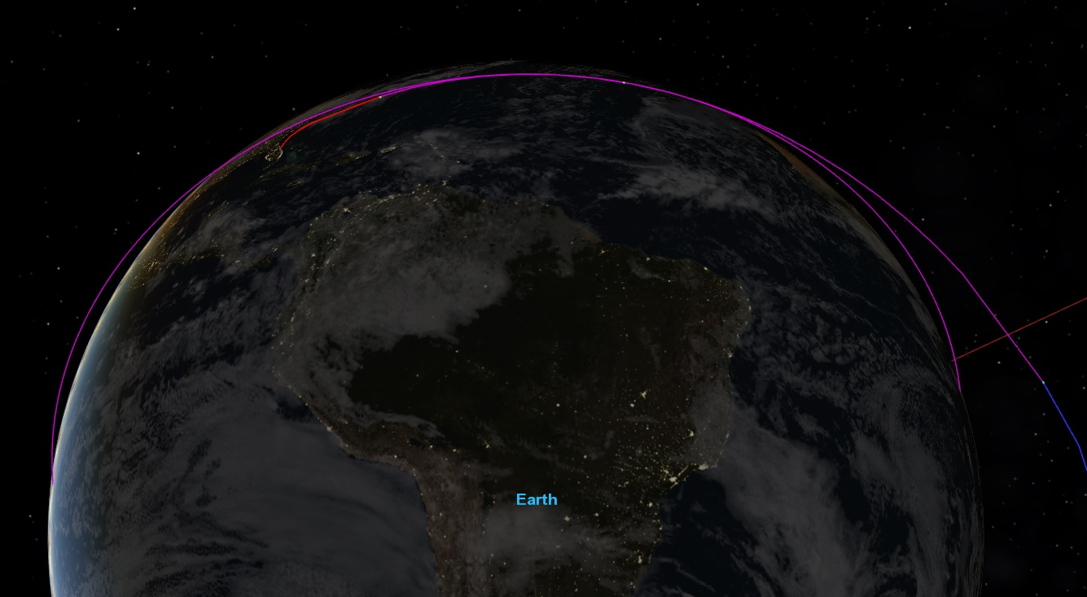
High C3 Representative Trajectory
Centaur Burn
Star48BV Burn
EUS Separation
Centaur Separation
EUS Ascent Burn
EUS Parking Orbit (1rev)
EUS 2nd Burn
Core Stage Separation
Core Stage Flight
EUS Orbit Insertion
EUS Separation

Slide 42
Supplemental Descriptions
Adaptor Sizing Description:
In support of the interstellar probe study, NASA SLS employed the Advance Concept Office (ACO) to generate estimated masses for the stage adaptors interfacing the various upper stages. The adaptors are sized assuming a maximum payload on top of the last stage on the order of 10t. The adaptors consist of two interface rings with composite face sheets and an aluminum honeycomb core. The composite structure sizing is consistent with NASA CR-1457 and NASA SP-8007 references. After the basic mass of each adaptor is estimated, 18% of Mass Growth Allowance is added. Furthermore, the tool used to size the structure is the Launch Vehicle Analysis Tool (LVA). LVA has been in use at NASA MSFC since 1985 and has been used to develop every major NASA launch vehicle since that time. In addition, most major launch vehicle providers have a copy of the LVA tool; including Blue Origin, SpaceX, Boeing, and Northrup Grumman.
Description of manager’s reserve:
The manager’s reserve has been allocated to the EUS and the additional stages encapsulated in the fairing. The margin allocated as a percentage of wet mass of the stage relative to the summed mass of all upper stages. Furthermore, the manager’s reserve varies relative to the vehicle configuration being flown. For the initial configuration of the Block 1B, 1.4t of manager’s reserve is applied to the vehicle. After the block 1B is upgraded to accept the new enhanced performance boosters, the manager’s reserve is 2.1t.

Slide 43
Embedded Data Files
Embedded Word Document
Embedded Excel Spreadsheet

