Slide 1
12th Annual Workshop on Spacecraft Flight Software
SLS FSW: Ensuring Highly Reliable Software During Development
Deanna Whitehead
Marshall Space Flight Center

Slide 2
Outline
The SLS Vehicle
SLS FSW Overview
Agile Lifecycle
Change Control
Static Analysis & Unit Testing
Quality Check
Integration
Summary

Slide 3
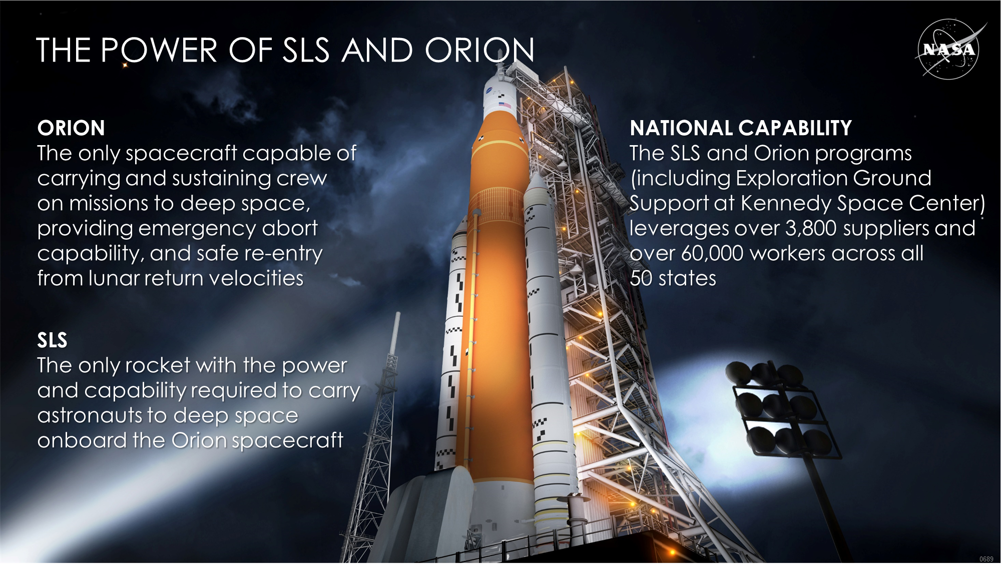
SLS

Slide 4
SLS FSW Overview
NPR 7150.2
Class A
Human Rated
ARINC-653
C++
~50,000 SLOC (logical)

Slide 5
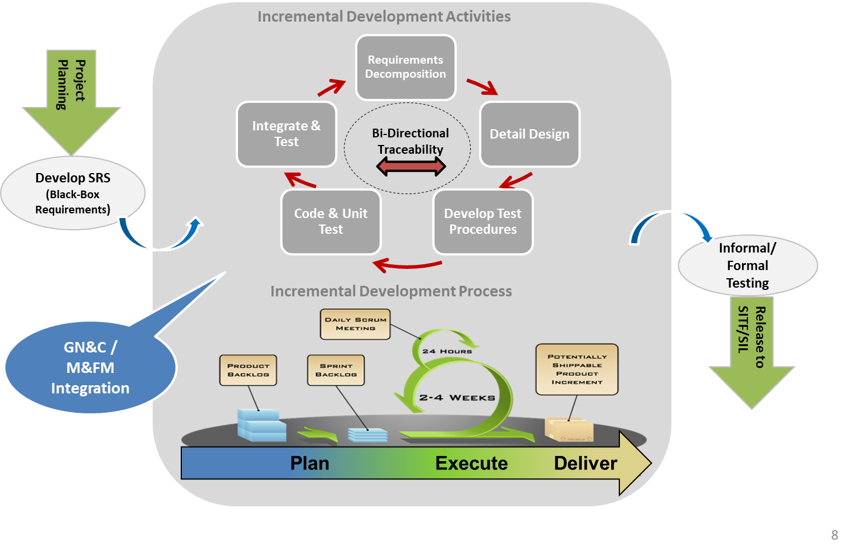
Modified-Scrum Lifecycle

Slide 6
Change Control
Change Management system provides mechanism to link the PR to multiple CRs at various levels
Avionics and Software Control Board Problem Request (PR)
PRs could be entered from other disciplines, system integration testing, etc
SLS FSW Change Request
Approved PRs are flowed down to the FSW team for assessment and decomposition
SLS FSW Design CR(s)
Approved FSW CRs are flowed down to one or many Design CRs for implementation
Once all approvals are given, design level CRs are moved into implementation state, allowing developers begin work
Each commit to the code repository is checked against the CR state and noted in the CM system

Slide 7
Static Analysis & Unit Testing
Static Analysis
Coding Standard (based on JSF) checked with automated tool.
Code Coverage
100% MCDC
Executed each night on the integration code branch
Functional Testing
1 Million + Module-level tests
Executed each night on the integration code branch
Executed each night on the integration code branch
100% Branch & Statement

Slide 8
Quality Check
Peer Review
Unit Testing Results
Integration Prep
Integration Test Type
Proposed Test Procedure
Functional Test Results
Static Analysis Results
Code changes are as intended (and nothing more)
Flyout
Extended Test

Slide 9
Integration
CR Integration
Static Analysis/UT against Integration Branch
Simulation-in-the-loop tests
Extended Integration Testing
Notify Developer of issues/update code in CR Branch

Slide 10
Summary
Best Practices followed for development of highly reliable SW
  Automated unit testing and static analysis
  Tightly controlled change management
  Modified agile processes to best meet the needs of the project
  Full compliance with NASA Procedural Requirement 7150.2B
Moving Forward
  Continue developing unit tests
  Off-nominal scenario testing
  System Integration testing

Slide 11

Notes:
We Go – The Artemis Generation
1:10

Slide 12
Questions
If there are any questions, feel free to contact me!
  deanna.j.whitehead@nasa.gov
  256-544-8787
  https://www.nasa.gov/exploration/systems/sls/faces-of-sls-deanna-whitehead.html

Slide 13

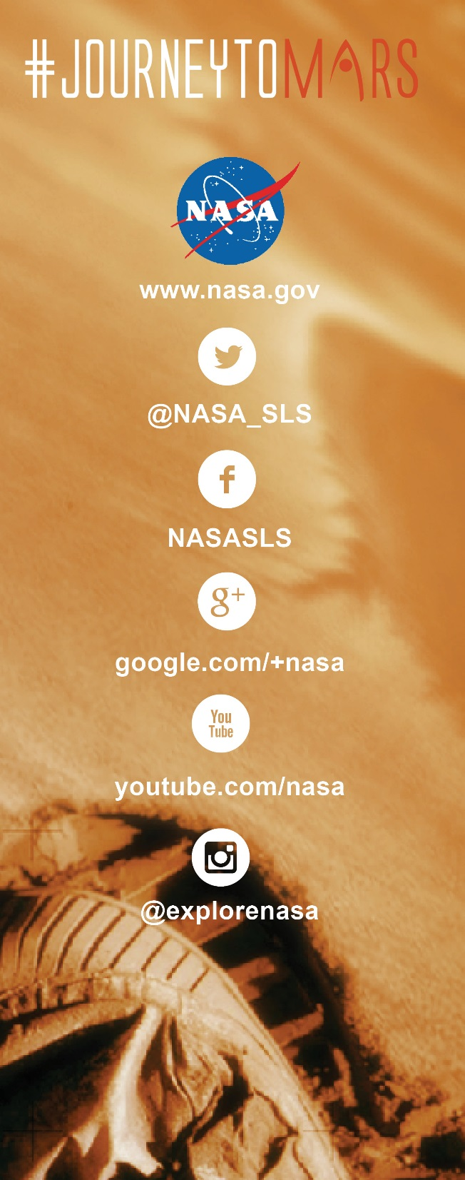

The Adventure Begins NOW.
Join Us on The Journey!

