Slide 1









AM Basic Personnel Certificate Program – Basic Training Course
Module 7, Qualification and Certification

Slide 2

Presenter Bio
Douglas Wells
NASA - Marshall Space Flight Center
Structural Materials Engineer, Materials and Processes Laboratory
25+ years experience in fatigue, damage tolerance, and fracture control of flight structures.
8+ years developing methodologies for the qualification and certification of additively manufactured spaceflight hardware
Developed first NASA standards to establish requirements for incorporating additively manufactured hardware into flight vehicles

Slide 3
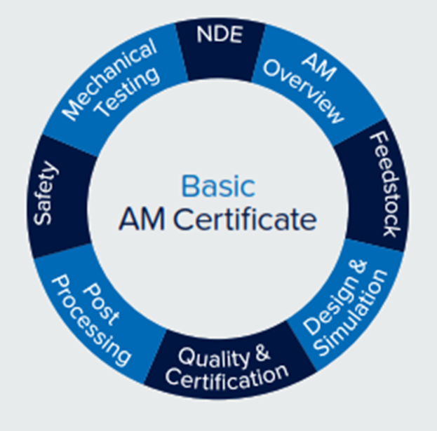
Introduction and Overview
Module 7: Qualification and Certification
This topic draws upon all the other modules
Qualification and Certification requires a framework governing the design and production of AM parts to enable their service in critical or regulated applications.
This framework integrates the entire AM value chain to enforce sufficient and meticulous rigor such that AM parts can achieve the reliability of design and integrity of material needed for service.
This module will illustrate one example of such a framework.
There is no singular “correct” way to achieve qualification and certification; however, the core concepts covered in this module are, in some manifestation, universally common to every Qualification and Certification framework.
We are here

Slide 4
Learning Objectives
Following this lecture, the student will have the basic understanding of the framework necessary to qualify the AM process and to have the basis for certifying an AM part to a set of regulations based on the application. At a minimum the student will achieve a basic understanding of the following:
Concepts underpinning the approach to achieving qualification and certification of AM parts
Essential nature of a quality management system and need for pervasive configuration control
Need for a disciplined AM control plan to enable controlled AM part certification
AM process foundational controls
  Considerations for AM equipment and facility control (maintenance and calibration), and personnel training
  Basic elements of an AM machine and process qualification approach (feedstock, process, post-process)
  Basics elements of AM material property definition and control
Process of AM part development for qualification, beginning with part production plans
Concepts and objectives of AM part classification
Importance of AM part pre-production articles
Concepts and importance of a locked Qualified Part Process

Slide 5
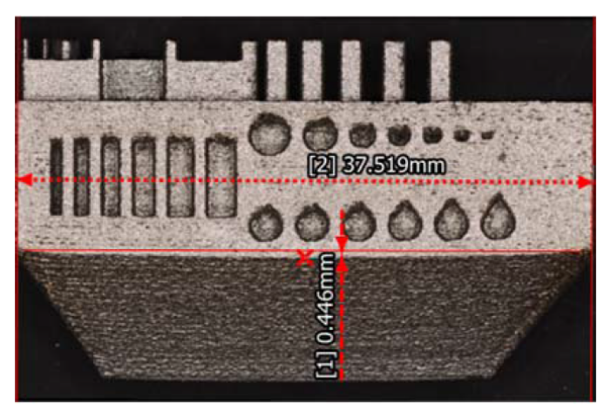
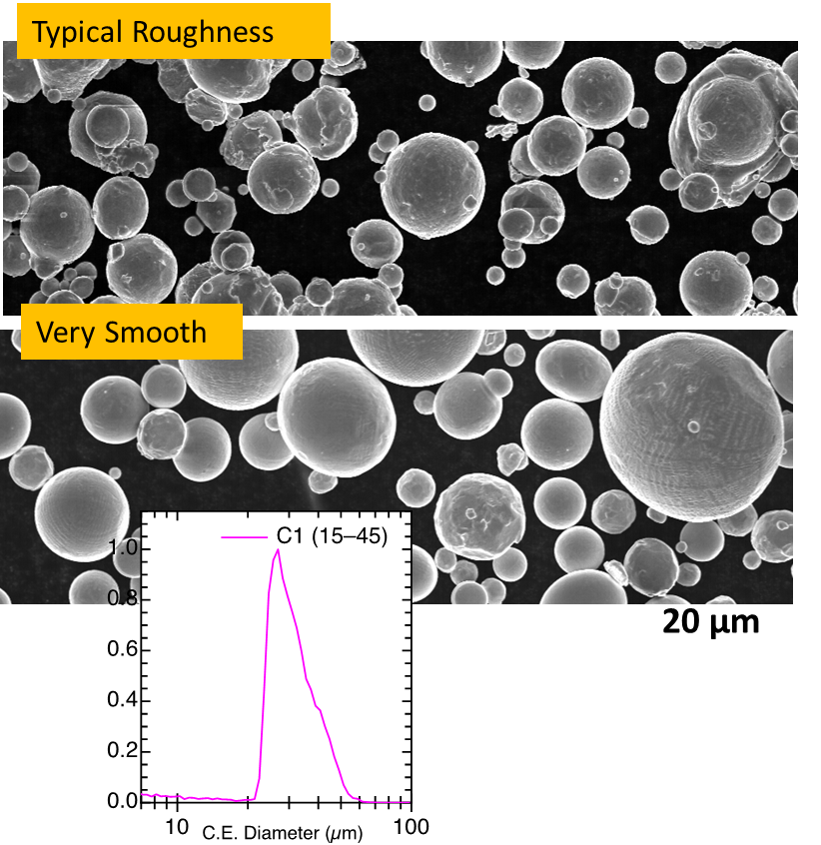
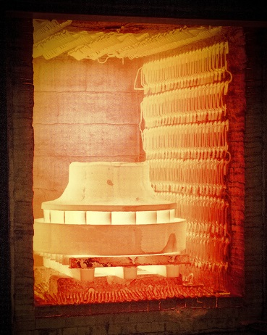

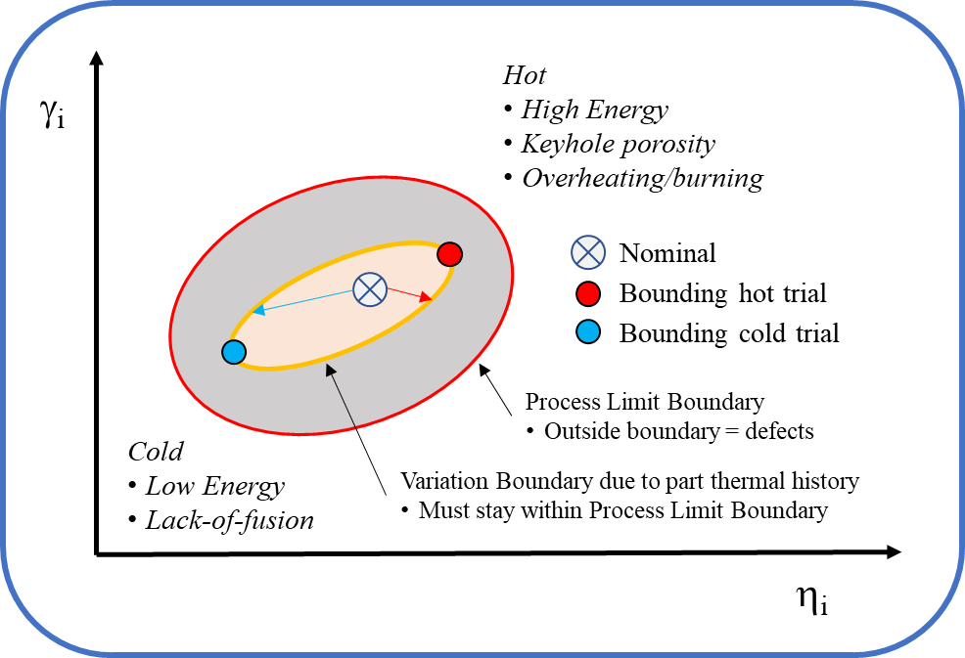
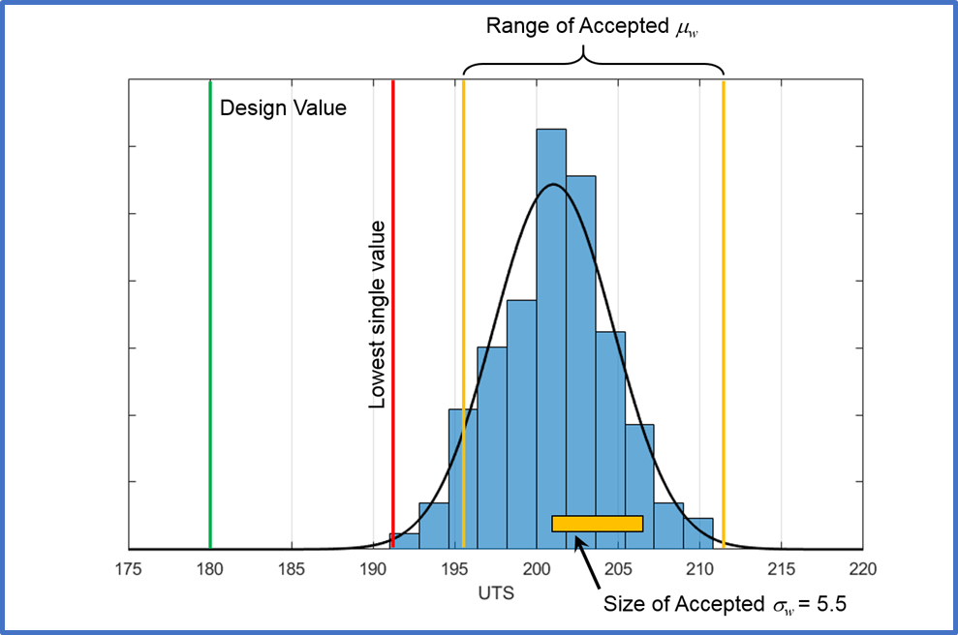
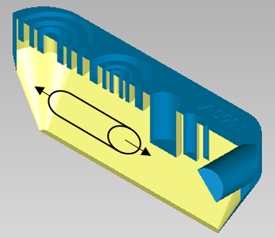

Topics to be Covered
Introduction, Key Ingredients, definitions
Overview of qualification and certification framework
Use of NASA requirements documents as a basis
Overarching and foundational controls
  AM Control Plan
  Quality Management System
  Equipment and facility control, need for personnel training
  Machine/process qualification
  Material property methodology for AM
Part production controls
  Part classification
  Part production plans
  Pre-production articles
  Qualified Part Process
Qualification Testing and Service

Slide 6

What are the Key Ingredients?
Ingredients for AM Qualification and Certification
Understanding and Appreciation of the AM process
Integration across disciplines and throughout the process
Discipline to define and follow a plan
Most of the traditional certification framework remains consistent
Only a few items are unique to additive manufacturing certification
Some traditional roles and responsibilities of the certification framework are transitioned
    Production facilities now largely responsible for material integrity
    Statistical process controls required in environments unaccustomed to it

Slide 7
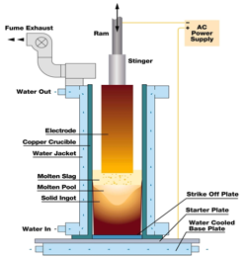
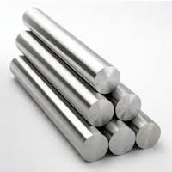
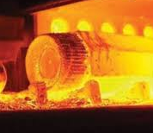



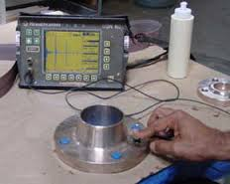
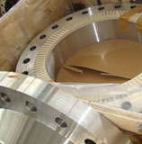
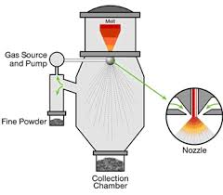
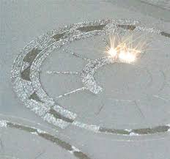
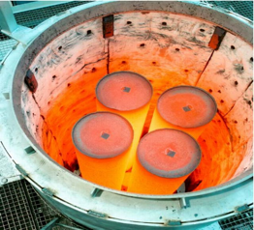
What are the Key Ingredients?
Some roles and responsibilities are transitioned to new entities
Subtractive Forging Process
1. Ingot Making
2. Cutting
3. Heating
4. Forging
5. Heat Treating
6. Machining
7. Inspection
8. Delivery with CoC
Additive SLM Process
1. Powder Making
2. Printing
3. HIPing
4. Heat Treating
5. Machining
6. Inspection
7. Final Part
  Manufacturing facilities now largely responsible for material integrity
  Statistical process controls required in environments unaccustomed to it

Slide 8
What are “Qualification” and “Certification”?
Answer varies by industry and even by culture within industries
The following interpretations are fairly common:
  Qualification applies to
    Parts and components
    Processes
  Certification applies to
    Design (e.g. status following Design Certification Review)
    Subsystems (e.g. engine level certification test series)
    Integrated system (Collective certification)
Certification is granted by the responsible reviewing authority when the verification process is complete, assuring both design and as-built hardware will meet the established requirements to safely and reliably complete the intended mission.

Slide 9
Overview of Certification Framework
Have a plan
Integrate a Quality Management System (QMS)
Build a foundation
  Equipment and facility controls
  Training
  Process and machine qualification
  Material properties / SPC
Part planning
  Design, classification, pre-production articles
  Qualify and lock the part production process
Produce to the plan – Stick to the plan

Slide 10
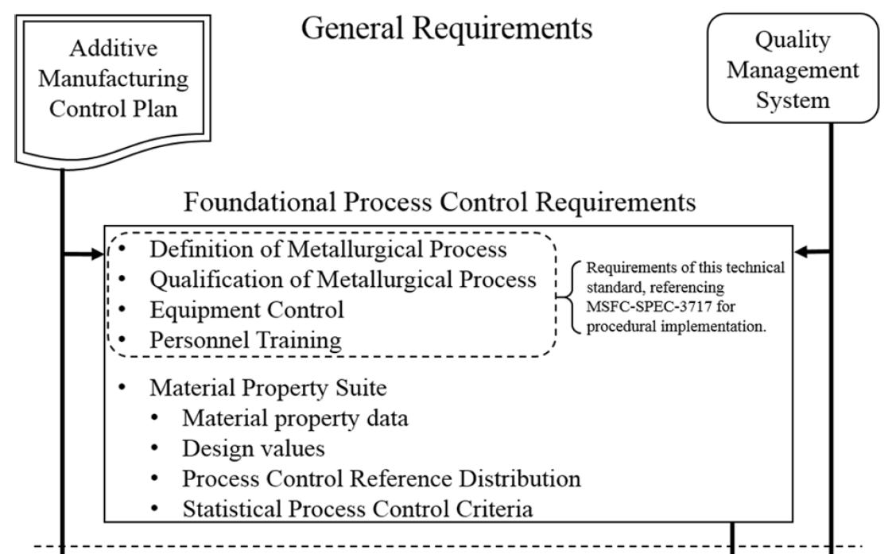
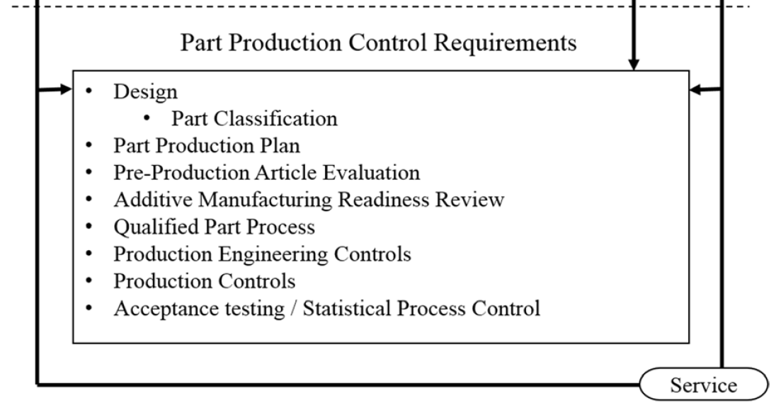
MSFC-STD-3716 Outline
NASA AM requirements perspective
General requirements in the Additive Manufacturing Control Plan (AMCP) govern the engineering and production practice and are paralleled by a Quality Management System (QMS).
Process control requirements provide the basis for reliable part design and production and include:
  qualified metallurgical processes (QMPs)
  equipment controls (ECP)
  personnel training
  material property development
Part Production Control requirements are typical of aerospace operations and must be met before placing a part into service.

Slide 11
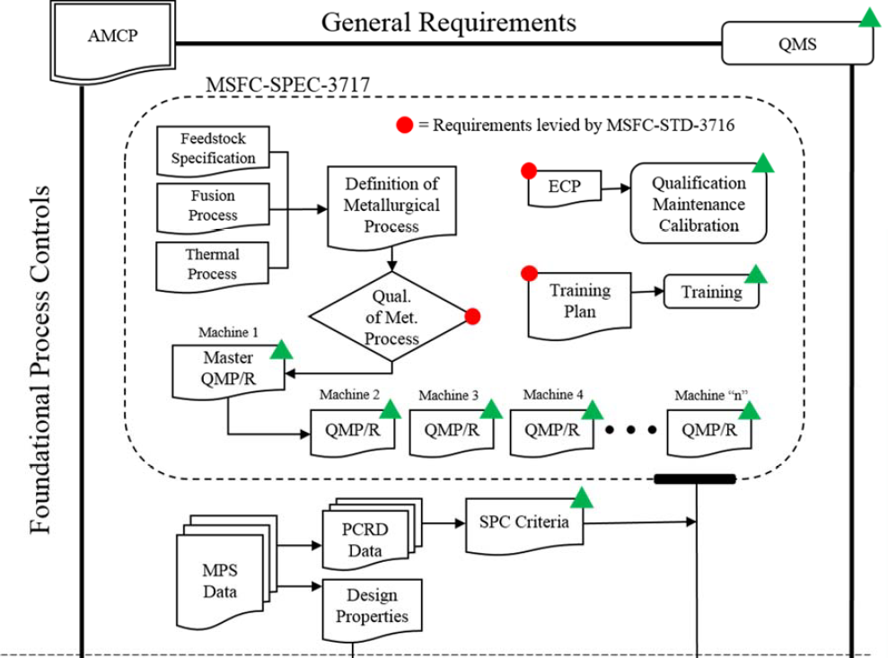
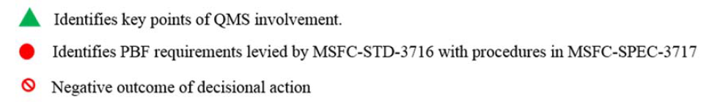
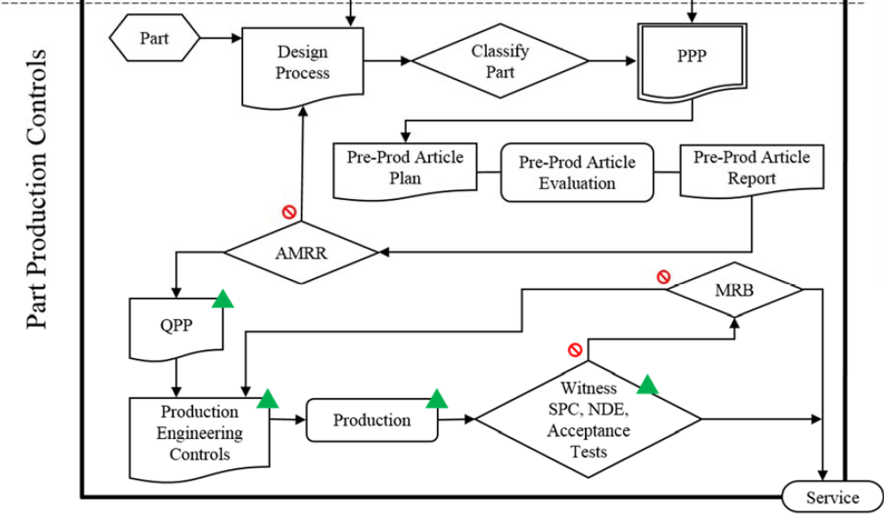
MSFC-STD-3716 & MSFC-SPEC-3717
First Part of Lecture:
Foundational Process Controls provide the basis for reliable part design and production
Second Part of Lecture:
Part Production Controls are typical of aerospace operations and include design, part classification, pre-production and production controls

Slide 12
Overarching and Foundational Controls
Foundational Process Controls
12

Slide 13
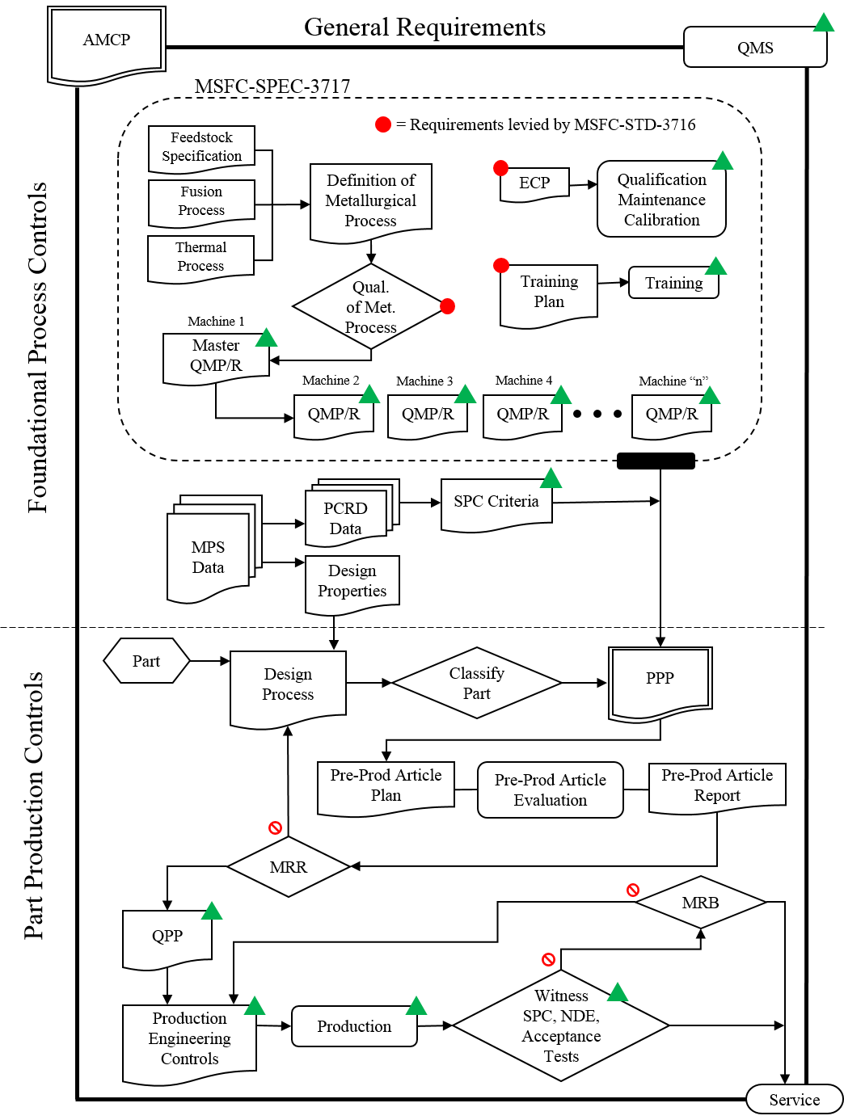
Overarching and Foundational Controls
Additive Manufacturing Control Plan
  Important for large projects
  Critical to define implementation policies for program or project
  Describes implementation of all requirements
    Includes tailoring of requirements
  Becomes governing document
13

Slide 14
Have a Plan!
Start with a “Big Picture” plan for handling AM
AM Control Plan
  Write it down – Communicate it.
  Authored by the Cognizant Engineering Organization, CEO (The Buck Stops Here)
Plan should establish practice and policy for all aspects of AM design, production, and part acceptance – tailors policy relative to risk acceptance of the company, organization, or project
Ensures everyone is on the same page
  Provides for consistency – particularly important in off-nominal situations
  Heightened importance when design and production entities are not the same
  Delineates roles and responsibilities

Slide 15
Overarching and Foundational Controls
Quality Management System
  There is no “qual” or “cert” without this in place!
  Critical to maintain consistent implementation policy
  Ensures you stick to your plan
  Ensures consistent training, processes, and procedures
  Maintains attention to detail
  Provides framework to handle off-nominal situations

Slide 16
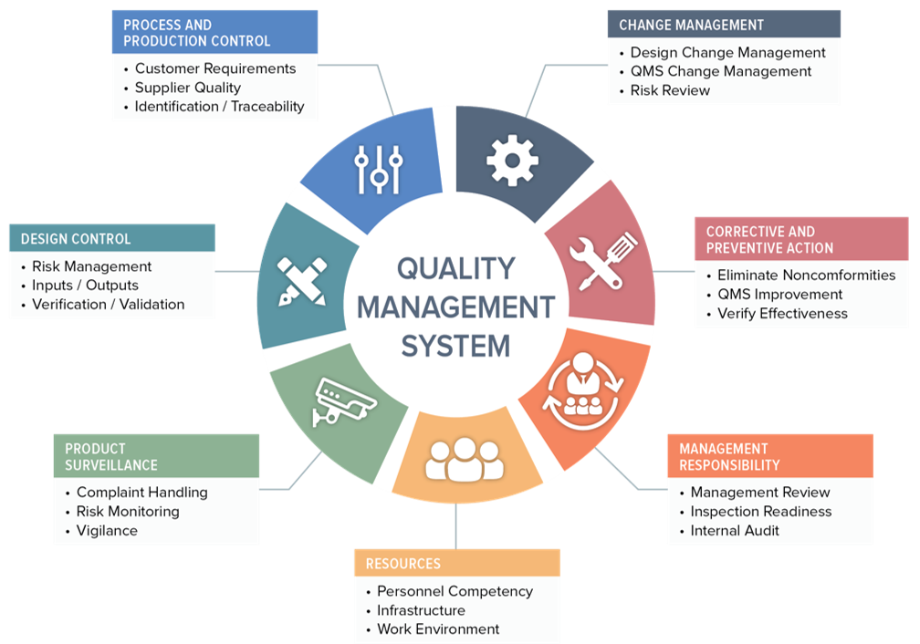
Integrate a Quality Management System
The Quality Management System (QMS) must be pervasive
Long, perilous chain of controls needed
  Design documentation
  Feedstock
  Facility control
  Machine calibration
  Digital Thread
  Inspection
  Statistical process controls…
AM is a new process – No common-knowledge standards of practice (We are setting these standards!)
Prepare for the unexpected – It will happen.
Source: https://www.orielstat.com/blog/medical-device-qms-overview/

Slide 17
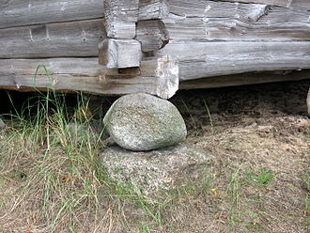
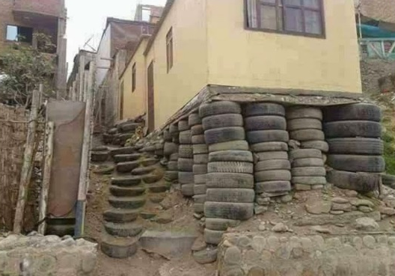
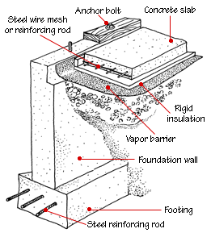

Build a Foundation
AM Control Plan should define how the foundation for certification is structured and how it operates
  Equipment and Facility Controls
  Personnel Training
  Process/Machine Qualification
  Material Properties
  Statistical Process Controls

Slide 18
Overarching and Foundational Controls
Equipment and Facility Control Plan
Critical piece of documentation
Be flexible in implementation
  Can be collection of AM producers controlling documents
  But, must be complete!
Governs AM equipment and facility
  Qualification
  Maintenance
  Calibration
Not discussing these CRITICAL aspects of the framework much in this lecture. Understand that these are unconditional prerequisites for all that follows.

Slide 19
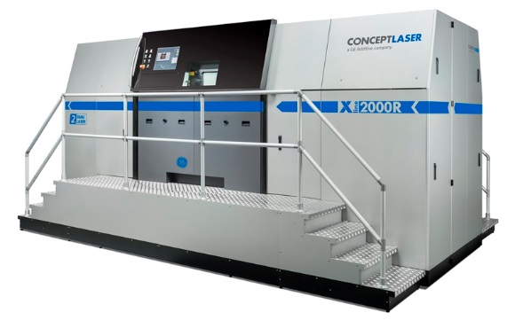

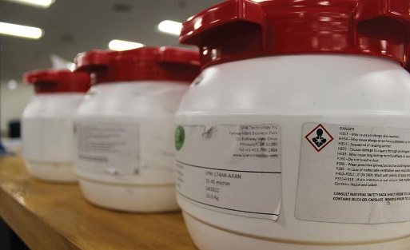
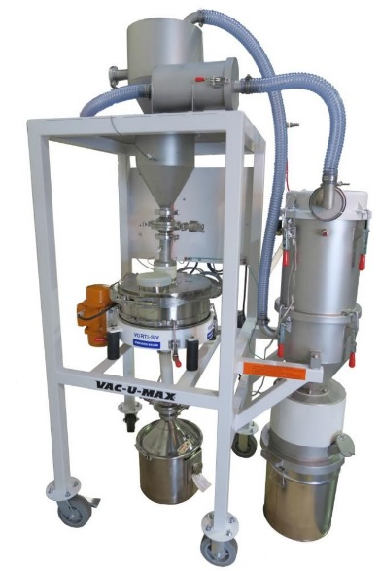
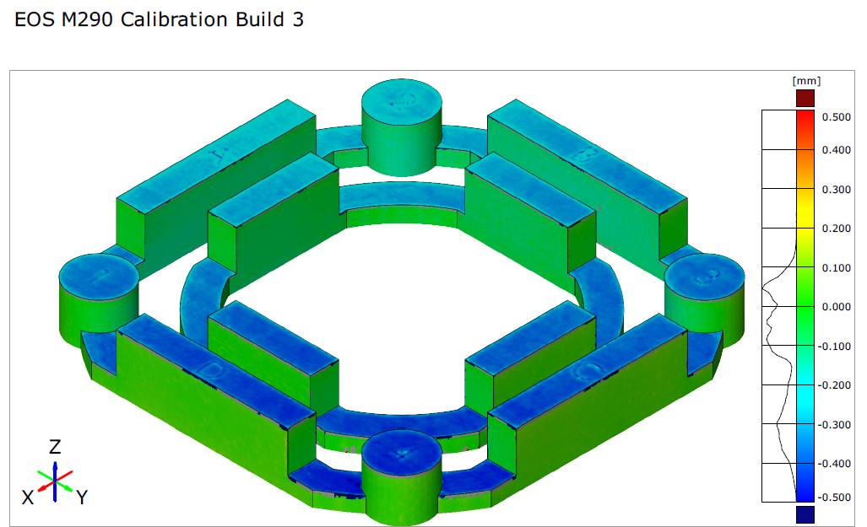
Equipment and Facility Control
Well documented and governed by QMS
Controls for all AM equipment and facilities
Significant list of controls needed:
  Tracking machine configuration status
  Tracking machine qualification status
  Maintenance: intervals, or unplanned
  Calibration intervals
  Feedstock storage and handling
  Contamination controls
  Computer security / cybersecurity
  Standard operating procedures/checklists
  Handling of Nonconformance in equipment

Slide 20
Overarching and Foundational Controls
Personnel Training
Training standardization still developing
Be flexible in implementation
Needs to cover all personnel involved in AM
  Consistent framework for training and certification of abilities
  Clear delineations of abilities and responsibilities associated with granted certifications
  Evaluations demonstrating adequacy
  QMS awareness

Slide 21
Training
Training program to be defined, maintained, and implemented to provide:
  A consistent framework of requirements for training and certification
  Content regarding the importance, purpose, and use of the QMS for all certifications
  Operators with all necessary skills, knowledge, and experience to execute the responsibilities of their certification safely and reliably
  Operator evaluations that demonstrate adequacy in skills, knowledge, and experience to grant certifications to personnel, ensuring only properly trained and experienced personnel have appropriate certifications
  Clear delineations of abilities and responsibilities associated with granted certifications (Technician, maintenance, Engineer)
  Records of all training and certifications

Slide 22
Qualified AM Material Process
Qualified Metallurgical Process, or
Qualified Material Process (QMP)
Begins as a Candidate Material Process
Defines aspects of the basic, part agnostic, fixed AM process:
  Feedstock
  Fusion Process
  Thermal Process (or other material post-process)
Enabling Concept
  Machine qualification and re-qualification, monitored by…
  Process control metrics, SPC, all feeding into…
  Design values

Slide 23
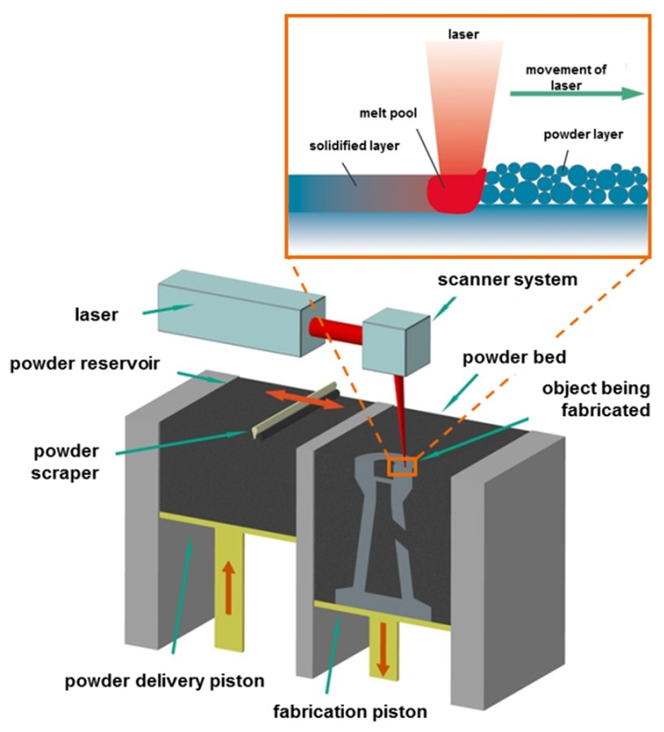
Machine & Process Qualification
Currently in AM, machine and process are indelibly linked
Step 1. Define a candidate process
  Material feedstock controls
  AM process conditions and machine configuration
  Post-processing that influences material performance
Step 2. Qualify the candidate process to well-defined metrics, for example:
  As-built material quality (fill and interfaces)
  Consistency throughout build envelope
  Appropriate detail and surface quality
  Tolerance to inherent process perturbations (thermal or otherwise)
  Mechanical and/or physical properties

Slide 24
Candidate AM Material Process
Definition of an AM Material Process
Feedstock Controls
  Controlling the input material
Fusion Process
  Controlling machine configuration and process parameters
Thermal Process
  Controlling the process that evolves your material state to the end-use condition

Slide 25
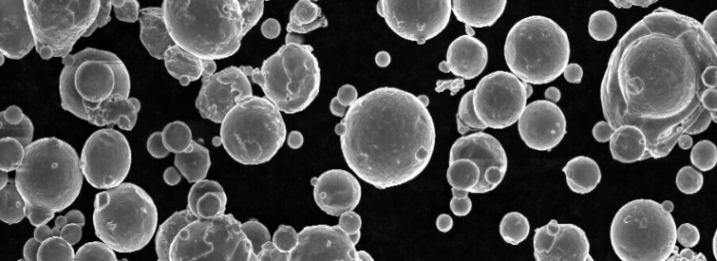
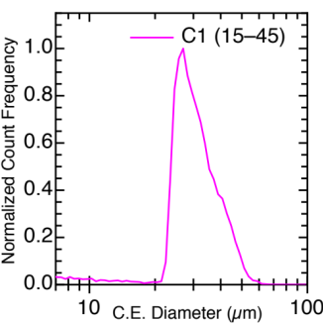
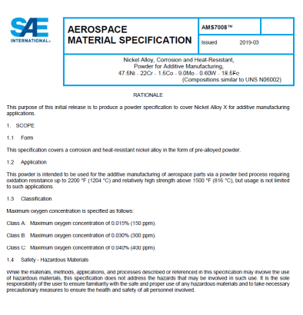
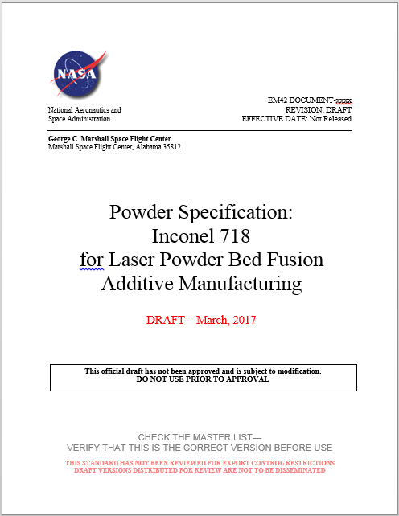
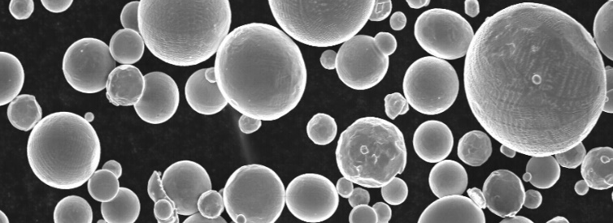
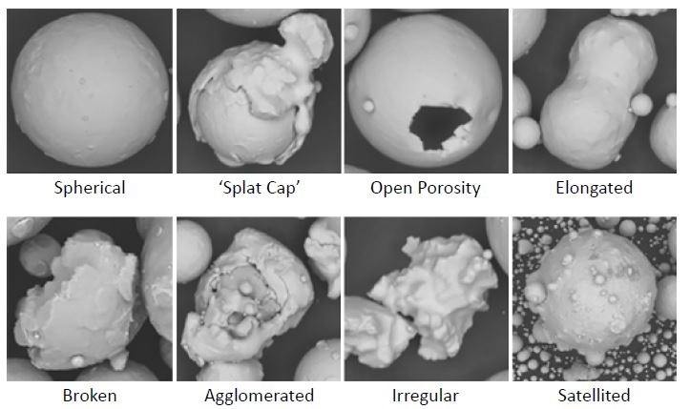
Feedstock Controls
Feedstock Controls for AM
Example of AM powder controls:
  Method of manufacture
  Chemistry
  Particle Size Distribution (PSD)
  Particle morphology
  Powder rheology (flow)
  Blending and doping controls
  Cleanliness and contamination
  Packaging, labeling, environmental controls
  Reuse controls
Typical Roughness
Very Smooth
20 µm
Powder Morphology. Courtesy Metal AM, Winter 2017.

Slide 26
Candidate AM Material Process
Fusion Process Controls
Equipment:
  Make, Model, Serial Number
  Software/Firmware versions
  Settings (dosing, recoater speed)
Atmosphere Controls
  Oxygen limits
  Ventilation flow rate
  Gas quality (purity, dew point)
Fusion Parameters
  Layer thickness
  Power, speed, hatch, contours…
Any machine parameter that may affect material quality must be controlled!
Source: Fraunhofer IWU

Slide 27
Introduction and Overview
Fusion Controls
Tolerance to variation
Part build scenarios create variation in process conditions
  Thermal history effects
  Scan patterns
“Process Box” evaluation for qualification
QMP needs to be “centered” in the process box to allow robust part build capability
Process Restarts
Hot
High Energy
Keyhole porosity
Overheating/burning
γ_{i}
Nominal
Bounding hot trial
Bounding cold trial
Process Limit Boundary
Outside boundary = defects
Cold
Low Energy
Lack-of-fusion
Variation Boundary due to part thermal history
Must stay within Process Limit Boundary
η_{i}
Process Box: Resulting variations in nominal commanded process due to part geometry, scan pattern and thermal history
Axis: Representative of any parameters, i.e. power, speed

Slide 28
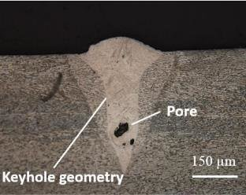

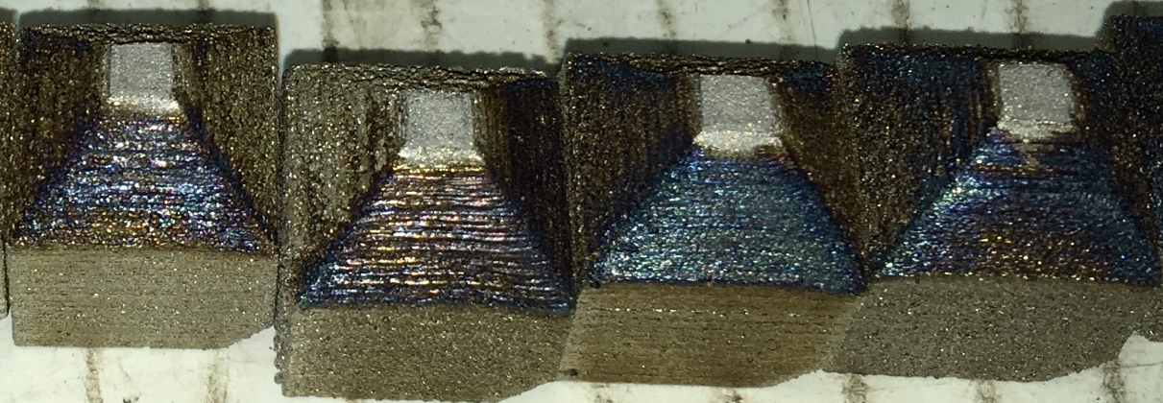
Parameter Influence on Defects
Lack of Fusion Defect
γ_{i}
Hot
High Energy
Keyhole porosity
Overheating/burning
Nominal
Lack of Fusion Defect after HIP
Cold
Low Energy
Lack-of-fusion
Everton, Sarah & Dickens, Philip & Tuck, Christopher & Dutton, B. (2019). IDENTIFICATION OF SUB-SURFACE DEFECTS IN PARTS PRODUCED BY ADDITIVE MANUFACTURING, USING LASER GENERATED ULTRASOUND.
η_{i}
Overheating discoloration

Slide 29
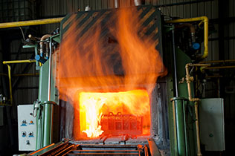
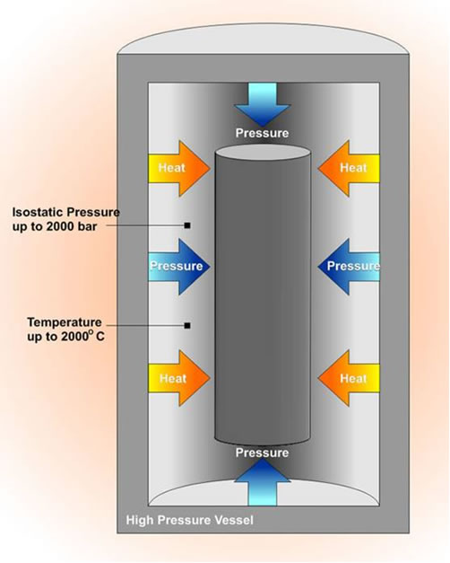
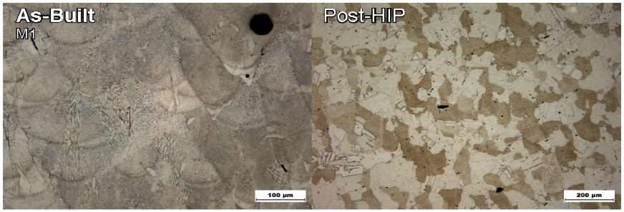
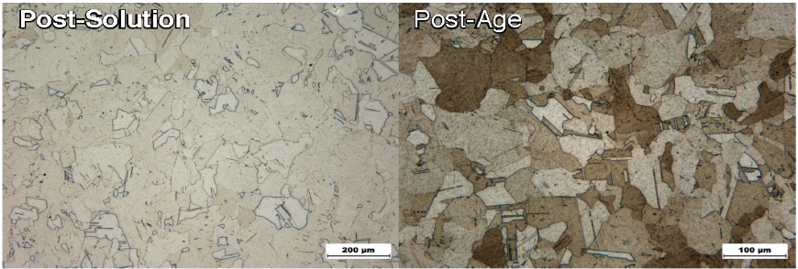
Candidate AM Material Process
Post-build Material Processing
Example: Thermal Process (metals)
Includes definition of all thermal process steps
Evolution of microstructure with acceptance criteria for As Built and Final
Stress Relief, Hot Isostatic Pressing, Solution Treating, Aging, etc.
IN718 Microstructural Evolution

Slide 30
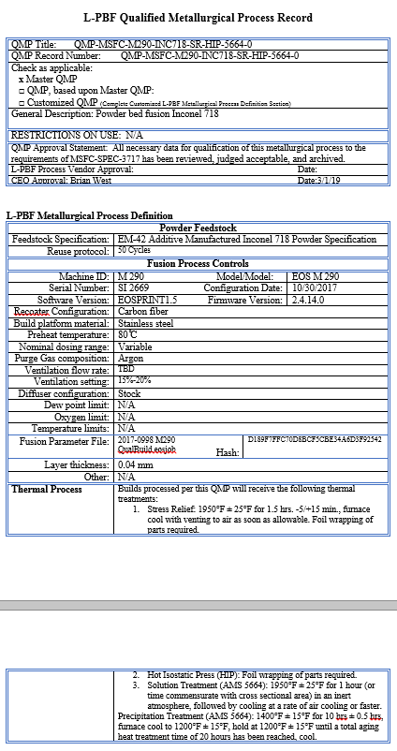
Candidate AM Material Process
QMS Records of Candidate AM Material Process Definition
  All aspects of the candidate process are
    Identified,
    Configuration controlled, and
    Documented

Slide 31
Qualifying the AM Material Process
Qualification of the Candidate AM Material Process
Establishes a QMP: Qualified Material Process

Slide 32
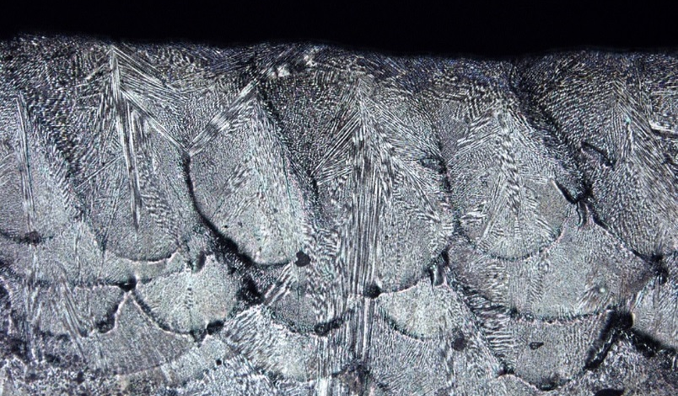
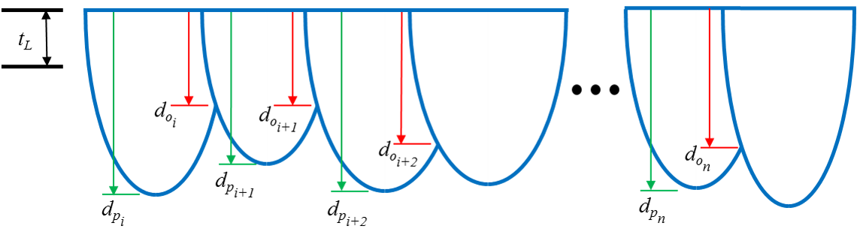
Qualifying the AM Material Process
Step 1: AM Material Qualification
  As-built internal quality and controlled defect state
  Consistency throughout build area
  Tolerance to variation
  Interface quality (restart, contour passes, striping,
  islands, multi-laser zones)
  Top layer melt pools
  Microstructural evolution
    Final state free of strong texture
    Acceptance criterial for As-Built and Final microstructure and defect state
  Material quality metrics will vary with material system and AM process
Melt Pool Evaluation

Slide 33
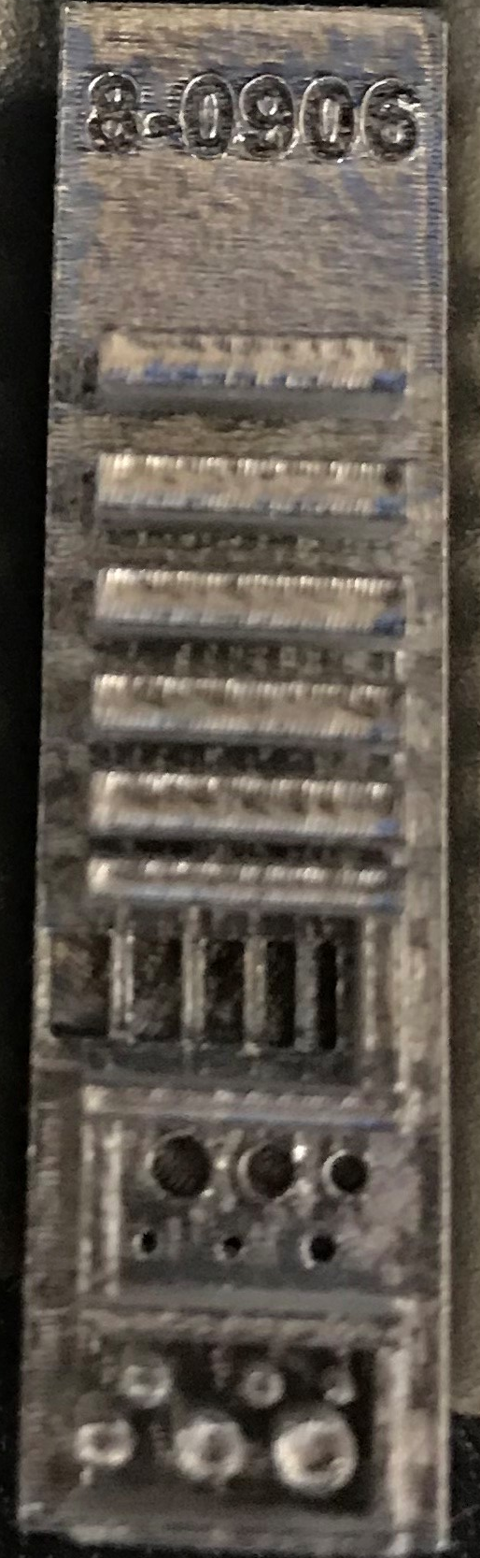
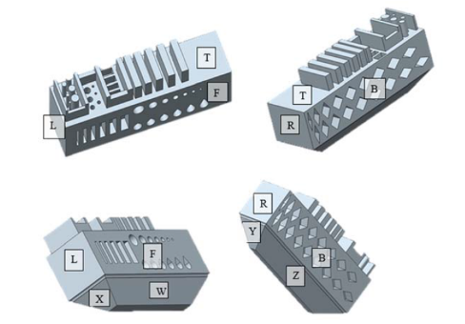
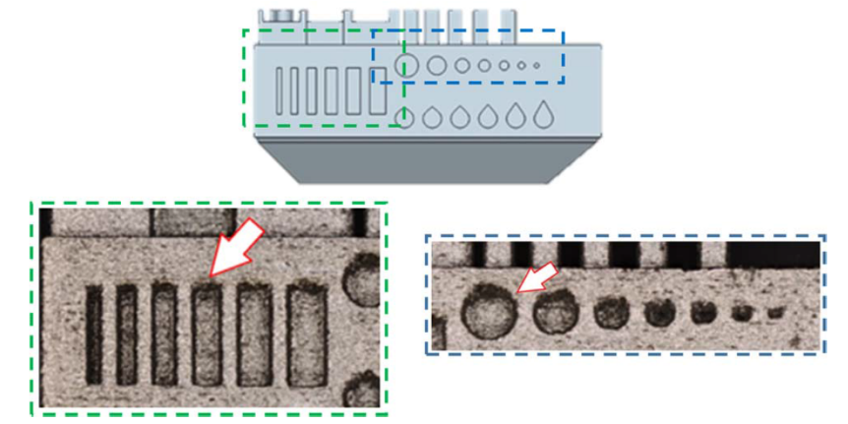
Qualifying the AM Material Process
Step 2: Surface texture and detail resolution
  Reference Parts
    For ideas: ISO / ASTM52902 Additive manufacturing — Test artifacts — Geometric capability assessment of additive manufacturing systems
  Mix of qualitative and quantitative measures
  Surface texture metrics

Slide 34
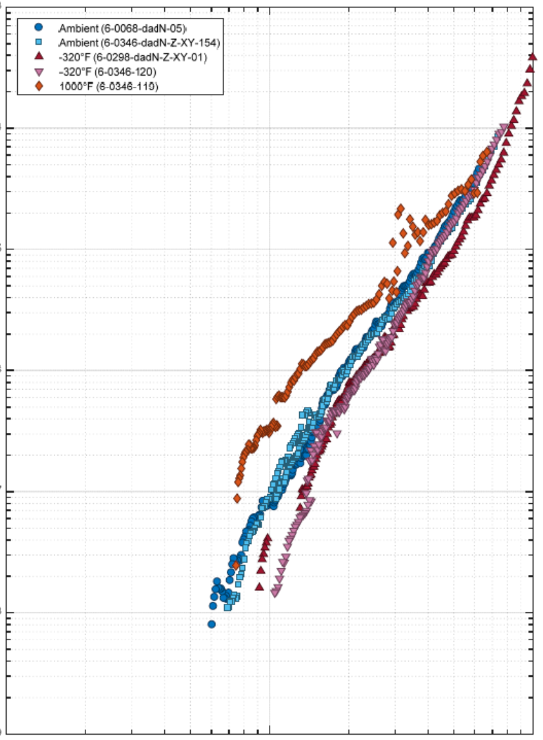
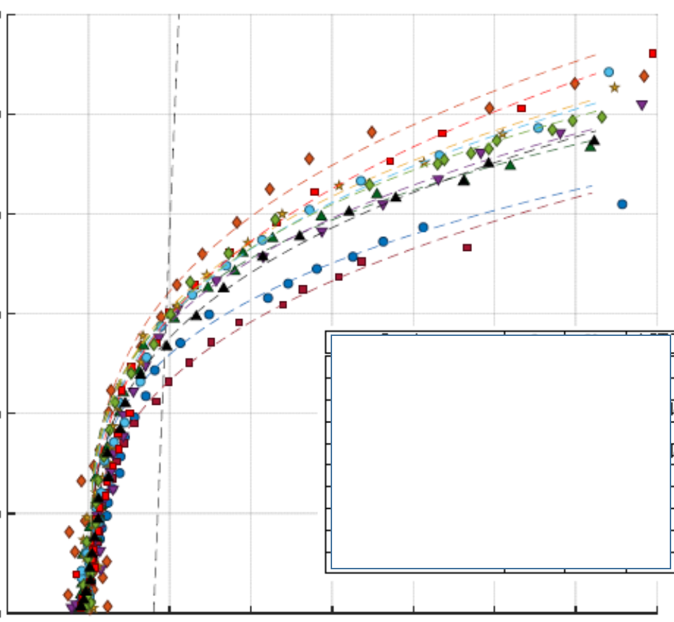


Qualifying the AM Material Process
Step 3: Mechanical properties
  Tensile, fatigue, toughness…
    May be dependent on use criticality
  Registration through Equivalence
    Material Property Suite (MPS):
    Actively maintained, material and condition specific material property information that includes material test data, design values, and SPC criteria
    Equivalent or “In-family” performance
    Requires judgement and statistics knowledge
NASA documents use the term QMP “Registration,” which is the process of demonstrating properties of the qualified process are equivalent to those in the applicable MPS.

Slide 35
Qualifying the AM Material Process
Step 4: Confirmation and Documentation
  Confirmation of successful AM material process qualification remains subjective
  There are no open standards defining the metrics or methodologies
    Establishing metrics and criteria is part of the AM process development activity
    This requires materials engineering skill sets, which are not common in many instances
  Given the lack of standardization, providing clear documentation of the qualification process is essential
  Qualification demarcates a point in time for a locked machine configuration and parameter set
  Changes to the machine or process will typically invalidate the qualification
  Review example of QMP record

Slide 36
Qualifying the AM Material Process
Break before material properties?

Slide 37
Material Properties
Challenges with AM materials properties and establishment of design values
AM material is process sensitive and local to each machine and build instance
Every AM machine acts as an independent material production mill or foundry
Traditional approach of relying on centralized mill production of material to a controlling specification is not feasible
Questions:
  How to establish and maintain assurance of AM material capability on every build from every machine?
  How to incorporate proper variability into material allowables and design values?
Policies for material property generation and maintenance are currently being developed in the MMPDS and CMH-17 committees
  (Metallic Materials Properties Development and Standardization, Composite Materials Handbook -17)

Slide 38
Material Properties
When design and production are not within the same entity, agreements must be reached regarding design value assumptions and associated qualification and monitoring requirements of the AM hardware
Design values must be continuously substantiated through process qualification and witness requirements
Material property evaluations are complicated by the AM process, leading to new considerations
    Feedstock lot variability
    Build-to-build and machine-to-machine variability
    Coupon to part transferability of properties
    AM process-specific influence factors
        Anisotropy, Surface finish effects, Thin walls, Build history effects on material structure, etc.

Slide 39
Material Property Suite
One potential approach to the problem:
The Material Property Suite (MPS) consists of four inter-related entities:
Data Repository
Design Values
Process Control Reference Distribution
Statistical Process Control acceptance criteria for witness testing

Slide 40



Material Property Suite
Data Repository
Includes data from
Qualification testing
Material Characterization
Pre-production Article Evaluations
Grouping of data
Group data by
QMP = Material/process/heat treat
“Combinable” conditions for design

Slide 41
Material Property Suite
Data Repository, continued
Contains all data needed for
Setting Design Values
Property equivalence evaluations and QMP Registration
Setting the Process Control Reference Distribution

Slide 42
Material Property Suite
Allowables and Design Values
Statistically substantiated
Applicable sources of variability included
Utilizes all appropriate data sources in Repository
May include additional margin for safety
DV
μ
Design
Values

Slide 43
Material Property Suite
Process Control Reference Distribution (PCRD)
Statistically describes nominal witness behavior of a machine
Utilizes all appropriate sources of witness coupon data in Repository
Used to set acceptance criteria for witness tests
σ
μ
PCRD

Slide 44

Statistical Process Controls
Statistical process controls are important in sustaining certification rationale
Statistical equivalency evaluations substantiate design values and process stability build-to-build
  Process qualification
  Witness testing
  Integration to existing material data sets
  Pre-production article evaluations
Equivalency of material performance is an anchor to the structural integrity rationale for additively manufactured parts
This is a realm where many manufacturers are NOT used to operating….

Slide 45
Material Property Suite
Statistical Process Control (SPC)
Acceptance Criteria
Derived from PCRD
Acceptance criteria for witness
tests
σ
SPC Acceptance Criteria for Witness Testing
μ
PCRD

Slide 46
Material Property Suite
Do not use design values for witness test acceptance criteria!
σ
SPC Acceptance Criteria for Witness Testing
μ
DV
μ
Design
Values
PCRD

Slide 47

Material Property Suite
PCRD and SPC Criteria
Witness test acceptance is not intended to be based upon design values or “specification minimums”
Acceptance is based on witness tests reflecting properties in the MPS used to develop design values
Potential approach
  Acceptance range on mean value
  Acceptance range on variability (e.g., standard deviation)
  Limit on lowest single value

Slide 48
Material Property Suite
Lots Of Data!
MPS, Lot-Mature:
  An MPS that contains data from a minimum of five (5) unique powder feedstock lots and ten (10) build and heat treat lots
  Nominally balanced distribution across lot data used for all design values
  Sufficient variability incorporated to be applied to parts of all classes
MPS, Lot-Provisional:
  An MPS that contains data from fewer than five (5) unique powder feedstock lots and ten (10) build and heat treat lots
  Only applicable to parts of Class B
Lot mature and lot-provisional design values are a MSFC-STD-3717 concept.
These are not universally accepted or endorsed by MMPDS or CMH-17

Slide 49

Foundation Complete
Equipment and facility understood and controlled
Well-trained personnel who understand the importance of their role
Properly qualified machines and processes consistently producing material of known quality
Understood material capability characterized and process controls established to substantiate the rigor of design values for materials from all qualified machines
Foundation ready to support AM part development in an environment with suitable rigor for certification.

Slide 50
Introduction and Overview
Break before Part Production Controls?

Slide 51
Introduction and Overview
Part Production Controls
Produce to the plan!
Stick to the plan!

Slide 52

AM Part Production Controls
Candidate Part
Part Production Controls

Slide 53
AM Part Planning
AM Part Design – Covered in AM Design Module
Requires integration across disciplines
  Manufacturing, Material properties, Inspection
AM design for manufacturability
  Ease of build, self supporting, cost effective
  For certification, NO awards given for most complicated, organic-looking part
  Prized certification characteristics are ease of access for verification and ability to inspect
Classification of parts for risk
  Consistent ranking and handling of parts based on risk

Slide 54
AM Part Classification
A part classification system is a risk evaluation and communication tool
  What happens if the part fails?
  How severe is the stress in the part?
  How challenging is the part to design, build, and inspect?
Consistent part classification is required
  Unambiguous criteria needed to maintain consistency
Based upon evaluated risk, requirements may change
  The higher a part’s classification, the more stringent the downstream requirements become
  Lower class parts should need less scrutiny than higher class parts
  For example, non-destructive evaluation needs would be expected to differ by class
Part-specific requirements tailoring begins with evaluation of part classification

Slide 55

AM Part Classification
From NASA-STD-6030 (DRAFT)
AM part classification is non-trivial
  Part classification is difficult to standardize
  Depends upon industry, use, and design culture
Example presented in this module reflects the approach favored by NASA
  Still HIGHLY debated within the Agency
  Yet, all agree (mostly) that it is a critical tool within the certification framework

Slide 56
Core Classification Questions
From NASA-STD-6030 (DRAFT)
What are the consequences of AM part failure?
How high are the structural demands (e.g., stress)?
How high are the risks due to the AM design or build process (e.g., inspection or unimproved fatigue critical surfaces)?

Slide 57
AM Part Classification
Consequence of Failure
Common criteria for high consequence of failure (Class A)
  Loss of life, or significant injury
  Loss of high-value asset
  Loss of high-cost primary mission objectives
  Loss of critical programmatic or strategic objectives
If none of the high consequence criteria are applicable, part is low consequence
Next evaluation is for negligible consequence of failure (Class C)
  Careful checklist evaluation defining “negligible”
If consequence of failure is not high but also not negligible, then part is Class B

Slide 58
AM Part Classification
Negligible Consequence of Failure Checklist, all must be true
Failure of part does not lead to any form of hazardous or unsafe condition.
Failure of part does not eliminate a critical redundancy:
  Part does not serve as primary or secondary containment.
  Part does not serve as redundant structure for fail-safe criteria.
  Part is not designated “Non-Hazardous Leak Before Burst.”
  Part is not relied on for fault tolerance
Failure of part does not cause debris or contamination concerns.
Failure of part causes only minor inconvenience to operations
Failure of part does not alter structural margins or related evaluations on other hardware.
Failure of part does not adversely affect other systems or operations.
Failure of part does not affect minimum mission objectives.

Slide 59
AM Part Classification, Secondary
Considerations of structural demand for secondary part classification.
The classification evaluation does not levy structural requirements!
This is only an evaluation of the structural demand relative to a defined benchmark to estimate risk.
Classification benchmark examples:
Metallic AM parts:
Polymeric AM parts:
Material Property | Criteria for Low Structural Demand
Loads environment | Well defined or bounded loads environment
Environmental degradation | Only due to temperature
Ultimate strength | Minimum margin* ≥ 0.3
Yield strength | Minimum margin* ≥ 0.2
Point strain | Local plastic strain < 0.005
High cycle fatigue, improved surfaces | Cyclic stress range (including any required factors) ≤ 80% of applicable fatigue limit
High cycle fatigue, as-built surfaces | Cyclic stress range (including any required factors) ≤ 60% of applicable fatigue limit
Low cycle fatigue | No predicted cyclic plastic strain
Fracture mechanics life | 20x life factor
Creep strain | No predicted creep strain
*Margin = [σ_{design}/(σ_{operation} * safety factor)] – 1
Analysis Input/Material Property | Criteria for Low Structural Demand
All Materials
Loads Environment | Well defined or bounded loads environment
Environmental Degradation | Only due to temperature and moisture, if specific environmental performance data exist. Design environment temperature does not cross the Tg.
Fatigue | Cyclic stress range (including any required factors) ≤ 50% of applicable fatigue limit
Sustained stress/creep strain | No sustained stress† and no predicted creep strain
Material with elongation at failure ≥ 3% in application environment
Ultimate strength | Minimum margin* ≥ 0.5
Yield strength‡ | Minimum margin* ≥ 0.3
Material with elongation at failure < 3% in application environment
Ultimate strength# | Minimum margin* ≥ 2.0

Slide 60
AM Part Classification, Secondary
Considerations of AM Risk for secondary part classification.
The classification evaluation does not levy AM design requirements!
This is only an evaluation of the AM design and build implications relative to a defined benchmark to estimate risk.
AM Risk is not about likelihood of build success
AM Risk is about design and build implications that may affect part quality control activities and/or impact part performance due to conditions sensitive to process quality.
Example of an AM Risk Scoring Table
 | Metallic |  | Polymer
 | L-PBF | DED | L-PBF | Score For
Additive Manufacturing Risk |  |  |  | Yes | No | Score
All surfaces and volumes can be reliably inspected, or the design permits adequate proof testing based on stress state? | X | X | X | 0 | 5
As-built surface can be fully removed on all fatigue-critical surfaces? | X | X |  | 0 | 3
Surfaces interfacing with sacrificial supports are fully accessible and improved? | X | X | X | 0 | 3
Structural walls or protrusions are the equivalent of ≥ 8 trace, (e.g., melt pool, bead, scan path) widths in cross section? | X |  | X | 0 | 2
Structural walls or protrusions are the equivalent of ≥ 2 trace, (e.g., melt pool, bead, scan path) widths in cross section? |  | X |  | 0 | 2
Critical regions of the part do not require sacrificial supports? | X | X | X | 0 | 2
Summed score for applicable criteria ≥ 5 is high AM risk.

Slide 61
Part Classification
What are the consequences of AM part failure?
How high are the structural demands (e.g., stress)?
How high are the risks due to the AM design or build process (e.g., inspection or unimproved fatigue critical surfaces)?

Slide 62

AM Part Planning
AM Part Production Plans (PPP)
AM part design and production does not yet
have a common industry standard of practice
  Challenge to integrate all required aspects of AM
  design requirements through drawing content
  Requires many aspects to be integrated
    Build layout
    Specification of qualified process ID
    Witness test and acceptance
    Post processing details
    Inspection requirements and limitations
Requiring a AM Part Production Plan as a drawing companion is currently the best option.
A PPP is similar to manufacturing plans required by most current SDO AM standards, but it encompasses more information than just the AM build process to enable an evaluation of the integrated scenario used to achieve part qualification / certification.

Slide 63
AM Part Production Plan
Part Production Plans force integration of part processing
Provides a “roadmap” to all information and controls needed for cert.
Drawing number and part name.
Illustrations and/or CAD model views (with scale).
The purpose of the part in context to the system.
The operational environments (e.g., temperatures, fluids).
Referenced revision controlled build file name, with cryptographic hash.
Material (including material specifications, if applicable).
Identification of the QMP specified for production.
Identification of specific MPS data used for part assessment, including influence factors.
Serialization, part marking, and methodology for tracking individual parts
Cleanliness, if special considerations or requirements apply (i.e., oxygen service, optical surfaces, delicate electronics).
Part Classification and associated rationale
Integrated structural integrity rationale
AM part production summary list of all primary production steps critical to successful part production and performance
Witness testing and acceptance criteria
Planned part build interruptions and approved restart procedures
Identification of process-sensitive post-build operations and their associated controls (heat treat, surface treatments, welding, cleaning, etc.)
Preproduction article requirements and evaluation criteria
Requirements contents of the part’s End Item Data Package

Slide 64
Integrated Structural Integrity Rationale
Common challenges for PPP development
Integrated Structural Integrity Rational (ISIR)
  Describes, in succinct fashion, how the quality assurance activities imposed on the part, when considered as a whole, form sufficient rationale for structural integrity.
    Commonly includes
      Structural margin status
      Any critical AM process controls or post-build processes
      Defect screening actions: Non-Destructive Evaluations, Proof Testing, Leak Testing, etc.
      Functional acceptance testing
Example:
The XYZ manifold has been classified B3 and is produced with all nominal process controls of the AMCP with no exceptions. All structural margins are positive. The manifold is non-fracture critical; nonetheless, multiple NDE inspections with quality oversight are in place to ensure structural integrity with areas of highest structural demand fully inspectable. The manifold will receive a surface penetrant inspection after final machining and etch followed by full volume NDE via XRCT scanning. The manifold will also be proof tested to 1.5 x MDP followed by a leak check and post-proof test surface penetrant inspection. After installation, a system-level proof test and leak check are performed, followed by confirmation of full functionality. The combination of process controls and workmanship NDE provide a fully adequate ISIR.

Slide 65










AM Part Production Plan
Common challenges for PPP development
  Locked build files
Description of controlled post processes
  NDE Plan
  Surface finish for Penetrant Inspection
  Flat enough for UT probe
  Thin enough for Micro Focus CT
Locked Build Files: Stray vectors Created During Re-slicing
Ground Surface
As-Built Surface
Near Surface Porosity
NDE: Powder not cleared, Imbedded Flaw

Slide 66




Pre-production Article
Common challenges for PPP development
Pre-production article evaluation
  Critical step to confirm established foundation successfully produces a part with full integrity and design intent
  Dimensional, cut-up material evaluations: microstructure and mechanical
  Confirmation of inspection procedure and non-destructive evaluation effectivity
  Evaluate your Critical Areas, Thin Sections, and Thick Sections
Contour Test Part
Cut Plan
Channels build correctly?
Thin sections OK?
Microstructure within acceptance criteria?
Mechanical properties?

Slide 67
Cryptographic Hash
Common challenges for PPP development
Understanding the cryptographic hash (see MSFC-STD-3716, Appendix D)
  Cryptographic hash functions can be used to establish identifiers for the exact content of any file, thus allowing absolute knowledge whether any changes have been made to that file.
  This allows the cryptographic hash to be used for version control, data integrity, and file verification.
  Standardized algorithms produce a hash of small identical length regardless of size of input.
  No change to the file’s content, no matter how insignificant, can occur without producing a completely different hash result – perfect to maintain definitive identity of contents in the AM digital thread
The Secure Hash Algorithm 1 (SHA-1) algorithm can operate on any file (or even a text string).
Use these algorithms to identify and confirm file integrity throughout the AM digital thread for parts maintaining certification status.
Examples of SHA-1 hash values:
Laser Powder Bed Fusion
85BB98E57467A82B39042331195E611F4A2EE823
Laser Powder bed Fusion
1DEB28D58F7F7EB55165AEC703C3DBA218B962F0

Slide 68
Qualified AM Part Process (QPP)
Establishing a Qualified Part Process (QPP)
AM Part Production Plan, agreed upon and approved
Pre-production article evaluation complete
AM Manufacturing Readiness Review
  All stakeholders agree AM part development is successful and complete for qualification or production articles to be produced
  Demarcates the point in time when changes to AM part definition (digital files, engineering instructions, etc.) are locked. NO MORE CHANGES
  Qualified Part Process (QPP) state is documented in the Quality Management System
Produce to the Plan and STICK TO THE PLAN
The Locked Process Is the QPP! Must be documented in the QMS!

Slide 69


AM Part Production
Part Production – Follow-through on controls
    Statistical Process Control (SPC)
    Must develop methodologies that support production scenario
    Continuous Production may differ from handling one-off parts
    Utilize PCRD or formal Control Chart methodologies
    SPC Challenges:
      Do the samples stay with the parts?
      How to flag a part without the samples tested?
      Setting limits that identify drift

Slide 70
AM Part Production
Part Production – Follow-through on controls
    Non-destructive Evaluation (NDE)
    Essential to certification logic for parts with high consequence of failure
    Important tool for AM process health monitoring
    Covered in detail in the NDE module.
NDE: Powder not cleared, Imbedded Flaw

Slide 71

Framework Assembled
Rationale for Qualified AM parts
Part certification rationale comes from the sum of both in-process and post-process controls, any weakness in one must be compensated in the other

Slide 72
AM Part Production
Follow the plan, always, with no short-cuts
Do not change a Qualified Part Process without re-qualification
Efficiency in process monitoring is critical to minimize the inevitable disruption
  Witness tests can take considerable time to complete
  Track the performance of each machine using all available metrics by control chart
  In-process monitoring may provide early warning of changes in machine performance
Emphasize the importance of inspection for every part
  Not just NDE, but visual inspection of as-built conditions
  Watch for changes in part appearance – colors, support structure issues, witness lines/shifts
Consider systemic implications for all non-conformances

Slide 73





Qualification Testing and Service
SpaceX SuperDraco
Dragon Capsule Abort Engine

Slide 74

Service: Qualification Testing
AM Injector Testing
Additively Manufactured Injectors Hot-fire Tested at NASA range from 1,200 lbf to 35,000 lbf thrust

Slide 75




Introduction and Overview
Successful hot-fire testing of full-scale Additive Manufacturing Part to be flown on NASA’s Space Launch System (SLS)
RS-25 Pogo Z-Baffle – Used existing design with additive manufacturing to reduce complexity from 127 welds to 4 welds

Slide 76
Conclusions
Certification rationale is most heavily rooted in the foundational controls
  Having a Plan
  Fully involved QMS
  Equipment and Facility Controls
  Training
  Process/machine qualifications
  Material properties
  SPC
Part planning must confirm the foundation produces a good part consistently
Part production follows a fixed process (QPP) with statistical process controls
Part function and reliability are verified through qualification testing

Slide 77

Questions?
Douglas.N.Wells@nasa.gov

