Slide 1
xEVA Flight Operations
Preparing for Lunar EVA
Training and Execution
Alex Kanelakos – Chief Engineer for EVA Operations and xEVA Ops Lead

Slide 2

Agenda
Role of EVA Flight Operations
Process of Designing a New Flight Operations System for Lunar EVAs
Capturing Historic EVA Lessons Learned
Influencing EVA Hardware Design from an Operations Perspective
Structured Analog Testing
Designing Lunar EVA Training Flows using a Risk-Based Approach
New Methods in Procedure Authoring
Designing Lunar EVA Execution Systems

Slide 3
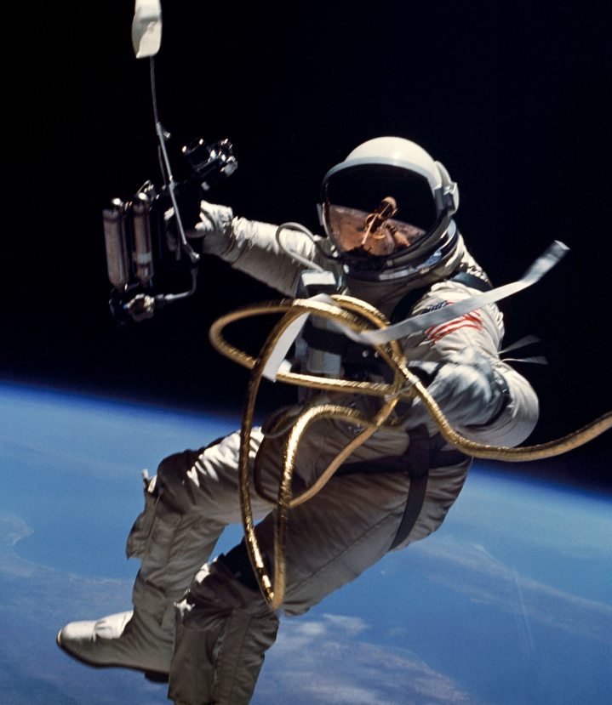
Role of EVA Flight Operations
To protect our astronauts and to plan, train, and fly humans in space.
Plan
  Build execution and training operation concepts and mission requirements
  Influence and evaluate hardware designs
  Develop operation products: lesson plans, EVA timelines, procedures, flight rules, etc.
Train
  Astronauts, flight controllers, and other groups (engineers, safety and program personnel, etc.)
  Use diverse facilities, laboratories, and analog environments to train EVA operations
Fly
  Execute missions from Mission Control Center – Houston
  Perform real-time troubleshooting and risk assessments for off-nominal operations
Notes:
*For ISS alone, we have:
Modify/Add ~150 Published Procedures
Modify/Add ~25 Flight Rules
Incorporate ~500 OCADs (FRs, Procedures, Training)
*Train more classes than all the other ISS systems combined

Slide 4
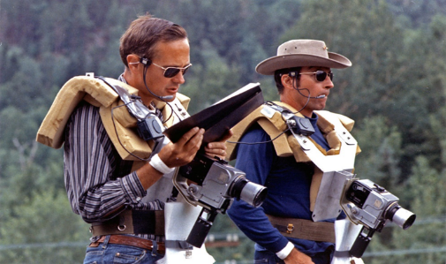
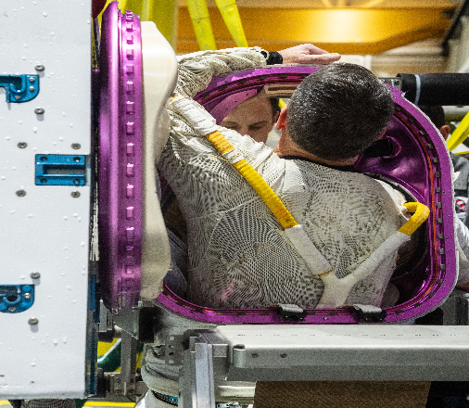
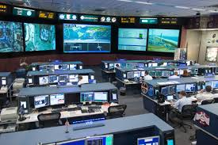
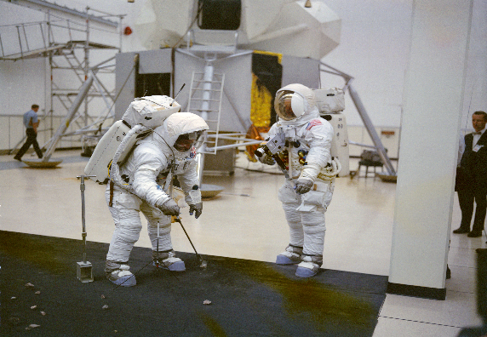
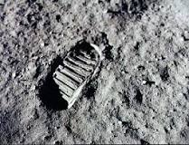
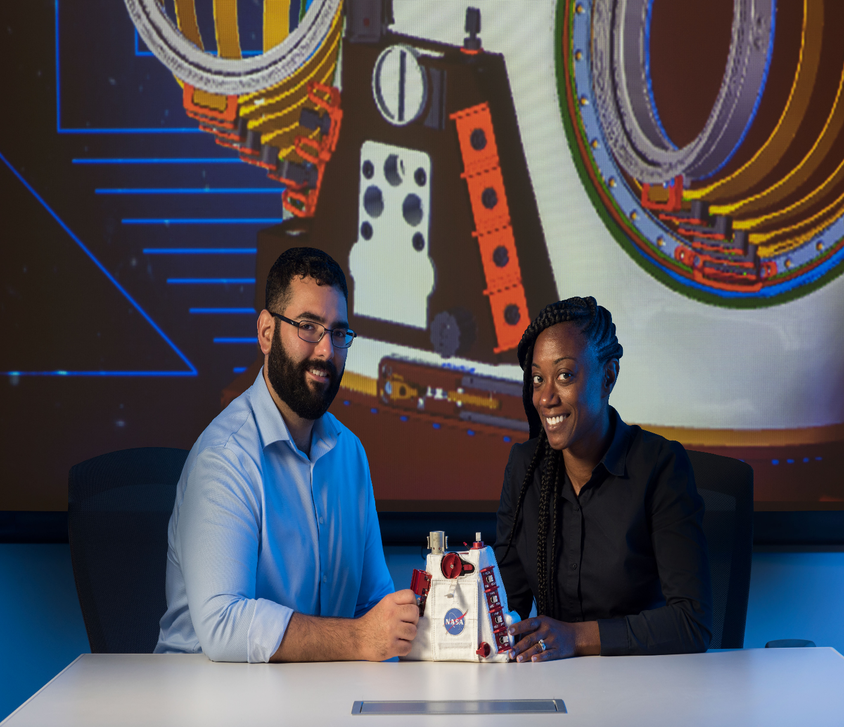
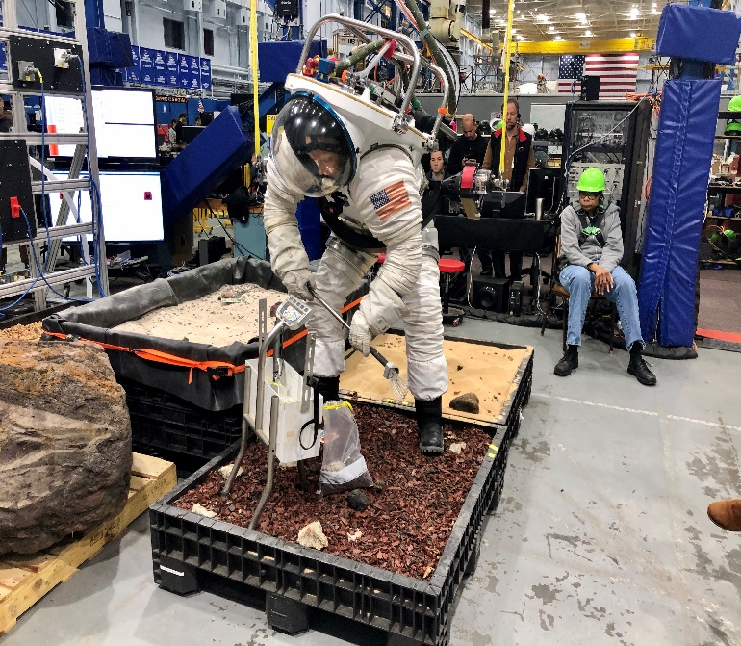
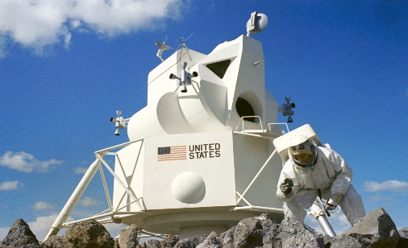
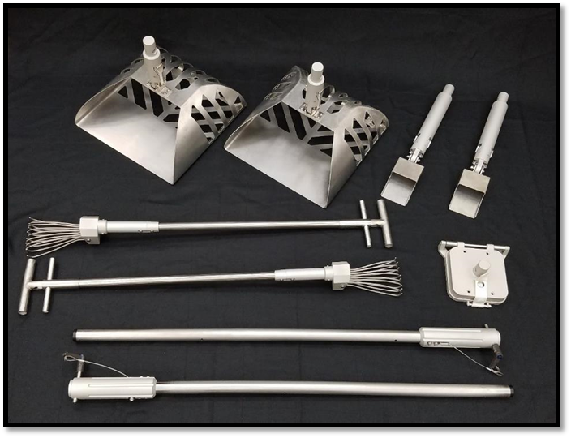
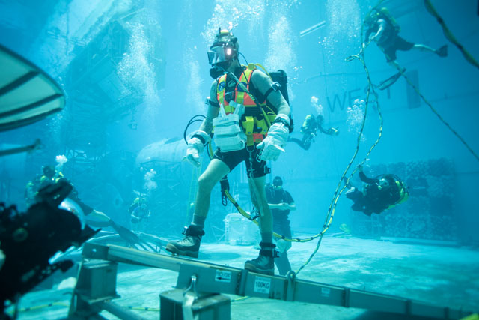
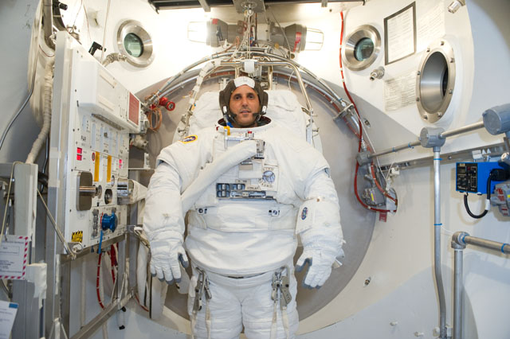
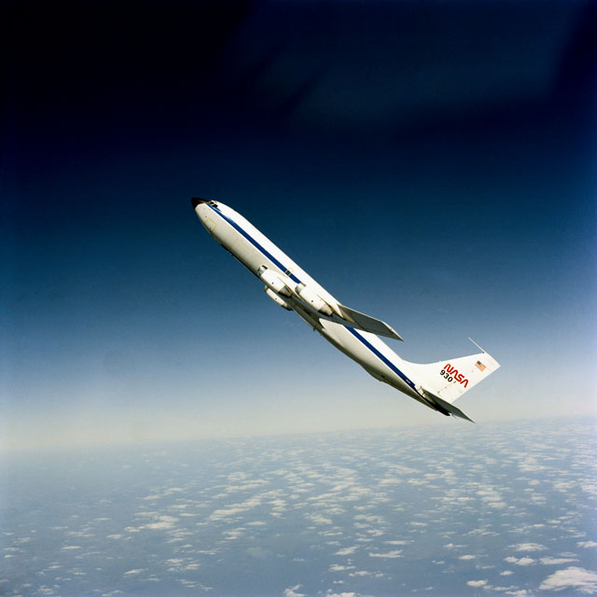
EVA Operations

Slide 5
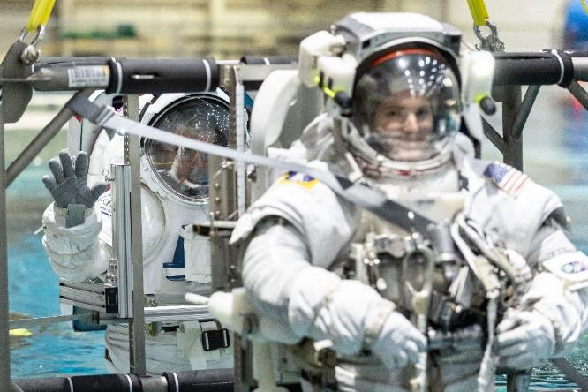
Organization Structure
EVA Systems
Airlock systems
Depress/repress
xEMU operations
  Pre EVA operations and prebreathe
  Post EVA operations and maintenance
  Resize
xEVA vehicle interface equipment
EVA Task
Suit mobility and translation
Ingress/egress
Tool and timeline management
Exterior vehicle maintenance
Electrical, fluid, and structural mechanisms for construction and deployment
Crew rescue
EVA Science
Site and sample characterization
Sample collection and curation
Science instrumentation

Slide 6
xEVA Operations Team
A. Kanelakos
FOD xEVA
S. Korona
J. Kagey
S. Wray
xEMU
xEVA Architecture Lead
xEVA Training Lead
J. Gaustad
C. Mavridis
K. Young
T. Graff
xPLSS, A/L
xPGS
Science Execution
Science Training
M. Dino
M. Russell
TBD
J. Montalvo
I. Theriot
D. Welsh
xInfo, xSPCE
CWS
HLS Integration
Lunar - EOS
Tools
PACES, xInfo
D. Simon
D. Barrett
B. Smith-Sparks
E. Matula
S. Mulhern
B. Scheib
Avionics
ORU
MCC Displays
P/B
Simulators
xPGS
C. Murphy
N. McHugh
V. Brooks
O. Koehler
Safety/ OCADs
Stowage
Data Mngt
Mockups

Slide 7



xEVA Schedule
xEMU
 | FY19 | FY20 | FY21 | FY22 | FY23 | FY24
Dev & Production
 | CY19 | CY20 | CY21 | CY22 | CY23 | CY24
xEMU ISS Demo Project
Lunar 2024
Flight Operations 3.1 ISS → 3.2 Lunar →
ISS
Demo EVAs
DVT Test
Qual Test
PIA
Lunar 2024 EVAs
xEMU SRR
xEMU PDR
CDR
Training Hdwr/ Product Dev
1st Round
Crew Training
TS21 Dev
Test
MER/ FCT Training
MCC Dev
Execution Products
Lunar Facility Buildup
Training Dev
1st Round
Crew Training
Training Hdwr/
Product Dev
TS21 Dev
Test
MER/ FCT Training
MCC Dev
Execution Products

Slide 8
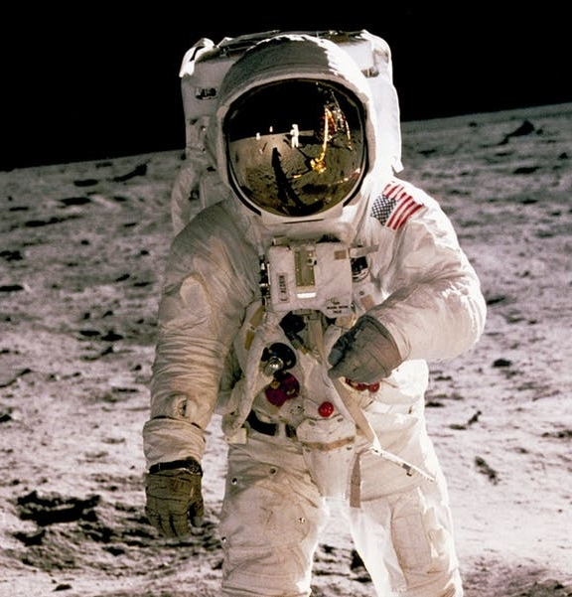
How do you build your operations systems for Moon and Mars?
Process:
Develop a robust set of lessons learned from previous programs
Assess training and execution systems from a risk perspective
Produce products and processes that increase efficiency
Leverage existing facilities and capabilities for training and execution
Develop new processes, facilities, and tools for operations
Training Timeframe:
Develop training (generic and assigned) and execution infrastructure for xEMU EVAs on ISS, Moon, Gateway, and Mars
  ISS goal of 2023 for Demo EVAs and ready to support a mid 2020’s EMU → xEMU transition
  Moon and HLS/Gateway 2024
  Mars 2033?

Slide 9
Operation Deliverables
Execute EVAs
Experts
Exec Infrastructure
Astronauts
Ground Team
Ground Systems
Flight Hardware
Mission Plan

Slide 10
Capturing Historic EVA
Lessons Learned
Ike Theriot – xEVA Task Instructor

Slide 11
Capturing Lessons Learned
Apollo Lunar Surface Journal
Coordination with stakeholders
Photos, Videos, other Media
Exploration Wiki Lessons Learned (by Category)
Design Reviews
Academia/Industry
Testing
Books
Lesson Plans
Operational Knowledge
Shuttle/ISS/Analogs
Timeline and Procedure Development

Slide 12
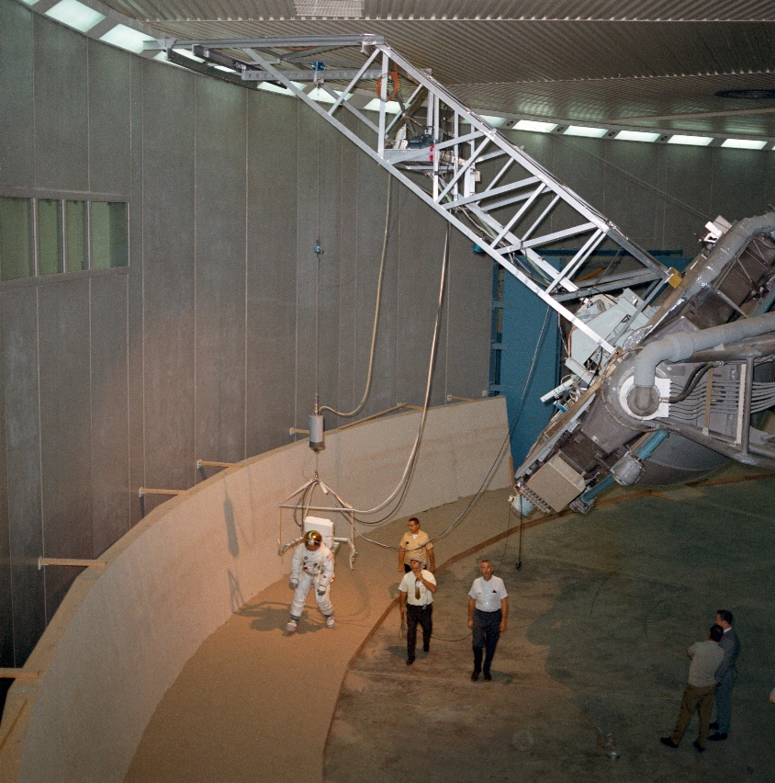
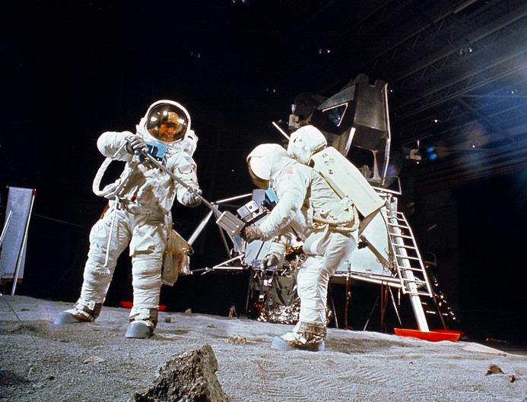
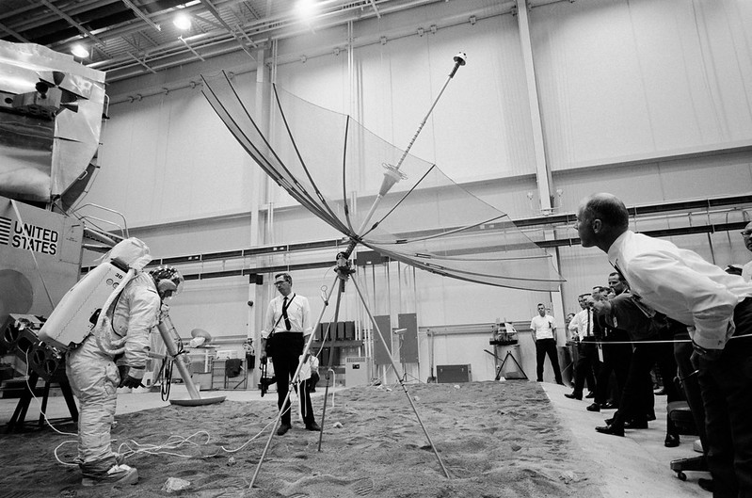
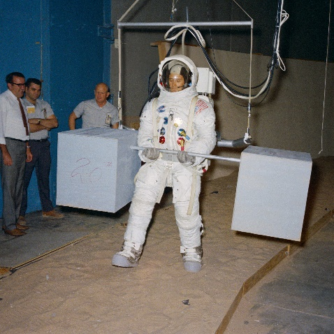
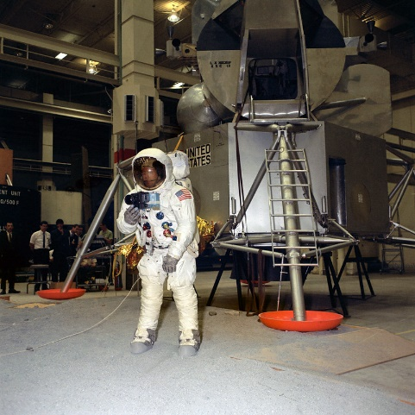
Example: EVA Crew Training and Facilities
  Various Training Facilities
    B29 Centrifuge
    POGO
    Parabolic Aircraft
    Vacuum Chambers
  Requirements for Artemis training facilities pulled from relevant lessons
    Crew feedback
    Facility layout and support equipment
    Current capabilities
    Shuttle/ISS crew training lessons learned

Slide 13
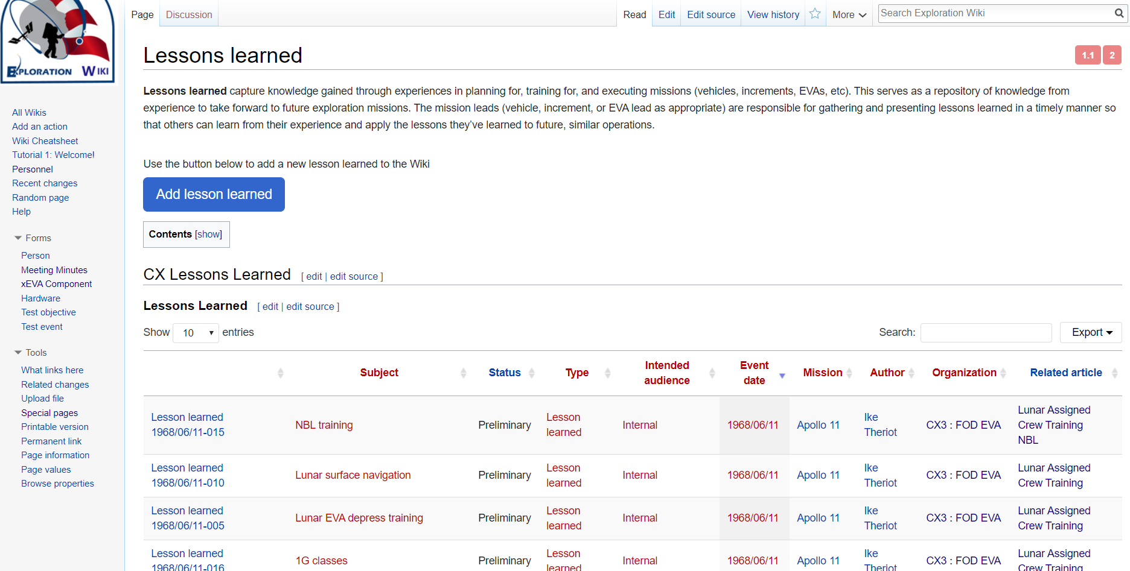
Sharing Knowledge
EVA Operations is leveraging our current Wikimedia platform of resource management to inform and share information to the broader NASA EVA community

Slide 14
Influencing Hardware Design from an Operations Perspective
Costa Mavridis – xEVA PGS Operations Lead

Slide 15
Influencing EVA Designs from an Operations Perspective
“It’s our job to fully grasp the needs of people using our products and be the spokesperson for them”*
  Available unassigned crew prevents astronaut office from supporting all design meetings and/or testing.
  ISS Ops team has the best collection of crew feedback (direct and indirect) on current and past EVA hardware
Ensure hardware is not over constrained
  Crew can be very creative and think of new ways to use the hardware to get the job done
Keep the bigger picture in mind
  SE&I Teams can help design integration from a requirements stand point, but ops team can help by keeping the ‘realistic’ use of the hardware in perspective.
*Catherine Courage: VP, Ads & Commerce User Experience (UX) Design at Google

Slide 16
Influencing EVA Designs from an Operations Perspective: Questions to ask on a Design
Reliable – Where does this suit, hardware, or tool need to be more robust or redundant to keep crew safe and to prevent failures?
Injury Prevention – Can this design injure the astronaut or suited subject?
Efficient – Does this design increase crew efficiency in EVA operations?
Reduced Workload – Does this design add to the cognitive or physical workload?
Upgradeable – If we have to live with this design for the next 40 years, can we make easy upgrades?
Maintainable – Does this design significantly reduce preventative and corrective maintenance requirements compared to current EVA hardware?
Flexible – Does this design lock in only one operations concept or does it allow for operation flexibility?
Compatible – Is this design compatible with the current and future operation concepts and other existing hardware?
Trainable – Does this design require new or modified training infrastructure?

Slide 17

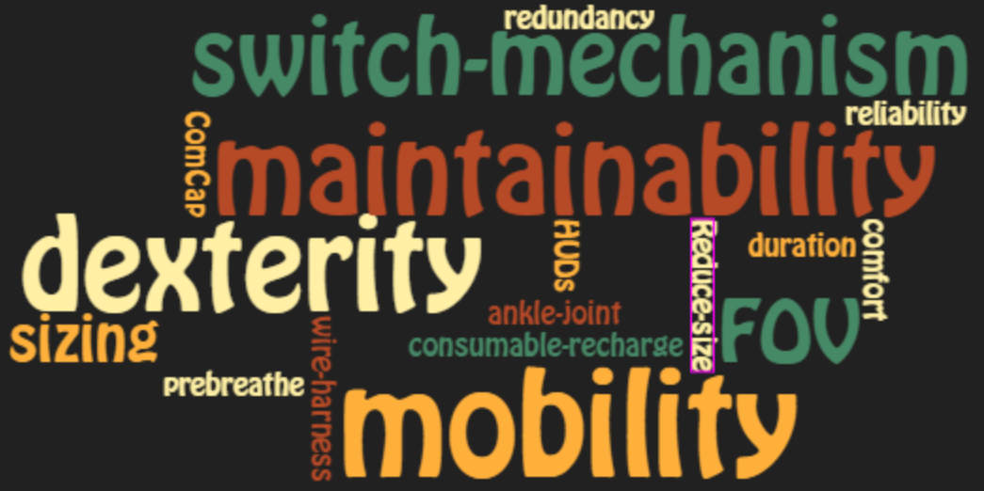
If crew and flight controllers could change one item of the current EMU:

Slide 18
Hardware Efforts in Development
Incapacitated Crew Rescue (ICR)
  Lunar lander designs with high platforms may require lifting operations for ICR scenarios, as well as, for science return mass. Hardware may need to be developed on both the xEMU and lander to raise a crewmember that cannot climb the ladder and assist in returning the crew to the lander.
Dust mitigation
  Many Apollo crew comments on the quantity of dust that returned into the vehicle after the EVAs, which created operational and health challenges. How do we remove dust from suits and tools in an effective and timely process.
Science, Tools, and Equipment
  There is a need to correctly stow and carry science samples to preserve qualities and characteristics of the samples, especially for volatiles.
  As seen from ISS, suit components fail, and many of theses failure can preclude an EVA (NO-GO for EVA). It is imperative to design for quick reparability.
  With the ever increasing sharp edges on ISS and the very sharp regolith and rock on the Moon, there is a need to ensure our xEMU design is at an appropriate risk level for leak penetration and we optimize a design that can sustain crew life in a feed-the-leak scenarios if a hole does penetrate the pressure garment.

Slide 19
Designing Lunar EVA Training Flows using a Risk-Based Approach
Scott Wray – xEVA Training Lead
Trevor Graff – Exploration Scientist

Slide 20
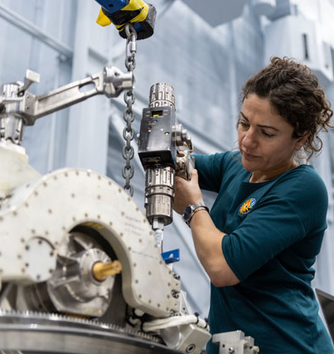
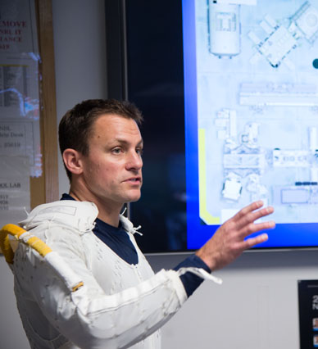
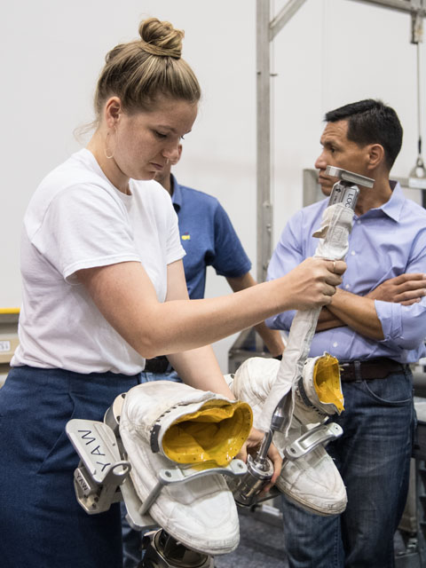
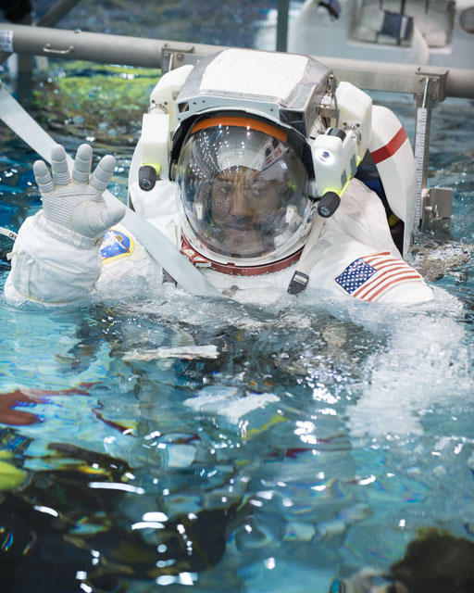
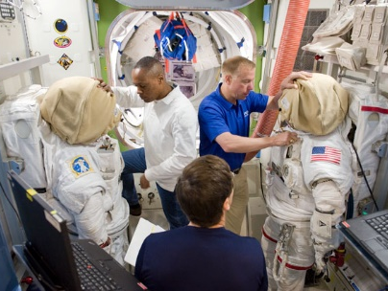
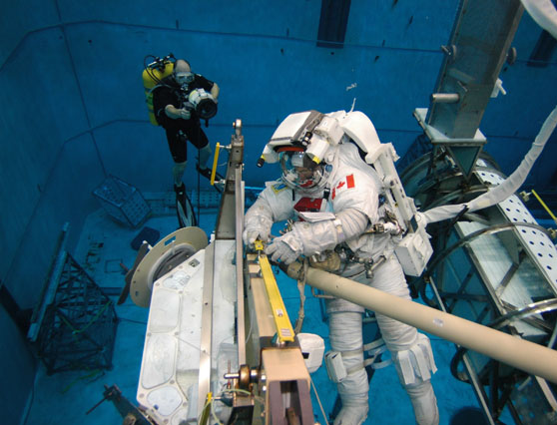
EVA Skills Training –Phased Approach
EVQ
Proficiency
Assigned
Initial Training
Intermediate Training
Intensified Training
During astronaut candidacy
Between completion of
initial training & flight assignment
Mission specific EVA training
Systems
  Basic, working knowledge of EMU
  Caution & Warning interface and boldface response
  Suit-IV role, understanding of Road-to-EVA activities
Task
  Optimize suit fit, safely performing basic skills and proficiency to complete 6.5-hour spacewalk
  Mastery in self-care and ability to rescue partner within 30 minutes
Plan/Ops
  Basic execution and participation in EVA development as EV crew and Ground IV.
  Assist with crew suit donning/doffing
Maintain EV-Q Proficiency
  Periodic NBL Runs to maintain EV-Q skills
  Periodic Systems courses to maintain Suit-IV skills
EVA Development
  EVA Hardware review
  NBL Development tests
Leadership and Ground-IV development
  Optional EV-L flow to increase leadership skills and mentor rookie crew
  Ground-IV training and execution of EVA from MCC
  ISS Maintenance
  Focus on Critical Contingency EVA tasks
  Skills based for both Nominal and Contingency EVAs
  Evaluation from EVA Evaluation Board
EMU & A/L Systems
  Road-to EVA and EMU Maintenance
  EVA Prep & Post (EV and Suit-IV roles)
  EVA Specific Training
  Training Specific EVA content which is scheduled within Increment timeframe
  Develop crew preferences for EMU and EVA timeline
  Evaluation from EVA Evaluation Board

Slide 21
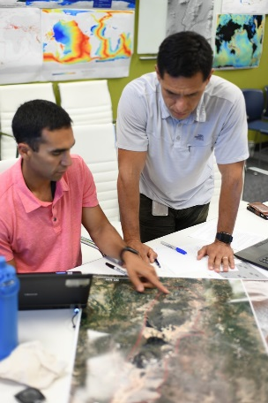

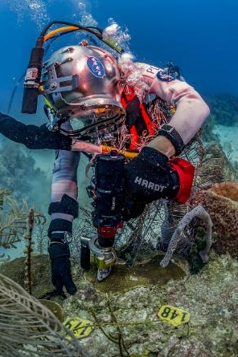
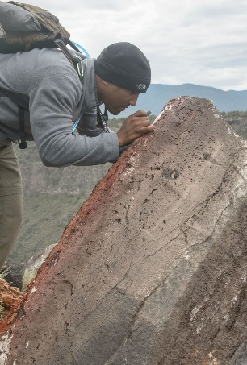
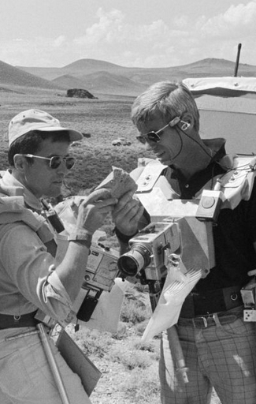
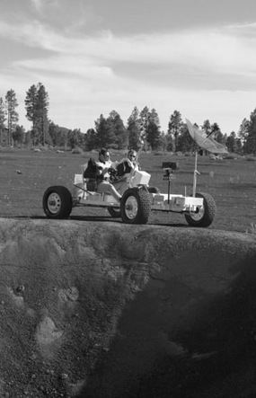
EVA Science Training – Phased Approach
PHASE 1
PHASE 2
PHASE 3
Initial Training
Intermediate Training
Intensified Training
During astronaut candidacy
(plus Engineer/Manager Courses)
Between completion of
initial training & flight assignment
Mission specific science training (patterned after Apollo J-missions)
JSC Classroom Training Modules
  Geo-Science Fundamentals
  Earth Systems
  Planetary Science & SMD Missions
Field Training
  Geologic Mapping & Traverse Planning
  Sampling & Instrumentation
Expeditionary Components
  Team Experiences & Leadership Opportunities
Advanced Field Opportunities
  Astronaut Field Assistant Program
  Additional exercises in observation & problem solving
ISS Specific Training
  Ex. Crew Earth Observations
Analog Mission Operations
  Science in relevant environments under operational conditions (e.g. NEEMO, CAVES, etc.)
  Additional leadership and teamwork opportunities
  Destination-Specific Training
  Target-specific approach
  Detailed focus on science objectives & operations
Extensive Field Experiences
  Numerous geologic/operational training trips Variety of relevant terrains
  Extensive Geologic Education
  Masters Degree proficiency level
  Proficient in multiple geo-science disciplines

Slide 22
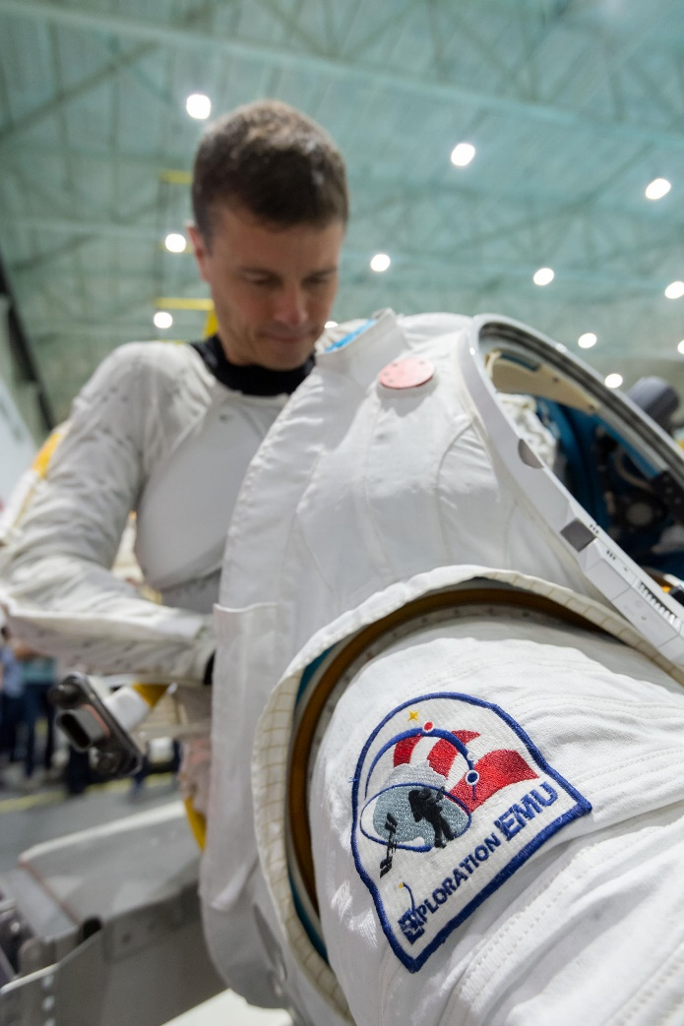
xEVA Training Philosophy
Our success in EVAs over the past 20+ years in ISS construction and maintenance can be attributed to our End-to-End Training philosophy. End-to-end Training was also used from Apollo-Shuttle Training:
  A two-member, gravity off-loaded, pressurized suited test environment with the highest fidelity mockups, tools, and hardware capable of running the entire duration of an EVA (6-8 hours).
Approach to assigning risk
  For every identified lunar task, a risk must be assessed to the task if no training is performed.
  The FOD training system and flow is developed around performing training events that reduce the risk of loss of crew, injury to crew, and loss of mission objectives.

Slide 23
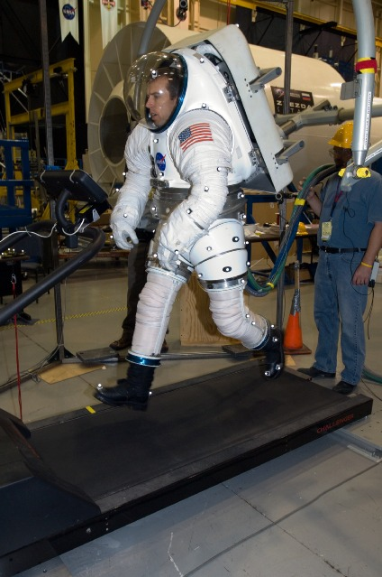
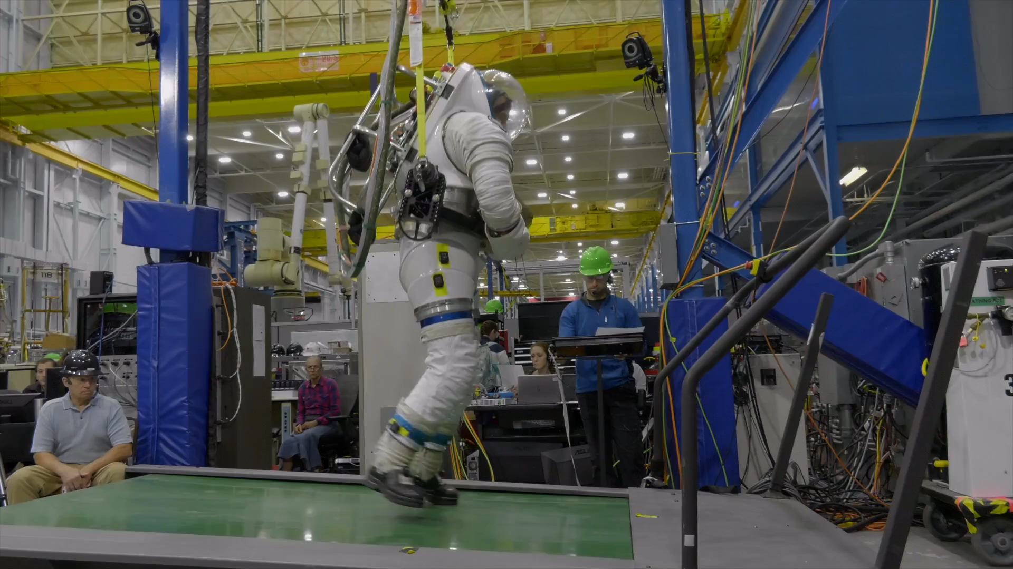
Example Risk:
Medium-Long Distance Ambulation
Current Risk:
With NO Training
Very High/Severe
(Falling, Fatigue, Injury)
Current Facilities:
Risk: High/Critical
ARGOS (Horse Treadmill)
  1/6g Pressurized walking suit
NBL*
  1/6g SCUBA
  1/6g Pressurized walking suit
LIKELIHOOD
5
4
3
2
1
 | 1 | 2 | 3 | 4 | 5
CONSEQUENCE
POGO
NBL
  *Not recommended for evaluation/verification of suit ambulation due to water drag effect
Notes:
https://io.jsc.nasa.gov/app/info.cfm?pid=26487790
https://io.jsc.nasa.gov/app/info.cfm?pid=26393628

Slide 24
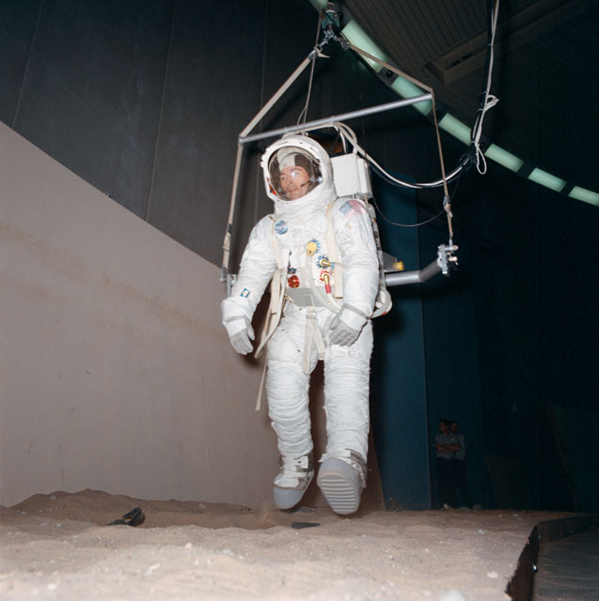

Example Risk:
Medium-Long Distance Ambulation
Risk Buy-down
Low/Severe
Future Facility:
Hi-Bay AXES facility
  Large Circular or Oval Track
    100 ft minimum diameter corners to minimize impacts to momentum management and gait
  1/6g off-load
  Hi-Fi Pressure Suit (xEMU)
  Simulated Lunar Lighting
  Simulated Lunar Topography
LIKELIHOOD
5
4
3
2
1
 | 1 | 2 | 3 | 4 | 5
CONSEQUENCE
Building 29
Building 29
Notes:
https://io.jsc.nasa.gov/app/info.cfm?pid=26487790
https://io.jsc.nasa.gov/app/info.cfm?pid=26393628

Slide 25
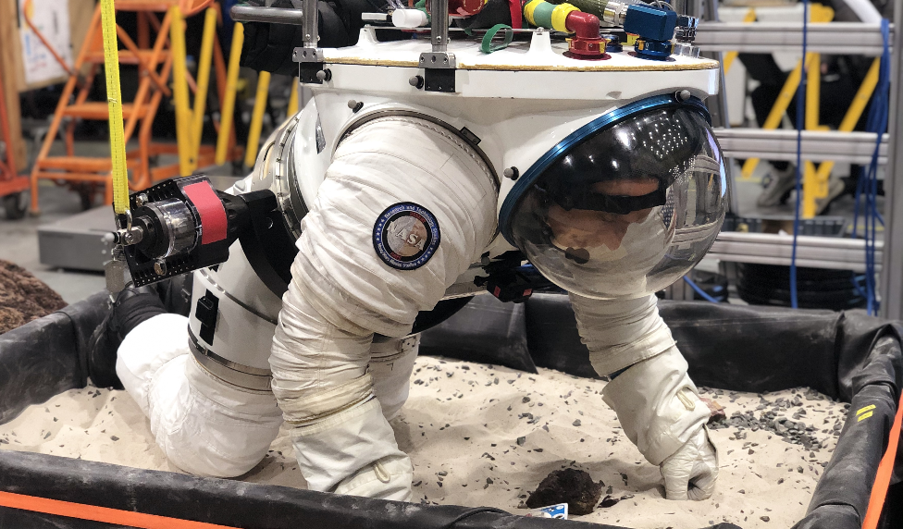
EVA Training Risk: One of Many Conclusions
NASA is missing a large facility to train end-to-end EVA timeline operations, manage metabolic rate while translating and performing other operation, characterize and collect diverse science samples, practice crew-MCC communications, and complete crew rescue, all while maintaining a diverse topography, oblique lighting angles, and active xEMU Caution & Warning System.

Slide 26
Structured Analog Testing
Daren Welsh – xEVA Operations Test Lead

Slide 27
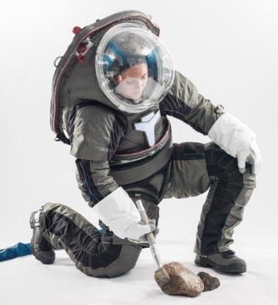
We need a unified, structured approach
Tests are performed in multiple environments, with different configurations, to address lots of objectives
A unified test structure will foster collaboration, improve work efficiency, and unify data so we can agree upon results
A single, unified set of test objectives ensures we are working to the same goals
Collocation of test documentation provides transparency for inter-team awareness

Slide 28
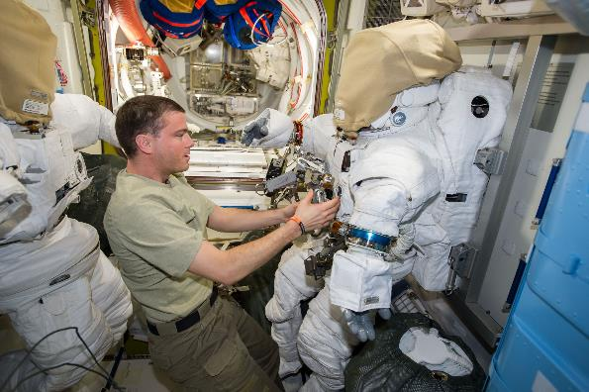
Test Environment Configurations
Test Environments
NBL
ARGOS
VR
Parabolic flight
NEEMO and other field tests
Shirt-sleeve (APACHE, NBL 1-G room, etc)
More …
Considerations
Each test environment can have multiple configurations
Mockups of flight hardware and tools
Method of providing Lunar weigh-out
  Different ARGOS gimbals
  Different NBL weigh-out systems
Subjects can have different configurations
  Suit type
  Dive helmet
Methods to record data (more on this later)

Slide 29
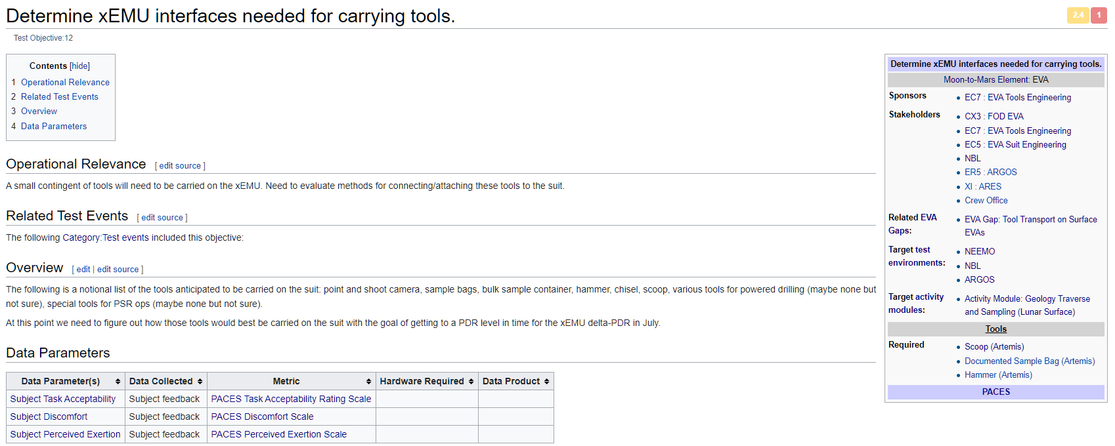
New Test Structure: Test Objectives
“We don’t just perform tests to perform tests. We do it to answer questions.”

Slide 30
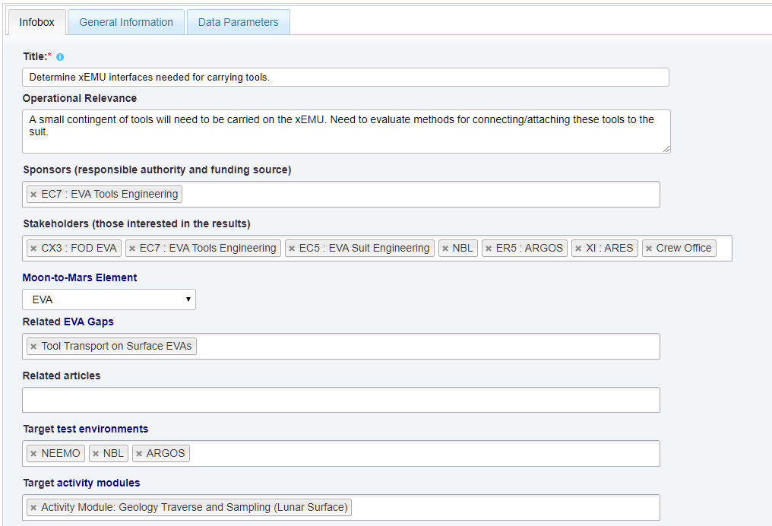
New Test Structure: Test Objectives Form

Slide 31
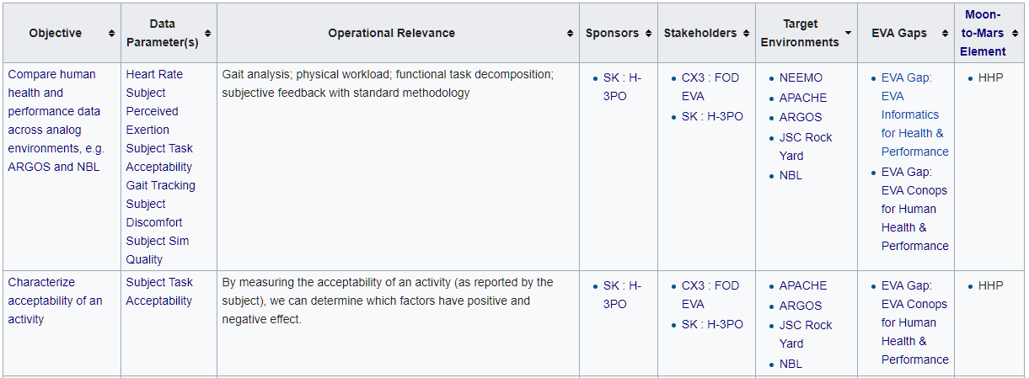
New Test Structure: Standard Measures
Some test objectives can be used generically across all tests

Slide 32

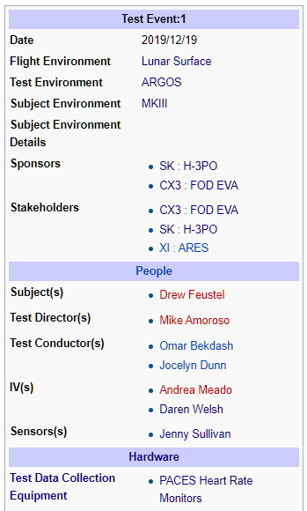
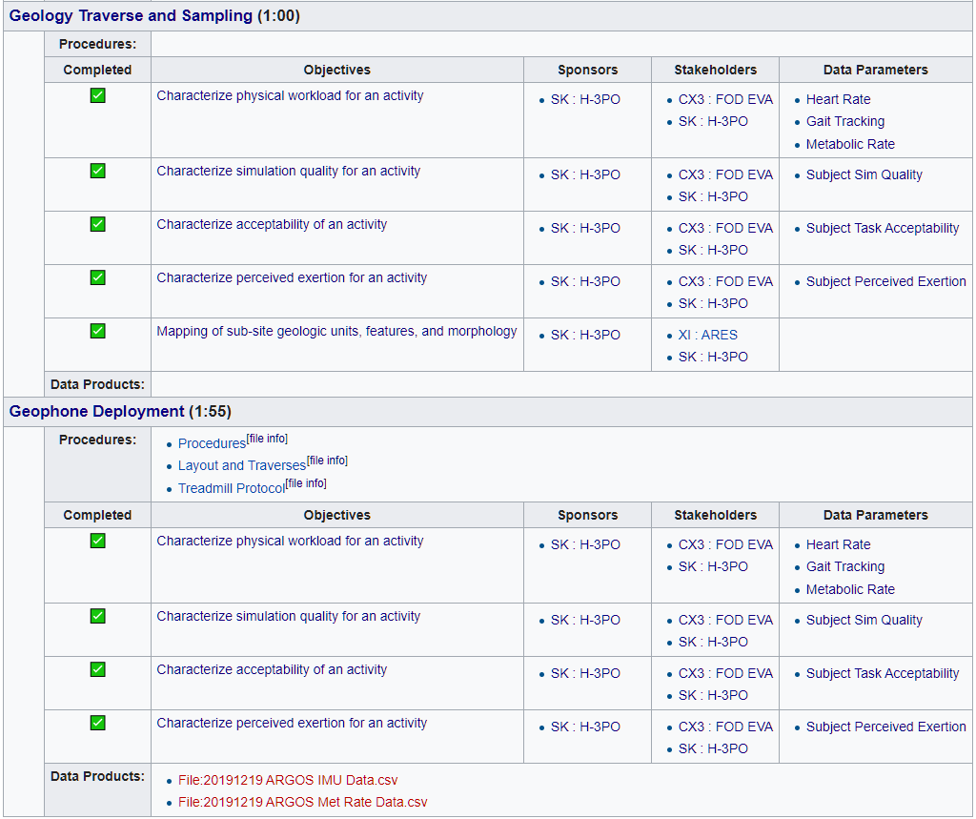
New Test Structure: Test Events

Slide 33
New Test Structure: Overall Structure
Activity Modules
Hardware Mockups
Test Events
Test Data Collection Equipment
?
Test Objectives
Test Data Parameters
Metrics

Slide 34
New Test Structure: Overall Structure
Test Events
Moon-to-Mars Domains
Data
?
EVA Gaps
Test Objectives

Slide 35
New Methods in Procedure Authoring
James Montalvo – xEVA Flight Controller

Slide 36
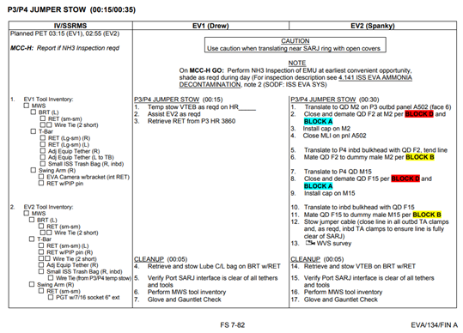
How we currently author and execute EVA procedures
Procedures authored in heavily-formatted Word documents
  Cumbersome to make changes
  Multiple authors collaborating difficult
  More cumbersome to review changes someone else has made
Procedures executed from printed versions of the Word documents
  Location in procedure (which steps are active) communicated verbally throughout team
  Notes tracked by hand on paper copy
  Times tracked on paper copy or in separate application (Excel)
Source: FOIA’d STS-134 Procedures (https://www.nasa.gov/centers/johnson/pdf/539922main_EVA_134_F_A.pdf)

Slide 37
Maestro: short-term objectives
Make raw procedure data both machine readable and human readable
Render that raw data into a document that looks nearly identical to current EVA procedures (and optionally into other formats)
Authors don’t have to worry about formatting
Authors should be able to easily receive changes from contributors and accept, reject, or request updates
Authors should be able to easily diff changes between non-sequential versions of procedures
Editing a procedure should have a simple user interface

Slide 38
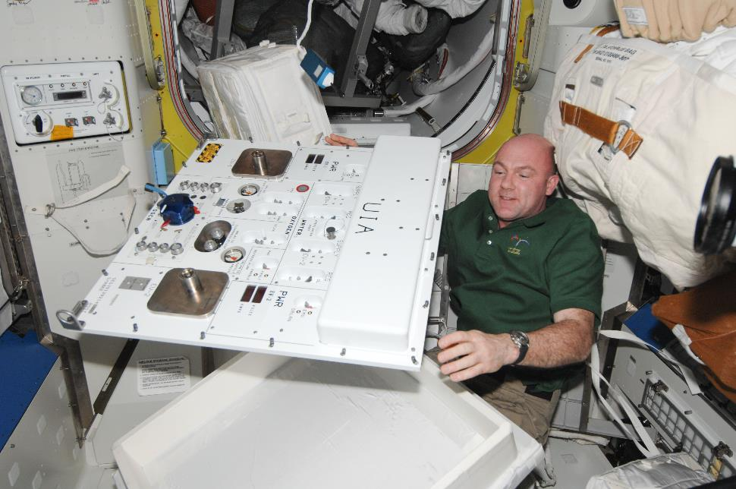
Maestro prototype
In-house developed
Out and in beta
Tech used:
  Written in Node.js
  Editor UI in React framework
  Desktop app in Electron
  Isomorphic code for terminal, web, and Electron

Slide 39
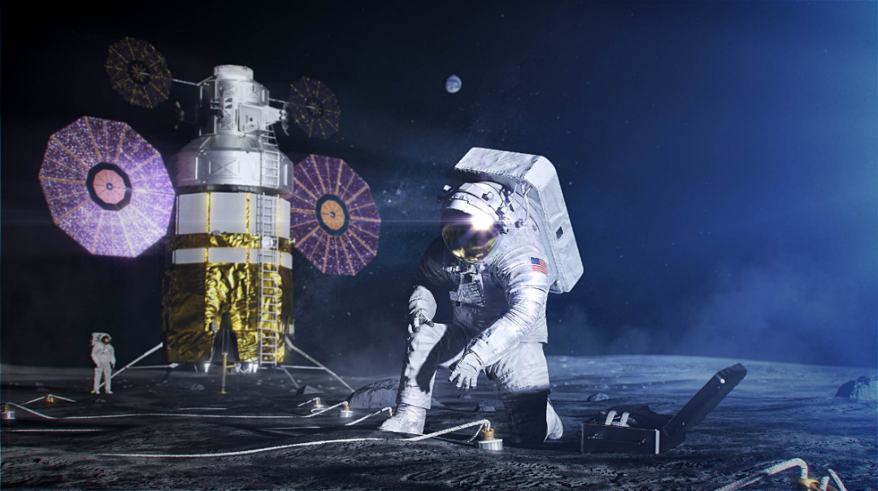
Maestro: long-term objectives
Machine readable means the procedure isn’t tied up in an inaccessible format
  Can query, restructure, and analyze easily
Complicated time math: Maestro generates a Simple Temporal Network (STN) to perform calculations on time constraints
Perform procedure verifications (glove/HAP checks placed appropriately, CETA brake release, thermal cover, SAFER checks, …)
Maestro can generate multiple versions of a procedure. In the future could generate a public version with sensitive info redacted
Create output to existing solutions (ProX, PRIDE)
Currently Maestro just an editor. Later: allow real time execution tracking:
  Take data on how and when steps performed
  Correlate exact steps to met rate and other data
  Record how long certain types of steps generally take
Tracking state
  Calculate in-EVA and post-EVA config
  Summing result of multiple EVAs to see config in future

Slide 40
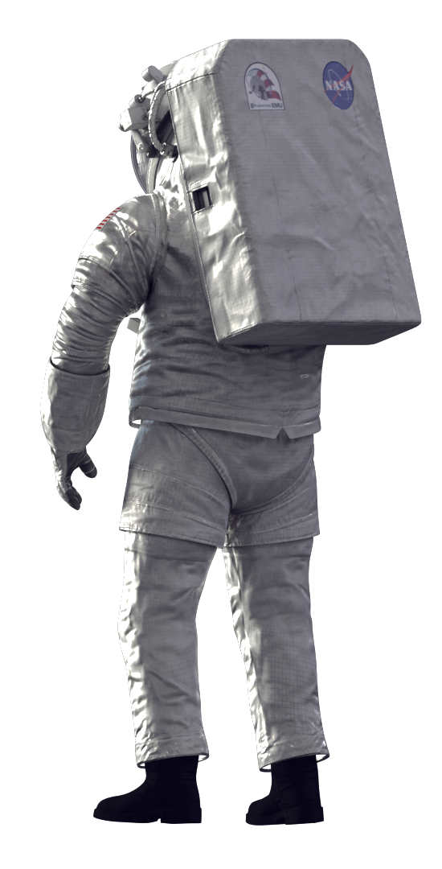
Maestro: Who else should be interested
IV procedure authors – FOD’s OSO group is working on making Maestro work for IV procedures
Electronic crew displays, AR, VR – Maestro could output content for next gen formats. Write one procedure, output to multiple formats.
Engineering, Safety – better procedure review process
Life sciences – Better tracking of steps performed for synchronizing met rate data with procedures
Researchers – With machine-readable procedures, the sky is the limit on what can be done

Slide 41
Designing Lunar EVA Execution Systems
Jaclyn Kagey – xEVA Lunar Architecture Lead

Slide 42
EVA Execution
FOD EVA is developing operational concepts for the future execution of lunar EVAs.
  These concepts utilize lessons learned from the success of both Apollo and International Space Station EVAs.
    Integrate lunar science experts into the flight control team and planning/training process.
      More efficient to the mission to have a science expert integrated into the FOD EVA team (including physical location during execution)
      With additional experts in the “Science Support Room” (Apollo SSR) interacting with the Flight Control Team, just like ISS Flight Controllers interact with the Mission Evaluation Room (MER)
    Plan to test ops concepts during analog missions (NEEMO)
  Communication and timely response are critical for the safety of the crew and mission success.
Current challenges include undefined vehicles, tools, and rover access and unknown landing site.

Slide 43
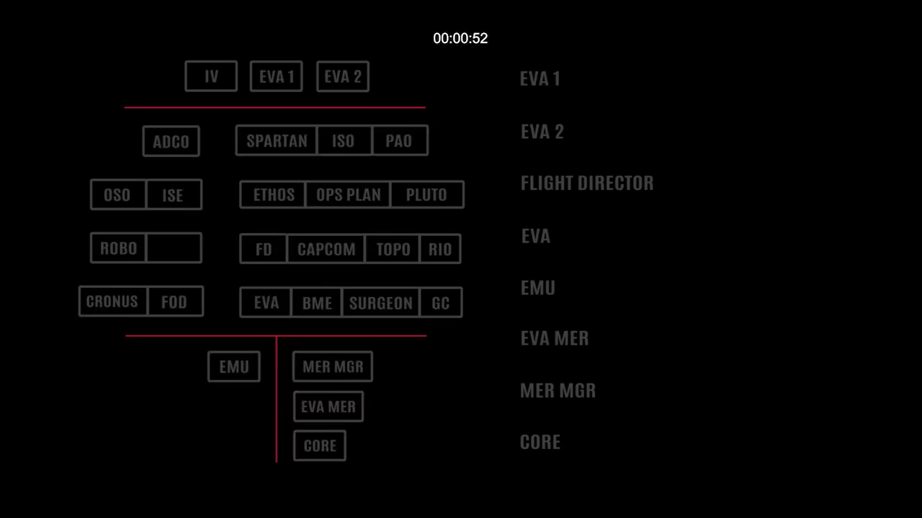
Criticality of Communication during Ops
Clear and timely communication is critical during real-time EVA operations. Past experiences have demonstrated that delays in information can cause teams to go down paths not intended by all teams.
Example from US EVA 32 – Water Switch flip during depress
Notes:
Sourced from https://fod2.jsc.nasa.gov/CA/CA7/onlinelessons/new_format/EVA32LessonsLearned/Lesson.html

Slide 44
EVA Development Process
Identify Prioritized Objectives
Create Draft Procedures and Training Documents
Test Procedures (NBL, Analog, etc)
Integrate Test results
Finalize Products for Execution

Slide 45

Notional EVA Timelines
FOD EVA is already working with ARES to identify potential objectives and their priorities.
These have been formulated into Summary EVA Timelines which can be used for testing and requirements development.

Slide 46
EVA Operations Continuing Work
Risk
  Method to improve crew autonomy due to ≥8 sec delay
    Real-time independent procedure tracking as locations start having longer comm delays.
    Verbal note taking paired with imagery for downlink and analysis.
    Ability to give crew real-time procedures, data, pictures, or diagrams during the EVA to assist the crew with questions or obstacles.
    Navigation and Location tracking are new needs as we venture further from our homw vehicle, into PSRs, and other limited visibility areas.
Open Work
  Expand communication and integration methods for ground teams
    Inclusion of science community, CLIPS, and other outside of NASA players
    Integration between NASA and hardware owners (vehicle, payload, etc.)
    Will need planning data transfer and real-time communication means

Slide 47
Collaborative Forum
Please join us on Thursday for our Collaborative Forum to discuss the following question:
What hardware and systems should be made available to the operations team to reduce risk to loss of crew and loss of mission from an operations perspective?
  Training systems, knowledge capture and sharing, procedure editors, execution systems and hardware, contingency operations, etc.
  Are these hardware and systems ready to go or need to be developed more?

