Slide 1
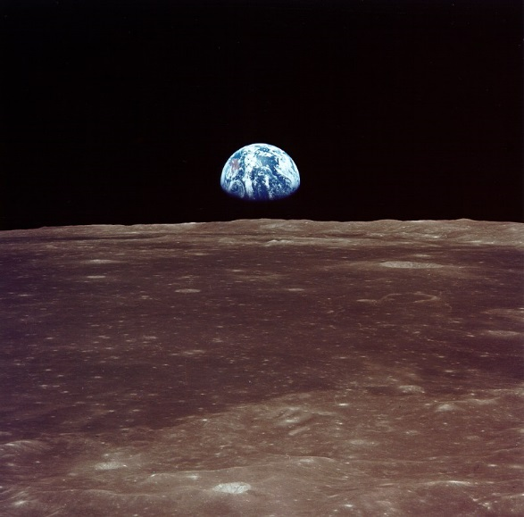
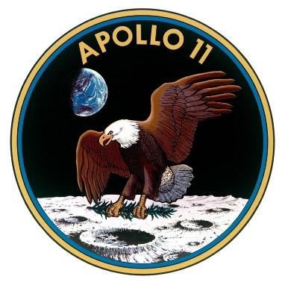
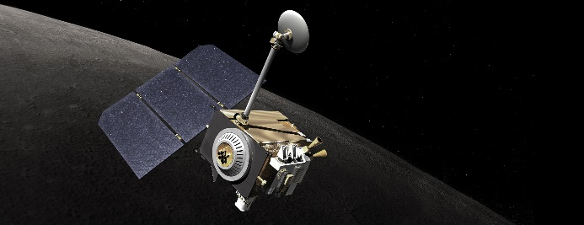
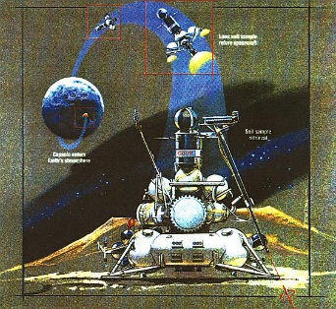

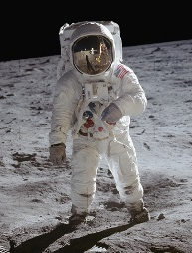
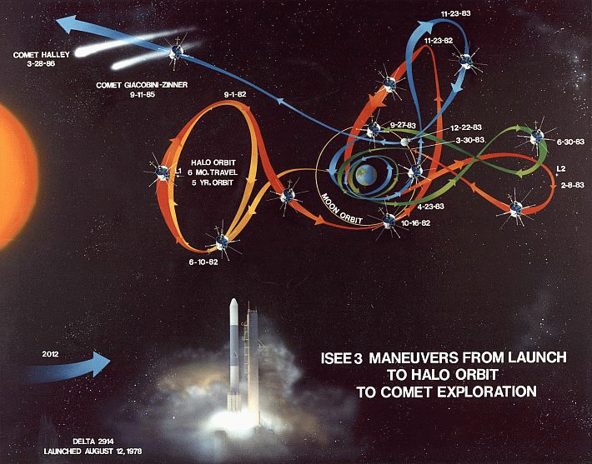
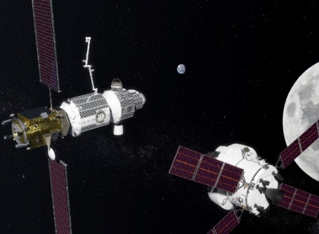
Astrodynamics of Lunar and Cis-Lunar Missions
IAC-19-C.1.4.1
70th International Astronautical Congress
David C. Folta
NASA Goddard Space Flight Center
Greenbelt, MD 20771
david.c.folta@nasa.gov
Luna
LRO
Chandrayaan
Gateway
Multi-body

Slide 2
Presentation Synopsis
Overview of astrodynamics evolution applied to lunar and cis-lunar missions
Assess background of the trajectory formulation of early missions and the ensuing astrodynamics expansion which followed
Discuss improvements applied to the lunar environment
  From a reliance on basic numerical and analytical modeling and targeting techniques to applications of dynamical systems and optimal formulations
  Thoughts on recent improvements that aid in the design of future mission hoping it will spark invention, regardless of how fanciful
Thank the many astrodynamicsts at NASA, universities, commercial partners, and international collaborators who strived to discover innovative methods to not only achieve lunar missions, but to provide access to distinctive orbits about the moon and in its neighboring environment
Its an honor to collaborate with these visionaries and to thank you for their tutelage and friendship

Slide 3
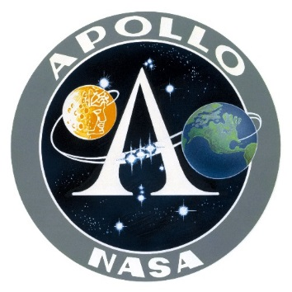
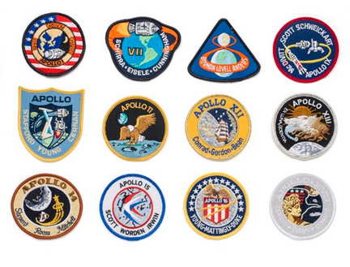
The Apollo Missions
Apollo Mission Goals
Project Apollo goals went beyond landing Americans on the moon and returning them safely to Earth included:
  Establishing the technology to meet other national interests in space.
  Achieving preeminence in space for the United States.
  Carrying out a program of scientific exploration of the Moon.
  Developing human capability to work in the lunar environment.
Insignia for the Apollo Program: a disk circumscribed by a band displaying the words Apollo and NASA.
50th anniversary of
Apollo 11 mission and the
first moonwalk by
Neil Armstrong
"That's one small step for a man. One giant leap for mankind.“ - Neil Armstrong

Slide 4


Apollo 11

Slide 5
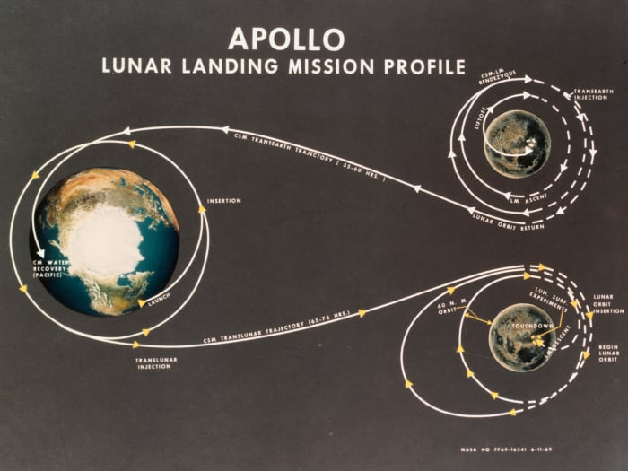
Apollo Mission Transfer Trajectory
Transfer design based on “Hohmann-like” transfer method
One revolution in Parking orbit before Translunar Injection
Injection on a direct transfer to encounter lunar gravity well
Included an Earth orbit midcourse transfer
Capture into an elliptical orbit of ~111km x ~314 km
A 100 km circular orbit (inclination ~ 32.5deg) with lower periapsis of ~ 18 km for the descent profile
Descent to Landing
Ascent profile to command module
~ 100 km orbit
Departure to Earth
Direct entry into atmosphere
Ref: Navigation Technical History with Lessons Learned, Mission Operations Directorate, Flight Design and Dynamics Division, Basic, April 2007, NASA, JSC

Slide 6
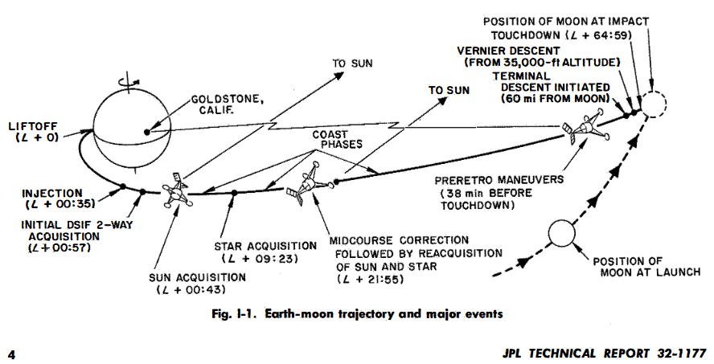
Pre-Apollo Missions
Out of the first 27 lunar missions, only three where successful !
Most encountered the lunar surface in direct motion along a hyperbolic trajectory
Example, Surveyor-III launched on April 17, 1967, at Cape Kennedy by Atlas/Centaur
What was the level of fidelity of the simulations and the environmental models for trajectory design and operations?
Ref: Goddard, https://nssdc.gsfc.nasa.gov/nmc/spacecraft/display.action?id=1964-041A
Ref: NASA Technical Report 32-1177 Surveyor Ill Mission Report Part I. Mission Description and Performance
Ref: https://moon.nasa.gov/exploration/moon-missions/

Slide 7
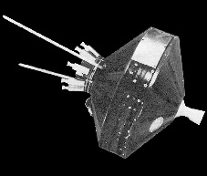
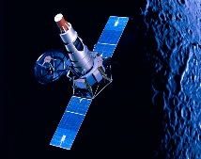
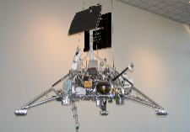
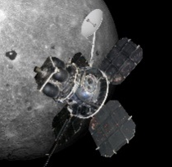
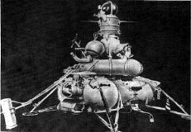
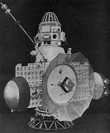
Pre-Apollo Missions
Dates | Mission | Details | Photos
1958- 1959 | Pioneer, Luna NASA, SPP | After seven failures, Pioneer and Luna missions provided photographs the Moon during flyby. Luna-3 developed film and transmitted the images of lunar far side back to Earth
1965-1969 | Ranger, NASA | Six s/c series of spacecraft launched in the 1960s to explore the Moon. Designed to take images as it descended to the lunar surface for impact
1965-1969 | SurveyorNASA | Five successful Surveyors returned >87,000 photos of the lunar surface and operated for about 17 months total on the lunar surface, demonstrated the feasibility of soft-landing a spacecraft on the lunar surface.
1960-1969 | Lunar Orbiter, NASA | Designed primarily to photograph smooth areas of the lunar surface for selection of safe landing sites for the Apollo missions. LO-1 was the first U.S. spacecraft to orbit the Moon, 186 km x 1866 km
1960-1974 | Luna, SPP | Designed to take the first photographs of the surface of the Moon from lunar orbit and to obtain data on gravitational anomalies on the Moon. Fifteen successful, each designed as either an orbiter or lander. Studied Moon's composition, gravity, temperature, and radiation
1960s | ZOND, SPP | Series of circumlunar spacecraft designed to rehearse a piloted circumlunar flight. initiated in 1965
Ref: https://moon.nasa.gov/exploration/moon-missions/
* SPP: Soviet Space Program, Prior to Roscosmos

Slide 8
Simulation and Modeling Progress
Trajectory design and maneuver model resolution increased and computer power improved, but most modeling and integration types are very similar to current types
Based on Apollo and NASA Libration, Cis-lunar, and lunar missions
 | Apollo Era * | 1980s Operation (GSFC Ref for Libration and flybys) | Current Operations (GSFC ref Lib, Cis-lunar, flybys, lunar orbiters)
Coordinate frame | Mean Celestial Eq and Vernal Equinox, IMU, LVLH, | Inertial, Rotating, Fixed, IMU, LVLH, VBN, | Inertial, Rotating, Fixed, IMU, LVLH, VBN, Body, numerous, others
Perturbations | Simplified Earth model, third body (Sun, Moon, Earth), | Earth, Moon, Point mass third body (all planets and sun), Solar radiation pressure | Earth, Moon, Point mass third body, Solar radiation Pressure flat plate and coefficients, tides
Integration | Encke and Cowell | Cowell 12th Adams Bashforth Predictor Corrector, fixed step and Time regularized | Many RKN, RKV, Cowell, ref to GMAT and commercial s/w for examples
Atmospheric | Basic drag models | Drag models based on Harris Priester | Drag Models, HP, MJ70, MSIS, etc.
Ref: Navigation Technical History with Lessons Learned, Mission Operations Directorate, Flight Design and Dynamics Division, Basic, April 2007, NASA, JSC
Ref: ISEE-3 support, Lunar Prospector Support, LRO Support, Current GSFC capabilities

Slide 9
Simulation and Modeling Progress
Trajectory design and maneuver model resolution increased and computer power improved, but most modeling and integration types are very similar to current types
Based on Apollo and NASA Libration, Cis-lunar, and lunar missions
 | Apollo Era * | 1980s Operation (GSFC Ref for Libration and flybys) | Current Operations (GSFC ref Lib, Cis-lunar, flybys, lunar orbiters)
Lunar Gravity Models | 4x2 | 20x20 (Bills and Ferrari) | >150x150 based on LP, LRO, Grail
Maneuvers | Impulsive and Finite, some attitude profiles | Attitude dependent frames for Impulsive and Finite | Attitude dependent frames for Impulsive and Finite
Computer Systems | Mainframes and simplified calculators | Mainframe IBM 360-90 and 360-75, Phase over to PC in early 90’s. Start of visualization | Laptops, Servers, Unix, PC, Multi-core systems High end 3-D Visualization
Analytical | Needed for speed, lambert targeting | Speed not required for mission types, Differential Correctors and Optimization (e.g. Steepest descent) | Increase CPU capabilities, e.g. GPU, Differential Correctors, Collocation, Optimization (multiple methods, e.g. SNOPT)
Ref: Navigation Technical History with Lessons Learned, Mission Operations Directorate, Flight Design and Dynamics Division, Basic, April 2007, NASA, JSC
Ref: ISEE-3 support, Lunar Prospector Support, LRO Support, Current GSFC capabilities

Slide 10
The Decade Without A Lunar Mission
No lunar missions were launched in the 1980s
Lunar Exploration ended with the last of the Apollo and Luna missions, the next program was the Space Shuttle / HST and planetary missions
  The last lunar missions being Apollo 17 (‘74), Luna 21 (Lunokhod 2 (rover)), 22-24 (‘76) and Luna 24 delivering a sample to Earth on August 23 1976
Improvements in Cis-lunar designs and astrodynamics advancement
  The ISEE-3 / ICE (Farquhar) mission began the improvement with first Sun-Earth libration orbiter that demonstrated multi-body dynamics and realism of circular restricted three body approach
  Multiple lunar flybys and Cis-lunar design
  Comet intercept of Giacobini-Zinner in 1985
  ISEE-3 / ICE returned to Earth in 2014, with a flyby after a completed heliocentric transfer
Ref: https://moon.nasa.gov/exploration/moon-missions/

Slide 11
The Decade Without A Lunar Mission
Mathematical approaches and applications of CRTB and its expansions
Research from Carlos Simo, Josep Masdemont, Gerard Gomez, Angel Jorba, Jerry Marsden, John Blackwell, Kathleen Howell, Martin Lo, Jim Miller, Edward Belbruno, Dan Scheeres, Bob Farquhar, Archie Roy, Victor Szebehely, and many others continued on dynamical systems
ISEE-3 / ICE Mission
Credit: (NASA) Farquhar, Dunham, Folta, Muhonen

Slide 12
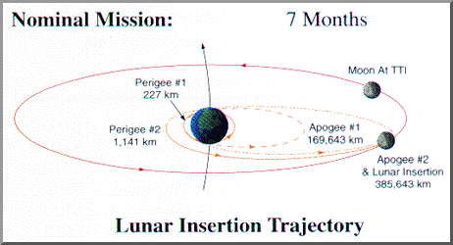
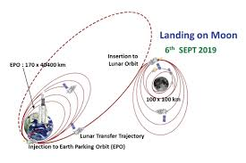
Restart of Lunar Exploration
      During the timeframe from Apollo to today, a principle transfer design is a direct or increasing apoapsis orbit which permit a direct lunar insertion or flyby
        The advantage of this Hohmann-like design permit rapid transfer and longer launch opportunities
      Increasing concentric elliptical orbits were used by several missions, use of the Oberth effect permits increased efficiency and allows the benefits of lunar encounter timing and perturbations
        WIND, Clementine, Themis/Artemis, Chandrayann
Clementine
Chandrayann

Slide 13
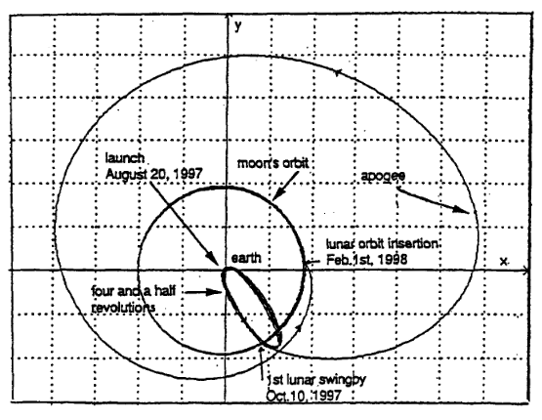
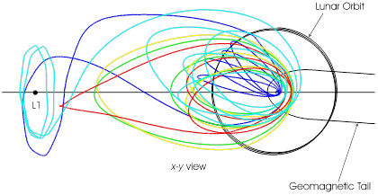
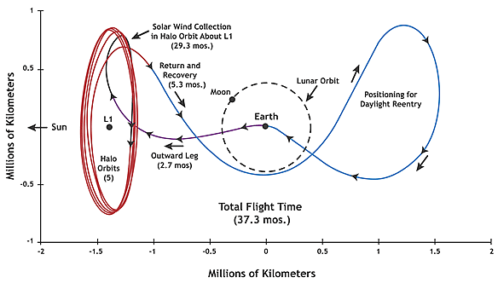
Restart of Lunar Exploration
The 1990’s provided continued improvements and mission applications for multibody dynamics and a return to the moon
Demonstrated new methods to reach the moon and to design cis-lunar missions, Improve the operational accuracies and navigation requirements
Hiten (1990) first use of a ballistic transfer with s/c in elliptical Earth orbit and flybys. (Wiki ref), Placed in to lunar orbit
WIND (1994) and Geotail missions did not enter into lunar orbit, but used lunar gravitational assist to attain their respective Cis-lunar and Sun-Earth libration mission orbits.
Genesis (2001) demonstrated the interactions of the dynamical regions for transfer to Earth entry
Hiten
WIND
GENESIS
Ref: https://en.wikipedia.org/wiki/Hiten
https://wind.nasa.gov/
https://genesismission.jpl.nasa.gov/

Slide 14
Restart of Lunar Exploration
Lunar missions in the 1990s lead to the discovery of water presence
  Clementine Mission (1994), Joint mission with Ballistic Missile Defense Organization (BMDO) and NASA
    Lunar orbit of 430 km x 2950 km in 1994, Transferred to trajectory for asteroid encounter Geographos
    Obtaining multi-spectral imaging of the entire lunar surface, assessing the surface mineralogy of the Moon, obtaining altimetry from +/- 60 deg latitude and obtaining gravity data for the near side
  Lunar Prospector mission (1997), NASA’s first low circular polar orbit of 100 km. Achieve orbit of ~15 km x ~40 km, and discovered frozen lunar orbit conditions Controlled impact at end of mission
    Increased gravity model degree and order, LP inserted into orbit with a 20 x 20 deg and order Bills and Ferrari (A Harmonic Analysis of Lunar Gravity, 1980)
    Six months later a 100 deg and order gravity model based on Doppler measurements (ref: Alex Konopliv / JPL and Frank Lemoine / GSFC)
    Previous (1963) research on the interaction of perturbations that permit lunar frozen orbits. Lidov, M.L., (1963), Ely and Lieb (2005), Ramanan and V. Adimurthy (2005), Park S.Y. and Junkins (1995), Elipe and Lara, (2003), Folta and Quinn (1998, 1999 (post LP mission results))

Slide 15

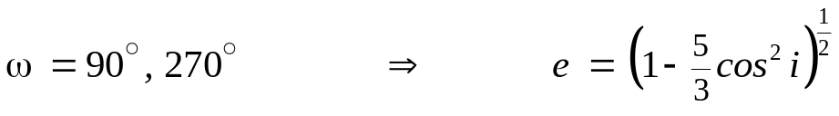

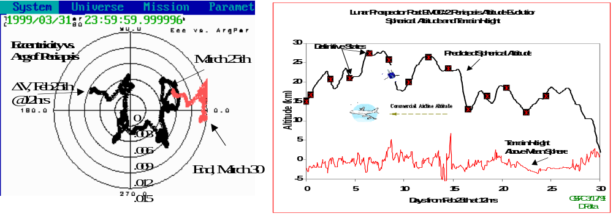
Low Lunar Frozen Orbits
No closed-form analytical solutions for frozen orbits below critical inclination of 39.23°
For inclinations between 39.23° through 140.77° (where ω = 90° or 270°), there exists an eccentricity which can set both ω and e rates to zero; hence the frozen condition is satisfied.

Slide 16
Two Decades of Lunar Exploration
SMART-1 | 2003 | ESA | Low thrust spiral to moon, multi body effects
SELENE | 2007 | JAXA | Low lunar circular orbit of 100 km
Chang’e 1 | 2007 | CNSA | Low Lunar circular orbit of 200 km
Chandrayann | 2008 | ISRO | Low Lunar polar circular orbit of 200 km
LRO (LCROSS) | 2009 | NASA | Lunar Mapping mission, now in Frozen polar orbit, LCROSS Impactor
Chang’e 2 | 2010 | CNSA | Low Lunar Orbit, Transfer to Sun-Earth L2 orbit, and then to Asteroid
ARTEMIS (2 s/c) (Themis) | 2010 | NASA | First Low energy transfer to Earth-Moon L1 & L2 Orbits, heteroclinc transfer from EML2 to EML1, transfer into elliptical lunar orbits (Still active)
GRAIL (2 s/c) | 2011 | NASA | Low energy transfer, Measured high-quality gravitational field mapping to determine its internal structure, 25 km x 86 km orbit
LADEE | 2013 | NASA | Launched from NASA's Wallops Flight Facility in Virginia. Lunar laser communications demonstration experiment (LLCD), ~25 x ~60 km orbit
Chang’e 3 (Yutu) | 2013 | CNSA | Low Lunar Orbit, Lander and rover, first since Luna in 1976
Chang’e 4 (Yutu) | 2018 | CNSA | Lander and EM L2 Relay with back side of moon lander and rover, Yutu
Beresheet | 2019 | Israel | Lunar Landing attempt
Chandrayann -2 | 2019 | ISRO | Low Lunar Orbiter, Lander, Rover
Ref: https://moon.nasa.gov/exploration/moon-missions/

Slide 17
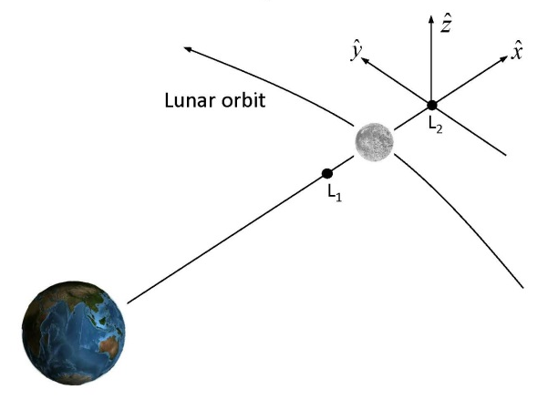
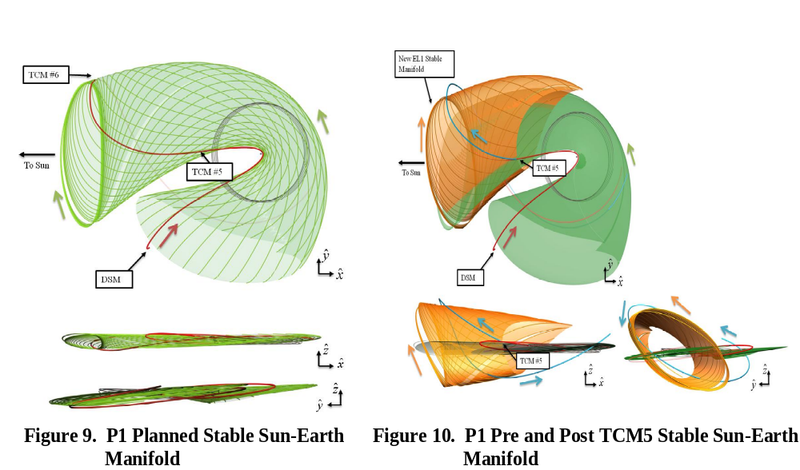
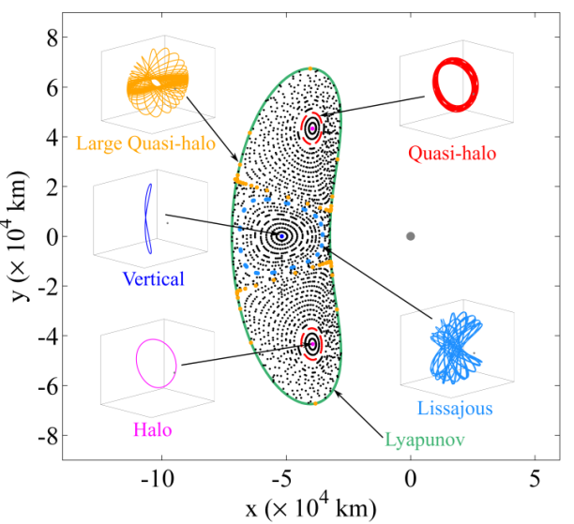
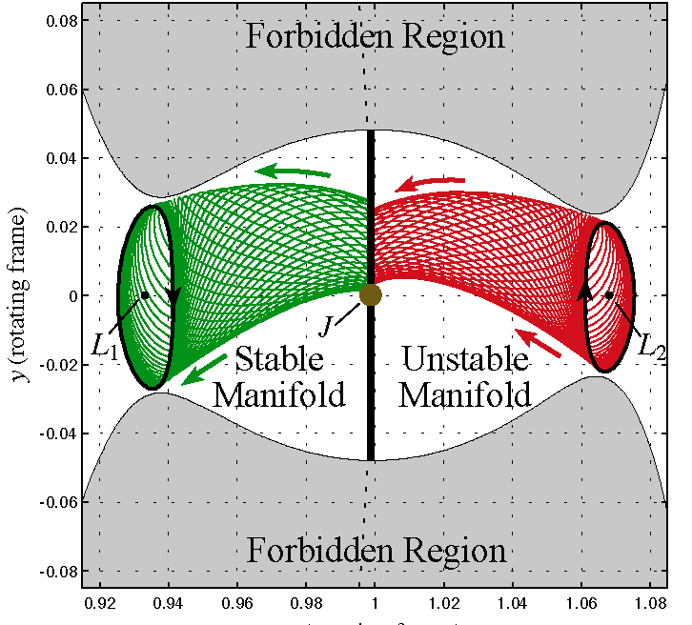
Multi-body Transport Network Building Blocks
Multi-body Motion
Manifolds
Poincaré Maps
Escape Flow
Credit: Martin Lo (JPL), Kathleen Howell (Purdue)

Slide 18

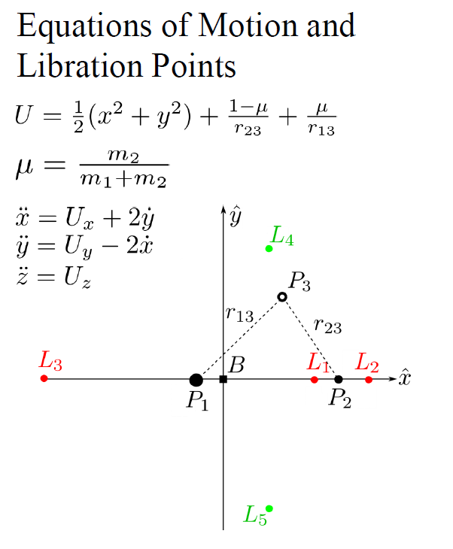
Circular Restricted Three Body Problem
Three-body problem: an analytical solution does not exist
A ‘rule’ for the evolution in terms of a set of nonlinear differential equations
  Deterministic for one particular initial state only one set of future states evolves
Know particular equilibrium solutions (L₁ and L₂ are equilibrium points, with two centre components,) and we have successfully determined – and learned to compute -- some periodic solutions of which there is an infinite number
Hamiltonian structure of the system gives rise to the different families of periodic orbits
Approximate solution numerically, linearize to understand the motion around the libration point, yield information on the stable and unstable directions which give rise to the stable and unstable manifolds
Spacecraft
Sun
Earth
Notes:
The circular restricted three-body problem is a valid approximation of elliptical orbits found in the Solar System, and this can be visualized as a combination of the potentials due to the gravity of the two primary bodies along with the centrifugal effect from their rotation (Coriolis effects are dynamic and not shown). The Lagrange points can then be seen as the five places where the gradient on the resultant surface is zero (shown as blue lines) indicating that the forces are in balance there.
Three-body problem: an analytical solution does not exist. So we have a ‘rule’ for the evolution in terms of a set of nonlinear differential equations. But the rule is deterministic, that is, for one particular initial state only one set of future states evolves. We do not have a complete solution; we cannot solve those equations so we do not know the states for all initial conditions and for times past, present and future. We know some particular equilibrium solutions (libration points) and we have successfully determined – and learned to compute -- some periodic solutions of which there is an infinite number.
We can choose the units of mass, distance and time so that the gravitational constant is 1, and the period of the circular orbits is 2π. . We can study the dynamics relative to a co-rotating system of coordinates for which the positions of the primaries relative to this system are … The motion of the infinitesimal particle relative to the co-rotating frame is described by the second order differential equations:
The Jacobi Constant; named after Carl Gustav Jacob Jacobi) is the only known conserved quantity for the circular restricted three-body problem.^{[1]} Unlike in the two-body problem, the energy and momentum of the system are not conserved separately and a general analytical solution is not possible. The integral has been used to derive numerous solutions in special cases.
Note that the Jacobi integral is minus twice the total energy per unit mass in the rotating frame of reference: the first term relates to centrifugal potential energy, the second represents gravitational potential and the third is the kinetic energy. In this system of reference, the forces that act on the particle are the two gravitational attractions, the centrifugal force and the Coriolis force. Since the first three can be derived from potentials and the last one is perpendicular to the trajectory, they are all conservative, so the energy measured in this system of reference (and hence, the Jacobi integral) is a constant of motion.

Slide 19
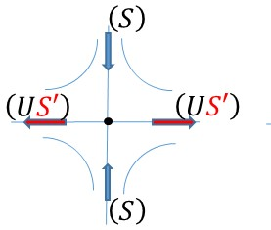
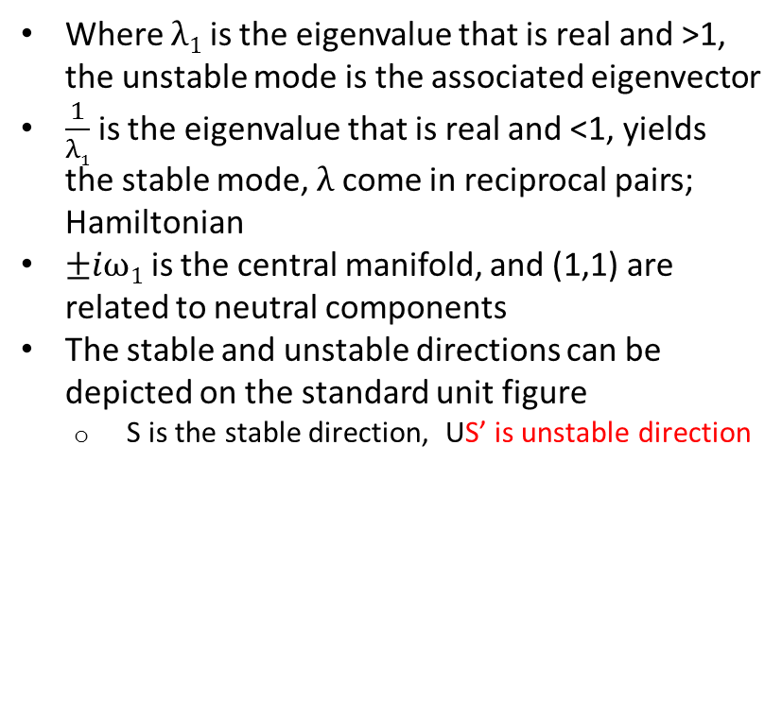
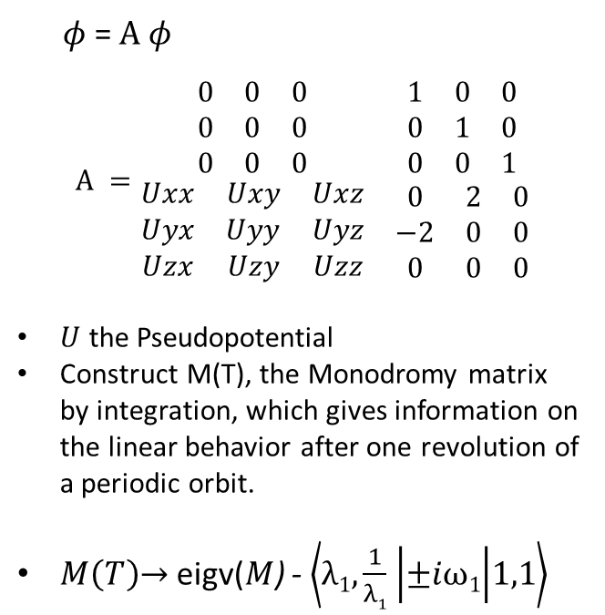
Circular Restricted Three Body Problem
Formulation of linear equations of motion and their stability that provides transfer information. Heteroclinic and homoclinic transfer designs are based on CRTB properties and numerical integration
Where $λ1$ is the eigenvalue that is real and >1, the unstable mode is the associated eigenvector
$\frac{1}{λ1}$ is the eigenvalue that is real and <1, yields the stable mode, $λ$ come in reciprocal pairs; Hamiltonian
$±iω1$ is the central manifold, and (1,1) are related to neutral components
The stable and unstable directions can be depicted on the standard unit figure
  S is the stable direction, US’ is unstable direction
.
$φ$= $A φ$
$$A =\begin{matrix}\begin{matrix}0 & 0 & 0 \\ 0 & 0 & 0 \\ 0 & 0 & 0\end{matrix} & \begin{matrix}1 & 0 & 0 \\ 0 & 1 & 0 \\ 0 & 0 & 1\end{matrix} \\ \begin{matrix}Uxx & Uxy & Uxz \\ Uyx & Uyy & Uyz \\ Uzx & Uzy & Uzz\end{matrix} & \begin{matrix}0 & 2 & 0 \\ −2 & 0 & 0 \\ 0 & 0 & 0\end{matrix}\end{matrix}$$
$U$ the Pseudopotential
Construct M(T), the Monodromy matrix by integration, which gives information on the linear behavior after one revolution of a periodic orbit.
$M\left(T\right)\overset{→}{ }$ eigv($M$) - $\left\langle λ1,\frac{1}{λ1} | ±iω1 | 1,1\right\rangle$
Notes:
The circular restricted three-body problem is a valid approximation of elliptical orbits found in the Solar System, and this can be visualized as a combination of the potentials due to the gravity of the two primary bodies along with the centrifugal effect from their rotation (Coriolis effects are dynamic and not shown). The Lagrange points can then be seen as the five places where the gradient on the resultant surface is zero (shown as blue lines) indicating that the forces are in balance there.
Three-body problem: an analytical solution does not exist. So we have a ‘rule’ for the evolution in terms of a set of nonlinear differential equations. But the rule is deterministic, that is, for one particular initial state only one set of future states evolves. We do not have a complete solution; we cannot solve those equations so we do not know the states for all initial conditions and for times past, present and future. We know some particular equilibrium solutions (libration points) and we have successfully determined – and learned to compute -- some periodic solutions of which there is an infinite number.
We can choose the units of mass, distance and time so that the gravitational constant is 1, and the period of the circular orbits is 2π. . We can study the dynamics relative to a co-rotating system of coordinates for which the positions of the primaries relative to this system are … The motion of the infinitesimal particle relative to the co-rotating frame is described by the second order differential equations:
The Jacobi Constant; named after Carl Gustav Jacob Jacobi) is the only known conserved quantity for the circular restricted three-body problem.^{[1]} Unlike in the two-body problem, the energy and momentum of the system are not conserved separately and a general analytical solution is not possible. The integral has been used to derive numerous solutions in special cases.
Note that the Jacobi integral is minus twice the total energy per unit mass in the rotating frame of reference: the first term relates to centrifugal potential energy, the second represents gravitational potential and the third is the kinetic energy. In this system of reference, the forces that act on the particle are the two gravitational attractions, the centrifugal force and the Coriolis force. Since the first three can be derived from potentials and the last one is perpendicular to the trajectory, they are all conservative, so the energy measured in this system of reference (and hence, the Jacobi integral) is a constant of motion.

Slide 20
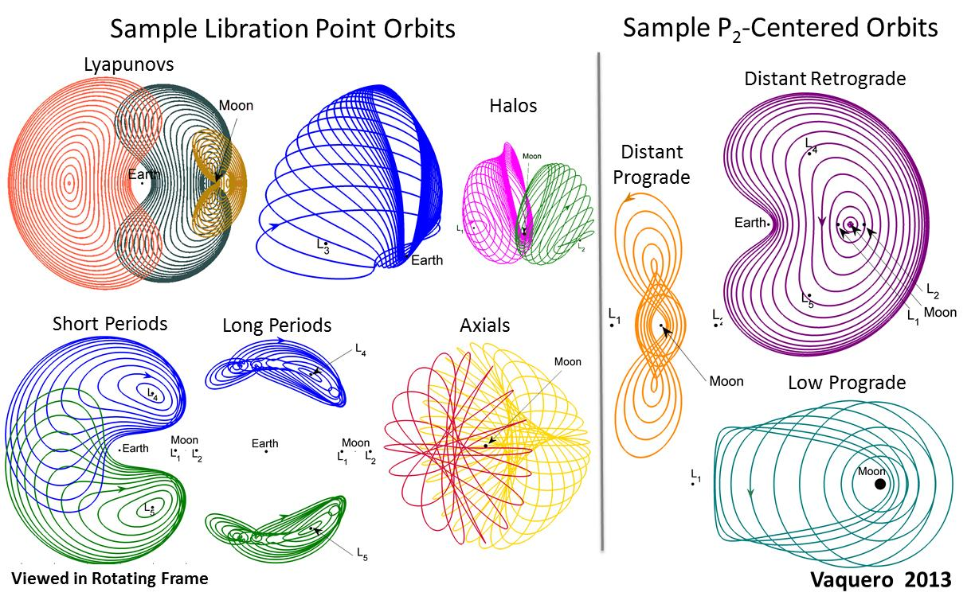
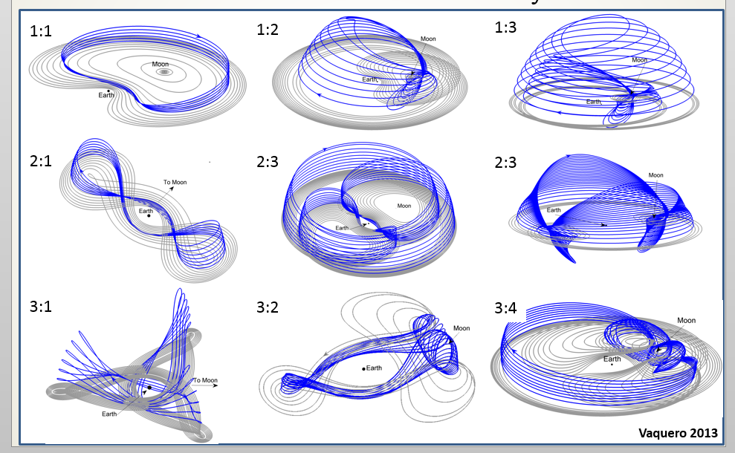
CRTB and Lunar Orbit Constructs
What did this dynamical system approach provide in cis-lunar orbit design?
CRTB system can be used to define types of orbits available for cis-lunar mission and to define initial conditions for lunar transfers
Credit: Mar Vaquero, Kathleen Howell (Purdue)

Slide 21
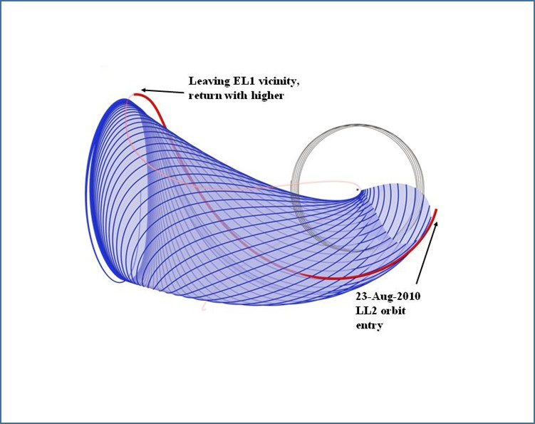
Multi-body Dynamics
The next logical step is to determine if the natural flow in the system has some structure
If the system does not originate (initial conditions) on one of the known particular solutions, is the evolution at all predictable?
Does the evolution of the states follow some pattern?
Since the orbits are unstable, there is flow toward and away from these structures (manifolds) and it is the natural place to start to seek understanding of the natural flow of the system
Natural flows evolve and we continue to learn how they are connected / linked and how they can be exploited for Cis-lunar and lunar missions
Sample Flow towards Libration Orbit
Credit: Howell (Purdue), Lo (JPL), Folta (GSFC)
Notes:
Manifolds: We do not know the complete evolution of the states but, given the particular solutions we have (points, periodic solutions, etc.) The next logical step is to determine if the natural flow in the system has some structure. If the system does not originate (initial conditions) on one of the known particular solutions, is the evolution at all predictable? Does the evolution of the states follow some pattern? Can it be predicted? Since the points/orbits are saddles, there is flow toward and away from these structures (manifolds) and it is the natural place to start to seek understanding of the natural flow of the system. We have examined how the flows evolve and continue to learn how they are connected/linked and how we can exploit that natural flow for space vehicles.

Slide 22
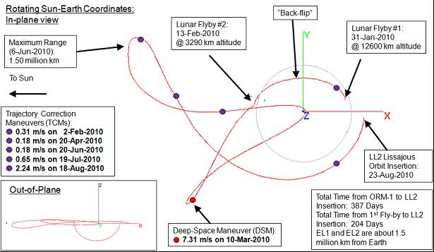
Applying Multi-body Dynamics
Applied to the Themis/ Artemis P1 Mission trajectory design to achieve lunar orbit from an Earth elliptical orbit, and to raise periapsis to lunar orbit
Two lunar gravity assist separated by 13 days for flip of apoapsis direction
Deterministic Deep Space Maneuver (DSM1) was performed 33 days later
All maneuvers target the Earth-Moon libration insertion state
Unstable Lissajous manifold towards the Earth-Moon system
An L₂ Lissajous insertion orbit maneuver of 2.56 m/s
Credit: Folta (GSFC), Woodward (GSFC), Sweetser (JPL), Broschart, (JPL)

Slide 23
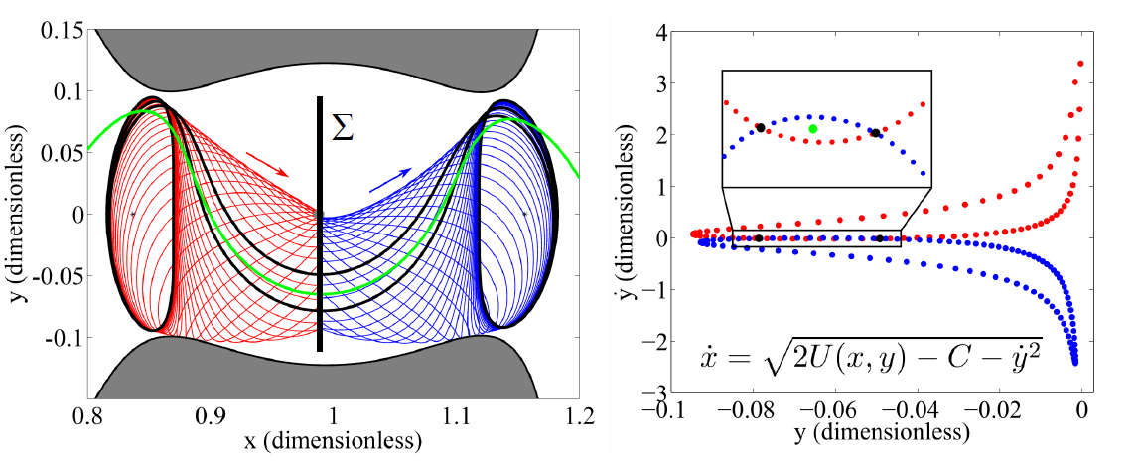
Applying Multi-body Dynamics
Combining Manifolds for Transfer between and within Libration Point Orbits
Technique from W.S. Koon, M. Lo, J.E. Marsden, and S. D Ross, “Heteroclinic Connections Between Periodic Orbits and Resonance Transitions in Celestial Mechanics”, Chaos, Vol 10, 2000, pp. 427-469

Slide 24
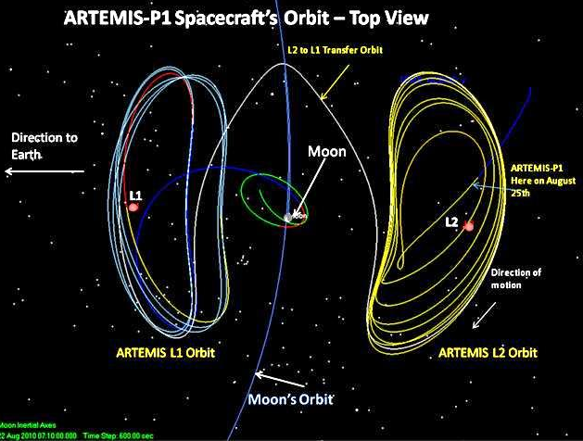
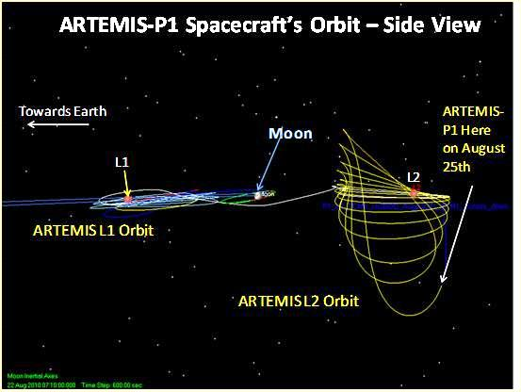
Applying Multi-body Dynamics
Themis/ Artemis Trajectory, first Earth-moon L1/L2 libration orbiters
Earth-moon Libration Orbit
P1 captured into EML₂ Orbit
Transferred to EML₁ Orbit
Transferred from EML₁ to Lunar Orbit
P2 s/c entered into EML1 via EML2 and transferred to lunar orbit
Credit: Folta (GSFC), Woodward (GSFC), Artemis Mission Design

Slide 25

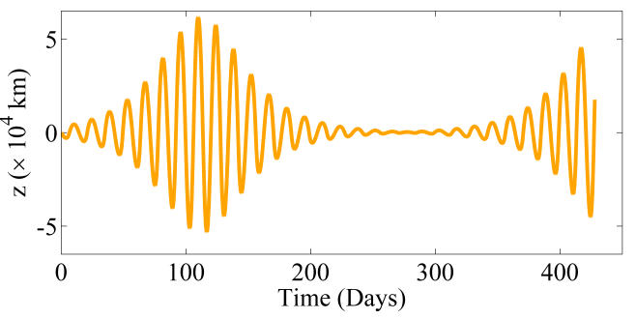
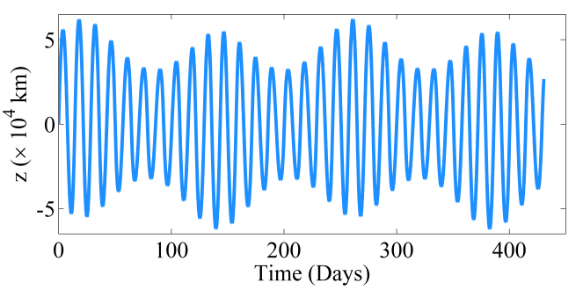
Mapping the Orbit Space Using Poincaré Sections
Poincaré Map Depicting Earth-moon L₁ Periodic and Quasi-Periodic Libration orbit Structures
Use the Earth – moon plane as the surface-of-section
Apply an Earth-Moon system energy level, e.g. C = 3.080
Large Quasi-halo
Moon
Lissajous
Credit: Martin Lo (JPL), Kathleen Howell (Purdue)

Slide 26
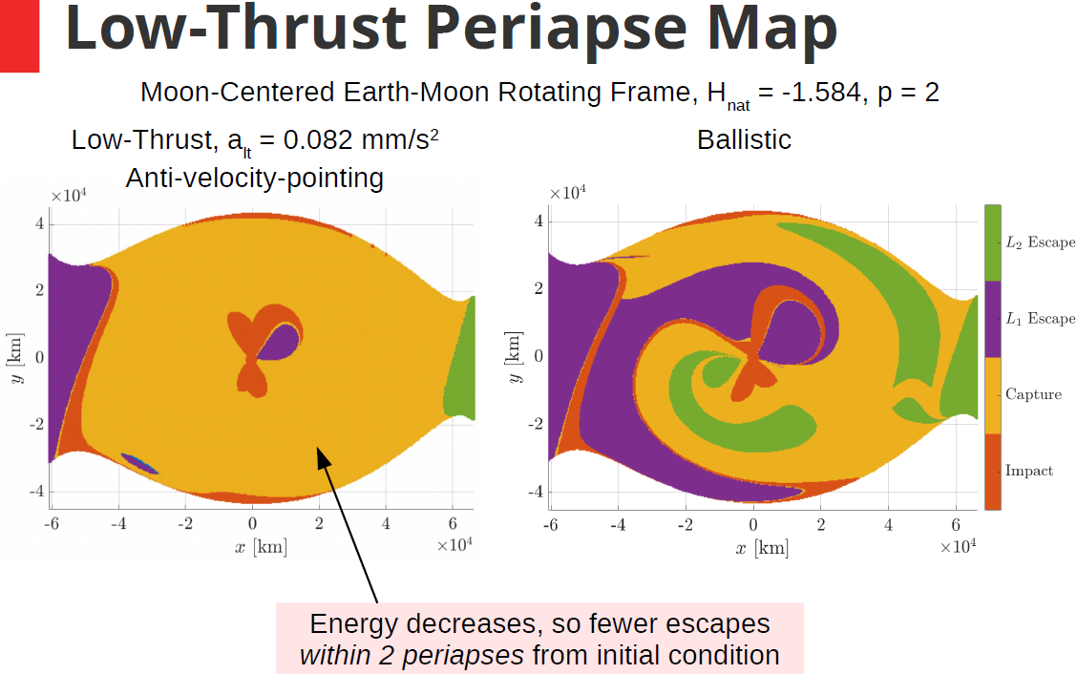
Application of Dynamical Systems for Lunar Exploration
Application to natural and low thrust lunar ballistic capture scenario
One common visualization strategy for apse maps is to color the initial apse states by the behavior of the resulting arc
The initial state of a trajectory that impacts the moon within the p = 2 map returns is colored red
The initial states for trajectories that depart through the L1 and L2 gateways are colored purple and green
Trajectories that remain in the lunar region (r < 115,500 km) are termed “captured,” and the associated initial states are depicted in orange
Credit: Andrew Cox (Purdue)

Slide 27
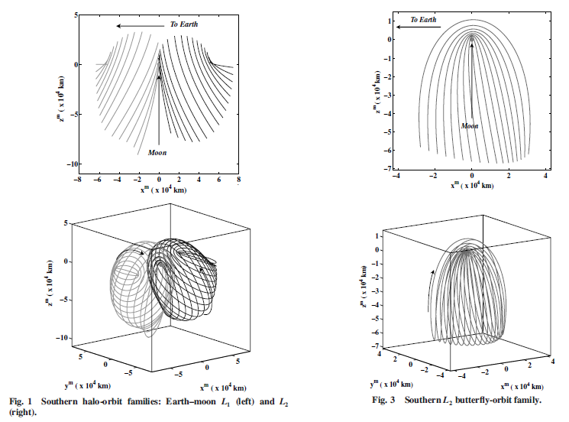
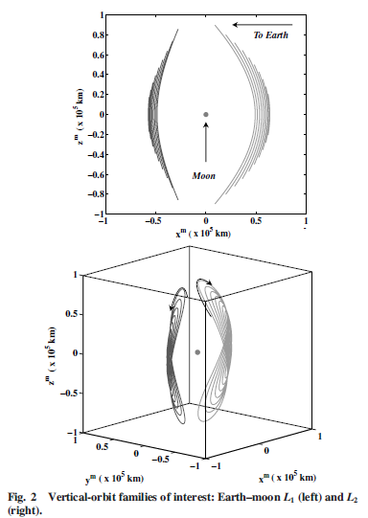
Application of Dynamical Systems for Lunar Exploration
Various lunar orbits can be implemented used these dynamics
Near Rectilinear Halo Orbits (NRHO), Butterfly, and Vertical orbits are useful for lunar communication and observation coverage
Southern Halo Families
Southern Butterfly Families
Vertical Families
NRHO
NRHO
Credit: Howell (Purdue), Ozimek (Purdue, APL), Bosanac (Colorado), Davis (JSC, ai-solutions)

Slide 28

Transfers to NRHO
Three NRHO transfers with similar arrival epochs
Credit: Diane Davis (ai-solutions) Gateway Lead, JSC

Slide 29
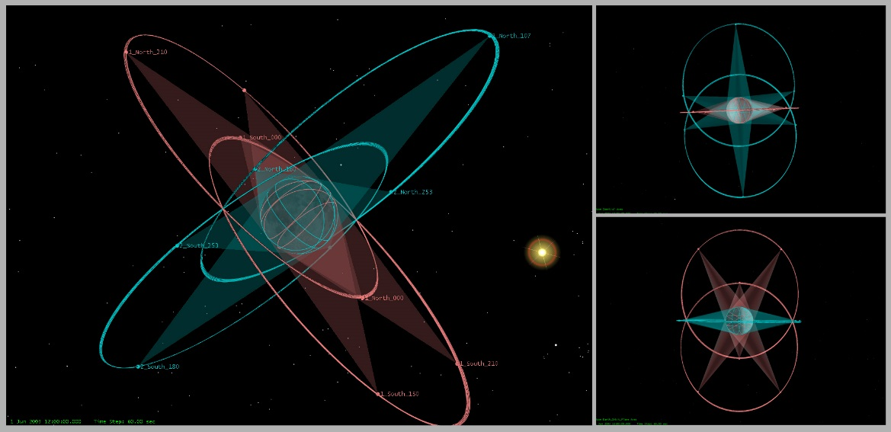
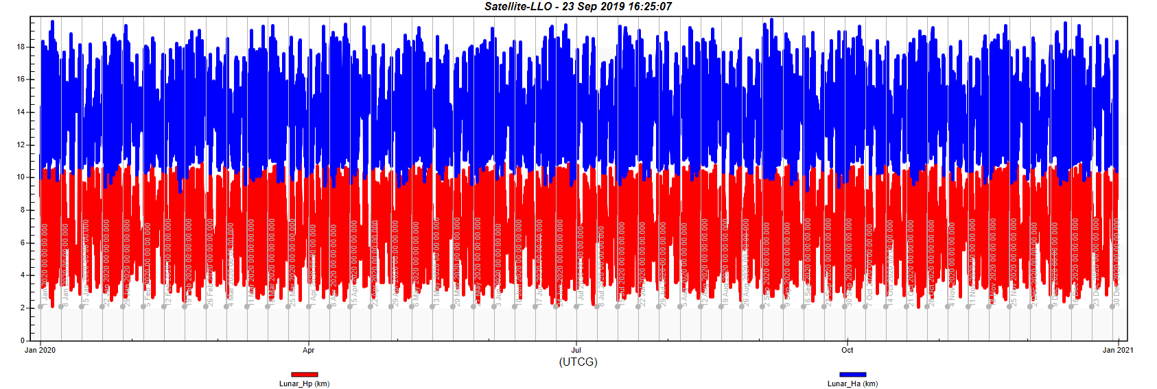
Frozen Orbits Application to Coverage and Altitude
Global Coverage Constellation Parameters: 2 s/c per orbit plane, 18hr orbits ( a~8049, e = 0.4082)
Orbit planes at right angle to each other but at i = 45º
For continuous and simultaneous coverage, two orbit planes with
ω = 90º and 270º
Nodes separated by 180º
Can utilize 8 or 12 spacecraft
Low Lunar Orbit, altitude
between 2 km and 20 km for long duration observations
Use of low lunar prediction of gravity effects and frozen orbit designs
Credit: Folta (GSFC), Quinn (GSFC), Ely (JPL)
Credit: Folta (GSFC), Quinn (GSFC), Mesarch (GSFC)

Slide 30
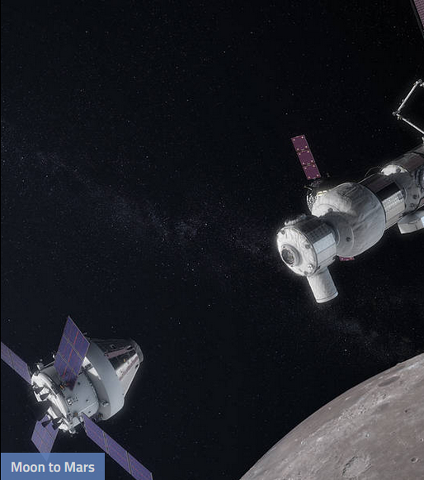
ARTEMIS - Going to the Moon
Gateway: Multi-body applications for a NRHO
Orion: Multi-body applications for DRO, NRHO, and transfers via lunar assist
Relays: Based on multi-body (EML₁, EML₂, NRHO) and two-body with perturbations (Circular relays at various orbit altitudes and inclinations
Low Lunar Orbits: Using improved gravity models
Landers: Transfers based on above improved gravity and navigation systems
The difficulties of Lunar and Cis-lunar missions are being challenged, we now have detailed understanding and innovative design methods
New innovations – Frozen Orbits, NRHO, EM-Libration, and more will permit achievement of upcoming international lunar missions

Slide 31
Thank You
My appreciation goes to Dr. Conrad Schiff (NASA/GSFC), Dr. David Dunham (KinetX), Dr. Josep Masdemont (Universitat Politecnica de Catalunya , UPC), Dr. Gerard Gomez (University of Barcelona), Dr. Edward Belbruno (Princeton), Dr. Daniel Scheeres (Colorado University), Dr. David Spencer (Penn State), Dr. Natasha Bosanac (Colorado University), Dr. Amanda Haapala (APL), Dr. Martin Ozimek (APL), Dr. Thomas Pavlak (JPL), Dr. Diane Davis (ai-solutions/JSC), and Dr. Belinda Marchand (Purdue / ProGalaxia). And to many others who developed the basics of what I applied in various missions, thank you.
I would especially like to recognize Dr. Kathleen Howell (Purdue University), Dr. Martin Lo (JPL) and the late Dr. Robert Farquhar (NASA, APL, KinetX), without whose guidance and friendship I would not have accomplished nor understood nearly as much in applying dynamical systems theory.
Needless to say, for all the tireless support and understanding, thank you Mary, my wonderful wife.

Slide 32
Thank You
AS11-44-6550
Earthrise viewed from lunar orbit prior to Apollo 11 landing
July 1969

