Slide 1
Psychoacoustic Considerations
for UAS/UAV and UAM
Andrew Christian
Structural Acoustics Branch
NASA Langley Research Center
Engineering a Quieter America – UAS and UAV:
Noise Emissions and Noise Control Engineering Technology Workshop
December 13th, 2018

Slide 2
What Do I Mean By Psychoacoustics?
Primarily three things:
The study of the human hearing mechanism (the ear, et al.), and how that mechanism shapes perception.
The study of human (qualitative) perception of sound.
The study of psychosocial factors that lead from perception to attitudes (annoyance) and behaviors (complaints).

Slide 3
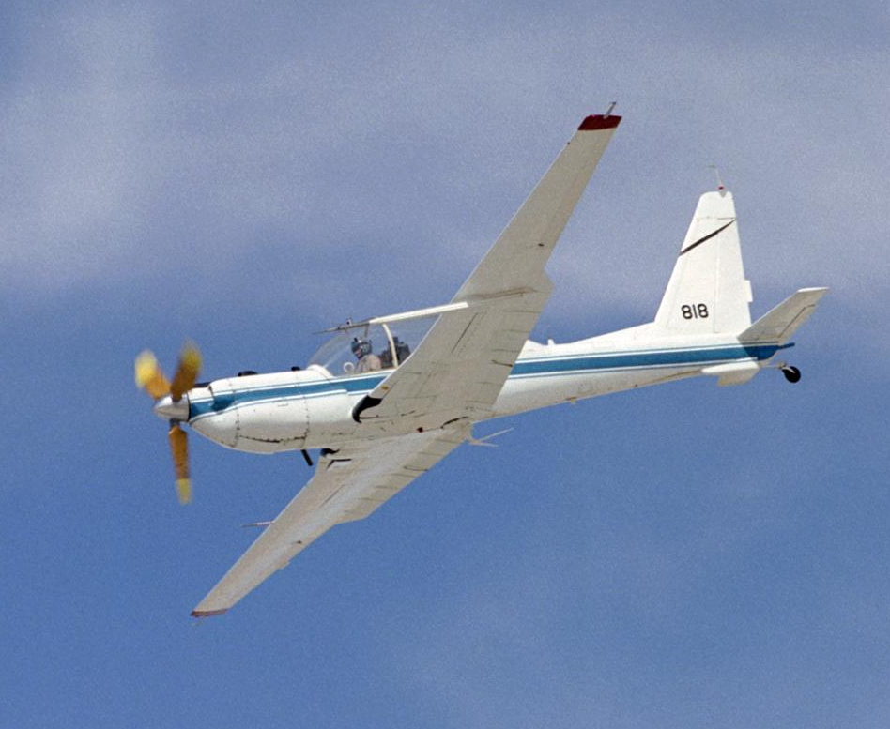
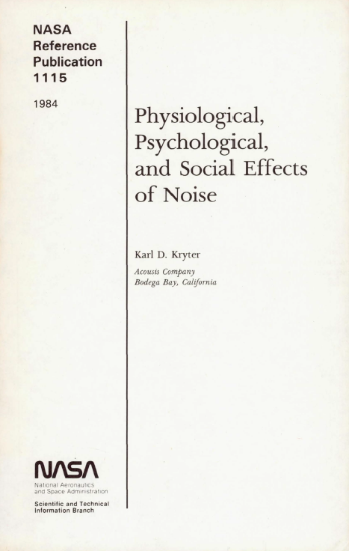
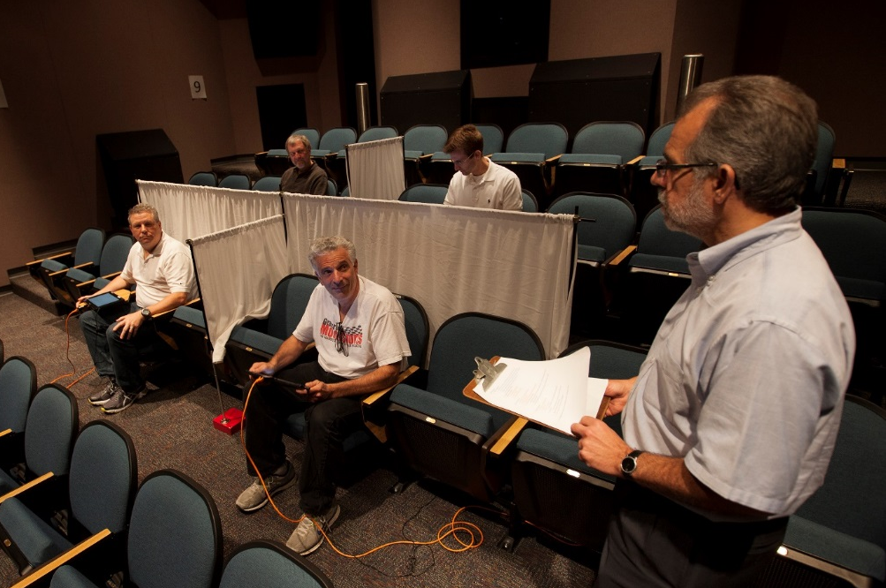
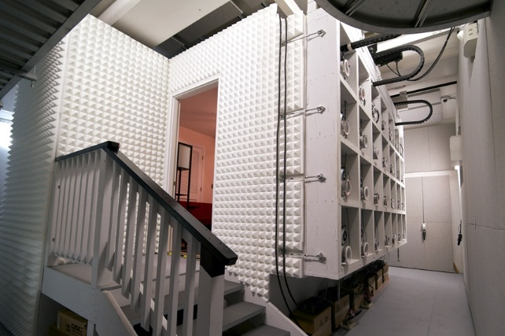
What Do I Mean By Psychoacoustics?
NASA has both recent and historical experience in all three aspects.
  For instance, with the execution of psychoacoustic tests in purpose-built facilities.

Slide 4
What Do I Mean By Psychoacoustics?
This presentation will cover facets of psychoacoustics that are likely to become pertinent to UAS/UAV and UAM noise.
A mix of contemporary research and well-established facts from the psychoacoustic literature will be provided.
Typically, there will be a mix of encouraging and discouraging implications.
Superscripts indicate Notes and References, which appear at the end of the presentation.

Slide 5
Loudness, In General
“…loudness may be defined as that attribute of auditory sensation that corresponds most closely to the physical measure of sound intensity…”¹
Throughout the past century, psychoacousticians have been refining their definition of loudness. Past definitions have come to heavily inform current aviation noise regulation (dBA, PNL, etc.).²
Now there are multiple standardized programs for the computation of “Loudness” for arbitrary sounds.³

Slide 6
Loudness, In Particular
The Loudness metrics generally correlate strongly with older measures of loudness (e.g., dBA), and to a first order with annoyance.⁴
The programs to calculate Loudness have become progressively more detailed over time.
  They are perhaps less than parsimonious if they are not significantly more accurate than simpler measures.⁵
Loudness-based computations produce estimates of the audibility of a sound in a background, as well as other related metrics that measure qualitative aspects of sound (e.g., impulsiveness).

Slide 7
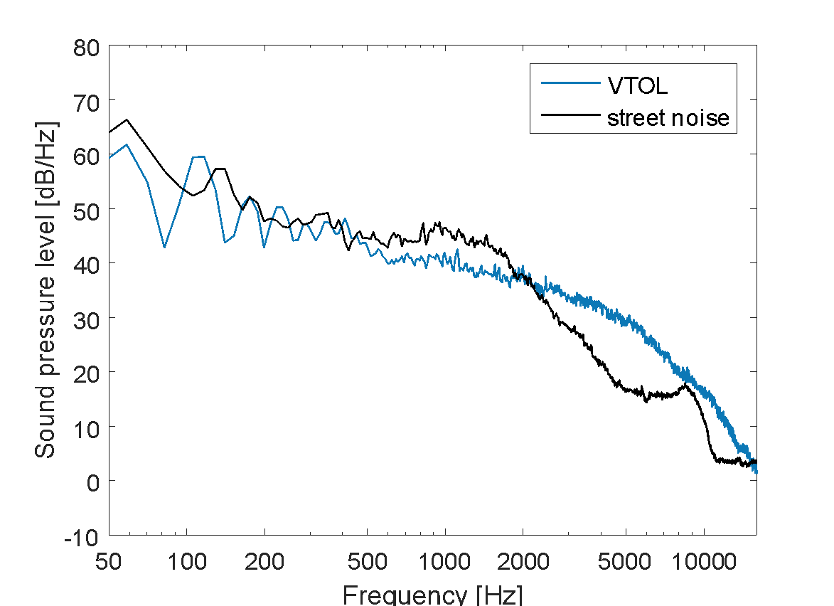
Loudness and Audibility
Recent work has joined Loudness, with empirical data to produce estimates of the audibility of a sound.⁶
  Instantaneous Partial Loudness (IPL):
  The fraction of Loudness that is not masked by another sound.
In this way, estimates of the loudness of a sound can be computed in concert with its audibility in a given situation.

Slide 8
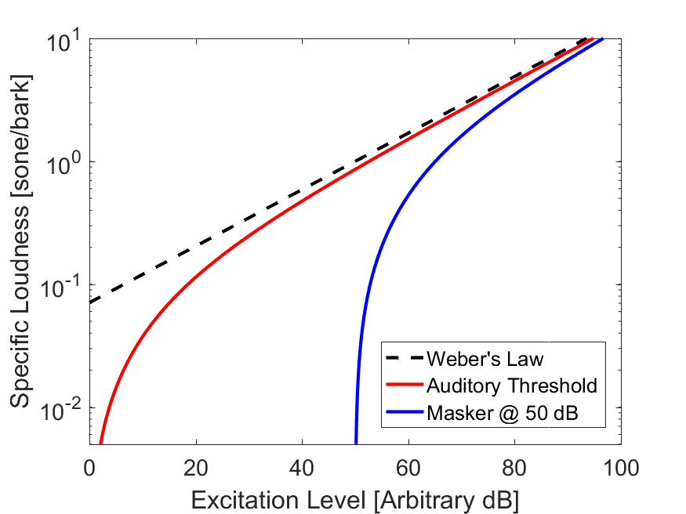
Loudness Recruitment⁷
While its true that people can’t hear inaudible things, the slope of the Loudness response steepens above audibility and asymptotes with the unmasked relationship.⁸
  This indicates a possible extreme sensitivity to annoyance predictions based on models of IPL in the region near audibility.

Slide 9
Audibility is Hard…⁹
Recent tests at NASA on low-frequency auditory filtering were difficult enough.
  These tests were conducted in a controlled laboratory environment, not in an urban one.
  Large differences between subjects was observed.¹⁰
Other real world effects will add uncertainty behind the recruitment function:
  Atmospheric propagation effects
  Cognitive effects such as time variation of sounds and informational masking
The best predictive model of audibility in the literature is based on a concept that is thought to be mostly incorrect!¹¹
  Similar to this model, IPL might give a good approximation, but will never be as good because it is based on data that has resulted from test of loudness testing (and not audibility).

Slide 10
Audibility is Necessary
Ultimately, it will be necessary to predict the audibility of, for instance, a UAV in an urban soundscape.
  It will be essential to be able to assess audibility when trying to correlate data from future community responses (e.g., field tests).
Differences between audibility and noticeability will also have to be assessed.¹²
→ Future psychoacoustic work at NASA (2-5 years) will likely produce data that will help to construct relationships between existing loudness models, lab-based audibility results, and annoyance.

Slide 11
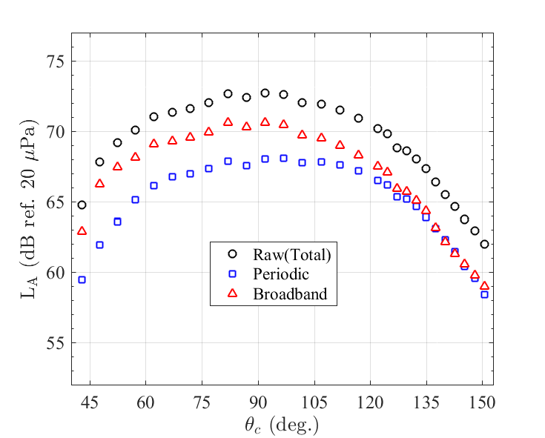
Broadband vs. Tonal Loudness
Recent measurements from NASA have shown that, for some UAS configurations, broadband sources dominate on a dBA basis.¹³
Loudness is known to differ between broadband and tonal sources.¹⁴
This indicates a need for further measures of sound beyond even contemporary Loudness.

Slide 12
Sound Quality Metrics
There has been a proliferation of techniques to quantify subjective aspects of arbitrary sounds to augment loudness.
Among the Sound Quality (SQ) metrics that can now be computed¹⁵:
  Tonality/Tone Prominence: The ‘tonalness’ of the sound
  Fluctuation Strength: Slow fluctuations of the sound
  Roughness: Rapid fluctuation of the sound
  Sharpness: The spectral balance of the sound
  Impulsiveness: How quickly the loudness of the sound changes

Slide 13
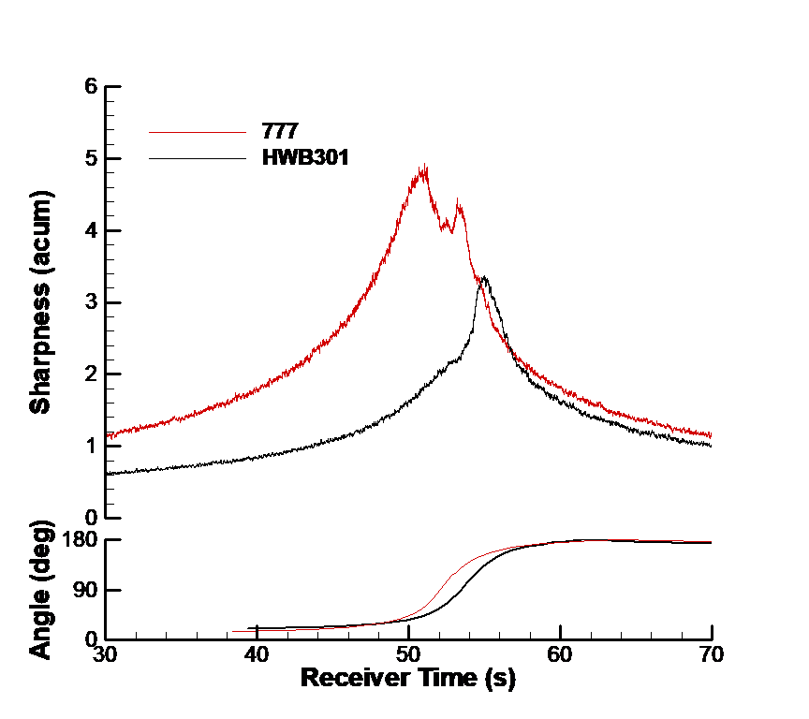
Sound Quality Metrics
SQ metrics have found use in aviation acoustics already:
  In the creation of combinations of SQ metrics (including loudness) to produce overall models of psychoacoustic annoyance.¹⁶
  In the comparison of multiple vehicles within a class.¹⁷
There has been a proliferation of techniques to quantify subjective aspects of arbitrary sounds to augment loudness.

Slide 14
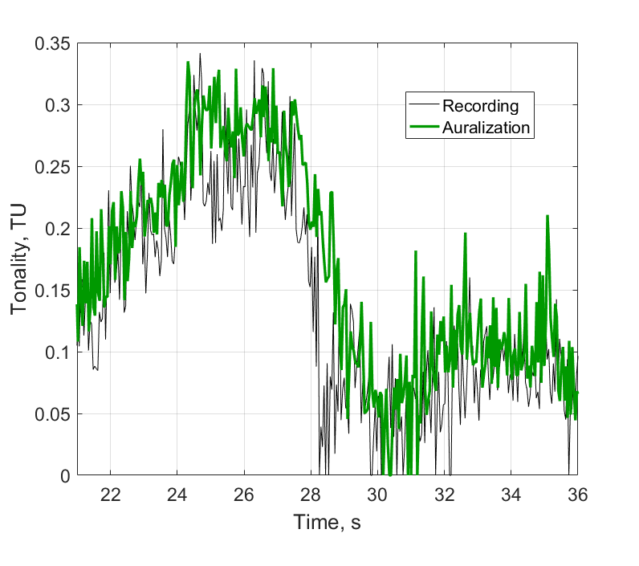
Sound Quality Metrics
SQ metrics have found use in aviation acoustics already:
  In comparisons of simulations of vehicles with recordings.¹⁸
  In studies to determine which SQs may be important to various classes of vehicles.¹⁹
There has been a proliferation of techniques to quantify subjective aspects of arbitrary sounds to augment loudness.

Slide 15
Sound Quality Metrics
There has been a proliferation of techniques to quantify subjective aspects of arbitrary sounds to augment loudness.
It is likely that they will be put to similar productive use in the UAS/UAV and UAM spaces.
  It’s important to keep in mind that these measures are all likely to appear as high-order terms in an expression of annoyance.
  None has ever been shown to supersede any measure of loudness.
NASA has several laboratory psychoacoustic experiments slated to look into the SQ aspects of UAM and helicopter noise.

Slide 16
Annoyance and Complaints²⁰
What factors moderate the process between the stimulus (perception), and:
Annoyance, an attitude
  Primarily fear, for example, of a noise source doing damage to someone’s person or property.
  Also, the economic relationship between the listener and the source. (Does it benefit the listener? How does the listener discount possible negative effects of noise?)
  Past experiences and future expectations also play a role.
  Demographics are generally not found to be a significant factor.
  People are also generally variable in their overall noise sensitivity.
Complaints, a related behavior
  The relationship between noise and complaints are moderated by more/different factors, some of which are demographic.
  Complaint activity is not necessarily indicative of annoyance.

Slide 17
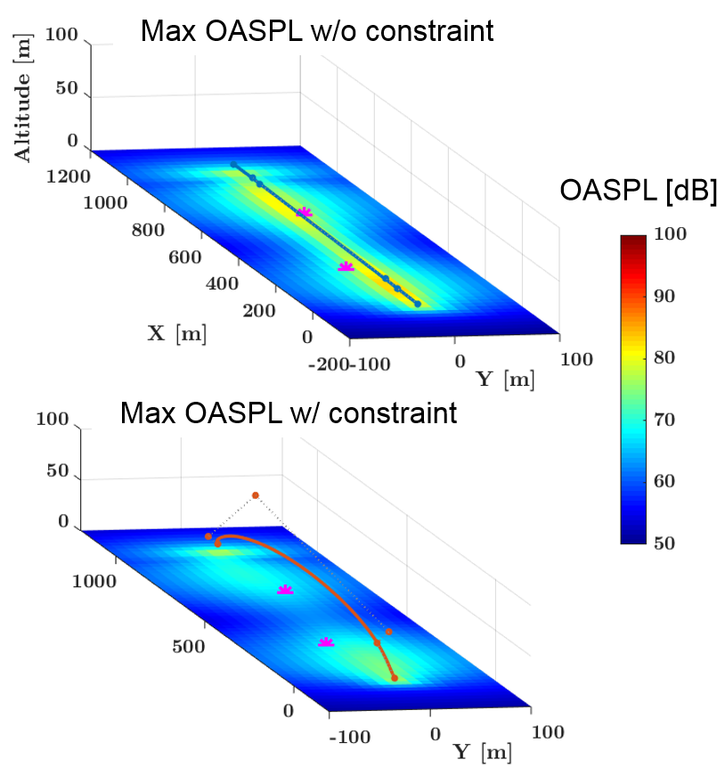
Flight Track Optimization
Recently, many approaches to doing flight track optimization have been proposed.²¹
  Preplanned routing
  Noise-aware vehicles
  Multiple objectives
  → Some of these are current
  NASA efforts.
The takeaway is that (most of) this is possible in 2018.

Slide 18
Flight Track Optimization
While this approach has promise, implementation of these procedures is not straightforward:
  What is the method of aggregation? (What is low noise across a community?)
  How do the above psychosocial factors interact with this?

Slide 19
Flight Track Optimization
These approaches have shown promise when used in concert with a community outreach strategy.²²
These techniques can be used to avoid specific noise-sensitive targets (e.g., schools).
  Helped by other technologies being developed at NASA and elsewhere.²³

Slide 20
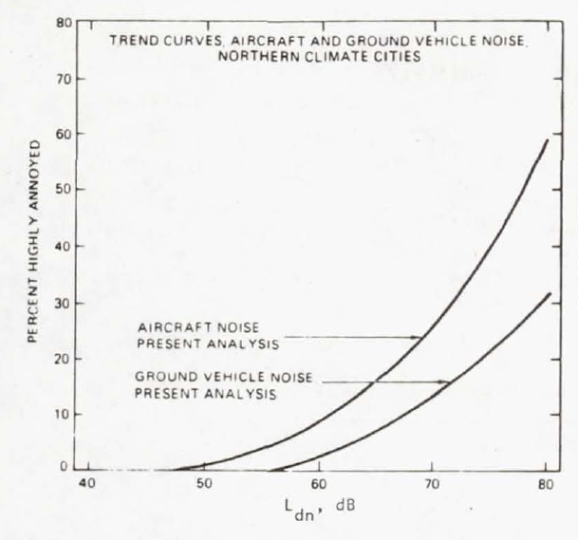
Vehicle-Type Differentials
There is a long history of finding gross differences in annoyance between classes of vehicles.
All of the effects discussed above may be in play.
The figure shown dates back to the 1980s, though there has been more work since then that has not contradicted this trend.²⁴

Slide 21
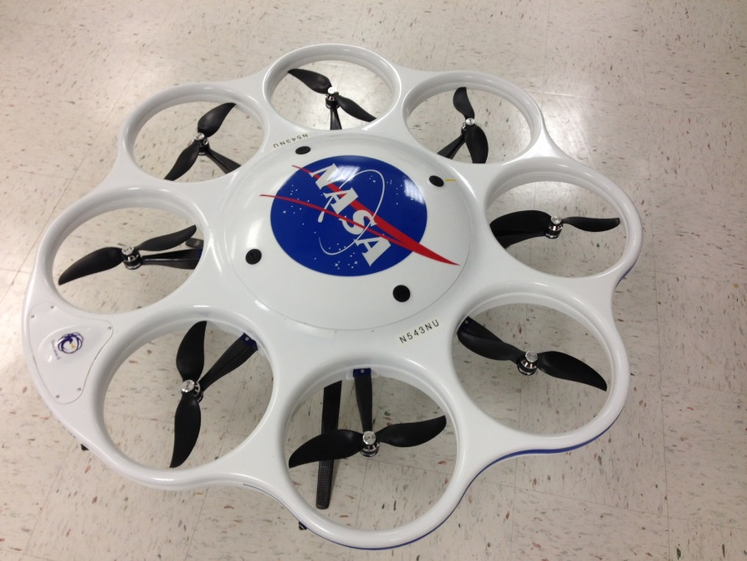
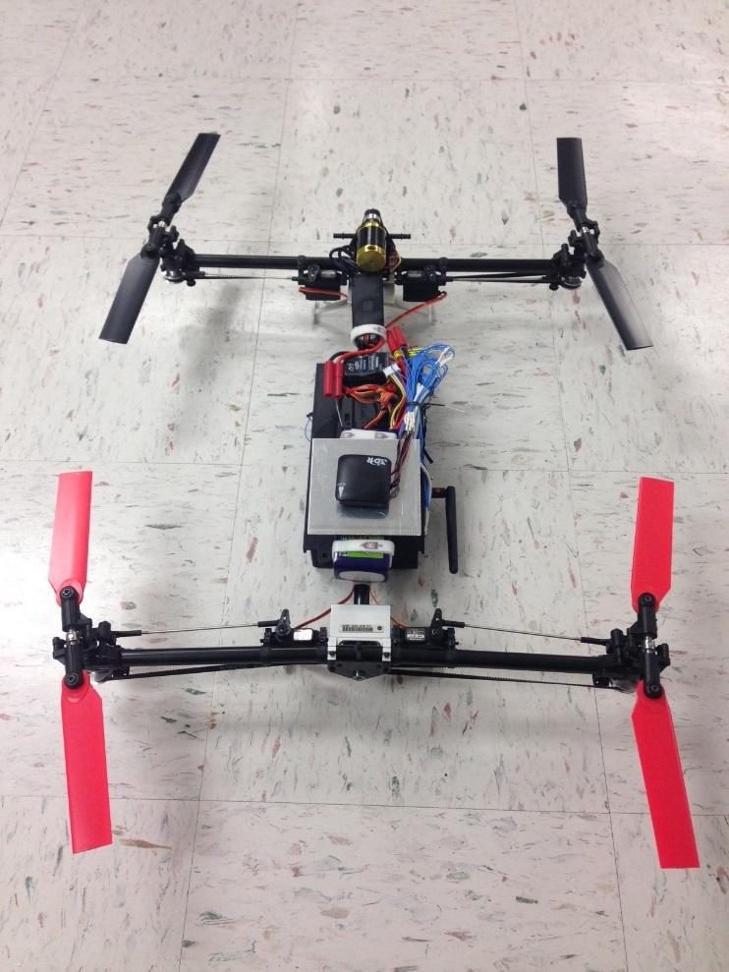
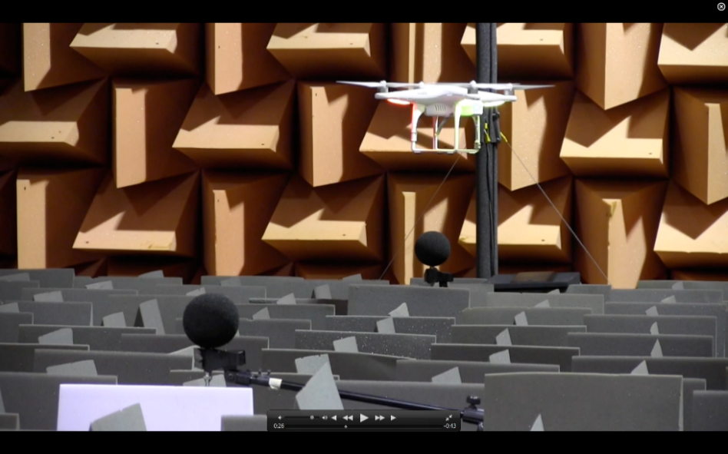
Initial Results for (small) UAS
A recent test at NASA Langley found a similar trend between a sample of recordings of (small) UAS, and road vehicles typical of package delivery applications.²⁵
  The magnitude of the effect was similar.
  Most of the subjects could not identify what the sounds were.

Slide 22
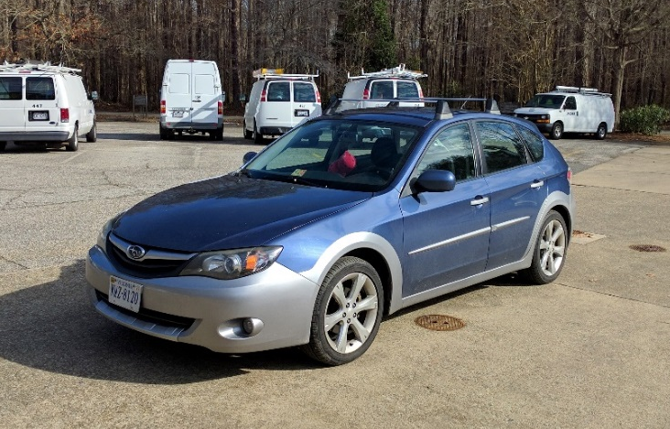
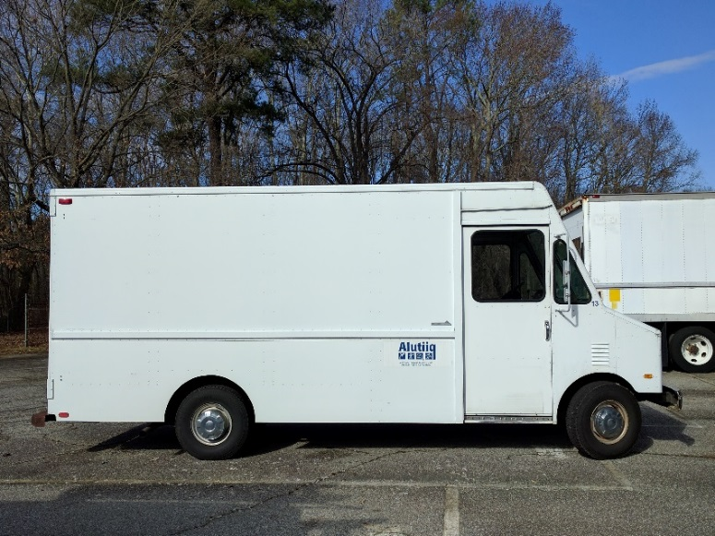
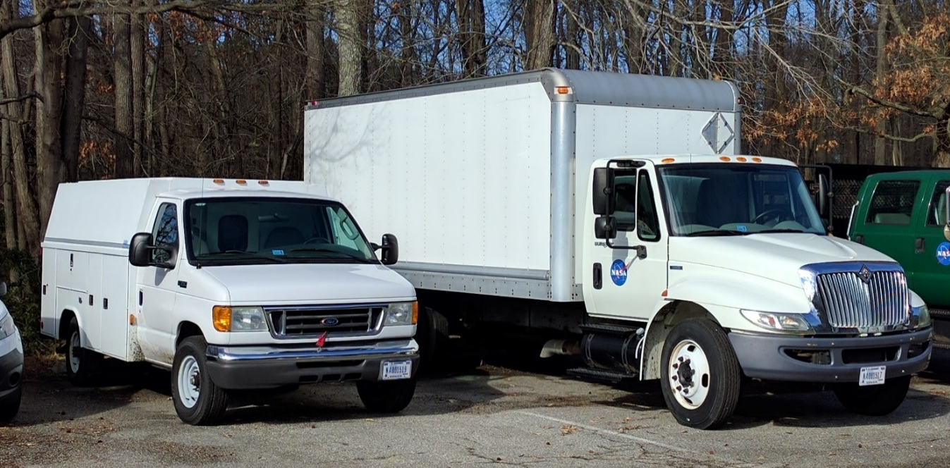
Initial Results for (small) UAS
A recent test at NASA Langley found a similar trend between a sample of recordings of (small) UAS, and road vehicles typical of package delivery applications.²⁵
  The magnitude of the effect was similar.
  Most of the subjects could not identify what the sounds were.

Slide 23
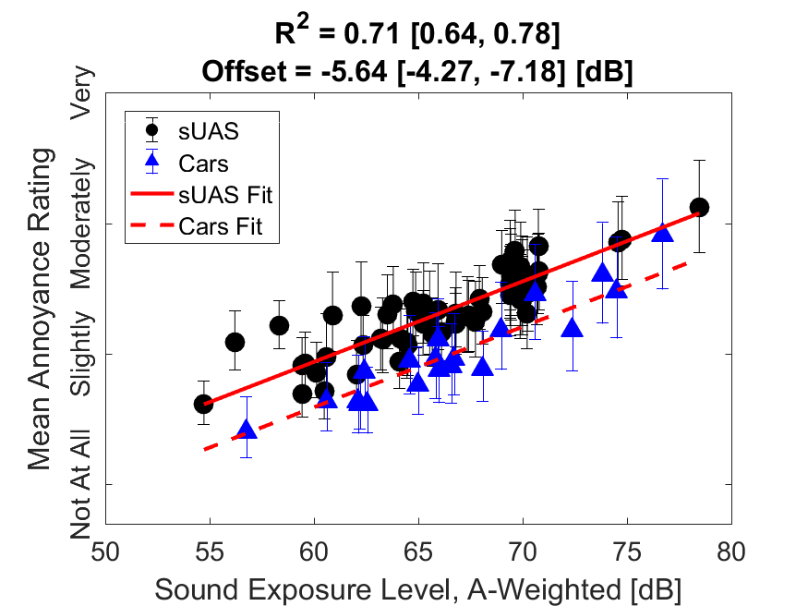
Initial Results for (small) UAS
A recent test at NASA Langley found a similar trend between a sample of recordings of (small) UAS, and road vehicles typical of package delivery applications.²⁵
  The magnitude of the effect was similar.
  Most of the subjects could not identify what the sounds were.

Slide 24
Initial Results for (small) UAS
An important distinction is that this laboratory study was conducted on ‘single events’ of noise, while the canonical differences shown between road and fixed-wing noise uses an aggregate noise measure (DNL).
  It’s still an open question as to how UAS noise might aggregate.²⁶
  No community response data yet exists for UAS/UAV and (especially) UAM.

Slide 25
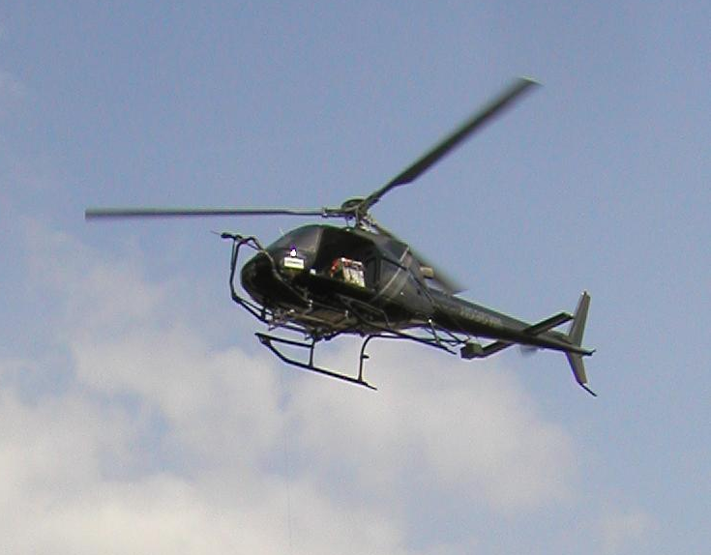
Helicopters
It may be informative to look at the state of psychoacoustic research into helicopters.
They persist as a thorn in the side of regulators.
Very difficult to do research on because of the nature of their operations (infrequent, not loud by conventional standards, not confined to predictable flight corridors).
  This is also why they are so useful.

Slide 26
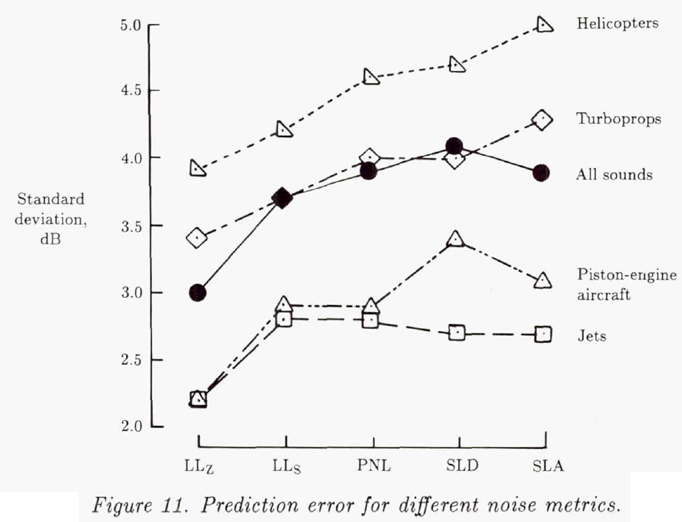
Helicopters
One thing that is agreed upon: they are a complicated issue.²⁷
Ultimately, they may share more operational and psychosocial qualities with UAS/UAV and UAM than any other contemporary noise source.
NASA has a history of involvement:
  Lots of past work
  Lots of planned work

Slide 27
The Conclusion
There are many open avenues of research into UAS/UAV and UAM psychoacoustics and noise abatement:
  The pivot to Loudness, and including a measure of audibility
  Sound quality considerations
  Operational optimization
  Vehicle class differences
All show promise, but come with caveats.
  No one thing should be expected to be a panacea.
It’s unlikely that we know all there is not to know…

Slide 28
Notes
This definition of loudness comes from Plack and Carlyon [Moore (Ed.) 1995, Chapter 4].
For a review of the common metrics of aviation acoustics, see [Ruijgrok 2007, Chapter 9].
The two main contemporary loudness models are attributed to Zwicker, and Moore and Glasberg. Both are now standardized in ISO 532:2017, Parts 1 and 2 respectively. A deprecated method (formerly ISO 532A) is attributed to Stevens.
C.f. the discussion in [Ruijgrok 2007, Page 190] regarding the correlation between integrations of dBA and PNL. Also, see many results regarding the usage of these measures as predictors for annoyance from psychoacoustic tests (e.g., [Christian and Cabell 2017]).
The concept of parsimony in scientific endeavor is typically attributed to William of Ockham, who posited (in Latin): “ It is foolish to do with more that which can be done with less.”
The formulation of IPL can be traced back to a number of human subject tests executed by [Glasberg and Moore, 2005]. IPL is on its way to joining the other flavors of the Loudness computations in a future ISO standard.
The figure on this slide comes from a similar presentation by a NASA Ames researcher [Begault 2018].

Slide 29
Notes
‘Recruitment’ is the term generally applied to this effect by audiologists. See [Fastl and Zwicker 2006, Chapter 8].
The plotted recruitment function comes from [Fastl and Zwicker 2006, Chapter 8]. There are other patterns in the literature (e.g., [Moore (Ed.) 1995, Chapter 4] and [Crocker (Ed.) 1998, Chapter 91]) all of which asymptote to the typical loudness relationship.
There may be disagreement with this effect and annoyance – that is, some authors report that annoying sounds are less annoying when there is a loud background. This may be a good indication for noise control engineers, as it would work to reduce the sensitivity of the annoyance function near the audibility threshold, but it would imply the need for a less-than-simple relationship between IPL and annoyance in future models.
[Leverton 2014] would suggest that any sound above audibility (even slightly so) would risk triggering a negative response due to ‘virtual noise.’
This observation comes from experience. For instance, with a battery of low-frequency auditory filtering experiments as extensively discussed in [Rafaelof et al. 2019].
Ibid. C.f. the ISO standard on hearing thresholds and the distribution thereof across the general population (ISO 7029:2017) which indicates significant variance between people, especially at low frequencies.
It is important to note that some authors report that inter-subject differences are reduced in masking experiments conducted away from the threshold of hearing (e.g., [Fastl and Zwicker 2006]).

Slide 30
Notes
This is a rather technical detail, but appears to be true, and highlights the difficulty of making accurate models of audibility. See the discussion by Buus in [Crocker (Ed.) 1998, Chapter 89].
There are indications that there is a significant lag between listeners physical ability to hear a sound (e.g., in a laboratory setting), and when they will report actually hearing the sound. See, for instance, a laboratory method proposed to assess this difference [Rizzi et al. 2017]. (Related work has also been done for the US Parks Department regarding the impingement of aircraft noise on ‘natural quiet’.)
This may be seen as a boon to UAM audibility issues, especially if the region of high sensitivity – just above psychophysical audibility – is also a region of indifference to listeners.
This result (and figure) come from recent work by [Zawodny and Pettingill 2018].
This is a well-known result. See, for instance, [Fastl and Zwicker 2006, Chapter 8].
[Fastl and Zwicker 2006] give good introductions for most of the SQ metrics. For a more current recitation of these, see [Krishnamurthy et al. 2018].
[Fastl and Zwicker 2006] give an account of their efforts to produce an overall ‘psychoacoustic annoyance’ metric, which is a composite of Loudness and other SQ metrics. [More 2011] extended this method to include other SQ parameters with a focus on fixed-wing aircraft noise.
An example is [Rizzi et al. 2016], which is also the source of the figure shown.

Slide 31
Notes
Recent examples come from [Sahai et al. 2018] and [Krishnamurthy and Rizzi 2019], the latter being the source of the figure.
Examples of this work, both coming from NASA, are [Krishnamurthy et al. 2018] and [Rafaelof and Schroeder 2018].
[Leverton 2014] indicates that qualitative aspects of helicopter noise may account for a third of the community response.
Current thinking on how psychosocial factors moderate annoyance and complaint activity is summarized by [Basner et al. 2017]. Many of these effects have been known or suspected for the better part of a century (see, for instance, [Kryter 1985, Chapter 11]). See also, generally, [NASA RP-1258, Chapter 11].
C.f. the presentation by Noah Schiller in this same workshop which covers many approaches to noise abatement being currently pursued at NASA, and the source of the figures on these slides.
A particular success of multi-objective evolutionary optimization applied to flight planning was described by [Christian and Sparrow 2013].
A recent example of a successful usage of flight track optimization of fixed-wing aircraft (for an entire airport’s operations) comes from Schiphol airport in The Netherlands.

Slide 32
Notes
Other technologies include those that might allow a noise-aware vehicle to avoid ensonifying a particular target. [Pascioni and Rizzi 2018]
Aviation noise is known to significantly, and negatively, impact educational performance in schools. [Basner et al. 2017] [Kryter 1985].
The figure shown is one of several shown by [Kryter 1985] in what is a rather extensive review. The most well known contemporary work is attributed to Miedema (e.g., [Miedema and Oudshoorn 2001]).
The discussion, pictures and figure shown come from [Christian and Cabell 2017].
Studies from noise on fixed-wing aircraft have never been able to soundly reject the concept of energy summation across events. There is very little research in to how heterogeneous sounds that arrive at uneven time intervals (and perhaps from various directions) will fare.
Research on the subject in regards to helicopter noise was summarized by [Mestre et al. 2017].
[Leverton 2014] provides a strong opinion regarding the role of individual distasteful noise events that condition community members to react to the ‘virtual noise’ of helicopters.
[Mestre et al. 2017] lay out a comprehensive argument based on a considerable literature review as to the fact that human response to helicopter noise is, on the whole, a more complex phenomenon than response to other common forms of noise. This sentiment is effectively echoed by [Leverton 2014].
The figure on this slide demonstrates that response to helicopter noise is systematically more difficult to predict via metrics (in the early 1990s) than for other noise sources. [NASA RP-1258]

Slide 33
References
[Moore (Ed.) 1995]: Moore, B.C.J. (Ed.), “Hearing (2nd Ed.),” Academic Press, San Diego, USA, 1995.
[Ruijgrok 2007]: Ruijgrok, G. J. J., “Elements of aviation acoustics (2nd Ed.),” VSSD, Delft, ND, 2007.
[Christian and Cabell 2017]: Christian, A. and R. H. Cabell, “Initial Investigation into the Psychoacoustic Properties of Small Unmanned Aerial Vehicle Noise," AIAA Aviation 2017, Denver, CO, June 5-9 2017.
William of Ockham, “Summa Totius Logicae,” c. 1323.
[Glasberg and Moore, 2005]: Glasberg, B. R. and B. C. J. Moore, “Development and Evaluation of a Model for Predicting the Audibility of Time-Varying Sounds in the Presence of Backround Sounds,” J. Audio Eng. Soc., Vol. 53, No. 10, 2005.
[Begault 2018]: Begault, D. R., “Overview of Metrics pertinent to Human Response to UAM Noise,” Presented at the 2nd UAM Noise Working Group Meeting, NASA Glenn Research Center, October 2018.
[Fastl and Zwicker 2006]: Fastl, H. and E. Zwicker, “Psychoacoustics: Facts and Models (3rd Ed.),” Springer, Berlin, DE, 2006.
[Crocker (Ed.) 1998]: Crocker, M. (Ed.), “Handbook of Acoustics,” John Wiley & Sons, Hoboken, USA, 1998.
[Rafaelof et al. 2019]: Rafaelof, M. et al., “Characterization of Low Frequency Auditory Filters,” NASA-TM-2018-220120, January 2019.
[Rizzi et al. 2017]: Rizzi, S. A., Christian, A., and M. Rafaelof, “A Laboratory Method for Assessing Audibility and Localization of Rotorcraft Fly-in Noise," AHS Forum 73, Fort Worth, TX, May 9-11th, 2017.
[Zawodny and Pettingill 2018]: Zawodny, N. S. and Pettingill, N. A., “Acoustic Wind Tunnel Measurements of a Quadcopter in Hover and Forward Flight Conditions,” 47th International Congress and Exposition on Noise Control Engineering, Chicago, Illinois, August 2018.

Slide 34
References
[Krishnamurthy et al. 2018]: Krishnamurthy, S., Christian, A.W., and Rizzi, S.A., "Psychoacoustic test to determine sound quality metric contributions to rotorcraft noise annoyance," InterNoise 2018, Paper 1338, Chicago, IL, 2018.
[More 2011]: More, S., “Aircraft Noise Metrics and Characteristics,” PhD thesis: Purdue University written as PARTNER Project 24, Report COE-2011-004, 2011.
[Rizzi et al. 2016]: Rizzi, S. A., Burley, C. L. and R. H. Thomas, “Auralization of NASA N+2 Aircraft Concepts from System Noise Predictions,” Presented at the 22nd AIAA/CEAS Aeroacoustics Conference, Lyon, FR, 2016.
[Sahai et al. 2018]: Sahai, A. K. et al., “Objective quantification of perceived differences between measured and synthesized aircraft sounds,” Aerospace Science and Technology, Volume 72, Pages 25-35, January 2018.
[Krishnamurthy and Rizzi 2019]: Krishnamurthy, S. and S. A. Rizzi, “Auralization of Amplitude Modulated Helicopter Flyover Noise,” To be presented at AIAA SciTech 2019.
[Rafaelof and Schroeder 2018]: Rafaelof, M. and A. Schroeder, “Assessment of learning algorithms to model perception of sound,” The Journal of the Acoustical Society of America 143, 1741, 2018.
[Leverton 2014]: Leverton, J. W., “Helicopter Noise: What is the Problem?,” VERTIFLITE, March/April 2014.
[Basner et al. 2017]]: Basner, M., Clark, C., Hansell, A., Hileman, J., Janssen, S., Shepherd, K., and Sparrow, V., "Aviation Noise Impacts: State of the Science," Noise and Health, Vol. 19, No. 87, 2017.
[Kryter 1985]: Kryter, K. D., “The Effects of Noise on Man (2nd Ed.),” Academic Press, Orlando, USA, 1985. (Also published as NASA Reference Publication 1115, 1984.)

Slide 35
References
[NASA RP-1258]: Hubbard, H. H. (Ed.), “Aeroacoustics of Flight Vehicles: Theory and Practice,” NASA Reference Publication 1258, 1991.
[Christian and Sparrow 2013]: Christian, A. and V. Sparrow, “A multi-objective evolutionary optimization approach to procedural fight noise mitigation," Presented at the 165th meeting of the Acoustical Soc. of Am., Montreal, QC, June 2-7 2013.
[Pascioni and Rizzi 2018]: Pascioni, K. and S. A. Rizzi, “Auralization of an unmanned aerial vehicle under propeller phase control,” INTER-NOISE 2018, Aug. 2018.
[Miedema and Oudshoorn 2001]: Miedema, H. M. and C. G. Oudshoorn, “Annoyance from transportation noise: relationships with exposure metrics DNL and DENL and their confidence intervals,” Environ Health Perspect., 109(4), 2001.
[Mestre et al. 2017]: Mestre, V. et al., “Assessing Community Annoyance of Helicopter Noise,” Report of the Airport Cooperative Research Program #181, The National Academies Press, Washington, D.C., 2017.

Slide 36

Questions
andrew.christian@nasa.gov

