Slide 1
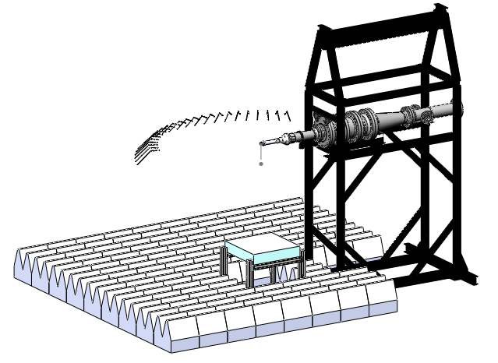
Experiments to Challenge Jet Noise Prediction
Small Hot Jet Acoustic Rig
NASA Glenn Research Center
James Bridges, Gary Podboy, Khairul Zaman
NASA Glenn Research Center
NASA Acoustics TWG
07 April 2020
Microphones r/D=150
48-mic Phased array
Work supported by NASA Advanced Aero Vehicle Program/Commercial Supersonic Technology Project

Slide 2
Three Case Studies
Case 1:
  What is acoustic impact of boundary layer thickness at nozzle exit?
Case 2:
  What is azimuthal variation in noise produced by chevron nozzles?
Case 3:
  Prediction of noise from mixer-ejectors

Slide 3
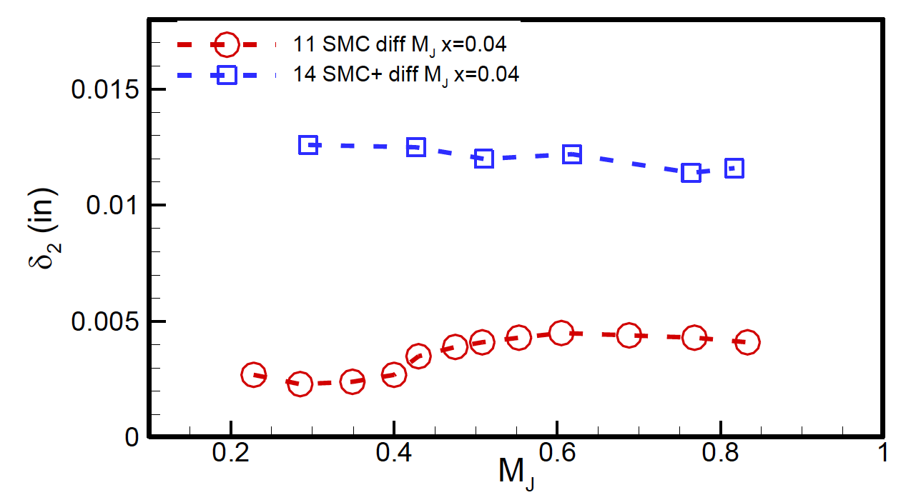
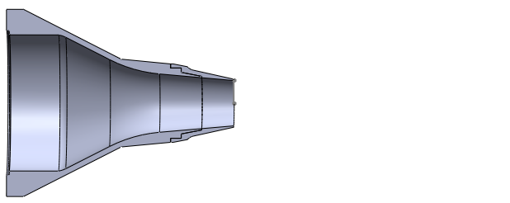
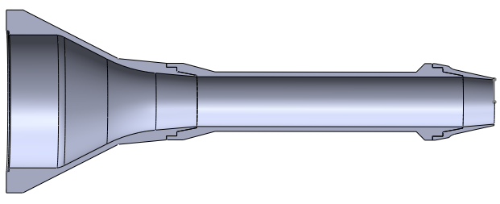
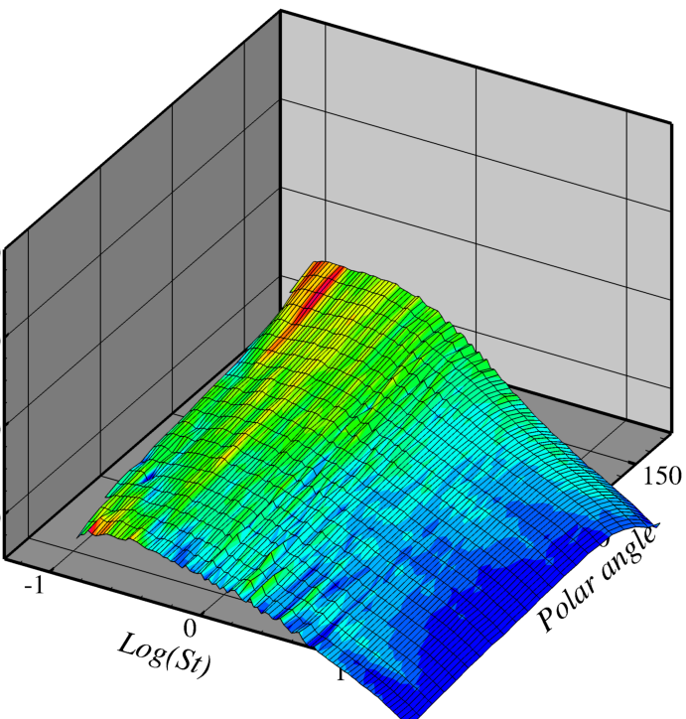
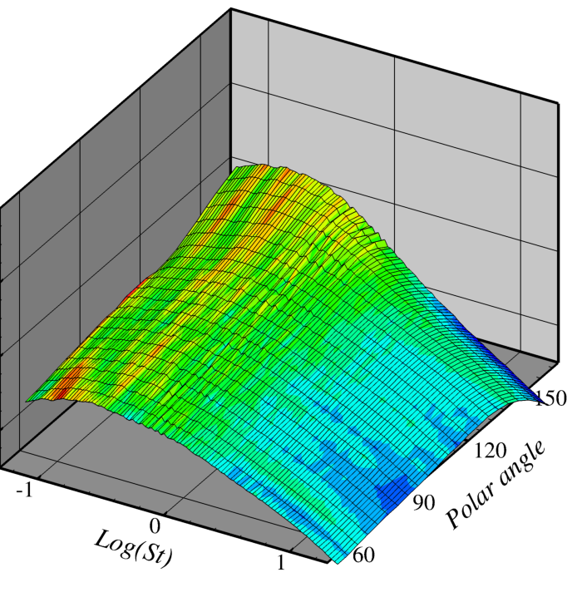
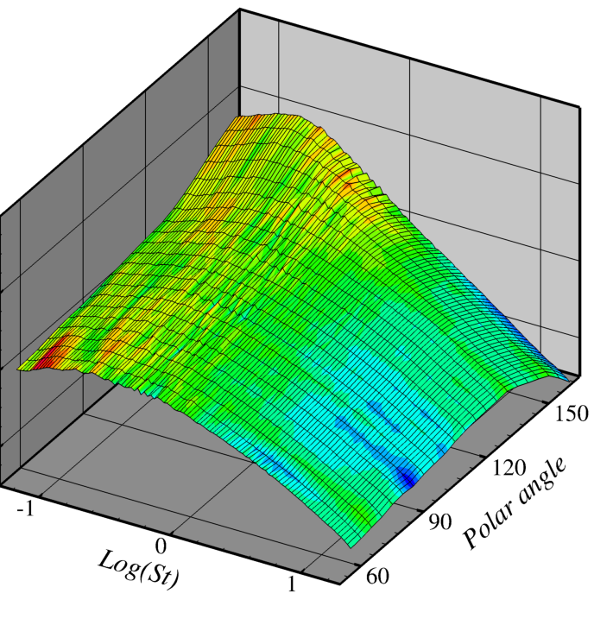
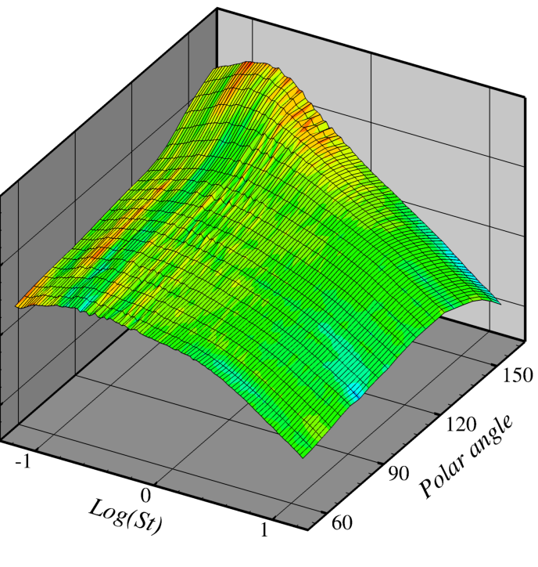

Case 1: Impact of nozzle boundary layer thickness
12” extension grows boundary layer, making boundary layer at nozzle exit 4x thicker with same nozzle.
Hotwire measurements by Zaman at nozzle exit document thicknesses over Mach. Shape factors indicate turbulent boundary layers in all cases.
Acoustic measurements shows thickening boundary layer reduces high frequencies at low speeds. No impact at high subsonic speeds.
Boundary layer at nozzle exit (K. Zaman)
SMC000
Displacement thickness (inch)
Re (x10⁶): 0.5 0.7 1.0 1.5
SMC000+12” extension
Long - Short
ΔPSD (dB)
120
PSD (dB)
60
90° 150°
Polar
90° 150°
Polar
90° 150°
Polar
90° 150°
Polar
0.1 1.0 10.0
Freq (St)
0.1 1.0 10.0
Freq (St)
0.1 1.0 10.0
Freq (St)
0.1 1.0 10.0
Freq (St)
Acoustic impact of boundary layer

Slide 4
Case 1: Impact of nozzle boundary layer
Significance
  LES has trouble with the turbulence in the initial shear layer.
  Boundary layer too small to grid for full LES.
  Many schemes to approximate decorrelated turbulence at nozzle lip.
  Boundary layer often blamed for poor result.
  New data gives benchmark for accurate boundary layer thickness and acoustic impact for model-scale nozzle.
Challenge 1: For two geometries tested, apply wall model, et al. Match boundary layer thickness and acoustic difference at Ma=0.5.

Slide 5
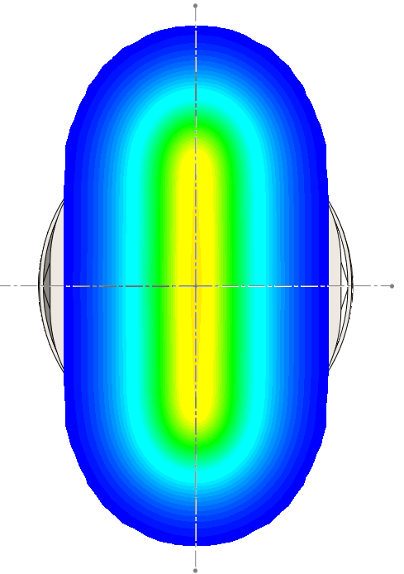
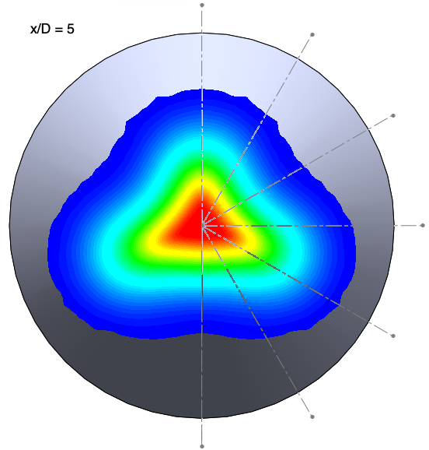
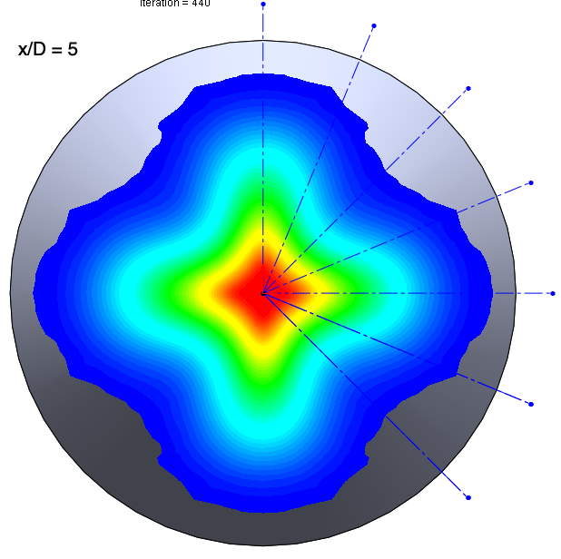
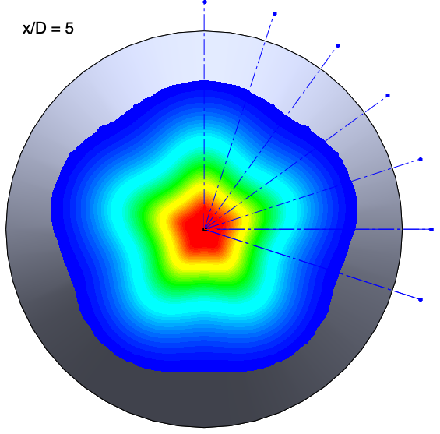
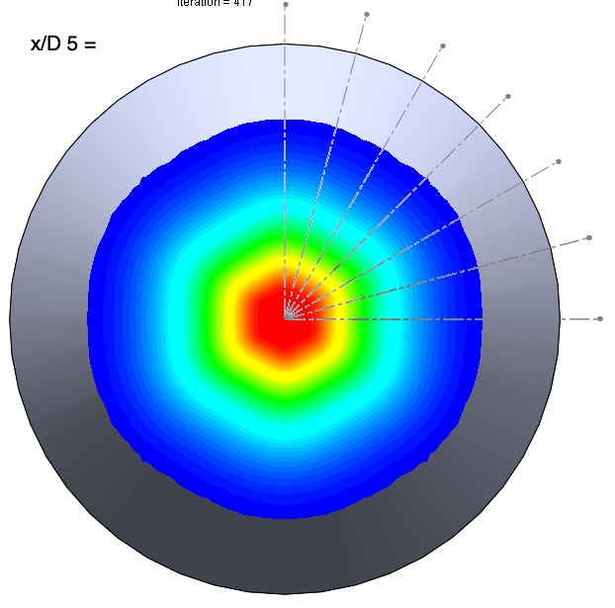
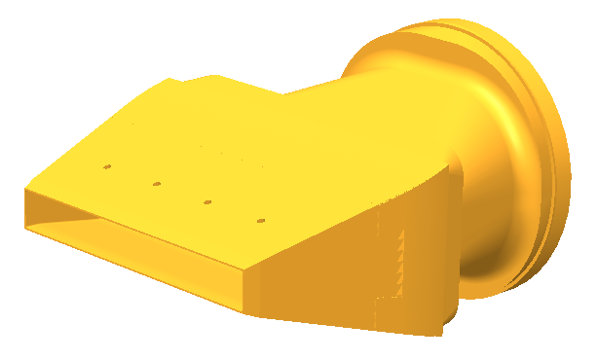
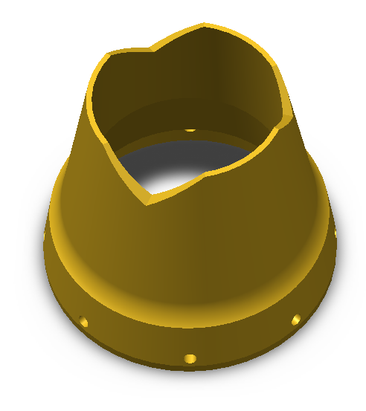
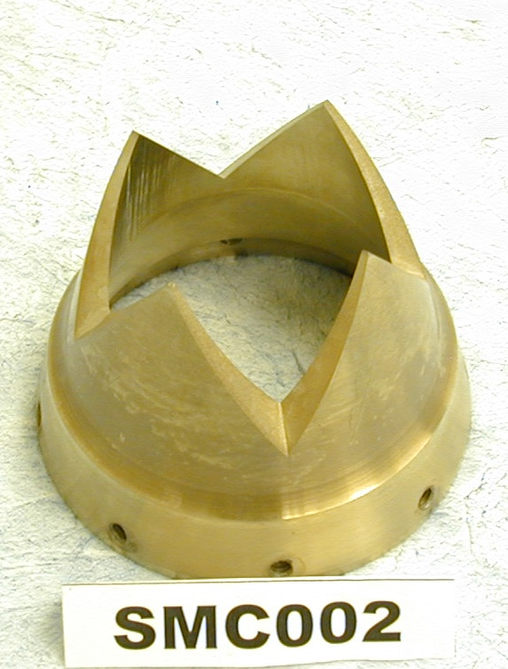
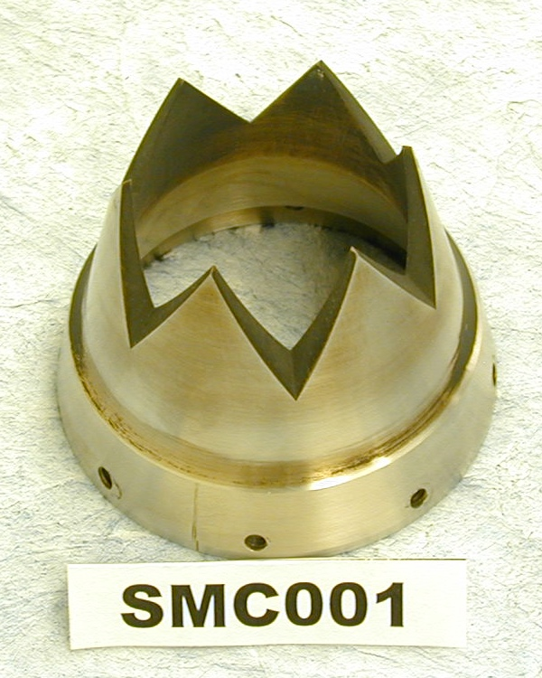
Case 2: Azimuthal directivity of jet noise
What is the azimuthal directivity of non-round jets?
  Flow field is clearly non-axisymmetric. Is sound?
  Is there a benefit to making jets non-axisymmetric, either in source distribution or propagation?
Measure chevron nozzles of different count m. Look at how sound deviates from azimuthal average.
Predicted mean velocity at x/D=5:
Nonaxisymmetric nozzles:
SMC026
m = 2 3 4 5 6

Slide 6
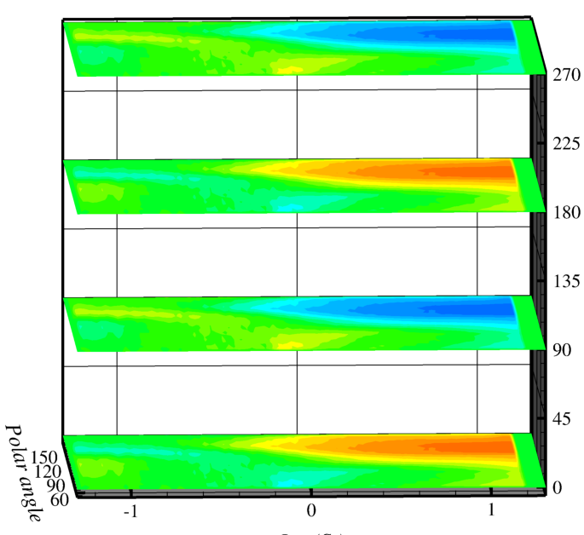
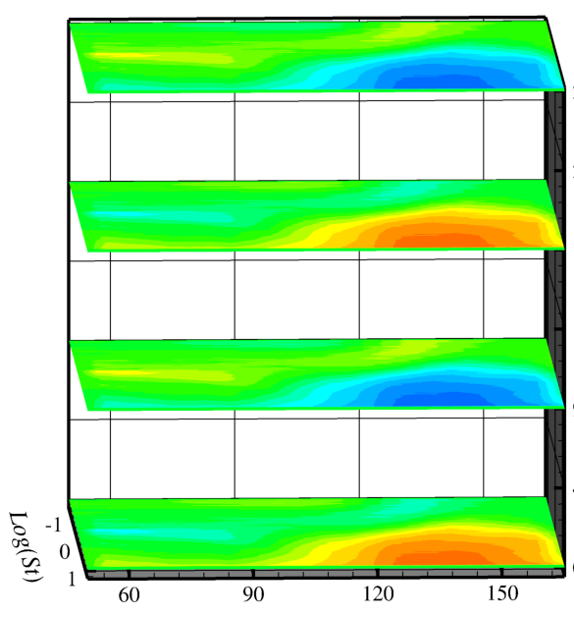

Rectangular nozzle: azimuthal mode m=2. Unheated jet, Ma = 0.9
Polar directivity (upstream to aft angles) as a function of frequency, given in four azimuthal directions. (Think stack of carpet plots)
Sound is axisymmetric except for high frequencies (St > 1) in aft angles (Polar > 105°).
  Deviation reaches ±5dB from average.
  Observers on thin sides (0°) see increase in high freq noise, thick sides (90°) see decrease.
  Similar result for Ma = 0.5
Deviation from azimuthal average
90°
270°
180°
90°
0°
ΔPSD (dB)
180°
0°
Azimuthal angle
0.1 1.0 10.0
Freq (St)
60° 90° 120° 150°
Polar angle
270°

Slide 7
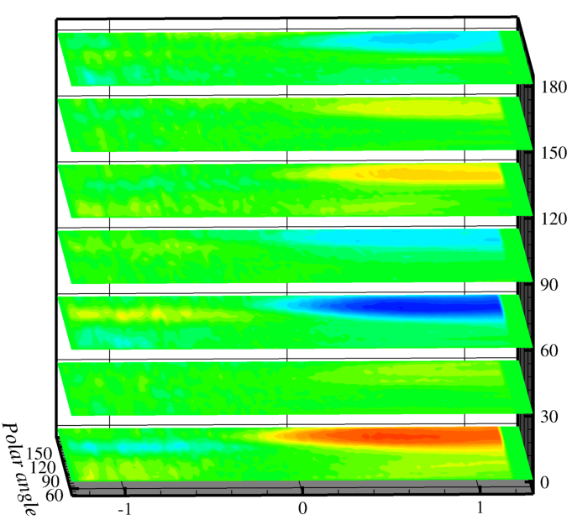
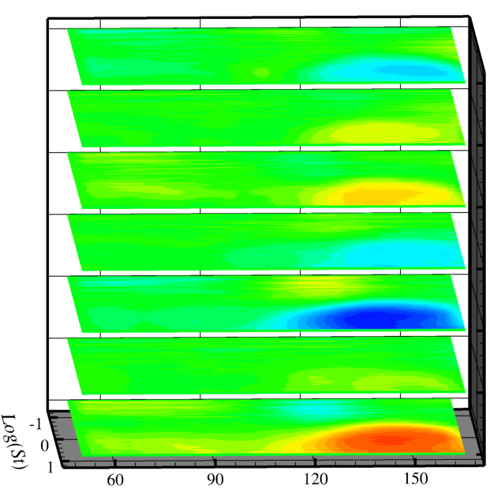

Chevron nozzle: azimuthal mode m=3. Unheated jet, Ma = 0.9
Polar directivity (upstream to aft angles) as a function of frequency, given in seven azimuthal directions.
Sound is axisymmetric except for high frequencies (St > 1) in aft angles (Polar > 110°).
  Deviation reaches ±3dB from average.
  Observers on thin sides (0°) see increase in high freq noise, thick sides (60°) see decrease.
  Similar result (±2dB) for Ma = 0.5
Deviation from azimuthal average
180°
150°
ΔPSD (dB)
180°
150°
120°
90°
60°
30°
0°
120°
90°
Azimuthal angle
60°
30°
0.1 1.0 10.0
Freq (St)
60° 90° 120° 150°
Polar angle
0°

Slide 8
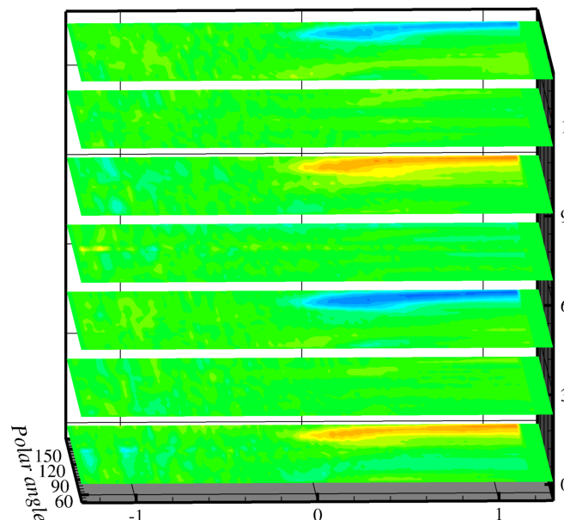
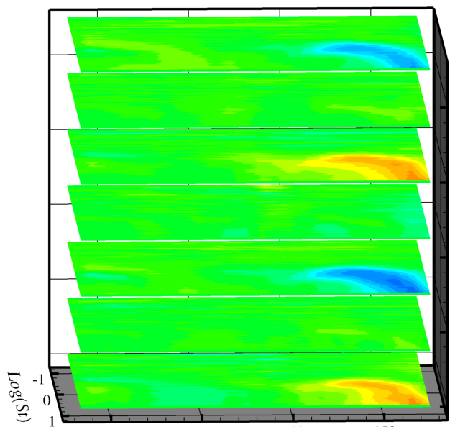

Chevron nozzle: azimuthal mode m=4. Unheated jet, Ma = 0.9
Polar directivity (upstream to aft angles) as a function of frequency, given in seven azimuthal directions.
Sound is axisymmetric except for high frequencies (St > 1) in aft angles (Polar > 130°).
  Deviation reaches ±2.5dB from average.
  Observers on thin sides (0°) see increase in high freq noise, thick sides (45°) see decrease.
  Similar result (±1dB) for Ma = 0.5
Deviation from azimuthal average
135°
113°
ΔPSD (dB)
90°
135°
113°
90°
68°
45°
23°
0°
68°
45°
Azimuthal angle
23°
0°
0.1 1.0 10.0
Freq (St)
60° 90° 120° 150°
Polar angle

Slide 9
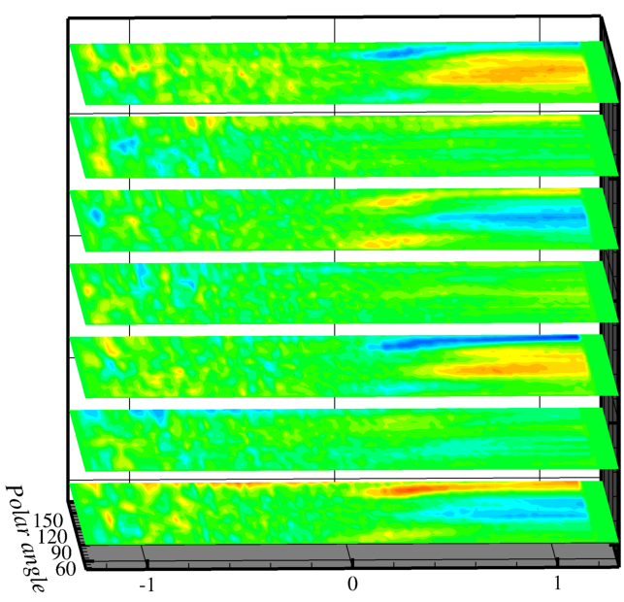
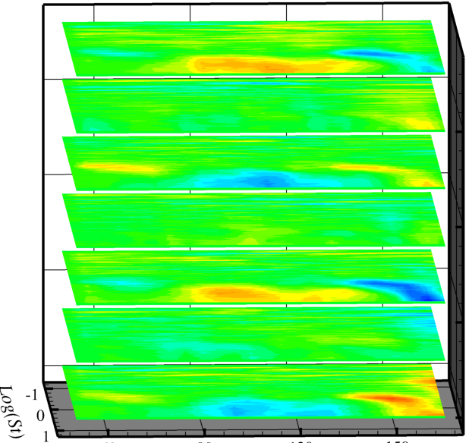

Chevron nozzle: azimuthal mode m=4. Unheated jet, Ma = 0.9
Polar directivity (upstream to aft angles) as a function of frequency, given in seven azimuthal directions.
Sound is axisymmetric except for high frequencies (St > 1) in aft angles (Polar > 90°).
  Deviation reaches ±1.0dB from average.
  Observers on thin sides (0°) see increase far aft, decrease near broadside. Thick sides (36°) see opposite.
  Ma = 0.5 impact more limited to near broadside angles.
Deviation from azimuthal average
108°
90°
ΔPSD (dB)
72°
108°
90°
72°
54°
36°
18°
0°
54°
36°
18°
Azimuthal angle
0°
0.1 1.0 10.0
Freq (St)
60° 90° 120° 150°
Polar angle

Slide 10
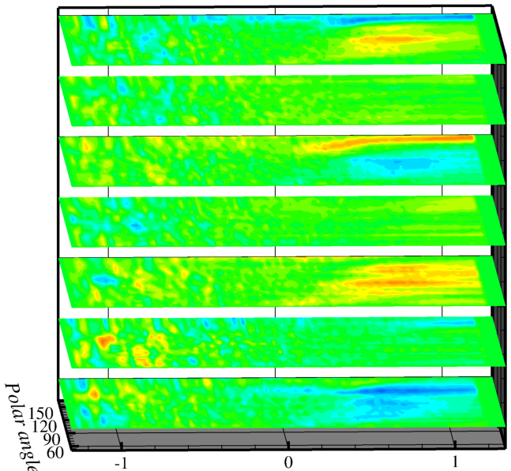
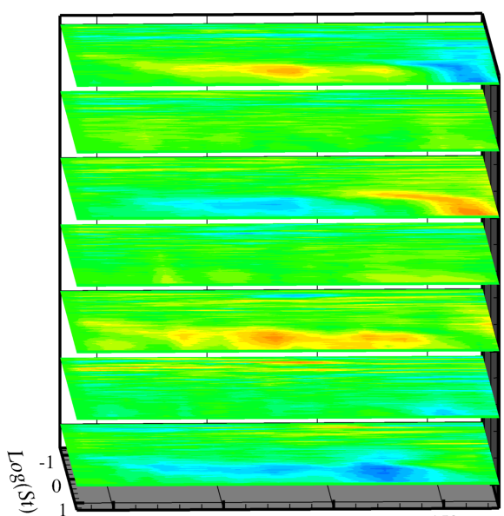
Chevron nozzle: azimuthal mode m=6. Unheated jet, Ma = 0.9
Polar directivity (upstream to aft angles) as a function of frequency, given in seven azimuthal directions.
Sound is axisymmetric except for high frequencies (St > 2)
Deviation reaches ±0.8dB from average. Not as periodic.
  Observers on thin sides (0°) see increase far aft, decrease near broadside.
  Ma = 0.5 impact smaller, more periodic.
Deviation from azimuthal average
90°
75°
ΔPSD (dB)
60°
90°
75°
60°
45°
30°
15°
0°
45°
30°
15°
0°
Azimuthal angle
0.1 1.0 10.0
Freq (St)
60° 90° 120° 150°
Polar angle

Slide 11
Case 2: Azimuthal directivity of jet noise
Significance
  Non-axisymmetric plumes hold promise of non-axisymmetric far field, hence a favored direction to observers.
  Some disagreement about whether sound propagates preferentially in the azimuthal direction (Papamoschou), especially for low frequency (large-scale) sources.
  In Goldstein’s generalized acoustic analogy, the Green’s function at Polar = 90° is not dependent upon flow gradients but will be strongly dependent at other angles. Can it be accurately computed at these other angles?
  Source models are also challenged by the changing isotropies of turbulence in chevron flows. Is this the key to accurately calculating azimuthal dependence of the source field?
  LES should be able to compute these directivities accurately, although it will take significant resources to get statistically significant results. Can it explain why they occur?
Challenge 2: Reproduce the azimuthal variations measured for five nozzles.

Slide 12
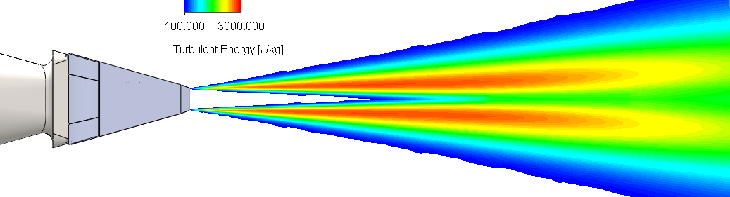
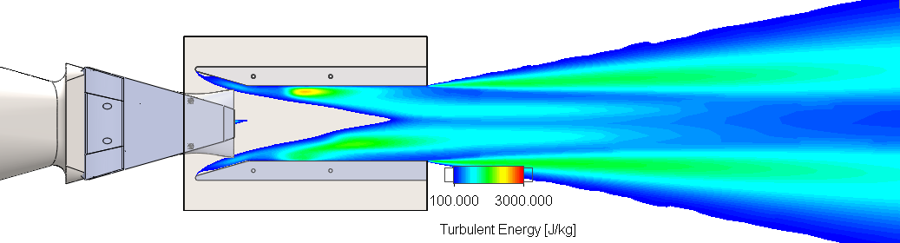
Case 3: Mixer-Ejector Aeroacoustics
Basic theory
  Ejector pulls static pressure down at nozzle, encourages mixing, lowers jet velocity and TKE downstream.
  Forced mixer improves mixing inside ejector. Extra TKE from mixing is shielded from observer by ejector.
Difficulties expected in predicting sound
  Accurate prediction of mixing.
  Solid surfaces.
  Flow resonance(!)

Slide 13
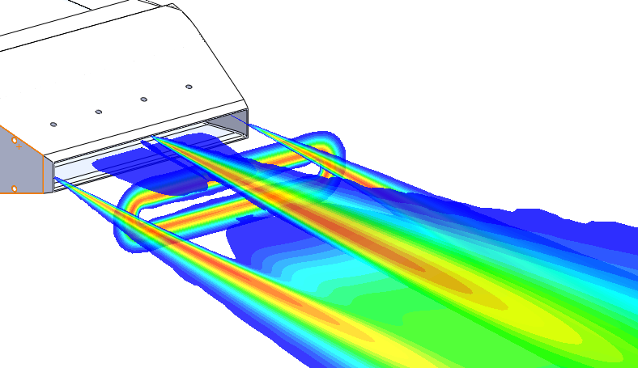
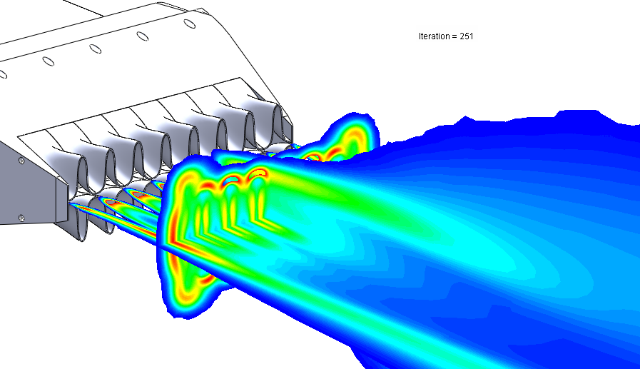
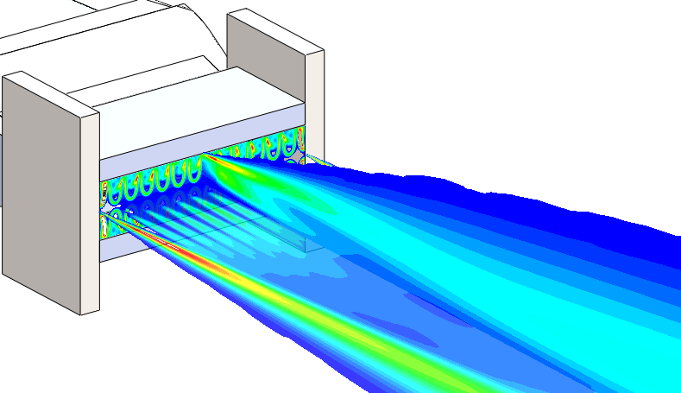
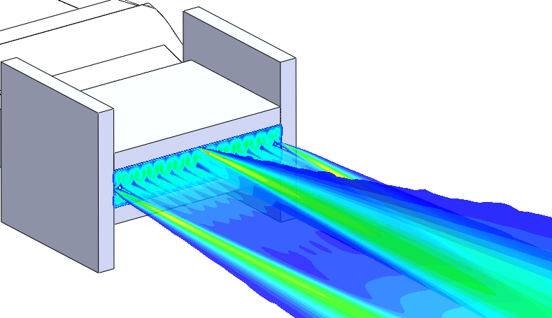
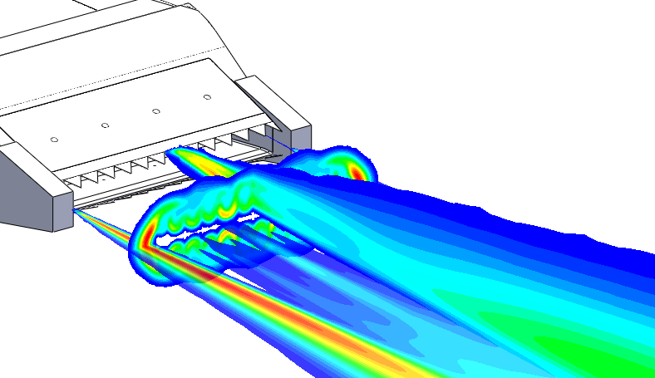
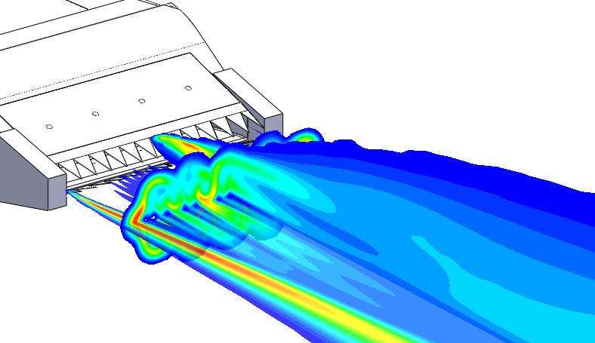
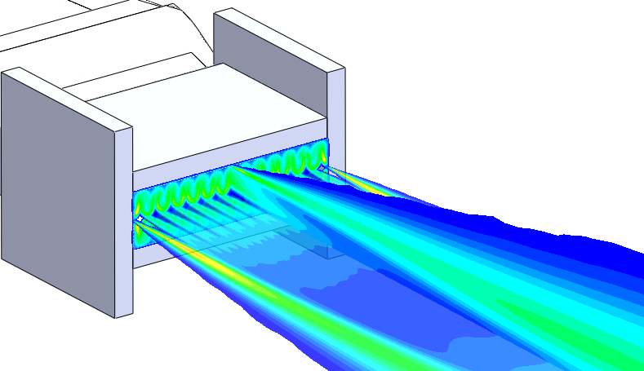
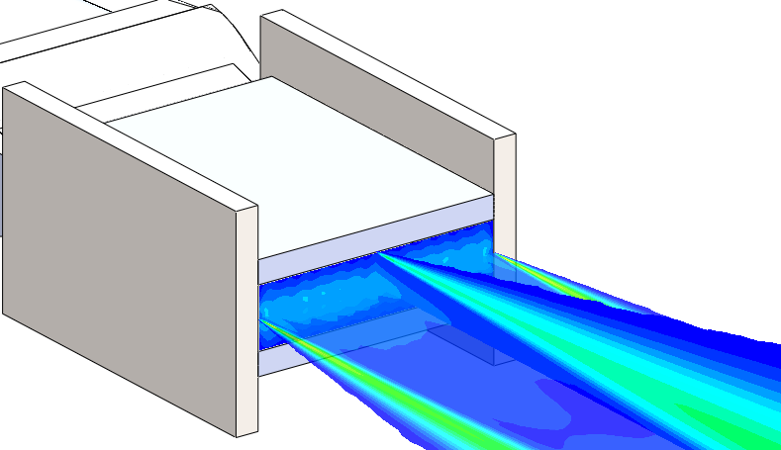
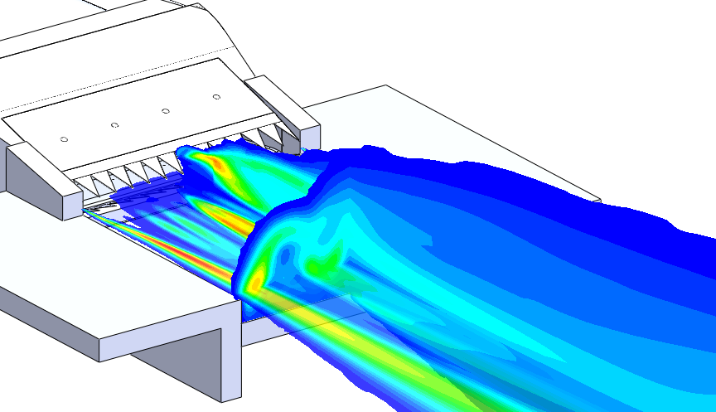
Mixer-Ejector configs
Mixer Designs
Ejector Length L
Ejector Area Ratio
EjH/h=1.6, 2.3, 2.9, 3.7
L/h = 4.5
L/h = 7.5
L/h = 12
Simple Shielding

Slide 14
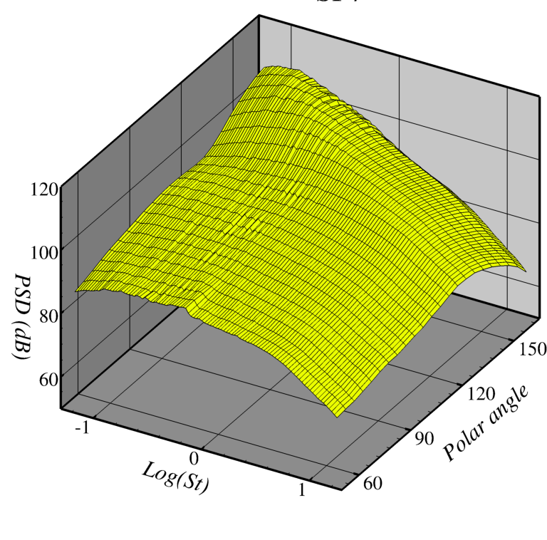
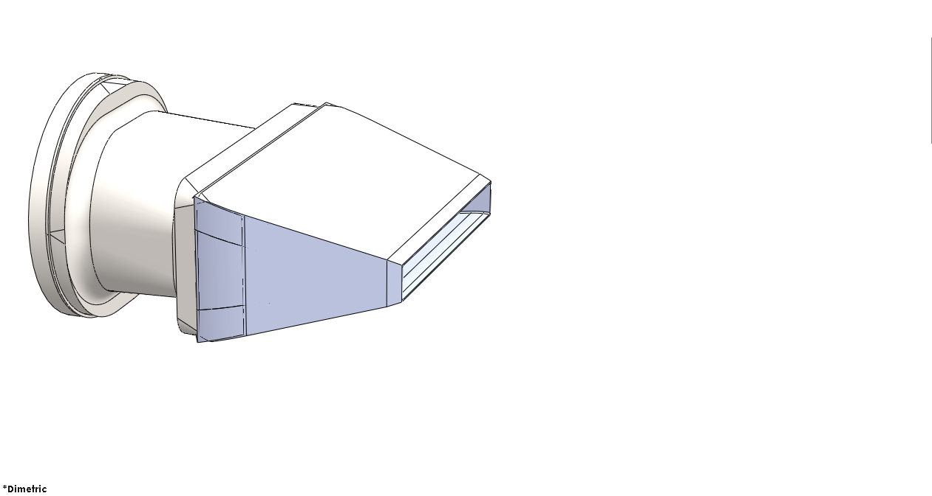
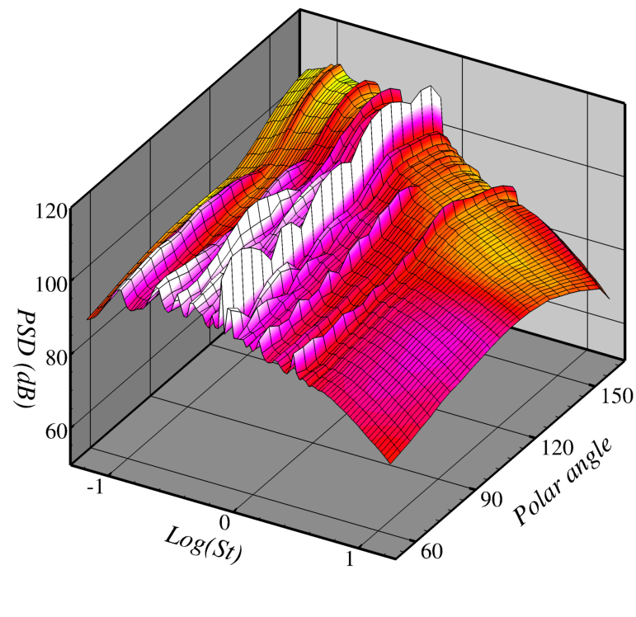
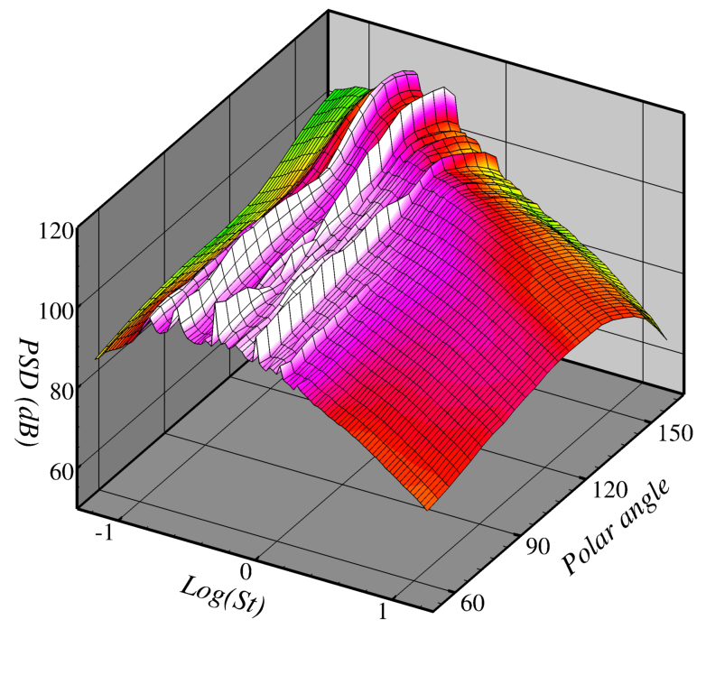
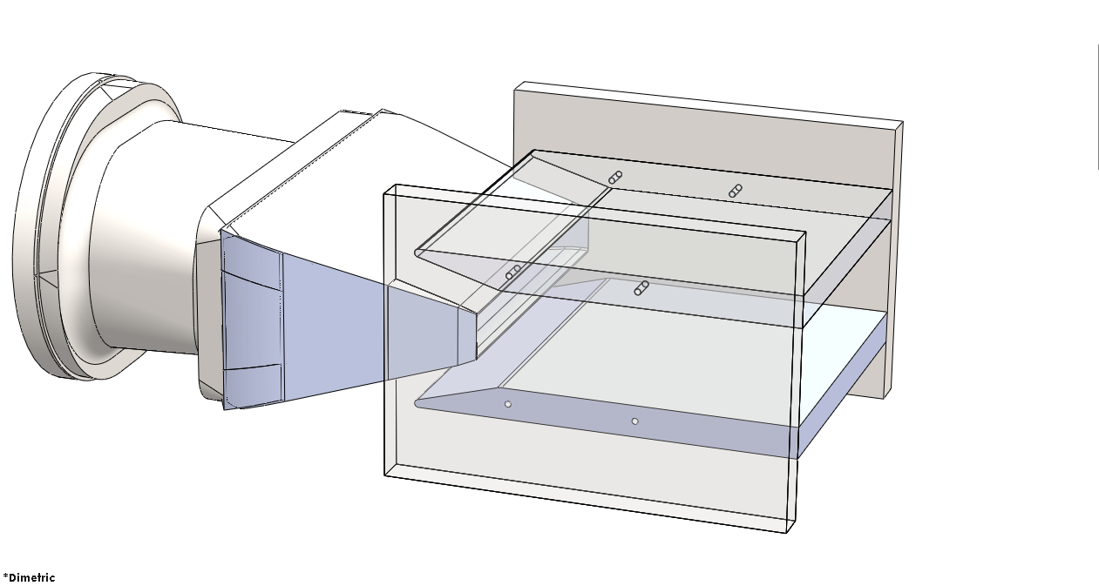
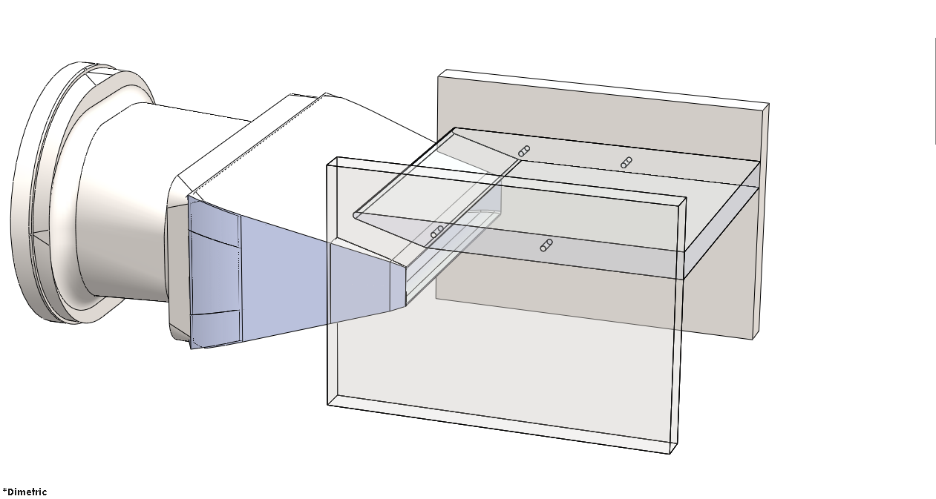
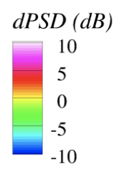
Highlights: Baseline nozzle with ejector
NPR=1.87, unheated. Observer on wide side of nozzle (above nozzle here).
Color bars are delta-dB from Baseline (bare rectangular nozzle).
Adding ejector or shield increases noise, creates new tonal source.
From jet-surface interaction studies, tonal source on shield looks like trailing edge dipole (TED), but with much richer content.
Resonances have higher frequencies with ejector than shield. Different but related resonance?
Other configs had varying resonances, but almost all with baseline mixer had them.
Baseline
Resonances
Resonances
Increase everywhere
Ejector
Increase everywhere
Shield

Slide 15
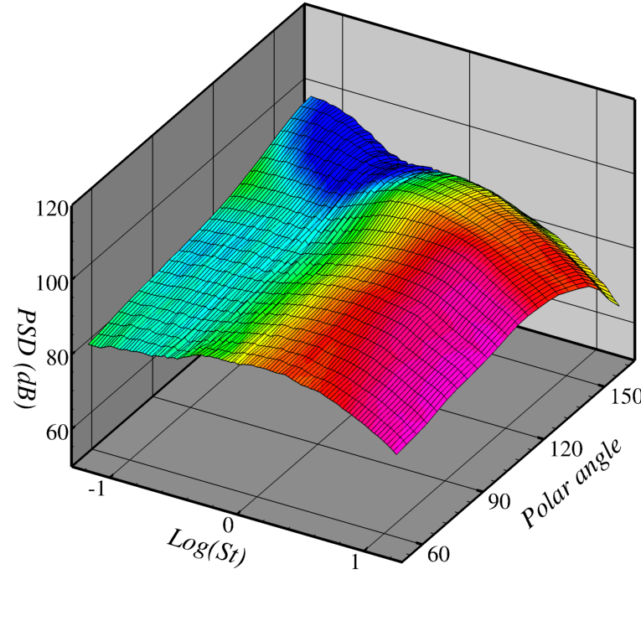
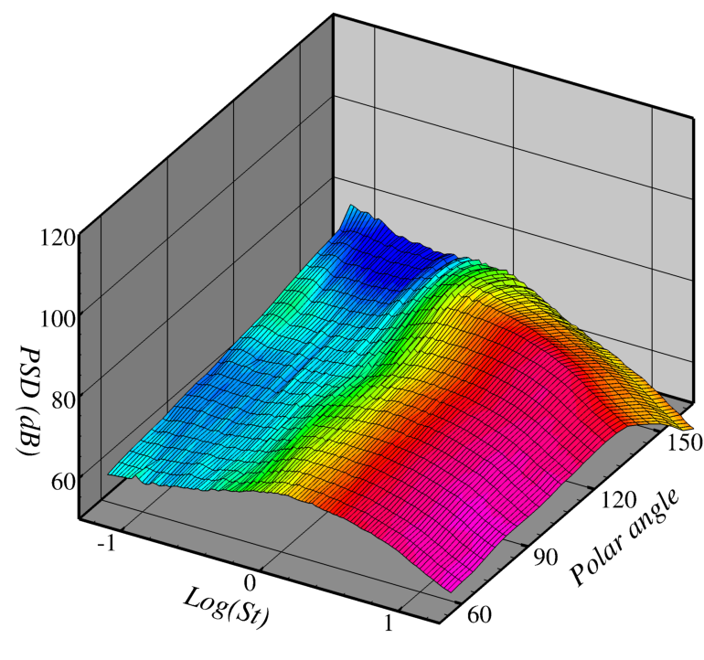
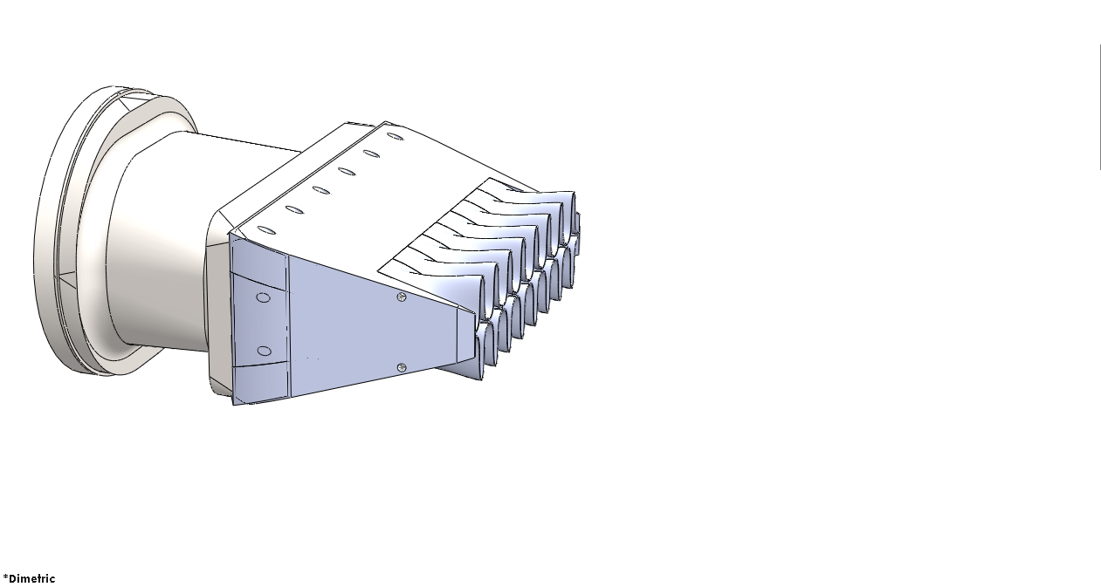
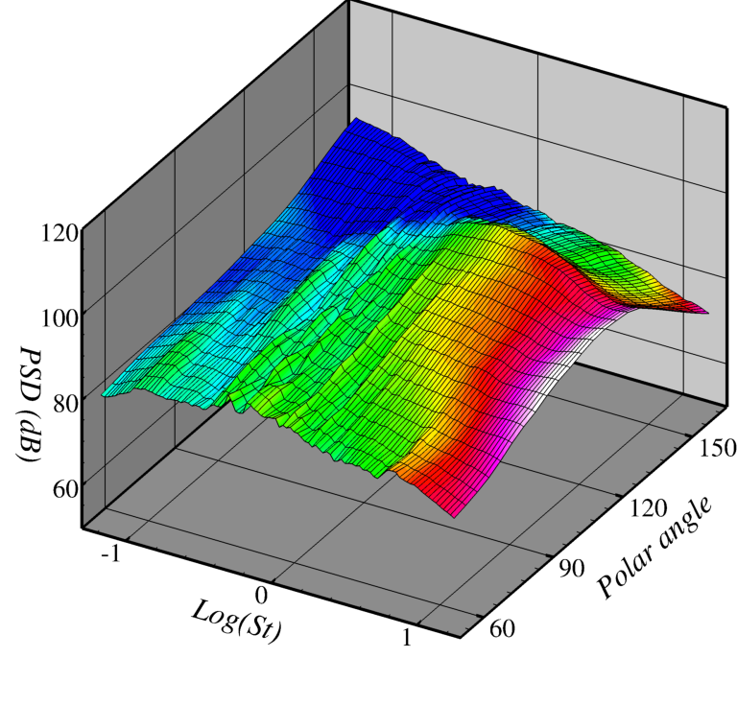
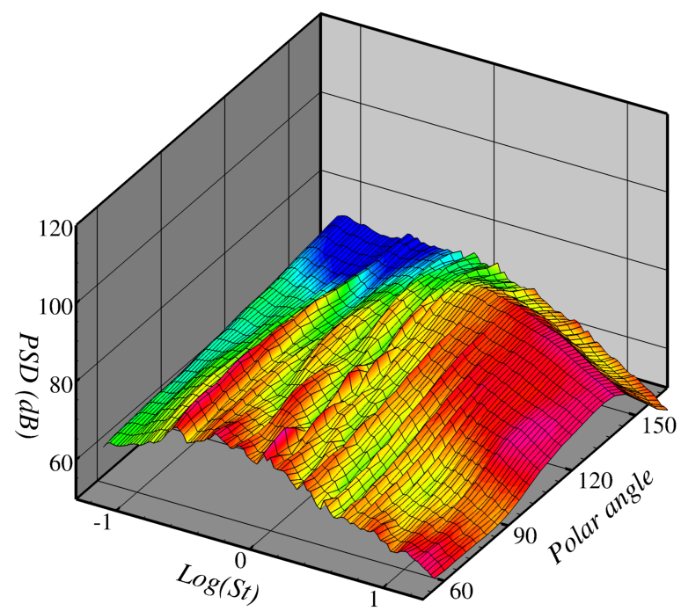

Highlights: Lobed mixer with ejector
NPR=1.86
NPR=1.2
Lobed mixer, with and without ejector.
Color bars are delta-dB from Baseline (bare rectangular nozzle).
Lobed mixer reduces low frequencies, increase high frequencies, as expected.
Ejector further reduces low frequencies, shields some high frequencies. No TED. Hint of resonances?
At lower speed, bare lobed mixer has same effect as at high speed.
At lower speed, ejector has resonances!
Lobes didn’t break up resonances in ejector.
Range of ejector configurations without debilitating resonance was much greater with lobed mixer than with baseline mixer.
Lobes reduce low freq
Same as NPR=1.86
Lobes increase high freq
More reduction
Resonances!!
Shielding until highest frequencies

Slide 16
Case 3: Mixer-Ejector Aeroacoustics
Significance
  Mixer-ejectors have been popular concepts for noise reduction, thrust augmentation.
  Previously shown thrust augmentation doesn’t happen with flight.
  If forced mixer used, noise impact can be very strong, and likely favorable. However, designs are not robust.
  SHJAR20 reinforced anecdotal evidence that global resonances often overshadowed benefits in ejector systems.
  Design of ejector systems requires unsteady flow and noise prediction tools.
Challenge 3: Using lowest order prediction code, reproduce resonance observed in any SHJAR20 ejector configuration. Bonus points: Show how to remove it!

Slide 17
Summary
Recent fundamental jet noise tests conducted with the objective of providing data that challenges jet noise prediction methods.
  Case 1 targeted efforts in LES to appropriately mimic unresolveable turbulent boundary layers in nozzles, and to demonstrate where they are, and are not, important for noise.
  Case 2 targeted acoustic analogy methods, providing cardinal data for the question of azimuthal localization and the broader issue of designing nozzles with favorable azimuthal directivity.
  Case 3 is an example where nozzle systems exhibit global resonances, which cannot be attacked by steady-state calculations. Given that it is very difficult to foresee such unsteady behavior (speaking from experience), it is crucial that low-cost methods be developed to catch these during the design process.
Analysis and documentation of the SHJAR20 test data is ongoing. We just took the data last month…

Slide 18
Backups

Slide 19







Case 1: Impact of boundary layer on hot jets and chevron nozzles
Boundary layer thickness more important for hot jets
Boundary layer thickness important for chevron nozzles as well.
Ma=0.5, Ts/T∞ = 0.95 1.76 2.3
120
PSD (dB)
60
90° 150°
Polar
90° 150°
Polar
90° 150°
Polar
0.1 1.0 10.0
Freq (St)
0.1 1.0 10.0
Freq (St)
0.1 1.0 10.0
Freq (St)
Unheated, Ma= 0.5 0.7 0.9
120
PSD (dB)
60
90° 150°
Polar
90° 150°
Polar
90° 150°
Polar
0.1 1.0 10.0
Freq (St)
0.1 1.0 10.0
Freq (St)
0.1 1.0 10.0
Freq (St)

