Slide 1
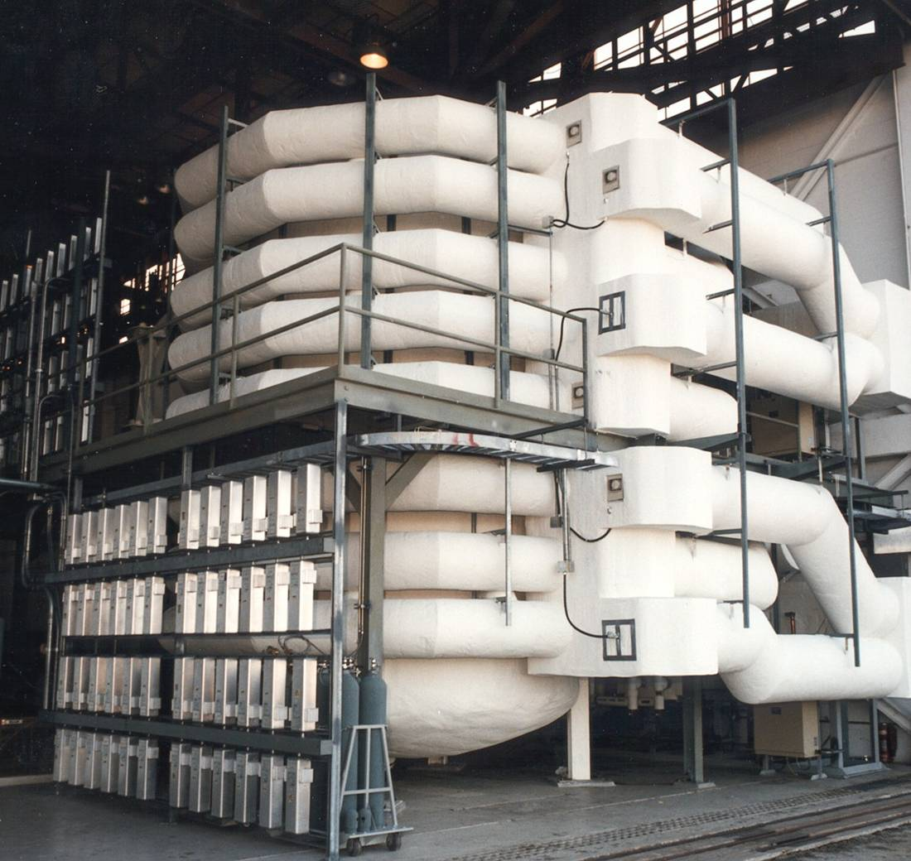
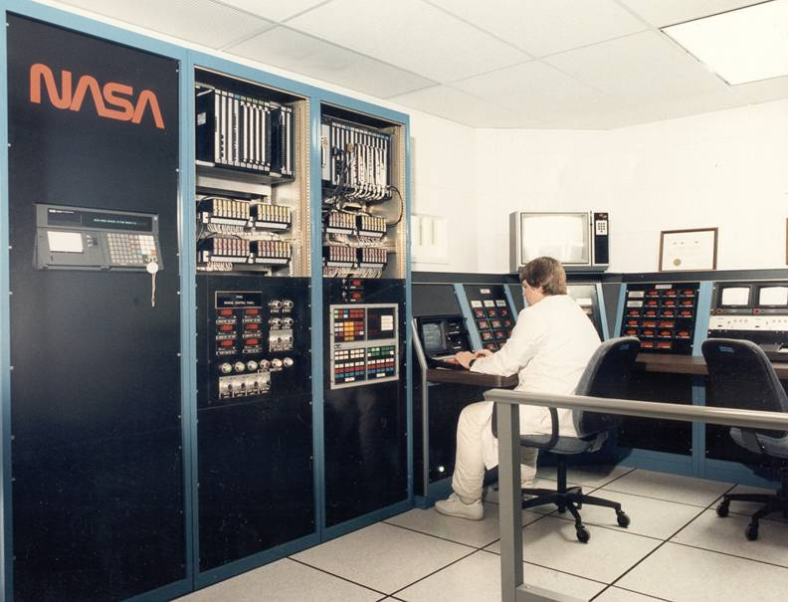
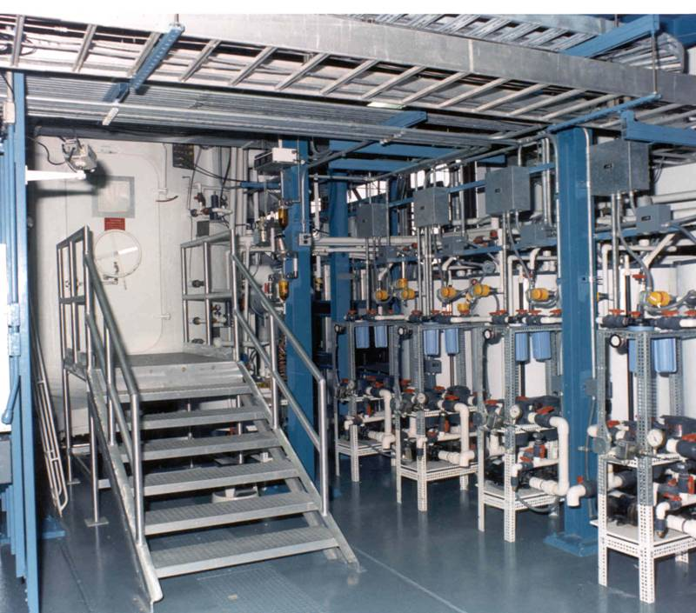
NASA’s Biomass Production Chamber (BPC)—Perhaps the First Operational Vertical Farm (1988)
Control Room
External View - Back
20 m² growing area; 113 m³ vol.; 96 400-W HPS Lamps;
400 m³ min⁻¹ air circulation; two 52-kW chillers
Wheeler. 1992. HortScience
Hydroponic System

Slide 2
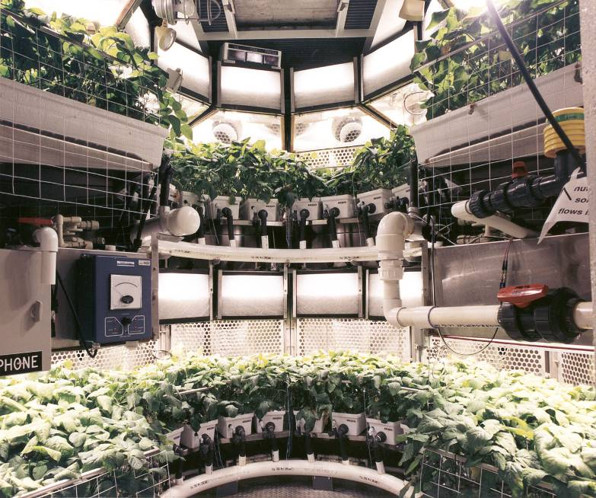
Soybeans in NASA’s Biomass Production Chamber (BPC)

Slide 3
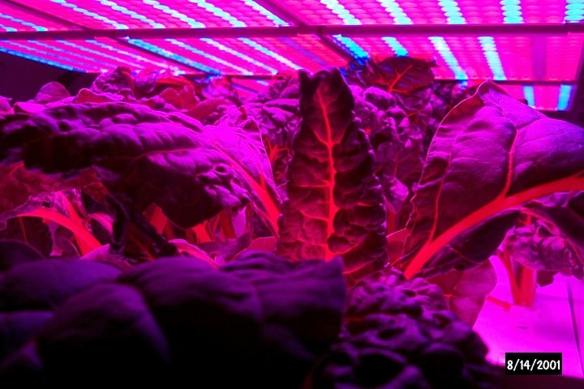
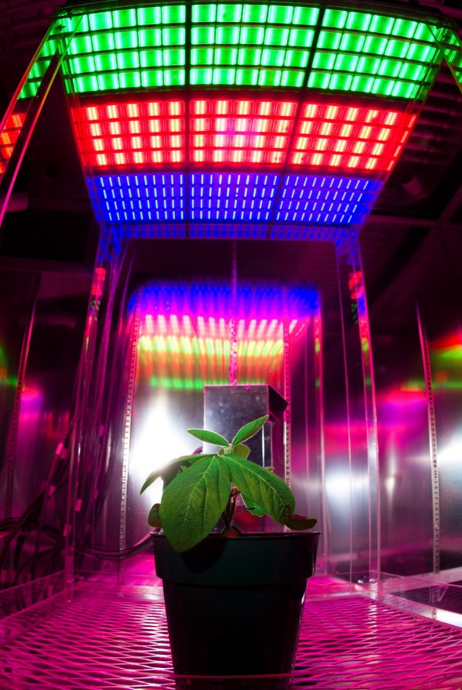
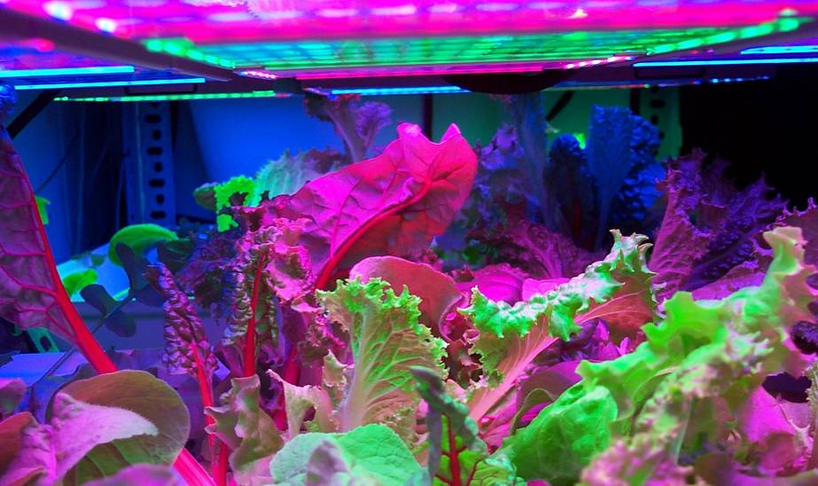
NASA Pioneered the use of Light Emitting Diodes (LEDs) to Grow Crops
LED Testing at Kennedy Space Center
US Patent for Using LEDs to
Grow Plants Developed with NASA Funding
at University of Wisconsin
Bula et al. 1991. HortScience
Goins et al., 1997. J. Exp. Bot.
Notes:
Continue investigations with red+ blue LEDs supplemented with green LEDs to improve whole-canopy light penetration/absorption, and enhance normal leaf color from a human visual perspective (photometric scale)
Explore opportunities to implement new high-brightness red (indium gallium aluminum phosphide) and blue LEDs (indium gallium nitride) in salad crop testing

Slide 4
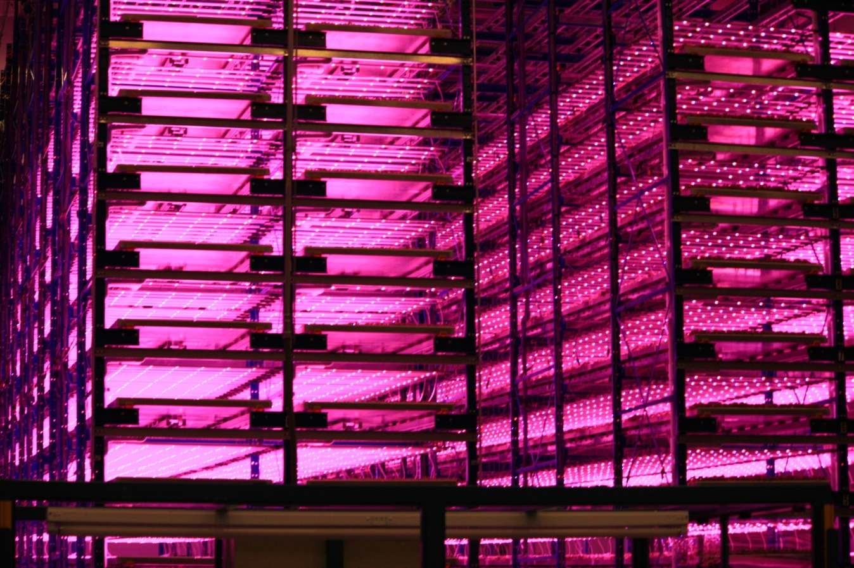
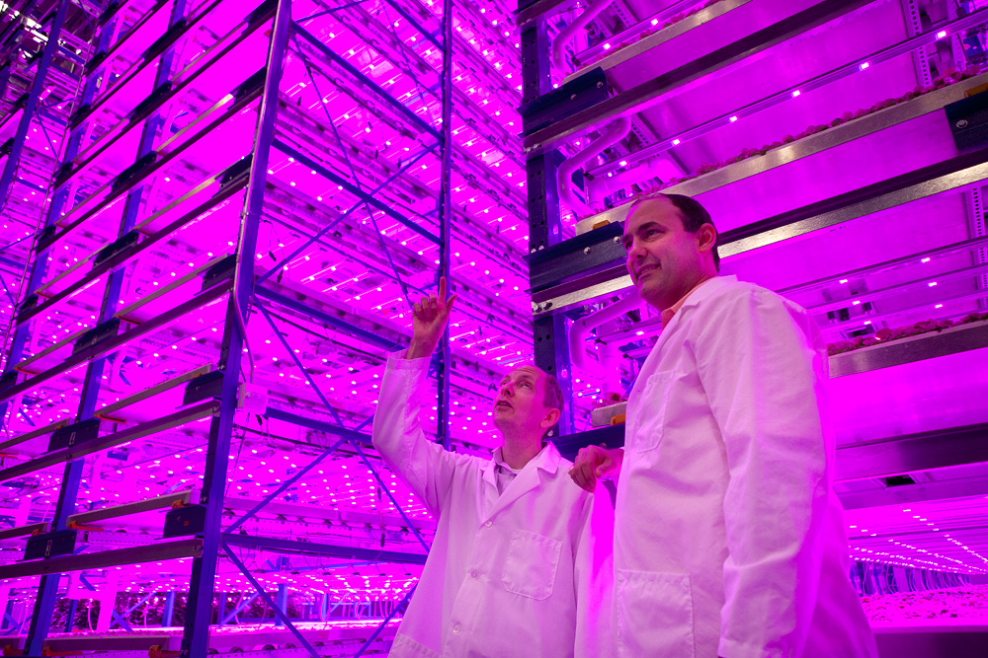
Now,
LEDs are Used
Widely in
Controlled
Environment
Agriculture
Texas Plant-Expressed
Vaccine Consortium
Photos Courtesy of Illumitex
Austin, TX

Slide 5
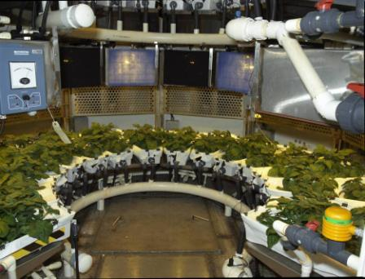
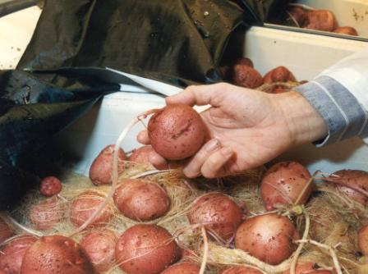
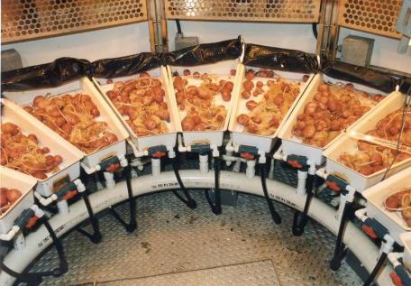
NASA’s Use of Nutrient Film Technique (NFT) to Grow
Potatoes
Wheeler et al., 1990. Amer. Pot. J.

Slide 6
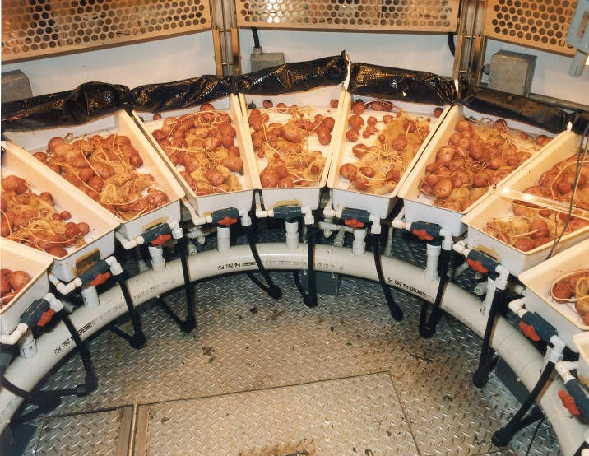
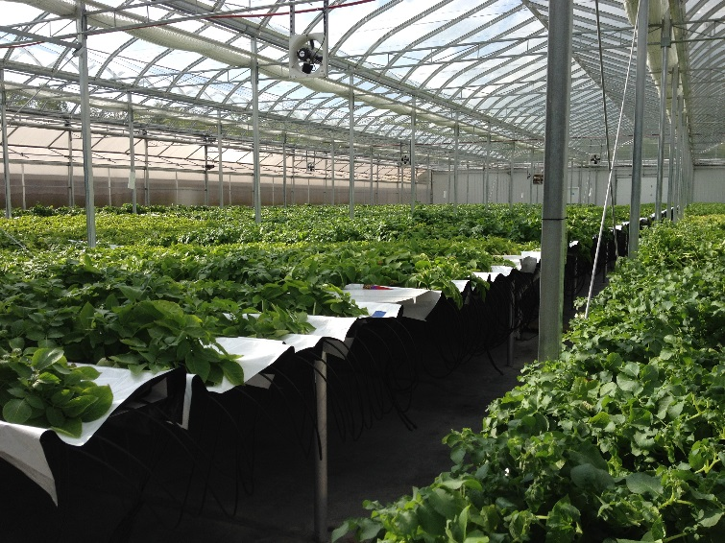
Commerical Production of
Seed Potatoes using NFT
Potatoes in NFT at NASA KSC 1992, ⇑
and at commercial “seed potato”
facility (Sklarczyk Farms, MI) 2016 ⇒

Slide 7
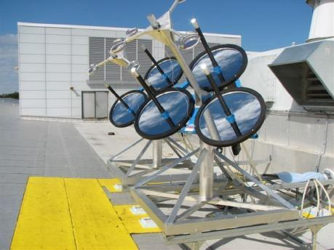
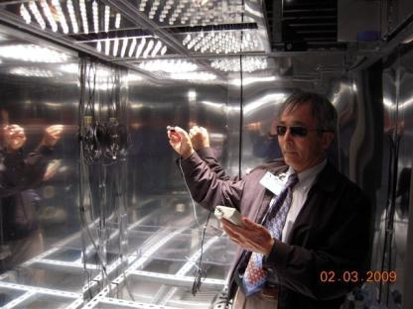
Solar Collector / Fiber Optic Demonstration
Up to 400 W light delivered to chamber
(40-50% of incident light)
2 m² of collectors on solar
tracking drive (SLSL Bldg,
Kennedy Space Center, FL)
Drysdale et al., 2008 . Adv. Space Res.

