Slide 1
AAM Ecosystem Working Groups Overview
For UAM Noise Working Group
Michael Patterson
Acting AAM Principal Investigator, AAM Mission Office
April 9, 2020

Slide 2
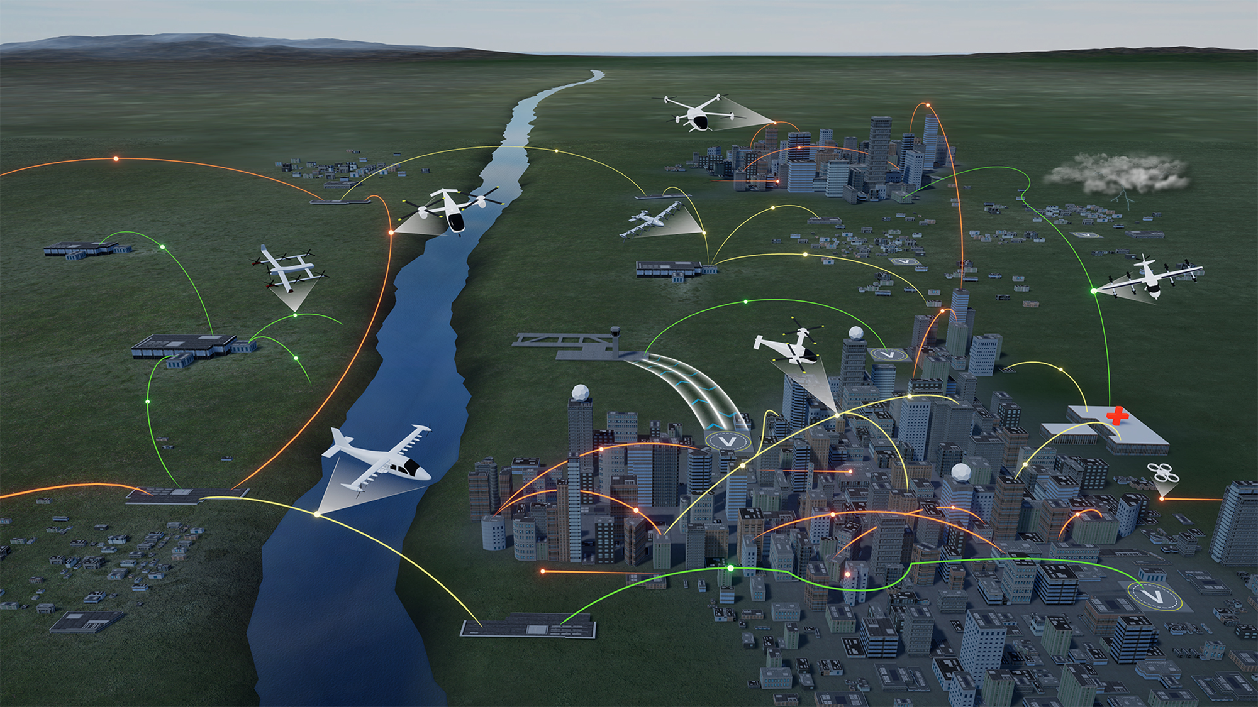
Advanced Air Mobility (AAM)
Safe, sustainable, affordable, and accessible aviation for transformational local and intraregional missions
Includes many applications and aircraft
  cargo transport, pax-carrying, aerial work, etc.
  eVTOL, sUAS, eCTOL, hybrid-electric, etc.
  Urban Air Mobility (UAM) as a challenging use-case with high benefit
Enabled largely by electrification and scaled through automation
Local missions < ~75 miles
Intraregional mission < ~300 miles
Does not include:
  Supersonic or hypersonic transport
  Existing hub-and-spoke air service with large transport aircraft

Slide 3
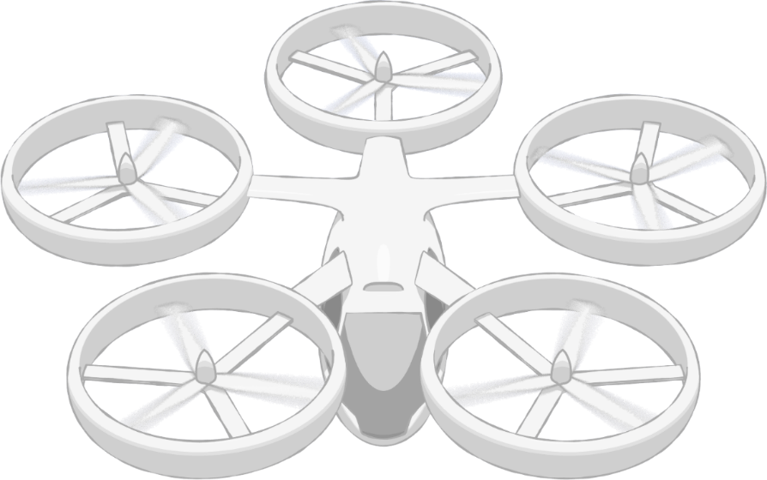
Framework
Societal integration and acceptance of UAM operations
Design, development, and implementation of infrastructure to enable safe and efficient multi-vehicle UAM operations
Operations and management of multiple vehicles within a UAM system that enable safe and efficient sharing of airspace and other system resources
Community Integration
Airspace System Design & Implementation
Airspace & Fleet Operations Management
5
3
4
Vehicle
Development & Production
Individual Vehicle Management & Operations
Operations and maintenance of a single UAM vehicle, independent of the sharing of airspace or other system resources
Design, manufacture, and system readiness of UAM vehicles
1
2
Aircraft & Aircrew
Airspace
Community Integration
Pillar number
#

Slide 4
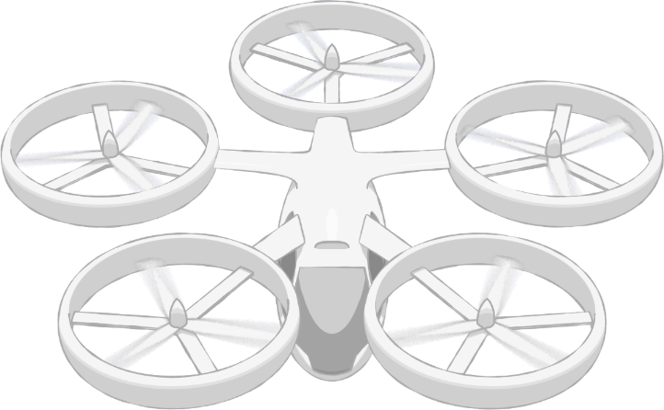
Framework and Barriers
1. Public Acceptance
2. Supporting Infrastructure
3. Operational Integration
4. Local Regulatory Environment & Liability
1. Safe Airspace Ops
2. Efficient Airspace Ops
3. Scalable Airspace Ops
4. Resilient Airspace Ops
5. Fleet Management
6. Urban Weather Prediction
1. Airspace Design
2. Operational Rules, Roles, & Procedures
3. CNSI & Control Facility Infrastructure
4. UAM Port Design
Community Integration
Airspace System Design & Implementation
Airspace & Fleet Operations Management
5
3
4
Vehicle
Development & Production
Individual Vehicle Management & Operations
1. Vehicle Design & Integration
2. Airworthiness Standards &
Certification
3. Vehicle Noise
4. Weather-Tolerant Vehicles
5. Cabin Acceptability
6. Manufacturing & Supply Chain
1. Safe Urban Flight Management
2. Increasingly Automated Vehicle Operations
3. Certification & Ops Approval
4. Ground Ops & Maintenance
1
Safety
2
Security
Affordability
Noise
Autonomy
Aircraft & Aircrew Barriers
Airspace Barriers
Community Integration Barriers
Pillar number
UAM Ports
Regulations/Certification
#

Slide 5






AAM Ecosystem Working Groups
Accelerate advanced air mobility through collaboration
Recognize and address near-term needs to kick-start AAM/UAM
Research needs for scalable AAM towards maturity level-4
Identify partnership opportunities with NASA projects including
National Campaign
Expected Outcomes
Foster collaborations among each other
Generate data and information for standards bodies
Collectively address pre-competitive considerations (e.g., protocols,
safety analysis)
Develop AAM system architectures, book of requirements and
guidelines, and scorecard

Slide 6
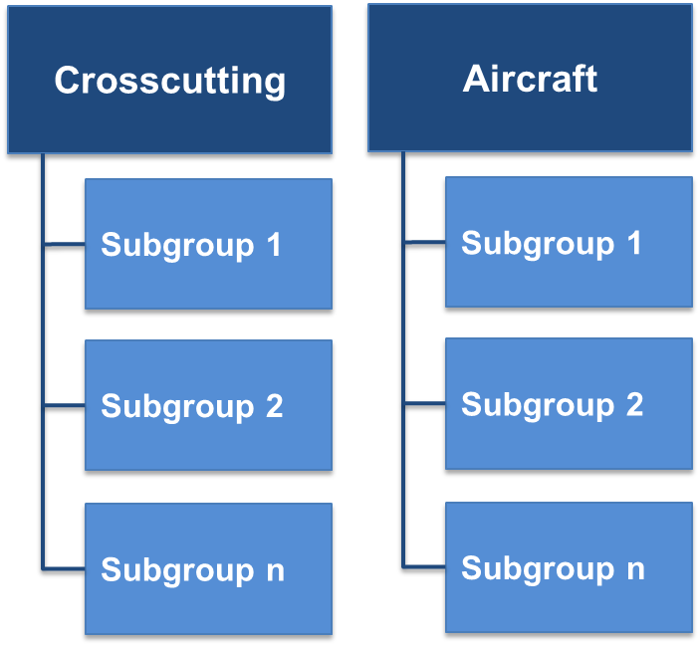
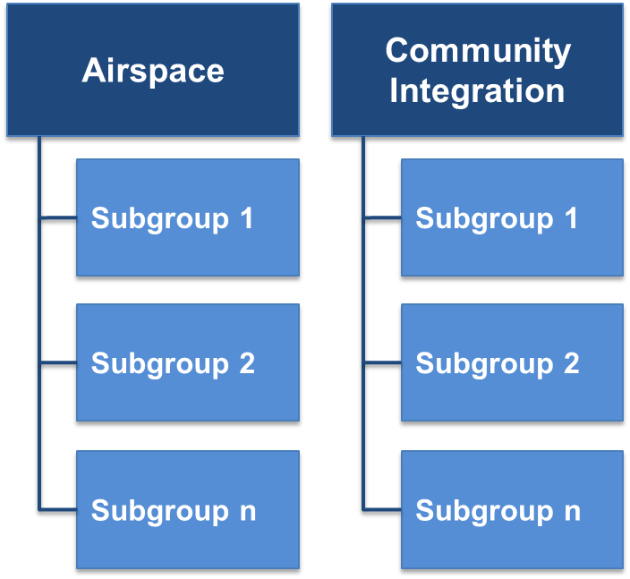
Current Ecosystem Working Group (WG) Execution Plans
Initial Working Groups: Aircraft, Airspace, Community Integration, Crosscutting
  Subgroups to be defined by member interests
    E.g., Crosscutting subgroups for National Campaign and ConOps
Leadership and Membership
  Each WG with NASA Lead and a group-elected Community Liaison
  Individuals self-select the WG(s) in which they wish to participate
    Crosscutting WG includes all who sign up for any group
Meeting Cadence
  Main WG meeting (for each WG) once per quarter
    Subgroup meetings and other interactions occur between meetings
    Anticipate beginning this schedule in May for each WG
  Two face-to-face meetings per year (nominally)
    2020 tentative: July 7-9 and Sept UAM Convention
General WG Structure
WGs will be flexible to fit the needs of the AAM ecosystem
Working Group
Subgroup

Slide 7
How does the UAM Noise Working Group Fit?
Still discussing possibilities; don’t want to negatively impact good work being done!
One thought:
Crosscutting
Aircraft
Airspace
Community Integration
Working Group
UNWG Executive Committee
Noise
Noise
Noise
Subgroup
Subgroup 2
Subgroup 2
Subgroup 2
Subgroup 2
Subgroup n
Subgroup n
Subgroup n
Subgroup n
POTENTIAL
TOPICS:
Maintain existing communication between UNWG subgroups
Conduit of noise related matters to the Crosscutting WG
Source noise
Individual vehicle-level tools & technologies
…
Fleet noise
Multi-aircraft tools & technologies
…
Human response to noise (e.g., metrics)
Community outreach
…
Notes:
Main downside is adding some “overhead” for reporting, but this could be good by increasing the visibility of what is being done
Existing Subgroups in UNWG: 1 Tools & Technologies, 2 Ground & Flight Testing, 3 Metrics, 4 Regulation & Community Outreach Framework

Slide 8
AAM Ecosystem Working Groups Planned Future Meetings
Virtual Meetings:
Thurs April 9 at 3:00pm EDT
  National Campaign Breakout Session
Other April Events (Tentative)
  National Campaign Breakout Sessions
  UAM Concept of Operations Overview
  ConOps Breakout Sessions
May Events (Tentative)
  Kickoff meeting for each individual WG
Tentative In-Person Meetings:
July 7-9, 2020
  WG Face-to-Face Meeting (DC area)
September 2020
  UAM Convention

Slide 9
Backup

Slide 10
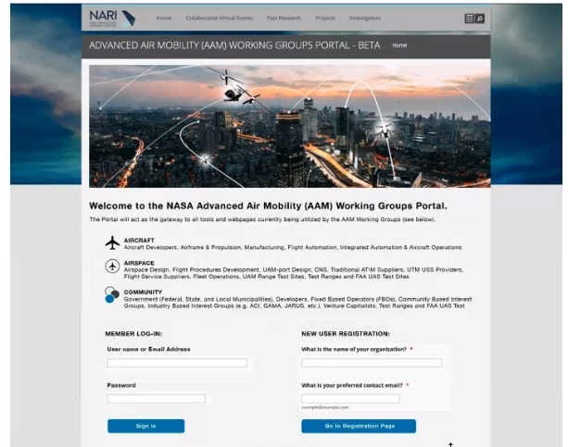
Ecosystem WG Collaboration Tools
Suite of virtual collaboration tools essential to work across many organizations, individuals, and time zones
Assessing options for virtual meetings, document archiving/editing, and between-meeting discussions
Developing a “portal” at NARI website for quick access to all WG tools, info from previous meetings, etc.
Notes:
Timeframe for having this up is likely mid-April
Consider jumping into the portal demo… will have:
Links to collaboration tools
News/highlights will appear
Upcoming events
Embedded youtube videos for archived recording

Slide 11
General Ecosystem Working Group Structure
Crosscutting
Aircraft
Airspace
Community Integration
Subgroup 1
Subgroup 1
Subgroup 1
Subgroup 1
Subgroup 2
Subgroup 2
Subgroup 2
Subgroup 2
Subgroup n
Subgroup n
Subgroup n
Subgroup n
Working Group
Subgroup

Slide 12
NASA AAM Mission Priorities
xTM Architectures
Operational Rules, Roles, & Procedures
Comm, Nav, Surveillance, Information
Human Response to Noise
Regional M&S Capabilities
AAM Airspace and Supplemental Data Services
In-time Aviation Safety Management System
Community Integration
Airspace System Design & Implementation
Airspace & Fleet Operations Management
5
3
4
Vehicle
Development & Production
Individual Vehicle Management & Operations
Source and Fleet Noise
Vehicle Propulsion Reliability
Safety in Environmental and Failure conditions
Distributed Electric Propulsion
Automated Flight and Contingency Management
m:N Pilots to Aircraft
1
2
Assured Automated Architectures
National Campaign
Aircraft & Aircrew
Airspace
Community Integration
Pillar number
High Density Microplex
AAM System Architectures
#

