Slide 1


Streamlining the ACS3 Solar Sail Manufacturing Process
Gabriela Griffin
NIFS Intern
Mentor- Dr. Olive Stohlman
Structural Dynamics Branch
NASA Langley Research Center
Spring 2020

Slide 2
Overview
Background on ACS3 Project
Internship Objectives
Sail Design Document
Material Storage Cover Design
Paper Forms
Abaqus/Working Remotely

Slide 3
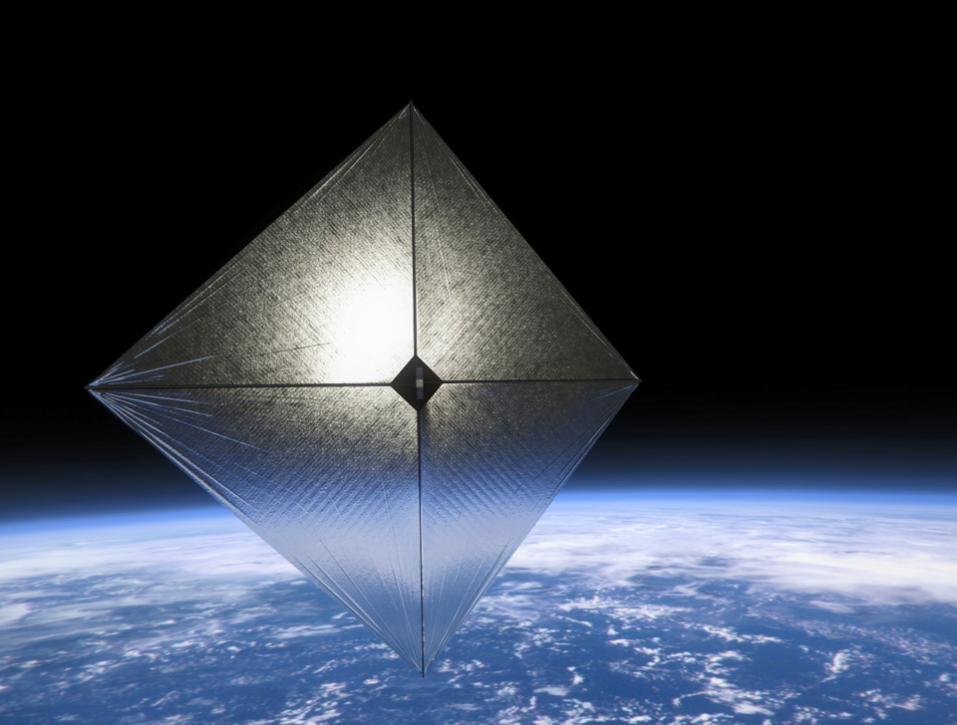
Background on ACS3 Project
Advanced Composite-based Solar Sail System
Technology demonstration project of a solar sail in low Earth orbit
Uses a 12U CubeSat Satellite platform
Notes:
A 12U is a 12 unit cube sat, with a unit being a 10x10x10 cm volume
Sail takes up about 4 of the 12 Units

Slide 4
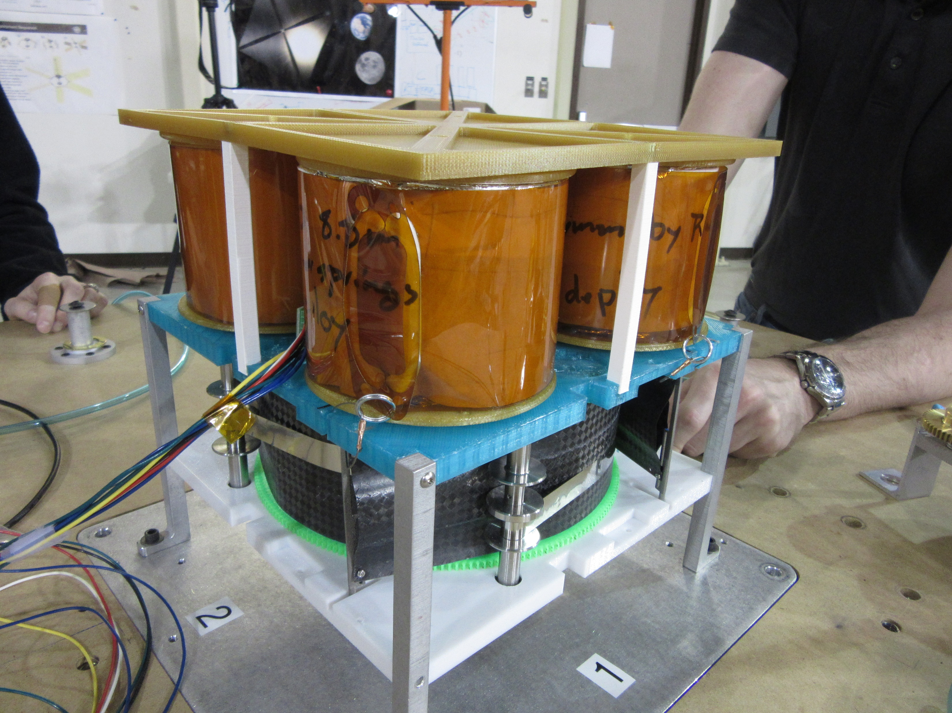
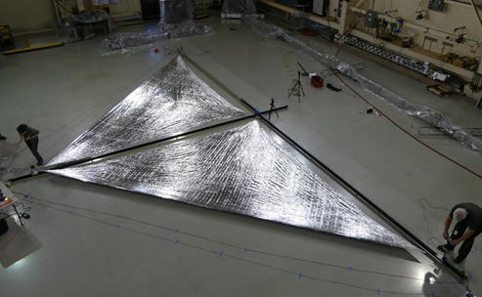
Background on Sail
Made of 2 μ thick Polyethylene Naphthalate (PEN)
Coating of 100 nm thick aluminum on one side
Coating of 15 nm thick chromium on other side
Four quadrant design rolls into four spools
Each quadrant unrolled by four composite booms
Notes:
Aluminum gives the sail the reflectiveness it needs
Chromium increases emissivity of sail to keep the temperature within operating conditions
Sail material is very thin and fragile, poses challenges when manufacturing. It is very easy to rip, and once a rip starts even it’s own weight will tear the sail. Another issue is that because sail is so thin, it does not crease or hold a fold, like how paper does. As the sail needs to be folded and packed tightly for deployment this poses a problem.

Slide 5
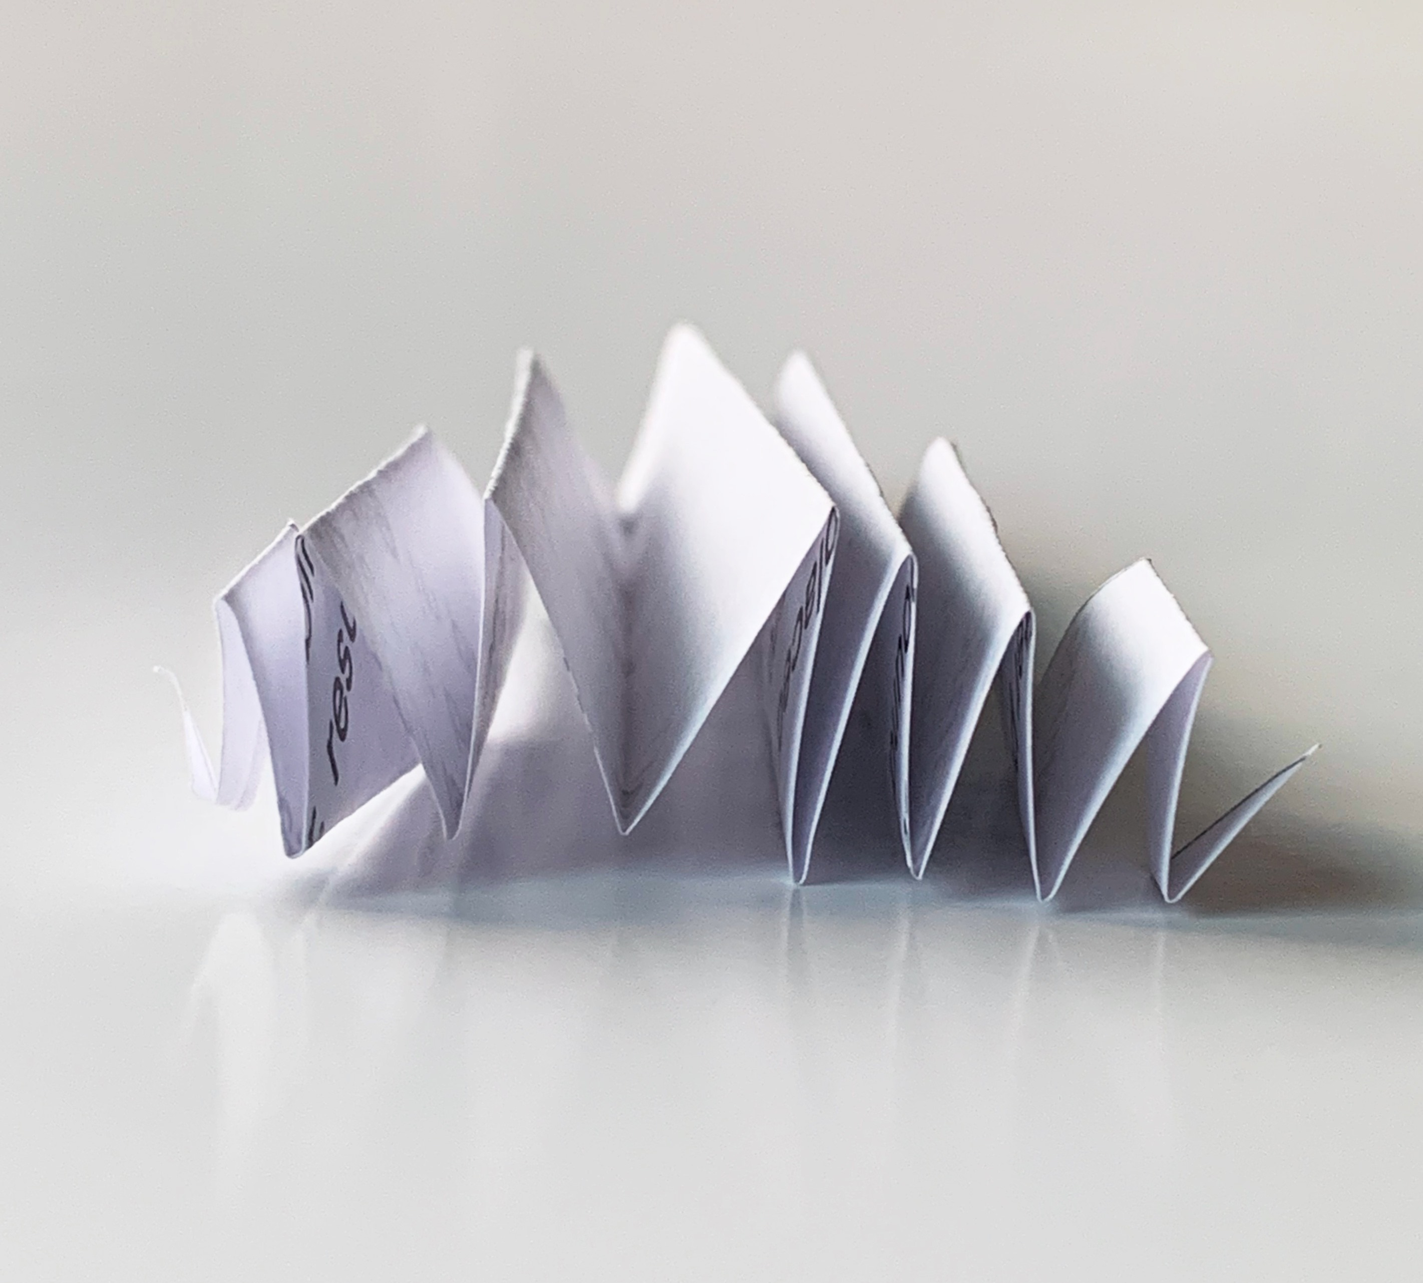
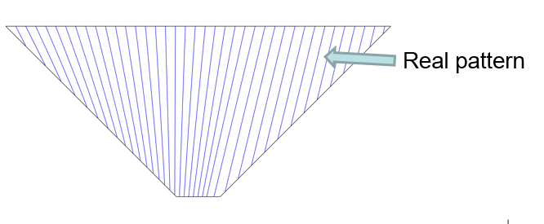
Background on Folding Pattern
154 folds
Z-folds
Fold angle changes
Asymmetric pattern to create uneven tail length
Folded from left to right
Fold Lines
Offset Center
Notes:
-folded from left to right
-z-fold example shown using a piece of paper, each fold line on the diagram corresponds to a mountain or valley fold on the sail
-takes about 4 days to fold one quadrant
-not offset center, will talk about in next slide

Slide 6
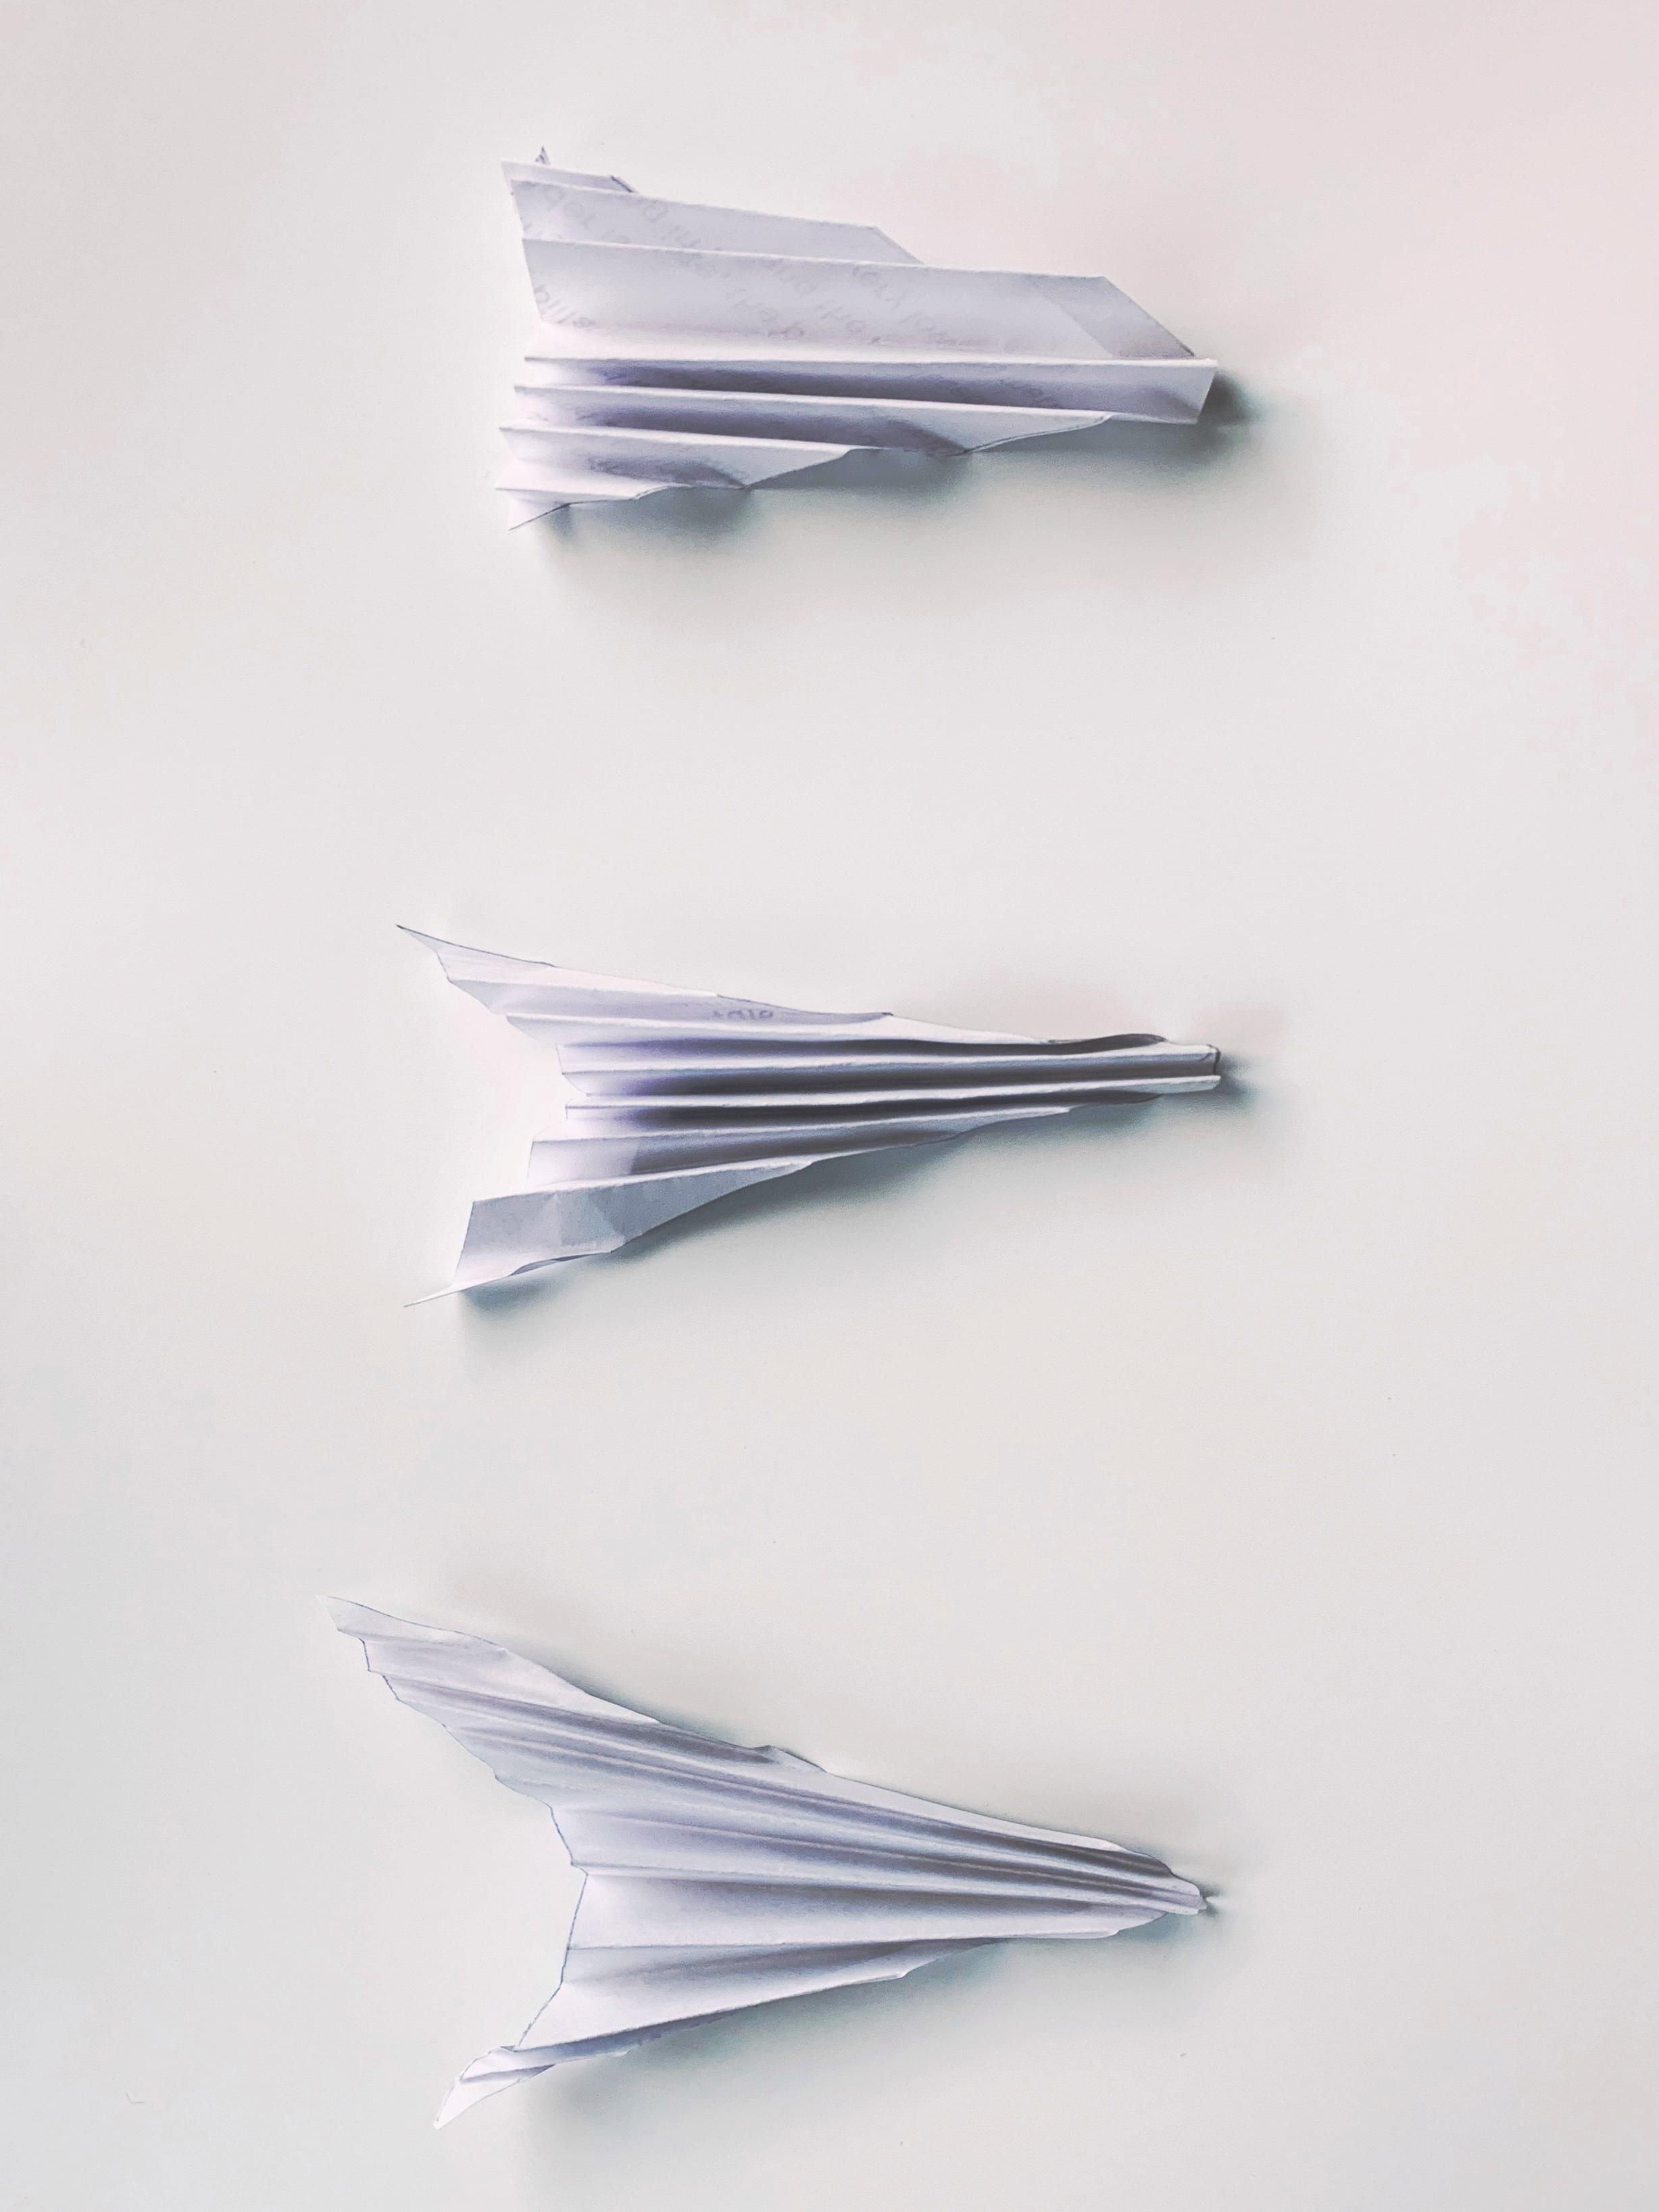
Sail Fold Pattern: End Shape
Parallel Folds
Angled Folds
Equal ends
Offset Center, Angled Folds
Shorter end
Longer end

Slide 7
Objectives for Internship
To streamline sail manufacturing process by documenting specific steps through images and text, designing and assembling storage container for sail material roll, and designing paper forms for sail shape
To model sail and boom structures using Abaqus in order to understand the relationship between line tensioning and the size of the sail areas under compression

Slide 8
Sail Design Document
Requirements:
Provide clear procedures for each sub process
Use images of manufacturing steps to assist in communicating procedures
Provide quantitative guidelines
Provide up-to-date list of materials required for manufacturing quadrants

Slide 9
Sail Design Document
Broken down into sections:
Parts and Tools
Membrane Geometry
Seaming
Ripstop Procedure
Corner Fitting Installation
Stainless Steel Cable Preparation
Packaging and Rolling
Sail requirements
Notes:
I mainly focused on
Parts and tools: in table format, includes source of tool
Geometry: diagram of sail shape including gores and rip stops, dimensions based on boom size
Seaming: process of creating seam material, as well as attaching gores to each other
Won’t touch on Corner fitting, Rip stop Procedure, and Sail requirements as I didn’t work on these sections.
Intended to also write stainless steel cable preparation as well as packaging and rolling, but had to leave lab before I was able to collect pictures and document steps

Slide 10
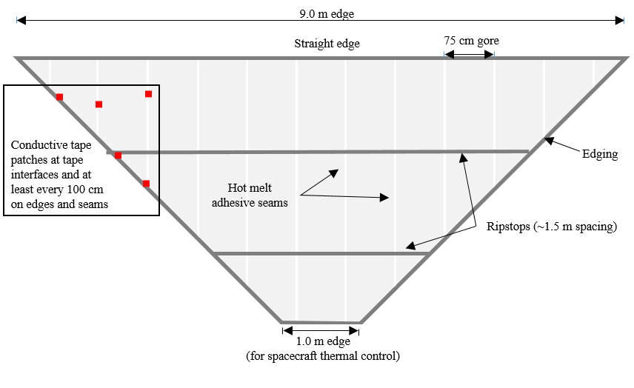
Sail Design Document: Membrane Geometry
Basic summary of sail geometry
0.75 meter gores
Example is for a 9 meter wide sail
Isosceles Trapezoid
Notes:
Sail geometry: made from 13 gores, each seamed together and then cut out to form an isosceles trapezoid
This example is for a 9 meter wide sail, but dimensions are given for smaller sails. A table is also given to determine width of the sail needed based on length of the booms
Gore strips are 75 cm wide, and cut to length based on gore number. This was assigned by us as a way to keep track of which gore was being seamed

Slide 11
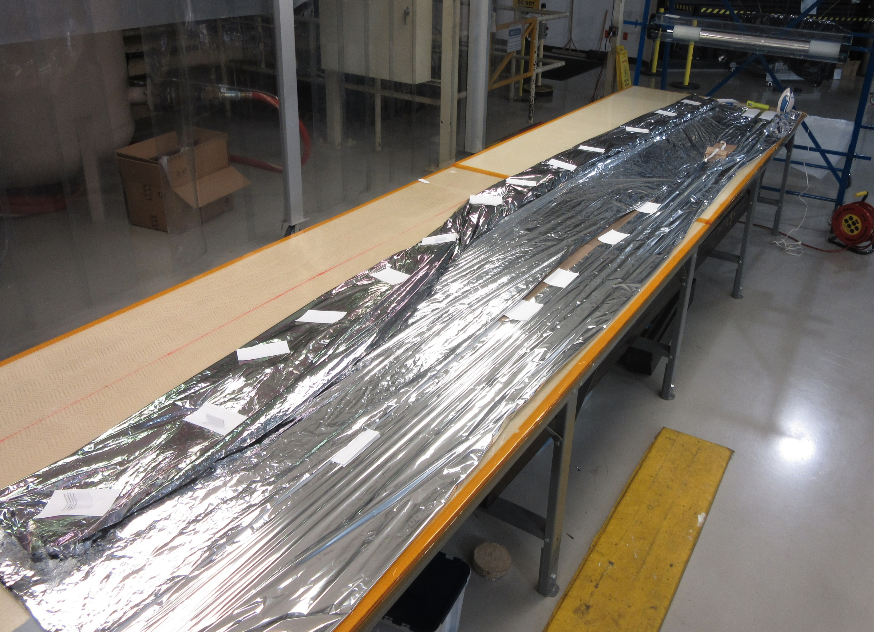
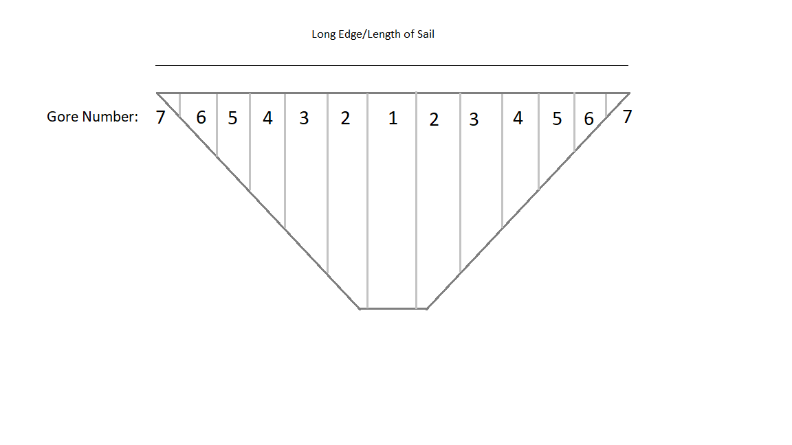
Sail Design Document: Membrane Geometry
Gores are rolled out as they are seamed together
Notes:
Rolled out as they are seamed together starting with gore 1
Then go into seaming material

Slide 12
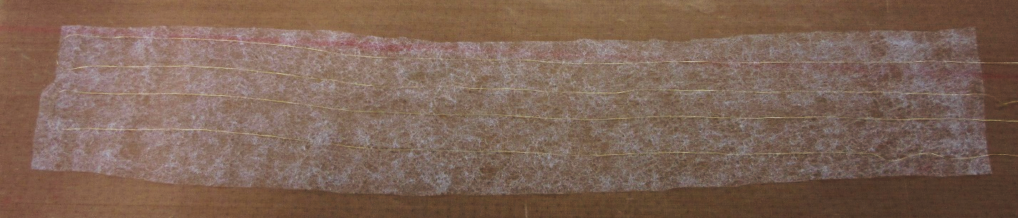
Sail Design Document: Seam Material
Gores are seamed together using a combination of PEN and polyester webbing adhesive
Kevlar thread is woven into webbing adhesive to add strength and stop rips if they occur
Iron melts polyester web adhesive
Notes:
Web adhesive melts at 165 degrees C

Slide 13
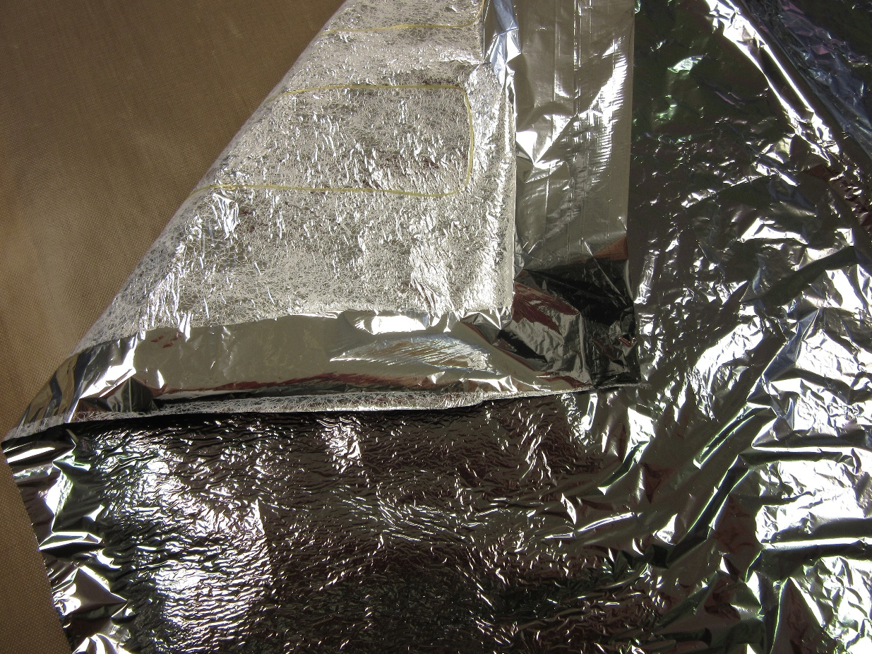
Sail Design Document: Seam Material
Webbing adhesive is attached to PEN in large sections using an iron
2 cm wide strips are cut out of section along Kevlar thread
Notes:
165 degrees Celsius
Webbing material feels similar to dryer sheets

Slide 14
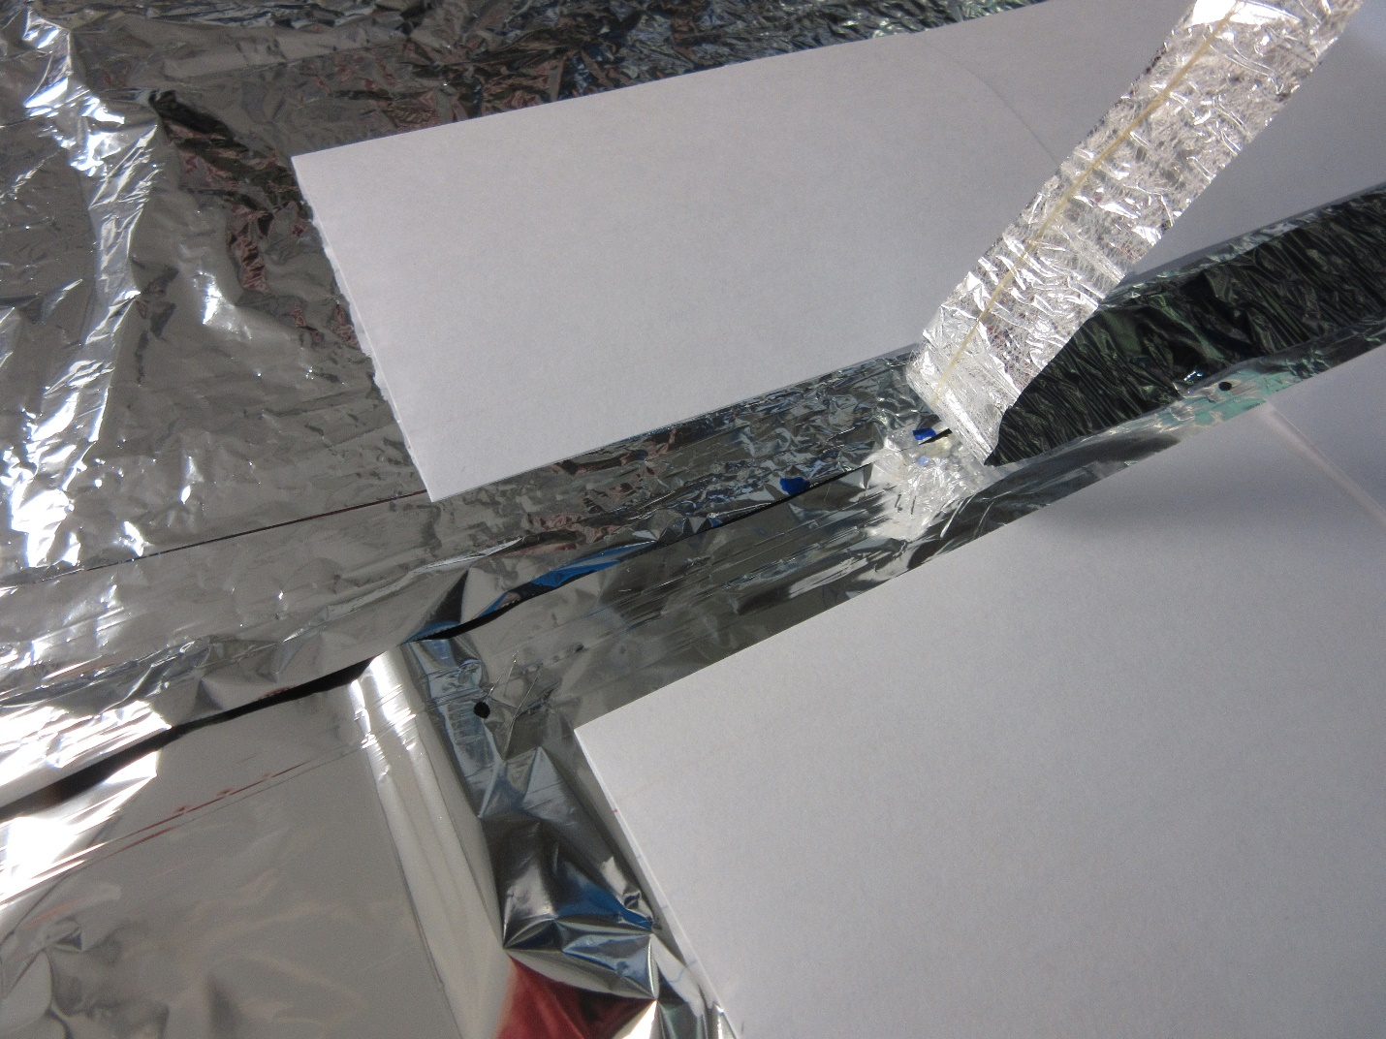
Sail Design Document: Seaming Process
Seam material is laid across gores
As small overlap as possible is desired between the gores
Notecards were used to hold sail material down

Slide 15
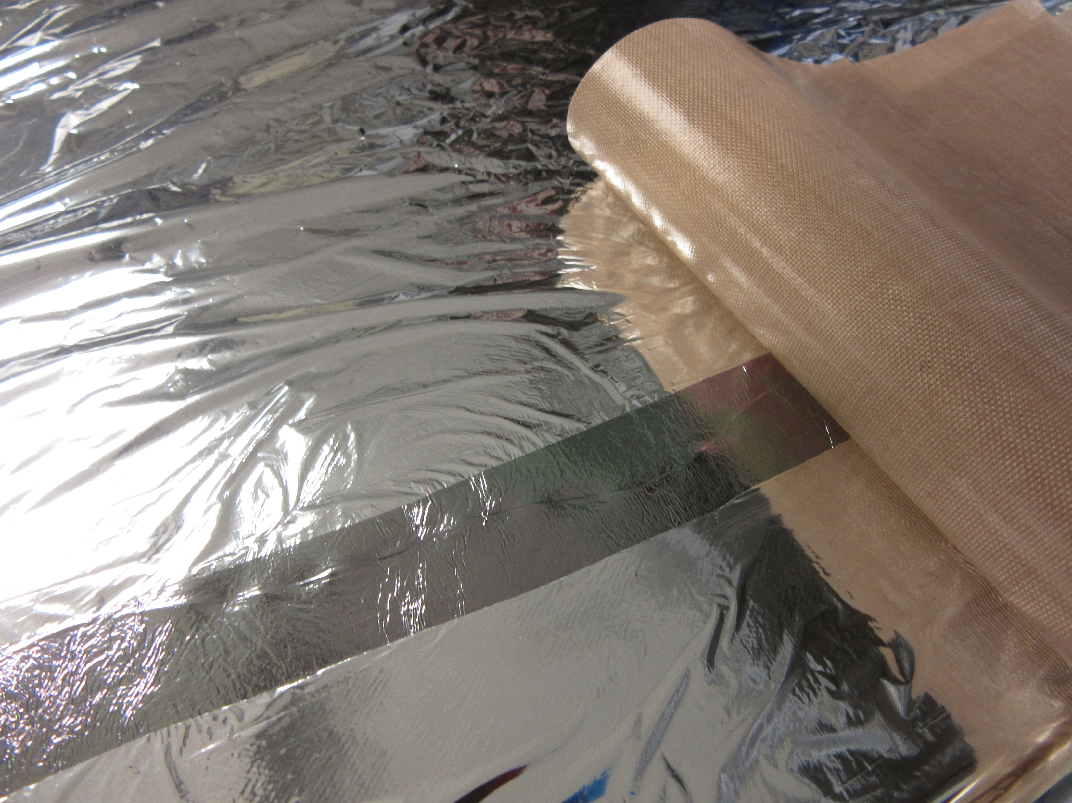
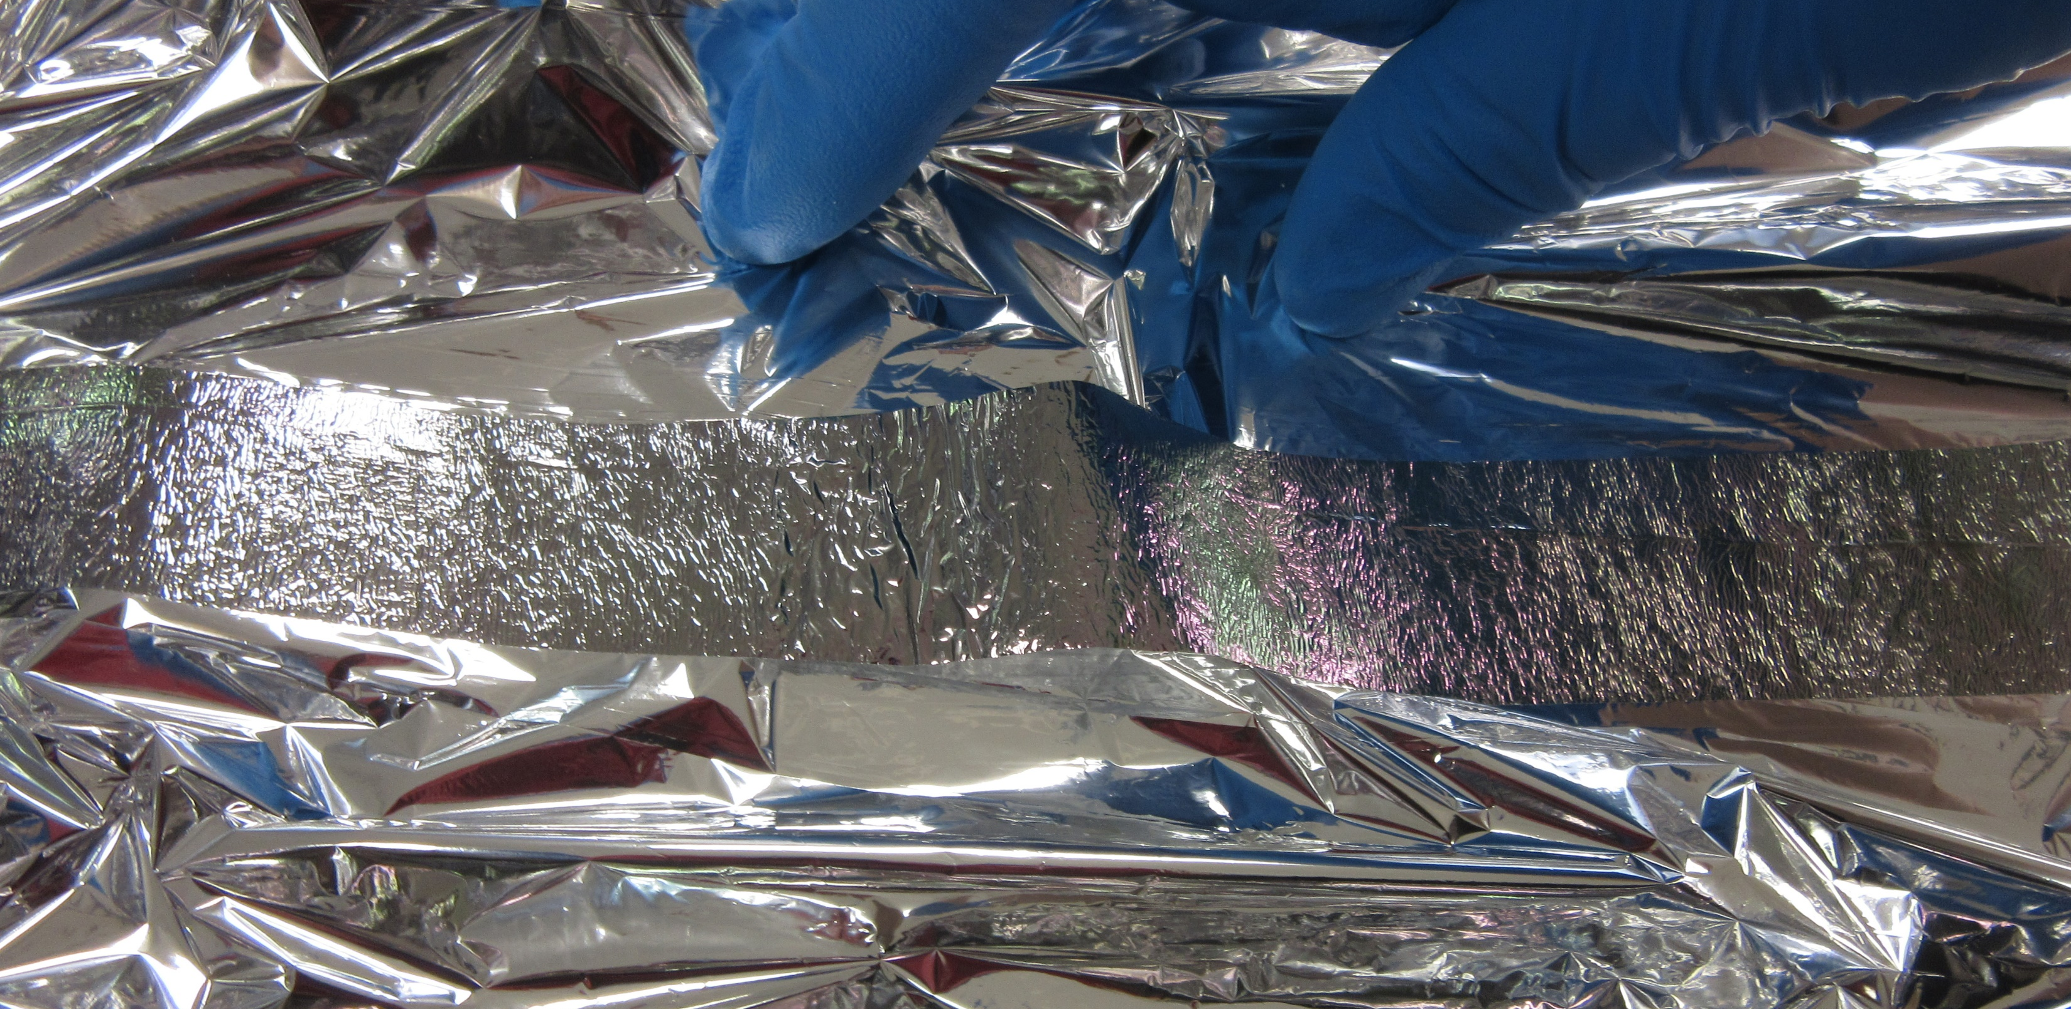
Sail Design Document: Seaming Process
Seaming process between gores
Teflon non-stick mat
Similar process for edging and ripstops
Notes:
Left is a seam that didn’t quite adhere. Right is a well adhered seam. The Kevlar thread can be seen in the seaming strip on the right.
Teflon non stick mat on the right protects the iron from the polyester webbing and allows the iron to slide smoothly across the PEN without damaging it

Slide 16
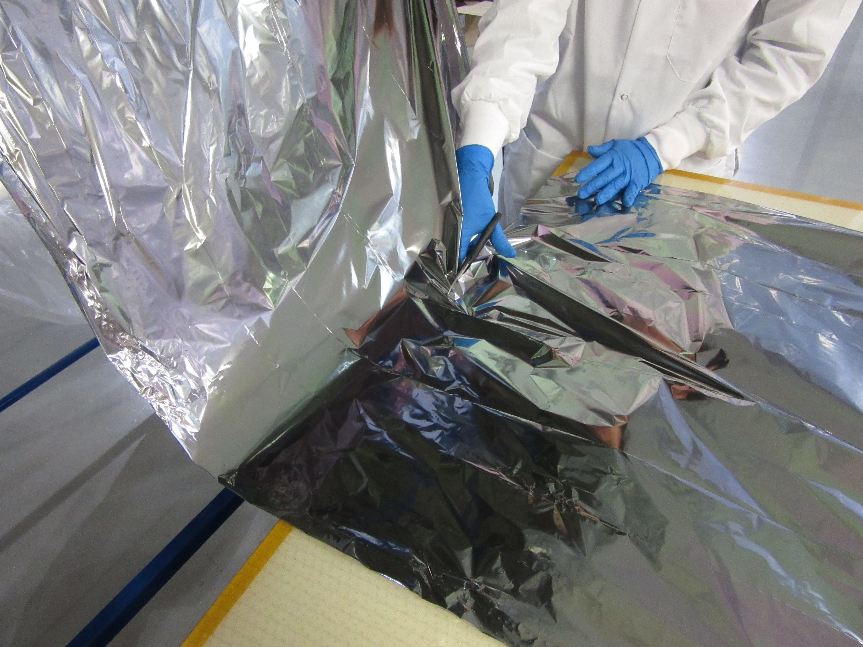
Cover Design Requirements:
Protect material from dust and sharp objects
Allow material to “roll”
Easily open and close
Easy to assemble and inexpensive

Slide 17
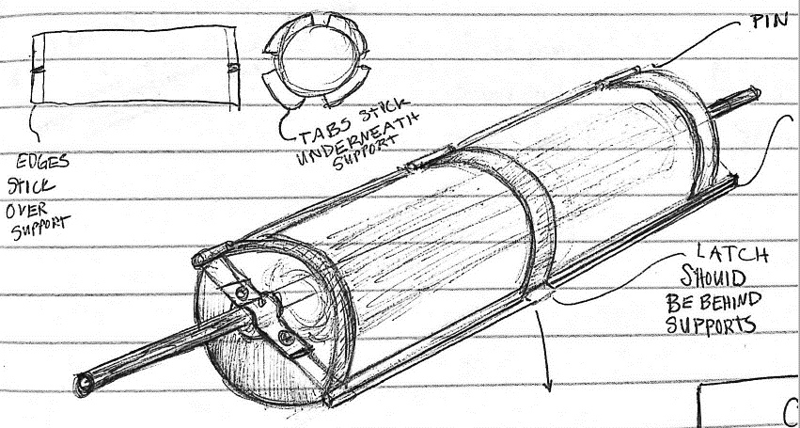
Cover Design: Initial Sketches
Changes Made:
Open ended top plate
Round vs. Square
Middle support removed
Wooden Dowel
Latch
Large Diameter
3D printed hinge and pin
Notes:
Consists of two end plates which support a stiff piece of plastic that wraps around the roll. Plates attach to shaft, and have a hinge so that the cover can easily be opened to roll out material

Slide 18
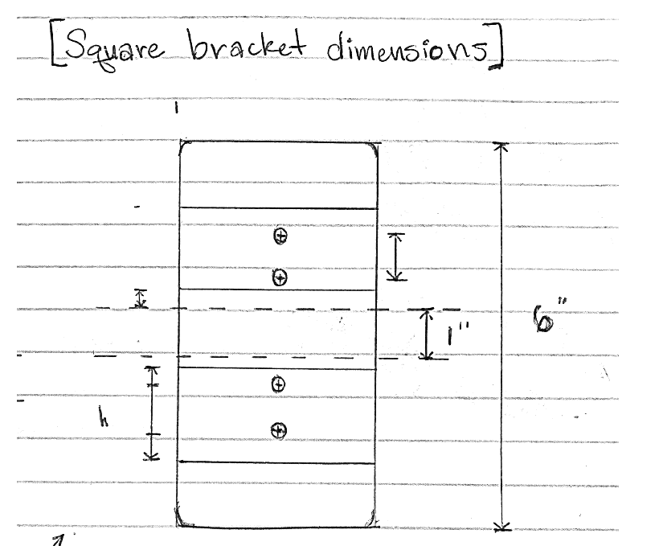
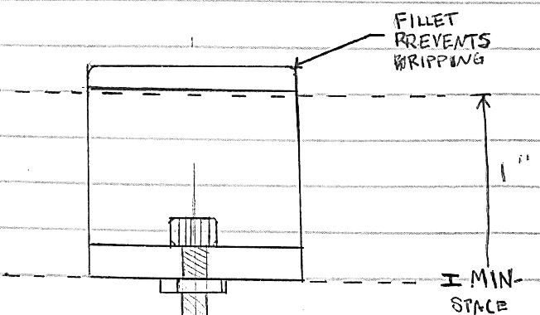
Cover Design: Initial Sketches
Side View
Top View

Slide 19
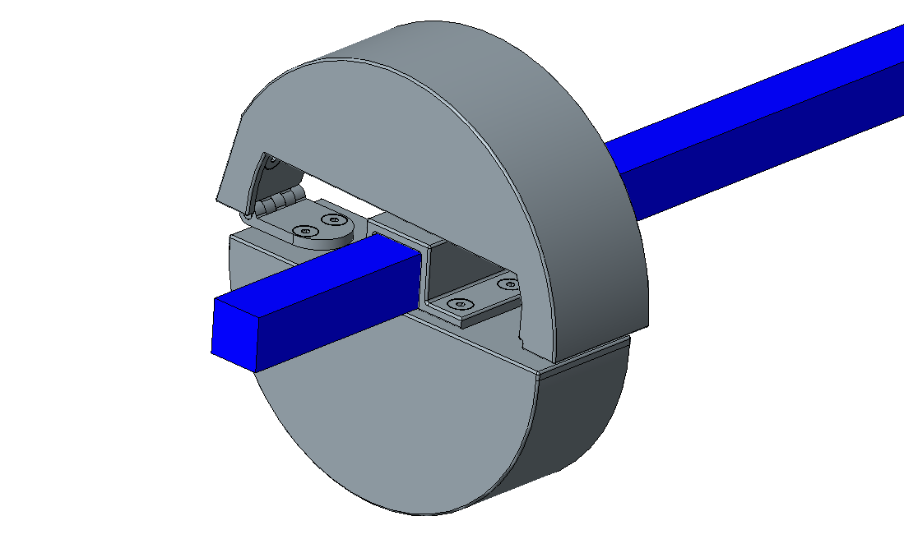
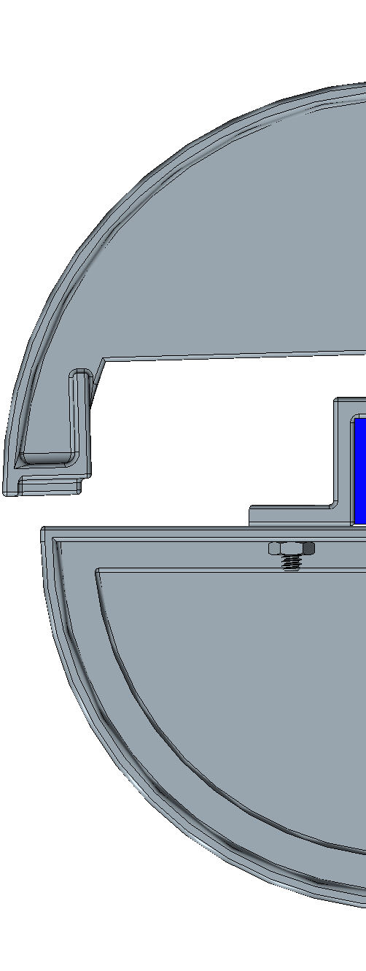
Cover Design: Initial CAD
Left Plate
Side View
Notes:
Add picture of ball bearing holder

Slide 20
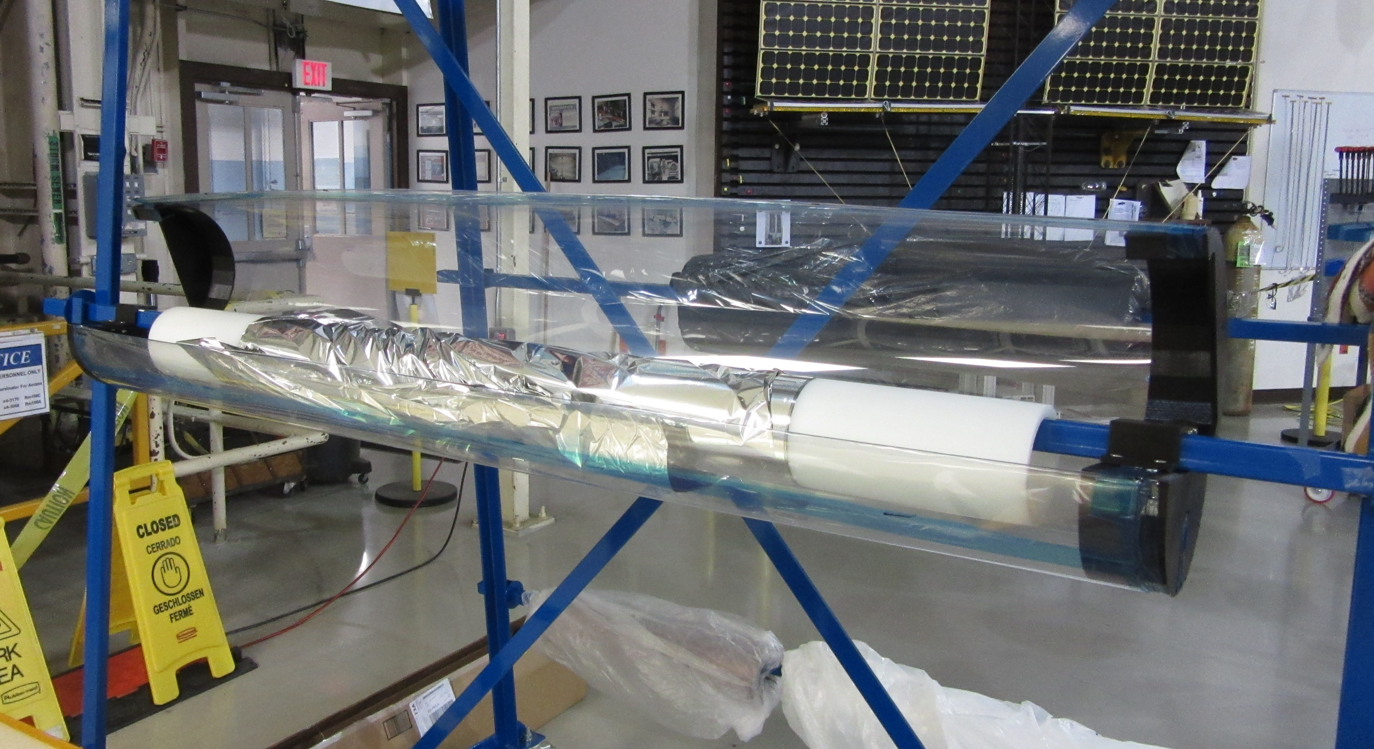
Cover Design: Printed and Assembled
3D printed end plates ($10.26 of filament)
Hardware and plastic from McMaster ($53.53)
Expensive components were hinges, plastic and ball bearings
Notes:
-3D printed in makerspace out of pla
-Each of the four end plates takes about 6 hours to print, with the square brackets taking 1 hr 45 min, and the ball bearing holders taking an hour
-Ball bearings were about 4 dollars each, possible to find cheaper ones, plastic was 4.50)
-total price is about 40 dollars, but 20 of that is ball bearing, cheaper ones could be found
-10.26 is based off price from matterhackers.com pla 1kg roll, which was 20 dollars each

Slide 21
Cover Design: Updates
Add height to square bracket for a better fit
Shorten hinge mount surface so top can open wider
Change angle to be downward
Notes:
-square bracket barely fit all the way down shaft
-top doesn’t open all the way because the end hits the bottom
-downward angle decreases friction on material when unrolling
Hinge shown in grey, top plate increase shown in blue

Slide 22
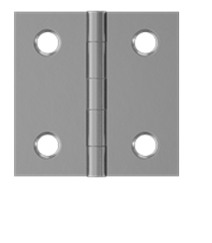
Cover Design: Updates
Add holes to attach plastic sheet
Remove place for dowel to sit
Modify hinge so a cheaper one can be used (dropped hardware total cost down to $31)
Notes:
-square bracket barely fit all the way down shaft
-top doesn’t open all the way because the end hits the bottom
-downward angle decreases friction on material when unrolling

Slide 23
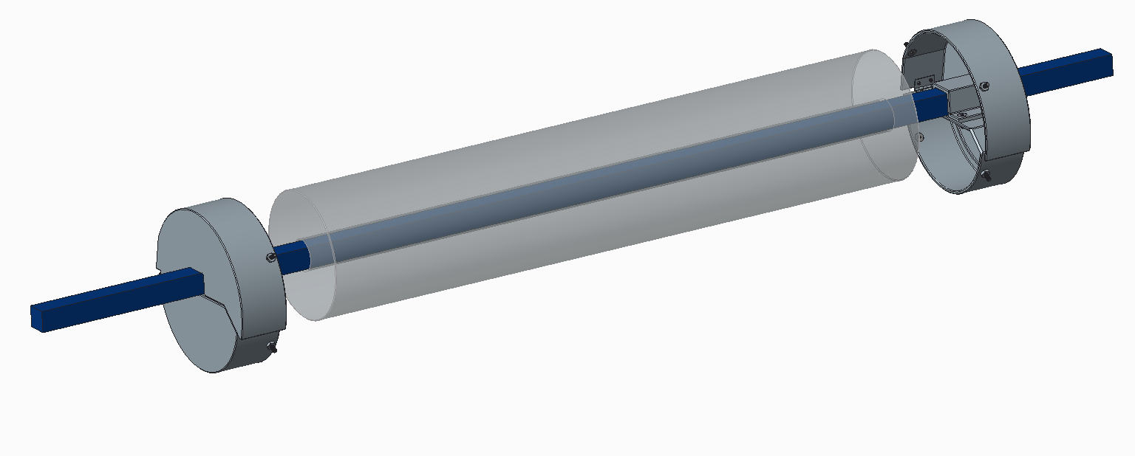
Cover Design: Updated CAD
Added attachment points for plastic sheet(not pictured)
Removed section for dowel
Downward angle to reduce friction on material
Material Roll

Slide 24
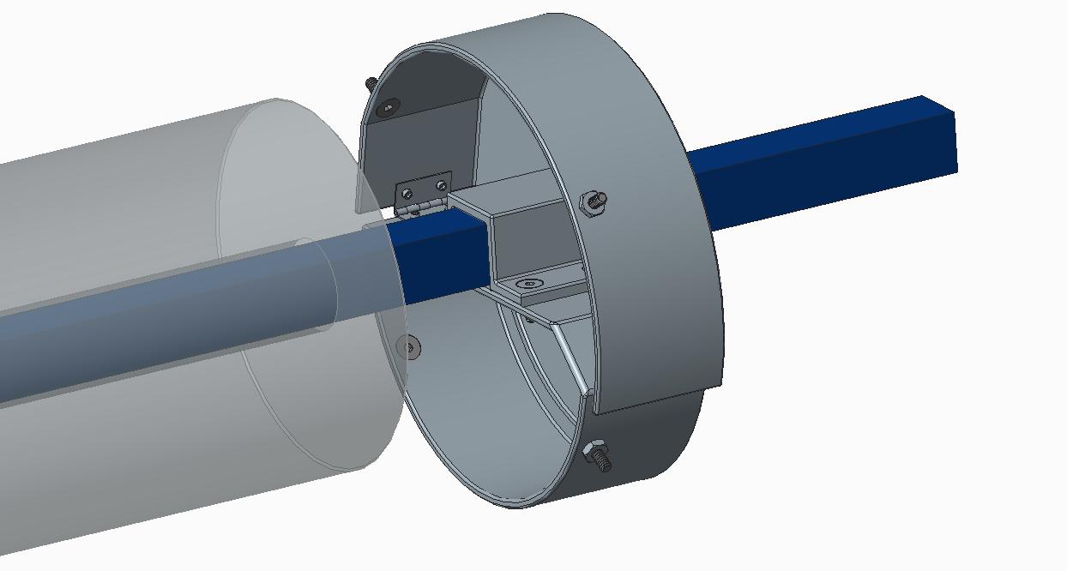
Cover Design: Updated CAD
Added attachment points for plastic sheet (not pictured)
Smaller, less expensive hinge
Downward angle to reduce friction on material
Removed section for dowel

Slide 25
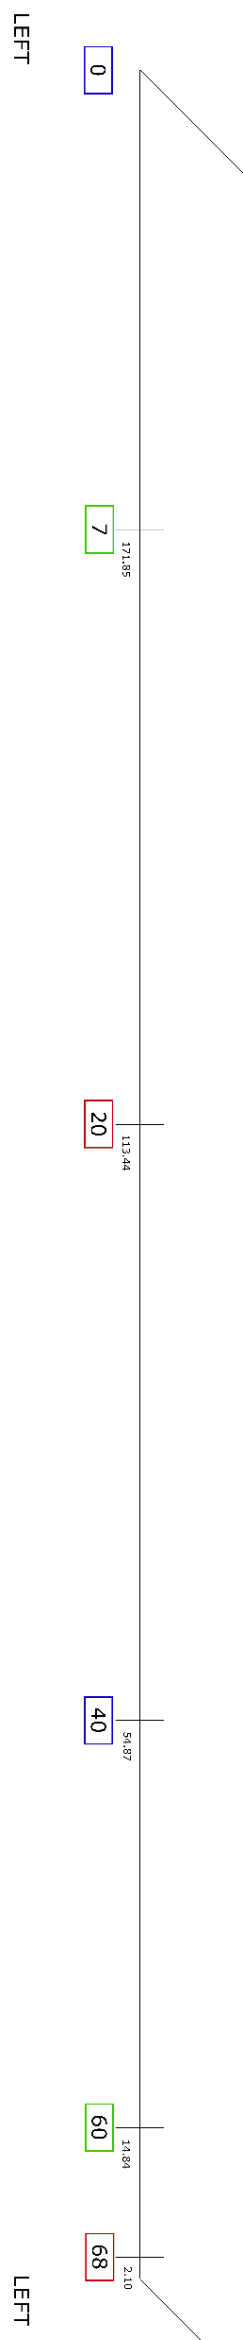
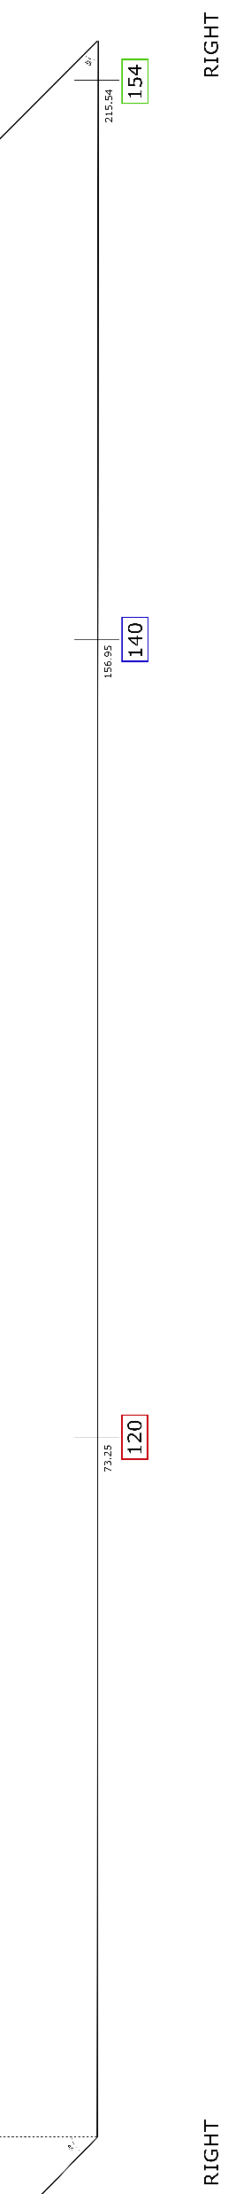
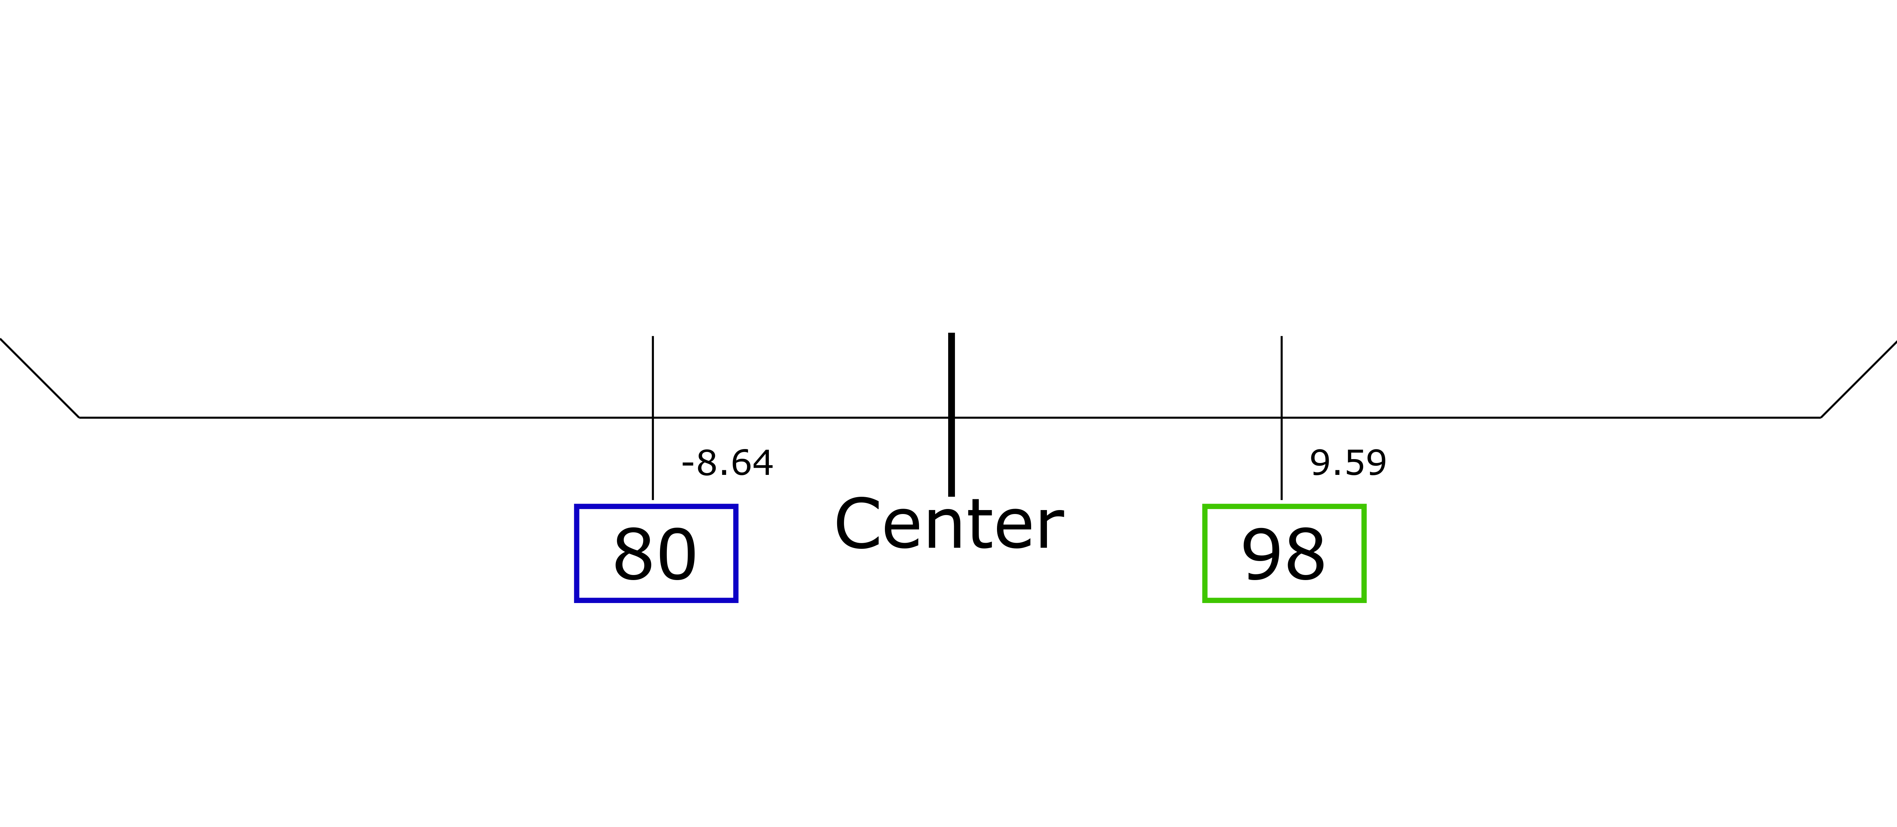
Paper Forms
Made in Inkscape as vector graphics
Can be printed in the model shop
Four pieces: Left, Right, Top, Bottom
Corners overlap for easy alignment on floor
Notes:
Use to mark fold lines on sail, folded from left to right so fold 1 is in far left corner
Cut correct shape from seamed gores

Slide 26
Paper Forms
Numbers in boxes indicate fold numbers
Number above box indicate distance in inches from geometric center of sail
Color is used for easy matching of the same fold line on top form
Notes:
Use to mark fold lines on sail
Cut correct shape from seamed gores

Slide 27
Working Remotely
Learned how to use Abaqus
Built sail and boom model
Troubleshooted problems with mentor during daily check ins
Difficulty getting entire model to run in the end
Switched to modeling connector force vs. boom end displacement based on material orientation

Slide 28
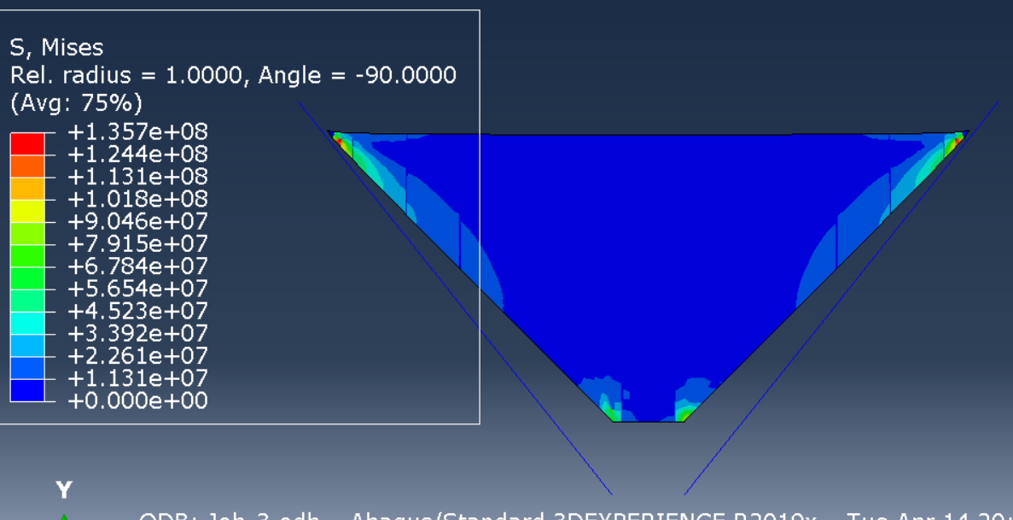
Abaqus Sail Model: Quadrant
Exercise to learn how to use Abaqus
Approximate values for material properties were used
Can look at whether gore seams change model results

Slide 29
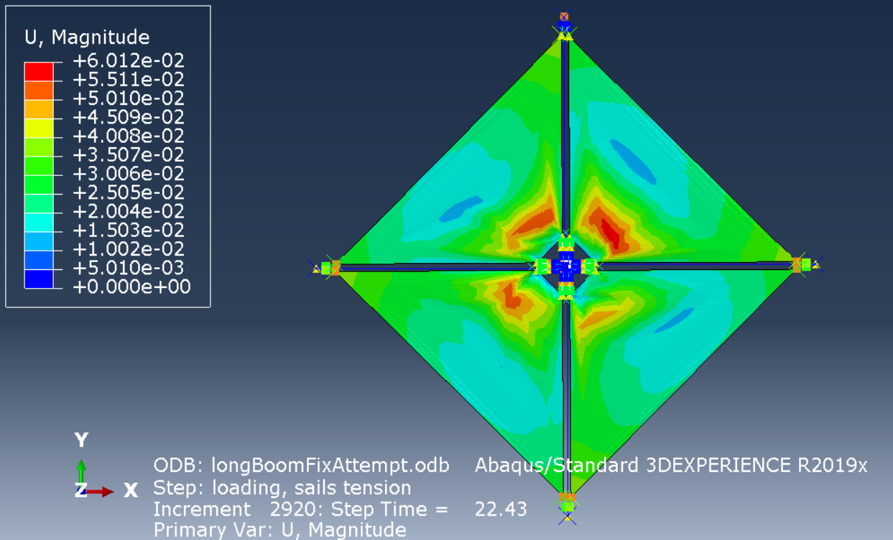
Abaqus Sail Model: Entire Sail
Sail Material Displacement Magnitude
Correct Material Property values were used
No information learned from model
Notes:
Earlier model

Slide 30
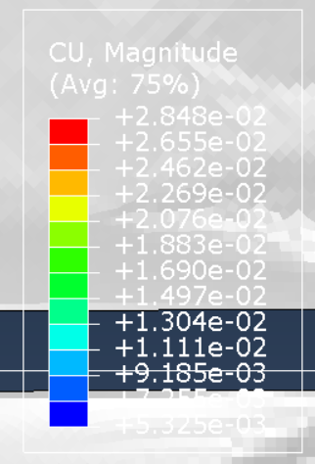
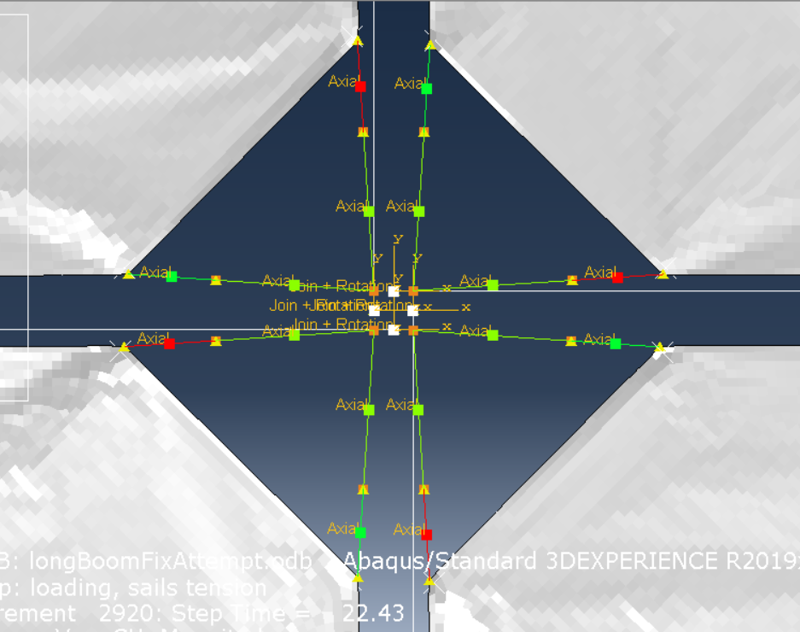
Abaqus Sail Model: Running Simulation
Connector Displacement
Inner lines modeled using two sections: no spring, and spring
No information from model

Slide 31
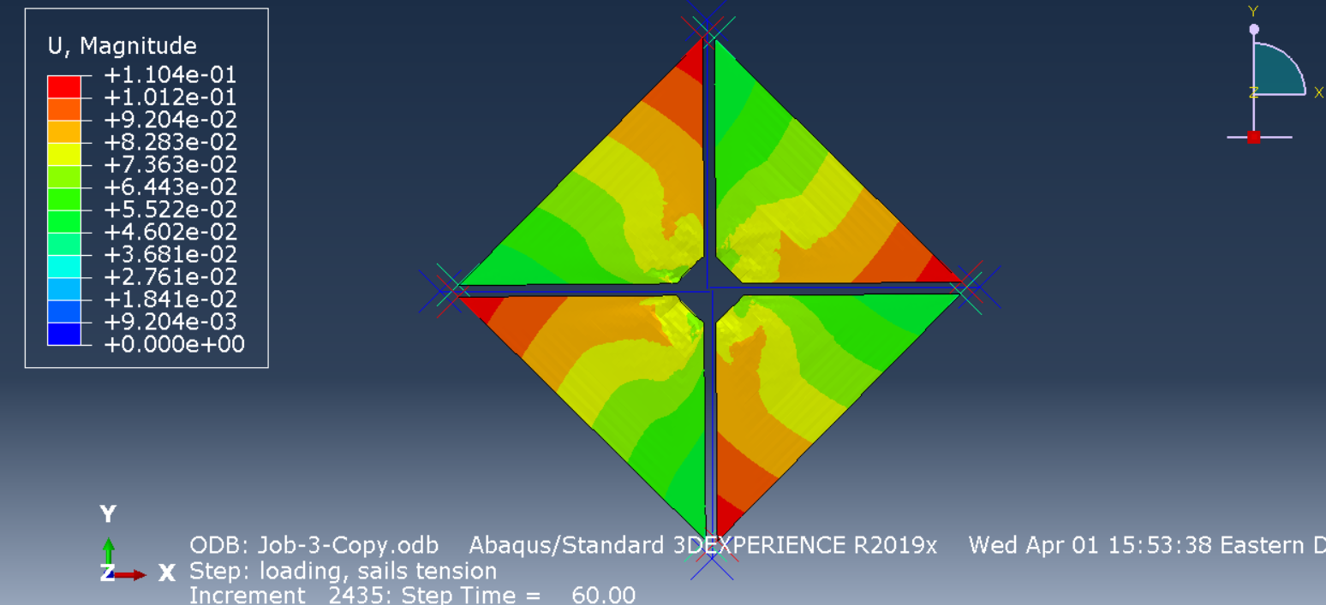
Abaqus Sail Model: Issues
Model would not converge when booms were included
Boom ends are fixed in sail models
Point mass added to place where connector sections joined
No information learned

Slide 32
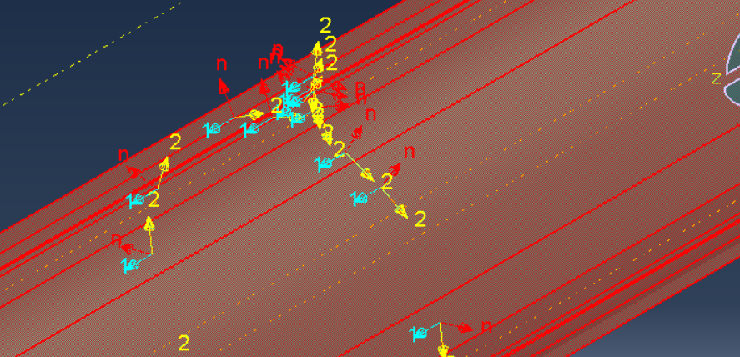
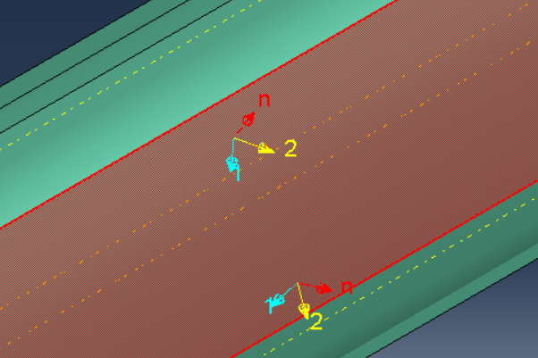
Abaqus Boom Model
Objective:
Change orientation of composite to determine how this changes the connector force vs. displacement graphs

Slide 33
Questions

Slide 34
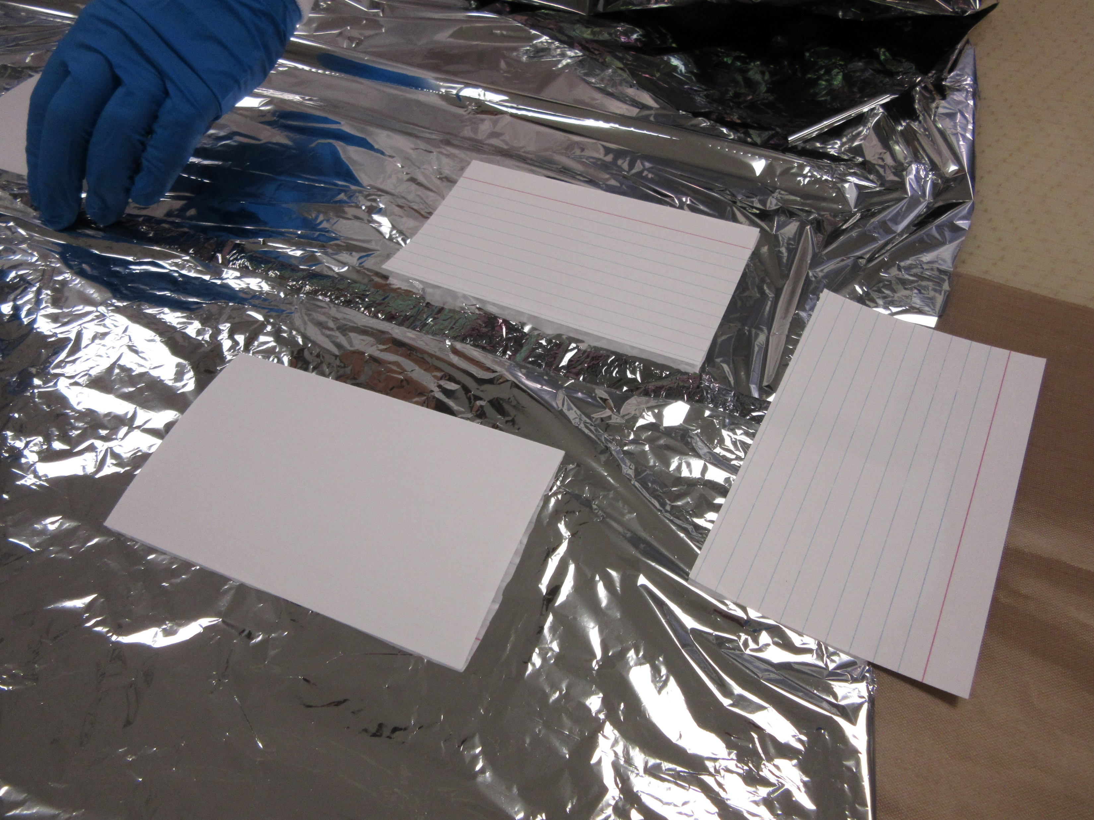
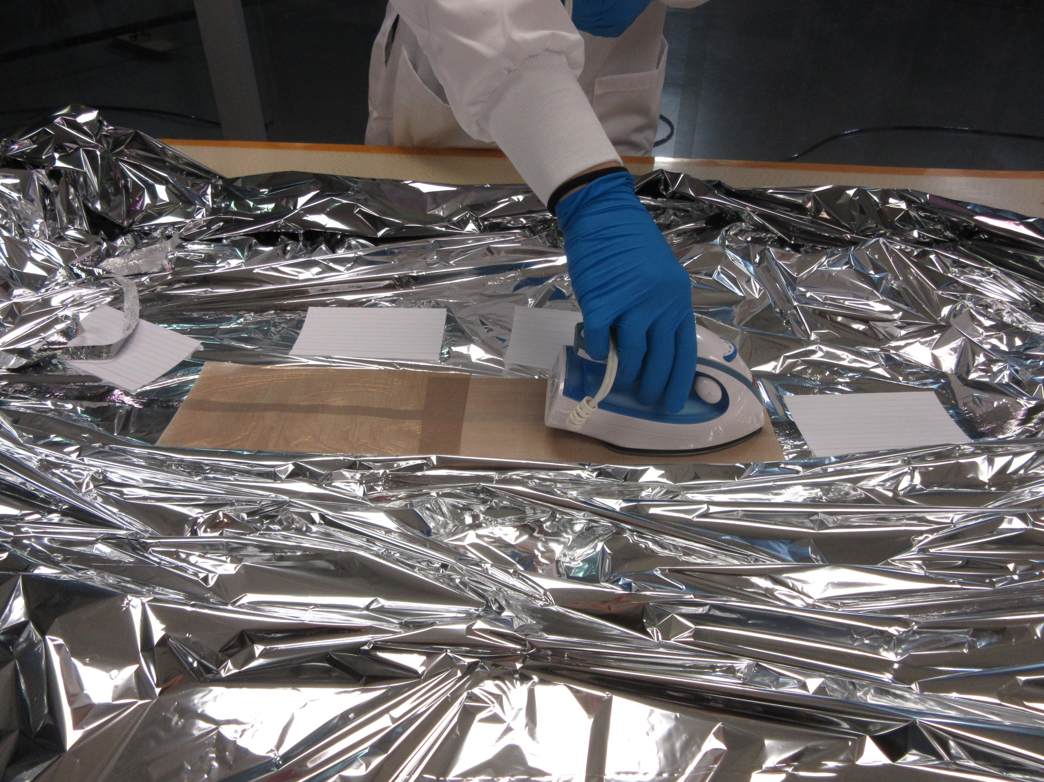
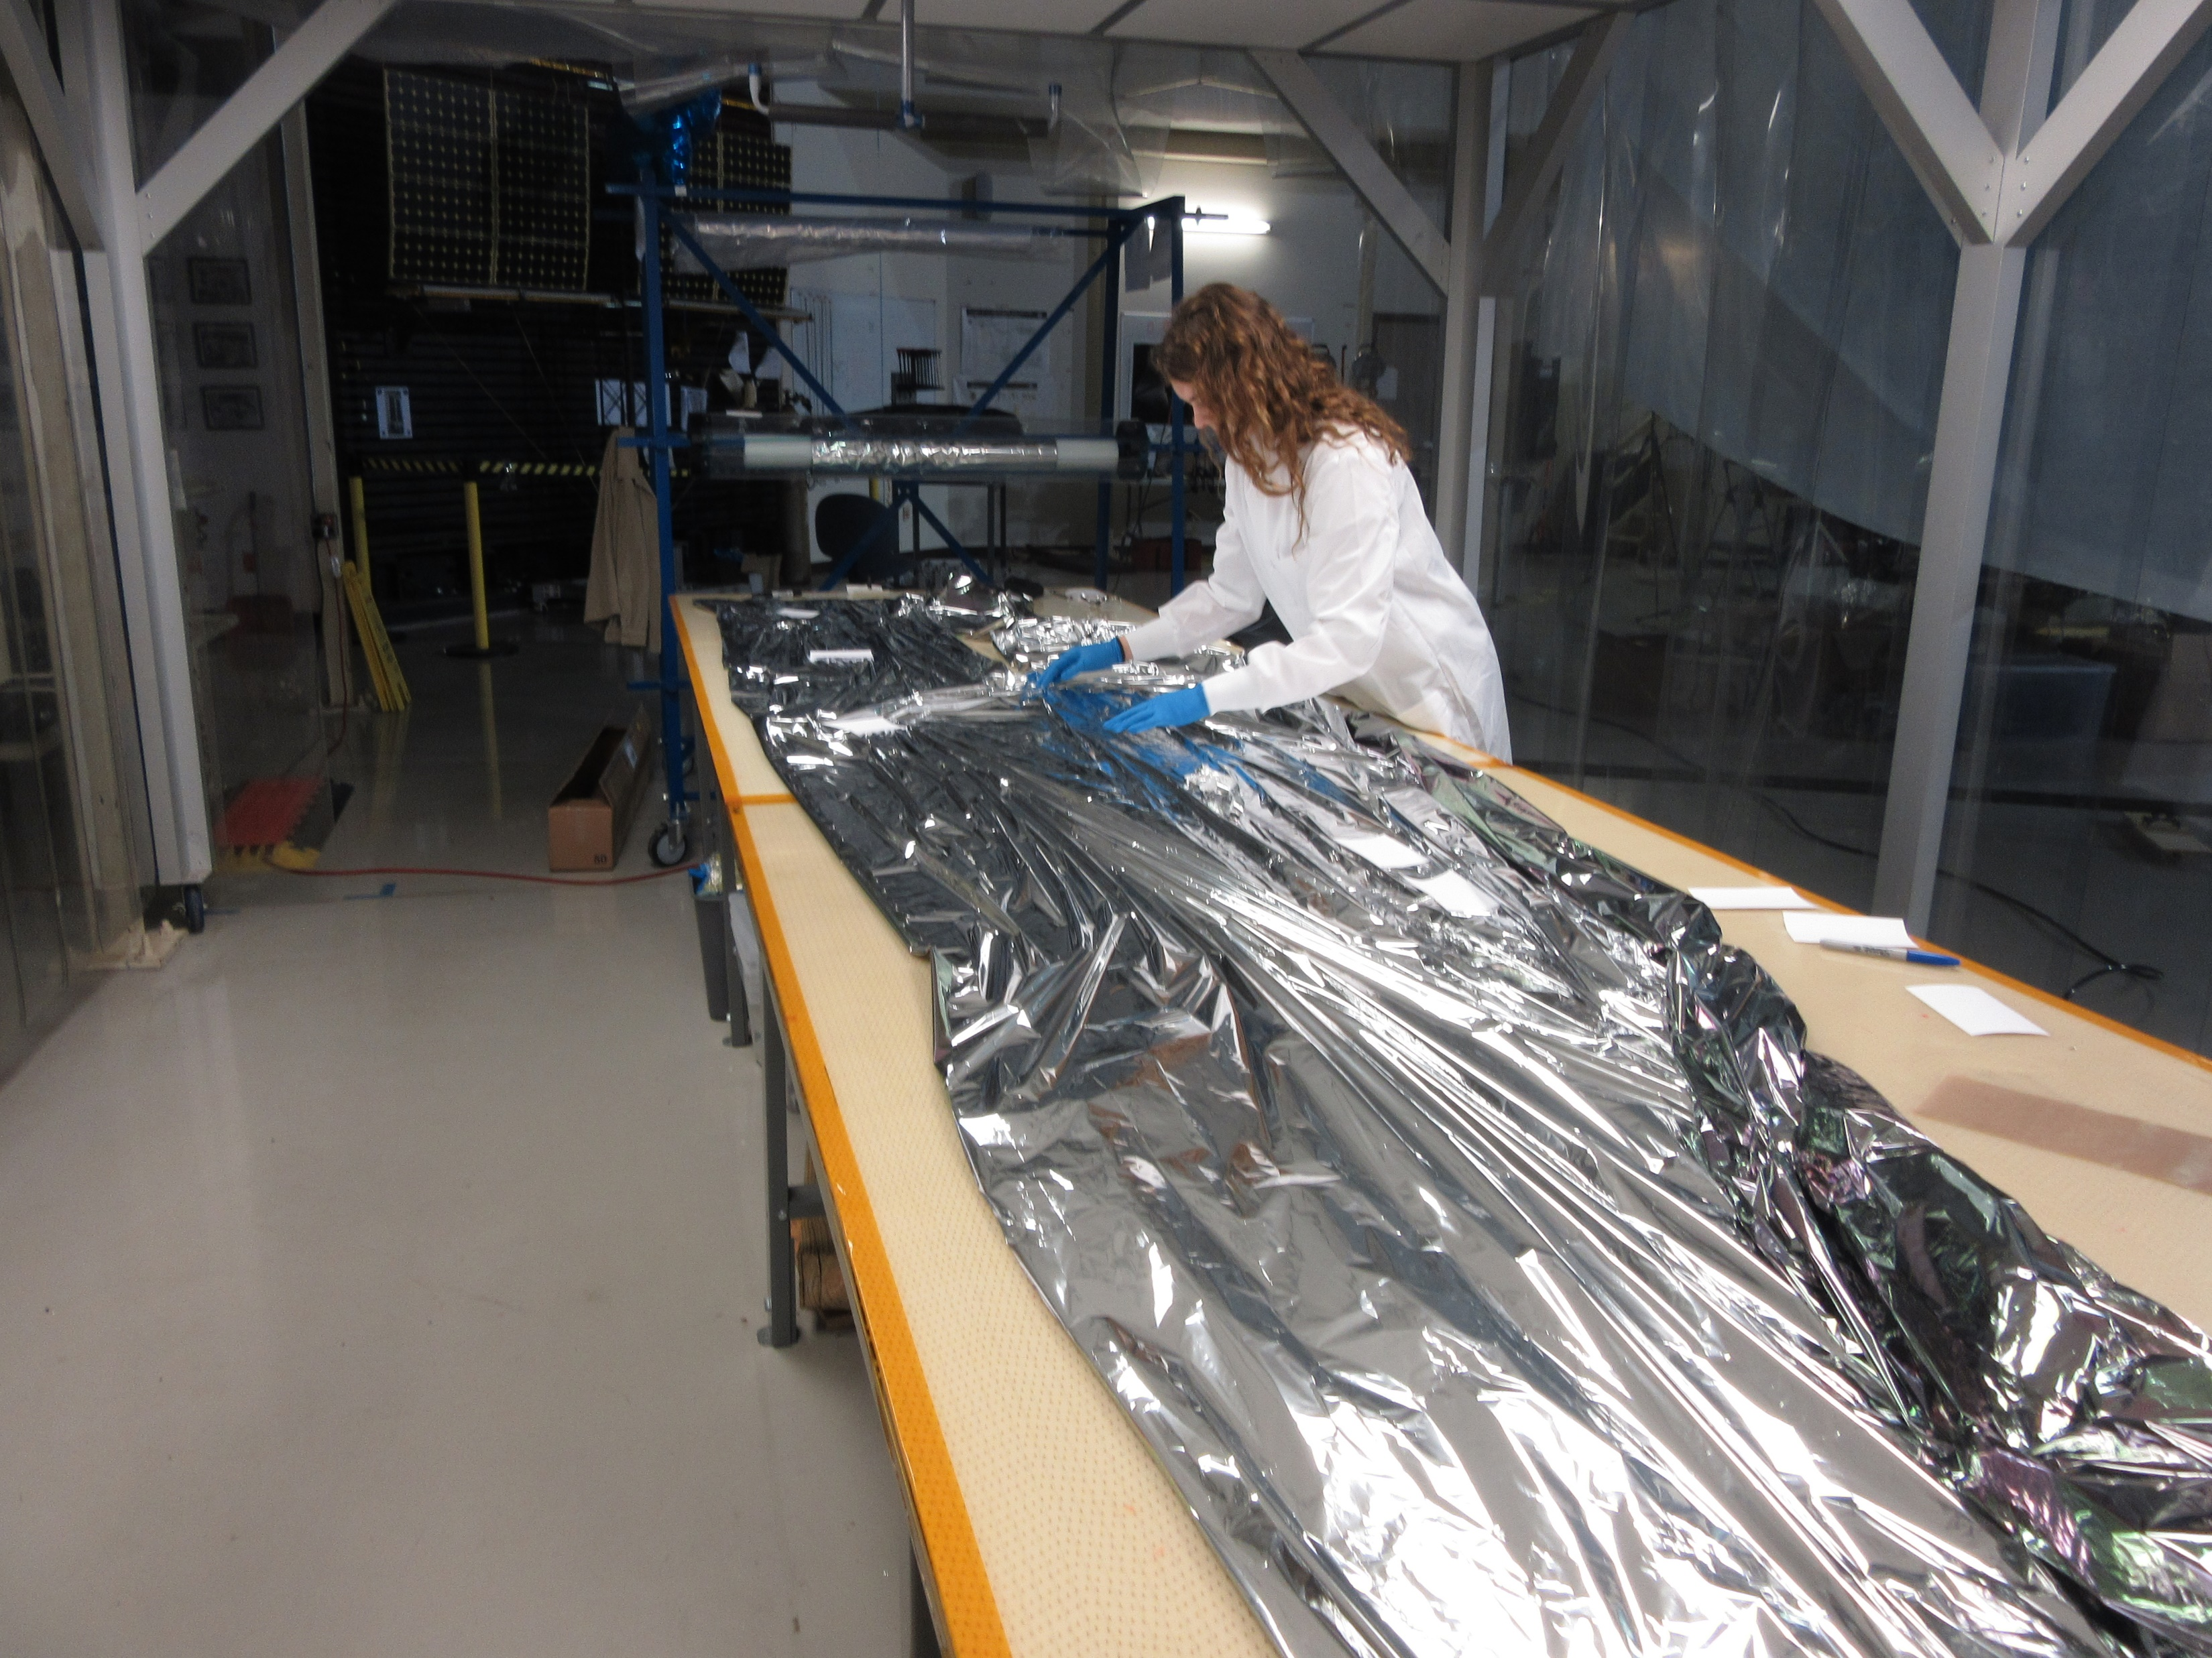
Extra Pictures

Slide 35
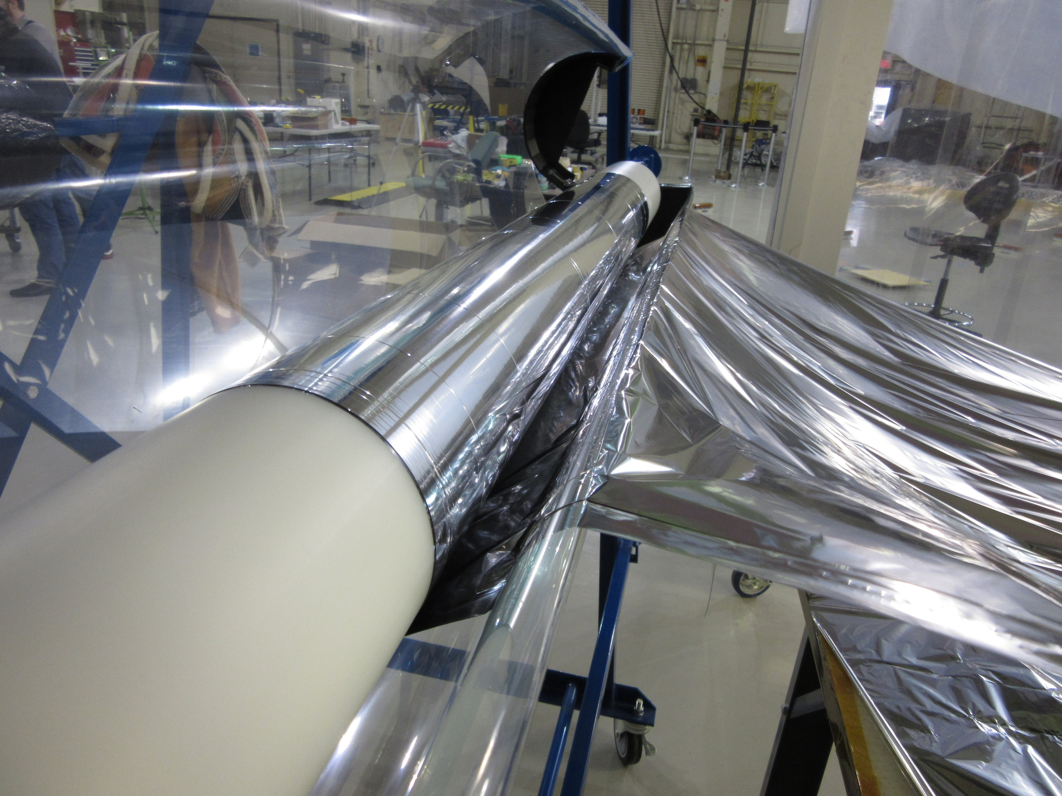
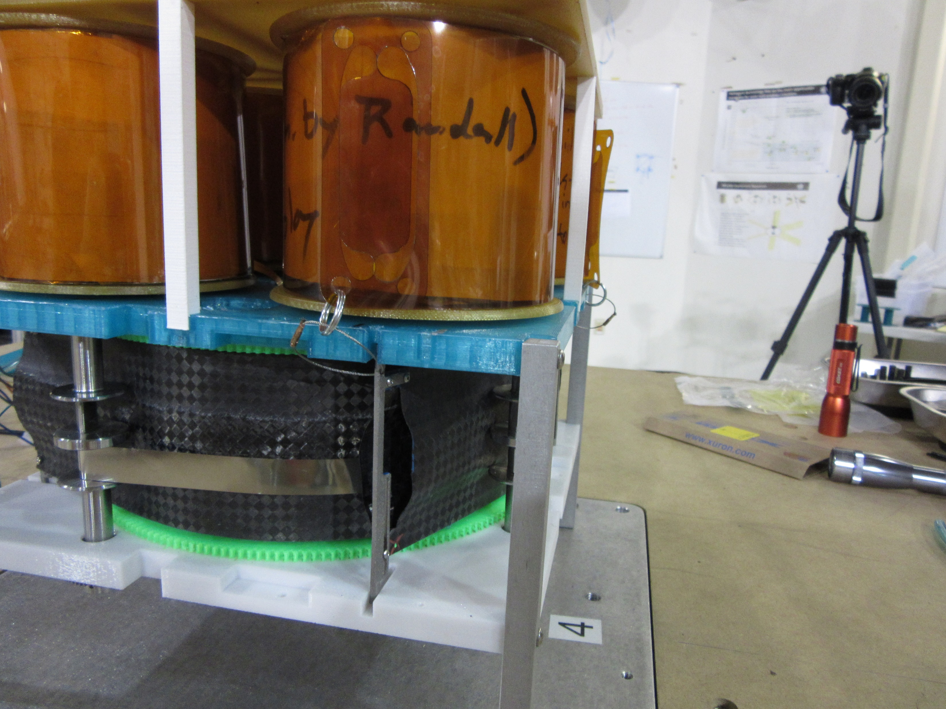
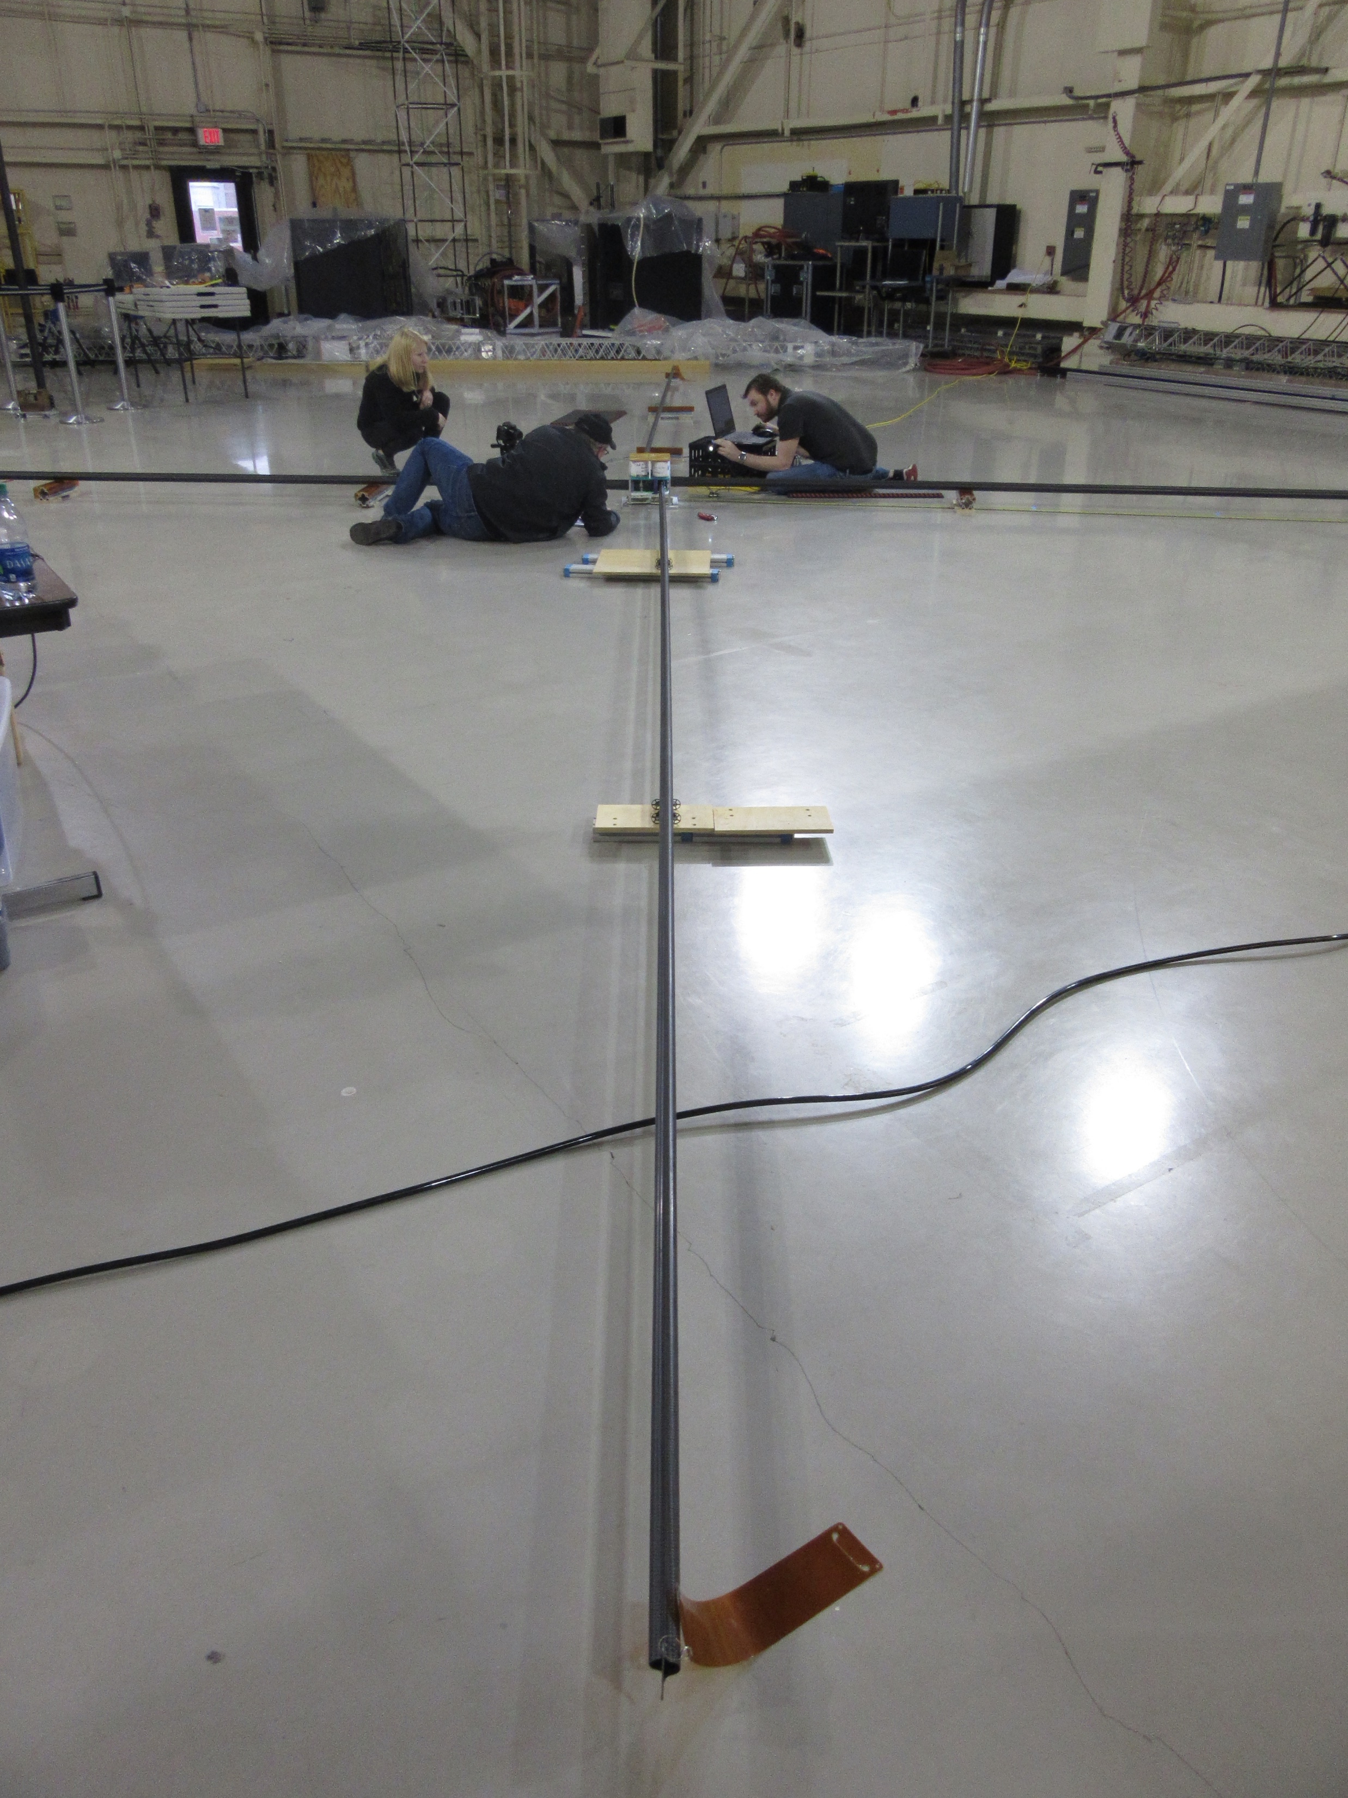
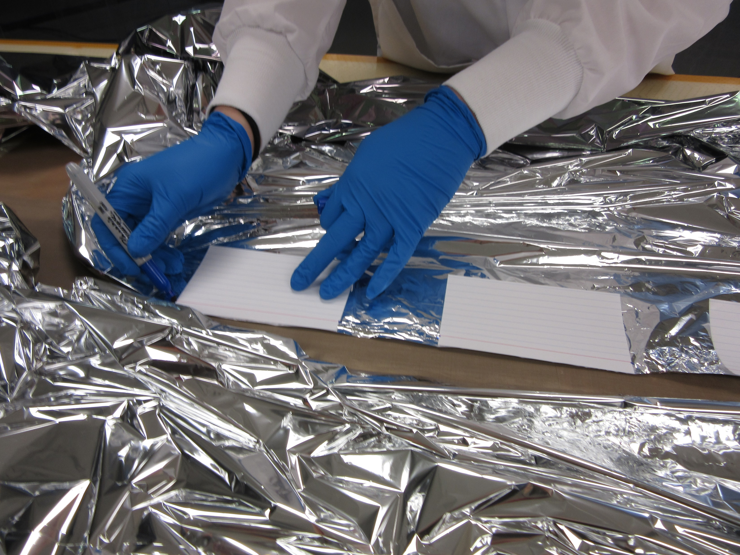
Extra Pictures

Slide 36
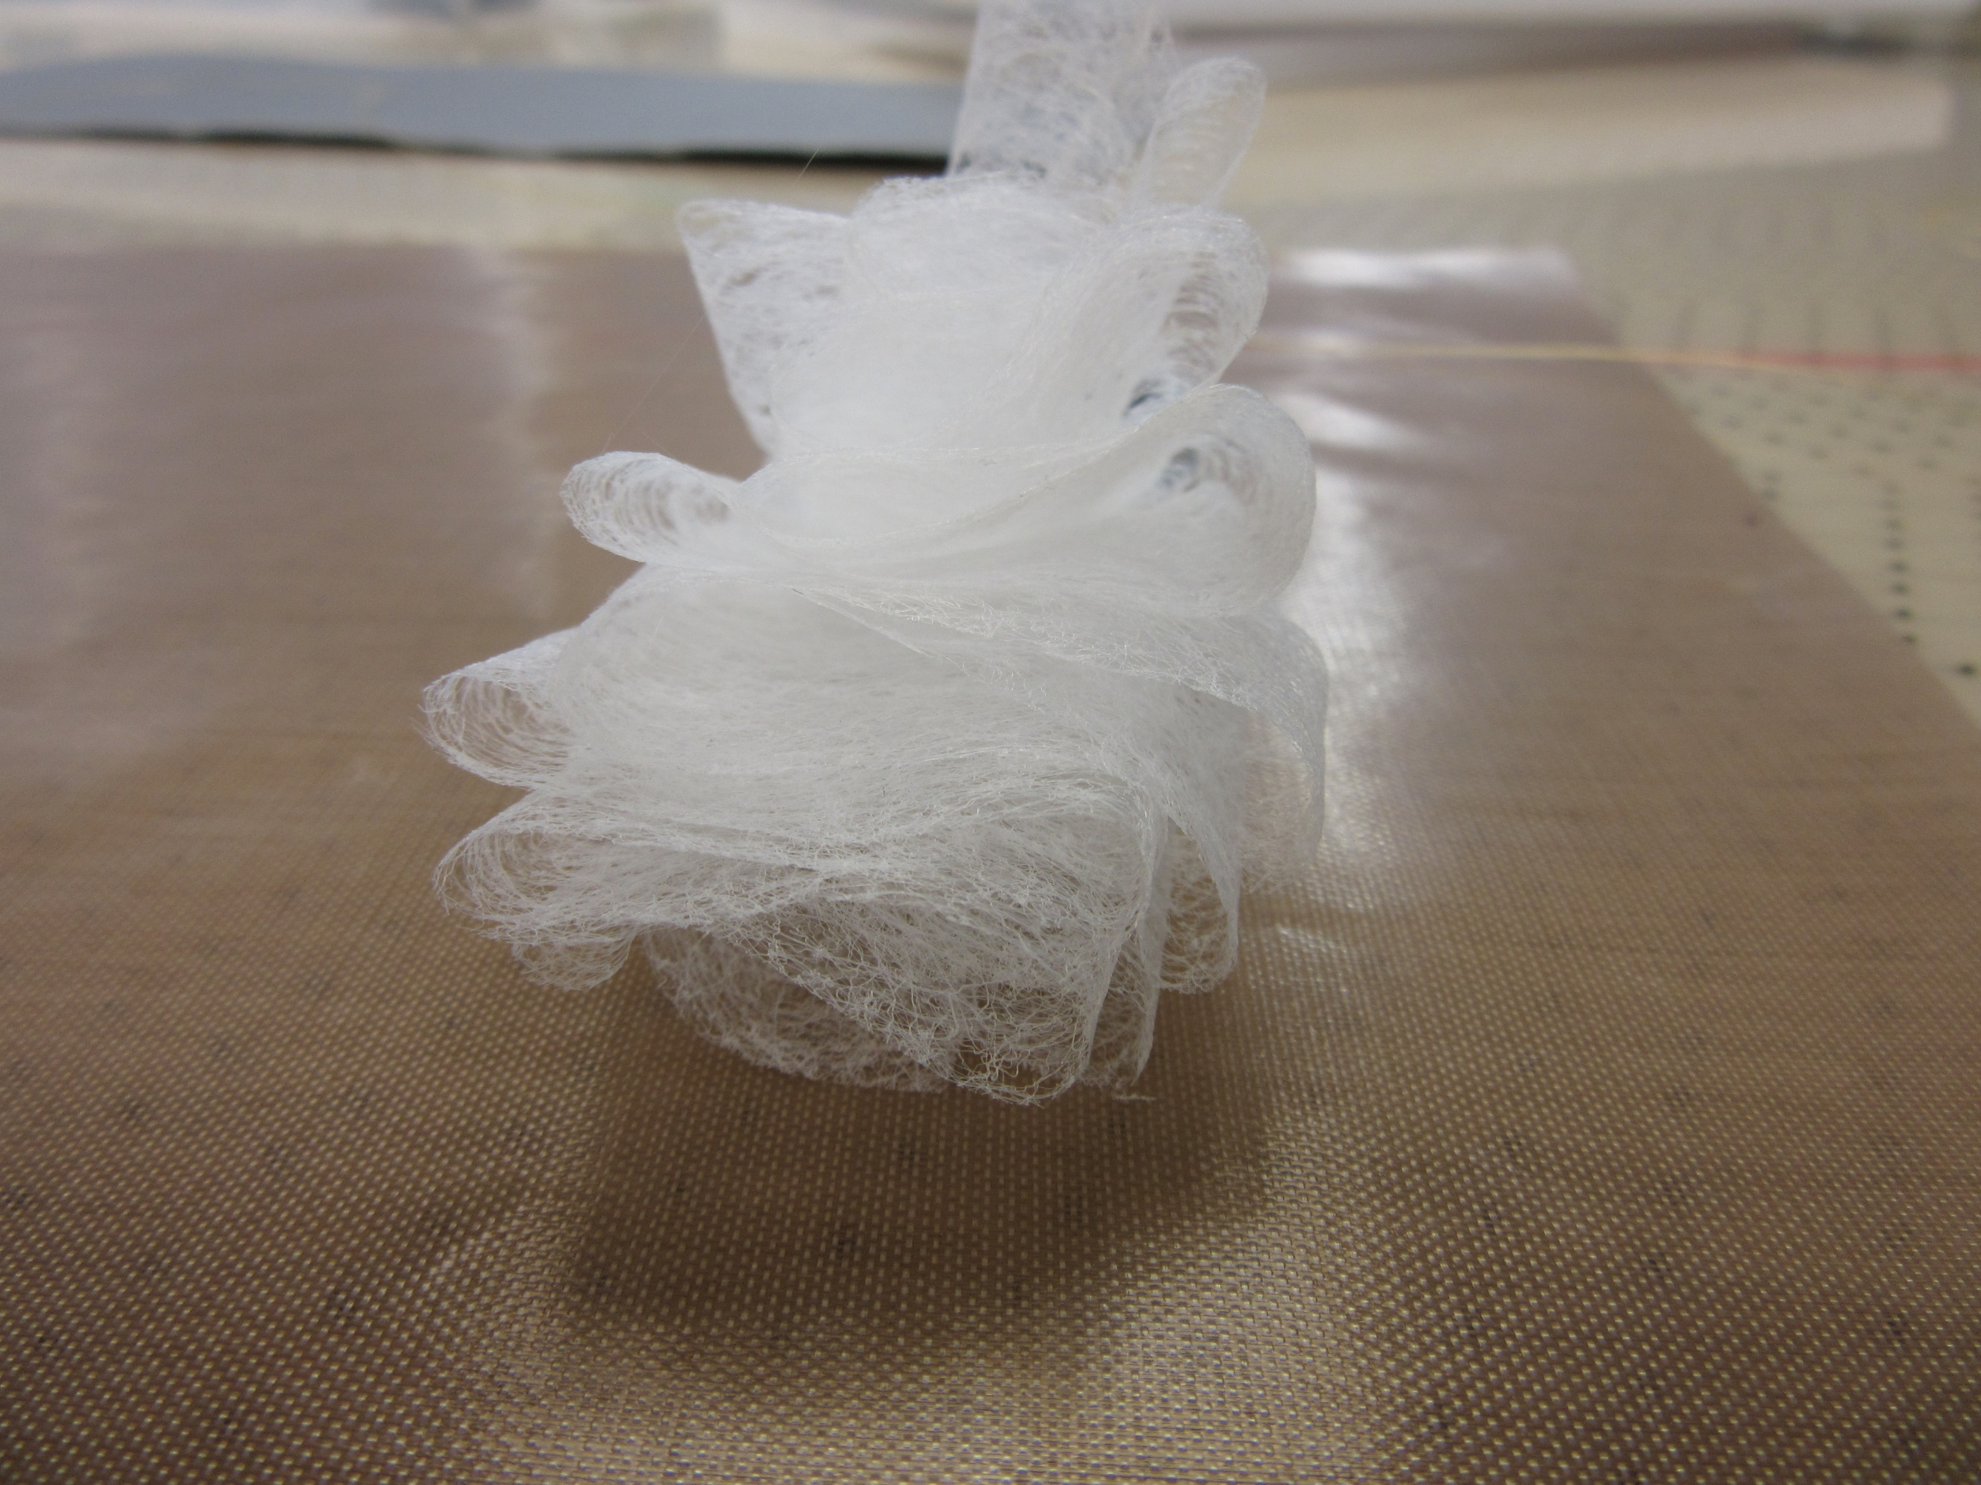
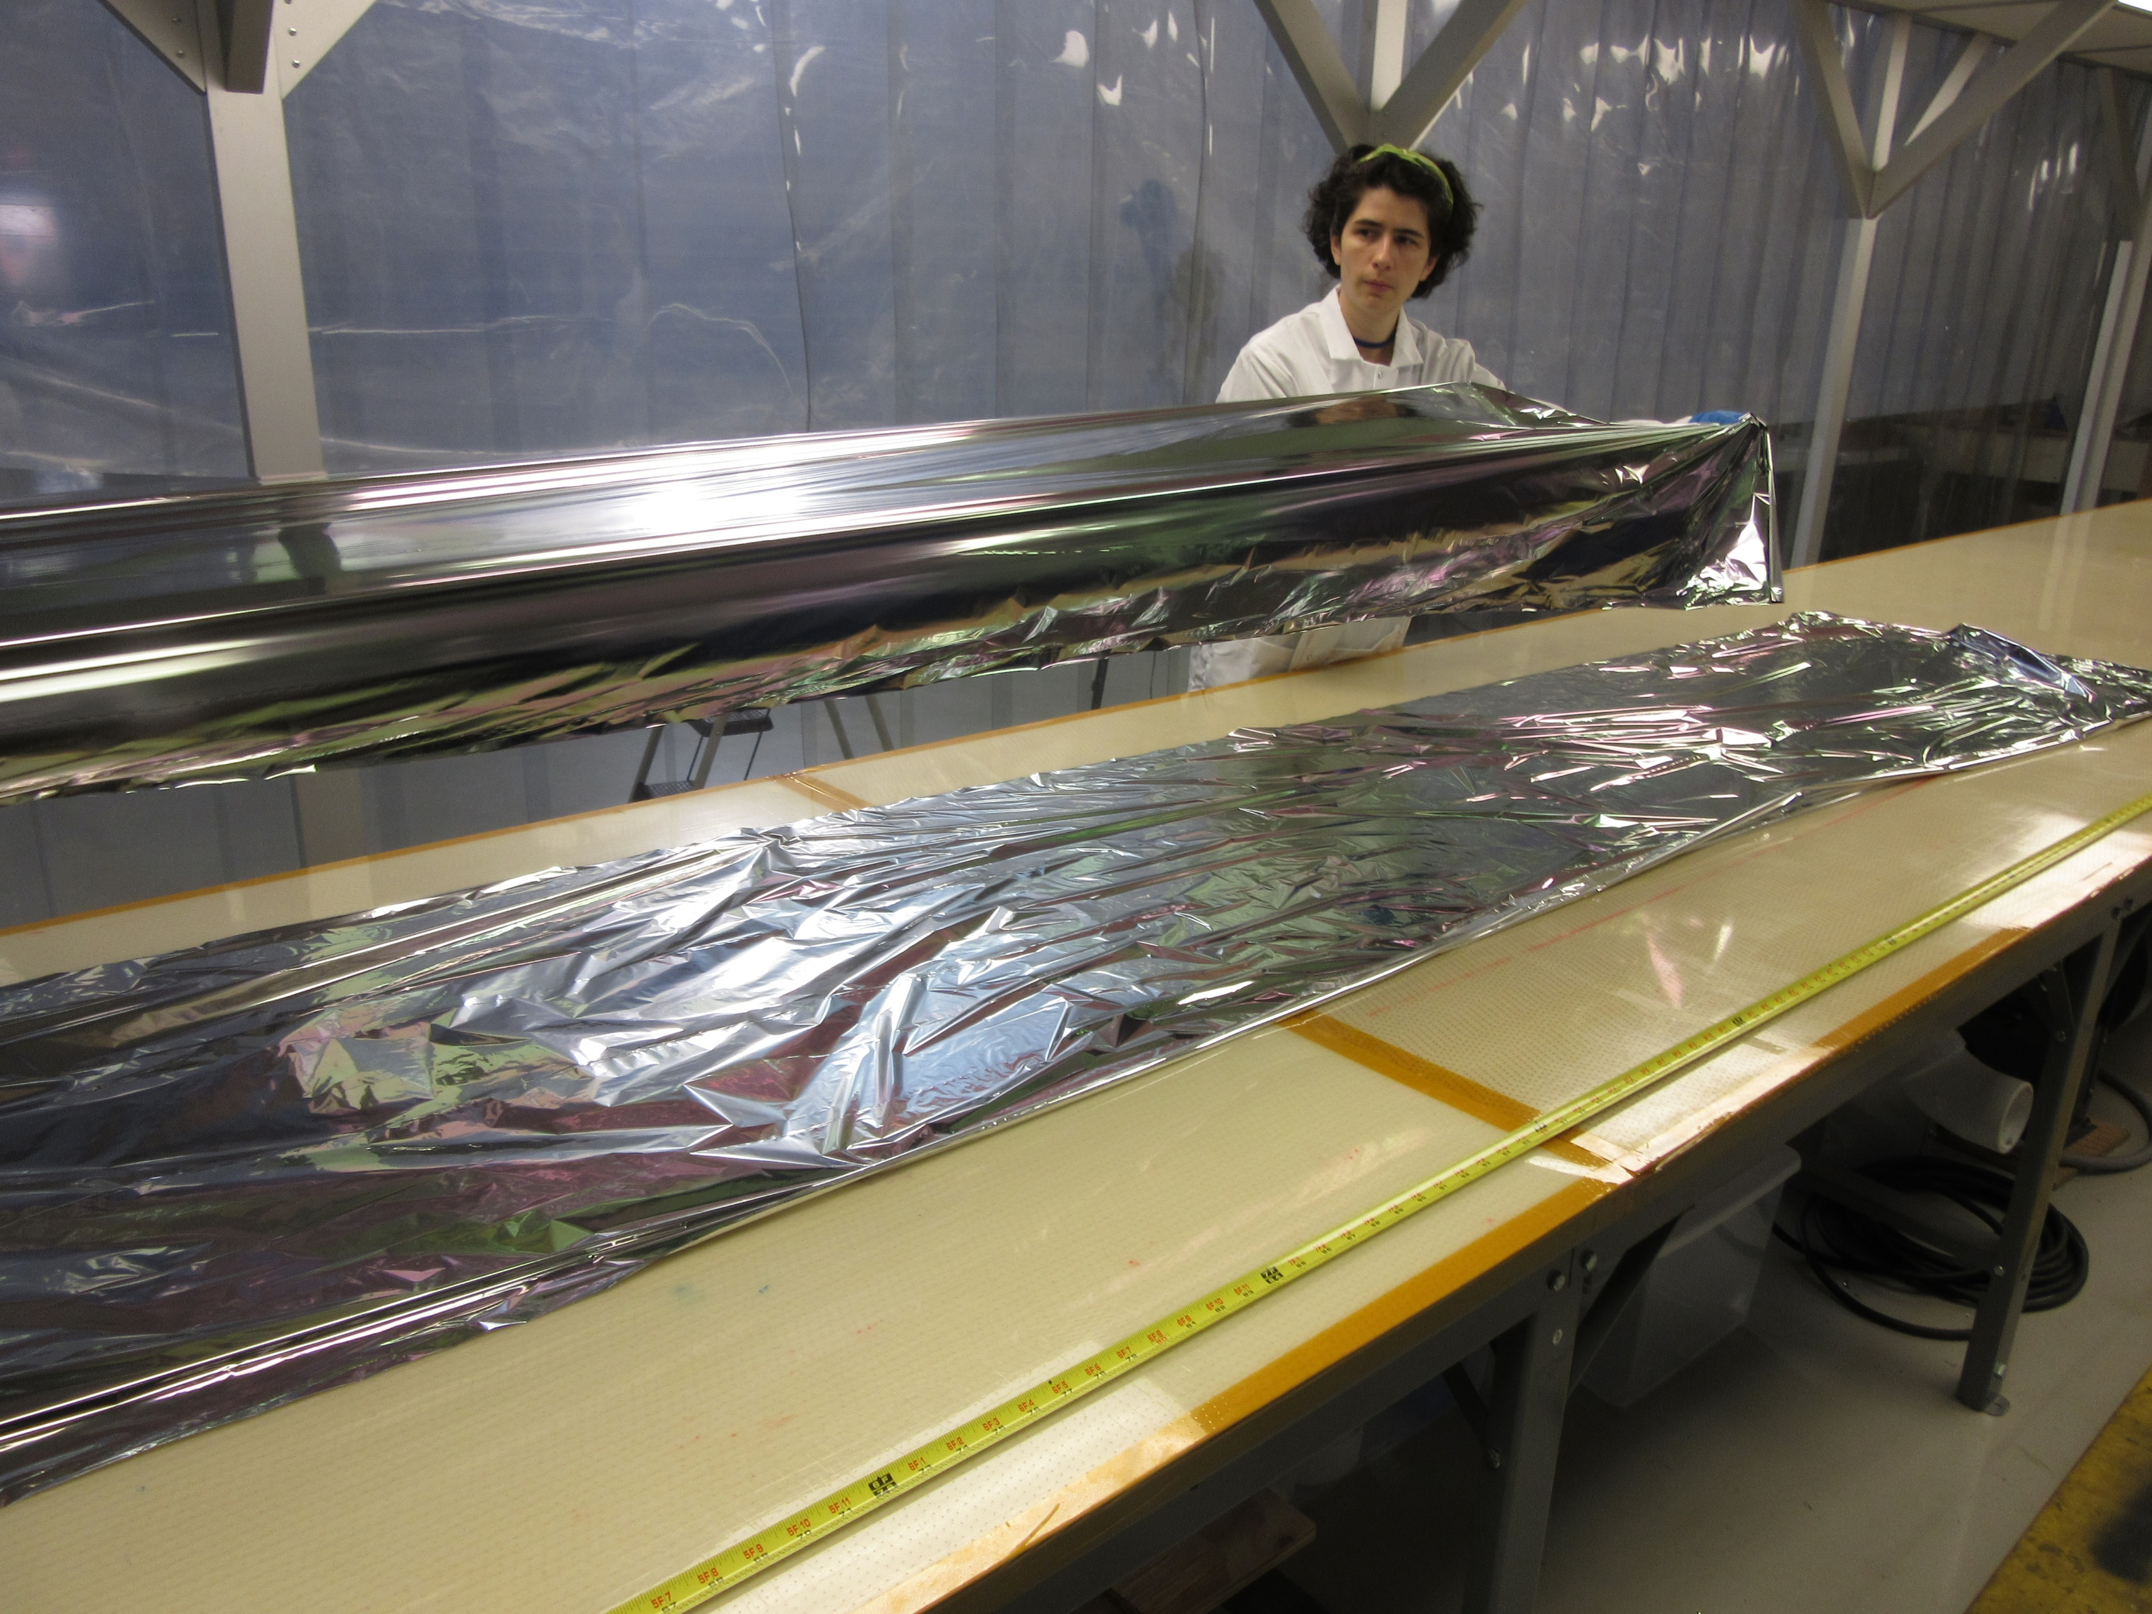
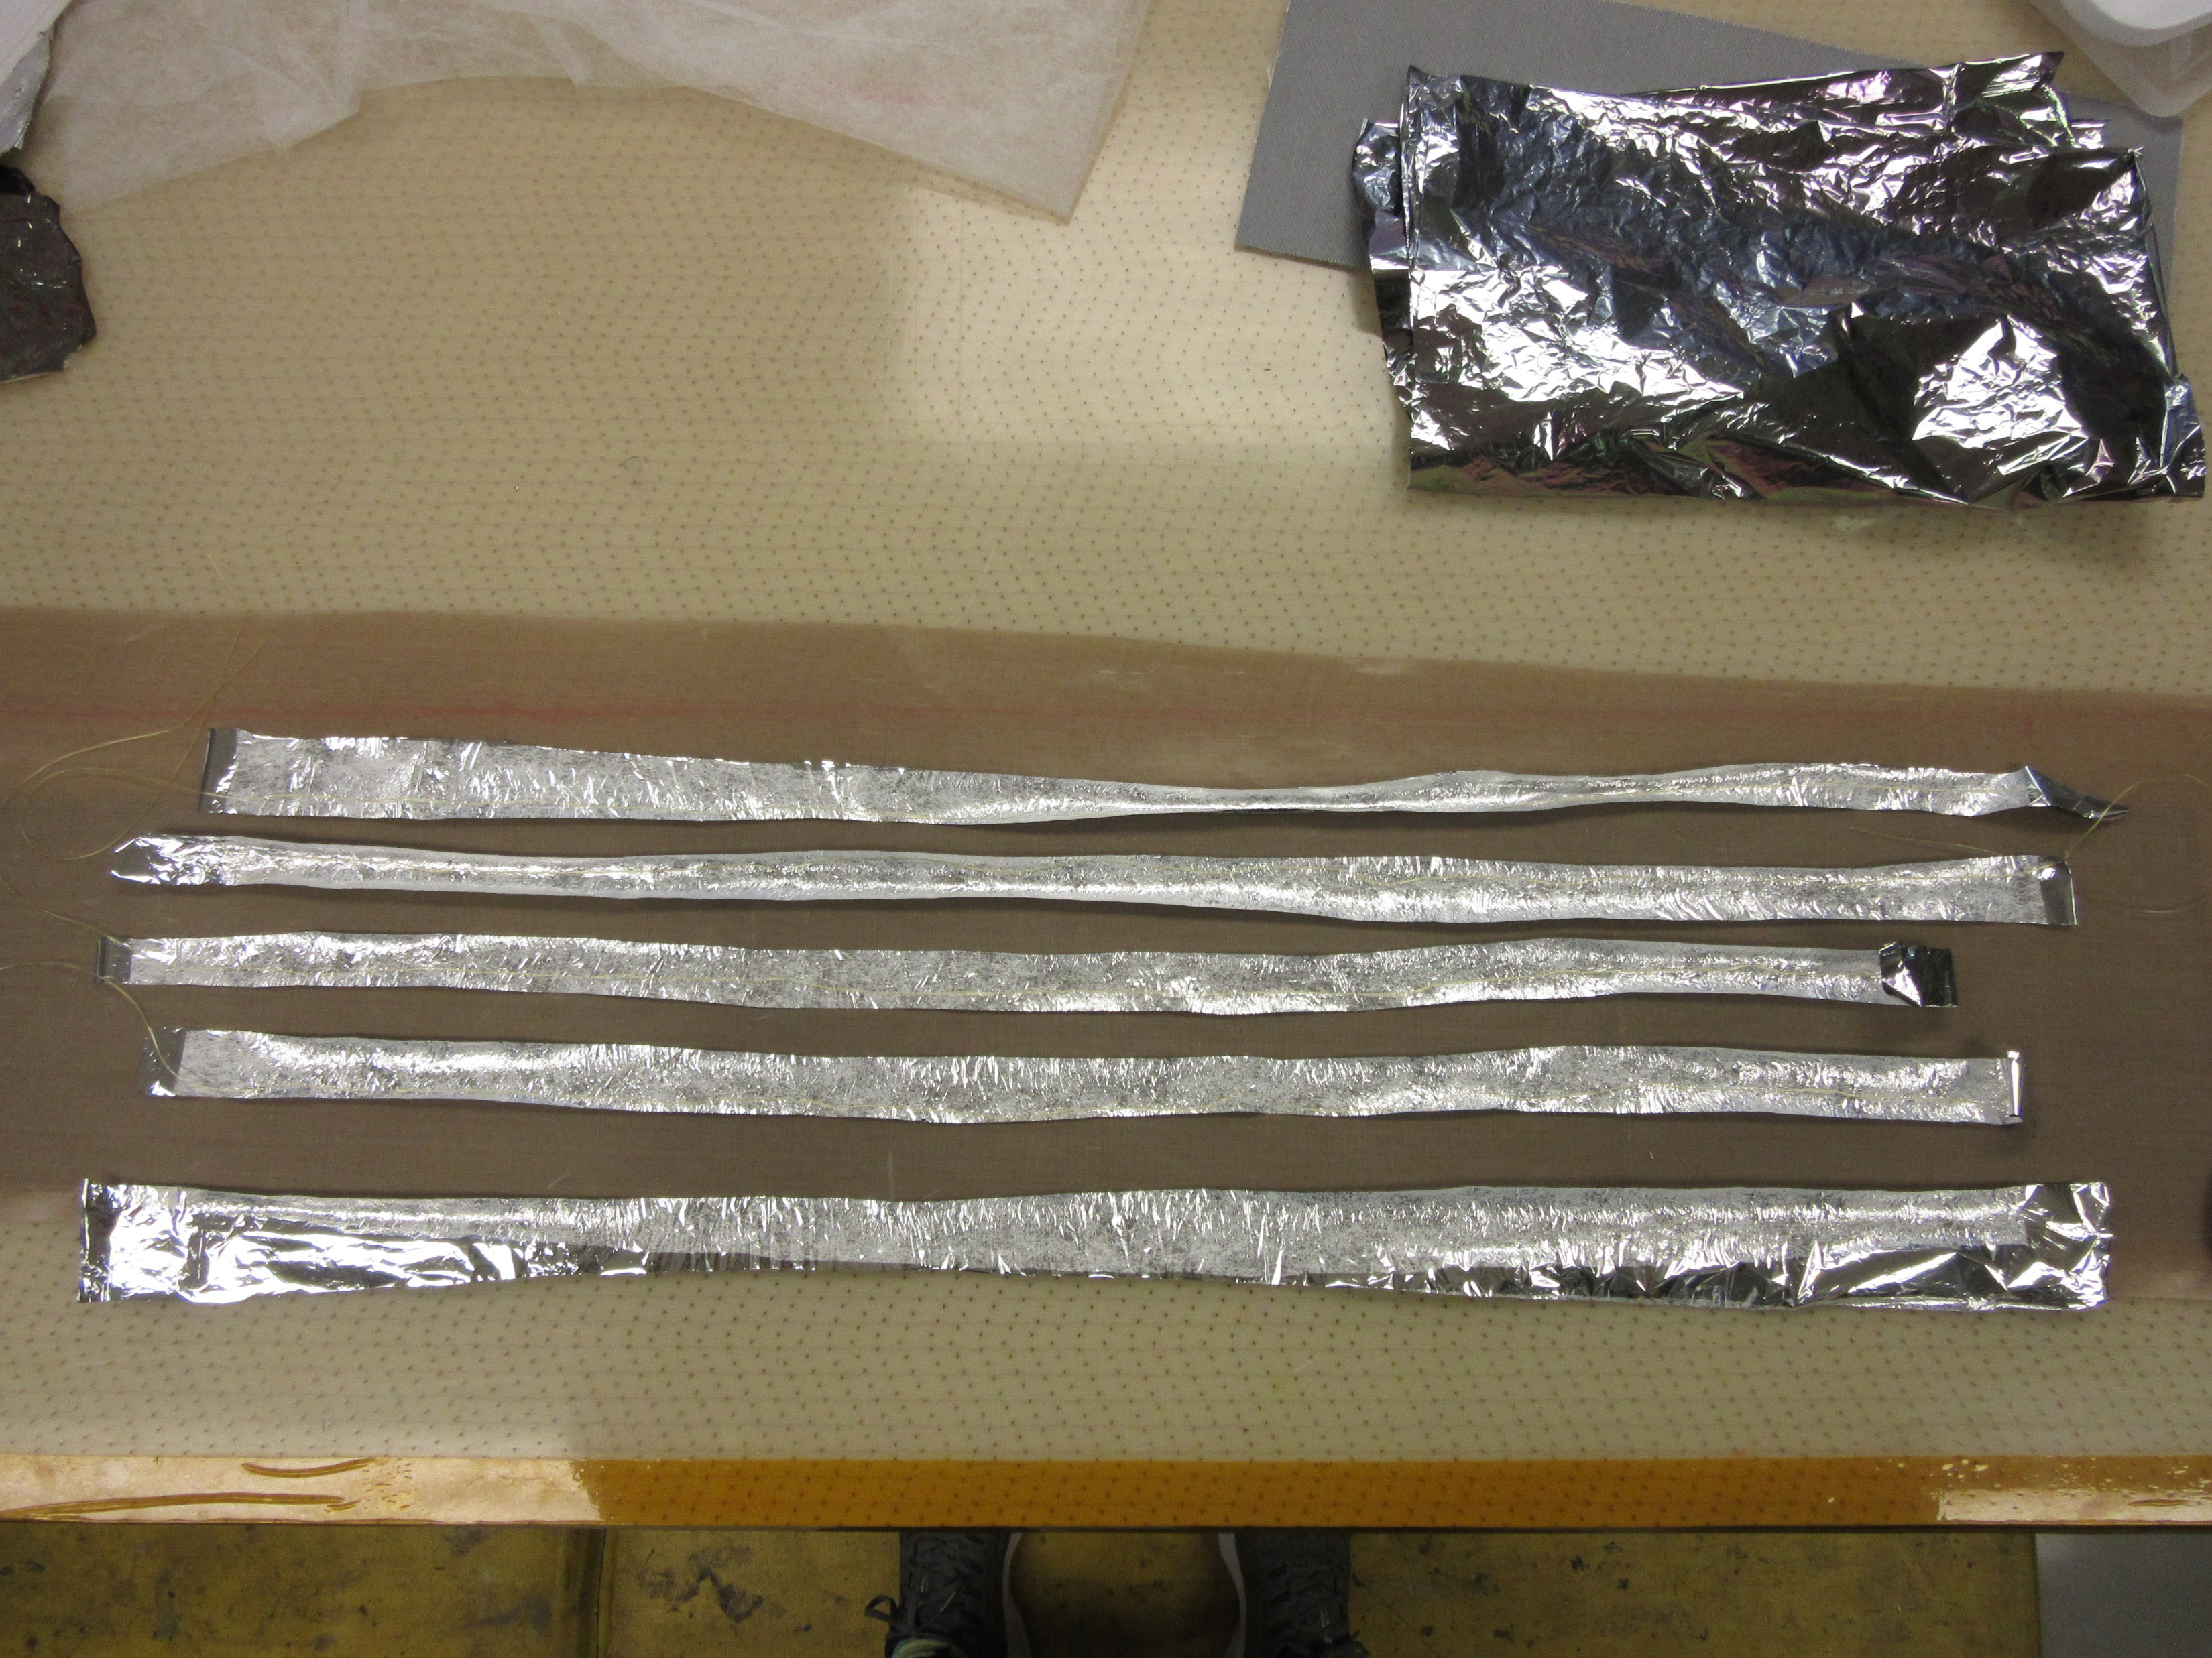
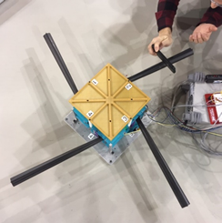
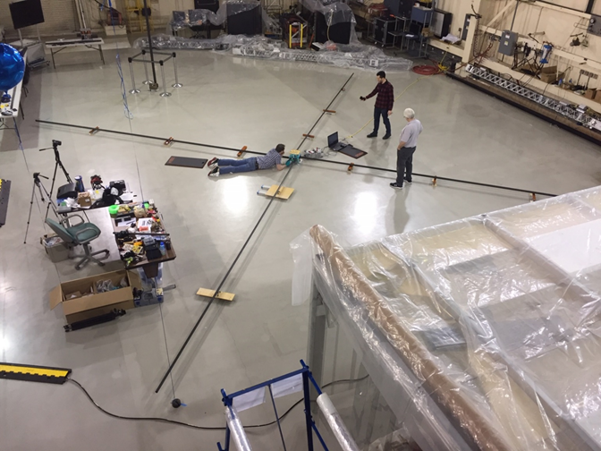
Extra Pictures

