Slide 1
Tuning Neural Network Models for Improved Prediction of Boundary Layer Transition
Tomas Osses

Slide 2
Presentation Overview
About me
Background
Boundary layer transition & the e^{N} method
Neural networks and hyper-parameter optimization
Methodology
Results
Predicting the range of disturbance frequencies
Conclusion and final thoughts
Questions

Slide 3
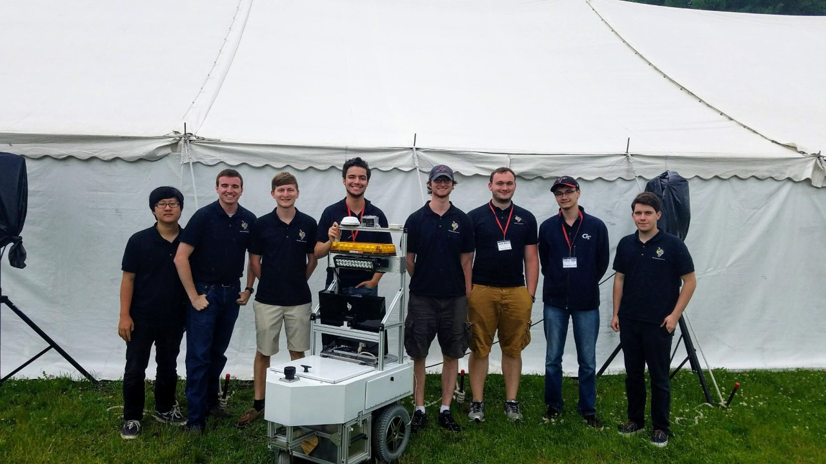
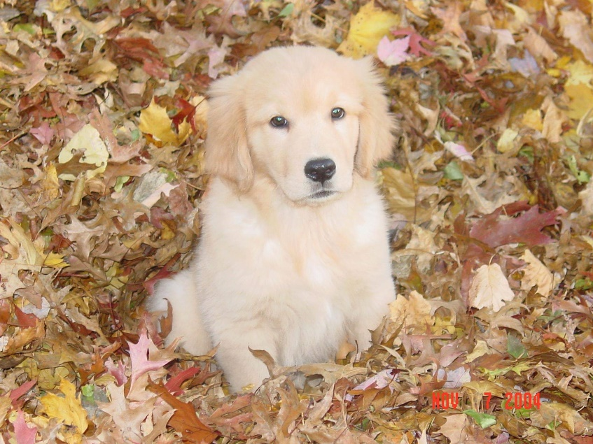
About Me
Notes:
I am a 4th year mechanical engineering undergrad from Georgia Tech, raised in Long Island, New York, and I am planning on doing my Master’s in mechanical engineering on computer aided engineering and design at Georgia Tech as well. At school, I am involved in my robotics club, RoboJackets, where I help design an autonomous robot to navigate an obstacle course. Finally, my previous internships for the past two summers were with Procter and Gamble, where I worked with the Materials and Modeling and Simulation groups on structural analysis and modeling.

Slide 4
Boundary Layer Transition
“Perhaps the single most critical area in CFD simulation capability that will remain a pacing item by 2030 in the analysis and design of aerospace systems is the ability to adequately predict viscous turbulent flows with possible boundary layer transition and flow separation present.” – Slotnick et al [1]
Notes:
To highlight the importance of predicting BLT, I would like to cite this direct quote from the CFD Vision 2030 study.
Significant advances in the ability to delay the onset of laminar-turbulent flow from the leading edge of a wing will be a critical stepping stone in designing the next generation of aerospace vehicles.
Because transition can strongly influence surface skin friction and aerodynamic heating, delaying boundary layer transition will reduce drag and improve the energy efficiency of flight vehicles. Accurate yet computationally efficient modeling of transition will help accelerate the development of the next generation aircraft by reducing the costs associated with testing and iterating physical prototypes.
The project I have been working on over the course of the internship concerns itself with predicting transition for self similar sub-sonic flows, for model simplicity and for the direct application of predicting flows in winged vehicles, where these self-similar sub-sonic flows have been observed in benign disturbance environments such as cruise conditions.
For boundary layers over a nominally smooth surface, the transition process in a low disturbance environment is often dominated by the growth of linearly unstable eigenmodes of the laminar basic state. For two dimensional (and weakly three-dimensional) subsonic flows, the dominant instabilities correspond to the Tollmien-Schlichting (TS) waves, whose direction of propagation is closely aligned with the inviscid streamline. Other instability mechanisms also exist, even for two dimensional compressible boundary layers, such as oblique first mode disturbances in supersonic flows, planar waves of the second mode type in hypersonic flows, and centrifugal instabilities in the form of Görtler vortices over surfaces with a significantly concave curvature.
As stated earlier, this project concerns itself with these 2D subsonic flows and, as such, I would like to quickly go over the underlying eigenvalue problem that can be directly used to predict the onset of TS wave instabilities.

Slide 5
The e^{N} Method
Disturbance stream function:
Orr-Sommerfeld equation after plugging into Navier-Stokes equations:
Disturbance growth rate and “N-Factor”:
Notes:
Note: the method presented comes from Van Ingen’s work on TS waves.[2]
We first define an orthogonal coordinate system for the 2D profile of interest to be (s,n) where s is the distance from the pressure/suction side (along the surface itself) and n is the distance normal to the surface. These coordinates are normalized to the boundary layer thickness, $θ(s)$, and the velocity profile is approximated by a parallel flow with velocity components, U and V, normalized to the edge velocity. The Reynolds number is based on the airfoil chord and freestream velocity.
We assume the small amplitude spatially evolving disturbance to have the stream function in the form above, where $α$ is the complex streamwise wavenumber, i is the imaginary unit, ω is the real valued disturbance frequency, and t is the normalized time. In accordance to linear stability theory, the following “Orr-Sommerfeld equation” is obtained from substituting the above normal mode expression into the linearized Navier-Stokes equation (where primes denote differentiation with respect to n). For this OS equation, the boundary conditions are U’ and V’ = 0 at the wall, and $φ\left(0\right)=φ^{′}\left(0\right)=0 φ\left(∞\right)=φ^{′}\left(∞\right)=0$ as we approach the freestream with n-> infinity.
The solution then yields a disturbance growth rate, $σ$, as a function of position along the surface and frequency, where the growth rate is just the imaginary component of the complex stream-wise wavenumber, $α$. Integrating these growth rates across the entire surface for an individual frequency, beginning with the point where the growth rate is first above 0, will yield the logarithmic amplification factor N as a function of that frequency. The point where the envelope/maximum of all of the N-factors across all disturbance frequencies goes above N = 9 to 11 has been shown to correlate with the onset of TS wave induced transition.

Slide 6
Current methods have disadvantages
$$ω$$
Database query
$${Re}_{θ}$$
$$σ$$
$$Shape$$
$$factor(s)$$
Notes:
Attempting to directly compute the eigenvalue problem underlying boundary layer stability behavior demands accurate computations for the mean flow when compared to the accuracy required to predict aerodynamic metrics such as skin friction drag. Additionally, solving the eigenvalue problem for the discrete linear stability equations adds significant computational cost to the already computationally expensive process of developing an accurate mean flow.
Some attempts have been made to simplify this technique such as using numerical database-queries of previous stability calculations [3-10] to complex analytical data fits [2, 11-12]. The database-queries typically use one or more manually derived shape factors that represent global flow characteristics along each boundary layer profile. After computing the shape factors and the local Reynolds number for the profile, a query is made to extract a growth rate for the given characteristics using previous stability results.
The problems with these methods come with how hard they are to integrate with CFD codes. Despite the widespread use of shape factors and databases to compute stability characteristics, they can perform rather poorly in high-speed applications [13] and have other limitations that restrict the expressive power of their respective transition prediction model [14]. Since there has been a recent push towards using Navier-Stokes solvers for computing mean flow, it may not be feasible to consistently and accurately calculate the shape factors that these methods require using CFD codes going forward.
They also require a specialist’s eye to use as they would need a deep understanding of the details of hydrodynamic stability. A proposed solution that I helped to further develop are machine learning models that predict BLT. If a machine learning model were developed to be able to predict several mechanisms of transition onset and could be automated into a CFD workflow, these problems may be completely circumvented.
In this project, I focused directly on improving the performance of machine learning models to predict the onset of TS wave instability both with networks that used these shape factors and networks that directly used the velocity profile as input. The shape factor input machine learning models were much simpler by using fewer overall parameters and made training much quicker than other models, which allowed for further experimentation to be done for other avenues of model improvement.

Slide 7
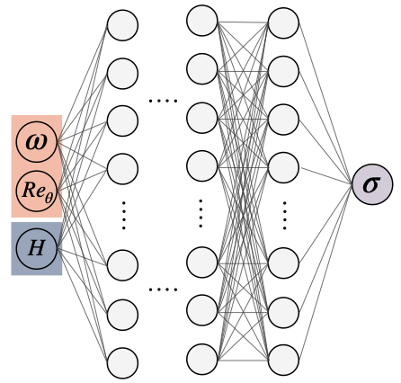
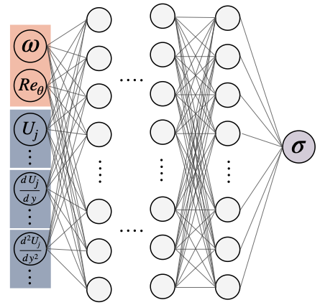
Different architectures were evaluated
(i)
(ii)
(iii)
Image source: Zafar et al [25]
Notes:
The first of which (i) makes use of scalar input parameters employed in the aforementioned database-query methods. The disturbance frequency, ω, the Reynolds number, Re_{θ}, and the velocity shape factor, H, are used as the input to a set of fully connected layers, which output a disturbance growth rate, σ. This velocity shape factor is derived from the ratio of the boundary layer displacement thickness to the boundary layer momentum loss thickness, and the parameter has been observed to correlate with disturbance growth rates. To potentially avoid the issue of relying on shape factors that were determined to be salient features based off the underlying physics, two additional neural network architectures were constructed that make no assumptions about feature significance to obtain the growth rates. In one of these architectures, the entire velocity profile is fed directly as the input to a set of fully connected layers as a direct replacement to the shape factor (ii). In the other, a series of convolving and subsampling operations are performed on the flow profile before being fed into the fully connected layers. (iii)
The training database used to develop these models was obtained by solving the Orr-Sommerfeld eigenvalue problem mentioned earlier for the Falkner-Skan family of self-similar boundary layer profiles over a wide range of Hartree pressure gradient parameters, β_{H}, and local Reynolds numbers, Re_{θ}. The LASTRAC software [15] generated the data by analyzing a selected set of 2D, self-similar boundary layer flows described by the Falkner-Skan equation. This group of boundary layers supports a single instability mode through the viscous-inviscid interactive Tollmien-Schlichting (TS) waves by themselves or a combination of TS waves and inviscid Rayleigh instabilities, making them a suitable choice for training networks intending to predict TS wave growth.

Slide 8
What is a Neural Network?
Maps a set of inputs to a set of outputs:
Example mapping from final layers to :
Network parameters updated via gradient descent:
Notes:
To elaborate a bit further on the architectures just mentioned, I would like to discuss what a neural network does internally to make predictions.
In essence, they are a series of sequential composite functions (organized in layers) that map an input vector to an output. In a set of “fully connected” layers such as the networks I mentioned previously, the composite functions are mapped from one layer to the next by a linear combination of weights, previous layer’s outputs, and biases. For each “neuron”, they are fed this linear combination from the previous layer and have their own individual sets of weights and biases that dictate their output. To capture non-linearity between inputs and outputs, an activation function is chosen to be applied on top of this linear combination, which in this case is the Rectified Linear Unit (ReLU) that takes the maximum between the linear combination and 0.
On the other hand, the convolutional layers of the third architecture mentioned works slightly differently but still provide a useful sort of mapping. Convolution involves performing tensor multiplications between a trainable “kernel” and sub-regions across the input layer with the same size as the kernel. The output of each convolution produces a feature map for which the kernel learns to highlight local features of importance. The activation function is also applied on top of the feature maps to, again, capture non-linearity. In combination with supplemental subsampling, convolutional architectures provide a means towards optimally encoding a downsized representation of the input flow profiles in a manner similar to the manually calculated shape factors. The convolutions, in this project, create a downsized representation of the boundary layer profile. However, this representation is derived through optimization alone and may benefit from making no assumptions about the physics underlying the boundary layer flow, letting the network weigh the importance of local and global features automatically.
The way these networks are “trained” is by feeding them a labelled dataset of inputs that correspond to known outputs, such as the FS database used in this project. After feeding a batch of inputs into a network, a loss function is defined to compare the predicted NN output to the labelled actual outputs, and the gradient of this loss is computed with respect to each individual parameter. The loss function used in the project (also shown here) is Mean Squared Error as it suits regression problems such as this one. The old network parameters are then updated by subtracting a fraction of this gradient from the parameters to produce a new set of parameters because the negative gradient represents the highest rate of loss reduction. This fraction is known as the learning rate and constitutes part of what are known as the “hyper-parameters”.

Slide 9
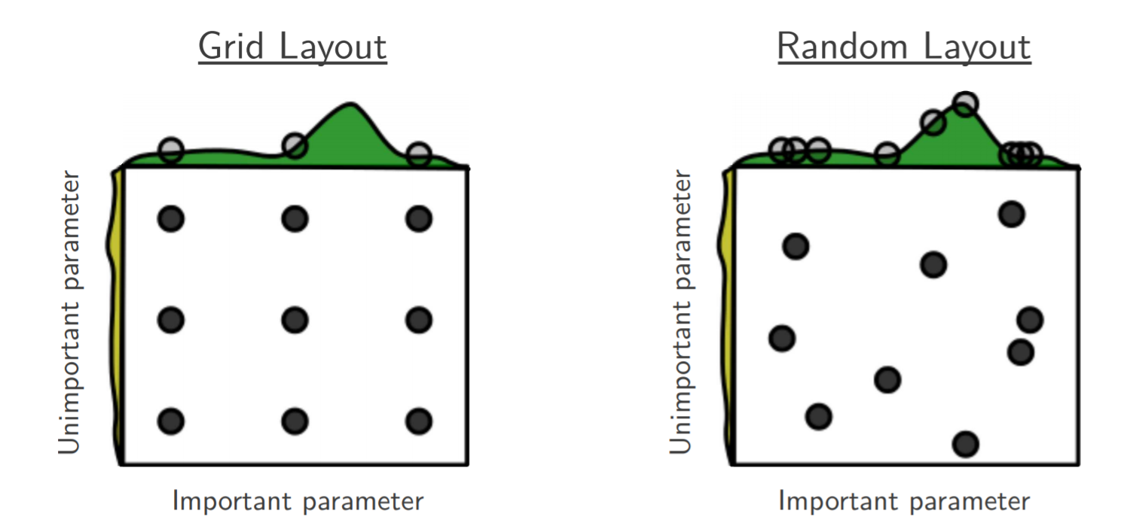
Hyper-parameter Optimization
Image source: Bergstra and Bengio [17]
Notes:
While it seems as though the learning rate is an arbitrary choice, methods have surfaced to choose higher performing hyper-parameter configurations.
In ANNs, the model parameters that compose the network architecture are what directly control the predicted output for a given input. These parameters are obtained from gradient-descent based optimization, as the output of a network and the gradient of the errors with respect to its parameters are computationally cheap. However, because training entails cycling through a preferably large dataset a significant number of times, and each cycle entails computing outputs, gradients, and parameter updates, a model is computationally expensive to train. The number of times to cycle through a dataset, the number of batches a dataset is divided into for each cycle, the size of each gradient descent step, the network depth, and the network width are all examples of what are known as hyper-parameters. These hyper-parameters are decided prior to training the network and generally have a substantial effect on final model performance; a bad choice could result in network prediction no better than random chance and a good choice could mean state-of-the-art performance [16].
Hyper-parameters were originally tuned manually and required a specialist’s eye to reach high performance because experts with an understanding of network behavior could be very efficient at selecting a configuration while running few trials. In more recent years, a variety of methods have seen widespread use to optimize hyper-parameter configurations as commonplace computer clusters and GPU processors made it possible to train more models. Grid and random search techniques, for example, define a hyper-parameter space from which a discrete or completely random set of configurations within the space are evaluated. The benefit of these approaches is that they could be trivially parallelized and, with enough trials and computational resources, could outperform manual search [17,18]. Unlike optimizing network parameters, the training of an entire model and computing of the gradient with respect to final model performance is far too computationally expensive for gradient-descent based procedures to work. Other algorithmic approaches in the form of Sequential Model Based Optimization (SMBO, but also known as Bayesian Optimization), however, have superseded the performance of the previously mentioned techniques [16].

Slide 10
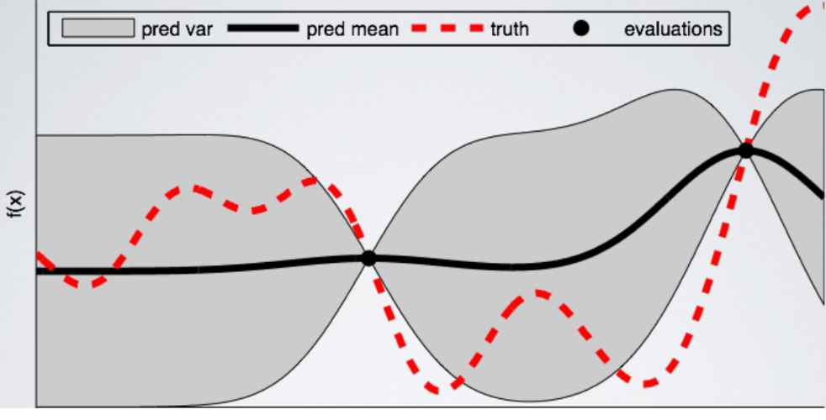
Sequential Model Based Optimization
Image source: Koehrsen [21]
Notes:
In SMBOs, the optimization problem is typically a computationally expensive black-box function, such as model output after training in this case, and the algorithm intends to construct a cheaper surrogate that predicts function output. An optimization run using this method entails running a function evaluation, updating the surrogate, choosing the next evaluation, and repeating until specified. When choosing the next evaluation, the decision is reached based off an acquisition function run over the surrogate, which outputs a promising configuration. An example of a commonly used acquisition strategy is the Expected Improvement criterion, which selects the point that maximizes the difference between the surrogate model output for a given point and the previous best function evaluation. In a way, this is a greedy algorithm that seeks to always evaluate at the optimum.
The example shown here is a Gaussian Process regression chosen to fit a one dimensional function. Every point represents a function evaluation, the red line is the true function, and the black line is the output of the surrogate approximation. [21]

Slide 11
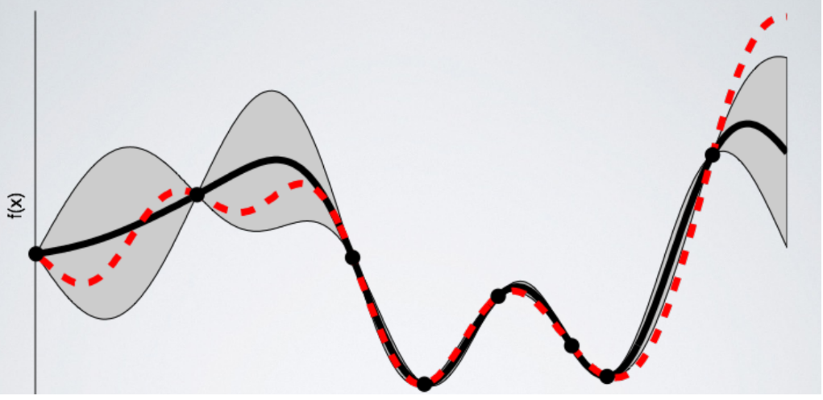
Sequential Model Based Optimization
Image source: Koehrsen [21]
Notes:
In SMBOs, the optimization problem is typically a computationally expensive black-box function, such as model output after training in this case, and the algorithm intends to construct a cheaper surrogate that predicts function output. An optimization run using this method entails running a function evaluation, updating the surrogate, choosing the next evaluation, and repeating until specified. When choosing the next evaluation, the decision is reached based off an acquisition function run over the surrogate, which outputs a promising configuration. An example of a commonly used acquisition strategy is the Expected Improvement criterion, which selects the point that maximizes the difference between the surrogate model output for a given point and the previous best function evaluation.
The example shown here is a Gaussian Process regression chosen to fit a one dimensional function. Every point represents a function evaluation, the red line is the true function, and the black line is the output of the surrogate approximation. [21]

Slide 12
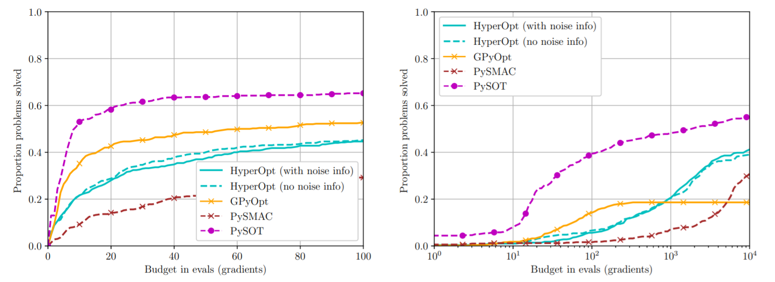
pySOT demonstrates superior performance
Image source: Cartis et al [22]
Notes:
Nowadays, a plethora of hyper-parameter optimization packages pervade the machine learning scene, and while the SMBO approach is largely the same, they mostly differ in choice of surrogate model and acquisition function. The acquisition function used in this project is the DYCORS algorithm with a radial basis function surrogate implemented in the Python Surrogate Optimization Toolbox (PySOT) package because of their ability to accurately predict the global optima of several well-known high-dimensional noisy functions [19, 20]. The DYCORS strategy differs from other acquisition functions by cycling between exploring the hyper-parameter space and exploiting the hyper-parameter space surrounding the best performing configurations. This potentially avoids the problem of greedily converging on a local optimum as occasionally exploring the hyper-parameter space helps find potentially better performing optima. Additionally, the DYCORS algorithm implementation from PySOT has repeatedly been shown to outperform other well-known derivative-free optimization algorithms and packages [22,23], making it a suitable choice of optimizer.
Neural networks used to predict TS waves thus far have been tuned manually and have yet been able to leverage the clear benefits of modern hyper-parameter optimization techniques. This paper will go over the method used to calculate predicted transition locations due to TS wave amplification, delineate the neural network architectures used to predict instability growth rates, describe the generation of training data as well as the data augmentations made, and explain the hyper-parameter optimization strategy employed on these architectures. The insights derived from investigating these strategies on simple ANNs for 2D subsonic flows will aid in the development of this capability on more complex cases and may help make the accurate and computationally efficient prediction of boundary layer transition a reality.

Slide 13
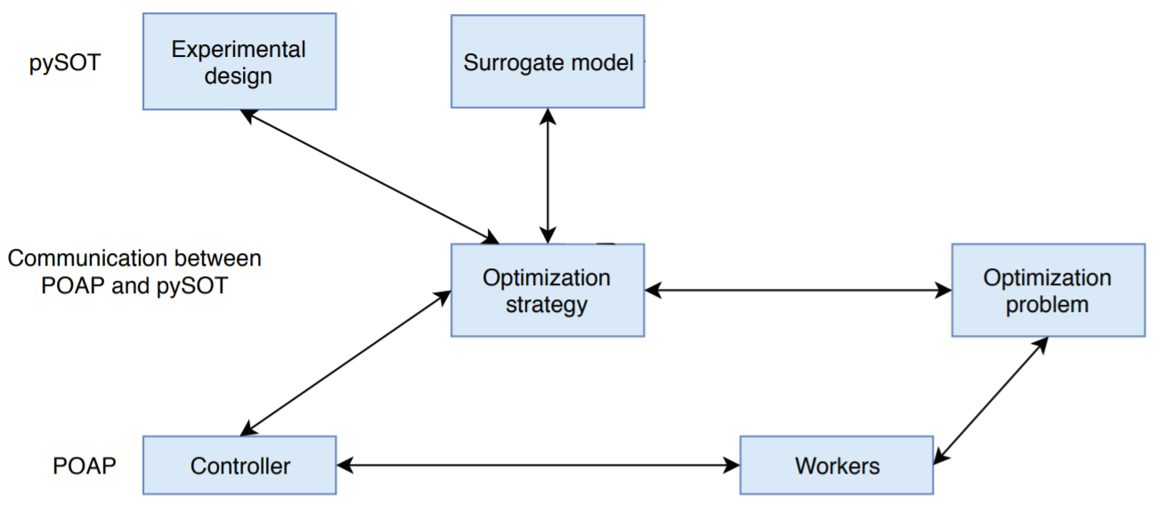
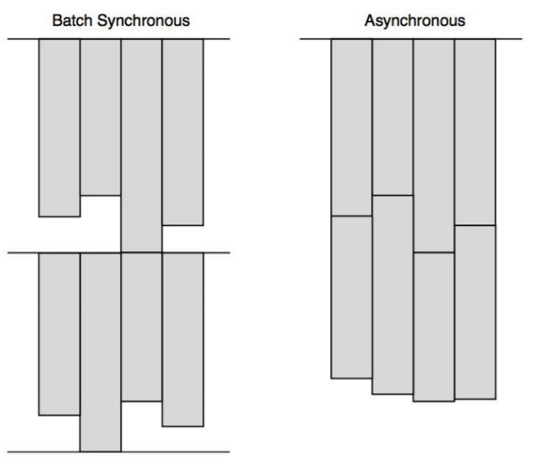
Asynchronous Network Training
Image source: Eriksson et al [24]
Notes:
In order to run as many network trainings as possible, the Plumbing for Optimization and Asynchronous Parallelism was used in conjunction with pySOT. To leverage the computing resources available from the NASA Advanced Supercomputing (NAS) division, the experiment was distributed to several GPU and CPU nodes concurrently. The POAP framework has the user define the optimization problem (which is the trained network’s performance on predicting transition location), the optimization strategy (the DYCORS algorithm described earlier), and a set of hyper-parameter configurations. At run-time, the “controller” constructs the surrogate model and sends out the configurations to try out to the “workers”. The workers evaluate the desired configuration and return the final output once it finishes running the configuration. The result is used to update the surrogate model and then choose the next point to evaluate. Immediately, this desired point is sent to a free worker to evaluate so that the computational resources available are always in use. This asynchronous method of running can be seen on the right and is helpful when the times it takes to evaluate a configuration have a significant amount of variance [24].

Slide 14
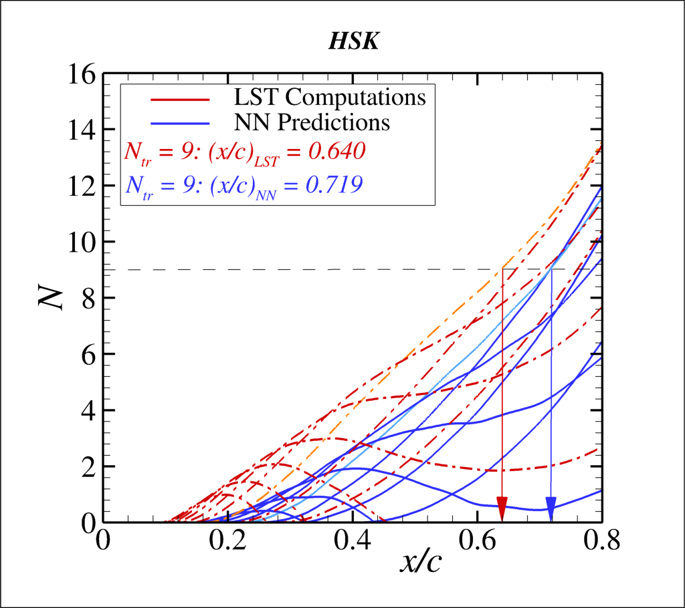
Methodology: Optimization metric
$Error(\%)= \left(\frac{{\frac{x}{c}}_{predicted}−{\frac{x}{c}}_{actual}}{{\frac{x}{c}}_{actual}}\right)$ X 100%
Notes:
Everything else in my presentation will be results I personally produced except for a few images, with the appropriate citations.
In the context of predicting boundary layer transition, the networks’ hyper-parameters were optimized for minimizing the average errors made on computing transition location for the test set of boundary layer flows over 5 selected airfoils. After calculating the local growth rates directly using linear stability theory and neural network prediction, the N-Factor envelope of the actual and predicted flows, respectively, is derived from applying the procedure outlined for using the e ^{N} method on a set of disturbance frequencies that were known ahead of time to yield maximum disturbance amplification. From the N-Factor envelope, the transition location was interpolated for the first value of$s^{∗}=\frac{s}{c}$ that yields N=9, where s is the distance from the pressure or suction side of the airfoil and c is the airfoil chord, because N values between 9 and 11 have been experimentally shown to correlate with the onset of TS wave induced transition. In the case of networks that do not predict transition, a linear extrapolation is performed to estimate location.
In the chart shown here, I have an example of N-factor curve over an airfoil surface. The red lines correspond to the predicted growth rates for an individual disturbance frequency by the LASTRAC software and the blue lines correspond to the NN predictions. The transition error for each airfoil was normalized by the actual location to account for the different x/c domains in the 5 airfoil cases tested. For extrapolations, the last two points on the largest N factor on the blue curve were used to perform an extrapolation for getting the predicted transition location.

Slide 15
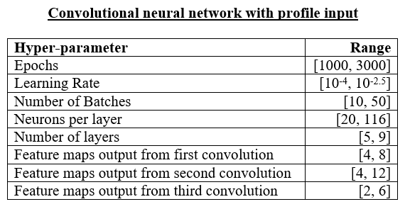
Hyper-parameter Space
Notes:
Before running the optimization, a hyper-parameter space was defined for each architecture from which an individual network could be trained. The spaces were chosen with the intention of providing flexibility in possible network configurations while minimizing the dimensionality of the optimization problem. Providing flexibility may allow the network architecture to obtain a lower global optima than a more rigidly defined space; however, an inherent tradeoff to using broader spaces exists because an increase in range and the number of dimensions increases the difficulty in finding a global minimum and may require significant computational resources. The networks with velocity profile input, however, were given more hyper-parameters to vary because of the higher number of inputs and, therefore, higher number of model parameters required to map the input to the output. The convolutional architecture also inherently has more hyper-parameters to vary as the convolution operations with their kernels and feature maps themselves increase the number of network variations. Finally, the ranges for each hyper-parameter were selected around the values for the previous manually trained hyper-parameters. If the global optimum was found to lie near the boundaries of the space after a run, the range was increased and the hyper-parameter optimization was restarted. The final hyper-parameter space for each architecture is shown above.
-Epochs are the number of times to cycle through the dataset
-Learning rate corresponds to the size of the gradient descent step
-Number of batches are the number of times the entire training database is divided
-Number of layers just corresponds to the depth of the network and how many fully connected layers there are
-

Slide 16
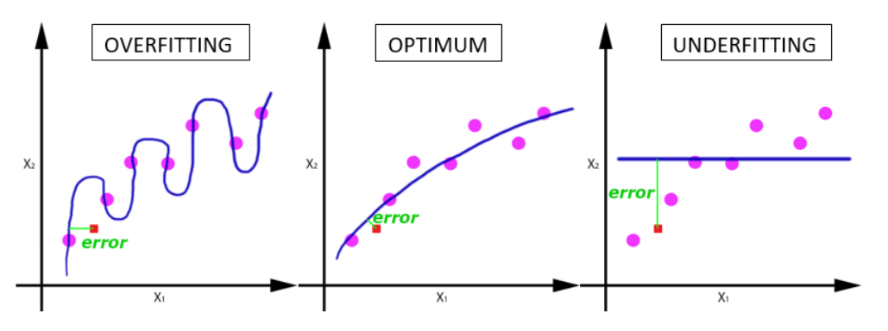
Epoch
Image source: Sharma [26]
Notes:
Epochs are the number of times going through the dataset and they have a large effect on how well the model fits the data. [27] Explain overfitting, underfitting, convergence.

Slide 17
Batch Size
1 Epoch:
Batch 1
Batch 2
Batch 3
Batch 4
…
Batch n-1
Batch n
SGD
SGD
SGD
SGD
Notes:
Batch size means how many individual sets of input and outputs you use in between each gradient descent step. It is an important hyper-parameter not just in terms of model performance, but also in terms of how fast the model is trained. Larger batch sizes oftentimes have issues generalizing, but will allow the network to fit the training data a lot easier as it takes in more information at once. [27]Additionally, large batch sizes allow the user to exploit parallelism as the evaluation of each point can be done separately from one another without affecting each other. As such, with GPU architectures and many computing resources, training a network can be trained much quicker.

Slide 18
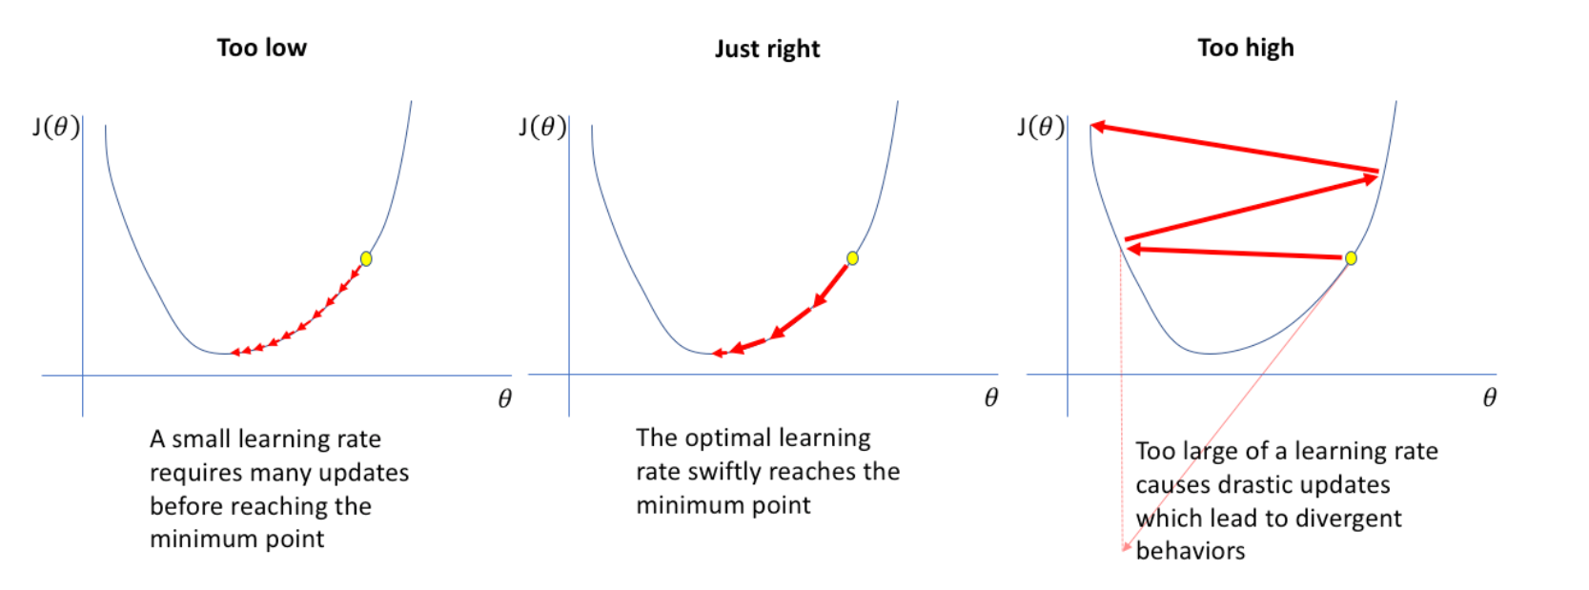
Learning Rate
Image source: Sharma [28]
Notes:
Paraphrasing Bengio’s work on “Practical Recommendations for Gradient-Based Training of Deep Architectures”, it is often the case that a few hyper-parameters makes the most difference. The learning rate is always one of them. The learning rate is simply just the “size” of the gradient descent step or by what fraction of the gradient do we update the parameters. A large learning rate will almost certainly cause the model to diverge and never collapse on to a local or global minimum loss. Smaller learning rates will be slow to converge and have a tendency to converge to a suboptimal minimum. [27] The picture shown above serves as a visual for how the learning rate affects the output, (J in the illustrator’s case), for a given network parameter, theta.
The gradient descent algorithm chosen and fixed in this project was Adam, which adapts the learning rate to each network parameter, constantly decreasing the individual learning rates of the parameters to make some converge faster than others [28]. While other adaptive algorithms exist, Adam was chosen for this very property and the fact that it is one of the most commonly used gradient descent algorithms in the ML scene. Other hyper-parameters than the type of optimizer were seen as more impactful, so this one was left alone to minimize the dimensionality of the optimization problem.

Slide 19
Network width and depth
Number of layers
Neurons per layer:
Number of feature maps
Image source: Zafar et al [25]
Notes:
The number of layers, feature maps and neurons all play a large role in the performance of the network and how well they generalize. [27] With a smaller number of parameters compared to the overall training data, the network’s generalization error can approach the training error. (with the CNN, the feature maps also represent how many local features and global features it can highlight)
To illustrate this effect at its most basic level, imagine we have a plot of 3 points y vs x and assume that the x is roughly proportional to y. A line (so mx+b) will have two parameters and can describe the three points fairly well and may generalize the regression to make predictions outside of its domain. A parabola (ax^2+bx+c) has three parameters but can fit the three points exactly without any error. However, this clearly misrepresents the input output relationship as the model describes a relationship that is inherently different from the underlying mechanisms.
In the same way, a model that has too many parameters may fit the training data exactly, but produce inherent generalization errors even with the proper learning rate/epochs/batch size.
Other hyper-parameters were considered for this optimization such as the other parameters in Adam dictating the adaptive portion of the algorithm (betas and epsilon), choice of activation function, and convolutional kernel size. These were kept constant at recommended settings as there seemed to be no immediate significant benefit as they have been shown to perform well enough (in the case of optimizer and activation) or significantly complicated the implementation and constraints of the model for the kernel (I can elaborate on this more if necessary, but this was purely empirical from the work I was doing).
In the future, if the hyper-parameter space chosen does not yield a significant enough benefit to the performance of the original network, I would recommend increasing the search space and looking for other methods that may improve performance.

Slide 20
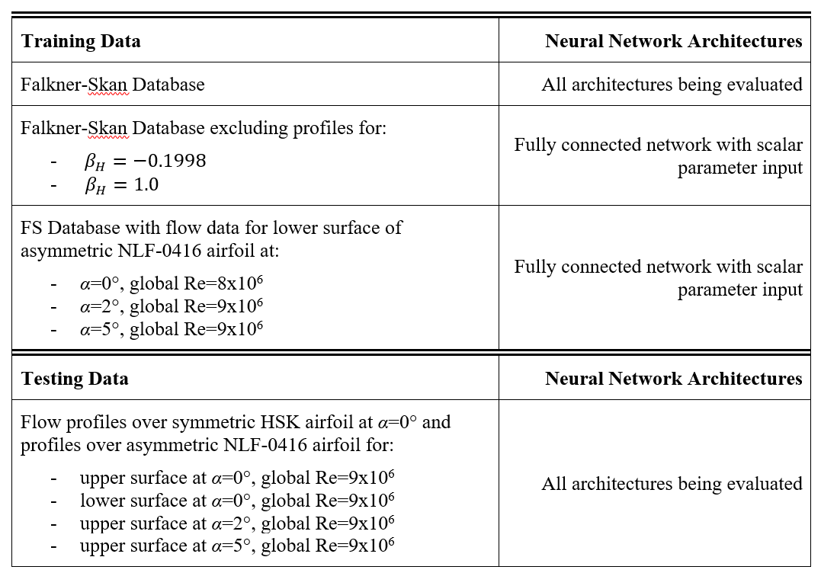
Training data set was varied for scalar network​
Notes:
During my internship I took the liberty to experiment with the data used to train the networks. For the scalar input/shape factor networks, I ran hyper-parameter optimizations on the fully connected scalar input network architecture in the manner described earlier, but using different training data. In the first trial, the networks were trained with the full Falkner Skan database. In the second, I removed the profiles corresponding to the two extremes of the Hartree parameters. This was to see whether reduced database scope reduced the ability for the networks to generalize. In the last trial, I added three additional airfoil profiles to the training data that are completely separate from the airfoils used to test the network because I wanted to see if the FS database was the best approach to training the networks and if any modifications to the dataset resulted in improvements to how well the models generalized.​
​
In the experiment to compare the architectures, the same training database of FS profiles was used.​
​
The training database was obtained by solving the Orr-Sommerfeld eigenvalue problem for the Falkner-Skan family of self-similar boundary layer profiles over a wide range of Hartree pressure gradient parameters, βH, and local Reynolds numbers, Reθ. The LASTRAC software [15] generated the data by analyzing a selected set of 2D, self-similar boundary layer flows described by the Falkner-Skan equation. This group of boundary layers supports a single instability mode through the viscous-inviscid interactive Tollmien-Schlichting (TS) waves by themselves or a combination of TS waves and inviscid Rayleigh instabilities, making them a suitable choice for training networks intending to predict TS wave growth. Similarly, the boundary layer profiles were obtained for the airfoil flow profiles shown in this table.​
​

Slide 21
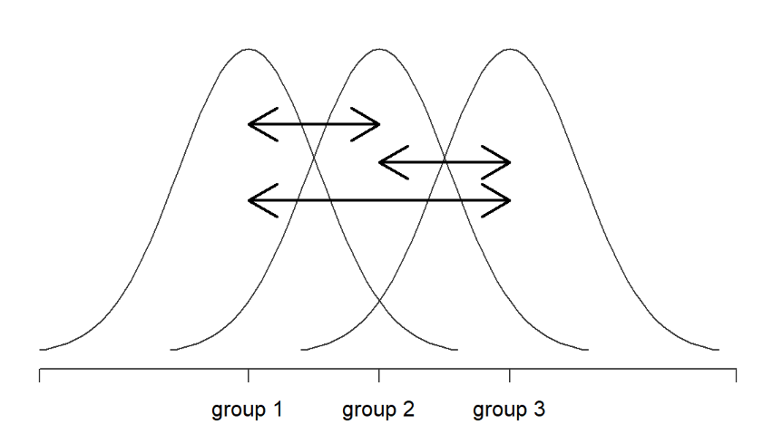
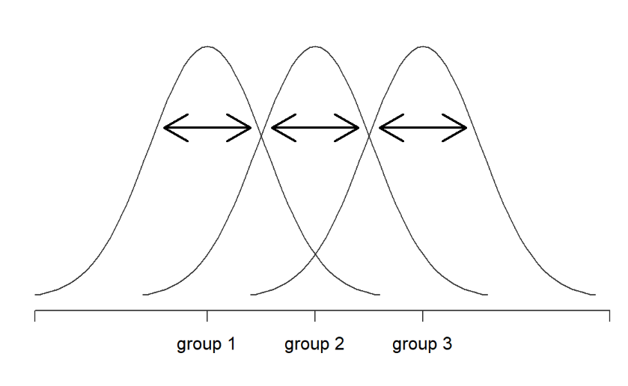
Descriptive Statistics Used – One Way ANOVA
Between Group Variation
Within Group Variation
Image source: Navarro [30]
Notes:
I would just like to iterate the statistical tool I am using to delineate the differences between two groups –be it an architecture or different training set- in case the method used needs clarification.
A one way ANOVA provides an metric of how different two or more groups are to see if the differences we see come about due to random chance. Essentially, it compares the distributions shared between the two groups (between group variation) to the rest of the distribution within a group (within group variation). The ratio between the two gives us a resulting value that could be looked up within the F distribution to obtain the p value. This p value is interpreted as the probability that two groups are the same, meaning that a smaller p value (typically less than 0.05) denotes a statistically significant difference since there is a low chance that the two groups are the same.

Slide 22
Scalar input network performed best
Compared architectures, with left networks performing better | p value from one way ANOVA
Scalar input fully connected | Profile input fully connected | 2.056e-95
Profile input convolved | Profile input fully connected | 2.517e-61
Scalar input fully connected | Profile input convolved | 6.461e-112
Notes:
These are all trained on the full FS database, to make the comparison apples to apples. The results were plotted against the number of parameters to attempt to account for model complexity, but it seems as though the easiest to generalize and easiest to train were still the scalar networks that used future input parameters.
The way I define better performing is by looking at the average performance of the architecture across the entire hyper-parameter optimization run. Since on average some performed better than others, I assert that the architecture has more potential to perform as they have an easier time generalizing and may be subject to further performance improvements after the fact.

Slide 23
Airfoil trained networks performed best
Compared training data | p value
Full FS database ~ FS – extreme β | 0.635
FS + Airfoil | Full FS database | 1.279e-204
FS + Airfoil | FS – extreme β | 3.190e-234
Notes:
The differences between the networks trained on different datasets is quite staggering. The average errors made on predicting transition overall were reduced by 43% when switching to a database that was comprised of only 13% airfoil data. Additionally, the regressions for the training error as a function of the transition error show a much higher correlation (near double) in the airfoil trained networks. A stronger correlation coupled with the improved performance suggests that including training data from flows more similar to those seen on airfoils may be a better way to train networks in order to generalize to more realistic cases.

Slide 24
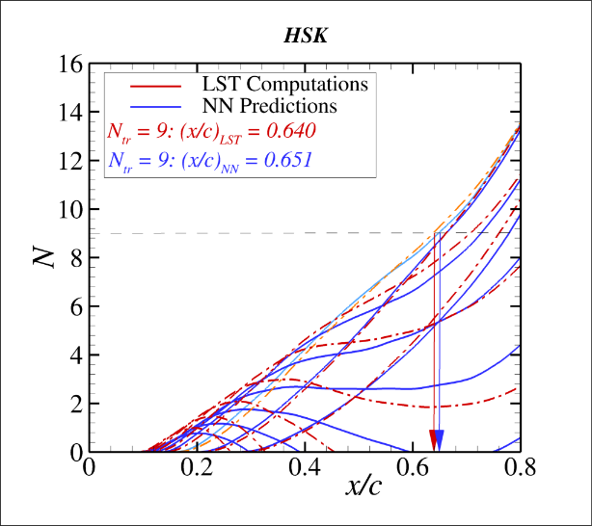
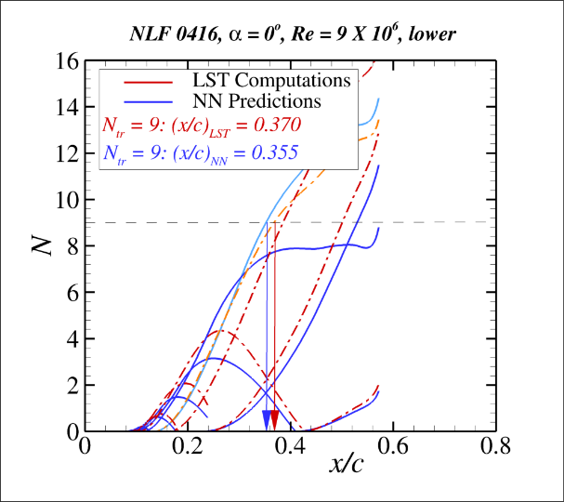
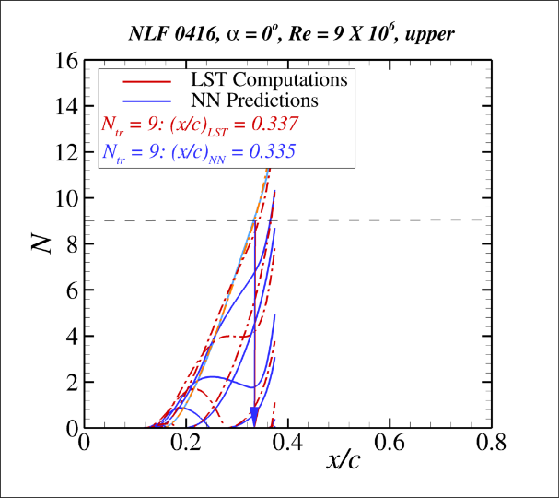
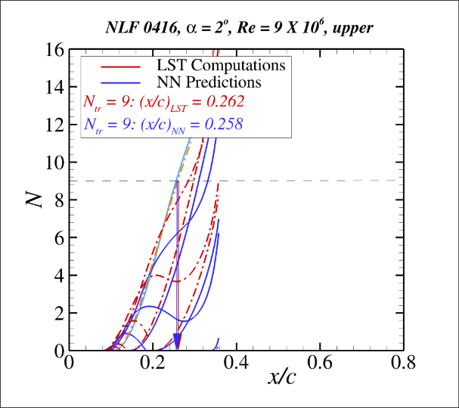
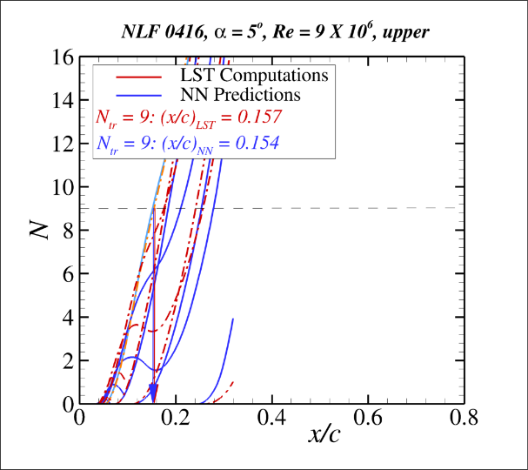
Optimized network averaged 1.91% error
Notes:
The best performing network after hyper-parameter optimization and improved training dataset produced on average 1.91% average error. The 99% confidence interval puts the expected maximum errors made to just under 5%, assuming that the performance on these airfoils is representative of the performance on all cases. On one hand, the network performs well even with the adverse pressure gradient seen in the HSK symmetric airfoil, meaning that these results may indicate high performance on other airfoils and boundary layer flows aside from these cases. On the other hand, the scope of all boundary layer flows is definitely not encapsulated by the cases shown as they only cover three separate airfoil surface geometries and are limited to a range of local Reynolds numbers. Further work and validation using more samples may help further substantiate or negate the hypotheses presented.

Slide 25
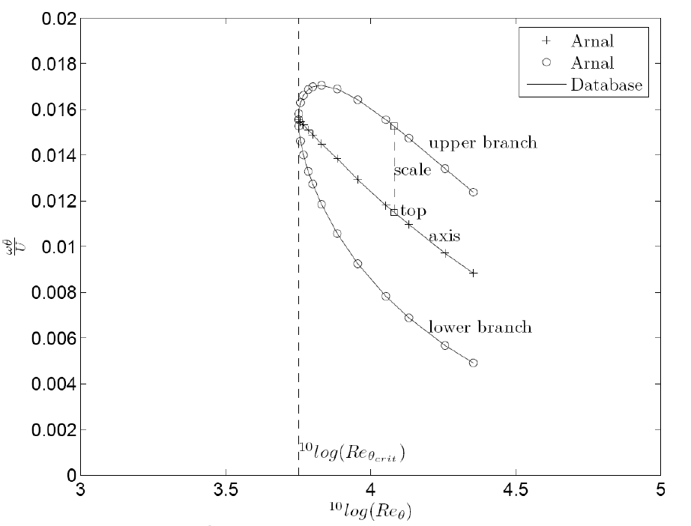
The entire workflow using ML can be automated
Neutral Curve for β_{H}=1.0
Image source: van Ingen et al [2]
Notes:
As a side project to optimizing hyper-parameters, I took the opportunity to provide proof of concept of finshing the entire work flow of calculating flow characteristics, finding relevant disturbance frequencies, computing predicted N factors across the surface, and finally predicting transition location. In this section, I will quickly discuss my approach to finding an appropriate range of frequencies to apply the neural network models.
Whereas the disturbance frequencies in the experiment were chosen manually, I was able to leverage the FS database that I used to train the networks to also automatically provide a range of frequencies of interest for which the N-Factor curves should be calculated. In the FS boundary layers, a neutral surface can be constructed to describe the minimum and maximum frequencies for which the local growth rate is greater than zero for every pair of Reynolds Numbers and Hartree parameters (or equivalently the shape factors).
I created a set of hashmap data structures to encapsulate the information for this surface. Each discrete Hartree parameter curve in the database (such as the one seen in the slide) can be looked up directly in constant run time and has an associated hashmap for each discrete Reynolds number that exists on the curve in the database. Each Reynolds number also has an associated minimum and maximum frequency that corresponds to the upper and lower branches seen in the figure above.
An additional set of sorted arrays of Reynolds numbers and Hartree parameters is stored to make finding the closest values of Re and H to that of the profile easier.
With the data set up in a hashmap, the range of frequencies can be derived by running through each velocity profile along the wall, looking up the closest two Hartree and Reynolds numbers that correspond to an individual profile in the database, and interpolate or extrapolote for the upper and lower branch frequencies. The maximum and minimum frequencies for the entire profile will simply just be the maximum and minimum of all the lower and upper branches found at each position along the surface.
With a database of length m and n profiles to examine, the runtime complexity ends up being O(m,n) = n log(m) since the algorithm only loops through the entire set of profiles once and looking up the closest Reynolds Numbers and Hartree parameters in the sorted arrays takes O(m)=log(m) time.

Slide 26
Predicting the range of unstable frequencies for a given flow
Greatest amplified frequencies confirmed to fall within predicted range
Airfoil case | First frequency where N > 9 (Hz) | Predicted Range (Hz)
HSK, α=0° | 200 | [15.3, 775.0]
NLF0416, α=0°, lower surface, Re = 9M | 130 | [17.1, 371.9]
NLF0416, α=0°, upper surface, Re = 9M | 190 | [33.2, 676.8]
NLF0416, α=2°, upper surface, Re = 9M | 160 | [35.1, 723.3]
NLF0416, α=5°, upper surface, Re = 9M | 370 | [44.8, 882.6]
Notes:
To validate the effectiveness of the algorithm, I tested it out on the 5 airfoil profiles that I used to test the neural network’s performance and was able to get frequencies. To phase out the shape factors, I conjecture that a similar database look up procedure could be created where the shape factors are replaced by the output of the convolutional layers for the FS database, and the output for the boundary layer profiles.

Slide 27
Conclusions
Hyper-parameter optimization and training data modifications can significantly improve model performance
Scalar input network architectures seem to outperform profile input architectures for TS growth prediction
Would not have expected this and reasons remain to be determined!
Further research on improving profile input network performance will be necessary to completely phase out the computational requirements for calculating shape factors
Automating the workflow of computing profiles using CFD codes, predicting relevant disturbance frequencies, and predicting transition location using neural network model, is possible
Notes:
-elaborate on each as necessary, summarizing the results sections

Slide 28
Thank you
Meelan Choudhari
Pedro Paredes
Irfan Zafar
Notes:
Meelan Choudhari for guiding me throughout my internship and pushing me to learn and grow from the opportunity as much as possible
Pedro Paredes for providing consistent support through obtaining databases and providing me the code to calculate the N-factor curves over the airfoils
Irfan Zafar for providing a stable platform through your code and documentation that made it easy for me to continue development on this research effort

Slide 29
Questions?

Slide 30
References
Slotnick, J., Khodadoust, A., Alonso, J., Darmofal, D., Gropp, W., Lurie, E. and Mavriplis, D. (2014). CFD Vision 2030 Study: A Path to Revolutionary Computational Aerosciences. P.12.
van Ingen, J., “The eN Method for Transition Prediction. Historical Review of Work at TU Delft,” AIAA Paper 2008-3830, 2008.
Dagenhart, J. R., “Amplified Crossflow Disturbances in the Laminar Layer on Swept Wings with Suction,” NASA TP-1902, Nov. 1981.
Stock, H. W., and Degenhart, E., “A Simplified en Method for Transition Prediction in Two-Dimensional, Incompressible Boundary Layers,” Zeitschrift f¨ur Flugwissenschaften Weltraumforsch., Vol. 13, 1989, pp. 16–30.
Gaster, M., and Jiang, F., “Rapid Scheme for Estimating Transition on Wings by Linear Stability Theory,” ICAS International Council of the Aeronautical Sciences Proceedings, Vol. 3, Anaheim, CA, 1995, pp. 1104–1113.
Langlois, M., Masson, C., Kafyeke, F., and Paraschivoiu, I., “Automated Method for Transition Prediction on Wings in Transonic Flows,” Journal of Aircraft, Vol. 39, No. 3, May–June 2002, pp. 460–750.

Slide 31
References
Krumbein, A., “eN Transition Prediction for 3D Wing Configurations Using Database Methods and a Local, Linear Stability Code,” Aerospace Science and Technology, Vol. 12, No., 2008, pp. 592-598.
Rajnarayan, D. G., and Sturdza, P., “Extensible Rapid Transition Prediction for Aircraft Conceptual Design Using Modal Decomposition,” AIAA Paper 2013-0231, 2013.
Begou, G, Deniau, Vermeersch, O., and Casalis, G., “Database Approach for Laminar-Turbulent Transition Prediction: Navier–Stokes Compatible Reformulation,” AIAA Journal, Vol. 55, No. 11, November 2017, pp. 3648–3660.
Pinna, F., Zanus, L., Demange, S., and Olazabal-Loume, M., “Reduced Model for Transition Prediction in Hypersonic Flows,” AIAA Paper 2018-3697, 2018.
Drela, M., Giles, M.B.: Viscous-Inviscid Analysis of Transonic and Low Reynolds Number Airfoils. AIAA Journal, Vol. 25, No. 10, 1986, pp. 1347–1355.
Perraud, J. P. and Durant, A., “Stability-Based Mach Zero to Four Longitudinal Transition Prediction Criterion,” J. Spacecraft and Rockets, Vol. 53, No. 4, pp. 730-742, 2016.

Slide 32
References
Paredes, P., Venkatachari, B., Choudhari, M., Li, F., Chang, C.-L., Xiao, H., and Zafar, M. I., " Toward Transition Modeling in a Hypersonic Boundary Layer at Flight Conditions," Submitted to AIAA SciTech Forum, Orlando, FL, Jan 6-10, 2020.
Crouch, J., Crouch, I. and Ng, L., 2002. Transition Prediction for Three-Dimensional Boundary Layers in Computational Fluid Dynamics Applications. AIAA Journal, 40(8), pp.1536-1541.
Langley Stability and Transition Analysis Code (LASTRAC) Version 1.2 User Manual.
Bergstra J, Yamins D, Cox DD. Hyperopt: a python library for optimizing the hyperparameters of machine learning algorithms. In: Proceedings of the 12th Python in science conference; 2013. p. 13–20.
J. Bergstra and Y. Bengio. “Random search for hyper-parameter optimization”. JMLR, 2012.
J. Bergstra, Y. Bengio, Bardenet R., Kégl B., “Algorithms for Hyper-Parameter Optimization”. JMLR, 2013.
R. G. Regis, and C. A. Shoemaker, “Parallel radial basis function methods for the global optimization of expensive functions,” Eur. J. Oper. Res., vol. 182, no. 2, pp. 514–535, 2007.
Jiang, P., Shoemaker, C., and Liu, X., “Time-varying hyperparameter strategies for radial basis function surrogate-based global optimization algorithm”, 984-988. 10.1109/IEEM.2017.8290039, 2017

Slide 33
References
W. Koehrsen, Surrogate function after 3 evaluations. 2018.
Ali, M.M., Khompatraporn, C. & Zabinsky, Z.B., “A Numerical Evaluation of Several Stochastic Algorithms on Selected Continuous Global Optimization Test Problems”, J Glob Optim 31, 635–672, 2005.
C. Cartis, L. Roberts, and O. Sheridan-Methven, “Escaping local minima with derivative-free methods: a numerical investigation,” arXiv:1812.11343, 2018.
Eriksson D., Bindel D., and Shoemaker C., “pySOT and POAP: An event-driven asynchronous framework for surrogate optimization,” arXiv:1908.00420, 2019.
Zafar M.I. et al., "Physics-Informed Convolutional Neural Network for Model Instabilities," 2020.
S. Sharma, What is the right number of epochs?. 2018.
Bengio Y., “Practical Recommendations for Gradient-Based Training of Deep Architectures”, arXiv: 1206.5533, 2012
Kingma D. P., and Lei Ba J., “Adam: a Method for Stochastic Optimization”. arXiv: 1412.6980. 2017.
Jordan J., Setting the learning rate of your neural network, 2018.

Slide 34
References
D. J. Navarro, “Learning statistics with R: A tutorial for psychology students and other beginners (Version 0.5).” Adelaide: University of Adelaide.

