Slide 1
xEMU Weld Analysis
Georgia Danehy
Governor's School for Science and Technology
Mentorship at NASA Langley Research Center
Mentor: Karen Taminger

Slide 2
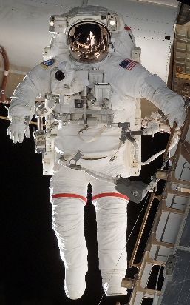
Introduction- xEMU Mission
EMU spacesuits
  Extravehicular Mobility Unit (EMU)
  in use since 1980’s
  Limited sizing available
  Hindered first all female spacewalk
By NASA - http://www.spaceflight.nasa.gov/gallery/images/shuttle/sts-118/html/s118e06304.html, Public Domain, https://commons.wikimedia.org/w/index.php?curid=9730436

Slide 3
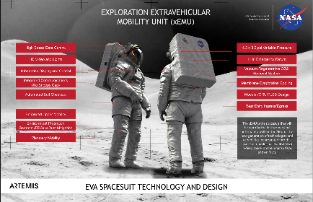
Introduction- xEMU Mission
xEMU Spacesuit
  Exploration EMU (xEMU)
  Improved Safety
  Modular
  Advanced Mobility
Roberts, J. (2019). Exploration Extravehicular Mobility Unit (xEMU). Retrieved from https://www.nasa.gov/image-feature/exploration-extravehicular-mobility-unit-xemu

Slide 4
Introduction- The Backplate
Our backplate
  Panel in life support backpack
  Contains water cooling channels
In here!
Roberts, J. (2019). Exploration Extravehicular Mobility Unit (xEMU). Retrieved from https://www.nasa.gov/image-feature/exploration-extravehicular-mobility-unit-xemu

Slide 5
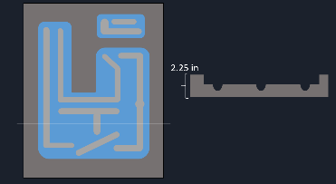
Introduction- The Backplate
Manufacturing process
  Mill away excess material
  Electron beam weld on cover plates
Mock up of panel

Slide 6
Introduction- Research Project
Goal: Examine the welds in the backplate
  Thermal map of weld process
  Characterization of welds
Why?
  Welds need to be secure
  Leaks or deformation could cause harm

Slide 7
Thermal Map of Weld
Provides information on where heat is concentrated.
Helps determine order in which the welds should be completed
  Issues with welding can cause plate to warp

Slide 8
Thermal Map of Weld – Tools Used
Tools used:
  PTC CREO (CAD software)
  Drawing of backplate
  Excel

Slide 9
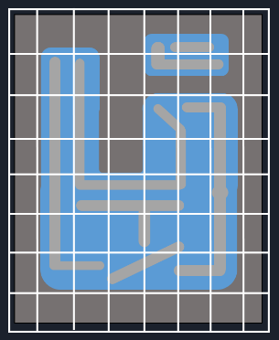
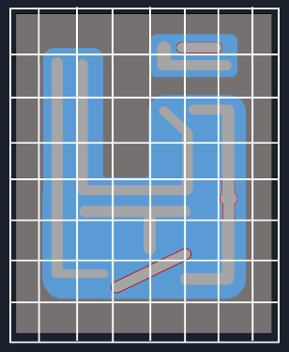
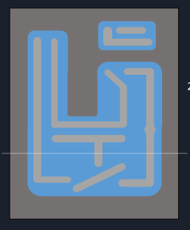
Thermal Map of Weld- Process
1. Split the model into a grid of 2 inch by 2 inch sections
2. Measure the length of the weld paths in each of the sections
2.7 in
3. Input data into Excel and plot (length of weld path used to assess heat input)

Slide 10
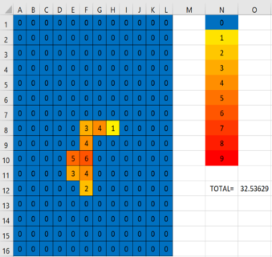
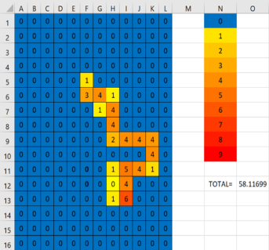
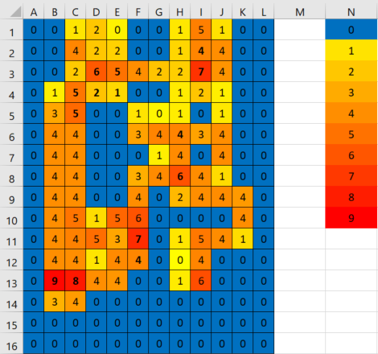
Results
12 heat maps
  One general map and 11 individual welds
Helpful for identifying hot spots

