Slide 1
Exit Presentation
Spring 2020
Mentors:
Soumyo Dutta
Joseph White
Intern:
Jared Ruzicka

Slide 2
Agenda
Introduction
  About Me
  About POST2
Aerodatabase Module
POST2 Manual Automation
NASA Experience

Slide 3

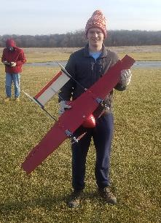

About Me
Iowa State University
  Aerospace Engineering
  Materials Engineering
Previous Work
  Materials Engineering at SNC
Hobbies
  Ice Hockey
  Backpacking/Hiking

Slide 4
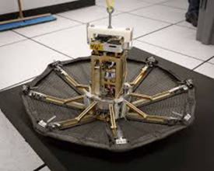
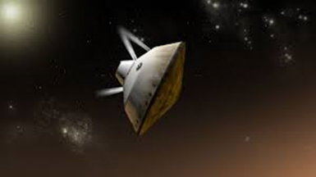
About POST2
Program to Optimize Simulated Trajectories II (POST2)
Ascent and reentry vehicle trajectory optimization simulator
  Can fly and navigate multiple vehicles in a variety of planet/atmospheric conditions
ADEPT SR1
MSL

Slide 5
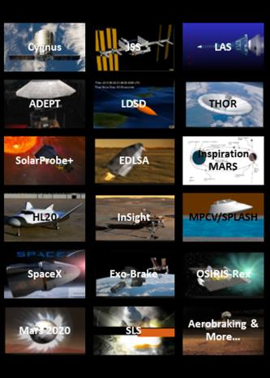
About POST2
Used to simulate many entry, ascent, and orbital missions
Notes:
Mention modules

Slide 6
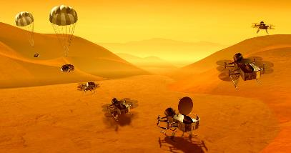
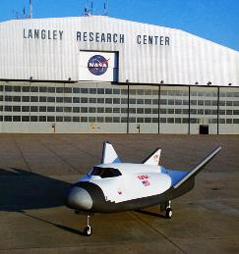
Aerodatabase Description
Aerodynamic data for specific vehicle geometry
  Mach
  Angle of Attack
  Sideslip
  Knudsen
    Continuum vs. statistical models
Written by Aeroscientists
Dragon Fly
HL20
Notes:
Outputs aerodynamic coefficients. Aeroscientists use CFD, wind tunnels, etc.

Slide 7
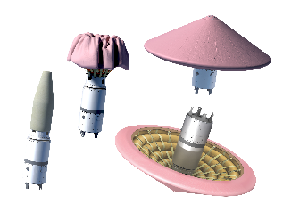
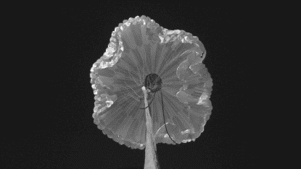
Aerodatabase Module
Aerodatabase module goal
  Create a module in POST2 in which heritage Aerodatabases can be integrated and verified for rapid implementation in new simulations.
    Initial verification by MATLAB
    Full verification by Aeroscientists
IRVE
ASPIRE

Slide 8
Aerodatabase Module
High Level Module Structure
POST2
POST2 Input Deck
Aerodatabase Module
Simulation Data
Interface Functions
Aerodatabase Repository
Standalone Check
Notes:
Aerodatabase repository maintained by Aeroscientists. Create interface files to incorporate fortran aerodatabases into c POST code. Initial Verification with MATLAB MEX interface.

Slide 9
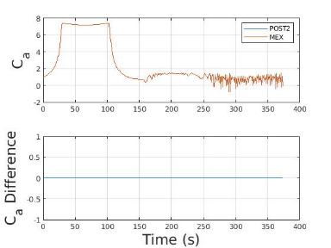
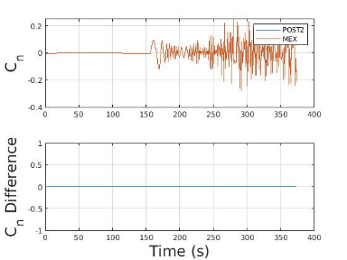
Module Verification
Standalone Check
  Initial aerodatabase verification
  Pass MATLAB data to MEX function
    MEX interface file
      Allows MATLAB to interface with other languages
      Passes data directly to the aerodatabase program
  Compare Results
Create User’s Manual entry
Send data to Aeroscientists for verification

Slide 10
Current Progress
Project | Aerodatabase Type | Compiled into POST2 | MATLAB Check in Representative Flight | Documentation | Checkout With Aeroscientists
Adept SR1 | fortran w/uncerts | yes | yes | draft | no
Aspire | fortran w/uncerts | yes | yes | no | no
Crewed Dragon | fortran w/uncerts | yes | no | no | no
HEART | fortran w/uncerts
LDSD | fortran w/uncerts
LOFTID | fortran w/uncerts
MMEEV | fortran w/uncerts
MSL | fortran w/uncerts | yes | yes | no | no
Genesis | fortran | yes | not representative | no | no
HL 20 | fortran
Mars Microprobe | fortran
Stardust | fortran
Cobra | data | in work | no | no | no
Soyuz | data
Notes:
Mention delay for Aeroscientists verification. Different types of aerodatabases.

Slide 11
High Level Module Creation
POST2
ADEPT Input Deck
Aerodatabase Module
Aerodatabase Module Struct
Aerodatabase Repository
ADEPT Struct
Genesis Struct
ADEPT Function
Interface Function
Genesis Itf. Function
Genesis Function
Genesis Dispersion Function
Dispersion Function
Notes:
For fortran w/ w/o uncerts. Mostly about storage and passing of data. Each database can be turned on/off in header makefile. Aerodatabases currently housed within aerodb module.

Slide 12
POST2 Data Tables
Still working on this last type of aerodatabase
POST2
Input Deck
Data Table File

Slide 13
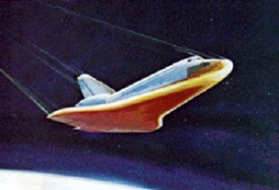
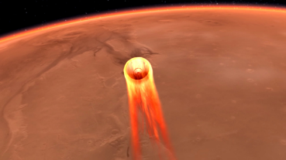
Future Features
More aerodatabases
Move aerodatabases to repository
Checkout verification by Aeroscientists

Slide 14
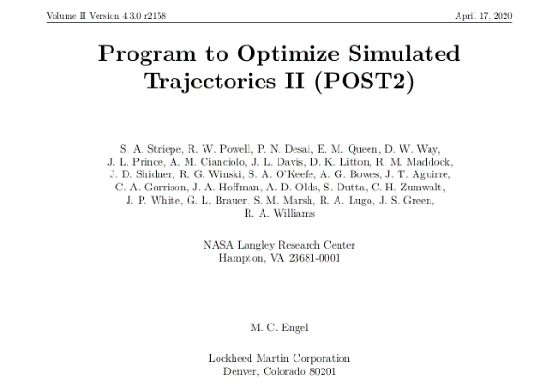
Manual Automation Statement
POST2 Manual Automation
  Automate and version control the creation of the User Manual based on the intended distribution version

Slide 15
Contrasting Source Documents
Previous manual (Word documents)
  130+ Word (.docx) documents
  Binary files
    Difficult to track exact changes
  Formatting inconsistencies
  Time consuming PDF conversion
New manual (Markdown files)
  Versatile (with Pandoc)
  Text based
    Easy to explicitly track changes
  Formatting benefits

Slide 16
Proposed Solution
Edit .md
md2pdf.py
.md master docs
Edit or
compile
Manual
Version
Append .md files together
Convert to .tex
Parse/ format .tex
Convert to .pdf
.pdf manual
pandoc
pdfLaTeX
Notes:
Explain pandoc, latex, pdflatex.

Slide 17
Results
Entire manual compiles into a PDF from markdown files
  User’s Manual LaRC
  User’s Manual Production
  New User’s Guide
Significant formatting consistency improvements
Auto generation of content
  Table of contents
  Page numbers
  Version number
  Date

Slide 18
Future Features
Hooks for Jenkins
  Automatic cronjob software
    Executes scripts on monitored repositories
  Automatically compile a new manual when changes are made to markdown files
508 compliance (ADA compliance)
  Additional LaTeX packages to allow the manual to meet accessibility standards
Different manual versions
  HTML
Auto-generation of manual content from source code comments

Slide 19
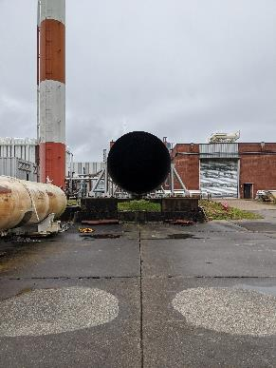
My Experiences
Working at LaRC
  Incredible projects
  Enthusiastic, knowledgeable researchers
  Impressive lab facilities
Transition to Telework
  Relatively easy for my project
  Lack of face to face interaction
  Excellent mentor support

Slide 20

Questions

Slide 21
Additional Slides

Slide 22
Current Progress
Aerodatabase code currently stored in aerodatabase module
Verified in representative mission profiles
  ADEPT SR1, ASPIRE, MSL
Verified without representative mission profiles
  Genesis
Integrated with POST2
  Crewed Dragon
Data not sent to Aeroscientists for verification

Slide 23
High Level Module Creation
High level module to contain all aerodatabases
  Limit on number of modules
  Many, many aerodatabases
Each aerodatabase can be included by editing one header make file
  common_src/makefile.setup
Include each aerodatabase in the aerodatabase module struct
  aerodb/makefile.setup
  aerodb/aerodb_data.h
  aerodb/aerodb_dic.h
  aerodb/aerodb_main.h
  aerodb/aerodb_structs.h

Slide 24
Regular Integration
Create and define a local struct
  <filename>_data.h
  <filename>_dic.h
  <filename>_gs.h
  <filename>_structs.h
Include the local struct in the aerodatabase struct
Create a c file to interface with the fortran aerodatabase
  <filename>_itf.c
  <filename>_main.h
Compile
Debug, debug, debug

Slide 25
No dispersed integration
Same process as with other fortran aerodatabases
Include another dispersion function
  Disperses values for Monte Carlo simulations
  Dispersion function is only accessed if dispersion flag is invoked

