Slide 1
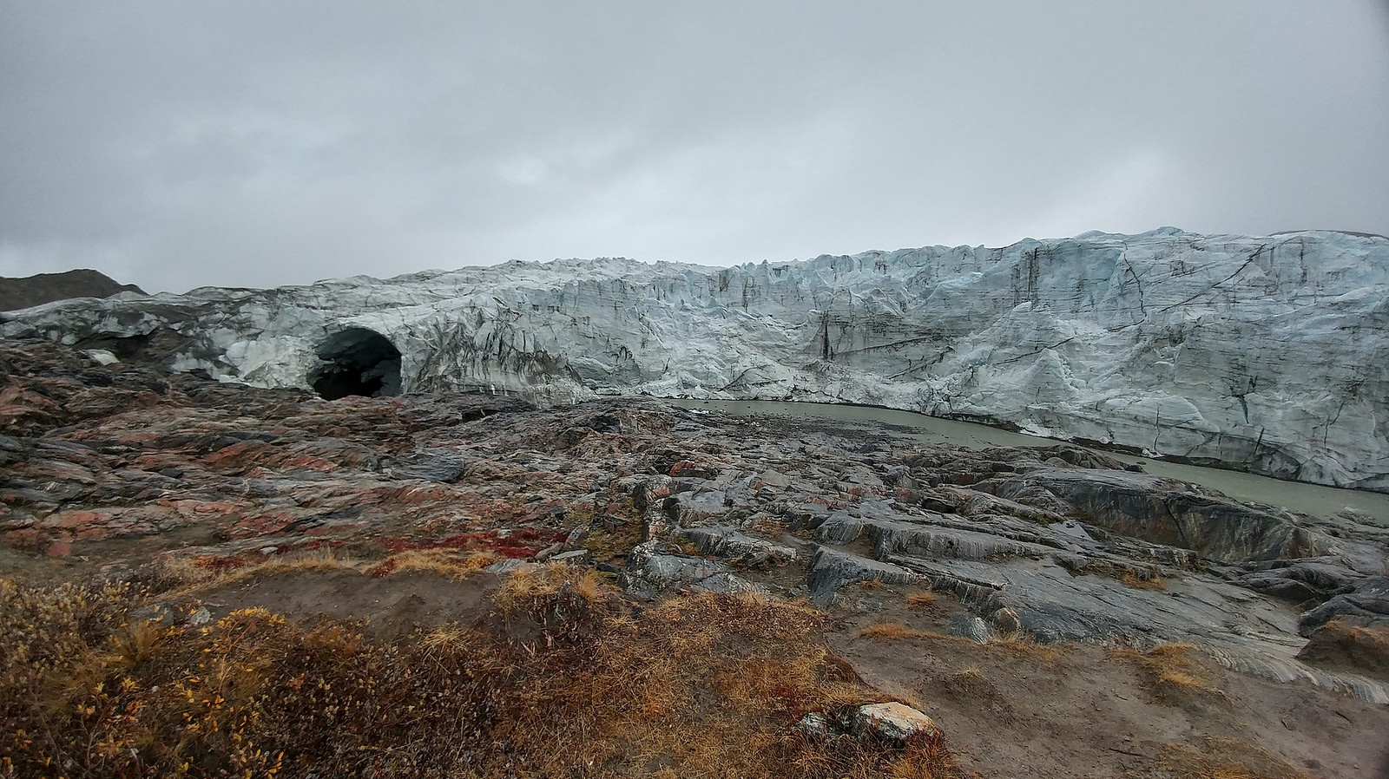

Arctic and Boreal Model Development in GMAO
Global Modeling and Assimilation Office
gmao.gsfc.nasa.gov
2020 CABs Quarterly Update, 21 April 2020
Lauren Andrews, GMAO
Richard Cullather, Abhishek Chatterjee, Steven Pawson, Lesley Ott, Andrea Molod
*Many people contributed to the work presented here.*
Photo: Jeremy Harbeck

Slide 2
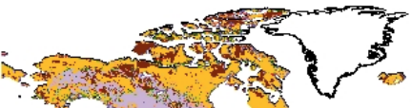

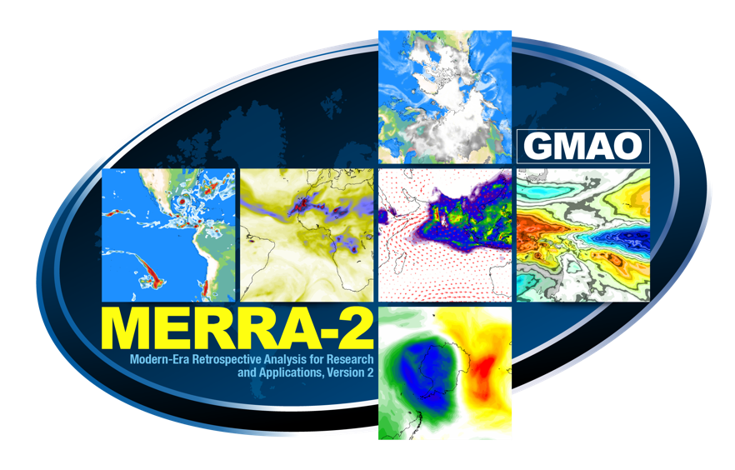
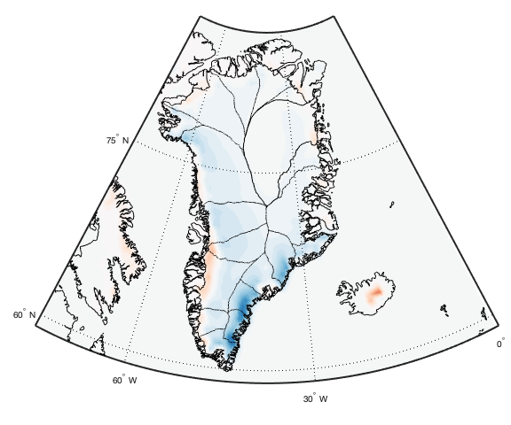

Arctic and Boreal Model Development in GMAO
Boreal land processes
ABoVE modeling efforts
GMAO’s Catchment Land Surface Model
GEOS model development to advance Arctic-Boreal carbon cycle research.
Led by Abhishek Chatterjee
S2S polar processes
PolarMERRA
Linking atmospheric and ocean processes through ice sheet runoff.
A new collaborative project with the Cryospheric Sciences Lab to improve atmospheric reanalyses in polar regions.
Notes:
Touch on a few things with which you may or may not be familiar with the goal of gaining your insight and potential collaborations

Slide 3
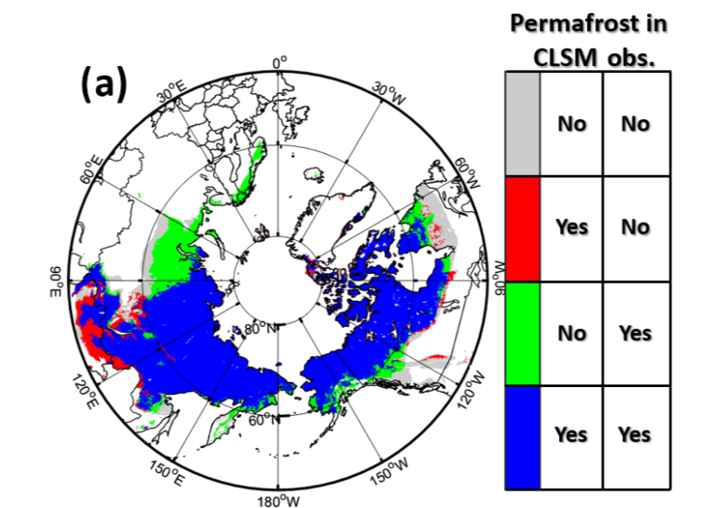
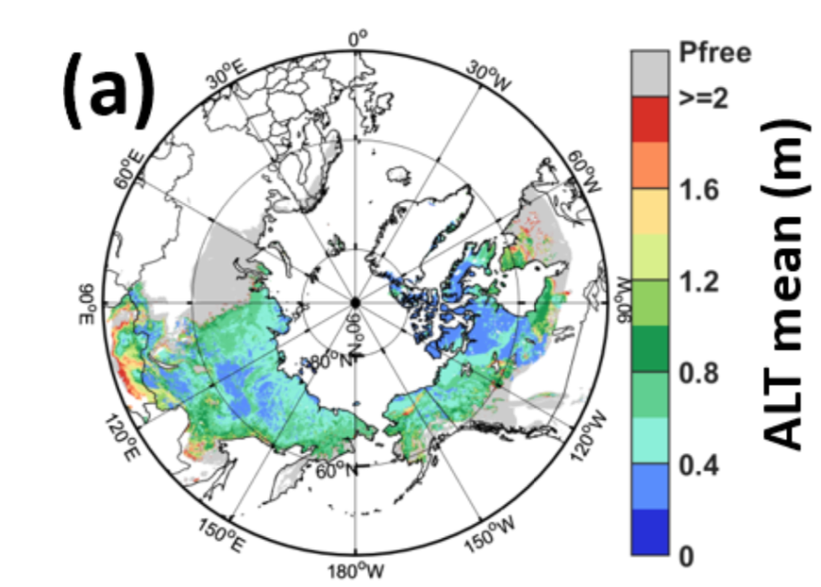
Improvements in permafrost representation
GMAO’s Catchment LSM is capturing the observed extent of continuous and discontinuous permafrost and simulated active layer thickness.
Tao, Koster, Reichle, et al. (2019)
Notes:
The updated version of CLSM used here includes mod- ifications aimed at improving permafrost simulation. It ac- counts, for example, for the impact of soil carbon on the soil thermal properties with soil porosity, thermal conductivity, and specific heat capacity calculated separately for mineral soil and soil carbon, after which the two are averaged using a carbon-weighting scheme. Higher (lower) soil carbon con- tent, therefore, results in lower (higher) soil thermal conduc- tivity. The updated version produces more realistic subsur- face thermodynamics in cold regions than does the original scheme (Tao et al., 2017). This version of CLSM, however, does not include dynamic soil carbon pools.

Slide 4
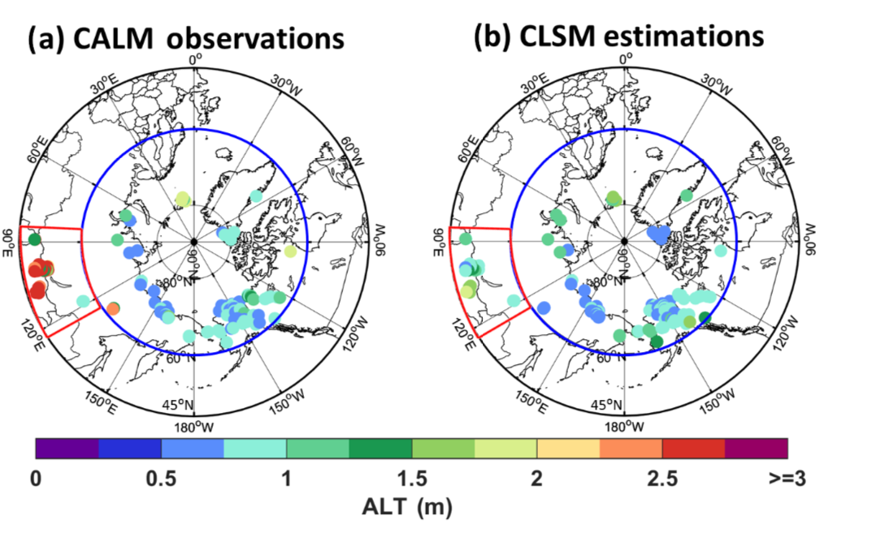
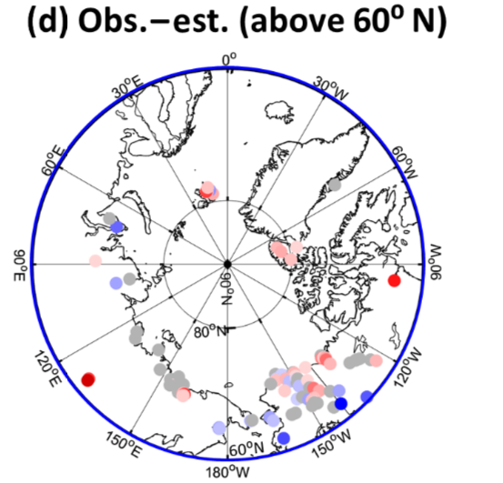
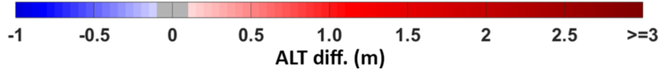
Assessing permafrost representation
GMAO’s Catchment LSM is capturing the observed extent of continuous and discontinuous permafrost and simulated active layer thickness.
Observed ALT (m)
Modeled ALT (m)
Observed – modeled ALT
Tao, Koster, Reichle, et al. (2019)
Notes:
The updated version of CLSM used here includes mod- ifications aimed at improving permafrost simulation. It ac- counts, for example, for the impact of soil carbon on the soil thermal properties with soil porosity, thermal conductivity, and specific heat capacity calculated separately for mineral soil and soil carbon, after which the two are averaged using a carbon-weighting scheme. Higher (lower) soil carbon con- tent, therefore, results in lower (higher) soil thermal conduc- tivity. The updated version produces more realistic subsur- face thermodynamics in cold regions than does the original scheme (Tao et al., 2017). This version of CLSM, however, does not include dynamic soil carbon pools.

Slide 5
“… a tale of three carbon species …”
Chatterjee-01 NASA ABoVE-funded project
PI: Abhishek Chatterjee (610.1)
GSFC Co-I and Collaborators: Lesley Ott (610.1), Ben Poulter (618), Peter Griffith (618), Liz Hoy (618), Jeff Masek (618), Bryan Duncan (614), Steven Pawson (610.1)
External Personnel: Charles Miller (JPL), Colm Sweeney (NOAA), Eugenie Euskirchen (UAF), Martijn Pallandt (610.1/MPI), Mathias Göckede (MPI-BGC)
ABoVE at GMAO
CO₂
CO
CH₄
SVS DRAFT : Stay Tuned!
Local and far-field signature
Local sources: fires, anthropogenic emissions, respiration
Local sinks: terrestrial & oceanic uptake
Primarily local signatures
Fire emissions
Major sink: reaction with OH, some surface deposition
Mostly local signatures
Extremely heterogeneous sources - wetlands, fires, oil and gas fields
Cold season emissions that remain highly uncertain
Notes:
Talking points:
Carbon cycle dynamics in the Arctic-Boreal region are among the largest sources of identified uncertainties to global climate projections. These uncertainties stem from two sources - (a) extremely complex interactions of ecosystem components, carbon sources and sinks and heterogeneous environment, and (b) lack of measurements
As shown in the table, fluxes of CO₂ and CH₄ are controlled by a complex combination of temperature, soil water, geochemistry, and microbial processes at the local scale. But then you have transport from mid-latitudes and other places that complicate understanding of the carbon cycle dynamics within this region.
Lack of observational data provides limited opportunities for model improvements, testing, and evaluation.
Current work has been tapping into the suite of observations that were collected during the 2017 ABoVE airborne campaign and using those data to benchmark the model. Establishing that the model is performing well provides a valuable tool for identifying the observing portfolio that we need to provide better constraints on pan-Arctic carbon cycle .

Slide 6
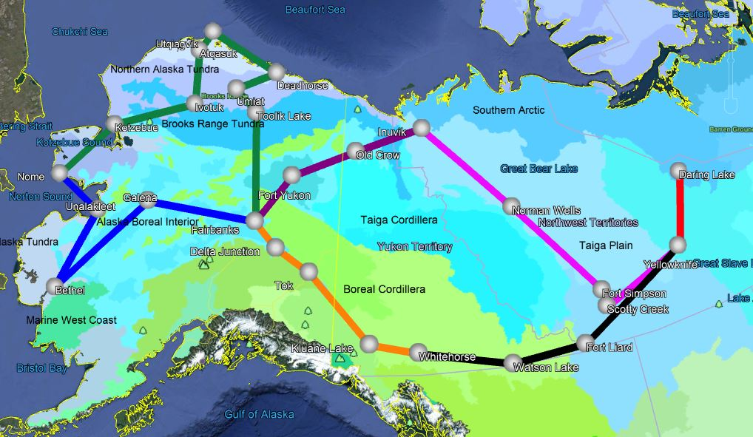
Constraining the timing of CO₂ uptake and CH₄ enhancement
Northern Alaska Tundra
Late CO₂ drawdown from mid-July, continues through September
CH₄ enhancements increase from July onward
Southern Arctic
Most mysterious seasonal pulsing in CO₂ and CH₄
Observations record high concentrations in CO₂ but low concentrations in CH₄ and CO
Boreal Cordillera
CO₂ drawdown starts early, peaks in August
CH₄ enhancements dominated by fire
Sweeney, Chatterjee, et al., Environ. Res. Letters, to be submitted, April 2020
Observations collected during the 2017 airborne campaign (colored lines) over the ABoVE domain. Domain is broken up by ”ecoregions” or the dominant biome.
Notes:
Talking points:
Paper that is about to be submitted in a week or two looks in detail at the aircraft observations and GEOS model simulations. Uses the information from the two to identify how spatially and temporally the carbon cycle regimes change in this region.
For example, in interior AK and Canada, where the environment is dominated by boreal forests, carbon uptake starts early, peaks by August. But as more and more fire incidents occur, the system is overwhelmed by the increase in carbon emissions from fires

Slide 7
Using the GEOS model to explore new observing portfolios to monitor and detect changes
Sample scenarios that we are running
What capability do we have to observe emissions & changes in emissions?
What observing network do we need to locate and detect future emission hotspots?
What temporal information would we need to constrain the spatial distribution of potential carbon-climate feedback?
Chatterjee, Ott, Poulter, in collaboration with Max Planck Institute for Biogeochemistry, Northern Arizona University, Lawrence Berkeley National Laboratory, among others
Notes:
Talking points:
Having a model that we can use to simulate multiple carbon species for several years (decades) is important not only for understanding the mechanisms but identifying what the next generation of observing systems should look like.
The Northern high-latitudes remain heavily under-sampled; folks at GMAO have undertaken an OSSE activity with several external partners to figure out what type of monitoring capabilities we need
Primary goals of this activity are → 3 bullet points
Suite of scenarios have been identified and we are running some of these scenarios through the model right now.
*SIDE NOTE* We have a visiting PhD student from Max Planck. His name is Martijn Pallandt and he was supposed to be working in GMAO from March - August with Abhishek and Lesley. Unfortunately, right now he is stranded in an Airbnb but we hope to have him on center eventually. Martijn has immense experience working with in situ data in remote locations in Siberia, he has been out in the field quite a bit. He is going to help design some of the ground-based measurement networks that can be utilized along with satellite and airborne assets for these OSSEs.

Slide 8
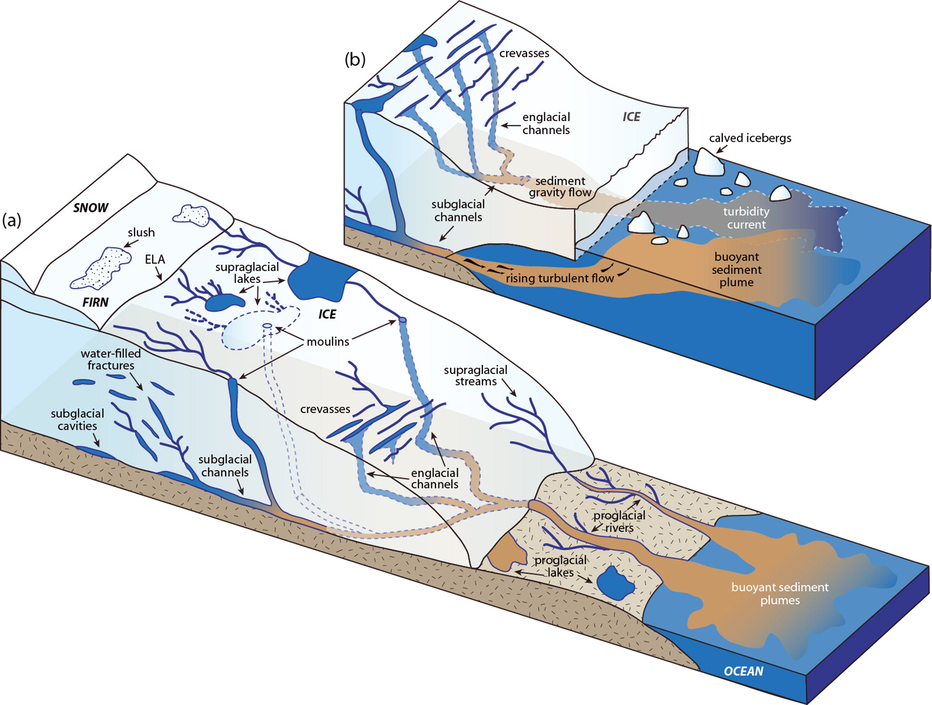
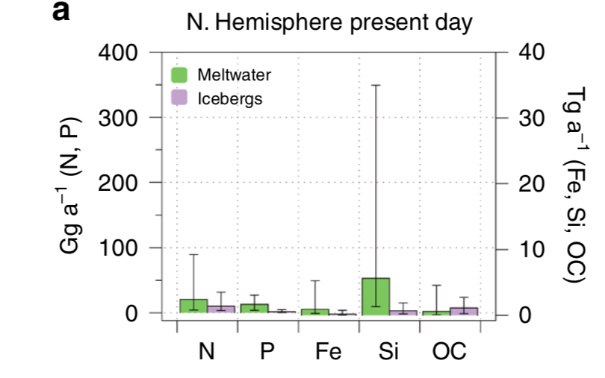
Linking polar atmospheric & ocean processes through ice sheet runoff
Meltwater routing can alter ice sheet and glacier dynamics and ocean runoff (and associated processes).
Nutrient & organic carbon flux
Sediment, nutrient, and methane entrainment when meltwater reaches the bed.
Wadham et al. (2019)
Chu (2013)

Slide 9
Meltwater runoff directly influences the ocean carbon cycle
Meltwater routing can alter ice sheet and glacier dynamics and ocean runoff (and associated processes).
Nutrient & organic carbon flux
Wadham et al. (2019)
Arrigo et al. (2017)

Slide 10
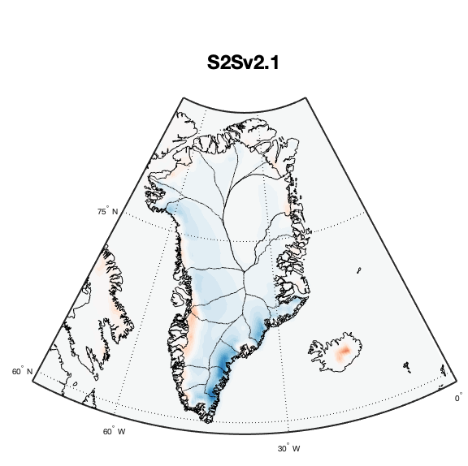
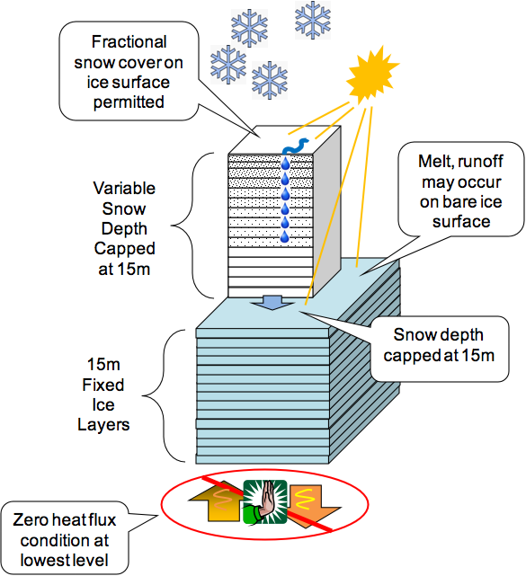
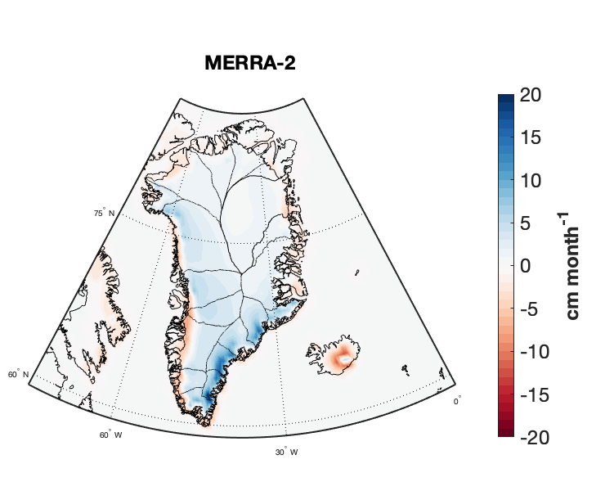
Improvements in the S2S coupled system
Adequately represent ice sheet surface mass balance.
Snow and ice processes included.
Surface routing is not representative of currently known processes.
Basal and ice dynamic processes not included.
Notes:
The snow model explicitly models heat and mass transport within a grid cell. Densification includes both mechanical and melt-freeze processes. Snow albedo evolves due to surface conditions, including the radiative flux.
Meltwater generated in a layer will remain in the layer if the liquid water content of the layer is less than the layer holding capacity. Oth- erwise, it will flow down to a lower layer where it will refreeze in the layer, remain in the layer in the liquid state, or pass through.
Things that we don’t include:
1. Evolving bare ice albedo
2. Firn
3. Explicit meltwater routing and associated features
2. A dynamic ice sheet and associated processed

Slide 11
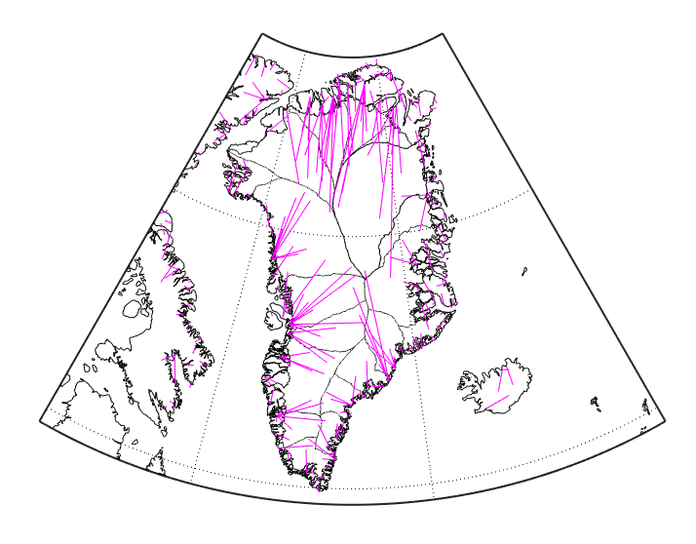
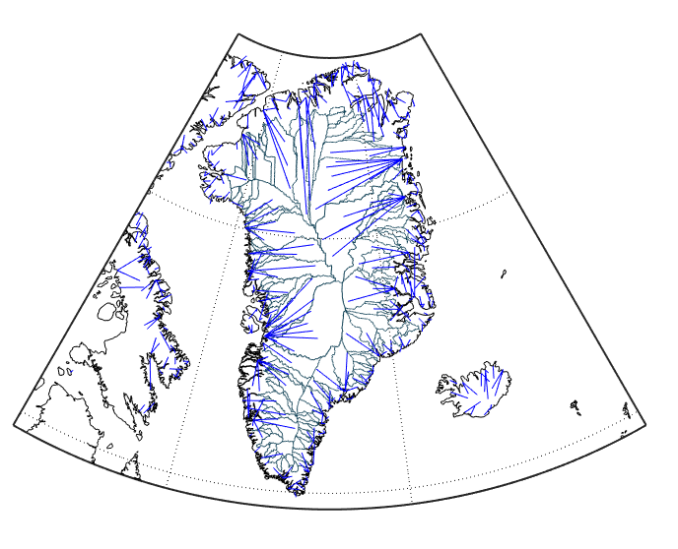
Step 1: Melt water in the appropriate ocean location
New surface routing
(GEOS-S2S v3)
Previous surface routing
Surface meltwater routing now reflects modern ice surfaces (Arctic DEM & REMA)
Notes:
Important due to coupled ocean-atm

Slide 12
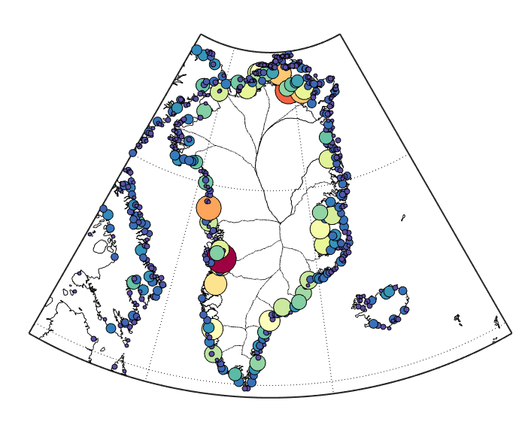
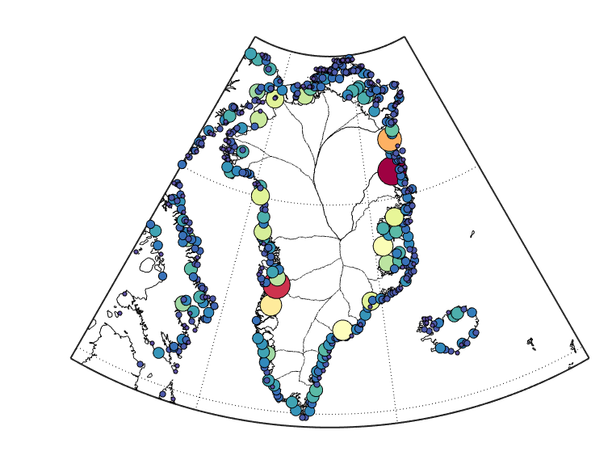
Step 1: Melt water in the appropriate ocean location
New surface routing
(GEOS-S2S v3)
Previous surface routing
Improved ice sheet runoff distribution.

Slide 13
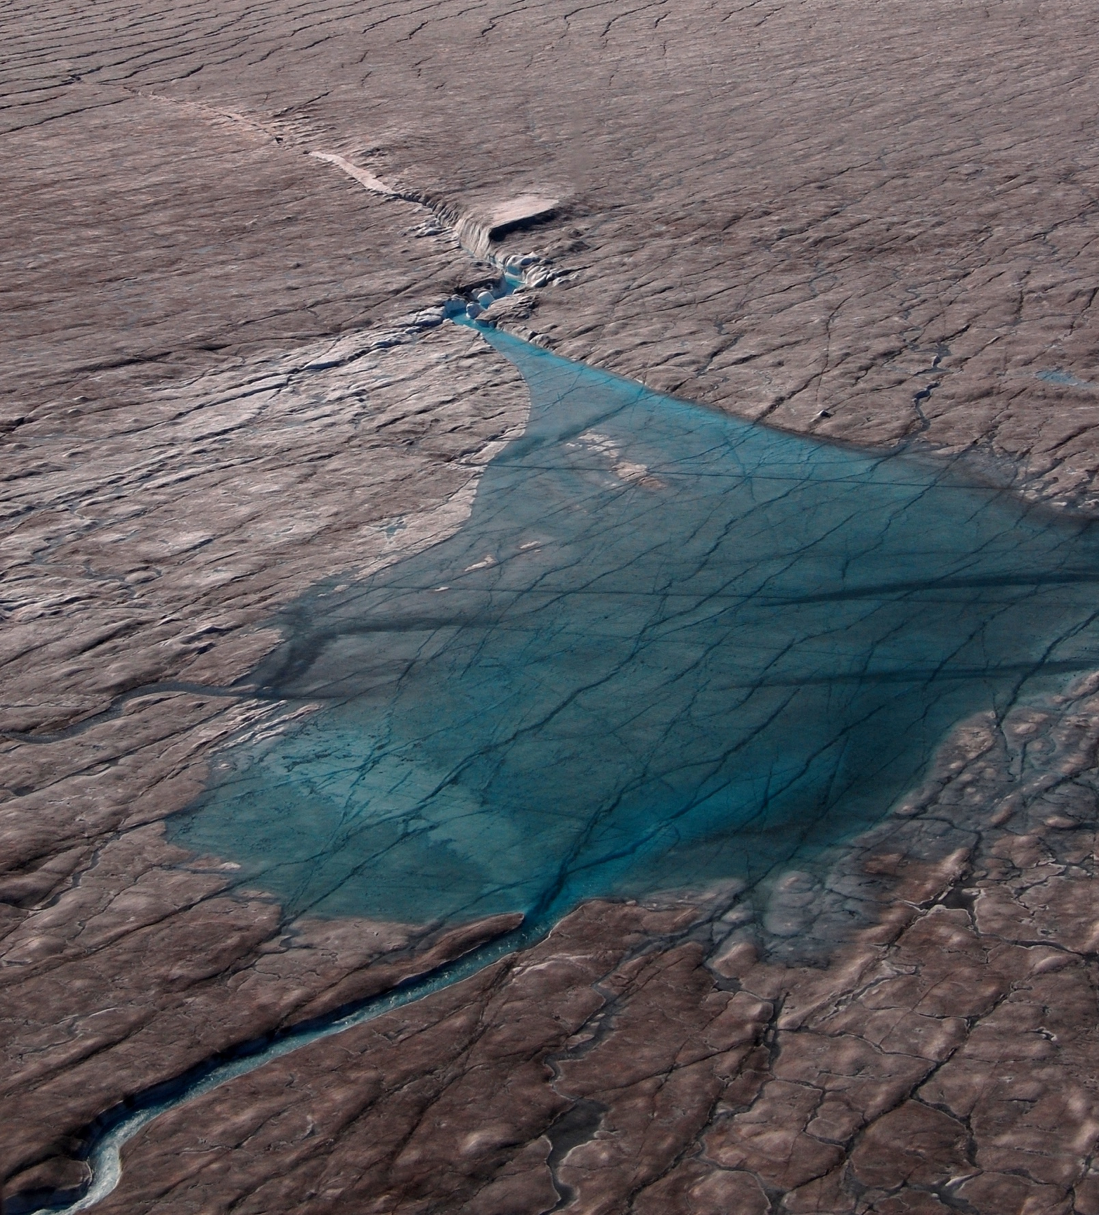
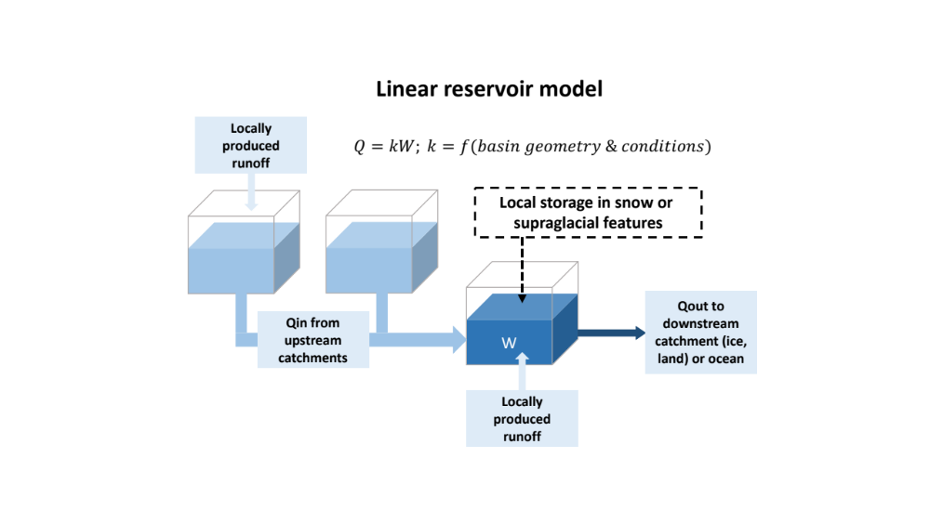
Future improvements in the S2S coupled system
Surface and subglacial routing with newly developed parameterizations for supraglacial-subglacial connections.
Photo: Matt Hoffman

Slide 14
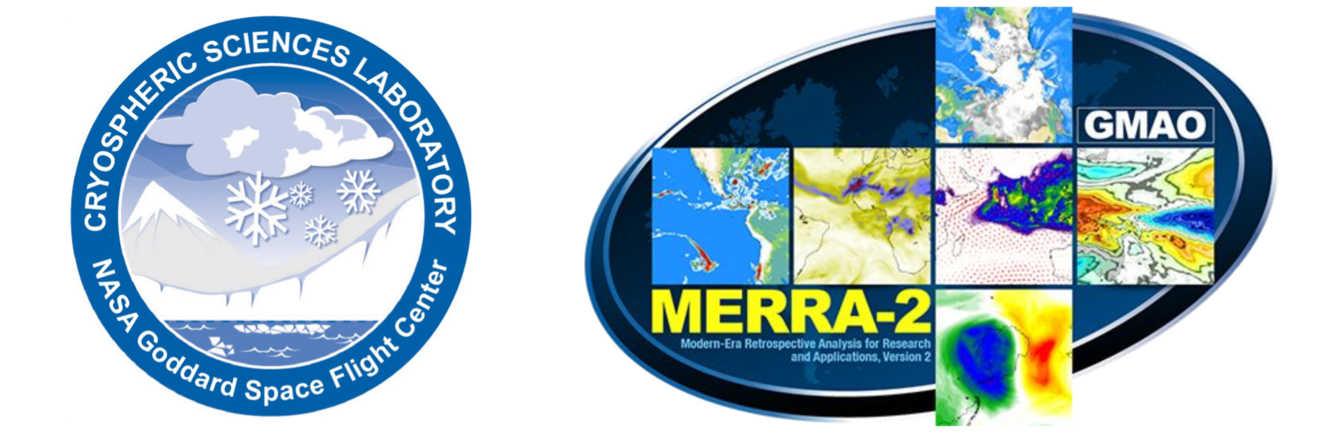
PolarMERRA
Polar atmospheric processes, including precipitation and surface air temperature, are difficult to constrain and simulate, but are critical for modeling sea ice and ice sheet mass balance and boreal processes.
PolarMERRA provides a pathway to unite & improve polar processes in the GEOS system.

Slide 15
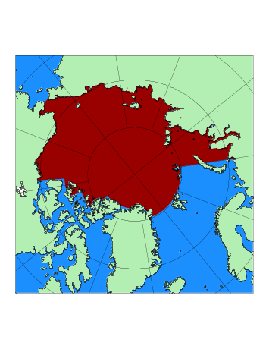
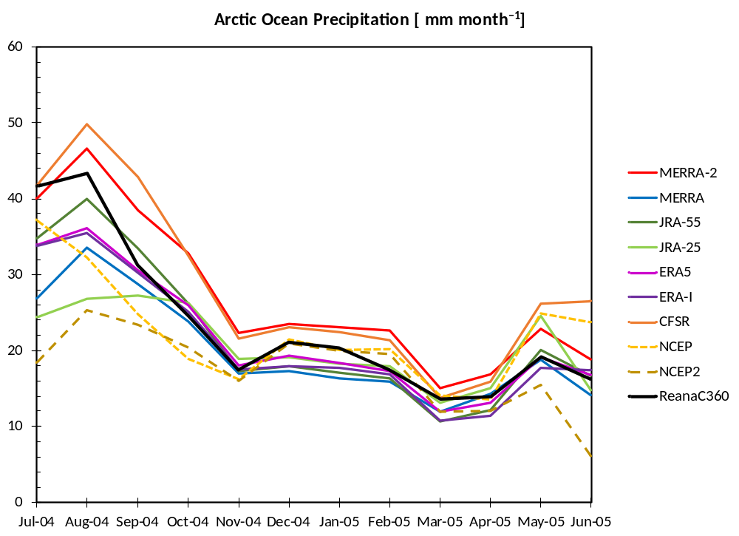
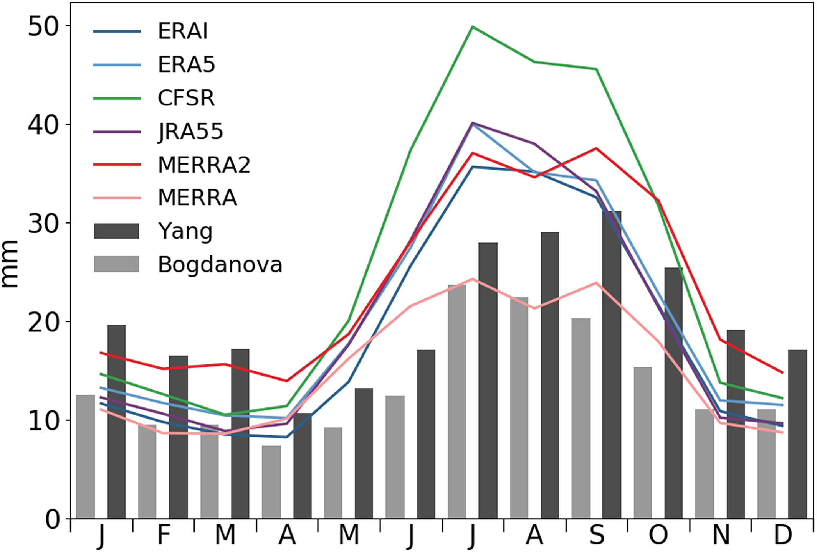
Polar biases in reanalyses
Precipitation
Mean monthly precipitation (mm)
Arctic ocean precipitation (2004- 2005; mm m⁻¹)
Barrett et al. (2020)
Courtesy of R. Cullather
Notes:
First is drifting stations

Slide 16
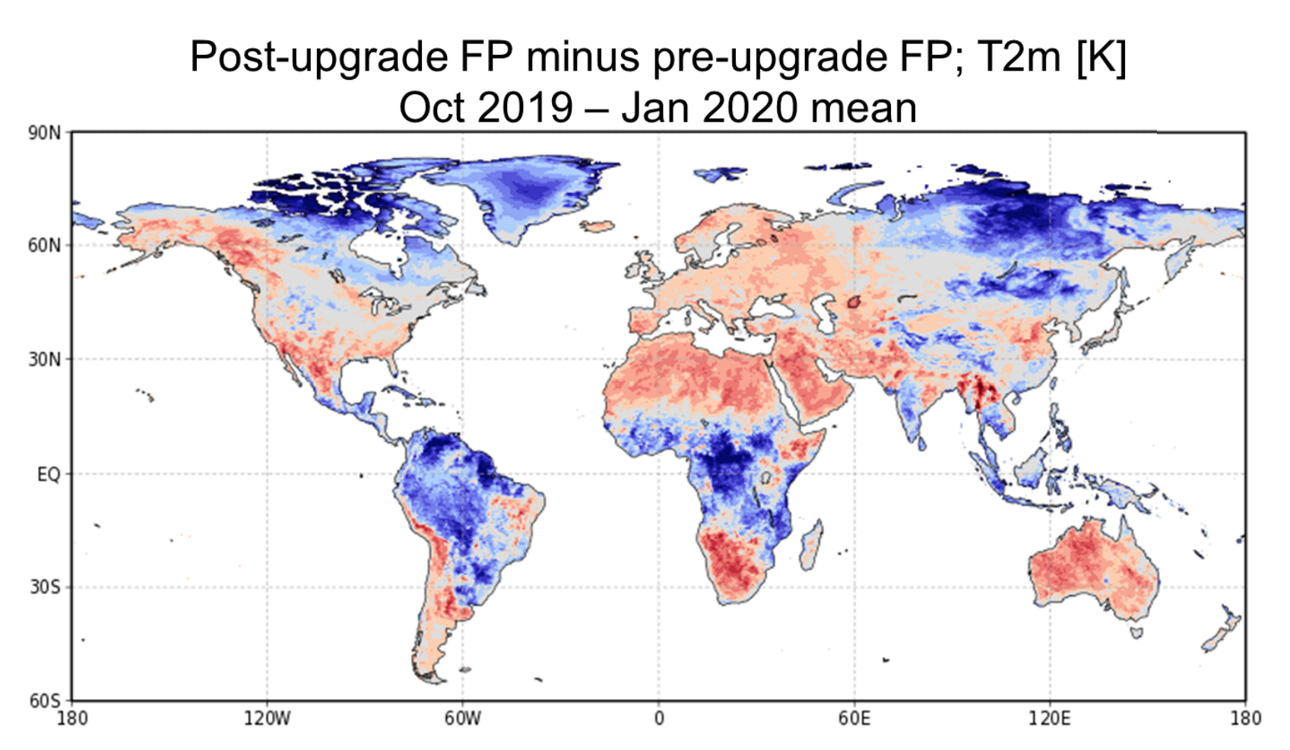
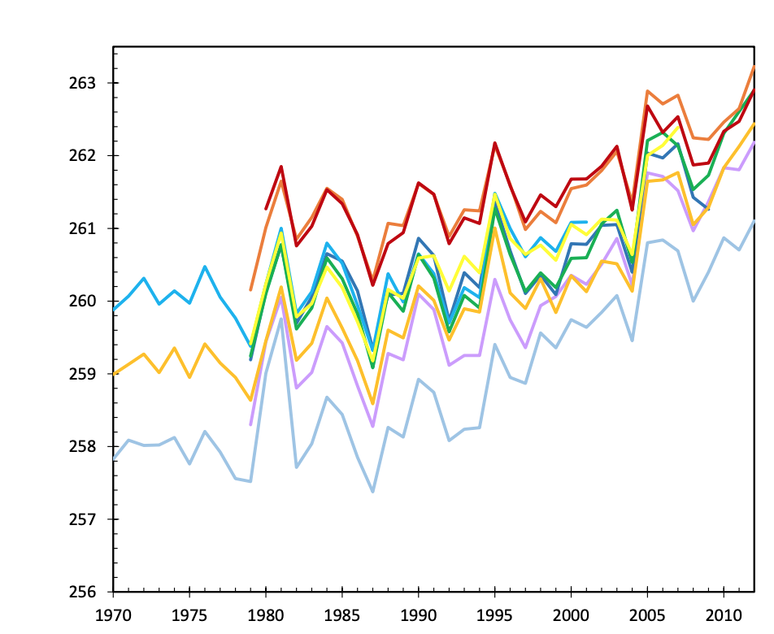
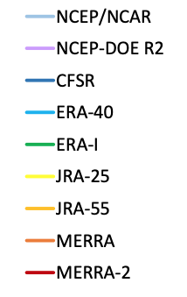
Polar biases in reanalyses
Air temperature
Land T2M (Candidate system - previous FP; K)
Mean for October 2019 to Jan 2020
Annual T2M (K) 70ºN - 90ºN
Cullather et al. (2016; IARPC white paper)
Koster et al. (2019; GMAO science brief)

Slide 17
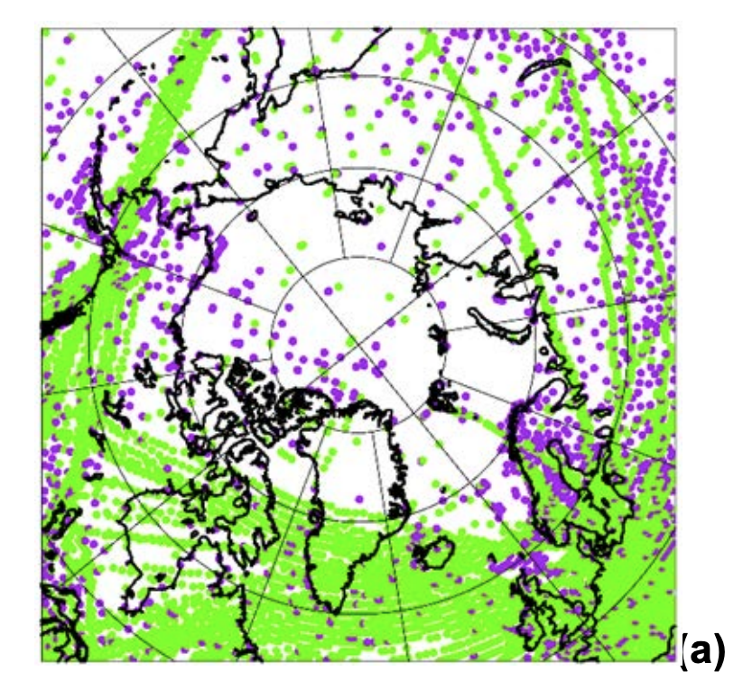
PolarMERRA: goals
In-situ observations
(MERRA; 00UTC 19-July 2007)
Polar-focused 2000’s reanalysis for scientific use
Improved atmospheric and, potentially, land conditions
  Temperature, precipitation, snow cover
  Increased polar resolution
    Several possible downscaling techniques
  Robust evaluation framework
    Minimize anecdotal performance evaluations
Air Land & Marine
Looking for insights, observations, thoughts on boreal processes/datasets for potential inclusion.

