Slide 1
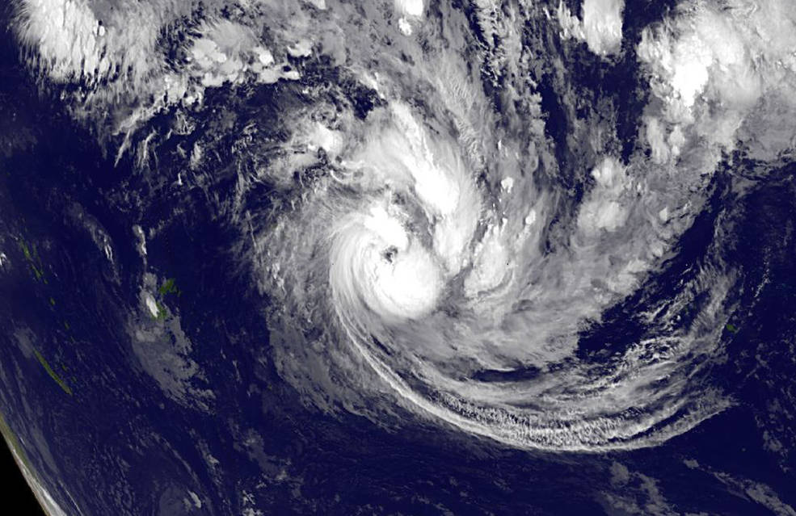


Exploring Earth Science Applications using Word Embeddings
Derek Koehl, Udaysankar Nair, Rahul Ramachandran*, Carson Davis, Manil Maskey
EGU 2020
May 7, 2020
Notes:
IMPACT is an interdisciplinary team situated in NASA’s Earth Science Data System Program. IMPACT improves processes and develops best practices that maximize the effectiveness and efficiency of Earth science data management and stewardship. Our efforts broaden access to Earth science data, expanding its use by researchers both inside and outside of NASA. We rapidly prototype the latest technical and management concepts in order to optimize their application to Earth science data.

Slide 2
Background and Presentation Outline
Word embedding are numeric representations of text which capture meanings and semantic relationships in text. Embeddings can be constructed using different methods such as One Hot encoding, Frequency-based or Prediction-based approaches. Prediction-based approaches such as Word2Vec word embeddings capture the underlying semantics and word relationships in a corpus.
We describe results from two different application experiments utilizing word embeddings constructed from a corpus of over 20,000 journal papers using Word2Vec.
Experiment 1
Explores the analogy prediction performance of word embeddings built from the Earth science journal corpus and trained using domain-specific vocabulary.
Experiment 2
Utilizes the word embeddings to augment classification performance for metadata keyword tagging

Slide 3
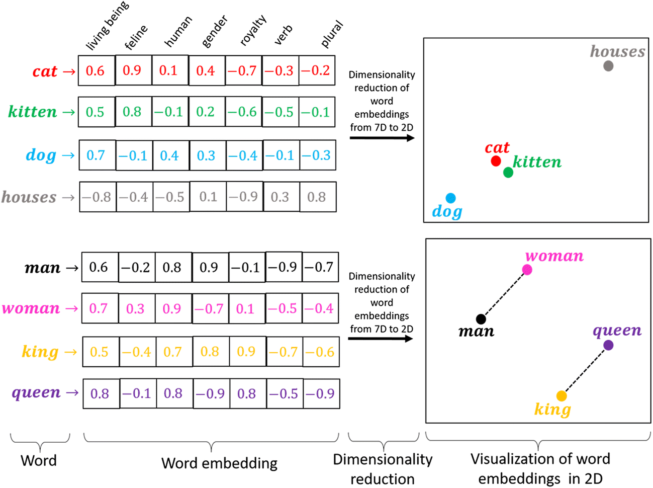
Word Embeddings: An Overview
Numerical representation of text
Maps words or phrases from the vocabulary to vectors of real numbers
Can be used for:
  compact and machine-readable representation of words in a corpus
  performing statistical analysis on corpus
  embedding text as input into ML models
Types of word embeddings:
  Count Vectors (CV)
  Tf-idf Vectors (TF)
  Word2Vec (W2V)
  Latent Dirichlet Allocation (LDA)
Utilized Word2Vec: trained on a corpus of ~23,000 Earth science journal articles
Image: Rozado, 2019
Notes:
Green: analogous to known thermoelectrics;
Red: analogous to thermoelectric properties;
Purple: analogous to thermoelectric materials and applications

Slide 4
Experiment 1
Analogy Prediction

Slide 5
Research Problem and Question
Non-domain specific word embeddings have been shown to predict general language analogies (e.g. king : man :: queen : ?) with reported accuracies exceeding 80%¹.
However those accuracies are not evenly distributed across all analogy subtypes. The two analogy categories in which domain knowledge resides, the lexicographic and encyclopedic, have shown respective average accuracies of 11% and 26%².
This research experiment posed the question: can a domain-specific word embedding better predict domain-specific analogies in the lexicographic and encyclopedic analogy categories as compared against the reported accuracies achieved by non-domain specific word embeddings?
¹ J. Pennington et al., 2014.
² A. Gladkova et al., 2016.

Slide 6
Domain Analogy Prediction: An Exploration
Can word embeddings trained on a domain-specific corpus utilizing domain-specific vocabulary outperform in domain-specific analogy prediction as compared to word embeddings trained on a non domain-specific corpus predicting non domain-specific analogies?
carbon dioxide:acidic :: ammonium:alkaline
vs.
horse:stable :: chicken:coop
Notes:
Using the Gladkova results as a baseline, would a domain-specific corpus perform better at predicting domain-specific analogy relationships?
A small pilot test was concieved.

Slide 7
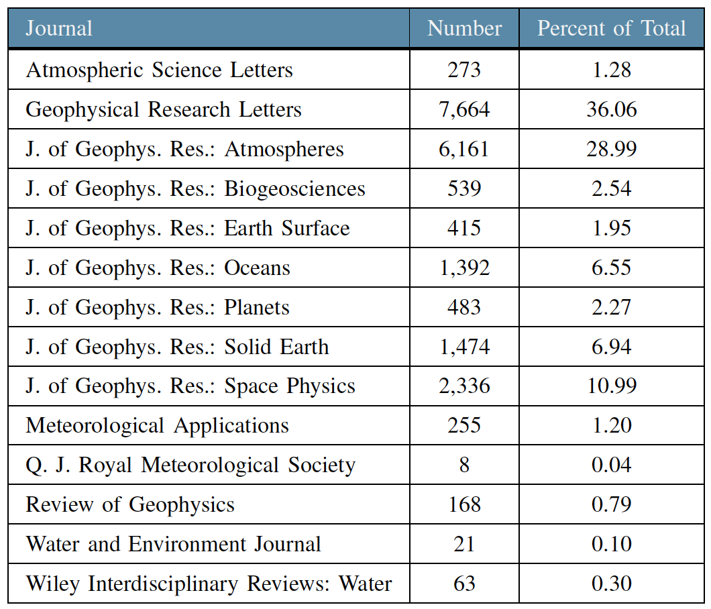
Domain Analogy Prediction: An Exploration
Domain corpus: 21,380 Earth science articles comprising 81 million words
Domain vocabulary:
Global Change Master Directory (GCMD) keywords
Semantic Web for Earth and Environmental Technology (SWEET) ontology
Notes:
From the GCMD and SWEET vocabularies, compound phrases were identified and tokenized with the corpus as a pre-processing step.

Slide 8
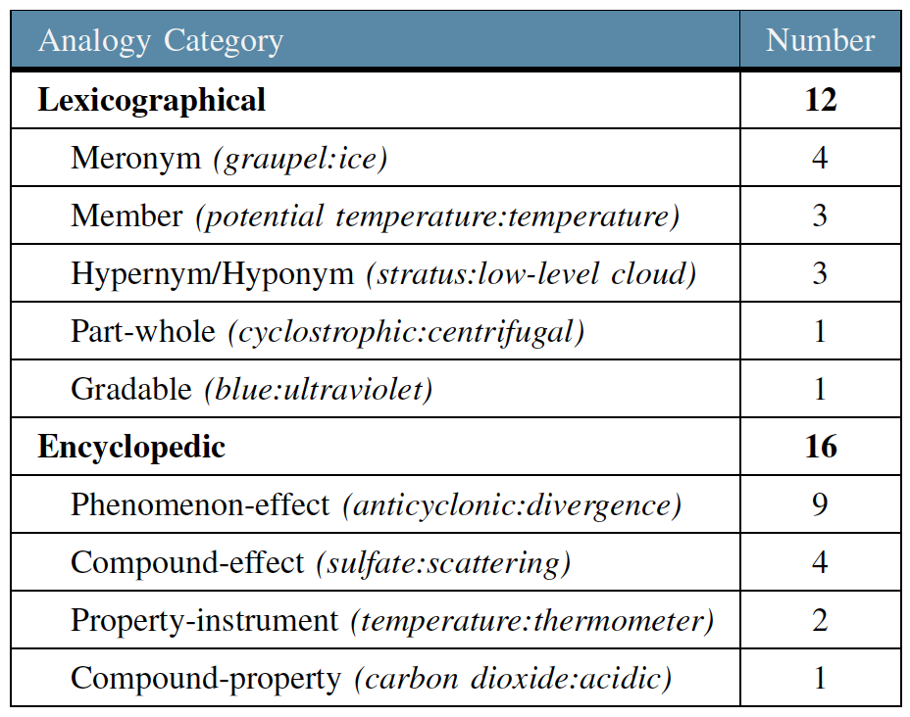
Domain Analogy Prediction: Analogy Test Set
The exploratory set of Earth science analogies categorized using a classification framework similar to the one employed by the Bigger Analogy Test Set.
Allows category-level comparison
Laying the groundwork for an Earth science analogy test set
Notes:
The exploratory set was small as this was a proof-of-concept effort.
We categorized the analogy questions to the sub-category level as an exploratory exercise; the analysis of the accuracy was constrained to the category level.

Slide 9
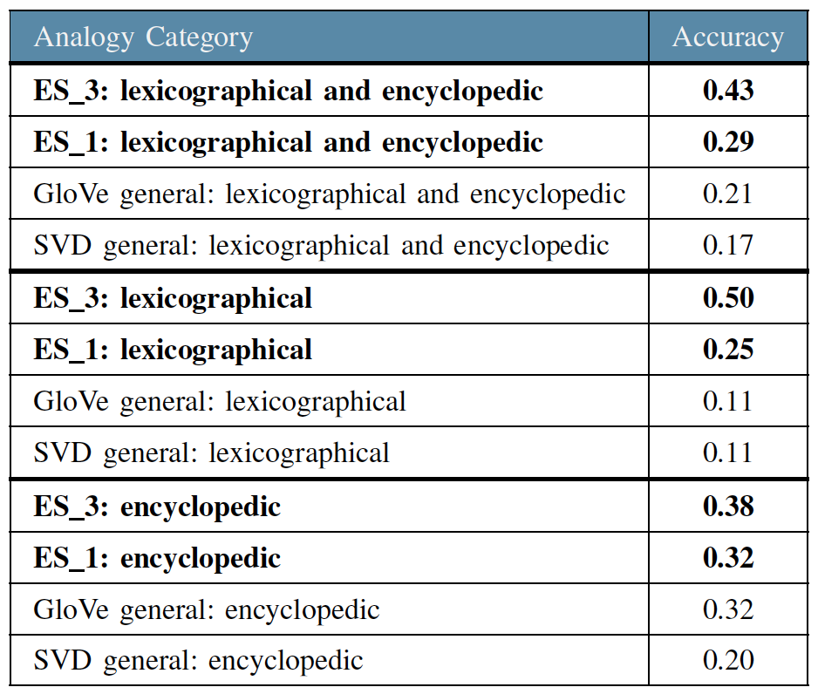
Domain Analogy Prediction: Accuracies
front : temperature :: dryline : ?
Accuracy tiers:
ES_1 – The fourth term of the analogy is the top prediction
ES_3 – The fourth term appears in the top three predictions
Comparison accuracies:
GloVe general – reported by Gladkova et al. using the GloVe model
SVD general – reported by Gladkova et al. using the Singular Value Decomposition model
Notes:
front : temperature :: dryline : humidity

Slide 10
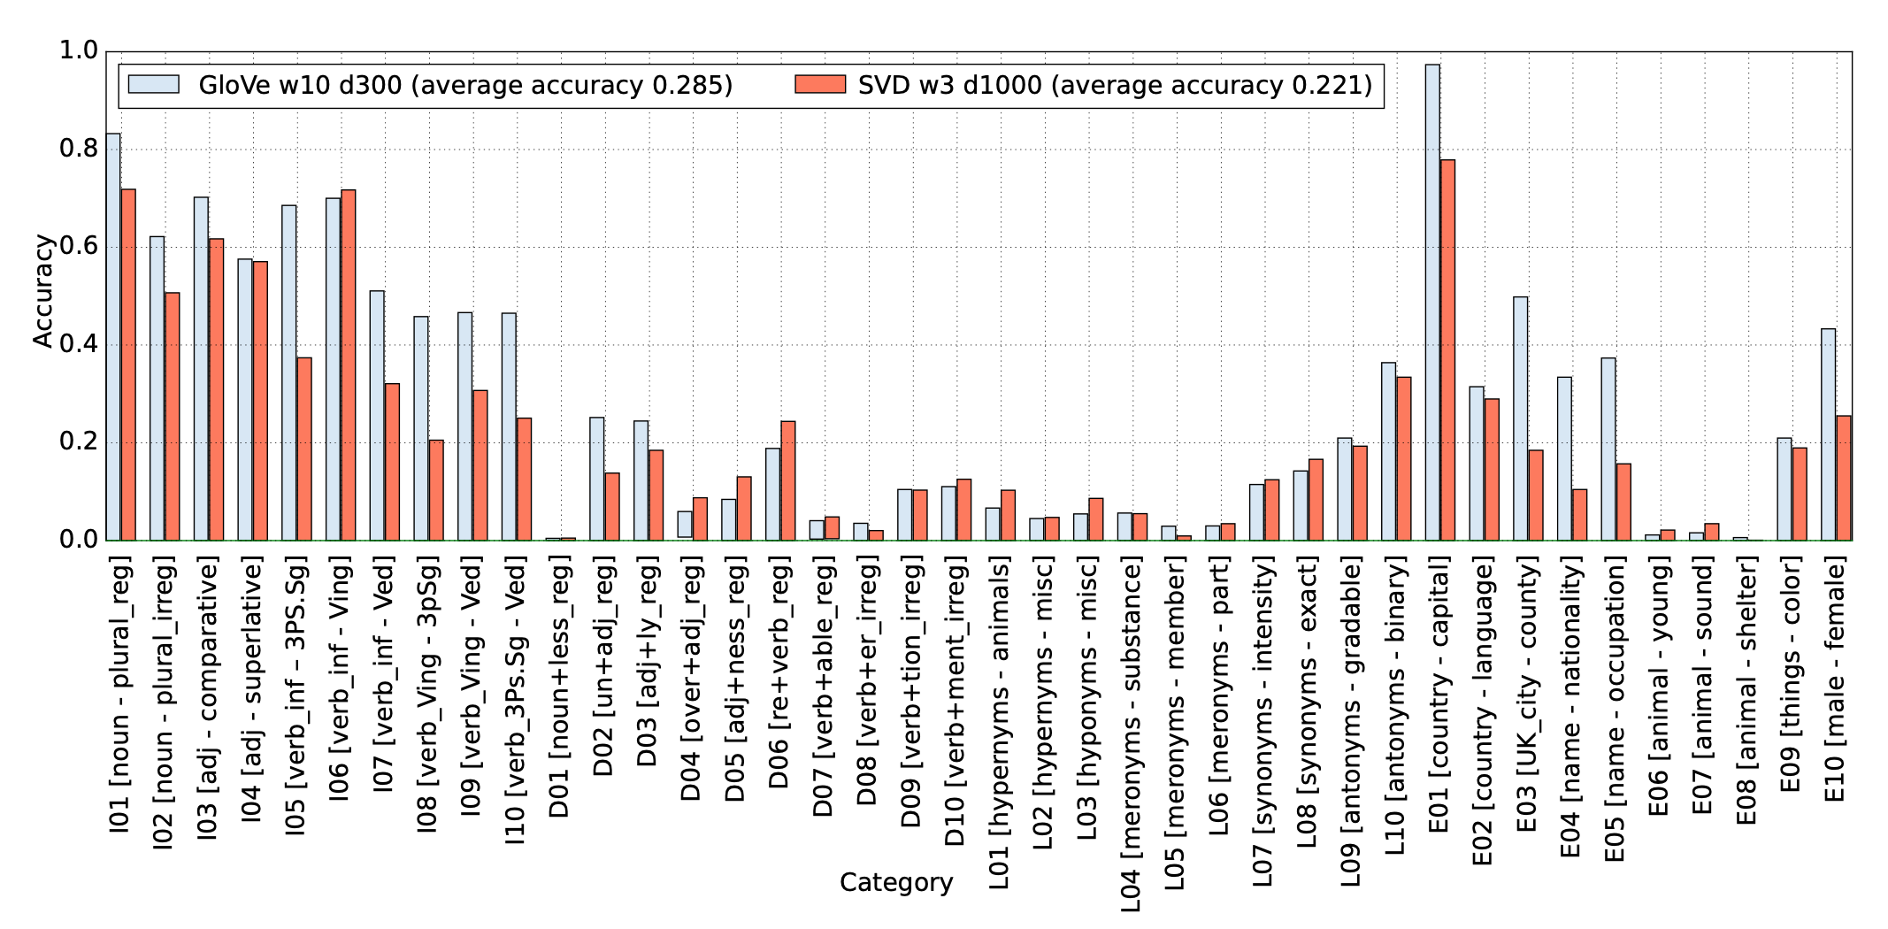
Domain Analogy Prediction: Comparisons
ES_3: lexicographical – 0.50; encyclopedic – 0.38
ES_1: lexicographical – 0.25; encyclopedic – 0.32
Underlying chart: Gladkova et al., 2016

Slide 11
Experiment 2
Metadata Keyword Tagging

Slide 12
Research Questions
Can machine learning be leveraged to accurately assign science keywords to metadata records in an automated, objective, and consistent manner?
  Train a model to accurately assign science keywords based on the dataset abstract
Does the use of word embedding generated from the science corpus improve the performance of the model?

Slide 13
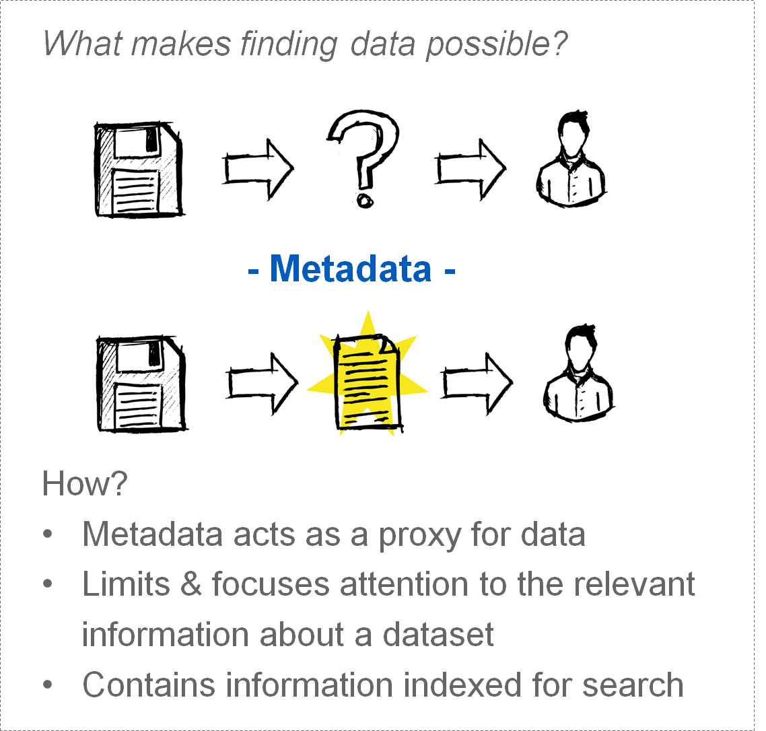

NASA’s Earth Science Data Catalog
NASA’s growing collection of Earth science datasets are described by metadata records stored in a database called the Common Metadata Repository (CMR)
Users can search the CMR directly via an API to to find and access Earth science data
The CMR also serves as the backend for search interfaces such as the Earthdata Search Client
Notes:
Metadata records contain many important specs about a dataset and are leveraged for search

Slide 14
Metadata of Focus
This research utilizes the following pieces of metadata:
1
Title: formal title of the dataset.
3
Science Keywords: controlled vocabulary field containing keywords relevant to the scientific purpose/content of the dataset. Science keywords aid in data discovery. For example, the Earthdata Search Client uses science keywords for:
faceted search
search relevancy rankings
2
Abstract: a brief but comprehensive description of the dataset. Comparable to a journal article abstract.
The CMR leverages the Global Change Master Directory (GCMD) science keyword taxonomy, which is a hierarchical set of controlled science keywords.
Notes:
Help ensure Earth science data, services, and variables are described in a consistent and comprehensive manner
Facilitate data search and discovery
Periodically analyzed and expanded/updated for relevancy in response to user needs
Science keywords are manually assigned to metadata records

Slide 15
Need
Assigning science keywords is currently a manual process, which is prone to human error and inconsistencies:
Metadata managed across a network of multiple data centers (i.e. keywords not assigned by a central entity)
Keywords may be assigned by non-subject matter experts (SMEs)
SMEs assigning keywords may not be familiar with GCMD keywords or how keywords are used in search engines
Science keywords are meant for data discovery across a broad range of users and may not encompass highly specific scientific variables
Notes:
Keywords are vital to data discovery
Need a reliable automated way to tag metadata with keywords

Slide 16
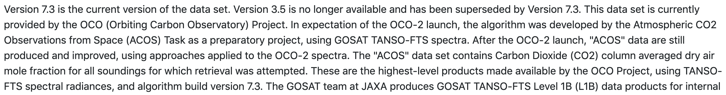
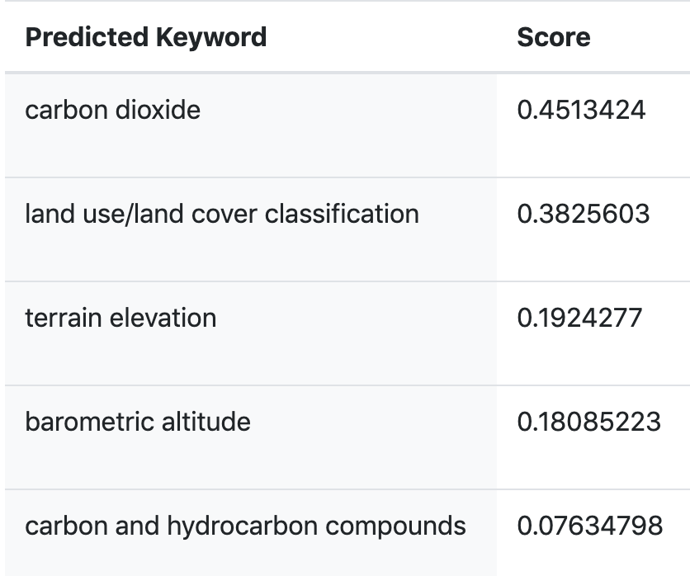
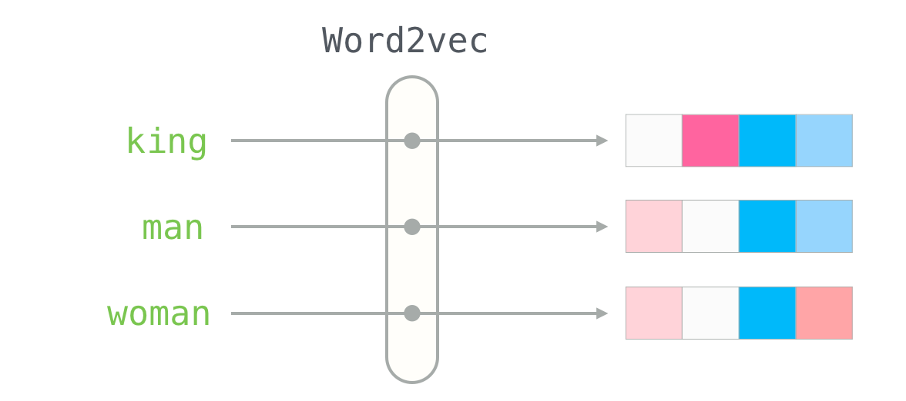
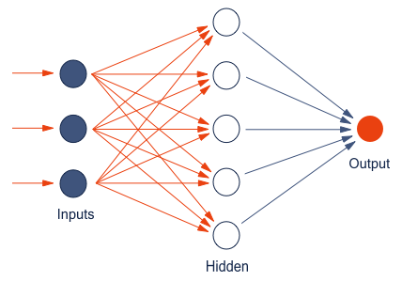
Approach
Dataset Abstract
Word Embeddings
Classifier
Suggested Keywords
Notes:
word2vec is also a neural network, this result of the word2vec layer is fed into a 2nd neural network

Slide 17
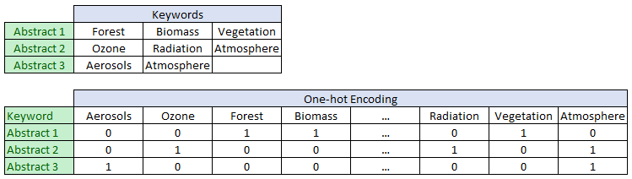
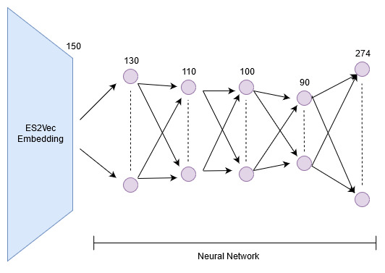
Classifier
Training data labels: Each dataset has human assigned earth science keywords, which is converted to one hot vectors
Classifier: A Neural Network 4 Fully connected layers with word embeddings as input and one hot keywords as output
Notes:
A classifier is a function that is used to assign class labels to particular data points.
Examples
given an email, is it spam or not?
given an image of an animal, Is it a cat or not cat?
widely used types of classifiers:
Logistic regression
Uses Logistic function to predict probability of a sample belonging to a class
bayesian models
Models based on bayes theorem
Support Vector Machines
Finds a hyperplane in the feature space that best separates the data points between classes.
Decision Trees
Uses trees as a decision model and classifies data points according to the leaves of the tree
Neural Networks
(this slide)

Slide 18
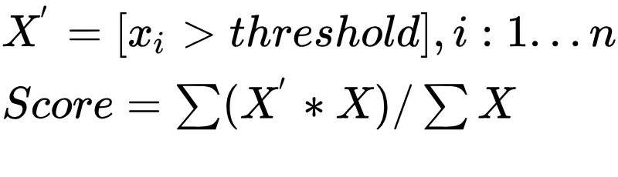
Classifier Training & Accuracy Metric
Trained on a total of 2,598 abstracts and keywords from the following NASA data centers:
  GHRC
  ORNL
  GODDARD
Training split: 2078, validation split: 520
Total number of unique science keywords: 274
Accuracy score is defined as the percentage of the number of keywords correctly predicted over the total number of true keywords. Threshold = 0.15, Empirically chosen
Notes:
Unique keywords from the 3 DAACs
word2vec is used to extract word embeddings from the abstracts.
word2vec is trained separately and used as a black box during both training and inference cycle.
predicted keywords in combination with the extracted keywords is used to calculate the error. the error is then used to update the weights between layers in the classifier.

Slide 19
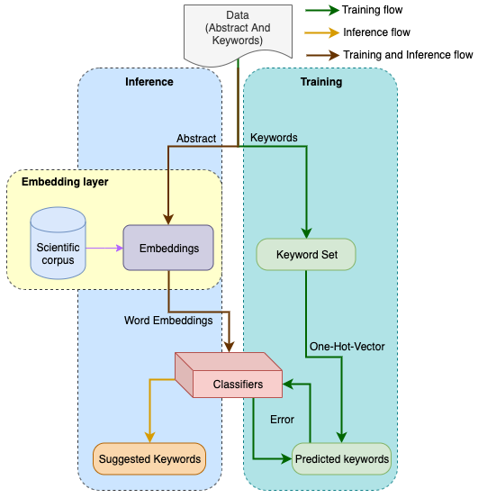
GCMD Classifier Tool
Tool input options:
  1. User selects metadata record from CMR (abstract is automatically extracted from the record)
  2. User provides abstract text
Abstract is passed through the word2vec to get word embeddings
Embeddings are passed to the classifier to get keyword predictions
Any keyword predictions with score higher than 0.15 is displayed as recommendation for the given abstract
Tool Pipeline
Notes:
Pre-processing steps are performed on the corpus & abstracts
During training, keywords in the record are used as labels (classes) > targets for training the classifier

Slide 20
Models Compared
Embeddings
Classifiers
Count Vectors from Descriptions (CV)
Tf-idf Vectors from Descriptions(TF)
Word2Vec built from science corpus (W2V)
Latent Dirichlet Allocation from corpus (LDA)
Multi-class Logistic regression (LR)
Random Forest Classifier (RF)
Fully Connected Neural Network (FCNN)
LSTM Neural Network* (LSTM)
1D Convolutional Neural Network* (1DCNN)
Labelled LDA (LLDA)#
*when using word2vec as embedding for LSTM and 1D convolutional networks, word embeddings for each word in the description is used as input, as opposed to averaging the embeddings together for other methods.
#For LLDA, the predicted keywords are labels with top 5 probability score from the label distribution.

Slide 21
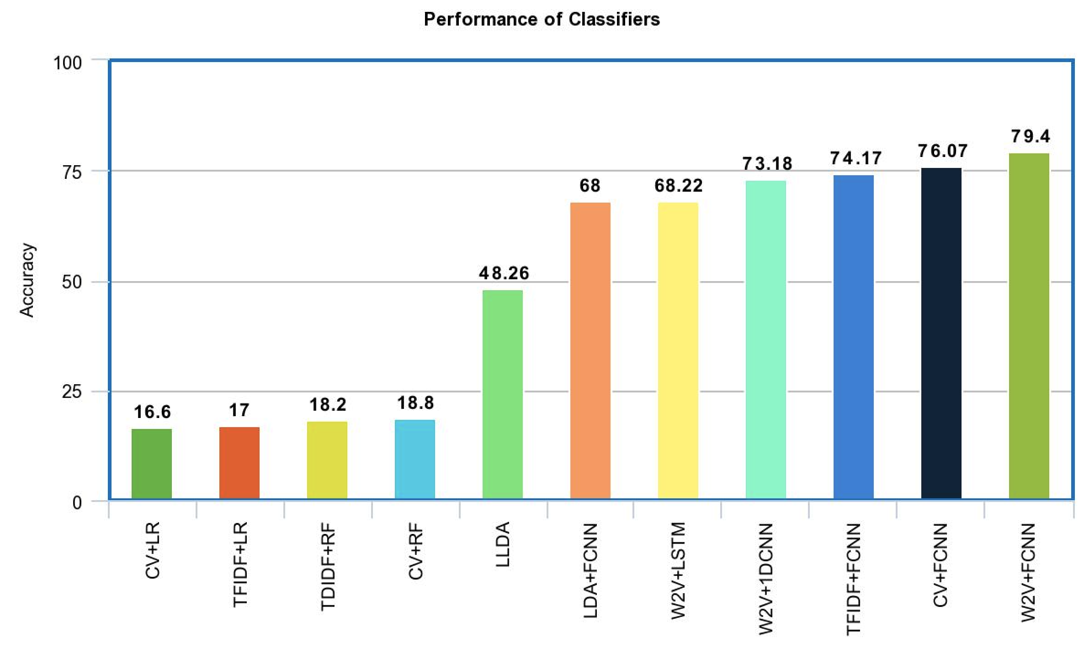
Performance
Fully connected neural network with word embeddings from Earth science corpus performed the best.

Slide 22
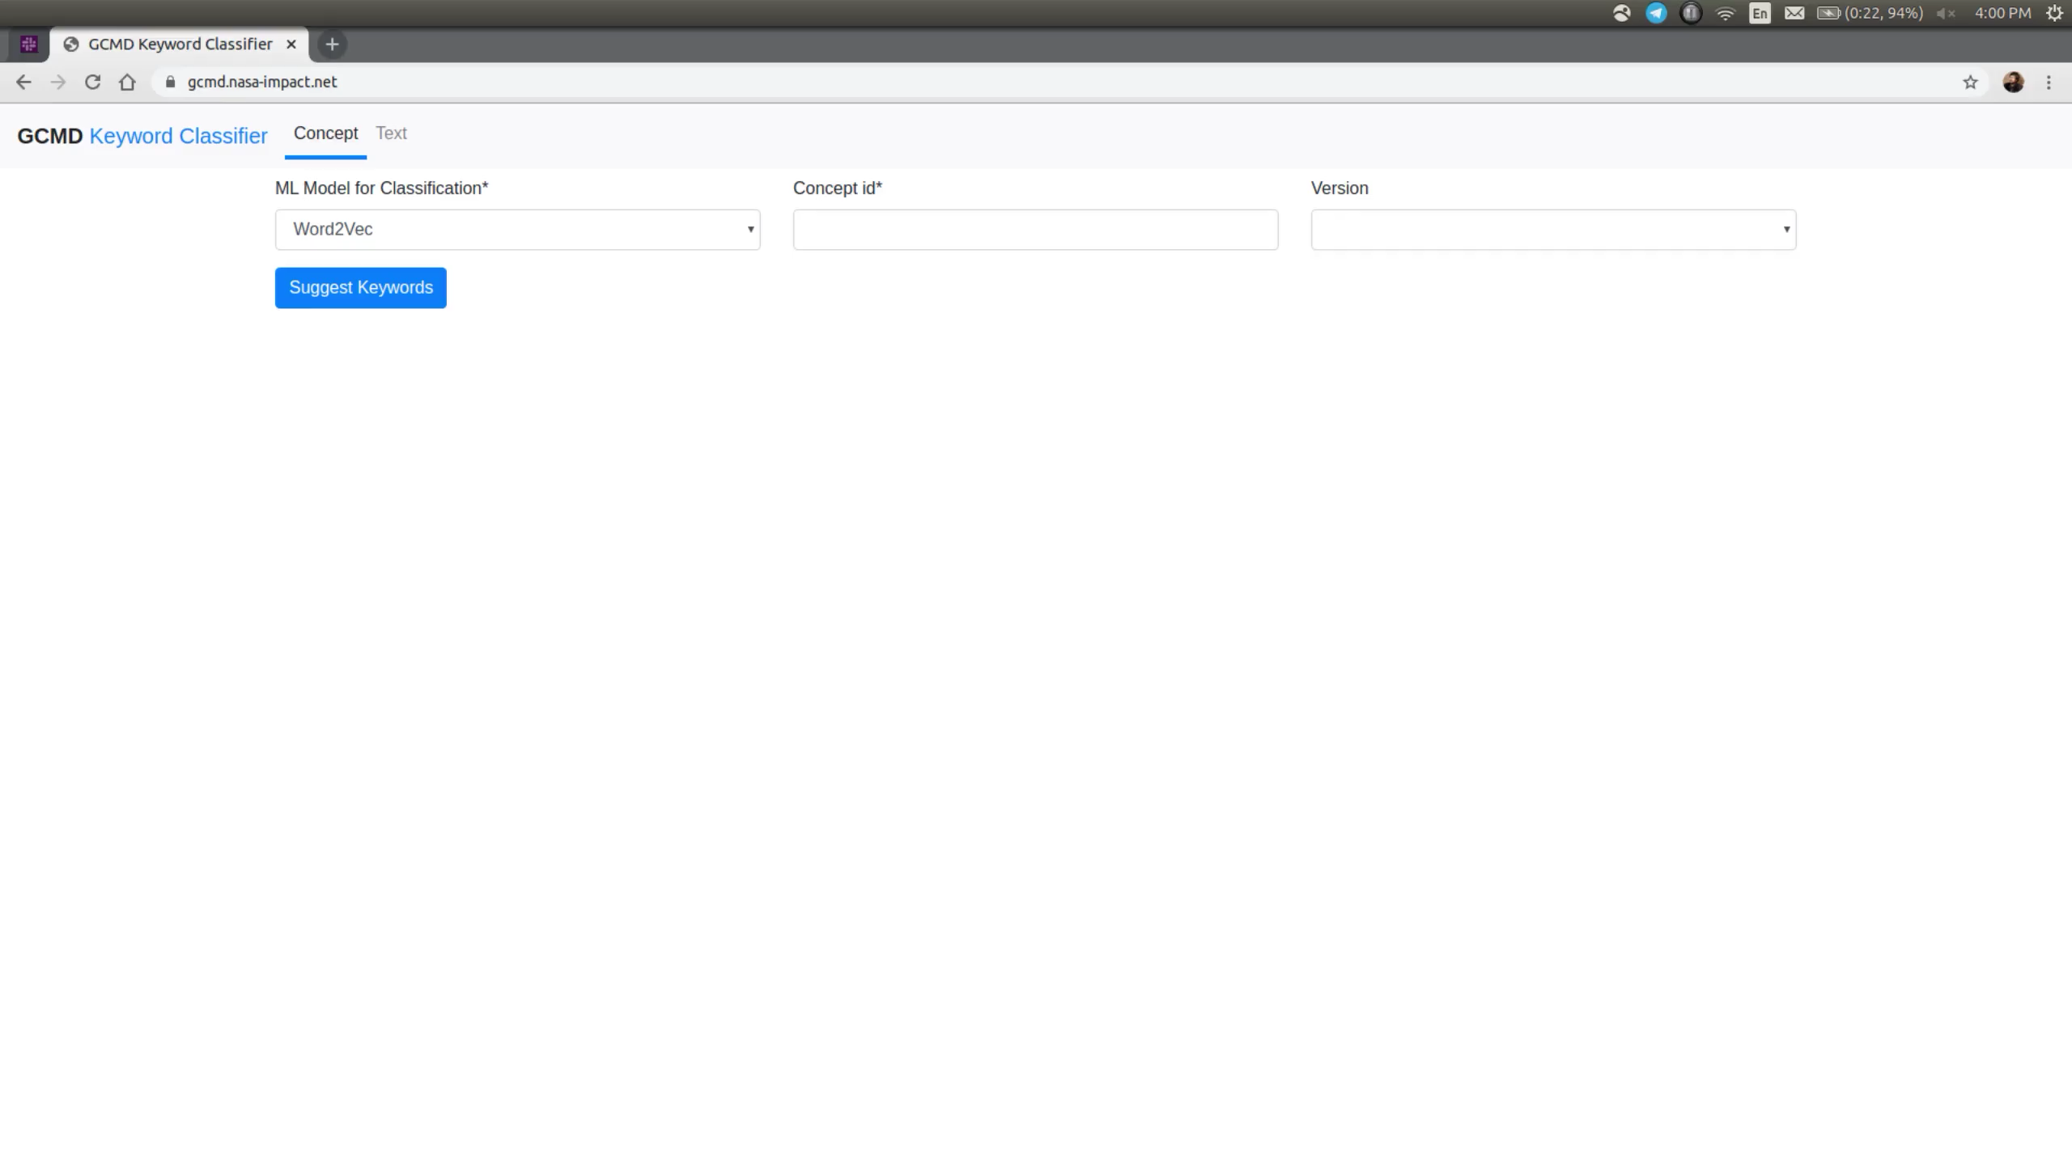
Tool Demo: https://gcmd.nasa-impact.net/

Slide 23
Questions?
Feel free to contact:
Rahul Ramachandran
rahul.ramachandran@nasa.gov
Citations:
A. Gladkova et al., “Analogy-based detection of morphological and semantic relations with word embeddings: what works and what doesn’t," In Proceedings of the NAACL Student Research Workshop, 2016.
J. Pennington et al., “Glove: Global Vectors for Word Representation,” in Proceedings of the 2014 Conference on Empirical Methods in Natural Language Processing (EMNLP), 2014.
D. Rozado, “Using Word Embeddings to Analyze how Universities Conceptualize ‘Diversity’ in their Online Institutional Presence,” Society 56, 256–26.

