Slide 1
Modeling Radiation Sources for Experimental Validation
Juliana Simon
Mentors:
Sheila A. Thibeault
Martha S. Clowdsley
2020 Spring NIFS Research Symposium

Slide 2
Challenge
Modeling lab setups computationally to check experimental results.
Previous work done exposing various materials to neutron source – interested in secondary production on planetary surfaces.
Ultimately adapt to modeling proton beam (Solar Particle Events) to look at polyethylene shielding in our radiation protection garments – use existing datasets.

Slide 3
Objective
Macro: To determine the shielding effectiveness of materials in space radiation environments.
Micro: To validate experimental data computationally and maintain a model that can swap out material input for each source type. If it performs reliably, can take the place of some experimental work.

Slide 4
Approach
What? Extensive research and preparation of physical parameters in MCNP6 (Monte Carlo N-Particle transport code) to accurately mimic real conditions.
How?
  Material calculations – chemical compositions and mass ratios of all material combinations including detector components.
  Energy distribution of source weighted by detector efficiencies.
  Tallies – what information we want returned:
    F6: Energy deposited over a cell (detector material) – neutrons
    F8: Energy distribution of pulses created in detector – secondary particles
  Geometry – adapting all materials into proper coordinates.

Slide 5
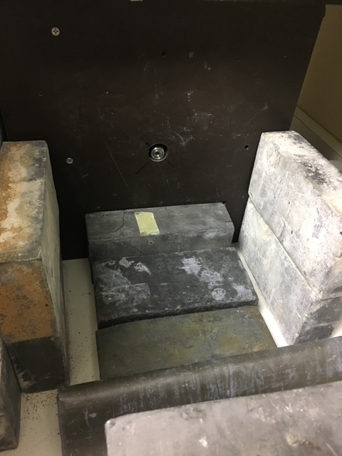
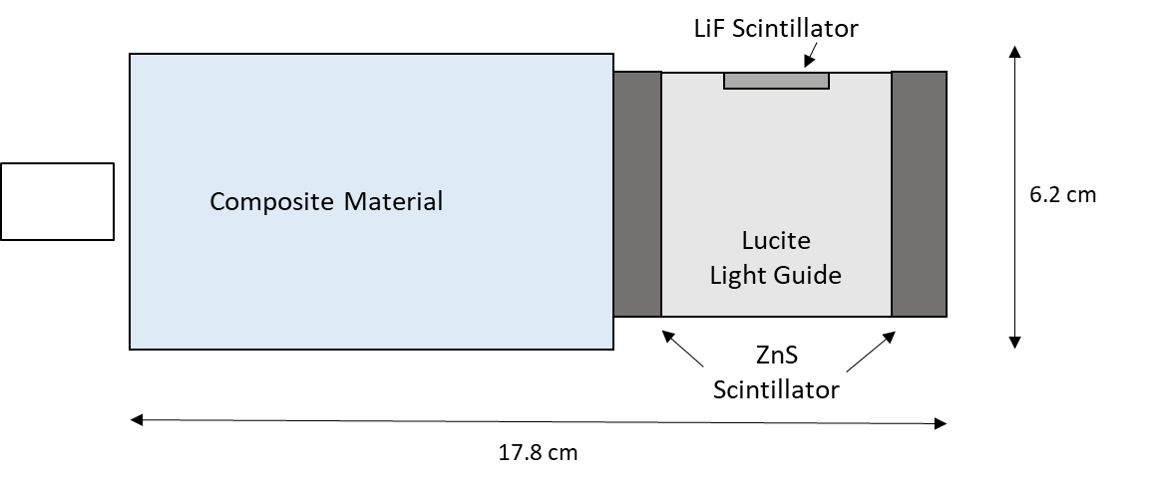
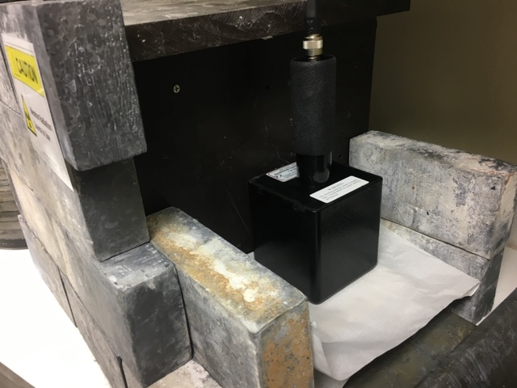
Approach
Neutron Source
Left: Basic geometry of model adapted to MCNP6 coordinate system.
Images on Right: Neutron source and detector.

Slide 6
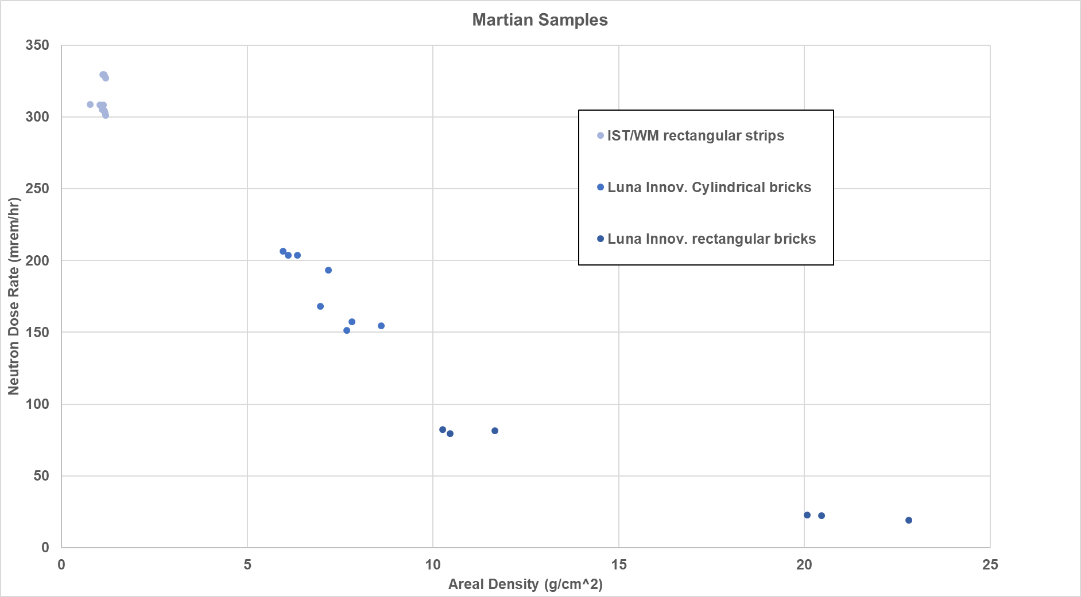
Results
Preliminary results using F6 tally gave 66% error from
experimental results.
Too soon for results from
updated model using F8
tally, hoping for similar
curve at a lower percent
error.

Slide 7
Analysis/Summary
F6 gave us energy deposited, but clearly is not the right way to approach the problem.
F8 is a more accurate way to obtain the total neutron energy deposited by adding up the pulse height distribution of the reaction products (alphas, tritons, and recoil protons) – unfortunately, our results to show this are not yet ready!
Proton detection method for next phase (Summer 2020).

Slide 8
Next Steps
Get results from new model, wrap up neutron work.
Determine detection method for proton model, use existing datasets for polyethylene target beam exposure to validate.
Submit paper for review.

Slide 9
Acknowledgements
Robert C. Singleterry, NASA Langley
AES (Advanced Exploration Systems) RadWorks Program

