Slide 1
ESPUR Spring 2020 Internship
Exit Presentation
Peter Strohmaier
Oregon State University, B.S. Mechanical Engineering (Dec. 2020)
Dr. Christopher J. Wohl
Advanced Materials and Processing Branch, Research Directorate
Bryce L. Horvath
Vehicle Analysis Branch, Systems Analysis and Concepts Directorate
2020 Spring NIFS Research Symposium

Slide 2
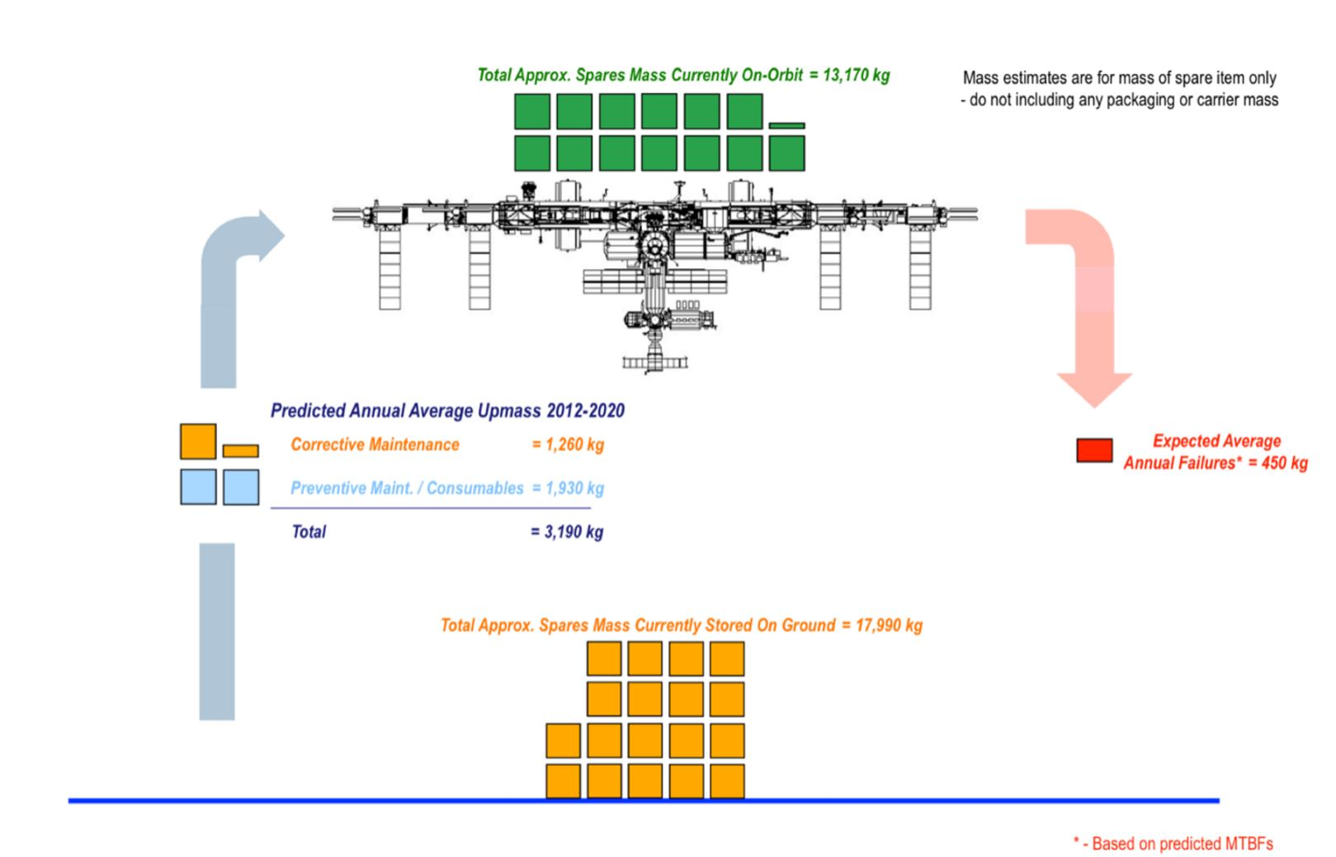
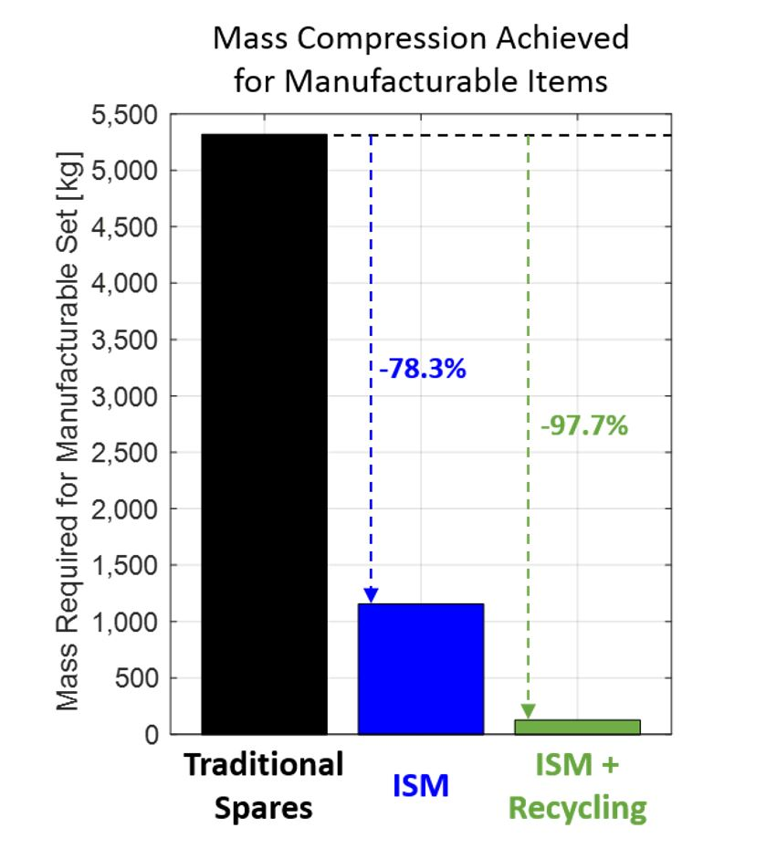
Challenge
ESPUR (Previously FIReFLIES): Enabling Sustained Presence Using Recyclables
Developing novel materials for in-space additive manufacturing
Enabling long-endurance space travel through rapid component manufacturing and reusability
In-space manufacturing and recyclable feedstocks present significant reductions in payload mass costs and spare part requirements
A. C. Owens and O. L. de Weck, “Systems Analysis of In-Space Manufacturing Applications for the International Space Station and the Evolvable Mars Campaign,” AIAA SPACE 2016 Forum, vol. AIAA 2016-5394, Sep. 2016.

Slide 3
Objective
Goals for ESPUR:
Develop advanced polymer materials and synthesis processes for 3D printing applications
Work with researchers at Marshall Space Flight Center to apply this research
Introduce new transformative research practices
Spring 2020 Internship Session Goals:
Develop a coating material with properties favorable for filament extrusion
Demonstrate “click chemistry”
Perform scale-up syntheses of the material
Characterize the thermal, rheological, and spectral properties

Slide 4
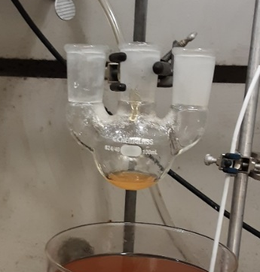
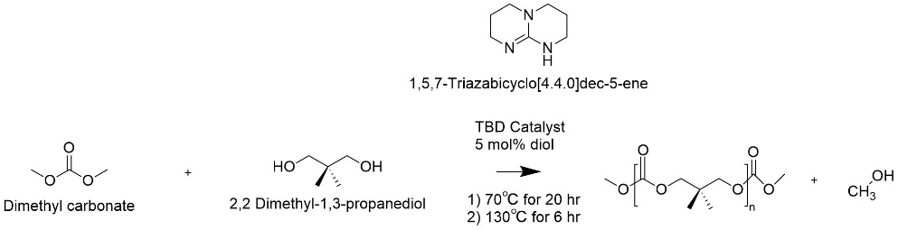
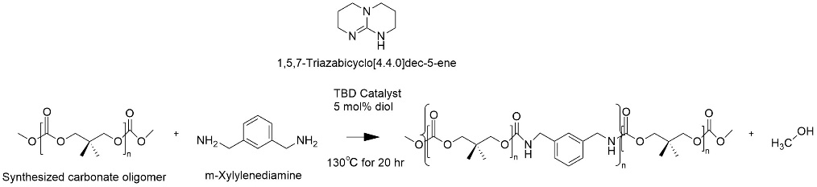
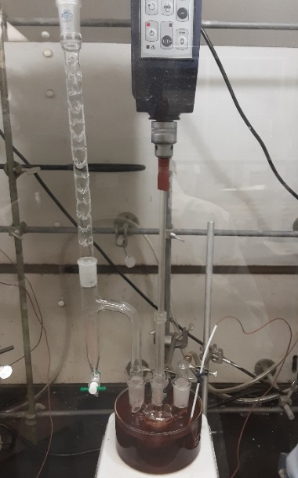
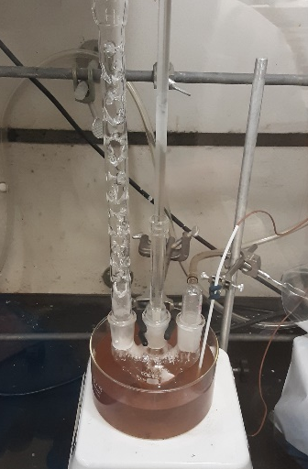
Approach
Polycarbonate (PC) Oligomer Synthesis:
CoPoly(Carbonate Urethane) [CPCU] Synthesis:
Two step polycondensation reaction
DMC:NPG Reaction Ratios:
Synthesis at ratio 1:1 (PC:diamine)
CPCU: Associated Polycarbonate:
PKS-PCU1-R1
PKS-PCU2-R1
PKS-PCU3-R1
PKS-PCU4-R1
PKS-PCU5-R1
PKS-PCU6-R1
PKS-CPCUF1-R1
PKS-CPCUM1-R1
PKS-PC2-R4.5
PKS-PC4-R1.33
PKS-PC6-R1.5
PKS-PC8-R1.05
PKS-PC11-R10
PKS-PC12-R1.018
PKS-PC12-R1.018
PKS-PC12-R1.018
1.018:1 (scale-up)
1.05:1
1.33:1
1.4:1
1.5:1
1.6:1
2:1
3:1
3.84:1 (scale-up)
4.5:1 (Three)
10:1

Slide 5
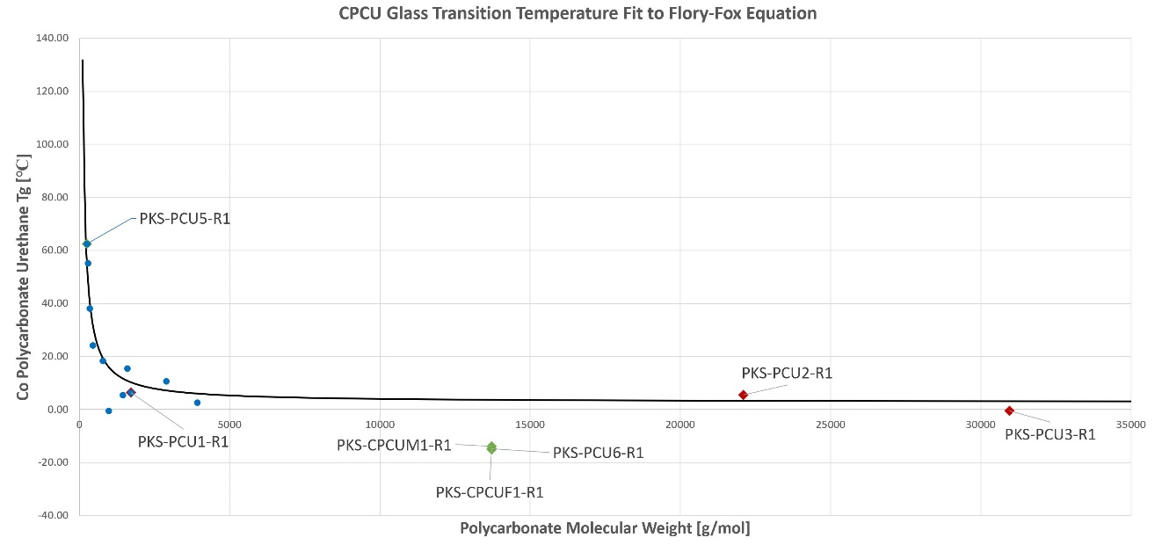
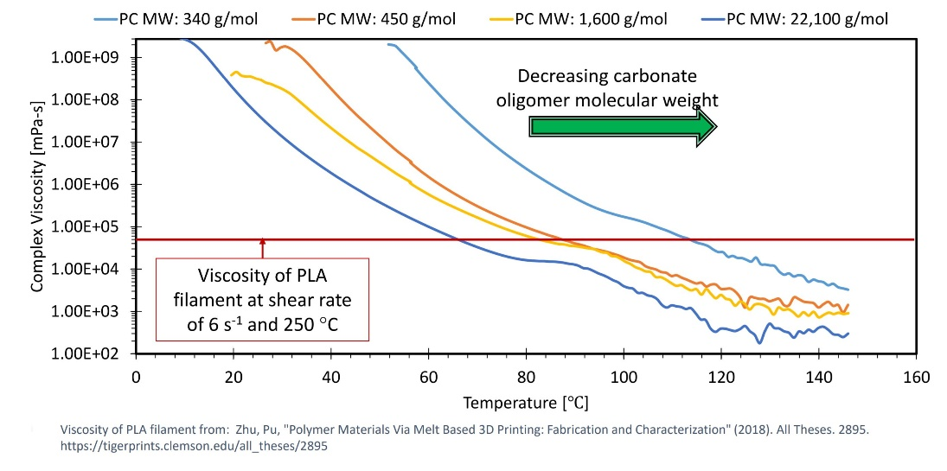
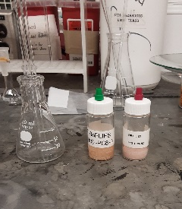
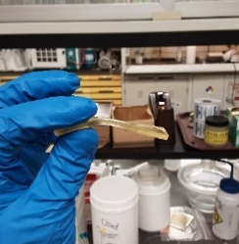
Results
Syntheses Conducted:
11 PCs
6 CPCUs
1 Furan and maleimide functionalized CPCU
IR and NMR Spectra, TGA, and DSC data for all samples
Rheological data collected for 6 CPCUs
Observations and Trends:
CPCUs are amber colored
CPCU1-4 are semi-solid, very pliable
CPCU5 is brittle (PC MW = 250.4 g/mol)
CPCU6 is elastic, retains shape (PC MW = 13712 g/mol)
SLE material rheology data comparable to PLA
Figure Credit: Christopher J. Wohl, NASA Langley Research Center

Slide 6
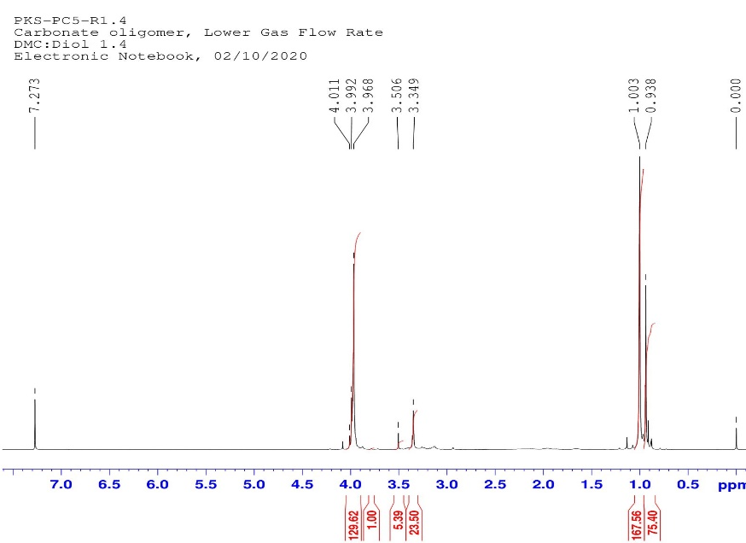
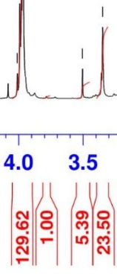
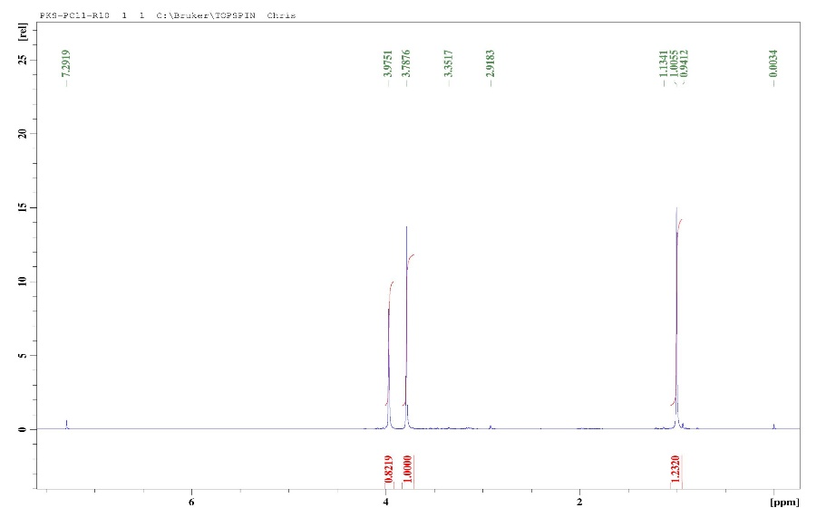
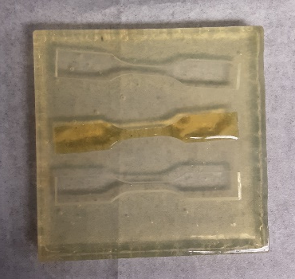
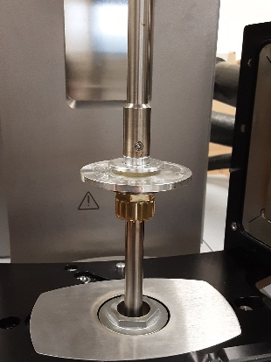
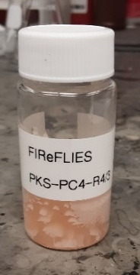
Analysis/Summary
NMR Analysis:
Below DMC:NPG ratios 3:1, ether groups appeared near 3.3-3.5 ppm
Carbonate peaks were mistaken for ether peaks
Incorrect molecular weights were used in stoichiometry for CPCU1-4
Moving Forward:
Molecular weights reasonable upon reanalysis
NMR analysis process confirmed for future syntheses
Carbonate End Group

Slide 7
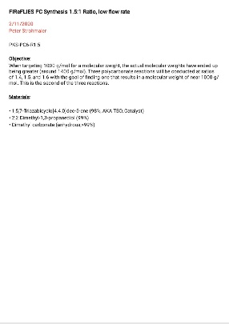
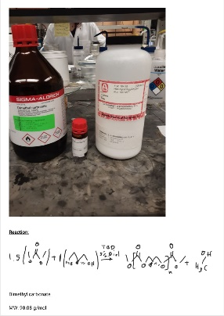
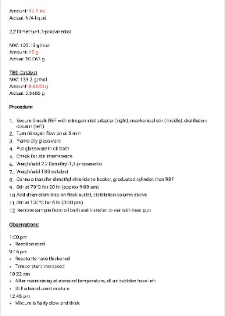
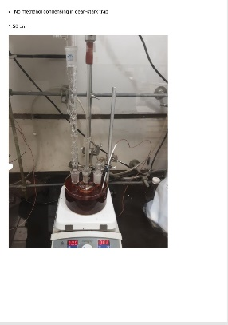
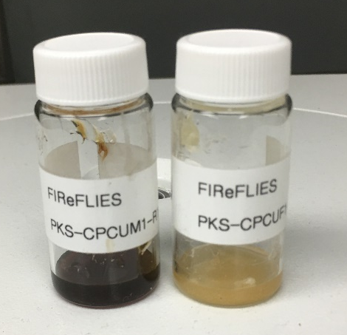
Next Steps/Outlook/Future Work
Near Future:
Test furan-maleimide functionalized CPCU coating
Integrate CPCU coating with epoxy microparticles
Arrive at an ideal carbonate/CPCU
Distant Future:
Characterize mechanical properties of the optimized material
Conduct a large-scale synthesis of bulk material (~500 g NPG)
Send material to MSFC and potential industry partners

Slide 8
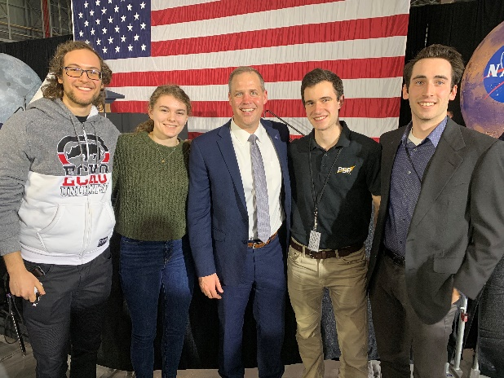
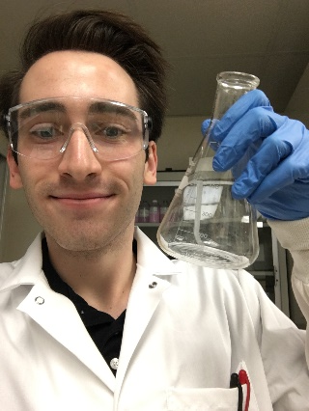
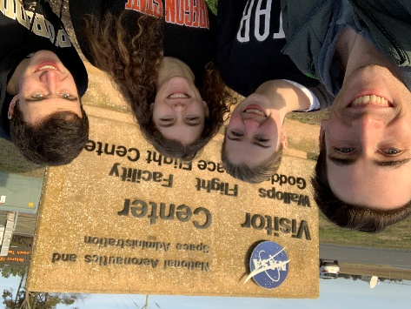
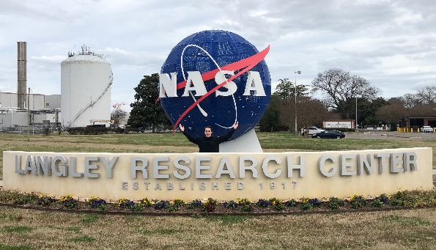
Acknowledgements
AMPB Research Staff and Interns
Dr. Joseph G. Smith
Dr. Keith L. Gordon
Dr. Frank L. Palmieri
Dr. Scott Zavada
Crystal Chamberlain
Dr. Lopamudra Das
NASA Langley Internships Team
Oregon Space Grant Consortium
Dr. Nancy Squires
Friends and Family

