Slide 1
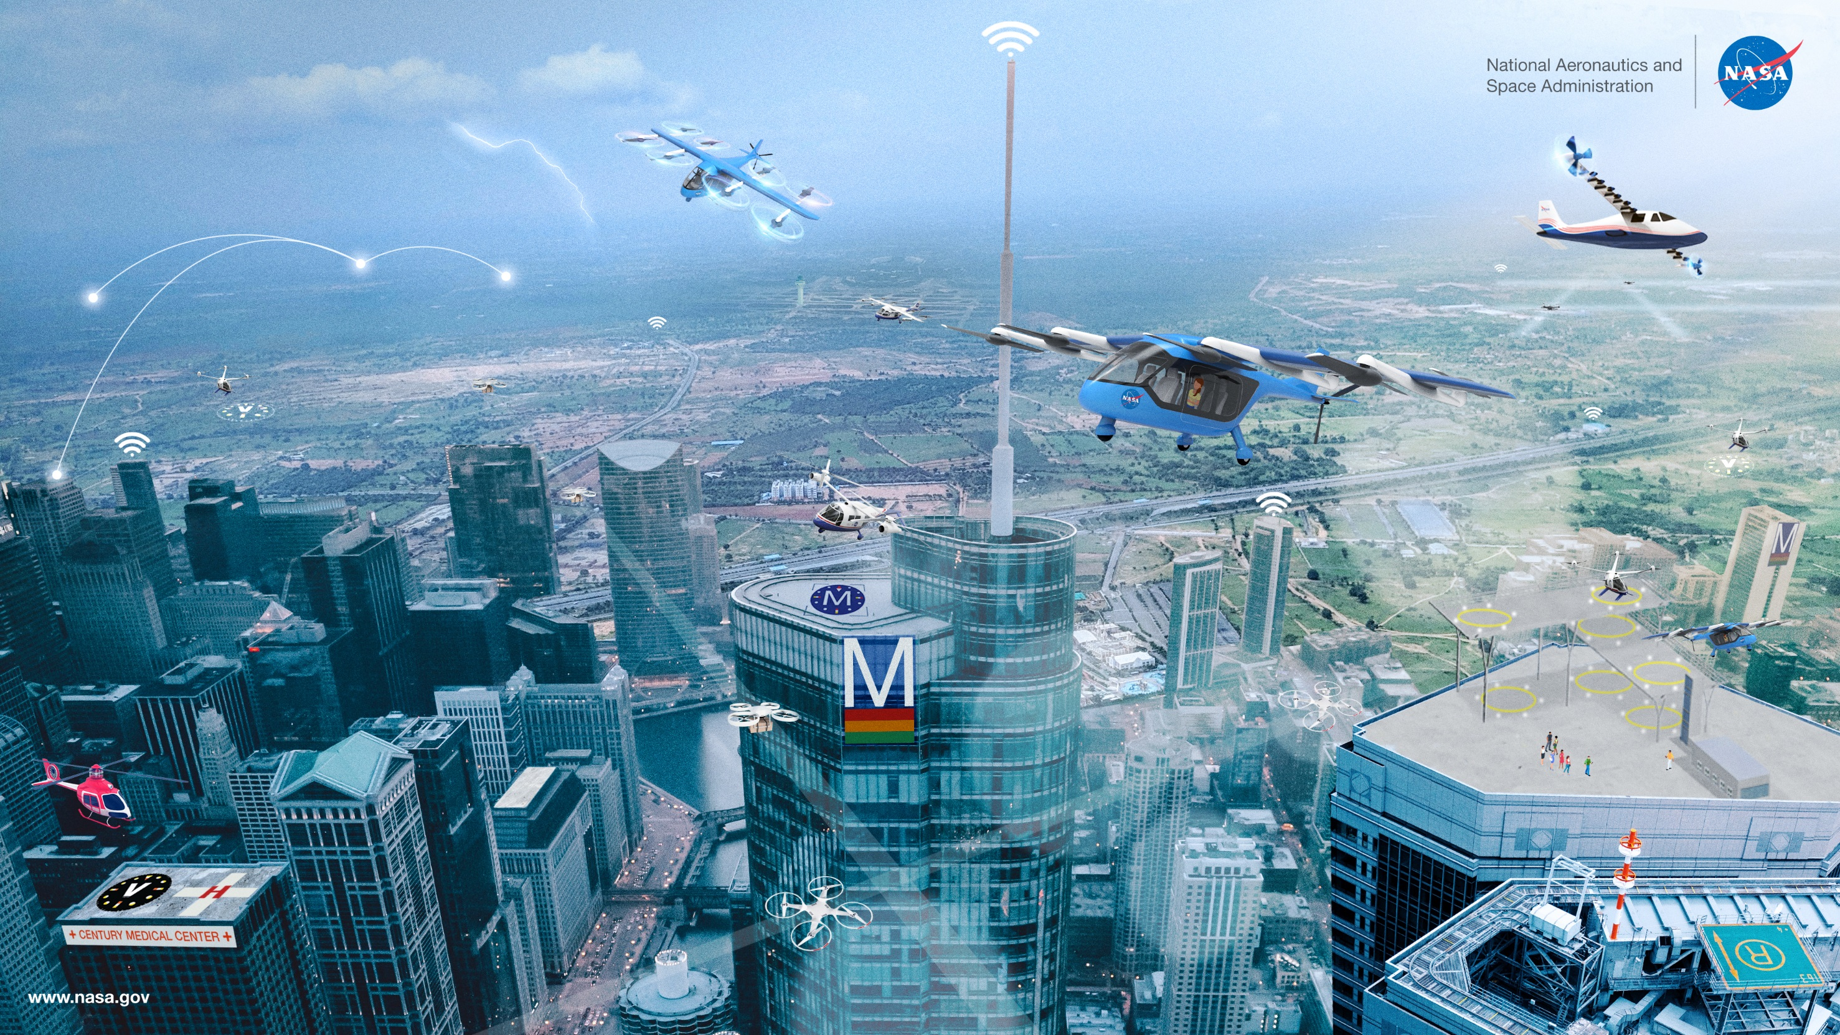
NASA Advanced Air Mobility (AAM)
Anna Cavolowsky and BreeAnn Stallsmith Project Administrators, NASA Aeronautics Research Institute

Slide 2
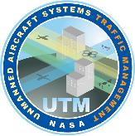
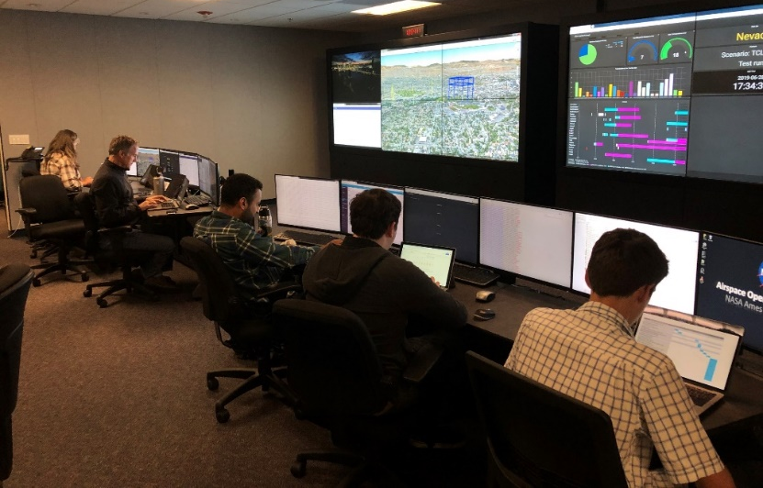
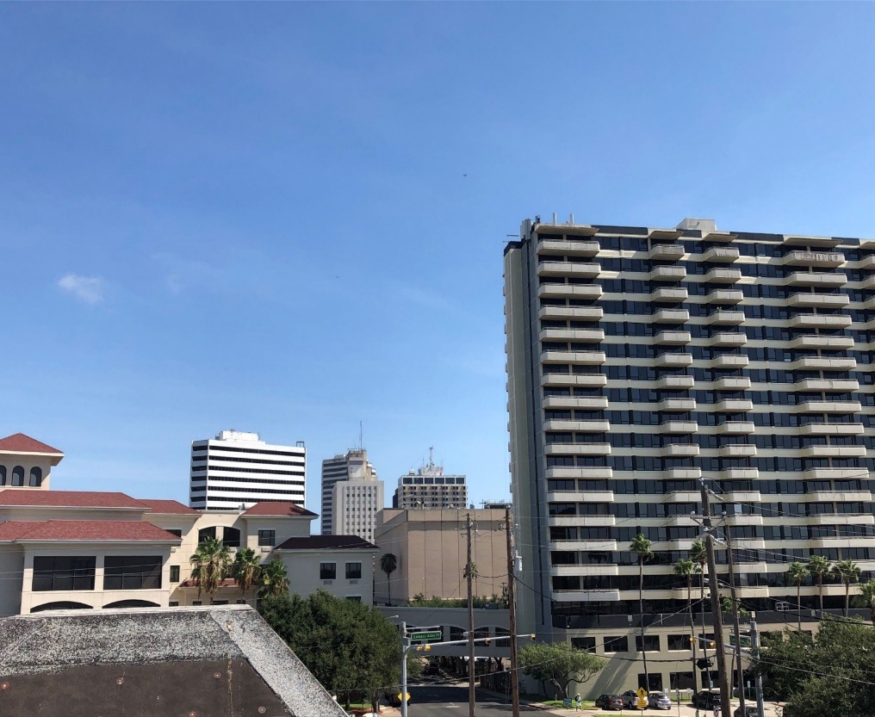
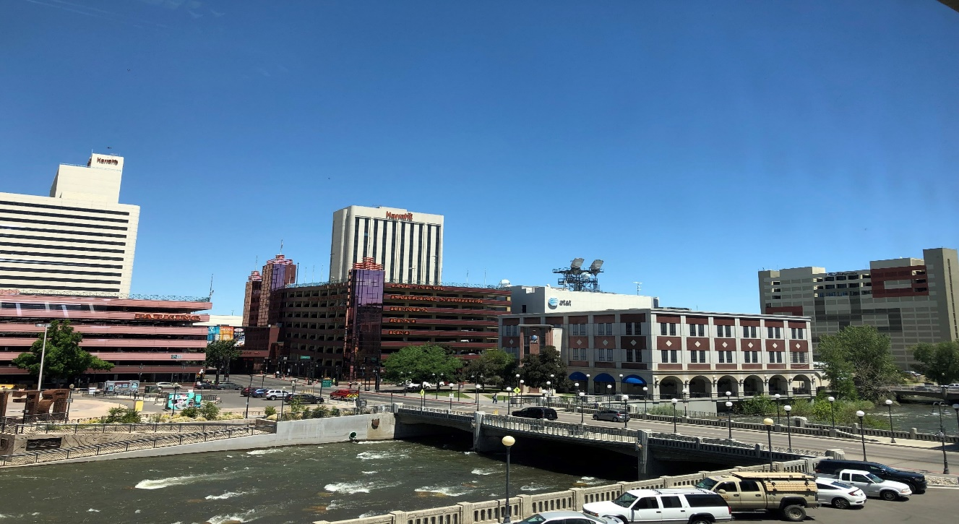
UTM TCL 4 Flight Demonstrations, Summer 2019
Objective
Demonstrate the UTM system managing high density drone traffic in urban environments under varying conditions
Approach
Fly live and simulated drones in downtown areas of Reno, NV and Corpus Christi, TX
Drones outfitted with advanced command and control communications, navigation, and safe landing technologies
2 Drones Operating over Corpus Christi
4 Drones Operating over Reno
Notes:
UTM Project is developing and testing a highly automated system for traffic management of small drones flying in low altitude
Project started in 2015 and since then we have been following a crawl, walk run approach to building and testing the UTM system
Started early with basic system testing in rural environment
Each year we have added capabilities to the system and tested it in more complex environments
In summer 2019, we tested in the complex urban environments of Reno, NV and Corpus Christi, TX
The Nevada and Texas FAA designated test sites ran the tests for us and used 35 industry partners to provide the highly advanced drones and UTM services.
What we see here is a picture of 4 drones flying simultaneously over downtown Reno. The other picture shows 2 drones flying over Corpus Christi. Day in the life …
Building inspections, news gathering, package delivery
Exercising Beyond Visual Line of Sight operations, roof top Takeoffs and Landings, flying between buildings, reacting to weather events
Top right picture is the Airspace Operations Lab at Ames which monitored the testing and collected data
We learned a lot about flying in cities and challenges with Communication, GPS navigation, and Safe Landings
Results and technologies will be transferred to the FAA and Industry for future implementation into the National Airspace

Slide 3
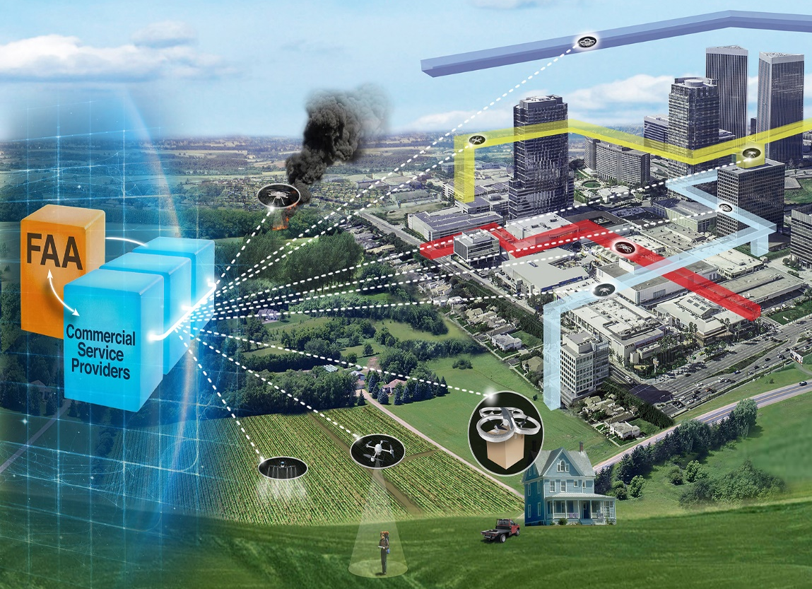
2020 Activities
Results from last summer’s testing have been analyzed and documented
SciTech 2020
Aviation 2020
Numerous NASA Technical Memorandum
Collaborating with the FAA on UTM Pilot Program 2.0
Testing at Virginia and New York FAA designated test sites. Several of the same industry partners that participated in TCL 4 last year are in UPP 2.0
Providing input to standards groups on UTM performance and operations
ASTM
JARUS

Slide 4
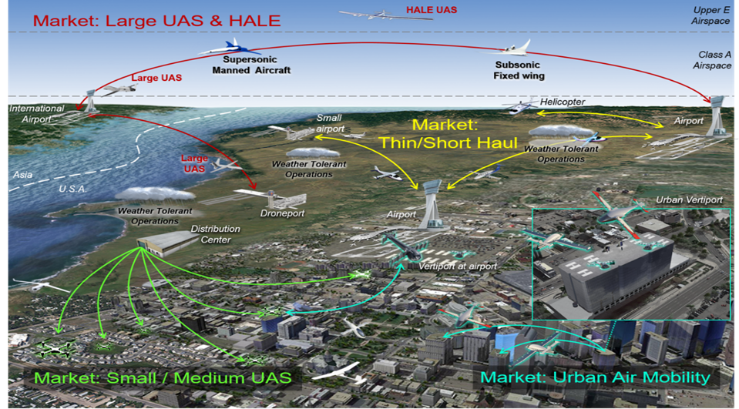
The Future
The concept of operations and architecture demonstrated by UTM in low altitude for small UAS is being applied to research of other flight regimes and emerging markets in aviation
Urban Air Mobility
Thin/Short Haul
High Class E Traffic Management
Space Traffic Management

Slide 5
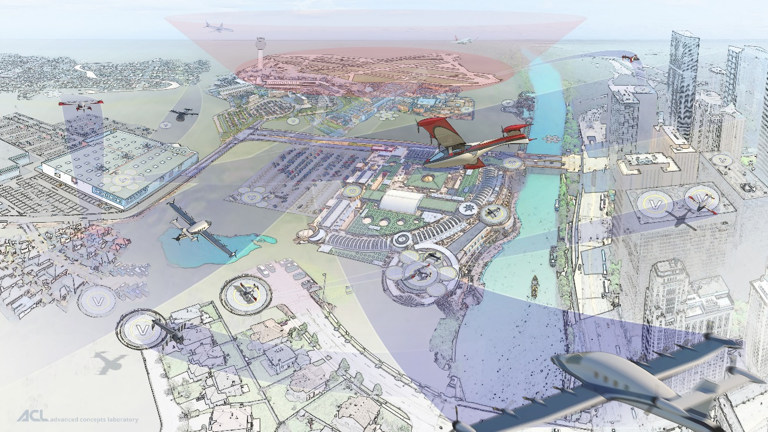
Advanced Air Mobility (AAM) Mission
Safe, sustainable, accessible, and affordable air transportation for passengers and payloads across local and intraregional missions reaching communities that are underserviced by aviation today
Includes “rural” and “urban” applications
cargo transport, pax-carrying, aerial work, etc.
eVTOL, sUAS, eCTOL, hybrid-electric, etc.
Urban Air Mobility (UAM) as a challenging use-case with high benefit
Enabled by electrification and automation
Does not include:
Supersonic or hypersonic transport
Existing hub-and-spoke air service with large transport aircraft
Notes:
The AAM mission is to develop and implement an integrated plan for enabling Emerging Aviation Markets that will provide substantial benefit to the US public and industry.

Slide 6
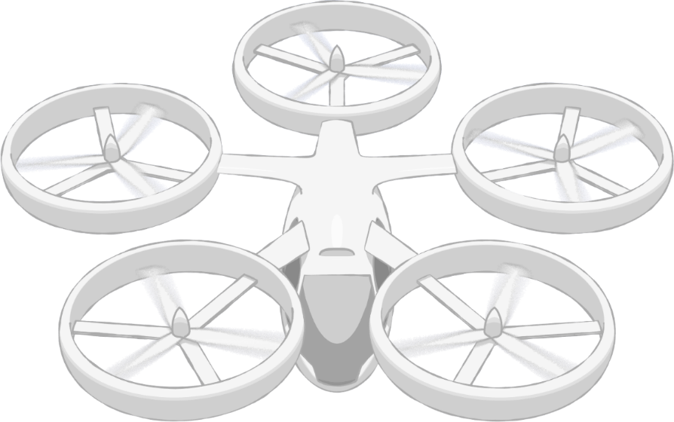
Framework
Societal integration and acceptance of UAM operations
Design, development, and implementation of infrastructure to enable safe and efficient multi-vehicle UAM operations
Operations and management of multiple vehicles within a UAM system that enable safe and efficient sharing of airspace and other system resources
Community Integration
Airspace System Design & Implementation
Airspace & Fleet Operations Management
5
3
4
Vehicle Development & Production
Individual Vehicle Management & Operations
Operations and maintenance of a single UAM vehicle, independent of the sharing of airspace or other system resources
Design, manufacture, and system readiness of UAM vehicles
1
2
Aircraft & Aircrew
Airspace
Community Integration
Pillar number
#
Notes:
NASA’s pillars framework contains two levels: pillars and barriers, visible on the next slide. Each pillar represents a key area of the AAM ecosystem at a given UML.
List framework categories
The five pillars encompass three major categories: airspace, vehicle, and community integration.

Slide 7
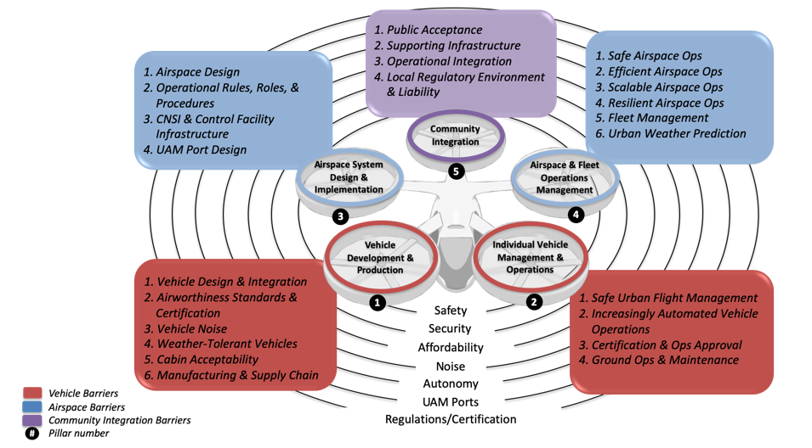
Barriers
Notes:
Within each pillar there are barriers, or challenges that must be addressed for the AAM ecosystem to be successful at the stated maturity level. There are also crosscutting barriers, which are barriers to UAM integration that impact multiple Pillars.
Talk about barriers more in depth and give description

Slide 8
AAM Maturity Levels (UMLs)
Focus UML’s
AAM Framework and Barriers
Vehicles
Airspace
Community
UML-1
Late-Stage Certification Testing and Operational Demonstrations in Limited Environments
UML-2
Low Density and Complexity Commercial Operations with Assistive Automation
UML-3
UML-4
UML-5
UML-6
Low Density, Medium Complexity Operations with Comprehensive Safety Assurance Automation
Medium Density and Complexity Operations with Collaborative and Responsible Automated Systems
High Density and Complexity Operations with Highly-Integrated Automated Networks
Ubiquitous AAM Operations with System-Wide Automated Optimization
INITIAL STATE
INTERMEDIATE STATE
MATURE STATE
Notes:
UML’s are full framework/barriers time phased against industry reference missions that increase in complexity over time
-Generally the UMLs lay out a path from today (UML-0) to a far future state
-Moving to higher UMLs generally increases the number of aircraft flying, the “complexity” of the operations, and the level of automation/“autonomy”
Medium Density
100’s of aircraft aloft over metro area
10s of vertiports, some capacity constrained with high traffic densities and rigorous slot management
Medium Complexity
Operations into urban cores (e.g. limited physical separation between vertiports, people, property)
Visibility independent operations
Collaborative and Responsible Automated Systems
FAA certifies automation as responsible for performing specified functions, relieving pilot from learning or performing them in any situation, including degraded system modes not shown to be extremely improbable
Automation has comprehensive, autonomous situation awareness and collaborates with pilot to identify and manage hazards while safely and appropriately executing flight and contingency operations
-Why focus on UML-4?
--Market studies indicated at this level industry can reach profitability and move lots of people/cargo.
---In UML-4, could see on the order of ~30-60k people/day moving via UAM (assume 100-200 aircraft per city, ~20 vertiports, with take-off’s and landings every 30-90 seconds at any given vertiport), which is about 1/10th DC metro daily traffic
--High level of industry interest in those capabilities -- everyone working toward that (with some focused on lower UMLs in near-term but some focused more-or-less exclusively on UML-4 from the start)
--It’s hard!
---Virtually all of the UCAT barriers become important to have solved by this time.
---NASA focus should be beyond industry state-of-the-art and enable the “next”
--A focus at UML-5 or -6 is so far into the future that

Slide 9
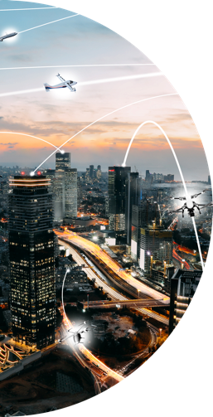
Accelerating Advanced Air Mobility through collaboration!
AAM Partnership Strategy
Notes:
We recognize that this is a complex ecosystem and has so many aspects that we need to make this a consorted effort to make this a real and practical transportation system.
We’re introducing some new and some more widespread capabilities than what we have today
This is going to affect a lot of people, with differing point of views on the technologies We need to find a way to engage all those people to make it a realistic time frame
Our goal is to generate good dialogue that helps not only NASA, but the entire ecosystem. NASA will play as facilitators for conversations and connections. It’s a place to foster collaboration and can help move industry much faster than any of us could as individual organizations.
However, the intention is not to duplicate efforts that are already being done, but rather amplify those efforts, fill existing gaps, and find our niche.

Slide 10






AAM Ecosystem Working Groups
Accelerate Advanced Air Mobility through collaboration
Recognize and address near-term needs to kick-start AAM/UAM
Research needs for scalable AAM towards maturity level-4
Identify partnership opportunities with NASA projects including
National Campaign
Expected Outcomes
Foster collaborations among each other
Generate data and information for standards bodies
Collectively address pre-competitive considerations (e.g., protocols,
safety analysis)
Develop AAM system architectures, Book of Requirements and
Guidelines (BoRG), and Ecosystem Scorecard
Notes:
These are effectively totally public working group meetings, and work on overall industry consensus standards to drive the big picture.
The national campaign, formally Grand Challenge, is a big part of the NASA strategy which can be another place to foster collaboration with industry and NASA sub-projects
Four groups: aircraft, airspace, community integration, and cross cutting
The crosscutting will include everyone that signs up for the working groups.
We want disciplines to be able to have their own conversations and deep dives with industry experts, but we also don’t want them to be siloed and never come together and never have ecosystem wide conversations that would keep everyone on the same page.
The general working group structure - each working group to have some number of subgroups which will be built out and decided by the needs of the members. Members can self-select what group they will be in
In terms of leadership and membership - coke ads one person from NASA and one working group member elected by members
Once a month - decided by the group. We do anticipate that Initially there will be a few more meetings to get everything started, and sub groups can meet as needed to accomplish whatever task they are set up for
We anticipate starting them in May and if possible with the continued state of affairs, have two face meetings a year. Those are to be determined at this time, but we are working towards that.

Slide 11
Open Source Collaboration
NASA will rely on open source collaboration with the community to build out the following resources:
Book of Requirements and Guidelines (BoRG)
Provide requirements, recommended practices, standards, regulatory guidance, accepted metrics and other information helpful for achieving AAM
Ecosystem Scorecard
Measures industry performance against AAM milestones
AAM System Architecture
Model based systems engineering approach to managing and organizing the AAM ecosystem body of knowledge
Notes:
Build a set of requirements and guidelines to ensure coordinated development of the entire ecosystem; consisting of vehicle, airspace, and infrastructure
It is envisioned that this “Book of Requirements and Guidelines” (BoRG) would focus on UML-4 and contain the following elements:
Concept of Operations, System Concept, Use Cases and System Architectures
Validated system requirements developed in concert with FAA and industry standards bodies
Regulatory guidance, recommended practices, Methods of compliance
Substantiating data and evidence supporting recommendations
A means of scoring the industry progress (i.e. Industry Scorecard)
A Model Based Systems Engineering (MBSE) framework will be used to manage the BoRG
The UAM Book of Requirements and Guidelines will be instrumental in shaping UML-4 requirements, policies, procedures, regulations, airworthiness certification criteria, and methods of compliance for the vehicles, airspace and infrastructure needed to enable the UAM Market.
Ecosystem Scorecard is a way for industry to judge their readiness
AAM System architecture will explore viable system concepts include target levels of safety, interoperability, user attributes, community integration, etc.
Trade-space exploration across ConOps, system concepts, technologies, etc.
Assess feasibility, scalability, cost, regulation, etc.
Develop critical technology prototypes (e.g. UTM-construct, simplified piloting)
So they’re all part of the big integrated picture. All of it is fed into an open source tool that we can build out in an integrated fashion to show where we’re at and where we’re going. Then we can document that and bring it into one big forum, which is the ecosystem working groups.

Slide 12
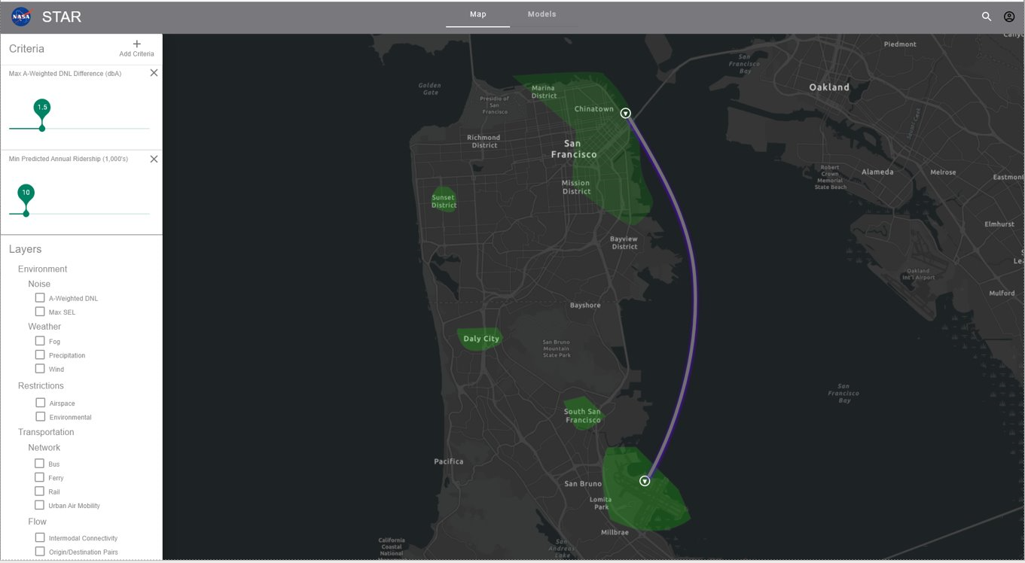
Regional Modeling & Simulation
NASA is building a decision support tool to help urban and transportation planners with vertiport location and route design.

Slide 13
Regional Modeling & Simulation
What are the concerns:
Public acceptance
Noise
Zoning
Intermodal Access/Impacts
Ridership
Environmental Regulation
Fire Safety
Social Equity
Funding, Zoning, Demographics, Congestion
Vertiport and Operational Certification Requirements
Terrain and Obstacle Avoidance enroute and during approach/takeoff
Micro Weather/Winds
Vehicle Models
Battery/Charging Models
Diversion sites, Airspace Restrictions, National Airspace Integration, airspace operations, etc.
Notes:
What are we solving:
Novel mode of transportation – means both challenges and opportunities
A new tool to help maximize the opportunities and overcome the challenges

Slide 14
Advanced Capable Aircraft
AAM Working Groups
Book of Requirements and Guidelines
Ecosystem Scorecard
AAM System Architectures
Aircraft
Supply Chain
National Campaign
Crosscutting
Airspace
UTM
Modeling & Simulations
Community Integration
Infrastructure Requirements

Slide 15
Anna Cavolowsky anna.e.cavolowsky@nasa.gov
Project Administrator, NASA Aeronautics Research Institute
BreeAnn Stallsmith
breeann.m.stallsmith@nasa.gov Project Administrator, NASA Aeronautics Research Institute

