Slide 1
CAS: AERoBOND Overview
PI: Frank Palmieri (LaRC)
Co-PI: Tyler Hudson (LaRC)
NASA Centers: LaRC, GRC, ARC
Partner: ASX Composites (SAA)
April 2020

Slide 2
Bottom Line
AERoBOND
  Rapid, reliable assembly of composite structures to reduce/eliminate redundant fasteners
  Enables unitization without complex tooling or processing
  Practical for near-to-mid-term implementation (commercially available precursors with aerospace history)
Transition portion of AERoBOND to AATT (FY21)
  Minimal fabrication and testing efforts
  Continue SAA / assess gap to commercial application
  Cost: 1 FTE/LaRC, $15k/materials
Transition to “High Rate Manufacturing” project (FY22)
  Re-expand testing, add industry partners, multi-center
  Further develop process model(s) as product, add analysis tools
  Cost: 2.5 FTE, $150k materials/equip., 0.5 WYE (~$115k)

Slide 3
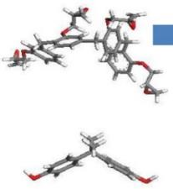
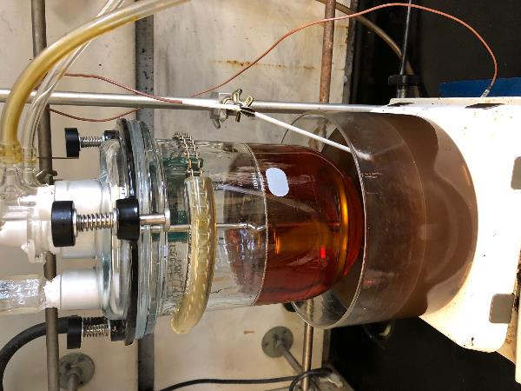
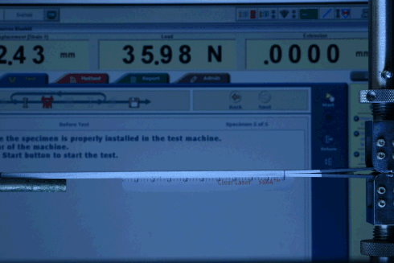
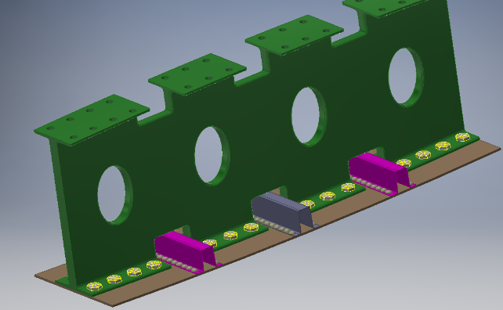
AERoBOND Project Overview
AERoBOND Goal: Increase Manufacturing Rate
  Reduce part counts (bolts)
  Eliminate drilling/installation
  Add no process time/steps
  No performance knockdown
AERoBOND activities
  Systems analysis
  Material multi-scale modeling
  Formulation & fabrication
  Mechanical testing
LaRC
(PI)
ARC
GRC
Notes:
The proposed activity require the convergence of three centers for efficient and rapid investigation of feasibility
ARC will conduct multi-scale modeling of the structural materials system to focus the experimental effort where feasibility is most likely. John Lawson’s group is known for their expertise in the multi-scale modeling needed to accelerate the study of this technology.
GRC will support mechanical testing with specially designed test methods and GRC owned expertise for studying the properties of composite joints.
LaRC will manage the project and carry out the fabrication of specimens and additional mechanical testing. LaRC will also conduct a systems analysis to quantify the impact of the joining concept on manufacturing rate.
Show that proposed study synergizes multiple disciplines and multi-center capabilities. A feasibility study that can be done by a group of similar engineers at one center is not suitable for a CAS proposal. Deliver slide in 30 seconds.

Slide 4
AERoBOND Team
Langley Research Center (6.5 FTE)
  Formulation: Frank Palmieri, Tyler Hudson, Roberto Cano, John Connell, Chris Wohl
  Testing: Austin Smith & James Ratcliffe
  Analysis: Cyrus Kosztowny, Carlos Davila, & Glenn Hrinda
  Laminate fabrication: Sean Britton, Hoa Luong, & Kelvin Boston
  Machining: Mike Oliver & Thomas Hall
Glenn Research Center (1.5 FTE)
  Mechanical testing: Jon Salem & Mike Pereira
Ames Research Center (1 FTE)
  Material/Process Model: John Lawson, Chang Woon Jiang, & Lauren Abbott

Slide 5
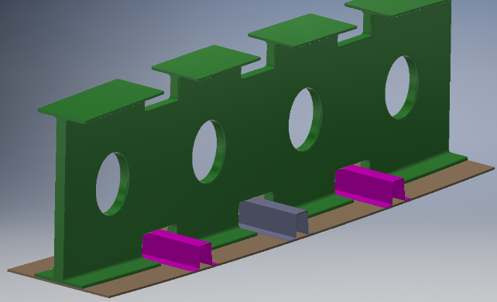
Manufacturing Bottleneck
Airframes are assemblies of many parts
Composites can be assembled rapidly with adhesives
Redundant load path (bolts) is required for certification
Thousands of drilling and installation steps
Composites should be replacing metals in aircraft but…
Fastener installation is too slow causing a bottleneck
Production rates can't meet demand
Bonded Wing Structures
Rib
Stiffener
Skin
Bolted Wing Structures
Rib
Stiffener
Skin
Notes:
The purpose of this slide is to answer the question(s) your audience is most interested in knowing, such as: “Why NASA and why now?” or “If you are successful, what difference will your idea/product make to the general public, stakeholders and/or relevant industry?” or “What is the WOW factor for your idea?” or “If you hit a home run, what is the ultimate result?” State Potential Aeronautics Transformative Impact (within 5, 10, or 20 years). Be concise. Deliver this slide in 30 seconds.

Slide 6

Fasteners in a Single-Aisle Composite Airframe
Wing 2
~21,000 bolts
Wing 1
~21,000 bolts
Fuselage
~70,000 bolts

Slide 7
Assembly of Composites
Co-Cure
uncured prepreg
Method limited by part complexity
Cure Process
Co-bond
cured
uncured
adhesive
Secondary Bond
cured
uncured
Unpredictable interfaces formed
adhesive
cured
Co-cure produces predictable components and joints but is limited by complexity
Bonded/Co-bonded joints are susceptible to weak bonds
Unpredictable bonds are a concern in primary structure
A redundant load path is required to ensure structural integrity

Slide 8
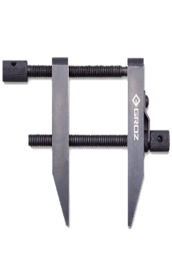
The AERoBOND Method
The reliability of co-cure in a “bonded” assembly
Joining Layer A
conventional materials (uncured)
Joining Layer A
Primary Cure
Co-cure reliability from “bonded” assemblies
partially cured
surfaces
cured laminate
partially cured interface
Assembly with
Joining Layer B
Secondary Cure
Co-cured structure
Notes:
This material innovation provides the reliability of the “co-cure” method and manufacturability of “secondary bonding”
Modified epoxy layers are applied to the bonding surfaces of conventional laminate materials
The primary cure process causes the structure to fully cure, but leaves the surface material partially cured
The two partially cured surfaces are assembled, clamped in alignment, and cured.
The partially cured layers reflow, mix together, fully cure, and produce a co-cured structure.
1.) State the name of your product or idea (should also be on slide#1).
2.) Provide brief high-level overview of what you’re trying to do. Don’t over explain the details. Use pictures or graphs if possible. Save the details for slide #7.
3.) You are answering the “Big Question” that will be answered, at least in part, by performing the proposed feasibility study. It is important that the idea has implications that would significantly transform aeronautics over 20 years should a follow-on project be shown to be feasible by this study and is funded.
Deliver slide 30 seconds.
Delete these instructions once you have completed each slide.

Slide 9
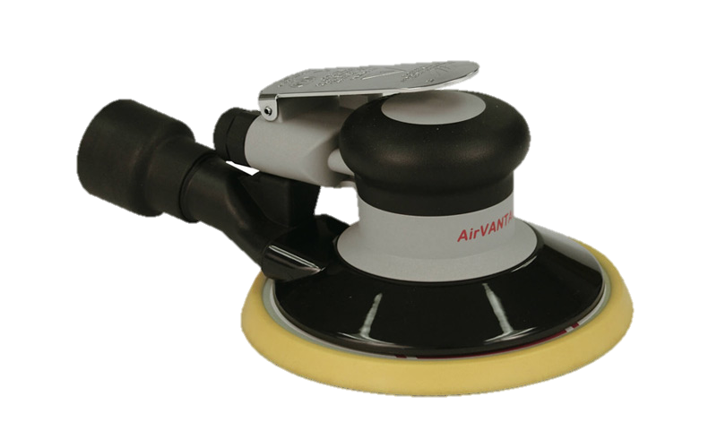
AERoBOND VS SoA
AERoBOND
State of Art (SoA)
Preform
Preform
Primary
Cure (~6 h)
Preform
Preform
Component
Component
Component
Component
Surface Treatment
(~2 h)
Joining
Layer B
Component
Assembly
(~2 h)
Adhesive
Secondary
Cure (~4 h)
Adhesive
Cure (~4 h)
Co-cured structure
Bonded structure
Total Time: ~12 h
Install bolts (~6 h)
Bonded and
Bolted
AERoBOND is ~40% Faster!
Total Time: ~20 h
Cure/assembly times are notional
Notes:
This material innovation provides the reliability of the “co-cure” method and manufacturability of “secondary bonding”
Modified epoxy layers are applied to the bonding surfaces of conventional laminate materials
The primary cure process causes the structure to fully cure, but leaves the surface material partially cured
The two partially cured surfaces are assembled, clamped in alignment, and cured.
The partially cured layers reflow, mix together, fully cure, and produce a co-cured structure.
1.) State the name of your product or idea (should also be on slide#1).
2.) Provide brief high-level overview of what you’re trying to do. Don’t over explain the details. Use pictures or graphs if possible. Save the details for slide #7.
3.) You are answering the “Big Question” that will be answered, at least in part, by performing the proposed feasibility study. It is important that the idea has implications that would significantly transform aeronautics over 20 years should a follow-on project be shown to be feasible by this study and is funded.
Deliver slide 30 seconds.
Delete these instructions once you have completed each slide.

Slide 10
Failure Mode and Certification
Bond Failure
AERoBOND Failure
Cohesive Failure
Adhesive Failure
Cohesive Failure
AERoBOND eliminates the potential for weak bond failure mode
Goal: AERoBOND mechanical properties similar to conventional co-cured laminates.

Slide 11
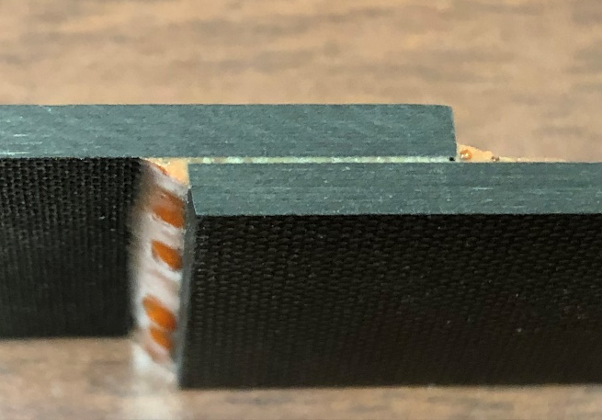
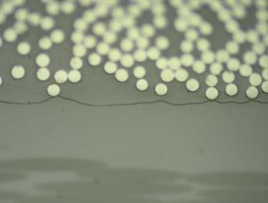
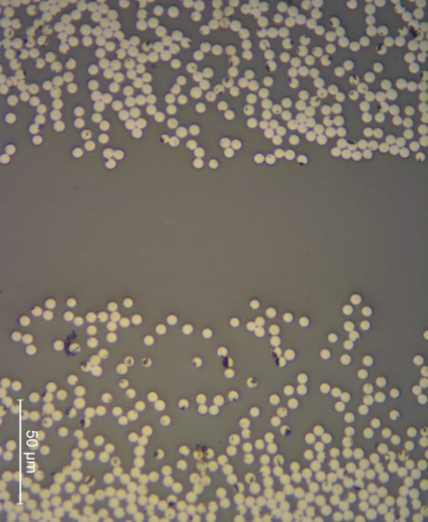
Adhesive Bondline vs. AERoBOND
Adhesive Bondline
AERoBOND Joint
Matrix resin
AERoBOND Joint
Adhesive
Cured matrix resin cannot mix with adhesive
Potential for weak bonds
The AERoBOND joint is indistinguishable from the matrix resin of adherends
Quantifiable, certifiable resin properties

Slide 12
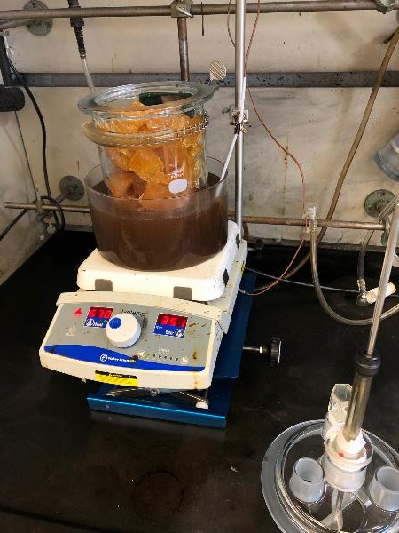
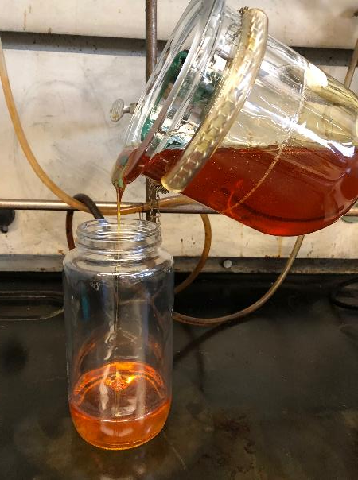
Resin Preparation
API-60 Part A and DETDA stirred 1 - 2.5 h at 100 -110 °C
Prepolymer diluted with 15 wt.% methyl ethyl ketone (MEK) prior to producing prepreg
Commercially available precursor, readily scalable process

Slide 13
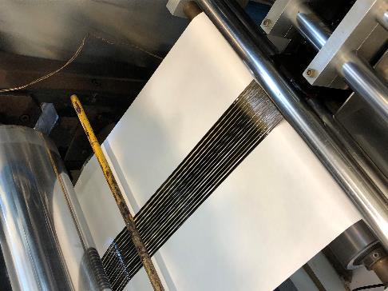
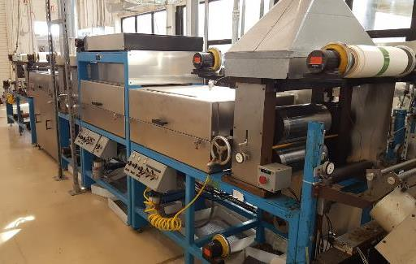
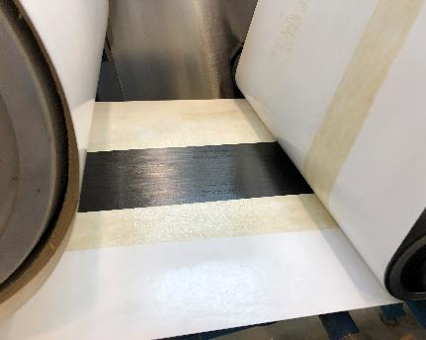
Prepreg Tape Production
Prepared prepreg tape using a custom tape machine at NASA Langley Research Center
  Fiber: IM7G, 14 to 16, 12k tows, 75-100 mm wide tape
  Better uniformity and larger batches compared to hand painted film
  Process development is complex/challenging

Slide 14
Preliminary Development and Testing
Two-step fabrication process
  1. Fabricate “half-panels” with ER surfaces
  2. Join ER panels with HR “adhesive” ply
Conventional material used in backer laminate
  Hexcel® IM7/8552 prepreg
  190 g/m² fiber areal weight (FAW), 35% resin content
Test Parameters
  Resin formulation (r-value, degree of cure)
  Ply thickness & resin content
  Cure process (time and temperature)
  Bagging scheme
Rapid Screening with End-Notched Flexure (ENF) test
  Mode II (Shear) Fracture Toughness
  Simple specimen fabrication and testing
Laminate Configuration
Hexcel IM7/8552 backer laminate
ER Ply
HR Ply
ER Ply
Hexcel IM7/8552 backer laminate
End-Notched Flexure (ENF) Test
Fiber direction
FEP crack starter
Layup: [0]₂₄
Non-Precracked (NPC) vs Precracked (PC)

Slide 15
Mechanical Test Methods 1
Quasi-static testing
ASTM D5528 (DCB) & D7905 (ENF) for mode I & mode II interlaminar fracture toughness
ASTM D3165 (SLS) & D3528(DLS): Apparent shear strength
ASTM D6415 (CB): Interlaminar tensile strength
Double Cantilever Beam (DCB) & End-Notched Flexure (ENF)
Fiber direction
FEP crack starter
Single-Lap Shear (SLS) & Double-Lap Shear (DLS)
Fiber direction
Fiber direction
Curved Beam (CB)

Slide 16
Mechanical Test Methods 2
Flatwise Tension (FWT)
ASTM D7291:Interlaminar Tensile Strength
ASTM D7136 (BVID) and ASTM D7137 (CAI): Damage tolerance
Two specimen styles
Barely Visible Impact Damage (BVID) & Compression After Impact (CAI)
Step 1
Step 2

Slide 17
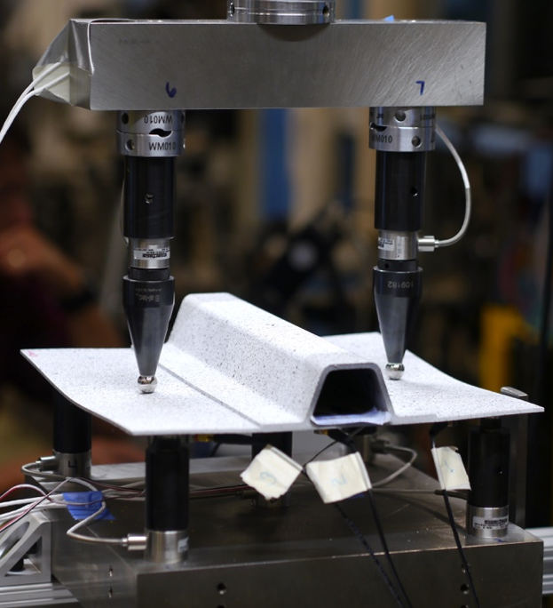
Sub-element Testing Concept
Derived from the Advanced Composites Project (ACP) Seven-point Bend (7PB) test
Stiffener separation is a major concern for primary aircraft structures
Mimics buckled half-wave deformation in stiffened composite panels
  Separation between the flange and skin interface
  Combined opening and shear loads

Slide 18
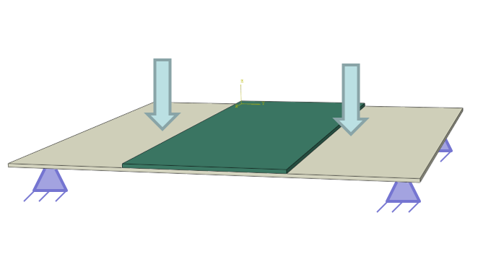
Sub-element Test Advantages
Specimen fabrication tooling is available on center
Test fixture is available on center
  Operator and test engineer familiarity with testing procedure
Simple geometry
  Building upon coupon characterization effort
Stable failure progression, which assists characterization, may be possible
Can add simulated damage (FEP insert)
Readily scaled to larger or more complex specimen designs when able
  Hat or other stiffened geometries
  Single-stringer compression panels
  Multi-stringer combined loading panels

Slide 19
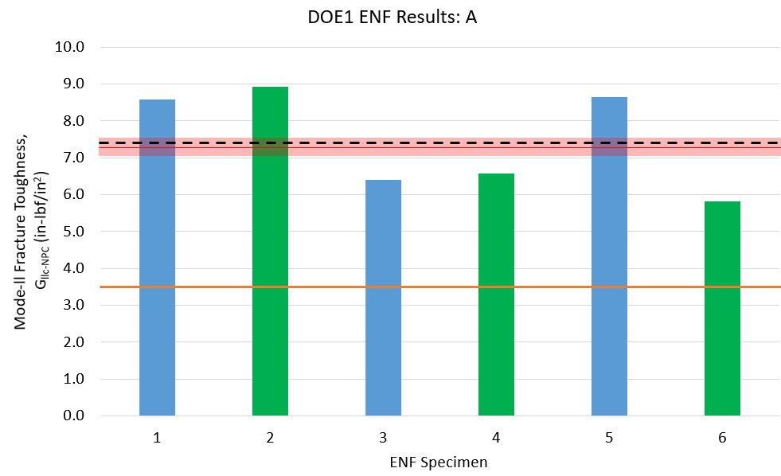
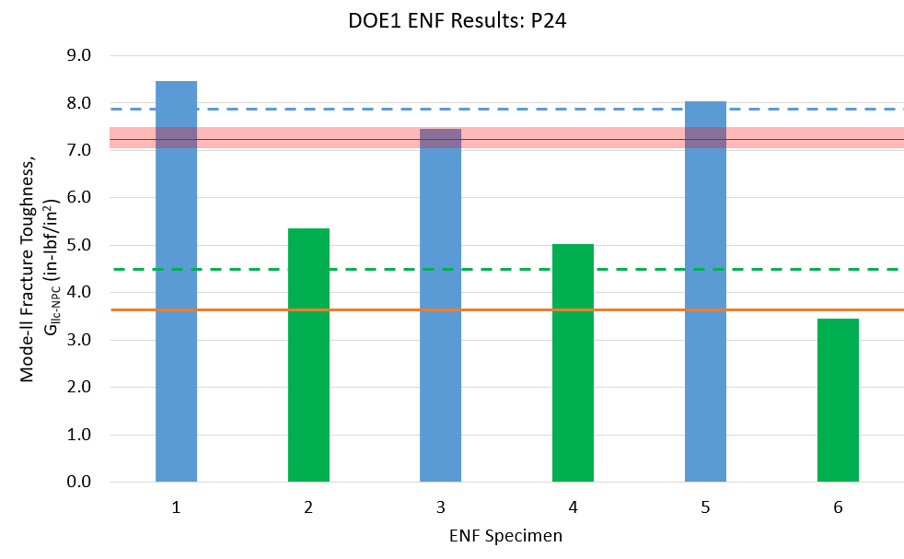
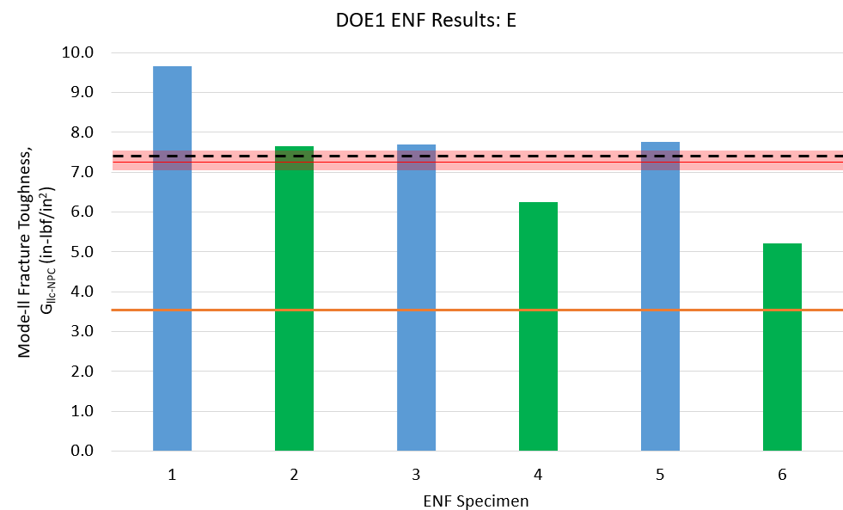
Achievement: Mode II Fracture Toughness/No Precrack (G_{IIc_NPC})
Exceeded CAS/AERoBOND goal to reach 80% of baseline (conventional properties)
  Project final goal was 80% baseline (red bar)
  Preliminary goal was 50% baseline (orange)
Ave: 7.496 in-lbf/in² %Baseline: 105%
Experiment A1
8
6 4 2 0
Shear Fracture Toughness (in-lb/in²)
ER activated (blue bars) 111% of baseline
HR activated (green bars) 64% of baseline
Experiment 24
1 2 3 4 5 6
6 4 2 0
Ave: 7.379 in-lbf/in² %Baseline: 103%
Experiment A5
Shear Fracture Toughness (in-lb/in²)
8
6 4 2 0
Shear Fracture Toughness (in-lb/in²)
1 2 3 4 5 6
1 2 3 4 5 6
Units conversion: 1 in-lb/in² = 175 J/m²

Slide 20
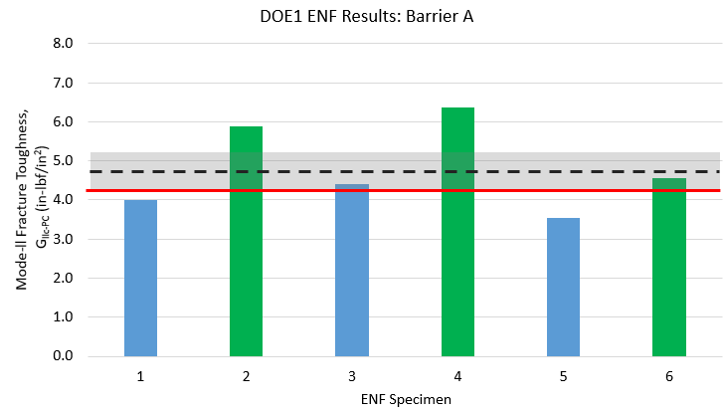
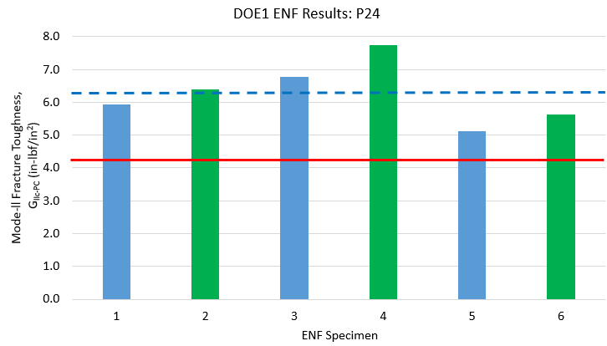
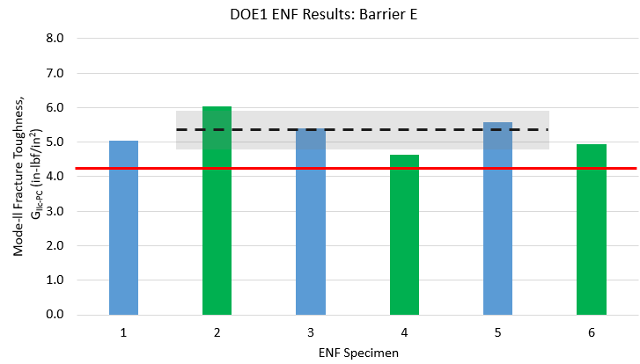
Achievement: Mode II Fracture Toughness/Precrack (G_{IIc_PC})
Exceeded CAS/AERoBOND goal to reach 80% of baseline (conventional properties)
  Project final goal was 80% baseline (red line)
Ave: 4.79 in-lbf/in² %Baseline*: 113%
Experiment A1 PC
6 4 2 0
Shear Fracture Toughness (in-lb/in²)
Ave: 6.26 in-lbf/in² %Baseline*: 148%
Experiment 24 PC
1 2 3 4 5 6
6 4 2 0
Ave: 5.410 in-lbf/in² %Baseline* : 128%
Experiment A5 PC
Shear Fracture Toughness (in-lb/in²)
6 4 2 0
Shear Fracture Toughness (in-lb/in²)
1 2 3 4 5 6
*IM7/8552 material property (not part of baseline dataset)
1 2 3 4 5 6
Unit conversion: 1 in-lb/in² = 175 J/m²

Slide 21
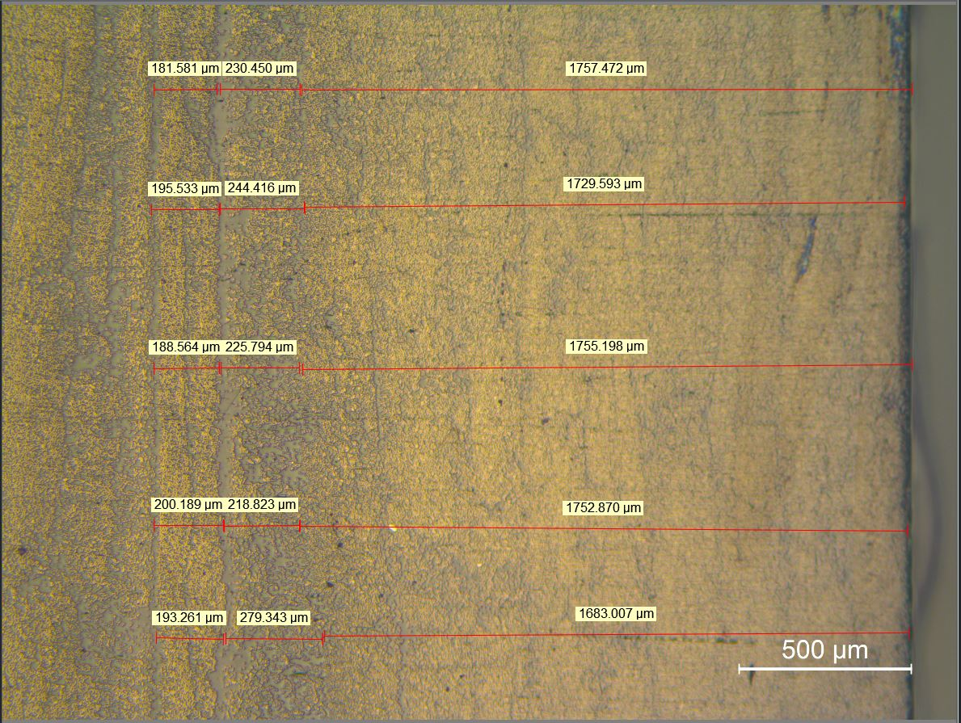
Optical Inspection of Interface
182 µm
230 µm
1757 µm
196 µm
244 µm
1730 µm
189 µm
226 µm
1755 µm
200 µm
219 µm
1753 µm
193 µm
280 µm
1683 µm
HR
(2plies)
ER
(2plies)
IM7/8552 Backer Laminate
(9plies)

Slide 22
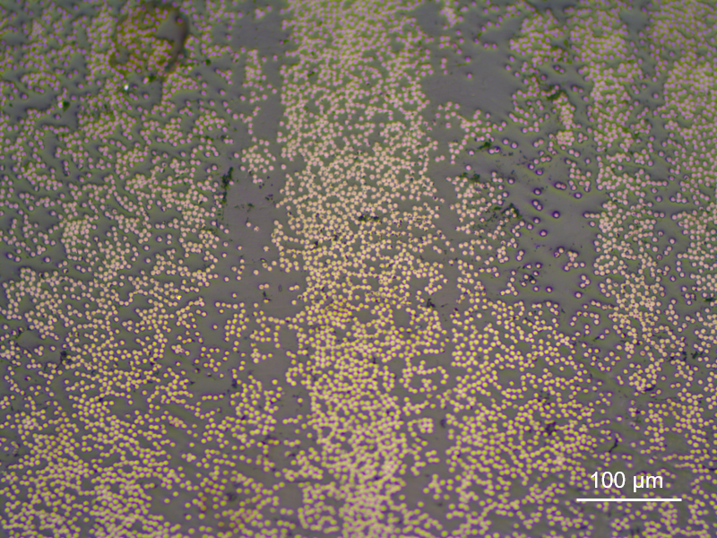
Looks Like Co-Cure
ER (2plies)
HR (2plies)
ER (2plies)
Find the interface

Slide 23
FY21 Transition Plan
Complete quasi-static testing (AERoBOND FY20 work)
  Depending on COVID-19 delays to project
Extend test campaign to include fatigue properties (FY21)
Assess the technical gap for transition to industry
  Determine industry pertinent tests
  Demonstrate on industry applicable joint
  Work with certification officials to determine test requirements
Continue partnership with ASX Composites (prepreg)
  Assess manufacturing challenges
  Develop SoA, scalable manufacturing process
  Test small batches of “commercial quality” material
Cost: ~1 FTE, $15k procurement, support for non-reimbursable SAA

Slide 24
FY22 and Beyond Activities
Sub-element or element scale test (LaRC)
  Wing structure with joint
  OEM and material supplier partnerships
  Materials from commercial source
Damage tolerance testing (LaRC/GRC)
Environmental testing (LaRC)
Process model development (ARC/GRC)
Continued support for SAA with ASX Composites
 | FTE | WYE | Procurement
LaRC | 2.1 | 0.2 (~$40k) | $120k
GRC | 0.4 | 0 | $30k
ARC | 0 | 0.3 (~$75k) | 0
*Industry partnership/cost-share not included, procurement does not include WYE

