Slide 1


OTC-30670-MS
Human Systems Integration Relationships Between Deep Space and Deepwater Exploration Challenges
George Salazar, P.E.,ESEP ,LSM-IEEE NASA/JSC
M. Natalia Russi-Vigoya, PhD, AHFP KBR/JSC
Notes:
http://www.otcnet.org/preparing-a-technical-session-presentation

Slide 2
Overview
NASA Human Systems Integration Overview
Methodology
Challenges identified and potential HSI solutions
Conclusions/final thoughts

Slide 3
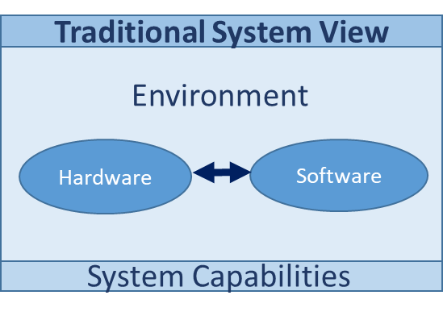
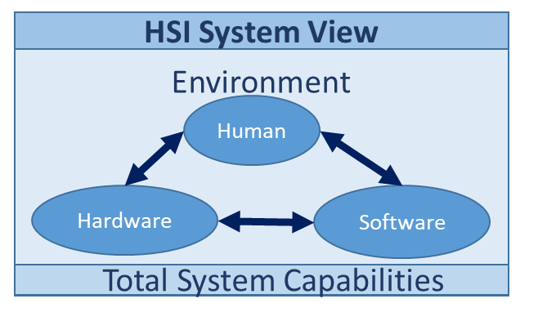
Human Systems Integration(HSI) Overview
An interdisciplinary and comprehensive management and technical process
Notes:
Human element focus in system development.
Enhance human system design, reduce life-cycle ownership cost, and optimize total system performance

Slide 4
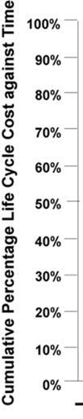
The Rationale for HSI at NASA
Project management emphasis on the human element
Designers understand H/W and S/W-not humans!
Escalation program operations costs
Define HSI Domains important to NASA
90%
100%
75%
500-1000X
20-100X
Operations through Disposal
Committed Life Cycle Costs
Prod/Test
45%
Cost to Change Design Direction
3-6X
50%
Develop
% Completed
(Costs Expended)
Concept
Design
20%
8%
15%
SDR
CDR
SRR
PDR
MCR
Adapted from Defense Acquisition University, 1993

Slide 5
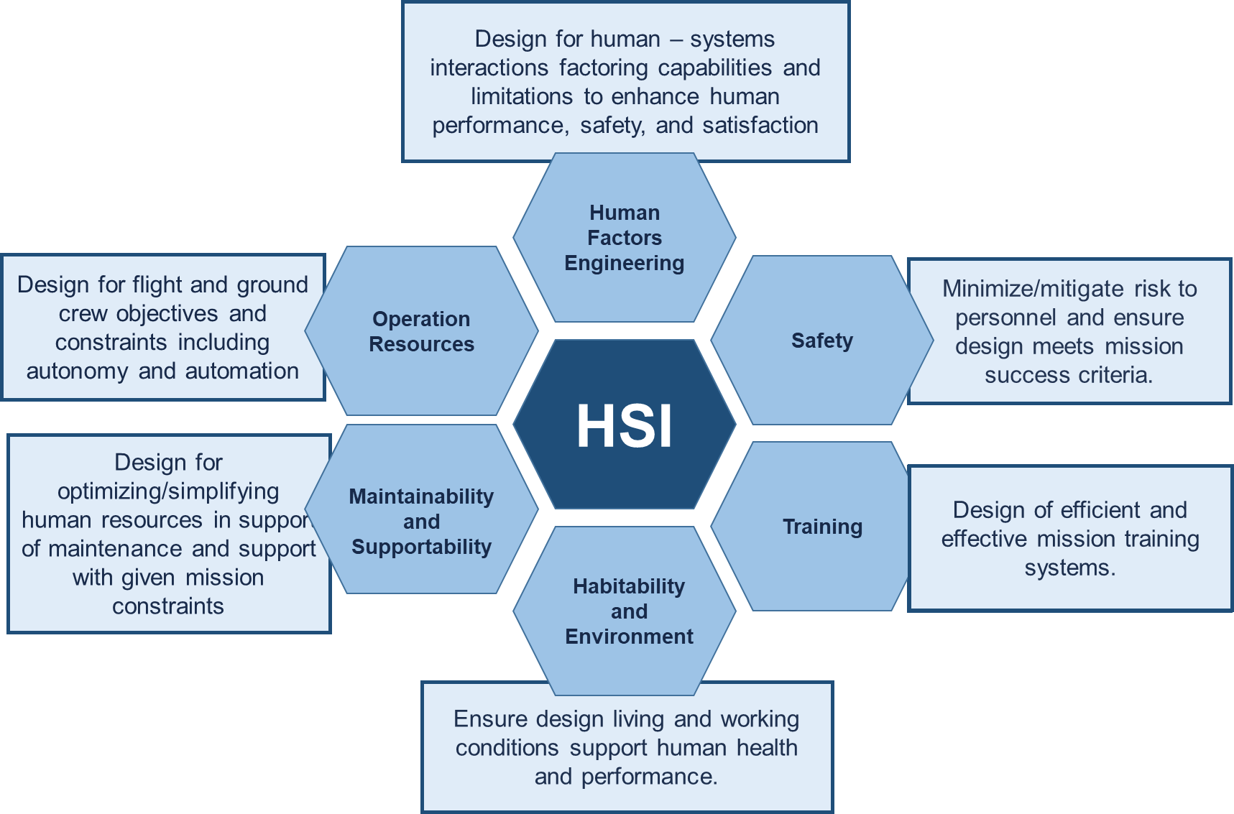
5
HSI Domains at NASA

Slide 6
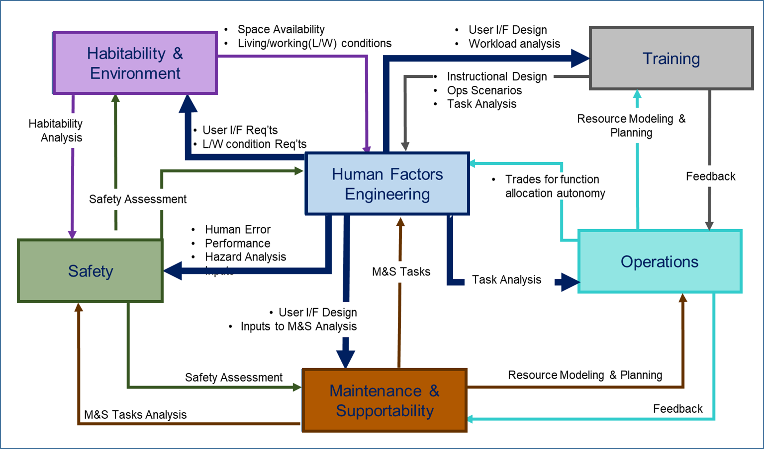
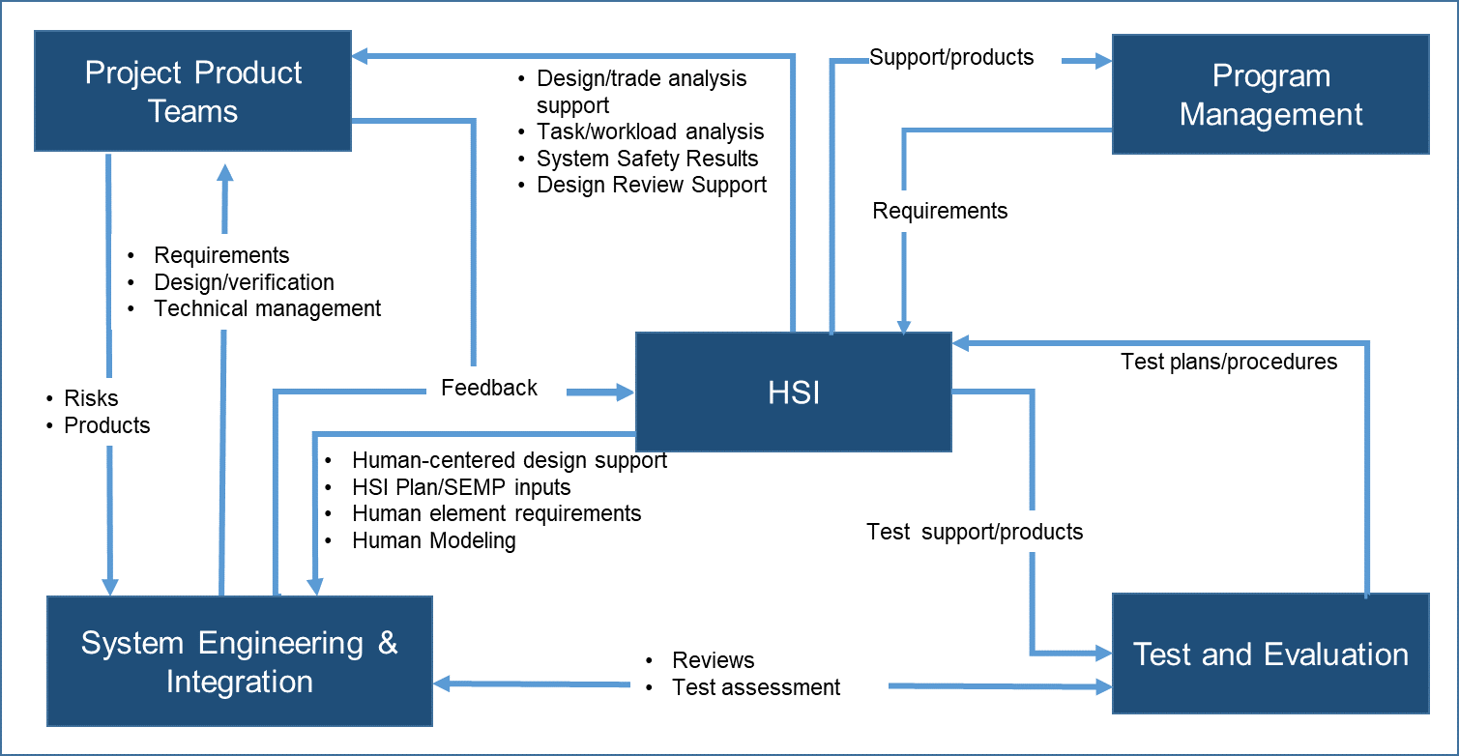
HSI Interactions
Notional representations

Slide 7
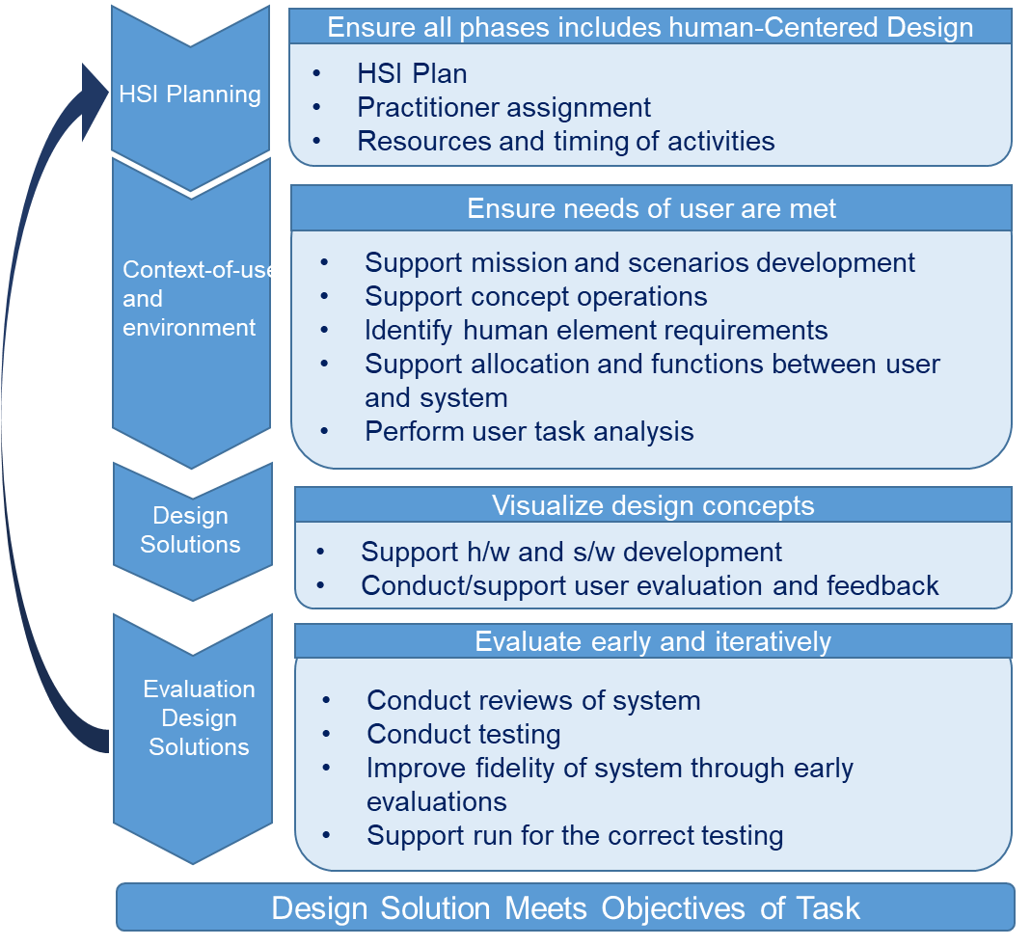
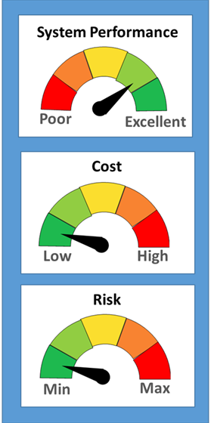
Human Centered Design Process

Slide 8
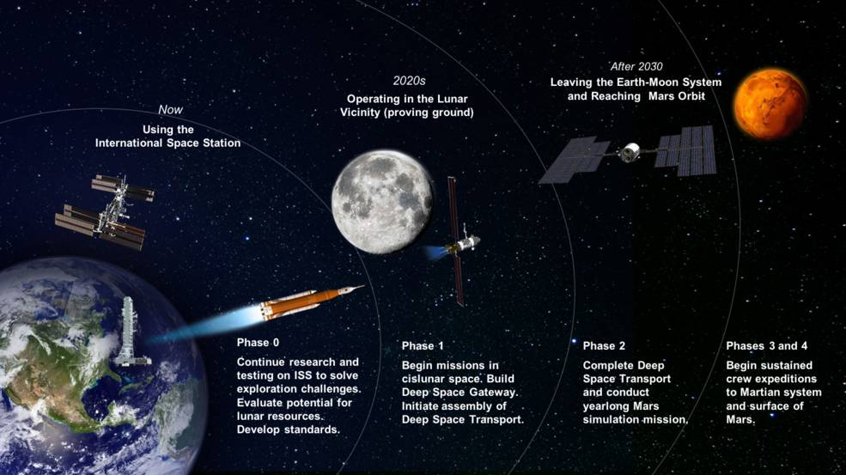

Methodology
Image Credit: The International Association of Oil & Gas Producers
Image Credit: NASA
HSI System Development Assessment

Slide 9





Exploration Challenges
Isolation and confinement
Hostile/closed environments
Long distances
Culture
Image Credit: NASA
Hazards hard to perceived
Gravity Fields
Technology/ Innovation/Adaptation
Operations
paradigms

Slide 10
HSI approach towards
solving the challenges
1. HSI from the onset of a project
Included all domains from the start of a project to ensure the various dimensions of the human are accounted for
Ensure the design is an iterative process
4. Hazards hard to perceive
Designing habitat based on anticipated hazards-labeling and displays & controls
HCD approach to flesh out habitat hazard procedures
High-fidelity training facility to capture hazards not identified as part of hazard analysis-environment and clothing
2. Operations paradigm
Develop and train for autonomy but ensure system situational awareness is maintained
Understand system dynamics in decision-making and train for it
Planning and prepare for self-sufficiency
5. Technology/ Innovation/Adaptation
Involve the HSI practitioner early
Work with systems engineering on maturing low TRL technology
Early evaluation of HITL testing towards human performance
Assess situation awareness impacts of technology through early iterative evaluations
3. Culture
Human-centered design
Rules and policies in place
Lessons learned incorporated into next similar project

Slide 11
HSI approach towards
solving the challenges Con’t
6. Isolation and confinement
Train for communications operations
Monitor, detect, and treat early health risk factors
Carefully chose crew for the mission
Habitat design for the duration of the mission
Nutrition
8. Hostile/closed environments
Habitability design-Protection,food, sleep, comfort, and exercise
Monitor environment
Train in simulated environment to prepare for nominal and off-nominal events `
7. Risks
HSI risks considered at the same level as H/W and S/W
HCD early risk assessment of designs
Burn down plan for risks through high-fidelity HITL testing
Safety & human error analysis
9. Gravity Fields
Monitor and treat changes in the human body
Aid deficiencies and body limitations with equipment or/and medicines
Exercise and fitness evaluation
Fine motor testing
Remote robotics operation training for safety

Slide 12
Swiss Cheese Model of Accidents
Culture/ Organizational
Hazard
-Human
-Hardware
-Software
-Environment
Requirements
Barriers
Design
Safety
Training
Maintenance
Crew Health
Adapted from Reason, 1990 ,Human Error
Accident
12

Slide 13
Conclusions
Space and Deep Water exploration share similar challenges
HSI can enhance safety, health, and performance of human spaceflight missions while reducing program lifecycle costs.
HSI is important throughout the design and development process and needs to be iterative
HSI can help to reduce lifecycle costs while maintaining the safety of the human operating complex systems

Slide 14
Acknowledgements
This work was performed at NASA Johnson Space Center. The authors would like to thank NASA, its Human Systems Integration (HSI) Employee Resource Group (ERG), and KBR for their support.

Slide 15
Questions?

