Slide 1
Uncertainty in Subseasonal Hydrological Forecasts
Randal Koster (GMAO, NASA/GSFC; randal.d.koster@nasa.gov)
with inputs from Siegfried Schubert, Anthony DeAngelis, Andrea Molod, Sarith Mahanama
Meteorological forecast uncertainty
Land model physics
Hydrological forecast uncertainty

Slide 2
Hydrological variables considered in this talk:
1) Soil moisture, W
Forecasted W has relevance to agricultural drought, transportability, streamflow generation efficiency…
2) Evapotranspiration, E
Forecasted E has relevance to crop yield projections, air temperature projections, ...

Slide 3
In this talk, “uncertainty” is equated with ensemble spread – a smaller ensemble spread implies a more confident forecast.
Always keep in mind, though, that
low uncertainty is not necessarily equivalent to high skill.
Skill must be evaluated independently.
value of forecasted variable
forecast spread: model is “over-confident”
actual value
time

Slide 4
Meteorological forecast uncertainty from full GMAO S2S system
Full GMAO land model physics
Hydrological forecast uncertainty
We could go about examining the problem with the full GMAO S2S system, but the data available for analysis (e.g., in terms of ensemble size) is limited – a large ensemble size is critical for the details we’re after.
So instead…

Slide 5
Meteorological forecast uncertainty from full GMAO S2S system
Full GMAO land model physics
Hydrological forecast uncertainty
Replace for initial analyses
Replace for initial analyses
Simple characterization of GMAO land model physics
Meteorological forecast uncertainty estimated from ranges seen in MERRA-2
Hydrological forecast uncertainty

Slide 6
Meteorological forecast uncertainty from full GMAO S2S system
Full GMAO land model physics
Hydrological forecast uncertainty
…we’ll look for evidence of that behavior in the full S2S system
Once we figure things out in the simpler system…
Simple characterization of GMAO land model physics
Meteorological forecast uncertainty estimated from ranges seen in MERRA-2
Hydrological forecast uncertainty

Slide 7
First question: where do we get this?
Simple characterization of GMAO land model physics
Meteorological forecast uncertainty estimated from ranges seen in MERRA-2
Hydrological forecast uncertainty

Slide 8
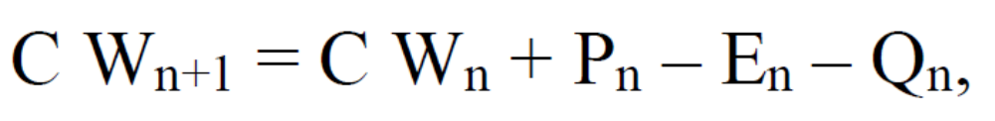
Water balance equation:
P
E
Q
Soil
Column
Soil profile water
holding capacity
Precipitation
Evapotranspiration
W
Total runoff
Soil moisture at start of day n (degree of saturation)

Slide 9
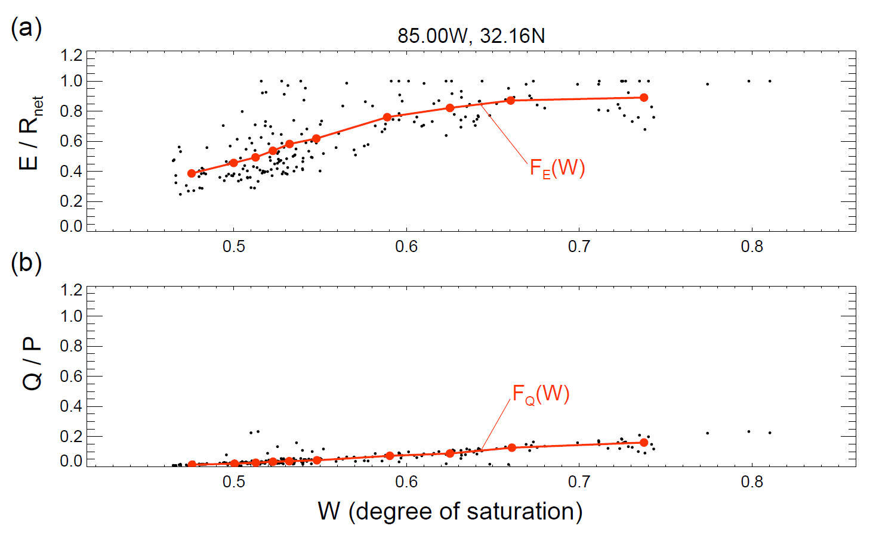
We can fit relationships (using MERRA-2) between W and both E and Q:

Slide 10
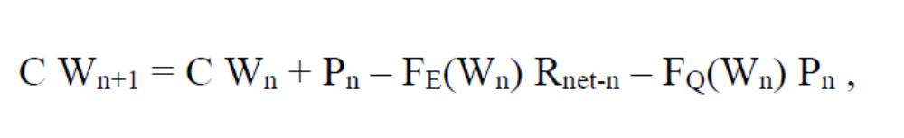
Revised water balance equation:
Replace
with

Slide 11
Revised water balance equation:
Replace
with
Forcing from atmosphere
Predetermined from MERRA-2
(independent time period)
Prescribed boundary condition

Slide 12
Basic approach:
P₁, P₂, … , P₃₀
Estimated E over days 16-30
R_{net-1}, R_{net-2}, … , R_{net-30}
Water balance equation framework
W₀

Slide 13
Basic approach:
P₁, P₂, … , P₃₀
Estimated E over days 16-30
R_{net-1}, R_{net-2}, … , R_{net-30}
Water balance equation framework
W₀
If we take these from MERRA-2,…
… run them through this framework, …
… and compare the results to MERRA-2 E, how well do we do?

Slide 14
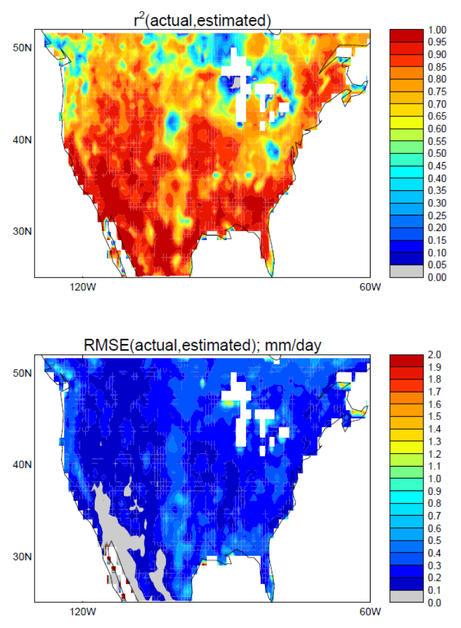
Actually, quite well…
Sample test: Compare E from simple model to MERRA-2 E for May 16-30, following initialization of simple model on May 1.

Slide 15
Second question: how do we do this?
Simple characterization of GMAO land model physics
Meteorological forecast uncertainty estimated from ranges seen in MERRA-2
Hydrological forecast uncertainty

Slide 16
P₁, P₂, … , P₃₀
Estimated E over days 16-30
R_{net-1}, R_{net-2}, … , R_{net-30}
Water balance equation framework
W₀
Answer: Accepting the fact that these P and R_{net} time series are very difficult to predict during a forecast…
… assume that for a given grid cell and time-of-year, the different years in the MERRA-2 record give different possible “realizations” of what the P and R_{net} time series might be during a forecast.

Slide 17
Basic approach:
P₁, P₂, … , P₃₀
Estimated E over days 16-30
R_{net-1}, R_{net-2}, … , R_{net-30}
Water balance equation framework
W₀
Approximation for subseasonal (days 16-30) prediction :
Multiple random but self-consistent time series of P and R_{net}
Multiple estimates of E for days 16-30 of a forecast
Single average E value
Water balance equation framework
Extract from MERRA-2 (independent time periods)
W₀

Slide 18
In this talk, we will focus mainly on uncertainty as described by the “spread” across these ensemble members.
Approximation for subseasonal (days 16-30) prediction :
Multiple random but self-consistent time series of P and R_{net}
Multiple estimates of E for days 16-30 of a forecast
Single average E value
Water balance equation framework
Extract from MERRA-2 (independent time periods)
W₀

Slide 19
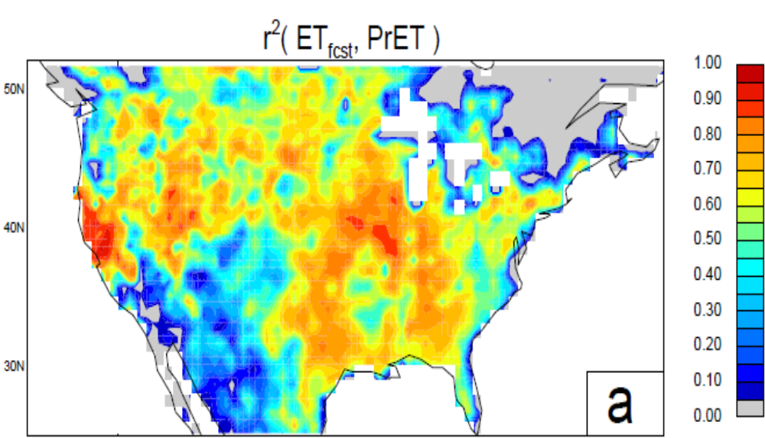
How well does the simple model reproduce a full S2S forecast? Compare E produced with this method (for days 16-30) with the E forecasted by the full GMAO S2S system:
High agreement across much of the US a The simple framework captures, to first order, the behavior of the full forecasting system.
(One implication: Initial soil moisture largely determines the E produced by the S2S system on days 16-30 of a forecast.)

Slide 20
With this tool in place, we will now examine hydrological uncertainty in subseasonal (days 16-30) forecasts.
Variance of forecasted quantity across all ensemble members of forecast n
1
N
Uncertainty (spread) metric:
Σ σ²_{ens-n}
N
n=1
U =
σ²_{all}
Variance of forecasted quantity across all ensemble members of all forecasts – the “climatological” variance of the quantity
U = 0: No uncertainty
U = 1: Maximum uncertainty (no potential for skill)

Slide 21
Years examined: 1999-2015
Source of W₀ values: MERRA-2
Source of F_{E}(W) and F_{Q}(W) relationships: MERRA-2 (independent time period).
Validation data for W and E: MERRA-2 (i.e., not truly observations)
Unless otherwise noted, we focus here on forecasts initialized July 5 and analyze the spreads of E and W forecasted for days 16-30.

Slide 22
We now explore 3 facets of hydrological uncertainty:
The relative importance of P variability and W₀ variability in defining E and W forecast uncertainty;
The shape of the land model’s effective “beta curve” on E and W forecast uncertainty; and
The impact of Covariance(P, W₀) on E and W forecast uncertainty.

Slide 23
The relative importance of P variability and W₀ variability
For a given location and forecast start date, consider the interannual variance of total initial water in the soil column….
… and the interannual variance of the total precipitation volume falling during the forecast period (across all ensemble members and all years)…
characterize with σ²_{W0} (mm²)
Year 1
Year 2
Year 3
Year 4
Year 5
Year N
Year 1
Year 2
characterize with σ²_{P} (mm²)
Year N
ens1
ens2
ens3
ens4
ens5
ens6
ens7
ens8

Slide 24
Suppose:
σ²_{W0} is high (initial soil moisture states vary greatly from year to year), and
σ²_{P} is low (rainfall is confidently predicted)
a Subseasonal W has low spread (as does subseasonal E)
Suppose:
σ²_{W0} is low (initial soil moisture states are similar from year to year), and
σ²_{P} is high (forecasted rainfall is highly variable)
a Subseasonal W has high spread (as does subseasonal E)
Hypothesize: The uncertainty metric U increases with
σ²_{P}
σ²_{W0} +
σ²_{P}

Slide 25
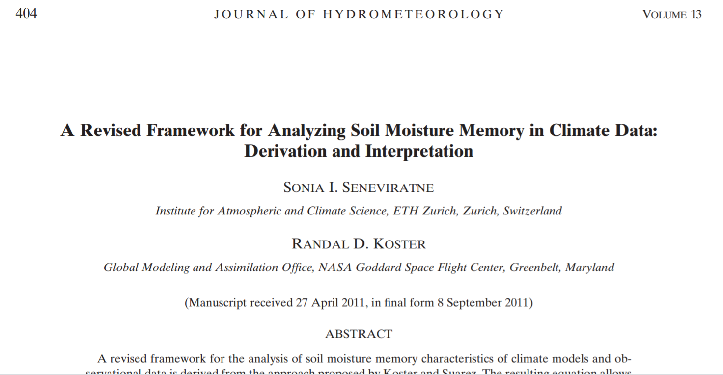
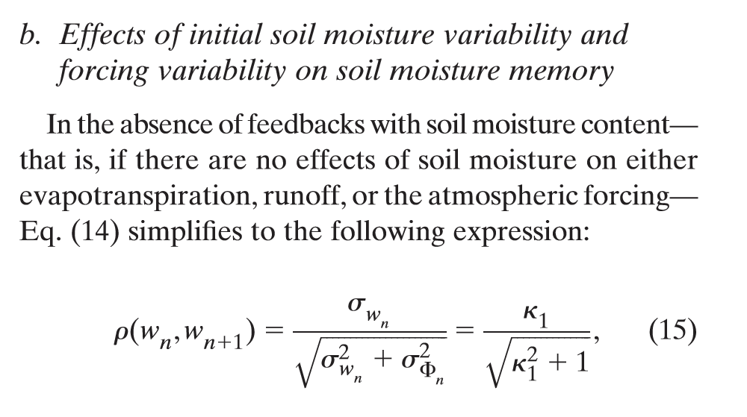
This, of course, is not a “new” idea. A similar equation, for example, was proposed by Seneviratne in 2011 to relate soil moisture memory to forcing variance:

Slide 26
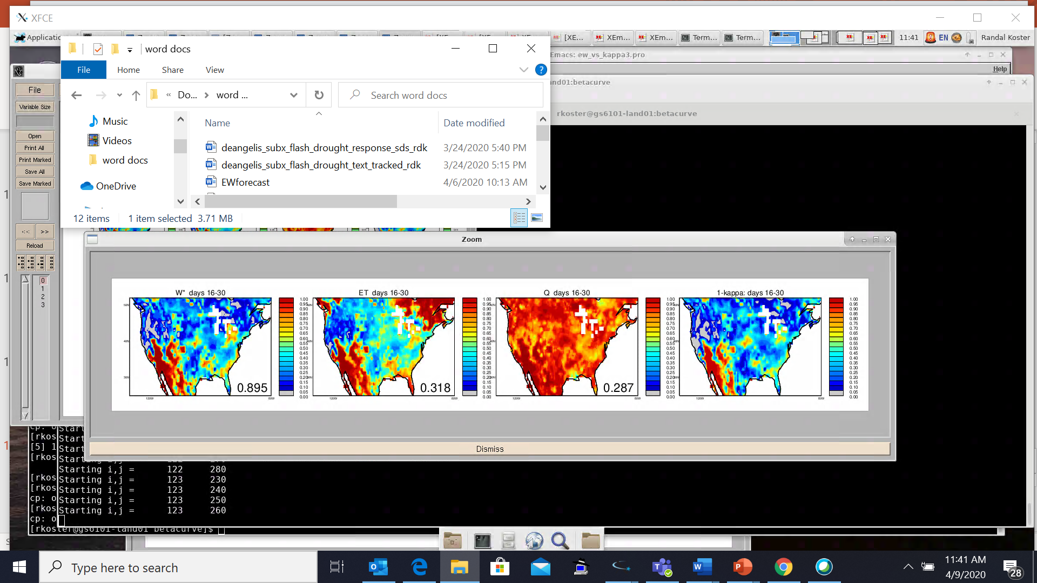
Results from ensemble analysis with simple modeling framework
computed from independent time period
Recall: smaller U a smaller forecast uncertainty
σ²_{P}
U for soil moisture
U for evapotranspiration
σ²_{W0} +
σ²_{P}
1.
1.
1.
0.8
0.8
0.8
Days 16-30 of forecast
0.6
0.6
0.6
0.4
0.4
0.4
0.2
0.2
0.2
0.
0.
0.
Spatial r² between the two fields = 0.895
σ²_{P}
Conclusion:
does underlie hydrological forecast uncertainty!
σ²_{W0} +
σ²_{P}

Slide 27
Results from ensemble analysis with simple modeling framework
The poor agreement here can be explained…
σ²_{P}
U for evapotranspiration
U for soil moisture
U for evapotranspiration
U for soil moisture
σ²_{W0} +
σ²_{P}
1.
1.
1.
0.8
0.8
0.8
Days 16-30 of forecast
0.6
0.6
0.6
0.4
0.4
0.4
0.2
0.2
0.2
0.
0.
0.
σ²_{P}
Conclusion:
does underlie hydrological forecast uncertainty!
σ²_{W0} +
σ²_{P}

Slide 28
Here, we’re always on this part of the curve – no skill for E
Results from ensemble analysis with simple modeling framework
1
λE/ R_{net}
σ²_{P}
U for evapotranspiration
U for evapotranspiration
U for soil moisture
U for evapotranspiration
σ²_{W0} +
0
σ²_{P}
σ²_{P}
W
1.
1.
1.
0.8
0.8
0.8
Days 16-30 of forecast
0.6
0.6
0.6
0.4
0.4
0.4
0.2
0.2
0.2
0.
0.
0.
σ²_{P}
Conclusion:
does underlie hydrological forecast uncertainty!
σ²_{W0} +
σ²_{P}

Slide 29
These uncertainty results should be reflected directly in “skill” levels (r² versus MERRA-2 “observations”).
That is, lower uncertainty should imply higher skill.
Does this hold when we look at the full GMAO S2S forecast system? (caveat: “observations” = MERRA-2)

Slide 30
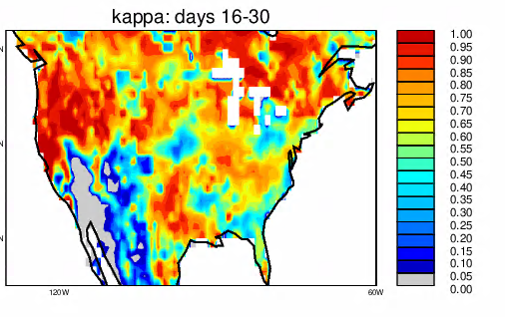
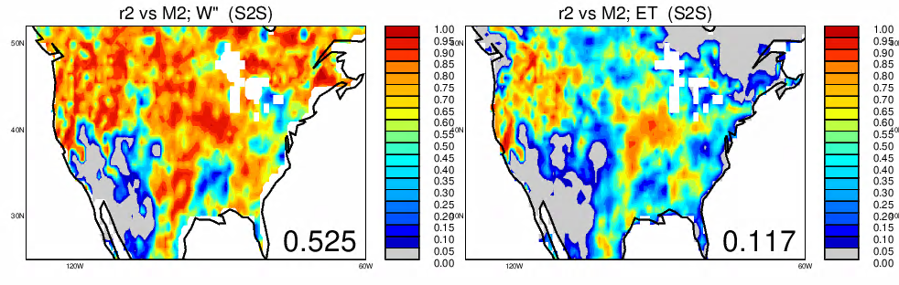
Full S2S Forecast System
σ²_{P}
r² skill for soil moisture
r² skill for evapotranspiration
1 –
σ²_{W0} +
σ²_{P}
1.
1.
1.
0.8
0.8
0.8
Days 16-30 of forecast
0.6
0.6
0.6
0.4
0.4
0.4
0.2
0.2
0.2
0.
0.
0.
From before; note that all information is from MERRA-2, with σ²_{P} from an independent time period

Slide 31
This ratio is relevant to the GMAO S2S system!
Full S2S Forecast System
σ²_{P}
r² skill for soil moisture
r² skill for evapotranspiration
1 –
σ²_{W0} +
σ²_{P}
1.
1.
1.
0.8
0.8
0.8
Days 16-30 of forecast
0.6
0.6
0.6
0.4
0.4
0.4
0.2
0.2
0.2
0.
0.
0.
And here, lower uncertainty is related to higher skill!

Slide 32
We now explore 3 facets of hydrological uncertainty:
The relative importance of P variability and W₀ variability in defining E and W forecast uncertainty;
The shape of the land model’s effective “beta curve” on E and W forecast uncertainty; and
The impact of Covariance(P, W₀) on E and W forecast uncertainty.

Slide 33
Recall the canonical shape of the relationship between soil moisture (W) and evaporative fraction:
1
λE/ R_{net}
0
W

Slide 34
1
Case 1: Initial soil moisture is wet
λE/ R_{net}
Case 2: Initial soil moisture is dry
0
W

Slide 35
A high-rain ensemble member may bring conditions here after a month
1
A low-rain ensemble member may bring conditions here after a month
Case 1: Initial soil moisture is wet
λE/ R_{net}
Case 2: Initial soil moisture is dry
0
W

Slide 36
Either way, E is not greatly affected
1
Case 1: Initial soil moisture is wet
λE/ R_{net}
a A wet soil moisture initialization implies low ensemble spread in the E forecast (low E forecast uncertainty)
Case 2: Initial soil moisture is dry
0
W

Slide 37
1
Case 1: Initial soil moisture is wet
λE/ R_{net}
A high-rain ensemble member may bring conditions here
high spread in E!
Case 2: Initial soil moisture is dry
A low-rain ensemble member may bring conditions here
0
W

Slide 38
1
Case 1: Initial soil moisture is wet
λE/ R_{net}
A high-rain ensemble member may bring conditions here
high spread in E!
a A dry soil moisture initialization implies high ensemble spread in the E forecast (high E forecast uncertainty)
Case 2: Initial soil moisture is dry
A low-rain ensemble member may bring conditions here
0
W

Slide 39
Now consider soil moisture uncertainty – a bit more subtle…

Slide 40
A high-rain ensemble member may bring conditions here after a month
1
Case 2: Initial soil moisture is dry
A low-rain ensemble member may bring conditions here after a month
Case 1: Initial soil moisture is wet
λE/ R_{net}
a high spread in W
0
W

Slide 41
1
Case 2: Initial soil moisture is dry
Case 1: Initial soil moisture is wet
λE/ R_{net}
a high spread in W
0
lower spread due to buffering
W

Slide 42
1
Case 2: Initial soil moisture is dry
Case 1: Initial soil moisture is wet
λE/ R_{net}
Soil moisture increases a higher E pushes it back down
Soil moisture decreases a lower E pushes it back up
a high spread in W
0
lower spread due to buffering
W

Slide 43
So, what do we expect?
    Low initial soil moisture:
        Low W forecast spread
        High E forecast spread
    High initial soil moisture:
        High W forecast spread
        Low E forecast spread

Slide 44
1
N
Σ σ²_{ens-n}
N
n=1
Recall uncertainty metric: U =
σ²_{all}
Define “dry” and “wet” versions:
driest third of initializations
wettest third of initializations
1
N_{dry}
1
N_{wet}
Σ σ²_{ens-n}
Σ σ²_{ens-n}
N_{dry}
n=1
N_{wet}
n=1
U_{dry} =
U_{wet} =
σ²_{all}
σ²_{all}

Slide 45
So, what do we expect?
    Low initial soil moisture:
        Low W forecast spread
        High E forecast spread
    High initial soil moisture:
        High W forecast spread
        Low E forecast spread
a we expect U_{dry} – U_{wet} to be negative for W and positive for E

Slide 46
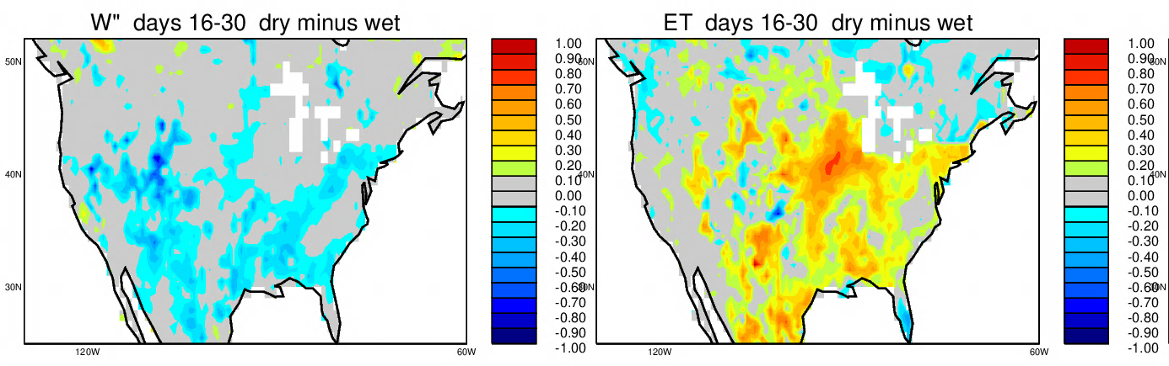
This is, in fact, exactly what we see in the simple model results:
U_{dry} – U_{wet}
for soil moisture
U_{dry} – U_{wet}
evapotranspiration
1.
1.
0.8
0.8
0.6
0.6
0.4
0.4
0.2
0.2
0.
0.

Slide 47
What does this say, though, about skill levels in the full GMAO S2S forecast system?

Slide 48
Compute skill (RMSE vs MERRA-2 “observations”) separately for two subsets of GMAO S2S subseasonal forecasts (days 16-30).
Subset 1: Driest third of soil moisture initializations
Subset 2: Wettest third of soil moisture initializations
We expect that RMSE(driest third) – RMSE(wettest third) should be:
  negative for soil moisture (skill higher for dry conditions)
  positive for evapotranspiration (skill higher for wet conditions)

Slide 49
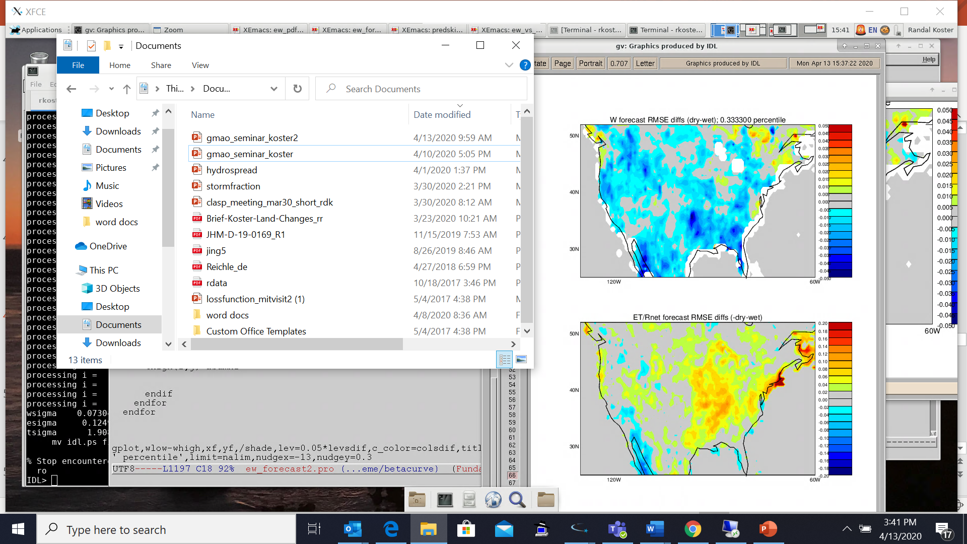
This is, in fact, what
we see.
Here, given the more limited data, we look at 10 forecast starts per year (May – September) during the SubX period, 1999-2015.
The mixing of different months motivates the scaling of E by R_{net-clim}.
Full GMAO S2S forecast (days 16-30):
RMSE(driest third) – RMSE(wettest third)
Soil moisture, W
.05
0.
-.05
Scaled evapotranspiration, E/R_{net-clim}
.2
0.
-.2

Slide 50
This is, in fact, what
we see.
Here, given the more limited data, we look at 10 forecast starts per year (May – September) during the SubX period, 1999-2015.
Full GMAO S2S forecast (days 16-30):
RMSE(driest third) – RMSE(wettest third)
Soil moisture, W
.05
0.
-.05
Scaled evapotranspiration, E/R_{net-clim}
.2
Here again, lower uncertainty is related to increased skill.
0.
-.2

Slide 51
We now explore 3 facets of hydrological uncertainty:
The relative importance of P variability and W₀ variability in defining E and W forecast uncertainty;
The shape of the land model’s effective “beta curve” on E and W forecast uncertainty; and
The impact of Covariance(P, W₀) on E and W forecast uncertainty.
(some preliminary results)

Slide 52
Recall earlier slide showing simple model framework:
Approximation for subseasonal (days 16-30) prediction :
Multiple random but self-consistent time series of P and R_{net}
Multiple estimates of E for days 16-30 of a forecast
Single average E value
Water balance equation framework
Extract from MERRA-2 (independent time periods)
W₀

Slide 53
Note that we can adjust these inputs to account for the covariance between W₀ and P (e.g., from land-atmosphere feedback or from SST regime)
Approximation for subseasonal (days 16-30) prediction :
Multiple random but self-consistent time series of P and R_{net}
Multiple estimates of E for days 16-30 of a forecast
Single average E value
Water balance equation framework
Extract from MERRA-2 (independent time periods)
W₀

Slide 54
Variance of forecasted quantity across all ensemble members of forecast n
1
N
Σ σ²_{ens-n}
N
n=1
Uncertainty metric: U =
σ²_{all}
Variance of forecasted quantity across all ensemble members of all forecasts
U = 0: No uncertainty
U = 1: Maximum uncertainty (no potential for skill)
Using simple modeling framework, compute:
U [accounting for Cov(Winit, P) ] – U [ignoring Cov(Winit, P) ]

Slide 55
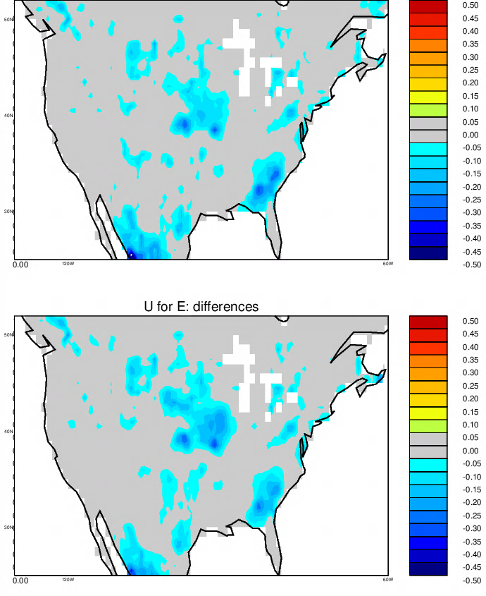
Soil moisture, W
Reduction in uncertainty measure U due to consideration of Cov(W₀, P) *
.5
0.
-.5
Evapotranspiration, E
Because the initial soil moisture says something about the upcoming forcing during a forecast, the uncertainty (ensemble spread) is reduced.
.5
0.
*results here not fully cross-validated – these results are preliminary
-.5

Slide 56
Summary
Using a simple representation of the land surface hydrologic branch of the GMAO S2S system, we examine controls over uncertainty in forecasted hydrological variables (soil moisture W and evapotranspiration E).
First, we find that the spread of W and E forecasts is determined in large part by
This ratio explains the spatial pattern of the uncertainty metric plotted across the US, and evidence of its relevance is seen in the full GMAO S2S subseasonal forecasts.
σ²_{P}
Variance of total P during forecast period
σ²_{W0} +
σ²_{P}
Variance (interannual) of initial moisture in soil column

Slide 57
Summary (cont.)
Second, we find that the shape of the E/R_{net} vs. W relationship has an impact on forecast spread.
Subseasonal Soil Moisture Forecasts
lower uncertainty for drier soil moisture initialization
pdf across ensemble
dry initialization
forecasted W
wet initialization
Subseasonal Evapotranspiration Forecasts
Some evidence for this in GMAO S2S results!
lower uncertainty for wetter soil moisture initialization
pdf across ensemble
dry initialization
forecasted E
wet initialization

Slide 58
Summary (cont.)
Finally, we find preliminary indications that accounting for the covariance between initial soil moisture and subsequent precipitation forcing should, in some places, reduce uncertainty.
Subseasonal Soil Moisture Forecasts
lower uncertainty if forecasted P correlates with initial W
pdf across ensemble
dry initialization
forecasted W
wet initialization

Slide 59
Thank you!

