Slide 1
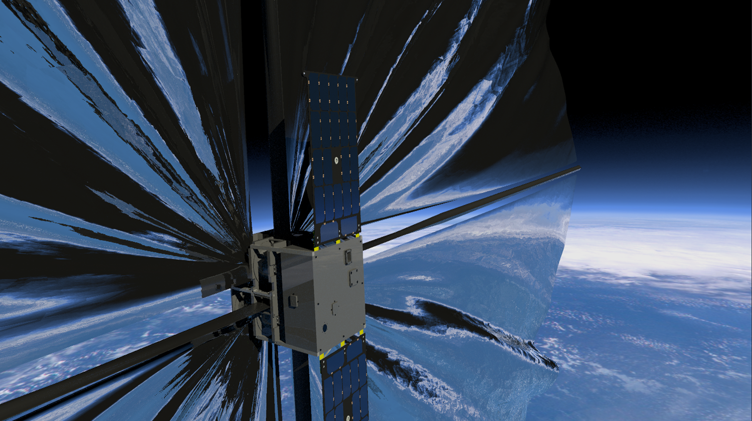

Thin-Ply Composite Deployable Boom Structures For Solar Sails
Joshua Edward Salazar

Slide 2
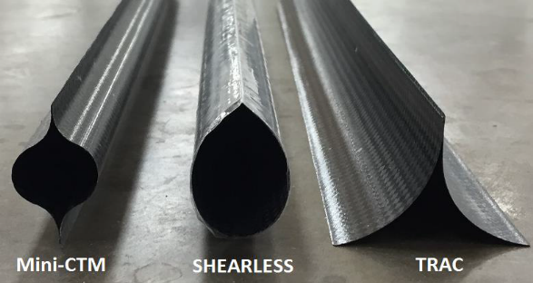
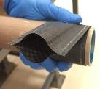
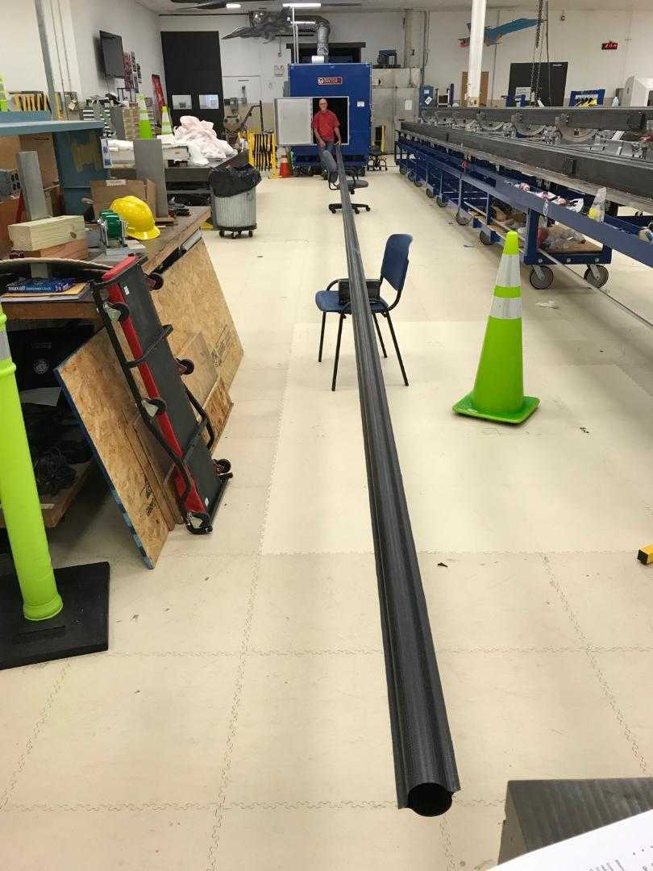
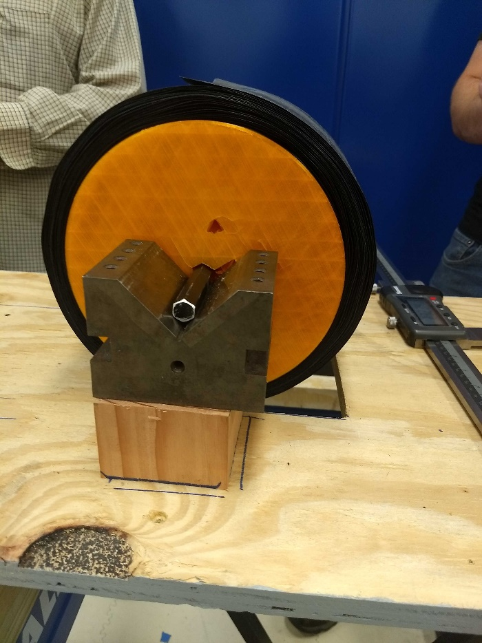
Thin-Ply Deployable Composite Booms
Carbon Fiber Reinforced Polymers (CFRP) composites
The Carbon fiber fabric is a spread tow fabric which allows Individual plies to be much thinner
Single ply thicknesses around 30-60 um
Laminate thicknesses around 120-300 um
54.5 ft boom stowed in less than 1 square foot
Rollable HSC booms under development at LaRC
CTM boom partially rolled
16.5 m (54.5 ft) boom stowed
1 ft OD

Slide 3
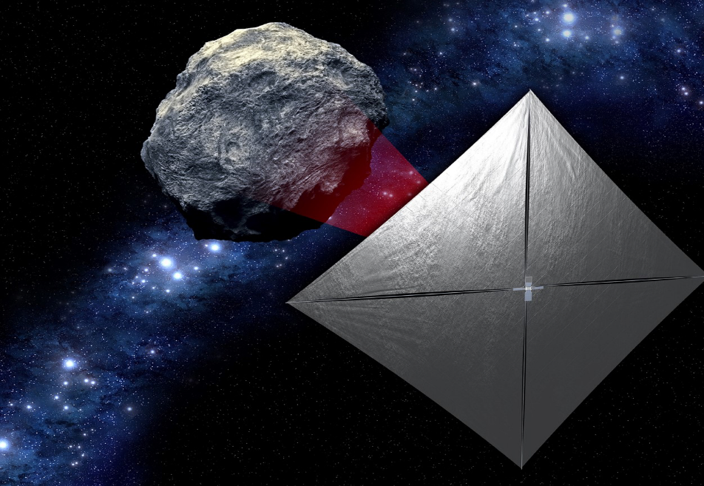
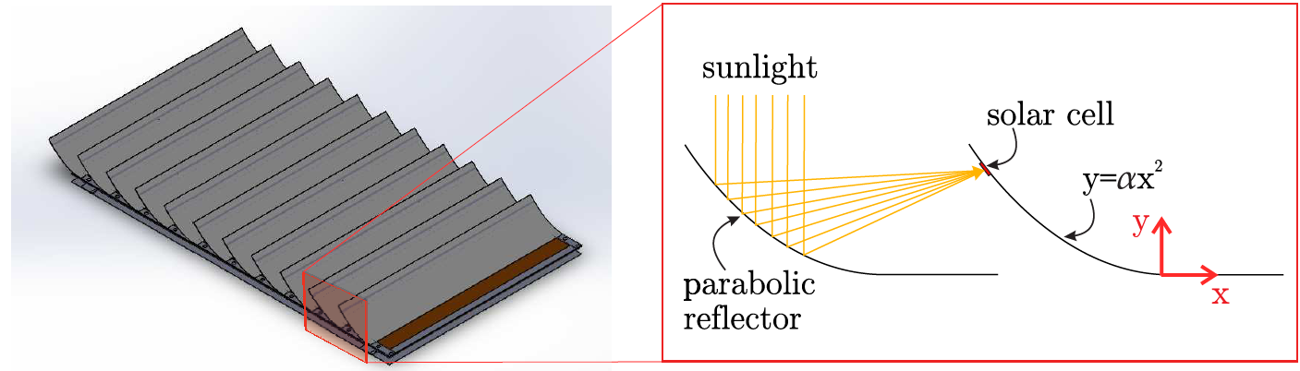
Motivation and Applications
Solar Sails:
  Near Earth Asteroid (NEA) scout is a 6U cubesat mission set to fly with the SLS Orion EM-1 mission as a secondary payload.
  7.5 meter metallic Triangular roll able and collapsable (TRAC) booms
  High CTE of metallic booms can cause deformations that severely limit the length of the booms
  LaRC’s Advanced Composites Solar Sail System (ACS3) 12U CubeSat solar sail flight demonstrator to fly in 2021 will have deployable composite booms.
Drag sails to quickly de orbit satellites
Deployable Antennas
Parabolic reflectors
Foldable panels / deployable surfaces
https://gameon.nasa.gov/projects/deployable-composite-booms-dcb/
Bosi, F., Schlothauer, A., Pellegrino, S., Cure-induced deformation of ultra-thin composite laminates, AIAA SciTech Forum, 8-12 (2018)

Slide 4
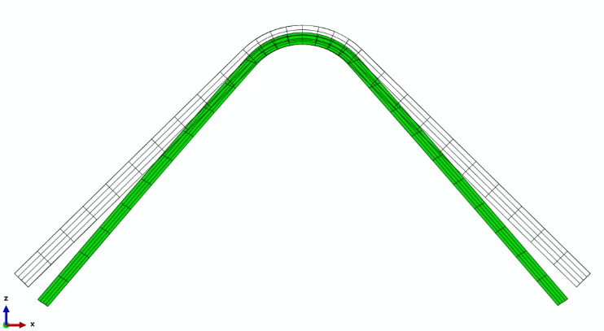

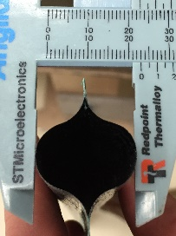

Technology Risks
Technology Limitations:
Loss of dimensional stability during manufacturing
  The manufacturing of high precision structures is limited by cure stresses causing relaxations and spring-in of curved parts
Loss of dimensional stability during stowage
  During stowage the composite is held in a high deformation state and is expected to have some amount of stress relaxation as a result of this. This stress relaxation can cause dimensional changes in the structure once released from stowage which could reduce load bearing capabilities
Load bearing capabilities of thin-ply composite structures is highly dependent on cross section and length dimensions.
The dimensional stability of both manufacturing and stowage need to be understood to utilize thin-ply deployable composites effectively
Molded shape
Cured shape
Example of spring-in after curing
Boom axial curvature (bow) developed after a one month stowage.
Note: Boom design and laminate not being used, shown here for illustrating the risk.
Boom flattens after prolonged stowage = 50% drop in buckling load
7 m
16 mm
23 mm
(-30%)
14 cm

Slide 5
Research Objectives
Determination of the dimensional Stability during the manufacturing of thin-ply Composites
Determination of the dimensional stability of thin ply composites during stowage

Slide 6
Research Objectives
Determination of the dimensional Stability during the manufacturing of thin-ply Composites
Determination of the dimensional stability of thin ply composites during stowage

Slide 7
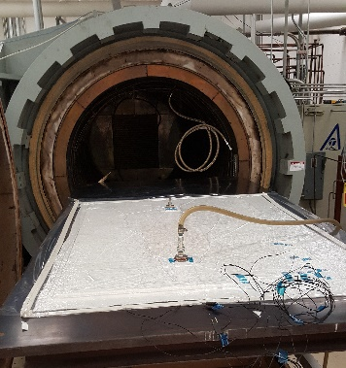
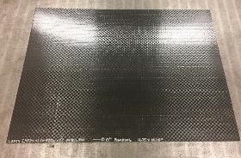
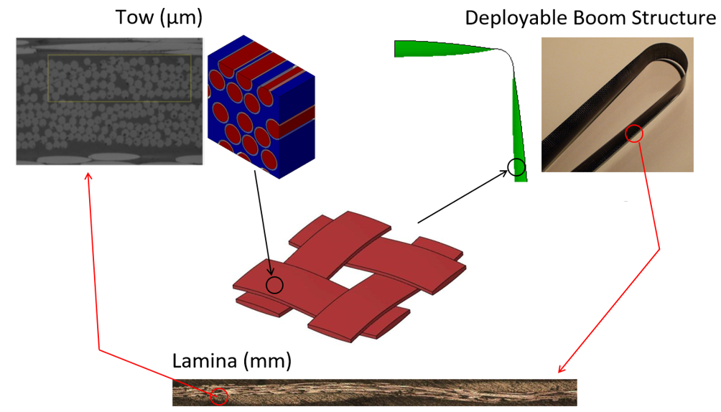
Composite Curing
Carbon Fiber is impregnated with a viscous resin
Composite is then placed under pressure and heat
As the polymer resin cures it shrinks and hardens
The combination of shrinking and pressure will also cause some amount of flow in the resin

Slide 8
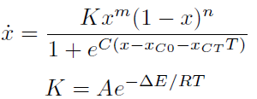
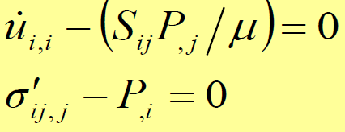
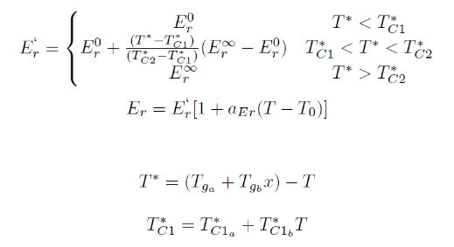

Process Flow For Cure Deformation Analysis
Large number of polymer samples
DSC
Measures the amount of heat the polymer resin is absorbing as it cures
DMA
Mechanical and viscoelastic properties of polymer
Rheology
Can measure how the polymer resin’s viscosity increases and how the polymer stiffens as it cures
Cure Kinetics Flow Compaction Modulus development
Material Models & Properties
Finite Element Analysis
Stress Deformation:

Slide 9
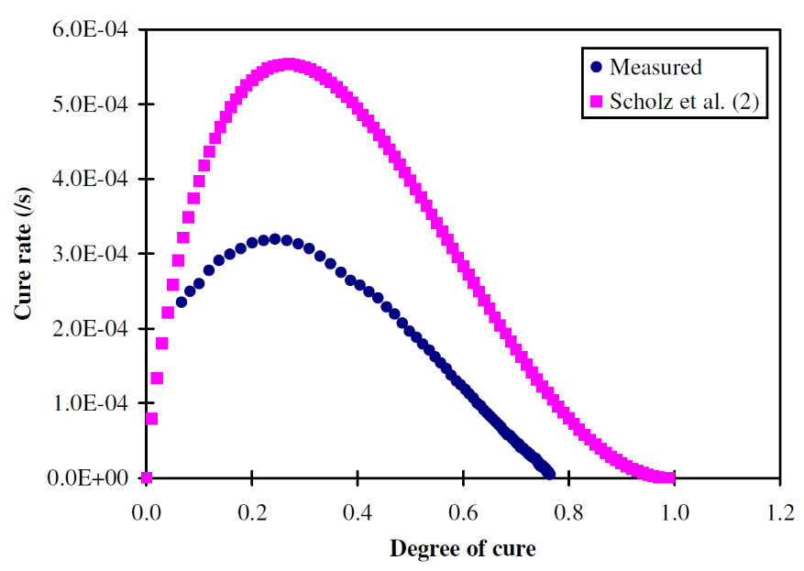
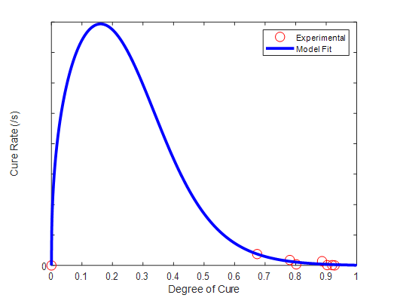
Degree of Cure Curve fitting
All images need to be updated
Data obtained gives degree of cure vs time
Slope between two point gives cure rate
Plot cure rate vs degree of cure
Fit model to experimental data
ref: Hubert, P., Johnston, A., Poursartip, A., Nelson, K. Cure kinetics and viscosity models for Hexcel 8552 epoxy resin, 46th International SAMPE Symposium and Exhibition, 2341-2354 (2001).
Parameter
Activation Energy (ΔE) - J/mole
Pre-exponential cure rate coefficient (A) - 1/s
First exponential constant (m)
Second exponential constant (n)
Diffusion constant (C)
Critical degree of cure at T = 0 K (x_{C0})
Increase in critical resin degree of cure with temperature (x_{CT}) – 1/K
R² = 0.85

Slide 10
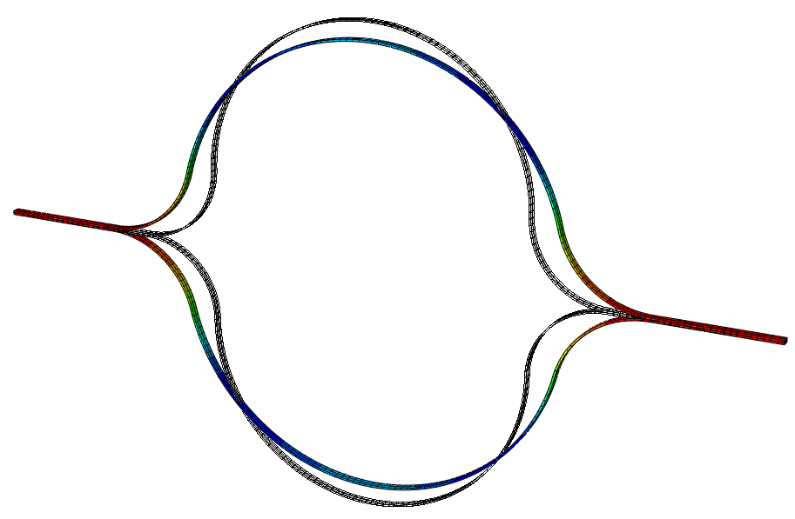
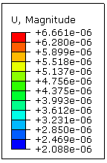
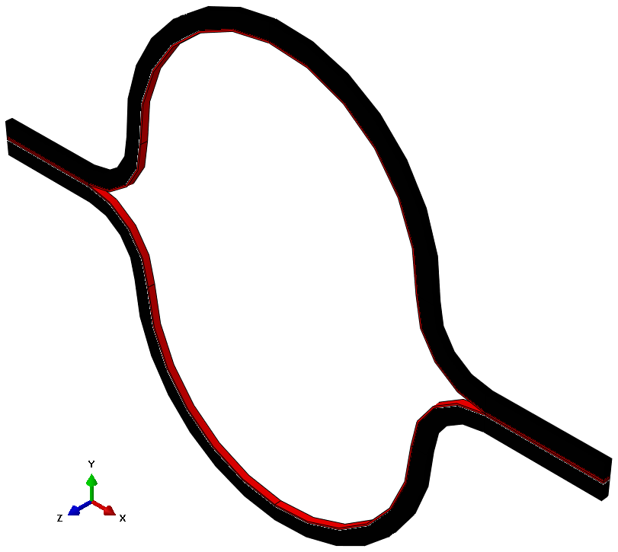
Preliminary FEA results Abaqus+COMPRO Results
Analysis Steps
Thermo-chemical
Stress deformation
Tool removal and relaxation
Horizontal Change = 0.013 mm
Vertical Change = -0.006 mm
Area Change = 0.269 mm²
Scale factor: 100

Slide 11
Research Objectives
Determination of the dimensional Stability during the manufacturing of thin-ply Composites
Determination of the dimensional stability of thin ply composites during stowage

Slide 12
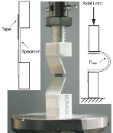
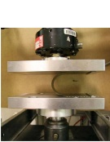
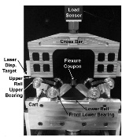
Background & Motivation
Previous tests developed for understanding the behavior of thin-ply composite flexures have limitations.
Simple Vertical Test with tape hinges is prone to gravity-induced lateral loads and moments that tend to produce coupon/tape shear distortion at large rotation angles or induced curvatures.
Platen Test generates a small localized region of high curvature in coupon apex, well away from coupon ends, that result in uncharacteristically high failure curvatures. The moment and stress over the coupon is highly non-uniform requiring complex structural analyses to interpret test results.
  Used for determining upper limit on maximum coupon curvature or for computing strains and stresses at failure.
  Not used to assess bending stiffness as it does not represent well the pure bending states of most thin-ply composite structures.
Large Deformation Four-Point Bending (LD-FPB) subjects the coupon to a pure bending stress state, and used to measure bending stiffness including fiber nonlinear effects.
  However, the abrupt transition from flat to curved causes premature failure at test grips (stress concentration).
  Hence, not normally used for bending strength and strain to failure evaluation.
Simple Vertical Test
Platen Test
LD-FPB Test

Slide 13


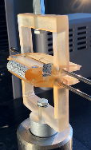
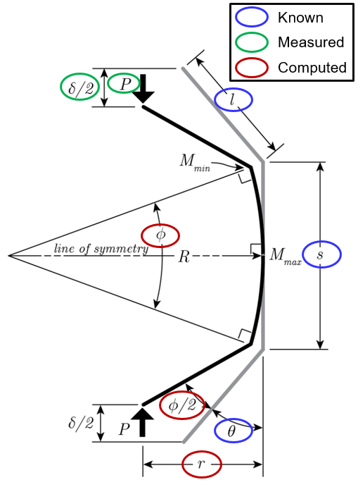






Column Bending Test (CBT)
CBT method initially developed by Opterus R&D and evaluated and refined for very thin composite flexures at Opterus R&D and LaRC: Fernandez, Murphey, AIAA 2018-0942.
Test setup consists of double-symmetric, weight-balanced rigid fixtures arms pinned inside a clevis, which firmly clamp the specimen at an offset distance from the pin axis.
As the fixture move vertically towards each other applying a compression force, they rotate causing a bending moment in the coupon.
Combines best features of previous tests:
  Vertical setup compatible with uniaxial load frames.
  Generates a max stress state at the coupon center (as in platen test) but only decreasing it to 80-90% of the max at the grips (and not 0%).
  Because a larger volume of material is subjected to high stress, the results are more representative of pure bending stress than in platen test.
  Stress state is mostly uniform, as in large deformation four point bending test (LD-FPB), allowing simple kinematic analysis to estimate moment and curvature: constant curvature assumption.
  Since curvature is slightly reduced at grips, failure likely to occur in coupon apex (as opposed to LD-FPB) for tests seeking bending strength and failure strain.
Testing machine extension
Bent flexible coupon
Rigid upper arm
Coupon grips
Rigid lower arm
U shaped clevis
Pinned joints
CBT Kinematics: numerically calculating $r$ and $φ$
$\frac{δ}{s}=1− \frac{2}{φ}\sin{\frac{φ}{2}+2\frac{l}{s}\left(\cos{θ− \cos\left(θ+\frac{φ}{2}\right)}\right) }$
$κ= \frac{φ}{s}$
$\frac{r}{s}=\frac{1}{φ} \left(1−\cos{\frac{φ}{2}}\right)+ \frac{l}{s}\sin\left(θ+\frac{φ}{2}\right)$
$M_{max}=Pr$
$M_{min}=Pl sin\left(θ+\frac{φ}{2}\right)$
Output: Bending Stiffness D*₁₁ = $\frac{M_{max}}{{\text{κ}}_{}}$

Slide 14

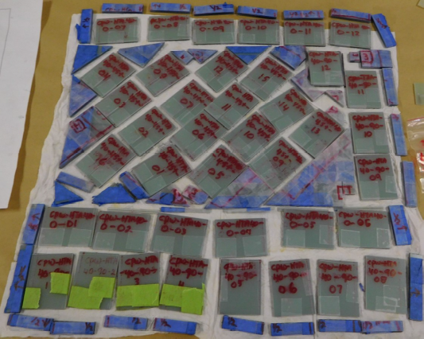
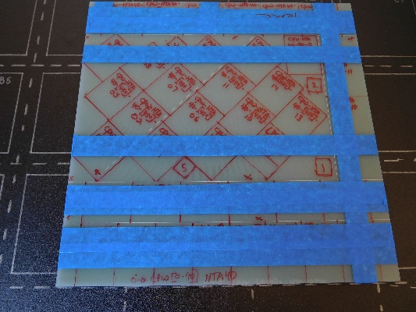
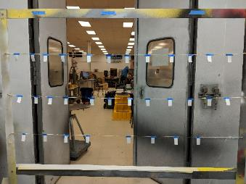
Material Preparation
  Test Coupon fabrication and painting
  Laminates are cured in an autoclave at 14 psi and 350⁰F and cut via water jet
  Coupons were wiped down with Isopropyl alcohol and hung on the painting rack
  The samples were painted with up to two coats of a matte white commercial aerosol spray paint
  After at least 12 hours, the samples were painted with Aeroglaze Z306 Flat Black Polyurethane paint mixed with Aeroglaze 9958 thinner using a detailing airbrush

Slide 15
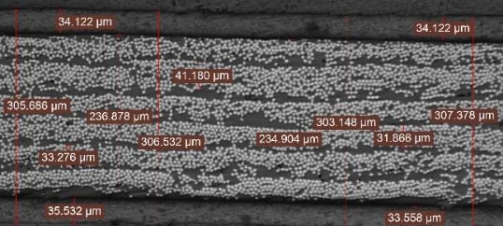
Material Preparation
  Polishing, Imaging & Micrographs
  After allowing the paint to dry for at least 24 hours the coupons were polished in the polishing lab in building 1205
    Coupons were polished with 600, 800, and 1200 grit sandpapers at a constant 120 rpm
  The coupons were then imaged using the inverted Leica optical microscope at 100x, 200x, and 500x
    100x images were used to stitch together multiple images for a larger image of the sample
    500x images were used to calculate the fiber volume fraction
Thin-ply laminates studied
Label | Laminate | # Coupons tested | Avg thickness (µm)
M30S PW_45_x4 | [±45PW]₄ | 4 | 250 ± 10
M30S PW_0_x4 | [0-90PW]₄ | 4 | 250 ± 10
LAM1_0_x6 | [±45PW₂/0UD₂/±45PW₂] | 5 | 330 ± 10
LAM1_90_x6 | [±45PW₂/90UD₂/±45PW₂] | 5 | 330 ± 10
Doubled the laminate layup (2x thickness) for ease of testing. Data is then scaled down.
Material (fiber/resin) | Spread-tow Fabric Form | Width (mm) | FAW (g/m²) | Ply AW (g/m²) | FVF (%) | Cured Ply Thickness (µm) | E₁ (GPa) | E₂ (GPa) | ν₁₂ | G₁₂ (GPa) | Vendor (fiber / resin)
MR60H/PMT-F7 | UD | 50 | 38.0 | 63.4 | 56 | 40 ± 3 | 174.4 | 8.4 | 0.259 | 6.4 | Sakai Ovex / Patz M&T
M30S/PMT-F7 | PW | 1000 | 61.0 | 89.7 | 54 | 60 ± 3 | 94.2 | 94.2 | 0.026 | 3.9 | Sakai Ovex/ PatzM&T

Slide 16
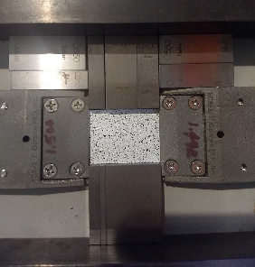
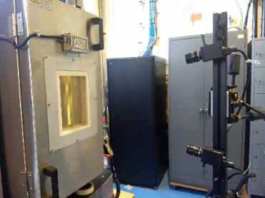
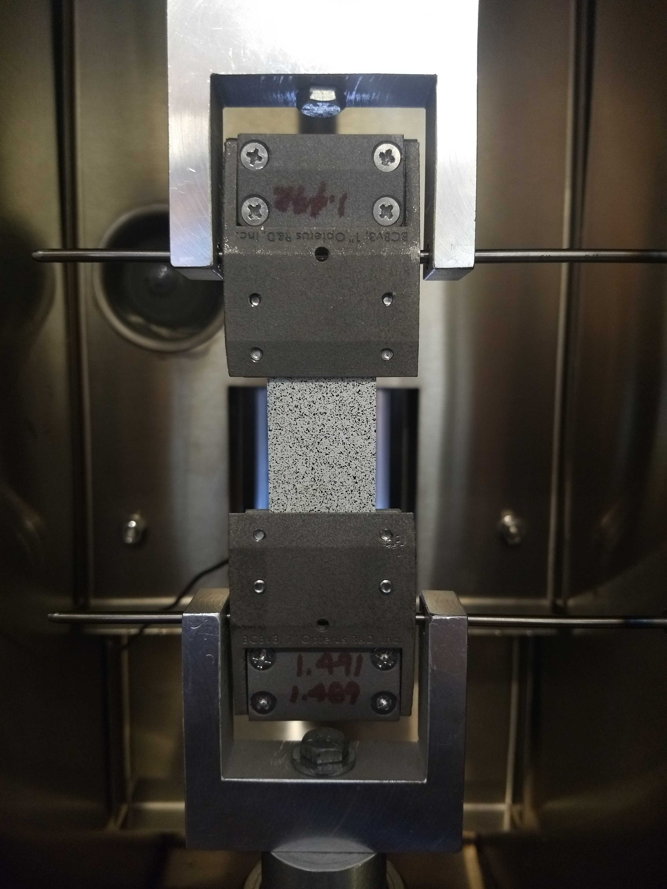
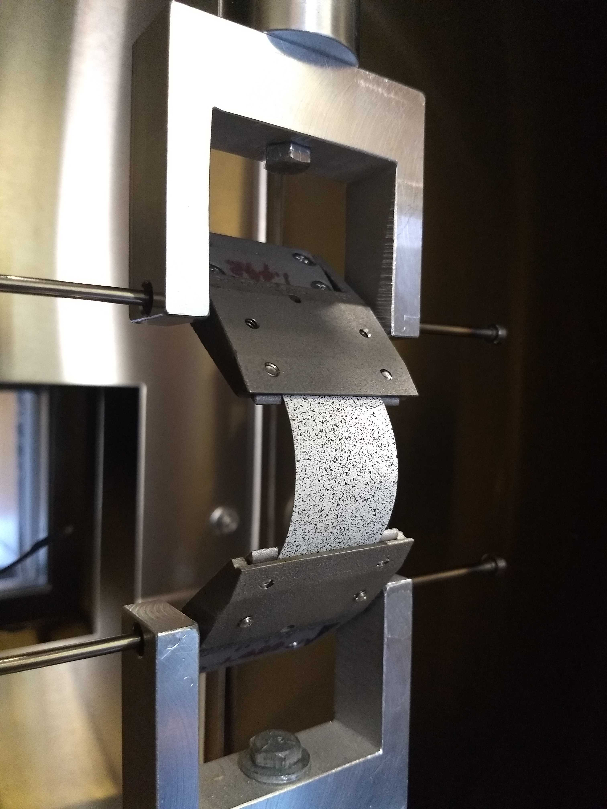
Preparing Coupons for Testing
Coupons were installed in CBT fixtures with pre determined gage lengths depend on material and laminate
The CBT fixtures were then installed in the thermal chamber and it was set to testing temperature and allowed to equilibrate for 90 minutes
MTS Load is zeroed at half the weight of the CBT clamps and coupon after they were installed
Notes:
The CBT fixtures were then installed in the MTS machine taking care to zero before installation in order to have the weight of the fixture evenly distributed between both platens

Slide 17

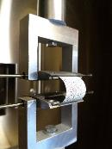
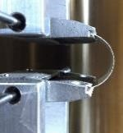
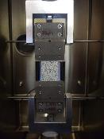
CBT Test Procedure for Viscoelastic Characterization
Test parameters adopted in this study
Fold
Unfold
Temperature | 40, 60, 80 ,100, 120°C
Temp. steady state time | 1.5 h
Fold/unfold rate | 12 mm/min
Fold/unfold time | 2 min
Estimated surface strain | 1%
Relaxation time: | 6 h
Recovery Time | 2 h
Total test time | 48 h
Relax
Recover
40° C
60° C
80° C
100° C
120° C
Folding strains are consistent at different temps after recovery

Slide 18
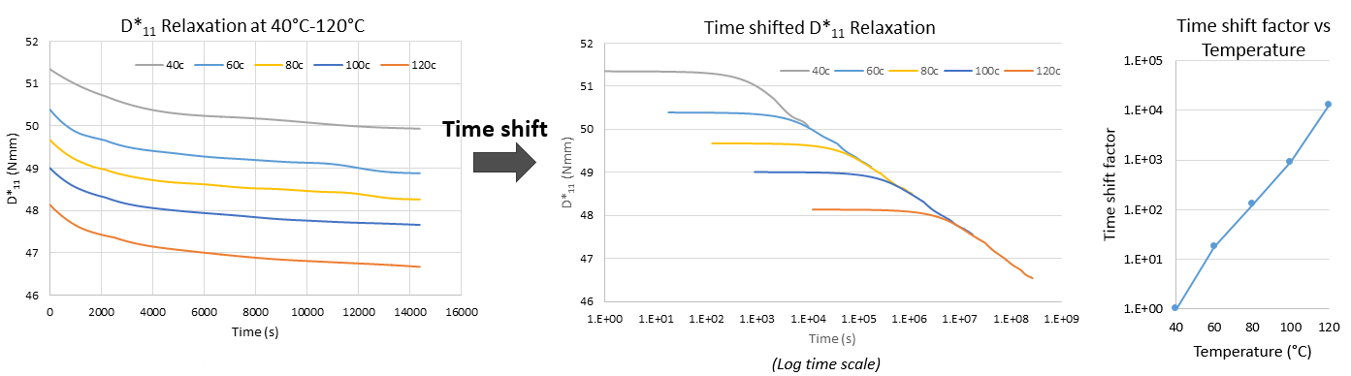
Composite Bending Viscoelastic Characterization
CBT Bending relaxation tests of 4-ply ±45º PW (M30S/PMT-F7) laminate performed at 40 - 120 ºC in 20 ºC increments.
Bending relaxation data shifted to form a master curve at 40 ℃ (expected max stowage temperature) using Time-Temperature-Superposition Principle.
High degree of linearity of log of time shift factor vs temperature curve indicates that the CFRP material behaves like a thermorheological one allowing the TTSP to be used for accelerated relaxation testing.

Slide 19
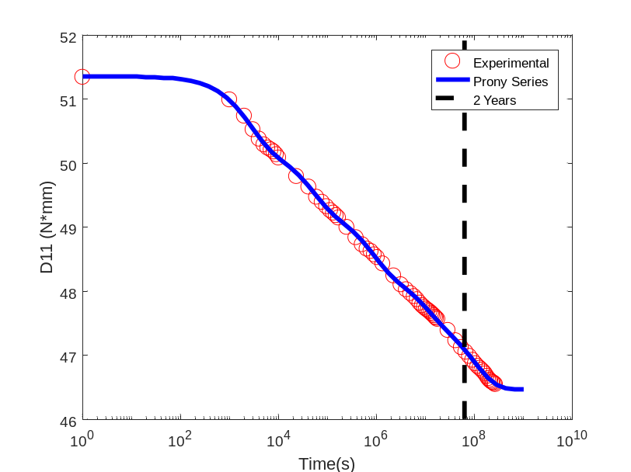
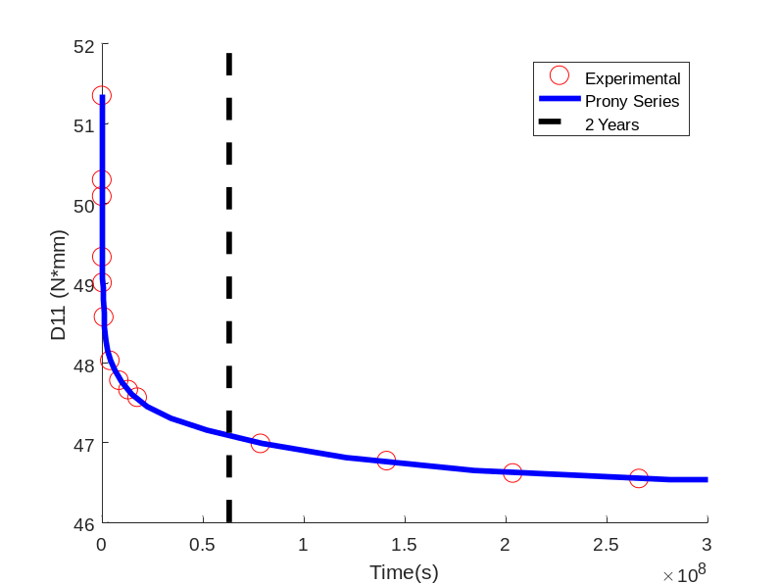
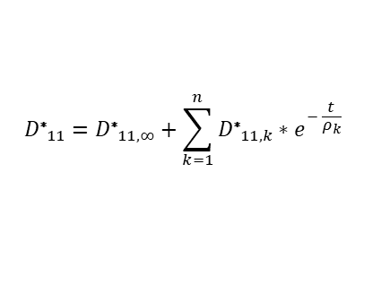
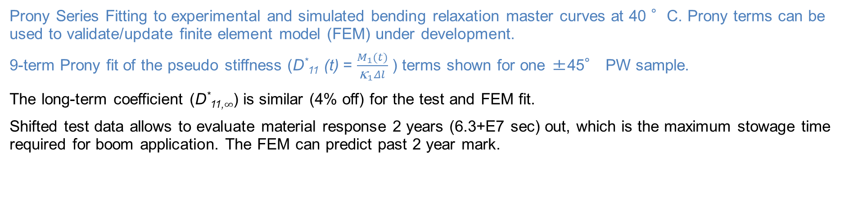
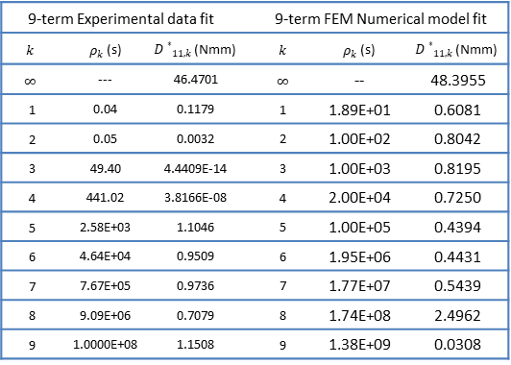
Composite Bending Viscoelastic Characterization
Prony Series Fitting to experimental and simulated bending relaxation master curves at 40 °C. Prony terms can be used to validate/update finite element model (FEM) under development.
9-term Prony fit of the pseudo stiffness (D*₁₁ (t) = $\frac{M_{1}(t)}{{\text{κ}}_{1}Δl}$ ) terms shown for one ±45° PW sample.
The long-term coefficient (D*_{11,}$∞$) is similar (4% off) for the test and FEM fit.
Shifted test data allows to evaluate material response 2 years (6.3+E7 sec) out, which is the maximum stowage time required for boom application. The FEM can predict past 2 year mark.
$${D\text{∗}}_{11}={D\text{∗}}_{11,∞}+\sum_{k=1}^{n}{{D\text{∗}}_{11,k}∗e^{− \frac{t}{ρ_{k}}}}$$
Prony series coefficients
9-term Experimental data fit |  |  |  | 9-term FEM Numerical model fit
$$k$$ | $ρ_{k}$ (s) | ${D∗}_{11,k}$ (Nmm) |  | $$k$$ | $ρ_{k}$ (s) | ${D∗}_{11,k}$ (Nmm)
$$∞$$ | --- | 46.4701 |  | $$∞$$ | -- | 48.3955
1 | 0.04 | 0.1179 |  | 1 | 1.89E+01 | 0.6081
2 | 0.05 | 0.0032 |  | 2 | 1.00E+02 | 0.8042
3 | 49.40 | 4.4409E-14 |  | 3 | 1.00E+03 | 0.8195
4 | 441.02 | 3.8166E-08 |  | 4 | 2.00E+04 | 0.7250
5 | 2.58E+03 | 1.1046 |  | 5 | 1.00E+05 | 0.4394
6 | 4.64E+04 | 0.9509 |  | 6 | 1.95E+06 | 0.4431
7 | 7.67E+05 | 0.9736 |  | 7 | 1.77E+07 | 0.5439
8 | 9.09E+06 | 0.7079 |  | 8 | 1.74E+08 | 2.4962
9 | 1.0000E+08 | 1.1508 |  | 9 | 1.38E+09 | 0.0308
*
*

Slide 20
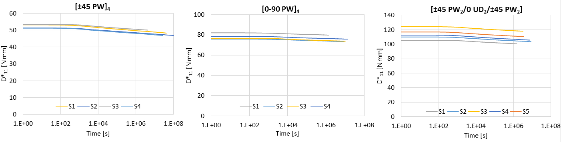
Thin-ply Composite Viscoelastic Characterization Summary
Bending relaxation data for all samples was normalized by the thickness of the thicker coupon in each batch.
The sample-to-sample thickness variability is acceptable and results show low standard deviations with [±45PW/0/±45 PW] laminate data having the largest spread given the large effect of the central 0° UD ply thickness on the laminate D*₁₁ value and its higher variability.
Most relaxation on ±45° PW laminate (10%), followed by [±45PW/0/±45 PW] laminate (6%) due to the viscoelastic matrix of the surface plies being highly loaded in shear as coupon gets bent axially.
0-90° PW relaxes the least (4.5%) due to elastic fibers oriented in the principal loading 1-direction.
The ±45° PW laminate showed the largest shift factors resulting in higher relaxation times, while the others had similar time predictions.
2x DCB Laminate
-10%
-4.5%
-6%

Slide 21


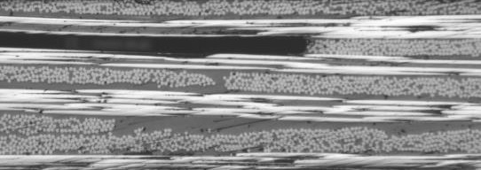
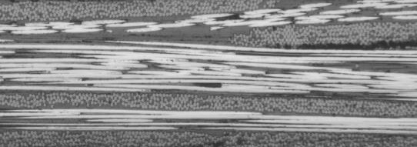
Composite Fiber Volume Fraction Variance
Fiber Volume Fraction - Jin Ho Kang and Brian Grimsley
Acid digestion method (ASTM 3171-15)
Procedure: (1) Heat in sulfuric acid at 280°C for 3 hours
(2) Heat in hydrogen peroxide at 280°C for 3 hours
(3) Vacuum filtering / rinse with DI water & Acetone
(4) Drying and measure weight the fiber
 | Sample 1 | Sample 2
D11 | 82 N*mm | 76 N*mm
Thickness | 0.241 mm | 0.234 mm
FVF | 60.4% | 62.4%
RVF | 38.4% | 38.5%
Voids | 1.2% | -0.9%
More voids and increased thickness moves fibers away from neutral axis

Slide 22
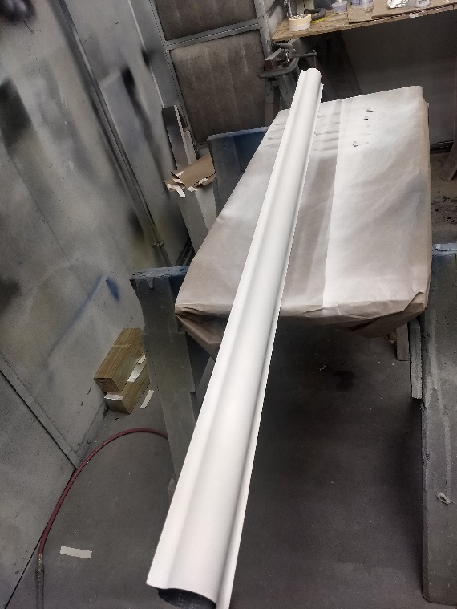
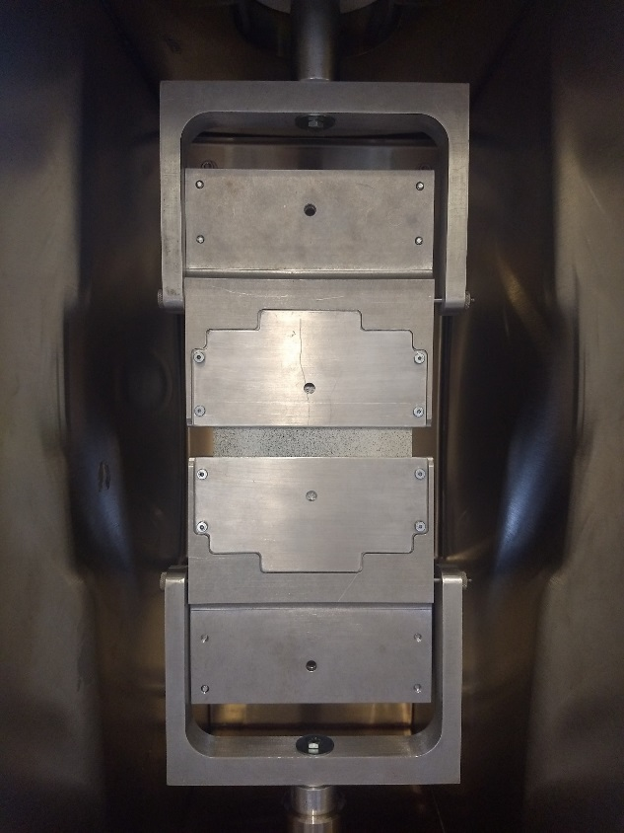
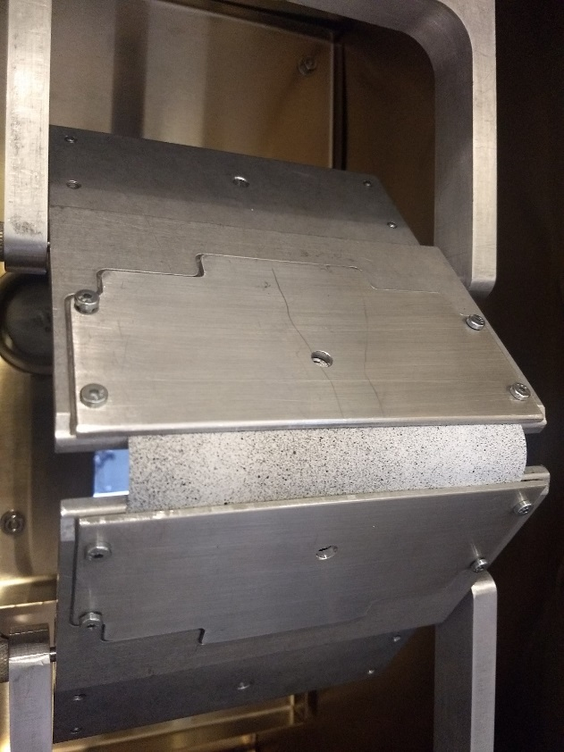
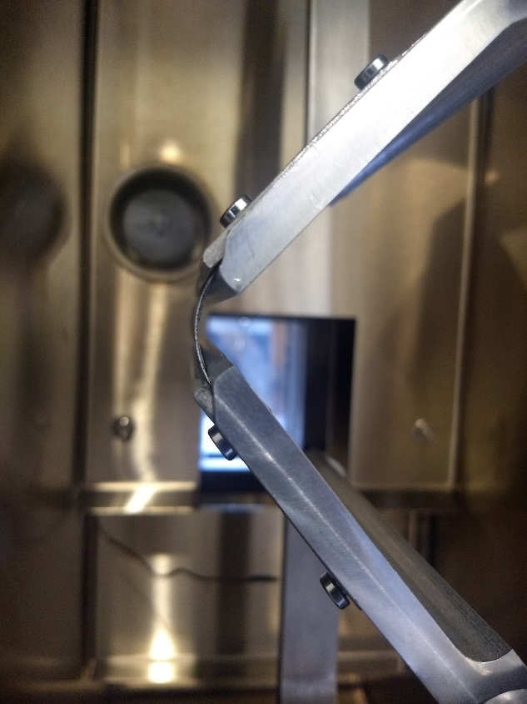
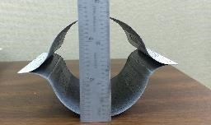

Boom CBT Testing
Boom is painted white and speckled with black paint then cut into 6 inch sections
CBT clamps are placed against flat surfaces for alignment while inserting boom
1 inch gage blocks are used to separate the clamps while inserting and clamping a section of the boom
The test has 5 repeated steps:
  Steady state, creep at 0 load – 92 min
  Cross head lowering – 2 min
  Relaxation, constant displacement – 360 min
  Unloading to 0 load - ~2min
  Recovery, creep at 0 load – 120 min
Flattened boom

Slide 23
Boom CBT Relaxation Test Results
The bending relaxation results from the CBT are shown below
The data shown has been filtered due to noise in the testing process
The Relaxation curves where then shifted to 40c using the shift factors on the right to produce the master curve
The Master curve shows a Reduction in D11 by 4.75 N*mm in about 4 years at a curvature of 0.04 mm⁻¹

Slide 24

Boom CBT Bending stiffness Model curve fitting
A Prony series was fit to the master curve using the method of least squares
The Prony series is fit to the data for up to 2 years at 40c
The D11 Prony coefficients and time constants are shown below
K | D11(N*mm) | Rho (sec)
0 | 23.6058 | NaN
1 | 0.0221 | 0.0084
2 | 0.0368 | 2.22E-14
3 | 2.22E-14 | 99.4824
4 | 0.8822 | 2.24E+03
5 | 0.7445 | 1.48E+04
6 | 0.8831 | 9.98E+04
7 | 0.5579 | 1.00E+06
8 | 1.532 | 1.00E+07

Slide 25
Summary
Dimensional stability of thin-ply composites post curing
Improved thin ply deployable composite structures
Molded shape
Cured shape
Example of spring-in after curing
Dimensional stability of thin-ply composites post stowage
7 m
14 cm
https://gameon.nasa.gov/projects/deployable-composite-booms-dcb/

Slide 26




Future Work
Adhesive Testing
Full Scale Boom Stowage Testing

Slide 27

Thank you!
Questions?

