Slide 1
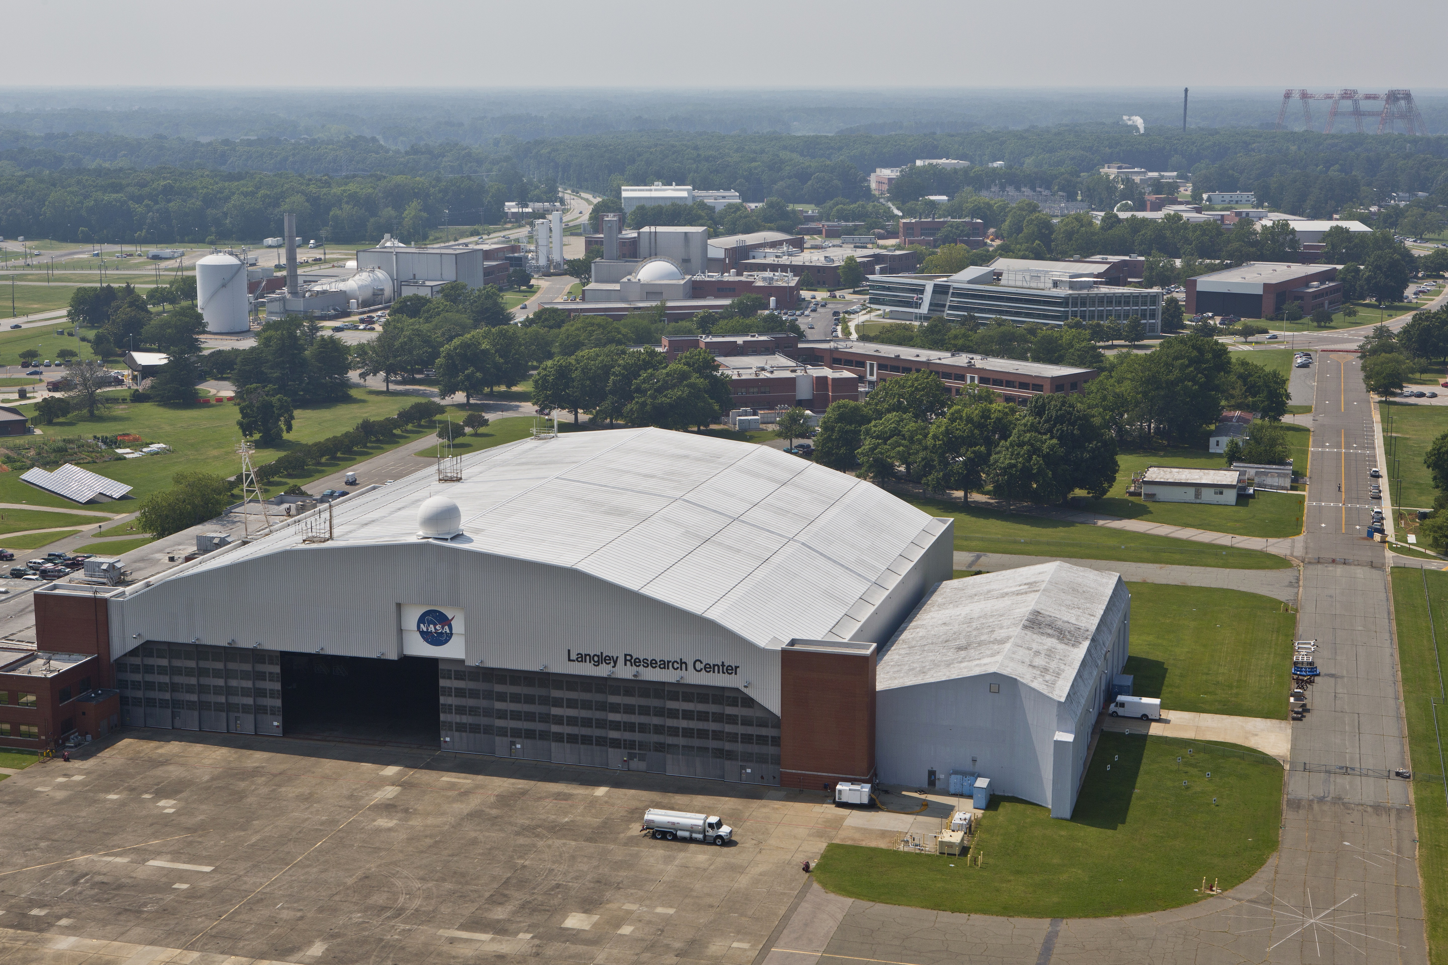


OnePlace Service Portal Redesign
Ariel Wald (NIFS Intern) | Cory Gilbert (Mentor)
OCIO | Information Management Branch (IMB) | CATT (Center Automation Transformation Team)
NASA Langley Research Center | Spring 2020

Slide 2

Table of Contents
Brief Autobiography
Objectives
Background
Model
  Current OnePlace Portal
  Mock-Ups
  Current Service Portal Implementation
  Project Management
  Training
Skills Learned & Value Added
Future Work & Impact
Acknowledgements

Slide 3
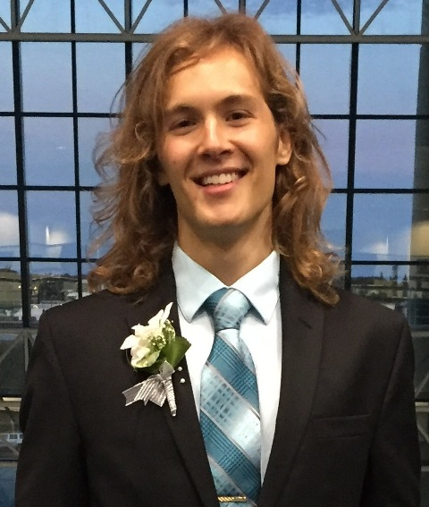
Brief Autobiography
I graduated this past December with my Bachelor's in Computer Science and Minor in Music Performance from the University of Florida. I am continuing in Fall 2020 with my Master's in Entrepreneurship.
My past internships were at Microsoft and Motorola, where I utilized Azure Web Apps with Angular, TypeScript, and the .NET framework, for client applications.
I find it important to be able to combine my musical, computer science, and astronomical passions into one, as so that’s why my Senior Project converts data of the Cassini mission from Saturn’s moon Titan into music to find the Music of the Cosmos.

Slide 4
Objective
The primary objectives for the OnePlace redesign are:
Convert the OnePlace home page to the Service Portal to match our current application design standards.
Allow users to easily find applications in OnePlace.
Allow users to easily find and request OnePlace services (new app development, new knowledge base, etc.).

Slide 5

Team Objectives
The Center Automation Transformation Team (CATT) is the support team for the OnePlace platform. The team is also responsible for developing most (but not all) of the custom OnePlace applications.
The Information Management Branch (IMB) is responsible for developing and providing Center-wide information systems and services for the management and archival of NASA Langley’s information and data assets, and providing access to global scientific and technical information.
The Office of the Chief Information Officer (OCIO) provides products and services that enable the capture, organization, communication, preservation, and protection of information and knowledge for Langley, NASA, and their customers.

Slide 6
Background
From the home page, end users will be able to do the following:
Search OnePlace
Browse OnePlace Applications
Access the Service Catalog
Access Knowledge
Request Help
Access My Requests
View Announcements.

Slide 7
OnePlace Portal Redesign – Browsing & Searching
Browse applications in the follow ways: access, favorites, newest, and by all.
Users will be able to initiate a OnePlace search from the homepage for the following resources:
  OnePlace Applications
  Knowledge Articles
  Service Catalog Items
Search Keyword
Knowledge Article
Catalog Item
Application

Slide 8
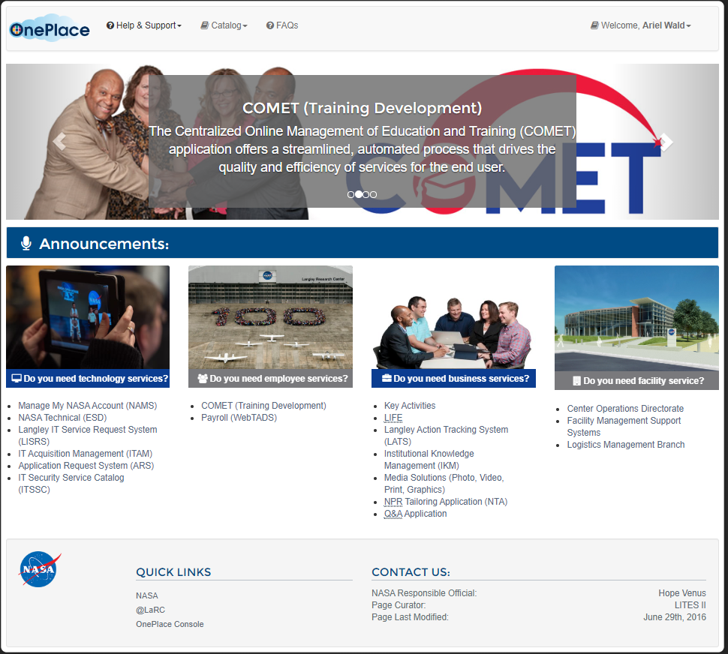
Current OnePlace Portal

Slide 9
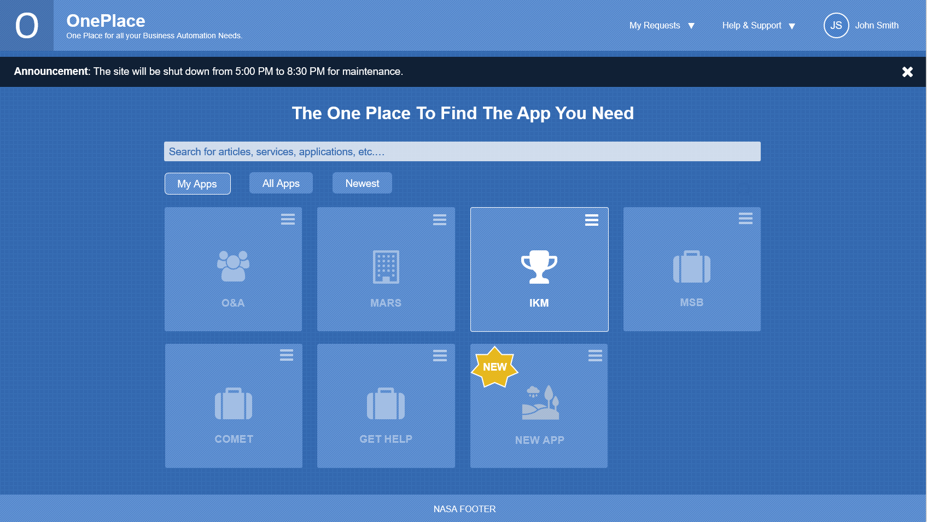
Mock-Up Design #1
Original mock-up view with additional updated UI elements in place based on initial user stories.

Slide 10
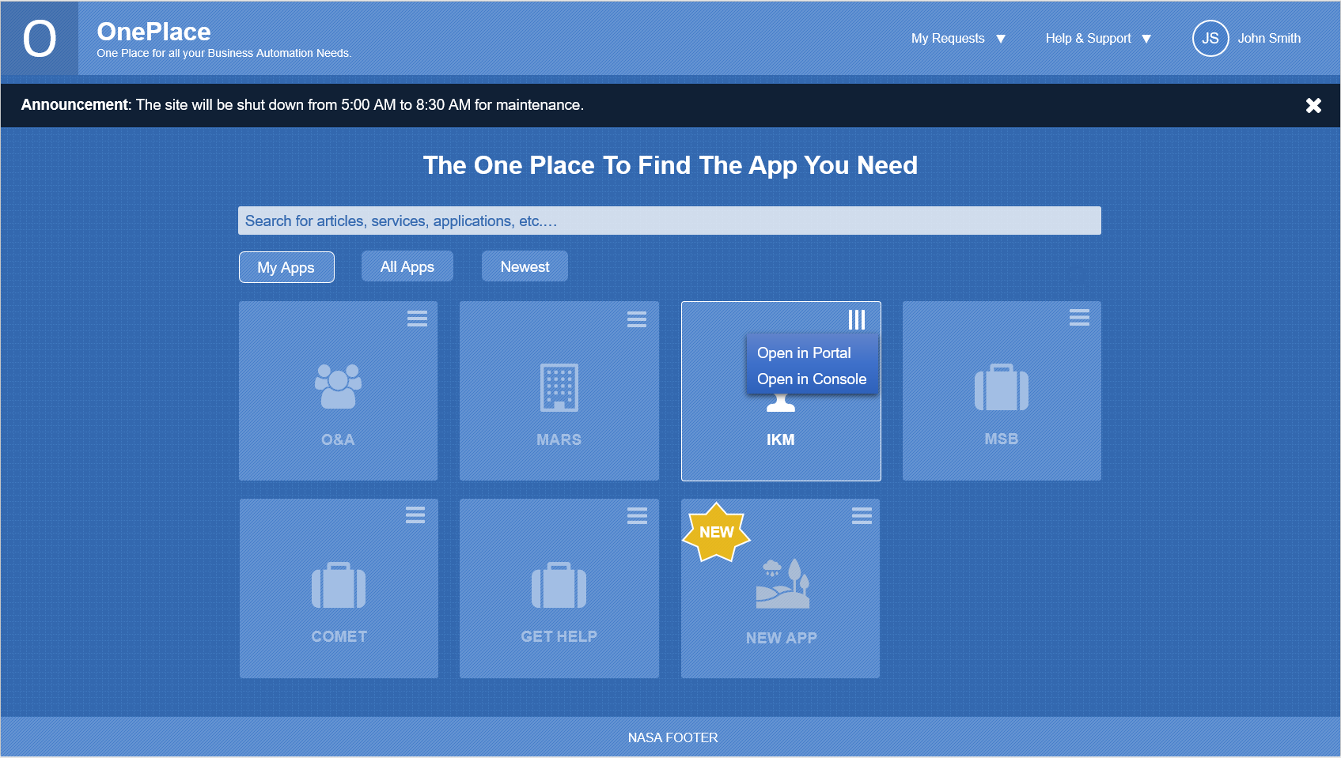
Mock-Up Design #2
Example of clicking the hamburger icon on an application. Responsive UI is the goal.

Slide 11
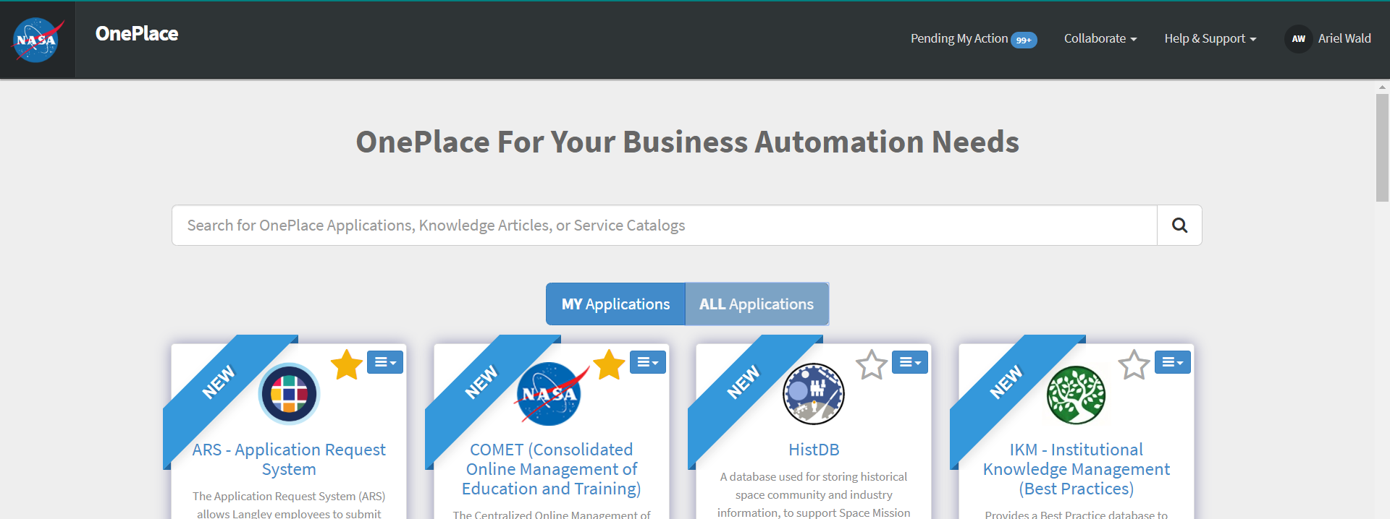
OnePlace Portal Redesign – Search Box
The text within the search box to explain the user what they can search for.
Note: In these examples, the apps display as “New” just for the purpose of demoing that feature.

Slide 12
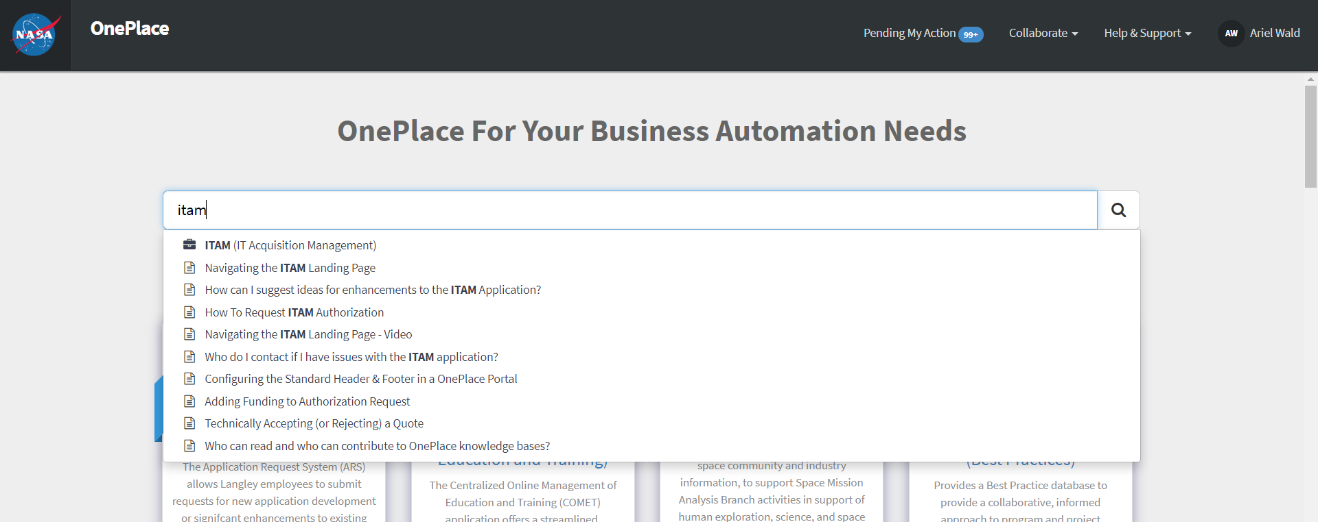
OnePlace Portal Redesign – Search Box Dropdown
We see the search dropdown. In order: applications (with differentiating glyph icon), service catalog, and knowledge articles. It is limited to only 10 results. This uses ServiceNow’s typeahead search.

Slide 13
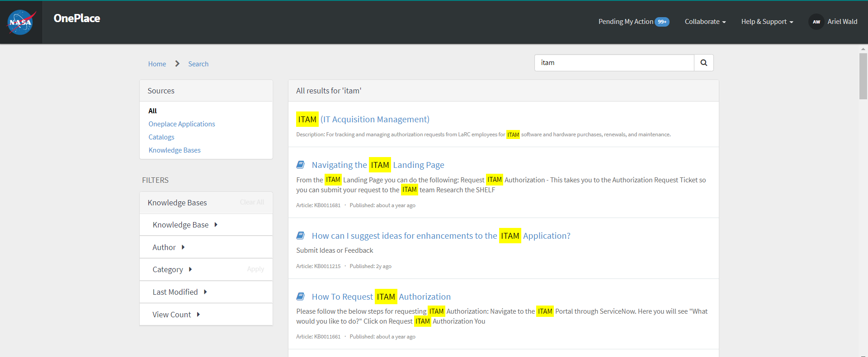
OnePlace Portal Redesign – Search Results Page
By clicking enter or the search icon, the user can see more results on the search results page using ServiceNow’s faceted_search and filtering options on the left side.

Slide 14
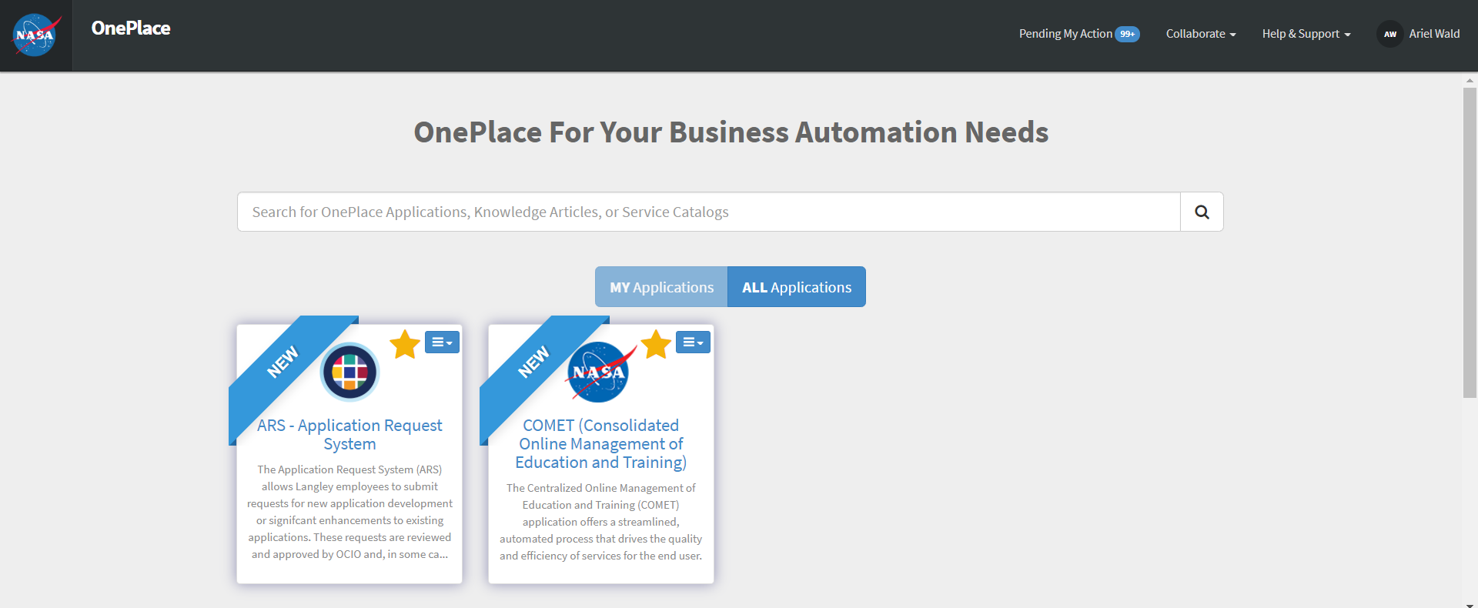
OnePlace Portal Redesign – My & All Applications
My Apps represents the user’s customized view of the applications they want. It initially displays all apps the user has access to as favorited, but the user can select which ones they want to keep as favorited by deselecting the favorite icon. In this example, the user only left two applications in My Apps and the rest of the applications are in All Apps.

Slide 15
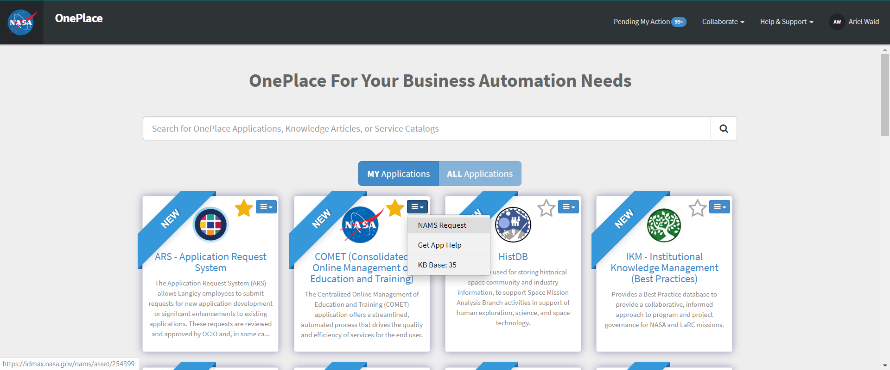
OnePlace Portal Redesign – Application Menu Options
The dropdown menu on each app displays three options: its NAMS Request, Application Help, and the Knowledge Base with its Knowledge Article count for accessibility. In this example, the user clicks the NAMS Request for the COMET application.

Slide 16
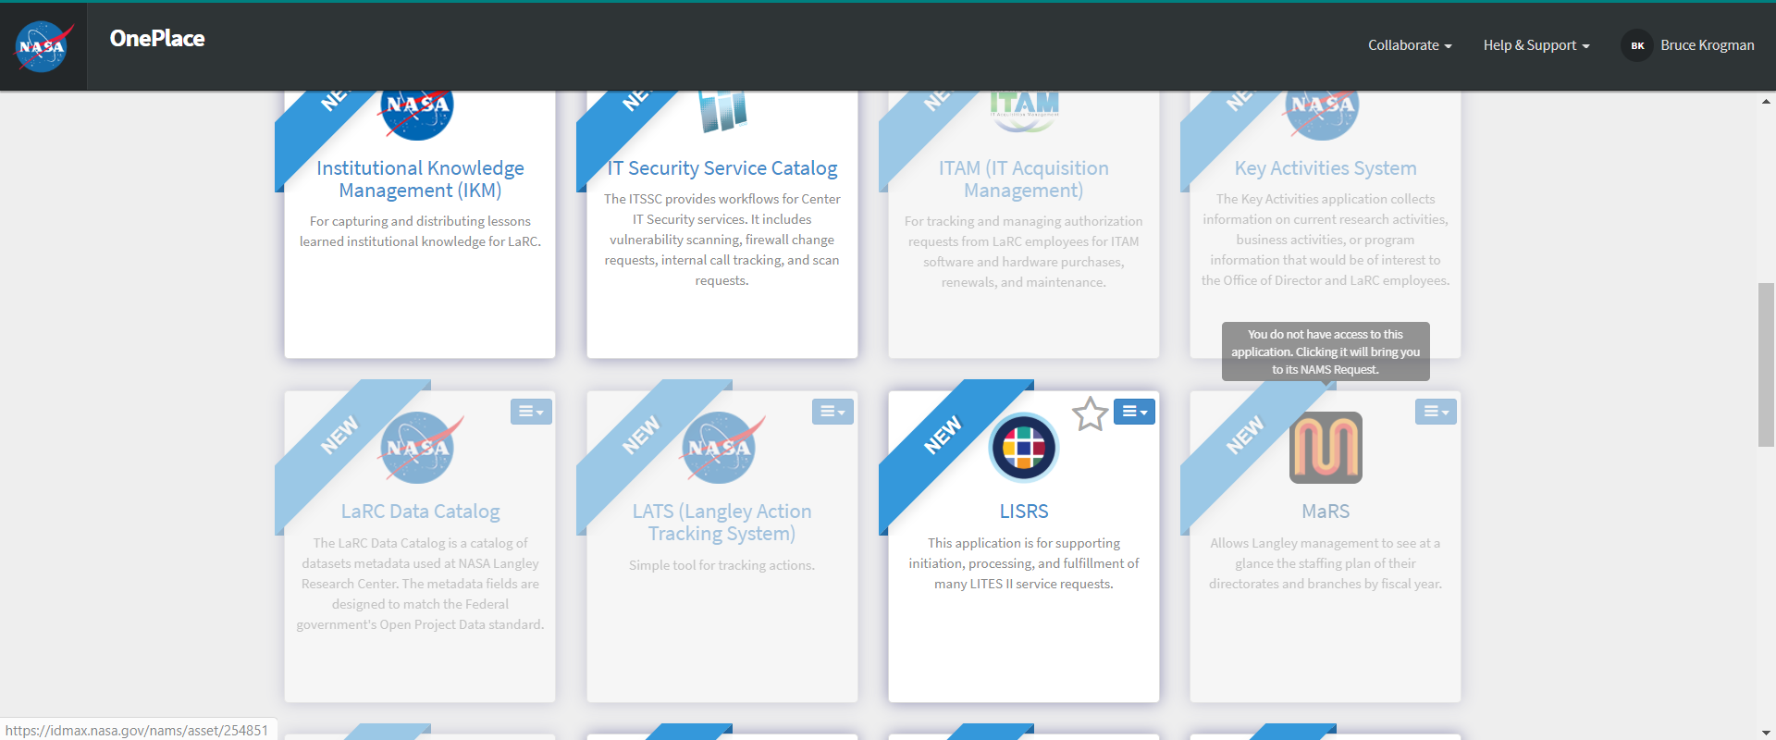
OnePlace Portal Redesign – Applications Without Access
If the user does not have access to an application, the application is greyed out for significance. The favorite icon is gone, and its dropdown only displays the KB Base. A tooltip (hovering message) lets the user know that since they do not have access to this application, clicking it will link them to its NAMS Request. Due to accessibility standards, a tooltip might not be read by screen readers. In this example, the impersonated user is Bruce Krogman from Glenn and he is trying to access the MaRS application.

Slide 17
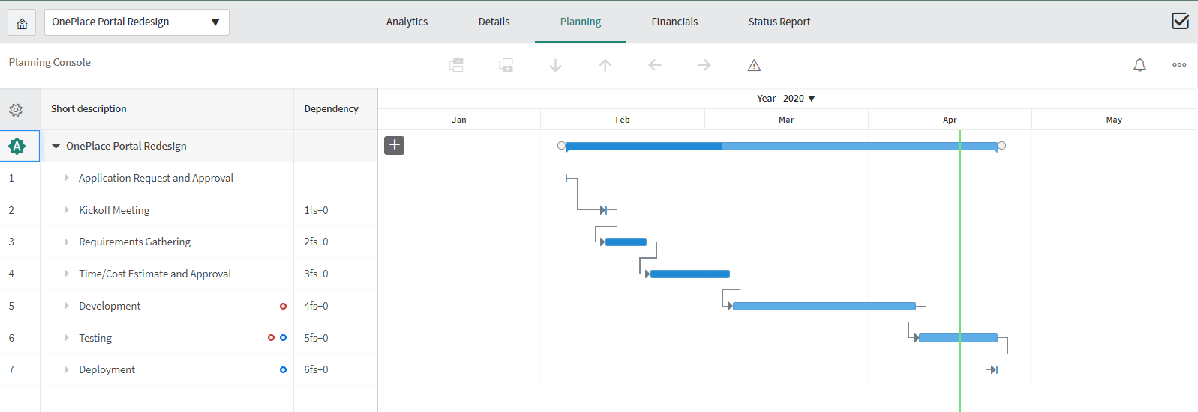
Project Experience – GANTT Chart
I also briefly gained some project management experience by the use of the Planning Console on OnePlace to track the application’s progress via a GANTT chart & user stories via Scrum Agile.

Slide 18
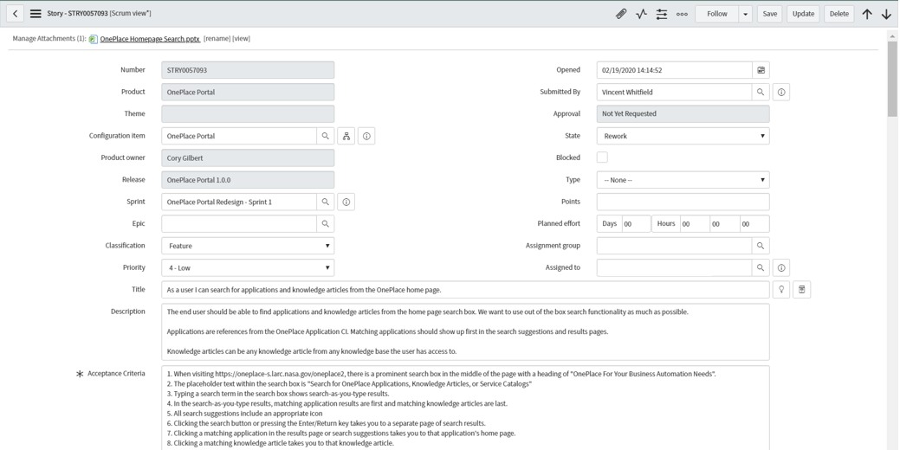
Project Experience – Story Example Description
Here is an example of a story that describes the search functionality and its Acceptance Criteria to test it.

Slide 19


Training
I completed several Training courses on developer.service.now, including
  Build My First Application
  Build the Needit Application
  Scripting in ServiceNow
  Securing Applications
  Importing Data Into ServiceNow
  REST Integrations
  Service Portal
  Building Apps with AngularJS
I even did the ServiceNow Fundamentals Course in route to take the CSA Exam!

Slide 20
Skills Learned & Project Experience – Value Added
Software: HTML/CSS to render and style the list of applications, JS for the functionality, AngularJS, Bootstrap, and Jquery for easy manipulation of JavaScript logic connecting the Client & Server/Ajax scripts.
ServiceNow uses JavaScript built-framework utilizing AngualrJS to manage the browser in the Service Portal view. Service Portal is an up-and-coming way to make efficient and manageable web applications in the front-end and back-end capability. There is a huge part of CRM experience that I obtained using the platform.
Configuration management experience with Update Sets.
Scrum Agile practices to effectively go about the adaptable stories effectively. Divided the work load into 3 sprints, depending on priority of stories (13 in total).

Slide 21
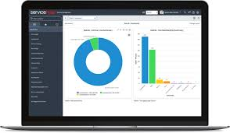
Skills Learned & Project Experience – Value Added
Understanding Acceptable Criteria for efficient testing experience. Learned how to deal with defects on each respective story and test it appropriately.
Taking NASA’s Accessibility Standards into account into the code itself.
Technical Documentation Experience to guideline the results & future work.
Experience utilizing a massive enterprise platform that runs the importance of connected workforce worldwide, maintaining customer data, integrity, and satisfaction intact.

Slide 22
Future Work Impact
Utilizing OnePlace to gain experience managing and building upon ServiceNow. Extended to take the CSA Exam. I am so thankful as this is an amazing skill to have. OnePlace’s incident management, IT operations, etc.
It was a privilege to help the Connected Workforce of my team, in the short-term, and, eventually, the entire NASA center who uses OnePlace for their business automation needs with a responsive UX.
Future possibilities:
  Smart Buildings. Incorporating facial-recognition about a customer under his/her user preferences to allow for smoother building access & maneuverability.
  DevOps integration, allowing for automated pipelining when making a push through production.
  End-to-End marketplace connecting the user’s questions and concerns about a tool or feature directly to buying it or installing it with a simple, unified system & minimum clicks.
    One way can be to link several existing pages into a centralized version. OnePlace Service Portal is just the beginning.

Slide 23

Acknowledgements
Special thanks to all those involved in making this summer a success, especially Cory, Lara, and Tanner!
Thank you deeply for opportunity to give my impact at NASA and learn from an agency that is helping develop the space goals of this nation to the next step.

Slide 24
