Slide 1
Developing Radiation Protection Garments with Additive Manufacturing
John W. Harden
Mentors: Sheila Thibeault & Julie Hanson
2020 Spring NIFS Research Symposium

Slide 2
Objective
Overall Objective:
  Develop wearable garments to protect crew from Solar Particle Events (SPEs).
Specific Objectives:
  Is it possible to use 3D printing with polypropylene to develop wearables?
  How do we collect data from human subjects regarding “wearability”?
My work as it relates to the overall project:
  By exploring additive manufacturing, we might revolutionize the production process and (possibly) allow for production in space or on the moon / Mars.
  Determining whether the garments are “wearable” might illustrate significant benefits over current methods of radiation protection.

Slide 3
Challenge
There are two issues we sought to address:
  Reporting the results of a previous additive manufacturing project.
  Developing a system for kinematic data collection.
History:
  SPEs (Solar Particle Events) pose a significant risk to crew. Though our team has developed functional prototype garments for radiation protection, we wanted to explore additive manufacturing.
What has been done to address that challenge in the past?
  There is a dearth of research for additive manufacturing with polyolefins.
  There is zero research for additive manufacturing for this specific purpose.

Slide 4
Approach
What I did:
  Wrote a draft technical memorandum and performed data analysis on data that were collected last semester.
  Began to develop a system for analyzing human movement in 3D space.
How did I do it?
  I performed statistical analyses (e.g., logistic regression) to associate variables with the probability of success.
  Developed a system for collecting kinematic data and proposed this to the team.
How does it contribute to your research objectives?
  Reporting the success of the additive manufacturing endeavor provides evidence that this method can be utilized, if desired. It also provides information to the broader research community.
  Developing a system of measurement is the first step in determining “wearability.”

Slide 5
Results
Figure 1. Effect of print resolution on success.
Figure 2. Effect of print speed on success.

Slide 6
Analysis/Summary
Statistical Interpretation:
  First, although variability was high, there is some predictability in the printing process.
  Larger print resolutions resulted in more successful prints.
  There may be a parabolic function to describe the line of best fit for print speed.
What we still don’t know:
  There is a considerable amount of unexplained variance.
  Temperature? Atmospheric pressure? Something else entirely?
  We should probably investigate these.

Slide 7
Future Work
Short-term:
  Define specific experimental protocols and exert greater control over the printing environment.
Long-term:
  Execute the new experimental protocols and collect new data on the effects of various system settings.
Expectations:
  We’ve made significant progress in defining protocols for additive manufacturing with polypropylene, but there’s still much we don’t know. A little more data collection could go a long way.

Slide 8
Acknowledgements
Thanks to the team for being so open to the possibility of exploring new solutions.
The staff members in the Langley Makerspace were an invaluable resource.

Slide 9
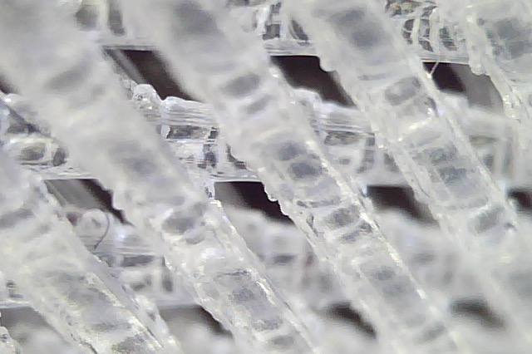
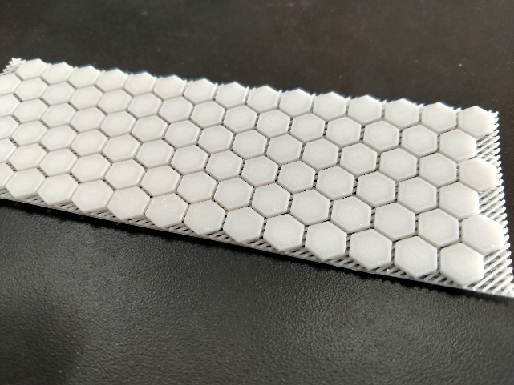
Supplementary Images
Figure 3. Magnified printed lattice structure.
Figure 4. Final product.

Slide 10
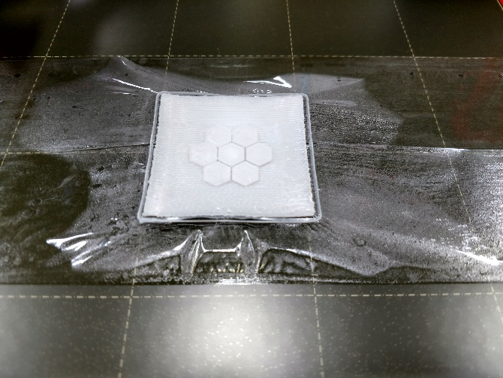
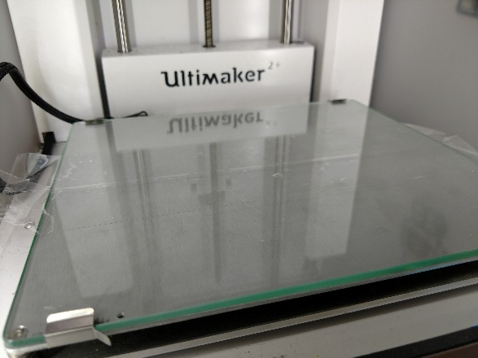
Supplementary Images
Figure 5. Demo of coefficient of expansion.
Figure 6. 3D printer used for this project.

