Slide 1

CERES Data Management Team Working Group Report
Katie Dejwakh
April 28, 2020

Slide 2
Outline
DMT Overview
Product Availability
Code Re-architecture
Systems & CM
DMT Activities

Slide 3
DMT Overview

Slide 4
Data Management Team (DMT)
Science research
DMT /
ASDC
User community

Slide 5
Data Management Team (DMT)
Responsibilities:
  Algorithm implementation
  Software:
    Maintenance
    Configuration management
    Processing
  Output validation

Slide 6
DMT-ASDC Interface
Science
Team
Data Management
Team (DMT)
Atmospheric Science Data Center (ASDC)
Funded by
Radiation Budget Measurements WBS
Funded by ESDIS

Slide 7
Product Availability

Slide 8
Edition 4 Terra & Aqua
Product | Platform | Processed Thru | Publicly Available?
BDS | Terra, Aqua | Dec. ‘19 | Yes
SSF |  | Dec. ‘19 | Yes
SSF1deg-Hour |  | Nov. ‘19 | Yes
SSF1deg-Day/-Month |  | Nov. ‘19 | Yes
SYN1deg-Hour/3Hour/MHour | Terra+Aqua | Nov. ‘19 | Yes
SYN1deg-Day/-Month |  | Nov. ‘19 | Yes

Slide 9
Edition 4 Terra & Aqua
Product | Platform | Processed Thru | Publicly Available?
CldTypHist | Terra+Aqua | Nov. ‘19 | Yes
FluxByCldTyp | Terra+Aqua | Dec. ‘19 | May ‘20
EBAF | Terra+Aqua | Nov. ’19 | Yes
EBAF ToA | Terra+Aqua | Dec. ‘19 | Yes

Slide 10
Edition 1 S-NPP
Product | Platform | Processed Thru | Publicly Available?
BDS | S-NPP | March ‘20 | Yes
SSF |  | Feb. ‘20 | Yes
SSF1deg-Hour |  | Sep. ’19* | Yes
SSF1deg-Day/-Month |  | Sep. ’19* | Yes
SYN1deg-Hour/3Hour/MHour | Terra+S-NPP | Nov. ’17* | Yes
SYN1deg-Day/-Month |  | Nov. ’17* | Yes
* SSF1deg is paused due to RAPS mode

Slide 11
DMT Activities

Slide 12

New Product – FluxByCldTyp
10 years in the making!
Gridded, L3 product
42 cloud types indexed by:
  Optical depth (6)
  Cloud pressure (7)
Available within the next month

Slide 13
Forthcoming Data Product Editions
Edition 2 S-NPP
  Processing thru: Instrument & ERBE-like
  Available early Fall 2020
  Need VIIRS data
  No L3 products from 9/2019 onward,
  while S-NPP in biaxial mode
Edition 1 NOAA-20
  Processing thru: Instrument, SSF, and Level 3
  Available early Summer 2020
Notes:
Ed 2 S-NPP: Need VIIRS data; assuming our test data is good enough that production can start immediately, will take two months of just Clouds processing
Ed 1 NOAA-20: Need to finish DQS (documentation). SSF is through September 2019 as of 4/27/20.

Slide 14
Notable Deliveries
Ed 1 NOAA-20/Ed 2 S-NPP work
  Sampling strategy updates
  Spectral correction coefficients
  SSF, SSF1deg implementation
FluxByCldTyp initial PGE
Libraries
  CERESLib netCDF4/HDF5 support
  CERESLib metadata update support
  PerlLib scoping changes

Slide 15
Migrated CERES Websites
Multiple platforms, predominantly:
  NASA LaRC OCIO’s WordPress environment
  ASDC’s OpenShift Container Platform (OCP)
WordPress
OCP
GEWEX SRB/RFA
PR Tool
CM website
CERES-WG website
CERES website (both)

Slide 16
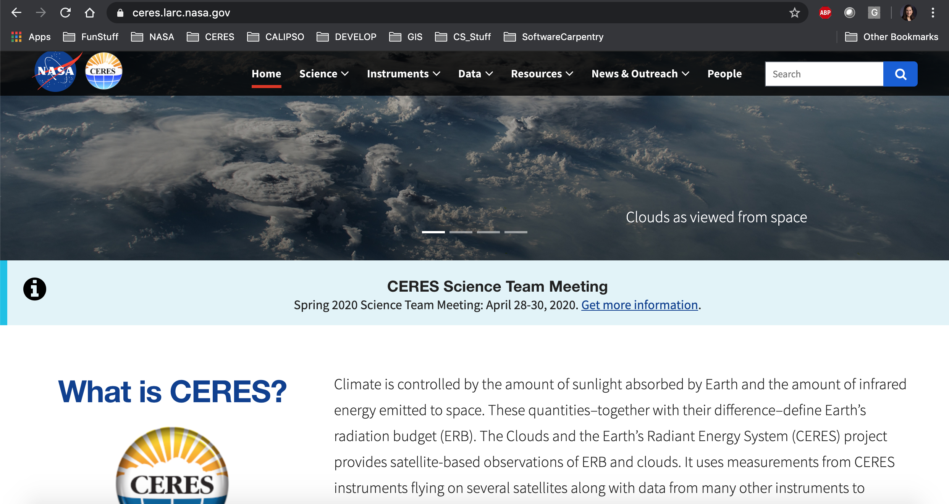
New CERES Website

Slide 17

New CERES Website
Emma Brand – part of Pathways work
Mobile-friendly
Runs in OCP
Easier to promote changes
ceres.larc.nasa.gov – check it out!

Slide 18
Running CERES PGEs in OpenShift
Emma Brand & Nelson Hillyer
75% CERES PGEs running in OCP thus far
Next up:
  “Vertical slicing” runs
  CATALYST integration
Flexibility to harness cloud computing power

Slide 19
Code Improvement Activities

Slide 20
CERES Code Re-architecture
Readability
Maintainability
Eliminate:
  “Dead” code
  Unreachable code
Cap length:
  Files
  Functions
No “magic” numbers
De-duplicate:
  Functions
  Functionality
Generalize

Slide 21
CERES Code Re-architecture
Modularity
Single functionality per unit
Interchangeable units
Abstraction to library
Two groups: Clouds and TISA

Slide 22
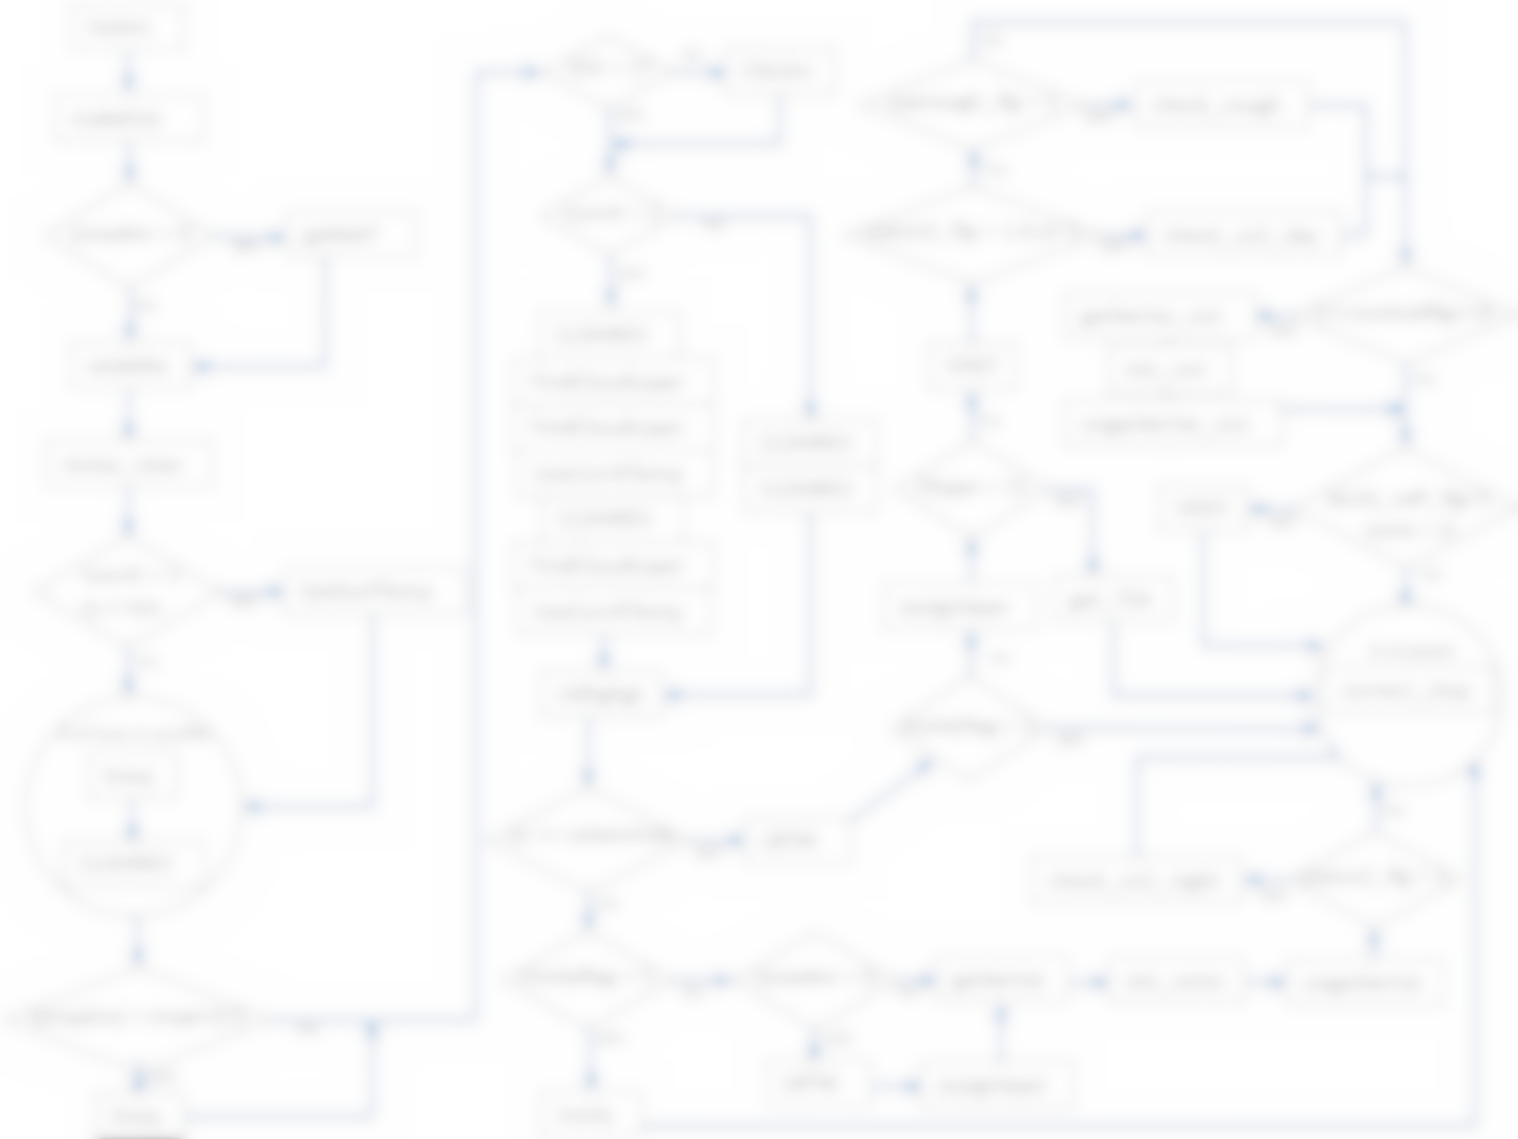
Clouds Re-architecture
Legacy code
Varying levels of complexity
GOTO statements
Redundancy throughout codebase
Hard-coded inputs
“Magic” numbers

Slide 23
Clouds Status
New team-member for re-architecture, Steve Kohler
Cloud mask work
Near-term Goals:
  Evaluate current code
  Position for better:
    Ability to unit test
    Exception handle
    Extend
  Validate, validate, validate

Slide 24
TISA Re-architecture – Parallel Efforts
“In-place” (Ed. 4-5)
- Remove “dead” code
- De-duplicate
- Generalize
- Collect multi-purpose routines for library
System-level (>= Ed. 5)
- Implement new framework
- Build general library
- Add spatiotemporal flexibility

Slide 25
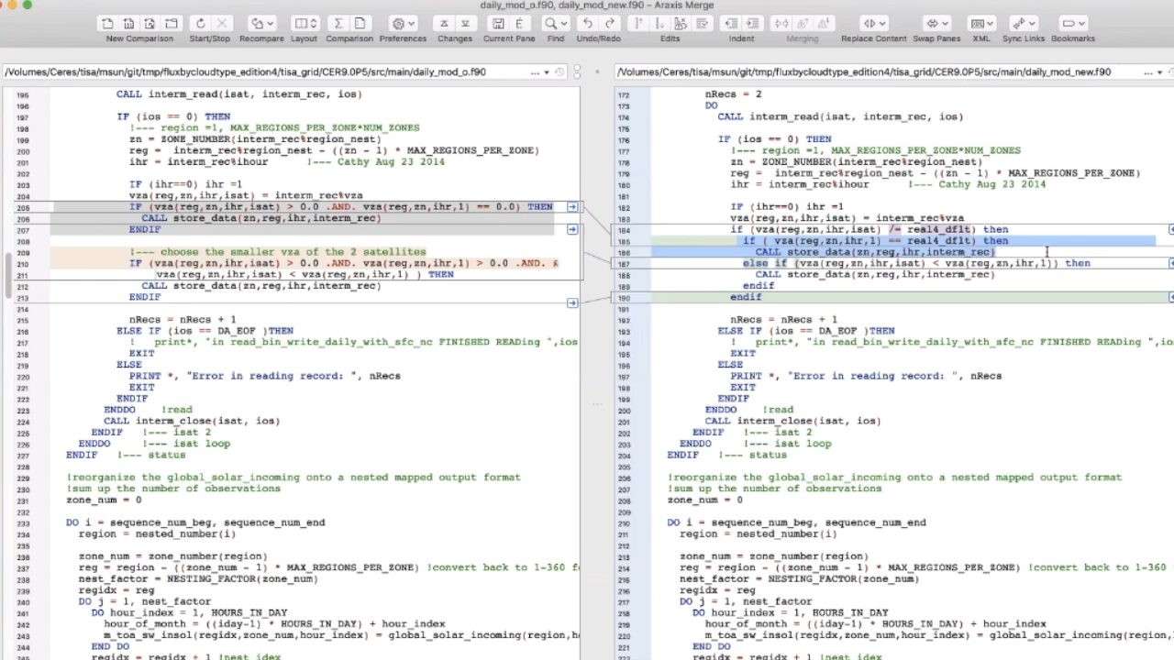
Notes:
Continue to find duplicate code, uninitialized variables, opportunities to generalize, INOUT parameter confusion.

Slide 26
TISA Status
~20% overall code reduction
Meet once/week
Using Jira/Bitbucket/Confluence
Arun – Ed 4-5 code changes:
Josh – Ed 5+ framework-level construction
  Fresh look at TISA – as a system
  “Event Storming” session

Slide 27
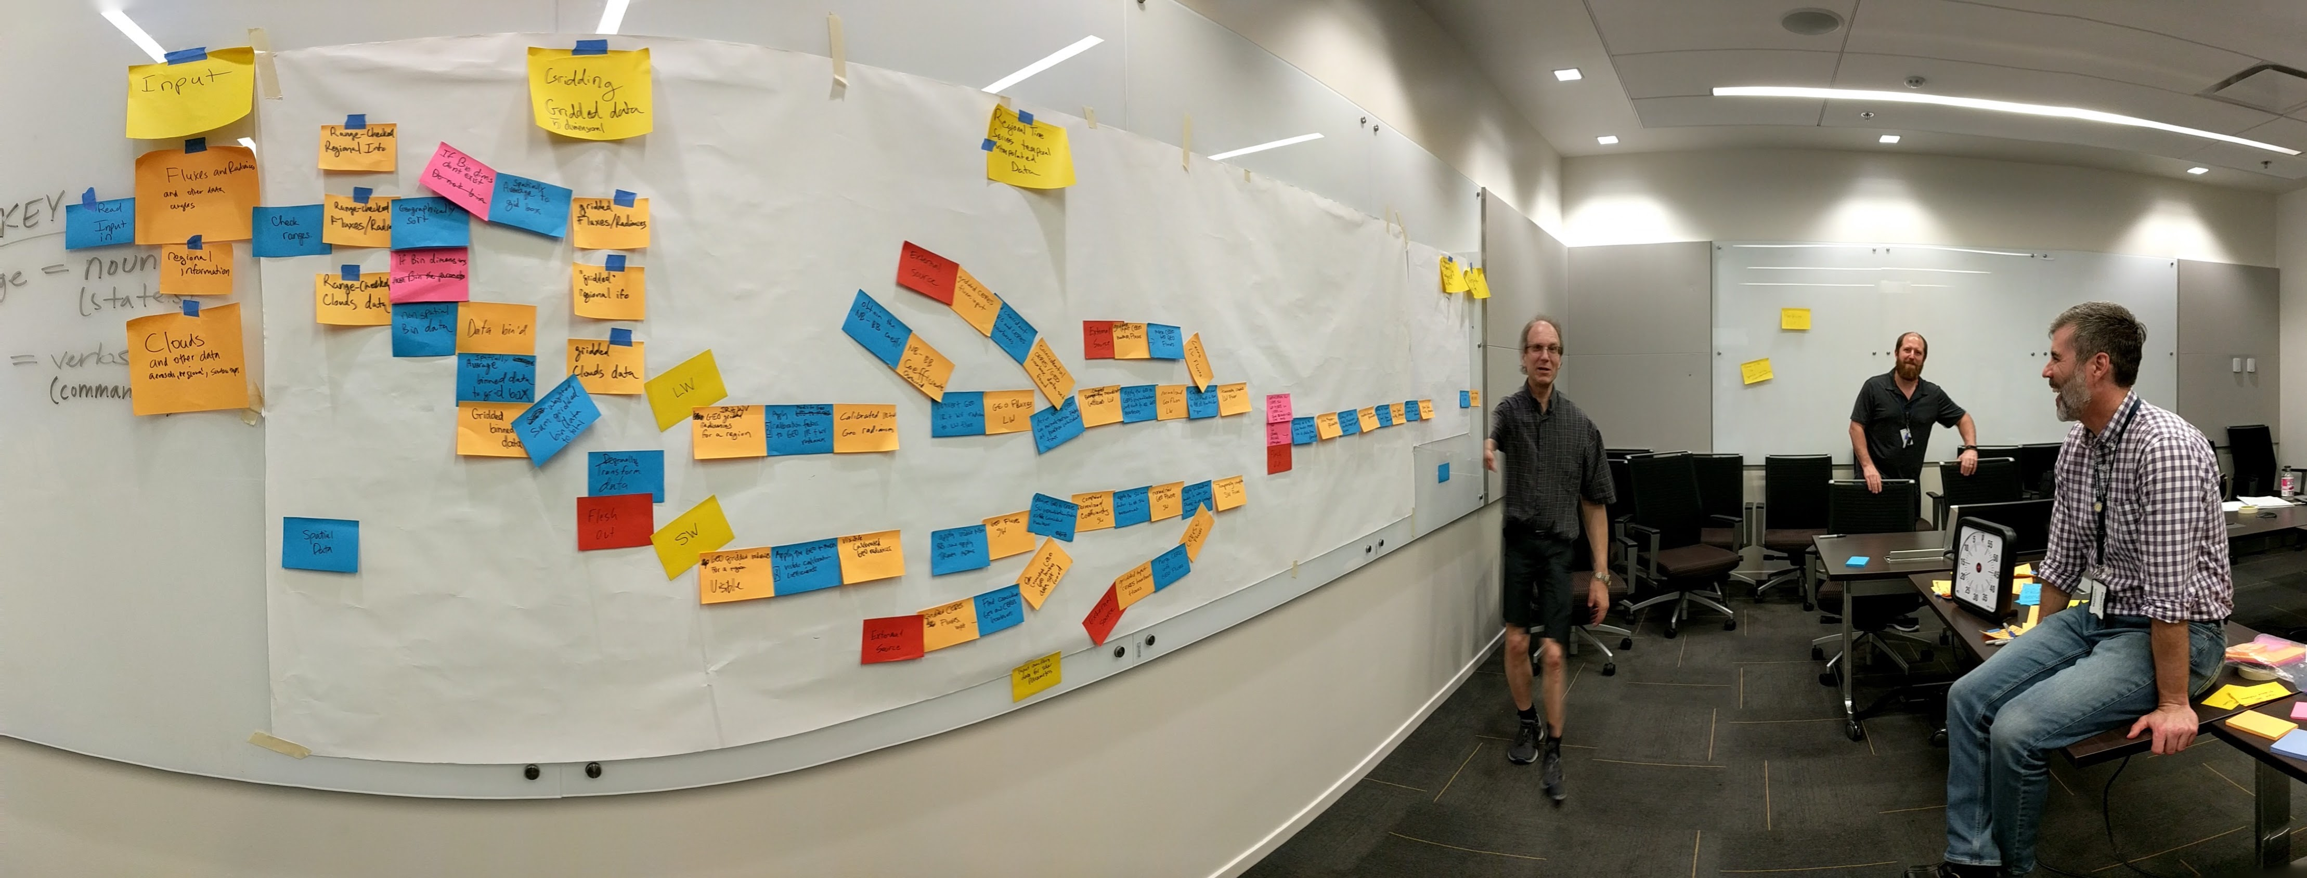
Event Storming

Slide 28
Subsetter/Ordering Tool
Serve parameter-level subsetting of CERES data
Two versions:
  Internal/Science Team-only
  Public
Prep for FluxByCldTyp:
  Monthly means map
  Time series – Babak Samani
Notes:
Science team-only is for quality control and testing.

Slide 29
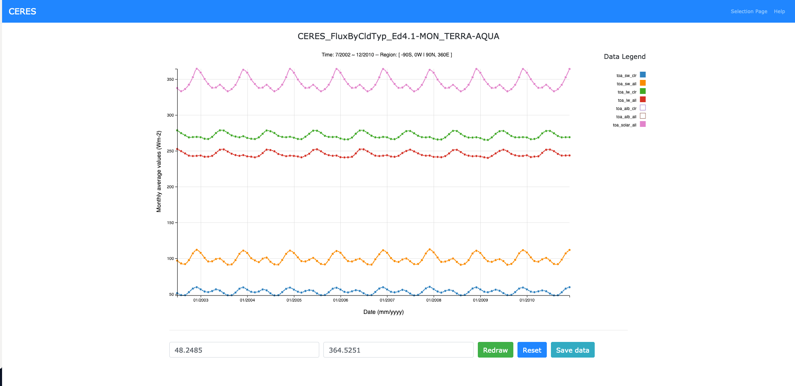
Notes:
Performs weighted and natural log averaging based on the parameter type.
Front-end: JavaScript, D3.js library
Back-end: Java → JSON file → RESTful API
Newest feature: averaging over user-selected region

Slide 30
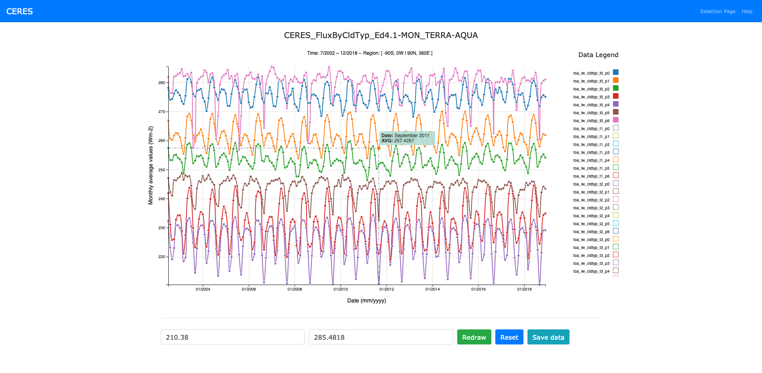
Notes:
Performs weighted and natural log averaging based on the parameter type.
Front-end: JavaScript, D3.js library
Back-end: Java → JSON file → RESTful API
Newest feature: averaging over user-selected region

Slide 31
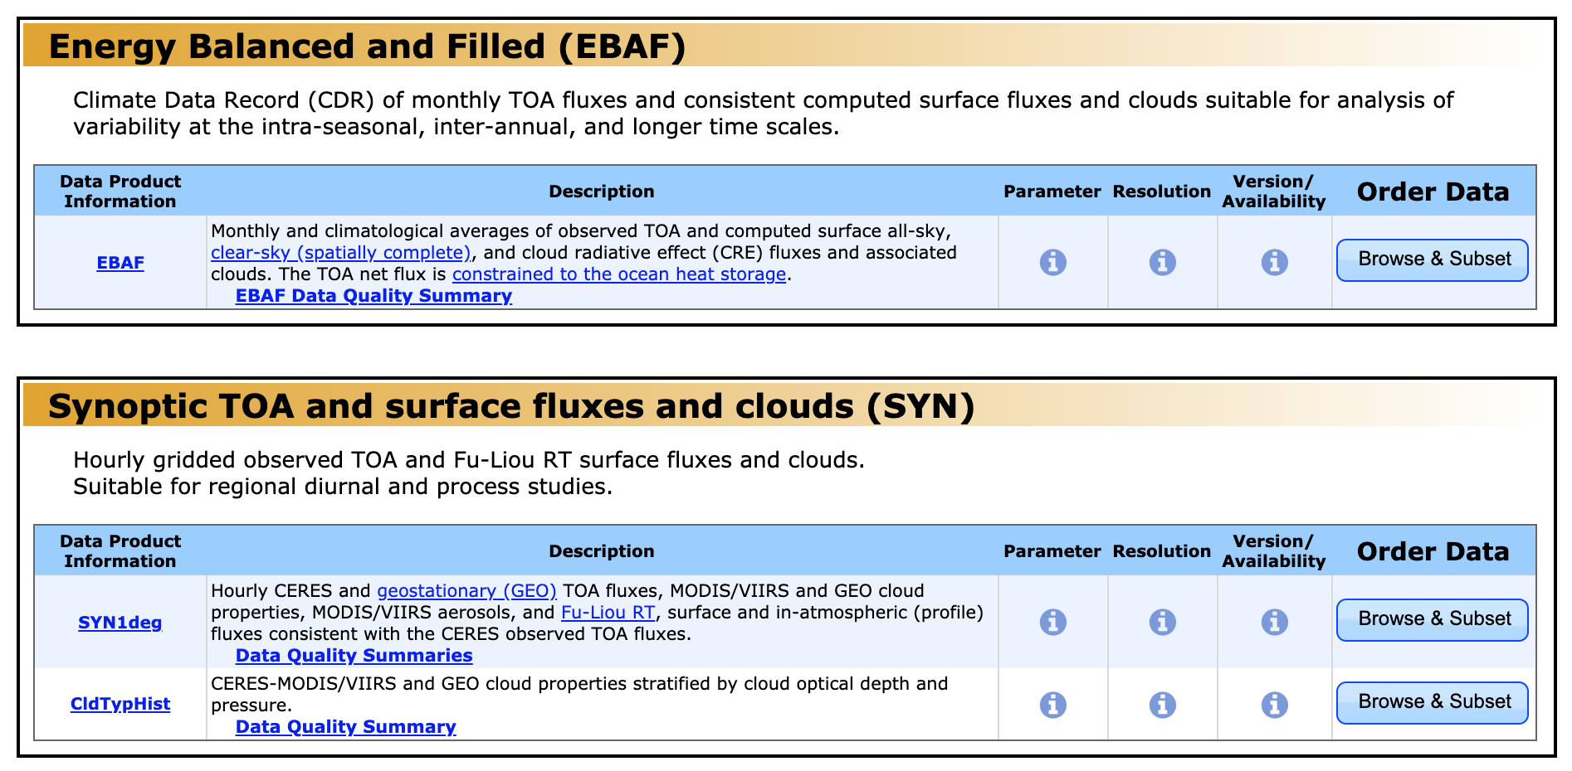
Subsetter/Ordering Tool
Migrating:
  Virtualization
  Containerization (OpenShift)
Emphases: availability and flexible ordering

Slide 32
Systems & CM

Slide 33
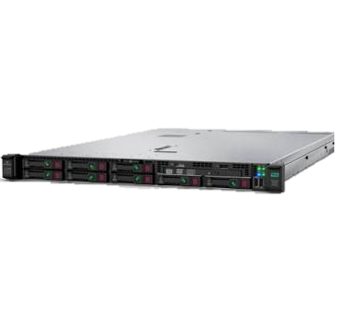
New Systems
EMC Isilon Storage
HPE DL360 Servers
Computational Research Facility (CRF)
Configuration on hold due to COVID-19
CRF and ASDC
Virtualized
  Red Hat virtual machines
  OpenShift PaaS virtual machines

Slide 34

Updated Data Formats
Upcoming Editions:
5/netCDF4
Many iterations with ASDC – ingest/metadata check
First products: Ed 1 NOAA-20 and Ed 2 S-NPP SSF
CM Team – lots of work!

Slide 35
Updated Metadata
Upcoming Editions
Conventions:
  Unified Metadata Model (UMM)
  Climate-Forecasting (CF)
  Attribute Convention for Data Discovery (ACDD)
  CERES-specific
Attributes in HDF5/netCDF4 files
Separate ”*.met” file until no longer necessary

Slide 36
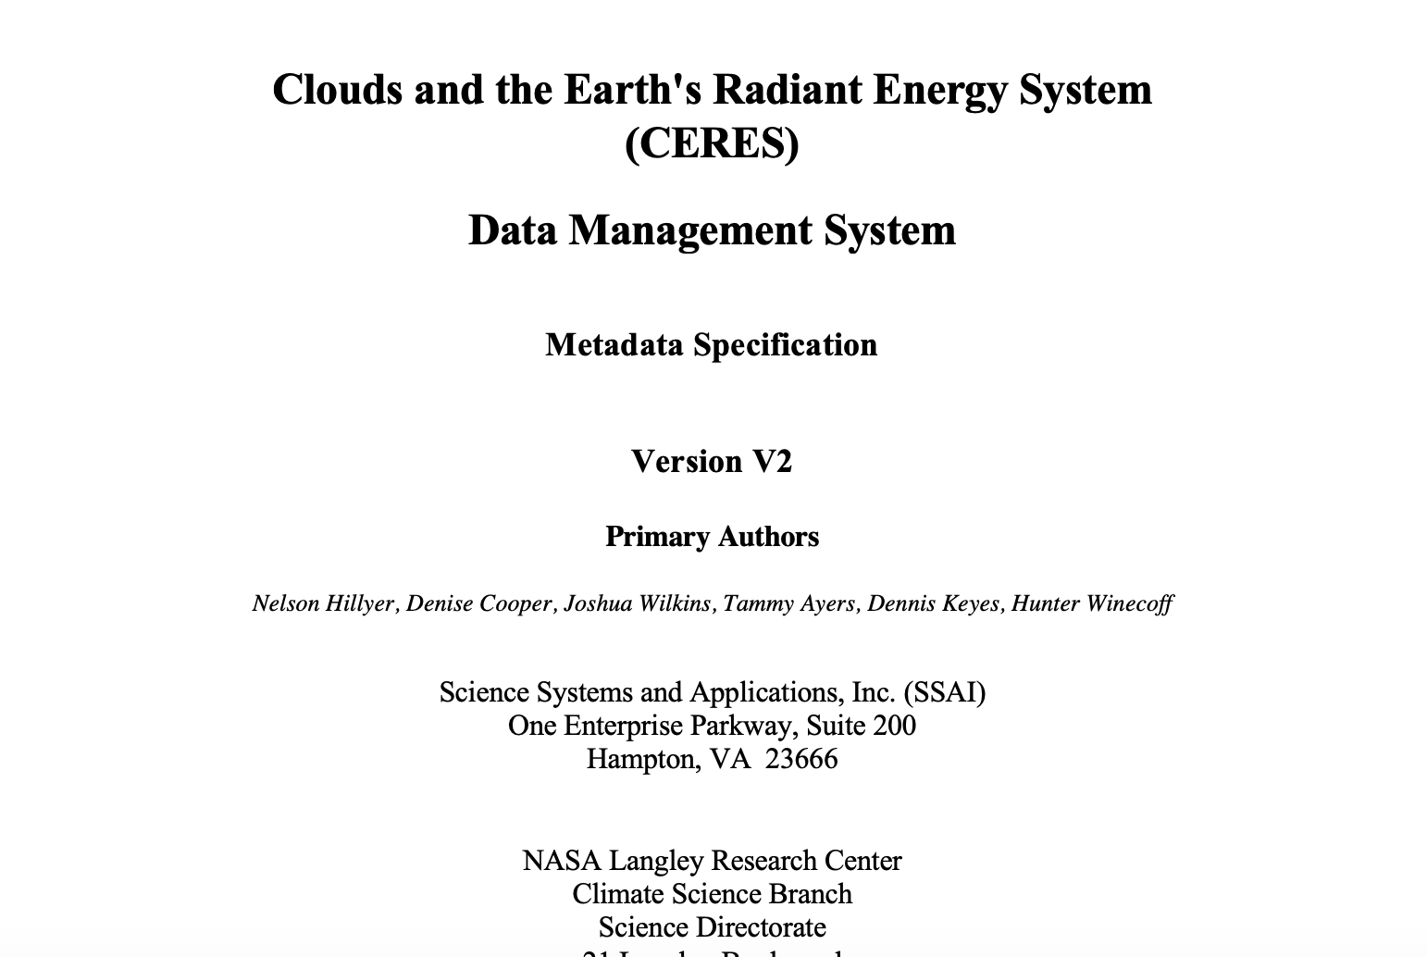
Updated Metadata

Slide 37
Updated Metadata
Metadata Checker Tool – Hunter Winecoff
Checks against CERES metadata standards
Must run
  before code delivery
  as part of integration testing

Slide 38
Summary
New products and editions on the way!
Virtualizing
Engaging in cloud preparation
Refreshing file formats, metadata
Improving user experience

