Slide 1
Radio Occultation
&
Cloud-Free Land Surface Imagery
Liam Coulter & Joel McCorkel

Slide 2
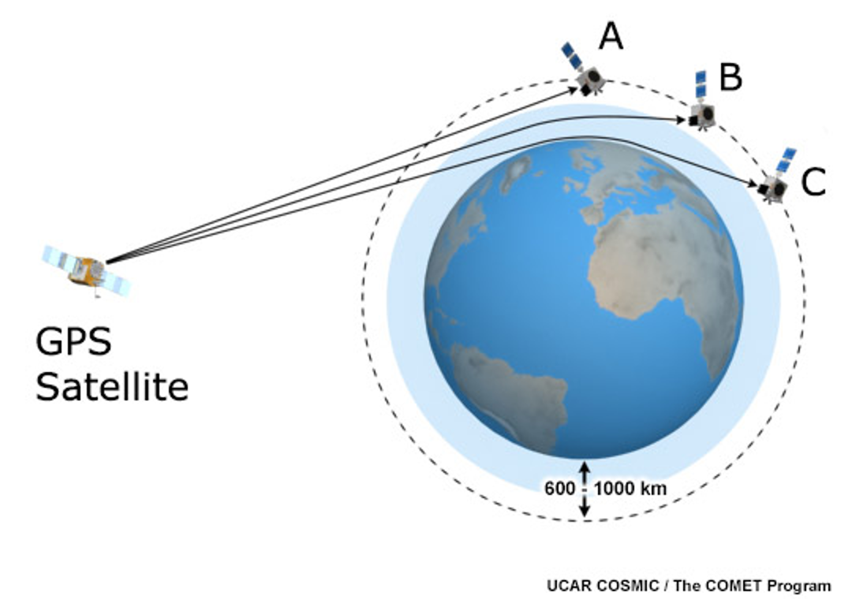
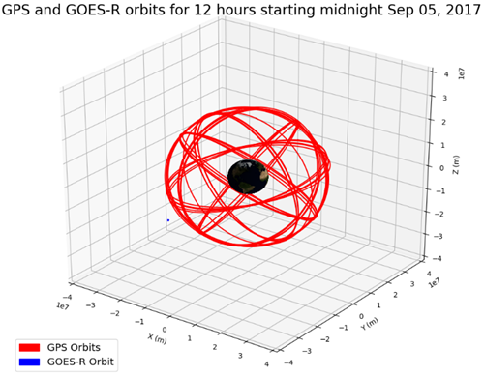
Radio Occultation
Remote sensing technique
Used to find atmospheric quantities:
  Temperature, pressure, water vapor content
Calculate bending of GPS signals through atmosphere
  Determine difference between theoretical distance wave travels vs actual distance
  Use integral transform to convert distance difference to angle of bending

Slide 3
Data Processing Chain
GPS Data
Telemetry, PRNs, transmitted signals, clock information
GOES-R Data
Telemetry, received GPS signals, tracked PRNs, clock information
Get GPS and/or GOES clock errors
Compare pseudo-range computed w/ GOES & GPS clocks and phase to actual LOS distance
Convert ephemeris/almanac to ECEF
Sort received signals by tracked PRNS vs. used for navigation
Correct for ionosphere delay (due to single frequency GOES receiver)
Calculate bending angle α as a function of “impact parameter”
Compare GPS position with GOES-R to find times of possible occultations
Calculate atmospheric profiles from bending angle
Compute pseudo-range from GPS & GOES-R timing, making more accurate by GOES phase observables
Border Legend:
Blue: Done
Yellow: In Progress
Red: Not Attempted
Dashed: Not Essential
End: Use RO in NWP
Determine PRNs from tracked GPS descending through atmospheric limb
Precise Orbit Determination (POD) algorithm for GOES with MIT software

Slide 4
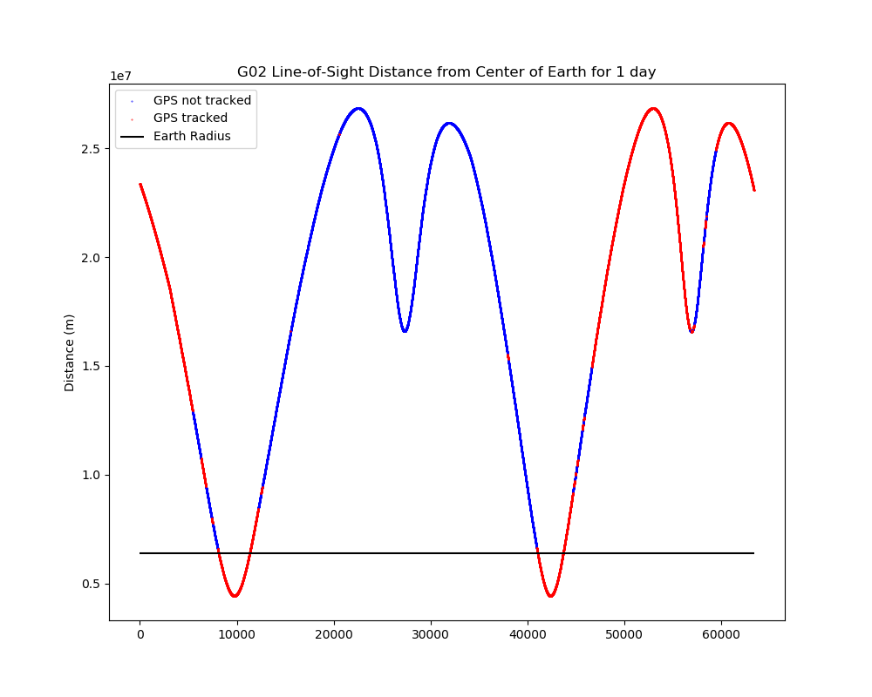
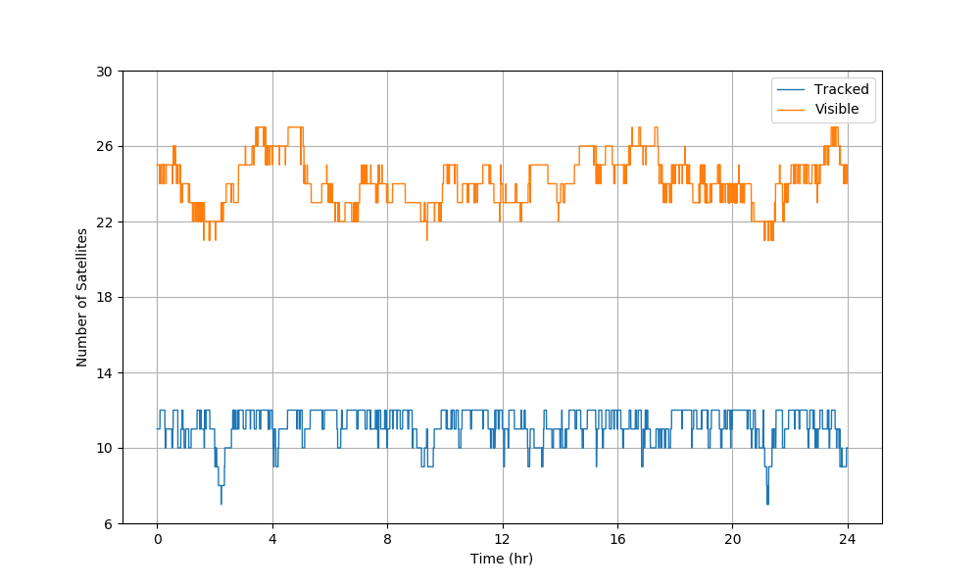
Radio Occultation

Slide 5
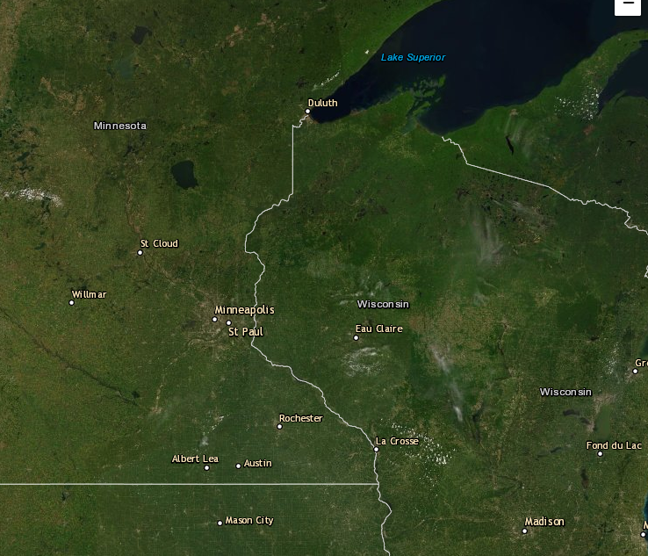
Cloud-Free Land Surface Imagery
Global Land Survey (GLS):
  Cloud-free land surface images generated every 10 years
  Image resolution: 30m (side of pixel)
MODIS-VIIRS:
  Cloud-free land surface images generated every 8 days
  Image resolution: ~1km
GOES-R:
  Could construct cloud-free images more quickly
  Image resolution: 2km (side of pixel)

Slide 6
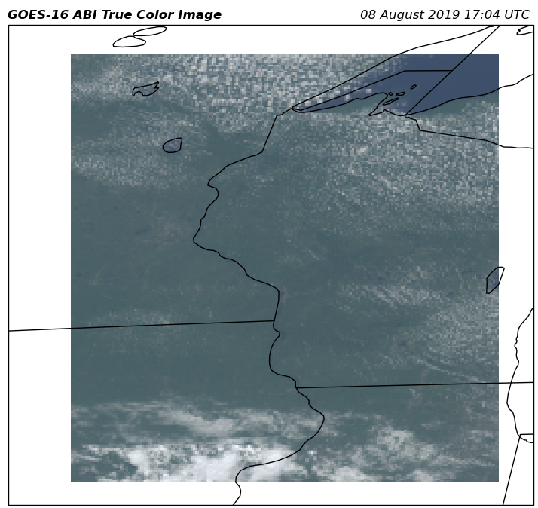
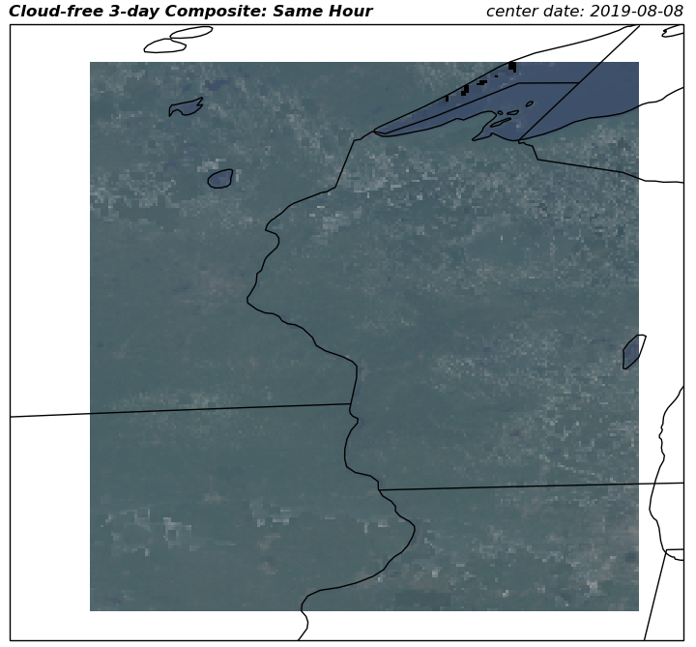
Cloud-Free Land Surface Imagery
Notes:
Geometrically calculated distance from GOES to GPS 01

Slide 7
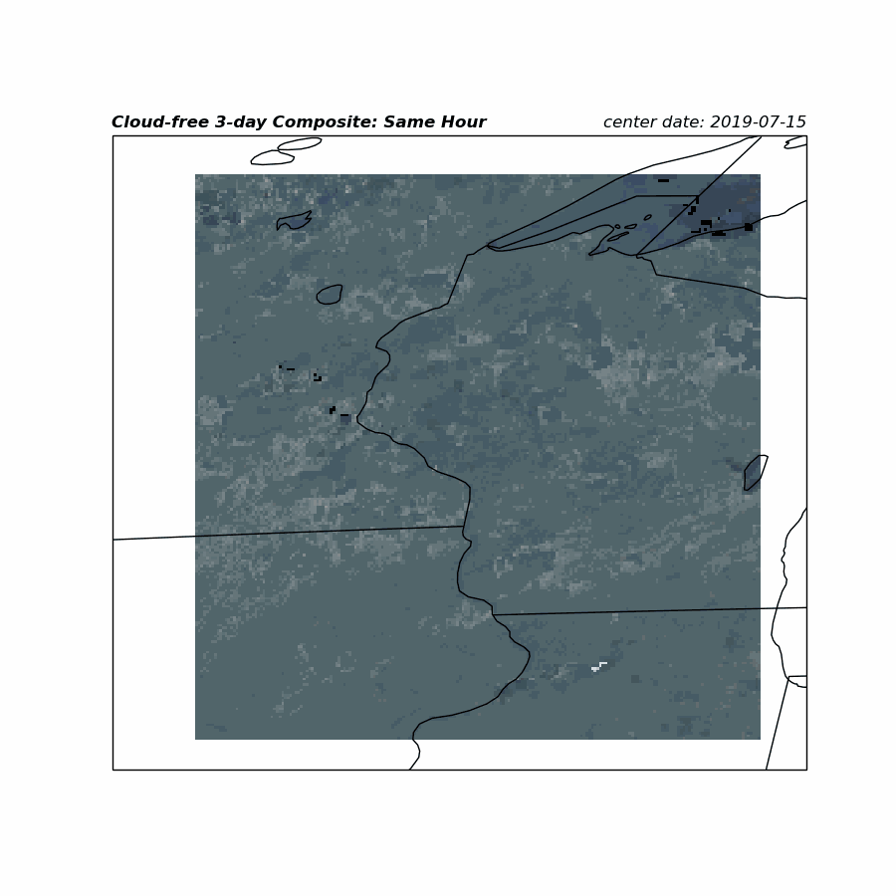
Cloud-Free Land Surface Imagery
Notes:
Geometrically calculated distance from GOES to GPS 01

Slide 8
Future Work

