Slide 1
Impact Icing Mitigation
Lenore Miller
Drs. Joseph G. Smith and Chris Wohl
2020 Spring NIFS Research Symposium

Slide 2
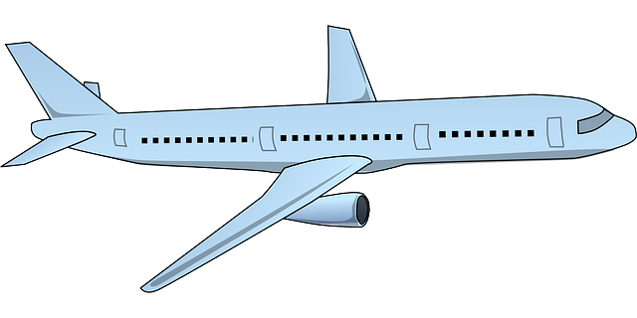
Impact Icing Challenge
In impact icing conditions, ice accretion occurs on aircraft surfaces increasing weight and non-aerodynamic surfaces resulting in increased drag and loss of lift.
Lift decreases
Drag increases
Thrust decreases
Source: clipart-library.com
Weight Increases

Slide 3
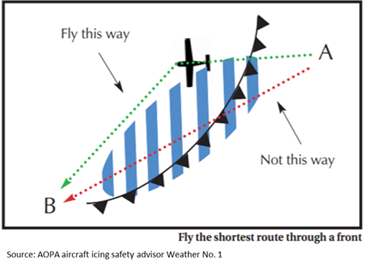
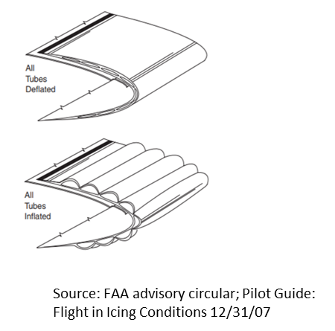
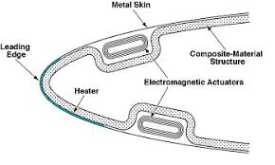
Means of Dealing with Impact Icing
Avoidance (if aircraft is not equipped with de-icing equipment)
De-icing systems (if aircraft is equipped)
  Engine bleed air
  Pneumatic boots
  Electro-thermal
Source: ICAS International Council of Aeronautical Sciences

Slide 4
Objective
Passive anti-icing coatings for the leading edge of airplane wings
  Must be wettable by current deicing fluids
  Must be durable
  Must lower impact ice adhesion strength
  Must resist impact deformations from objects and debris
  Must be stable to UV light

Slide 5
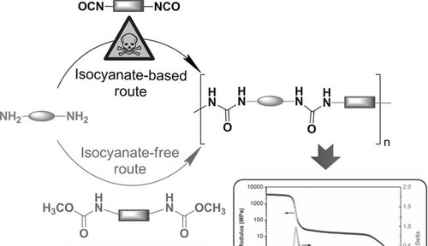
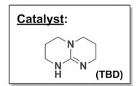
Approach
Source: 2011, Macromol. Rapid Commun., 32, 1379-1385.

Slide 6
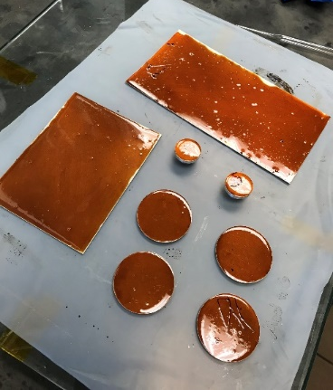
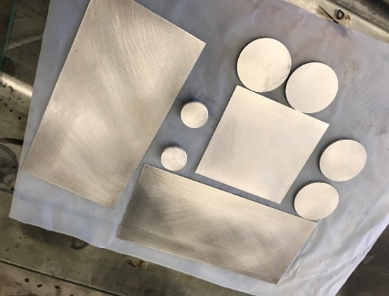
Sample Fabrication
Abrade and clean aluminum substrates with Chemetall.
Apply AC-131 Surface Treatment.
3. Prepare resin by combining urea
monomer with epoxy.
4. Apply a controlled volume of resin to
each substrate configuration.
5. Cure in oven at 177°C.

Slide 7
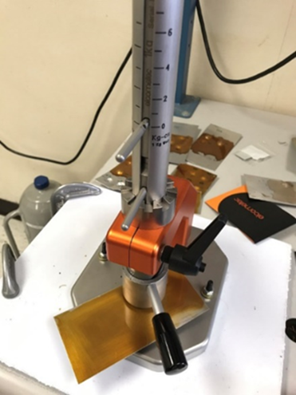
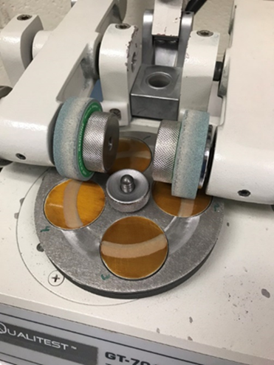
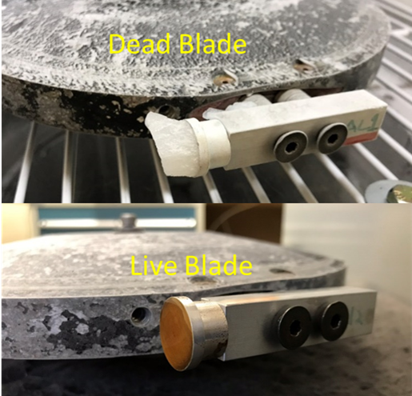
Material Characterization
Rapid Impact Deformation
ASTM D2794 - 93(2010)
Taber Abrasion Test
ASTM D4060 - 19
AERTS Jr. Dynamic (Impact) Icing Test

Slide 8
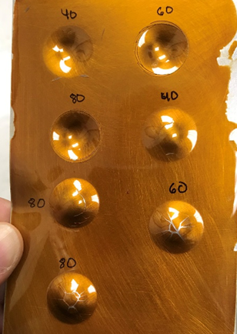
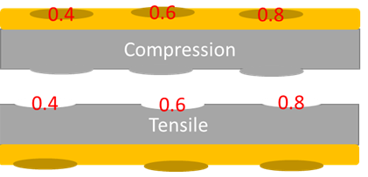
Rapid Impact Deformation Testing
A sample would be tested by raising a 1 kg weight to a height of 40, 60, and 80 cm and dropped onto the coated and uncoated side of a sample, in order to test both compressive and tensile strength.
kg m
kg m
kg m
kg m
kg m
kg m

Slide 9
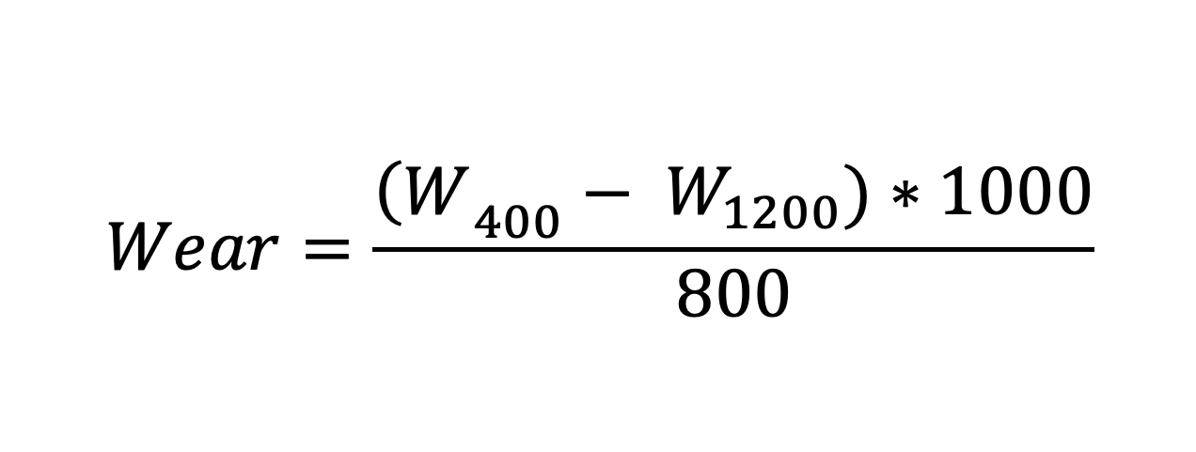
Taber Abrasion Testing
Testing involved taking four coated disks and exposing them to 1200 revolutions under an H18 abrasion wheel. Due to concerns that the domed shaped of the resin on the disks could impact results the first 400 revolutions were not factored into the calculations.
$$Wear=\frac{{\left(W\right.}_{400}− W_{1200})∗1000}{800}$$

Slide 10
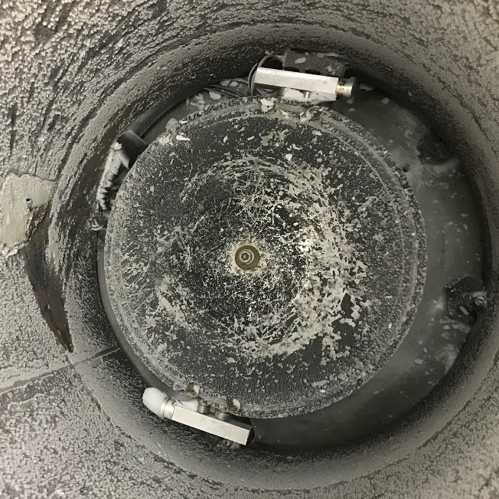
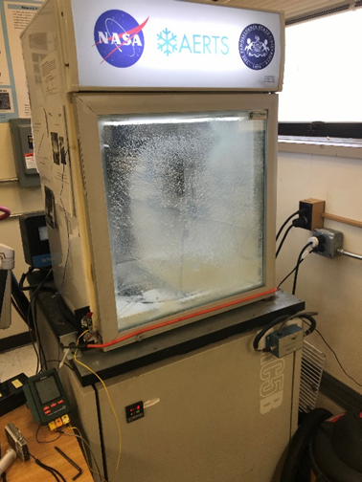
AERTS Jr. Dynamic Ice Testing
Adverse Environment Rotary Test Stand (AERTS), Jr. is designed after the larger AERTS facility at PSU.
A test sample and a control sample are on opposing sides of a rotor that are exposed to a supercooled mist to simulate the icing environment of an aircraft in-flight.

Slide 11

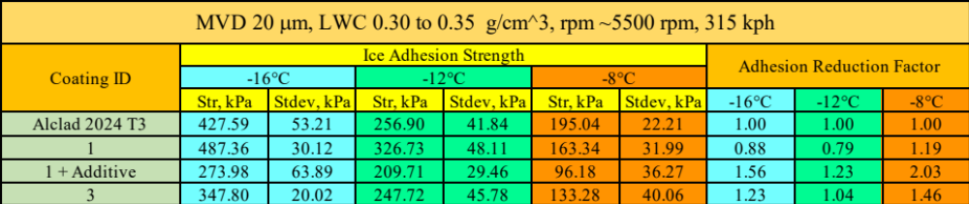
Adhesion Reduction Factor (ARF)
ARF > 1 implies that the coating performed better (i.e., lower ice adhesion)
ARF < 1 indicates greater ice adhesion on the coated surface

Slide 12
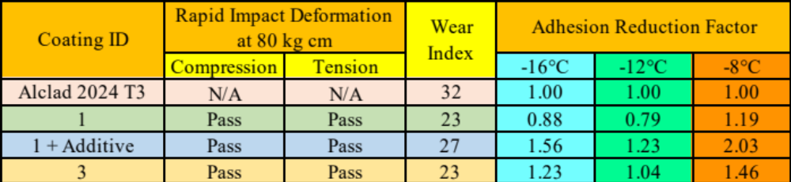
Overall Performance Results

Slide 13
Future Work
Collect remaining data on other coatings.
Investigate why the additive improved the ice performance of coating 1.
Apply what is learned to improve coating formulations to attain the best
overall performance.

Slide 14

Acknowledgements
Miranda Beaudry
USRA
NIFS
Advanced Materials Processing Branch
Source: DLPNG.com

