Slide 1


Durability Characterization of Coated Materials with Low-Ice Adhesion
Miranda L. Beaudry¹, Christopher J. Wohl², and Joseph G. Smith Jr²
¹NASA Internship, Fellowship, and Scholarship Program, NASA Langley Research Center, Hampton, VA, 23681, USA
²NASA Langley Research Center, Hampton, VA, 23681, USA
c.j.wohl@nasa.gov

Slide 2

Background
Low ice adhesion coatings have been documented in the literature, however durability testing is lacking.
Impact ice testing is very time consuming. Methodology developed to assess preliminary durability properties quickly to act as a screening process.
Test assessments ranked in order of which they are performed.
The sequence is Rapid Deformation Impact, Taber Abrasion, then Impact Ice Testing.
NASA Langley Research Center – April 2020 – NASA Internships, Fellowships, and Scholarships Program
Notes:
Make sure to highlight that epoxy is largely comparable, even the icing values

Slide 3
Rapid Impact Deformation
Impact testing is the preliminary qualifier to advance a coating into Taber abrasion and impact ice testing.
If coating is intact after being impacted from the front (compression) and rear (tension) of the substrate, it is considered a passing result.
Compression and tension impact occurs at three heights, resulting in impact forces of 40, 60 and 80 kg cm.
If a coating is undamaged at all three heights, it’s considered to be a “Full Pass”.
Surfaces that become damaged at any one height are no longer considered.
NASA Langley Research Center – April 2020 – NASA Internships, Fellowships, and Scholarships Program
Notes:
Make sure to highlight that epoxy is largely comparable, even the icing values

Slide 4
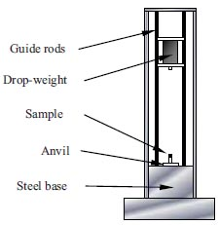
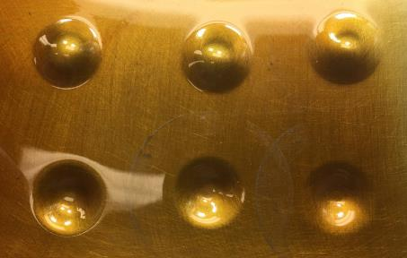
Rapid Impact Deformation
Referenced in ASTM D2794-93 this test uses rapid deformation to mimic an impact from a falling object or debris.
Impact characterizes a coating’s ability to flex and resist cracking under tension and compression.
Twelve formulations passed at 80 kg cm (Full Pass).
Graphic Credit: ASTM D2794-93
Guide Rods
40 kg cm
60 kg cm
80 kg cm
Drop Weight
Compression (Concave)
Sample
Anvil
Steel base
Tension (Convex)
Image Credit: NASA
Notes:
Discriminatory test that advances coatings to more data collection – Add an example of a failed test image

Slide 5
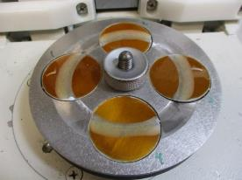
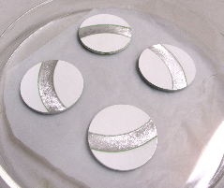
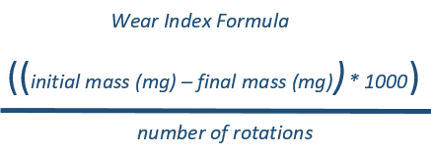
Taber Abrasion
Taber measures the rate which a coating can be abraded by friction over a set number of rotations with a selected Taber wheel.
Per ASTM D4060, the wear index can be calculated, providing an understanding of a surface’s abrasion durability.
Image Credit: NASA

Slide 6
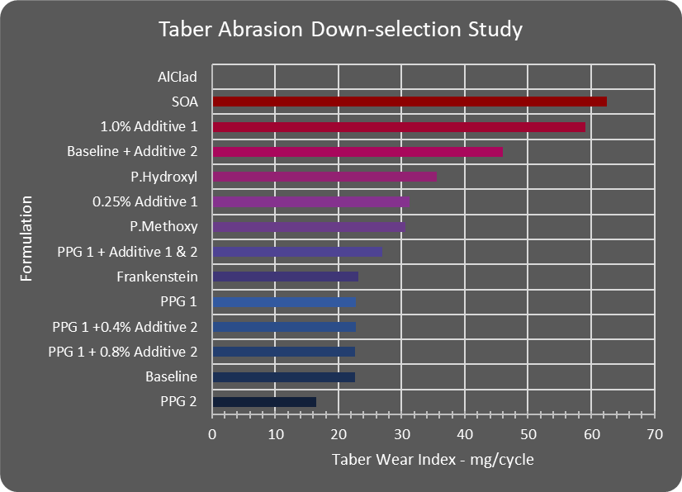
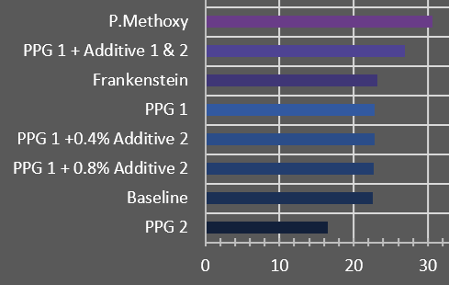
Taber Abrasion Durability Comparison
30.63
26.93
23.15
22.78
22.78
22.68
22.63
16.53
Taber wear index results narrow twelve formulations down to eight.
NASA Langley Research Center – April 2020 – NASA Internships, Fellowships, and Scholarships Program
Notes:
Make sure to highlight that epoxy is largely comparable, even the icing values

Slide 7
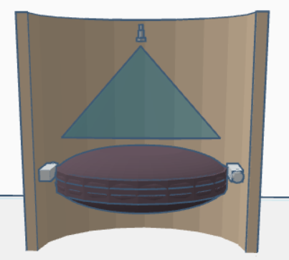
Impact Ice Adhesion Testing: AERTS Jr.
Tests are conducted from -16 to -8°C using 20 μm droplets. Ice is accumulated on the sample and sheds after a period of time.
Once this occurs, the rpm at shed, mass, and area are collected to determine the adhesion strength.
Super-cooled water droplets
Sample coating
5500 rpm
Smith, Jr., J. G.; Wohl, C. J.; Palacios, J.; Connelly, B. D. Design and Development of a Laboratory-scale Ice Adhesion Testing Device. 41st Annual Meeting of the Adhesion Society, San Diego, CA, February 25-March 1, 2018.
Image/Graphic Credit: NASA

Slide 8
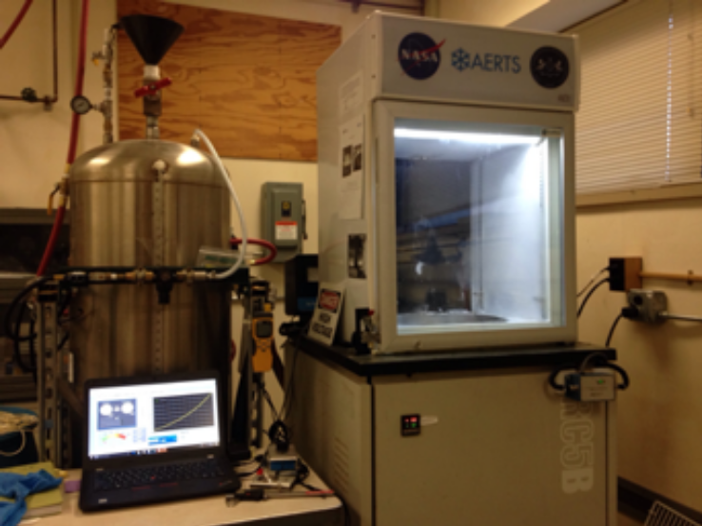
Adhesion Reduction Factor: AERTS Jr.
Alclad 2024 T3 was used to represent current aircraft wing leading edge material.
Alclad icing values were used to calculate the ice adhesion reduction factor (ARF).
Average Alclad IAS
Adhesion Reduction Factor
=
Average Sample IAS
NASA Langley Research Center – April 2020 – NASA Internships, Fellowships, and Scholarships Program
Notes:
Make sure to highlight that epoxy is largely comparable, even the icing values

Slide 9
Select Epoxy Based Coatings
Baseline
PPG 1 + Additives 1 & 2
P.Methoxy
PPG 2
Impact: Full Pass
Wear Index: 23 mg/cycle
-8°C ARF: 1.8
-12°C ARF: 1.0
-16°C ARF: 1.2
Impact: Full Pass
Wear Index: 27 mg/cycle
-8°C ARF: 2.0
-12°C ARF: 1.2
-16°C ARF: 1.6
Impact: Full Pass
Wear Index: 31 mg/cycle
-8°C ARF: 2.0
-12°C ARF: 1.5
-16°C ARF: 1.3
Impact: Full Pass
Wear Index: 17 mg/cycle
ARF Values TBD
NASA Langley Research Center – April 2020 – NASA Internships, Fellowships, and Scholarships Program
Notes:
Make sure to highlight that epoxy is largely comparable, even the icing values

Slide 10
Conclusions
The rapid impact deformation test was found to be the best test in determining whether a coating proceeded to the next round of test.
The incorporation of additives either resulted in no change or an increase in the wear index.
The formulations presented showed the best ARF values (2.0) at -8°C.
PPG 1 with additives had the best balance of properties.
NASA Langley Research Center – April 2020 – NASA Internships, Fellowships, and Scholarships Program
Notes:
Make sure to highlight that epoxy is largely comparable, even the icing values

Slide 11
Acknowledgements
NASA Langley Research Center
STEM Takes Flight Internship Program
Virginia Space Grant Consortium (VSGC)
NASA Internships, Fellowships & Scholarships (NIFS) Program
Universities Space Research Association (USRA)
Lenore Miller
John Tyler Community College
Advanced Air Transport Technology (AATT)

