Slide 1
SPHERES/Astrobee Working Group (SAWG)
Meeting
April 29th, 2020

Slide 2
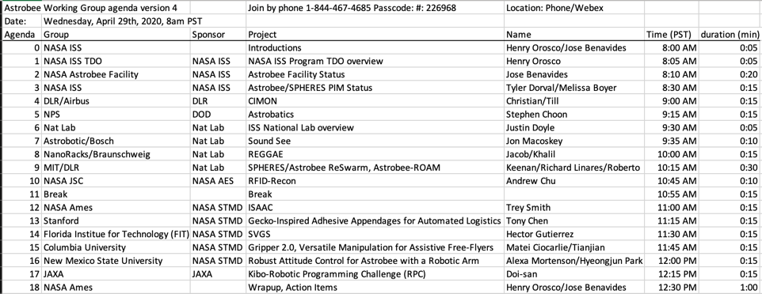
Agenda

Slide 3

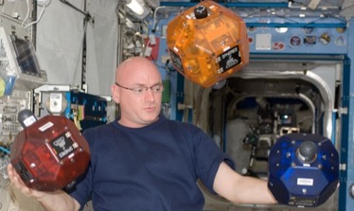
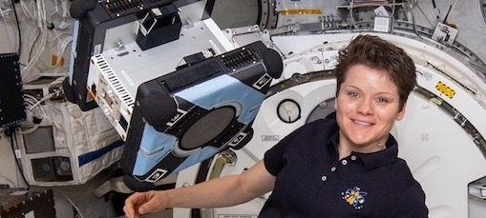
Project Overview
Why Free Flyers on ISS? Provide a risk-tolerant testbed to:
Enhance & Enable Human Exploration (e.g. Gateway)
Astrobee can potentially perform a range of Intra-Vehicluar Robotics (IVR) caretaking tasks to help maintain and protect the Gateway, particularly during uncrewed mission phases.
Perform Fundamental Research
Objectives
Based at Nasa Ames Research Center, the ISS Astrobee Facility provides a free-flying robotic system for ISS research and ISS STEM outreach. The Astrobee free-flying robotic system consists of three cubed-shaped robots, software, and a docking station used for recharging.
The project provides sustaining engineering tasks for ensuring the facility operational readiness on ISS.
The project provides payload support to users from academia, private industry, NASA, and other government agencies in the execution of ISS approved research and STEM objectives.
Current activities
Closing out SPHERES
Completing Astrobee commissioning activities
Maintaining & Operating Astrobee
Facilitating Free Flyer user community
SPHERES/Astrobee Working Group (SAWG)
International Partners: JAXA (Int-Ball) and DLR/Airbus (CIMON)
Notes:
Tech dev, Tech matureing, Analog

Slide 4
SAWG Community
SPHERES/Astrobee Working Group (SAWG) meeting
Face-to-Face, twice a year
Next will be in November 2020, location: Huntsville, AL
Purpose:
Information sharing across the SPHERES/Astrobee community
Astrobee Facility shares
Status of resources (batteries, CO2 tanks, etc.),
Overall Calendar (scheduled Test Sessions, upmass/return), and
Updates on “new” PD, Investigations, and ISS infrastructure.
Provide the SPHERES/Astrobee community (PD, investigators, etc.) with up-to-date information to determine opportunities to use the NL Facility
Discuss proposed changes/updates to Astrobee Nat Lab which may be required to support a specific activity or research.

Slide 5
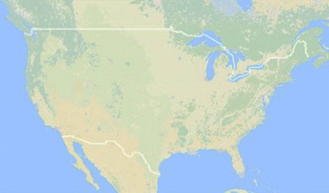
Astrobee Users
10 Projects actively working towards ISS payloads
Astrobatics (Naval Postgraduate School)
SoundSee (Astrobotic/Bosch)
Gecko (Stanford)
RFID Recon (NASA AES/REALM-2)
JAXA Kibo-RPC
Astroporter (Tethers Unlimited)
REGGAE (NanoRacks/Braunschweig)
ISAAC
R2AL (NASA AES)
SVGS (FIT)
Ground Studies
NMSU

Slide 6
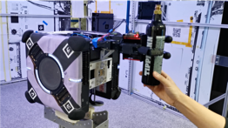
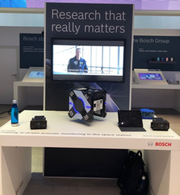
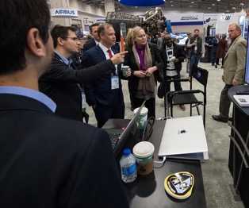
Highlights
SPHERES/Astrobee Working Group, Nov. 6th 2019
Hosted testing for JAXA, Columbia, Braunschweig, Naval Postgraduate School, RFID-Recon, and ISAAC
Last SPHERES session in December
Ramping up ISS Ops support capability from home during Covid-19 restrictions
Three-fingered Hand Integration, Columbia University
IAC 2019
Astrobee SoundSee (Bosch) at CES 2020

Slide 7
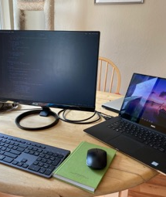
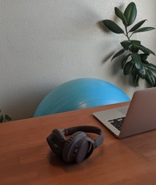
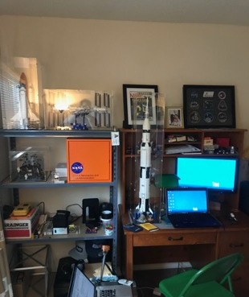
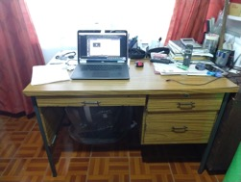
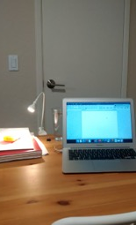
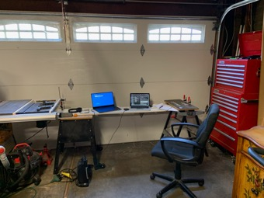
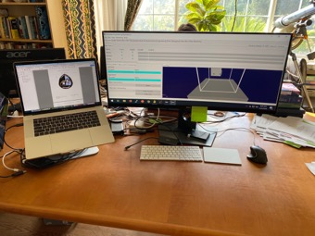
Astrobee From Home

Slide 8
Completed Commissioning
Crew Activity | Robot | Date
Checkout | Bumble | 4/30/19
Calibration & Mapping | Bumble | 5/13/19
Additional Mapping | Bumble | 5/23/19
Localization & Mobility 1 | Bumble | 6/14/19
Localization & Mobility 2 | Bumble | 7/12/19
Localization & Mobility 3a | Bumble | 7/24/19
Localization & Mobility 3b | Bumble | 8/28/19
Checkout & Calibration | Honey | 10/30/19
Localization & Mobility 4 | Bumble | 11/01/19

Slide 9
What’s next
Extended Commissioning (Phase 1)
Crew Activity | Robot | Date
Battery Swap | Bumble and Honey | 04/29/20
Localization & Mobility 1 | Honey | 04/30/20
Payload Installation | TBD | TBD
Payload Demo | TBD | TBD
SPHERES/Astrobee Hand-off | TBD | TBD
Completion of Phase 1 enables support of initial Guest Scientists
RFID Recon, JSC
SoundSee, Astrobotic / Bosch
Gecko Gripper, Stanford
Kibo-RPC, JAXA
Notes:
Update dates to be “Fall” “Spring 2020”

Slide 10
Engineering

Slide 11
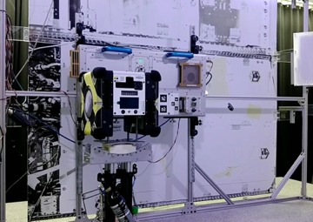
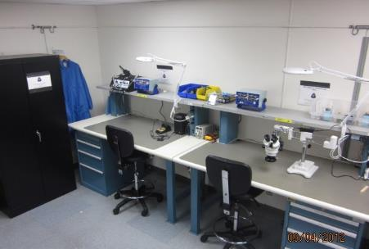
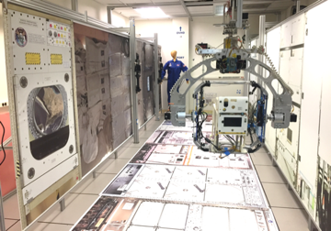
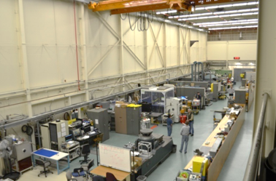
Ground Lab Status
Granite Lab: Online
Flight Lab: Online
Under Renovations
Micro Gravity Test Facility (MGTF) Lab: Under Renovations
Engineering Evaluation Lab (EEL): Available upon request

Slide 12
Hardware Status
Name | Status | Plans
Flat Sat A | Operational | Hardware checkout
Flight 1,2 | In Space, checked out | Honey LOMO
Flight 3 | In Space, still in box | None currently
Flight Spare | Complete | At JSC for integrated testing (EMI, Acoustic)
Cert (B#) | Operational | Available for testing
Ground (Wannabee) | Operational | Available for testing

Slide 13
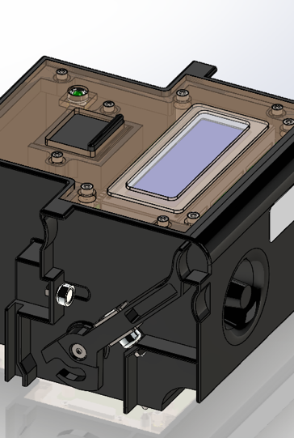
Port Tester
Astrobee Port Tester delivered for launch on SpX-19
Objectives:
Facilitate diagnostics of the Astrobee Free Flyers’ internal USB ports
Test safe electrical current and voltage operation limits
Connect with Astrobee through the High Level Processor (HLP) using Guest Science APK
Serves as a USB pass-through connection to the HLP
Serve as an internal ARC based payload to learn and better improve the guest science payload development process
Ground unit has been tested on FlatSat, Bsharp, and Wannabee
Ground and Crew procedures submitted for review

Slide 14
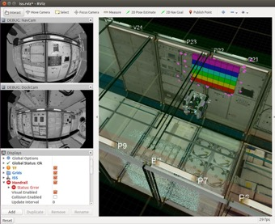
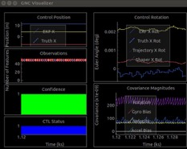
Mapping Trajectory Generation
To facilitate mapping process, a repeatable trajectory is being tested/developed
Simulation/GDS first, and then Astrobee in Lab
2 sets of trajectories are required:
Initial operation (by human operator):
Nav Camera used for collecting data for Image processing, i.e Features/Control points
Robot has no pre-known information of coordinate system or environment
Suggestion for Crew operation
Updated operation (by unattended Astrobee):
Nav Camera used for collecting images for map updates
Known Features/Control points
Plan for Autonomous motion
Future direction
Tool for updating/expanding an existing Sparse Map

Slide 15
Dock Shutdown anomaly
The dock switches to an unknown state every few weeks, causing the Astrobees connected to not charge their batteries and die.
Solution: Three Watchdog Timers
EPS Watchdog (~17 mins)
Dock Controller Watchdog (~17 mins)
Dock Processor Watchdog (Wandboard) (20 mins)
Dock Processor
I2C
Dock Controller
3) DP
2) DC
I2C
I2C
1)EPS
AB1
1)EPS
AB2

Slide 16
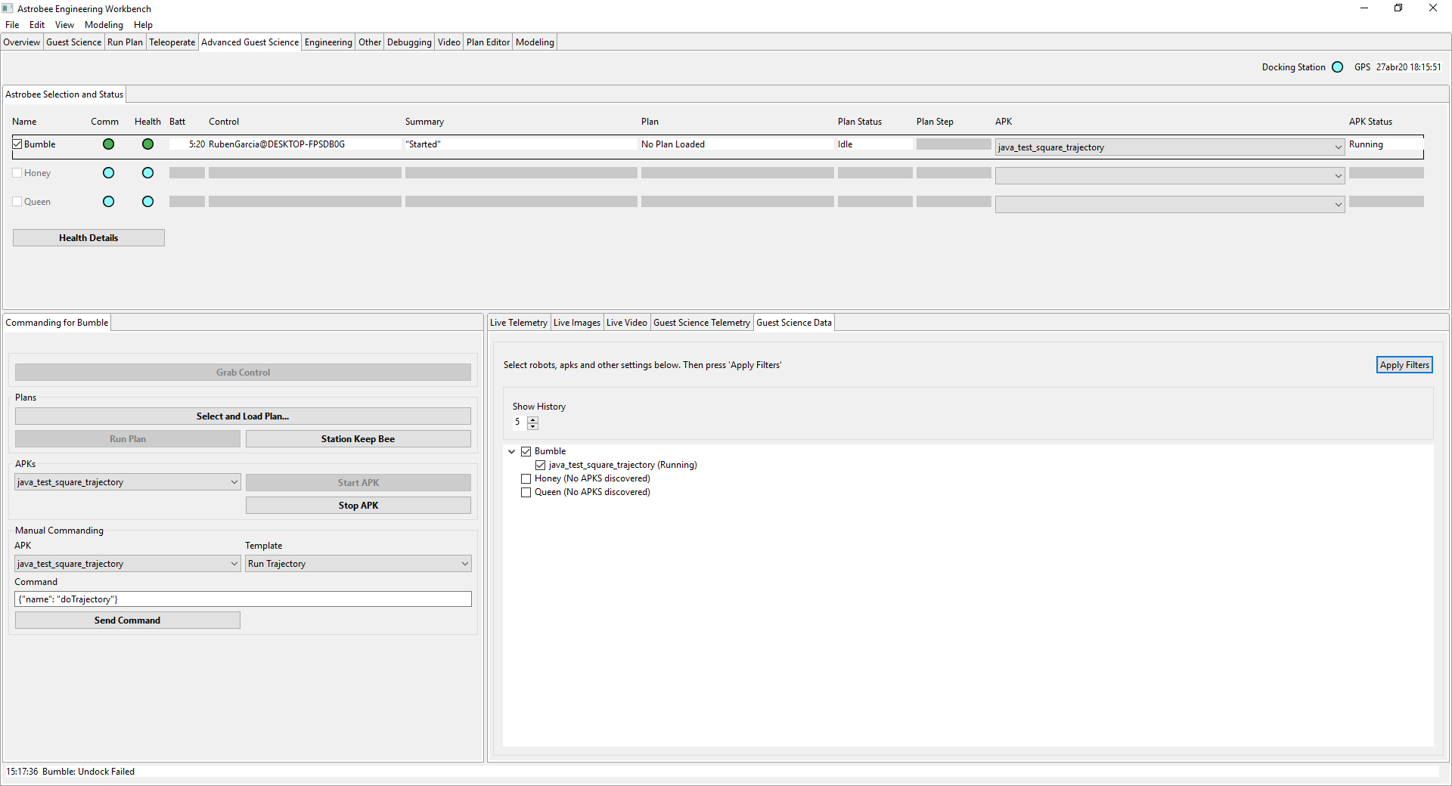
GDS Guest Science Data View
Guest Science Commanding and Data View in the same place

Slide 17
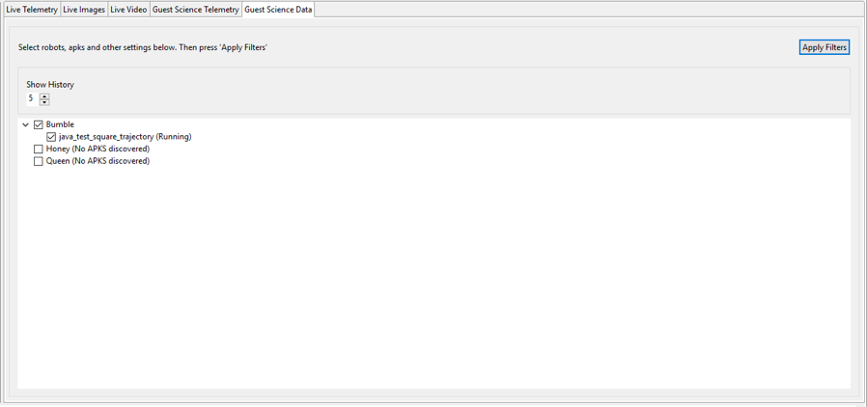
GDS Guest Science Data View
Advance to Data View
View messages history
View data from multiple robots and APKS

Slide 18
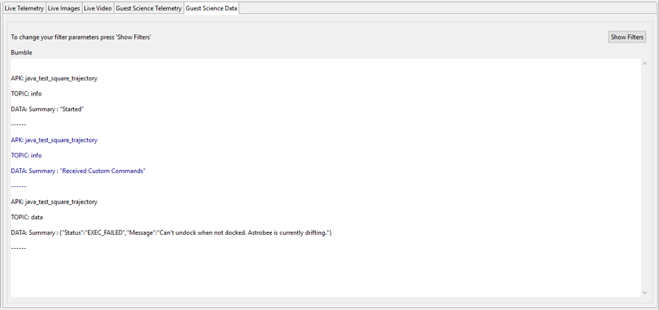
GDS Guest Science Data View
Return to Filters
Simple text based data display. More displays will be added

Slide 19
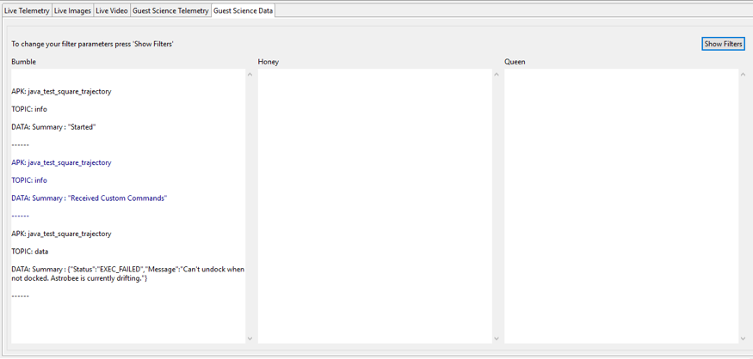
GDS Guest Science Data View
Simultaneous data display

Slide 20
Flight Testing
Astrobee Robot Software release 0.10.4 is out on Github, it is being used for Honey LoMo
Today: Battery Swap
Tomorrow: Honey LoMo
Verify Honey flight performance – have a second unit fully ready
Validate current map prior to Kibo-RPC process checkout
Gather mapping data
Execute plans as time allows

Slide 21
Lab Testing - Highlights
User Testing
At Ames Visits
JAXA visit to Ames developing testing strategy and evaluating game concept
Astrobatics Lab test gathering trajectory data during tossing maneuver
REGGAE lab test developing approach for operations and evaluating performance of various samples
Columbia 3-finger gripper testing
Remote Tests
End-to-end test with JAXA controlling lab Astrobee from their lab
Imagery streaming to JSC Building 8 (a.k.a. VCC)
Revalidated lab imagery streaming to Building 8
Procedure for coordinating with Building 8 tested and finalized
Observing Honey LoMo and viewing telemetry
SciCam Streaming
End-to-end test successful.
Will not be used until Building 8 Gateway-to-gateway VPN in place
Building 8 Gateway-to-gateway VPN planned completion in June

Slide 22
Ops

Slide 23
Operations: Functions
Ensure Facility Readiness for ISS Test Sessions
All crew training is handled via Onboard Training (OBT).
Manage crew procedure and all planning products updates via OCR/ECR system
Coordinate crew time with ISS Lead Increment Scientist and POIC Cadre
Assist Astrobee team & PDs in acquiring proper access to ops systems as needed
Coordinate with investigators for product development and delivery
Help investigators set up remote communication capabilities as needed
Real-Time ISS Test Session support
Coordinate with SpOC (Specialist OC) any deltas to real-time ops and products
Support crew & POIC cadre real-time ops – conduct crew conferences as needed
Coordinate Commanding Window requirements and planning
Test session data and video management
Public Relations
Maintain website, work with ARC PAO office to publish material on site

Slide 24
Operations: Functions
Increment Planning
2-pager development and submittal, updates as needed throughout increment
Regular timeline planning with Lead PPM (Payload Planning Manager) and PPM planning team.
Safety and Verification Assessments
Integrated Safety & Verification Assessments as needed (Guest Science etc.)
Current SPHERES Safety & Verification focuses on return of hardware.
Complete CoFR (Certification of Flight Readiness) for ground systems and on-orbit hardware and operations products.
Astrobee Ground Ops Development
Coordinate ground Engineering and Operations Readiness Tests (ERTs/ORTs) in preparation for real-time ops.
Work with Astrobee team and PDs to develop flight procedures, coordinate reviews with MSFC for final delivery and formal ECR review.

Slide 25
Increments 60/61 & 62/63
Increments 60/61 (~Sept 2019 to April 2020)
SPHERES Test Sessions (since last SWG 11.6.19)
ReSwarm Science 3 – December 31
Astrobee Commissioning Activities (since last SWG 11.6.19)
Astrobee A Localization & Mobility 4 – October 30
Astrobee B Checkout/Calibration – November 1
Increments 62/63 (April 2020 to April 2021)
Astrobee B Localization & Mobility 1 – April 30
JAXA Kibo-RPC Process Checkout – May 13
JAXA Kibo-RPC Rehearsal for Final Round – ~August 18
JAXA Kibo-RPC Final Round – ~September 17
SoundSee TBD [crew procedure initial draft in development]
RFID-Recon TBD [crew procedure final draft to be delivered to MSFC over next week]
Payload Install (Astrobee Arm) TBD [crew procedure in pre-ECR review at MSFC]
SPHERES/Astrobee Handoff TBD [no procedure]
Payload Demo (Astrobee Arm) TBD [procedures need to be developed]
Astrobee A/B LoMo as needed TBD [procedures already baselined]

Slide 26
Increments 60/61 & 62/63
Increments 62/63 (April 2020 to April 2021)
Additional Guest Science
Gecko TBD [final draft of crew procedure delivered to MSFC]
Port Tester [final draft of crew procedure delivered to MSFC]
Astrobatics [initial draft of crew procedure to be developed over next month+]
REGGAE [initial draft of crew procedure to be developed over next month+]
Other ground and ISS activities
Weekly Mondays commanding (Jonathan has been working his magic.)
16 ERT/ORTs (Engineering/Operational Readiness Test)
Astrobee Ops Planning for Increment 62/63 with MSFC ongoing
59S Crew Debrief for Christina Hammock Koch & Luca Parmitano (3.25.20)
A majority of the safety paperwork for return and trashing of SPHERES hardware has been complete.

Slide 27
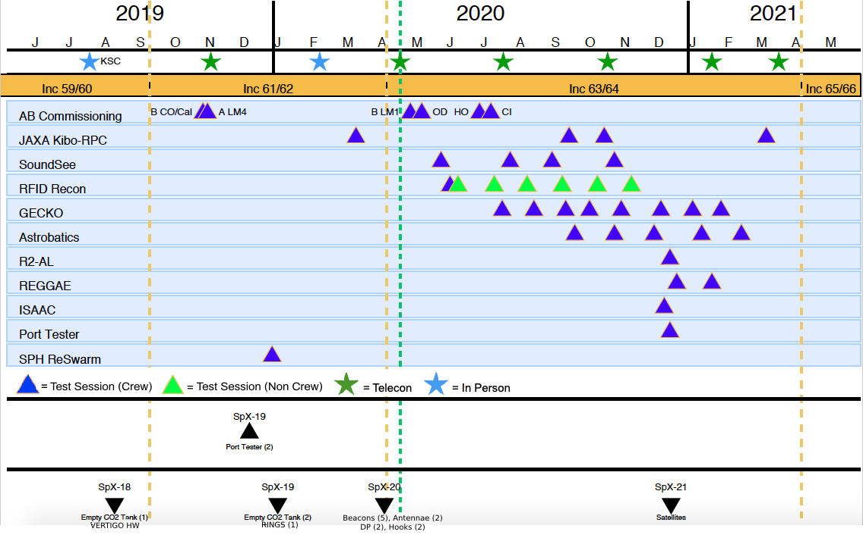
SPHERES & Astrobee Calendar

Slide 28
Safety, Verification, Consumables
Safety
SPHERES (beacons, antenna, DP, 3D printed hooks) Return on SpX-20 – Approved: 2019/03/16
SPHERES (satellites) Return on SpX-21 – In work
Astrobee - JAXA Kibo-RPC software hazard exception – In Review
Consumables downmass
Empty SPHERES CO2 tanks have been returned to ARC. Remaining tanks on ISS have been trashed.
All SPHERES battery packs have been trashed.

Slide 29
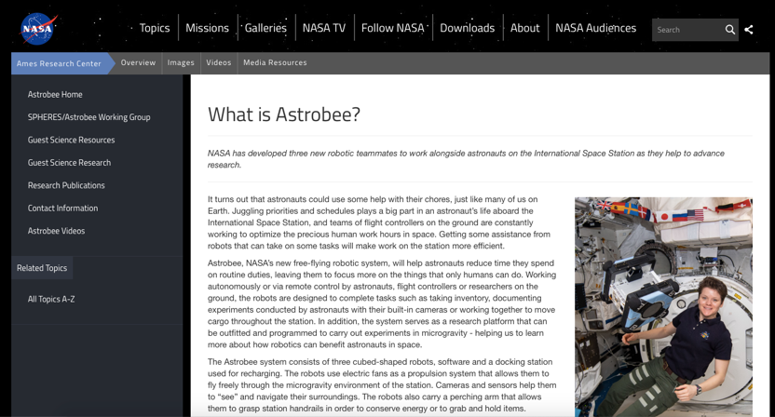
Astrobee and SPHERES on Social Media
Twitter
https://twitter.com/NASA_SPHERES
Website
http://www.nasa.gov/spheres
http://www.nasa.gov/astrobee

