Slide 1
Low Creep/Low Relaxation Thermoplastic Polymer Composites for Deployable Structures
Kyle Horn (Arizona State University)
Mentors: Jin Ho Kang and Keith Gordon
2020 Spring NIFS Research Symposium

Slide 2
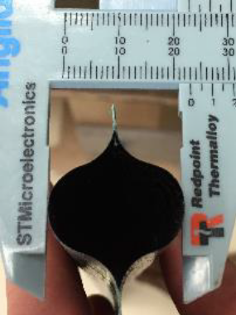
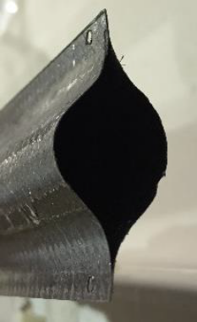
Problem
Key Term – Stress Relaxation: the time-dependent decrease in stress of
a viscoelastic material held under constant strain
Deployable structures spend up to one or two years in stowage before deployment
  Can result in loss of structural integrity if significant relaxation occurs
Need to mitigate stress relaxation within ultralightweight carbon fiber / polymer composites
Current investigations in thermosets have yielded significant progress for BMI matrices
Prolonged Stowage
16 mm
23 mm
Fig. 1. About 50% loss in buckling strength due to stress relaxation [1]. Image credit: NASA

Slide 3
Objective
Driving Question: What progress can be made in reducing the relaxation modulus of carbon fiber / polymer composites?
Investigate thermoplastics for use as a matrix material in low-relaxation carbon fiber composites
Characterize Polyether-Ether-Ketone (PEEK) to fabricate samples of CF/PEEK composites
  Benefits of PEEK
    One-step cure process
    Out-of-autoclave
    Reusability
    Strong fiber-matrix interface adhesion

Slide 4
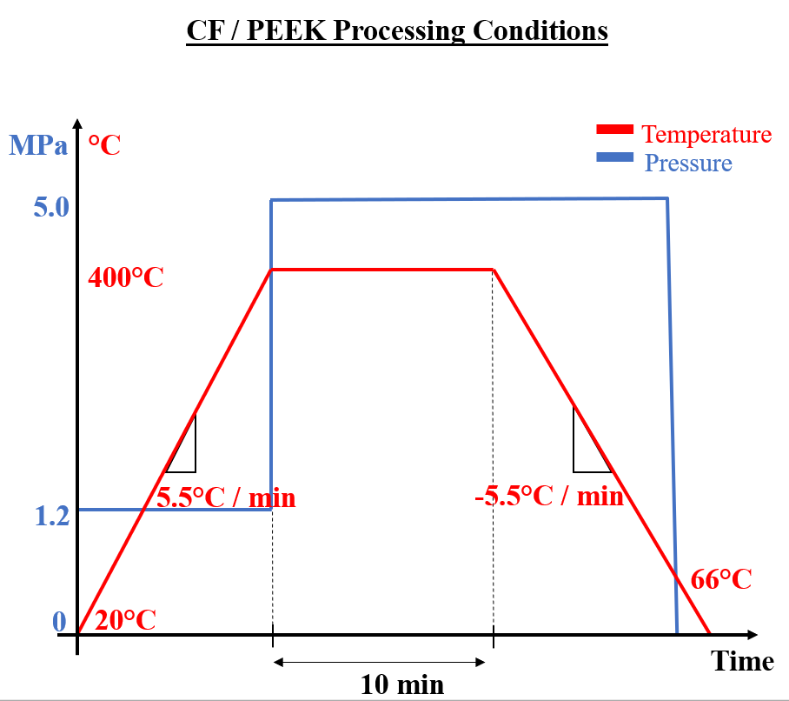
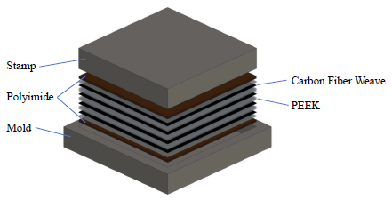
Approach
Layup
  Three layers polyimide release film bookends sample
  1.5” X 2.5” mold
  4 layers
  CF to PEEK ratio / layer
    CF: 1 ply CF weave @ 62 gsm
    PEEK: 4 plies PEEK foil @ 8μm thick / ply
Fig. 2. Process conditions for CF/PEEK sample fabrication
Processing conditions
  Apply pre-holding pressure of 1.2MPa
  Heat layup to 400°C @ about 5.5°C/min
  Apply 5MPa at temp 400°C
  Hold 10 min
  Decrease temp @ about -5.5°C/min
  Release pressure when layup temp < 66°C
Fig. 3. schematic of film stacking process for consolidation of CF/PEEK sample (not to scale)

Slide 5
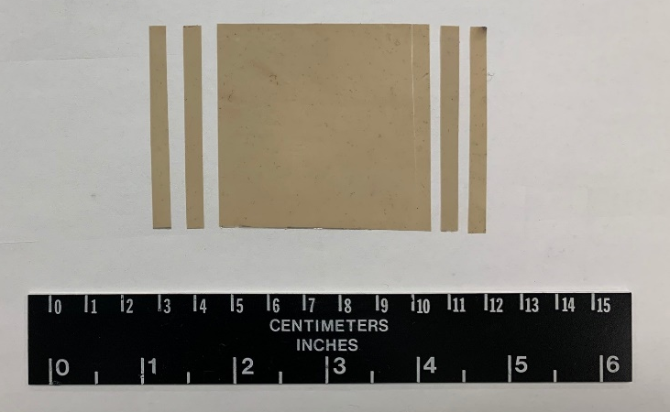
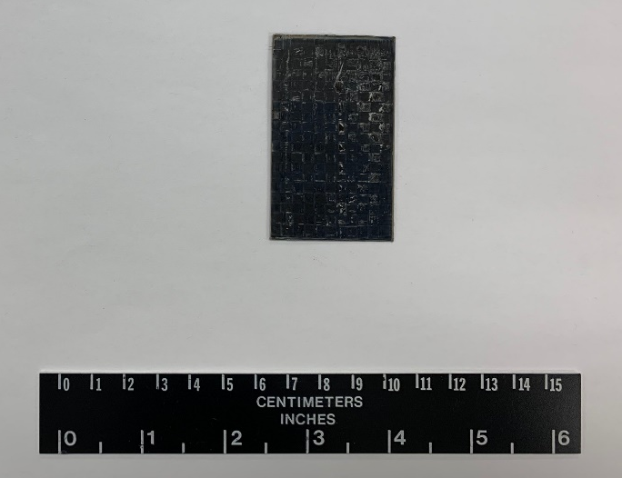
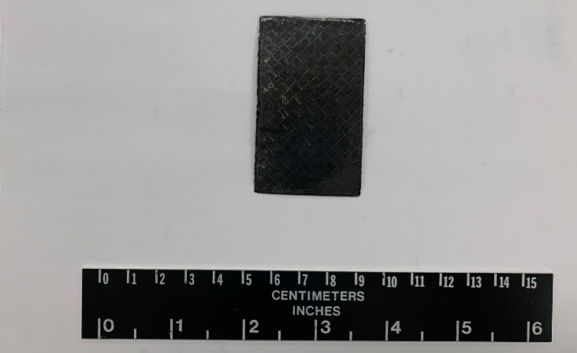
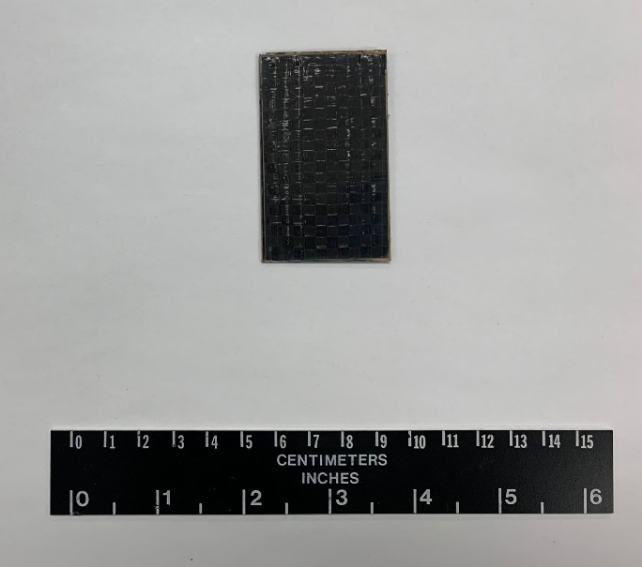
Results
KH 00280-33-1
Fig. 4.
KH 00280-31-1
Fig. 6.
PEEK Pristine
CF/PEEK [±45 PW₂/0-90 PW₂]
Fig. 5.
KH 00280-32-1
Fig. 7.
CF/PEEK [±45 PW]₄
KH 00280-34-1
CF/PEEK [0-90 PW]₄
Fig. 4 – 7. Successfully fabricated samples of PEEK Pristine, CF/PEEK [±45 PW]₄, CF/PEEK [±45 PW₂ /0-90 PW₂], CF/PEEK [0-90 PW]₄, respectively

Slide 6
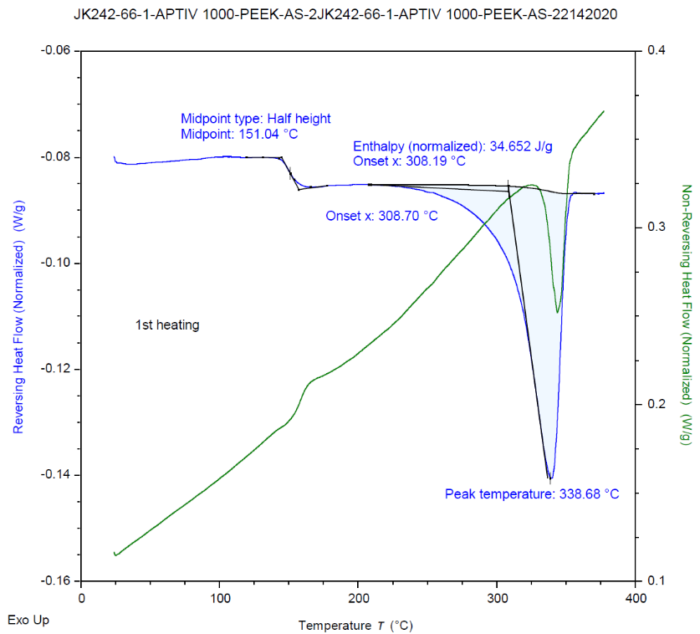
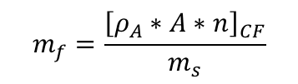
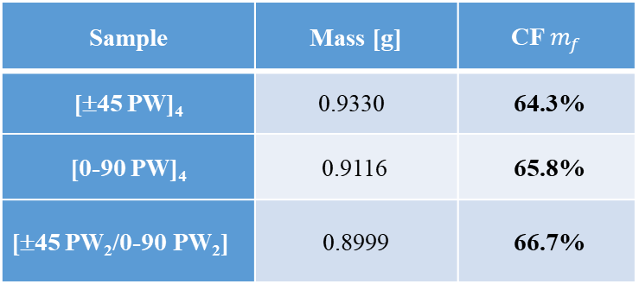
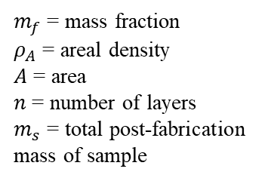
Analysis
JK242-66-1 APTIV 1000-PEEK-AS-2
Table 1. Carbon Fiber Mass Fractions
$$m_{f}=\frac{{\left[ρ_{A}∗A∗n\right]}_{CF}}{m_{s}}$$
Midpoint: 151.04°C
Enthalpy (normalized) 34.652 J/g
Sample | Mass [g] | CF $m_{f}$
[±45 PW]₄ | 0.9330 | 64.3%
[0-90 PW]₄ | 0.9116 | 65.8%
[±45 PW₂/0-90 PW₂] | 0.8999 | 66.7%
Onset x: 308.70°C
$m_{f}$ = mass fraction
$ρ_{A}$ = areal density
$A$ = area
$n$ = number of layers
$m_{s}$ = total post-fabrication mass of sample
Reversing Heat Flow (Normalized) (W/g)
1st Heating
Non-Reversing Heat Flow (Normalized) (W/g)
Peak Temperature: 338.68°C
Typical CF mass fraction: 60% - 70%
Suggests low void content
Low void content tends to improve fiber-matrix interface adhesion
  Need SEM & acid digestion for confirmation
All results are as expected
Temperature
Fig. 8. DSC thermogram of PEEK
Differential Scanning Calorimeter (DSC) data shows a glass transition temperature of 151°C and a melting onset temperature of 309°C.
  Upper limit of application temperature for CF/PEEK composites

Slide 7
Summary
Easy one-step cure process
  Total process takes ~6 hrs to complete
4 CF/PEEK composite samples were fabricated successfully in unique ply orientations for deployable structures
All mass fractions were within typical ranges for carbon fiber polymer composites
SEM data is needed to verify void content and completeness of individual fiber coatings

Slide 8
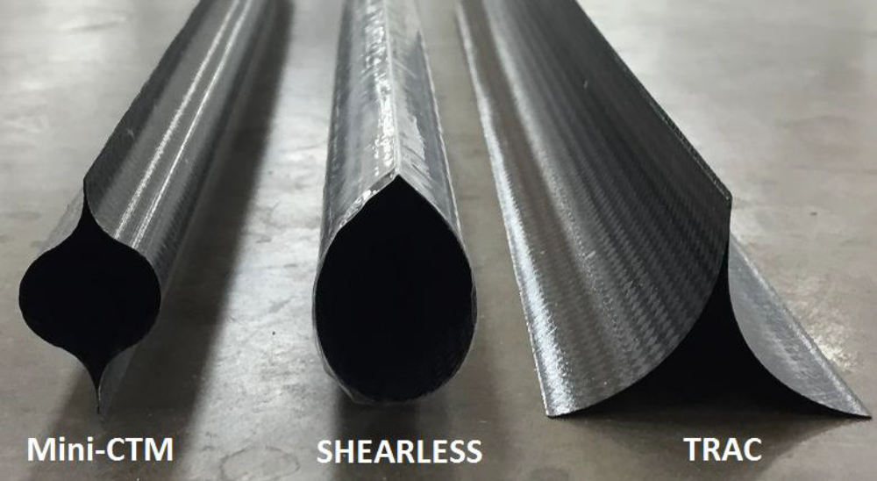
Next Steps
COVID-19 impacted research efforts at week 8 of investigation
  ~3 weeks in-lab time required for relaxation testing on DMA
Fabrication of subscale demonstration specimens
  Long term TRAC boom stowage test comparing reduction in creep/stress relaxation for BMI thermoset and PEEK thermoplastic
Fig. 8. Future work of comparing the relaxation in Triangular Rollable And Collapsible (TRAC) booms between CF/PEEK and CF/BMI composites illustrated [1]. Image credit: NASA

Slide 9
Acknowledgements
Special Thanks to:
  Steve Lee & Janeene Sevilla for safety and lab trainings
  Jeff Hinkley & Sheila Thibeault for providing ideas and solutions to key problems during biweekly update presentations
  Christine Dillard, Valerie Ellis, Patricia Sanchez, & Jalisa Thomas for coordinating the internship program
  Brandon Fallon & Jynette Tigner for lab help, constructive criticism, and making the internship experience overall more fun
  Hoa Luong, Johnny Fernandez, Kevin McClain, Keats Wilkie, Phil Brown for sample supply, support and process
Figure References:
  [1] J. M. Fernandez et al., “An Advanced Composites-Based Solar Sail System for Interplanetary Small Satellite Missions,” in 2018 AIAA Spacecraft Structures Conference, Kissimmee, Florida, 2018, doi: 10.2514/6.2018-1437.

