Slide 1


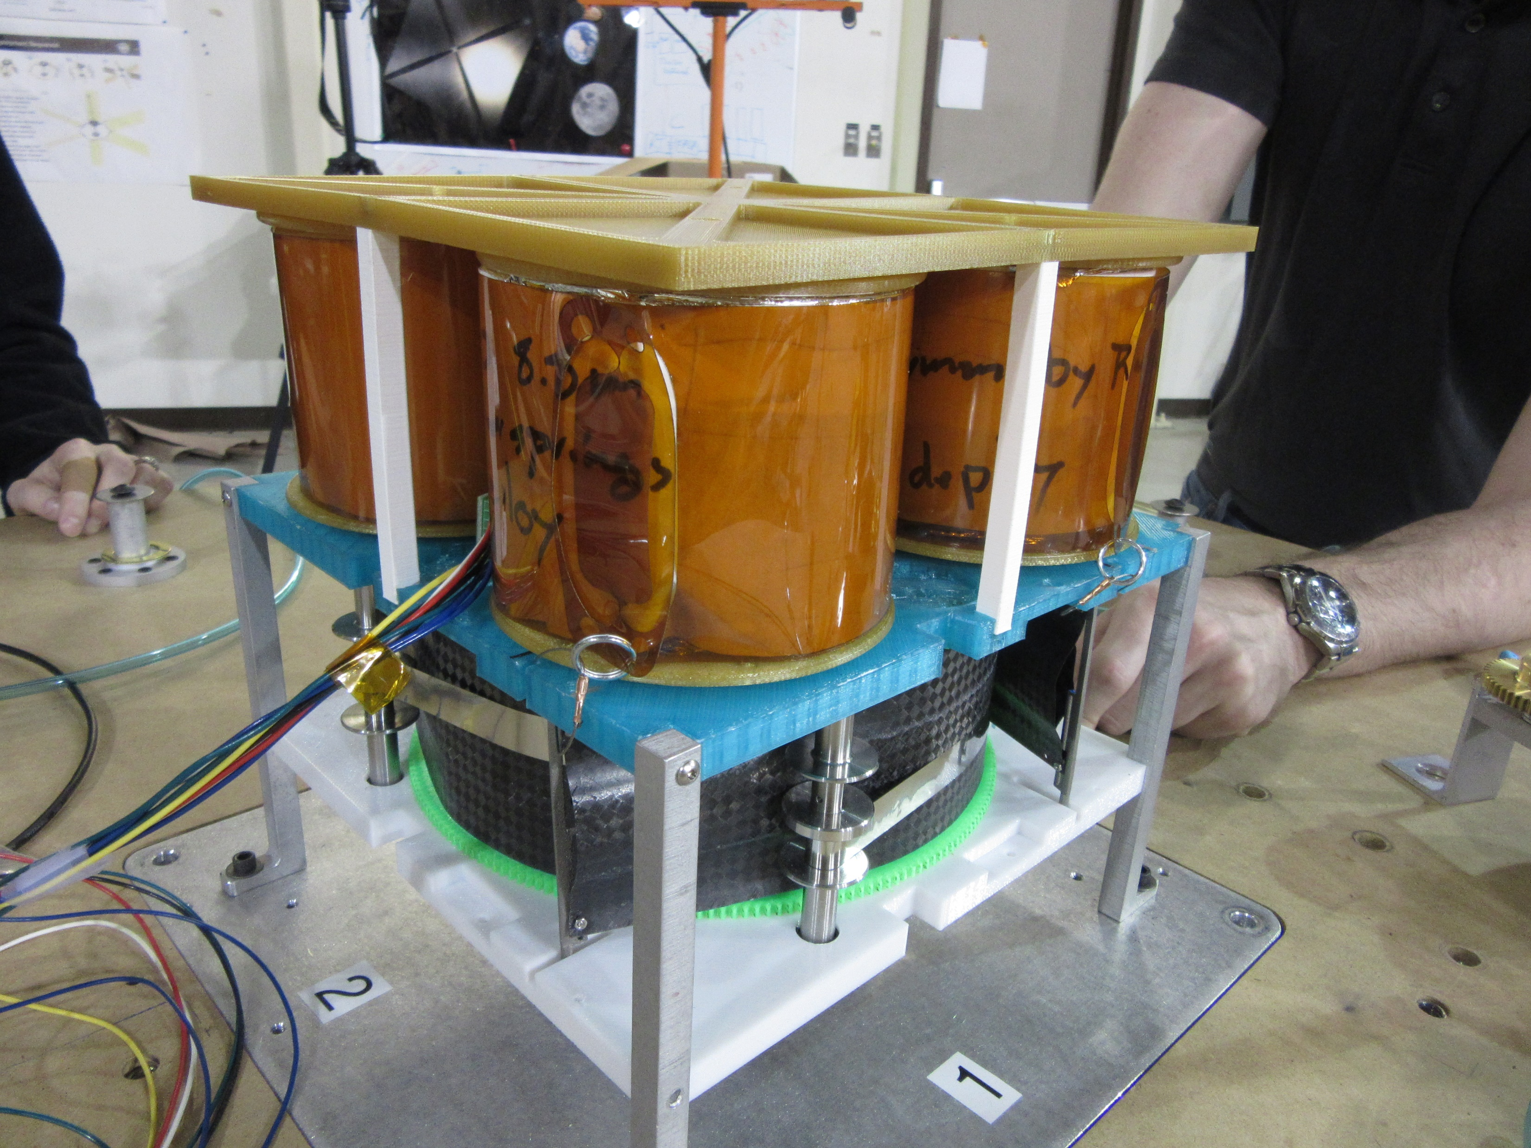
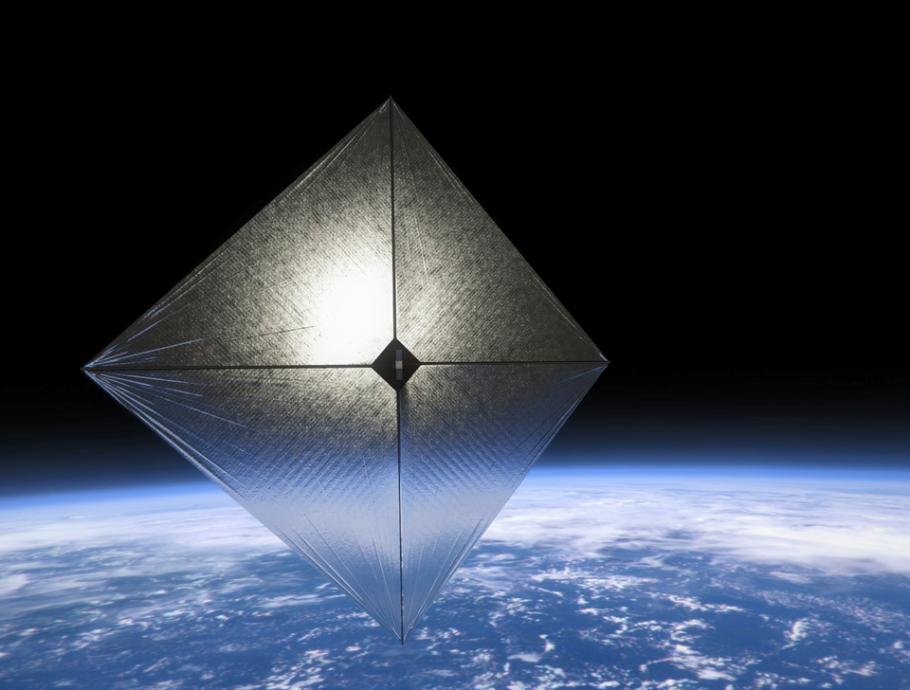
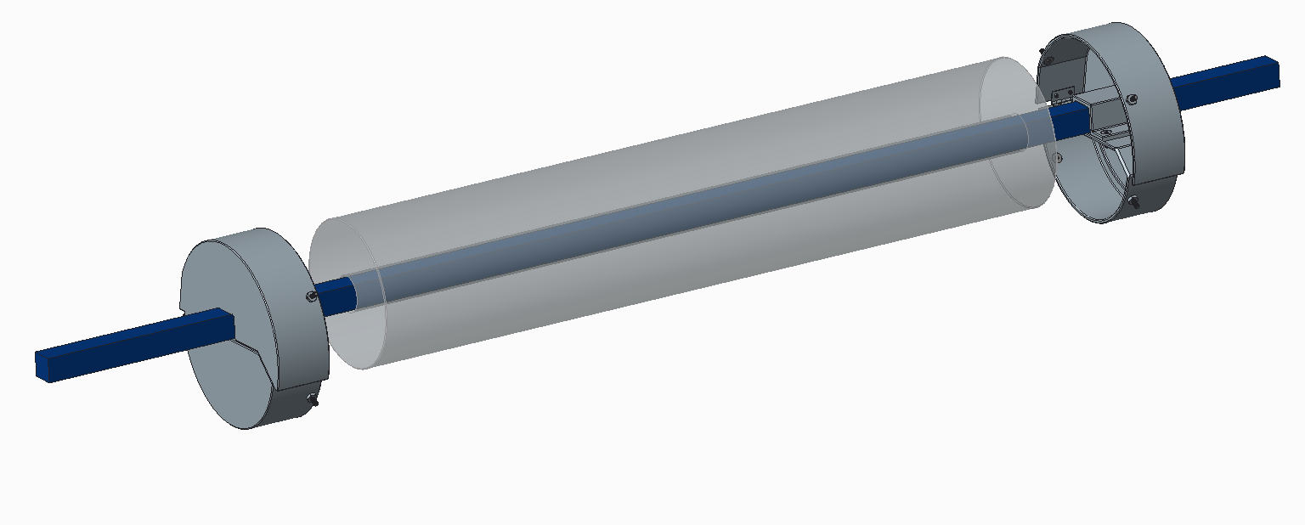
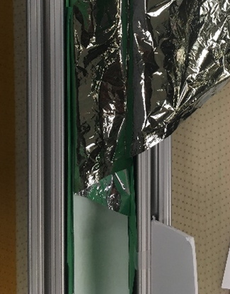
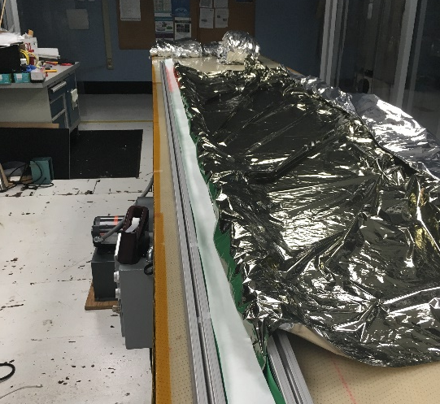
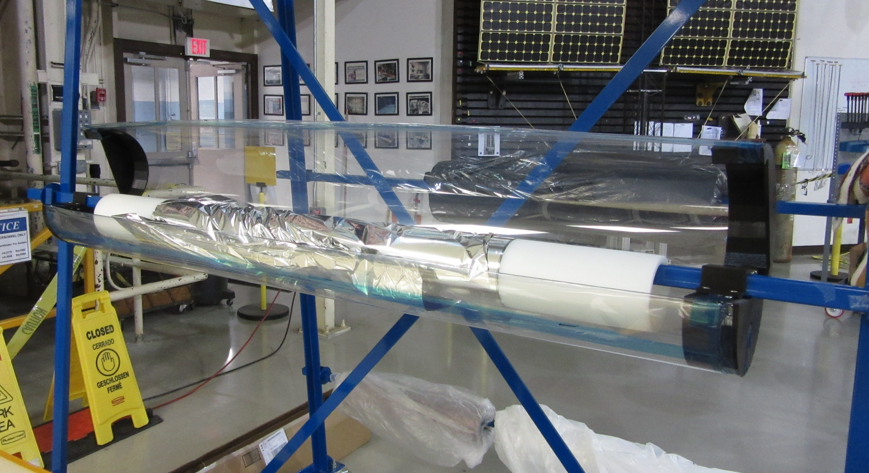
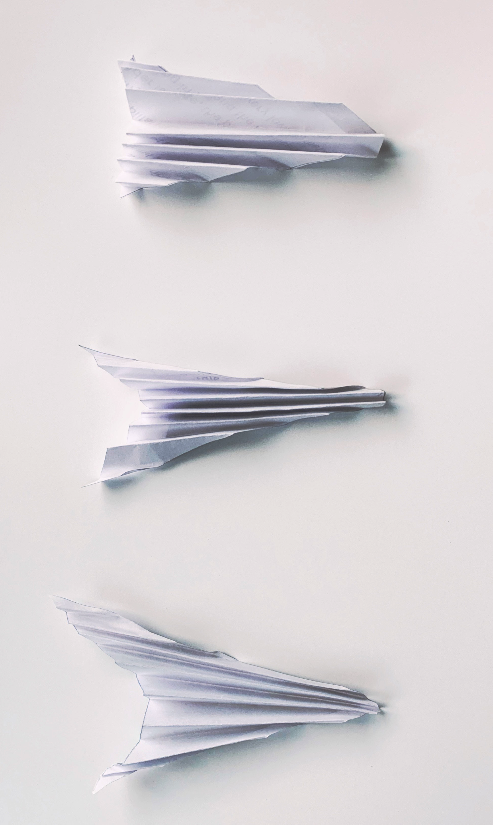
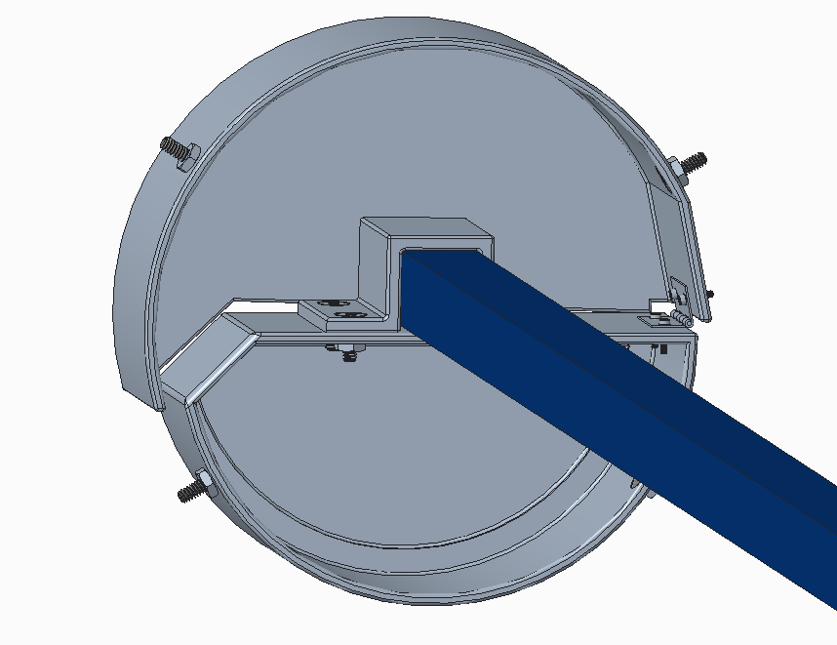
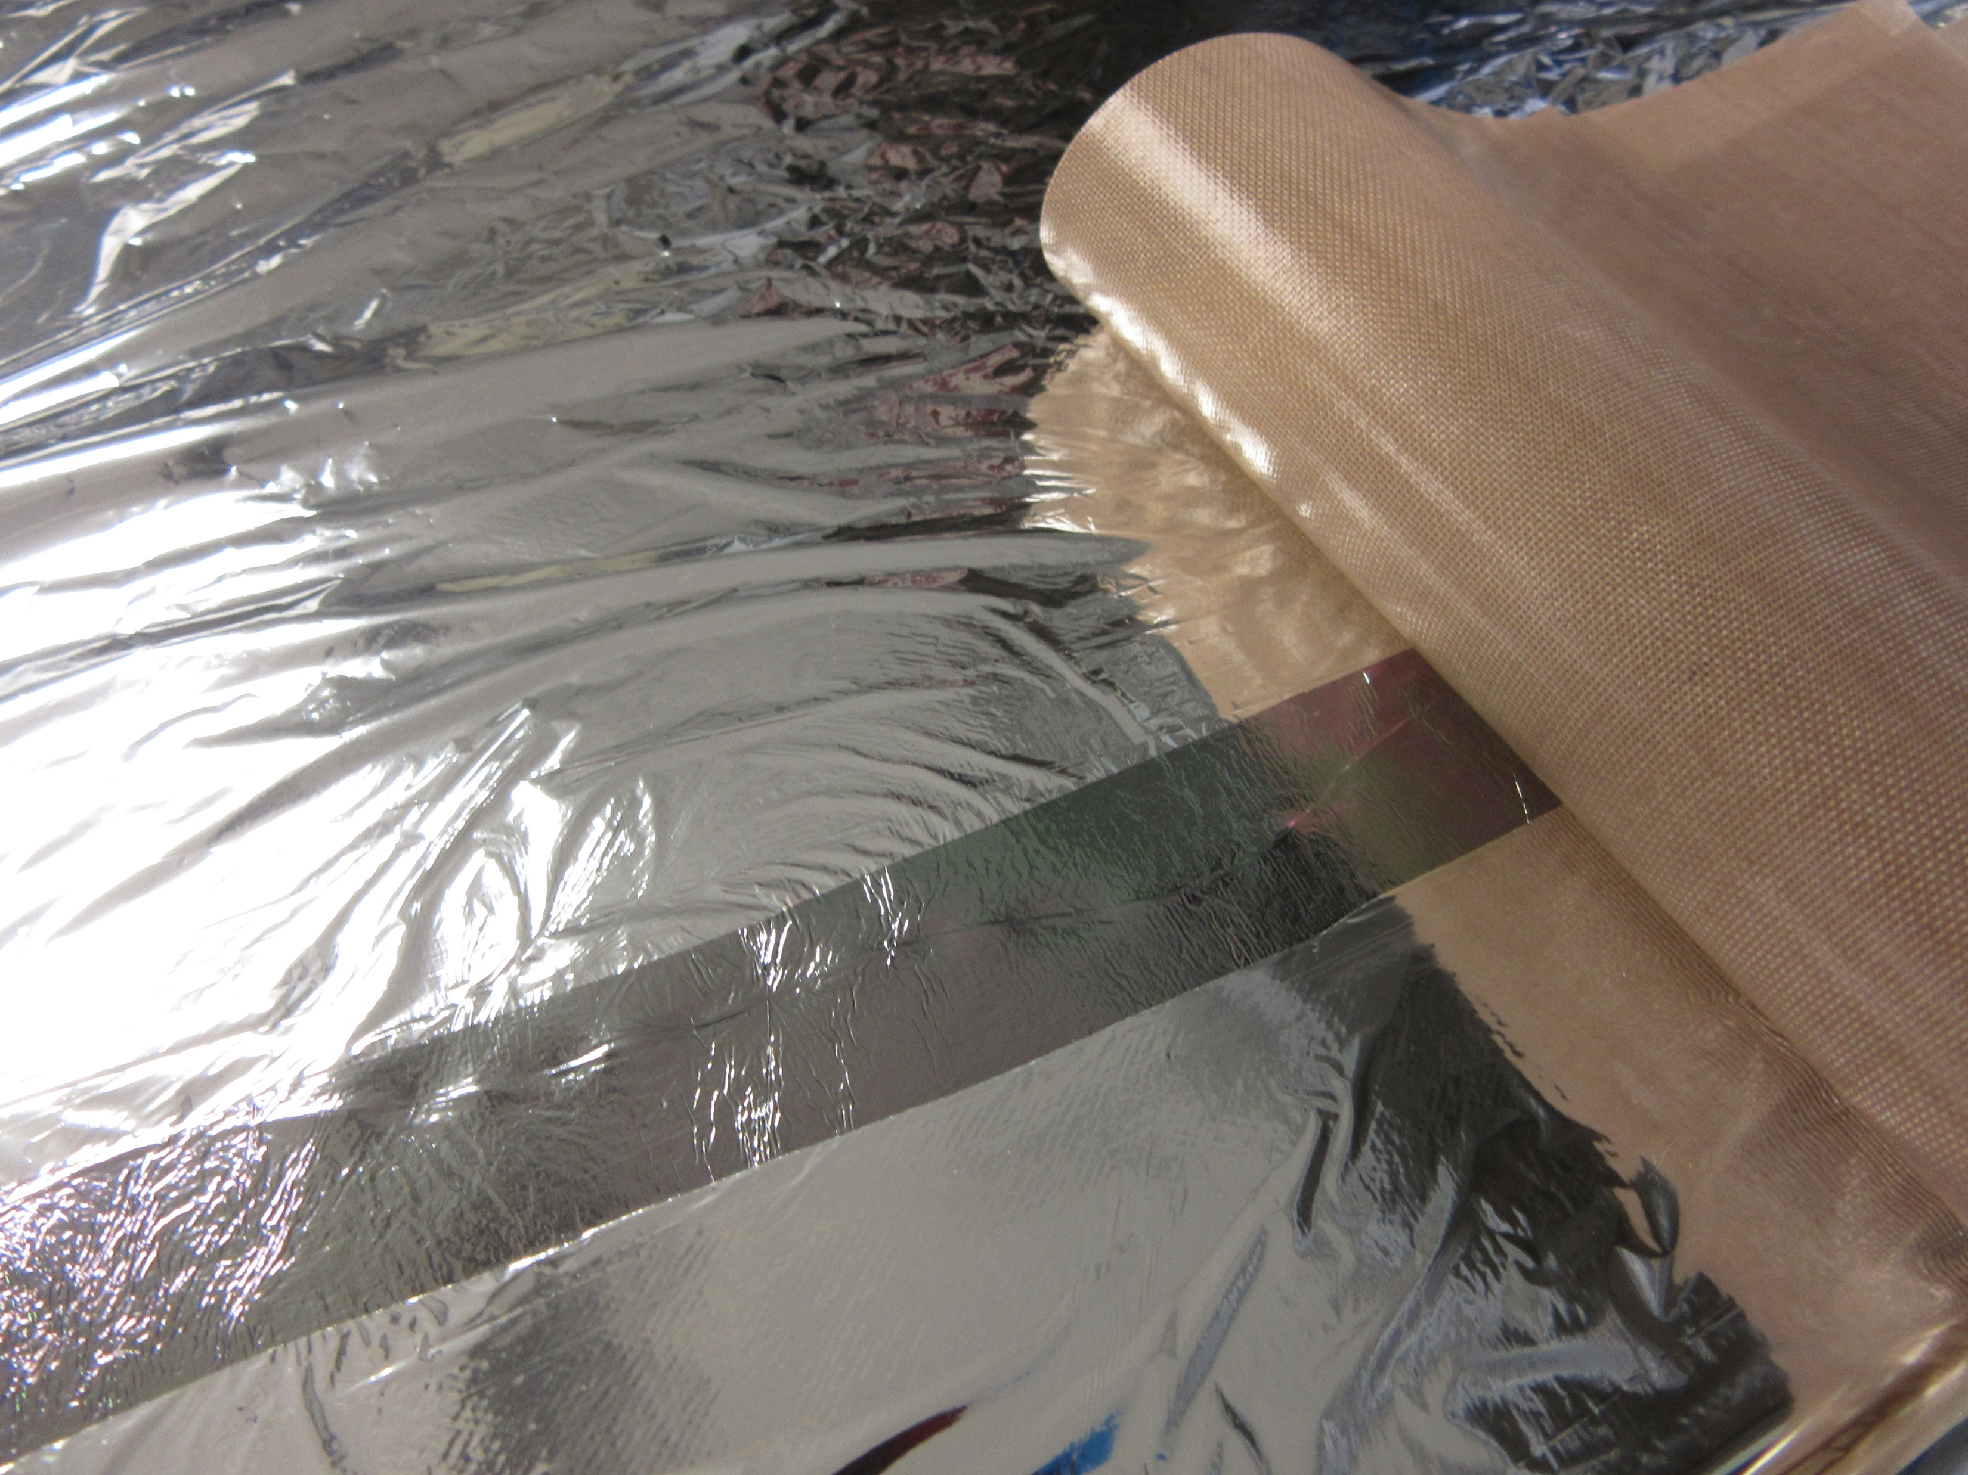
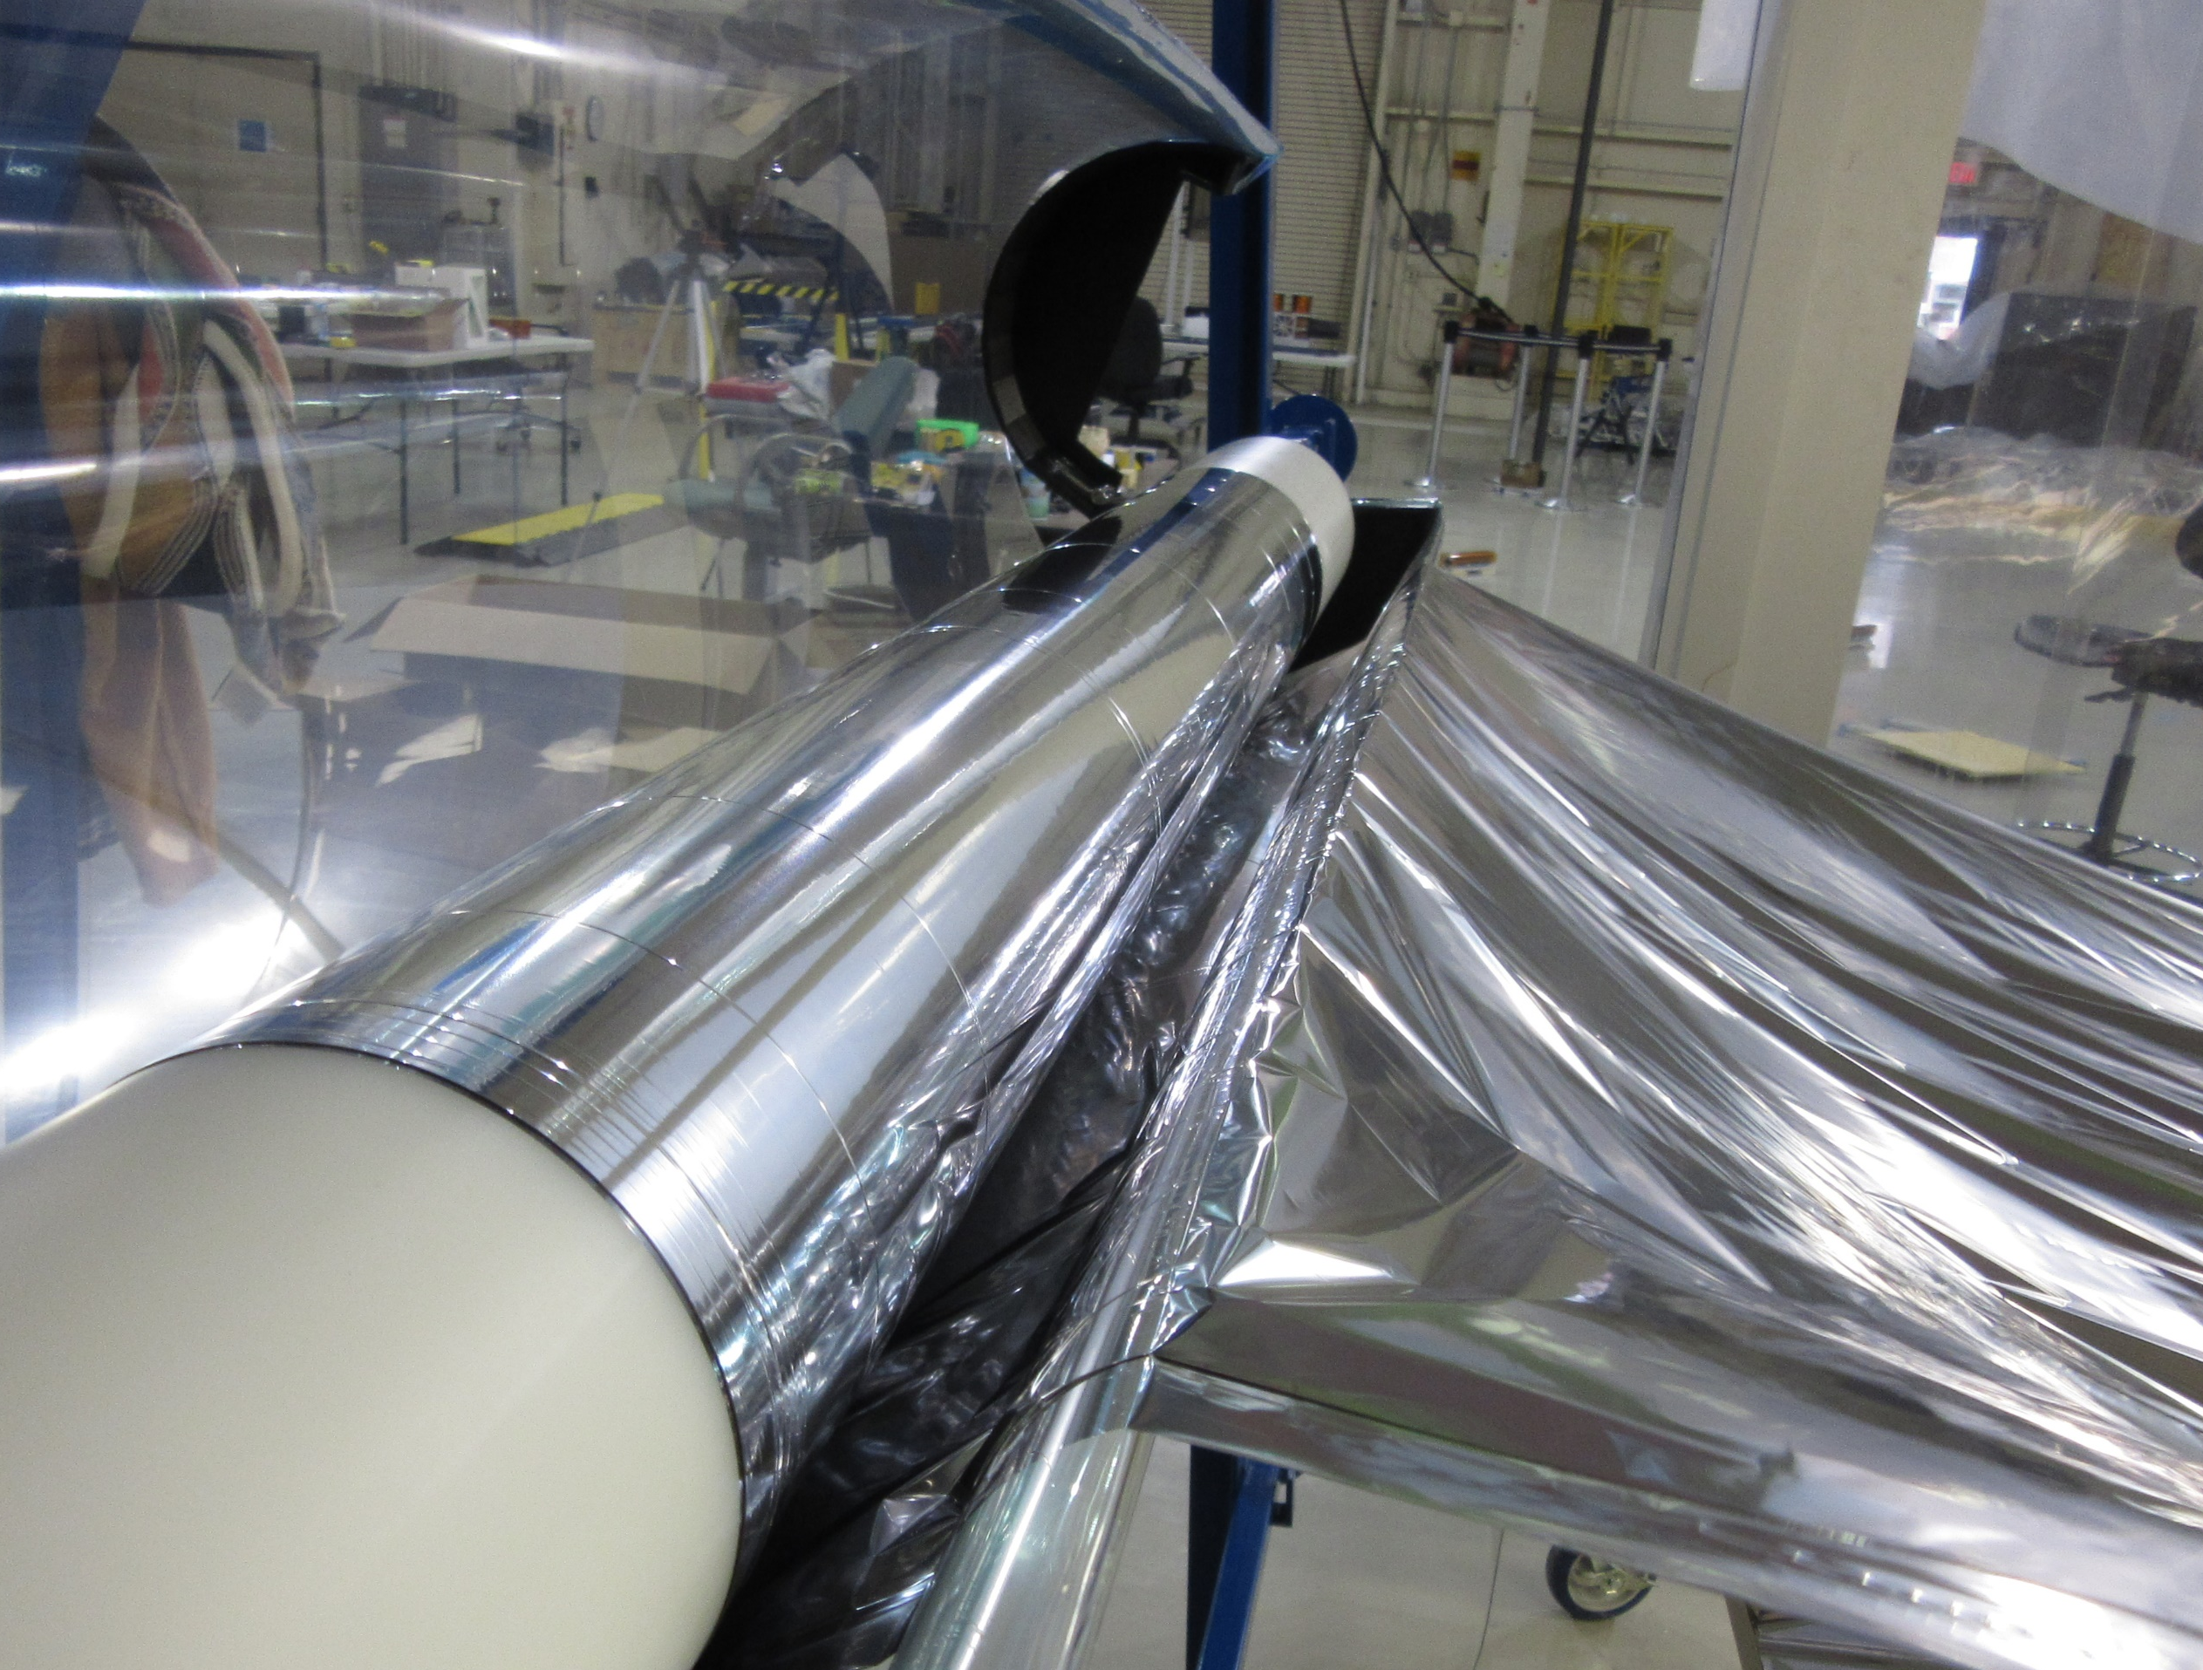
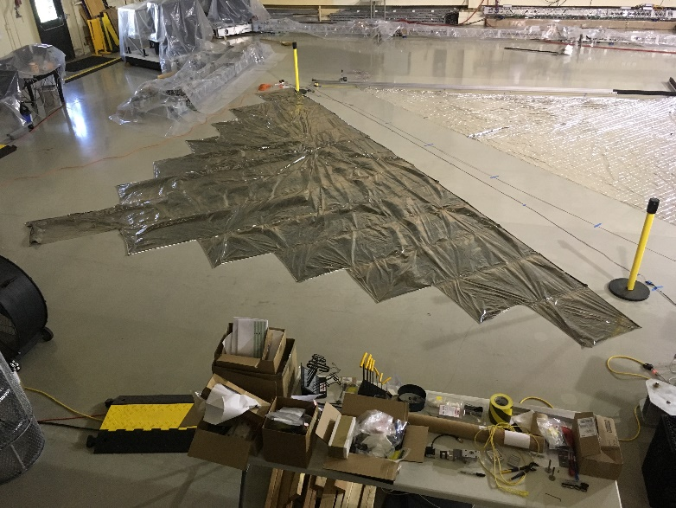
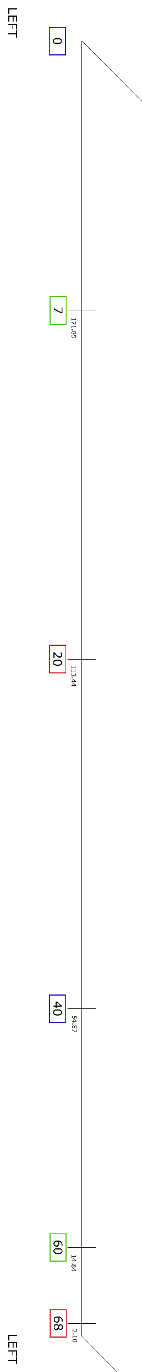
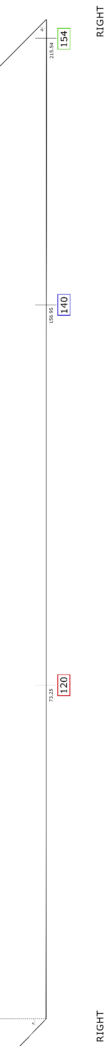
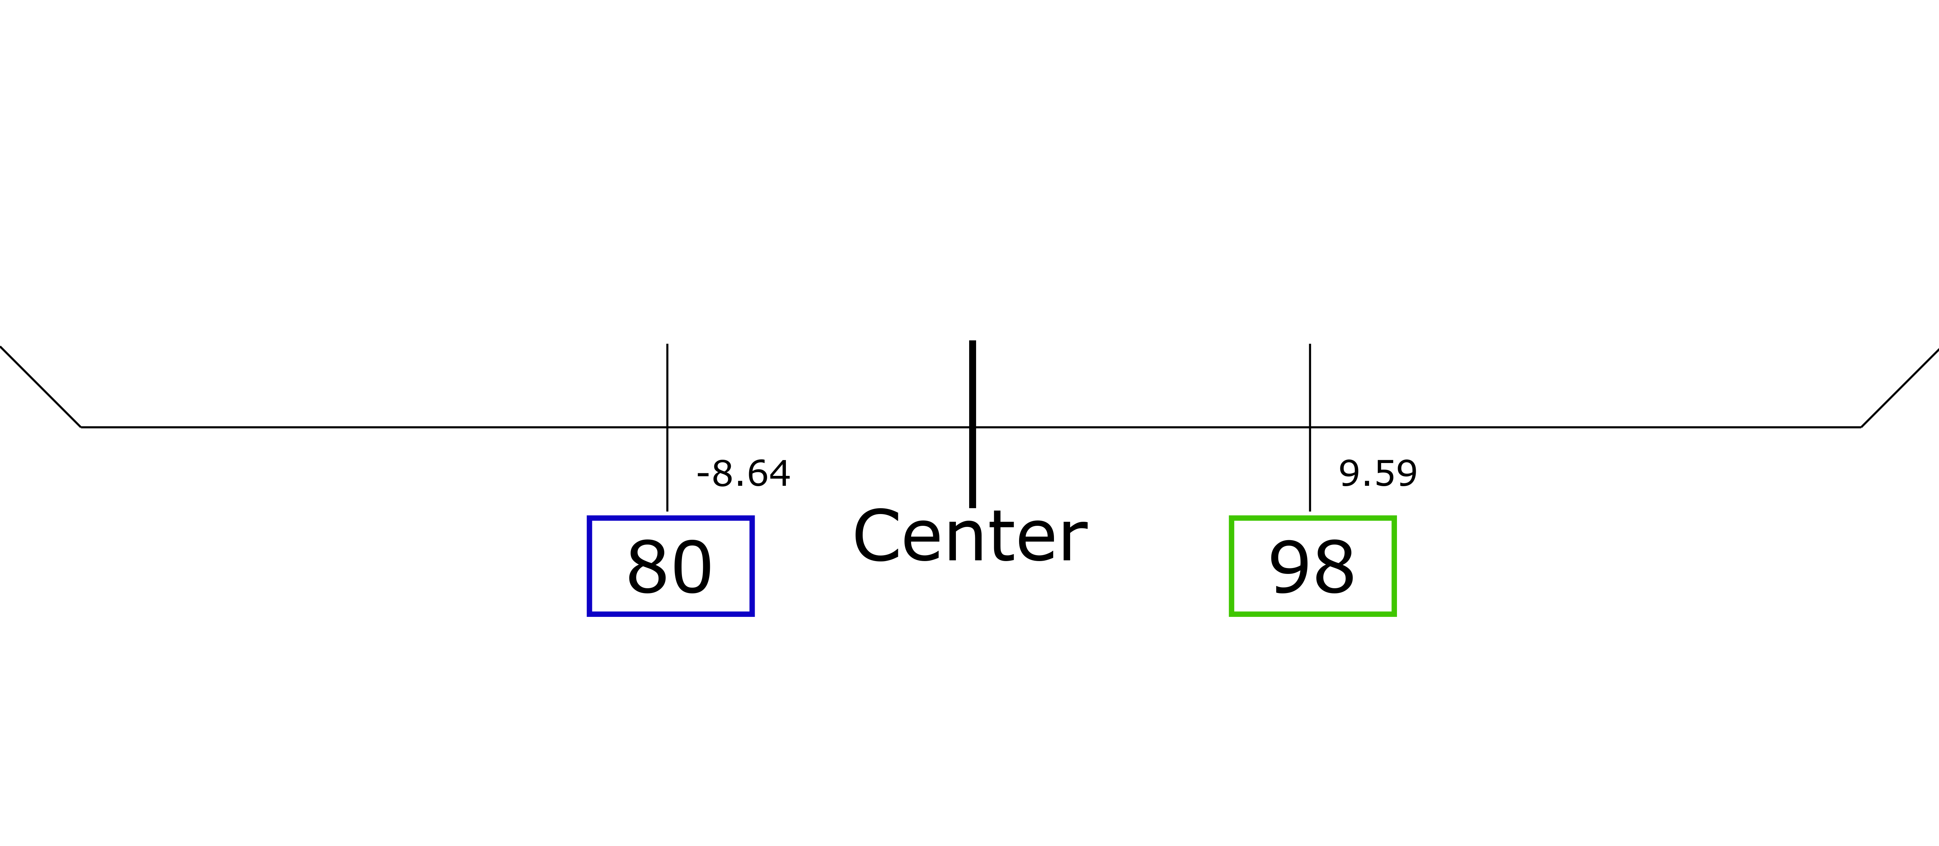
Streamlining the Solar Sail Membrane Manufacturing Process for ACS3
Gabriela Griffin Dr. Olive Stohlman
Internship Objectives
ACS3 Project and Solar Sail Background
Folding and Packaging
To streamline the sail membrane manufacturing process by documenting specific steps through images and text, designing and assembling a storage container for the sail raw material roll, and designing paper forms for the sail shape
To model sail and boom structures using Abaqus in order to understand whether the additional material due to membrane support should be included in analysis
The Advanced Composites-based Solar Sail System (ACS3) is a technology demonstration project of a solar sail in low earth orbit. ACS3 uses a 12U CubeSat platform with an approximate volume of 24 x 24 x 34 cm. The sail is deployed using composite booms which unroll over the course of 45 minutes. The sail membrane is made of polyethylene naphthalate (PEN). One side has an aluminum coating to increase reflectivity; the other is coated in chromium to increase thermal emissivity.
The sail and booms must be folded up and packaged tightly so that they will fit onto the hub. As shown in Figure 8, the sail quadrants are each rolled onto their own spool and can be seen in the top layer. Laser-cut Mylar covers (shown in orange) protect the sail and keep it wound around the spool. The booms are rolled onto a single spool and can be seen on the bottom layer. The sail is folded using z-folds in an angled, off-set pattern as shown in Figure 11. As the sail membrane material is 2 μm thick, the material does not crease. Because of this, a special channel made of 80-20 rails and layers of paper, shown in Figures 9 and 10, are used to hold the sail folds down. After the sail quadrant is folded, it is rolled up onto a spool.
Membrane Material Storage
Figure 8. The above image is a prototype of the hub that the sail and booms roll into.
A method of storage for the membrane material roll was needed in order to protect the material as well as provide easy access for seaming the gores. An inexpensive, custom material storage solution was designed using Creo Parametric 4.0, and is shown in Figure 1.
9 m
Figure 1. The above picture is the final design iteration of the CAD assembly model of the material cover. The raw material roll is pictured. The plastic cover sheet is not pictured.
Figure 9. The above image shows a top view of the channel and the partially folded sail membrane.
Figure 10. The above image is a view of the channel used to fold the sail. The half folded sail can also be seen, as well as one of the paper strips
In Figure 11, the various fold patterns are shown. The sail is folded using the “Angled Folds + Offset Center” pattern. Angled folds are used because this creates “tails” in the folded sail. In addition, the offset center is used because it causes one of the tails to be longer than the other as the sail unspools. When the sail is rolled onto the spool, it is rolled so that the shorter tail is on the outside, causing it to always be in tension when the sail is deployed.
Fold Pattern
Result
Figure 2. The above picture is the assembled cover with the raw material roll inside. In the picture, the cover is open, and the material can be rolled out.
Figure 5. A rendering of a solar sail above Earth (NASA image).
Parallel Folds
The design consists of two 3D printed end plates which hold a piece of plastic sheeting around the material. The plates are able to open and close using a hinge. The end plates in the assembled version, pictured in Figure 2, were 3D printed on a Prusa M3 and cost $10 in PLA filament. The upper end plates take about 5 hours to print, and the lower end plates take about 7 hours. The square bracket which holds the end plates to the shaft was also 3D printed in PLA. The hardware and plastic sheeting were sourced from McMaster-Carr, and cost $31. It takes about 15 minutes to assemble.
Sail Membrane Assembly
Manufacturing the sail quadrants is a multi-step process. It begins with rolling out individual gores and seaming them together, as shown in Figure 6. The gores are seamed using a seam tape. This tape is made of polyester webbing adhesive, Kevlar thread, and a layer of PEN. The Kevlar thread is woven into the adhesive to prevent rips from spreading, and the adhesive is then attached to the aluminum side of the PEN. This is then cut into 1 cm wide strips to form the seam tape. The seam tape is carefully laid across the gores.
Angled Folds
Equal ends
Angled Folds + Offset Center
Longer end
Longer end
Figure 11. The figure shows possible sail fold patterns, and the result it would create if folded in the sail membrane. The examples are made using paper so that the creases would hold and the examples could be photographed. The third fold pattern shown, “Angled Folds + Offset Center” is the closest to the fold pattern used for the sail membrane.
Figure 3. The above picture is a closer view of the left end plate from the final, updated CAD assembly model.
Figure 6. The above picture is of a finished seam. A non-stick mat is also shown. The Teflon non-stick mat was used to protect the iron from the adhesive.
Paper Forms
Design updates were made between the first design, shown assembled in Figure 2, and the final design. The final design updates, shown in Figure 3, include a downward-sloped cutout to ease friction on the membrane material when unrolling, cheaper hinges, and attachment points for the plastic sheeting.
Because the material is so light, it will shift with any kind of air movement. Alignment is important, so notecards are used to weight the gores down and aid in the seaming process. The adhesive is then melted to the PEN using an iron at 165°C. After all thirteen gores are seamed together, shown in Figure 7, the sail shape must be cut out. The paper forms shown in Figure 12 assist in cutting the correct shape. At least one week is required to assemble one sail quadrant. After assembly, the next step is to package the sail onto a spool.
Created in Inkscape, these vector files can be printed on sheets of paper and placed on the floor to create a guide for the shape of the sail. There are four pieces, each with overlap in the corners for easy alignment. In addition, there are color coded labels for fold placement, which can be transferred over to the sail membrane for the packaging process.
9 m
Figure 4. The above picture is of the open cover and the raw sail membrane material being rolled out to cut gores.
Figure 7. The above picture is of a sail quadrant after all thirteen gores are seamed together.
Figure 12. The paper forms are shown above. On the left is all four pieces arranged how they would be for referencing the shape of the sail and fold lines. On the right is the bottom piece expanded so fold number can be seen.

