Slide 1
Co-cure-ply Materials Development (AERoBOND)
Intern: Charlotte Brandenburg
Mentor: Frank Palmieri
Co-mentor: Tyler Hudson
2020 Spring NIFS Research Symposium

Slide 2
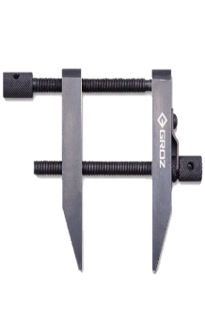
Challenge
Problem:
Adhesive bonding of composites is unpredictable, and requires redundant fasteners
Fastener installation creates a bottleneck in the airframe assembly line
Co-cure assembly eliminates fasteners, but is limited to simple structures
Approach:
Partially cured panels with offset resin
(epoxy-rich) stoichiometry
Panels joined with a layer of
hardener-rich resin and fully cured
conventional materials (uncured)
Joining Layer A
Joining Layer A
Primary Cure
partially cured
surfaces
cured laminate
Project history:
Initial set of 24 test panels completed prior to internship
Now narrowing in on the more
successful tests
partially cured interface
Assembly with
Joining Layer B
Secondary Cure
Co-cured structure

Slide 3
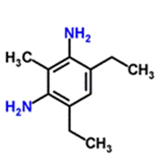
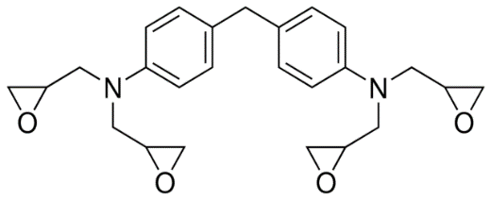
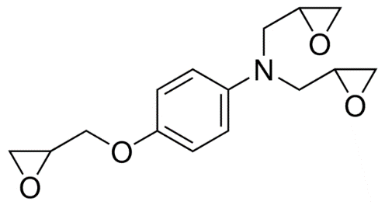

Objective
Project Objective:
  Achieve mechanical properties of at least 80% that of conventional composite
Internship Objectives:
  Experimentally validate predicted properties of neat resin from molecular simulation
  Manufacture composite panels for mechanical testing
  Mix large batches of resin for pre-preg production
+
API-60 Part A: 65% tetrafunctional epoxy,
20% trifunctional epoxy, 15% toughener
DDS Hardener
DETDA Hardener

Slide 4
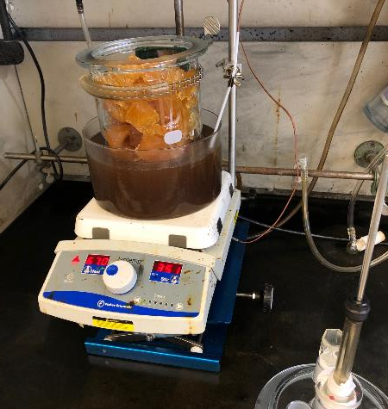
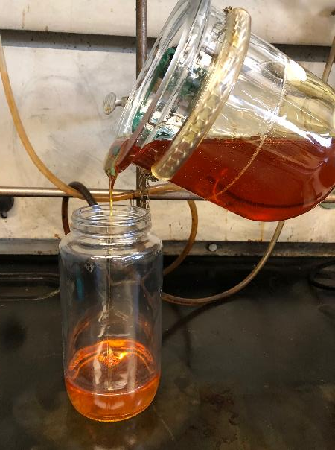
Approach
Uncured density:
  Resin poured into 25 mL volumetric flasks and weighed
  Remainder of the flask filled with water and weighed again to find resin volume
Cured density: Archimedes method
  Measured dry mass and weight of sample suspended in water
  Density = dry/(dry-suspended)
Tensile modulus: modified ASTM D638
  Rectangular specimen, 37 mm gage length
  5 mm/min strain rate
Bulk resin production
  Resin was heated to 100 °C in an oil bath
  Stirred for 1 hour
  Mixed with solvent on rolling mill for 3 days

Slide 5
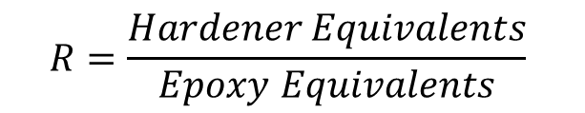
Results
$$R=\frac{Hardener Equivalents}{Epoxy Equivalents}$$
Nominal Density: 3.3 g/mL
@ R~0.8
Literature modulus: 3500 MPa
@ R~0.8

Slide 6
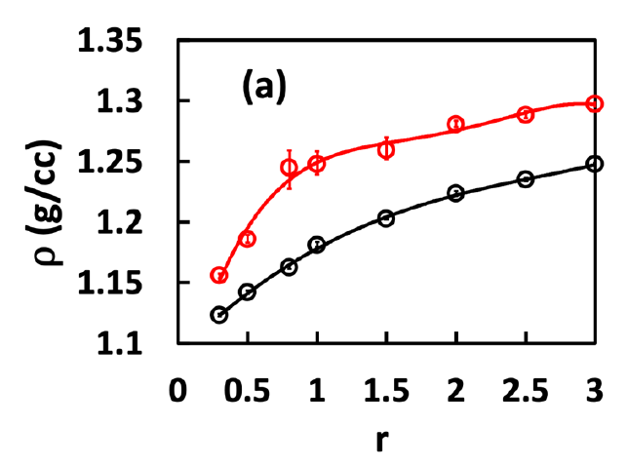
Analysis/Summary
Density results are consistent with model
  Density increases with increasing R-value
  Similar numeric values
  Validated trend of the model
Modulus measurement needs additional work
  Expect a peak at R=1
  Test at higher strain rates, smaller samples
  Does proprietary toughener contribute to differences from model?
Model: data points with curve fit
Experiment: data points

Slide 7
Next Steps/Future Work
Next Steps:
  DMA – modulus at higher strain rates, controlled temperature
  Continue fabricating panels
Other possible future work:
  Same set of measurements on API-60/DETDA resin system

Slide 8
Acknowledgements
  Jin Ho Kang - guidance
  Hoa Luong - panel fabrication
  Sean Britton - panel fabrication

