Slide 1

CERES Data Production Overview
Katie Dejwakh
May 6, 2020

Slide 2
Outline
CERES Overview
Interfaces & Dependencies
Code Re-architecture
Assorted Updates
Data Products

Slide 3
CERES Overview

Slide 4
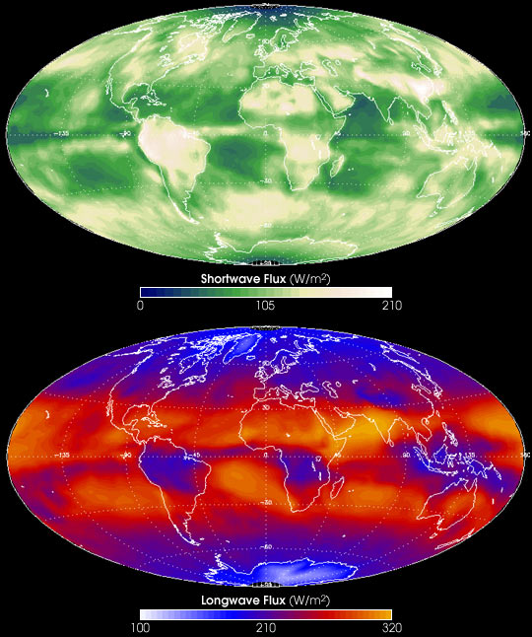
CERES Measurements
Radiances (SW, LW, WN)
Shortwave Flux
Longwave Flux
Notes:
CERES has a 20 km footprint at nadir.

Slide 5
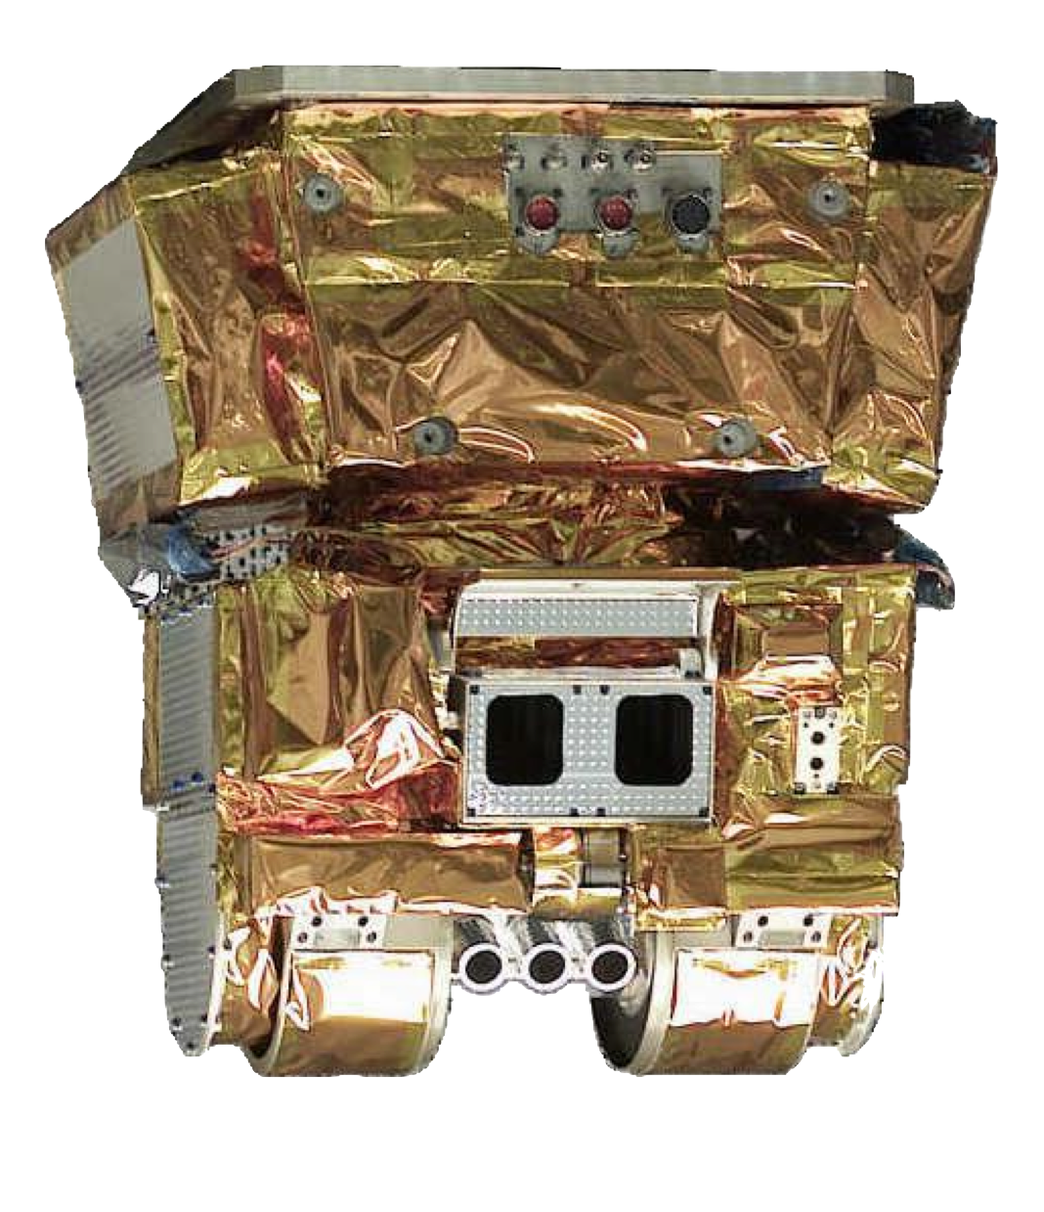

CERES Overview
Produce a long-term record of
Earth’s radiation budget from:
Top-of-atmosphere (ToA)
Within atmosphere
At Earth’s surface
with consistent cloud and aerosol properties at climate accuracy

Slide 6
Data Management Team (DMT)
Science research
DMT /
ASDC
User community

Slide 7
Data Management Team (DMT)
Responsibilities:
  Algorithm implementation
  Software:
    Maintenance
    Configuration management
    Processing
  Output validation

Slide 8
DMT-ASDC Interface
Science
Team
Data Management
Team (DMT)
Atmospheric Science Data Center (ASDC)
Funded by
Radiation Budget Measurements WBS
Funded by ESDIS

Slide 9
Interfaces & Dependencies

Slide 10
CERES Instrument Data from EDOS
Product | Granule Size (MB) | Number of Granules Per Day | Average Volume per Month (MB)
Terra Level 0 | 88.00 | 8 (FM1 and FM2) | 5,354
Terra Ephemeris | 0.46 | 12 | 168
Terra Attitude | 0.88 | 12 | 321
Aqua Level 0 | 88.00 | 8 (FM3 and FM4) | 5,354
Aqua Ephemeris | 5.30 | 1 | 161
Aqua Attitude | 0.46 | 12 | 168
NPP Level 0 | 88.00 | 4 | 2,677
NPP Ephemeris and Attitude | 0.50 | 12 | 178
JPSS-1 Level 0 | 88.00 | 4 | 2,677
JPSS-1 Ephemeris and Attitude | 0.50 | 12 | 178

Slide 11
MODIS & VIIRS Data
Source | Product | Granule Size (MB) | Number of Granules Per Day | Average Volume per Month (MB)
MODAPS | MOD02_SS | 12 - 65 | 288 | 340,300
MODAPS | MOD03 | 28 | 288 | 245,150
MODAPS | MOD04 | 1.5 | 130 | 6,000
MODAPS | MYD02_SS | 12 - 65 | 288 | 340,300
MODAPS | MYD03 | 28 | 288 | 245,150
MODAPS | MYD04 | 1.5 | 130 | 6,000
Land SIPS | VIMD_SS | 160 - 360 | 288 | 2,141,000
Land SIPS | VNP04E_L2.A | 0.8 | 288 | 7,000
Land SIPS | VNP0203IMD_SS | 300 - 415 | 240 | 2,736,000
Atmosphere SIPS | VAERDT | 38 | 130 | 150,000
Atmosphere SIPS | VAERDB | 15 | 130 | 59,280

Slide 12
MODIS & VIIRS Data
Source | Product | Granule Size (MB) | Number of Granules Per Day | Average Volume per Month (MB)
MODAPS | MOD02_SS | 12 - 65 | 288 | 340,300
MODAPS | MOD03 | 28 | 288 | 245,150
MODAPS | MOD04 | 1.5 | 130 | 6,000
MODAPS | MYD02_SS | 12 - 65 | 288 | 340,300
MODAPS | MYD03 | 28 | 288 | 245,150
MODAPS | MYD04 | 1.5 | 130 | 6,000
Land SIPS | VIMD_SS | 160 - 360 | 288 | 2,141,000
Land SIPS | VNP04E_L2.A | 0.8 | 288 | 7,000
Land SIPS | VNP0203IMD_SS | 300 - 415 | 240 | 2,736,000
Atmosphere SIPS | VAERDT | 38 | 130 | 150,000
Atmosphere SIPS | VAERDB | 15 | 130 | 59,280
Notes:
VIMD is the radiance subset file.
VNP… is the aerosol file.
will discontinue these when we have all the version 002 data.
VAERDT (Dark Target) has been received through mid 2014 at this point. Have not seen forward processing start yet.
Awaiting NOAA-20 aerosol data.

Slide 13
Other Ancillary Data
Source | Product | Granule Size (MB) | Number of Granules Per Day | Average Volume per Month (MB)
NSIDC | NISE | 2.1 | 1 | 64
CLASS | 1/8th mesh Snow/Ice (DMSP EDR) | 9.6 | 8 (NH and SH) | 2,335
557 WW (Air Force) | 1/16th mesh Snow/Ice (SNODEP) | 2.3 | 2 (NH and SH) | 140
GMAO | GEOS 5.4.1 Met-Reanalysis | varies | 8 files / day | ~83,000
U. of Wisc SSEC | Geostationary Weather Satellite (area files) | 5 – 37 | 120 (5 GEO) | ~84,000
SSAI | MATCH Model Aerosols from MODIS | varies | 2 files / day | 5.3

Slide 14
Data Products

Slide 15
Edition 4 Terra & Aqua
Product | Platform | Processed Thru | Publicly Available?
BDS | Terra, Aqua | Dec. ‘19 | Yes
SSF |  | Dec. ‘19 | Yes
SSF1deg-Hour |  | Nov. ‘19 | Yes
SSF1deg-Day/-Month |  | Nov. ‘19 | Yes
SYN1deg-Hour/3Hour/MHour | Terra+Aqua | Nov. ‘19 | Yes
SYN1deg-Day/-Month |  | Nov. ‘19 | Yes

Slide 16
Edition 4 Terra & Aqua
Product | Platform | Processed Thru | Publicly Available?
CldTypHist | Terra+Aqua | Nov. ‘19 | Yes
FluxByCldTyp | Terra+Aqua | Dec. ‘19 | May ‘20
EBAF | Terra+Aqua | Nov. ’19 | Yes
EBAF ToA | Terra+Aqua | Dec. ‘19 | Yes

Slide 17
Edition 1 S-NPP
Product | Platform | Processed Thru | Publicly Available?
BDS | S-NPP | March ‘20 | Yes
SSF |  | Feb. ‘20 | Yes
SSF1deg-Hour |  | Sep. ’19* | Yes
SSF1deg-Day/-Month |  | Sep. ’19* | Yes
SYN1deg-Hour/3Hour/MHour | Terra+S-NPP | Nov. ’17* | Yes
SYN1deg-Day/-Month |  | Nov. ’17* | Yes
* SSF1deg is paused due to RAPS mode

Slide 18
FLASHFlux
CERES’ near-real time stream
  Footprint (SSF): ~4 days
  Gridded data (TISA): ~7 days
FLASHFlux needs CERES + imager data within 2 days
Edition 4A operational – August 2020
1-2-year plan:
  Terra, then Aqua drifts
  Develop NOAA-20 + GEO configuration
Notes:
All core products produced:
Footprint: Terra, Aqua SSFs (within 4 days)
Gridded: Time- and space-averaged (within 7 days)
Superseded by CERES edition product when available, then removed from public access

Slide 19
Code Re-architecture

Slide 20
CERES Code Re-architecture
Readability
Maintainability
Modularity
Two groups: Clouds and TISA

Slide 21
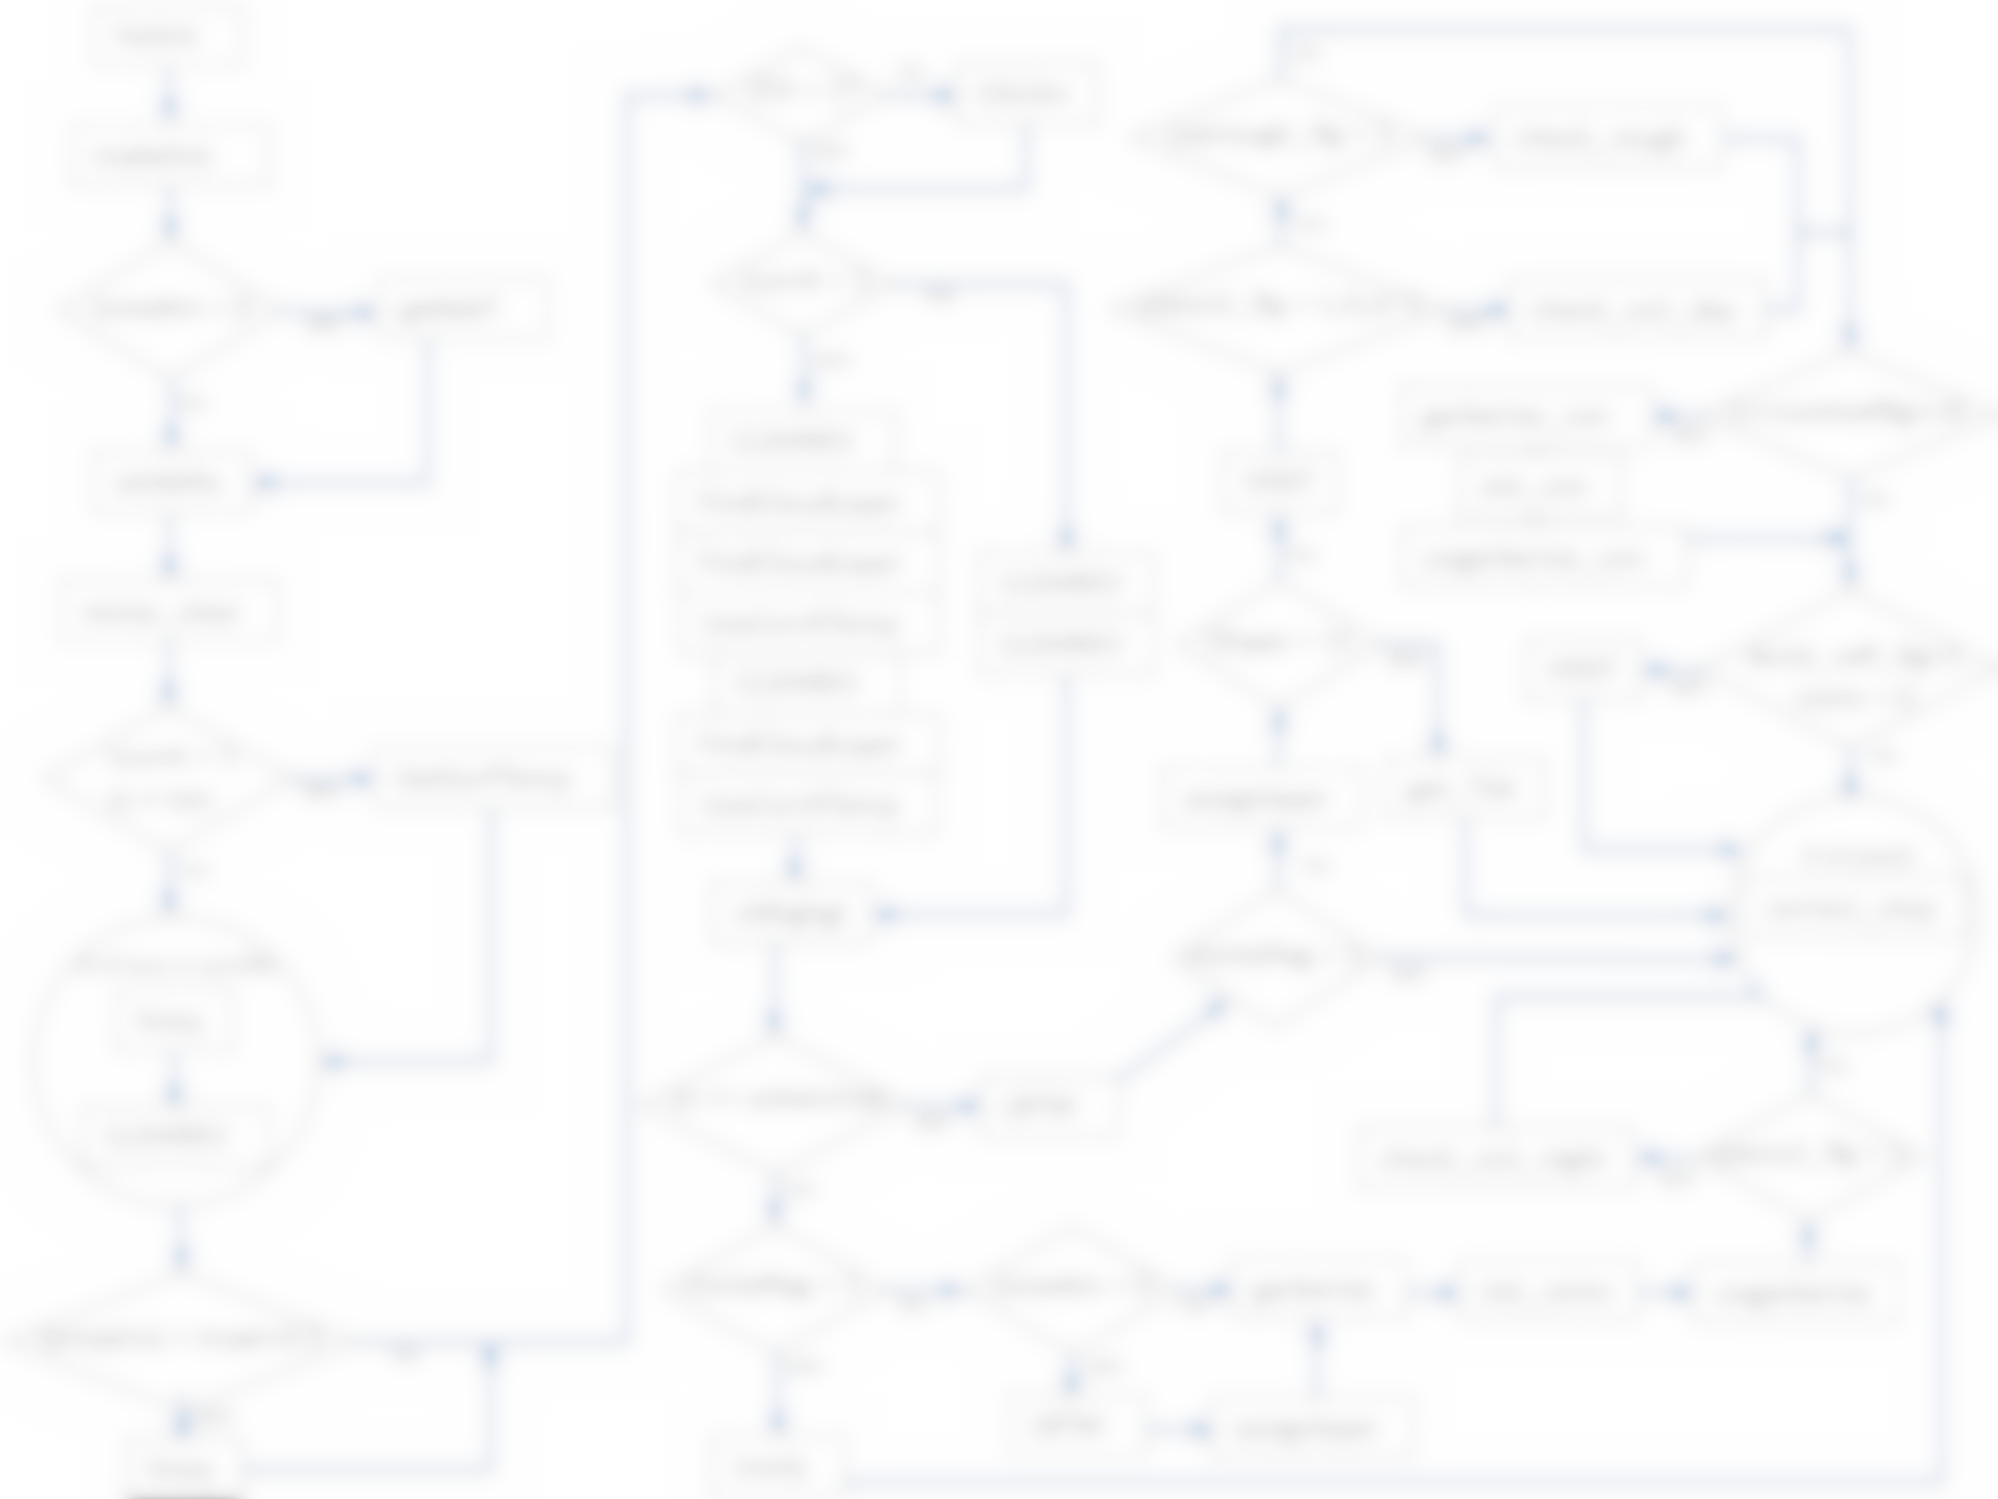
Clouds Re-architecture
Legacy code
Varying levels of complexity
GOTO statements
Redundancy throughout codebase
Hard-coded inputs
“Magic” numbers

Slide 22
Clouds Status
New team-member for re-architecture, Steve Kohler
Cloud mask work
Near-term Goals:
  Evaluate current code
  Position for better:
    Ability to unit test
    Exception handle
    Extend
  Validate, validate, validate

Slide 23
TISA Re-architecture – Parallel Efforts
“In-place” (Ed. 4-5)
- Remove “dead” code
- De-duplicate
- Generalize
- Collect multi-purpose routines for library
System-level (>= Ed. 5)
- Implement new framework
- Build general library
- Add spatiotemporal flexibility

Slide 24
TISA Status
~20% overall code reduction
Meet once/week
Using Jira/Bitbucket/Confluence
Arun – Ed 4-5 code changes:
Josh – Ed 5+ framework-level construction
  Fresh look at TISA – as a system
  “Event Storming” session

Slide 25
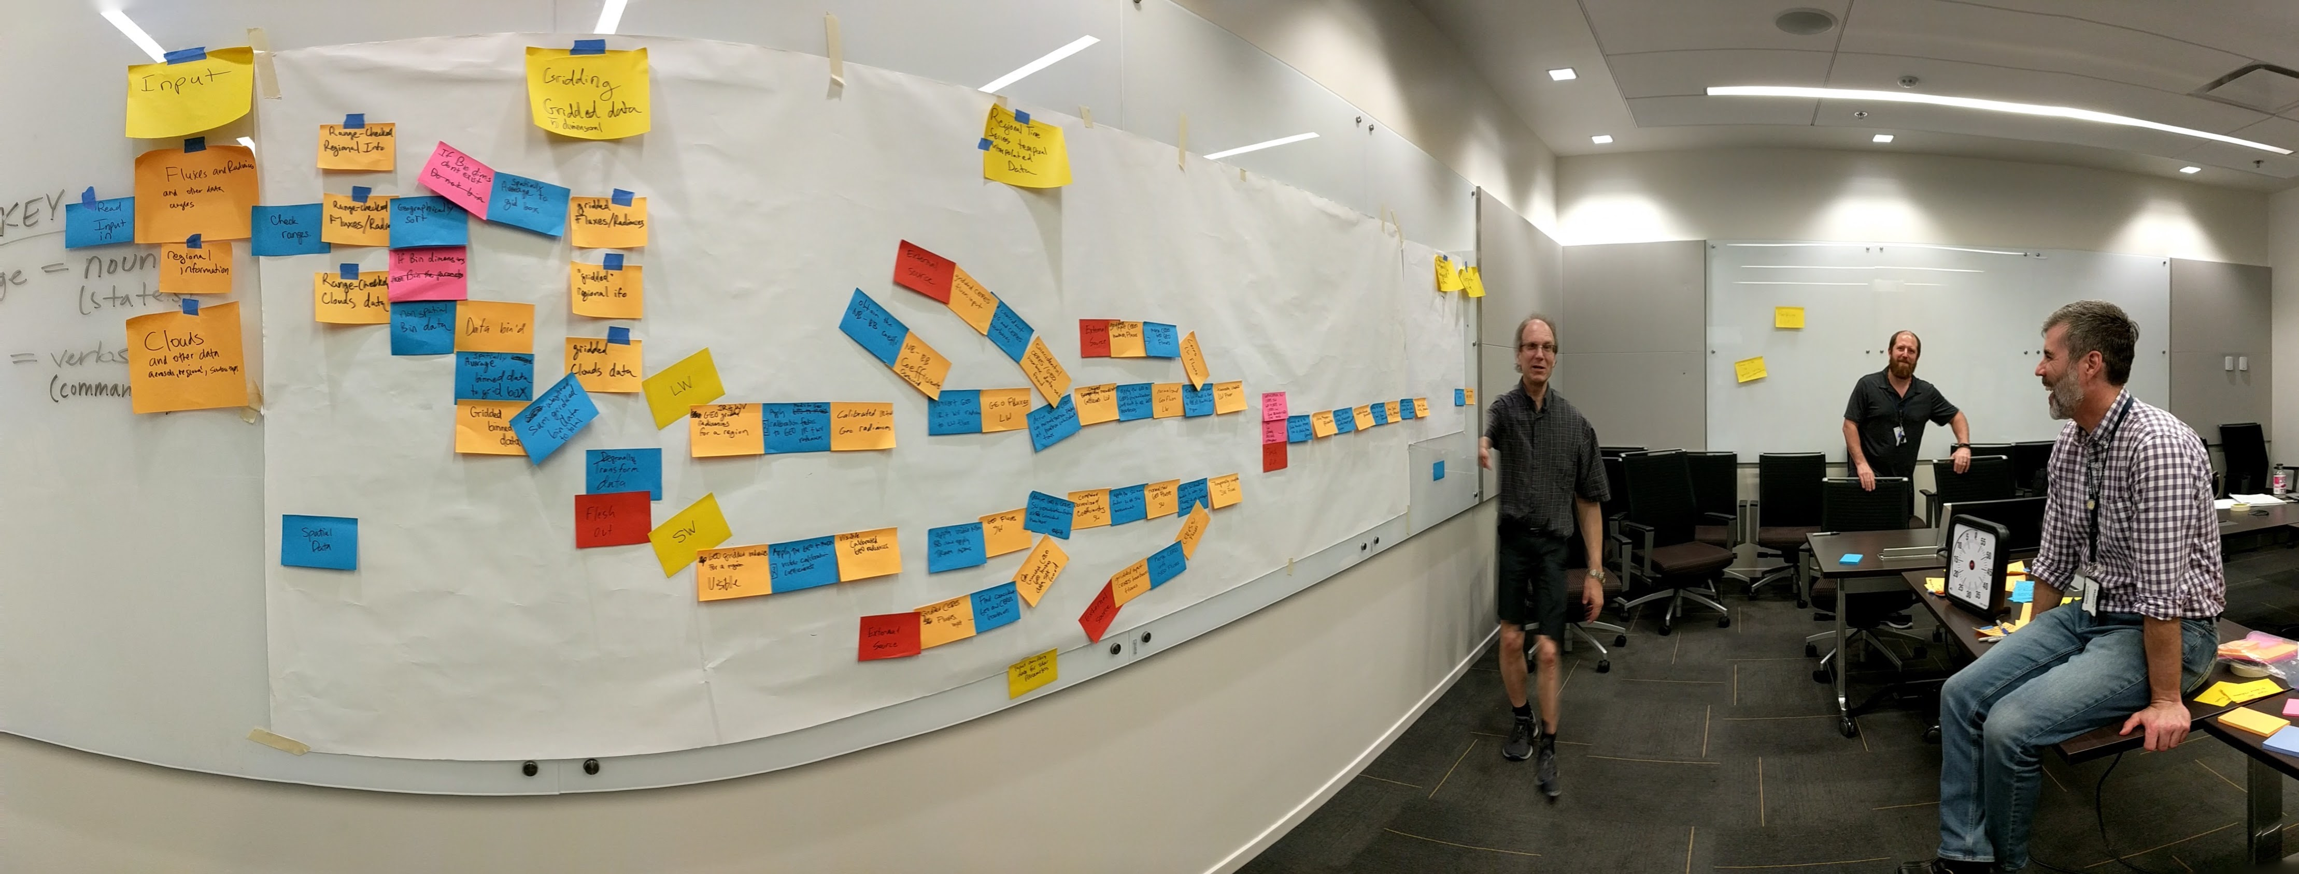
Event Storming

Slide 26
Assorted Updates

Slide 27
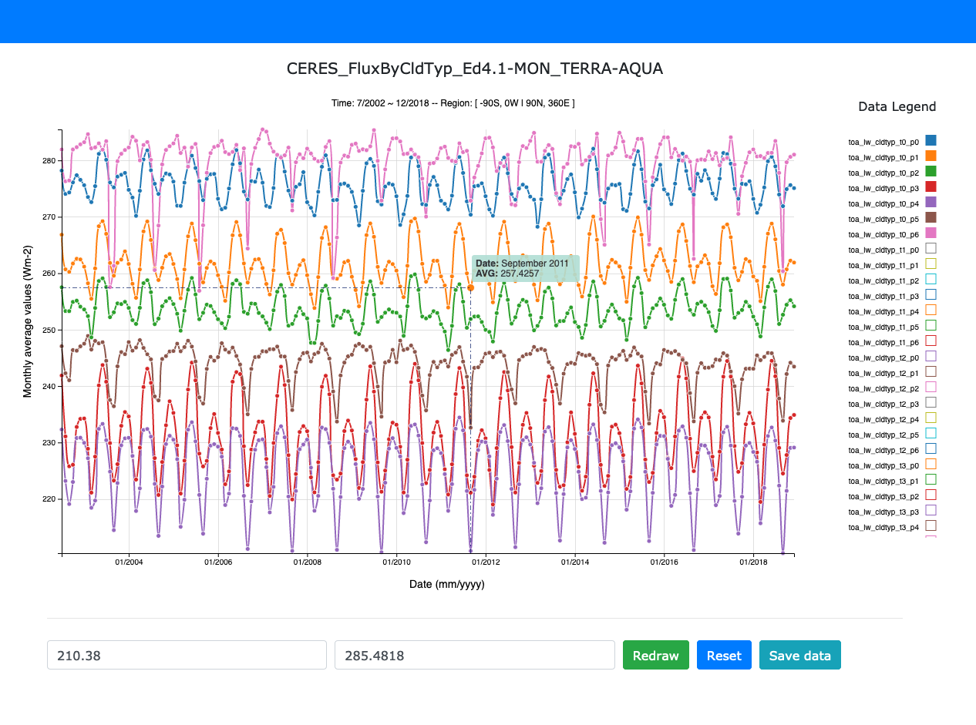
New Product – FluxByCldTyp
10 years in the making!
Gridded, L3 product
42 cloud types indexed by:
  Optical depth (6)
  Cloud pressure (7)
Available within the next month

Slide 28
Forthcoming Data Product Editions
Edition 2 S-NPP
  Processing thru: Instrument & ERBE-like
  Available early Fall 2020
  Need VIIRS data
  No L3 products from 9/2019 onward,
  while S-NPP in biaxial mode
Edition 1 NOAA-20
  Processing thru: Instrument, SSF, and Level 3
  Available early Summer 2020
Notes:
Ed 2 S-NPP: Need VIIRS data; assuming our test data is good enough that production can start immediately, will take two months of just Clouds processing
Ed 1 NOAA-20: Record starts from May 2018. Need to finish DQS (documentation). SSF1deg is through December 2019 as of 5/4/20.
Both sets of these gains and SRFs have been delivered through Jan. 2020.

Slide 29
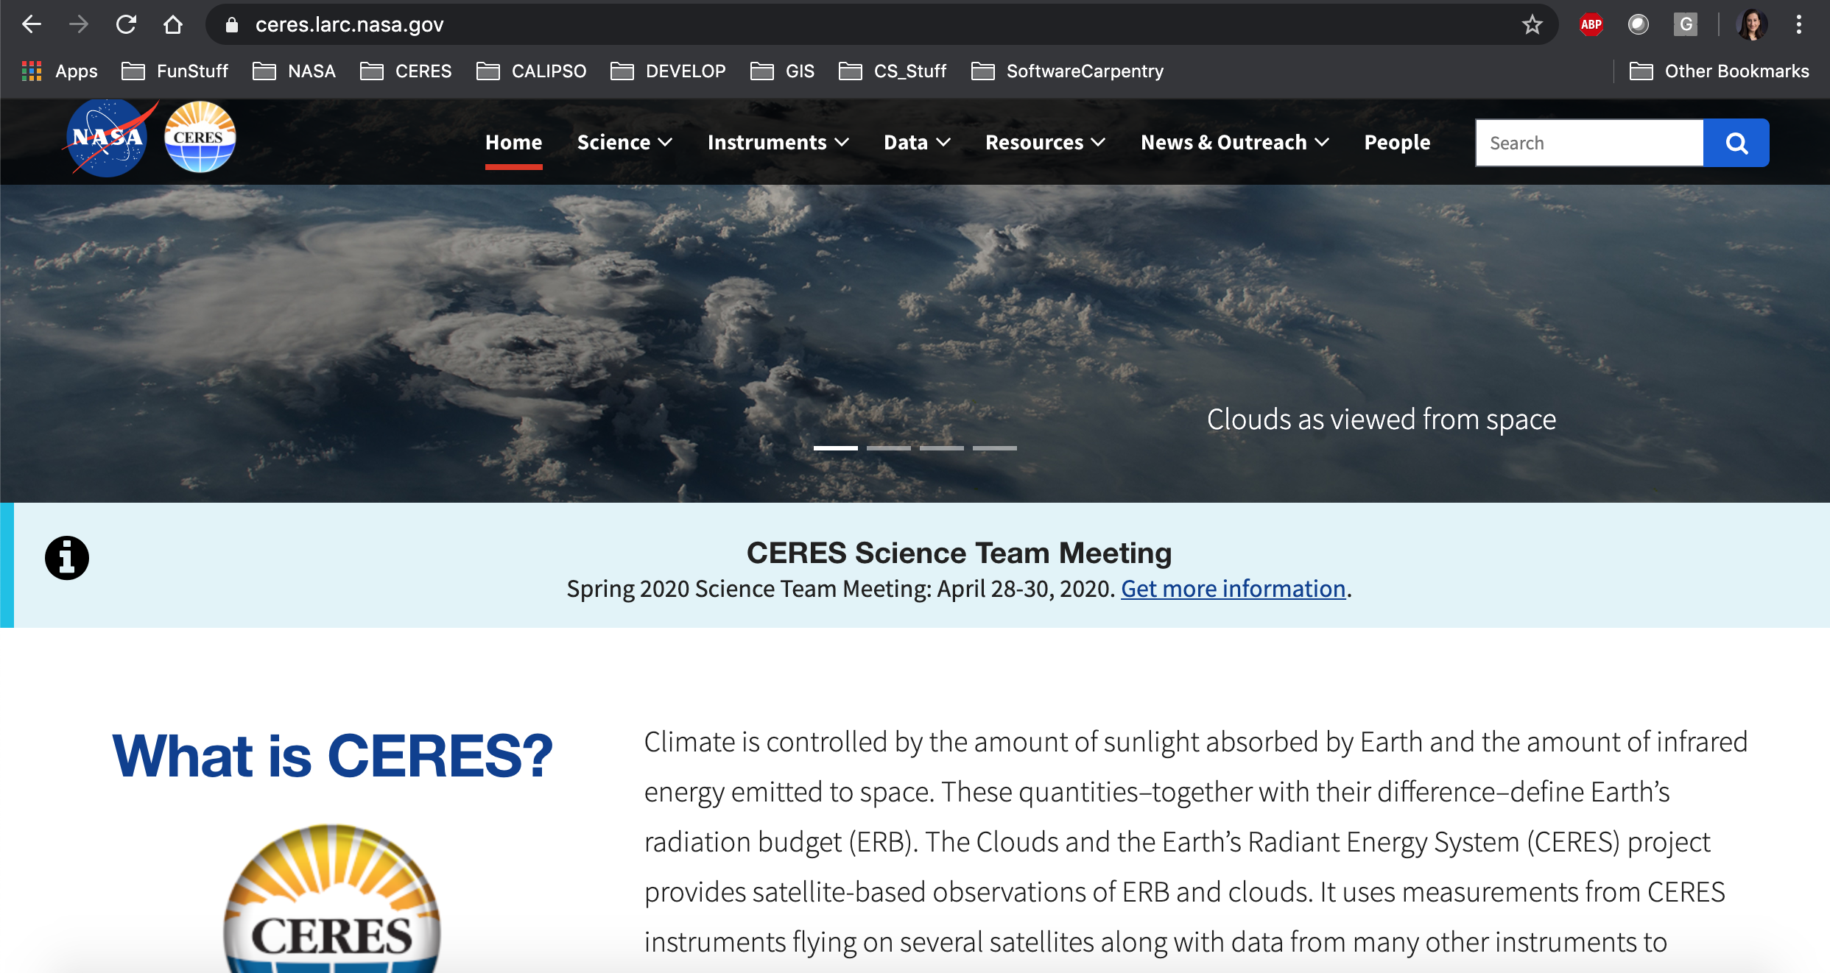
New CERES Website
Notes:
Emma Brand – part of Pathways work
Mobile-friendly
Runs in OCP
Easier to promote changes
ceres.larc.nasa.gov – check it out!

Slide 30

Running CERES PGEs in OpenShift
Emma Brand & Nelson Hillyer
75% CERES PGEs running in OCP thus far
Next up:
  “Vertical slicing” runs
  CATALYST integration
Flexibility to harness cloud computing power

Slide 31
Libera (EV-C1 Selection)
Begun interaction – data system
DAAC unselected
Libera:
  Operate the instrument
  Provide L1B data
  After 1 year – handoff:
    Operations
    Processing – L1B+?

Slide 32
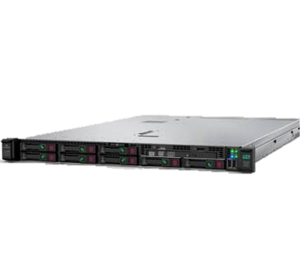
New Systems
EMC Isilon Storage
HPE DL360 Servers
Computational Research Facility (CRF)
Configuration on hold due to COVID-19
CRF and ASDC
Virtualized
  Red Hat virtual machines
  OpenShift PaaS virtual machines

Slide 33

Updated Data Formats
Upcoming Editions:
5/netCDF4
Many iterations with ASDC – ingest/metadata check
First products: Ed 1 NOAA-20 and Ed 2 S-NPP SSF
CM Team – lots of work!

Slide 34
Updated Metadata
Upcoming Editions
Conventions:
  Unified Metadata Model (UMM)
  Climate-Forecasting (CF)
  Attribute Convention for Data Discovery (ACDD)
Data Product Developer’s Guide (DPDG)
Attributes in HDF5/netCDF4 files

Slide 35
Summary
New products and editions on the way!
Virtualizing
Engaging in cloud preparation
Refreshing file formats, metadata
Improving user experience

