Slide 1

GeneLab : The NASA Systems Biology Platform for Space Omics Repository, Analysis and Visualization
To enable scientific discovery and space exploration through multi-omics data-driven research
Sylvain V. Costes, PhD
GeneLab Project Manager

Slide 2

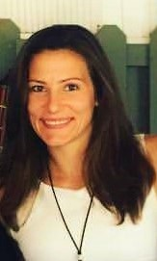
GeneLab: The NASA Systems Biology Platform for Space Omics Repository, Analysis and Visualization
Welcome to the NASA GeneLab Webinar Series
Wednesday, May 6, 2020
9am, PDT
Today’s speakers
Sylvain Costes, Ph.D Amanda Saravia-Butler, Ph.D
GeneLab Project Manager GeneLab Data Processing Lead

Slide 3



GeneLab: The NASA Systems Biology Platform for Space Omics
Repository, Analysis and Visualization
Schedule
9:05 am – 9:35 am, Explore NASA GeneLab Space Omics Database and Discover How Life Adapts to Space, Sylvain Costes
9:35 am – 9:45 am, GeneLab Analysis Platform Overview, Amanda Saravia-Butler
9:45 am – 10:00 am, Chat Room Q&A*
*Questions may be entered into the chat room anytime during the webinar and will be answered by the GeneLab Team.
Twitter handle: @NASAGeneLab
https://genelab.nasa.gov

Slide 4
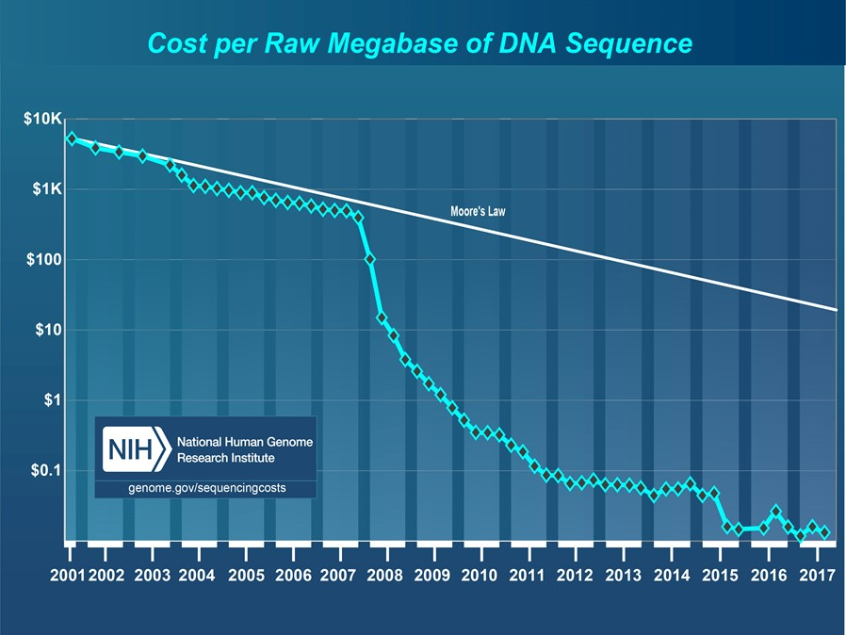
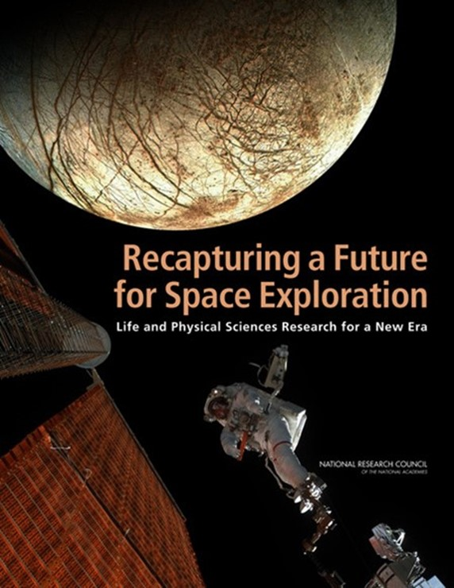
2011 NRC Decadal Survey and the Sequencing Paradigm Shift
Another log10 since 2011
“…genomics, transcriptomics, proteomics, and metabolomics offer an immense opportunity to understand the effects of spaceflight on biological systems…”
“…Such techniques generate considerable amounts of data that can be mined and analyzed for information by multiple researchers…”

Slide 5

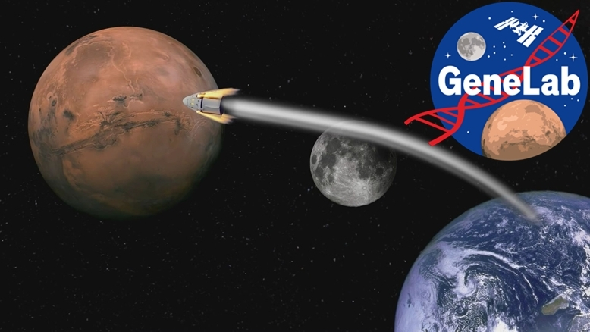
NASA Space Stressors
Distance
Confinement
Hostile/Closed Environments
Radiation
Gravity Fields

Slide 6
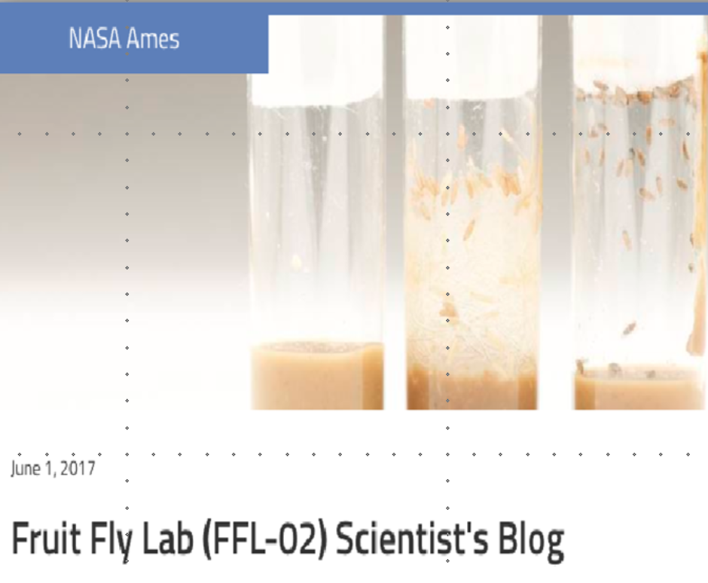







GeneLab ecosystem: maximizing knowledge by bringing experiments together as a system
Sequencing on ISS is still limited in the amount of data generated
  Most of the work needs to happen on earth
Measurements on human cannot be too invasive and limited in numbers
  Usage of animals
Increasing Genetic Diversity (more samples/payload)
Identify Shared Processes/ Molecular Signatures
Hypoxic Response ?
Oxidative Stress
Common Tissue (e.g. muscle, liver, heart, eyes, brain,…)
Human?
PLANT
For Spaceflight
High “n” number – statistically significant data
Genetically identical animals
Low resource requirements
Short life cycle - multiple generations
Measure response of a whole multicellular animal
Flies used as a model for humans for innate immunity, circadian rhythm, oxidative stress, neurobehavior, development, genetics, GWAS, “omics” studies etc.
Increasing Human Relevance
ANIMAL
MULTI-OMICS
MICROBE

Slide 7
Overview: Organisms and Assay
May 6 2020: Total # of studies: 244

Slide 8
GeneLab: The most FAIR Life Science Data Repository Systems
Findable
  Assign persistent IDs (PIDs), provide rich metadata, register in a searchable resource, …
Accessible
  Retrievable by their ID using a standard protocol, metadata remain accessible even when data are no longer available…
Interoperable
  Use formal, broadly applicable languages, use standard vocabularies, qualified references…
Reusable
  Rich, accurate metadata, clear licenses, provenance, use of community standards…
Wilkinson, M. D. et al. The FAIR Guiding Principles for scientific data management and stewardship. Sci. Data 3:160018 doi: 10.1038/sdata.2016.18 (2016).
Berrios DC, Beheshti A, Costes SV. FAIRness and Usability for Open-access Omics Data Systems. AMIA Annu Symp Proc. 2018;2018:232‐241. Published 2018 Dec 5.

Slide 9









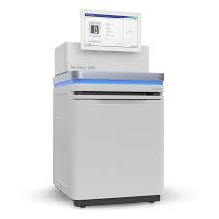



Leverage Rich Metadata for Indexing and Semantic Search
FAIR Data Repository
  Data DOIs
  Data Set Versioning
Collaborative workspace
Data Analysis tools
API - internal and external; api.nasa.gov
Tutorials
In progress: Web Submission Portal
  ISA Data Model Refinement
  Taxonomies indexing/Search
  Linked Data
Application
Data Repository
Collaborative Workspace
Submssion Portal
Analysis Platform
Visualization Platform
GEODE
Platforms
NASA ICAM
ElasticSearch
No SQL database
EC2 Cloud
Indexing
EC2 Cloud – Scalable, flexible
NoSql database (MongoDB) using json-ld
  Flexibility, extensibility in metadata
  Cheaper database maintenance
Data Sources
Multi-sources Data Discovery
  Mapped metadata
  Currently: NCBI GEO, MG-RAST, PRIDE
GL generated
PI Submitted
External Databases
Publications
Notes:
Web apps
-GLDS Admin
-data versioning
-data citation

Slide 10
Study to be discussed
GLDS-80: Response of mammary tissue to high-LET HZE particle (Silicon ions) radiation or low-LET gamma-rays
GLDS-104: Rodent Research-1 (RR1) NASA Validation Flight: Mouse soleus muscle transcriptomic and epigenomic data
GLDS-120: Genetic Dissection of the Spaceflight Transcriptome Responses in Plants: are some responses unnecessary?
GLDS-4: Microarray Analysis of Space-flown Murine Thymus Tissue (DOI example)

Slide 11
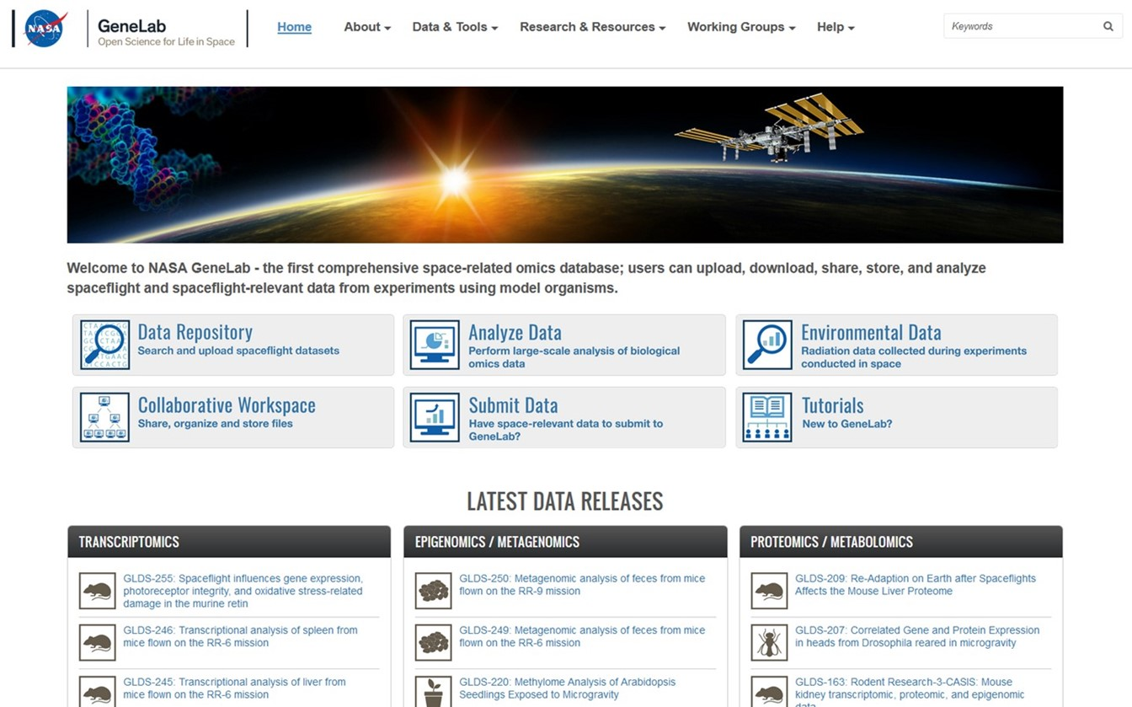
GeneLab Demo: genelab.nasa.gov

Slide 12
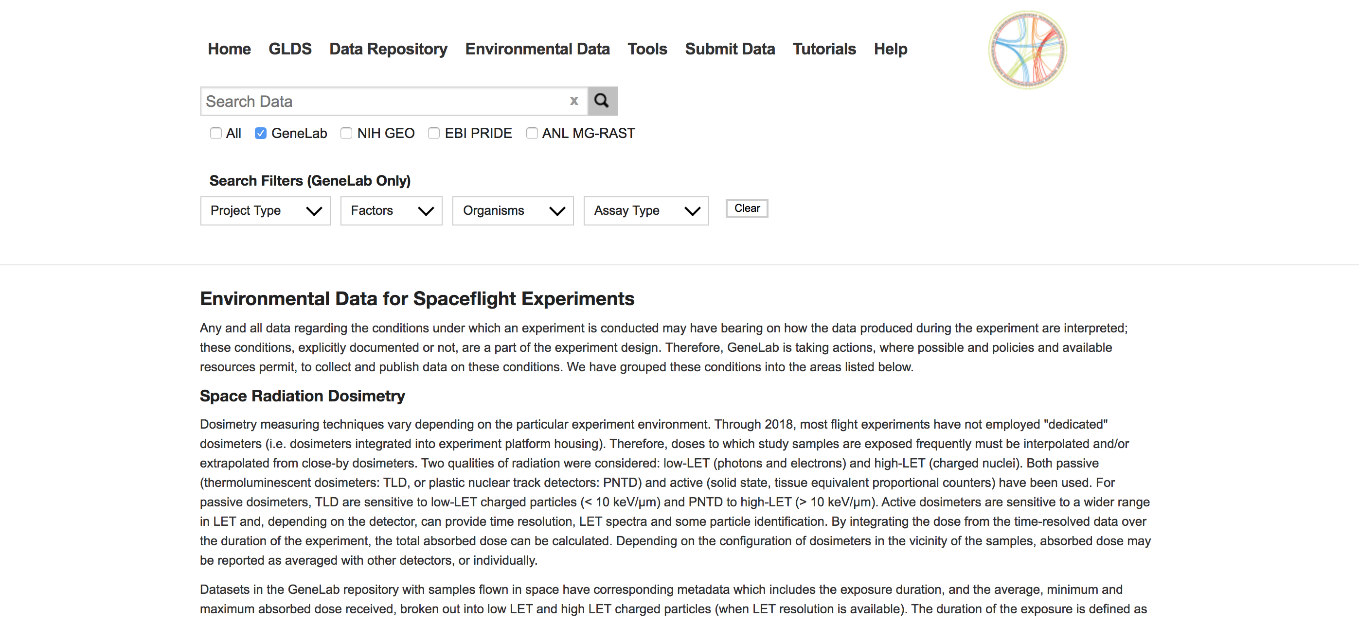
GeneLab Environmental Data

Slide 13
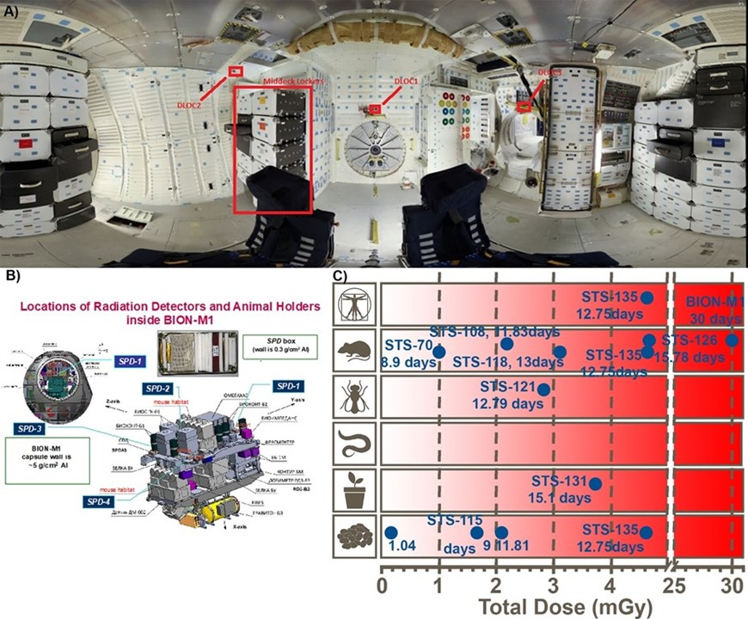
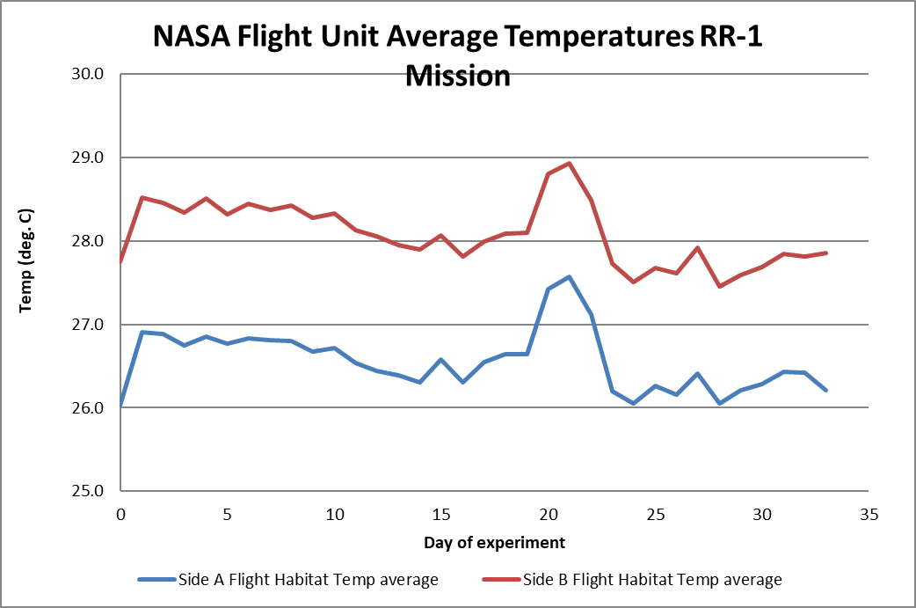
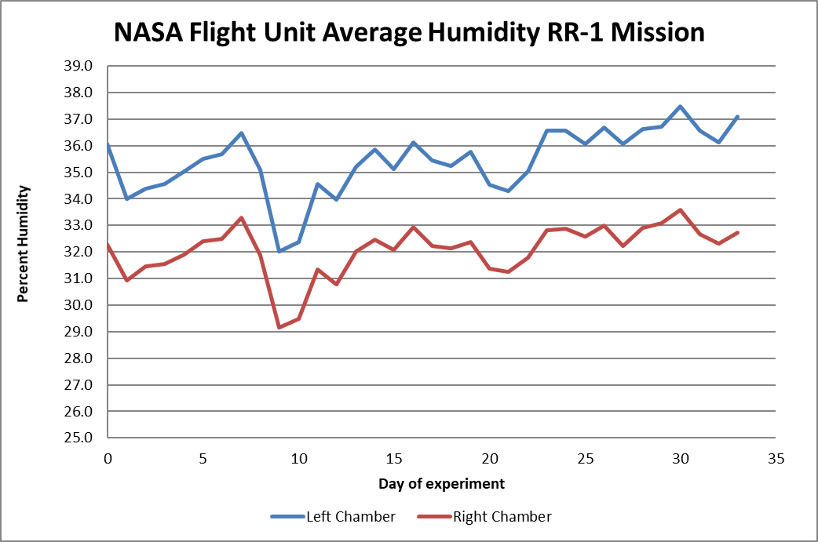
Actual Cosmic radiation doses in GeneLab dataset (typically low dose, low dose rate and large uncertainties)
Abs Dose Rate
(mGy/day)
 | DLOC1 | DLOC2 | DLOC3
STS-126 | 0.22 | 0.33 | 0.35
STS-131 | 0.20 | 0.20 | 0.34
STS-135 | 0.26 | 0.43 | 0.41
Beheshti et al., Radiation Research 2018
STS = Space Transportation System (Shuttle Program)

Slide 14
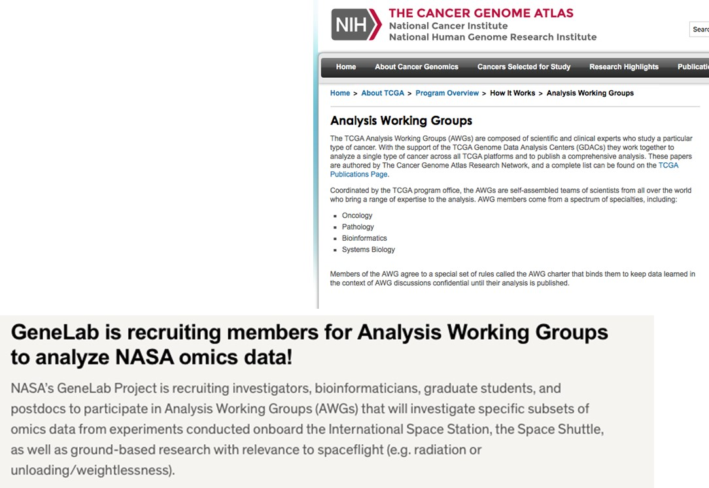
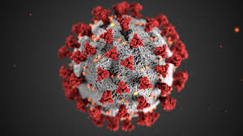

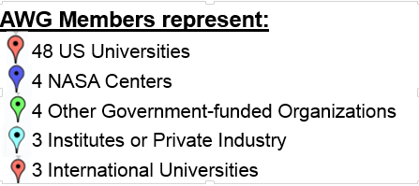
GeneLab Analysis Working Groups (AWGs): Inspiration
Created on January 2018 – Kick off meeting at IWS HRP meeting in Galveston TX
Modeled on the NIH TCGA Analysis Working Groups
Analyze a single type of cancer across all TCGA platforms and publish comprehensive analyses
Have generated very high profile publications
Total AWG Members: ~120
Members are now the leads
AWG Members Per Group:
Animal 30
Multi-Omics/System Biology 45
Plants 15
Microbes 17
*Some members are in multiple groups
cdc.gov
https://www.cov-irt.org/

Slide 15
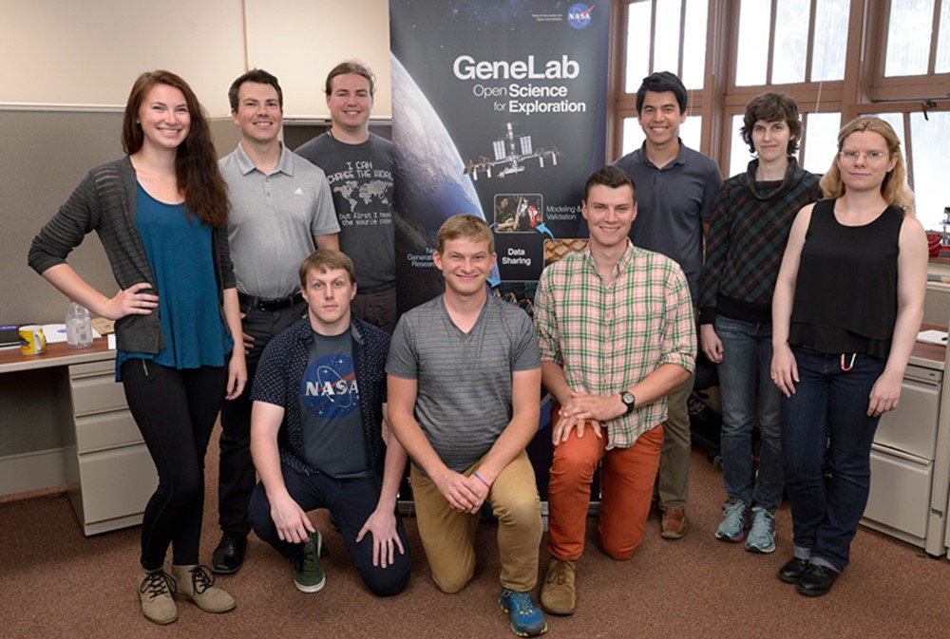
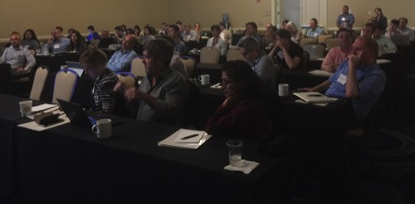

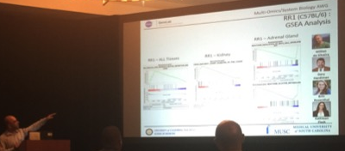
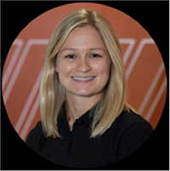
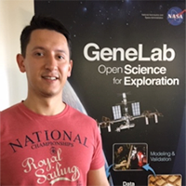
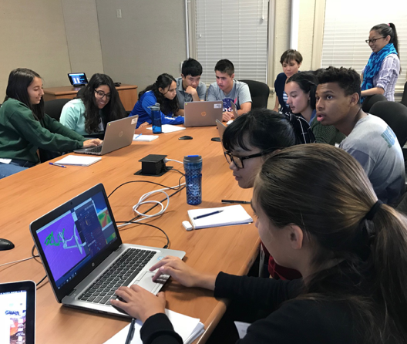
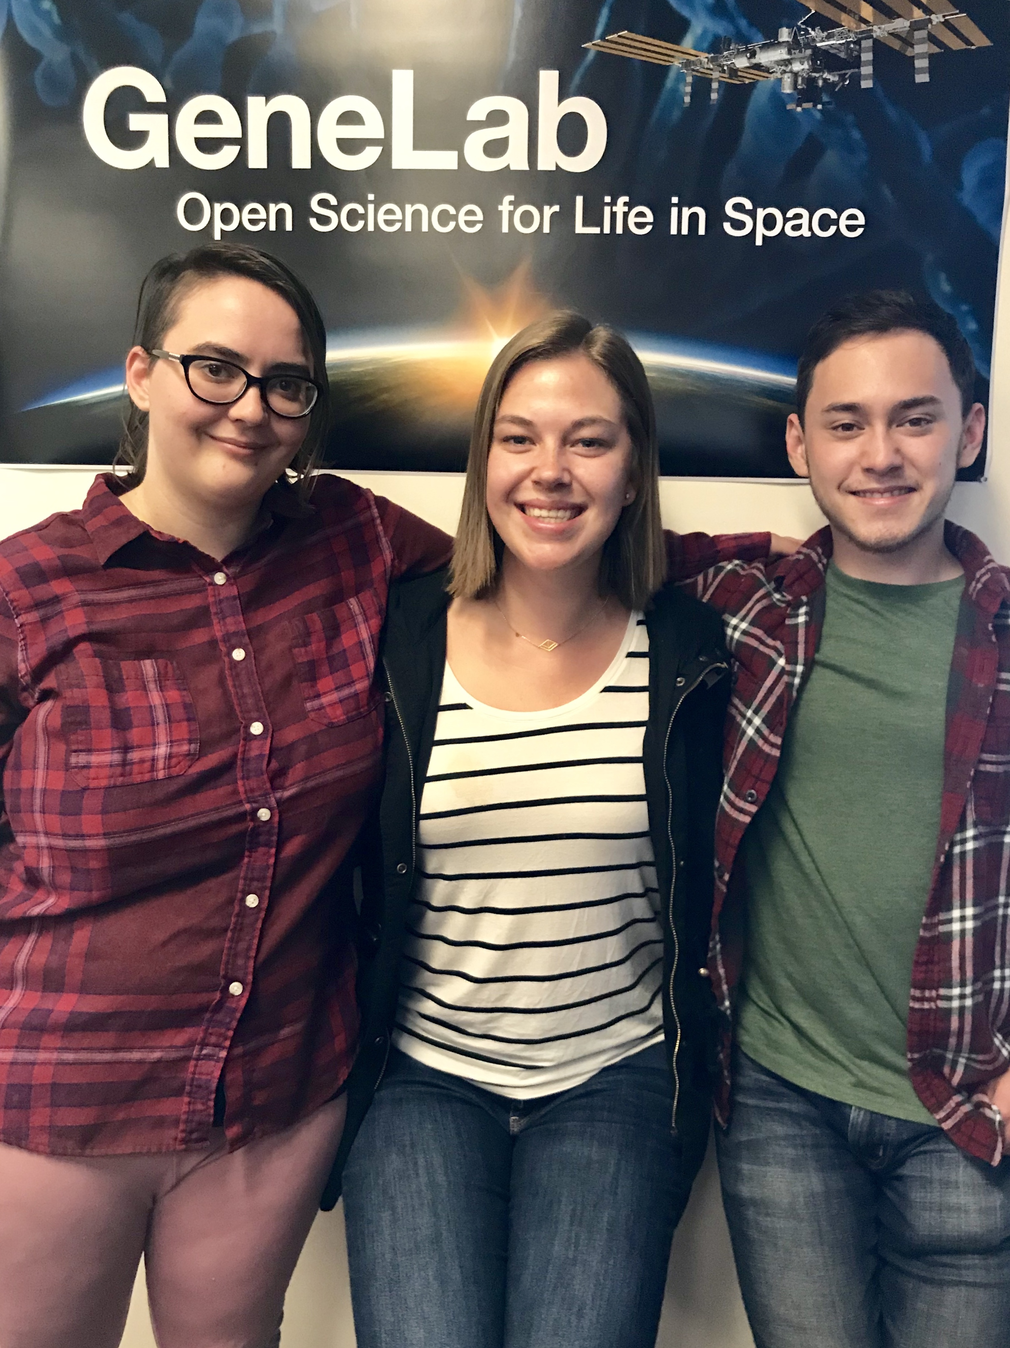
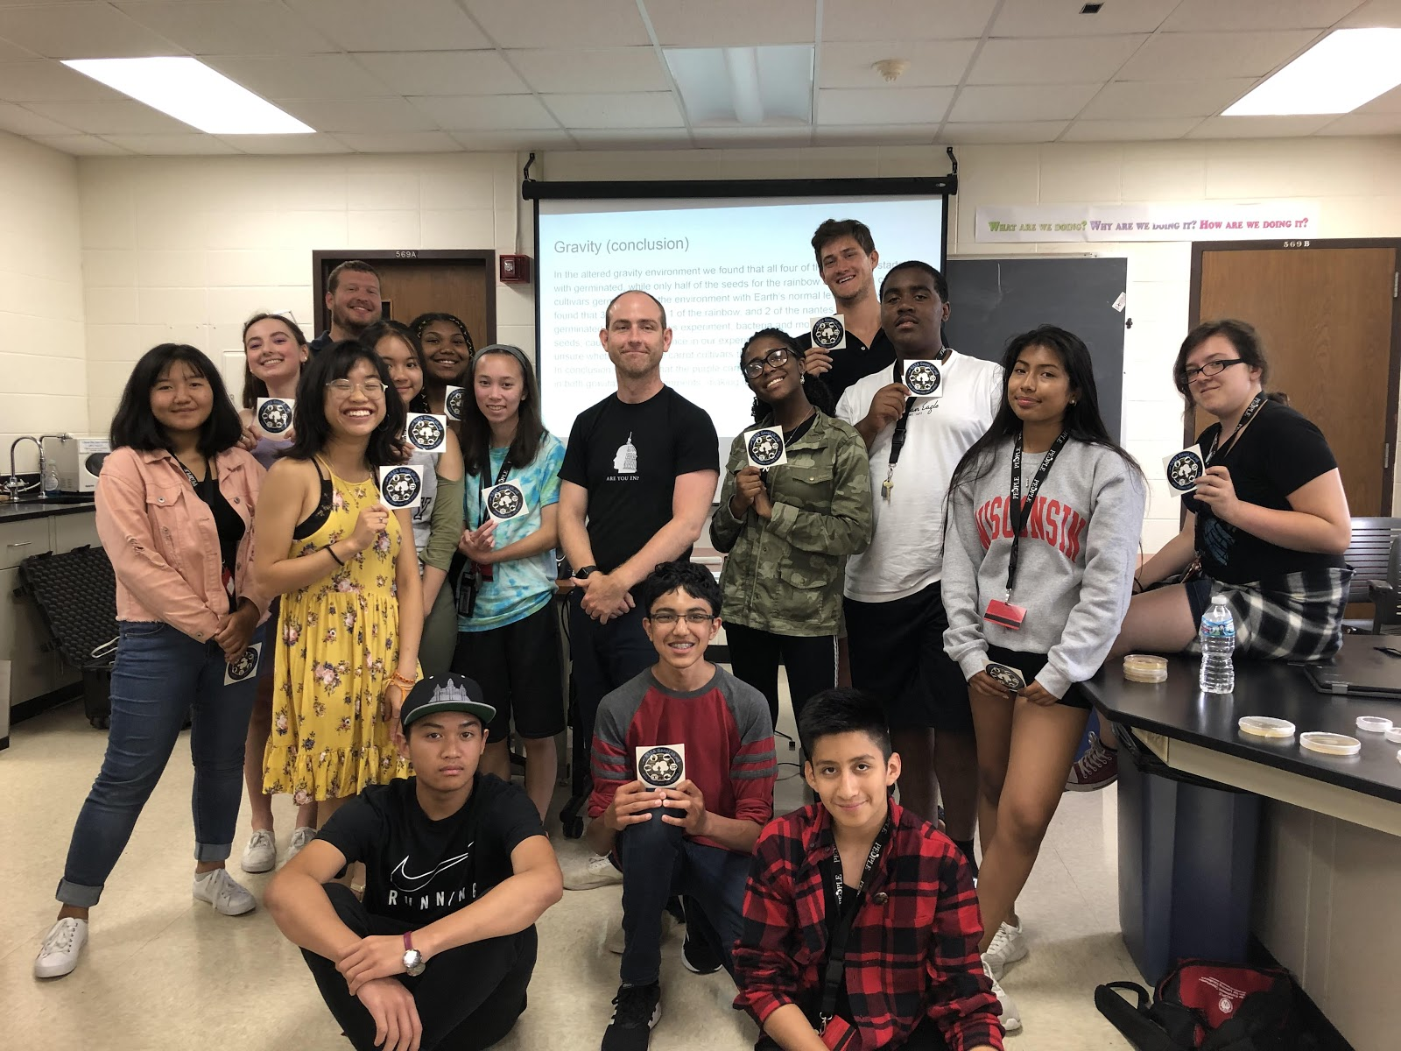

Scientific Outreach Highlights
Letting the scientific community take the lead
GeneLab included in Bioinformatics curriculum of degree granting university
Pre-ASGSR AWG Workshop (Nov 2019)
2018 Summer Internship
GeneLab for High School
(Tutorial + Tools)
NASA GeneLab AstroBotany COSE TOAST experience
UK bedrest study
Spatial RNAseq
Visiting Scientists
2018-2019
  GeneLab 1st NASA project approved for technical social media audience
  (vs general public @ 6th grade level)!
2019 Summer Internship

Slide 16
Publications using GeneLab: 16 derived, 1 pending
# | Year | Title | Journal | Authors | Status | GLDS # | Utilizing GeneLab
1 | 2017 | Validation of methods to assess the immunoglobulin gene repertoire in tissues obtained from mice on the international space station | Gravitational and Space Research | Rettig TA, Ward C, Pecaut MJ, Chapes SK | Published |  | GLDS-48
2 | 2018 | A microRNA signature and TGF-β1 response were identified as the key master regulators for spaceflight response | PLoS One | Beheshti A, Ray S, Fogle H, Berrios D, Costes SV | Published |  | GLDS-25, 21, 63, 111, 4, 61, 48
3 | 2018 | Nasa GeneLab project: Bridging space radiation omics with ground studies | Radiation Research | Beheshti A, Miller J, Kidane Y, Berrios D, Gebre SG, Costes SV | Published |  | Database paper- radiation datasets
4 | 2018 | Global transcriptomic analysis suggests carbon dioxide as an environmental stressor in spaceflight: A systems biology GeneLab case study | Scientific Reports | Beheshti A, Cekanaviciute E, Smith DJ, Costes SV | Published |  | GLDS-21,111,25,63
5 | 2018 | Meta-analysis of data from spaceflight transcriptome experiments does not support the idea of a common bacterial “spaceflight response” | Scientific Reports | Michael D. Morrison & Wayne L. Nicholson | Published | GLDS-185 | GLDS-31,39,15,11,185,138,145
6 | 2018 | GeneLab: Omics database for spaceflight experiments | Bioinformatics | S Ray, S Gebre, H Fogle, D Berrios, PB Tran , JM Galazka, SV Costes | Published |  | Database paper
7 | 2018 | FAIRness and Usability for Open-access Omics Data Systems | AMIA Annual Symposium Proceedings Archive | Daniel C. Berrios, Afshin Beheshti, and Sylvain V. Costes | Published |  | Database paper
8 | 2019 | Exploring the Effects of Spaceflight on Mouse Physiology using the Open Access NASA GeneLab Platform | JoVE | A Beheshti, Y Shirazi-Fard, S Choi, D Berrios, SG Gebre, JM Galazka, SV Costes | Published |  | Database paper
9 | 2019 | GeneLab database analyses suggest a long term impact of Space Radiation on the Cardiovascular System by the activation of FYN through Reactive Oxygen Species | International Journal of Molecular Sciences | A Beheshti, J. T. McDonald, J. Miller, P. Grabham, SV Costes | Published |  | GLDS-52,109,117
10 | 2019 | Comparison of Bacillus subtilis transcriptome profiles from two separate missions to the International Space Station | NPJ Microgravity | Michael D. Morrison, Patricia Fajardo-Cavazos & Wayne L. Nicholson | Published | GLDS-185 | GLDS-185, 138
11 | 2019 | Reproducible changes in the gut microbiome suggest a shift in microbial and host metabolism during spaceflight | BMC Microbiome | Peng Jiang, Stefan J. Green, George E. Chlipala, Fred W. Turek, and Martha Hotz Vitaterna | Published |  | GLDS-48, 168
12 | 2019 | Mice exposed to combined chronic low-dose irradiation and modeled microgravity develop long-term neurological sequelae | International Journal of Molecular Biology | E. G. Overbey, A. M. Paul, W. da Silveira, C. G.T. Tahimic, S. S. Reinsch, N. Szewczyk, S. Stanbouly, C. Wang, J. M. Galazka and X.W. Mao | Published |  | GLDS-202
13 | 2019 | Multi-omics Analysis of Multiple Missions to Space Reveal a Theme of Lipid Dysregulation in Mouse Liver | Scientific Reports | Afshin Beheshti, Kaushik Chakravarty, Homer Fogle, Hossein Fazelinia, Willian A. da Silveira , Valery Boyko, San-Huei Lai, Amanda M. Saravia-Butler, Deanne Taylor, Jonathan M. Galazka, and Sylvain V. Costes | Published |  | GLDS-25, GLDS-47, GLDS-137, GLDS-168
14 | 2020 | Test of Arabidopsis Space Transcriptome: A Discovery Environment to Explore Multiple Plant Biology Spaceflight Experiments | Frontiers in Plant Science | R Barker, J Lombardino, K Rasmussen and S Gilroy | Published |  | 7,8,16,17,22,37,38,44,47,120,121,144,147,205,208,213,217,251
15 | 2020 | NASA GeneLab platform utilized for space radiation dosimetry biological response in animal models | Cancers | J.T. McDonald, R Stainforth, J. Miller, T Cahill, W. A. da Silveira, K. S. Rathi, G. Hardiman, D. Taylor, S.V. Costes, V. Chauhan, R. Meller, and A. Beheshti | Published |  | 4,21,25,52,61,63,73,80,98,99,100,101,102,103,104,105,109,111,114,117,161,162,163,168,168
16 | 2020 | Multi-Omics Analysis using GeneLab database recognizes Mitochondrial Dysfunction as a mediator of spaceflight health risks. | Pending | Willian A. da Silveira, Hossein Fazelinia, Sara Brin Rosenthal, Evagelia C. Laiakis, Cem Meydan, Jonathan Foox, Yared Kidane, Komal S. Rathi, Susana Zanello , Scott M. Smith, Brian Crucian, Dong Wang, Adrienne Nugent, Sara R. Zwart, Sonja Schrepfer, Larry N. Singh, Douglas Wallace, Jeffrey S. Willey, J. Tyson McDonald, Sylvain V. Costes, Helio A. Costa , Christopher E. Mason, Kathleen Fisch, Deanne Taylor, Gary Hardiman, Afshin Beheshti |  |  | Multiple
17 | 2020 | Visualizing Omics Data from Spaceflight Samples using the NASA GeneLab Platform | BICOB | D. Berrios, E. Weitz, K. Grigorev, S.V. Costes, S. G. Gebre, and A. Beheshti | Submitted |  | OMICS Software paper
18 | 2020 | MicroRNAs (miRNAs), the Final Frontier: The Hidden Master Regulators Impacting Biological Response in All Organisms Due to Spaceflight | The Health Risks of Extraterrestrial Environments | Vanderburg, C., Beheshti, A. | Published

Slide 17
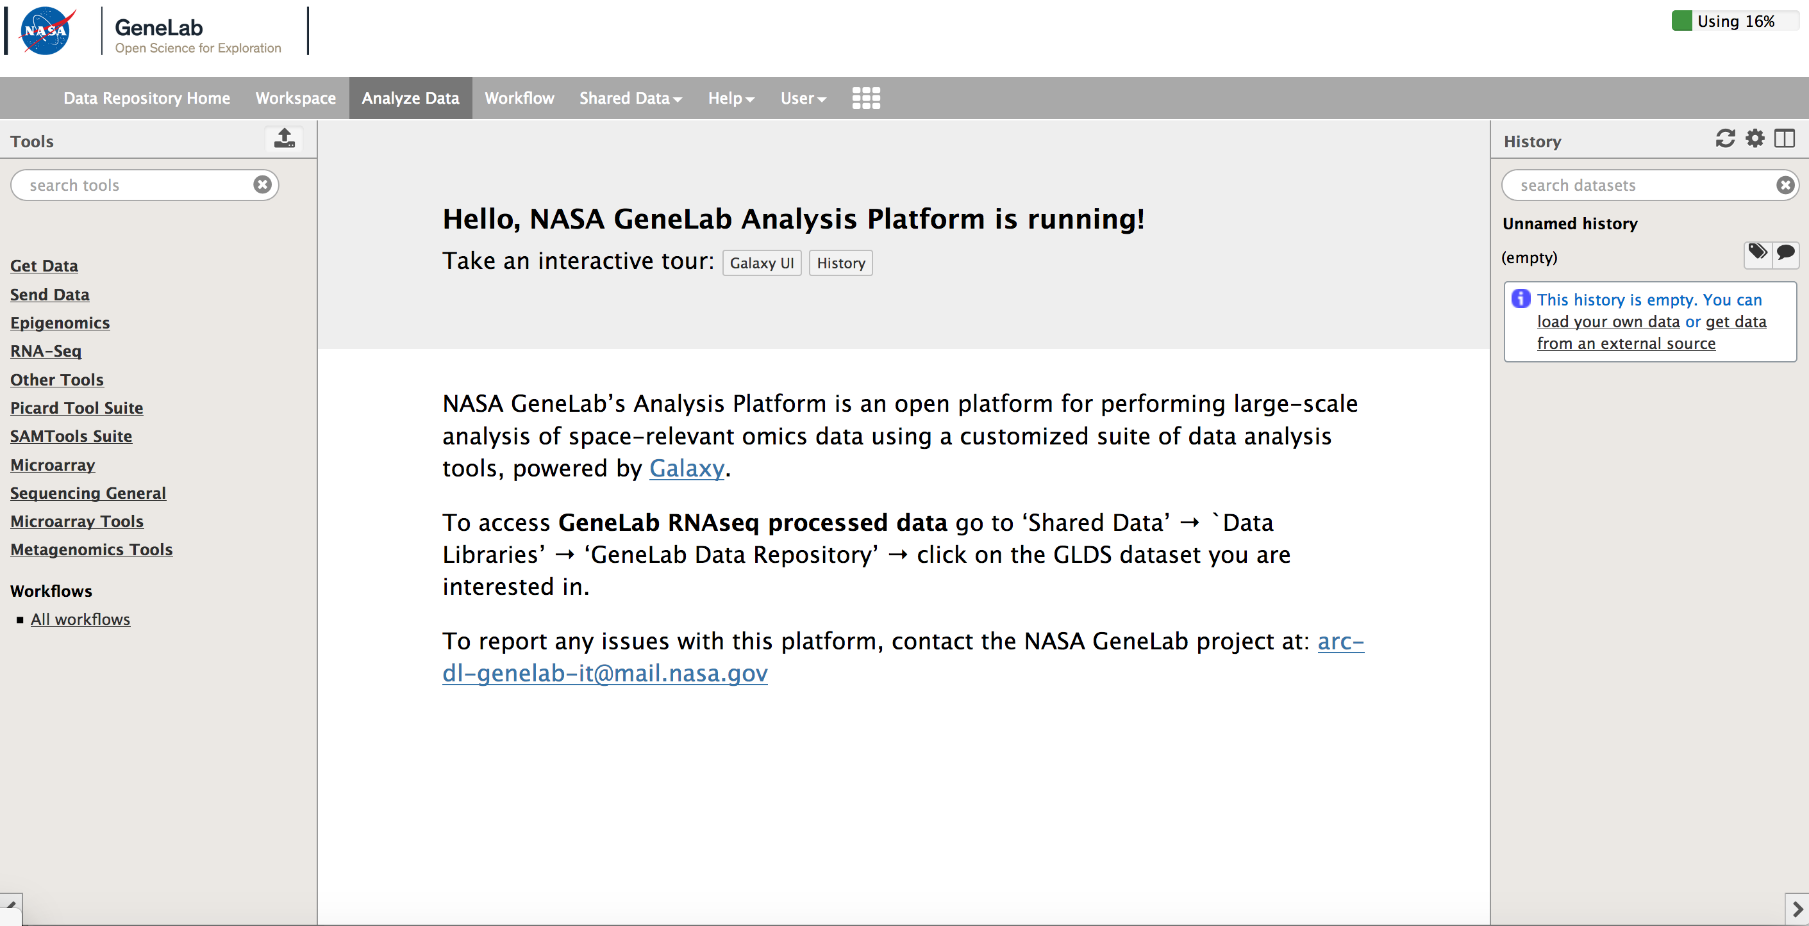
GeneLab: The NASA Systems Biology Platform for Space Omics
Repository, Analysis and Visualization
Schedule
9:05 am – 9:35 am, Explore NASA GeneLab Space Omics Database and Discover How Life Adapts to Space, Sylvain Costes
9:35 am – 9:45 am, GeneLab Analysis Platform Overview, Amanda Saravia-Butler
9:45 am – 10:00 am, Chat Room Q&A*
*Questions may be entered into the chat room anytime during the webinar and will be answered by the GeneLab Team.
Twitter handle: @NASAGeneLab
https://genelab.nasa.gov
Data Analysis Tools
Jobs and output files will be displayed here
Now used by universities to teach omics

Slide 18
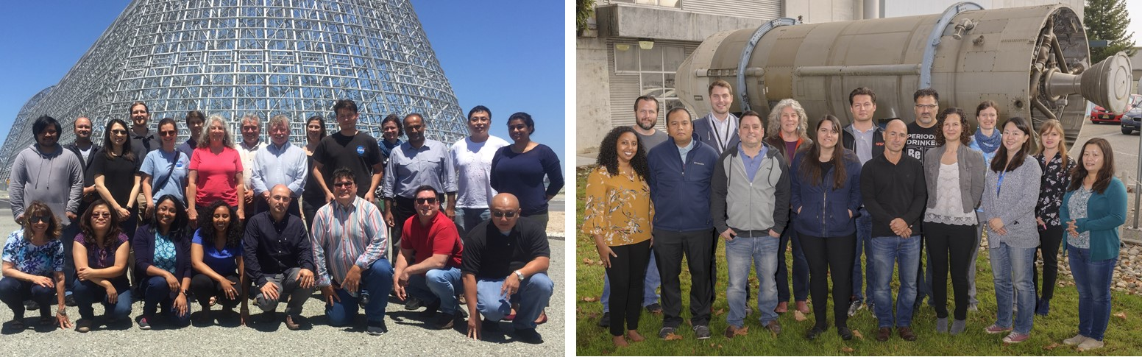
GeneLab Team
2017-2018
2018-2019
Thank you

