Slide 1

NASA Langley Research Center
Spring 2020 Internship
Haik Martirosyan
Boston University

Slide 2
Introduction
Virtual Acoustic Simulation and Psychoacoustic Testing
for Community Noise Project
Statistical Analysis
Sound Emission from Moving Source
Exterior Effects Room Equalization
Exterior Effects Room Session Files
  Mentors: Andrew Christian and Matthew Boucher
Mentors: Andy Christian and Matt Boucher
Notes:
Start off introducing the title of the project, go into a little of the expectations listed
Describe the 4 projects were apart of, listing them off and a quick one sentence description
Statistical analysis-worked with understanding stats concepts and generating algorithm
Equalization-Faller HDD and trying to unwrap that thing
Psychoacoustic- Get familiar with actual testing process in EER
Sound emission- Placeholder quarantine project
Say Mentors’ name

Slide 3
Statistical Analysis
Markov Chain Monte Carlo (MCMC)
  create samples from a continuous random variable, with probability density proportional to a known function
  Used to evaluate an integral over that variable, as its expected value
  created to address multidimensional problems
Metropolis-Hastings algorithm
  generates a Markov chain using a proposal density for new steps and a method for rejecting some of the proposed moves
Notes:
Give a very brief background on MCMC and what it’s used for
Talk about Metropolis-Hastings algorithm and what it’s used for
can talk about how read subsection of “Puppy Book”
worked initially on the “island” hopping

Slide 4
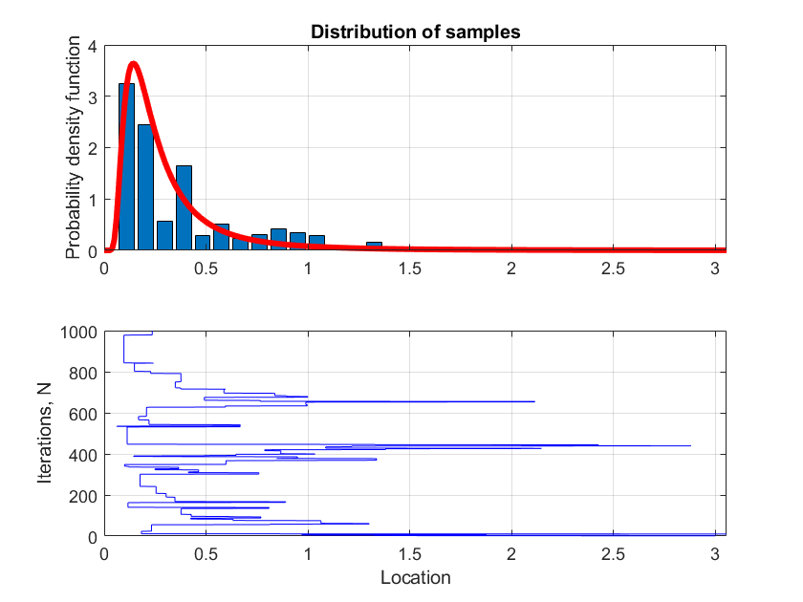
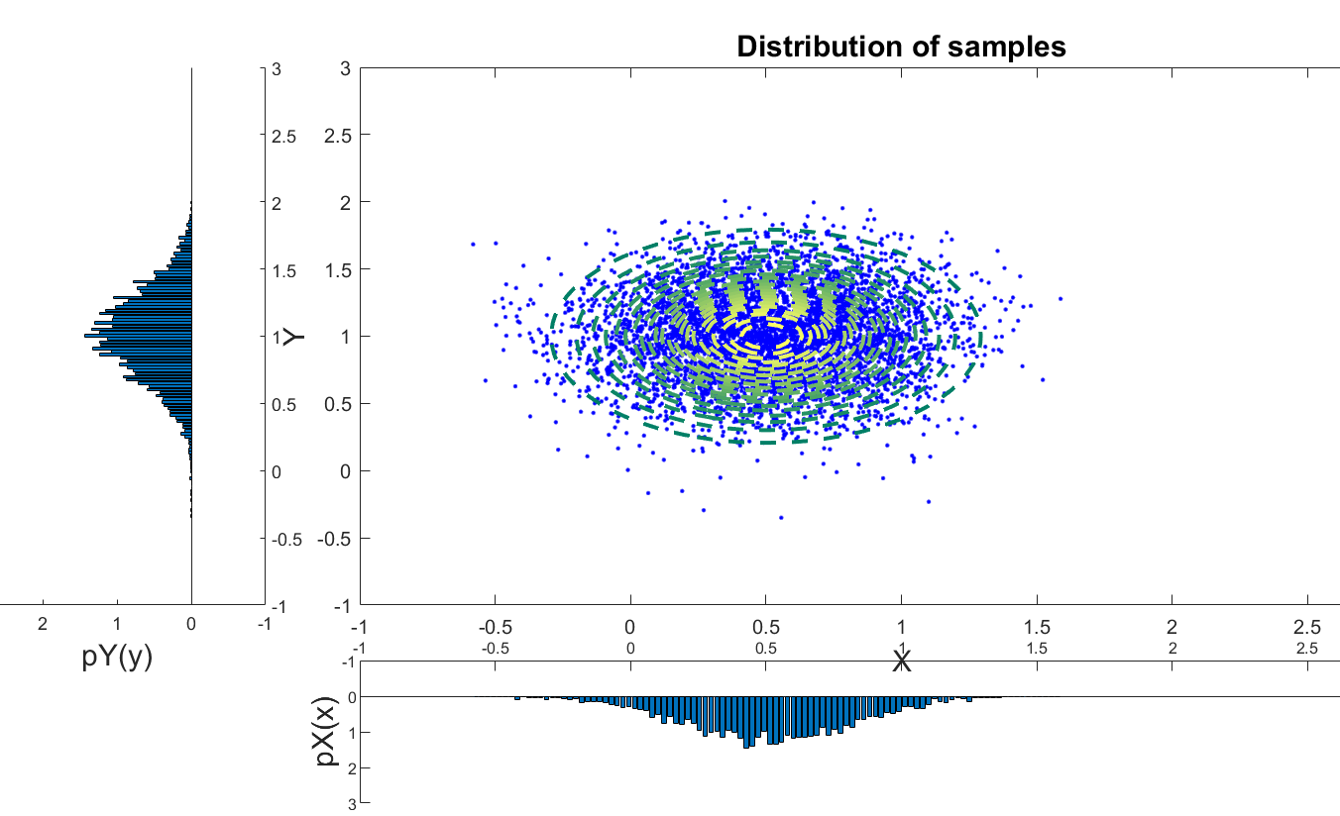
Statistical Analysis
Fig 1. Distribution of samples across one dimension
Fig 2. Distribution of samples across two dimensions
Notes:
Describe figures, explain what theyre looking at
Left is a 1D representation of algorithm, talk about the parameters
Right is a 2D representation of algorithm, talk about parameters
Talk about what it represents
was going to lead to “Pure Death” stuff but at this point decided to prioritize HDD

Slide 5
EER Speaker Equalization
The EER has a real-time simulation environment that includes a three-dimensional sound-reproduction system using 31 speakers. This system requires real-time application of equalization filters to compensate for spectral coloration of the sound reproduction due to installation and room effects.
General process:
Measure Speaker Resp
Convert NI to MATLAB format
Create Weiner FIR EQ Filters
Create IIR Filters
Combine IIR, Delay, Gain into EQF
Notes:
Faller 2TB HDD with a lot of data and a lot of code that needed to be sifted through
Go through the general process, say that these are the discovered blocks that go into the EER calibration
Did equalization on each speaker individually, and combined at the end

Slide 6
EER Speaker Equalization
Step 1
Measure uncompensated, or “raw”, speaker responses using NI hardware
Step 2
Convert data from NI binary format to a MATLAB readable format
Notes:
Step 1- measure noise by playing pink noise through individual speaker to mult microphones, first 2, then 12. record data
Step 2-convert data to matlab format so that the data can be manipulated and processed

Slide 7
EER Speaker Equalization
Step 3 - Create Weiner FIR EQ Filters
Requires: Response and excitation signal, desired cutoff frequencies, desired resp type (‘bp’), desired resp order, order of filter, and sampling rate
First, generate Linkwitz-Riley cross-over filter
  Cascading Butterworth second-order-systems (SOSs)
Then, generate the system response autocorrelation matrix and the cross-correlation matrix of the system and desired responses
Finally, solve Toeplitz system of equations
Outputs: Weiner FIR filter
  Extract N-point complex frequency response
  Semilogx plot of response magnitude
Notes:
Step 3 is where I spent a good chunk of time trying to understand what’s happening
This is the step where FIR EQ filters are generated
Go through bullet points, detailing what the in depth process is

Slide 8



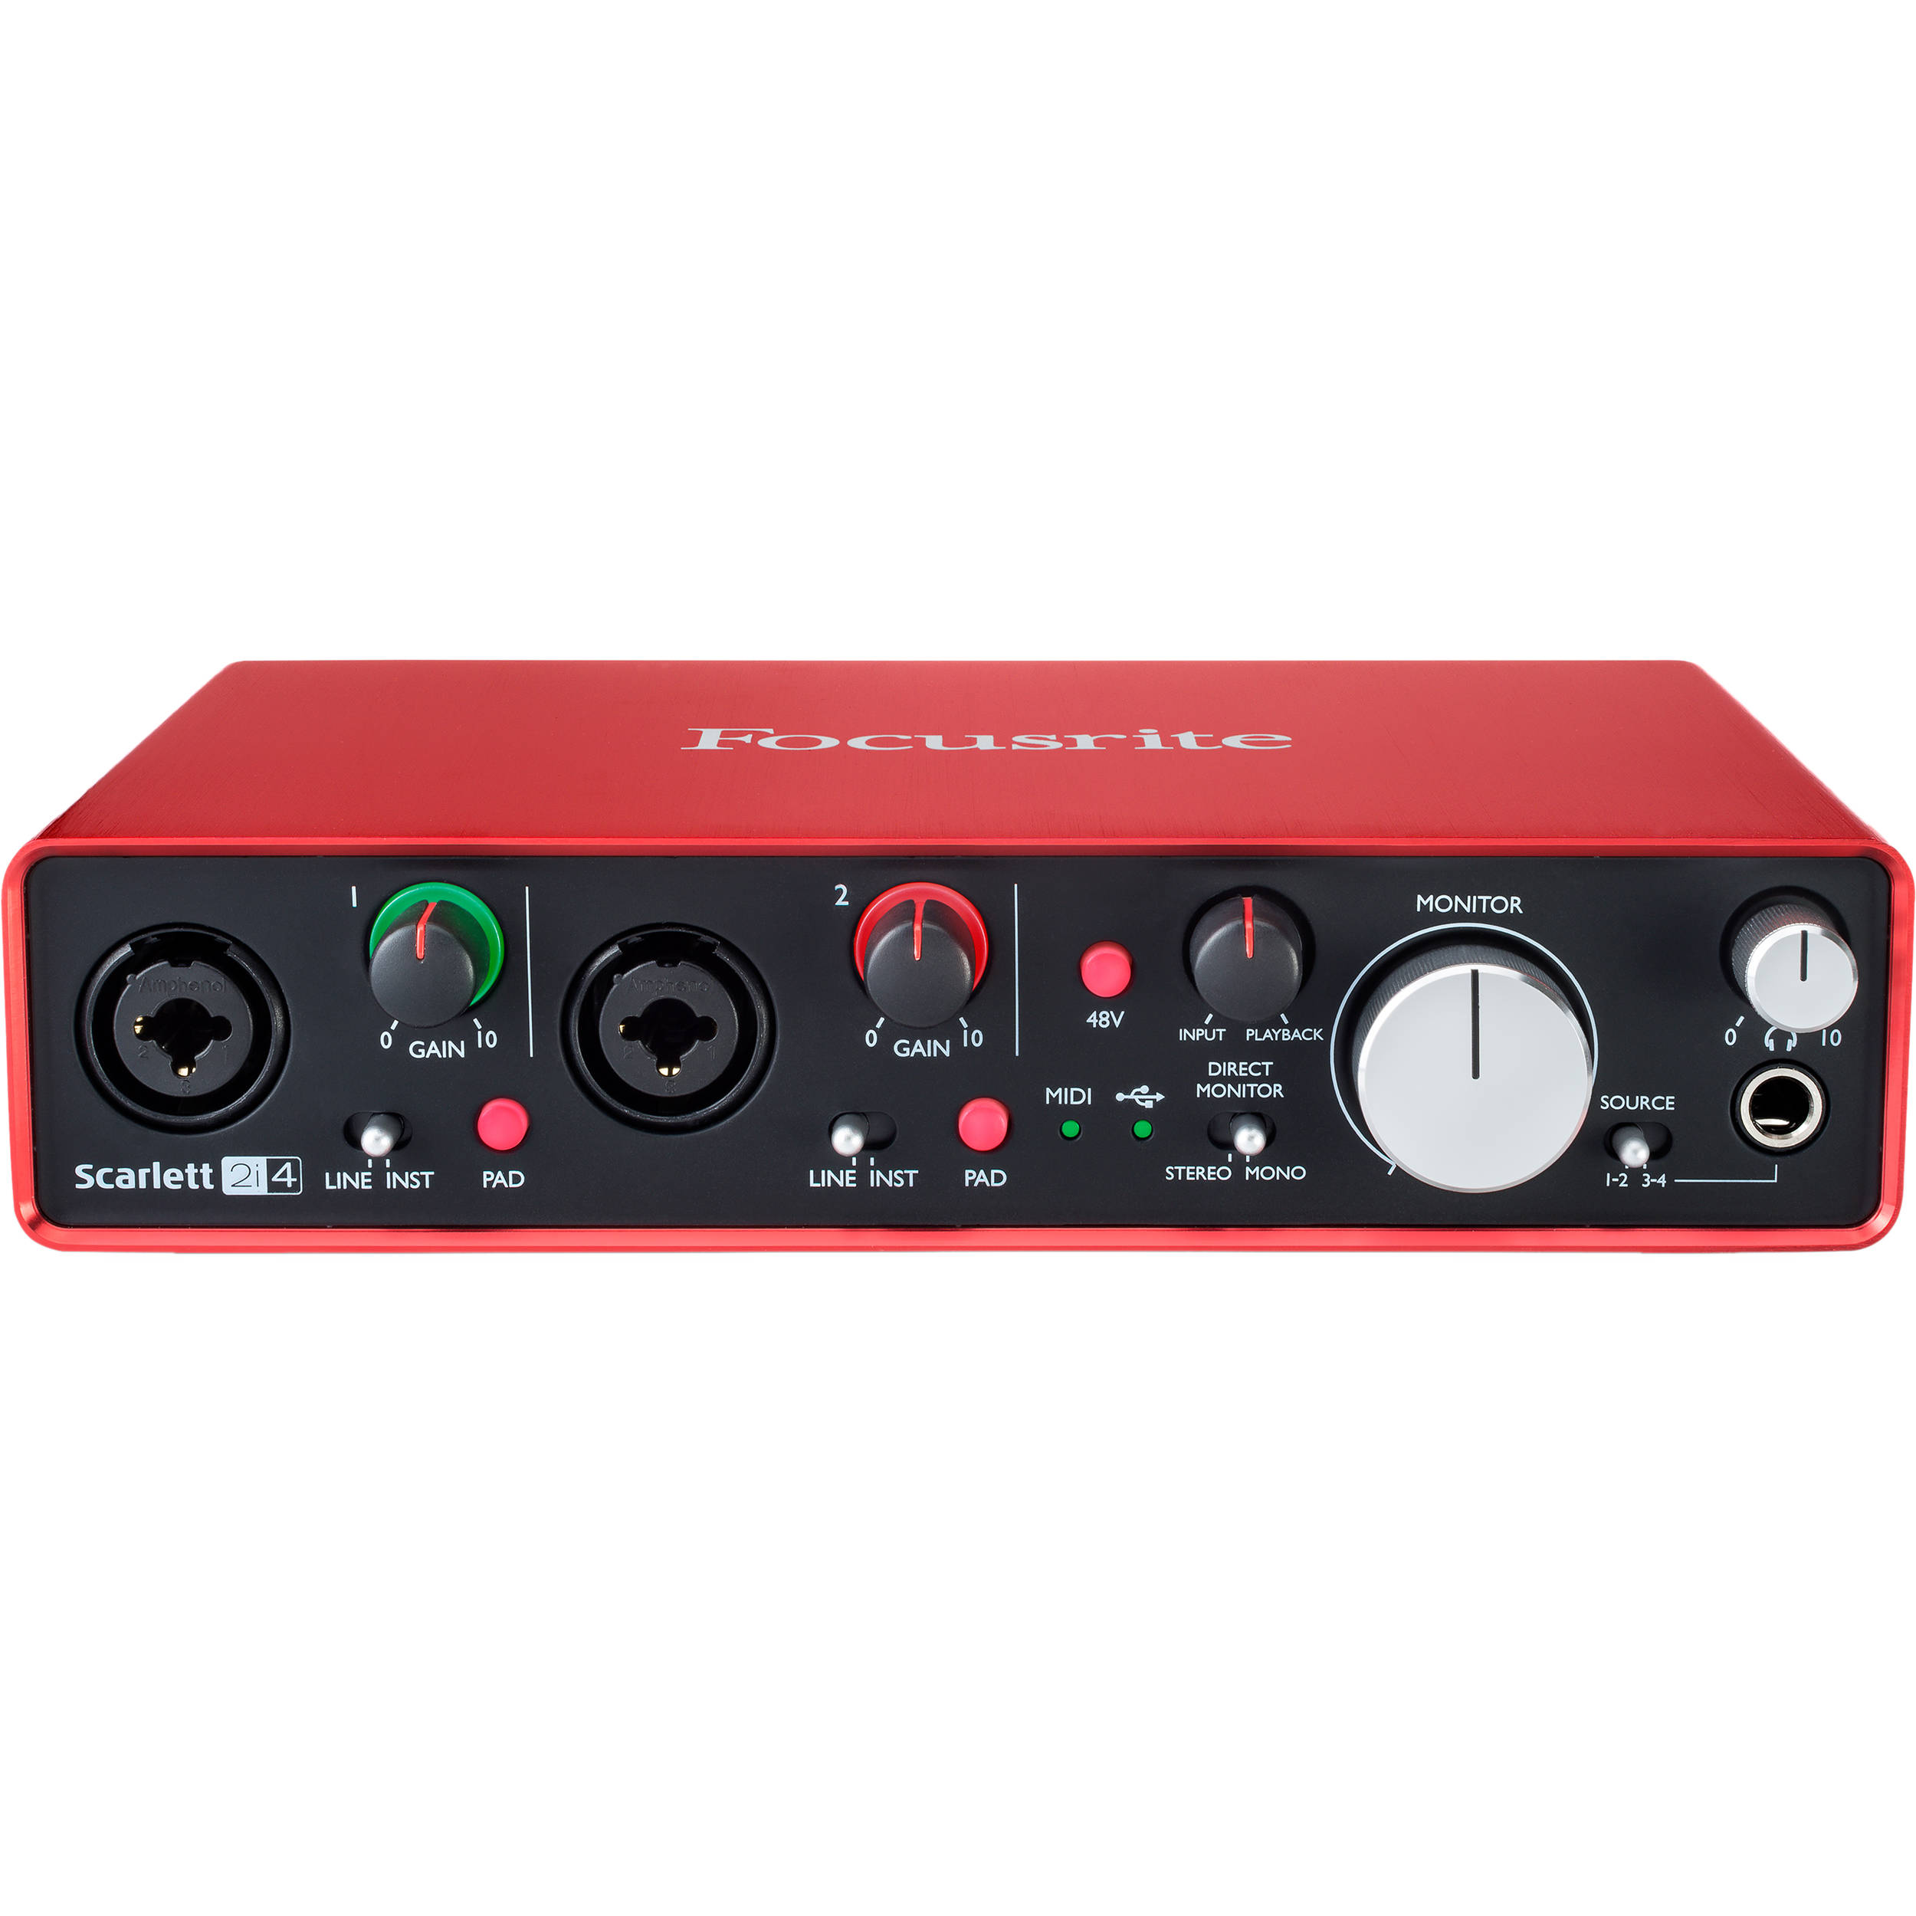
EER Speaker Equalization
Mic 1
Mic 2
Notes:
My setup, small infographic to give idea since was not able to grab a pic. Initial setup was one microphone split to have both response and excitation. Would play pink noise through speaker to microphone and look at frequency response plots, along with throwing it through his block to see what happens to it. Once got results with that, changed to 2 microphone setup to equalize between them and do the real meat of the block, equalizing between mult microphones

Slide 9
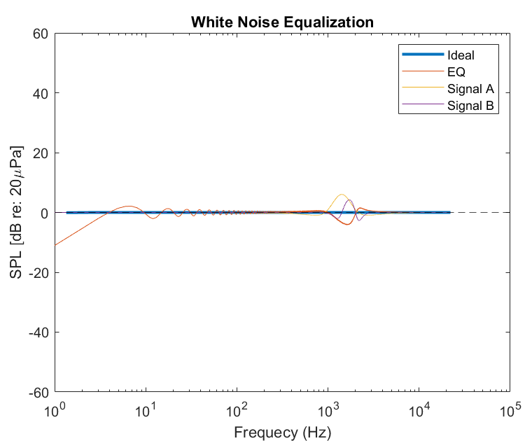
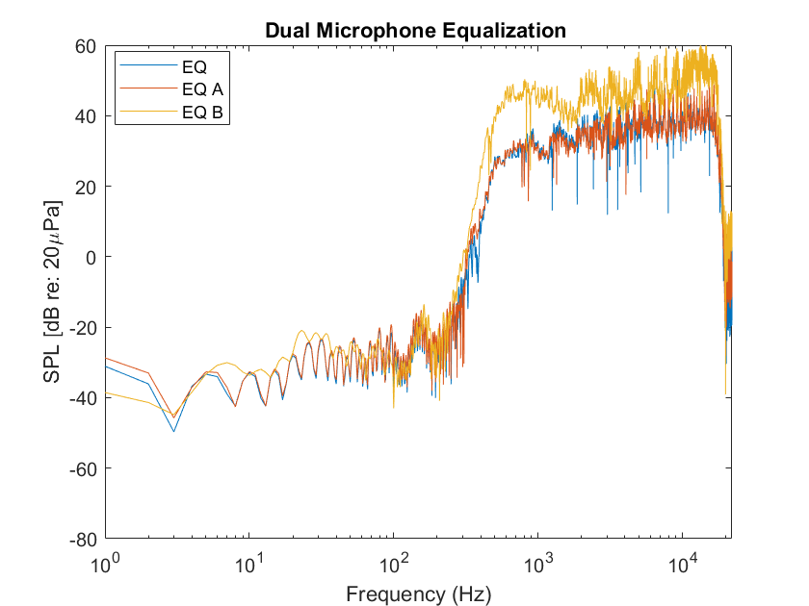
EER Speaker Equalization
Fig 3. Synthetic white noise equalization
Fig 4. Dual mic equalization using pink noise
Notes:
Couple graphs to show the process of generating the filter from pink noise and how clean it appears, makes easier to understand. From this able to generate a eq filter that followed the desired ideal shape that faller uses for his data.

Slide 10
EER Speaker Equalization
Step 4
Create IIR EQ Filters from FIR filters
Spectral Factorization
  Utilizes Complex Cepstrum approach and Control System Toolbox
Executable files need to be updated to 64-bit processor
Step 5
Combine IIR EQ filters with delay and gain estimates to generate final EQ files
  Delay and gain estimates computed separately
  Writes binary .ahm file as result
Notes:
Talk about step 4, can go into a bit more, describe the process.
Have generated the IIR filter after tinkering with initial errors of code, but cant analyze.
Talk about how hit a roadblock with IPP Plot being out of date and waiting for a update. Latest update on that is Bill was told by Aric throough Email we need by early May if possible bc he is busy.
Step 5 is the combination of the IIR filter with the delay estimate and gain estimate. Talk about what goes into gain estimate and delay estimate-how calculated
What it outputs as -> .ahm file

Slide 11
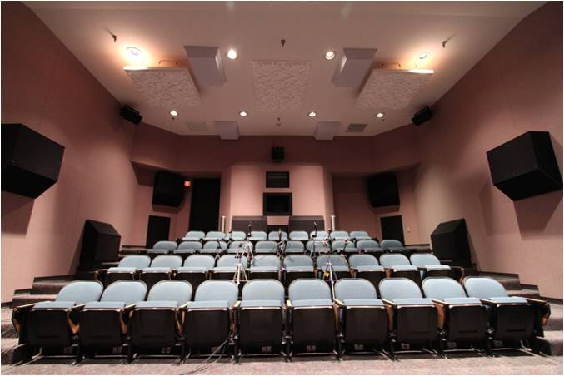
EER Session Files
EER psychoacoustic test administration process
Finished ICHIN IIIB and RQMM II session files, self-administering RQMM II full test
Familiarized with audio config files for generation of new files
Weekly DNA meetings for summer test design
Notes:
Add bullet point about psychoacoustic test background, and annoyance, relation to paper
Picture of EER in case anyone has forgotten what it looks like
For this part, worked with Matt to understand how the EER runs (startup, logging procedures, running session files, shutdown)
Went through a couple demos (ICHIN IIIB, did part of on tablet, run by Matt), and RQMM II demo (started up, played demo self went back and forth to work)
Which were cool and gave a better sense of what the tests were like

Slide 12
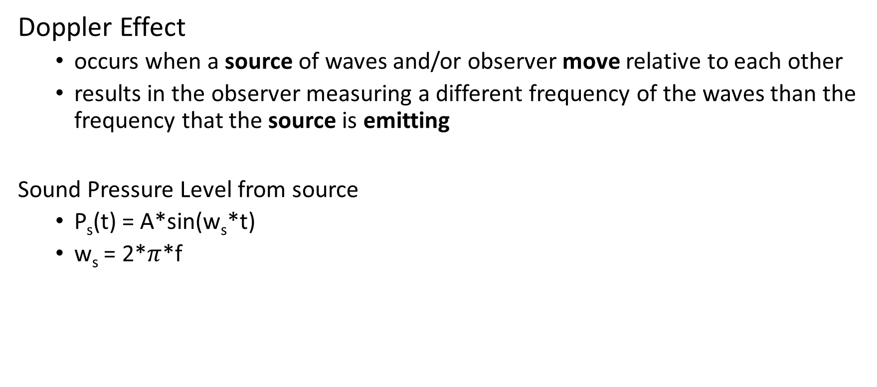
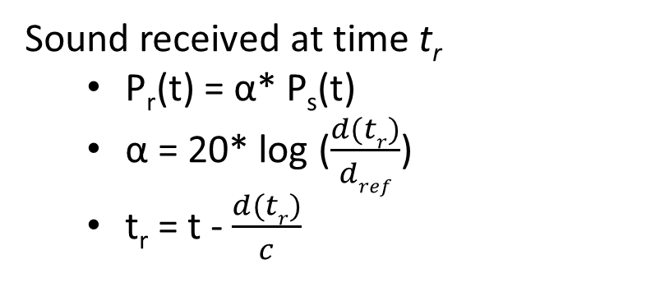
Sound Emission from Moving Source
Doppler Effect
  occurs when a source of waves and/or observer move relative to each other
  results in the observer measuring a different frequency of the waves than the frequency that the source is emitting
Sound Pressure Level from source
  P_{s}(t) = A*sin(w_{s}*t)
  w_{s} = 2*$π$*f
Sound received at time t_{r}
  P_{r}(t) = α* P_{s}(t)
  α = 20* log ($\frac{d(tr)}{dref}$)
  t_{r} = t - $\frac{d(tr)}{c}$
Notes:
Project thought of by Andy regarding sound emission from moving source in relation with aliasing
Quick background
Quick run through of the formulas used, just go through
Mention had to indirectly solve for retarded time in algorithm to get sound perceived from receiver

Slide 13
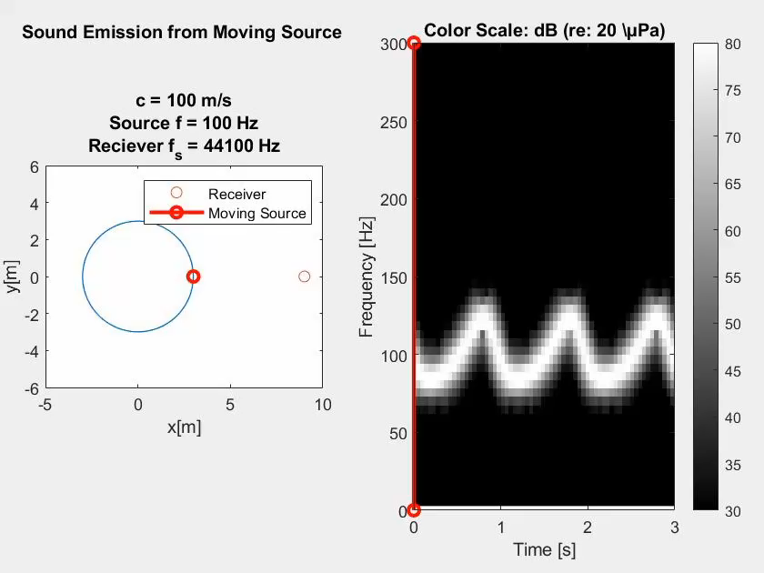
Sound Emission from Moving Source
Notes:
Talk about the initial parameters. Setup in a circular path. Set side by side with a spectrogram to show time v freq relationship
Play video with sound, simple oscillating sound

Slide 14
Sound Emission from Moving Source
Notes:
Now what happens when modify the receiver sampling freq to 441 Hz from 44.1kHz and maintain source signal freq at 100Hz
Sounds pretty much identical, and has an identical spectrogram

Slide 15
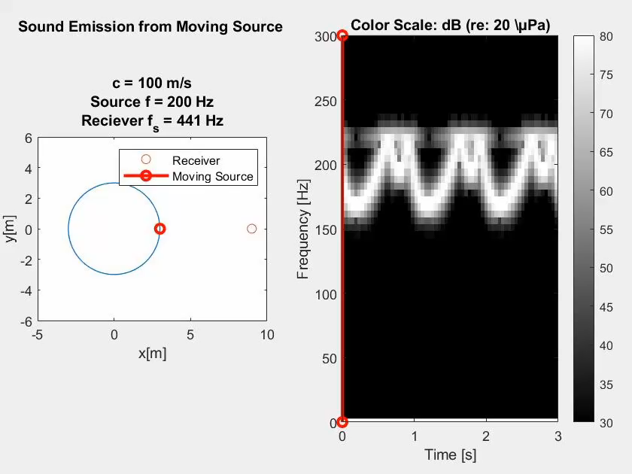
Sound Emission from Moving Source
Notes:
Starts to get interesting when modify the source signal freq to 200Hz and receiver at 441Hz. Now start to show some overlapping freq/aliasing and sound sounds distorted

Slide 16
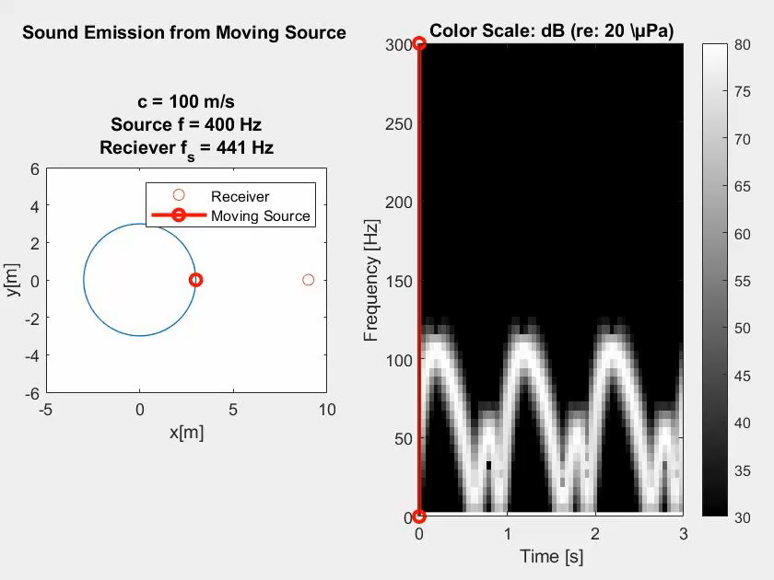
Sound Emission from Moving Source
Notes:
Shown even further here with the source signal freq at 400 Hz. Sound is distorted even more
Applications and why significant, tag in andy

Slide 17
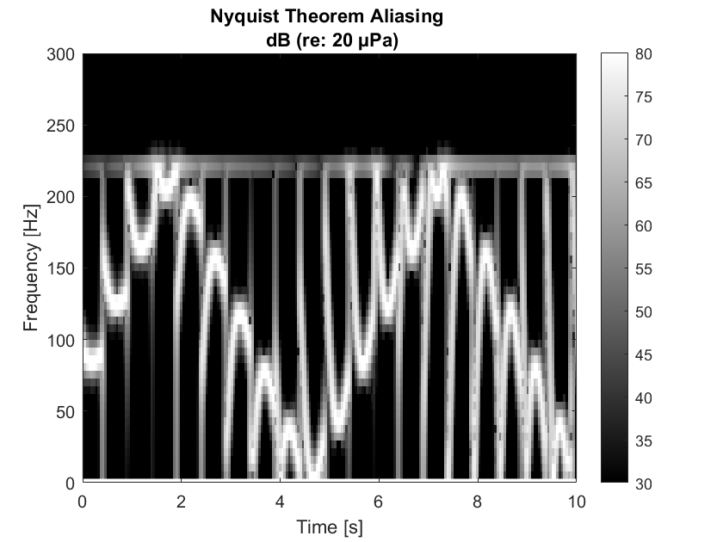
Sound Emission from Moving Source

Slide 18
Moving Forward – Summer 2020
Summer internship dates: July 6, 2020 – Aug 21, 2020
Closed Center
  Continue working on generating filters from Faller HDD when .dll file has been updated to 64-bit processor
  Continue working on solution to aliasing problem presented in demos now that problem has been demonstrated
Open Center
  Continue working on generating filters from Faller HDD when .dll file has been updated to 64-bit processor
  Work on generating new audio session files for EER
Notes:
Just read through upcoming plans

Slide 19
Thank You!
Notes:
Thank you, hope it wasn’t boring

