Slide 1
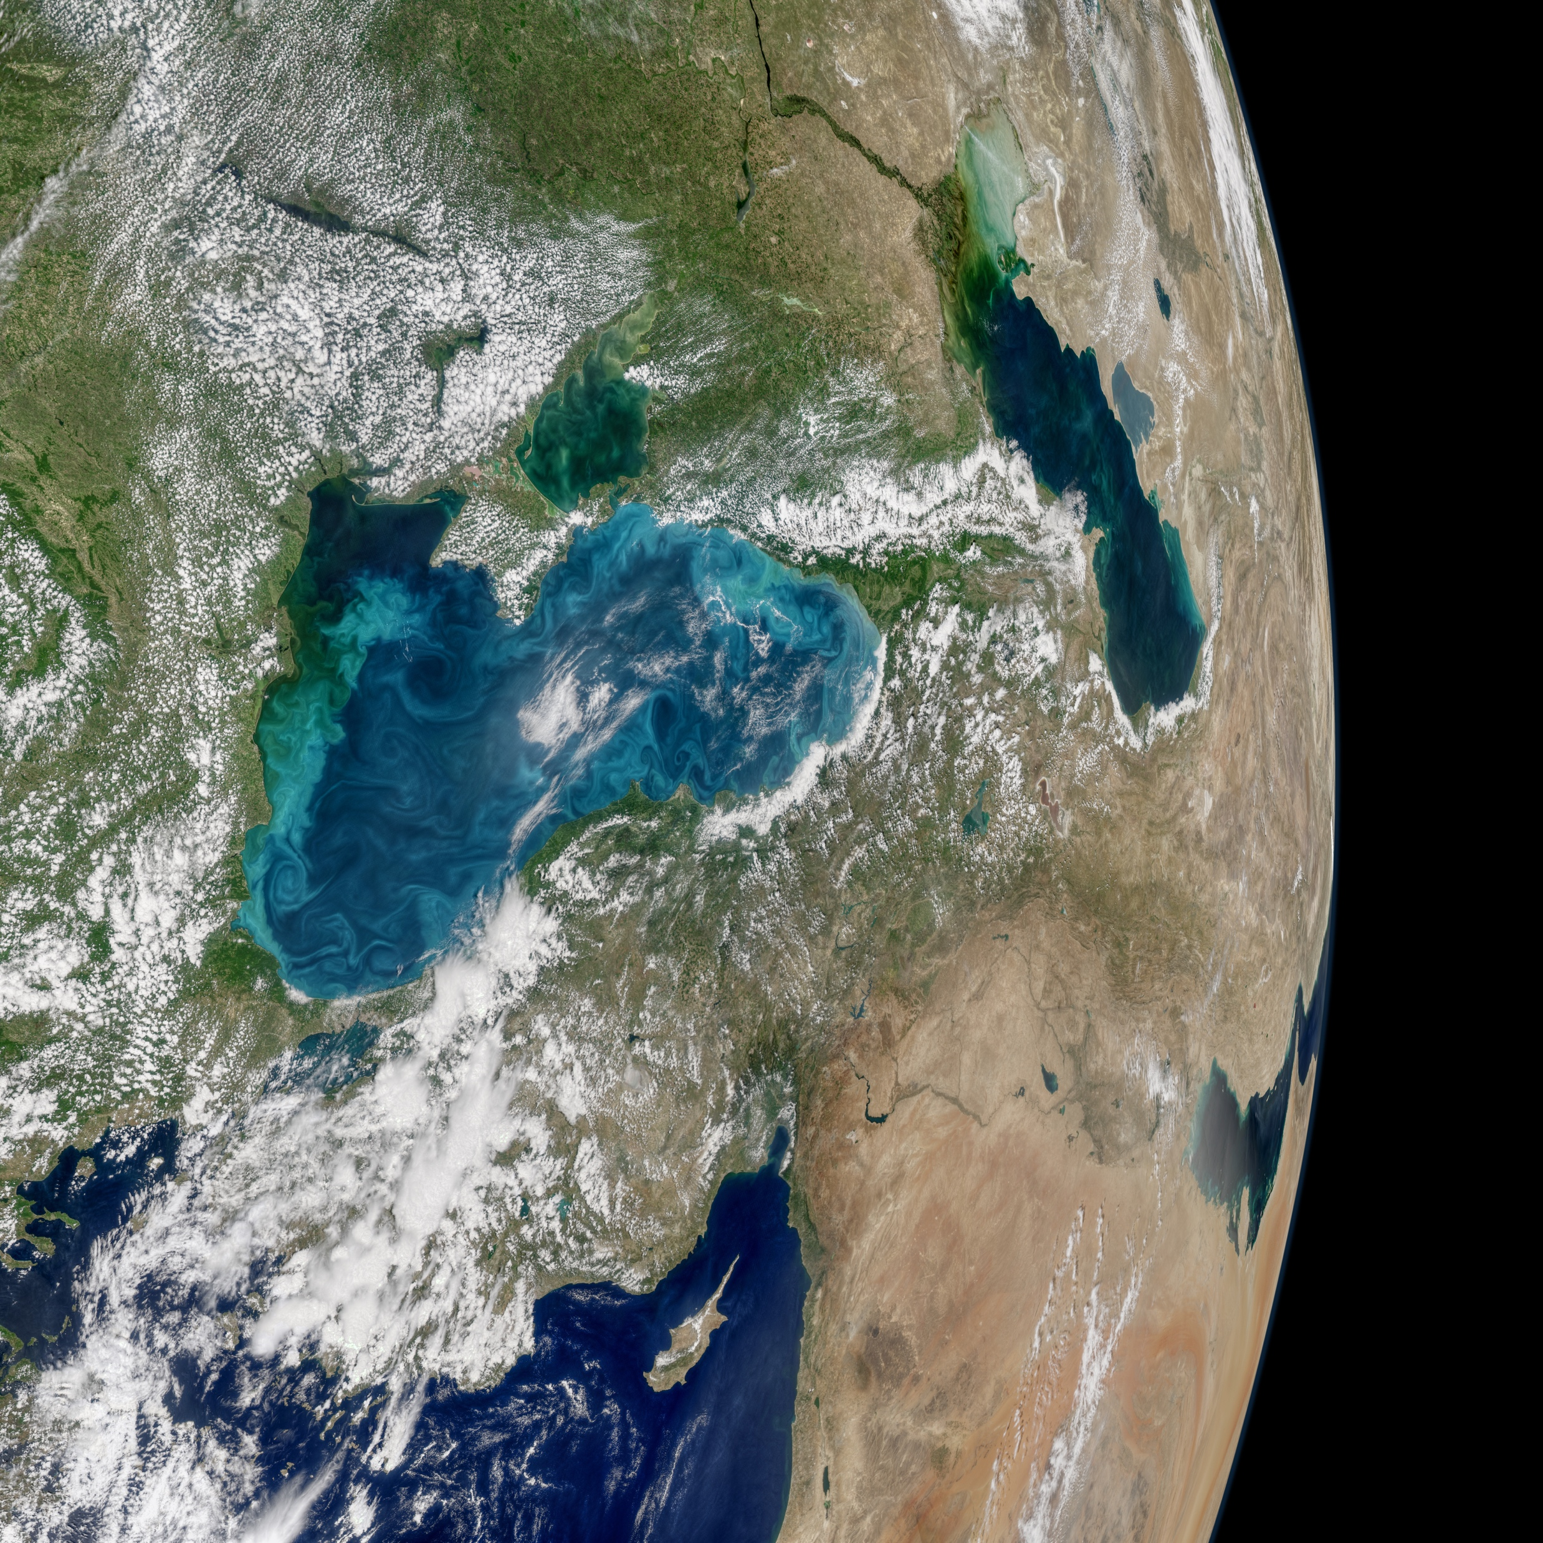


A software framework for
optimizing the design
of spaceborne hyperspectral
imager architectures
Adam Erickson, Benjamin Poulter, David R. Thompson,
Greg Okin, Shawn Serbin, Weile Wang, Dave Schimel
EGU General Assembly 2020

Slide 2


Overview
The 700-kilometer view
SBG Study Phases
Task: Uncertainty Quantification
Methods: Need for HyperTrace
Early Results
Example Application
Uninformed priors
on architectures?

Slide 3
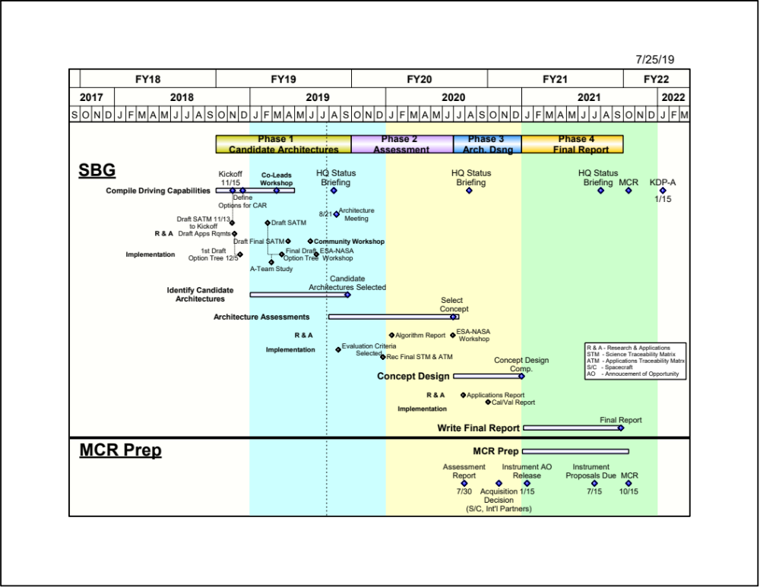
SBG
Phases

Slide 4
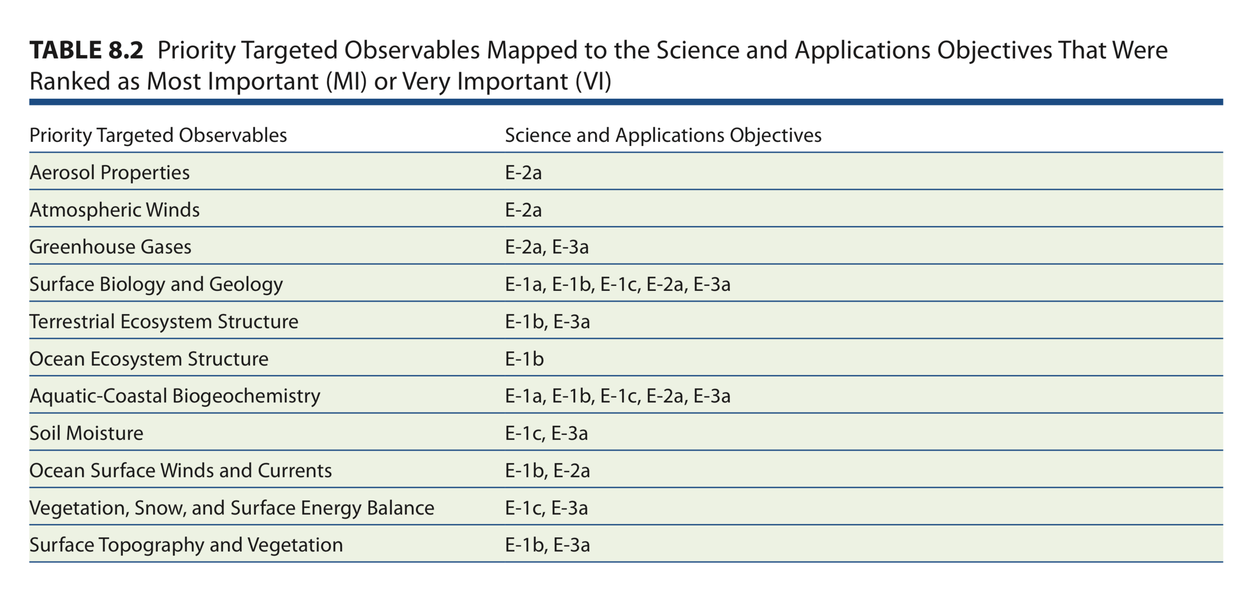
(1a) Composition, (1b) Structure,
(1c) Physiology, (2a) CO₂ & CH₄,
(3a) Energy & Biogeochemistry
Vanilla hyperspectral lends to composition, physiology, biogeochemistry
Structure, 3-D (SfM) helped by VHR, multi-angular
CH₄, CO₂ with polarization
Energy balance helped by diurnal observations at µm scale (fire radiative power)

Slide 5
Phase 1: Linking SATM with Capabilities
Capability Code | VSWIR Spatial | VSWIR Temporal | VSWIR Range | VSWIR Sensitivity | TIR Spatial | TIR Temporal | TIR Range | TIR Sensitivity | VSWIR/TIR Coincidence
A | ≤ 30 m | ≤ 8 days for global coverage* | ≤ 380 – ≥ 2500 nm @ ≤10nm | SNR ≥400 VNIR, SNR ≥250 SWIR, accuracy ≤10% | ≤ 30 m | ≤ 1 day for global coverage* | ≥ 5 bands in 8-12 um, ≥ 1 band in 3 -4.5 um | ≤ 1K absolute ≤ 0.2K NeDT / band | Simultaneous within 30 seconds
B | ≤ 60 m | ≤ 16 days for global coverage* | ≤ 380 nm – ≥1000 nm @ ≤10nm | ≤10% Absolute accuracy | ≤ 60 m | ≤ 3 days for global coverage* | ≥ 5 bands in 8-12 um | ≤ 1.5% Absolute < 1K NeDT / band | Same day
C |  |  | VNIR multiband |  | ≤ 100 m | ≤ 5 days for global coverage* | ≥ 3 bands in 8-12 um |  | VNIR within 3 days

Slide 6
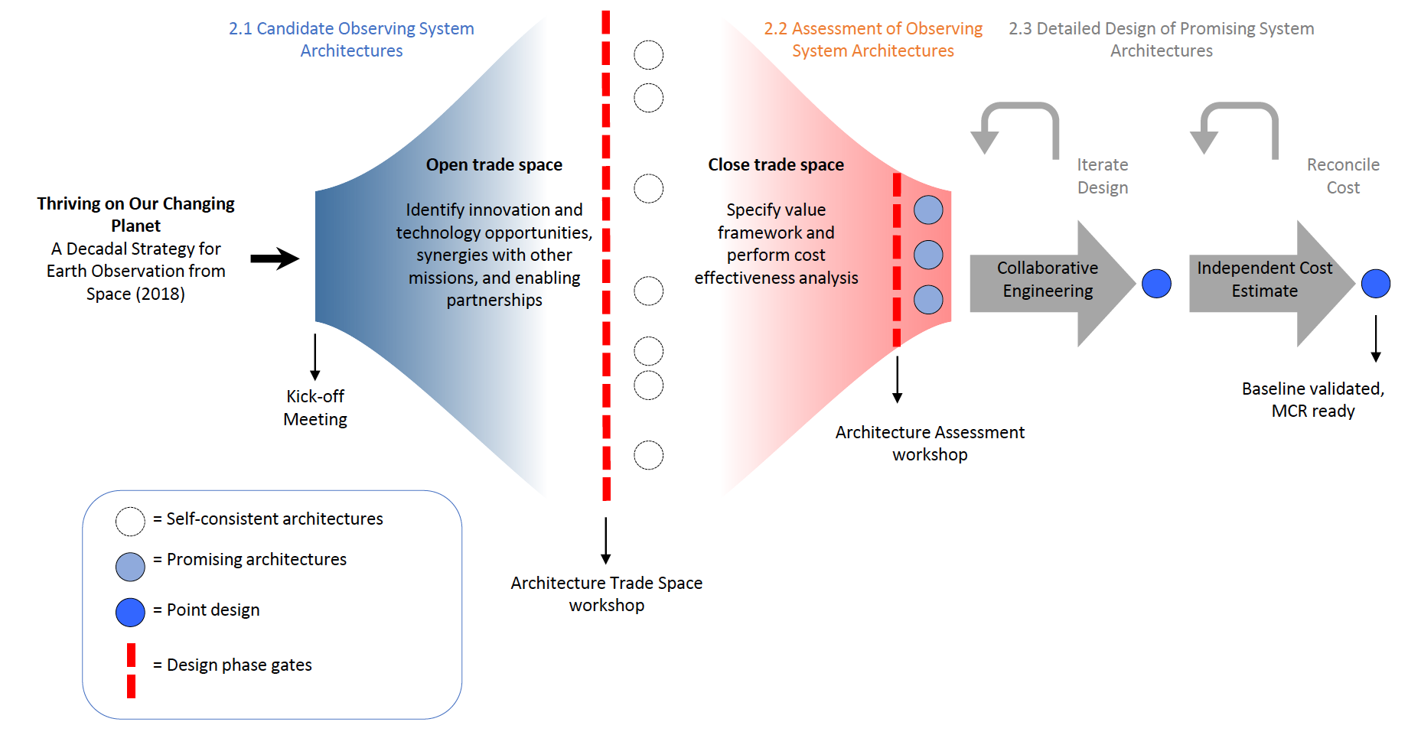
Phase 2: Tradespace Downselect
NASA TE 2019 Site Visit

Slide 7
Phase 2: Tradespace Downselect
What we seek to accomplish in our modeling work
Quantify retrieval potential, uncertainties
Quantify interactions between atmosphere, geometry, imaging system components
Quantify synthetic retrieval accuracy (SRA), uncertainty (SRU), and sensitivity (SRS)
Score architectures by ability to satisfy DOs
Python library for this and LSM-RTM coupling

Slide 8
Methods
Forward and inverse radiative transfer modeling
Generating globally representative atmospheres
MODIS
AOD₅₅₀ H₂O vapor
10 states AOD, H₂O
k-means
clustering
where k = 10
Atmosphere
State + Cov
Optimal
Estimation
MODTRAN LBL
Covariances = sky view factor, H₂O absorption, general, and per-band
Notes:
The forward model also accounts for uncertainty due to unknown, unretrieved variables:
•Uncertainty in the sky view factor, a random variable with standard deviation σ_{SV}. The sky view represents the fraction of hemispherical sky illumination visible from the surface.
•Uncertainty in H₂O absorption coefficients, a random variable with standard deviation σIH2O
•Uncertainty due to non-systematic error in Radiative Transfer (RT) and calibration that manifests differently in multiple spectra, a random variable with standard deviation σ_{CAL}
•Uncertainty due to systematic error in Radiative Transfer and calibration in each channel that is consistent in multiple spectra, a vector of random variables with standard deviations σ_{λ} = [σ_{λ1},…,σ_{λm}]^{T}.
The forward model also incorporates a complete signal- and wavelength-dependent instrument noise model as a multivariate Gaussian random variable with diagonal covariance S_{y}.

Slide 9
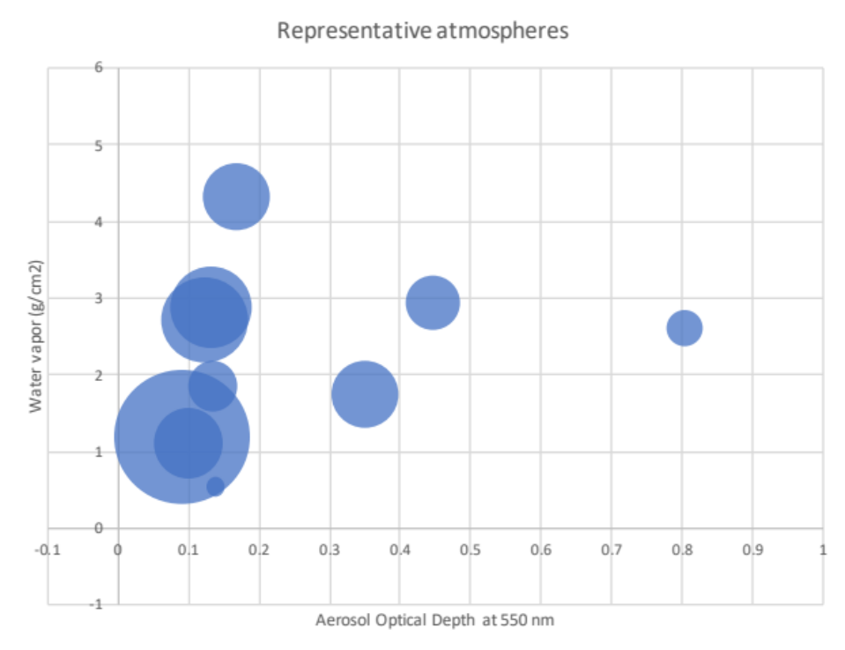
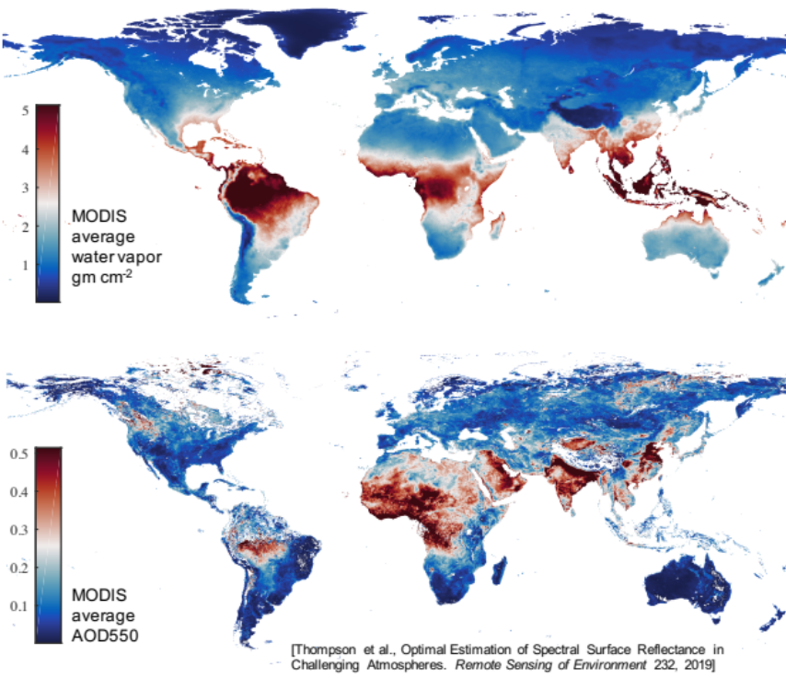
Methods
Forward and inverse radiative transfer modeling
Notes:
The forward model also accounts for uncertainty due to unknown, unretrieved variables:
•Uncertainty in the sky view factor, a random variable with standard deviation σ_{SV}. The sky view represents the fraction of hemispherical sky illumination visible from the surface.
•Uncertainty in H₂O absorption coefficients, a random variable with standard deviation σIH2O
•Uncertainty due to non-systematic error in Radiative Transfer (RT) and calibration that manifests differently in multiple spectra, a random variable with standard deviation σ_{CAL}
•Uncertainty due to systematic error in Radiative Transfer and calibration in each channel that is consistent in multiple spectra, a vector of random variables with standard deviations σ_{λ} = [σ_{λ1},…,σ_{λm}]^{T}.
The forward model also incorporates a complete signal- and wavelength-dependent instrument noise model as a multivariate Gaussian random variable with diagonal covariance S_{y}.

Slide 10



Methods
Forward and inverse radiative transfer modeling
Surface
Reflectance
$$Y$$
At-sensor
Radiance
Forward OE
Model
Score
$$f(Y, \hat{Y})$$
Surface
Reflectance
$$\hat{Y}$$
Atmosphere?
Inverse OE
Model
Estimation over joint surface-atmosphere-instrument model (all models together for n free parameters)

Slide 11
Methods
Forward and inverse radiative transfer modeling
Optimal Estimation (OE)
“OE inverts y by iteratively optimizing an estimate for x based on a cost function incorporating prior information and goodness of fit criteria. One begins by initializing the state to a reasonable first guess. One then linearizes the forward model about this estimate and adjusts the state vector in the direction of reducing cost. Multiple iterations of forward model predictions and error gradient descent move the state vector to a local cost minimum.”
Thompson et al., (2018) Optimal estimation for imaging spectrometer atmospheric correction

Slide 12
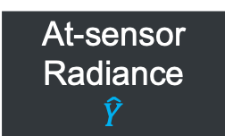


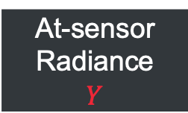
Lambertian
HDRF
AOD₅₅₀ H₂O
Optics
Detector Electronics
TOA
Solar Spectrum
Forward OE
Model
Surface
Reflectance
$$Y$$
Surface Model
MODTRAN
LBL
Instrument
Model
At-sensor
Radiance
$$\hat{Y}$$
Surface
Reflectance
$$\hat{Y}$$
MODTRAN
At-sensor
Radiance
$$Y$$
Inverse OE
Model
Unknown
TOA
Solar Spectrum

Slide 13
Methods
Forward and inverse radiative transfer modeling
Looping over all possible parameter combinations
Parameters | Values
Inversion | Simple, Uncorrelated, Basemap
Atmospheres | 0…9 (AOD, water vapor) cluster
Azimuth | 90, 180
Zenith | 0, 22.5, 45, 75
View-zenith | 0, 22.5
SNR | 50, 100, 200, 400, 800, 1600

Slide 14
Methods
Forward and inverse radiative transfer modeling
Two classes of instrument models used
  Fixed mean SNR across bands
  Per-band mean SNR with covariances (n-D density)
Considers a full instrument model with components and associated uncertainties
Group the 60-80 candidate architectures from Phase 1 into 12 representative instruments (8 VSWIR + 4 TIR)
Instrument based on full probabilistic model

Slide 15
Methods
Example JSON configuration file
Contact information for automated email system notifications
Metadata for subsequent analysis
ENVI reflectance file input
Optional at-sensor radiance for inversion-only mode
Sensor bands can be set to match surface reflectances or different
Custom atmospheres can be provided
Pre-computed atmospheric data included
A range of geometries and inversion methods supported
By default, runs a radiative transfer model on-the-fly, falls back on LUTs if not available
{
"name": ["First", "Last"],
"affiliation": "Organization",
"email": "example@email.org",
"focus": "geology",
"landcover": "rock",
"type": "observed",
"surface_reflectance": "reference_reflectance",
"sensor_radiances": ["atm_0_az_90_zen_00.0_vzen_00.0_snr_400_radiance"],
"sensor_wavelengths": "shared",
"spatial_dims": [15, 1],
"spatial_resolution": 30,
"spectral_range": [376.351593, 2500.027588],
"spectral_resolution": 5.804256988235294,
"target_spatial_resolution": 30,
"target_spectral_range": [380, 2500],
"target_spectral_resolution": 10,
"atmospheres_file": "clusters.csv",
"atmospheres": [0, 1, 2, 3, 4, 5, 6, 7, 8, 9],
"azimuths": [90, 180],
"zeniths": [0, 22.5, 45, 75],
"viewzeniths": [0],
"inversions": ["uncorr", "simple", "basemap"],
"snrs": [50, 100, 200, 400, 800, 1600],
"noisefiles": false,
"plot": false
}

Slide 16
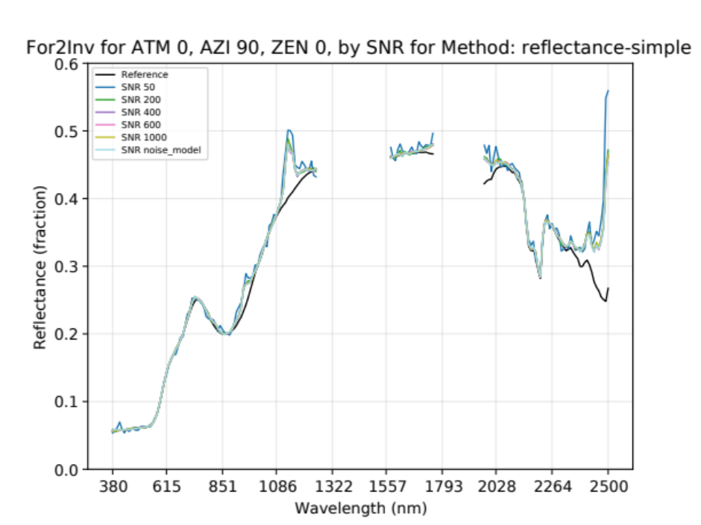
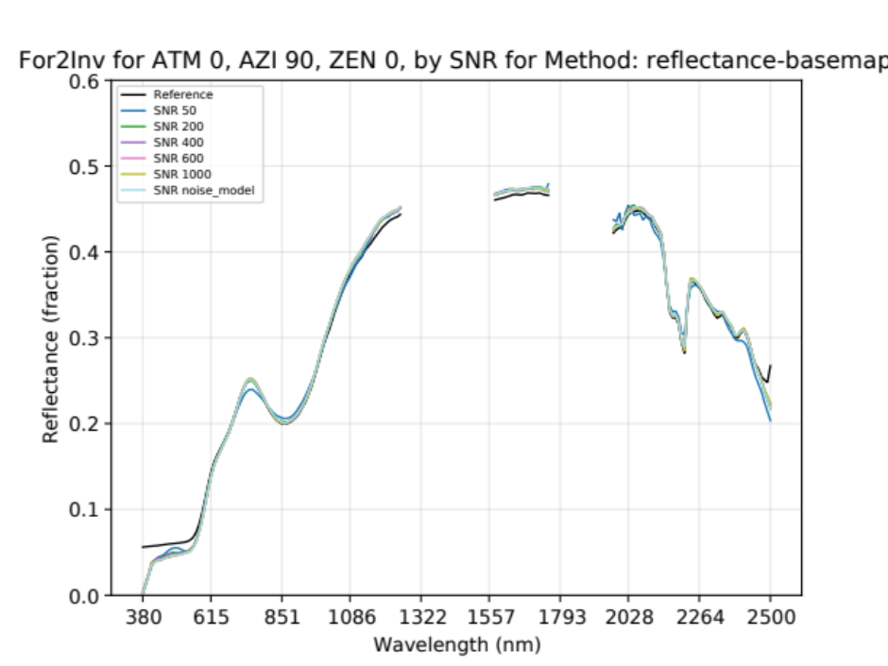
Preliminary Results
SR by method, geometry, and SNR:
Little variation in well-constrained case (right)
Weighting of prior a form of regularization
Example: stonewall reflectances
Ignore
Ignore

Slide 17
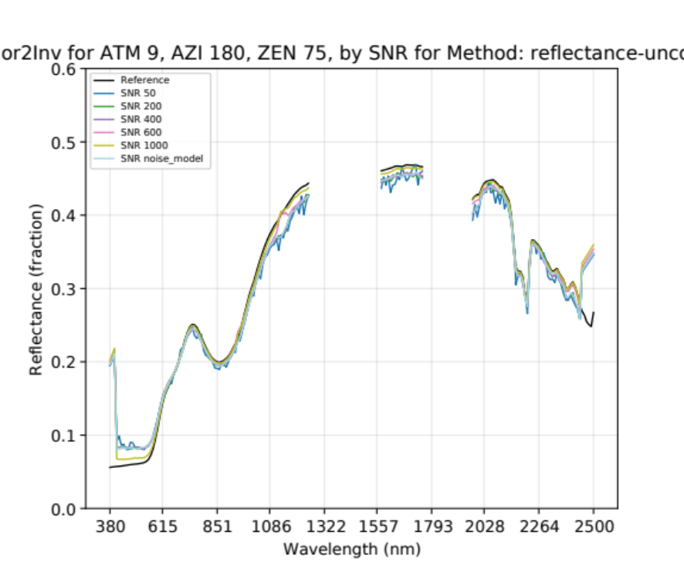
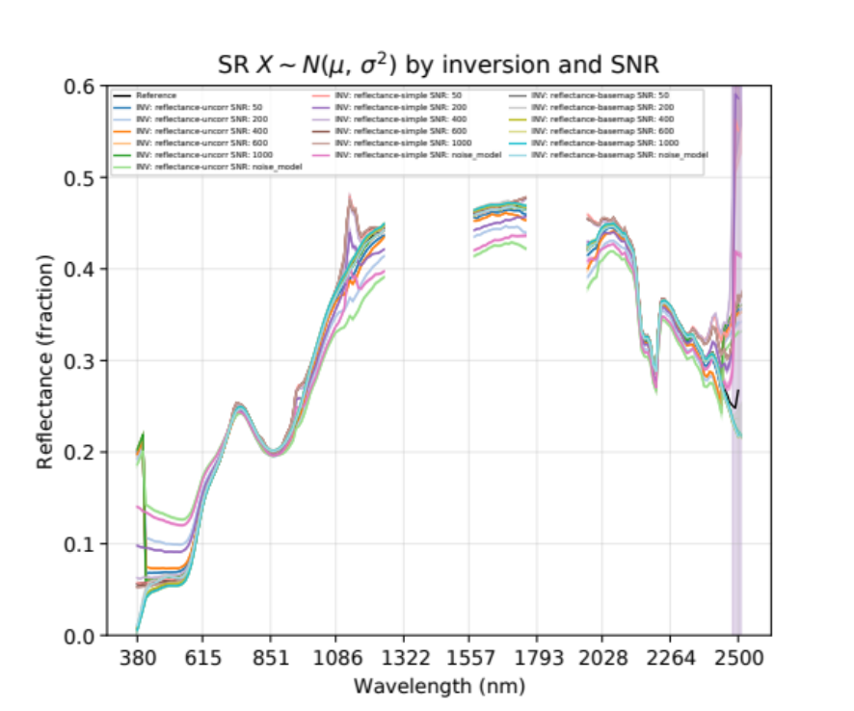
Preliminary Results
SNR shows minimal effect, but…
SNR effects some methods more than others
Example: stonewall reflectances
Ignore
Ignore

Slide 18
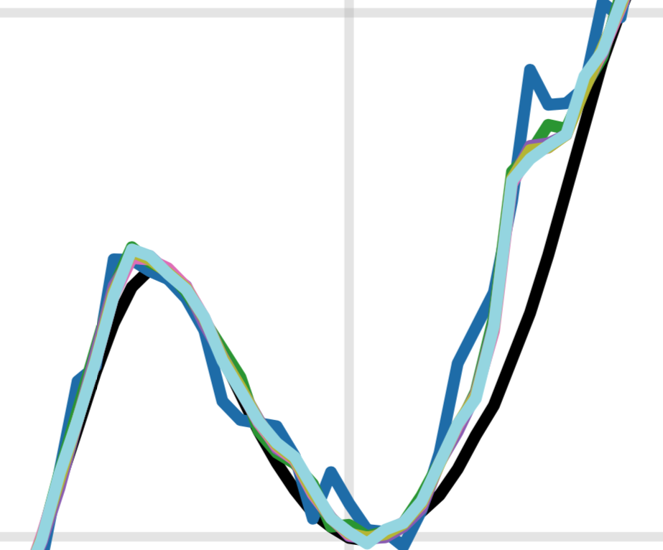
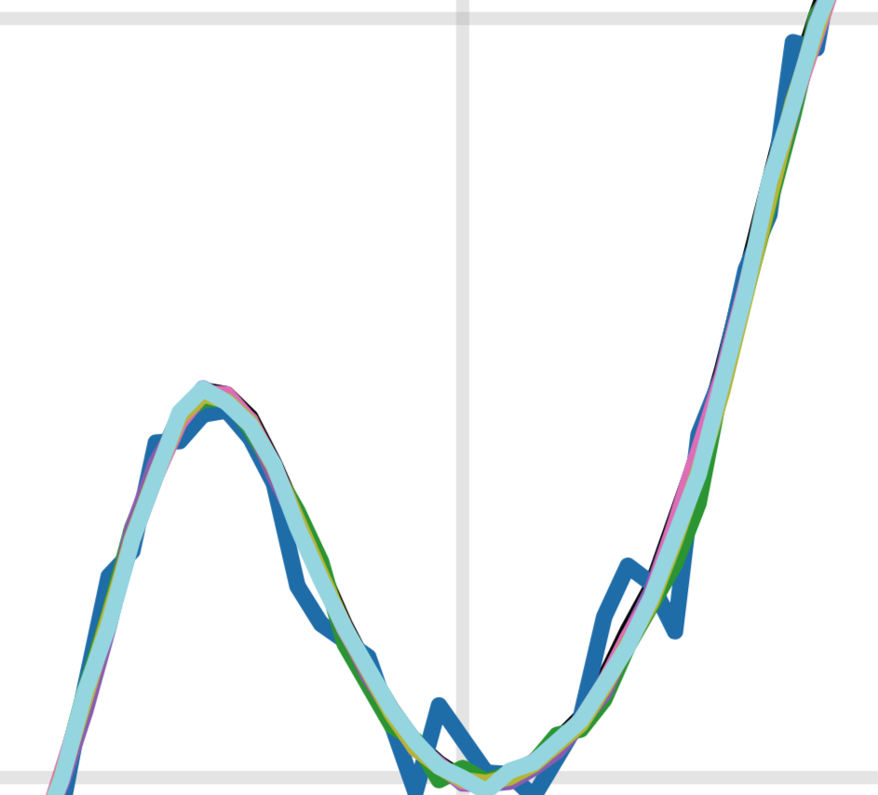
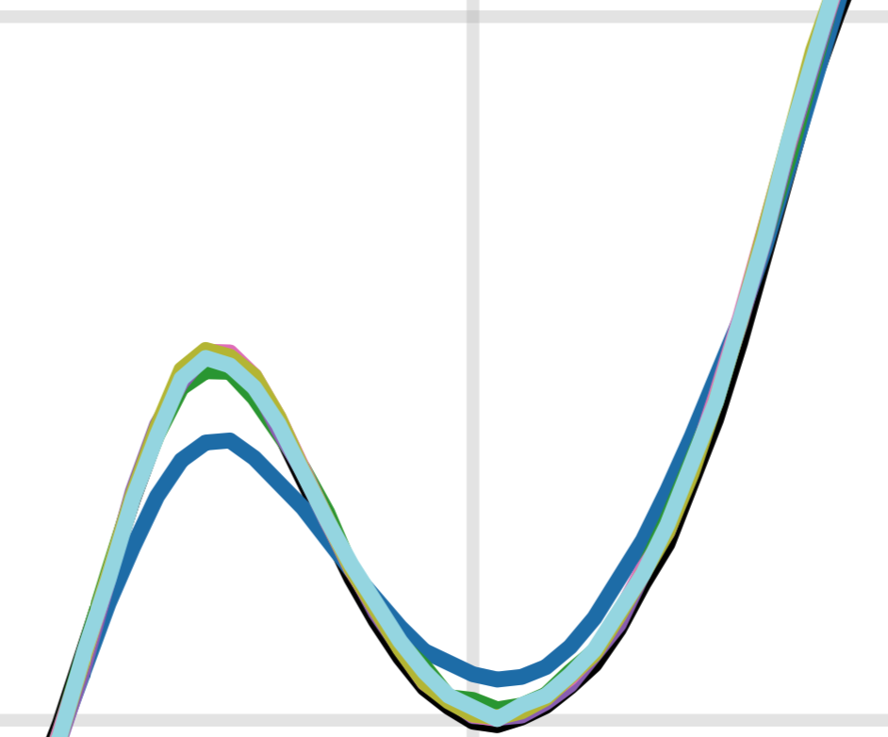
Preliminary Results
Exploring fine details in the ideal case
Smoother is not better! Regularization effect
Example: stonewall reflectances
Simple
Uncorrelated
Basemap

Slide 19
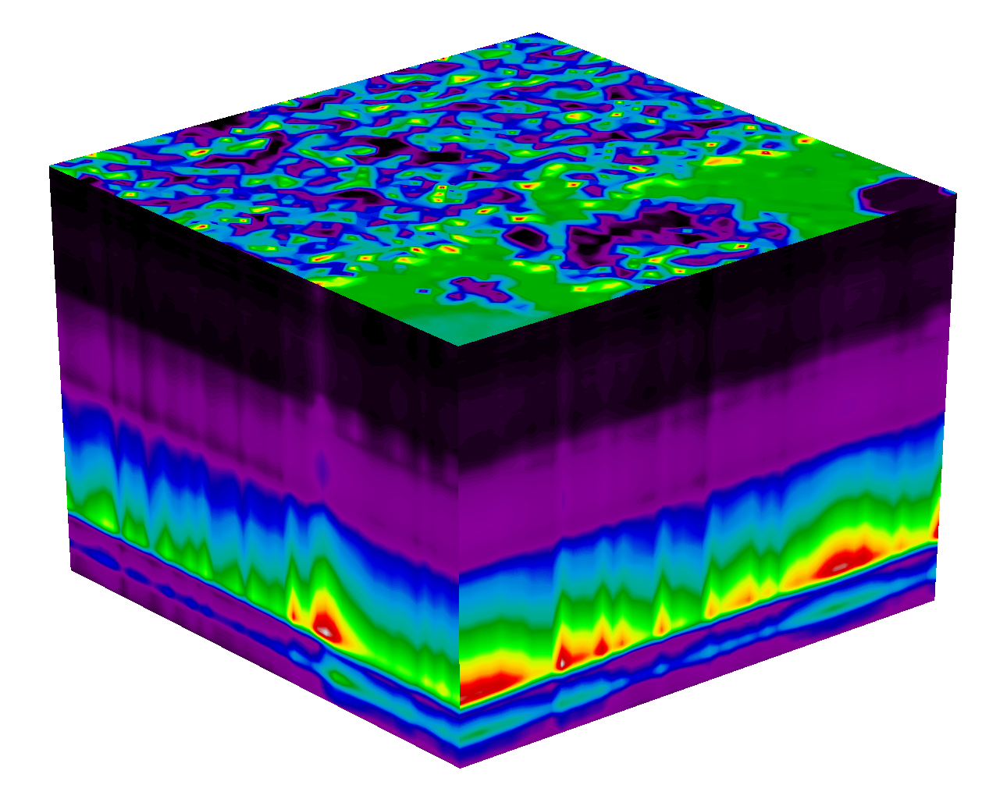
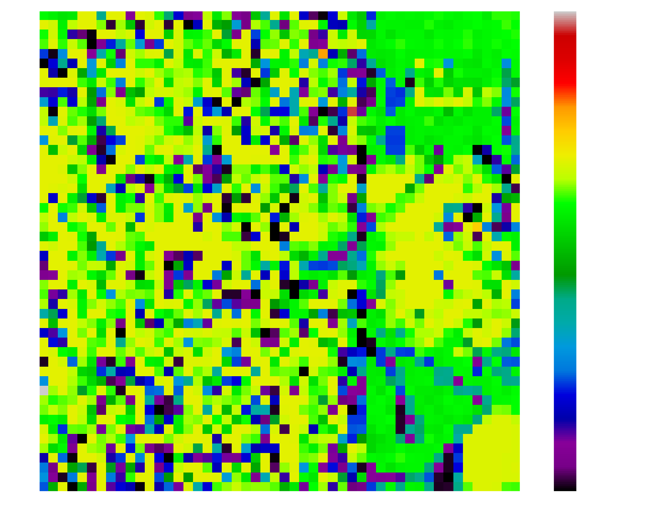
Preliminary Results
Forward-to-inverse
per-pixel RMSE
Example: DIRSIG surface reflectance

Slide 20
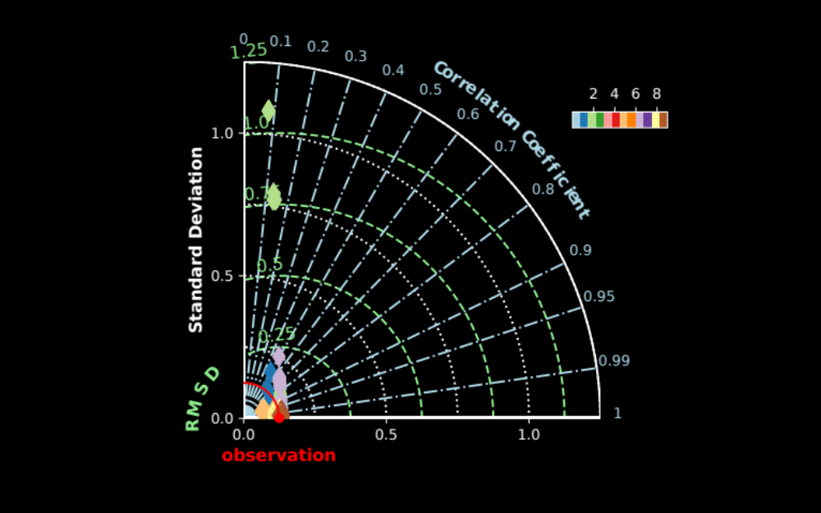
Preliminary Results
Inversion performance is generally high,
lower with greater spectral variability
A brief summary of early results

Slide 21
Preliminary Results
| ------------------------ |
| Feature | Importance |
| ------------------------ |
| Method | 0.236 |
| Atmosphere | 0.482 |
| Azimuth | 0.001 |
| Zenith | 0.280 |
| View-zenith | 0.000 |
| SNR | 0.001 |
| ------------------------ |
A brief summary of early results
What controls variation in
model performance?
Train a machine-learning
model to predict the forward-
to-inverse SR error on
matrix of parameters, errors,
for simple spectra.
R² = 0.80; RMSE = 0.04
(1) Atmosphere; (2) Zenith; (3) Method
DIRSIG
Columns: ['inversion', 'atm', 'az', 'zen', 'vzen']
R2: 0.7910928996865043 RMSE: 0.007451074018209009
Importance Feature
0 0.442798 inversion
1 0.308114 atm
2 0.000000 az
3 0.249089 zen
4 0.000000 vzen
SNR2
R2: 0.803848316974592 RMSE: 0.04180547153612444
Importance Feature
0 0.235036 inversion
1 0.428000 atm
2 0.001386 az
3 0.326742 zen
4 0.000000 vzen
5 0.008836 snr

Slide 22
Example Application
An example user application for SBG
Extract ENVI ROIs from AVIRIS-NG flight in Alaska
  Elevational gradient from sea to mountains
  Coastal water, mineralogy, vegetation, snow, inland water
Parse endmembers into BIL binary ENVI spectra
Run each of the spectra through HyperTrace
  A suite atmospheres
  A suite view geometry conditions
  A suite instrument noise models
Fully automated experiment design for rapid analysis
DIRSIG
Columns: ['inversion', 'atm', 'az', 'zen', 'vzen']
R2: 0.7910928996865043 RMSE: 0.007451074018209009
Importance Feature
0 0.442798 inversion
1 0.308114 atm
2 0.000000 az
3 0.249089 zen
4 0.000000 vzen
SNR2
R2: 0.803848316974592 RMSE: 0.04180547153612444
Importance Feature
0 0.235036 inversion
1 0.428000 atm
2 0.001386 az
3 0.326742 zen
4 0.000000 vzen
5 0.008836 snr

Slide 23
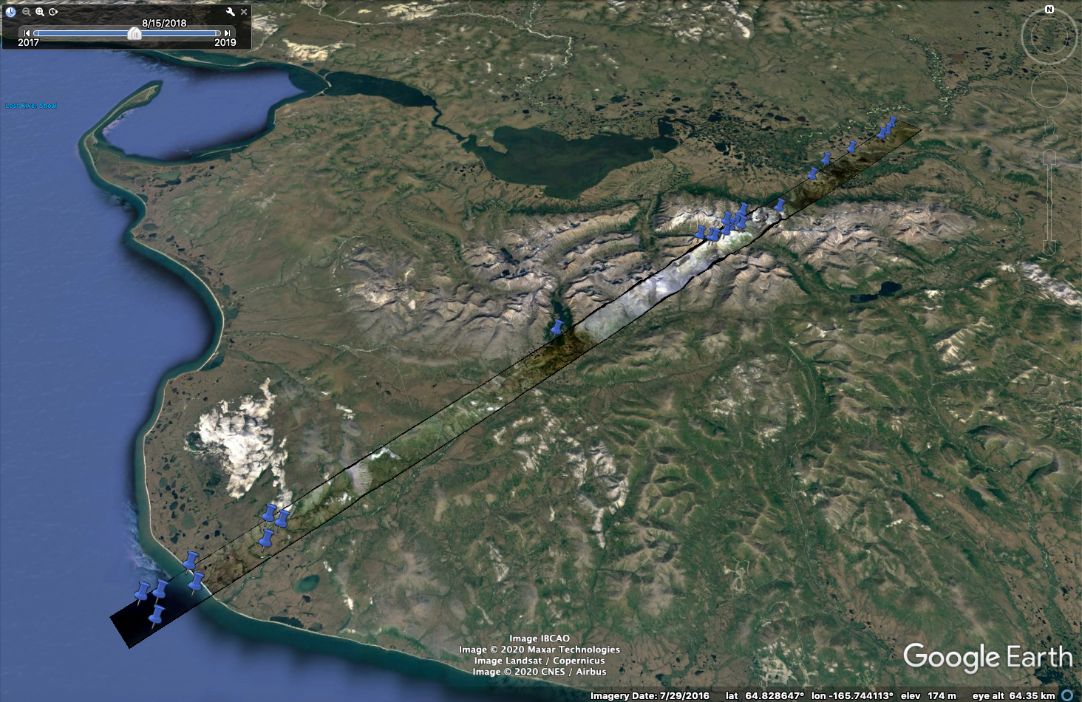
Image courtesy of Alexey Shiklomanov
DIRSIG
Columns: ['inversion', 'atm', 'az', 'zen', 'vzen']
R2: 0.7910928996865043 RMSE: 0.007451074018209009
Importance Feature
0 0.442798 inversion
1 0.308114 atm
2 0.000000 az
3 0.249089 zen
4 0.000000 vzen
SNR2
R2: 0.803848316974592 RMSE: 0.04180547153612444
Importance Feature
0 0.235036 inversion
1 0.428000 atm
2 0.001386 az
3 0.326742 zen
4 0.000000 vzen
5 0.008836 snr

Slide 24
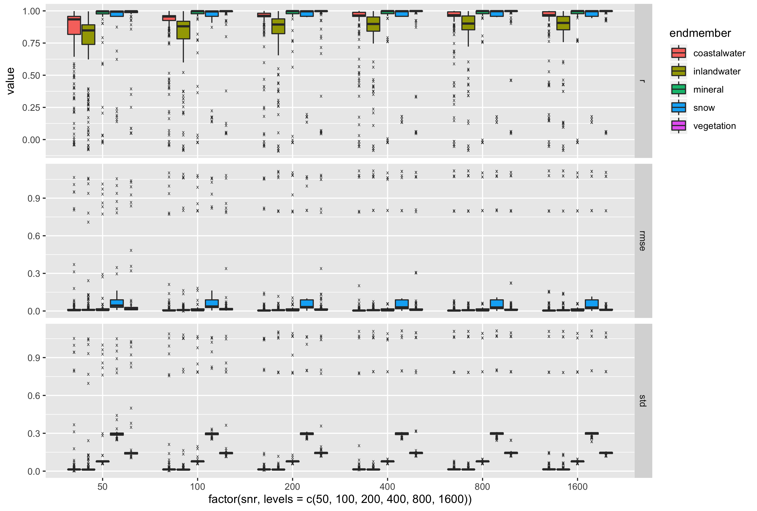
SNR ratio
effects on endmember
modeling
performance
Image courtesy of Alexey Shiklomanov
DIRSIG
Columns: ['inversion', 'atm', 'az', 'zen', 'vzen']
R2: 0.7910928996865043 RMSE: 0.007451074018209009
Importance Feature
0 0.442798 inversion
1 0.308114 atm
2 0.000000 az
3 0.249089 zen
4 0.000000 vzen
SNR2
R2: 0.803848316974592 RMSE: 0.04180547153612444
Importance Feature
0 0.235036 inversion
1 0.428000 atm
2 0.001386 az
3 0.326742 zen
4 0.000000 vzen
5 0.008836 snr

Slide 25
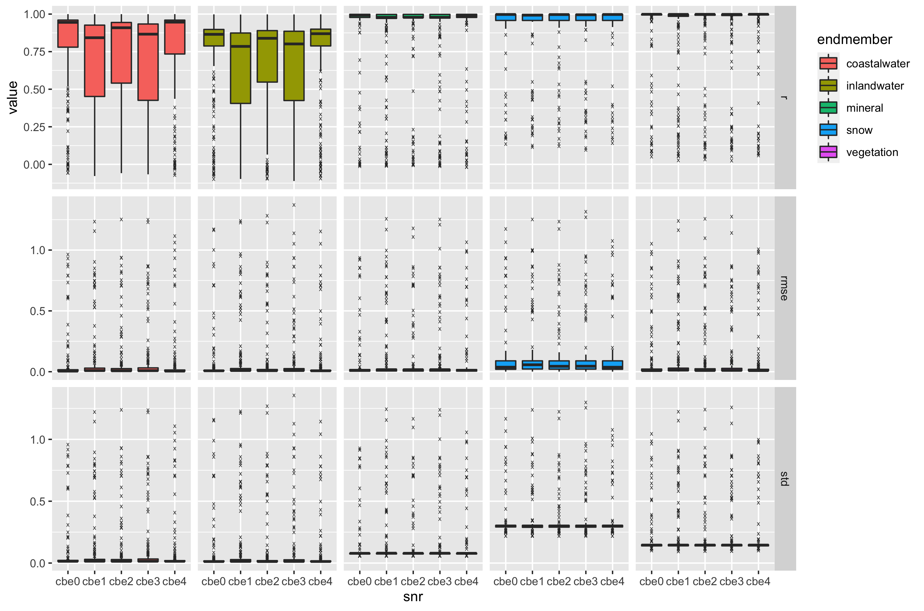
Noise model effects on endmember
modeling
performance
Image courtesy of Alexey Shiklomanov
DIRSIG
Columns: ['inversion', 'atm', 'az', 'zen', 'vzen']
R2: 0.7910928996865043 RMSE: 0.007451074018209009
Importance Feature
0 0.442798 inversion
1 0.308114 atm
2 0.000000 az
3 0.249089 zen
4 0.000000 vzen
SNR2
R2: 0.803848316974592 RMSE: 0.04180547153612444
Importance Feature
0 0.235036 inversion
1 0.428000 atm
2 0.001386 az
3 0.326742 zen
4 0.000000 vzen
5 0.008836 snr

Slide 26
Conclusion
A rapid summary of HyperTrace
HyperTrace is a cross-platform Python library for running forward-to-inverse or surface-to-instrument-to-surface radiative transfer model loops
Provides a wrapper to the ISOFIT library, which provides optimal estimation (OE) and algebraic inversions
HyperTrace fully automates experiments to inform SBG architecture downselect process
HyperTrace also provides full built-in SaaS capability
To be released publicly as open-source software
DIRSIG
Columns: ['inversion', 'atm', 'az', 'zen', 'vzen']
R2: 0.7910928996865043 RMSE: 0.007451074018209009
Importance Feature
0 0.442798 inversion
1 0.308114 atm
2 0.000000 az
3 0.249089 zen
4 0.000000 vzen
SNR2
R2: 0.803848316974592 RMSE: 0.04180547153612444
Importance Feature
0 0.235036 inversion
1 0.428000 atm
2 0.001386 az
3 0.326742 zen
4 0.000000 vzen
5 0.008836 snr

