Slide 1
Webinar Preparation Underway
If you cannot hear meeting room activity on your computer:
Be sure your computer audio volume is high enough to hear
If there’s still a problem, use the “Chat Box” facility of Webex to request a telephone callback. (The Chat box is reachable from the green tab at the top of your screen.)

Slide 2
Instructions for Participants
How to hear the audio (in order of preference):
  Use your computer audio to follow the training
    This should work with Windows and Mac, but maybe not with Linux
  Dial 650-479-3208
Participants not in the meeting room at NAS have been muted
  This should reduce cross-talk and provide everyone with better audio
Questions are welcome during the presentation:
  Ask a question in the Chat facility
    The host will be monitoring and will relay your question to the speaker
  If the question is too complicated to ask in text, call 650-479-3208 and ask the host to unmute you in order for you to communicate by phone.

Slide 3
HECC Data Science Platform
5/29/2020
NASA Advanced Supercomputing Division

Slide 4
Outline
About the Data Science Team
HECC Data Science
  Data Science Conda Environments
  Deploying Environments on Pleiades
  Distributed TensorFlow using GPUs
  Dask (Distributed Python using CPUs)
Pilot Projects
  Solar Cell Materials Prediction
  Carbon Nanotube Neural Network Gas Sensor
  System Log Aggregation

Slide 5
About the Data Science Team
Shubha Ranjan – Data Science Group Lead​
Data Science Team Members​
  Thaddeus Norman
  Jeff Becker
  Samson Cheung
  Jonathan Gee
  Mark Jacquet
  Thai Truong

Slide 6
HECC Data Science
Data Science Conda Environments
  TensorFlow: tf1_14, tf2, tf2_1
  PyTorch: pyt1_3
Deploying Environments on Pleiades
  Accessing Environments
    module use -a /swbuild/analytix/tools/modulefiles
    module load miniconda3/v4
    source activate <environment_name>

Slide 7
Common Python Packages
Pandas – Data analytic platform
Dask – Distributed data analytic platform
Scikit-learn – Machine learning platform
Matplotlib – Plotting and graphics platform
Pillow – A fork of Python Image Library (PIL)
Jupyter Lab – A collaborative and integrated development environment
To request or suggest a package:
  Contact: support@nas.nasa.gov​

Slide 8
Creating a Custom Conda Environment
Accessing NAS conda environments:
  module use -a /swbuild/analytix/tools/modulefiles
  module load miniconda3/v4
  source activate environment_name
Adding packages for local use:
  pip install --user package_name
Creating a new conda environment:
  export CONDA_ENVS_PATH=/nobackup/$USER/.conda/envs
  conda create –-name my_env --clone base

Slide 9
Jupyter Lab & Web UIs
Web UIs and security
  Web servers allow access to your file system!
  When using a web server you must be on a compute node!
  Compute nodes have restricted access
  Compute nodes will not allow you to download files from internet
Interactive Mode
  qsub –I –l select node …
Reserved Front End
  pbs_rfe --duration 10+ --model bro

Slide 10
Setting Up Jupyter Lab
Log into rfe or PBS interactive mode:
  ssh node_name
  qsub –I –l select=1:ncpus=28:model=bro
Load data analytics modules:
  module use -a /swbuild/analytix/tools/modulefiles
  module load miniconda3/v4
  source activate tf2
Generate Jupyter config file:
  jupyter notebook --generate-config

Slide 11
Securing & Verifying Jupyter Setup
Setup a Jupyter password & secure config:
  jupyter notebook password
  chmod 700 $HOME/.jupyter
  openssl req -x509 -config /swbuild/analytix/tools/jupyter_setup/jupyter_ssl.conf \ -newkey rsa -out $HOME/.jupyter/jupyter.pem -days 1000
  cp /swbuild/analytix/tools/jupyter_setup/jupyter_notebook_config.py $HOME/.jupyter/
Verifying setup:
  $HOME/.jupyter
  (jupyterlab)% ls -l $HOME/.jupyter/
  -rw------- 1 103 Jun 17 13:47 jupyter_notebook_config.json
  -rw------- 1 1704 Jun 17 14:35 jupyter.key
  -rw------- 1 1155 Jun 17 14:35 jupyter.pem
  -rw------- 1 29875 Jun 17 14:35 jupyter_notebook_config.py

Slide 12
Jupyter Config Settings
In jupyter_notebook_config.py confirm:
  #c.NotebookApp.certfile = os.path.join(our_dir, 'jupyter.pem')
  #c.NotebookApp.keyfile = os.path.join(our_dir, 'jupyter.key')
  c.NotebookApp.certfile = '/home6/username/.jupyter/jupyter.pem'
  c.NotebookApp.keyfile = '/home6/username/.jupyter/jupyter.key’

Slide 13
Running Jupyter Lab
Start PBS interactive session:
  qsub -I -q k40 –l select=1:ncpus=16:model=san_gpu
Or log onto rfe:
  ssh node_name
Start conda environments and Jupyter:
  module use -a /swbuild/analytix/tools/modulefiles
  module load miniconda3/v4
  source activate tf2
  jupyter lab –no-browser
In a new shell on your local machine:
  ssh -o "StrictHostKeyChecking ask" -L 8080:localhost:8888 –o ProxyJump=sfe,pfe21 node_name

Slide 14
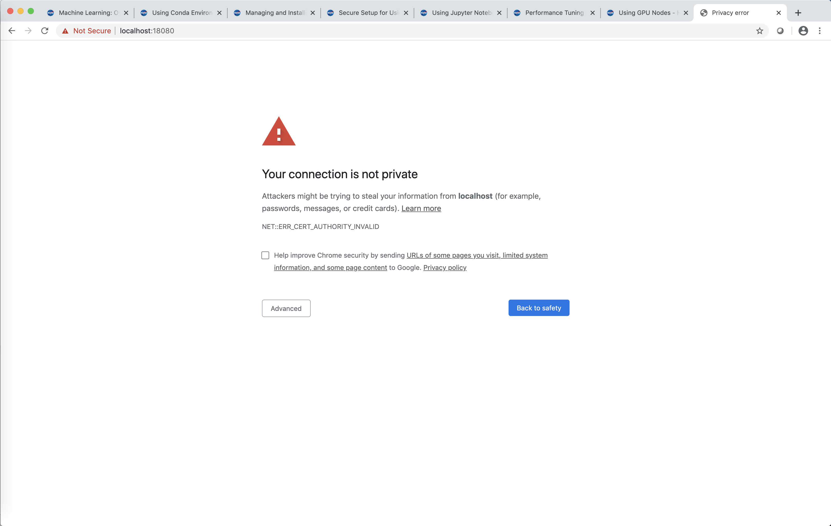
First Login to Jupyter-Initial Screen

Slide 15
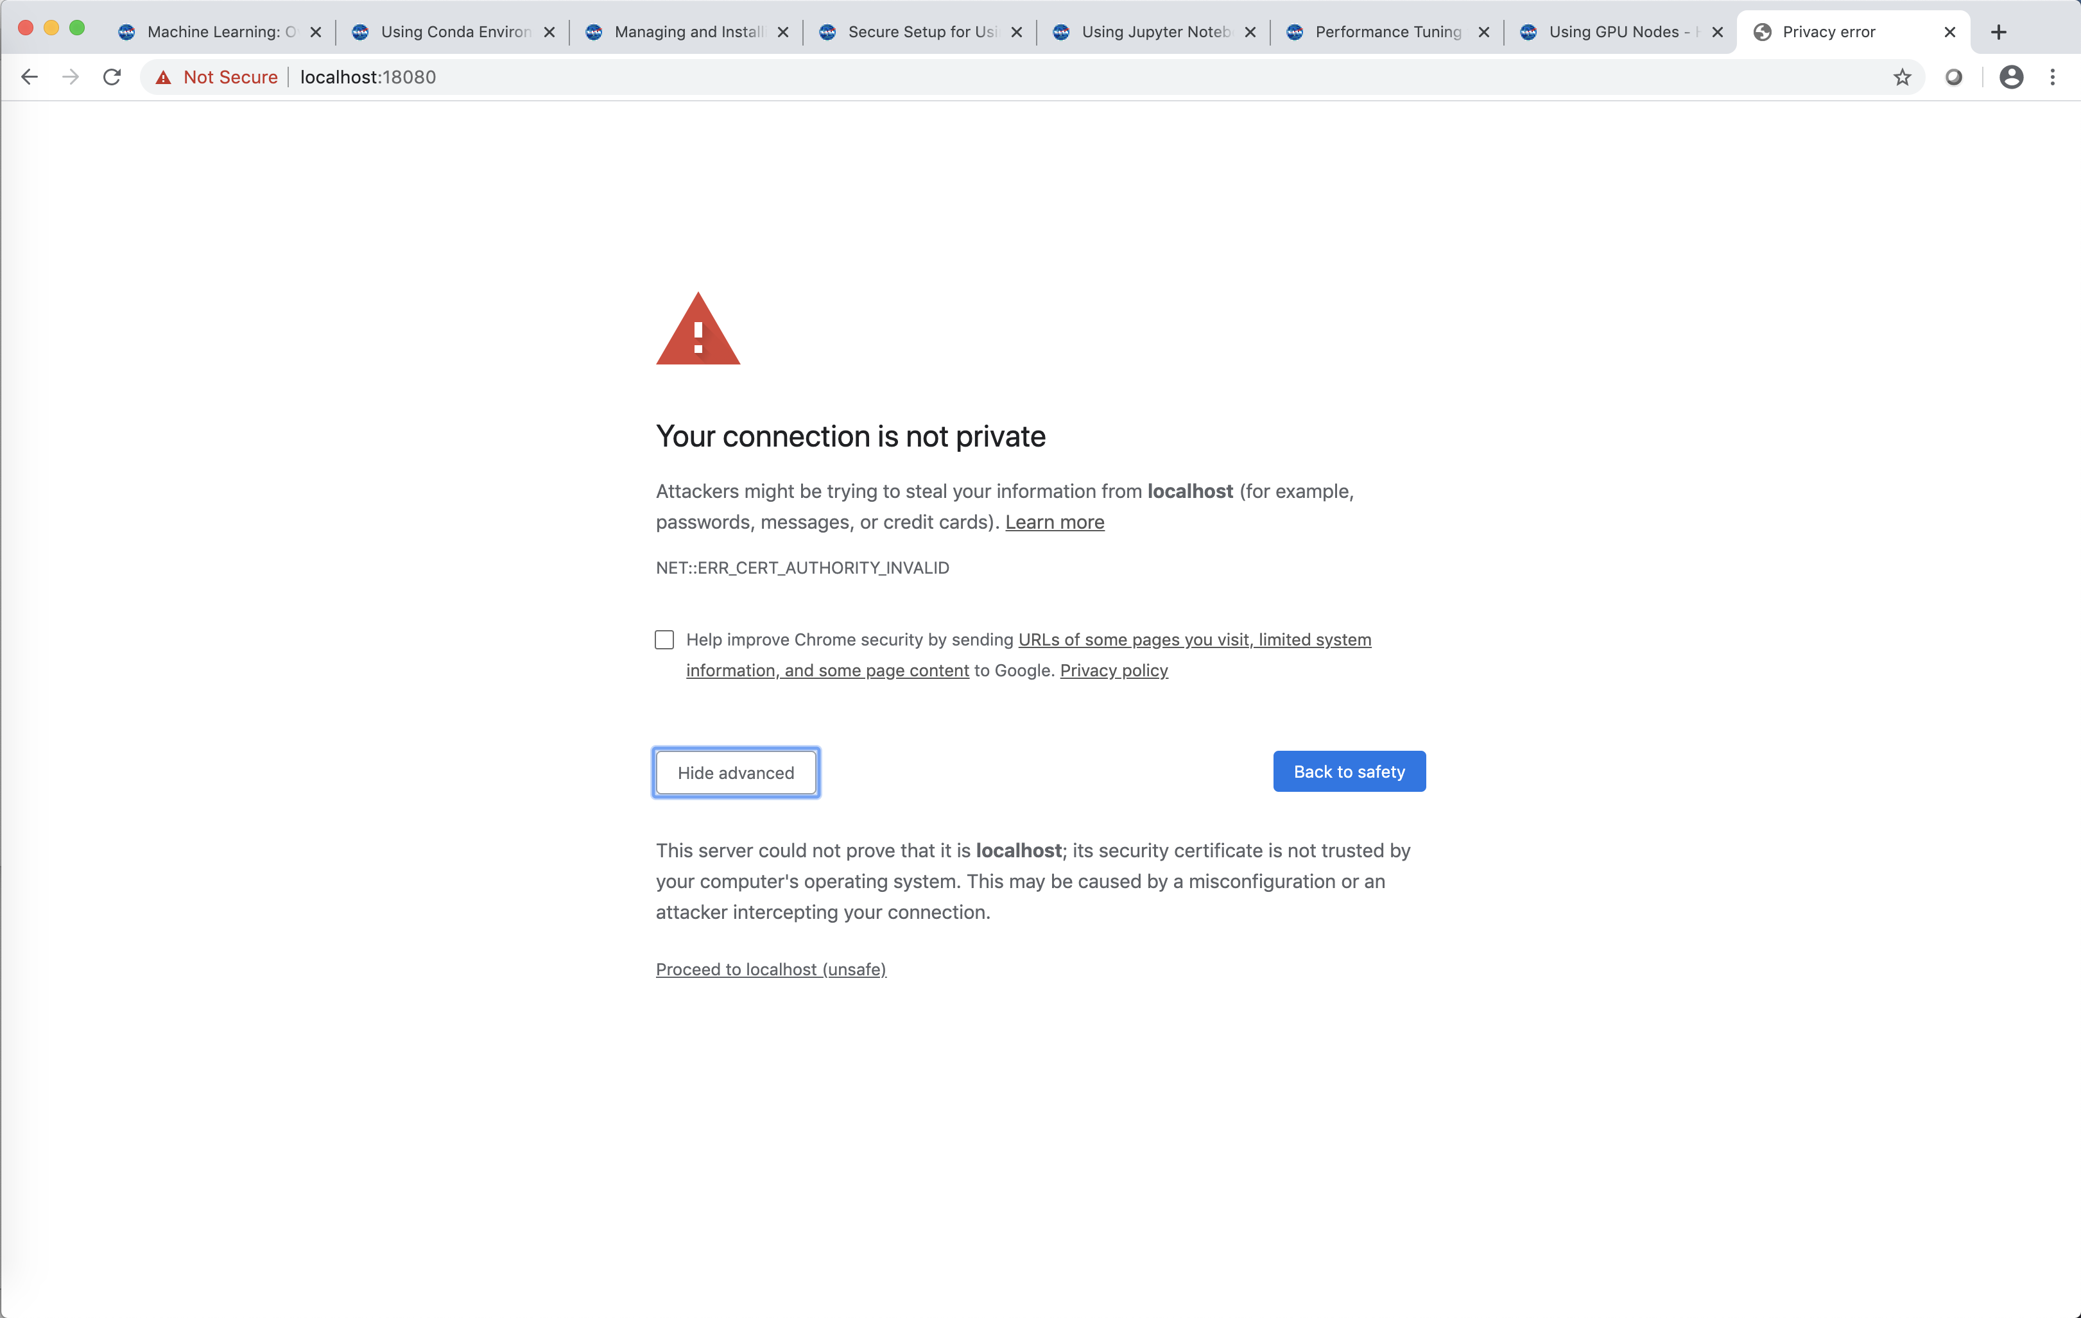
First Login to Jupyter-Second Screen

Slide 16
First Login to Jupyter-Enter Your Password

Slide 17
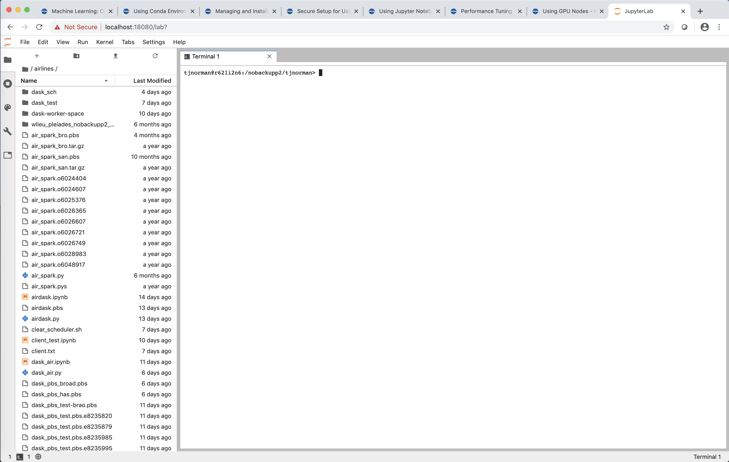
First Login-Jupyter Interface

Slide 18
Deep Learning Tutorials
TensorFlow:
  https://www.tensorflow.org/tutorials
  https://developers.google.com/machine-learning/crash-course
PyTorch
  https://pytorch.org/tutorials/

Slide 19
TensorFlow & Tensorboard
TensorFlow environments:
  TensorFlow 1.14: source activate tf1_14
  TensorFlow 2.0: source activate tf2
  TensorFlow 2.1: source activate tf2_1
To use Tensorboard:
  Log onto RFE or start PBS interactive mode
  Activate tf2 environment
  At command prompt: tensorboard --logdir= target_directory
  On your local machine:
    ssh -o "StrictHostKeyChecking ask" -L 8085:localhost:6006 -o ProxyJump=sfe,pfe21 node_name

Slide 20
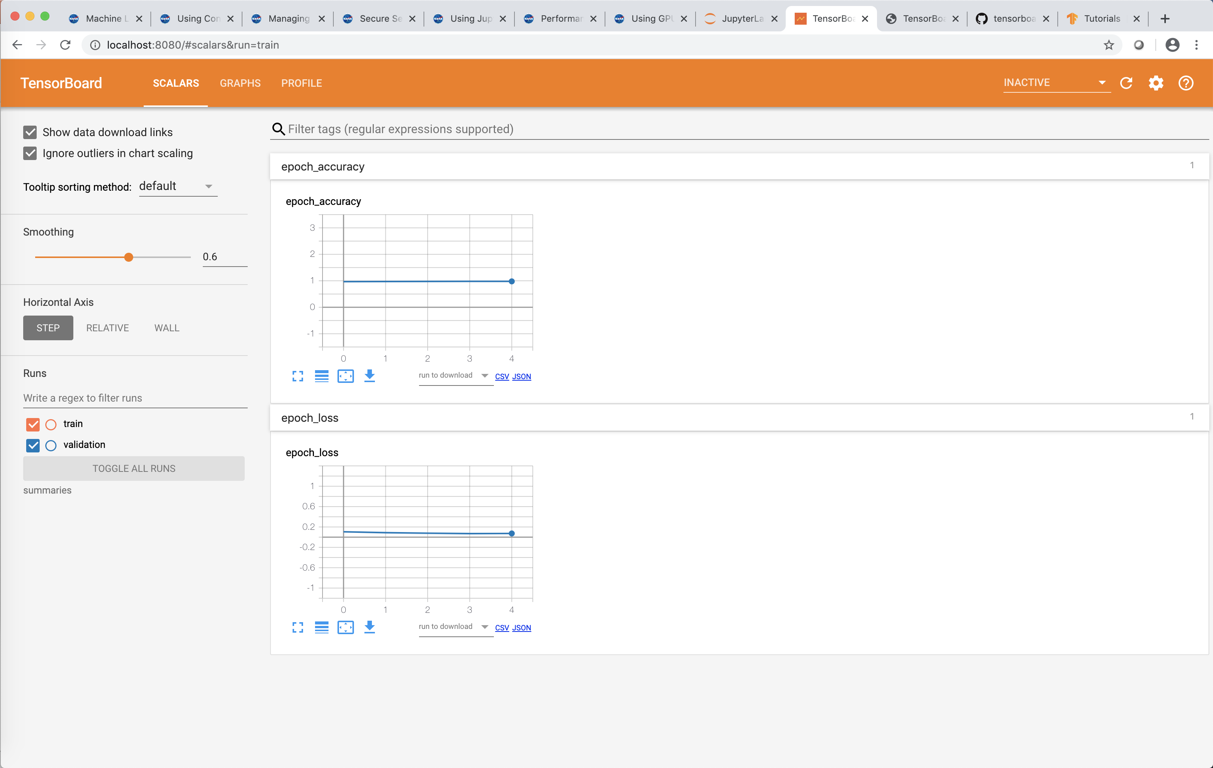
Tensorboard Example: Scaler

Slide 21
Tensorboard Example: Hyperparameters
Import functions:
  import tensorflow as tf
  from tensorboard.plugins.hparams import api as hp
Setup hyperparameters:
  HP_NUM_UNITS = hp.HParam('num_units', hp.Discrete([16, 32]))
  HP_DROPOUT = hp.HParam('dropout', hp.RealInterval(0.1, 0.2))
  HP_OPTIMIZER = hp.HParam('optimizer', hp.Discrete(['adam', 'sgd']))
Setup dictionary of hyperparameters:
  hparams = {
  HP_NUM_UNITS: num_units,
  HP_DROPOUT: dropout_rate,
  HP_OPTIMIZER: optimizer,
  }
Insert into keras:
  tf.keras.layers.Dense(hparams[HP_NUM_UNITS], activation=tf.nn.relu),
  tf.keras.layers.Dropout(hparams[HP_DROPOUT]),
  model.compile(optimizer=hparams[HP_OPTIMIZER], ….. )

Slide 22
Tensorboard Example: Hyperparameters

Slide 23
Using GPU Nodes
GPU nodes currently available
  san_gpu (Sandy Bridge GPU)
  #PBS -l select=xx:ncpus=yy:model=san_gpu –q k40
  sky_gpu (Skylake GPU)
  #PBS -l select=xx:ncpus=yy:model=sky_gpu –q v100
  #PBS -l select=xx:ncpus=yy:model=sky_gpu:naccelerators=8 –q v100
  xx == number of nodes
  yy == number of cpus

Slide 24
Distributing TensorFlow Over GPUs
TensorFlow Documentation:
  https://www.tensorflow.org/guide/distributed_training
  https://www.tensorflow.org/tutorials/distribute/multi_worker_with_keras
TensorFlow mirroredstrategy:
  mirrored_strategy = tf.distribute.MirroredStrategy()
  mirrored_strategy = tf.distribute.MirroredStrategy(devices=["/gpu:0", "/gpu:1"])
Example Code:
  mirrored_strategy = tf.distribute.MirroredStrategy()
  with mirrored_strategy.scope():
      model = Model()
      model.complile(loss = …, optimizer = …, …)
  model.fit(x_train, y_train, batch_size, epochs, …)

Slide 25
Distributing TensorFlow Over
Multi GPU Nodes
Four Step Process:
  Get nodes from PBS
  Run shell script on each node
  Assign nodes to TensorFlow
  Setup model and data in MultiWorkerMirroredStrategy() scope
Step 1: Get nodes from PBS
  #in PBS script get node information from nodefile
  NODES=($( cat $PBS_NODEFILE | sort | uniq ))
  NUM_OF_NODES=${#NODES[@]}

Slide 26
Distributing TensorFlow Over
Multi GPU Nodes
Step 2: Run shell script on each node
  #worker number for other nodes
  C=1
  # for each node that's not the current node
  for node in ${NODES[@]}
  do
  if [[ $node != $(eval hostname) ]]
  then
  # ssh into each node and run the .sh script with node info
  ssh $node "$BASE/script.sh $C ${NODES[*]}" &
  C=$(($C+1))
  sleep 2
  fi
  Done
  #run the main worker node
  $BASE/script.sh 0 ${NODES[*]}
Still in PBS
run script.sh in each worker node
run script.sh in master node

Slide 27
Distributing TensorFlow Over
Multi GPU Nodes
The Shell Script – script.sh
  #cd to code location cd /nobackup/$USER
  BASE=/nobackup/$USER/directory
  module purge
  module -a use /swbuild/analytix/tools/modulefiles
  module load miniconda3/v4
  source activate tf2
  #run python script with inputs from this .sh script python $BASE/python_code.py $@

Slide 28
Distributing TensorFlow Over
Multi GPU Nodes
Step 3: Assign nodes to TensorFlow
  base_dir = os.path.dirname(os.path.abspath(__file__))
  # --------------- Set up TF_CONFIG --------------- #
  # load the index and node info from the command line
  index = int(sys.argv[1])
  verbose = index < 1
  nodes=[]
  # node names for each node, append a port # to the names
  for i in range(2,len(sys.argv)):
  nodes.append(sys.argv[i] + ':2001')
  # set TF_CONFIG variable that MultiWorkerMirroredStrategy needs
  os.environ['TF_CONFIG'] = json.dumps({
  'cluster': {
  'worker': nodes
  },
  'task': {'type': 'worker', 'index': index}
  })
In python code
Collect node information
Assign node to TF_CONFIG

Slide 29
Distributing TensorFlow Over
Multi GPU Nodes
Step 4: Setup model in data in MWMS scope
  #use the distributed strategy and create model and data in strategy scope
  strategy = tf.distribute.experimental.MultiWorkerMirroredStrategy(tf.distribute.
  experimental.CollectiveCommunication.AUTO)
  with strategy.scope():
    datasets = make_datasets()
  model = Model()
  model.compile(loss = …, optimizer = …, …)
  model.fit(x_train, y_train, batch_size, epochs, …)

Slide 30
Using Dask
Distributed Python Environment
  https://tutorial.dask.org/
  https://github.com/dask/dask-tutorial
  https://docs.dask.org/en/latest/setup/hpc.html
Single Node Interactive Mode:
  from dask.distributed import Client, LocalCluster
  cluster = LocalCluster()
  client = Client(cluster)
Multiple Node Interactive Mode:
  mpirun -np <number of cpus> dask-mpi --no-nanny --interface ib0 --local-directory /nobackup/<username>/dask_sch/ --scheduler-file / nobackup/<username>/dask_sch/ sched.json

Slide 31
Submitting a Dask Job
In PBS script:
#clear and create directory for dask scheduler
if [ -d dask_sch ]
then
echo "removing old scheduler directory"
rm -r dask_sch
echo "creating new scheduler directory"
mkdir dask_sch
else
echo "creating scheduler directory"
mkdir dask_sch
fi
#run program
#MPI is included in the environment through MPICH.
mpirun -np <number of cpus> dask-mpi --no-nanny --interface ib0 --local-directory /nobackup/username/dask_sch/ --scheduler-file / nobackup/username /dask_sch/sched.json & python <filename.py>
In Python Code:
from dask.distributed import Client
client = Client(scheduler_file=‘/…/dask_sch/sched.json')

Slide 32
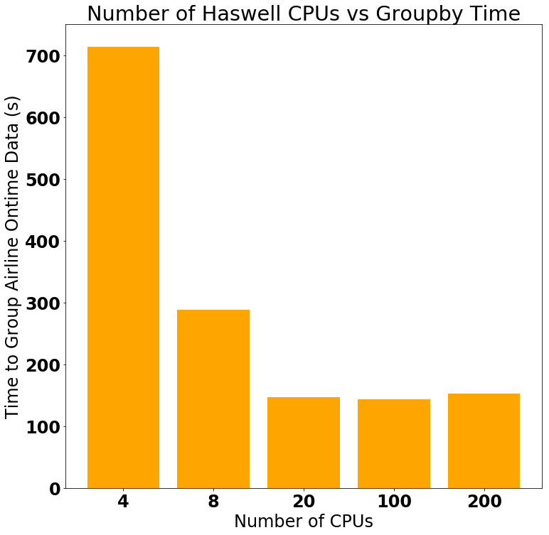
Example: Airline Ontime Data Set
Dask Code:
  from dask.distributed import Client
  client = Client(scheduler_file='/nobackupp2/tjnorman/airlines/dask_sch/sched.json’)
  df_airlines = dd.read_csv(data + '/On_Time_Reporting_Carrier_On_Time_Performance_*.csv',
  assume_missing=True, dtype={'Year':'int64’, ….. }, encoding='ISO-8859–1’)
  df_air = df_airlines[[…selected columns…]]
  df_air_year = df_air.groupby('Year').mean()
  df_air_year = df_air_year.reset_index()
  df_air_year = df_air_year.compute()
  df_air_year.to_csv('ontime_data_279_dis.csv', index=False)

Slide 33
Pilot Projects
What Are Pilot Projects?
  Highlight Existing Capabilities
  Explore New Technology
How Do You Initiate One?
  Contact Shubha Ranjan: shubha.ranjan@nasa.gov
Here Are Some Examples:
  Solar Cell Materials Prediction
  Carbon Nanotube Neural Network Gas Sensor
  System Log Aggregation

Slide 34
Predicting PV Cell Material Form
Electrical Data
Compounds targeted in model:
  GaAs (1055), Ge (323), InP (27), Si (1156), a-Si (22)
  SCC, RCS, RSH, RS, DIF, VOC

Slide 35
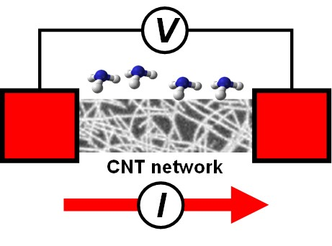
Carbon Nanotube NN Gas Sensor
CNT Pros
Inexpensive
Easy to fabricate
Resistance Sensitive to gas concentration
CNT Cons
Non-linear response
Difficult to model
Neural Network Solution
Trained model to predict gas concentration
Recommended path for future work

Slide 36
System Log Aggregation
Problem:
System log data stored in various different files
Interest in understanding log statement to predict node failure
Solution:
Park et al: Titan supercomputer at the Oak Ridge Leadership Computing Facility (OLCF)
2017 IEEE International Conference on Cluster Computing (DOI 10.1109/CLUSTER.2017.113
Software Stack Description
Web Interface – Jupyter Lab:
  Gives access to Python, Dask and related data science tools
Memory Management – Arrow:
  Facilitates data transfer between Spark and Python data formats
Query Engine – Spark:
  Will allow rapid retrieval and manipulation of the data
Database – Cassandra:
  Setup in single node mode for prototyping purposes

Slide 37
Summary
Conda environments based on popular Deep Learning Frameworks​
Additional Software added on user request​
Secure Jupyter Lab by using RFE or PBS interactive​
Help get you started with Machine Learning​
Pilot Projects​
We’re Here To Help!

Slide 38
Questions?
A PDF and recording of this webinar will be available within 48 hours at:
http://www.nas.nasa.gov/hecc/support/training.html

