Slide 1


Physics Informed Generative Adversarial Networks (PIGANs)
Theodore Lewitt – University of Southern California
Mentors – James Warner, Geoffrey Bomarito, Patrick Leser
NASA Langley Research Center & My Couch in Boulder, CO
Spring 2020
Notes:
Hey Everyone,
My name is Ted Lewitt and I’m going to be talking to you today about Physics Informed Generative Adversarial Networks, also known as PIGANs
I’d like to start by thanking my mentors Jim, Geoff and Pat for hiring me and all their help making an smooth transition to working at home!

Slide 2
The Problem
Newer materials and manufacturing processes have more uncertainty
Need new databases for new materials
Testing novel materials is expensive
Notes:
The motivation behind PIGANs stems from the need for materials testing in order to certify the safety of newer and more complex materials. Previously, there were robust databases for the materials being used, but now new databases need to be developed for new materials like carbon fiber. The testing needed to create these databases is very expensive and many strategies are being used to try and bring the cost down.

Slide 3
Certification by Analysis Simulations
Requirements:
- Probabilistic
- High Fidelity
- Calibrate with only a few tests
Notes:
One of the proposed solutions is certification by analysis, using computer simulations to model these materials for their certification. These simulations could reduce the amount of physical testing needed but also are held to a very high standard. They have to be probabilistic to account for uncertainty in both the simulations and the manufacturing, they have to be high fidelity, meaning they are extremely accurate and closely mimic the real world physics and they have to reduce the total amount of material and time needed for physical testing by calibrating quickly from only a few results.

Slide 4
Combining Machine Learning and Physics Based Knowledge
Low
Data
High
High
Physics
Low
Methods:
Finite Element Analyisis
Molecular Dynamics
Pros:
Encode years of physics research
Explainable
Cons:
Computationally expensive for Uncertainty Quantification
Notes:
These CBA algorithms have been in development for decades and all fall somewhere on this rough spectrum of how much physics knowledge versus testing data is incorporated into the simulations . On the far left, with little to no data but lots of encoded physics knowledge are algorithms like Finite Element Analysis and Molecular Dynamics modeling. These rely solely on the physics models that have been created over the last century in accurately modeling the real world and are very explainable. Unfortunately there is an computational drawback as these models become very computationally expensive.

Slide 5
Combining Machine Learning and Physics Based Knowledge
Low
Data
High
High
Physics
Low
Methods:
Deep Learning
Bayesian Networks
Pros:
Low computational cost
Cons:
Not Explainable
No encoded physics knowledge
Notes:
On the other end of the spectrum are data driven approaches like deep learning that rely only on huge datasets of test data. Once trained, they provide low computational cost but are not explainable and don’t factor in any of our physics knowledge

Slide 6
Combining Machine Learning and Physics Based Knowledge
Low
Data
High
High
Physics
Low
Combines:
Low cost of data driven models
Explainability of physics based models
Notes:
The sweep spot in the center is where PIGANs reside, they combine the low computational cost of the data driven methods with the physics knowledge and explainability of the physics based methods.

Slide 7
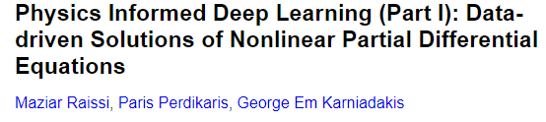
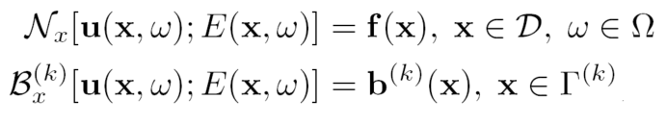
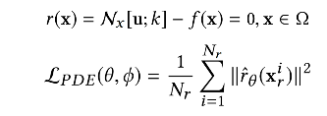
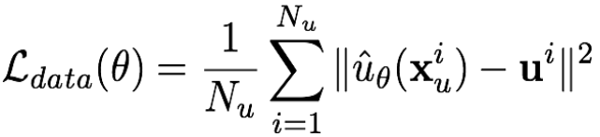
Governing Equations
Neural Network Loss
+
Physics Loss
Notes:
PIGANS are an combination of two recent advances in the field of deep learning. The PI part of an PIGAN is the Physics informed neural network. This model encodes the physics knowledge of the governing partial differential equations and boundary conditions of the physical system in an extra loss term called the physics loss that measures how closely the model follows these equations. This is used in addition to the normal loss term of the model that only assesses how closely the model learns the test data.

Slide 8

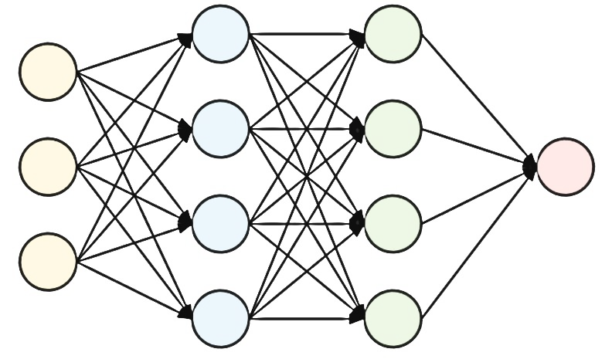
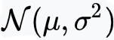
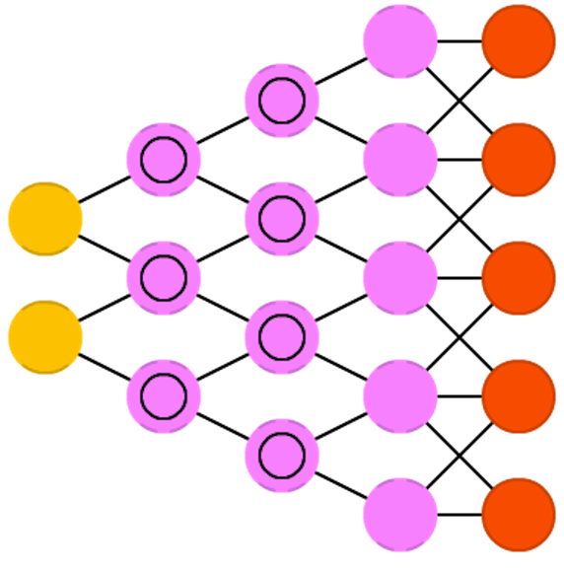
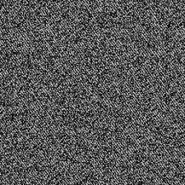
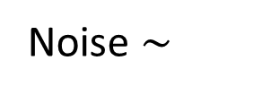
Real?
or
Noise $\sim$
Fake?
Critic Network
Generator
Network
Notes:
The GAN part of PIGAN comes from Generative Adversarial networks. In 2013 Ian Goodfellow pitted two neural networks against each other, one called the generator and one called the critic, to try to generate realistic images. The generator takes random noise and tries to transform it into an realistic image to fool the critic, in this case an photo of the Mona Lisa with glasses. The critic looks at both an dataset of real images and generated fake images and tries to determine whether they are real or fake and both networks learn by playing this game against each other.

Slide 9

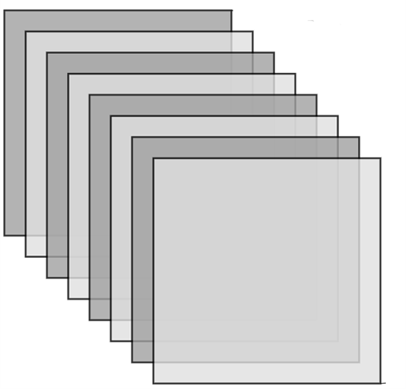
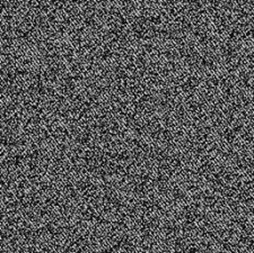
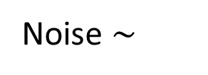
Real Samples
TotalLoss
Noise $\sim$
Critic
Generator
Generated Samples
Notes:
To create the PIGAN by combining these two methods, the generated samples from the generator network not only go to the critic to assess how realistic they are compared to the real samples

Slide 10
Real Samples
TotalLoss
Noise $\sim$
Critic
Generator
PDE/BC
PDE = Partial differential equation
BC = Boundary condition(s)
Generated Samples
Notes:
But they also go through the governing PDE and BC equations to assess how realistic they are in respect to the physical system.

Slide 11
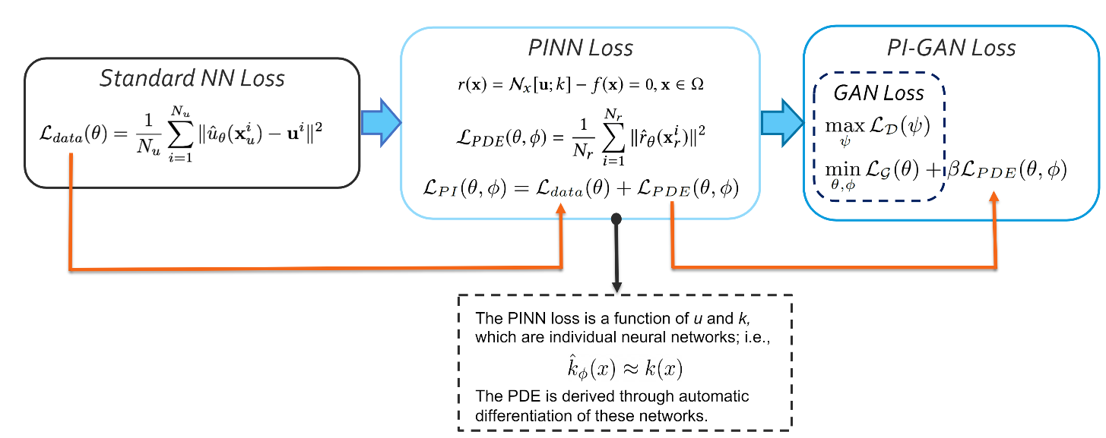
PIGAN Loss
Generator: GAN LOSS + PDE LOSS + BC LOSS
Discriminator: GAN LOSS
Physics Loss
PIGAN Loss
Standard Neural Network Loss
*PINN = Physics-Informed Neural Network
Notes:
The total loss is used as the feedback to the generator and critic networks to help them learn. The critic network’s only feedback is the GAN loss, how well it categorizes real samples as real and generated samples as fake. The Generator learns from both the GAN Loss and the Physics Loss, so it is incentivized to not only make realistic samples that fool the critic, but also samples that model the physical system dictated by the governing PDE and BC.

Slide 12
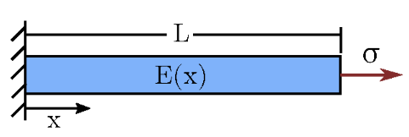
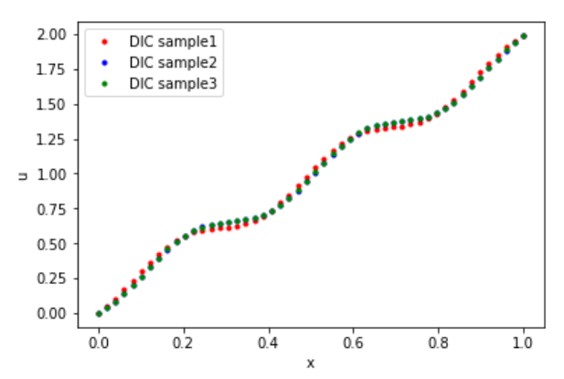
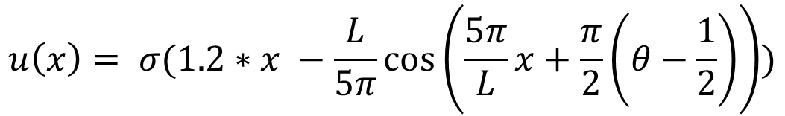

1D Application
(Displacement only in x-direction)
Bar with known stress σ
Unknown elastic modulus E(x)
Known u(x)
$$u\left(x\right)= σ(1.2∗x −\frac{L}{5π}\cos\left(\frac{5π}{L}x+\frac{π}{2}\left(θ−\frac{1}{2}\right)\right))$$
Governing PDE:
$$r\left(x\right)=E\left(x\right)u^{′}\left(x\right)− σ$$
Notes:
The first application of PIGANs we developed is an 1D bar with unknown elastic modulus E(x) being subjected to some stress sigma. We also know another material property called u(x). The graph to the right shows some examples of what U looks. The system‘s governing equation is the PDE seen here that relates both U and E to the stress. Our goal is for the PIGAN to model both U and E

Slide 13
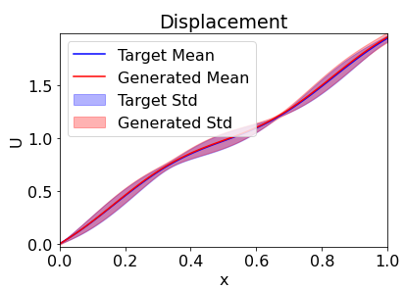
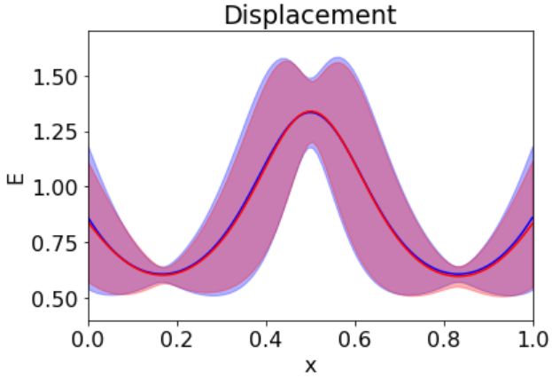
1D Results
Elastic Modulus
Notes:
Given only some test data of U and the PDE, The PIGAN not only learns to correctly mimic U, but also learns to mimic E as well, and also preserves the uncertainty of the system .

Slide 14
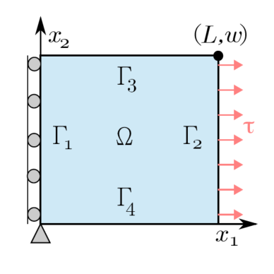


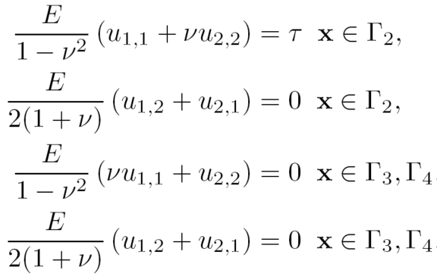
2D Application
(Displacement in x- and y-direction)
2D square, known stress τ
Unknown elastic modulus E(x)
Governing Equations
Notes:
The next application developed was the 2D continuation of our 1D example, still trying to predict E(x) given some U(X) data and the governing equations of the system, in this case 2 PDEs and 4 Boundary Conditions

Slide 15
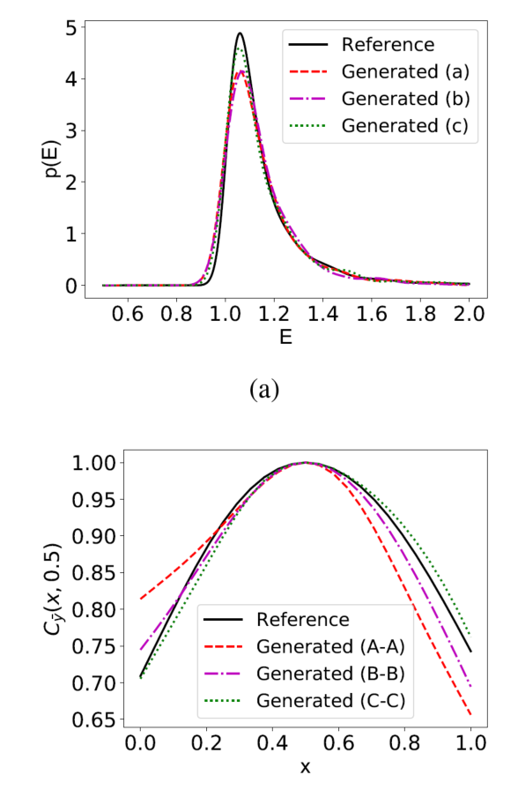
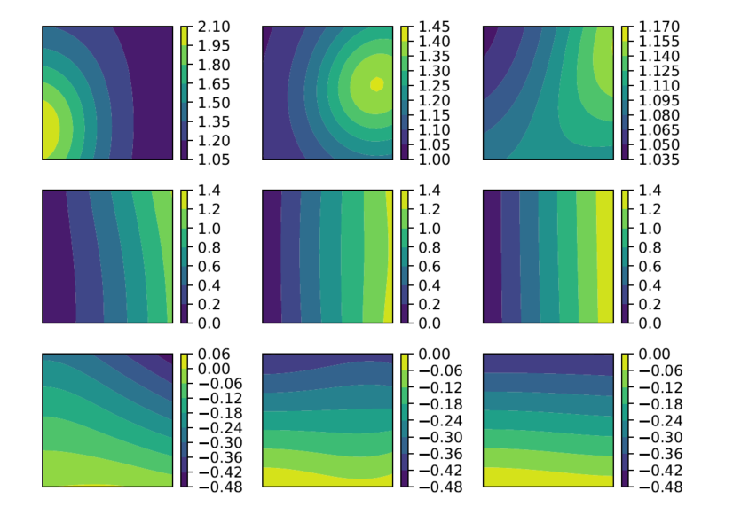
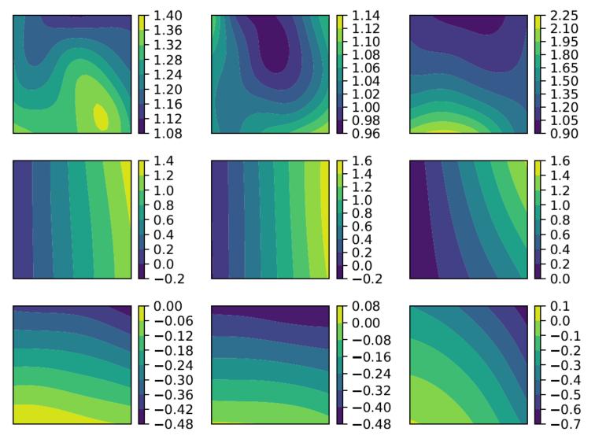
True Samples
Probability Density of E
2D Results
Generated Samples
Correlation
Notes:
The PIGAN works here as well, generating samples that look similar to the true samples, but not the exact same due to the initial uncertainty of the problem. Even though each sample is different, we can see the PIGAN still learns the probability distribution of E and the correlation between variables .

Slide 16
Refactoring the Code
Add Tests
Test Driven Development
Additional Flexibility for:
  Different Boundaries
  Any number of discriminators/generators
  Any number of dimensions
Refactor
See Tests Fail
Test Driven Development (TDD)
Run Tests
Write Code
Notes:
When I arrived in January, all of that initial groundwork had been done by the previous intern Julian Cuevas. The model worked great on specific examples, but lacked generality and didn’t have any testing to ensure the accuracy of the code. Over the last three months, I have been adding testing to ensure the code works exactly the way we expect it to, and generalizing the code for more varied examples. I added in the ability for different, non-linear boundaries, so instead of just the sheet of metal on left, we could also test how the PIGANs would simulate an piece of metal with lots of drill holes like the one on the right. I also added in the flexibility for numerous generators and discriminator networks as well as seamless switching between 1, 2 or even 3 dimensional problems.

Slide 17
Performance Using Tensorflow
Repeated Concatenation vs List-Append + 1 Concatenation
Array Size (# Total Elements) | Concatenation (ms) | List Append (ms)
1000 | 44 | 30
10,000 | 27 | 20
100,000 | 102 | 32
1,000,000 | 801 | 87
,
,
,
,
Notes:
Another thing I looked at was improving the speed of the code using the intricacies of Tensorflow, the deep learning framework used to write the code. For example, we need to do many repeated array concatenations, taking two arrays and combining them together. I found it was faster to create all the arrays separately and store them in a list before concatenating them all at once as opposed to concatenating each time to an existing array. As the size of the array grows, this speed up becomes more important, and because of the frequency of this operation in our code, it will hopefully reduce the training time by over 30 minutes.

Slide 18
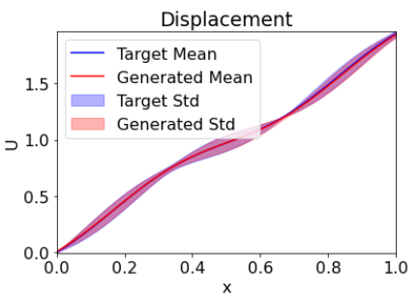
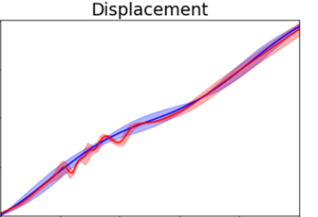
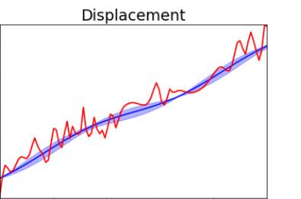
Optimizer Hyper-Parameters
Beta_1 = 0.0
Beta_1 = 0.5
Beta_1 = 0.9
Default!
Notes:
An additional area I tried to improve in was hyperparameter tuning,. Finding the best hyperparameter, or avoiding an bad one, has an huge affect on how the network learns. This hyperparameter relates to how the generator and critic networks use the feedback from the total loss to update their own parameters. The default setting for this hyperparameter gives much worse results than other values we explored and it shows the importance of doing this testing on all of the hyperparameters.

Slide 19
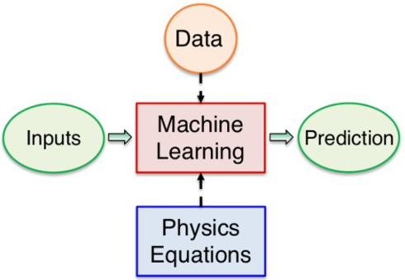
Summary
PIGANs combine deep neural networks with partial differential equations
PIGANs can be trained to simulate material properties and their uncertainties
Improvements are being made in hyper-parameter tuning, performance and testing coverage
Notes:
In summary, PIGANs are deep neural networks that try to learn to mimic the testing data, while also satisfying governing partial differential equations of the physical system they are a part of. They have shown success simulating material properties while also allowing for uncertainty that is always present in the materials. My main contributions to this research this Spring were in hyperparameter tuning, code performance and improving testing.

Slide 20
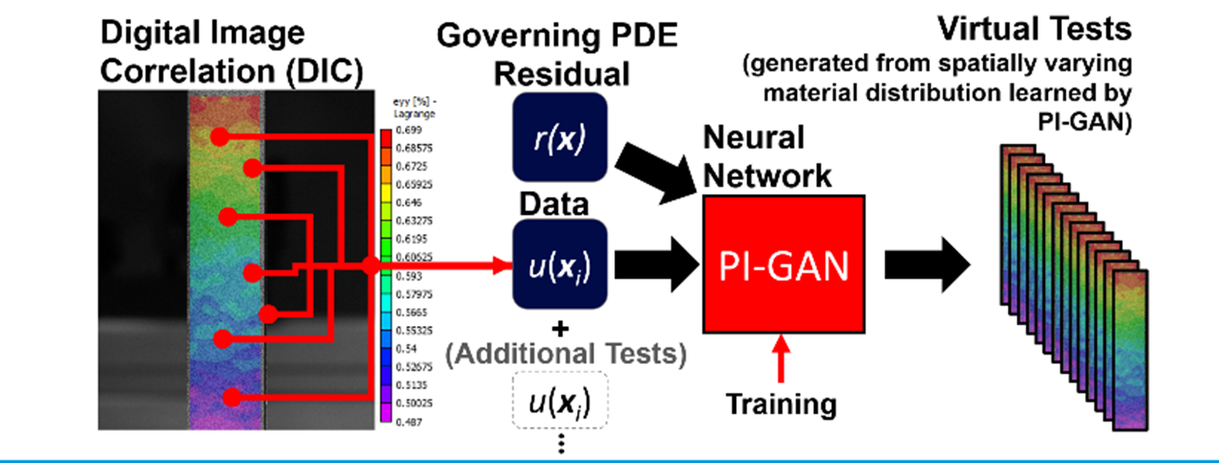
Future Work
Additional hyper-parameter tuning
Moving to 3 Dimensions
Validation using real samples
Notes:
I’m looking forward to continuing this work into the summer, with an bunch of additional hyperparameter tuning to be done. Some other goals for the summer include an 3 dimensional application and validating our model using real samples.

