Slide 1
Mars Surface Operations:
What Humans Plan To Do on Mars?
Stephen J. Hoffman, Ph.D.
JSC EMPO
19 May 2020
Notes:
Template Revision C, dated 21-Jan-2019

Slide 2
Presentation Overview
The purpose of this presentation is to describe NASA’s plans for human exploration on the surface of Mars
Presentation outline
  Guidance and Objectives
  Candidate landing sites
  Notional site layout
  Typical crew activities
  Some Planetary Protection issues still open for discussion

Slide 3
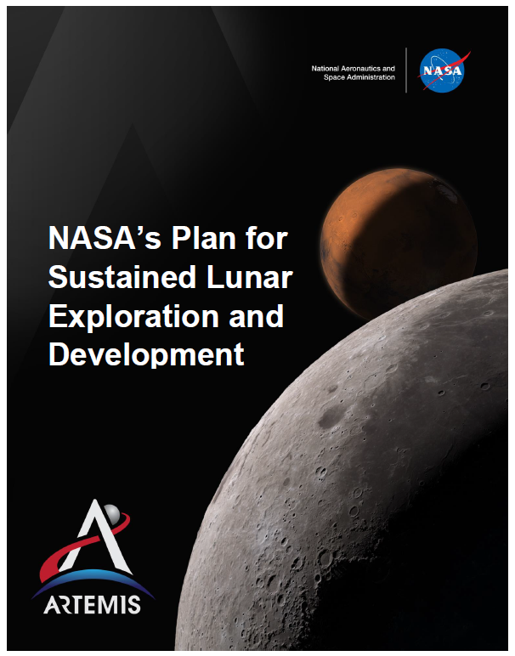
Key Phrases from NASA’s Report for the
National Space Council (April 2020, page 13)
The initial lunar missions will greatly inform our concept of operations for Mars. Every day in deep space increases the probability of catastrophic events occurring.
The concept of operations NASA is working toward for the first human mission to Mars is therefore one that reduces trip time significantly and minimizes time spent on the surface to around 30-45 days.
Factors NASA will continue to consider include:
  risks to crew health during transit, both from galactic cosmic ray (GCR) radiation and from potential catastrophic mission events;
  the complexity of mission operations on the Martian surface; and
  the complexity and cost of mission systems, such as in-space propulsion, the ability to land heavy payloads, and required surface systems.
NASA has targeted conducting a human mission to Mars that can be realized as soon as possible, while still ensuring that our Mars surface capabilities will allow for extensive exploration on our first mission, including a search for Martian life.
The Moon will allow us to test and demonstrate significant parts of this mission before sending humans on this epic journey. NASA will have more to share on the strategy for how the Moon prepares us for the first human mission to Mars in the coming months.

Slide 4
Other Guidance for Future Mars Exploration by Human Crews
Space Policy Directive 1​ (Section 1. Amendment to Presidential Policy Directive-4 of June 28, 2010)
  Lead an innovative and sustainable program of exploration with commercial and international partners to enable human expansion across the solar system and to bring back to Earth new knowledge and opportunities. Beginning with missions beyond low-Earth orbit, the United States will lead the return of humans to the Moon for long-term exploration and utilization, followed by human missions to Mars and other destinations​
Artemis Program​ (www.nasa.gov/specials/artemis)
  With the Artemis program, NASA will land the first woman and next man on the Moon by 2024, using innovative technologies to explore more of the lunar surface than ever before. We will collaborate with our commercial and international partners and establish sustainable exploration by 2028. Then, we will use what we learn on and around the Moon to take the next giant leap – sending astronauts to Mars.​
MEPAG Goals document (Goal I: Determine if Mars ever supported, or still supports, life; page 7)
  Similarly, ice-bearing permafrost, which on Mars could be significantly older than on Earth, could preserve evidence of past life, but could also have created a transient habitable environment during warmer periods triggered by recent orbital fluctuations. Brine-filled ice veins may offer a refuge for Martian life or preserve biosignatures. In such instances, mission concepts to search for evidence of life could target biosignatures of extant AND of past life, without the need for prioritization.

Slide 5
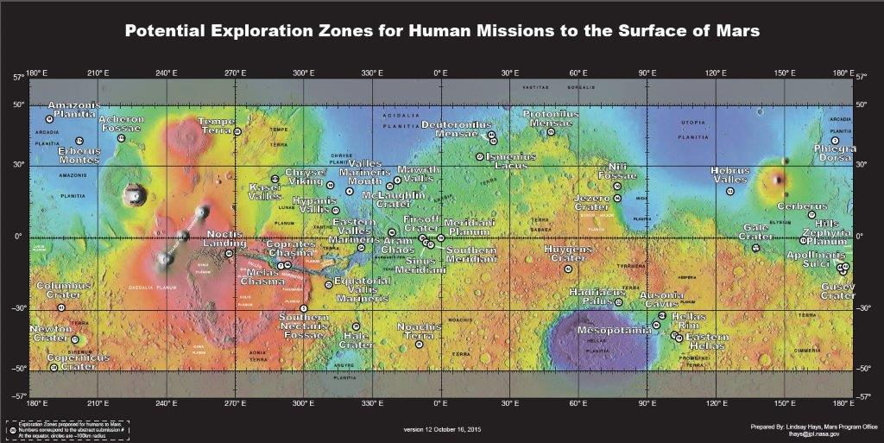
Exploration Zones Proposed at First EZ Workshop
This map is posted at http://www.nasa.gov/sites/default/files/atoms/files/exploration-zone-map-v10.pdf

Slide 6
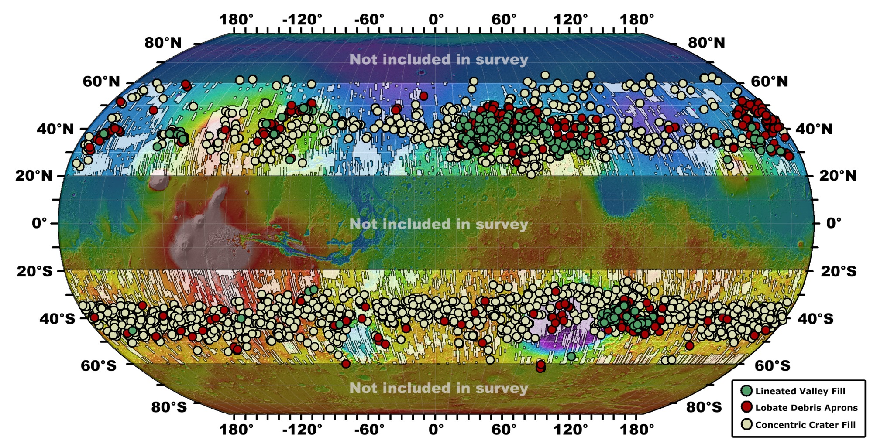
Mid-latitudes have Significant Ice-bearing Regions of Interest for Science and ISRU
Patterns of accumulation and flow of ice in the mid-latitudes of Mars during the Amazonian
James L. Dickson, James W. Head III, Caleb I. Fassett
Icarus Volume 219, Issue 2, June 2012, Pages 723-732

Slide 7
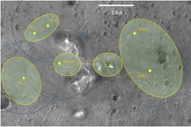
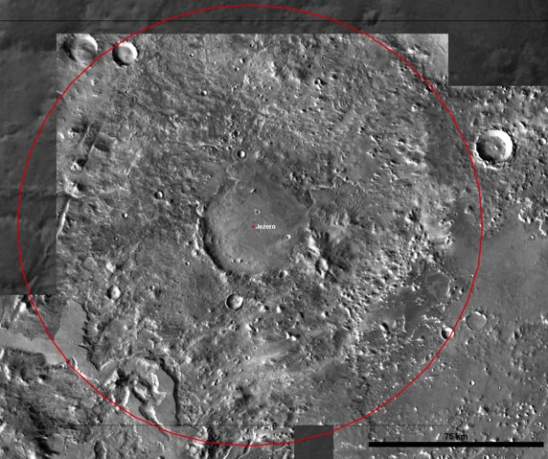
Example Mars Surface Field Station and Surrounding Regions of Interest (ROI’s)
Engineering Considerations
Site Buildup Considerations and Constraints
Bussey, B. and Hoffman, S., “Human Mars Landing Site and Impacts on Mars Surface Operations,” IEEE-2016-2515, IEEE Conference, Big Sky, MT, March, 2016.
Science ROI’s
ISRU ROI’s
Exploration Zone
Science ROI’s
Science ROI’s
ISRU ROI’s

Slide 8
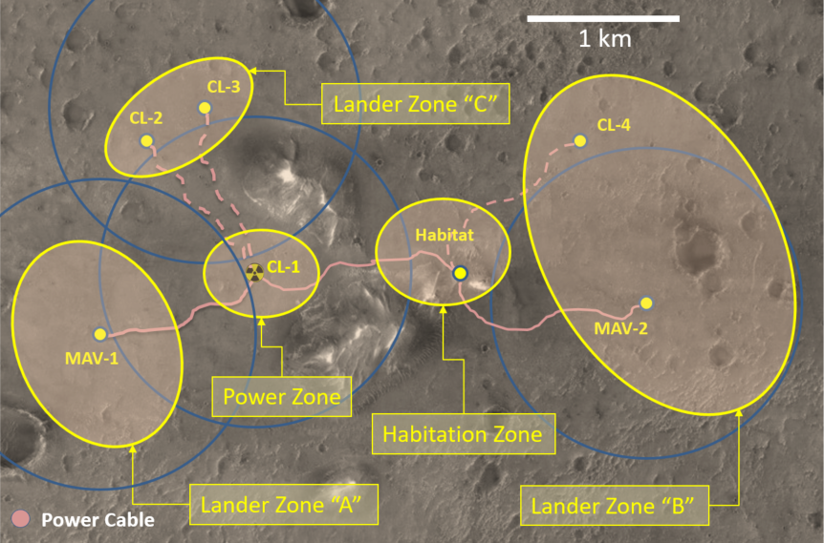
Example of Field Station Layout with Specific Utilization Zones Identified
Bussey, B. and Hoffman, S., “Human Mars Landing Site and Impacts on Mars Surface Operations,” IEEE-2016-2515, IEEE Conference, Big Sky, MT, March, 2016.
MAV
Mars Ascent Vehicle
CL
Cargo/Crew Lander

Slide 9
End-to-End Mars Mission – Across One or More Missions
Year 1
Year 2
Year 3
Year 4
Year 5
Year 6
Year 7
Expansion of Figure 2-1, page 3 from B. Drake, Human Exploration of Mars: Design Reference Architecture 5.0., NASA/SP-2009-566A, 2009.
J
F
M
A
M
J
J
A
S
O
N
D
J
F
M
A
M
J
J
A
S
O
N
D
J
F
M
A
M
J
J
A
S
O
N
D
J
F
M
A
M
J
J
A
S
O
N
D
J
F
M
A
M
J
J
A
S
O
N
D
J
F
M
A
M
J
J
A
S
O
N
D
J
F
M
A
M
J
J
A
S
O
N
D
Mission #1
Cargo (Mixed)
Cargo (MAV)
Crew
Depart
Arrive
Mission #2
Depart
Arrive
Depart
Arrive
Cargo (Mixed)
Cargo (MAV)
Crew
Depart
Arrive
Depart
Arrive
Depart
Arrive
Mission #1
  First element launched from KSC through crew return to Earth
Surface Mission Phases
Phase 0
Phase 1
P-2
P-3
P-4
P-5
Phase 6
Mission #2
  First element launched from KSC through crew return to Earth
Surface Mission Phases
Phase 1
P-2
P-3
P-4
P-5
Phase 6
Launch Campaign
Cargo Outbound
Unoccupied Wait
Crew Transits
Surface Mission
Overlapping Elements

Slide 10
Mission Phase Descriptions
Phase 0 – Prior to Cargo Landing
  Observations and investigations of the landing site by previously deployed orbital and surface assets
  Characterize habitability, including potential special regions
Phase 1 – Post Cargo Landing (~2-4 Years)
  Cargo Landing
  Power system deployment (Mission #1 only),
  Exploration by robotic assets, micro-climate monitoring
  Final crewed landing site selection (Mission #1 only)
Phase 2 – Crew Landing & Acclimation (~7-30 Sols)
  Crew landing and acclimation to Mars gravity environment
  Additional deployment of assets and local science investigations as time and crew capabilities permit
Phase 3 – Local Exploration (~30 Sols)
  Highly scripted initial set of mission and science objectives
  EVAs and UPR/SPR traverses within local area (~5-10 km) to set up central stations and complete initial science objectives
  Deployment of large assets (e.g. deep drill system)
Phase 4 – Regional Exploration (mission dependent)
  Several (TBD) separate ~5-15-Sol traverses with SPRs and UPRs
  Mobility extends 10s of kilometers from landing site (mission rule dependent)
  On-site sample analysis and follow-on local investigations continue
Phase 5 – Preparation for Ascent (~5-30 Sols)
  Final curation of samples and preparation of MAV
  Crewed Launch with contingency window
Phase 6 – Post Crew Departure
  Robotic assets continue exploration

Slide 11
Some Open Questions for Planetary Protection
How to “break the chain” with a human crew?
High level guidance calls for testing Mars mission systems and operations on the Moon – what aspects of Planetary Protection would benefit from testing on the Moon?
Search for Martian life involving a human crew?

