Slide 1
NASA
Space Communications and Navigation (SCaN)
Quantum Vision
La Vida Cooper,
Goddard- SCaN Technology Manager
Dr. Babak Saif,
SCaN’s Quantum Science & Technology Program Scientist
QED-C Presentation May 19, 2020

Slide 2
Outline
NASA’s SCaN: The Organization, its vison and mission
Executive Branch Vision for Quantum
SCaN’s Quantum Vision
Collaboration and Partnership
Key Questions and Preliminary Insights

Slide 3
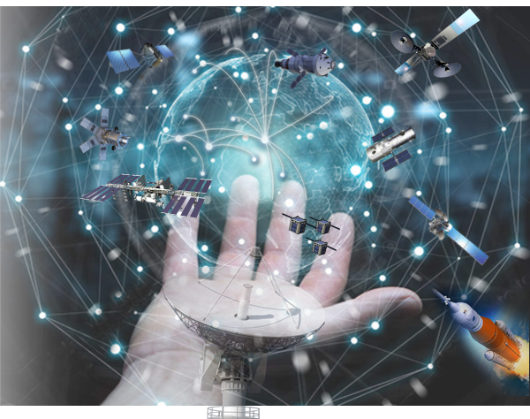

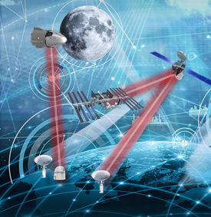
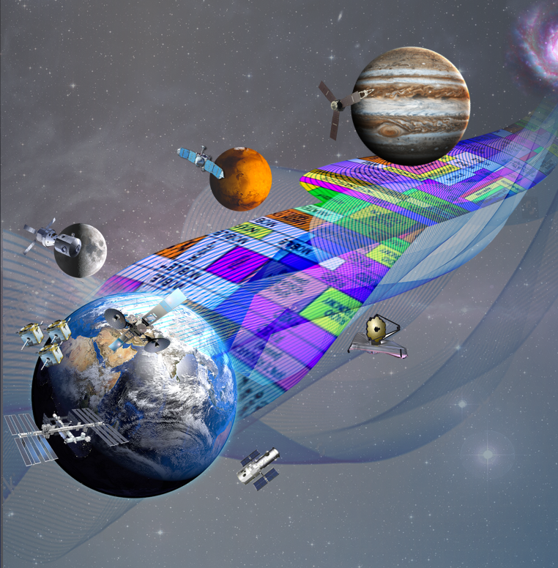
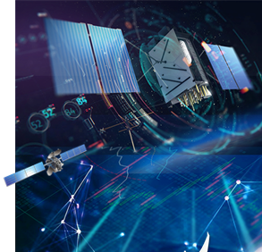
SCaN’s Vision, Goal & Strategy
VISION: Interoperable and resilient space and ground communications and navigation infrastructure
GOAL: Enable high speed, robust, secure, and cost-effective space communications and navigation services to future science and exploration missions
Foster an Affordable and
Growing U.S. Space Industry
Leverage Commercial Capabilities to Increase Efficiency and Robustness of NASA Space Networks
Infuse Transformational Technologies to Enhance Services Near the Earth and Beyond
Ensure Efficient Use of Spectrum through Regulatory Oversight and Streamlined Processes
Provide Technical Leadership in Pursuing and Implementing PNT Policies and Technology
Notes:
3 Networks

Slide 4
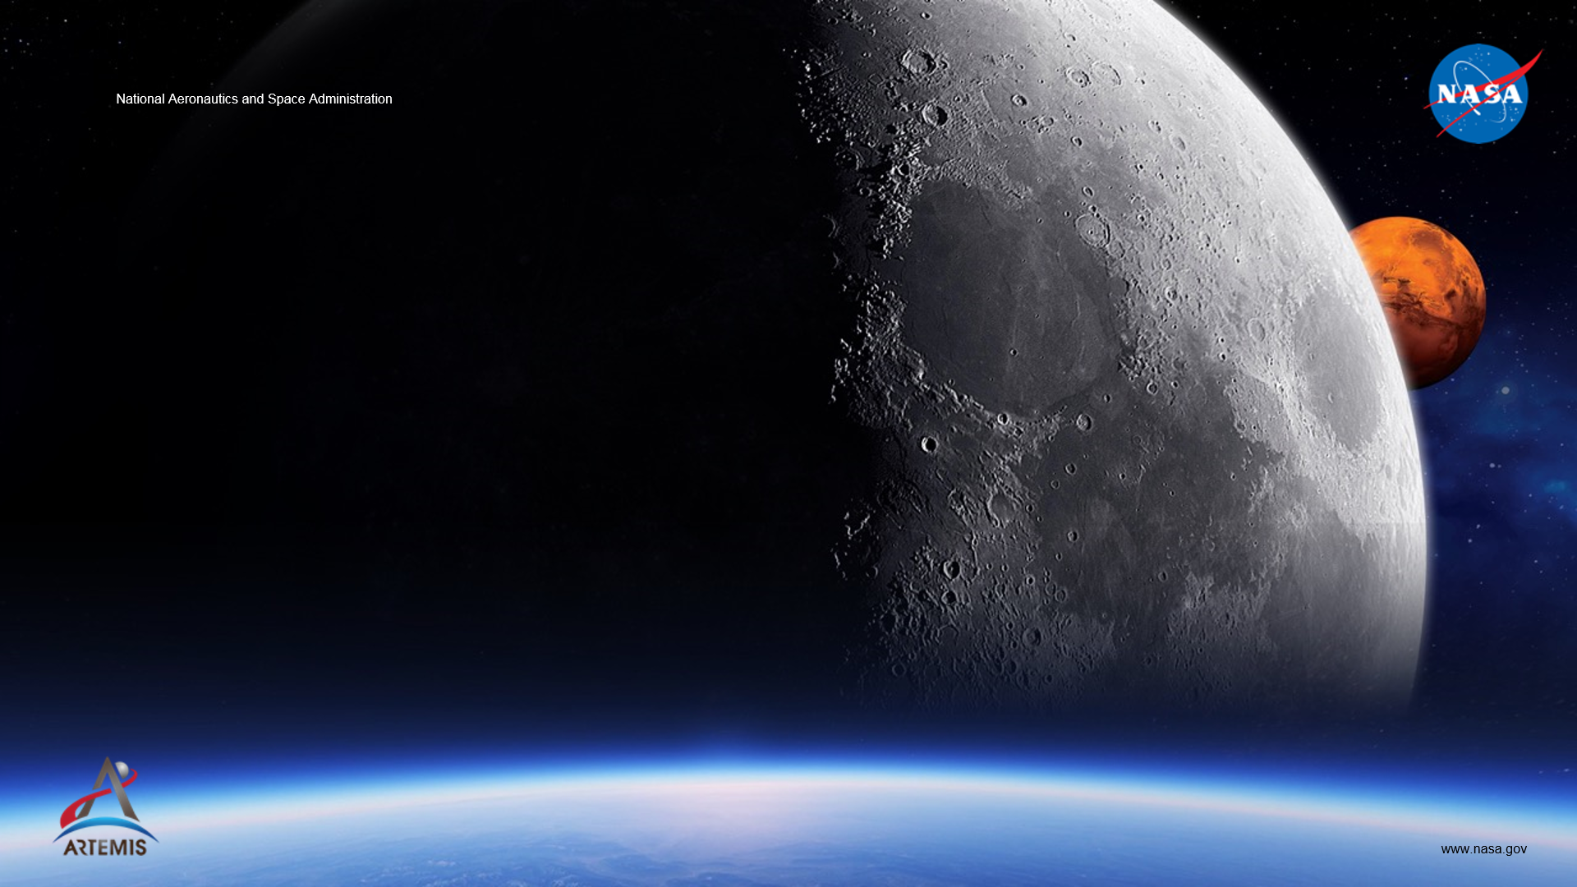
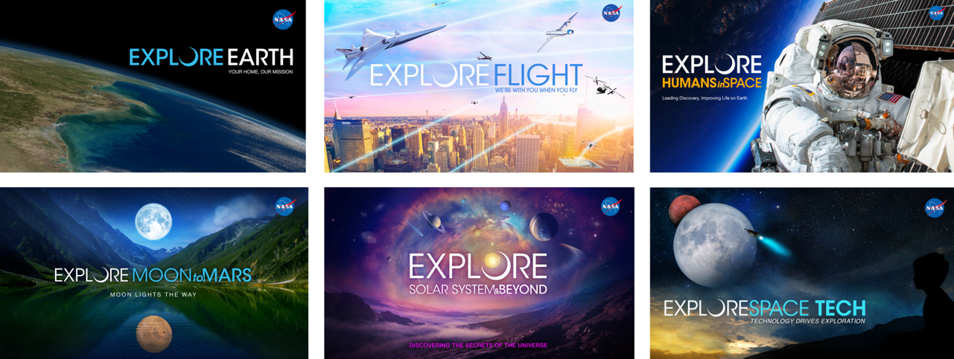
SCaN supports the breadth of NASA’s Science and Exploration endeavors

Slide 5
Executive Branch Guidance via OSTP NQCO
“Quantum networking uses the quantum properties of light and information to enable secure communication, new sensing modalities, and enhanced quantum computation. Research in this area will ensure continued advances in fundamental science and enable innovative applications of quantum devices to improve the Nation’s economy and security. Long-term prospects for quantum networks hinge on our ability to pioneer platforms that reliably link together quantum devices, and to develop applications that leverage quantum-enabled security, sensing, and computation modalities. By making a concerted and sustained effort to develop these prospects, the foundations for a quantum internet will be in place to enhance America’s future.
Two specific goals will focus efforts in this direction:
Over the next five years, companies and laboratories in the United States will demonstrate the foundational science and key technologies to enable quantum networks, from quantum interconnects, quantum repeaters, and quantum memories to high-throughput quantum channels and exploration of space-based entanglement distribution across intercontinental distances. At the same time, the potential impact and improved applications of such systems will be identified for commercial, scientific, health and national security benefits.
Over the next twenty years, quantum internet links will leverage networked quantum devices to enable new capabilities not possible with classical technology, while advancing our understanding of the role entanglement plays”

Slide 6
SCaN’s Quantum Vision
Vision:
Current Quantum Efforts:
“Operational Quantum Networking Service”
Partner- OGAs, Commercial, Academia, Globally
Space Segment focus; performance, security, interoperability; leverage prior investments
Milestone- First quantum intercontinental service – 202x
Low-TRL Technology Development
Vetted mid-TRL Tech Development Roadmap
Quantum Technology Roadmap &
Mission Concept Pre-Formulation
SCaN/NIST 2020 Berkeley Workshop:
Applications:
The Workshop
Technology Roadmap
Architectures
and Mission Concepts
Quantum Information Science (QIS)- national infrastructure and “user” needs (DOE and more)
Quantum computing
Enhanced time transfer
Distributed clock network
Long baseline interferometry
Exploration and additional Space Science applications
Many more terrestrial and space based applications
Promote a broad, diverse quantum space-comm community
Augment SCaN’s quantum space-comm program
Quantum and quantum-enhanced capabilities/services for national need, exploration and science applications

Slide 7
Collaboration and Partnerships
OGAs
Commercial Industry
SCaN will:
Serve as an early adopter and service provider
Contribute to and promote the growth of a quantum ecosystem
Identify and execute strategic collaborations
Leverage strengths and key capabilities of partners
Encourage commercialization and utilize emerging commercial supply chain
Infuse new ideas and approaches
Encourage and leverage applied research
Promote “interdisciplinary” physics and engineering STEM education, research and internship opportunities
  In addition to Quantum Scientists... this endeavor will benefit from having a diversity of disciplines within the ecosystem (i.e. material scientist, computer scientists, software developers, AI specialists, IT specialists, mechanical engineers, electrical engineers, optics experts, mathematicians, network architect, operators and many more).
  “Multi-discipline-lingual” subject matter experts will be critical
and much more…
NASA
International Partners
Academia

Slide 8
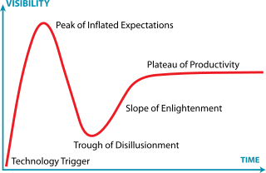
Key Questions & Preliminary Insights
What enabling technologies are essential to realizing communications and network systems?
  Sources, detectors, memories and more
What are the highest priority technology gaps that must be overcome?
  Sources, memories, adaptive optics
What is the timeline for deploying quantum communication systems
  late 2020’s for initial intercontinental capability
Security
  QKD: Accessible quantum communications application that can be implemented using widely available optical technologies. Has many uses; globally, wide variety of systems are commercially available with more under development. However, not adopted as a Nationally-certified cryptographic system.
  Need to continue exploration of innovative approaches to meet robust cryptographic requirements
Will quantum networks be able/need to integrate with today’s networks?
  Increased focus on interoperability standards and interfaces required
  Beneficial to consider key lessons from ARPANET era
How do advances in quantum computing affect quantum networks, and vice versa?
  User requirements and applications can/will drive data service infrastructure (i.e the network) evolution, and alternatively, network performance can/will drive advances in user applications and enable innovation, just as we see with today’s terrestrial networks.
Balancing the Value Proposition and
Technology Lessons Learned
Gartner Hype Cycle
https://en.wikipedia.org/wiki/Hype_cycle
Importance of data informed decisions

Slide 9
Contact Information
For additional engagement and discussion, please contact:
Badri Younes
Deputy Associate Administrator for
SCaN and SCaN Program Manager
badri.younes-1@nasa.gov
Nasser Barghouty
SCaN Quantum Science & Technology
Lead
nasser.barghouty@nasa.gov
Dr. Babak Saif
SCaN Quantum Science & Technology
Program Scientist
babak.n.saif@nasa.gov
La Vida Cooper
Goddard-SCaN Technology
Manager
lavida.d.cooper@nasa.gov

Slide 10
Questions?

