Slide 1

NASA Aeronautics Overview
USACA Meeting
Jimmy Kenyon
Director, Advanced Air Vehicles Program
May 29, 2020

Slide 2


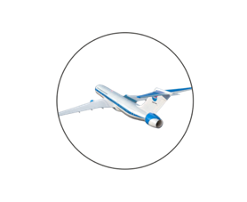
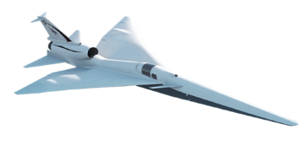
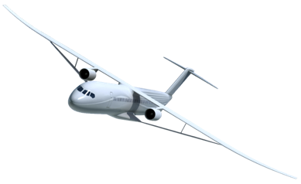
A New Era of Innovation Emerging for Long-Haul Aviation
  NASA Aeronautics’ vision and leadership underpin U.S. industry’s ability to win the future
NASA is on track to enable a new era of supersonic air travel that will further connect the world and establish a new market segment for U.S. industry
Low Boom Flight Demonstration Mission on schedule
  Industry innovation has begun – Boeing/Aerion, Lockheed, Boom, GE
NASA has established the concepts and key technologies required to enable 2030s transports
  Next step is ground and flight validation of integrated technologies by the mid-2020s
  Industry ready to cost-share partnerships – Boeing, GE, P&W, etc.
Global travel is predicted to more than double from 4 billion passengers annually today to over 8 billion annually in 20 years. This growth would support a nearly $6.8 T commercial transport market over that same timeframe.
Europe is aggressively investing to capture the technology lead from the U.S. and adding taxes/regulation to drive emissions reductions.
China is seeking to capture the fastest growing market in Asia-Pacific through government funded R&D. American technology leadership at risk.

Slide 3
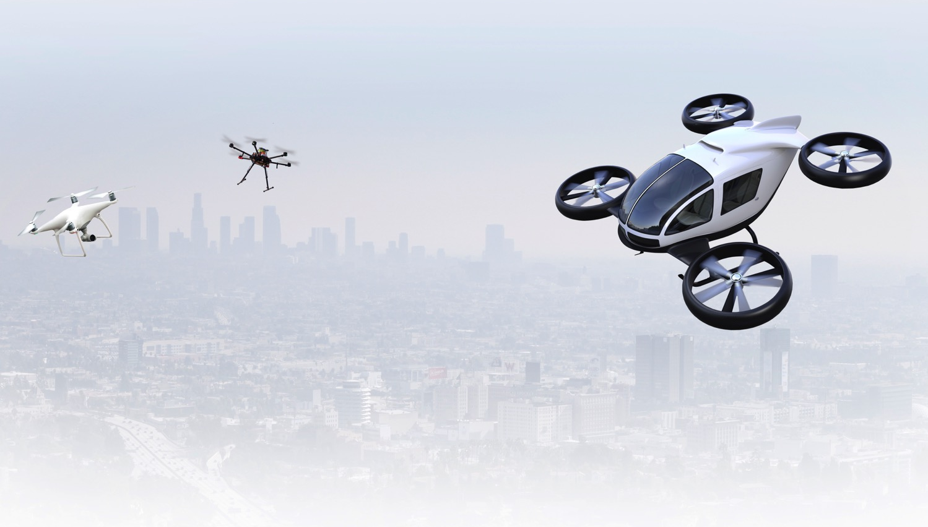
A New Era of Urban and Thin Haul Flight is Emerging
  NASA Aeronautics’ vision and leadership have stimulated aviation and non-aviation communities to pursue transformative aviation capabilities
NASA led the U.S. community with the UAS Traffic Management (UTM) and UAS in the NAS projects
Integration of commercial systems is now beginning to emerge
UTM is now the accepted concept all over the world
Urban Air Mobility (UAM) is fast on the heels of UAS integration
U.S. industry looking for NASA leadership now to help overcome key barriers
Aggressive industry timeline for scalable operations creates challenging requirements
Significant Private Sector Investment – Aircraft Designs Maturing Rapidly – Competitive International Landscape – Advancing Regulatory Environment – Local/Regional Community Awareness and Interest

Slide 4

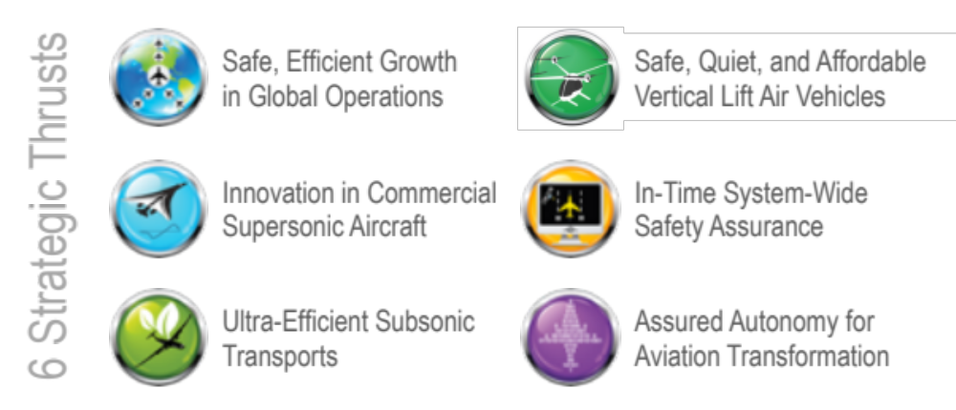
NASA Aeronautics – Vision for Aviation in the 21st Century
ARMD continues
to evolve and
execute the
Aeronautics Strategy
https://www.nasa.gov/
aeroresearch/strategy
U.S. leadership for a new era of flight

Slide 5
FY 2021 Budget Request - Aeronautics
$ Millions | FY 2019 | FY 2020 | FY 2021 | FY 2022 | FY 2023 | FY 2024 | FY 2025
Aeronautics | $724.8 | $783.9 | $819.0 | $820.7 | $820.7 | $820.7 | $820.7
Airspace Operations and Safety | 105.7 |  | 90.4 | 92.6 | 94.4 | 96.2 | 96.2
Advanced Air Vehicles | 272.1 |  | 212.7 | 222.2 | 230.3 | 261.2 | 266.2
Integrated Aviation Systems | 209.6 |  | 269.0 | 256.4 | 244.4 | 209.5 | 204.5
Transformative Aeronautics Concepts | 137.4 |  | 129.9 | 132.3 | 134.6 | 136.7 | 136.7
Aerosciences Eval and Test Capabilities |  |  | 117.0 | 117.1 | 117.1 | 117.1 | 117.1
FY 2021 PBR supports critical needs of the U.S. aviation industry to maintain leadership in a new era of aviation
Readies Low Boom Flight Demonstration Mission to achieve first flight in FY 2022 and deliver data that will support new noise standards
Invests in critical needs for the emerging AAM market – building upon NASA’s UAS technology development and airspace integration success
Develops and matures technologies in time to support U.S. industry development of new subsonic aircraft by the early 2030s
  Accelerates key enabling technology development: advanced aerodynamics, electrified aircraft propulsion, small core turbine engine technologies, and high rate production of composite materials
  Demonstrates electrified aircraft propulsion via flight testing, first flight in FY 2023
Invests in fundamental hypersonic research supporting DoD and commercial applications
Note: FY 2020 includes the Aerosciences Evaluation and Test Capabilities Program at $117M

Slide 6
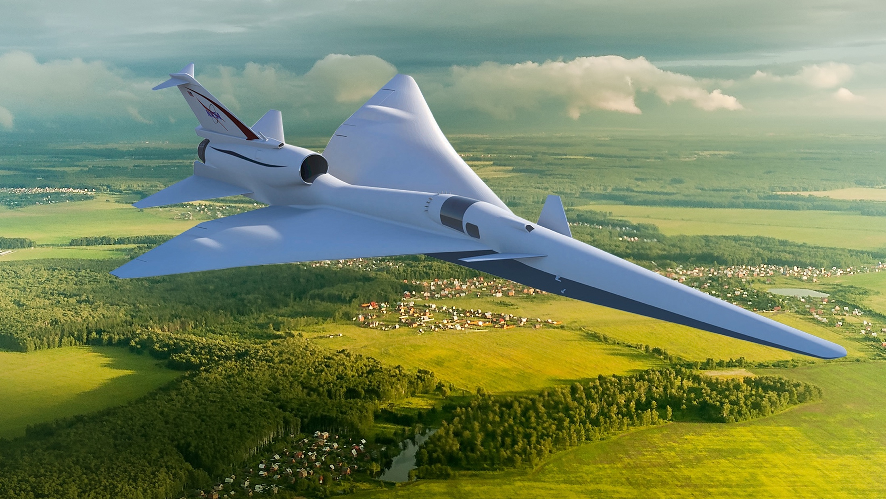
Overcoming the Barrier to Overland Flight
  Standards to Replace Current Prohibitions
New Environmental Standards are needed to open the market to supersonic flight
An En Route Noise Standard is the biggest challenge
  Requires proof of new design approaches, test procedures and response metrics
  No relevant data exists to define limits - community data from large, diverse population is a requirement
  Standard must be accepted internationally

Slide 7
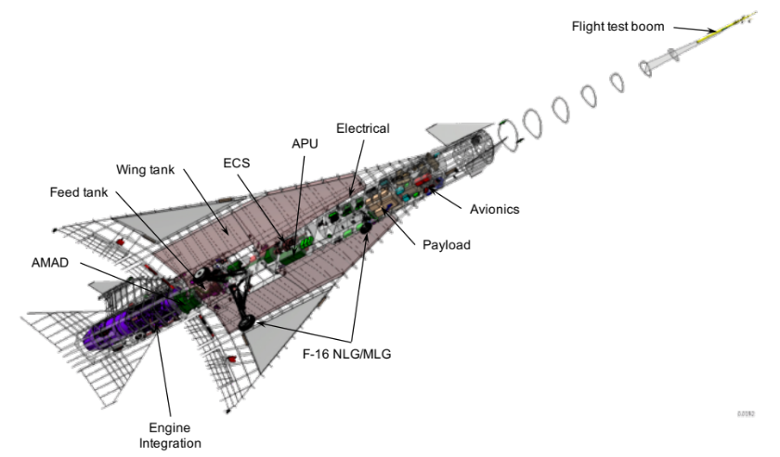
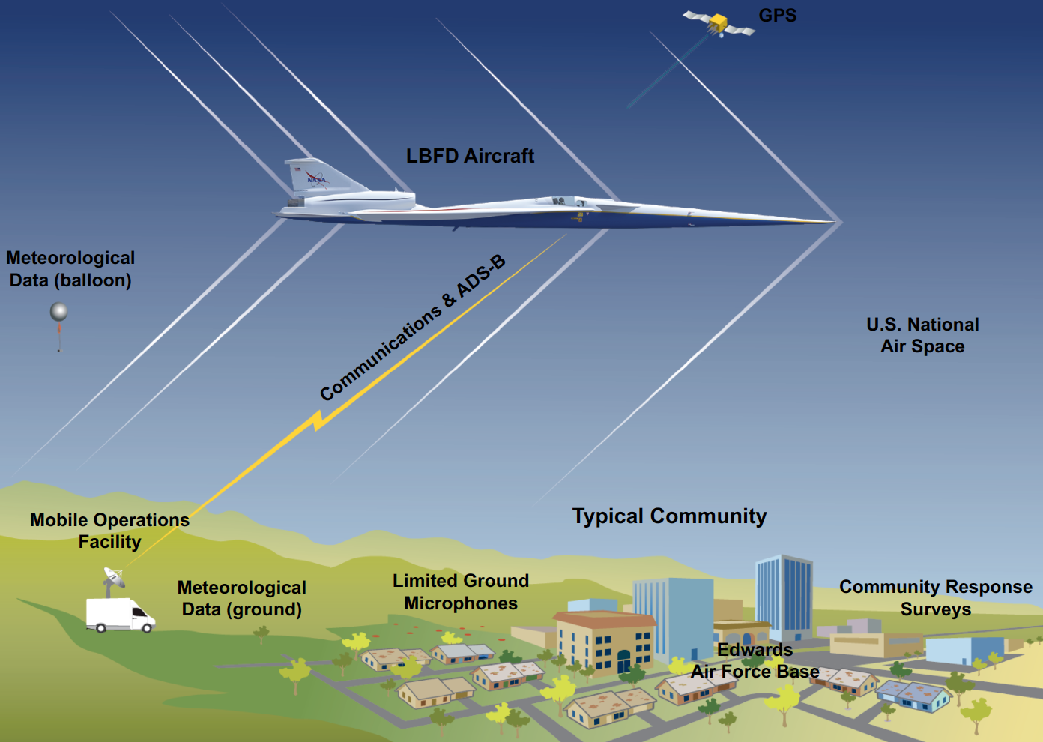
Low Boom Flight Demonstration Mission
Phase 1 – X-59 Aircraft Development (FY18 - 22)
  Detailed Design
  Fabrication, Integration, Ground Test
  Checkout Flights
  Subsonic and Supersonic Envelope Expansion
Phase 2 – Acoustic Validation (FY22 - 23)
  Aircraft Operations / Facilities
  Research Measurements & Capabilities
Phase 3 – Community Response (FY24 - 26)
Initial community response overflight study
Multiple campaigns (4 to 6) over representative communities and weather across the U.S.

Slide 8
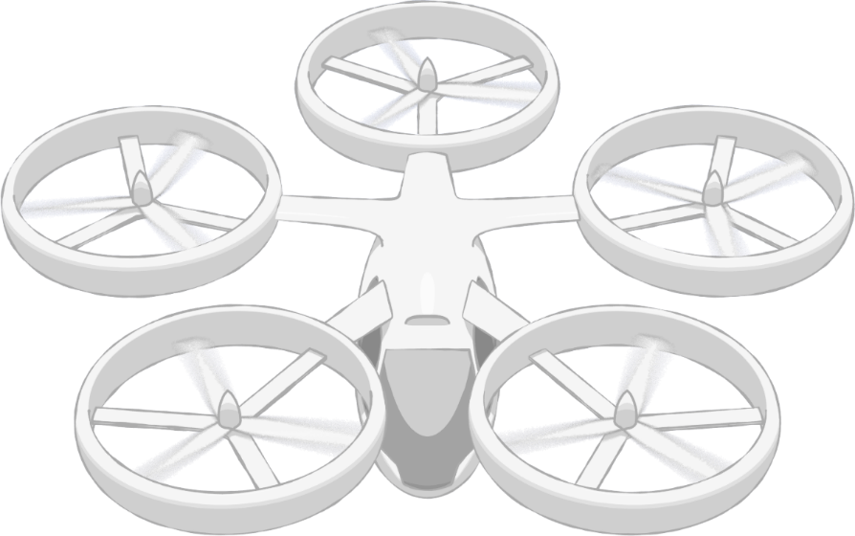



AAM Vision and Framework
Community Integration
Community Integration
Airspace & Fleet Operations Management
AAM Community Outcome
  Deliver a validated
    1) system concept and
    2) corresponding set of requirements
  for a safe and scalable AAM transportation system.
Airspace System Design & Implementation
Airspace Design & Operations
Vehicle
Development & Production
Individual Vehicle Management & Operations
Vehicle Development & Operations
Advanced Air Mobility (AAM) Vision
Revolutionize mobility in and around metropolitan areas by enabling a safe, efficient, convenient, affordable, and accessible air transportation system for passengers and cargo

Slide 9
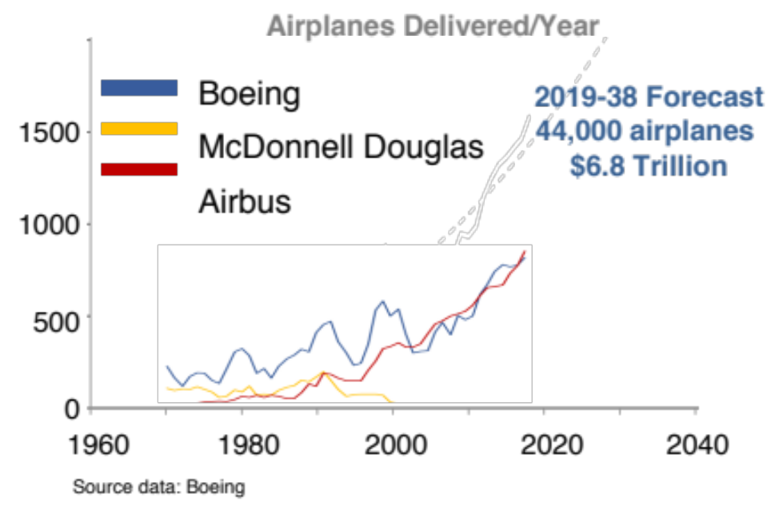
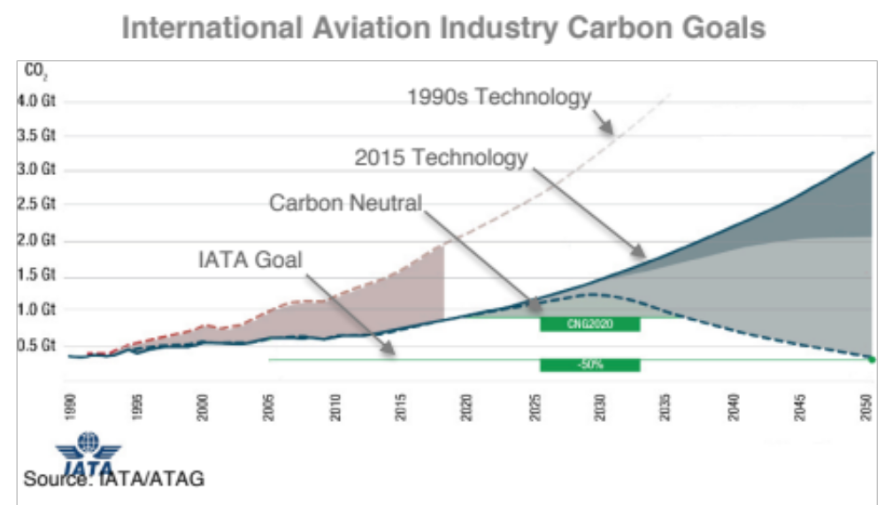
Subsonic Transport Airplane Market
  Global competition and environmental pressure expanding
European manufacturers reaching parity
New competitors in key Asia-Pacific growth market
U.S. leadership at risk
Market-based measures in place
New ICAO CO₂ and nvPM standards starting in 2020
Social pressure growing, e.g., flight shaming
U.S. industry must meet global standards
Ultra-efficient subsonic transport technologies address both needs and offer operating cost benefits to airlines

Slide 10
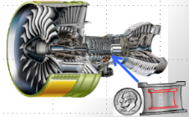
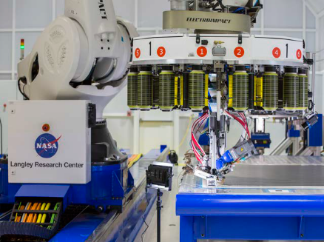
Four Key Subsonic Transport Technologies
  Create new “S” curve for the next 50 years of subsonic transports
Electrified Aircraft Propulsion
Improved efficiency/emissions
Mild hybrid systems promising for early 2030s
Small Core Gas Turbine
Increased gas turbine efficiency
Facilitates airframe integration – conventional or EAP
Transonic Truss-Braced Wing
Increased aerodynamic and structural efficiency
Propulsion system integration and high rate production
High Rate Composites
Critical to US competitiveness via reduced delivery time
Reduced time/cost to market with increased performance
synergistic
Electrified Aircraft Propulsion
Small Core Gas Turbine
synergistic
High Rate Composites
Transonic Truss-Braced Wing
Advance key technologies to TRL 6 by 2025-28 to create early 2030s market opportunities for US industry

Slide 11
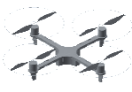
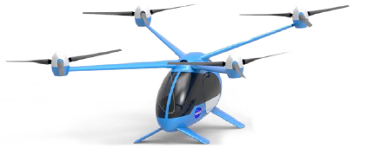
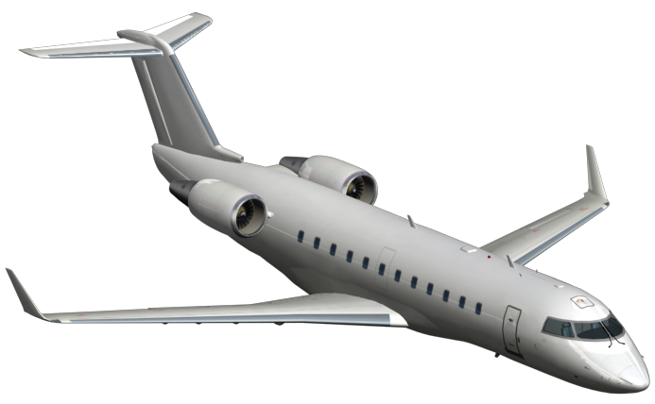
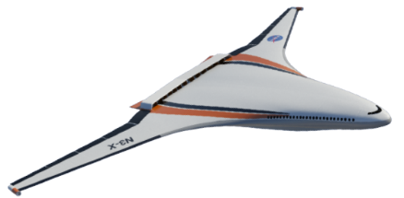
Electrified Aircraft Propulsion – a 60,000 ft Perspective
UAS
UAM
Small A/C
RJ
Single Aisle
Twin Aisle
Implementation
Status
All electric vehicles in operation
All electric or hybrid applications being developed
Potential for hybrid or turbo-electric within 10 years
Significant progress needed for practical implementation
NASA research not needed
NASA focus on informing standards, regulations & design tools
NASA focus on enabling technologies, demonstrating benefits, addressing safety needs
Still too long term – not yet a NASA focus
NASA Role
Small Vehicle EAP
Transport Scale EAP
Energy & cost efficient, short range aviation
Energy & cost efficient, transport aviation
AATT/RVLT & IASP/X-57
AATT/AAVP & UEST/EAP/IASP
Leverage learning at smaller size to inform scale-up
Fundamental challenges span range of sizes

Slide 12
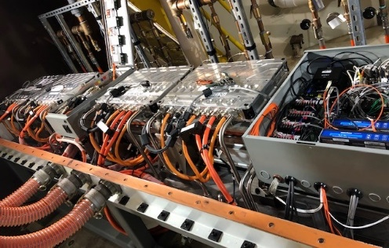
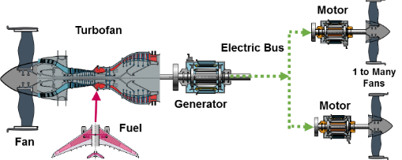
Electrified Aircraft Propulsion
Goal: Identify and retire barrier technical and integration risks for MW-class electrified aircraft propulsion systems
Objectives:
Demonstrate representative hybrid electric powertrain
Total power of 3X state-of-the-art with large engine power extraction
Meet fault management, redundancy, and power quality requirements
Technical Challenges:
High power density and efficiency requirements
Operation of high voltage components at altitude
Integration at scale in flight-relevant environment
Approach:
System studies, ground test, and flight test to advance to TRL6
Partner with industry on ground and flight tests of electrified propulsion architectures
Leverage prior EAP advances (TRL~4)
Game-changing architectures offer significant fuel burn benefits

Slide 13

Small Core Gas Turbine
  Increase thermal efficiency of engine core while reducing size and facilitating hybridization
Goal: Establish integrated high power-density hybrid core engine technologies for early 2030s Entry Into Service aircraft
Objectives:
Demonstrate 5-10% fuel burn benefit on representative system to TRL6
Demonstrate practicality of representative system
Characterize and validate engine design trade space
Technical Challenges:
High overall pressure ratio and T4 challenges
Ultra compact size constraints
Engine life and maintenance
Integration challenges for electrical components
Approach:
Partner with industry (General Electric, Pratt and Whitney, and Rolls Royce) for ground test of small core engine, potentially with hybrid architecture
Leverage prior small core and hybrid advances (TRL~4)
Rapid prototype and agile development through potential full engine test opportunity

Slide 14
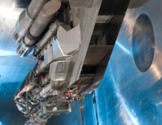
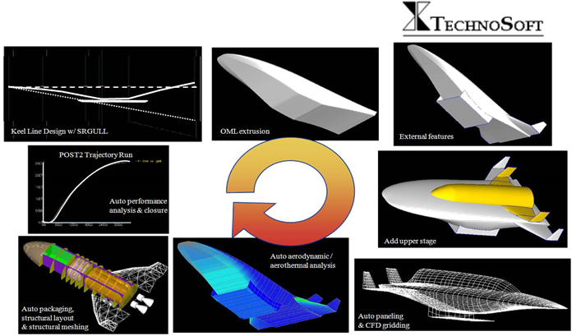
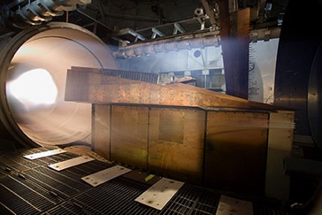
NASA Hypersonic Research
  Enable routine, reusable, airbreathing hypersonic flight
Multiple challenges but propulsion is the tallest pole
NASA focused on mode transition between a turbine and scramjet
Creating a design capability, not a point solution
Recent testing shows a viable path forward
NASA leveraging advances in other communities
NASA leveraging comprehensive DoD ground and flight tests
High priority area where industry needs help
Unique NASA testing capability and analysis provides a National resource
Emerging vision for future point-to-point transport

Slide 15
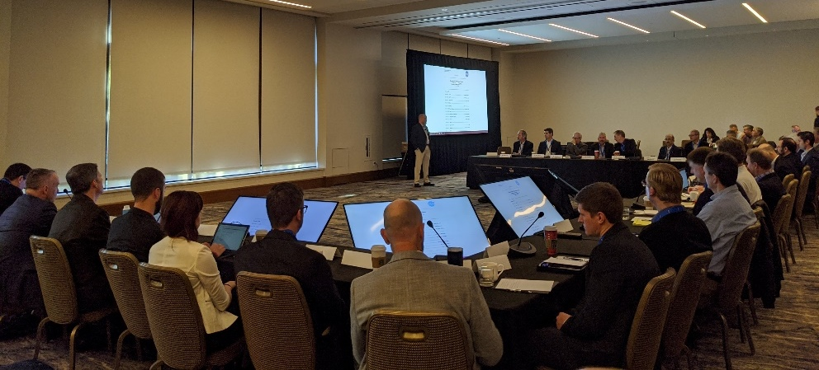
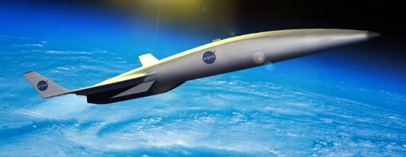
Hypersonic Technology Strategy
  Enabling routine, reusable, airbreathing hypersonic flight
Industry announcements reveal interest in commercial applications
Workshop held to understand interest and identify needs
  Independent market study
  Regulatory and data protection concerns
  Hypersonic ground and flight test capability
  Technology development
Assessing strategy in light of growing industry interest
Continuing to support strong DoD partnership
Emerging industry vision for potential future commercial hypersonic market

Slide 16
Supporting a New Era in the U.S. Aviation Industry
A new era of aviation is rapidly emerging
  Growing international competition and environmental pressure will drive rapid advancements in commercial aviation
  A UAM market is emerging that could transform transportation and mobility
NASA investing in key areas to address emerging markets
  Scientifically acquired data on community response to low sonic boom to enable new international standards
  Key enabling technologies to ensure U.S. leadership and open a scalable, safe, efficient, and environmentally acceptable AAM market
  Technologies including electrified aircraft propulsion to transform the efficiency and sustainability of commercial transports
  Fundamental hypersonic research for dual-use applications
Creating new “S” curves for the next 50 years of aviation

