Slide 1
Preparations for Tomographic Background-Oriented Schlieren Measurements in the 11-by 11-Foot Transonic Wind Tunnel
Joshua M. Weisberger, Brett F. Bathel, Stephen B. Jones
NASA Langley Research Center, Hampton, VA 23666
Mark R. Woike and Jonathon D. Ponder
NASA Glenn Research Center, Cleveland, OH, 44135
James T. Heineck and Edward T. Schairer
NASA Ames Research Center, Moffett Field, CA, 94035
AIAA Aviation 2020, June 15 – 19
Copyright 2020 United States Government as represented by the Administrator of the National Aeronautics and Space Administration. No copyright is claimed in the United States under Title 17, U.S. Code. All Other Rights Reserved. Published by the American Institute of Aeronautics and Astronautics, Inc. with permission.

Slide 2
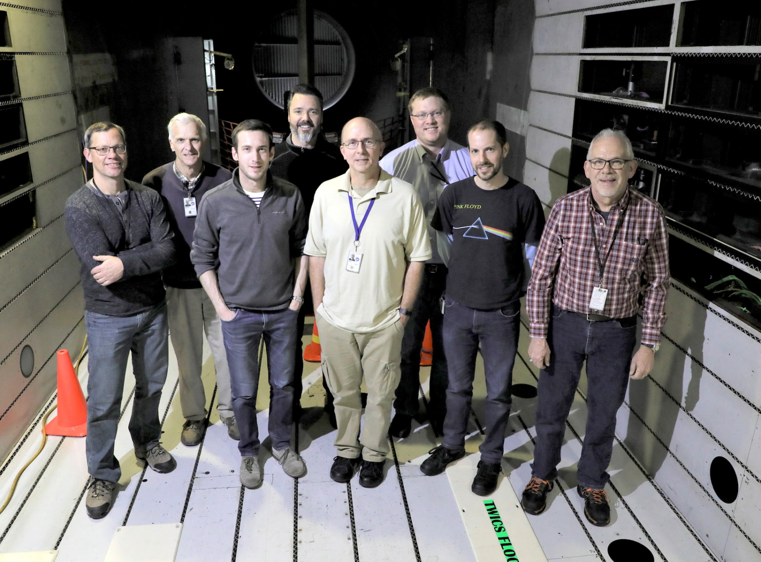
Outline
Motivation
Experimental Setup
Tunnel Facility
Camera Modules
Data Acquisition System
Background Material
Tunnel Mock-Up
Results
Camera Window Reflections
Calibration
LaRC Candle
LaRC Heat Gun
ARC Heat Gun
Conclusions / Lessons Learned

Slide 3
Motivation
Collaborative opportunity to develop tomographic BOS capability for large NASA wind tunnels
Piggy-back on a test at the Ames 11-by 11-Foot Transonic Wind Tunnel
Limited time available during tunnel testing
Construct a mock-up to get a feel for setup, acquisition, calibration, and data processing before test
Mock-up constructed at Langley in mid-November 2019
Ames testing in early-to-mid December 2019
Coordinated effort among the three centers
Langley (LaRC) : camera module development
Glenn (GRC) : data acquisition system development
Ames (ARC) : camera positions/orientations in tunnel, background material development

Slide 4
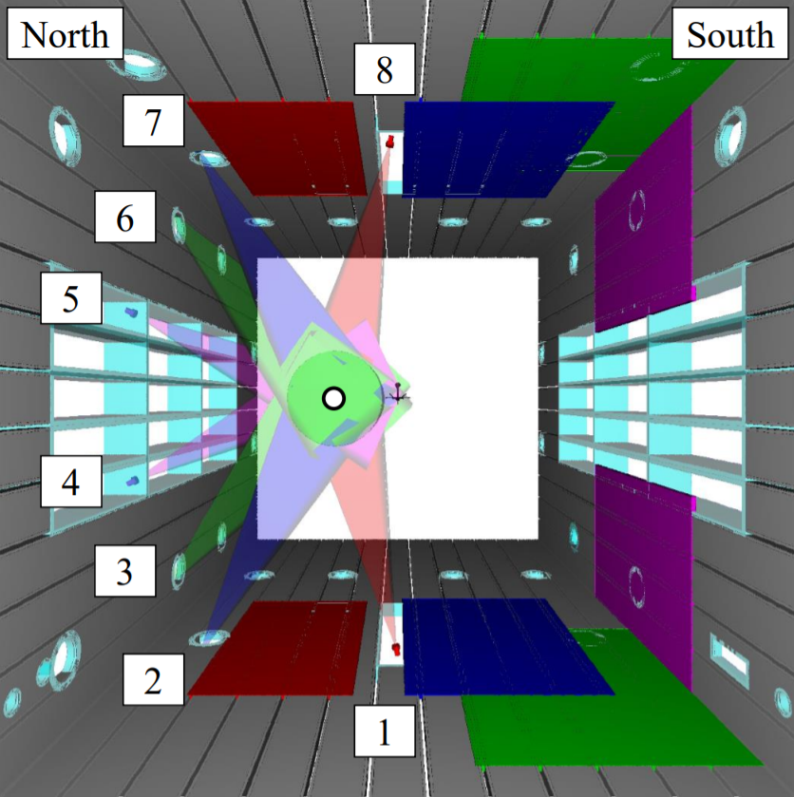
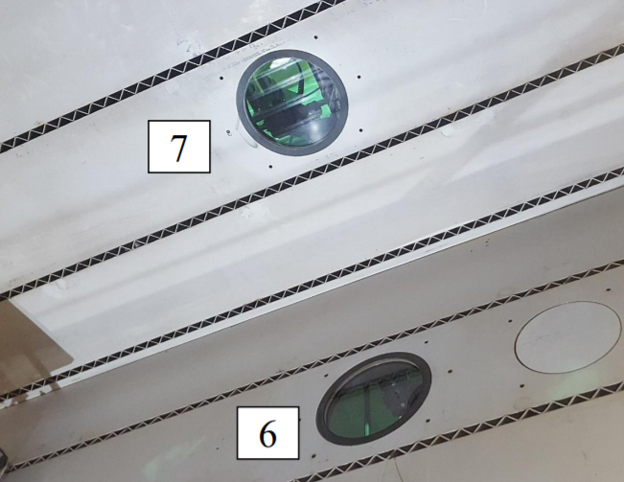
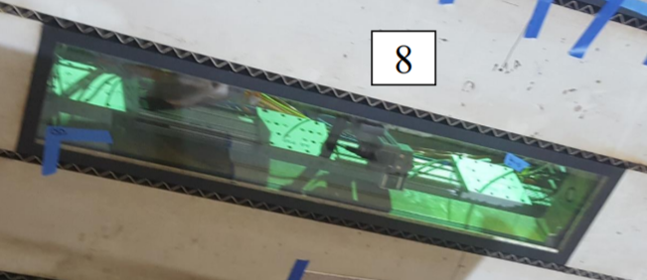
[Experimental Setup] // 11-by 11-Foot Tunnel
Camera placements dictated by available window locations at the tunnel
[Left]
Tunnel rendering looking downstream
Proposed camera locations indicated
ROI offset from centerline of tunnel
[Top Right]
Porthole windows for cameras 6 and 7
[Bottom Right]
Rectangular window for camera 8
Baffled slots not permitted to be covered by the background material
How would this affect the BOS reconstructions?

Slide 5
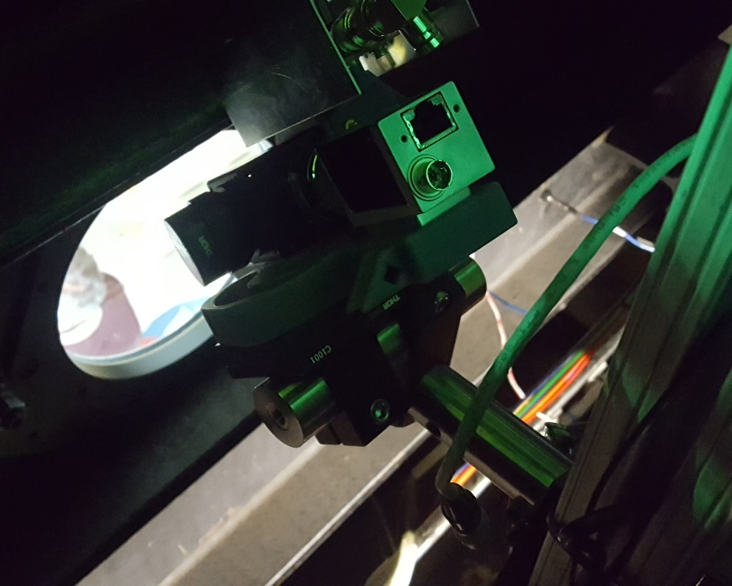
[Experimental Setup] // Camera Module Requirements
Camera module requirements
One camera per porthole/window around the circumference
Compact system to fit into tight spaces in plenum behind windows
Full adjustment of rotation and translation for ideal placement/viewing
Low-speed acquisition (on the order of a few Hz)
Withstand low pressures and high temperatures in plenum
Short exposure to ‘freeze’ fluid flow up to Mach 1.4
Synchronously trigger all cameras remotely
On-axis lighting to maximize intensity return
Minimize reflections from tunnel windows
Include on-board PCB-based LED driver to maximum intensity and minimize pulse width

Slide 6
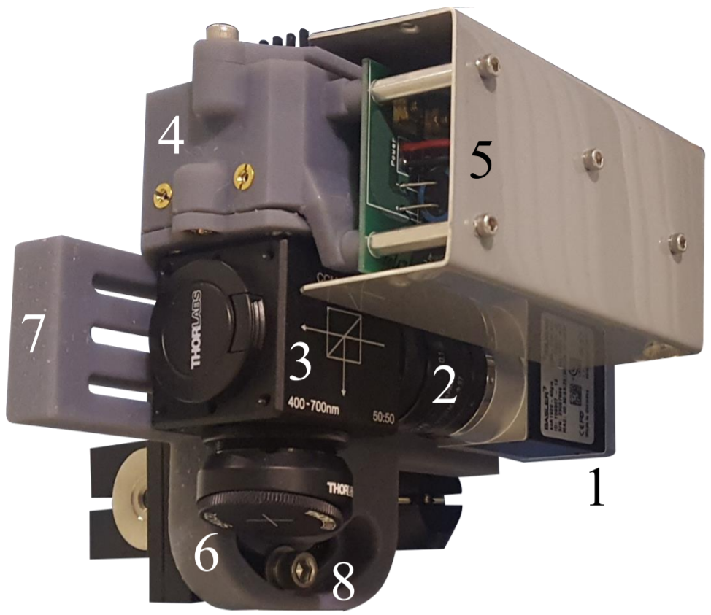
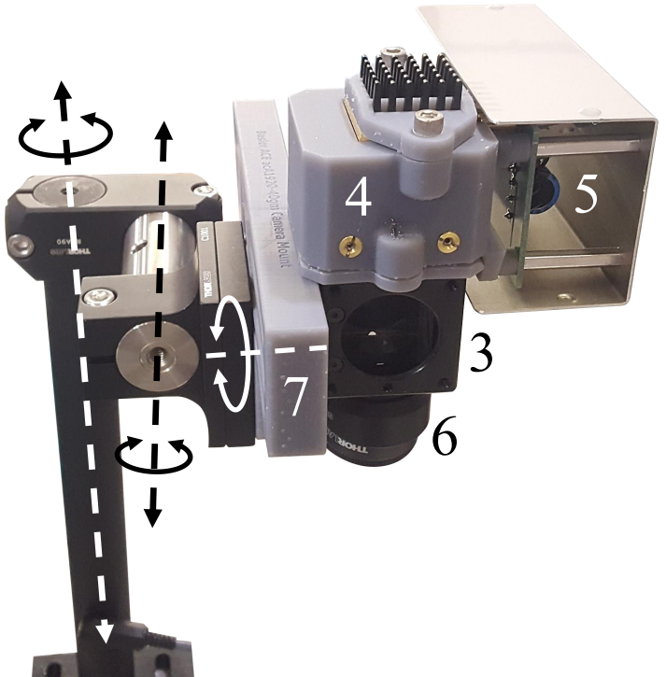
[Experimental Setup] // Camera Module Components
Camera module components (x8)
Machine vision CMOS camera
25 mm focal length lens
Beamsplitter cube
3D-printed housing which holds:
Aspheric condenser-diffuser lens
LED and heat sink
PCB-based LED driver circuit
Angled neutral density filter and flat black cap
3D-printed adapter plate
Circular arc slot with set screw
Translation/rotation of the camera modules along/about the dashed lines

Slide 7
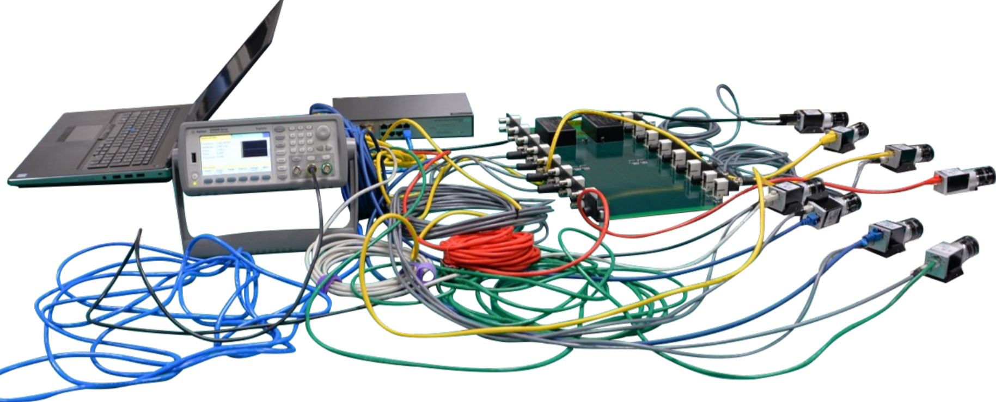
[Experimental Setup] // Data Acquisition System
Ethernet cables connect cameras to network switch
Network switch connects to laptop for image acquisition
Function generator and camera trigger lines connect to trigger board
Trigger the LEDs
Pulse width of LEDs
Phase delay between camera and LED trigger
Laptop
Network Switch
Cam 1
Cam 2
Cam 3
Function Generator
Trigger Board
Cam 4
Cam 5
Cam 6
Cam 7
To LED PCB
Cam 8

Slide 8
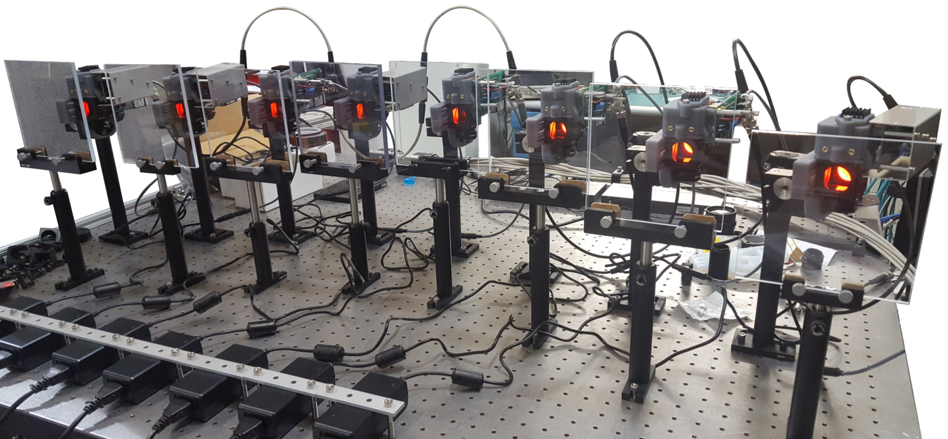
[Experimental Setup] // Simultaneous Acquisition
Acrylic Windows
LED Trigger Lines
LED Power

Slide 9
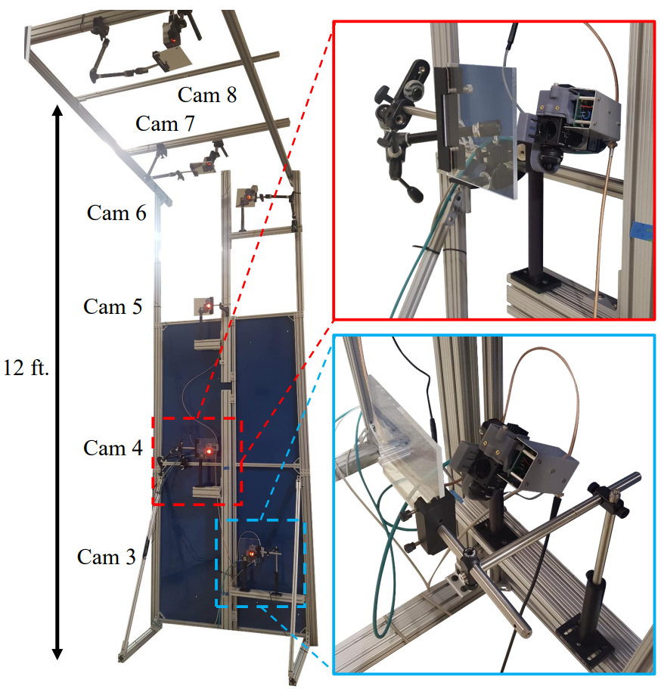
[Experimental Setup] // Tunnel Mock-Up
Goals
Detail a calibration method
Determine whether a successful tomographic reconstruction could be obtained with the camera modules in their proposed positions
Ensure a quick setup and calibration when system is installed at the tunnel
T-slotted aluminum frame for “tunnel” structure
Camera modules and acrylic “windows” placed at their approximate locations based on renderings/schematics provided by ARC

Slide 10
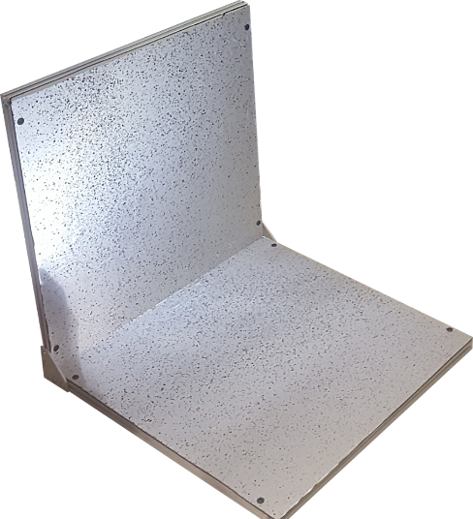
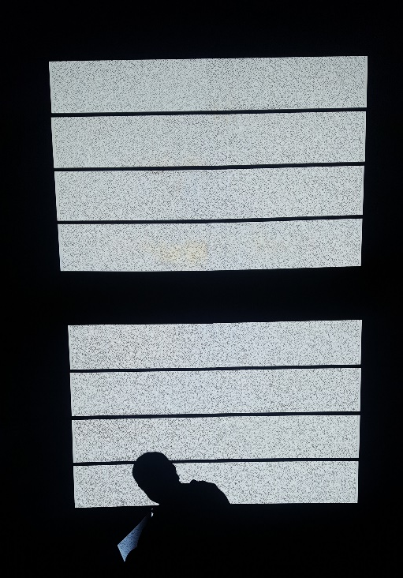
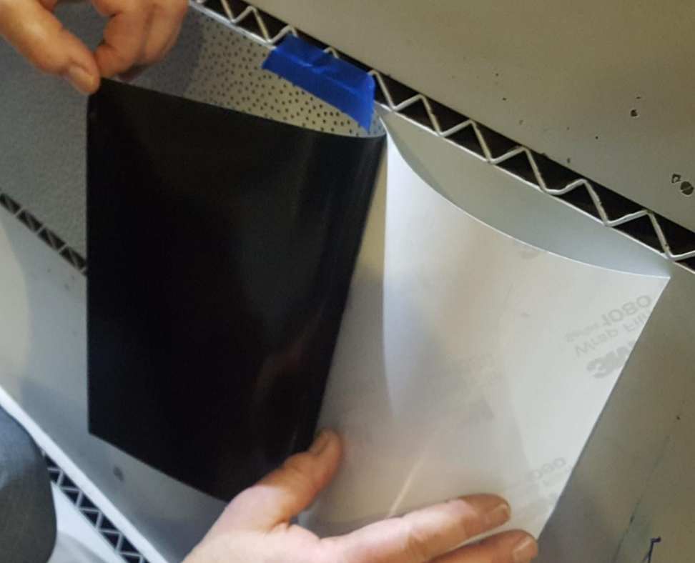
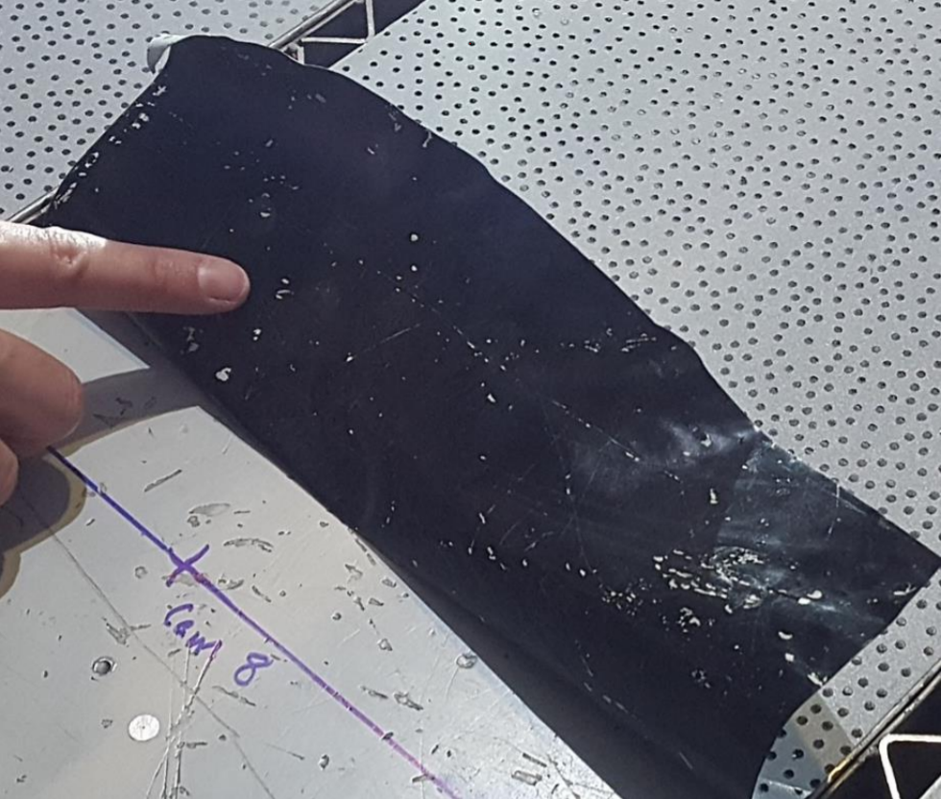
[Experimental Setup] // Background Material
Langley Mock-Up
Alumalite backing panels
3M Scotchlite 7610 high gain retroreflective sheeting
Flat black spray paint can with enlarged nozzle to create dot pattern
Ames Tunnel
7610 adhered to vinyl backing
From PDF, silk-screen printing of 24” x 63” sections
Cut to 9.75” width for tunnel slats (between baffled slots)

Slide 11
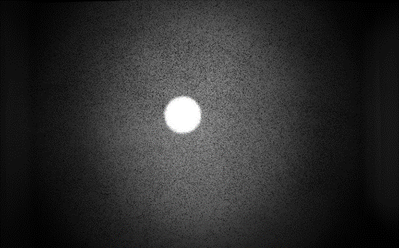
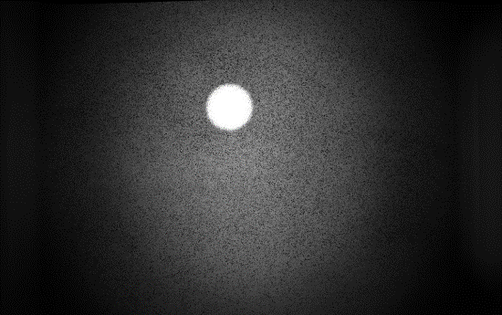
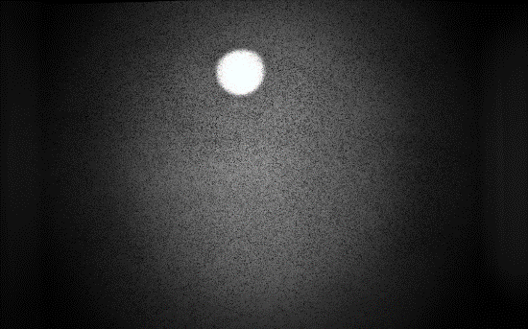
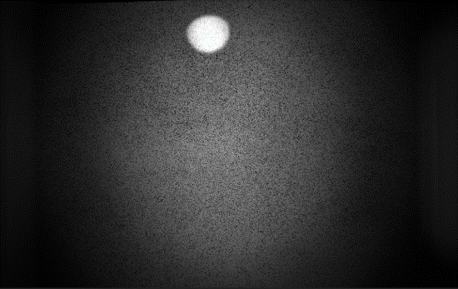
[Results] // Camera Module Window Reflection
Why
Find limits of camera incidence angle to eliminate reflections
How
Flat pieces of ¼” thick acrylic used to simulate the windows of the tunnel
Camera module placed 8.75” away from acrylic
Acrylic rotated about its axis from 0º to 10º degrees, in steps of 2º
$$θ$$
8.75”
Results
Back-reflection of light source eliminated at 10º
Vignetting → beamsplitter cube aperture is too small for camera lens (25 mm)
Could use 50 mm lens to solve this issue, but would not get correct FOV of the model and backgrounds
Actual FOV for the Ames tunnel test was cut down to a square (white dashed box)
0º
2º
4º
6º
8º
10º

Slide 12
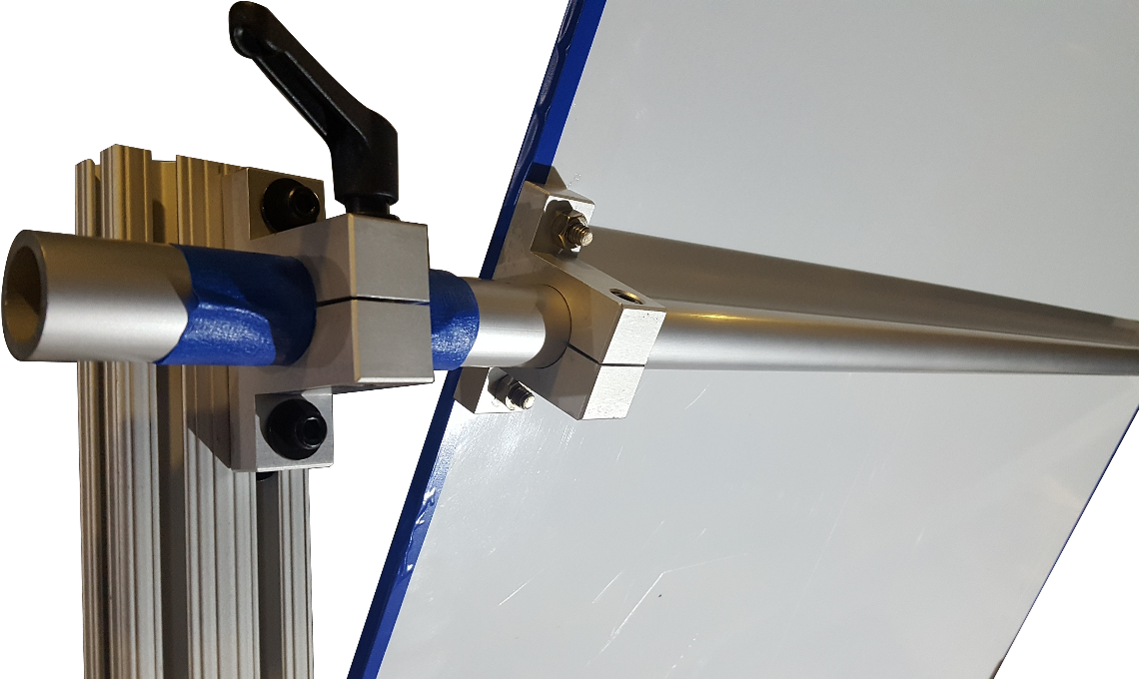
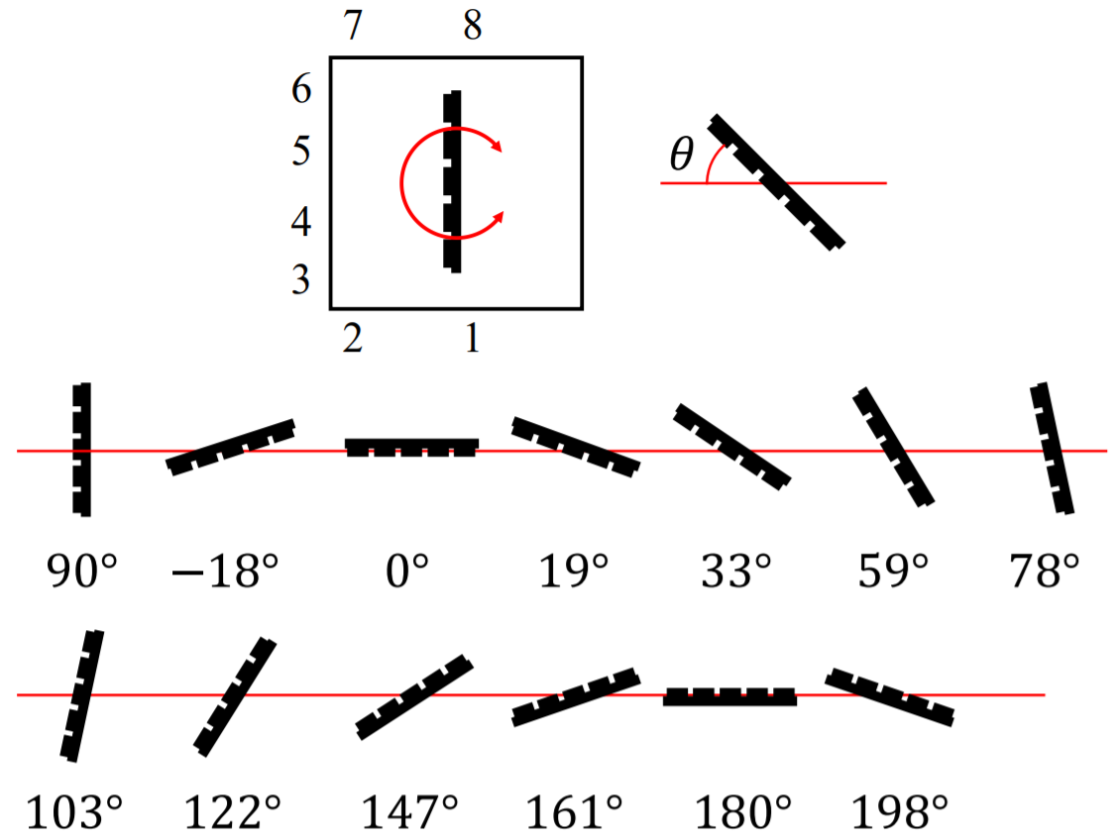
[Results] // Calibration Plate
Cameras all located in roughly same plane
Rod fixed to back of calibration plate
Allowed 360º of rotation of plate, with rigid locking at each image location
Back of calibration plate
Initial plate view defines origin/coordinate system of volume
Images at 13 different views for mock-up calibration

Slide 13
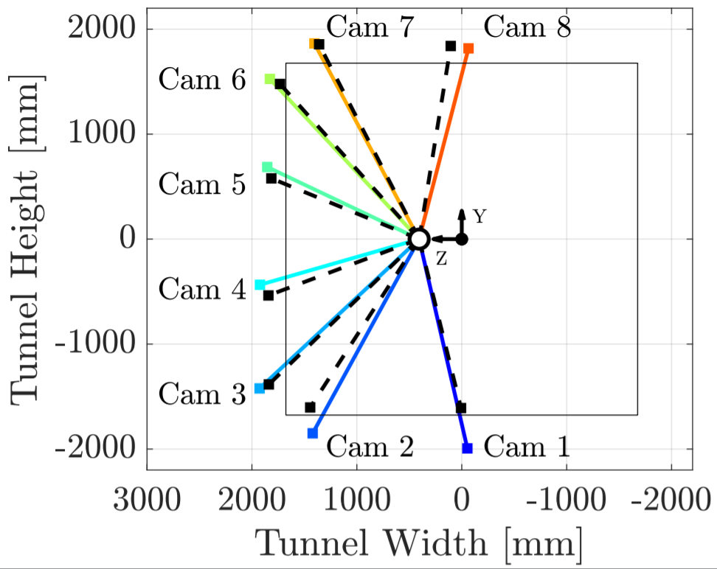
[Results] // Calibration Results
Translation and rotation from calibration plate origin provided in calibration results
Plot camera locations for LaRC mock-up and Ames tunnel
Ames tunnel calibration camera locations
Langley mock-up calibration camera locations
Camera locations in mock-up very close to final camera locations in tunnel tests
Cameras 1 and 2 at mock-up located on the floor
Tunnel Walls

Slide 14
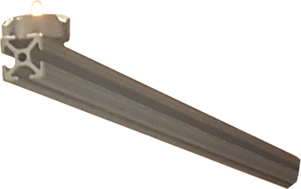
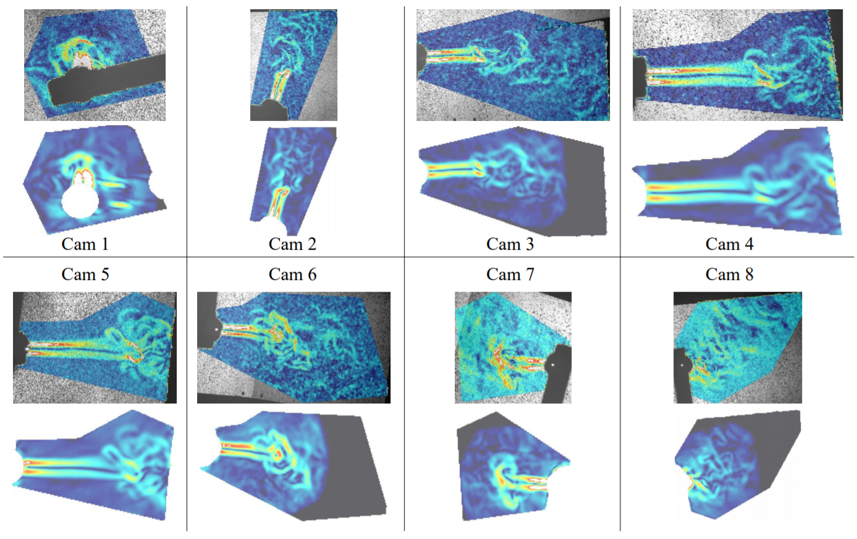
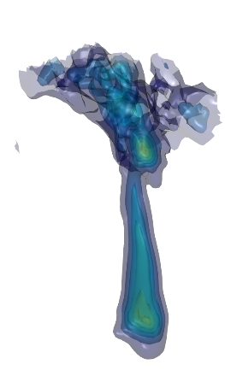
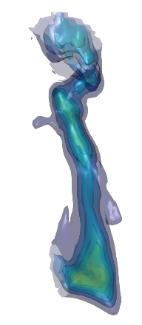
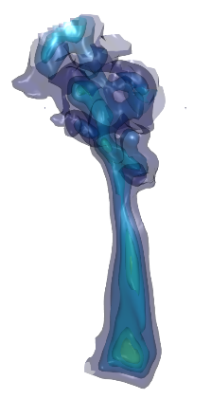
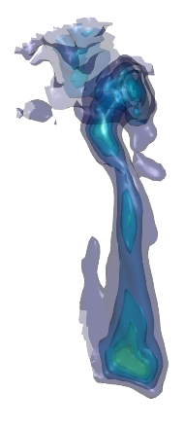
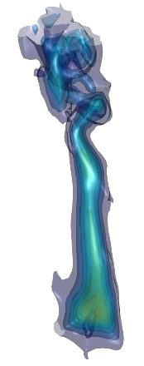
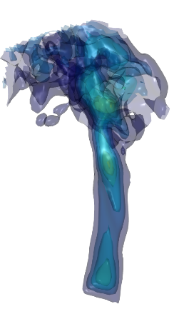
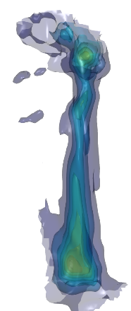
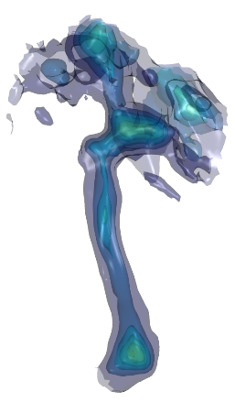
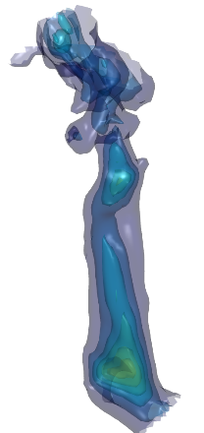
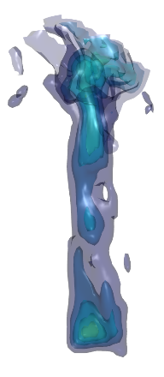
[Results] // Langley Candle Results
What
Single tea-light candle held at
center of ROI using a piece of 80/20
Why
Small density object
Slight obstruction in some frames due to rod
Nearly axisymmetric reconstruction in laminar region
Results
2D BOS images colored by pixel displacement
3D reconstruction projected back to each camera (a sort of synthetic 2D BOS)
Ten time frames of the reconstruction (acquired at 4 Hz)

Slide 15
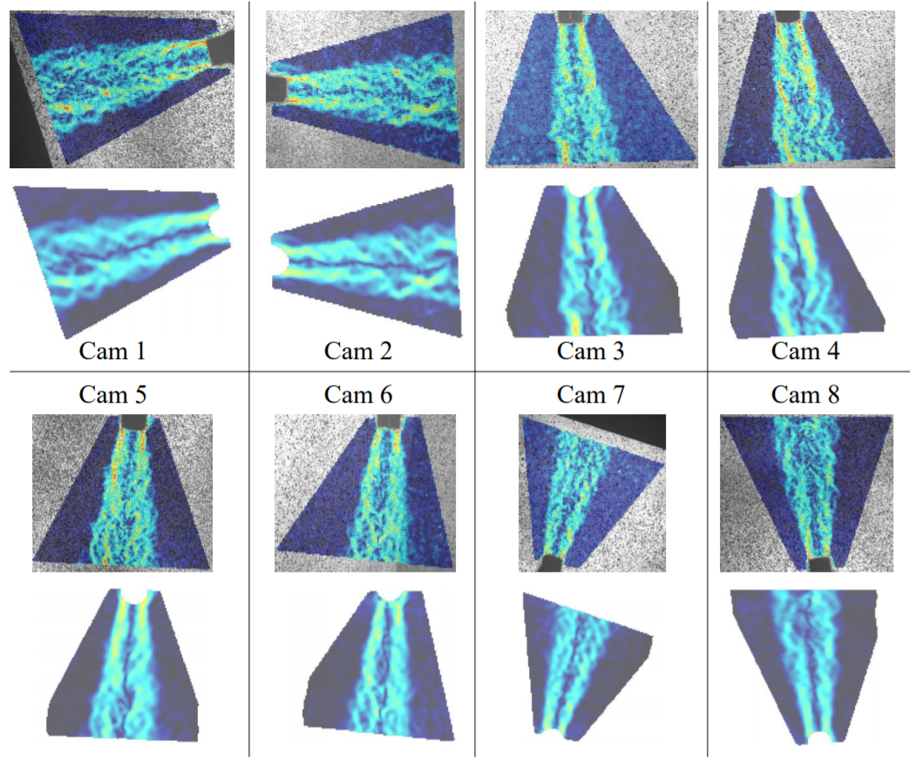
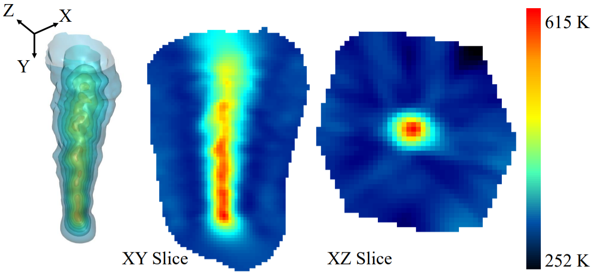
[Results] // Langley Heat Gun Results : Round Nozzle
What
Heat gun with round nozzle attachment
Why
Density object similar size to flight vehicle model
Quasi-axisymmetric turbulent plume
Results
2D BOS images colored by pixel displacement
3D reconstruction projected back to each camera (a sort of synthetic 2D BOS)
Temperature iso-surfaces, and two plane slices of the reconstruction
Takeaway
3D reconstruction qualitatively looks reasonable
Temperatures are reasonable

Slide 16
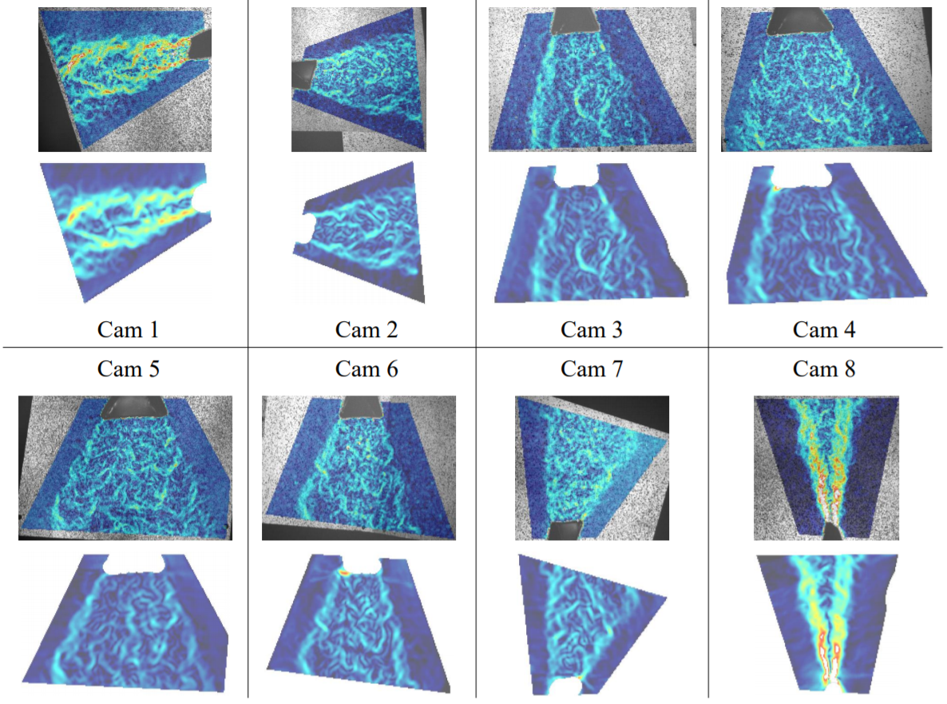
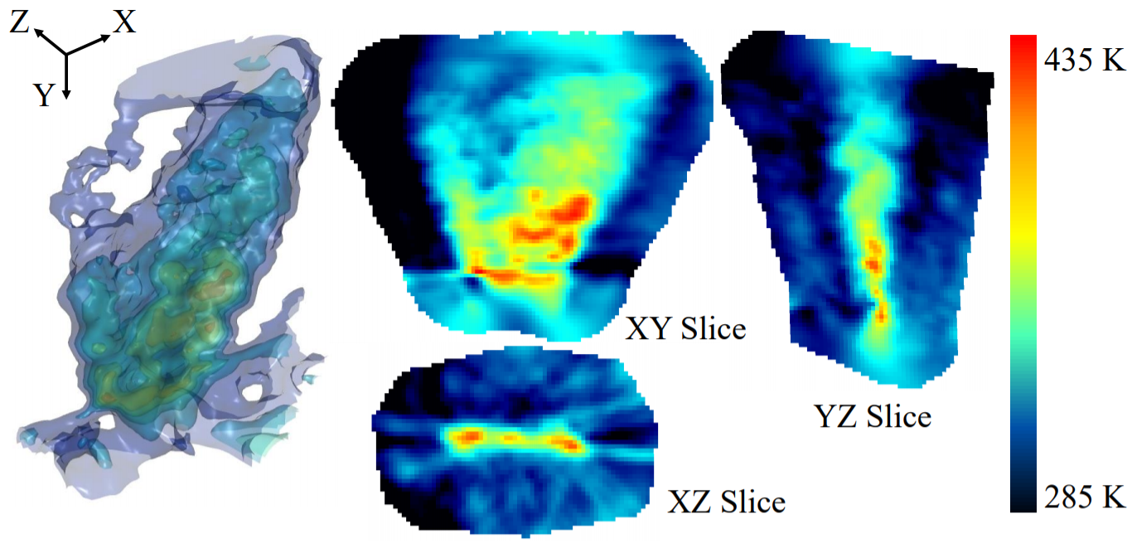
[Results] // Langley Heat Gun Results : Flat Nozzle
What
Heat gun with flat nozzle attachment
Why
Density object similar size to flight vehicle model
Plume shape different in all three dimensions
Results
2D BOS images colored by pixel displacement
3D reconstruction projected back to each camera (a sort of synthetic 2D BOS)
Temperature iso-surfaces, and three plane slices of the reconstruction
Takeaway
Fully 3D object able to be reconstructed successfully
Qualitatively looks reasonable
Temperatures are reasonable

Slide 17
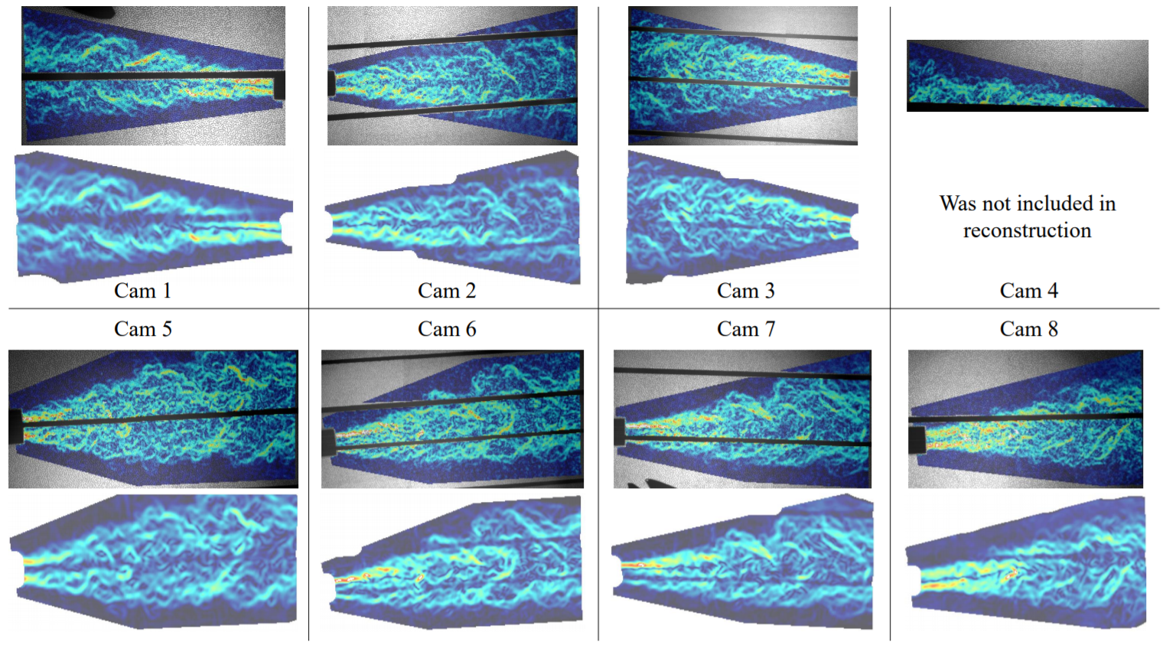
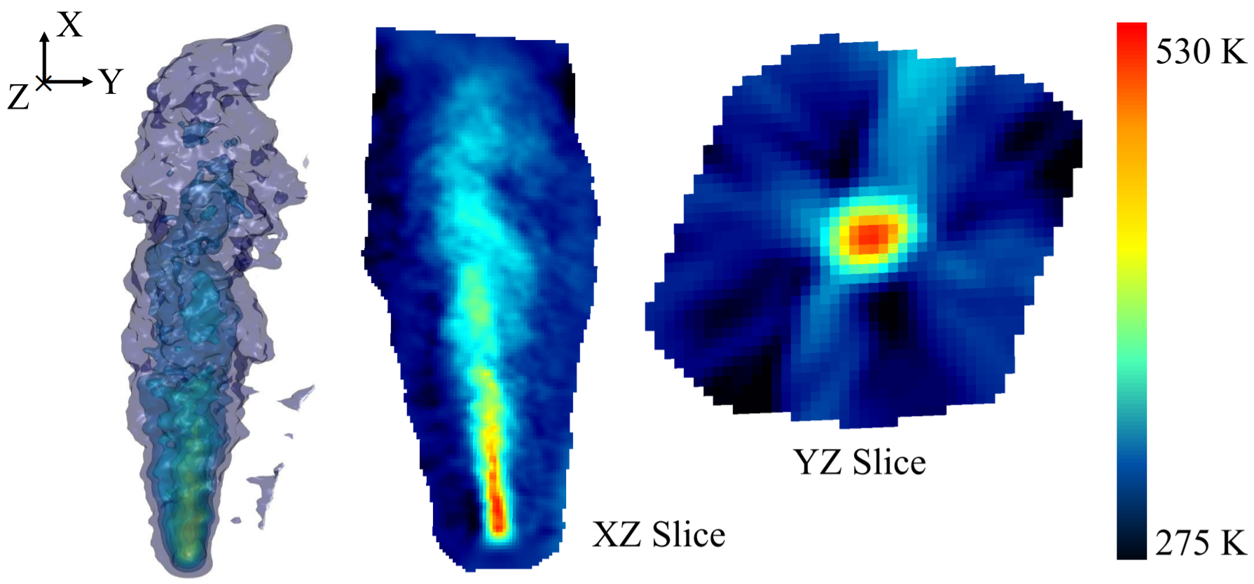
[Results] // Ames Heat Gun Results : Round Nozzle
What
Heat gun with round nozzle attachment
Why
Density object similar size to flight vehicle model
Quasi-axisymmetric turbulent plume
Results
2D BOS images colored by pixel displacement
Reconstruction of the projected 3D reconstruction back to each camera
Temperature iso-surfaces, and two plane slices of the reconstruction
Takeaway
Slots can be seen in projected reconstruction, but are not noticeable in 3D and slice views
3D result looks qualitatively accurate
Temperatures in plume are reasonable
High level of confidence for actual model testing

Slide 18
Conclusions / Lessons Learned
Did we accomplish our goals?
Detail a calibration method
Successful tomographic reconstruction of a small BOS object with camera modules in proposed tunnel locations
Quick setup, calibration, acquisition, and teardown at the tunnel to adhere to time allotment
Additional acknowledgments:
NASA Transformation Tools and Technologies (TTT)
NASA Aerodynamic Evaluation and Test Capabilities (AETC)
NASA Commercial Supersonic Transport (CST)




