Slide 1
High-Order Shock Fitting With Finite Element Methods
Luke D’Aquila*, Brian Helenbrook*, Alireza Mazaheri**
*Clarkson University, Department of Mechanical and Aeronautical Engineering
**NASA Langley Research Center, Aerothermodynamics Branch
AIAA Aviation Forum, June 15-19 2020
by Luke D’Aquila.
Published by the American Institute of Aeronautics and Astronautics, Inc., with permission.

Slide 2
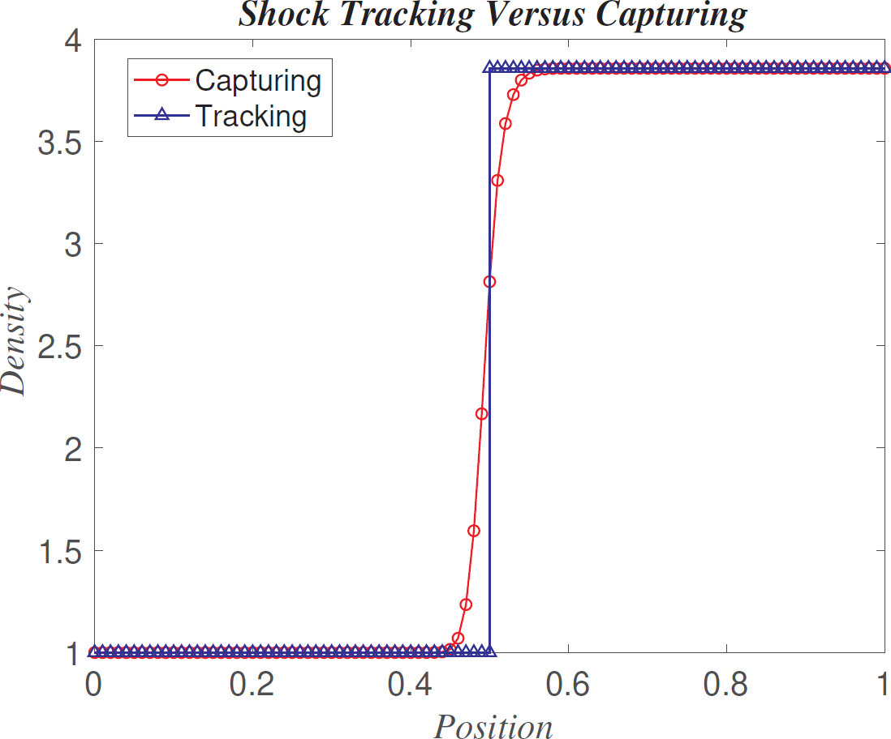
Background – Shock Wave Simulations
Shock Capturing
  Maintain monotonicity of flow solution around shock
  Capture shock within multiple mesh elements
  Easier to implement and generalize
Shock Tracking
  Align discontinuity with mesh interface
  Shock as a true discontinuity
  Difficult to generalize for multiple shocks

Slide 3
Methodology
Moving grid shock tracking
  Shock fitted mesh interface moves with shock
  Interior mesh deforms and adapts to maintain quality
Finite element solver
  Euler equations
  Arbitrary Lagrangian-Eulerian (ALE) moving mesh
  Time advance flow solution and shock location consistently

Slide 4
Shock Motion
Three methods implemented:
  Zou (JCP 2017) Use a Riemann invariant with the Rankine-Hugoniot (RH) jump conditions to evaluate shock velocity [1]
  Henrick (JCP 2006) Use equation for momentum immediately downstream of shock with the RH jump conditions to evaluate shock acceleration [2]
  Zhong (JCP 1998) Use characteristic relation behind shock along with RH jump conditions to evaluate shock acceleration [3]

Slide 5
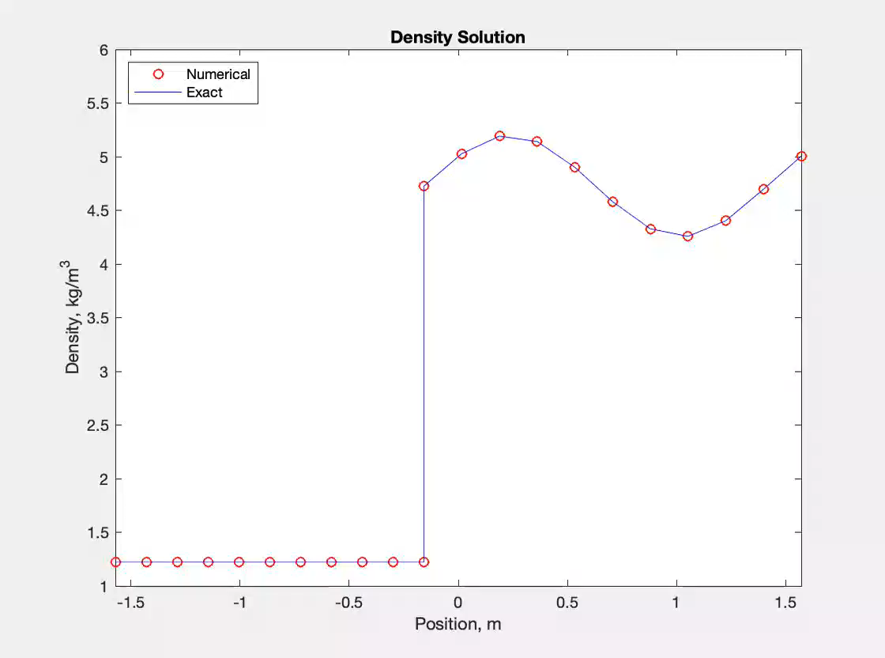
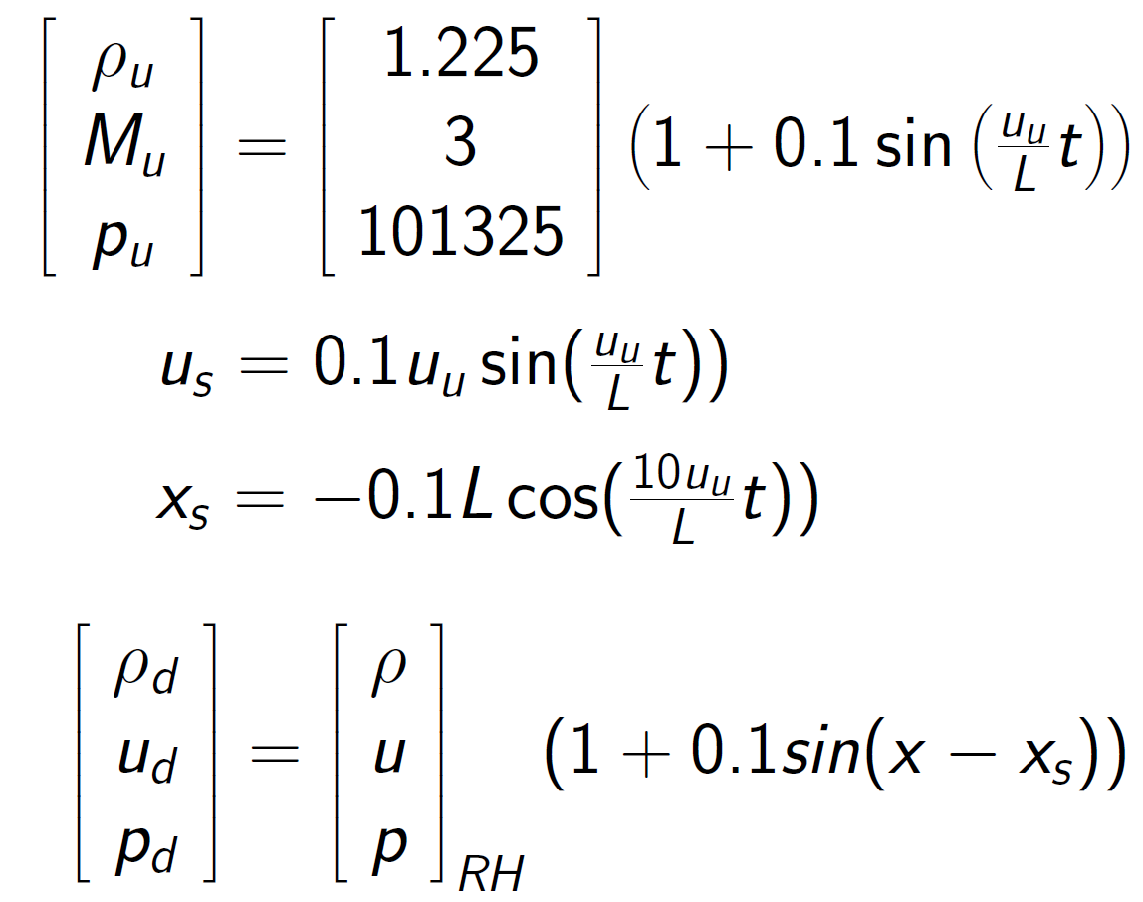
1D Method of Manufactured Solution (MMS)

Slide 6
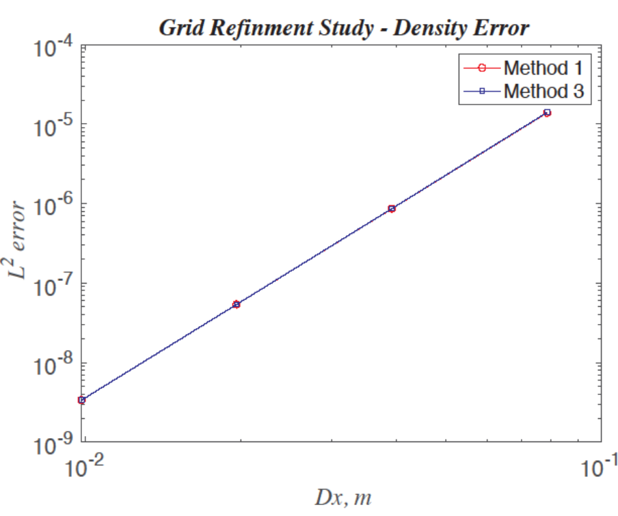
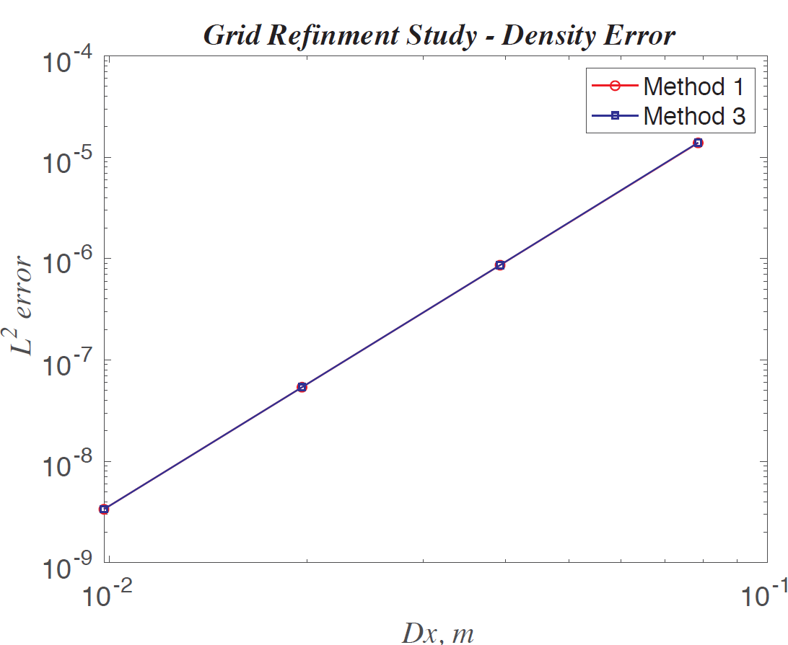
1D MMS – Grid Refinement Study
Mesh Spacing [m] | Method 1 | Method 2 | Method 3
0.1571 | 1.3854e-5 | N/A | 1.3969e-5
0.0785 | 8.6167e-7 | N/A | 8.6316e-7
0.0393 | 5.3834e-8 | N/A | 5.3856e-8
0.0196 | 3.3641e-9 | N/A | 3.3641e-9
Convergence Rate | 4.0024 | N/A | 4.0062

Slide 7
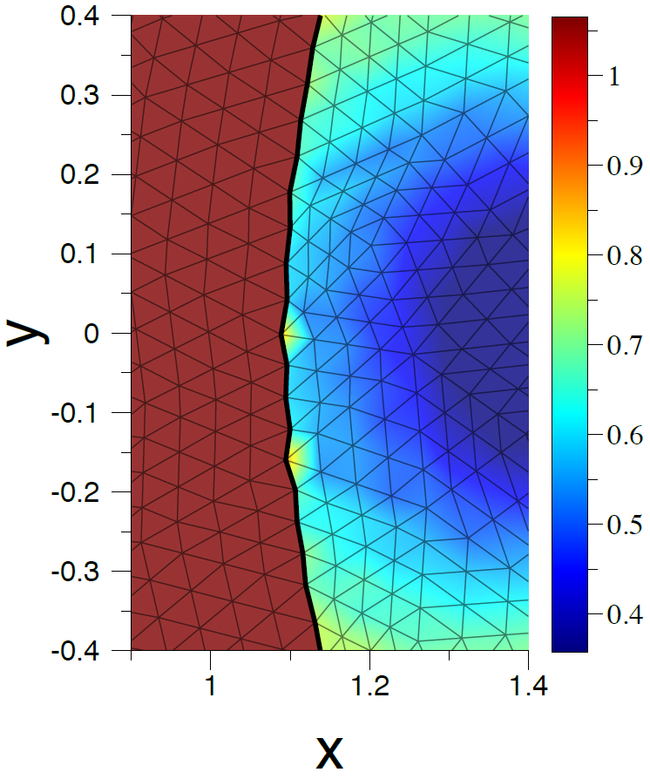
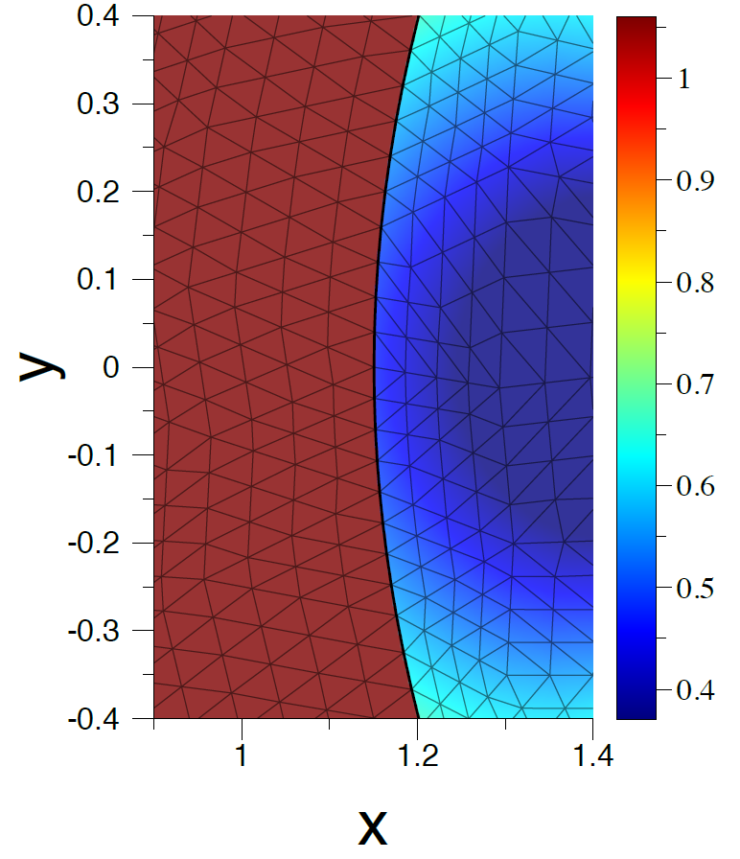

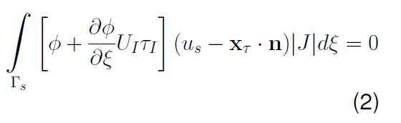
2D Interface Motion
Interface motion normal to shock:
Discrete form:
Stabilization of interface motion
  U is interface wave speed
  𝜏 is stabilization parameter
No Stabilization
Stabilization

Slide 8
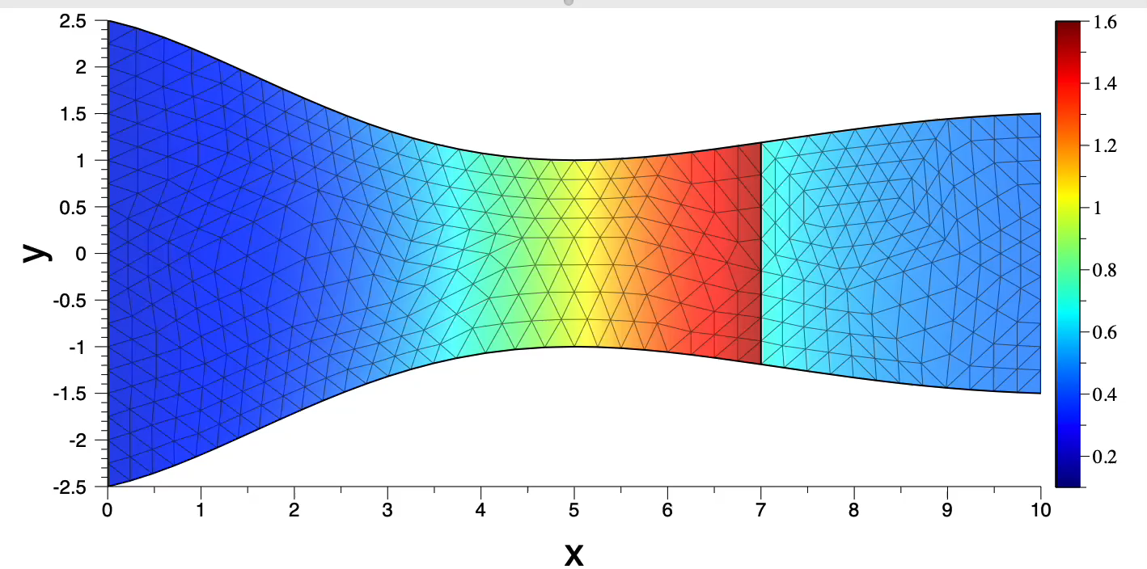
2D Supersonic Nozzle
Initialization
  1D isentropic nozzle
  Conserve mass in y-direction
  Initial shock at x = 7
Run simulation until steady state is reached
Evolution to steady state -- Mach number contours

Slide 9
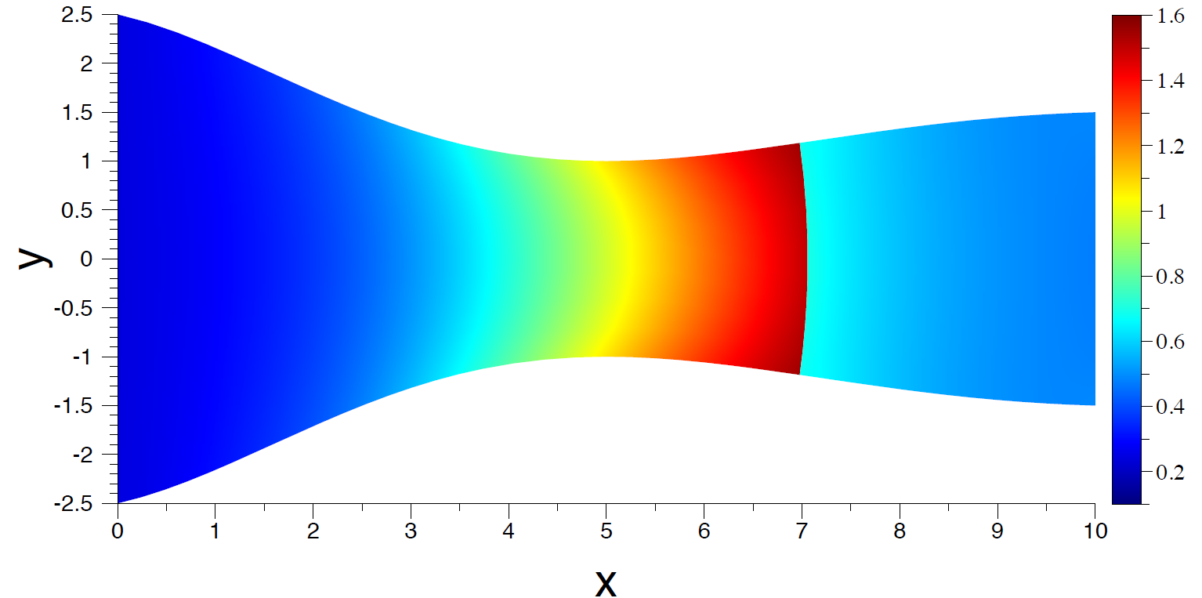
2D Supersonic Nozzle
Steady state Mach number contours

Slide 10
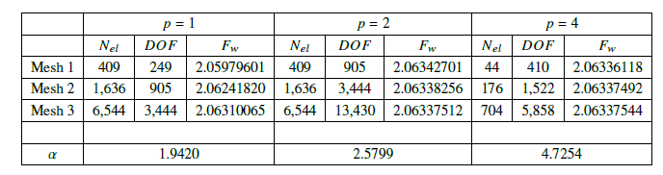
Nozzle Solution Convergence
Richardson extrapolation
  Compare net wall force on 3 nested meshes
  Assume error ~ h^{α}

Slide 11
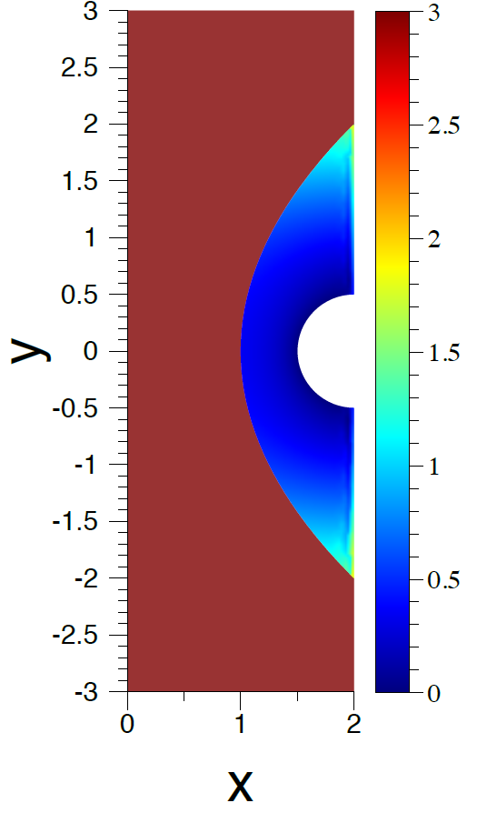
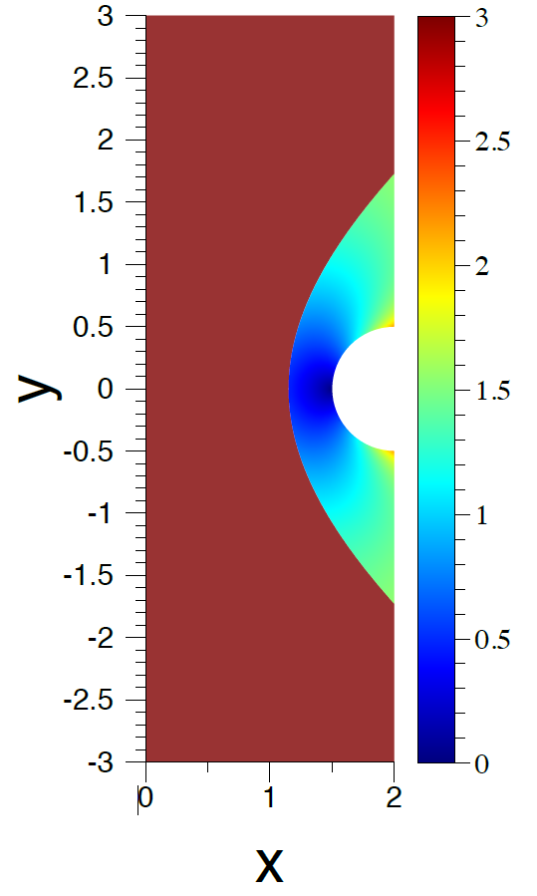
Blunt Body Problem
Mach 3 flow over cylinder at (2,0) with r = 0.5
Initialization
  Initial shock at x = 0.25y² +1
  Initialize downstream properties based on incompressible flow over a cylinder
  Ramp up velocity near shock-outflow intersection
Run simulation until steady state is reached
Initial (left) and steady state (right) Mach number contours

Slide 12
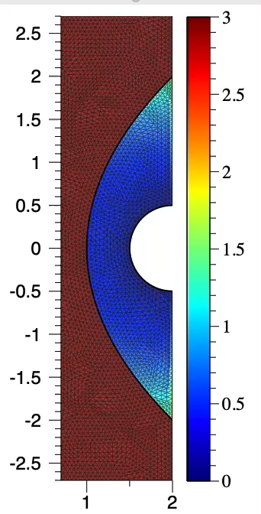
Blunt Body Problem
Evolution from initial condition to steady state
  Contours of Mach number

Slide 13
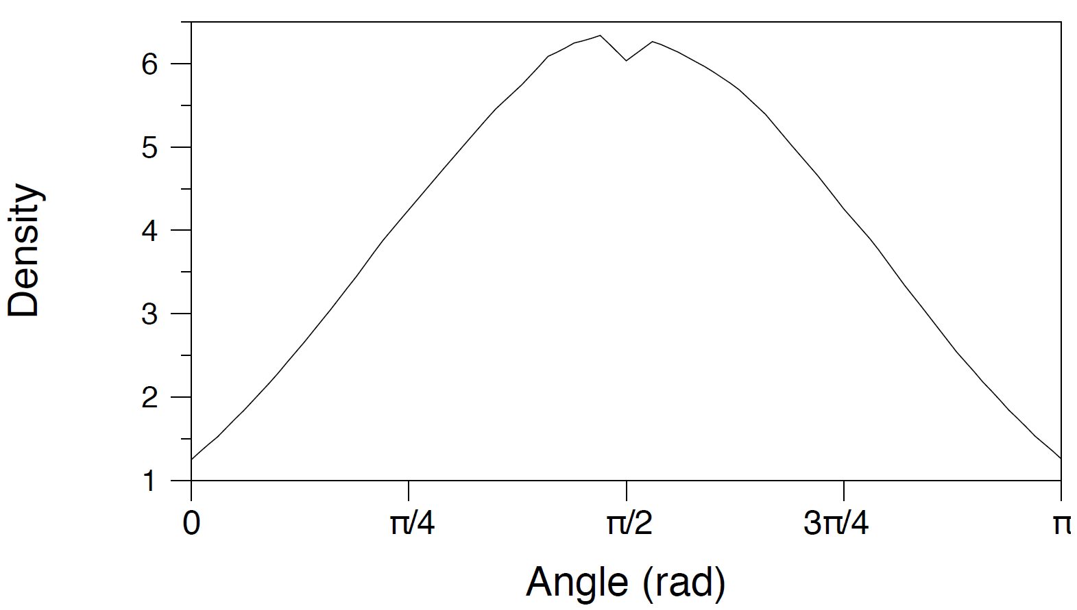
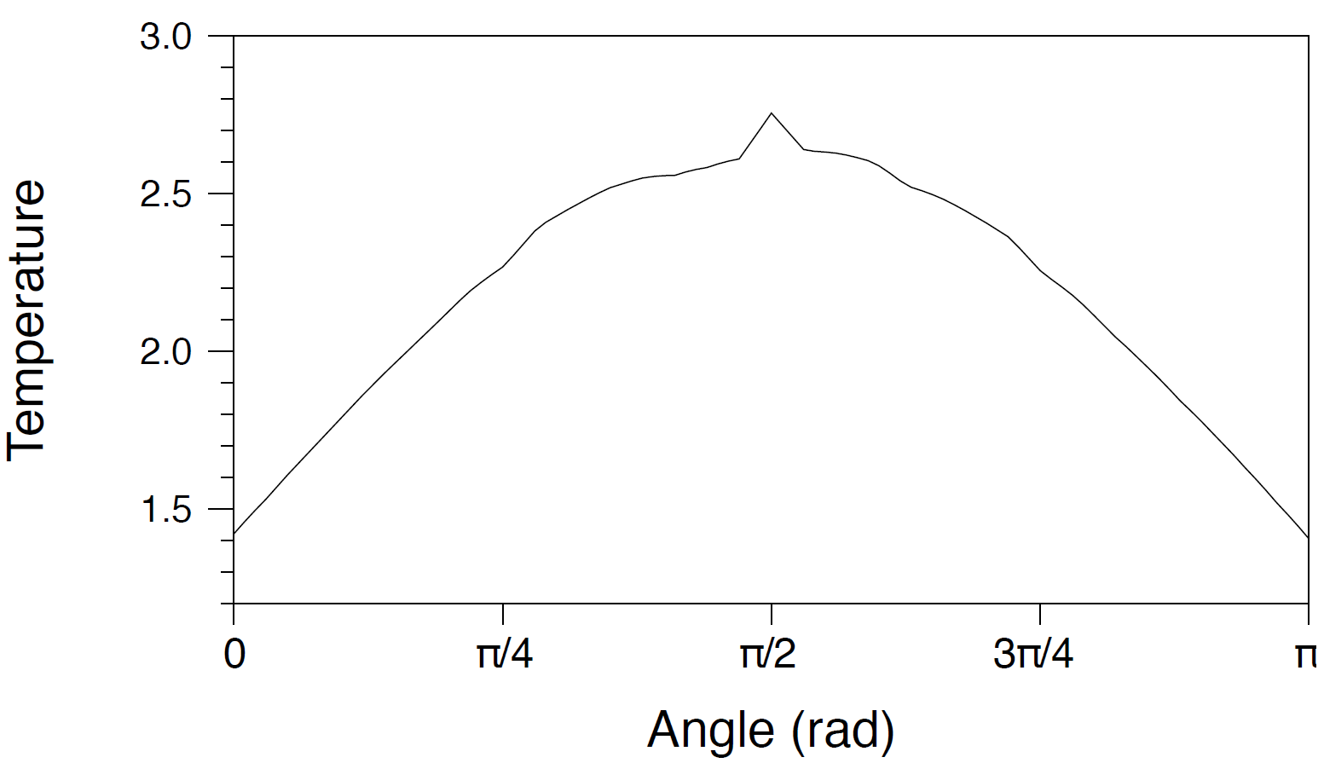
Blunt Body Problem – No Interface Stabilization
Solution does not converge
Left: Density (top) and temperature (bottom) along cylinder surface
Right: Contours of Mach number near the shock

Slide 14
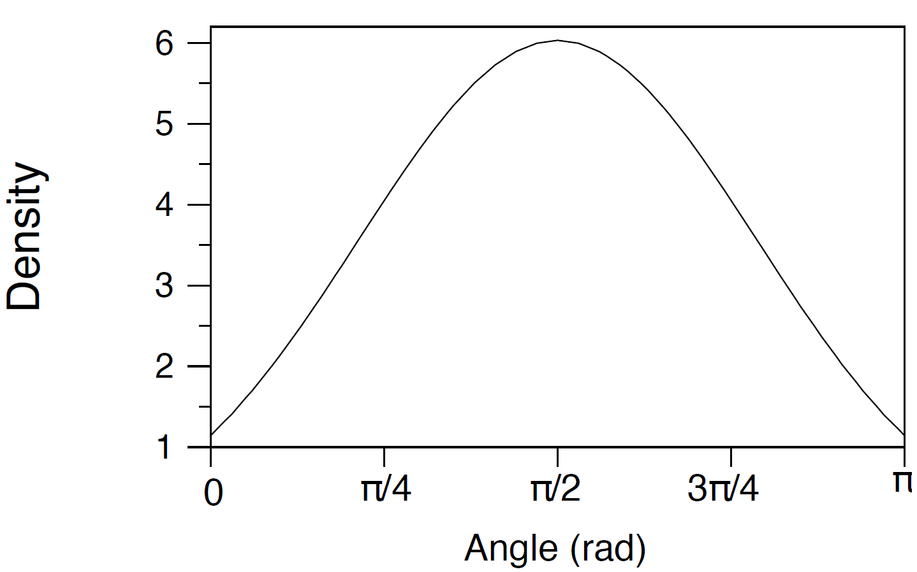
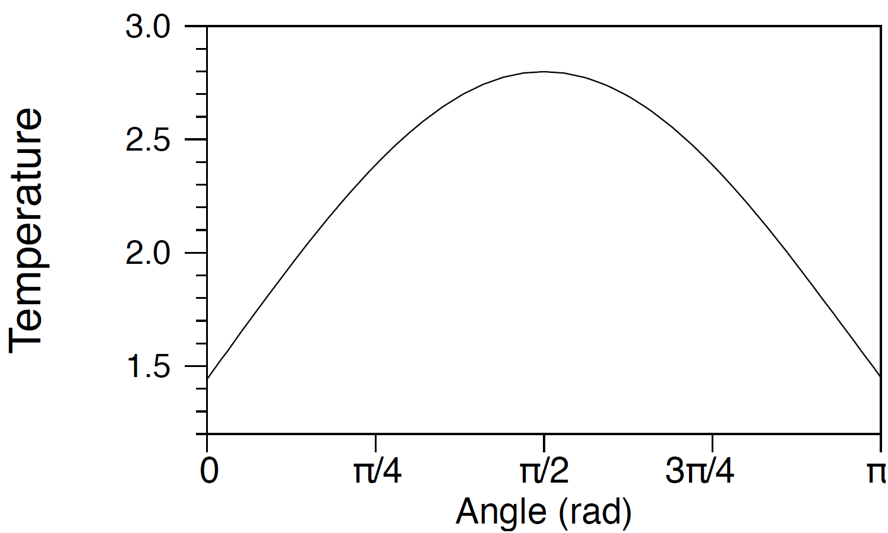
Blunt Body Problem – With Interface Stabilization
Nondimensional density (left) and temperature (right) along cylinder surface

Slide 15
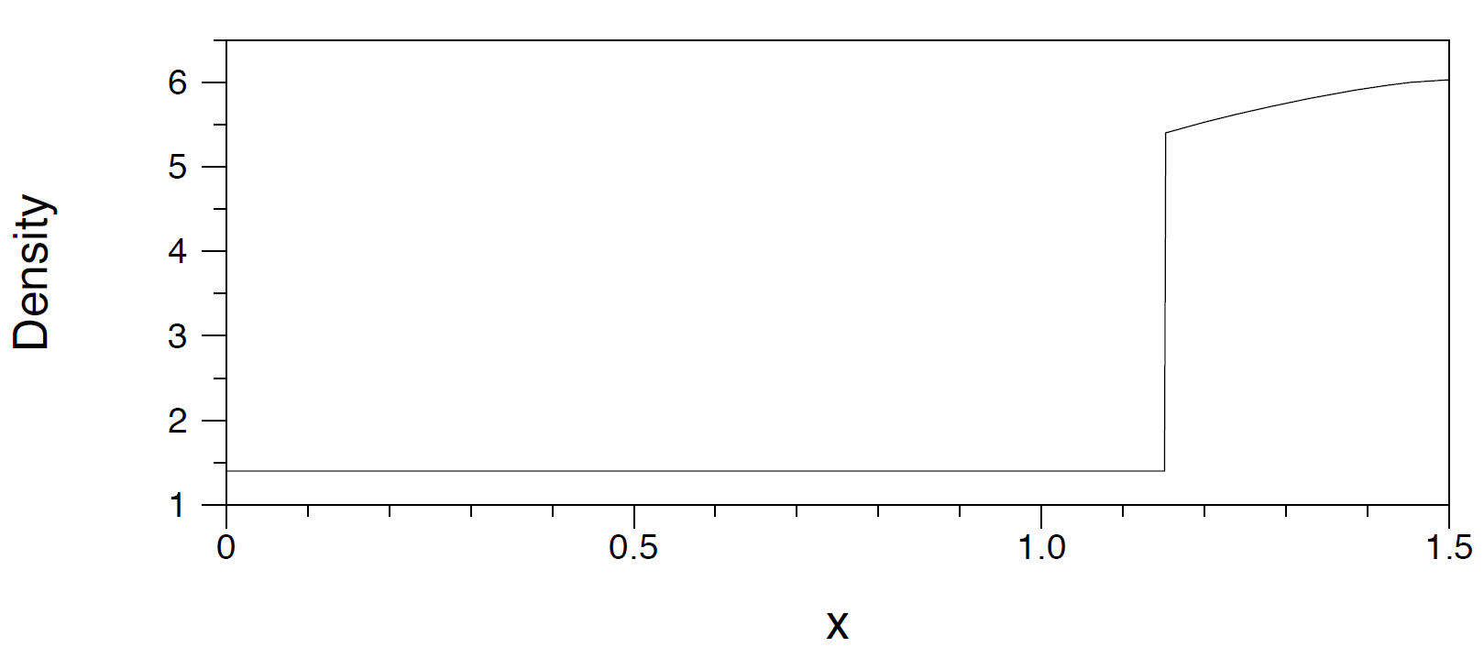
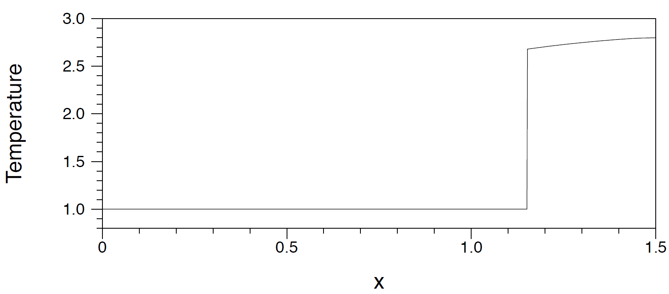
Blunt Body Problem
Nondimensional density (top) and temperature (bottom) along stagnation line

Slide 16
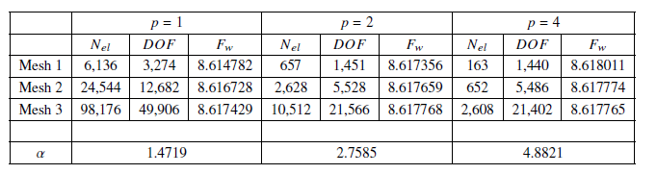
Blunt Body Solution Convergence
Richardson extrapolation
  Compare net force on cylinder surface

Slide 17
Conclusions
  Shock tracking can provide high-order solution accuracy
  Accurate evaluation of shock motion is critical
    Of the methods tested, Method 1 is preferred
  Initialization is a challenge when solving practical problems
  Stabilization must be introduced to the interface motion equation

Slide 18
References
[1]
Dongyang Zou, Chunguang Xu, Haibo Dong, and Jun Liu. A shock-fitting technique for cell-centered finite volume methods on unstructured dynamic meshes. Journal of Computational Physics, 2017.
[2]
A. Henrick, T. Aslam, and J. Powers. Simulations of pulsating one-dimensional detonations with true fifth order accuracy. Journal of Computational Physics, 2006.
[3]
Xiaolin Zhong. High-order finite-difference schemes for numerical simulation of hypersonic boundary-layer transition. Journal of Computational Physics, 1998.

